Slide 1
Insurance: Financial Resilience
UC ANR Fire Summit
April 17, 2019
Janet Ruiz, Director Strategic Communication, California
Insurance Information Institute  110 William Street  New York, NY 10038 707.490.9365  janetr@iii.org  www.iii.org

Slide 2
Our Promise
We are the Insurance Information Institute. Since 1960, the "Triple I" has had a single mission: To improve public understanding of insurance—what it does and how it works. We are here to serve everybody: consumers; students and educational institutions; insurance professionals; government and regulatory organizations; and the media.

Slide 3
Fifteen Minutes
A brief look at issues and solutions

Slide 4
Homeowners Insurance: Availability and Affordability
Choice and competition protect consumers by helping keep rates competitive.
THE FACTS
California’s home insurance market is healthy. | Frequent catastrophes strain our insurance market.
There are 99 homeowners insurance carriers writing coverage throughout California – not including the FAIR plan.1 | Existing regulations do not allow insurers to consider any of the below when setting rates:
Homeowners insurance is still readily available in the regular insurance market, however the California FAIR plan has seen an increase in policy subscribers.2 | Impacts of climate change Recent catastrophic fires Newest modeling and technology data
California has some of the most competitive rates for homeowners insurance in the nation. ranked 46th - when factoring in home value.3
1California Department of Insurance, 2RAND Corporation, Greenware Tech, The Impact of Changing Wildfire Risk on California’s Residential Insurance Market – August 2018 ,3 2017 National Association of Insurance Commissioners (NAIC)

Slide 5
CALIFORNIA INSURANCE MARKET
~98
1.1
%
%
Admitted Market
Insurance coverage purchased from an insurance company that is regulated and formally licensed to operate in the state.
FAIR Plan
Fire insurance coverage for homeowners who otherwise cannot obtain coverage in California.
Policyholders Are Being Paid: Over $15 billion in claims have been paid and we continue to help our customers through the claims process.
Wildfires Are Insurable: Unlike earthquakes, insurers are able to plan for wildfire risks. The California Earthquake Authority was a result of insurers leaving the market because they could not predict and insure that risk.¹ Insurers are not leaving the home insurance market.
Homeowners Drive Policy Switches: Policyholders are 2.5 times more likely to change their home insurer than be non-renewed.²
0.16
%
Surplus Lines
Insurance coverage from a non-state-regulated provider who may be willing to take on a higher financial risk.
¹ History of the California Earthquake Authority. California Earthquake Authority, www.earthquakeauthority.com/About-CEA.
² Lloyd, D., Tsang, F., & Fitts, G. (2018). The Impact of Changing Wildfire Risk on California’s Residential Insurance Market(Rep.). RAND Corporation, Greenware Tech.

Slide 6
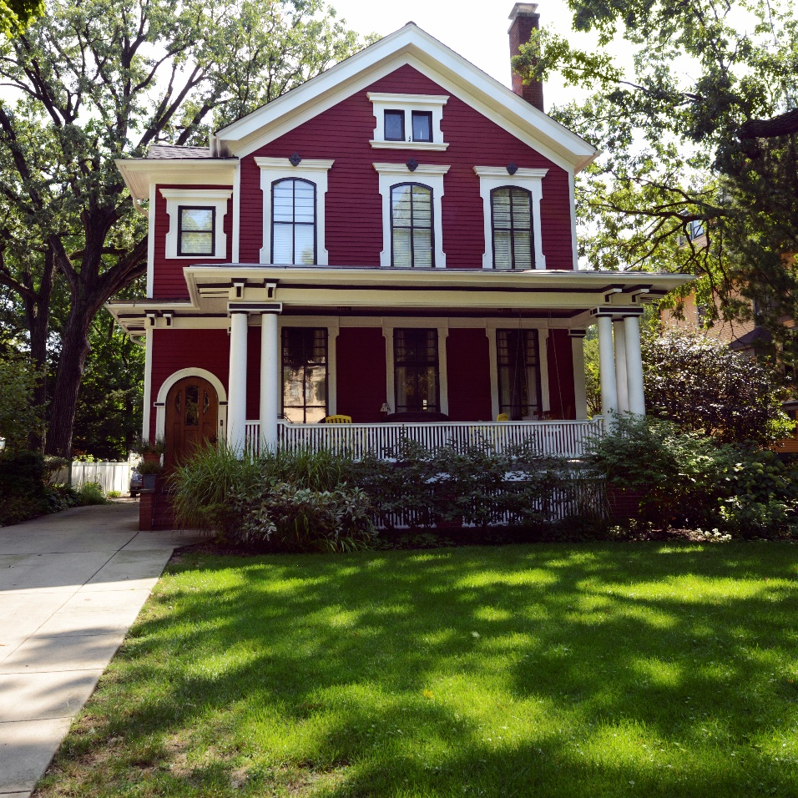
CALIFORNIA IS A LEADER IN PROTECTING CONSUMER RIGHTS
Starting in 2019, homeowners are protected against policy cancellations and nonrenewals in zip codes or fire perimeters where a State of Emergency has been declared. (SB 824)
Starting in 2019, insurers must renew your homeowners policy for at least two years for homes that were burned down or destroyed in a declared State of Emergency. (SB 894)
In 1968, California created the Fair Access to Insurance Requirements (“FAIR”) Plan which provides a safety net that assures home insurance is available for all homeowners.
Your home is your biggest asset, so make sure you have the information you need to insure it properly.

Slide 7
Core Logic 2019: Insurance Coverage Adequacy Report
The Effects of Insurance to the Property Ecosystem
CoreLogic says today’s best practice for reconstruction cost estimating uses information specific to each home and its location.
Current localized costs of labor and building materials are applied to create a reconstruction cost estimate unique to the specific home.
This best practice produces objective estimates without the inaccuracies introduced by subjective quality judgments, unsophisticated estimating tools, or simple inflation adjustments.
California’s insurers are required effective July 1, 2019, to recalculate reconstruction costs every two years, at a minimum, or offer the policyholder at renewal the opportunity to recalculate using a reconstruction cost inflation factor instead (AB 1797).

Slide 8
Tools to Prevent Underinsurance
Understanding your coverage: Insurance companies offer homeowners options for their coverage at different price points in order to balance choice with vital protections. This flexibility keeps coverage accessible for consumers by giving them the power to control their insurance costs.
A-Covers the cost of replacing a structure.
B-Covers detached structures like a garage.
C-Covers personal property and household contents.
D-Covers additional living expenses (ALE) that are incurred when one’s house cannot be occupied due to a covered loss.
TIPS FOR CONSUMERS
Under Coverage A, homeowners may purchase extended replacement cost coverage which could provide up to 150% of the coverage purchased.
Building Code Upgrade provides extra coverage for older homes.
Always report home additions and remodels to keep your coverage current.
Keep your home inventory list up-to-date and store all important photos, receipts, etc offsite or in the cloud.
NOTE: Coverages vary by insurance company.

Slide 9
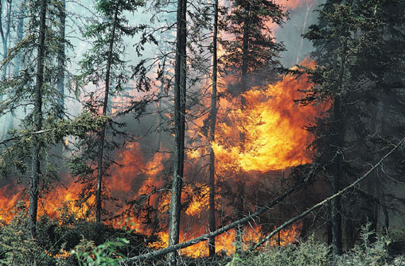
We support efforts to protect residents, businesses and homeowners by taking proactive steps against catastrophes now. Fire Safe Council, Firewise USA, Insurance Institute for Business/Home Safety.
Improved vegetation and land management practices
Hardening of our electrical grid
Defensible space for structures
Supporting our fire and emergency services
Designing building codes with catastrophe prevention in mind
.

Slide 10
Thank you!
RESOURCES:
CAL FIRE Ready, Set Go Program features Insurance Preparedness.
Core Logic 2019 Insurance Adequacy Report: The Effects of Underinsurance to the Property Ecosystem.
Headwater Ecomonics Report shows wildfire resistant homes cost less to build.
Insurance Information Institute: Wildfire Facts and Statistics
Insurance Institute for Business and Home Safety features wildfire demo and home hardening.
RMS Releases U.S. Wildfire High-Definition Model to Empower (Re)insurers to Address Pervasive Wildfire Risk.
Stronger California: Information on insuring your home/business in wildfire risk areas
www.iii.org

