Slide 1
The Plain Truth about Flood Insurance and Floodplain Management
March 24, 2016
National Hurricane Conference
Orlando, Florida
Jeanne M. Salvatore, Senior Vice President and Chief Communications Officer, I.I.I.

Slide 2
Presentation Outline
What is a Flood?
Flood Insurance Basics
How the NFIP Works?
Risk of Flooding
I.I.I. Pulse Study Results on Flood insurance
NFIP Reforms
Questions/Discussion

Slide 3
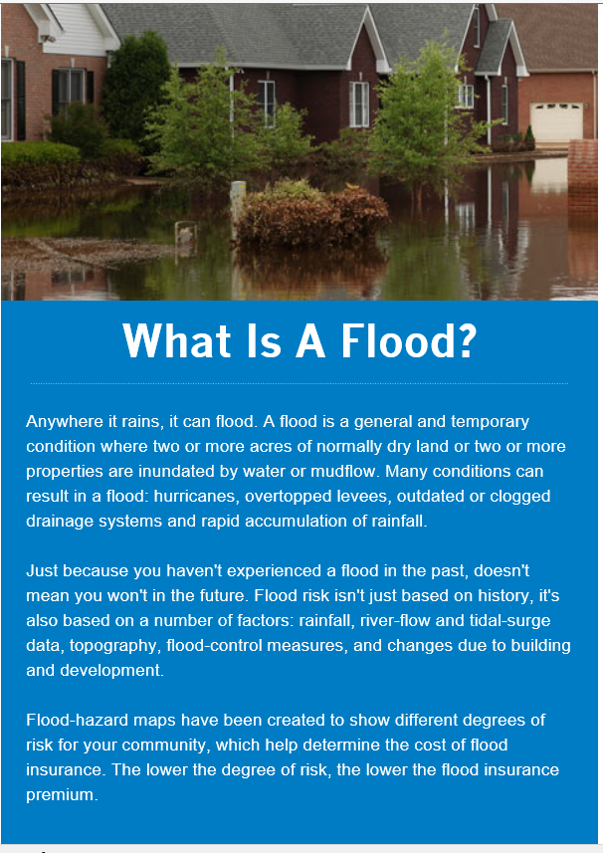
What is a Flood ?
Anywhere it rains, it can flood.
Many conditions can result in a flood – hurricanes, overtopped levees, melted snow and the rapid accumulations of rainfall.

Slide 4
Flood Insurance Basics
Flood damage is excluded under standard homeowners and renters insurance policies. However, flood coverage is available in the form of a separate policy both from the National Flood Insurance Program (NFIP) and from a few private insurers.
Congress created the NFIP in 1968 in response to the rising cost of taxpayer-funded disaster relief for flood victims and the increasing amount of damage caused by floods.
The NFIP makes federally backed flood insurance available in communities that agree to adopt and enforce floodplain management ordinances to reduce future flood damage.
The NFIP provides coverage for up to $250,000 for the structure of the home and up to $100,000 for personal possessions. The NFIP policy provides replacement cost coverage for the structure of the home but only actual cash value for personal possessions.
The NFIP does not cover additional living expenses. And, the coverage for basements is limited to the systems in the house (heating, etc.) that make a home habitable.

Slide 5
Flood Insurance Basics
There is a 30-day waiting period before the coverage takes effect.
Excess flood insurance is also available from some private insurers for those who need additional insurance protection over and above the basic policy or whose community does not participate in the NFIP.
Excess flood insurance is available in all parts of the country—in high risk flood zones along the coast and close to major rivers as well as in areas of lower risk—wherever the federal program is available. It can be purchased from specialized companies through independent insurance agents, or from regular homeowners insurance companies that have arrangements with a specialized insurer to provide coverage to their policyholders.

Slide 6
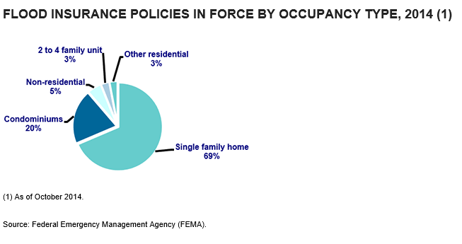
69 Percent of NFIP Polices are for Single Family Homes

Slide 7
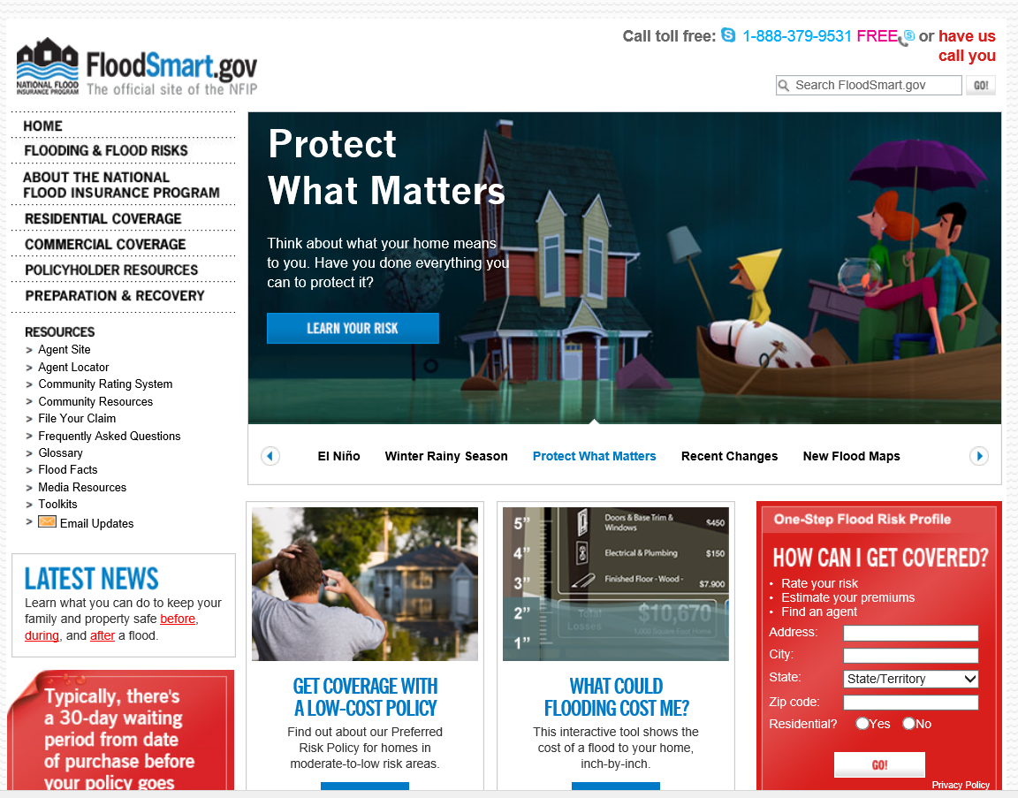
FloodSmart.gov – Provides Information on the Risk of Flood and Cost of the Policy

Slide 8
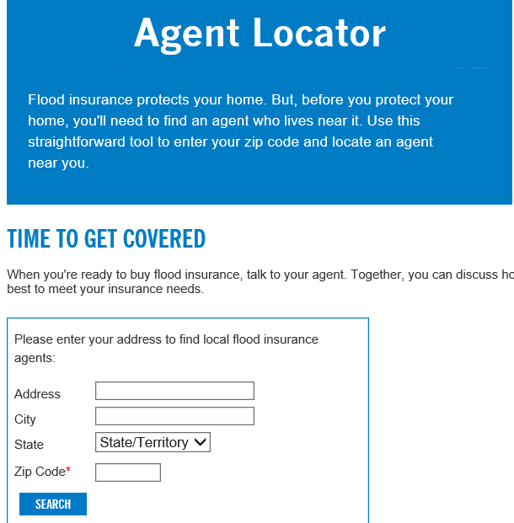
NFIP Makes it Easy to Find a Flood Insurance Agent

Slide 9
How the NFIP Works
The NFIP is administered by FEMA, part of the Department of Homeland Security. Flood insurance was initially only available through insurance agents who dealt directly with the federal program.
The direct policy program has been supplemented since 1983 with a private/public cooperative arrangement, known as "Write Your Own," through which a pool of insurance companies issue policies and adjust flood claims on behalf of the federal government under their own names, charging the same premium as the direct program.
Participating insurers receive an expense allowance for policies written and claims processed.
The federal government retains responsibility for underwriting losses. Today, most policies are issued through the Write-Your-Own program..

Slide 10
More on the NFIP
As of October 2015, 79 insurance companies participated in the Write Your Own program, started in 1983, in which insurers issue policies and adjust flood claims on behalf of the federal government under their own names.
As of August 2015, 67 percent of policies covered single family homes, 21 percent covered condominiums, and 6 percent covered businesses and other non-residential properties. Two- to four-family units and other residential policies accounted for the remainder.
Superstorm Sandy, which occurred in October 2012, resulted in $8.0 billion in NFIP payouts as of October 2015, second only to 2005’s Hurricane Katrina with $16.3 billion in payouts.

Slide 11
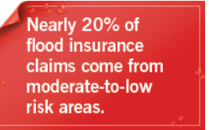
Risk of Flooding
Flooding is the most common and costly natural disaster in the U.S.
It causes an average of $50 billion in economic losses each year.
Most U.S. natural disasters declared by the president involve flooding.
Ninety percent of all natural disasters in the U.S, involve flooding.
Everyone should consider purchasing flood insurance and find out their flood insurance risk.

Slide 12
HURRICANE-RELATED FLOODING
A 2013 study of coastal areas by Core Logic found that 4.2 million homes, with $1.1 trillion in total property exposure, are at risk of damage caused by hurricane storm surge flooding.
In the Atlantic Coast region alone, there are approximately 2.4 million homes at risk, valued at more than $793 billion.
Total exposure along the Gulf Coast is $354 billion, with 1.8 million homes at risk for potential storm-surge damage..

Slide 13
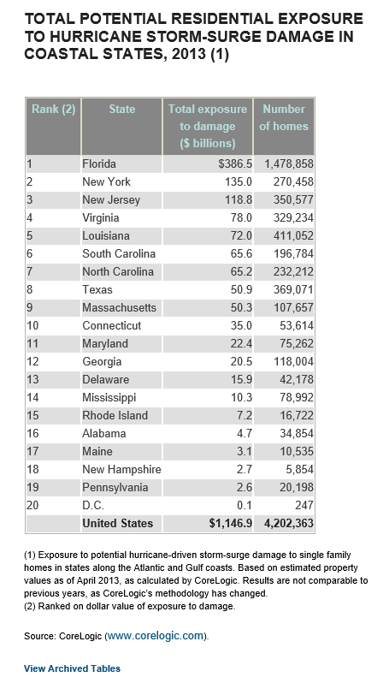
Residential Exposure to Hurricane Storm-Surge Damage
Residential properties in Florida have the most exposure to hurricane storm surge damage, followed by New York, New Jersey, Virginia and Louisiana, according to Core Logic.
Among the most densely populated metropolitan areas, the New York City metro area, which includes Long Island and the New Jersey coast, has the highest exposure to potential storm surge damage ($206 billion).
The next four areas in terms of exposure were Miami ($100 billion), Virginia Beach ($73 billion), Tampa ($55 billion) and New Orleans ($43 billion).

Slide 14
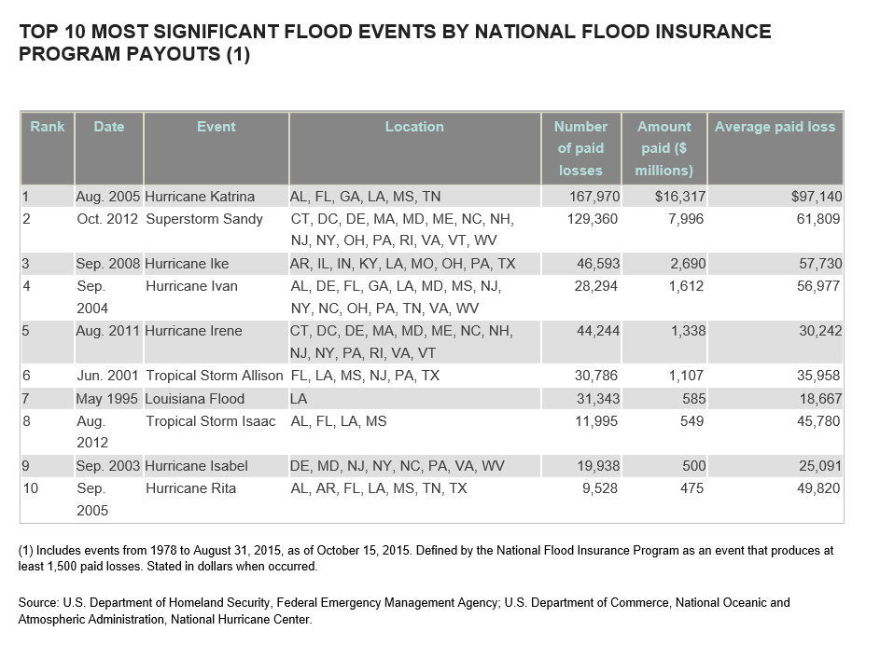

Slide 15
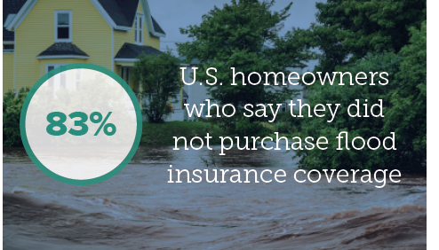
I.I.I. Pulse Study Results on Flood Insurance
Despite the fact that flooding is the most common and costly natural disaster in the U.S., the majority said they did not have a flood insurance policy.
Only 14 percent said they had a policy – a statistic that has remained fairly consistent in recent years.

Slide 16
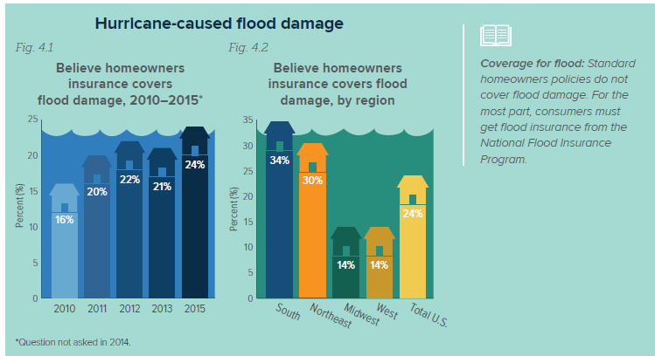
Public Understanding of Flood Insurance
Nearly One Quarter of Homeowners incorrectly thought their homeowners insurance policy would cover flood damage

Slide 17
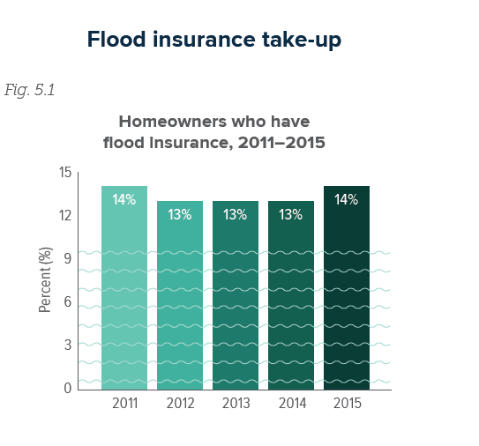
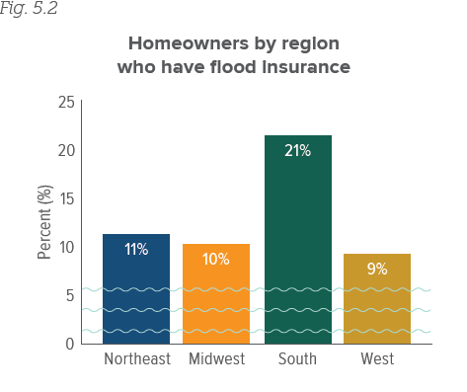
Flood Insurance Take-up Rates
The South had the Highest Proportion of Homeowners with a flood insurance policy
The percentage of homeowners purchasing Flood insurance has remained consistent
The South had the Highest Proportion of Homeowners with a flood insurance policy
The percentage of homeowners purchasing Flood insurance has remained consistent

Slide 18
National Flood Insurance Reforms
In March 2014 Congress rescinded many of the rate increases called for by The Biggert-Waters Flood Insurance Reform Act, passed two years earlier.
The original act sought to make the federal flood insurance program more financially self-sufficient by eliminating rate subsidies that many property owners in high-risk areas receive.
The new law reduces some rate increases already implemented, prevents some future increases and puts a surcharge on all policyholders.

Slide 19
National Flood Insurance Reforms
It also ends a provision in Biggert-Waters that removed a subsidy once a home was sold. People who purchased homes after Biggert-Waters became law will receive a refund. Many lawmakers in coastal states were concerned that the higher cost of flood insurance would have a negative impact on the real estate industry.
The subsidy will now be covered by a $25 surcharge on homeowners flood policies and a $250 surcharge on insurance for nonresidential properties and secondary (vacation) homes.
According to data from FEMA, most current flood insurance policyholders (81 percent, or 4.5 million) pay rates based on the true risk of flood damage and so were not affected by Biggert-Waters or the subsequent rollback.

Slide 20
National Flood Insurance Reforms
The 2014 law prevents any policyholder from seeing an annual rate increase exceeding 18 percent. This will result in refunds in some cases. Refunds began in October 2014. FEMA has a fact sheet on who is eligible for refunds.
The law also reinstates a practice known as grandfathering, meaning that properties re-categorized as being at a higher risk of flooding under FEMA’s revised maps would not be subject to large increases.
Properties most affected by the rate hikes were in high-risk flood zones;
Were built before communities adopted their first Flood Insurance Rate Map; were second homes;
Or are second homes that have not been elevated.
Others affected include businesses and those who live in homes that have been repeatedly flooded.

Slide 21
Questions/Discussion

Slide 22
Thank you!
Jeanne M. Salvatore, Senior Vice President, Public Affairs and Chief Communications Officer
212-346-5555 (Office)
917-612-4088 (Cell)
jeannes@iii.org
@JeanneSalvatore

