Slide 1
Facing Down Fraud with Words & Deeds
Florida Property/Casualty Fraud Task Force July 10, 2014
Download at www.iii.org/presentations
Lynne McChristian, Florida Representative
Insurance Information Institute ♦ 110 William Street ♦ New York, NY 10038
Tel: 813.480.6446 ♦ lynnem@iii.org ♦ www.InsuringFlorida.org ♦ www.iii.org

Slide 2
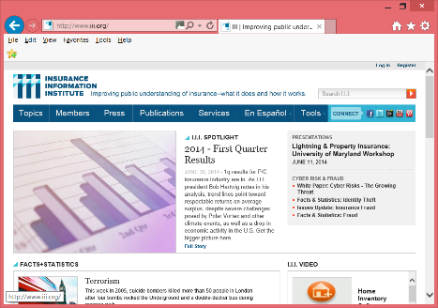
About Us
The Insurance Information Institute was founded more than 50 years ago to improve the public understanding of insurance – what it does and how it works. The I.I.I. is a primary source for information, analysis and referral concerning insurance topics.
www.iii.org
www.InsuringFlorida.org
We are a resource for consumers, media, insurers and researchers.

Slide 3
Examples of What the I.I.I. Offers
3

Slide 4
Return on Equity: Property/Casualty Insurance vs. Fortune 500, 1987–2013E*
(Percent)
P/C Profitability Is Both by Cyclicality and Ordinary Volatility
Katrina, Rita, Wilma
Low CATs
Sept. 11
Hugo
Lowest CAT Losses in 15 Years
4 Hurricanes
Sandy
Andrew
Record Tornado Losses
Northridge
Financial Crisis*
* Excludes Mortgage & Financial Guarantee in 2008 – 2013. 2013 Fortune 500 figure is I.I.I. estimate.
Sources: ISO, Fortune; Insurance Information Institute.

Slide 5
Direct Premiums Written: Total P/C Percent Change by State, 2007-2013
Top 25 States
North Dakota was the country’s growth leader over the past 6 years with premiums written expanding by 74.6%
Sources: SNL Financial LC.; Insurance Information Institute.

Slide 6
Direct Premiums Written: Total P/C Percent Change by State, 2007-2013
Bottom 25 States
Growth was negative in 8 states, including Florida.
Sources: SNL Financial LC.; Insurance Information Institute.

Slide 7
Top States by Inflation-Adjusted Insured Catastrophe Losses, 1983–2012
Over the past 30 years, Florida has accounted for the largest share of catastrophe losses in the U.S., followed by Texas and Louisiana.
Louisiana
$42.0B
Texas
$48.8B
Rest of the U.S.
$309.9B
Florida
$66.7B
Total: $467.5 Billion, an average of $16.6B per year or $1.3B per month
Source: PCS unit of ISO, Verisk Company.; Insurance Information Institute.

Slide 8
Questionable Claims
On the Rise
Message: Fraud Activity is Growing – and So Are Fraud-Fighting Efforts.
8

Slide 9
Questionable Claims, Top 10 Loss States, All Lines: 2010–2012
(Number of Questionable Claims)
California had the largest number of Questionable Claims in 2012; Florida ranks second – 22.6% increase over two years.
+28.3%
+22.6%
+37.9%
+29.1%
+72.9%
+39.3%
+37.1%
+0.8
+53.3
+50.0
Source: National Insurance Crime Bureau, ForeCAST Report, May 10, 2013; Insurance Information Institute

Slide 10
Questionable Claims, Top 10 Loss Cities, All Lines: 2010–2012
(Number of Questionable Claims)
New York City had the largest number of Questionable Claims in 2012, but Florida is the only state with two metro areas in the Top 10 - Miami and Orlando.
+28.5%
+55.1%
+93.2%
+18.7%
+99.0%
+19.8%
-27.7%
+63.8
+82.8
+1.2
Source: National Insurance Crime Bureau, ForeCAST Report, May 10, 2013; Insurance Information Institute

Slide 11
Questionable Claims, Top 10 Policy Types: 2010–2012
Private Passenger Auto had the largest number of Questionable Claims in 2012, but Personal Property (Other) led the way in growth, with the number of QCs more than tripling from 2010 to 2012
(Number of Questionable Claims)
+24.9%
+47.1%
+38.4%
+2.4%
+15.3%
+205.1%
+34.8%
+30.0%
-10.1%
+6.0%
Source: National Insurance Crime Bureau, ForeCAST Report, May 10, 2013; Insurance Information Institute

Slide 12
Task Force Public Outreach
Strategies for Discussion
12

Slide 13
Stakeholder Focus
Who are our audiences? Rank their importance to Task Force goals.
Prosecutors
Law Enforcement
General Public
Insurers
Government/Regulatory Bodies
Media
Contractors, Remediation Companies
Others?
Need a strategic approach for each audience.
Decide:
Which audiences require face-to-face meetings?

Slide 14
Insurance fraud is a crime.
Showing that crime doesn’t pay. Some current activities:
Law enforcement uses social media as a type of “police blotter” with mug shots.
State CFO’s office issues press releases of arrests.
Promotion of Fraud Tipster phone lines.
NICB reports and media outreach.
Educational videos on fraud detection & prevention.
Dept. of Insurance Fraud annual report and statistics.
Reposting the above on “Stomp Out Fraud” Face Book page.

Slide 15
Research needed into fraud deterrents
There has been no specific study of words that work to deter insurance fraud.
Audiences, and criminal participants, are diverse. Most education efforts now are one-size-fits-all.
White collar criminals deterred by photos of a guy in a suit & tie being handcuffed. Not so for others?
Who has been arrested vs. who has been sentenced.
The Coalition of Insurance Fraud says 20% of Americans have few qualms about bilking insurers.
In a state like Florida, with the highest property insurance rates in the U.S., that number may be higher.

Slide 16
Opportunities
Let’s try positive messages!
Tout effective anti-fraud controls that insurers use.
Profile of a fraudster.
Focus on education about not being a victim.
Be out front after disaster. Consider a “Fraud Fighters Press Event” immediately after a hurricane.
Help keep people alert to “opportunistic” fraud. In other words, look for teachable moments.
Continually stress that insurers fight fraud because it’s the law AND it keeps the consumer costs in check.
It is NOT to avoid paying legitimate claims.

Slide 17
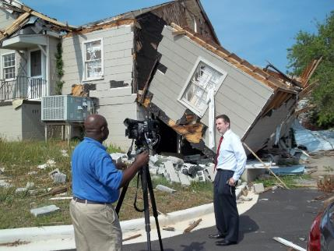

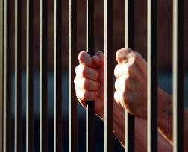
Insurers Making a Difference
Highlight individual company efforts post-disaster to fight fraud.
Tell your story about the investigative process. Stories are remembered!
Share details of successful prosecutions.
17

Slide 18
Using social media effectively
What we say and what the public hears are not always aligned. Always pointing to “bad guys” getting caught may send a signal that is not intended.
Can we “catch” people doing something good? Need real life stories!
Use your own Twitter account to share Task Force news.
Social media is for friends and foes alike. It’s not all happy talk.
Listening to industry critics helps us improve our communication efforts.
Remember: It’s a team effort!

Slide 19
Insurance Information Institute Online:
www.iii.org
www.InsuringFlorida.org
Twitter: @InsuringFLA Face Book: Insuring Florida
Download at www.iii.org/presentations

