Slide 1
Triple-I State of the Industry Review
March 12, 2024

Slide 2
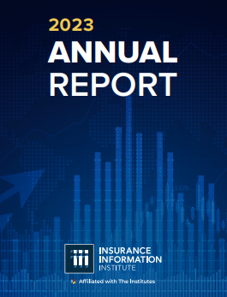
Insurance Information Institute (Triple-I) Mission
The trusted voice of risk and insurance; providing unique, data-driven insights to educate, elevate and connect consumers, industry professionals, public policymakers, and media.

Slide 3
Driving Influence for Insurance Trades
Triple-I plays a supporting and collaborative role in all
      Research & Information:
      Content Development
        Communications: Media Relations, Social, Web
        Primary:
        Triple-I
Griffith
IRC
        Secondary:
APCIA
NAMIC
RAA
Big-I
CIAB
        Primary:
        Triple-I
        Secondary:
        APCIA
NAMIC
RAA
IIHS
IBHS
Affiliates of The Institutes
Industry Influence & Reputation
Consumers
Professionals
Media
Policymakers
      Lab: Physical Labs Functioning
      Public Policy: Lobbying, Regulation, Legal
        Primary:
        APCIA
NAMIC
RAA
Big-I
CIAB
        Primary:
IIHS
IBHS
        Secondary
        (Lab Partners)
Triple-I
APCIA
NAMIC
        Secondary:
Triple-I
Griffith
IRC
IBHS
IIHS
Non-lobbying, e.g., content, briefings, testimony

Slide 4
2024 Issue Management
If it’s important to you, it’s important to us
Elevate
Lead
High
Audiences
Legal System Abuse
Commercial
Property
Auto
Personal
Risk Based Pricing
Climate Risk Resilience (ESG?)
Public Sector
Insurance Economics & Public Policy
Campaign Initiative
Triple-I Opportunity
Inform
Manage
Life
Cyber
DEI &Talent
Business Interruption
Innovation & AI
Terror
Low
Low
Industry Oppty./Risk
High

Slide 5
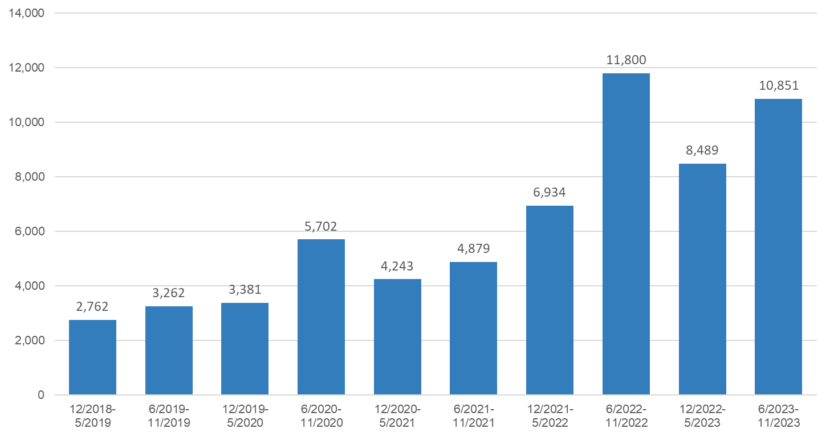
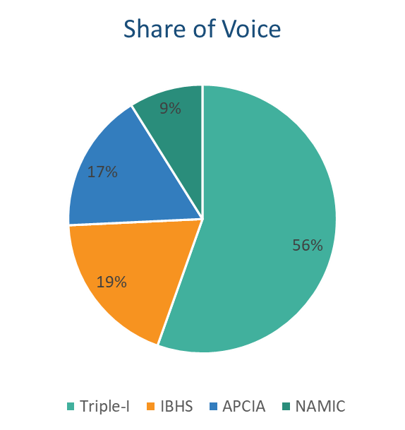

Triple-I Media Citations (2018-Present)
Record citations, plus share of voice is greater than all other trades combined
Source: Cision Media Tracking
Feeling the pinch of high home insurance rates? It's not getting better anytime soon
Homeowners Flock to Last-Resort Insurance Policies

Slide 6
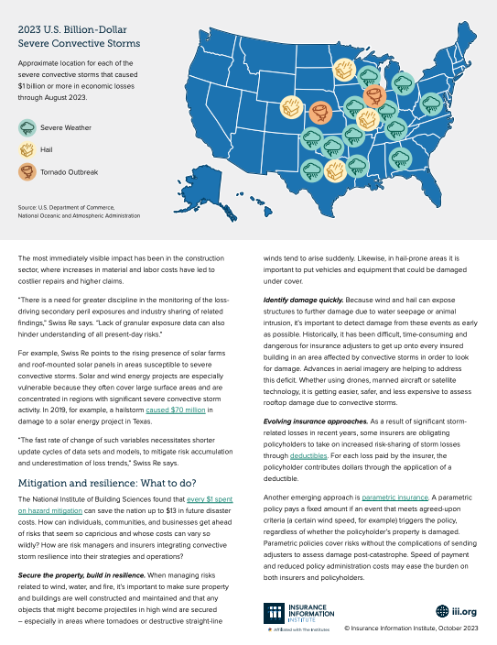
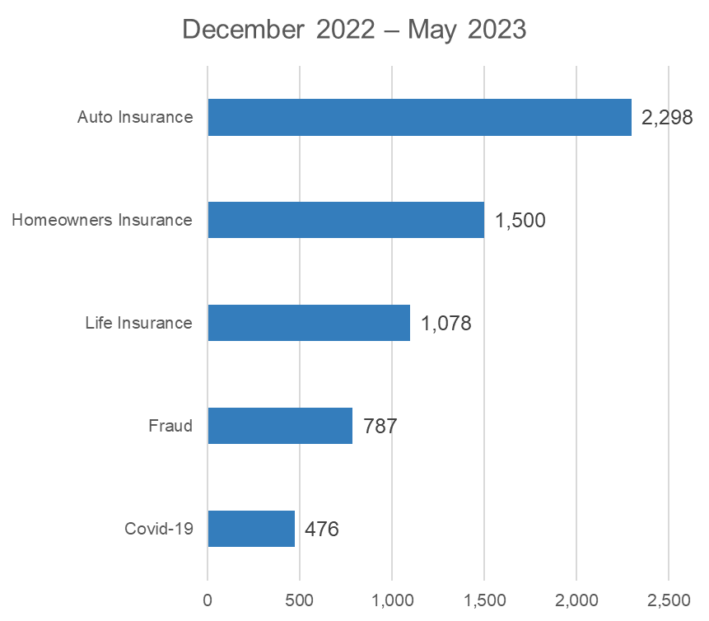
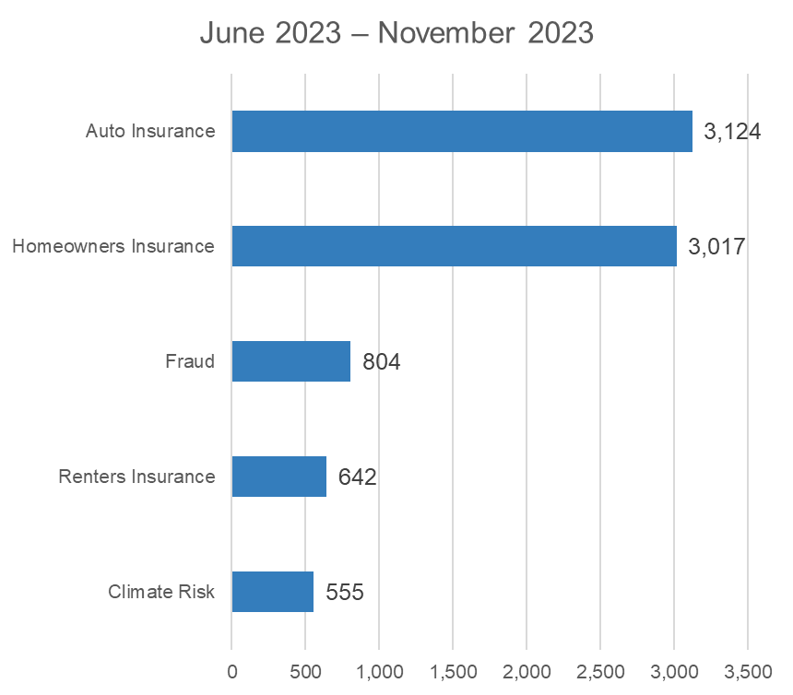
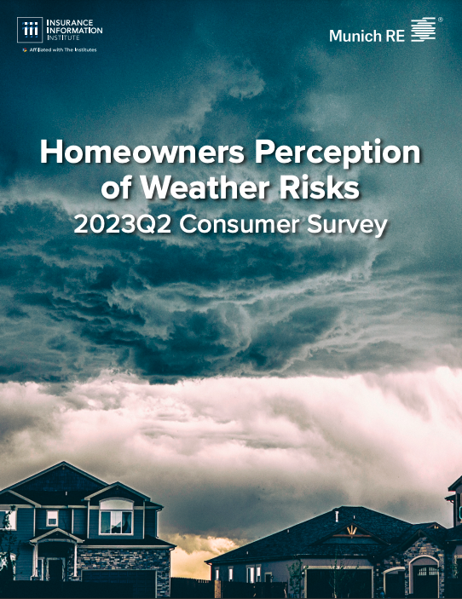
Top 5 Media Citations by Issue
Homeowners doubles, fraud and climate risk on the rise
Source: Cision Media Tracking

Slide 7
Millions Continue to Rely on the Triple-I Website
1.8 Million pageviews in last six months
Source: Google Analytics 4. Six-month for 2023 are from May 1 - Oct. 31, 2023. Please note views for top 100 pages do not add to total views.
*Other includes homepage views (140,698), publication pages, charts, etc.
Notes:
1
www.iii.org/
140,698
2
www.iii.org/article/understanding-the-insurance-claims-payment-process
35,772
3
www.iii.org/fact-statistic/facts-statistics-wildfires
30,261
4
www.iii.org/es/article/como-funciona-el-deducible-de-su-seguro
27,431
5
www.iii.org/es/article/responsabilidad-civil-en-el-caso-de-mordeduras-de-perros
21,284
6
www.iii.org/article/what-gap-insurance
20,209
7
www.iii.org/article/12-ways-to-lower-your-homeowners-insurance-costs
19,808
8
www.iii.org/article/understanding-your-insurance-deductibles
19,734
9
www.iii.org/article/how-can-i-locate-lost-life-insurance-policy
19,168
10
www.iii.org/article/how-much-homeowners-insurance-do-you-need
19,109
11
www.iii.org/article/nine-ways-to-lower-your-auto-insurance-costs
19,094
12
www.iii.org/fact-statistic/facts-statistics-auto-theft
18,349
13
www.iii.org/es/article/que-son-los-diferentes-tipos-de-anualidades
18,285
14
www.iii.org/article/lightning-safety-10-myths-and-the-facts
18,221
15
www.iii.org/table-archive/21040
17,065
16
www.iii.org/fact-statistic/facts-statistics-homeowners-and-renters-insurance
15,075
17
www.iii.org/fact-statistic/facts-statistics-identity-theft-and-cybercrime
14,981
18
www.iii.org/article/understanding-inland-marine-insurance
14,254
19
www.iii.org/article/can-i-own-home-without-homeowners-insurance
13,253
20
www.iii.org/fact-statistic/facts-statistics-auto-insurance
12,859
21
www.iii.org/es/article/que-sucede-cuando-un-conductor-sin-seguro-de-auto-tiene-un-accidente
12,574
22
www.iii.org/article/background-on-insurance-fraud
12,492
23
www.iii.org/article/what-auto-insurance
12,106
24
www.iii.org/article/auto-insurance-basics-understanding-your-coverage
11,994
25
www.iii.org/article/what-determines-price-my-auto-insurance-policy
11,491
26
www.iii.org/article/insurance-company-claims-filing-telephone-numbers
11,204
27
www.iii.org/fact-statistic/facts-statistics-motorcycle-crashes
11,142
28
www.iii.org/fact-statistic/facts-statistics-uninsured-motorists
11,104
29
www.iii.org/article/what-employment-practices-liability-insurance-epli
10,673
30
www.iii.org/automobile-financial-responsibility-laws-by-state
10,671
31
www.iii.org/fact-statistic/facts-statistics-pet-ownership-and-insurance
10,176
32
www.iii.org/fact-statistic/facts-statistics-hurricanes
9,966
33
www.iii.org/article/what-if-i-cant-find-auto-coverage
9,837
34
www.iii.org/top-10-writers-of-homeowners-insurance-in-florida
9,786
35
www.iii.org/article/how-do-i-file-claim
9,687
36
www.iii.org/es/article/que-es-una-anualidad
9,673
37
www.iii.org/article/if-i-file-claim-will-my-premium-go
9,415
38
www.iii.org/article/spotlight-on-dog-bite-liability
8,864
39
www.iii.org/article/what-covered-standard-homeowners-policy
8,836
40
www.iii.org/publications/insurance-handbook/regulatory-and-financial-environment/reinsurance
8,820
41
www.iii.org/publications/insurance-handbook/regulatory-and-financial-environment/background-on-insurance-accounting
8,789
42
www.iii.org/publications/commercial-insurance/rankings
8,533
43
www.iii.org/fact-statistic/facts-statistics-industry-overview
8,487
44
www.iii.org/article/why-did-my-auto-insurance-costs-go-up-even-when-i-didnt-file-a-claim
8,316
45
www.iii.org/article/commercial-general-liability-insurance
8,150
46
www.iii.org/services/directory/company-categories/state-insurance-departments
7,977
47
www.iii.org/es/article/como-se-determinan-el-valor-y-costo-de-reparacion-de-su-auto
7,658
48
www.iii.org/article/preparing-effective-evacuation-plan
7,457
49
www.iii.org/insuranceindustryblog/
7,280
50
www.iii.org/article/how-are-value-my-car-and-cost-repair-determined
7,237
51
www.iii.org/article/how-to-assess-the-financial-strength-of-an-insurance-company
7,146
52
www.iii.org/about-us
7,139
53
www.iii.org/article/should-i-buy-long-term-care-insurance
6,964
54
www.iii.org/article/what-covered-basic-auto-insurance-policy
6,879
55
www.iii.org/fact-statistic/facts-statistics-life-insurance
6,786
56
www.iii.org/insurance-basics
6,786
57
www.iii.org/article/insurance-101
6,742
58
www.iii.org/fact-statistic/facts-statistics-insurance-company-rankings
6,692
59
www.iii.org/article/social-inflation-hard-to-measure-important-to-understand
6,687
60
www.iii.org/article/what-if-i-cant-get-coverage
6,640
61
www.iii.org/article/settling-insurance-claims-after-a-disaster
6,452
62
www.iii.org/publications/insuring-your-business-small-business-owners-guide-to-insurance/specific-coverages/workers-compensation-insurance
6,382
63
www.iii.org/research-data
6,373
64
www.iii.org/es/article/que-informacion-necesita-la-aseguradora-para-emitir-un-seguro-de-auto
6,232
65
www.iii.org/article/how-create-home-inventory
5,776
66
www.iii.org/top-10-writers-of-homeowners-insurance-in-california
5,673
67
www.iii.org/article/unclaimed-life-insurance-benefits
5,616
68
www.iii.org/fact-statistic/facts-statistics-hail
5,511
69
www.iii.org/article/homeowners-insurance-basics
5,491
70
www.iii.org/article/if-i-cant-pay-my-premium-what-should-i-do
5,424
71
www.iii.org/article/if-a-tree-falls-on-your-house-are-you-covered
5,307
72
www.iii.org/article/how-can-i-save-money-auto-insurance
5,174
73
www.iii.org/fact-statistic/facts-statistics-sports-injuries
5,106
74
www.iii.org/insurance-basics/auto-insurance/shopping-for-insurance
5,060
75
www.iii.org/fact-statistic/facts-statistics-tornadoes-and-thunderstorms
4,994
76
www.iii.org/state-drivers-license-renewal-laws-including-requirements-for-older-drivers
4,915
77
www.iii.org/publications/insuring-your-business-small-business-owners-guide-to-insurance/risk-management/risk-management-basics
4,876
78
www.iii.org/es/article/como-determina-la-aseguradora-el-pago-de-la-indemnizacion-de-un-reclamo
4,840
79
www.iii.org/publications/a-firm-foundation-how-insurance-supports-the-economy/a-50-state-commitment/insurance-companies-by-state
4,818
80
www.iii.org/article/does-my-business-need-terrorism-insurance
4,667
81
www.iii.org/article/understanding-crop-insurance
4,652
82
www.iii.org/es/article/como-cuando-y-porque-considerar-una-anualidad-como-parte-del-panorama-financiero
4,610
83
www.iii.org/publications/insurance-handbook/brief-history
4,547
84
www.iii.org/publications/commercial-insurance/how-it-functions/regulation
4,488
85
www.iii.org/article/what-are-different-types-annuities
4,432
86
www.iii.org/article/what-are-principal-types-life-insurance
4,295
87
www.iii.org/article/securing-your-home-against-burglary
4,162
88
www.iii.org/es/article/cual-es-la-diferencia-entre-una-cancelacion-y-la-no-renovacion-de-una-poliza
4,146
89
www.iii.org/insurance-basics/homeowners-renters-insurance/shopping-for-insurance-0
4,080
90
www.iii.org/fact-statistic/facts-statistics-teen-drivers
4,146
91
www.iii.org/publications/insurance-handbook/insurance-basics/auto-insurance-basics
4,047
92
www.iii.org/user/register
4,027
93
www.iii.org/es/article/que-factores-influyen-en-el-precio-de-una-poliza-de-seguro-de-auto
4,027
94
www.iii.org/fact-statistic/facts-statistics-us-catastrophes
3,945
95
www.iii.org/fact-statistic/facts-statistics-mortality-risk
3,857
96
www.iii.org/article/what-are-different-types-term-life-insurance-policies
3,856
97
www.iii.org/article/what-beneficiary
3,840
98
www.iii.org/fact-statistic/facts-statistics-distribution-channels
3,804
99
www.iii.org/fact-statistic/facts-statistics-highway-safety
3,786
100
www.iii.org/publications/commercial-insurance/the-global-dimension/london-market
3,777
1,064,977

Slide 8
Number of Websites Linking to Triple-I
Content Continues to Proliferate
Authority Score
60 (Max)
54
32
31
44
Source: SemRush.

Slide 9
Insurance Economics
Macro drivers of insurance performance

Slide 10

Cumulative P&C Replacement Costs Increases From 2019 to 2022
Cumulative P&C Replacement Cost Increases from 2019 to 2022
All P&C and Key Lines (YoY% and Yo3Y%)
UP 40.4% SINCE 2019
Replacement costs for all P&C lines increased 40.4% from 2019 to 2022, even after recent decreases in U.S. CPI
Cumulative P&C Replacement Costs Increases (Yo3Y% 2019-22)
All P&C Lines: 40.4%
Homeowners: 55.4%
Private Auto: 45.6%
Commercial Property: 39.9%
Source: Triple-I (as of 03/25/2023)

Slide 11
P&C Industry Macroeconomic Drivers
Real GDP Growth at 2.1% YTD, with Q3 higher at 4.9% - for GDP, all eyes on Q4 numbers.
CPI continues to slow down to 3.1% as of November - but CPI Less Food & Energy is still up 4.0% YoY.
P&C replacement costs confirm trend and increasing slower than full CPI.
U.S. payrolls up by 216,000 in December, but unemployment rate unchanged at 3.7%.
Growth & Inflation (Change YoY%) | 2022 | 2023YTD | 2024 | 2025
Growth
U.S. Real GDP | 1.9% | 2.1% | 1.5% | 1.8%
Finance & Insurance Output | 0.5% | -5.5% | -4.4% | 1.0%
P&C Underlying Growth | 0.6% | 1.3% | 2.6% | 4.5%
Inflation
U.S. Inflation | 6.4% | 3.1% | 2.5% | 2.2%
P&C Replacement Costs | 3.1% | 1.1% | 2.0% | 1.9%
Source: U.S. Economic data: FRED; Insurance data and analysis: Triple-I; as of 01/09/2024
Takeaway 1
Takeaway 2

Slide 12
Homeowners
Mortgage rates and lending standards punishing housing growth.
Mortgage rates reached 7.79% in October, down to 6.62% by January or $2,306 on average.
Rebound requires record low Inventories to loosen up first.
Homeowners insurance replacement costs continue to increase below overall CPI.
Bright spot: new apartments growth in the Sunbelt.
Homeowners (Change YoY%) | 2022 | 2023YTD | 2024 | 2025
Underlying Growth | -2.2% | -5.3% | 3.0% | 4.0%
Housing Units Starts | -4.5% | -17.2% | 2.0% | 3.0%
All Construction Employment | 4.2% | 2.8% | 2.8% | 3.8%
Retail Trade | -3.8% | 10.2% | 5.0% | 6.0%
Replacement Costs | 3.9% | 2.4% | 2.3% | 2.2%
Shelter | 7.5% | 7.2% | 5.0% | 4.0%
Household Furnishing & Supplies | 6.7% | 2.2% | 2.1% | 2.1%
Construction Materials | -2.6% | -2.3% | 1.5% | 1.5%
Source: U.S. Economic data: FRED; Insurance data and analysis: Triple-I; as of 01/09/2024
Takeaway 1
Takeaway 2

Slide 13
Commercial Property
Lending and bond interest rates continue to punish industry’s rebound; may see some relief into Q2-Q3 2024.
Bulk of positive news comes from retail sector rents and related commercial structures construction.
Normalization of remote work and lending environment may lead to rebound start in 2024, especially for class A offices.
Commercial Property (Change YoY%) | 2022 | 2023YTD | 2024 | 2025
Underlying Growth | 3.8% | 3.3% | 2.5% | 3.0%
Real Estate, Rental & leasing | 3.3% | 2.5% | 2.1% | 2.5%
All Employees Commercial Buildings | 4.6% | 4.9% | 4.8% | 4.9%
Replacement Costs | 0.7% | -0.5% | 1.3% | 1.5%
Construction Materials | -2.6% | -2.3% | 1.6% | 1.6%
Equipment & Other Capital Goods | 9.3% | 2.0% | 2.1% | 2.5%
Information Technology Prices | -4.6% | -1.1% | 0.5% | 0.8%
Source: U.S. Economic data: FRED; Insurance data and analysis: Triple-I; as of 01/09/2024
Takeaway 1

Slide 14
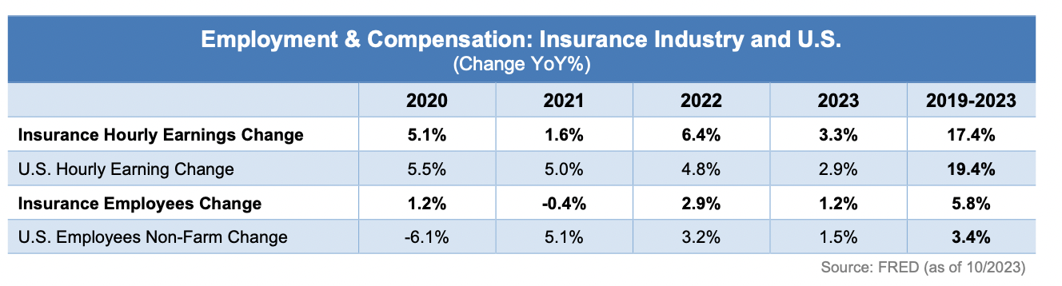
Insurance Employment Trends
Looking at specific roles within the insurance industry, the number of sales agents and underwriters increased the most, while the number of claims and processing clerks decreased the most.
Nominal wages in insurance increased by 3.3% YTD in 2023, above U.S. wage increases of 2.9%. Adjusted for 2023 inflation, real wages in insurance remained flat this year, while in the U.S. they decreased -0.4% this year.
Takeaway 1
Takeaway 2

Slide 15
Underwriting Projections

Slide 16
P&C Industry Outlook
Bad News #1: Homeowners 2023 Q3 Incurred Loss Ratio was higher than average of prior 10 years
Good News: Unlike Q1 and Q2, Homeowners 2023 Q3 Incurred Loss Ratio was not the worst in the prior 10 years
Bad News #2: Commercial Auto 2023 Q3 Incurred Loss Ratio was highest in over 15 years
Bad News #3: CMP 2023 Q3 Incurred Loss Ratio was higher than average of prior 10 years
Sources: NAIC Statutory Financial Data through S&P Global Market Intelligence
Analysis (as of 12/21/2023): Insurance Information Institute, Milliman.

Slide 17
P&C Industry Trends
Net Combined Ratio | 2018 | 2019 | 2020 | 2021 | 2022 | 2023 E | 2024 F | 2025 F
Personal Lines | 99.4% | 98.8% | 96.8% | 102.1% | 109.9% | 109.9% | 105.2% | 101.9%
Commercial Lines | 98.7% | 98.8% | 100.9% | 96.7% | 94.8% | 97.7% | 97.7% | 97.0%
Overall picture from prior quarter remains the same with Commercial Lines performing better than Personal
Personal Lines 2023 Net Combined Ratio improved 0.7 points from prior evaluation and is now flat with 2022
Commercial Lines 2023 Net Combined Ratio deteriorated 0.8 points due to Commercial Auto and CMP
Net Written Premium Growth Rate for Personal Lines expected to surpass Commercial Lines by nearly 7% points in 2023, first time since 2017
Net Written Premium Growth Rate | 2018 | 2019 | 2020 | 2021 | 2022 | 2023 E | 2024 F | 2025 F
Personal Lines | 8.1% | 3.3% | 0.0% | 5.0% | 7.2% | 12.5% | 10.8% | 8.3%
Commercial Lines | 14.0% | 3.7% | 5.4% | 14.0% | 9.8% | 5.6% | 5.5% | 4.7%
Sources: NAIC Statutory Financial Data through S&P Global Market Intelligence
Analysis (as of 12/21/2023): Insurance Information Institute, Milliman.

Slide 18
Personal Auto
2023 Net Combined Ratio of 108.8 is 3.4 points better than 2022
2023 Underwriting Loss of $28B follows $33B loss in 2022, multiples of industry’s $18B profit in 2020
2023 Net Written Premium growth rate of 12.5% is highest in over 15 years, reflecting rate increases to offset inflationary loss costs
2024 and 2025 are expected to improve but remain unprofitable
Sources: NAIC Statutory Financial Data through S&P Global Market Intelligence
Analysis (as of 12/21/2023): Insurance Information Institute, Milliman.

Slide 19
Personal Auto
2023 Q3 Direct Incurred Loss Ratio of 75% is 8 points improved from 2022 Q3 but still 2 points worse than 2021 Q3
Physical Damage performed better than Liability in 2023 Q3, flipping their relativity to total quarter-over-quarter
Sources: NAIC Statutory Financial Data through S&P Global Market Intelligence
Analysis (as of 12/21/2023): Insurance Information Institute, Milliman.

Slide 20
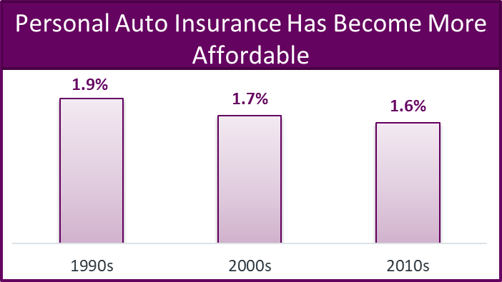
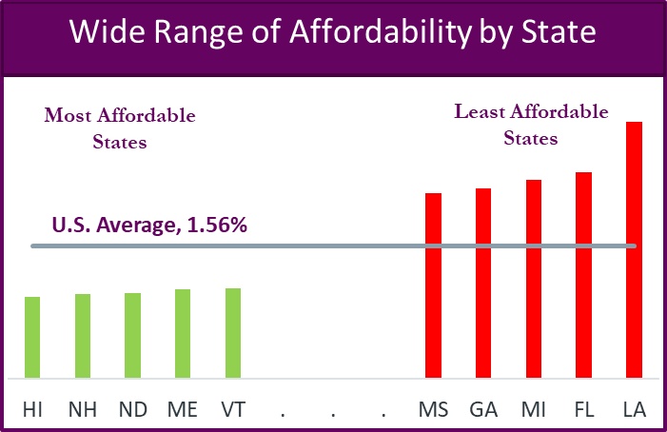

Personal Auto Insurance Affordability
Insurance Research Council (IRC) measures auto insurance affordability by calculating the ratio of average auto insurance expenditures to median household income
From 1990s to 2010s, personal auto insurance has become more affordable
Across jurisdictions in the United States, auto insurance affordability ranges widely from a high of 3.01% in Louisiana to a low of 0.95% in Hawaii
Any efforts to improve affordability must address the underlying key cost drivers as these factors vary widely across the 51 different auto insurance systems in the U.S.
20

Slide 21
Homeowners
2023 Net Combined Ratio of 112.3 is worst since 2011
2023 Net Written Premium Growth Rate of 12.4% is highest in over 10 years, reflecting rate increases to offset inflationary loss costs
2024 and 2025 are expected to improve but remain unprofitable
Sources: NAIC Statutory Financial Data through S&P Global Market Intelligence
Analysis (as of 12/21/2023): Insurance Information Institute, Milliman.

Slide 22
2021 Homeowners Insurance Premiums as
Percent of Median Income
Most affordable
Least affordable

Slide 23
Commercial Property
2023 Net Combined Ratio of 89.9 is lowest since 2016
2023 Net Written Premium growth rate of 12.6% is the highest of all commercial lines
Favorable results expected in the next two years with slowing premium growth rates
Sources: NAIC Statutory Financial Data through S&P Global Market Intelligence
Analysis (as of 12/21/2023): Insurance Information Institute, Milliman.

Slide 24
Key Industry
Risks & Opportunities

Slide 25
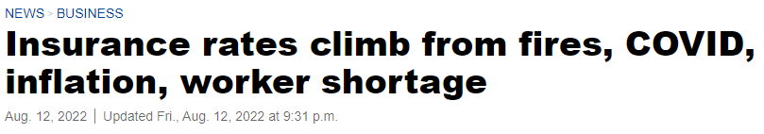
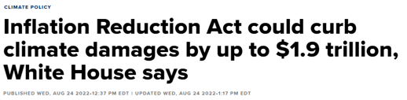
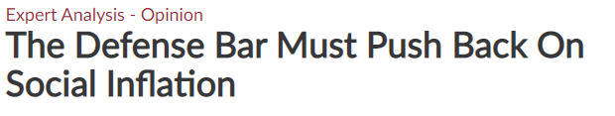
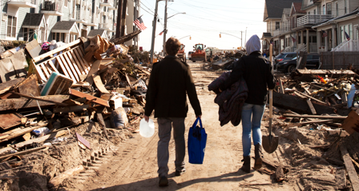
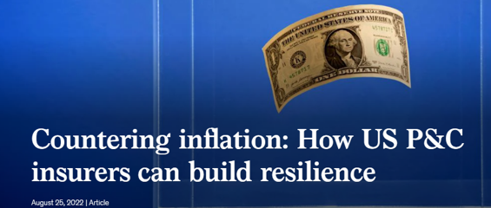

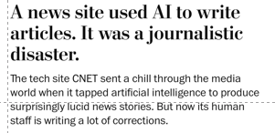
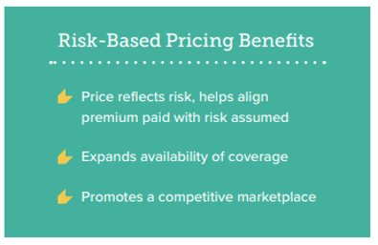
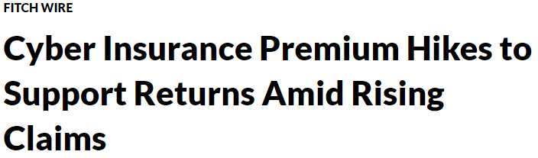


Risks & Opportunities
Economic Inflation
Climate & Resilience
Legal System Abuse
Artificial Intelligence
Risk-Based Pricing
Cyber
25

Slide 26
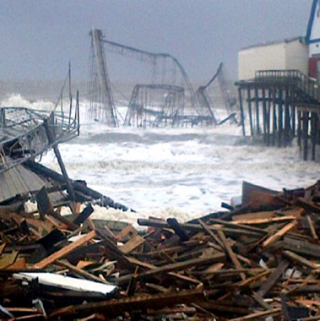
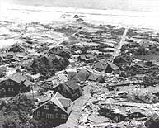
“Those who cannot remember the past are condemned to repeat it.”

Slide 27
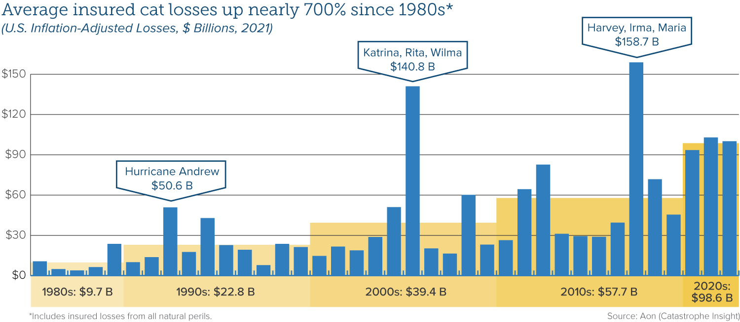
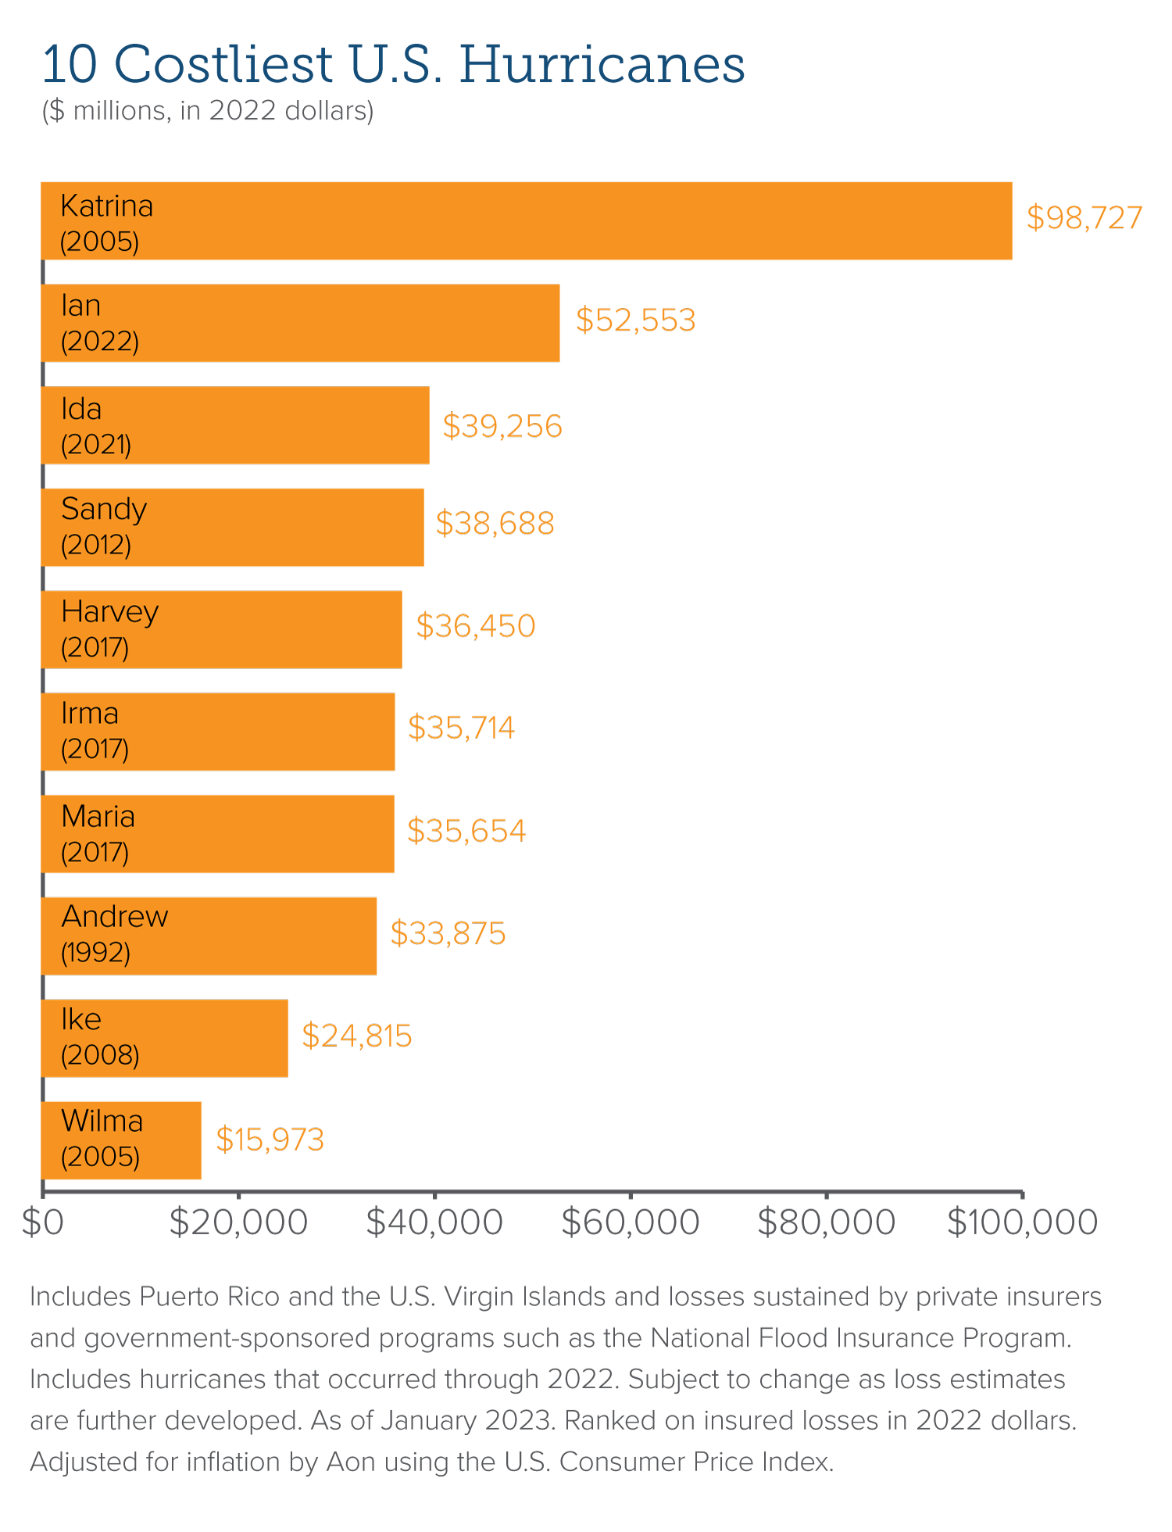
U.S. Catastrophe Losses Steadily Climbing
Risk transfer is essential, but just one tool in the resilience toolkit alongside
risk modeling, technology, public policy, finance, and science

Slide 28
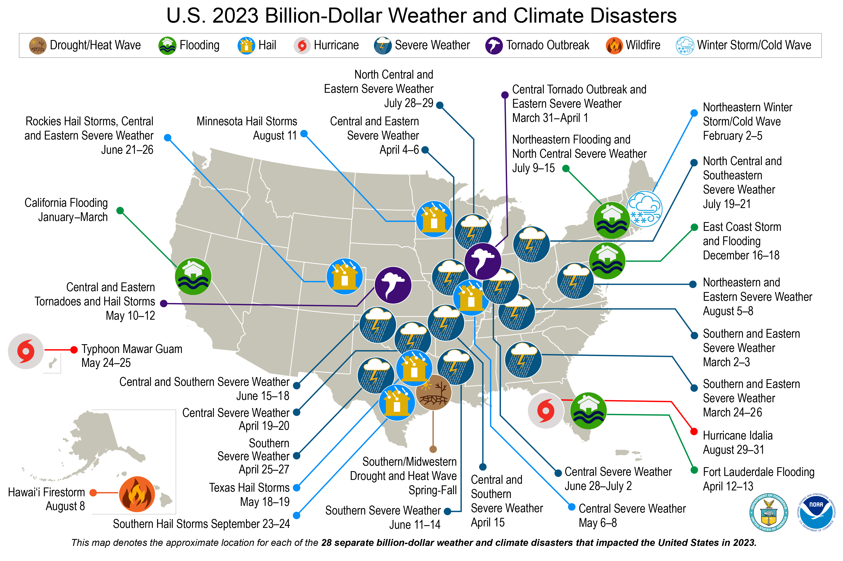
Record 28 billion-dollar events in 2023
Prior record was 22 events in 2020
$93B total cost in 2023
Record more than $50B in severe convective storms through Q3

Slide 29
P&C Financials Strong Despite Market Volatility & UW Losses
P&C Quarterly Policyholder Surplus 2009Q1-2023Q3
Q3 2023 at $966B nearing Q3 2022 low of $926B
Billions
Surplus at end of Q4 2021 stood at $1,053B, an all-time high
Post-Global Financial Crisis Low 2009Q1
Sources: NAIC data sourced through S&P Global Intelligence; Insurance Information Institute.
29

Slide 30
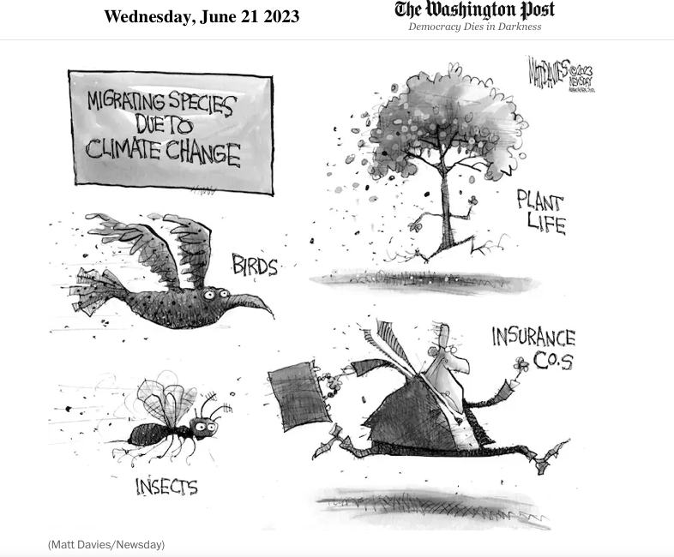
Really?

Slide 31
Triple-I’s Climate Risk Objective
Drive behavioral change to help people and communities better manage risk and become more resilient
Predict
&
Prevent
Recognize insurance and its role.
Remove the politics – focus on the solutions.
Be responsible about the low carbon transformation.
Balance out the long-term (carbon) and short-term (physical infrastructure) risks.
Institute public policies and government spending projects.
Integrate new public-private collaboration options.

Slide 32
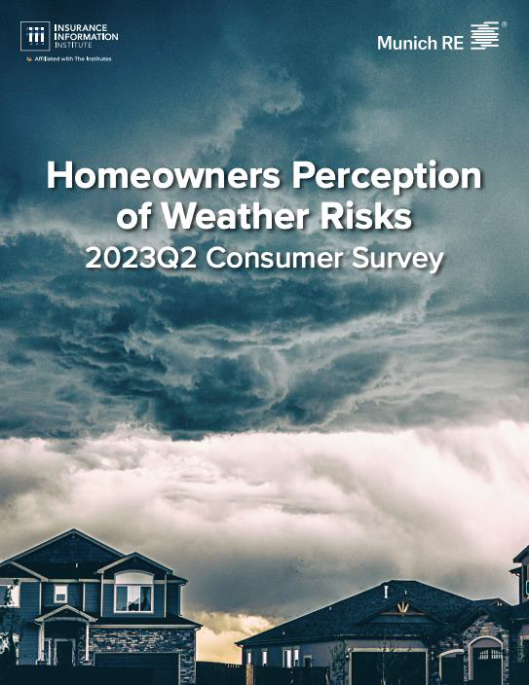
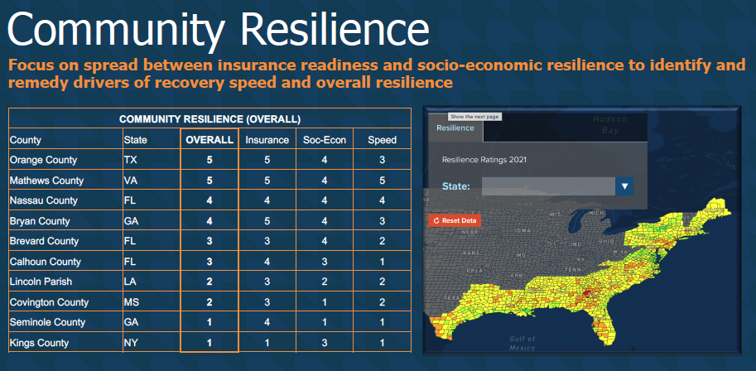
Advancing The Climate Risk Discussion
Triple-I is actively informing how insurance is leading the resilience dialogue
Published Content
Consumer Awareness Survey in collaboration with Munich Re
Wrote/edited the Insurance Chapter in the National Institute of Building Sciences' (NIBS) Roadmap to Resilience
Contribute to Milwaukee Municipal Sewerage District Flood Mitigation Research Brief
State of the Risk Issues Briefs on Flood, Hurricanes, Convective Storms, Wildfires
Resilience Accelerator Hub
Community Resilience Ratings added two more years of experience

Slide 33
Defining Legal System Abuse
What Is It?
Exploits litigation when a disputed claim could have been resolved without judicial intervention.
  Shadowed Third-Party Litigation Funding (TPLF)
  Exploitative Plaintiff Advertising — “The Billboard Effect”
  Increasing Plaintiff Attorney and Contingency Fees
  Eroding Caps on Damages
Why Does It Matter?
Claimants receive less.
Higher costs for for all consumers and businesses.
What Can Be done?
Increase and inform understanding of dangers.
Foster legislative and judicial reform.
Create transparency on TPLF.

Slide 34
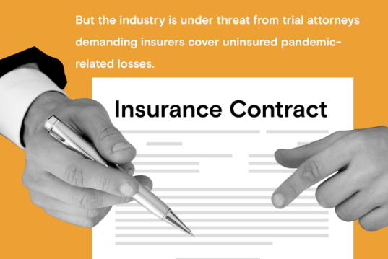
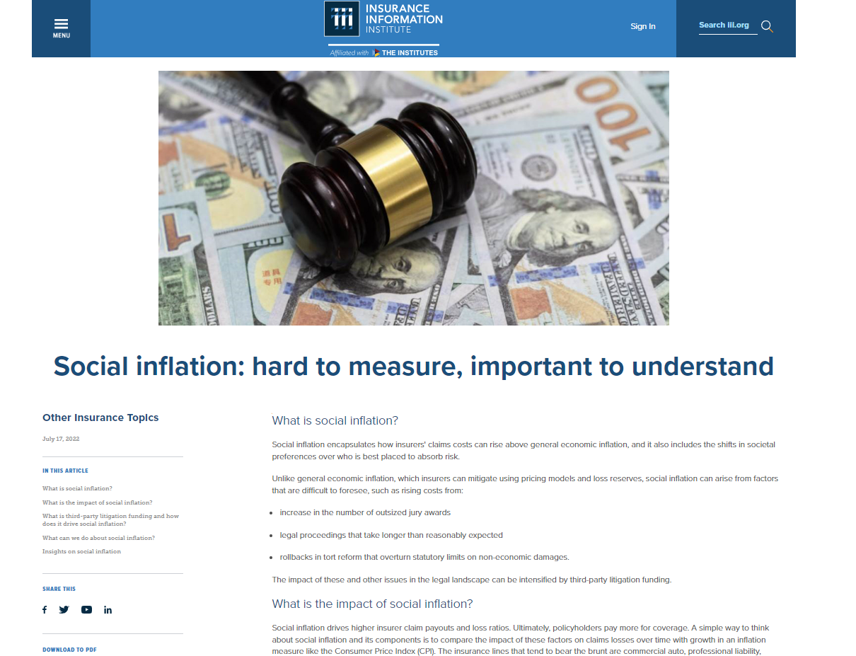
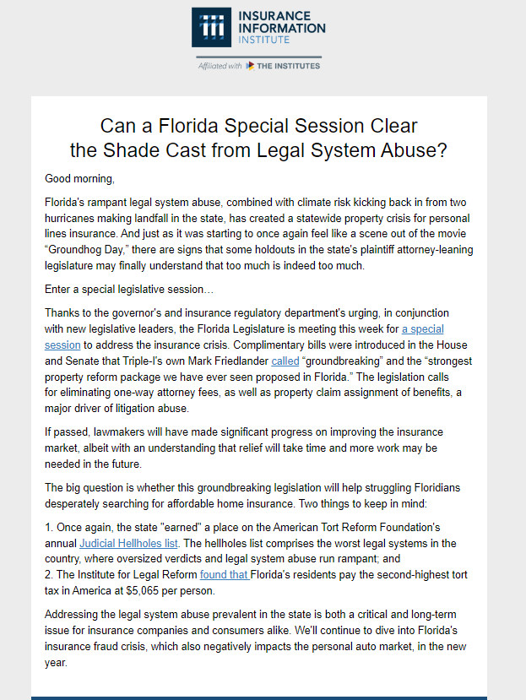
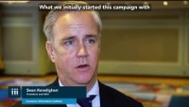
Triple-I Taking on Legal System Abuse
Two-years of proactive work to build strong foundation
80% increase in annual web site views
200%+ increase in media citations
7k+ subscribers to legal abuse e-blasts Research, insights, videos and communications to media, consumer, industry, and members
Testimony in NY and OH
Targeted social media campaigns
Web hub
Message testing and polling

Slide 35

2024 Legal System Abuse Strategy
Echo Industry Lobbying Trades State-Based Initiatives While Shining Light on TPLF
Lead via Proactive Triple-I Thought Leadership
Focus on “Battleground” States: GA, LA, MI, TX, FL
Develop and Launch TPLF Transparency Campaign
  Message testing with ILR and APCIA, then apply to thought leadership and state campaigns
Build Coalition with APCIA, NAMIC, RAA, CIAB, Big-I
  Lobbying Trades: On-the-ground government affairs and legal tactics
  Triple-I: Research and Communications “Echo Chamber” e.g., briefings, fact sheets, editorial boards, Rapid Response, targeted email and digital advertising, testimony
Leverage Third-Party Relationships
  American Tort Reform Association, U.S. Chamber of Commerce Institute for Legal Reform, National Association of REALTORs, Triple-I Non-Resident Scholars, American Trucking Associations

Slide 36
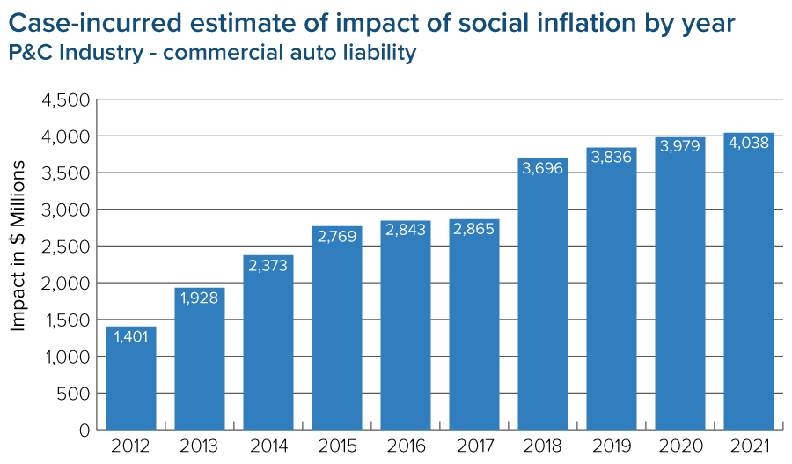
Financial Impact of Legal System Abuse
Triple-I Actuaries Quantified The Problem
Key Findings
Social Inflation contributed to increased claims by estimated $30-34B (18-20%) from 2012 to 2021 in Commercial Auto Liability
Research suggests Social Inflation could be causing losses to increase faster than general inflation by 2-3% per year
Evidence of similar trends found in Other Liability Occurrence and Medical Malpractice Claims-made
State of the Risk: Social Inflation
*Triple-I and Casualty Actuarial Society analysis of National Association of Insurance Commissioner (NAIC) data. Social Inflation and Loss Development - An Update, Lynch, J. and Moore, D., March 2023
36

Slide 37
Attorney Involvement is Growing Steadily

Slide 38

Attorney Involvement and Litigation
Consumers understand connection between attorney advertising and insurance costs
Opportunities for education about Third-Party Litigation Funding
Source: Public Attitudes on Litigation Trends and the Role of Attorneys in Auto Insurance Claims | Insurance Research Council (insurance-research.org)

Slide 39
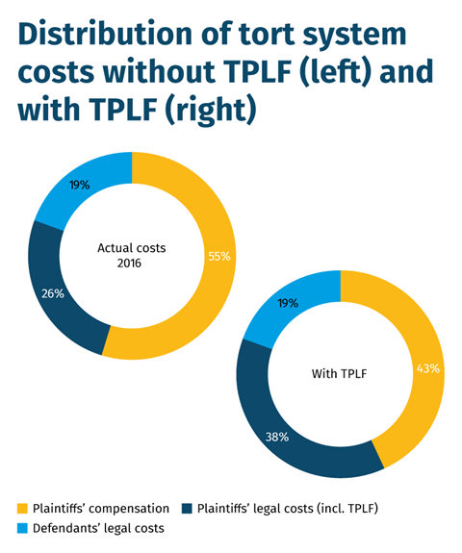
Third-Party Litigation Funding
Who typically provides this money?
Deep-pocketed investors – accredited investors, hedge funds, financial institutions, asset managers, other large funds – seeking above-average returns on their investments
What kinds of cases are funded?
Torts and contract breaches
Personal injury
Class Action
Intellectual Property
Whistleblower
Arbitration
Plaintiff compensation drops to 43% from 55% when TPLF involved
Source: Swiss Re, Institute for Legal Reform, Research Nester

Slide 40
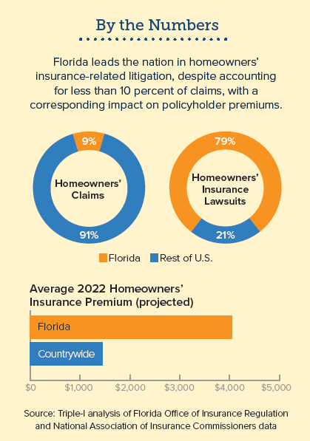
Climate Risk x Legal System Abuse = Property Crisis
Compounding of cats, fraud, and legal system abuse has led to a property crisis in key states
Florida
$51B was paid out by insurers over 10-year period, with 71% going to attorneys' fees and public adjustors*
Nine insurance company insolvencies since 2021
Citizens Property Insurance Corp. insured over 1.4M policies
Louisiana
2021 Industry Combined Ratio of 462 pts and Underwriting Loss of $7.2B due primarily to Hurricane Ida
Nine companies were declared insolvent in 2022
Lawsuit environment costs the state $3.9B in lost economic activity, imposing a "tort tax" of $451 per resident annually**
Trends & Insights: Florida Insurance Crisis
*Florida Office of Insurance Regulation
**American Tort Reform Association
40

Slide 41
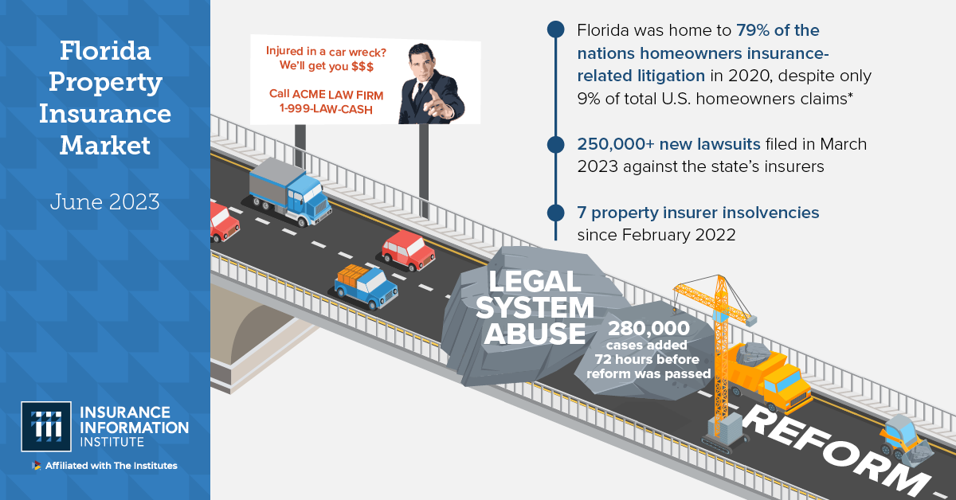
Florida: Coming to a State Near You…

Slide 42
Thank you!
Questions?

