Slide 1
The Internet of Things: Insurance in the Age of the “Sharing” and “On Demand” Economy
Annual Circle of Chief Economists
The Geneva Association
The Hague, Netherlands
17 March 2016
Download at www.iii.org/presentations
Robert P. Hartwig, Ph.D., CPCU, President & Economist
Insurance Information Institute ♦ 110 William Street ♦ New York, NY 10038
Tel: 212.346.5520 ♦ Cell: 917.453.1885 ♦ bobh@iii.org ♦ www.iii.org

Slide 2
TECHNOLOGY, DISRPTORS AND INSURANCE
Applications of Technology in P/C Insurance Have Gripped the Media as Have Industry Solutions
2

Slide 3
Interest in Technology Issues and Insurance Is Surging: Presents Opportunity
Insurers are at the intersection of many of the most important technological innovations of the early 21st century
  Problem→Solution→Opportunity
Industry is too often depicted as a technology laggard
I.I.I. is highlighting the industry as being on the technological cutting edge—an innovative, nimble industry with solutions for managing countless new risks of the current era:
  Sharing economy Cyber Auto Technology
  Supply Chain Climate Risk Drones
  Wearable devices The “Internet of Things”
Positions industry well with customers, investors, current and prospective workers/Millennials, regulators/legislators and (tech) media
3
12/01/09 - 9pm
eSlide – P6466 – The Financial Crisis and the Future of the P/C
Notes:
3

Slide 4
CYBER RISK AND INSURANCE
Cyber Risk is a Rapidly Emerging Exposure for Businesses Large and Small in Every Industry
4

Slide 5






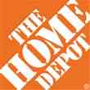

Data Breaches 2005-2015, by Number of Breaches and Records Exposed
# Data Breaches/Millions of Records Exposed
Millions
The 781 reported data breaches in 2015 was virtually unchanged form the record 783 reported in 2014. The number of exposed records soared to 169.1 million, and increase of 97.5%.
Source: Identity Theft Resource Center (updated as of Jan. 6, 2016);
http://www.idtheftcenter.org/images/breach/ITRCBreachReport2015.pdf

Slide 6
Data/Privacy Breach:
Many Potential Costs Can Be Insured
Data Breach Event
Costs of notifying affecting individuals
Defense and settlement costs
Lost customers and damaged reputation
Cyber extortion payments
Costs of notifying regulatory authorities
Regulatory fines at home & abroad
Business Income Loss
Forensic costs to discover cause
Source: Zurich; Insurance Information Institute.
6

Slide 7
Estimated Cyber Insurance Premiums Written, 2014 – 2020F
Cyber insurance premiums written could more than triple to $7.5 billion by 2020
$ Billions
I.I.I.’s Cyber Risk paper issued Oct. 2015
Source: Advisen (2014 est.); PwC (2015, 2020); Insurance Information Institute.

Slide 8
The Sharing Economy
The Sharing (On-Demand or ‘Gig’) Economy Will Transform the American Workforce and the P/C Insurance Industry Too
8

Slide 9

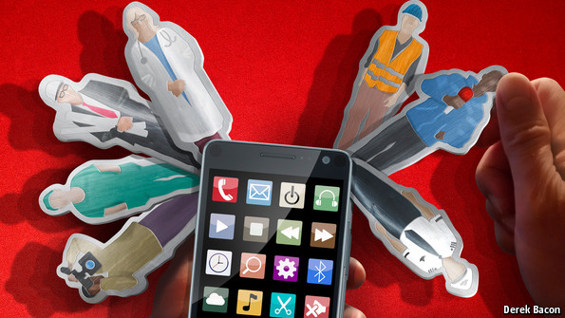

Labor on Demand: Huge Implications for the US Economy, Workers & Insurers
Will YOUR job be reduced to an app?

Slide 10
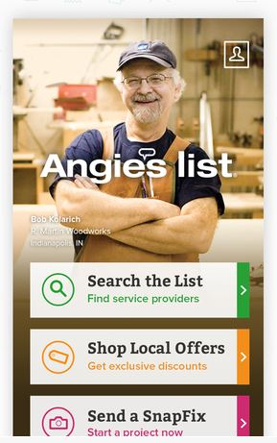


The “Sharing Economy” or “On-Demand” World is Not New…
Companies like Angie’s List (established in 1995 and going online in 1999) have been around for decades
The Geek Squad has been around since 1994…
Peapod sprouted way back in 1989!
Source: Insurance Information Institute.

Slide 11



…But the “On-Demand” World is Exploding as Is the Demand for “On-Tap” Workers
Need something done around the house…Click on Handy
Hate doing laundry? Washio will do it for you…
Hate doing just about everything? Taskrabbit will take on virtually all your “tasks”…
Source: Insurance Information Institute.

Slide 12




You Can Live Your Life with the Swipe of a Finger…
Get married…
…Move
…And if it doesn’t work out…

Slide 13



Some Players in the Sharing Economy
Have Become Household Names
Rent a place…
…Need a Lyft?
…This ride has taken Wall Street to the stratosphere

Slide 14


On-Demand/Sharing/Peer-to-Peer Economy Impacts Many Lines of Insurance
The “On-Demand” Economy is or will impact many segments of the economy important to P/C insurers
  Auto (personal and commercial)
  Homeowners/Renters
  Many Liability Coverages
  Professional Liability
  Workers Comp
Many insurance questions arise—some fairly simple, some complex
Insurance solutions are increasingly available to fill the many insurance gaps that arise
Some regulatory issues remain
14
12/01/09 - 9pm
eSlide – P6466 – The Financial Crisis and the Future of the P/C
Notes:
14

Slide 15
Regulation, Politics and the Sharing Economy
Insurers Need to Operate in a Complex and Rapidly Changing Regulatory Environment
15

Slide 16

Political Skepticism About the
‘Gig’ Economy
"Many Americans are making extra money renting out a spare room, designing a website ... even driving their own car. This on demand or so called 'gig' economy is creating exciting opportunities and unleashing innovation, but it's also raising hard questions about workplace protections and what a good job will look like in the future."
--Hillary Clinton, July 13, 2015
16
12/01/09 - 9pm
eSlide – P6466 – The Financial Crisis and the Future of the P/C
Notes:
16

Slide 17

Regulatory Issues Abound as Well, With Implications for Insurance Coverages
In California, Uber Driver Is Employee, Not contractor: Agency
By Sarah McBride and Dan Levine
A driver for Uber is an employee, not a contractor, according to a California ruling that eventually could push up costs for the smartphone-based ride hailing service and hurt the closely watched start-up's valuation.
The California Labor Commissioner's decision could ripple through the burgeoning industry of providing services via smartphones, with potential implications for other “crowdsourced” services such as Uber rival Lyft, chore service TaskRabbit, and cleaning service Homejoy.
--Reuters, June 18, 2015
17
12/01/09 - 9pm
eSlide – P6466 – The Financial Crisis and the Future of the P/C
Notes:
17

Slide 18
Technology and Employment
What Makes the On-Demand Economy Possible?
Why Does It Matter for Insurers?
18

Slide 19
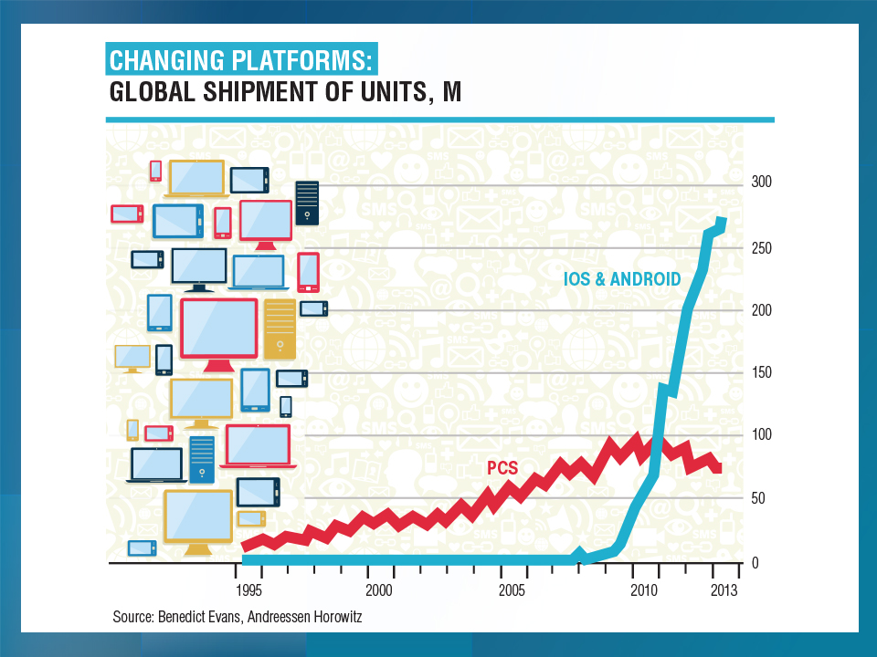
GLOBAL SHIPMENTS OF SMARTPHONES (MILLIONS)
Smartphones are the breakthrough technology behind the on-demand economy
2015: ~50% of adults globally have a smartphone
2020: About 80% will own one

Slide 20
Growth in Temporary Workers vs.
All Nonfarm Employment, 2010-2016*
Annual Percent Change
Demand for temporary workers has increased 2 to 3 times faster than for workers overall in recent years, but relative pace of temporary hiring is slowing
*Through February 2016.
Source: US Bureau of Labor Statistics , Insurance Information Institute.

Slide 21
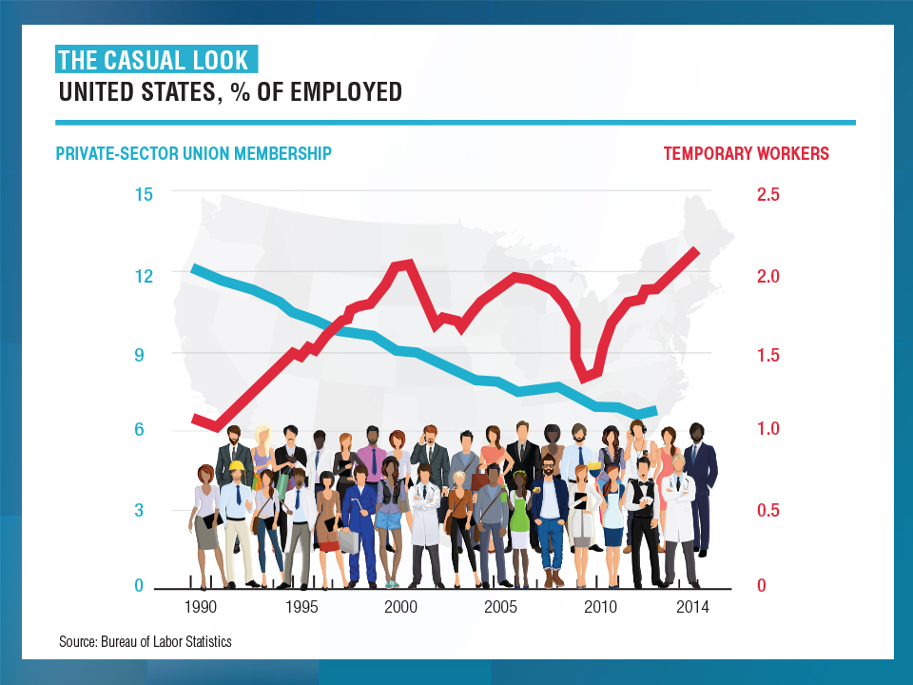

Slide 22
The On-Demand Economy and American Workers: What Is Happening?
Technology is Fundamentally Transforming How Resources are Allocated and Used in the Economy
Labor is No Exception to this Transformation
Technology Offers New Opportunities to Match Labor to Jobs
  Owners of spare capacity (workers with time and skill) can be paired at low cost with those with a demand for that time and skill
  Bringing together labor and those who employ labor is not new
  BUT: Pairing occurs with a speed and breadth never before possible
Witnessing the Demise of the Traditional Understanding of What is Meant by a “Good” Job
  Concept born in the Industrial Age (1880-1980), but is eroding
  Disintermediation of the firm as the place where labor, jobs matched
Accelerating Trends that Started with Labor Strife, Globalization and Automation that Began in the 1970s and 1980s
22
12/01/09 - 9pm
eSlide – P6466 – The Financial Crisis and the Future of the P/C
Notes:
22

Slide 23
What’s In Store for the American Worker, Labor Force and Workers Comp
THE NEW AMERICAN WORKER: Two Schools of Thought
OPTIMISTIC OUTLOOK
  Technology frees workers from the bonds of centralized, hierarchical institutions (the firm)
  Enhanced coordination of “haves” with “needs” that bypass firms as intermediaries
Who Benefits?
  “Flexers”: People who value or require flexibility in work arrangements (stay-at-home parents, retirees, students, disabled)
  Professionals: People with portable skills that can be offered through online platforms (semi and high-skilled trades, professional services)
  Unemployed/Underemployed: Offers at least some opportunity to offer and utilize skills and generate income
Sources: Wall Street Journal; The Economist; Insurance Information Institute research.
23
12/01/09 - 9pm
eSlide – P6466 – The Financial Crisis and the Future of the P/C
Notes:
23

Slide 24
What’s In Store for the American Worker, Labor Force and Workers Comp
PESSIMISTIC OUTLOOK
  On-Demand companies are software-driven marketplaces and position themselves as “platforms” rather than “employers”
  Enormous valuations (e.g., $40B for Uber on $2B in earnings) reflect the extraction of resources that otherwise would go to benefits, investments in safety, training, etc.
    Uber’s valuation was greater than that of 72% of the S&P500 at YE 2014
    Valued more than Delta Airlines, Kraft Foods, CBS, Macy’s, Hilton, Aflac…
  Jobs reduced to freelanced, temporary “gigs”
  Low skill workers and those who lack flexibility are left further behind
  Workers treated as independent contractors without intrinsic or basic economic rights
What Is Potentially Lost or Compromised?
  Stability, Retirement Benefits, Sick Pay, Maternity Leave, Overtime
  Health Insurance, Liability Coverage, Workers Comp Coverage
Sources: Wall Street Journal; The Economist; Fortune; Insurance Information Institute research.
24
12/01/09 - 9pm
eSlide – P6466 – The Financial Crisis and the Future of the P/C
Notes:
24

Slide 25
Potential Consequences for Insurers
On-Demand Platforms Have Struggled with Concepts of Liability
There Has Been a General Resistance to Assuming Liability or Responsibility Unless Compelled to Do So
Companies Have Sought to Keep as Much Liability as Possible on the Individual Offering their (Contracted) Labor or Resources
Minding the Gap
  Traditional insurance will often not cover a worker engaged in offering labor or resources through these platforms
  E.g., Auto ins. generally won’t cover you if you while driving for Uber
  Home ins. won’t cover for other than occasional rentals of property
  Unless self-procured, on-demand worker (independent contactors) will generally have no workers comp recourse if injured on the job
Long Legislative and Court Battles Lie Ahead, Including Determination of Who is an Employee vs. Independent Contractor
Insurance Solutions Becoming More Common
25
12/01/09 - 9pm
eSlide – P6466 – The Financial Crisis and the Future of the P/C
Notes:
25

Slide 26
On-Demand Workers
Who Are They?
And Who’s Driving Demand for Them?
26

Slide 27
Percent of People Who Have Engaged in an “On Demand/Sharing Economy” Transaction
Percent
The majority of the US population has yet to engage in the “On Demand” economy
About 19% of the US population has engaged in an “On Demand/Sharing Economy” Transaction
Sources: PwC survey of 1,000 adults in the U.S., conducted online, December 2014; Insurance Information Institute.

Slide 28
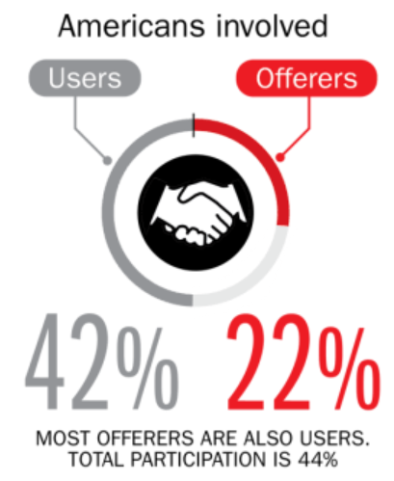
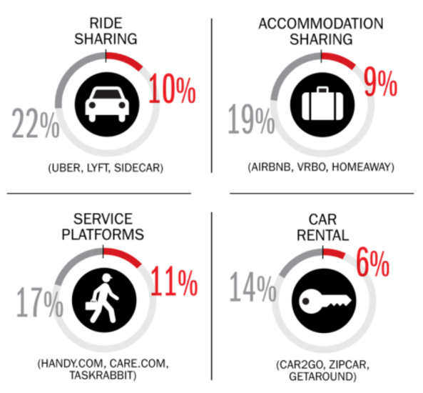
Percent of Americans Who Have Engaged in the “Gig/Sharing Economy” by Transaction
Drivers have significant WC exposures
Service platforms have the most direct link to WC; 11% of Americans have offered their services
About 22% of Americans have offered services in the sharing economy
Sources: The SelfEmployed.com accessed at https://www.theselfemployed.com/gig-economy/infographic-inside-the-new-economy/ based on a poll by Time magazine, Bursten-Marsteller and The Aspen Institute; Insurance Information Institute.

Slide 29
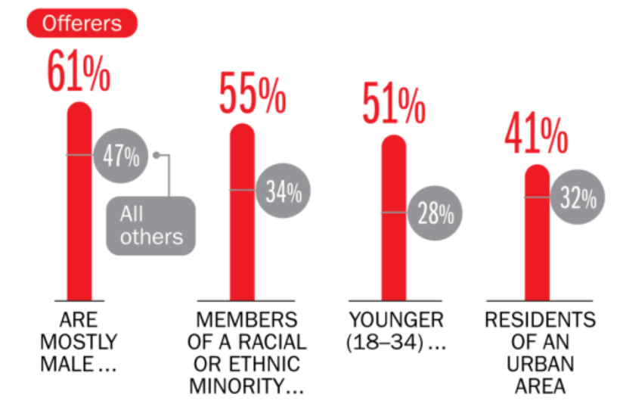
Americans Who Offer Services in the Sharing/Gig Economy Are Statistically More Prone to Workplace Injury
Young, Urban Minority Males Are the Most Likely to Offer their Services in the Sharing Economy
Sources: The SelfEmployed.com accessed at https://www.theselfemployed.com/gig-economy/infographic-inside-the-new-economy/ based on a poll by Time magazine, Bursten-Marsteller and The Aspen Institute; Insurance Information Institute.

Slide 30
Age of People Who are Providing the Sharing/On-Demand Economy
Being a provider of services in the Sharing/On-Demand Economy is attractive to workers in the 25-44 age range (who want flexibility in raising families) as well as seniors age 65+ who see the offering their services on-demand as a way to augment retirement income
About 7% of US population are providers in the Sharing Economy, cutting across age and incomes; 51% of those familiar with the concept could see themselves as providers within the next two years.
Sources: PwC survey of 1,000 adults in the U.S., conducted online, December 2014; Insurance Information Institute.

Slide 31
Household Income: Providers of the Sharing/On-Demand Economy
Being a provider of services in the Sharing/On-Demand Economy is particularly attractive to workers with household incomes under $50,000
About 7% of US population are providers in the Sharing Economy, cutting across age and incomes; 51% of those familiar with the concept could see them selves as providers within the next two years.
Sources: PwC survey of 1,000 adults in the U.S., conducted online, December 2014; Insurance Information Institute.

Slide 32
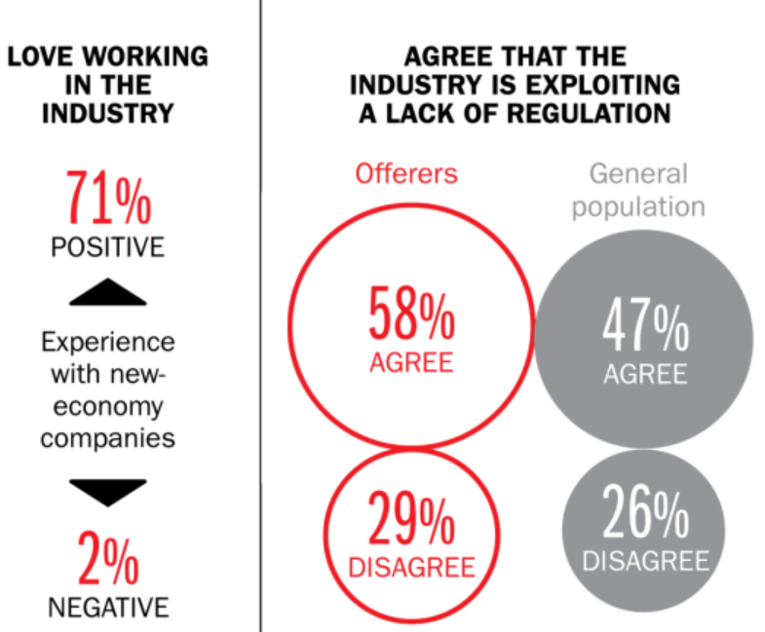
Americans Love Working in the Sharing Economy but Many Feel Exploited
Despite general satisfaction with sharing economy as an “industry,” there is a sense that workers are being exploited—especially by the workers themselves
Sources: The SelfEmployed.com accessed at https://www.theselfemployed.com/gig-economy/infographic-inside-the-new-economy/ based on a poll by Time magazine, Bursten-Marsteller and The Aspen Institute; Insurance Information Institute.

Slide 33
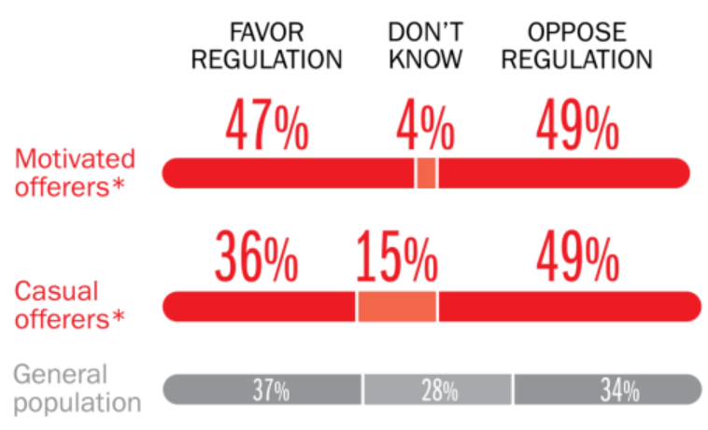
Opinions Are Split on Whether the Sharing Economy Needs More Regulation
The most frequent offerers of services though online platforms are equally divided over the need for more regulation
Sources: The SelfEmployed.com accessed at https://www.theselfemployed.com/gig-economy/infographic-inside-the-new-economy/ based on a poll by Time magazine, Bursten-Marsteller and The Aspen Institute; Insurance Information Institute.

Slide 34
The On-Demand Economy and
Wall Street
Wall Street Loves the On-Demand Economy
Labor Markets, Insurance Markets Will Be Impacted
34

Slide 35
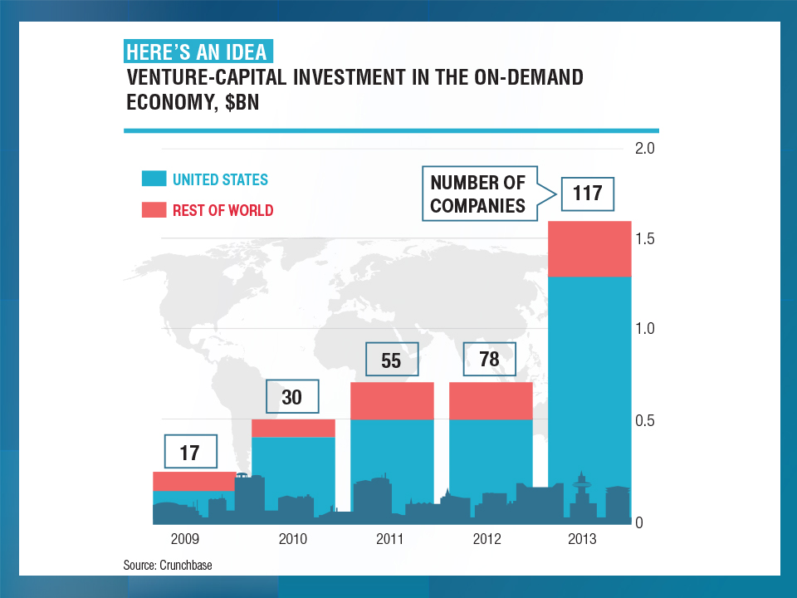

Slide 36
An UBER Case Study
Uber is the Best Known of the
On-Demand Companies
Wall Street Loves Uber
Vested Interests Hate Uber
36

Slide 37
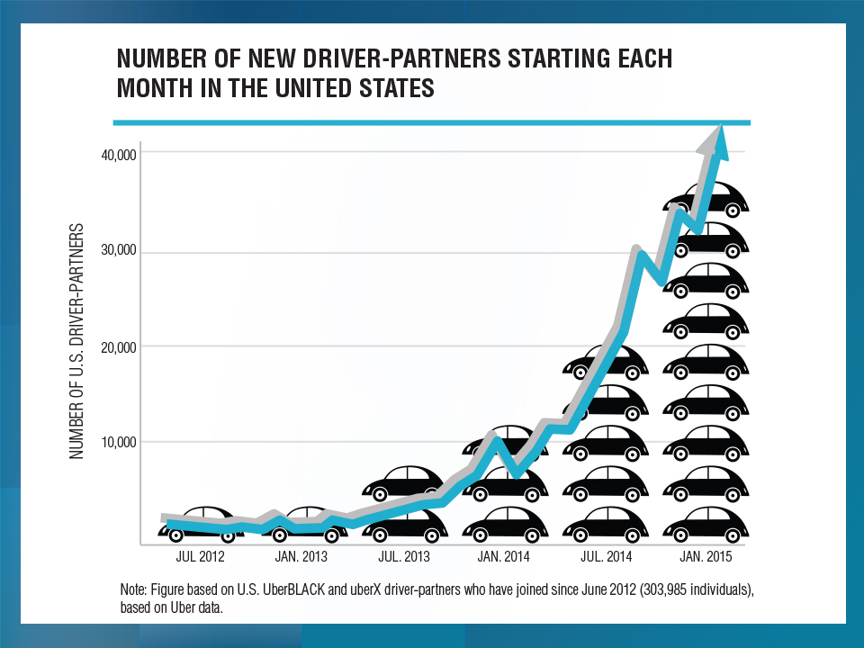
UBER Challenges
Are Uber drivers independent contractors or employees?
California DOL has ruled they’re employees
Different states may reach different conclusions
Determination significant impacts insurance framework

Slide 38
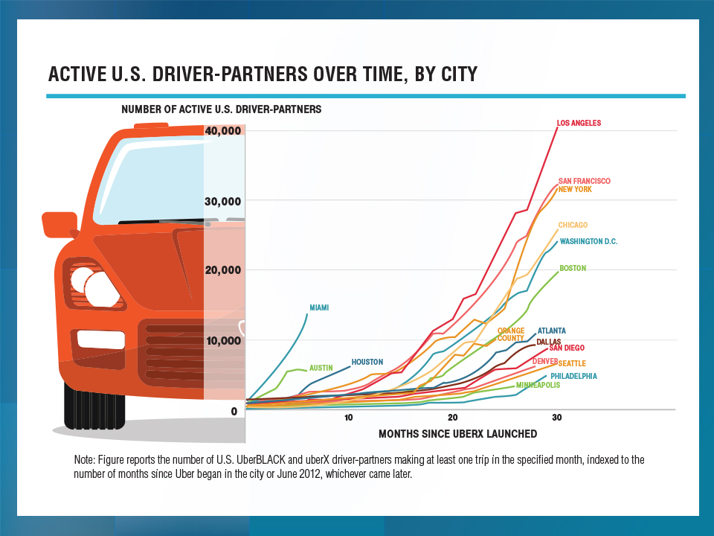

Slide 39
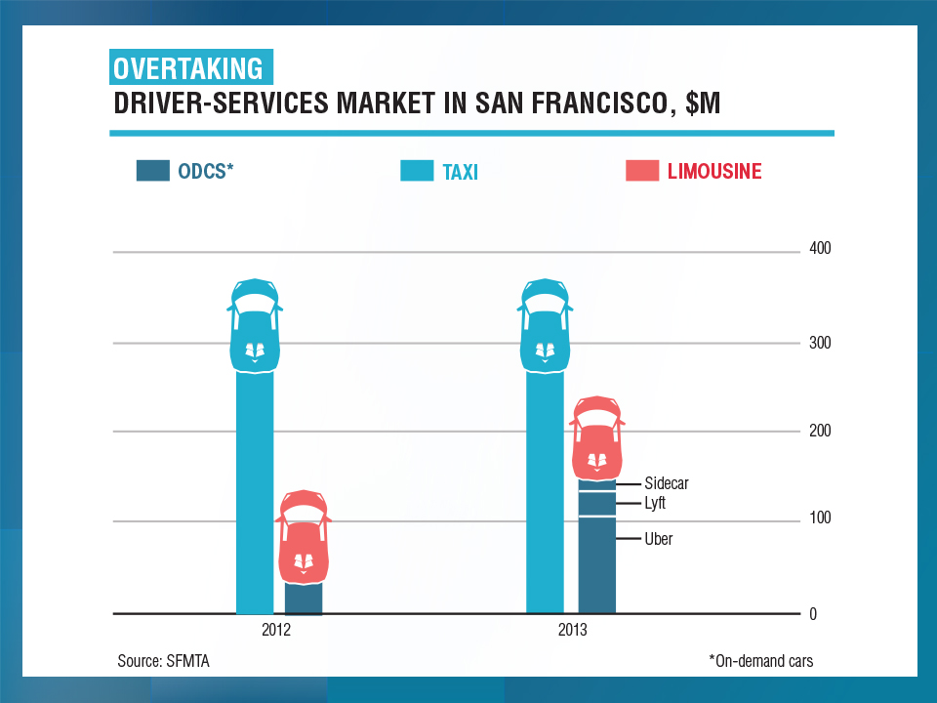

Slide 40
Ridesharing Regulation/Legislation and Status of ISO Filings as of 9/30/15
Status Ride Sharing Legislation/Regulation
Status of ISO Filings
40
Source: ISO.

Slide 41
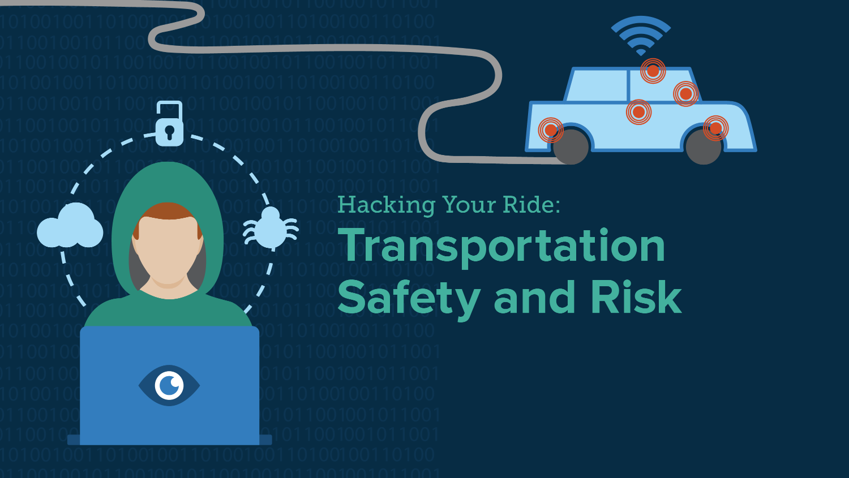
#RiskyRide
SXSW
March 13, 2016, Austin, TX

Slide 42

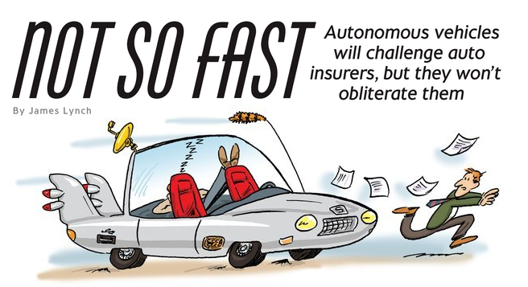
Media is Obsessed with Driverless Vehicles: Often Predicting the Demise of Auto Insurance
By 2035, it is estimated that 25% of new vehicle sales could be fully autonomous models
Questions
Are auto insurers monitoring these trends?
How are they reacting?
Will Google take over the industry?
Will the number of auto insurers shrink?
How will liability shift?
Source: Boston Consulting Group.

Slide 43


2015: Transportation Incidents on the Rise
“Is It Possible for Passengers to Hack Commercial Aircraft?”
- Federal Highway Administration Report, 1997
“Fiat Chrysler Issues Recall Over Hacking”
- The New York Times,
July 24, 2015
“Hackers Cut a Corvette’s Brakes Via a Common Car Gadget”
- Wired, August 11, 2015
“Hackers Show They
Can Take Control of Moving Jeep Cherokee”
- Wall Street Journal, July 21, 2015

Slide 44
FROM GIG TO GONE?
Will Robots and Automation Destroy the Gig Economy?
44

Slide 45
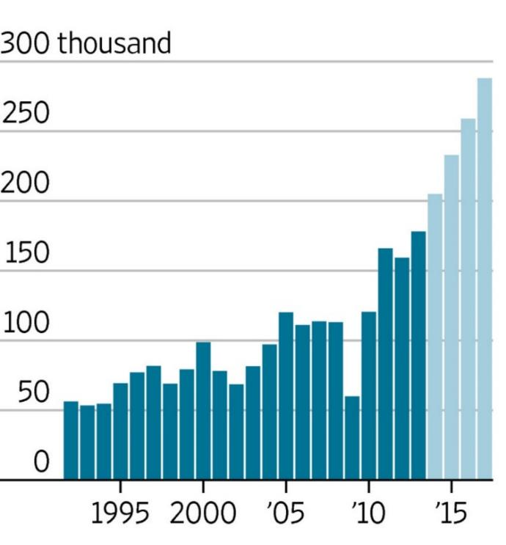
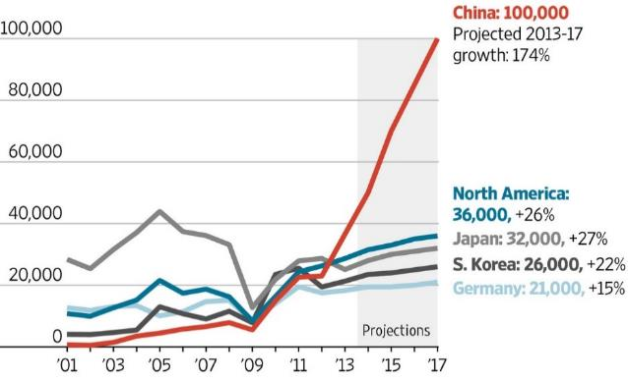
Worldwide Industrial Robot Installations,
1992-2017F
Worldwide installations of industrial robots exceeded 200,000 in 2014—a new record and will approach 300,000 by 2017
36,000 installations are expected in North America by 2017
Many jobs in the ‘gig’ economy are vulnerable to automation
*Estimate.
Sources: Outlook on World Robotics 2014, International Federation of Robotics; Insurance Information Institute.

Slide 46
The Internet of Things and the Sharing/Gig Economy
Capturing Economic Value Amid a Shifting Insurer Value Chain
46

Slide 47
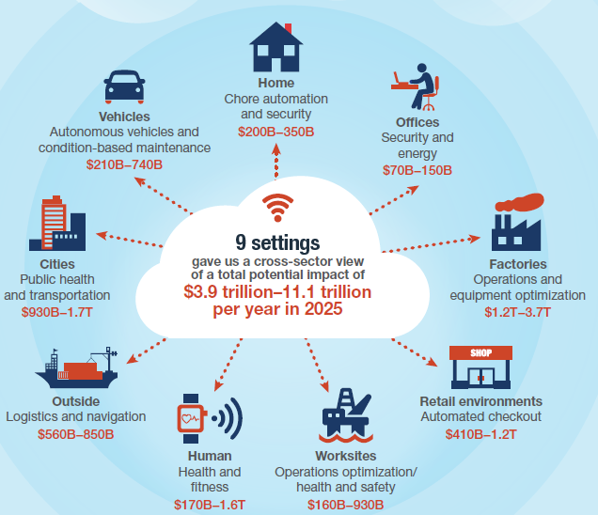
The Internet of Things and the Insurance Industry
The “Internet of Things” will create trillions in economic value throughout the global economy by 2025
What opportunities, challenges will this create for insurers?
What are the impact on the insurance industry “value chain”?
Sources: McKinsey Global Institute, The Internet of Things: Mapping the Value Beyond the Hype,
June 2015; Insurance Information Institute.
47
12/01/09 - 9pm
eSlide – P6466 – The Financial Crisis and the Future of the P/C
Notes:
47

Slide 48
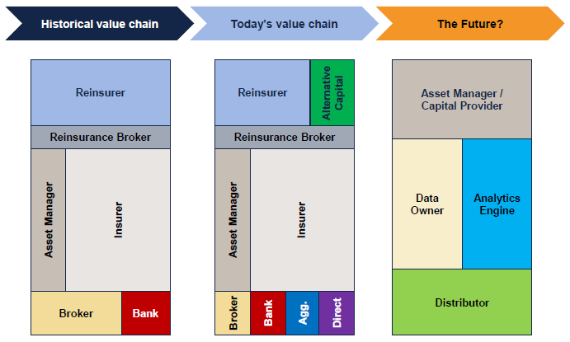
The Internet of Things and the Insurance Industry Value Chain
The Insurance Industry Value Chain Is Changing for Many Reasons
Source: Willis Capital Markets & Advisory; Insurance Information Institute.
48
12/01/09 - 9pm
eSlide – P6466 – The Financial Crisis and the Future of the P/C
Notes:
48

Slide 49
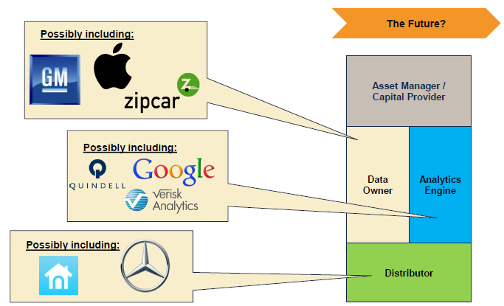
The Internet of Things and the Insurance Industry Value Chain
Who owns the data? Where does It flow? Who does the analytics? Who is the capital provider?
Source: Willis Capital Markets & Advisory; Insurance Information Institute.
49
12/01/09 - 9pm
eSlide – P6466 – The Financial Crisis and the Future of the P/C
Notes:
49

Slide 50

A NEST Case Study
Nest: A Leader in the “Internet of Things”
Collision Course or Cooperation with the Insurance Industry?
50

Slide 51


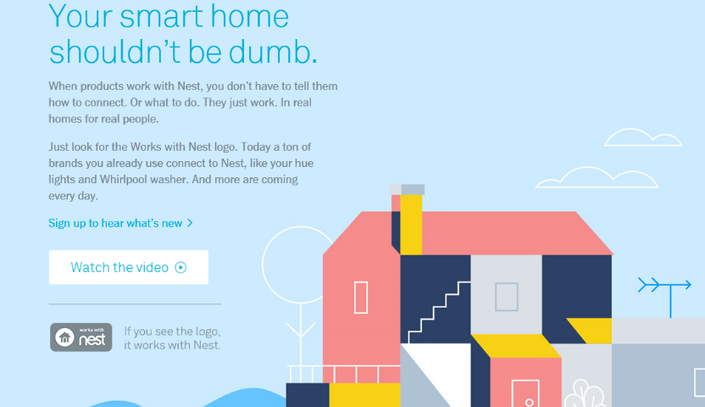
Telematics for Your Home:
The Internet of Things
The home is the next frontier for telematics
Rapidly becoming a crowded space
How and with whom will insurers partner?
Can control increasing array of household systems remotely
  Heat, A/C
  Fire, CO detection
  Security Systems
  Cameras/Monitors
  Appliances
  Lighting
Technology is adaptive
  Uses sensors and algorithms to learn about you
51
12/01/09 - 9pm
eSlide – P6466 – The Financial Crisis and the Future of the P/C
Notes:
51

Slide 52
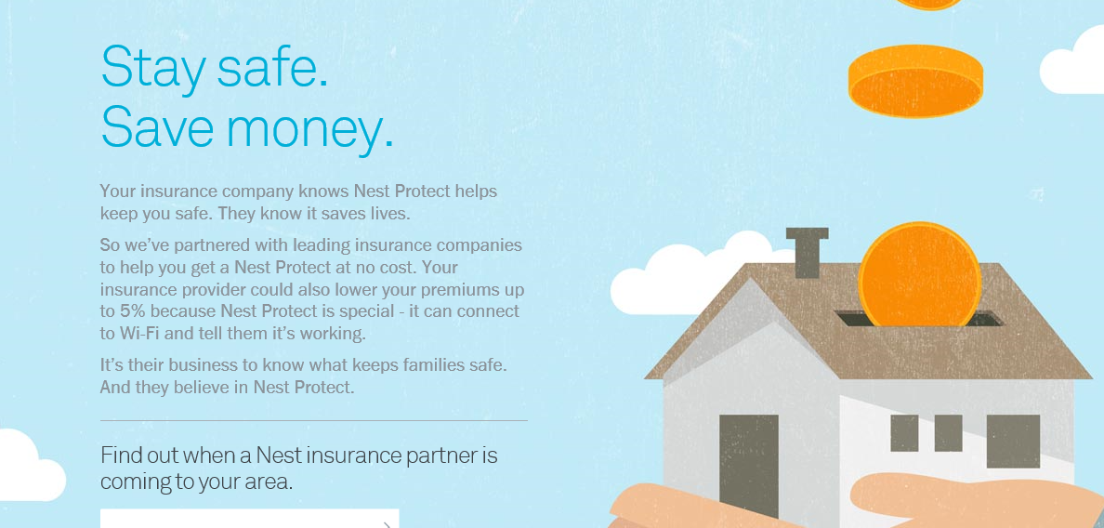
Partnerships with Insurers: Selling Safety and Savings Simultaneously
Nest is actively seeking to partner with insurers. As of Jan. 10, 2016, Nest listed 2 insurance partners offering discounts in a number of states
Source: https://nest.com/insurance-partners/ accessed 1/10/16; Insurance Information Institute research.
52
12/01/09 - 9pm
eSlide – P6466 – The Financial Crisis and the Future of the P/C
Notes:
52

Slide 53
Wearables and Beyond…
Where The Internet of Things
Meets Health, Disability and Workers Compensation Insurance
53

Slide 54
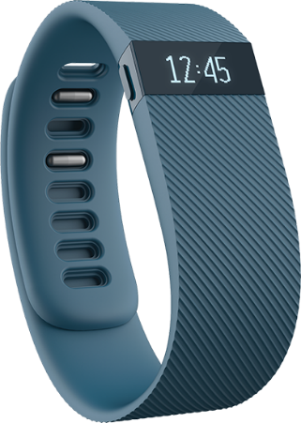
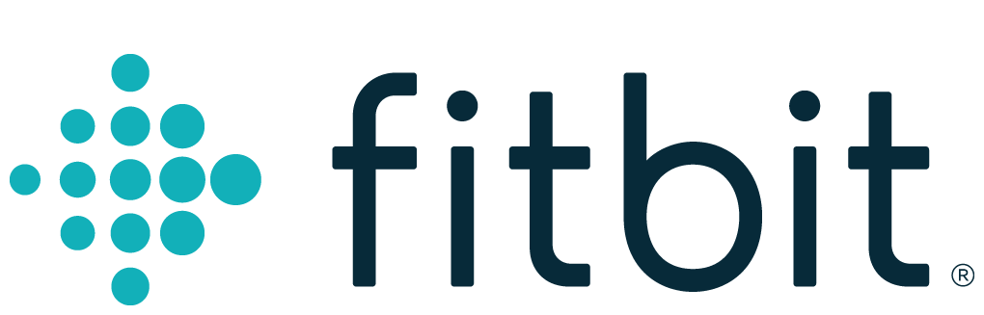
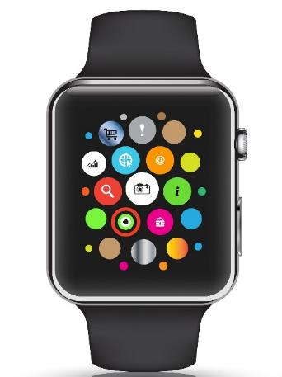

Wearables Show Significant Potential to Reduce Workplace Injury, Death
Wearables Today Can Monitor:
  Location
  Heart rate
  Temperature
  Steps/Exertion
  Sweat
  Sleep
In the Near Future Could Monitor:
  Glucose level
  Oxygen levels
  Pain
  Nausea
54
12/01/09 - 9pm
eSlide – P6466 – The Financial Crisis and the Future of the P/C
Notes:
54

Slide 55

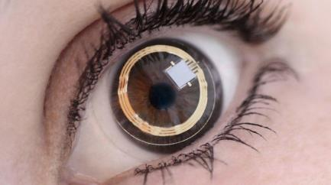

Beyond Wearables: Ingestibles and Implantables, VR Could Have Big Impacts Too
Ingestibles:
  Body chemistry
  View malignancies
  Detect diseases
  Medication adherence
Implantables
Smart Fabrics
Virtual Reality
  Computer simulated reality
Augmented Reality
  Real world environment supplemented by computer generated inputs
55
12/01/09 - 9pm
eSlide – P6466 – The Financial Crisis and the Future of the P/C
Notes:
55

Slide 56
A Few Outstanding Issues (Among Many)
Worker Status
  Are workers independent contractors or employees?
Privacy
  Where is the dividing line between data that is useful or necessary for the conduct of business and truly private information?
Security
  How will data be protected?
  How will the inevitable breaches be managed?
Data Ownership and Portability
  Who owns the data? Is the data portable?
Insurance
  Need for evolving property and liability coverages
  Concern over disintermediation
56
12/01/09 - 9pm
eSlide – P6466 – The Financial Crisis and the Future of the P/C
Notes:
56

Slide 57
Insurance Information Institute Online:
www.iii.org
Thank you for your time
and your attention!
Twitter: twitter.com/bob_Hartwig
Download at www.iii.org/presetations

