Slide 1
Capital Punishment?
The Challenge of Profitability and Growth in an Industry and World Awash in Capital
Geneva Association
10th Annual Insurance and Finance Seminar
London, UK
4 November 2014
Download at: www.iii.org/presentations
Robert P. Hartwig, Ph.D., CPCU, President & Economist
Insurance Information Institute ♦ 110 William Street ♦ New York, NY 10038
Tel: 212.346.5520 ♦ Cell: 917.453.1885 ♦ bobh@iii.org ♦ www.iii.org

Slide 2
A World Awash in Capital
Too Much of a Good Thing?
The Global Glut of Capital is Not Unique to (Re)Insurance
2

Slide 3
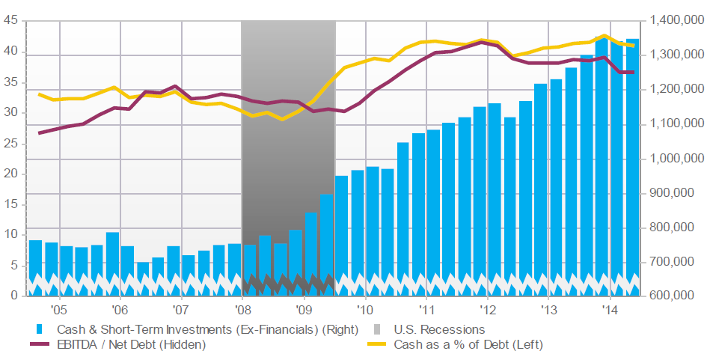
S&P 500 (Excl. Financials):
Cash & Short-Term Investments
Cash and ST investments holdings have nearly doubled since 2007
Holdings of Cash and Liquid Asset Holdings Have Soared Across Virtually All Industries Since the Financial Crisis
Source: Fact Set Fundamentals.

Slide 4
Hedge Fund Industry: Assets Under Management: 1997–2014:Q2¹
($ Billions)
Assets managed by hedge funds are up 63% or $894.7 billion since 2008 to $2.35 trillion
Yield Hungry Pension Funds Have Grown Rapidly Since the Financial Crisis, Deploying Oceans of Capital in Industries Across the Globe—Including the Global Reinsurance Industry
¹ Figures for 2011-2013 are as of Q4 for each year.
Sources: BarclayHedge: http://www.barclayhedge.com/research/indices/ghs/mum/Hedge_Fund.html; Insurance Information Institute.

Slide 5
Global Pension Assets Growth,
2008 – 2013*
Global pension assets for the top 13 pension markets reached $31.98 trillion in 2013 (+9.5% from 2012), an amount equal to 83.4% of these economies
Compound Annual Growth Rate (%)
CAGR of pension fund assets in most major pension markets has been quite strong since the financial crisis
*As of year-end.
Source: Towers Watson Global Pensions Asset Study 2014 at: http://www.towerswatson.com/en-US/Insights/IC-Types/Survey-Research-Results/2014/02/Global-Pensions-Asset-Study-2014
5
12/01/09 - 9pm
eSlide – P6466 – The Financial Crisis and the Future of the P/C
Notes:
5

Slide 6
Pension Asset Allocation
(World’s 7 Largest Pension Markets)
Alternative investment’s share of assets is up +15 points since 2001 from 5% to 18%
Holdings of Cash and Liquid Asset Holdings Have Soared Across Virtually All Industries Since the Financial Crisis
*Australia, Canada, Japan, Netherlands, Switzerland, UK, US.
Source: Towers Watson Global Pensions Asset Study 2014 at: http://www.towerswatson.com/en-US/Insights/IC-Types/Survey-Research-Results/2014/02/Global-Pensions-Asset-Study-2014

Slide 7
U.S. Policyholder Surplus,
2006:Q4–2014:H1
Drop due to near-record 2011 CAT losses
($ Billions)
2007:Q3
Pre-Crisis Peak
Surplus as of 6/30/14 stood at a record high $671.6B
The industry now has $1 of surplus for every $0.73 of NPW,
close to the strongest claims-paying status in its history.
2010:Q1 data includes $22.5B of paid-in capital from a holding company parent for one insurer’s investment in a non-insurance business .
The P/C insurance industry entered 2014
in very strong financial condition.
Sources: ISO, A.M .Best.
7
12/01/09 - 9pm
eSlide – P6466 – The Financial Crisis and the Future of the P/C
Notes:
7

Slide 8
U.S. Policyholder Surplus:
1975–2014*
($ Billions)
Surplus as of 6/30/14 was a record $671.6, up 2.8% from $653.3 of 12/31/13, and up 53.6% ($234.5B) from the crisis trough of $437.1B at 3/31/09
“Surplus” is a measure of underwriting capacity. It is analogous to “Owners Equity” or “Net Worth” in non-insurance organizations
The Premium-to-Surplus Ratio Stood at $0.73:$1 as of
6/30/14, a Near Record Low (at Least in Recent History)
* As of 6/30/14.
Source: A.M. Best, ISO, Insurance Information Institute.

Slide 9
Premium-to-Surplus Ratio:
1985–2014*
The larger surplus is in relation to premiums—the lower the P:S ratio—and the great the industry’s capacity to handle the risk it has accepted
(Ratio of NWP to PHS)
Surplus as of 6/30/14 was $0.73:$1, a record low (at least in modern history)
Financial crisis had virtually no effect on the capital adequacy of the US nonlife insurance sector
9/11, Recession & Hard Market
The Premium-to-Surplus Ratio Stood at $0.73:$1 as of
6/30/14, a Record Low (at Least in Recent History)
* As of 6/30/14.
Source: A.M. Best, ISO, Insurance Information Institute.

Slide 10
A World of Low Yields
Capital Will Seek Its Highest (Risk-Adjusted) Return
10

Slide 11
U.S. Treasury Security Yields:
A Long Downward Trend, 1990–2014*
Yields on 10-Year U.S. Treasury Notes have been essentially below 5% for a full decade.
U.S. Treasury yields plunged to historic lows in 2013. Longer-term yields have rebounded a bit.
Since roughly 80% of P/C bond/cash investments are in 10-year or shorter durations, most P/C insurer portfolios will have low-yielding bonds for years to come.
*Monthly, constant maturity, nominal rates, through September 2014.
Sources: Federal Reserve Bank at http://www.federalreserve.gov/releases/h15/data.htm. National Bureau of Economic Research (recession dates); Insurance Information Institute.
11
12/01/09 - 9pm
eSlide – P6466 – The Financial Crisis and the Future of the P/C
Notes:
11

Slide 12
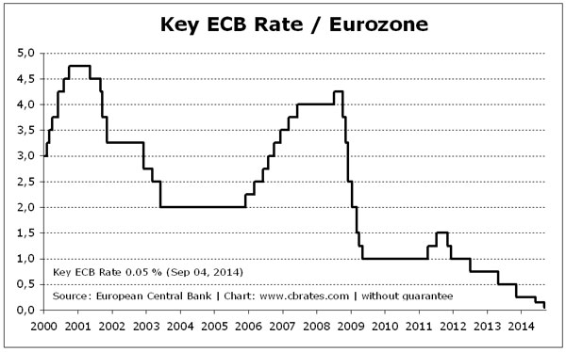
Key European Central Bank Interest Rates, 2000 - 2014
ECB’s cut its key rate to 0.05% on 4 Sept. 2014
Interest Rates Have Been Slashed by Most Major Central Banks, Igniting a Global Quest for Yield. Reinsurance Is Just One of Many New Areas “Discovered” by Large Institutional Investors
Source: European Central Bank from www.cbrates.com; Insurance Information Institute.

Slide 13
Alternative Capital in Global Reinsurance Markets
The Global Hunt for Yield Pushed Institutional Investors Into Countless New Areas—(Re)Insurance Being One of Them
13

Slide 14
Mentions of the Term “Alternative Capital” with “Insurance” or “Reinsurance”
Should the Increased Use of Terms Such as “Alternative Capital,” “Hedge Fund” and “Pension Fund” in Conjunction with a (Re)Insurance Be a Concern
* Estimate is annualized figure based on actual data through September 30, 2014.
Source: Insurance Information Institute search of Factiva database.

Slide 15
Global Reinsurance Capital (Traditional and Alternative), 2006 - 2014
Total reinsurance capital reached a record $570B in 2013, up 68% from 2008.
But alternative capacity has grown 210% since 2008, to $50B. It has more than doubled in the past three years.
2014 data is as of June 30, 2014.
Source: Aon Benfield Analytics; Insurance Information Institute.

Slide 16
Global Reinsurance Capital Share (Traditional and Alternative), 2006 - 2014
Alternative Capital’s Share of Global Reinsurance Capital Has More Than Doubled Since 2010.
2014 data is as of June 30, 2014.
Source: Aon Benfield Analytics; Insurance Information Institute.

Slide 17
Growth in Traditional and Alternative Capital, 2007-2014
Post 2011, alternative capital is growing four and five times faster than traditional capital.
Alternative capital has grown 247% since 2006, vs. 39% growth in traditional capital.
2014 reflects growth through June 30 from prior year end.
Source: Aon Benfield Analytics; Insurance Information Institute.

Slide 18
Growth of Alternative Capital Structures, 2002 - 2014
Collateralize Re’s Growth Has Accelerated in the Past Three Years.
Collateralized Reinsurance and Catastrophe Bonds Currently Dominate the Alternative Capital Market.
2014 data is as of June 30, 2014.
Source: Aon Benfield Analytics; Insurance Information Institute.

Slide 19
ILS: Issuance and Outstanding,
1997- 2014:Q2
Risk Capital Amount ($ Millions)
Risk Capital Outstanding Is at a Record
Financial Crisis Depressed Issuance
Model Uncertainty, Concerns on Economy Pushed Issuance Lower.
2014 Has Seen the Largest Cat Bond Ever - $1.5 Billion (Florida Citizens). Bond Issuance Will Set a Record.
Sources: Artemis.bm, Insurance Information Institute.

Slide 20
Cat Bond:
Investor by Category
Mutual Funds Share of Cat Bond Purchases is Growing; Most Hedge Funds Participate Via Collateralized Reinsurance.
Years ended June 30.
Source: Aon Benfield Securities; Insurance Information Institute.

Slide 21
Catastrophe Bonds Outstanding, Q2 2014
Catastrophe Bonds Are Heavily Concentrated in U.S. Hurricane Exposures. More Than 70 Percent of Catastrophe Risks Outstanding Cover U.S. Wind Risks.
Source: Willis Capital Markets, Insurance Information Institute.

Slide 22
Alternative Capital Is Impacting the Reinsurance Pricing Environment
Traditional and Alternative Returns Are Under Pressure
22

Slide 23
U.S. Wind-Exposed Risk Premium* 2010:Q1 to 2014: Q1
Risk spreads rose in 2011-2012 from cat activity and changes to catastrophe models.
Risk spreads dropped – equivalent to lower rates – low cat losses, capital entering market.
* Trailing 12-month average
SOURCE: Willis Capital Markets, Insurance Information Institute.

Slide 24
Non-U.S. Wind-Exposed Risk Premium*
2010:Q1-2014: Q1
Spreads are also falling in non-U.S. wind exposures, but less sharply and in line with expected losses
* Trailing 12-month average.
SOURCE: Willis Capital Markets, Insurance Information Institute.

Slide 25
Insurance-Linked Securities:
Average Multiple Since 1997
In Early Years, Investor Reluctance Kept Multiples High in Tiny Market.
2014: Breaking 2013 Record for Lowest Multiple.
Range Established
Multiple is a Rough Estimate of Risk-Adjusted Return.
Cat Bond Terms Have Also Softened, With Indemnity Triggers (Favored by Insurers) Growing More Common.
SOURCE: www.Artemis.bm Deal Directory, Insurance Information Institute.

Slide 26
Reinsurance Pricing: Change in Rate on Line for U.S. CAT Business
Alternative Capital, Low Levels of Catastrophe Drive Rates Down.
76%
Some Observers Predict Catastrophe Prices Will Fall Another 10 Percent in 2015, Driven by Emergence of New Capital.
2014 reflects growth through June 30 from prior year end.
Source: Guy Carpenter; Insurance Information Institute.

Slide 27
What Is Happening to Insurer Profitability?
Has Capital Accumulation
Impacted Profitability?
Déjà Vu: Does History Suggest Cycles or Super-Cycles in Insurance?
27

Slide 28
ROE: Property/Casualty Insurance by Major Event, 1987–2014:H1
(Percent)
P/C Profitability Is Both by
Cyclicality and Ordinary Volatility
Katrina, Rita, Wilma
Low CATs
Sept. 11
Hugo
Lowest CAT Losses in
15 Years
4 Hurricanes
Sandy
Andrew
Record Tornado Losses
Northridge
Financial Crisis*
* Excludes Mortgage & Financial Guarantee in 2008 – 2014. 2014 figure is through H1:2014.
Sources: ISO, Fortune; Insurance Information Institute.

Slide 29
Profitability Peaks & Troughs in the P/C Insurance Industry, 1975 – 2014:H1*
ROE
1977:19.0%
History suggests next ROE peak will be in 2015-2016
1987:17.3%
10 Years
2006:12.7%
1997:11.6%
10 Years
2013 10.4%
9 Years
2014:H1 7.7%
1975: 2.4%
1984: 1.8%
1992: 4.5%
2001: -1.2%
*Profitability = P/C insurer ROEs. 2011-14 figures are estimates based on ROAS data. Note: Data for 2008-2014 exclude mortgage and financial guaranty insurers.
Source: Insurance Information Institute; NAIC, ISO, A.M. Best.

Slide 30
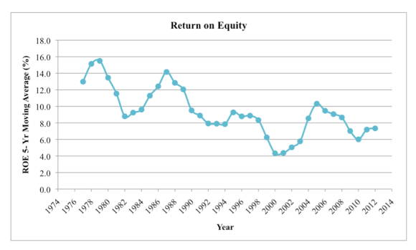
P/C Insurance ROE as 5-Year Moving Average
After smoothing, there is a more evident trend over the past 40 years toward lower peak profitability
The Tradeoff:
Impairment rates have plunged
Source: Jessica Weinkle, Insurance Journal, “An Average Perspective Based Insurance Profitability Cycles,” October 6, 2014, based om I.I.I. data, http://www.insurancejournal.com/magazines/closingquote/2014/10/06/342096.htm.

Slide 31
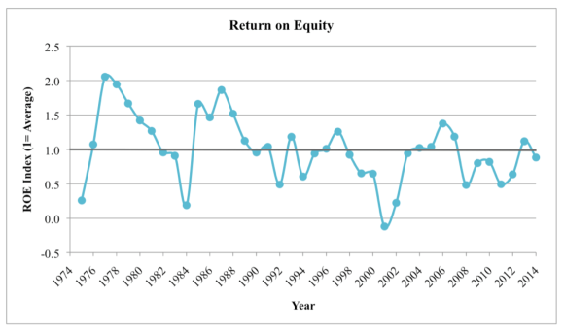
P/C Insurance ROE Index
(1974-2014:Q1 = 100)
Lower peak profitability seems to be the norm after 1994. Is RBC a cause? Greater use of modeling? Lower interest rates?
The Tradeoff:
Industry impairment rates have plunged
Source: Jessica Weinkle, Insurance Journal, “An Average Perspective Based Insurance Profitability Cycles,” October 6, 2014, based om I.I.I. data, http://www.insurancejournal.com/magazines/closingquote/2014/10/06/342096.htm.

Slide 32
Back to the Future: Profitability Peaks & Troughs in the P/C Insurance Industry, 1950 – 2014*
ROE
1970-90: Peak ROEs were much higher in this period while troughs were comparable. High interest rates, rapid inflation, economic volatility all played roles
1950-70: ROEs were lower in this period. Low interest rates, low inflation, “Bureau” rate regulation all played a role
1990-2010s: Déjà vu. Excluding mega-CATs, this period is very similar to the 1950-1970 period
1977:19.0%
1987:17.3%
2006:12.7%
1972:13.7%
1997:11.6%
2013 10.4%
1950:8.0%
1966-67: 5.5%
1959:6.8%
2014:H1 7.7%
1969: 3.9%
1957: 1.8%
1965: 2.2%
1975: 2.4%
1984: 1.8%
1992: 4.5%
2001: -1.2%
*Profitability = P/C insurer ROEs. 2011-14 figures are estimates based on ROAS data. Note: Data for 2008-2014 exclude mortgage and financial guaranty insurers. 2014 figure is through Q2.
Source: Insurance Information Institute; NAIC, ISO, A.M. Best.

Slide 33
Average ROE for the P/C Insurance Industry by Decade, 1950s – 2010s
Profitability peaked in the 1970s and 1980s but has tapered off since then
Average Annual Percent Change (%)
P/C profitability was much lower in the 1960s and 1970s
Profitability in the current low yield, low Inflation environment has declined since the highs of the 1970s and 1980s, but is above that of the 1950s and 1960s and the industry’s impairment rates have dropped since the 1980s
Sources: Insurance Information Institute research.
33
12/01/09 - 9pm
eSlide – P6466 – The Financial Crisis and the Future of the P/C
Notes:
33

Slide 34
A 100 Combined Ratio Isn’t What It
Once Was: Investment Impact on ROEs
A combined ratio of about 100 generates an ROE of ~7.0% in 2012/13, ~7.5% ROE in 2009/10,
10% in 2005 and 16% in 1979
Combined Ratio / ROE
Lower CATs helped ROEs in 2013
Combined Ratios Must Be Lower in Today’s Depressed
Investment Environment to Generate Risk Appropriate ROEs
* 2008 -2014 figures are return on average surplus and exclude mortgage and financial guaranty insurers. 2014:H1 combined ratio including M&FG insurers is 98.9; 2013 = 96.1; 2012 =103.2, 2011 = 108.1, ROAS = 3.5%.
Source: Insurance Information Institute from A.M. Best and ISO Verisk Analytics data.

Slide 35
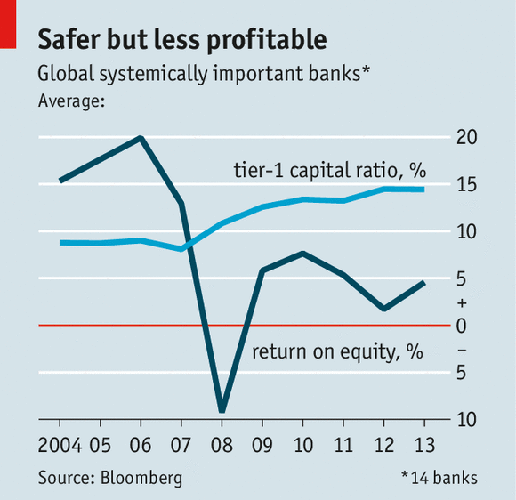
BANK LESSON: Profitability, Capital and Systemically Important Banks
Global Systemically Important bank Tier-1 capital ratios are up since the global financial crisis, but ROEs are lower
The Message from Bank Regulators:
Get used to it!
Source: The Economist, “No Respite,” September 27, 2014.

Slide 36
P/C Insurer Impairments, 1969–2013
Impairments among P/C insurers remain infrequent
The Number of Impairments Varies Significantly Over the P/C Insurance Cycle, With Peaks Occurring Well into Hard Markets
Source: A.M. Best Special Report “U.S. P/C Impairments Down Sharply in 2013; Alternative Risk Players Faltered,” June 23, 2014; Insurance Information Institute.

Slide 37
P/C Insurer Impairment Frequency vs. Combined Ratio, 1969-2013
2013 impairment rate was 0.43%, down from 0.76% in 2012; the rate is lower than the 0.81% average since 1969
Impairment Rates Are Highly Correlated With Underwriting Performance and Reached Record Lows in 2007; Recent Increase Was Associated Primarily With Mortgage and Financial Guaranty Insurers and Not Representative of the Industry Overall
Source: A.M. Best; Insurance Information Institute

Slide 38
Reasons for US P/C Insurer Impairments, 1969–2013
Historically, Deficient Loss Reserves and Inadequate Pricing Are
By Far the Leading Cause of P-C Insurer Impairments.
Investment and Catastrophe Losses Play a Much Smaller Role
Reinsurance Failure
Sig. Change in Business
Misc.
Investment Problems (Overstatement of Assets)
Deficient Loss Reserves/
Inadequate Pricing
Affiliate Impairment
Leading causes of death (reserves and growth) are generally under the control of insurers
Catastrophe Losses
Alleged Fraud
Rapid Growth
Source: A.M. Best Special Report “U.S. P/C Impairments Down Sharply in 2013; Alternative Risk Players Faltered,” June 23, 2014; Insurance Information Institute.

Slide 39
Summary
Capital Accumulation is Not Unique to (Re)Insurance
  Large corporations, institutional investors (e.g., pension funds), hedge funds, sovereign wealth funds have experienced rapid cash (or equivalent) accumulation
All Are Chasing Yield—Globally
Capital Has Generally Been Accumulating on the Balance Sheets of Nonlife (Re)Insurers for Years
  Era of rapid accumulation pre-dates financial crisis
  Pace has accelerated post-financial crisis
  Profits, capital gains and “alternative capital” all contribute

Slide 40
Summary (Continued)
Nonlife ROEs Have Trended Downward
  Downward trend pre-dates financial crisis
  Capital accumulation, RBC requirements are factors; Low yields
  Tradeoff: Impairment rates have trended downward
Quantum Shift or Evidence of a Super-Cycle?
  Profitability patterns today are more reminiscent of the pre-1970 era (and in the US back to WW II and even pre-war)
Capital Allocation Challenges:
  Excess capital seemingly “stuck” in the industry
  Sluggish economy diminishes rate of exposure growth
  Insurance penetration lags economic growth in emerging markets
  Changes in the nature of insurable exposures (e.g., cyber, IP, etc.)
  Share repurchases preferred over long-term investments or acquisitions (situation is not unique to insurance)
  Tax and regulatory obstacles

Slide 41
Insurance Information Institute Online:
www.iii.org
Thank you for your time
and your attention!
Twitter: twitter.com/bob_hartwig
Download at www.iii.org/presentations

