Slide 1
Geopolitics & Insurance
September 15, 2016
Sean Kevelighan, CEO
James Lynch, Chief Actuary
Insurance Information Institute  110 William Street  New York, NY 10038
212.346.5520  seank@iii.org  www.iii.org
212.346.5533  jamesl@iii.org  www.iii.org

Slide 2
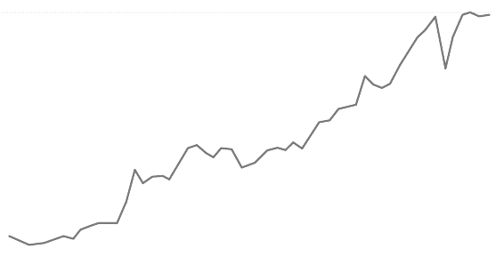
Economic Uncertainty
Global Growth...
US Growth...
  *Since 2008 we've had the longest period of stagnation in trade growth since World War II...
  Investment
  Growth
  GDP
  1.4
...Monetary vs. Fiscal Policy
Monetary vs. Fiscal illustration is WIP
  Monetary: Low interest rates mean insurers are struggling to meet interest rate guarantees for life insurance and annuities must diversify their investment portfolios
  Fiscal: Supply-side debate heating up, i.e. Tax reform
¹ The Peterson Institute for International Economics

Slide 3




Globalization
Geopolitical Polarization
Rise of the
Far Right
Regional
Tensions
Global Trends Impacting
Domestic Market
Regulatory Trends
"Conduct of Business"
TPP
Capital/Solvency
Dodd-Frank
China Rising
HK$16.9B*
HK$7.1B*
* Mainland purchases of insurance and related investment policies in the three months ended June 2016 vs. June 2015
Notes:
Elected Officials: "Rise of the far right" -- US, France, Germany
Neither US presidential candidate supports TPP
Regions: Europe (EU/Brexit/Russia), Asia (China/North-South Korea/Japan), Middle East (Syria/Iraq)
Global trends impacting domestic market
Regulatory trends:
"Conduct of Business"
Capital/Solvency
Climate Change
China rising: Mainland purchases of insurance and related investment policies in the three months ended June climbed to HK$16.9 billion ($2.2 billion) from HK$7.1 billion a year earlier, according to numbers derived from first-half figures reported Wednesday by the Office of the Commissioner of Insurance in Hong Kong. That compared with the previous high of HK$13.2 billion in the first quarter.

Slide 4
Geopolitics – US

Slide 5

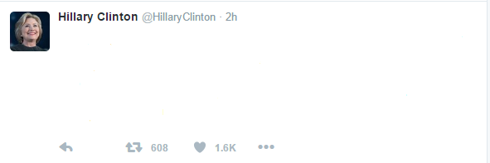
Clinton vs. Trump:
The Alternative Twitterverse*
The Economy
  Will Congress pass tax plans?
  Higher Deficits
  Interest Rates Higher?
Trade
  A little protectionist or a lot
Judges/Tort Reform
  Court Relatively Friendly to Business
  Could Appoint Four
I’ll protect manufacturers. Build big walls! Get tough on trade cheats!
Protectionist during campaign (down on TPP), but generally a realist.
* Where issues matter.

Slide 6

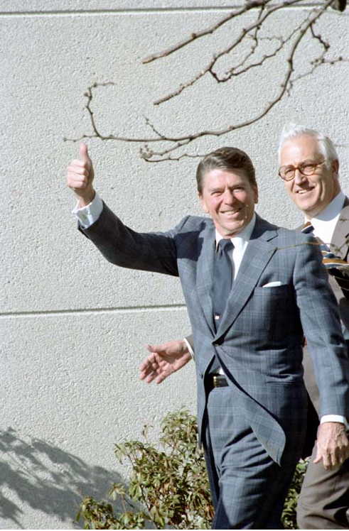



The Return of the ‘Bully Pulpit’
Bypassing the Media to Effect Policy
Next?

Slide 7
Profitability & Politics
How Is Profitability Affected by
the President’s Political Party?

Slide 8
P/C Insurance Industry ROE by Presidential Administration
1950-2015*
OVERALL RECORD:
1950-2015*
Democrats 7.72%
Republicans 7.85%
Party of President Has Marginal Bearing on Profitability of P/C Insurance Industry
*Truman administration ROE of 6.97% based on 3 years only, 1950-52;.
Source: Insurance Information Institute

Slide 9
P/C Insurance Industry ROE by Presidential Party Affiliation
1950-2015*
Truman
Eisenhower
Kennedy/ Johnson
Nixon/
Ford
Carter
Reagan/
Bush I
Clinton
Bush II
Obama
BLUE = Democratic President RED = Republican President
.
*2015 data is through Q3.
Source: Insurance Information Institute

Slide 10
But State Politics Drives Insurance
And Every State is Different
C
WA
D
MT
C
ND
B
ME
B
OR
C+
MN
B
ID
B
WI
D
NY
NH B
VT A
MA C-
RI C+
CT B
NJ B
DE C
MD B
B+
SD
B+
WY
C
MI
A-
NE
A
IA
C
PA
D
CA
B+
NV
B
OH
A
UT
B
IL
C+
IN
B
CO
C
WV
A
VA
C+
KS
B
MO
A
KY
A TN
F NC
B
AZ
B
NM
C
OK
B
AR
A-
SC
D+
MS
C
AL
C
GA
D
TX
D
LA
= A
= B
= C
= D
= F
= NG
C
AK
D
FL
D
HI
Not Graded: District of Columbia
Source: R Street Insurance Regulation Report Card, December 2015

Slide 11
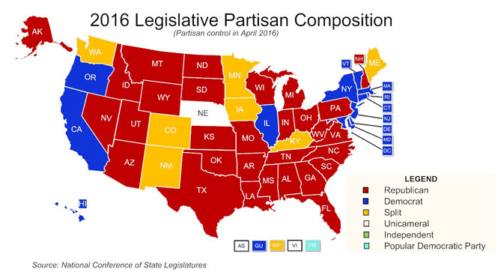
Republicans Control Most States . . .
. . . It is Likely to Remain That Way
Makeup Today
Control could change
20 Chambers Could Switch – Mainly in States With ‘Split’ Legislatures.
* Nebraska: Unicameral, nonpartisan, Republican dominated. New York: Democratic-majority Senate controlled by Republicans.
Source: National Conference of State Legislatures, Ballotpedia, Insurance Information Institute.

Slide 12
State Races
Governorships
Insurance Commissioner
D-18; R-31; 1 Independent (AK)
12 States With Elections This Year; Democrats Defend 8
  Five Tight Races
    Dem-held: NH, VT, WV
    Rep-held: IN, NC
11 Elected (D-5; R-6)
5 Elections (DE, MT, NC, ND, WA); Incumbent Party Favored
Miscellaneous
9 States Have Marijuana Referendums
  (AR Has Two – One Would Let Patients Grow Their Own.)
SOURCE: Ballotpedia, Insurance Information Institute.

Slide 13





State Issues
Auto Insurance
Increase in Loss Costs, 2014:Q1–2016:Q1
Bodily Injury
9.6%
Property
Damage
14.7%
Personal Injury Protection
18.4%
Collision
11.1%
Comprehensive
11.0%
From early 2014 to early 2016, the cost of accidents
has risen dramatically. By contrast, consumer prices overall
rose 1.7 percent during 2014 and 2015.
Source: Fast Track Monitoring System.
Notes:
The amount of claim costs per vehicle insured - known as loss costs in the industry - is the primary cost in auto insurance rates. Those have been rising across all major coverages.

Slide 14
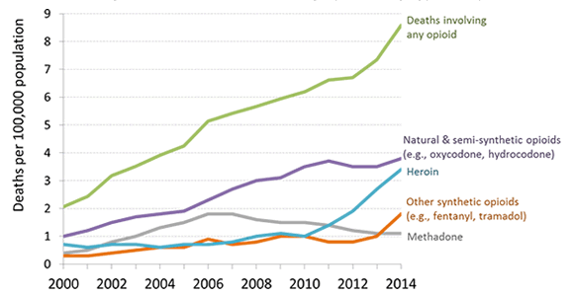
State Issues
Workers Compensation
The Grand Bargain – Still?
Opioids
Opt Out
  Big Issue One Year Ago
  Oklahoma Law Unconstitutional
Department of Labor/ Pro Publica: Benefit Cuts Shifted Injury Costs from Employer
Benefit Cuts?
  Evidence-Based Guidelines
  Outside Medical Reviewers
Nationwide Epidemic
¼ of Drug Costs in WC Claims
13 States Limiting WC Opioid Prescriptions
SOURCES: Department of Labor, “Does the Workers’ Compensation System Fulfill Its Obligations to Injured Workers?”; Centers for Disease Control and Prevention.

Slide 15


State of Insurance
Top Issues
Catastrophe Costs
Consolidation/M&A
Insurance-related Deals
Involving U.S. Firms²
Autonomous
Vehicles
P/C Payouts / Property Losses¹
564
+11.5%
$194B
+517%
P2P insurance
2014
2015
2015
$15.5B
$15.2B
Cybersecurity
DEALS
VALUE
506
2014
$38B
Sharing Economy
U.S. Insured Cat Losses
Workers Comp
Regulation
2005 vs. 2015:
Loss Relatively Small Compared to Surplus On Hand
$6.3B
Politics
(JAPAN)
(BERMUDA)
pending or completed M&As involving U.S. insurance companies (2016 YTD)²
Overcapitalization
(Reinsurance)
54
1. PCS; 2. iii Fact Book.

Slide 16
Thank you for your time and your attention!
www.iii.org

