Slide 1
Changing trends
in auto insurance
James Lynch, Chief Actuary
Insurance Information Institute

Slide 2

Who is the i.i.i.?
Improving public understanding
of insurance...
…what it does and how it works

Slide 3




Insurance: by the numbers
2.8 million
People in the U.S. employed, in a wide variety of careers, from IT experts, to human resource administrators to public relations managers to financial analysts (and agents and claims adjusters)
$5.8 trillion
Assets under management
at year-end 2016, including
$1.5 trillion for the property/
casualty sector and $3.7 trillion
for the life sector
$508 billion
Contributed to the U.S. gross domestic product in 2016,
roughly 2.7%
of the whole
$40.0 billion
Federal and foreign income taxes paid
in 2016, plus U.S. premium taxes paid
Source: https://www.bls.gov/cps/cpsaat18.htm (Employment)

Slide 4
Insurance: by the numbers
* Includes Automotive Repair and Maintenance.
Sources: US Bureau of Economic Analysis; Insurance Information Institute.
Notes:
Housing is 9.8%
Health care and services 7.4%
Scientific and Technical services are 4.4%
Ambulatory health care is 3.6%
Federal government is 4.0% (defense is 2.2%)
State and local government is 8.9%
Food services is 2.1%

Slide 5

Financial first responders
Insurers annually pay over a trillion dollars in claims to rebuild lives, property and businesses.
In 2016 alone, the industry paid
$ 386.4 billion P/C incurred claims (L + LAE)
554.7 Life/Annuity benefits
560.9 Health Insurance benefits
= $1.502 trillion
This is equivalent to $125 billion per month.

Slide 6
Tough times in auto
Source: National Association of Insurance Commissioners data, sourced from S&P Global Market Intelligence;
Insurance Information Institute.

Slide 7





Increasing costs
Auto Insurance
Increase in Claim Costs, 2015:Q1–2017:Q1
Bodily Injury
15.3%
Property
Damage
15.0%
Personal Injury Protection
14.1%
Collision
13.2%
Comprehensive
22.5%
By contrast, consumer prices overall
rose 3.3 percent during the same period.
SOURCE: Fast Track Monitoring System.
Notes:
The amount of claim costs per vehicle insured - known as loss costs in the industry - is the primary cost in auto insurance rates. Those have been rising across all major coverages.

Slide 8
Driving fatalities are rising
Annual Change in Motor Vehicle Deaths
Seatbelt Use Rose to 62% of Drivers, From 49% in ‘90
Big Drop-off Due to the Great Recession
Sources: National Safety Council, Insurance Information Institute.
Notes:
Source: http://www.nsc.org/NewsDocuments/2017/12-month-estimates.pdf

Slide 9






What is happening?
Better Economy = More Drivers = More Accidents
18 Percent of Injury Crashes
Economic
well-being
Distracted driving
Safety Devices Can Be Expensive
Why rates go up
Speed
Still
Kills
Expensive auto parts
Faster driving
Legalized marijuana
Driving While High
Source: Insurance Information Institute research.
Notes:
More recently the problem has been claim severity rather than frequency.
Fatalities in H117 fell 1 percent, to 18,680. They remain 8% higher than in 2015.

Slide 10

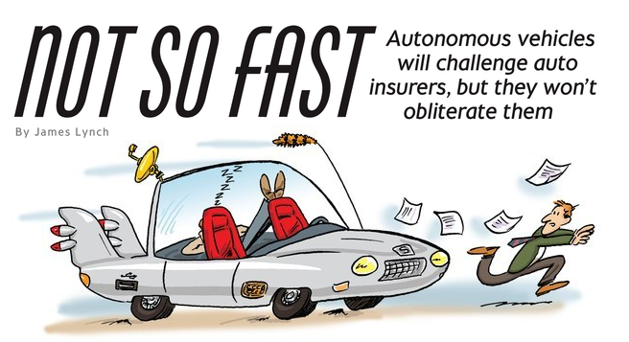
THE DRIVER WILL GO AWAY . . .
Commercial Auto
6%
. . . SOMEDAY

Slide 11
Step 1: self-driving
In Theory
Crashes Avoided Per Year | All | Injury | Fatal
Forward Collision Warning | 1,165,000 | 66,000 | 879
Lane Departure Warning | 179,000 | 37,000 | 7,529
Side Assist View (Blind Spots) | 395,000 | 20,000 | 393
Adaptive Headlights | 142,000 | 29,000 | 2,484
Total Unique Crashes | 1,866,000 | 149,000 | 10,238
6% of Injuries
30% of Fatalities
In Practice
Forward Collision Warning Working
Adaptive Headlights Working
Others: Benefits ‘Less Clear’

Slide 12
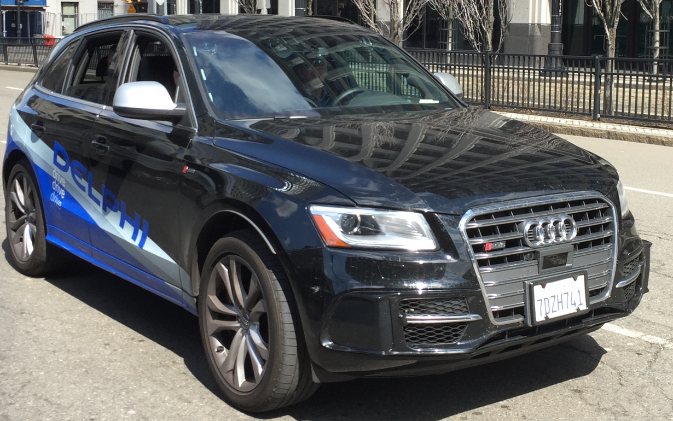
Step 2: driverless
Delphi prototype “Roadrunner”
SF to NYC in Nine Days (4/2015)
3,400 Miles – All but 50 Autonomous
Issues: ‘Unmarked Lanes, Heavy Roadworks,’ When Sun Was Low in Sky
These Are on the Drawing Boards of Almost All Automakers. But the Dream Vehicle Is a Long Way Off.

Slide 13
How soon?
SOURCE: Autonomous Vehicle Implementation Predictions, Victoria Transport Policy Institute, 2015.

Slide 14
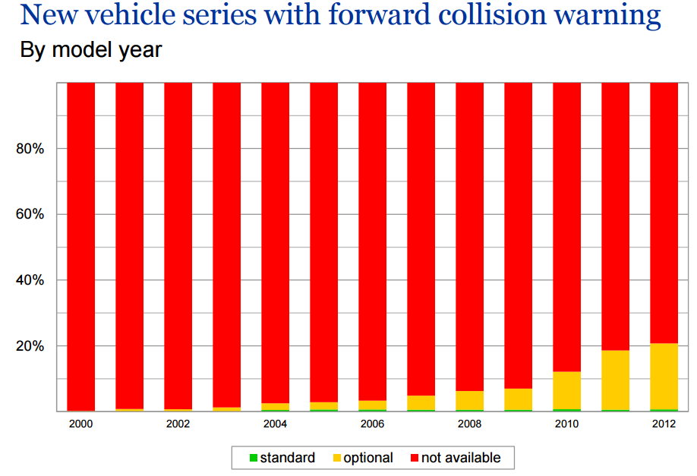
Issue 1: tech
Source: Highway Loss Data Institute, Insurance Institute for Highway Safety.

Slide 15
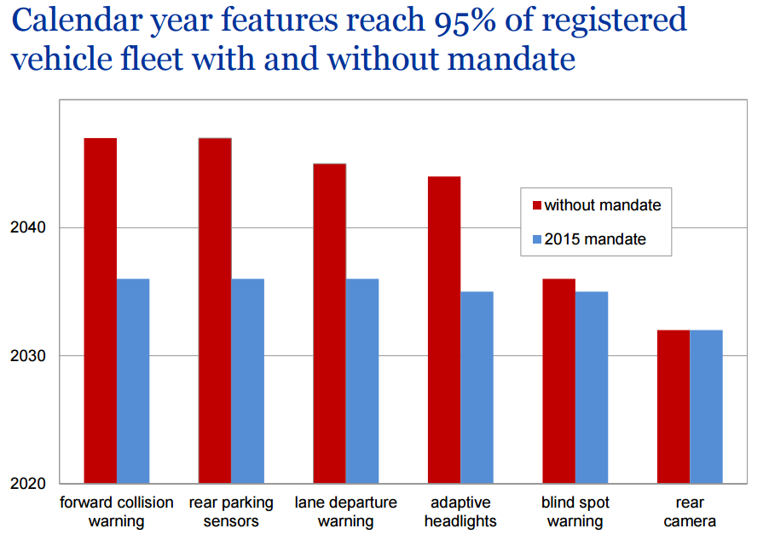
Issue 1: tech
Source: Highway Loss Data Institute, Insurance Institute for Highway Safety.

Slide 16
Issue 1: tech
Average Vehicle Age (Years)
SOURCES: Polk, August 2013 Survey, IHS Automotive November 2016; Insurance Information Institute.

Slide 17
Issue 2: consumers
Do You Consider Yourself a Better-Than-Average Driver?
Would You Be Willing to Ride in a Driverless Car?
Don’t Know
Yes
No
SOURCE: Insurance Information Institute annual Pulse Survey, June 2014.
SOURCE: “Auto Insurance Telematics: Consumer Expectations and Opinions,” Insurance Research Council, 2015.

Slide 18
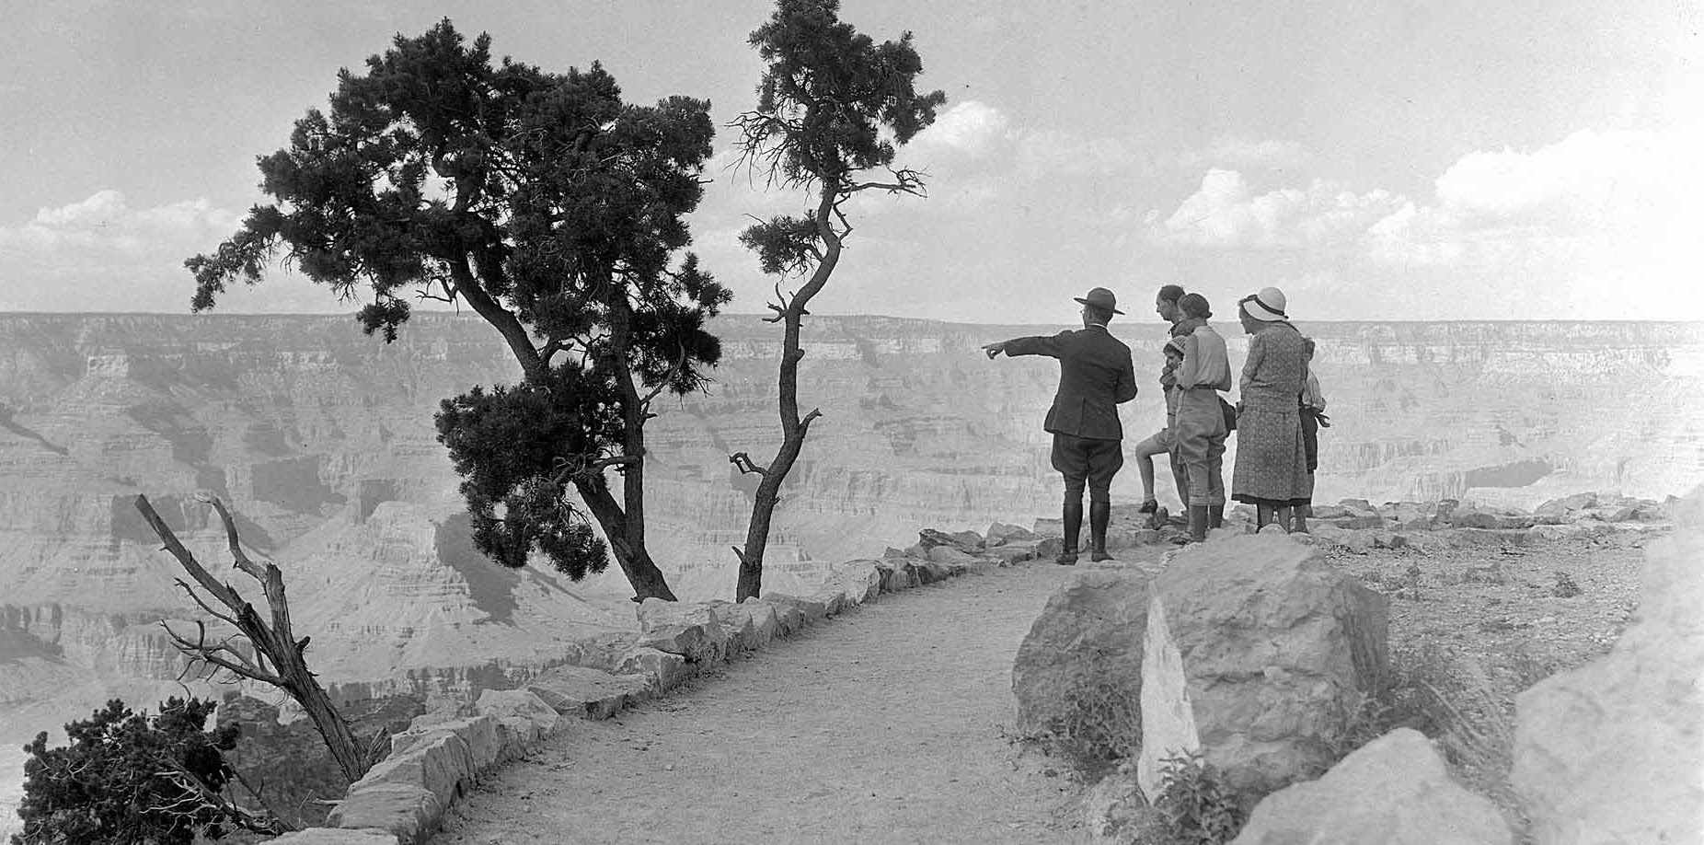
Issue 3: how do you get there?

Slide 19
ISSUE 3: FUMBLED HANDOFFS
Anatomy of an AV Claim
What Happened?
The Accident
May 7, 2016 – Williston, FL
Tesla Model S
  74 mph In A 65 Zone
  Engaged Technology “Autopilot”
    Traffic-Aware Cruise Control
    Autosteer (Lane-keeping)
    Car Had Auto Emergency Braking
Truck Turned in Front of Car
Autopilot Warned Driver 7 Times
SOURCES: National Transportation Safety Board; Florida Highway Patrol; New York Times.

Slide 20
Safety: an old story
SOURCES: Insurance Institute for Highway Safety, Insurance Services Office, Insurance Information Institute.

Slide 21
Impact on insurance
Type of Coverage | Examples | Accident Rate | Claim Size
Damage | PD, Collision | Decrease | Increase
Injury | BI, PIP, MedPay | Decrease | Unclear
Uninsured | UM/UIM | None | None
Miscellaneous | Comprehensive | None | Increase
Coverages on 21% of Premium Will Be Unaffected for Decades
Autonomous Vehicles Will Have Different Impacts on Different Coverages and Will Not All Happen At Once.

Slide 22
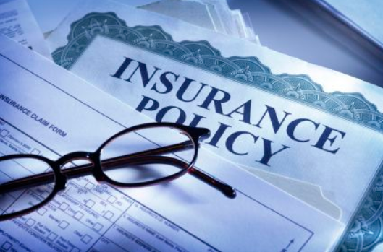
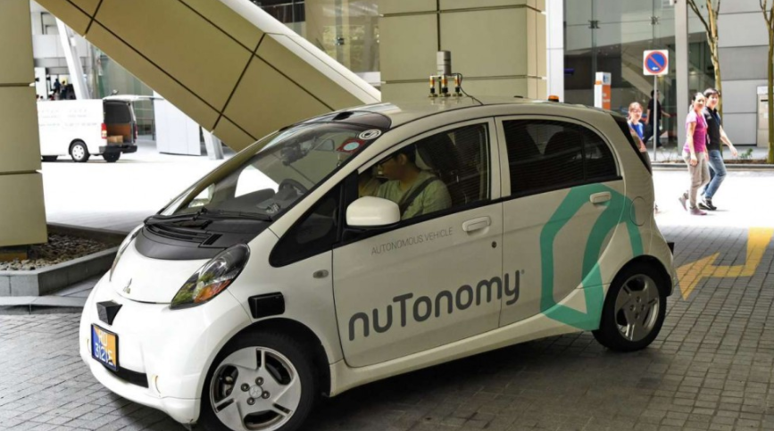
Two final issues
Shift to product liability
Will people still own cars?

Slide 23
summary
Radical Change is Coming.
It Takes a Long Time for Technology to Penetrate the Marketplace.
Technology Has Been Making Cars Safer for Decades.
There Will Still Be Accidents.

