Slide 1
The Global Economy, Rising Risk and Insurance Markets Risk and Reward in a Troubled World
Globex Partner Broker Conference
Miami, FL
October, 2016
Download at www.iii.org/presentations
Robert P. Hartwig, Ph.D., CPCU, Special Consultant ♦ Insurance Info. Inst.
Co-Director, Center for Risk and Uncertainty Mgmt. ♦ University of South Carolina
Cell: 917.453.1885 ♦ bobh@iii.org ♦ www.iii.org

Slide 2
Outlook: Property/Casualty & Economy
Modest growth will continue in 2016 (~ 3% DPW in US)
Exposure growth tied primarily to overall GDP growth/key sector drivers
Rates remain flat to marginally negative for commercial lines in 2016
Reinsurance pricing under pressure—more so for property risks
Underlying loss cost trends remain manageable
Industry is very well capitalized on a global scale
Continued pressure from alternative capital
Anti-trade, nationalistic sentiments bad for marine ins.
Sluggish growth abroad impacts trade flows
Strong dollar has hurt US manufacturing, exports
Commodity prices remain weak but have likely bottomed

Slide 3
Risk & Insurance
U.S. and Global Perspective
Marine Insurance Is Very Sensitive to the Global Economic and Political Environment
3

Slide 4
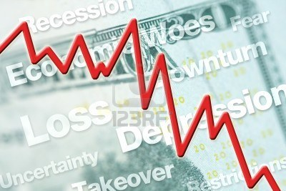



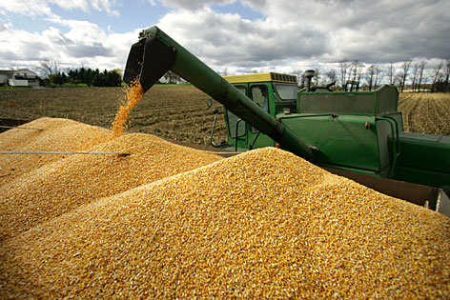
5 Major Categories for External Global Risks, Uncertainties and Fears: Insurance Solutions
Economic Risks
Geopolitical Risks
Environmental Risks
Technological Risks
Societal Risks
While risks can be broadly categorized, none are mutually exclusive
Source: Adapted from World Economic Forum, Global Risks 2014; Insurance Information Institute.

Slide 5
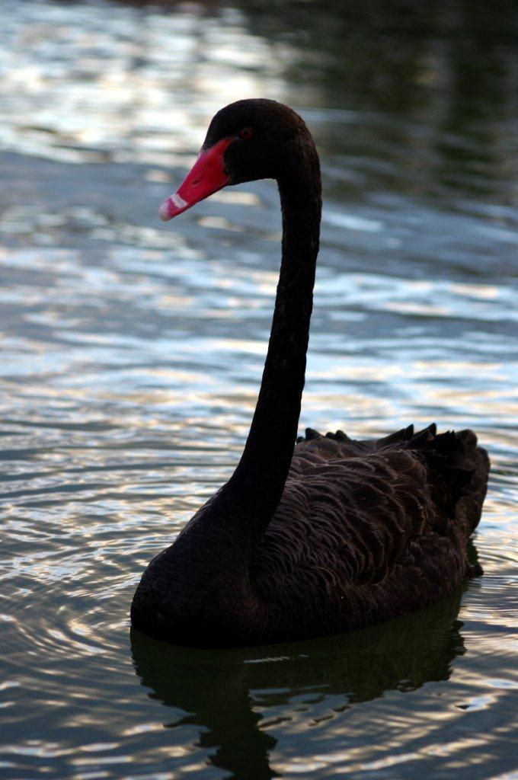
Multitude of Exogenous Factors Influence Growth, Performance & Cyclicality
Tepid growth in US, Europe
Weakness in China/Emerging Economies
Political uncertainty in the US, Brazil, Argentina
UK “Brexit”
Low/Negative Interest Rates
Resurgent Terrorism Risk: ISIS & Other Groups
Cyber Attacks
Sabre Rattling (e.g., US-China, Russia)
Severe Natural Disaster Losses→Supply Chain
Nationalism
International trade deals under siege
(Over)Regulation: Systemic Risk?
Strong dollar has impacted manufacturing
Are “Black Swans” everywhere or does it just seem that way?

Slide 6
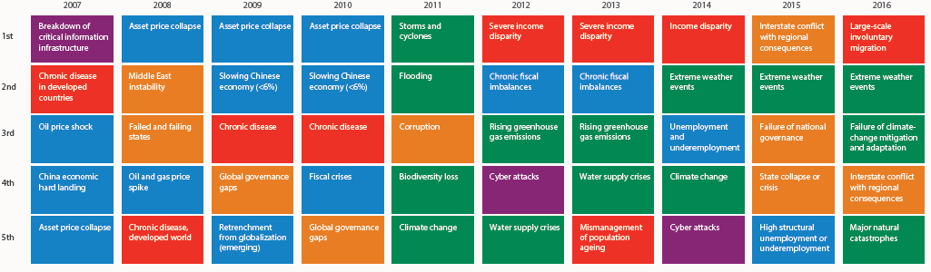
Top 5 Global Risks in Terms of Likelihood, 2007—2016: Insurance Can Help With Most
In 2016, societal and environ-mental issues dominated frequency concerns
Concerns Shift Considerably Over Short Spans of Time. 2016 Includes a Mix of Environmental Economic, Social and Environmental Risks
Source: World Economic Forum, Global Risks 2016; Insurance Information Institute.
6
12/01/09 - 9pm
eSlide – P6466 – The Financial Crisis and the Future of the P/C
Notes:
6

Slide 7
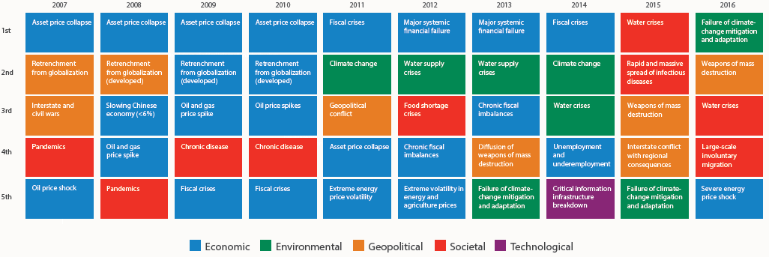
Top 5 Global Risks in Terms of Impact, 2007—2016: Insurance Can Help With Most
In 2016, societal issues dominated severity concerns
Concerns Over the Impacts of Societal Risks Remained High in 2016, but Economic, Environment and Geopolitical Risks Also Loom Large
Source: World Economic Forum, Global Risks 2016; Insurance Information Institute.
7
12/01/09 - 9pm
eSlide – P6466 – The Financial Crisis and the Future of the P/C
Notes:
7

Slide 8
Globalization: The Global Economy Creates and Transmits Cycles & Risks
Globalization Is a Double Edged Sword—Creating Opportunity and Wealth But Potentially Creating and Amplifying Risk
Emerging vs. “Advanced” Economies
8

Slide 9
GDP Growth: Advanced & Emerging Economies vs. World, 1970-2016F
Emerging economy growth rates are expected to increase to 4.2% in 2016 and 4.6% in 2017
GDP Growth (%)
World output is forecast to grow by 3.1% in 2016 and 3.4% in 2017. The world economy shrank by 0.6% in 2009 amid the global financial crisis
Advanced economies are expected to grow at a modest pace of 1.6% in 2016 and 1.8% in 2017.
Source: International Monetary Fund, World Economic Outlook, Oct. 2016; Insurance Information Institute.

Slide 10
Real GDP Growth Forecasts: Major Economies: 2014 – 2017F
US growth should acceleratein 2017
The Eurozone remains weak but should improve
Growth in China has slowed but outpaces the US and Europe
“Brexit” impact will be negative
Germany’s growth mirrors the Eurozone overall
Growth Prospects Vary Widely by Region; US and the UK Lead the Advanced Economies; Germany Leads in the Euro Area; China Has Slowed
Sources: Blue Chip Economic Indicators (10/2016 issue); IMF ( Oct. 2016); Insurance Information Institute.
10
Notes:
10

Slide 11
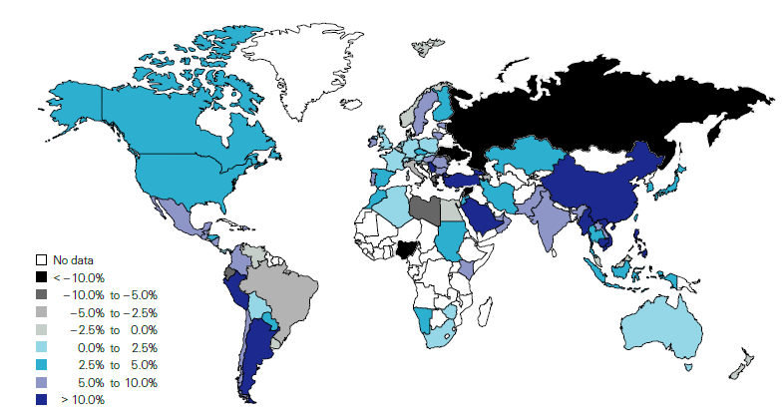
Non-Life Insurance: Global Real (Inflation Adjusted) Premium Growth, 2015
Real non-life premium growth was stronger in the US in 2015 than in most of Europe
Market | Life | Non-Life | Total
Advanced | 2.5 | 2.6 | 2.5
Emerging | 12.0 | 7.8 | 9.8
World | 4.0 | 3.6 | 3.8
Source: Swiss Re, sigma, No. 3/2016.
11
12/01/09 - 9pm
eSlide – P6466 – The Financial Crisis and the Future of the P/C
Notes:
11

Slide 12
Distribution of Global Insurance Premiums, 2015 ($ Trillions)
Total Premium Volume = $4.534 Trillion*
Life insurance accounted for nearly 56% of global premium volume in 2015 vs. 44% for Non-Life
Source: Swiss Re, sigma, No. 3/2013; Insurance Information Institute.

Slide 13
World Trade Volume Growth*, 2012 – 2017F
World trade volume growth is expected to accelerate modestly in 2017 after dipping in 2015, 2016
*Goods and services.
Source: International Monetary Fund, World Economic Outlook, October 2016; Insurance Information Institute.

Slide 14
World Trade Volume: IMPORTS 2010 – 2017F
Growth (%)
Advanced Economies
Emerging Economies
Import growth in Advanced Economies is expected to decelerate in 2016 before rising in 2017
Import growth in emerging economies outpaces Advanced Economies has been hit hard
Sources: IMF World Economic Outlook (October 2016 ); Insurance Information Institute.

Slide 15
World Trade Volume: EXPORTS 2010 – 2017F
Growth (%)
Advanced Economies
Emerging Economies
Export growth in emerging economies has struggled but should improve in 2016-17
Export growth in advanced economies is expected to decelerate in 2016 before accelerating in 2017
Sources: IMF World Economic Outlook (October 2016); Insurance Information Institute.

Slide 16
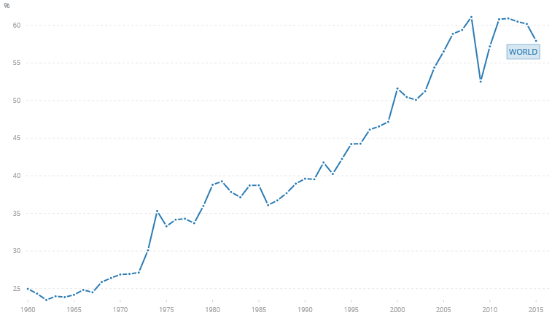
World Trade is an Increasingly Important Part of Global Economic Output
Trade as a % of Global GDP
Global trade, which has expanded from 25% of GDP in the mid-1960s to more than 60%, is in decline
Sources: The World Bank: http://data.worldbank.org/indicator/NE.TRD.GNFS.ZS accesses 10/13/16; Insurance Information Institute

Slide 17
Ocean Marine Overview
Underwriting is Historically Volatile But Improved in Recent Years
17

Slide 18
U.S. Ocean Marine Combined Ratio: 2004–2015
Ocean Marine results have improved markedly since 2012
Ocean Marine Results Have Been Quite Volatile Over the Past Decade, with the Combined Ratio Ranging by More than 20 Points
Sources: A.M. Best; Insurance Information Institute.

Slide 19
Ocean Marine vs. Commercial Lines Combined Ratio: 1989–2015
Average: 1989-2014
Ocean Marine: 103.9
All Commercial Lines: 105.6
Ocean Marine has marginally outperformed Commercial Lines overall over the period from 1989 – 2015
Sources: A.M. Best; Insurance Information Institute.

Slide 20
U.S. Ocean Marine Direct Written Premiums: 2004–2015
$ Billions
Ocean Marine premium volume has been volatile
Ocean Marine Premium Volume Fell During the Global Financial Crisis, Increased but Is Now Falling Again
Sources: A.M. Best; Insurance Information Institute.

Slide 21
Global Insurance Premium Growth Trends
Growth Is Uneven Across Regions and Market Segments
21

Slide 22
Distribution of Global Insurance Premiums, 2015 ($ Trillions)
Total Premium Volume = $4.534 Trillion*
Life insurance accounted for nearly 56% of global premium volume in 2015 vs. 44% for Non-Life
Source: Swiss Re, sigma, No. 3/2013; Insurance Information Institute.

Slide 23
Non-Life Insurance: Global Real (Inflation Adjusted) Premium Growth, 2015
Real non-life premium growth was stronger in the US in 2015 than in most of Europe
Market | Life | Non-Life | Total
Advanced | 2.5 | 2.6 | 2.5
Emerging | 12.0 | 7.8 | 9.8
World | 4.0 | 3.6 | 3.8
Source: Swiss Re, sigma, No. 3/2016.
23
12/01/09 - 9pm
eSlide – P6466 – The Financial Crisis and the Future of the P/C
Notes:
23

Slide 24
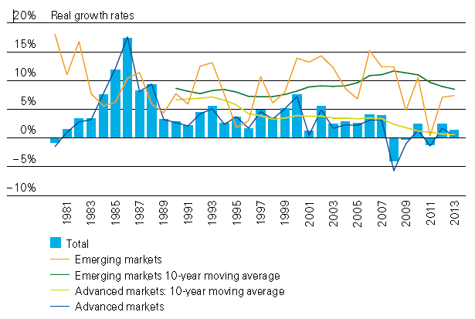
Global Real (Inflation Adjusted) Premium Growth: 1980-2013
Premium growth is very erratic in part to inflation volatility in emerging markets as well as a lack of consistent cyclicality
Emerging market growth has exceeded that of industrialized countries in 30 of the past 34 years, including the entirety of the global financial crisis and subsequent recovery
Source: Swiss Re, sigma, No. 3/2014.
24
12/01/09 - 9pm
eSlide – P6466 – The Financial Crisis and the Future of the P/C
Notes:
24

Slide 25
The Unfortunate Nexus: Opportunity, Risk & Instability
Most of the Global Economy’s Future Gains Will be Fraught with Much Greater Risk and Uncertainty than in the Past
25

Slide 26
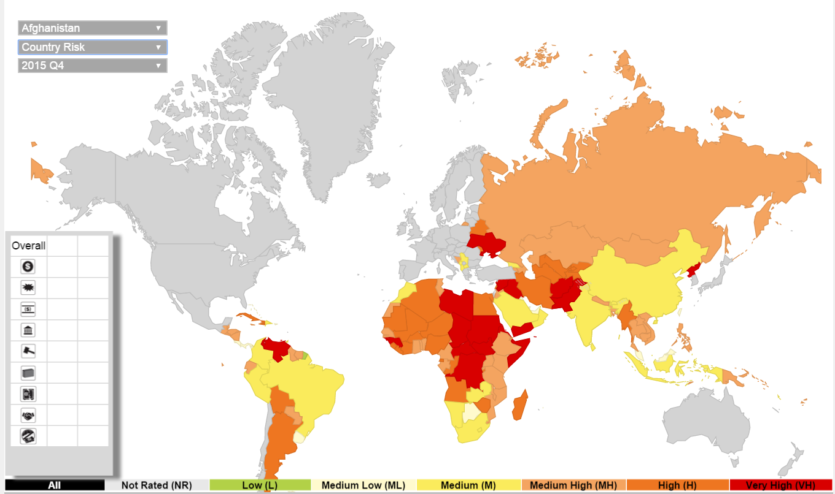
Political Risk: Greatest Opportunities Often in Risky Nations
As of 2015:Q4
Latin and South America have modest terrorist threats though Brazil is elevated
Terrorism remains a greater concern in the Middle East, Africa and South Asia
Source: Aon PLC; Insurance Information Institute.

Slide 27
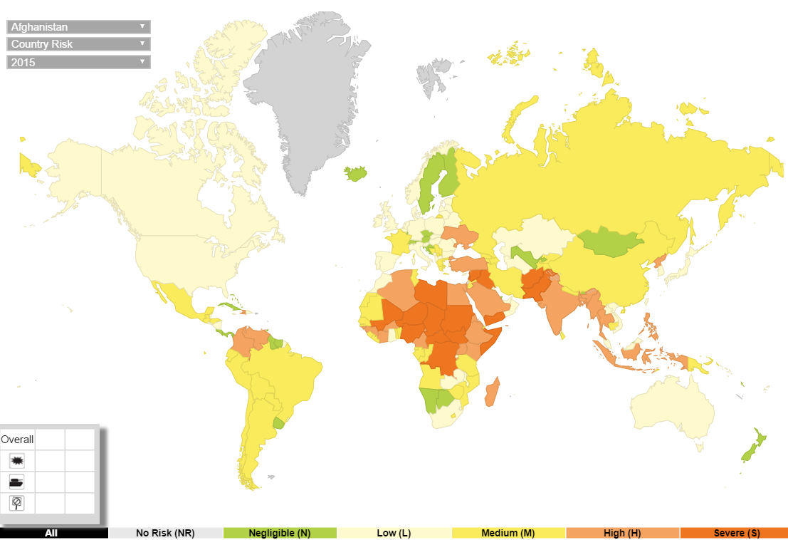
Terrorism Risk: Greatest Opportunities Are Often in Risky Nations
As of 2015:Q4
Problems in the Ukraine will intensify political risk in several former Soviet republics
Latin and South America also present insurers with growth opportunities but political instability has increased markedly
The fastest growing markets are generally also among the politically riskiest, including East and South Asia and Africa
Source: Aon PLC; Insurance Information Institute.

Slide 28
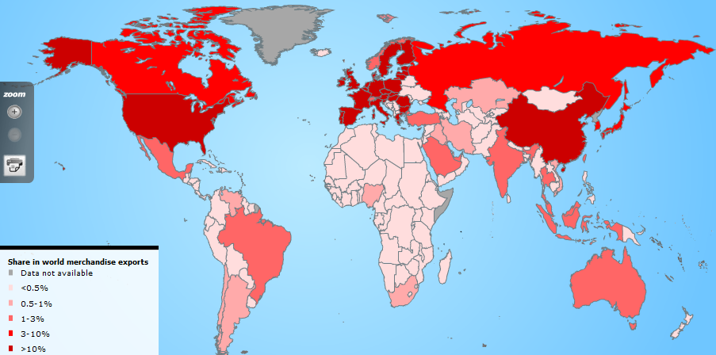
Country Shares of World Merchandise Exports
The US, China, Japan and Western Europe lead the world in merchandise exports
Source: World Trade Organization accessed 4/30/14 at: http://www.wto.org/english/res_e/statis_e/statis_e.htm ; Insurance Information Institute.
28
12/01/09 - 9pm
eSlide – P6466 – The Financial Crisis and the Future of the P/C
Notes:
28

Slide 29
Loss Distribution by Type of Insurance from Sept. 11 Terrorist Attack ($ 2015)
($ Billions)
Total Insured Losses Estimate: $43.7B**
*Loss total does not include March 2010 New York City settlement of up to $657.5 million to compensate approximately 10,000 Ground Zero workers or any subsequent settlements.
**$32.5 billion in 2001 dollars.
Source: Insurance Information Institute.

Slide 30
P/C (Re)Insurance Industry Financial Overview
The Past Few Years Have Been Very Similar and Reasonably Good
30

Slide 31
Commercial Lines Outlook: 2017
Flat to modest deceleration in premium growth in 2017
Rate environment suggests flat-to-slightly negative renewals in 2017
Economic growth continues at a very modest pace but unevenly across industries and regions; Nearly full employment and tighter labor market conditions are pluses and should drive new exposures
Service sector is a positives but manufacturing, energy, commodities, trade, agriculture all face headwinds
Loss costs driven by modest frequency and severity trends, but helped by reserve releases, modest cats
Property cat reinsurance costs continue to fall
Investment income still under pressure from low yields

Slide 32
P/C Industry Net Income After Taxes 1991–2016:Q2
$ Millions
2005 ROE*= 9.6%
2006 ROE = 12.7%
2007 ROE = 10.9%
2008 ROE = 0.1%
2009 ROE = 5.0%
2010 ROE = 6.6%
2011 ROAS¹ = 3.5%
2012 ROAS¹ = 5.9%
2013 ROAS¹ = 10.2%
2014 ROAS¹ = 8.4%
2015 ROAS = 8.4%
2016:H1 ROAS = 6.4%*
Net income in Q2:2016 on an annualized basis was on track to fall short of full-year 2015
ROE figures are GAAP; ¹Return on avg. surplus. Excluding Mortgage & Financial Guaranty insurers yields a 8.2% ROAS in 2014, 9.8% ROAS in 2013, 6.2% ROAS in 2012, 4.7% ROAS for 2011, 7.6% for 2010 and 7.4% for 2009; 2015E is annualized figure based actual figure through Q3 of $44.0
Sources: A.M. Best, ISO; Insurance Information Institute

Slide 33
Profitability Peaks & Troughs in the P/C Insurance Industry, 1975 – 2016:H1
ROE
1977:19.0%
History suggests next ROE peak will be in 2016-2017
1987:17.3%
10 Years
1997:11.6%
2006:12.7%
10 Years
2015: 8.4%
9 Years
2013 9.8%
2016:H1 6.4%
1975: 2.4%
1984: 1.8%
1992: 4.5%
2001: -1.2%
*Profitability = P/C insurer ROEs. 2011-15 figures are estimates based on ROAS data. Note: Data for 2008-2014 exclude mortgage and financial guaranty insurers.
Source: Insurance Information Institute; NAIC, ISO, A.M. Best, Conning

Slide 34
ROE: Property/Casualty Insurance by Major Event, 1987–2016:H1
(Percent)
P/C Profitability Is Both by Cyclicality and Ordinary Volatility
Modestly higher CATs
Katrina, Rita, Wilma
Low CATs
Sept. 11
Hugo
Lowest CAT Losses in 15 Years
4 Hurricanes
Sandy
Andrew, Iniki
Northridge
Record Tornado Losses
Financial Crisis*
* Through 2016:H1. Excludes Mortgage & Financial Guarantee in 2008 – 2014.
Sources: ISO, Fortune; Insurance Information Institute.

Slide 35
P/C Insurance Industry ROE: Magnitude of Cyclicality, Volatility Changes Over Time, 1950-2015
1950 - 1970
Low
Volatility
1971 - 1992
Extreme
Volatility
1993 - 2008
Moderate
Volatility
2009 - Present
Modest
Volatility
.
Source: Insurance Information Institute

Slide 36
P/C Insurance Industry Combined Ratio, 2001–2016:Q2*
Heavy Use of Reinsurance Lowered Net Losses
Relatively Low CAT Losses, Reserve Releases
Higher CAT Losses, Shrinking Reserve Releases, Toll of Soft Market
As Recently as 2001, Insurers Paid Out Nearly $1.16 for Every $1 in Earned Premiums
Relatively Low CAT Losses, Reserve Releases
Avg. CAT Losses, More Reserve Releases
3 Consecutive Years of U/W Profits: First Time Since 1971-73
Sandy Impacts
Best Combined Ratio Since 1949 (87.6)
Cyclical Deterioration
Lower CAT Losses
Elevated CATs
* Excludes Mortgage & Financial Guaranty insurers 2008--2014. Including M&FG, 2008=105.1, 2009=100.7, 2010=102.4, 2011=108.1; 2012:=103.2; 2013: = 96.1; 2014: = 97.0.
Sources: A.M. Best, ISO (2014-2015); Figure for 2010-2013 is from A.M. Best P&C Review and Preview, Feb. 16, 2016.

Slide 37
Number of Years with Underwriting Profits by Decade, 1920s–2010s
Number of Years with Underwriting Profits
Underwriting Profits Were Common Before the 1980s (40 of the 60 Years Before 1980 Had Combined Ratios Below 100) – But Then They Vanished. Not a Single Underwriting Profit Was Recorded in the 25 Years from 1979 Through 2003
* 2009 combined ratio excl. mort. and finl. guaranty insurers was 99.3, which would bring the 2000s total to 4 years with an u/w profit.
**Data for the 2010s is for the period 2010 through 2015.
Note: Data for 1920–1934 based on stock companies only.
Sources: Insurance Information Institute research from A.M. Best Data.
37
12/01/09 - 9pm
eSlide – P6466 – The Financial Crisis and the Future of the P/C
Notes:
37

Slide 38
P/C Insurance Loss Reserve Development, 1992 – 2017E*
Reserve releases are expected to gradually taper off slowly, but will continue to benefit the bottom line and combined ratio through at least 2017
Reserve Change
Source: A.M. Best; Barclays research for estimates.

Slide 39
Policyholder Surplus, 2006:Q4–2016:Q2
($ Billions)
2007:Q3 Pre-Crisis Peak
Drop due to near-record 2011 CAT losses
Surplus as of 6/30/16 stood at a record high $680.64B
The industry now has $1 of surplus for every $0.76 of NPW, close to the strongest claims-paying status in its history.
2010:Q1 data includes $22.5B of paid-in capital from a holding company parent for one insurer’s investment in a non-insurance business .
The P/C insurance industry entered 2016 in very strong financial condition.
Sources: ISO, A.M .Best.
39
12/01/09 - 9pm
eSlide – P6466 – The Financial Crisis and the Future of the P/C
Notes:
39

Slide 40
US Policyholder Surplus: 1975–2016*
($ Billions)
Surplus as of 6/30/16 was a record $680.6, up 1.0% from $673.7 of 12/31/15, and up 55.7% ($243.5B) from the crisis trough of $437.1B at 3/31/09
“Surplus” is a measure of underwriting capacity. It is analogous to “Owners Equity” or “Net Worth” in non-insurance organizations
The Premium-to-Surplus Ratio Stood at $0.76:$1 as of 12/31/15, a Near Record Low (at Least in Recent History)
* As of 6/3016.
Source: A.M. Best, ISO, Insurance Information Institute.

Slide 41
RNW All Lines, 2005-2014 Average: Highest 25 States
(Percent)
The most profitable states over the past decade are widely distributed geographically, though none are in the Gulf region
Profitability Benchmark: All P/C
US: 7.7%
Source: NAIC; Insurance Information Institute.

Slide 42
RNW All Lines, 2005-2014 Average:
Lowest 25 States
(Percent)
Some of the least profitable states over the past decade were hit hard by catastrophes
Source: NAIC; Insurance Information Institute.

Slide 43
Net Premium Growth (All P/C Lines): Annual Change, 1971—2016:Q2
(Percent)
1975-78
1984-87
2000-03
Net Written Premiums Fell 0.7% in 2007 (First Decline Since 1943) by 2.0% in 2008, and 4.2% in 2009, the First 3-Year Decline Since 1930-33.
2016 Q2: 3.0%
2015: 3.4%
2014: 4.2
2013: 4.4%
2012: +4.2%
Outlook
2016F: 3.0%
2017F: 2.9%
Shaded areas denote “hard market” periods
Sources: A.M. Best (1971-2013), ISO (2014-16).

Slide 44
NPW Premium Growth: Peaks & Troughs in the P/C Insurance Industry, 1926 – 2015
ROE
Post WW II Peak:
1947: 26.2%
1970-90: Peak premium growth was much higher in this period while troughs were comparable. Rapid inflation, economic volatility, high interest rates, tort environment all played roles
Start of WW II
1941: 15.8%
Economic Shocks, Inflation:
1976: 22.0%
Tort Crisis
1985/86: 22.2%
Post-9/11
2002:15.3%
1988-2000: Period of inter-cycle stability
2015 3.4%
1950-70: Extended period of stability in growth and profitability. Low interest rates, low inflation, “Bureau” rate regulation all played a role
2010-20XX? Post-recession period of stable growth?
Twin Recessions; Interest Rate Hikes
1987: 3.7%
Great Recession:2010: -4.9%
Great Depression
1932: -15.9% max drop
Note: Data through 1934 are based on stock companies only. Data include state funds beginning in 1998.
Source: A.M. Best; Insurance Information Institute.

Slide 45
Commercial Lines NPW Premium Growth:
1975 – 2015E
ROE
Commercial lines is prone to more cyclical volatility that personal lines. Recently, growth has stabilized in the 4% to 5% range.
Economic Shocks, Inflation:
1976: 22.2%
Tort Crisis
1986: 30.5%
Post-9/11
2002: 22.4%
Post-Hurricane Andrew Bump:
1993: 6.3%
1988-2000: Period of inter-cycle stability
Post Katrina Bump:
2006: 7.7%
2015E 3.3%
2010-20XX? Post-recession period of stable growth?
Recessions:
1982: 1.1%
Great Recession:2009: -9.0%
Note: Data include state funds beginning in 1998.
Source: A.M. Best; Insurance Information Institute.

Slide 46
Direct Premiums Written: Total P/C Percent Change by State, 2007-2014
Top 25 States
North Dakota was the country’s growth leader over the past 7 years with premiums written expanding by 70.7%, fueled by the state’s energy boom
Growth Benchmarks: Total P/C
US: 13.0%
Sources: SNL Financial LC.; Insurance Information Institute.

Slide 47
Direct Premiums Written: Total P/C Percent Change by State, 2007-2014
Bottom 25 States
Growth was negative in 4 states and DC between 2007 and 2014
Sources: SNL Financial LC.; Insurance Information Institute.

Slide 48
Direct Premiums Written: Comm. Lines Percent Change by State, 2007-2014
Top 25 States
43 states showed commercial lines growth from 2007 through 2014
Growth Benchmarks: Commercial
US: 5.9%
Sources: SNL Financial LLC.; Insurance Information Institute.

Slide 49
Direct Premiums Written: Comm. Lines Percent Change by State, 2007-2014
Bottom 25 States
Nearly half the states have yet to see commercial lines premium volume return to pre-crisis levels
Sources: SNL Financial LLC.; Insurance Information Institute.

Slide 50
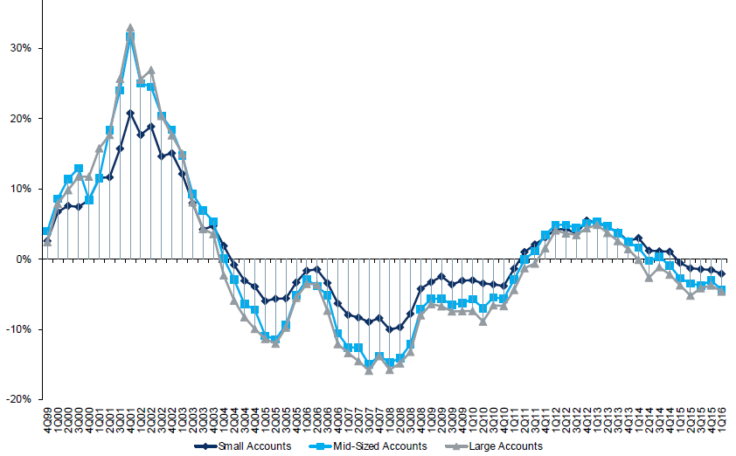
Change in Commercial Rate Renewals, by Account Size: 1999:Q4 to 2016:Q1
Percentage Change (%)
Peak = 2001:Q4 +28.5%
Pricing turned positive in Q3:2011, the first inrease in nearly 8 years; Q1:2015 renewals were down 2.8%; Some insurers posted stronger numbers.
Pricing Turned Negative in Early 2004 and Remained that way for 7 ½ years
Trough = 2007:Q3 -13.6%
KRW : No Lasting Impact
Source: Council of Insurance Agents and Brokers; Barclay’s Capital; Insurance Information Institute.
Note: CIAB data cited here are based on a survey. Rate changes earned by individual insurers can and do vary, potentially substantially.

Slide 51
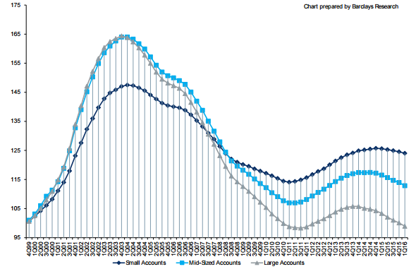
Cumulative Qtrly. Commercial Rate Changes, by Account Size: 1999:Q4 to 2016:Q1
1999:Q4 = 100
Pricing for smaller accounts has been more stable than for larger accounts
Note: CIAB data cited here are based on a survey. Rate changes earned by individual insurers can and do vary, potentially substantially.
Source: Council of Insurance Agents and Brokers; Barclay’s Capital; Insurance Information Institute.

Slide 52
CIAB: Average Commercial Rate Change, All Lines, (1Q:2004–2Q:2016)
(Percent)
Q2 2011 marked the last of 30th consecutive quarter of price declines
Pricing as of Q2:2016 remained somewhat negative
KRW Effect
Note: CIAB data cited here are based on a survey. Rate changes earned by individual insurers can and do vary, potentially substantially.
Source: Council of Insurance Agents & Brokers; Insurance Information Institute

Slide 53
Change in Commercial Rate Renewals, by Line: 2016:Q2
Percentage Change (%)
Commercial Auto rate increases are larger than any other line, followed by EPL
Major Commercial Lines Renewals Were Mixed to Down in Q2:2016; EPL and Commercial Auto Saw Gains
Note: CIAB data cited here are based on a survey. Rate changes earned by individual insurers can and do vary, potentially substantially.
Source: Council of Insurance Agents and Brokers; Insurance Information Institute.

Slide 54
INVESTMENTS: THE NEW REALITY
Investment Performance is a Key Driver of Profitability
Depressed Yields Will Necessarily Influence Underwriting & Pricing
54

Slide 55
S&P 500 Index Returns, 1950 – 2016*
Annual Return
Stock market is off to its worst start ever but volatility is endemic to stock markets—and may be increasing—but there is no persistent downward trend over long periods of time
Fed Raises Rate
Tech Bubble Implosion
2016*:
+6.5%
Energy Crisis
Financial Crisis
*Through Oct. 12 2016.
Source: NYU Stern School of Business: http://pages.stern.nyu.edu/~adamodar/New_Home_Page/datafile/histretSP.html Ins. Info. Inst.

Slide 56
Property/Casualty Insurance Industry Investment Income: 2000–2016:Q2¹
Investment earnings are still 19% below their 2007 pre-crisis peak
($ Billions)
Due to persistently low interest rates, investment income fell in 2012, 2013 and 2014 but showed a small (1.9%) increase in 2015—another drop in 2016 seems likely.
*Annualized figure based on actual Q2:2016 net investment income earned of $22.067B.
¹ Investment gains consist primarily of interest and stock dividends. Sources: ISO; Insurance Information Institute.

Slide 57
U.S. Treasury Security Yields: A Long Downward Trend, 1990–2016*
Yields on 10-Year U.S. Treasury Notes have been essentially below 5% for more than a decade.
Despite the Fed’s December 2015 rate hike, yields remain low though short-term yields have seen some gains; Yield curve is flattening.
Since roughly 80% of P/C bond/cash investments are in 10-year or shorter durations, most P/C insurer portfolios will have low-yielding bonds for years to come.
*Monthly, constant maturity, nominal rates, through August 2016.
Sources: Federal Reserve Bank at http://www.federalreserve.gov/releases/h15/data.htm. National Bureau of Economic Research (recession dates); Insurance Information Institute.
57
12/01/09 - 9pm
eSlide – P6466 – The Financial Crisis and the Future of the P/C
Notes:
57

Slide 58
Distribution of Invested Assets: P/C Insurance Industry, 2013
$ Billions
Total Invested Assets = $1.5 Trillion
Source: Insurance Information Institute Fact Book 2015, A.M. Best.

Slide 59
Net Investment Yield on Property/ Casualty Insurance Invested Assets, 2007–2016P*
(Percent)
Estimated book yield in 2016 is down about 140 BP from pre-crisis levels
The yield on invested assets remains low relative to pre-crisis yields. The Fed’s plan to raise interest rates in late 2015 has pushed up some yields, albeit quite modestly.
Sources: A.M. Best; 2015E-2016P figures from A.M. Best P/C Review and Preview, Feb. 2016; Insurance Information Institute

Slide 60
Interest Rate Forecasts: 2016 – 2021F
Yield (%)
3-Month Treasury
10-Year Treasury
10-year yields are actually down in 2016
A full normalization of interest rates is unlikely until 2019, more than a decade after the onset of the financial crisis.
Sources: Blue Chip Economic Indicators (10/16 for 2016 and 2017; for 2018-2021 10/16 issue); Insurance Info. Institute.

Slide 61
Annual Inflation Rates, (CPI-U, %), 1990–2017F
Annual Inflation Rates (%)
Inflation peaked at 5.6% in August 2008 on high energy and commodity crisis. The recession and the collapse of the commodity bubble reduced inflationary pressures in 2009/10
Inflationary expectations have slipped (due in part to falling energy costs) allowing the Fed to maintain low interest rates
Slack in the U.S. economy and falling energy prices suggests that inflationary pressures should remain subdued for an extended period of times
Sources: US Bureau of Labor Statistics; Blue Chip Economic Indicators, 4/16 (forecasts).

Slide 62
P/C Insurer Net Realized Capital Gains/Losses, 1990-2016:Q2
Realized capital gains are down from their 2013 peak
($ Billions)
Insurers Posted Net Realized Capital Gains in 2010 - 2015 Following Two Years of Realized Losses During the Financial Crisis. Realized Capital Losses Were a Primary Cause of 2008/2009’s Large Drop in Profits and ROE.
*Annualized based on actual of $4.438B through Q2 2016
Sources: A.M. Best, ISO; Insurance Information Institute.
62
12/01/09 - 9pm
eSlide – P6466 – The Financial Crisis and the Future of the P/C
Notes:
62

Slide 63
Property/Casualty Insurance Industry Investment Gain: 1994–2016:Q2¹
($ Billions)
Investment gains in 2015 were unchanged from 2014; 2016 is running slightly behind 2015 and 17% below the pre-crisis peak
Total Investment Gains Were Flat in 2015 as Investment Income Rose Marginally and Realized Capital Gains Fell Slightly
¹ Investment gains consist primarily of interest, stock dividends and realized capital gains and losses.
* 2005 figure includes special one-time dividend of $3.2B; 2016 figure is annualized based on actual Q2 2016 figure of $26.505B.
Sources: ISO, SNL; Insurance Information Institute.

Slide 64
Reduction in Combined Ratio Necessary to Offset 1% Decline in Investment Yield to Maintain Constant ROE, by Line*
Lower Investment Earnings Place a Greater Burden on Underwriting and Pricing Discipline
*Based on 2008 Invested Assets and Earned Premiums
**US domestic reinsurance only
Source: A.M. Best; Insurance Information Institute.
64
12/01/09 - 9pm
eSlide – P6466 – The Financial Crisis and the Future of the P/C
Notes:
64

Slide 65
Profitability & Politics
How Is Profitability Affected by the President’s Political Party?
65

Slide 66
P/C Insurance Industry ROE by Presidential Administration, 1950-2015*
OVERALL RECORD: 1950-2015*
Democrats 7.72%
Republicans 7.85%
Party of President has marginal bearing on profitability of P/C insurance industry
*Truman administration ROE of 6.97% based on 3 years only, 1950-52;.
Source: Insurance Information Institute

Slide 67
P/C insurance Industry ROE by Presidential Party Affiliation, 1950- 2015
BLUE = Democratic President RED = Republican President
Nixon/Ford
Carter
Reagan/Bush I
Clinton
Bush II
Obama
Truman
Eisenhower
Kennedy/ Johnson
.
Source: Insurance Information Institute

Slide 68
Trump vs. Clinton: Issues that Matter to P/C Insurers
Issue | Trump | Clinton
Economy | Supply Side-Like Philosophy: Lower taxes→Faster real GDP growth; Deficits likely grow as tax cuts are combined with targeted increased spending on Homeland Security, Defense, etc. | Keynesian Philosophy: More government spending on infrastructure, education, social services; Deficits likely increase as tax increases likely difficult to pass
Interest Rates | May trend higher with larger deficits; Shift from monetary policy to fiscal focus (tax cuts, government spending) | Status quo at the Fed; Net impact on interest rates unclear
Taxes | Favors lower tax rates for corporate and personal income tax rates; Tax code overhaul? | Unlikely to reduce taxes or embark on major overhaul of tax code
International Trade | Protectionist Tendencies | Has criticized Trans-Pacific Partnership but is a realist on international matters
Tort System | Doesn’t like trial lawyers but seems to like filing lawsuits | Status Quo

Slide 69
GLOBAL M&A UPDATE: A PATH TO GROWTH?
Are Capital Accumulation, Drive for Growth and Scale Stimulating M&A Activity?
69

Slide 70
U.S. INSURANCE MERGERS AND ACQUISITIONS, P/C SECTOR, 1994-2015 (1)
M&A activity in the P/C sector in 2015 totaled $39.6B, its highest level since 2000
($ Millions)
(1) Includes transactions where a U.S. company was the acquirer and/or the target.
Source: Conning proprietary database.

Slide 71
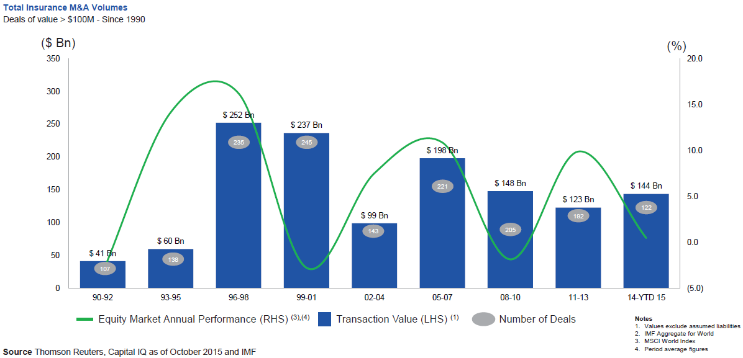
Global M&A Activity Tends to Follow Equity Market Performance
The number and volume of insurance M&A deals was up globally in 2015
.
Source: Thomson Reuters, Capital IQ as of Oct. 2015 and IMF from Geneva Association Newsletter Insurance and Finance, Jan. 2016, presentation “Facts vs. Sentiment: Deals in the Insurance Sector,” by Aviva CEO Mark Wilson.

Slide 72
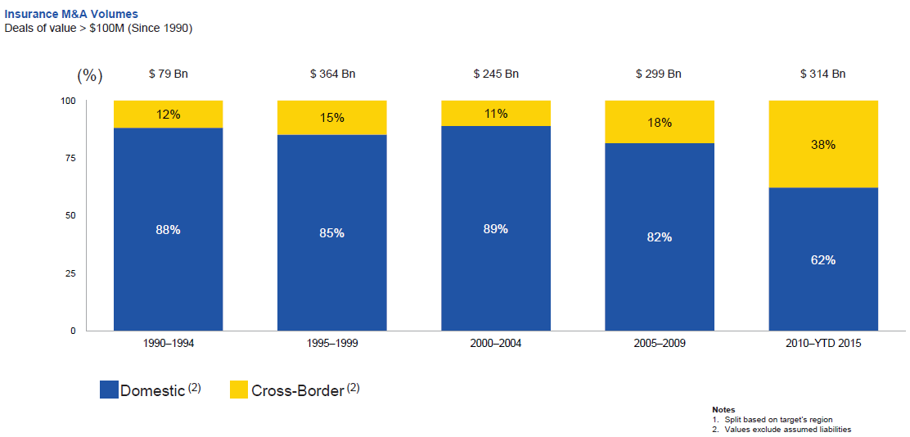
Huge Shift from Domestic M&A Activity to Cross-Border
The share of M&A deal volume that was cross-border more than doubled in 2015
.
Source: Thomson Reuters as of Oct. 2015 from Geneva Association Newsletter Insurance and Finance, Jan. 2016, presentation “Facts vs. Sentiment: Deals in the Insurance Sector,” by Aviva CEO Mark Wilson.

Slide 73
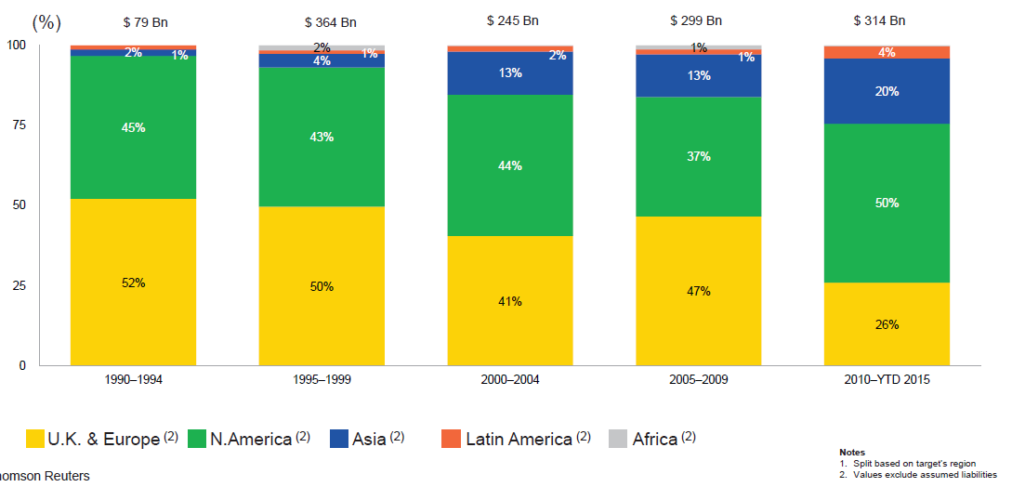
M&A Activity Has Shifted Away from Europe and Towards Asia and N. America
Asian, N. American deal volumes were up sharply in 2015
.
Source: Thomson Reuters as of Oct. 2015 from Geneva Association Newsletter Insurance and Finance, Jan. 2016, presentation “Facts vs. Sentiment: Deals in the Insurance Sector,” by Aviva CEO Mark Wilson.

Slide 74
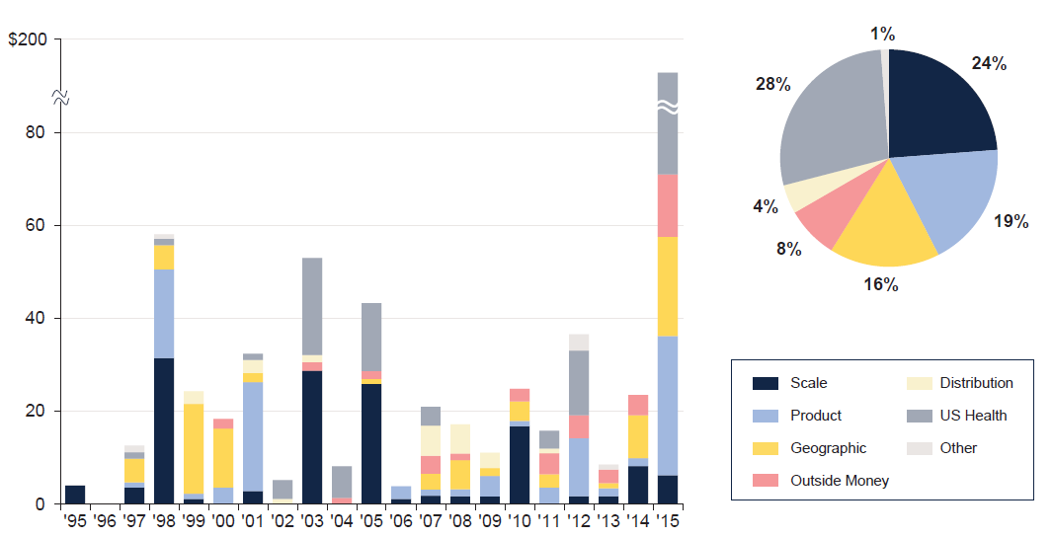
M&A: Deal Rationale by Dollar Amount
Scale drives most deals (excluding health sector)
Source: SNL Financial and WCMA estimates from Geneva Association Newsletter Insurance and Finance, Jan. 2016, presentation “What is the Logic Behind Consolidation? And Does It Create Value? A View from Outside,” by Brian Shea, Head of Willis Capital Markets & Advisory Europe (WCMA).
.

Slide 75
Some Key Drivers in the US Economy
Economic Factors Driving Exposure Growth and Insurer Performance
75

Slide 76
US Real GDP Growth*
The Q4:2008 decline was the steepest since the Q1:1982 drop of 6.8%
Real GDP Growth (%)
Recession began in Dec, 2007
Q1 2014/15 GDP data were hit hard by this year’s “Polar Vortex” and harsh winter
GDP Growth Is Expected to Continue at a Steady, Albeit Moderate Pace that Gradually Benefits the Economy Broadly
* Estimates/Forecasts from Blue Chip Economic Indicators.
Source: US Department of Commerce, Blue Economic Indicators 10/16; Insurance Information Institute.

Slide 77
US Unemployment Rate Forecast
Rising unemployment eroded payrolls and WC’s exposure base.
Unemployment peaked at 10% in late 2009.
2007:Q1 to 2017:Q4F*
Jobless figures have been revised downwards for 2016
Unemployment forecasts have been revised modestly downwards. Optimistic scenarios put the unemployment as low as 4.3% by Q4 of 2017.
* = actual; = forecasts
Sources: US Bureau of Labor Statistics; Blue Chip Economic Indicators (10/16 edition); Insurance Information Institute.

Slide 78
Continued Business Investment Will Spur Commercial Exposure Growth
The level and direction of interest rates is likely to affect these growth rates.
Business investment was a major drag on the economy in 2016 and adversely impacts commercial property and liability insurance exposures. Growth should begin a modest recovery in 2017.
Sources: Blue Chip Economic Indicators, 10/2016 (history and forecasts for 2016 and 2017, 10/2016 for forecasts for 2018-2022; Insurance Information Institute.

Slide 79
Annual Inflation Rates, (CPI-U, %), 1990–2017F
Annual Inflation Rates (%)
Inflation peaked at 5.6% in August 2008 on high energy and commodity crisis. The recession and the collapse of the commodity bubble reduced inflationary pressures in 2009/10
Inflationary expectations remain muted, allowing the Fed to maintain low interest rates without concern of inflation
Slack in the U.S. economy and falling energy prices suggests that inflationary pressures should remain subdued for an extended period of times
Sources: US Bureau of Labor Statistics; Blue Chip Economic Indicators, 10/16 (forecasts).

Slide 80
Commodity Prices In Early 2016 Plunged to Lowest Levels Since 2000
Bank of Canada, Commodity price indices, weekly data, (indexed to Jan 2000=100)
Energy and other commodity prices tumbled
Note: Total index includes energy, metals & minerals, agriculture, forestry and fish.
Upside for most advanced economies, but a downside for commodity exporters
Source: Datastream from IUMI Hamburg 2016 presentation by Doug Harrell, Aspen Insurance.
Notes:
http://www.bankofcanada.ca/rates/price-indexes/bcpi/
Energy
Crude Oil [WTI, Brent, Western Canada Crude 1], Natural Gas, Coal
Metals and Minerals
Potash, Aluminum, Gold, Nickel, Iron, Copper, Silver, Zinc, Lead
Forestry
Lumber, Pulp, Newsprint
Agriculture
Cattle, Canola, Wheat, Hogs, Corn, Barley, Potatoes
Fisheries
Finfish, Shellfish 2

Slide 81
MANUFACTURING SECTOR OVERVIEW & OUTLOOK
The U.S. Manufacturing Sector Is Being Buffeted by a High Dollar, Weak Export Markets and Plunging Oil Prices
81

Slide 82
ISM Manufacturing Index
(Values > 50 Indicate Expansion)
January 2010 through September 2016
Manufacturing began to contract in late 2015 and is experiencing only tepid growth
The manufacturing sector expanded for 68 of the 72 months from Jan. 2010 through Dec. 2015. The Manufacturing then weakened due to weakness abroad, the strong dollar and a collapse in oil prices
Source: Institute for Supply Management at http://www.ism.ws/ismreport/mfgrob.cfm; Insurance Information Institute.

Slide 83
Dollar Value* of Manufacturers’ Shipments Monthly, Jan. 1992—December 2015
$ Millions
The value of Manufacturing Shipments in Dec. 2015 was $467.0B—down 8% from the July 2014 record high of $508.1B
Monthly shipments in Nov. 2014 exceeded the pre-crisis (July 2008) peak but has declined in recent months. Weakness abroad, falling energy prices and a strong dollar are hurting the sector, especially exports. Manufacturing growth leads to gains in many commercial exposures: WC, Commercial Auto, Marine, Property, and various Liability Coverages.
* Seasonally adjusted; Data published Feb. 4, 2016. Source: U.S. Census Bureau, Full Report on Manufacturers’ Shipments, Inventories, and Orders, http://www.census.gov/manufacturing/m3/
83
12/01/09 - 9pm
eSlide – P6466 – The Financial Crisis and the Future of the P/C
Notes:
83

Slide 84
Manufacturing Growth for Selected Sectors, 2015 vs. 2014*
Growth (%)
Durables: +1.8%
Non-Durables: -9.6%
Manufacturing of non-durable goods is weaker than for durables
Manufacturing Is Contracting Across a Number of Sectors, Especially Petroleum. Adverse Exposure Impacts Are Likely for: WC, Commercial Property, Commercial Auto and Certain Liability Coverages
*Seasonally adjusted; Date are YTD comparing data through November 2015 to the same period in 2014. Source: U.S. Census Bureau, Full Report on Manufacturers’ Shipments, Inventories, and Orders, http://www.census.gov/manufacturing/m3/

Slide 85
CYBER RISK AND INSURANCE
Cyber Risk is a Rapidly Emerging Exposure for Businesses Large and Small in Every Industry
85

Slide 86








Data Breaches 2005-2015, by Number of Breaches and Records Exposed
# Data Breaches/Millions of Records Exposed
Millions
The 781 reported data breaches in 2015 was virtually unchanged form the record 783 reported in 2014. The number of exposed records soared to 169.1 million, and increase of 97.5%.
Source: Identity Theft Resource Center (updated as of Jan. 6, 2016);
http://www.idtheftcenter.org/images/breach/ITRCBreachReport2015.pdf

Slide 87
Data/Privacy Breach: Many Potential Costs Can Be Insured
Data Breach Event
Costs of notifying affecting individuals
Defense and settlement costs
Lost customers and damaged reputation
Cyber extortion payments
Costs of notifying regulatory authorities
Regulatory fines at home & abroad
Business Income Loss
Forensic costs to discover cause
87

Slide 88
Estimated Cyber Insurance Premiums Written, 2014 – 2020F
Cyber insurance premiums written could more than triple to $7.5 billion by 2020
$ Billions
I.I.I.’s Cyber Risk paper issued Oct. 2015
Source: Advisen (2014 est.); PwC (2015, 2020); Insurance Information Institute.

Slide 89
Insured Catastrophe Losses
2013-2015 Experienced Below Average CAT Activity After Very High CAT Losses in 2011/12
2016 Is On Track to Surpass Recent Years
89

Slide 90
U.S. Insured Catastrophe Losses
($ Billions, $ 2015)
2012 was the 3rd most expensive year ever for insured CAT losses
2013/14/15 Were Welcome Respites from 2011/12, among the Costliest Years for Insured Disaster Losses in US History. 2016 Is Off to a Costlier Start.
$11.0B in insured CAT losses though 6/30/16
*Through 6/30/16. 2016 figure stated in 2016 dollars.
Note: 2001 figure includes $20.3B for 9/11 losses reported through 12/31/01 ($25.9B 2011 dollars). Includes only business and personal property claims, business interruption and auto claims. Non-prop/BI losses = $12.2B ($15.6B in 2011 dollars.)
Sources: Property Claims Service/ISO; Insurance Information Institute.
90
12/01/09 - 9pm
eSlide – P6466 – The Financial Crisis and the Future of the P/C
Notes:
90

Slide 91
Combined Ratio Points Associated with Catastrophe Losses: 1960 – 2016F*
Avg. CAT Loss Component of the Combined Ratio by Decade
1960s: 1.04 1970s: 0.85 1980s: 1.31 1990s: 3.39 2000s: 3.52 2010s: 5.47*
Catastrophe losses as a share of all losses reached a record high in 2011
Combined Ratio Points
The Catastrophe Loss Component of Private Insurer Losses Has Increased Sharply in Recent Decades
*2010s represent 2010-2015.
Notes: Private carrier losses only. Excludes loss adjustment expenses and reinsurance reinstatement premiums. Figures are adjusted for losses ultimately paid by foreign insurers and reinsurers.
Source: ISO (1960-2009); A.M. Best (2010-16E) Insurance Information Institute.

Slide 92
Inflation Adjusted U.S. Catastrophe Losses by Cause of Loss, 1996–2015¹
Other Wind/Hail/Flood (3), $19.9
Fires (4), $7.3
Winter storm losses were much above average in 2014/15 pushing this share up
Other (5), $0.8
Insured cat losses from 1996-2015 totaled $404.1B, an average of $20.2B per year or $1.68B per month
Terrorism, $24.6
Winter Storms, $30.4
Hurricanes & Tropical Storms, $158.6
Tornado share of CAT losses is rising
Wind losses are by far cause the most catastrophe losses, even if hurricanes/TS are excluded.
Events Involving Tornadoes (2), $158.6
Catastrophes are defined as events causing direct insured losses to property of $25 million or more in 2015 dollars.
Excludes snow.
Does not include NFIP flood losses
Includes wildland fires
Includes civil disorders, water damage, utility disruptions and non-property losses such as those covered by workers compensation.
Source: ISO’s Property Claim Services Unit.

Slide 93
U.S. Insured Catastrophe Losses
($ Billions, $ 2015)
2012 was the 3rd most expensive year ever for insured CAT losses
2013/14 Were Welcome Respites from 2011/12, among the Costliest Years for Insured Disaster Losses in US History. Longer-term Trend is for more—not fewer—Costly Events
$15B in insured CAT losses though 12/31/15 (est.)
*Estimate hrough 12/31/15 in 2015 dollars.
Note: 2001 figure includes $20.3B for 9/11 losses reported through 12/31/01 ($25.9B 2011 dollars). Includes only business and personal property claims, business interruption and auto claims. Non-prop/BI losses = $12.2B ($15.6B in 2011 dollars.)
Sources: Property Claims Service/ISO; Insurance Information Institute.
93
12/01/09 - 9pm
eSlide – P6466 – The Financial Crisis and the Future of the P/C
Notes:
93

Slide 94
Top 16 Most Costly Disasters in U.S. History—Katrina Still Ranks #1
(Insured Losses, 2014 Dollars, $ Billions)
Storm Sandy in 2012 was the last mega-CAT to hit the US; Northridge still ranks as the 4th costliest disaster of all time
Includes Tuscaloosa, AL, tornado
Includes Joplin, MO, tornado
12 of the 16 Most Expensive Events in US History Have Occurred Since 2004
Sources: PCS; Insurance Information Institute inflation adjustments to 2014 dollars using the CPI.

Slide 95
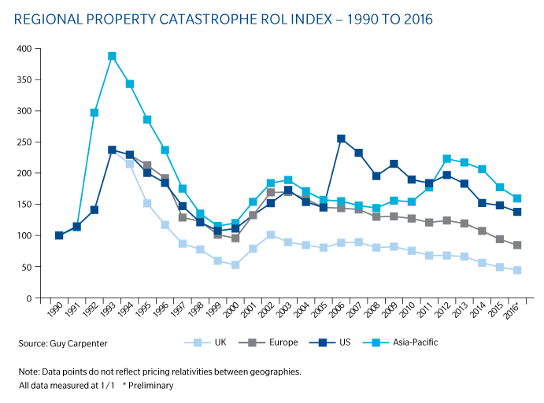
Regional Property Catastrophe ROL Index: 1990 – 2016
Record traditional capacity, alternative capital and low CAT activity have pressured reinsurance prices; ROEs are down only very modestly
Source: Guy Carpenter; Insurance Information Institute.

Slide 96
Alternative Capital
New Investors Continue to Change the Reinsurance Landscape
96

Slide 97
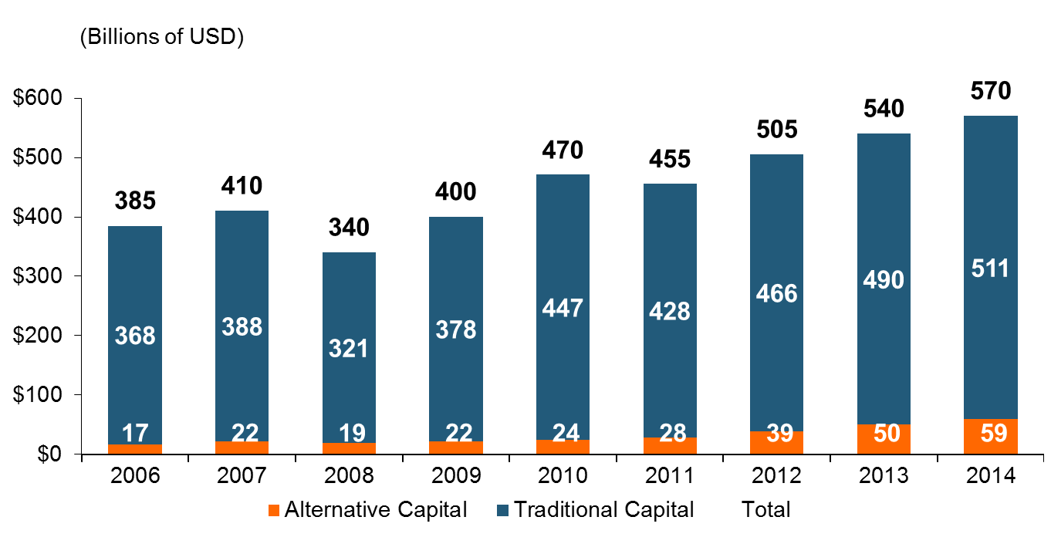
Global Reinsurance Capital (Traditional and Alternative), 2006 - 2014
Total reinsurance capital reached a record $570B in 2013, up 68% from 2008.
But alternative capacity has grown 210% since 2008, to $50B. It has more than doubled in the past three years.
2014 data is as of June 30, 2014.
Source: Aon Benfield Analytics; Insurance Information Institute.

Slide 98
Alternative Capital as a Percentage of Traditional Global Reinsurance Capital
Alternative Capital’s Share of Global Reinsurance Capital Has More Than Doubled Since 2010.
2014 data is as of June 30, 2014.
Source: Aon Benfield Analytics; Insurance Information Institute.

Slide 99
Catastrophe Bond Issuance and Outstanding: 1997-2015
Risk Capital Amount ($ Millions)
Cat Bond Issuance Declined Slightly in 2015 from 2014’s Record Pace. Lower Yields on Bonds Explain Some of the Contraction.
Source: Guy Carpenter, Artemis accessed at http://www.artemis.bm/deal_directory/cat_bonds_ils_issued_outstanding.html .

Slide 100
Insurance Information Institute Online:
www.iii.org
Thank you for your time and your attention!
Twitter: twitter.com/bob_Hartwig
Download at www.iii.org/presentations

