Slide 1
Disruption on the Horizon
2017 Actuarial Forum
August 29, 2017
Hartford, CT
James Lynch, FCAS MAAA, Chief Actuary
Insurance Information Institute  110 William Street  New York, NY 10038 Tel: 212.346.5533  jamesl@iii.org  www.iii.org

Slide 2
Politics
Divisiveness Makes Governing Difficult

Slide 3
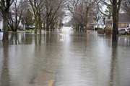
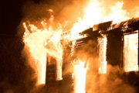

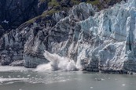
Disruption is Everywhere
Catastrophes – Increases in frequency and severity
Natural Catastrophes
Water
Fire
2016 Flood Loss 6x Greater
2015: A Record
Wind
Climate Change
8 of 10 costliest since 2004
Tornadoes +40%

Slide 4
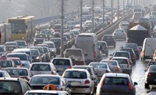

Disruption is Everywhere
Catastrophes – Increases in frequency and severity
Man-Made Catastrophes
Autos
Cyber
“Induced” Earthquakes
More cars on road
Distracted driving
$445 million/year
~950 3.0+
60% in OK

Slide 5



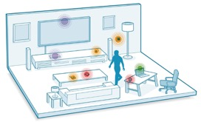

Technology / Digitalization
Sharing Economy
The Internet of Things
Big Data
Notes:
All industries being impacted

Slide 6
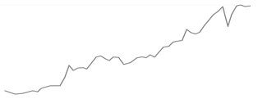
Economic Uncertainty
Global Growth...
US Growth...
*Since 2008 we've had the longest period of relative trade stagnation since World War II...
Investment Growth
GDP
1.6%
...Monetary vs. Fiscal Policy
Monetary: Low interest rates mean insurers are struggling to meet interest rate guarantees for life insurance and annuities must diversify their investment portfolios
Fiscal: Supply-side debate heating up, i.e., tax reform
* The Peterson Institute for International Economics
Notes:
GDP – Per Steve full year 2016 GDP is 1.6%

Slide 7




Globalization
Geopolitical Polarization
Rise of Nationalism
Regional Tensions
Global Trends Impacting Domestic Market
Regulatory Trends
"Conduct of Business"
TPP
Capital/Solvency
Dodd-Frank
* Mainland purchases of insurance and related investment policies in the nine months ended September 2016 surged to a record high.
Notes:
Elected Officials: "Rise of Nationalism" -- US, France, Germany
Neither US presidential candidate supports TPP
Regions: Europe (EU/Brexit/Russia), Asia (China/North-South Korea/Japan), Middle East (Syria/Iraq)
Global trends impacting domestic market
Regulatory trends:
"Conduct of Business"
Capital/Solvency
Climate Change

Slide 8
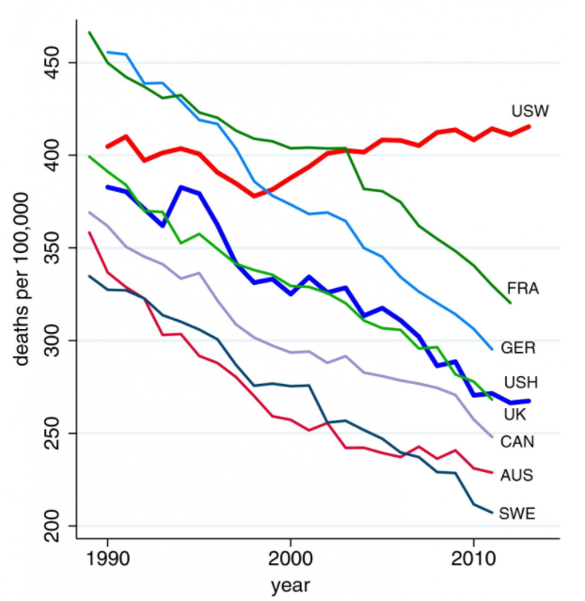
Stagnation’s Toll
Cumul Chg in Real Avg Income
Death Rates, 45-64
SOURCES: World Wealth and Income Database (from motherjones.com), Insurance Information Institute; Washington Post (from Proceedings of National Academy of Sciences).

Slide 9
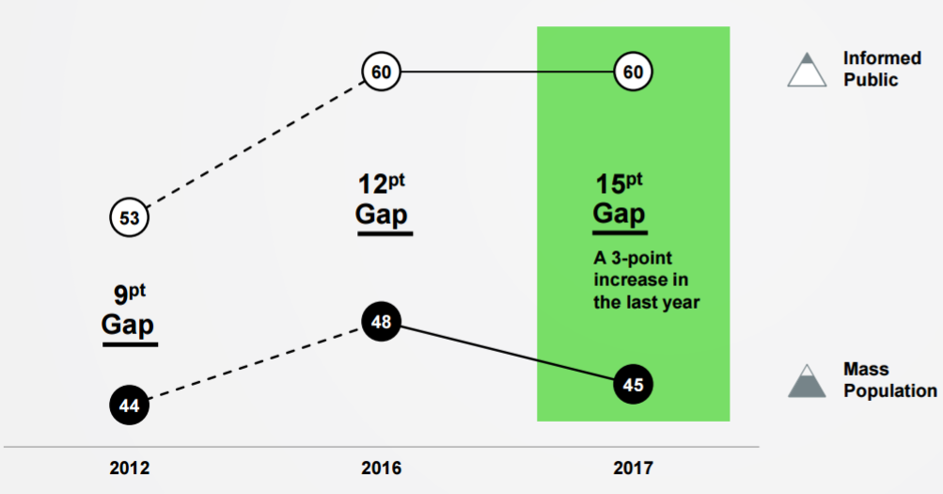
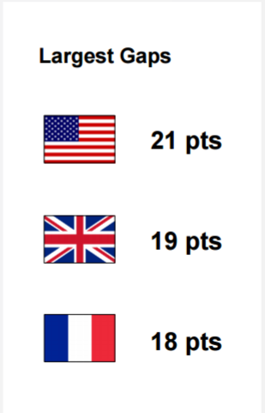
The Trust Gap
Average of trust in Government, NGOs, Media and Business.
SOURCE: Edelman Trust Barometer, 2017

Slide 10
Geopolitics – US

Slide 11

The ‘Bully Pulpit’ Evolution
Has Trump Changed the Game?
@USTreasSec where is #TaxReform? Get R done!
@USAG #Waterboarding will #MakeAmericaGreat!
Notes:
Social media has been changing politics for the last several years.
Halls of legislatures and Congress – "Follow, Like!"
When I started – answering phones – messages, weekly reviews
Members are voting by their facebook and twitter accounts
Corporate advocacy sites – Crowd finding = grassroots.
Media is following as well vs. primary driver.

Slide 12
Politicians Catch On
But Can They Overdo It?
Responses to Charlottesville
Is President’s Use of Twitter a `Bad Thing?
Sources: NJ-11 for Change; POLITICO/Morning Consult Poll, http://www.politico.com/f/?id=0000015c-8041-d9ca-adfc-85c1c6990000; Insurance Information Institute.

Slide 13
P/C Insurance Industry ROE by Presidential Party Affiliation
1950-2016*
Truman
Eisenhower
Kennedy/ Johnson
Nixon/ Ford
Carter
Reagan/ Bush I
Clinton
Bush II
Obama
BLUE = Democratic President RED = Republican President
.
*2016 data is through Q3.
Source: Insurance Information Institute.

Slide 14
Insurance Industry ROE by Presidential Party Affiliation
1950-2016*
Truman
Eisenhower
Kennedy/ Johnson
Nixon/ Ford
Carter
Reagan/ Bush I
Clinton
Bush II
Obama
BLUE = Democratic President RED = Republican President
.
*2016 data is through Q3.
Source: S&P Global Market Intelligence, Insurance Information Institute.

Slide 15
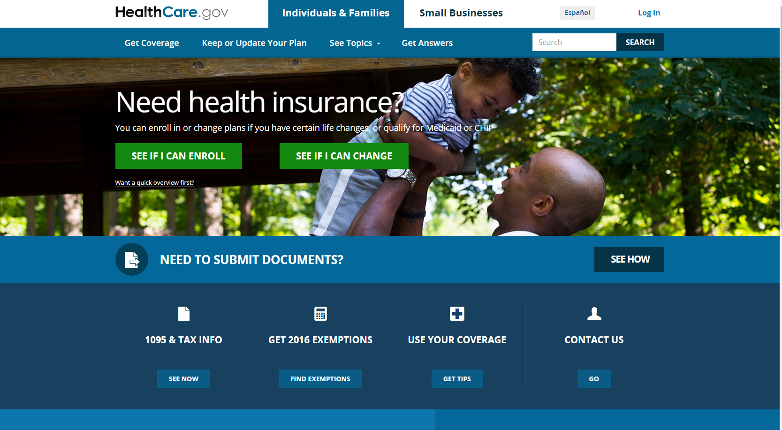
Affordable Care Act
Going …. Going ….. Maybe Not Going Anywhere
?
Notes:
One WC issue that might depend on federal control: health care
Does ACA affect comp
New enrollees raise prices all around
New enrollees mean doctors stop accepting WC patients
Doctors have incentives to push claims into WC

Slide 16
2017: Key Insurance Issues
Taxes – Promises, promises
Flood Insurance
NFIP reauthorization
A private role?
Fiduciary Rule
Here today. . .
. . . gone tomorrow?
Notes:
Taxes – Republican Party ran on tax cuts – as they have for 35 years – but it is hard to see what legislation will look like
Flood Insurance – NFIP expires Sept. 30. Both parties want to extend it, but they wanted that in 2012, but it took five years last time
Private role – Private insurance is small
HNW
Commercial
Rules make it hard; trying to loosen them
Fiduciary Rule – advice for retirement planning from DOL
Trying to “improve” advice (best interests standard vs. suitable
Lack of access by small business; low and middle income persons hurt the most
Tough on annuity sellers . . .
In Feb. Trump administration ordered the rule to be re-examined
Portions of rule went into effect June 9
The issue has toggled through the courts – now the rule is set to be fully implemented in July 2019 – whatever form that will be

Slide 17
But State Politics Drives Insurance
And Every State is Different
C-
WA
D
MT
D+
ND
A
ME
B+
OR
B
MN
A
ID
A-
WI
D+
NY
NH A-
VT A+
MA D-
RI C+
CT C+
NJ B-
DE D
MD C+
B-
SD
B
WY
C+
MI
B
NE
B+
IA
B-
PA
D
CA
B+
NV
B
OH
A
UT
A
IL
B
IN
C
CO
C
WV
B
VA
C
KS
B
MO
A-
KY
B- TN
F NC
A
AZ
B
NM
C
OK
C+
AR
B
SC
D
MS
C-
AL
C
GA
B-
TX
D
LA
= A
= B
= C
= D
= F
= NG
D-
AK
C
FL
D
HI
Not Graded: District of Columbia
Source: R Street Insurance Regulation Report Card, December 2016

Slide 18
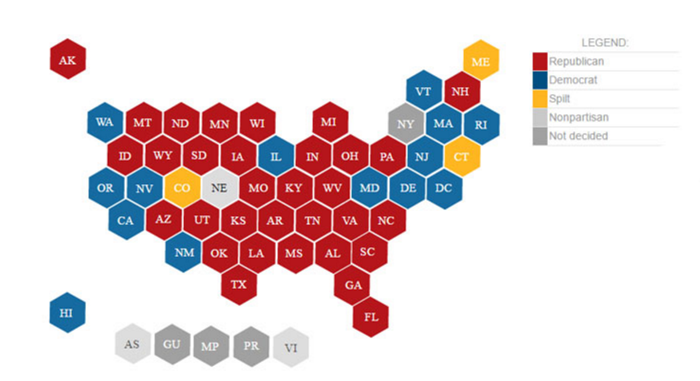
Republicans Control Most States . . .
In The November Election They Lost One Legislature Overall
Makeup Today
Seven chambers flipped control after the November 2016 elections.
* Nebraska: Unicameral, nonpartisan, Republican dominated. New York: not decided. Source: National Conference of State Legislatures, Ballotpedia, Insurance Information Institute.
Notes:
Republicans controlled 69. They now control 68.
The Iowa Senate switched D to R; Kentucky House switched from D to R; Minnesota Senate switched D to R. The Nevada Senate switched R to D; Nevada Assembly switched R to D; New Mexico House switched R to D; and Alaska House switched R to D.

Slide 19
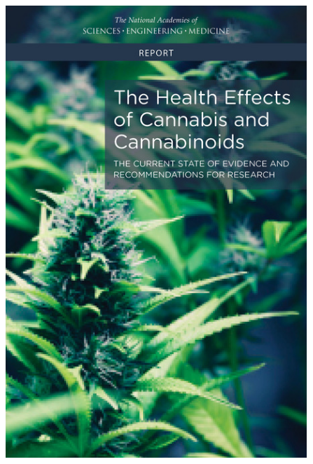
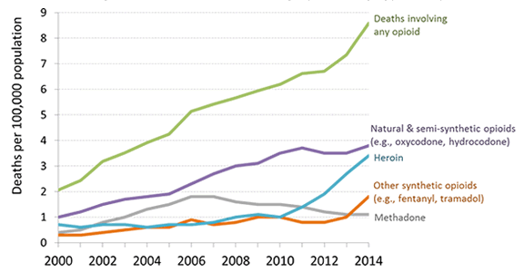
Medical Marijuana
Insurers Caught in the Middle
Opioid Alternative?
https://www.nap.edu/catalog/24625/the-health-effects-of-cannabis-and-cannabinoids-the-current-state
Notes:
There is conclusive evidence or substantial evidence that marijuana:
Improves the lot of adults in chronic pain.
Increases the risk of motor vehicle crashes. (IIHS – 3% increase in frequency)
Increases the risk of developing schizophrenia and other psychoses.
There is moderate support suggesting that marijuana:
Improves short-term sleep outcomes for people with fibromyalgia or chronic pain.
Increases impairment of learning, memory and attention span.
Increases dependence on alcohol, tobacco and illicit drugs.
It is not possible to determine whether marijuana use is statistically correlated with occupational injuries.
47,000 drug deaths in USA in 2015. 60,000 estimated for 2016 (NY Times)

Slide 20
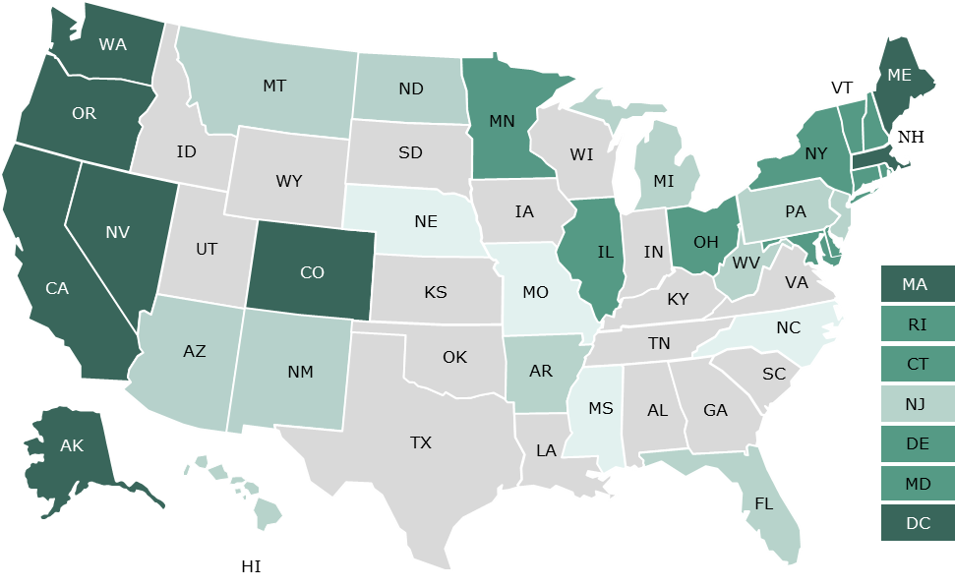
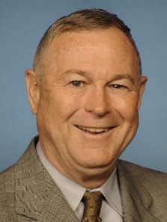
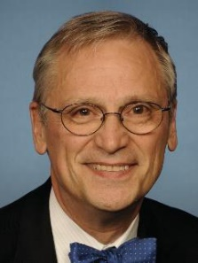
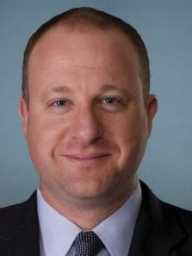
Medical Marijuana
Insurers Caught in the Middle
■ Fully legal ■ Medical use legal and recreational use decriminalized ■ Medical use legal ■ Recreational use decriminalized ■ Fully illegal
Congressional Cannabis Caucus
Rohrbacher (CA)
Bluemenauer (OR)
Young (AK)
Polis (CO)
SOURCE: National Journal, July 19, 2017.
Notes:
There were 9 referenda on marijuana legalization. Only one failed – recreational use in Arizona.
Six states require payment for medical marijuana in WC claims – CT, ME, MA, MN, NJ, NM
Six states forbid payment for medical marijuana in WC claims – AZ, CO, MI, MT, OR, VT
It is illegal to use the banking system to purchase marijuana. So an insurer can’t write a check against to pay for the drug. They use cash.
Trump OK with med mar. Sessions, not so much. We wind up with one more conflict, Trump vs. his Cabinet.

Slide 21
Personal Auto
Rising Frequency, Severity Pinching the Largest P/C Line

Slide 22
Auto Net Combined Ratio, 2005-2016
Loss Ratios Have Been Rising for a Decade. 2015 Return on Net Worth is Likely Close to Zero or Negative.
Source: National Association of Insurance Commissioners data, sourced from S&P Global Market Intelligence; Insurance Information Institute.

Slide 23





State Issues
Auto Insurance
Increase in Loss Costs, 2015:Q1–2017:Q1
Bodily Injury
15.3%
Property
Damage
15.0%
Personal Injury Protection
14.1%
Collision
13.2%
Comprehensive
22.5%
From 2015 to 2017, the cost of accidents has risen dramatically. By contrast, consumer prices overall rose 3.9 percent during 2014 and 2015.
Source: Fast Track Monitoring System.
Notes:
The amount of claim costs per vehicle insured - known as loss costs in the industry - is the primary cost in auto insurance rates. Those have been rising across all major coverages.

Slide 24
Claim Trends by Coverage
Focus on Collision

Slide 25
Collision Claims: Frequency Trending Higher in 2010s
Annual Change, 2006 through 2017
For a Long Time, Claim Frequency Was Falling, But Since 2010 This Trend Seems to Have Reversed.
*Four Quarters Ending in March.
Source: ISO, a Verisk Analytics company; Insurance Information Institute.

Slide 26
Collision Claims: Severity Trending Higher in 2010-2017
Annual Change, 2006 through 2017
The Great Recession and High Fuel Prices Helped to Temper Claim Severity, But These forces Have Clearly Reversed, Consistent with Experience from Past Recoveries.
*Four Quarters Ending in March.
Source: ISO, a Verisk Analytics company; Insurance Information Institute.

Slide 27
What’s Driving These Trends?
Frequency; Severity; Distraction?

Slide 28
America is Driving More Again: 2000-2017
Percent Change, Miles Driven*
Fastest Growth in More Than a Decade
Tremendous Growth In Miles Driven. The More People Drive, The More Frequently They Get Into Accidents.
*Moving 12-month total vs. prior year through March. Sources: Federal Highway Administration; Insurance Information Institute.
Notes:
28

Slide 29
Medical Inflation Heating Up.
Annual Percent Change, CPI - Medical
Fastest Growth in More Than a Decade
Tremendous Growth In Miles Driven. The More People Drive, The More Frequently They Get Into Accidents.
*April 2017 vs. Year Earlier. Sources: St. Louis Federal Reserve (FRED), Bureau of Labor Statistics; Insurance Information Institute.
Notes:
29

Slide 30
More Miles Driven => More Collisions, 2006-2016
Billions of Miles Driven in Prior Year
Overall Collision Claims Per 100 Insured Vehicles
Recession
The More Miles People Drive, the More Likely They are to
Get in an Accident, Helping Drive Claim Frequency Higher.
Sources: Federal Highway Administration; Rolling four-quarter average frequency from Fast Track Monitoring System; Insurance Institute for Highway Safety; Insurance Information Institute.
Notes:
30

Slide 31
Why Are People Driving More Miles? Cheap Gas?
Billions of Miles Driven in Prior Year
Average Price Per Gallon
Recession
Gas Prices Don’t Seem Correlated With Miles Driven.
Sources: Federal Highway Administration; Energy Information Administration (All Grades All Formulations Retail Gas Prices); Insurance Institute for Highway Safety; Insurance Information Institute.
Notes:
31

Slide 32
Why Are People Driving More Miles? Jobs?
Billions of Miles Driven in Prior Year
Millions Employed
Recession
People Drive to and from Work and Drive to Entertainment.
Out of Work, They Curtail Their Movement.
Sources: Federal Highway Administration; Seasonally Adjusted Employed from Bureau of Labor Statistics via FRED; Insurance Institute for Highway Safety; Insurance Information Institute.
Notes:
32

Slide 33
More People Working and Driving => More Collisions, 2006-2016
Number Employed, Millions
Overall Collision Claims Per 100 Insured Vehicles
Recession
When People are Out of Work, They Drive Less. When They Get Jobs, They Drive to Work, Helping Drive Claim Frequency Higher.
Sources: Seasonally Adjusted Employed from Bureau of Labor Statistics; Rolling four-quarter average frequency from Fast Track Monitoring System; Insurance Information Institute.
Notes:
33

Slide 34
Comparing Gas Prices, Employment on Collision Frequency Through 2015
Gas Price vs. Collision Frequency
Number Employed vs. Collision Frequency
Sources: Seasonally Adjusted Employed from Bureau of Labor Statistics; Energy Information Administration; Rolling Four-Qtr Avg. Frequency from Fast Track Monitoring System; Insurance Information Institute.

Slide 35
Severity: Driving Fatalities are Rising
Annual Change in Motor Vehicle Deaths
Seatbelt Use Rose to 62% of Drivers, From 49% in ‘90
Big Drop-off Due to the Great Recession
Driving Has Been Getting Safer for Decades, But Recent Trend is Discouraging—38,300 Deaths in 2015.
Sources: National Safety Council, Insurance Information Institute.
Notes:
Source: http://www.nsc.org/NewsDocuments/2017/12-month-estimates.pdf

Slide 36
Does Spending on Vehicles Affect Claim Severity?
Annual Change, 2005 through 2016
As the Economy Has Gotten Better, People Are Spending More on Vehicles – When Those Cars Wreck, Severity Increases.
Source: Fast Track Monitoring System; Bureau of Labor Statistics Consumer Expenditure Survey (vehicle purchases – net outlay) Insurance Information Institute.

Slide 37
Fixing a Bumper
. . . On an Entry-Level Luxury Car (~$35K)
2014 Cost vs. 2016 Cost
What Has Changed?
 | 2014 | 2016
Grille: Distance Sensor | $0 | $2,818
Headlamp Assembly | 394 | 918
Mechanical Labor | 0 | 108
Fewer Accidents, Higher Costs
Parts: 130% Higher
Labor: 18% Higher
Total cost: $1,705 higher
2016 vehicle has LED headlights and adaptive cruise control.
SOURCE: Liberty Mutual Insurance.

Slide 38
What About Distractions?
It’s A Problem. Is It Growing?
What We Do Behind The Wheel
But Impact Is Not Clear
Talking Less . . .
Most Recent Year
* Property Damage Only.
SOURCES: State Farm, National Highway Transportation Safety Administration (distraction.gov)

Slide 39
Commercial Auto
The Long Burn

Slide 40
Comm Auto Net Combined Ratio, 2005-2015
Loss Ratios Have Been Rising for a Decade. 2015 Return on Net Worth is Likely Close to Zero or Negative.
Source: National Association of Insurance Commissioners data, sourced from S&P Global Market Intelligence; Insurance Information Institute.

Slide 41
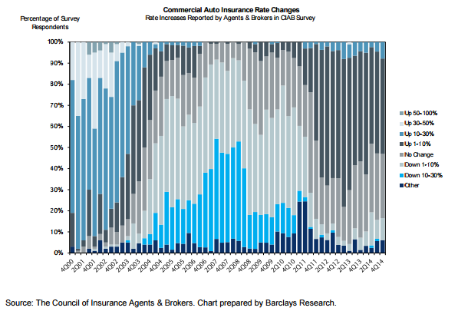
Soft Market: 2006 to 2008
Rate Decreases from 10% to 30% for Three Years

Slide 42
Comm Auto Liab Development, 2005-2015
(Development on Prior as % of NEP)
Insurers Have Struggled to Estimate Loss Reserves.
Source: National Association of Insurance Commissioners data, sourced from S&P Global Market Intelligence; Insurance Information Institute.

Slide 43
Commercial Auto Rates Since Late 2008
(Rate Index: December 2008 = 100)
Commercial Auto Rates Fell Less in Soft Cycle and Have Risen More Than Overall Property/Casualty Market.
Sources: MarketScout, Insurance Information Institute.

Slide 44
Vehicles in Crashes Per 100
Registered Vehicles (Government Data)
(% Change From Year Earlier)
Signs Frequency May Have Peaked
Fast Track Data Lag Government Data.
Commercial Auto Claim Frequency Began Growing Before Personal Auto.
Property Damage Only (PDO) claims involving passenger vehicles and large trucks, respectively. Large trucks: GVW > 10,000 lbs. SOURCES: Federal Highway Administration, National Highway Traffic Safety Administration, Insurance Information Institute.
Notes:
The chart on the left:
What is it?
For passenger vehicles (blue), it shows the change in the number of non-injury crashes involving passenger vehicles for every 100 passenger vehicles registered.
For large trucks (orange), it shows the change in the number of non-injury crashes involving large trucks for every 100 large trucks registered.
What does it say?
It says that after the great recession, people got in fewer accidents. In large part this is because people drive fewer miles when the economy is weak. Fewer people have jobs, and those without jobs drive less. When they drive less, they get in fewer accidents.
Also note that the accident rate is more volatile for large trucks. This makes sense because a falloff in trucking is a leading or coincident economic indicator while a falloff in employment is a lagging indicator.
The chart on the right
What is it?
It’s a lot like the chart on the left, showing passenger vehicle and large truck crash rates. Now, it is the crash rate per 100 million miles driven
What does it say?
Well, if number of miles driven falls, it makes sense that the crash rate per vehicle would fall. That is what the chart on the left shows.
However, it is not at all clear that accident rates should rise or fall once we’ve accounted for miles driven, which we do in the right hand chart. All else being equal, there should be little or no change in accidents per mile driven – or they should fall, as highways and vehicles get safer.
Instead, the accident rate falls per mile driven. This means in the recession and aftermath, drivers got safer and as the recovery accelerates, they are getting worse
Again notice that large trucks are more volatile than passenger vehicles.
Thoughts:
Driving more miles increases congestion, which increases the accident rate.
The people driven off the road may have been the worst drivers. IIHS has studied how the growth in teen employment seems to have accelerated the accident rate. The same logic may apply even more to commercial auto. If you lay off drivers, you’ll typically lay off the one who is the worst driver.

Slide 45
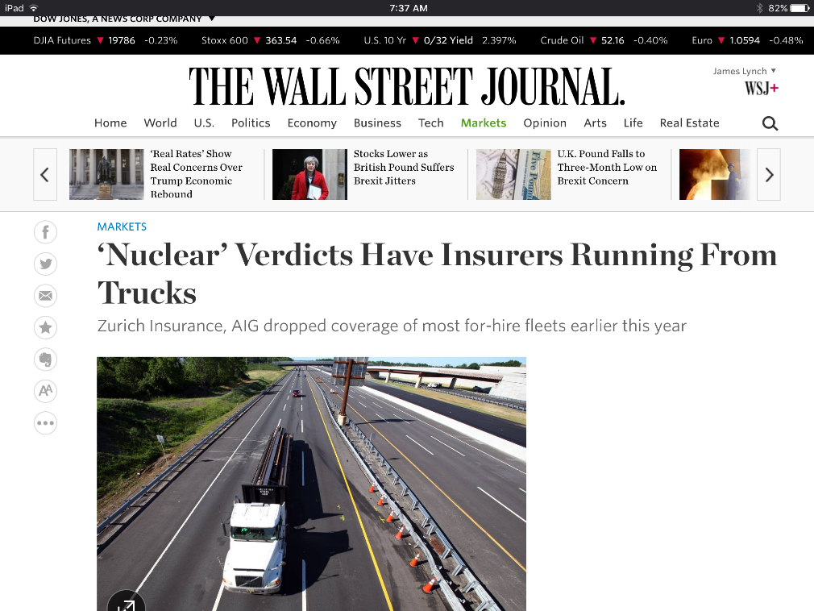
Trucking Trends
Driver Shortage
Laid-off Drivers Aren’t Returning
Older, Inexperienced Drivers Entering Force
High Turnover Exacerbates Problem
‘Super Lawyers’
Moving From Products into Trucking
Allege “Insured Indifference to Safety”
Lots of Data
Cases Settle Faster

Slide 46
Disruption and Insurance
Challenges and Opportunities All Along the Value Chain

Slide 47
Insurance Disruption Technology / Digitalization
Fundamental Changes
Opportunities
Challenges
Future of Auto
Future of Reduced Risk Pools
Automation / Efficiencies
New Product Lines (Cyber)
Emerging Technologies
Consumer Trust – Demonstrate the Societal Value
Big Data vs. Individual Privacy
New Market Entrants “Uber of Insurance”?
Regulatory Opportunities/Threats
Lemonade
Offered in CA, IL, NJ, NY
Barrier to Entry
US vs. Other Less Regulated Regions
Trust Pull-back – the Sandbox Approach
Notes:
Insurance Disruption
Technology / Digitalization
Fundamental changes
Future of auto insurance
Autonomous vehicles -- reduction of accidents
Future of reduced risk pools
Disparate Impact
Opportunities
Automation and efficiencies -- claims, underwriting, filings (?)
New product lines -- cyber, sharing economy
Emerging technologies -- cognitive computing, predictive analytics
Challenges
Consumer trust will be key -- demonstrate the societal value
Big data vs. personal/information privacy
New market entrants -- "Uber of Insurance"
Lemonade: Approved in State of New York
Regulatory -- Opportunity / Threat
Barrier to entry (for potential disrupters)
US -- 50+ individual regulatory bodies
Taxi vs. Insurance Regulator: One can put you in jail…
Pull back / curb
Consumer trust will play key role
Sandbox approach
US vs. other global regions with less regulatory burden
[TBD] Audience Relevance Section

Slide 48
Greatest Threats, Opportunities
Whither Silicon Valley?
Greatest Opportunity
Greatest Threat
SOURCE: A.M. Best Winter 2016-17 Insurance Industry Survey.

Slide 49
Insurance Technology Financing – Change Is Coming
More Than Half This Funding Was in Two Deals (Zenefits/ Zhong An)
Investment ($ Millions)
Deals
Investment In Insurance Tech Is Rising. Number of Deals Set A Record Last Year.
SOURCES: CB Insights, Insurance Information Institute.

Slide 50
The (Re)Insurance Value Chain
Where Could Disruption Lie?
Create Policy/ Treaty
Brains + Bank Account
Write Risk
Perform Loss Control
Settle Claims
Market Policy/ Treaty
Improve World
Price Risk
Protecting People & Organizations
Most Links in the Value Chain Have the Potential
to Be Disrupted in Next 10 Years.

Slide 51
Alternative Capital Potentially Disrupting the Bank Account
Alternative capacity has grown 350% since 2006. It has more than tripled in the past six years.
Source: Aon Benfield Analytics; Insurance Information Institute.
Notes:
Mainly catastrophe reinsurance, but also deals involving longevity swaps

Slide 52
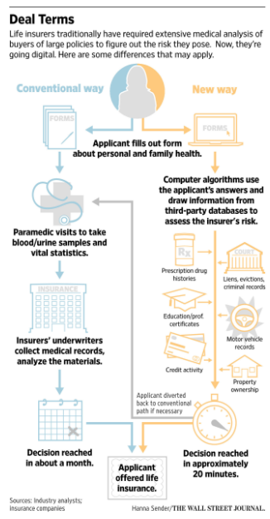
Life Underwriting
Lower underwriting costs
20 minutes vs. 1 month
Mainly for under 45s
Policies at $1 million limit
Motor Vehicle Records – Surprisingly important!
Notes:
$750K life policy quoted a favorable rate for

Slide 53
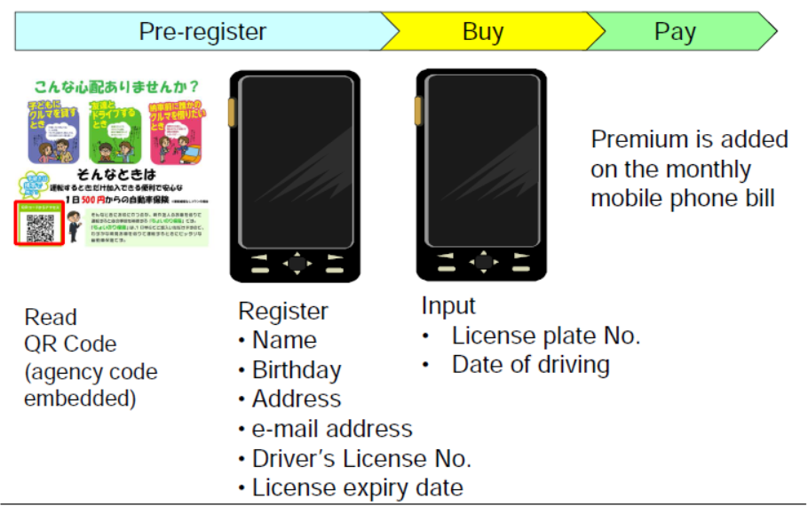
One-Day Auto Insurance

Slide 54
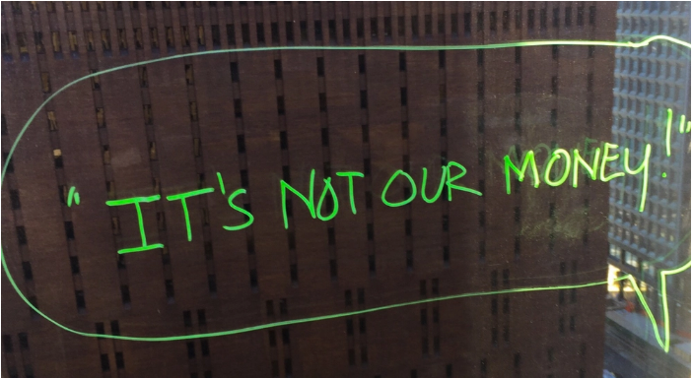

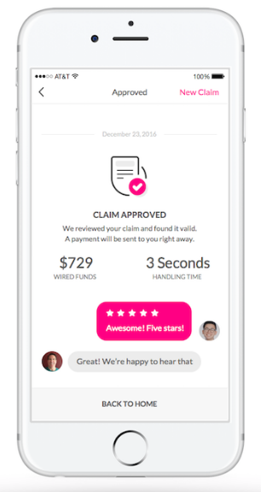
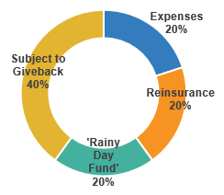
Claims Disruptor
Artificial Intelligence + Behavioral Economics
Notes:
AI Jim
IDs suspicious activity
Marries Artificial Intelligence, Behavioral Economics (file via video)
Bot handles simplest claims

Slide 55
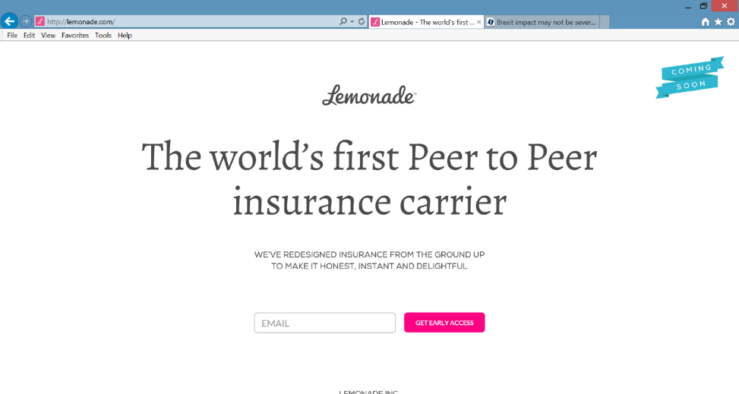
Peer-to-Peer (P2P) Insurance
Lemonade’s Model: Unknown
Taking on the Entire Value Chain
A Typical P2P Model
Resembles Mutuals/Reciprocals
People Join Small Group of Friends to Prefund Deductible or Bear Other Small Risk.
Leftover Deductible $$ Rolled Forward.
May Deter Fraud – You Wouldn’t Cheat Your Friends!
CEO Daniel Schreiber
Our Chief Behavioral Officer, Professor Dan Ariely, says that “If you tried to create a system to bring out the worst in humans, it would look a lot like the insurance of today.”
Source: “UberX-ing Insurance : Is Peer-to-Peer Insurance Viable?”, presentation by Jay Sarzen, Aite Group at Drinker Biddle Insurance Conference, June 21, 2016.

Slide 56
InsurTech Disruption: Threat or Opportunity?
Automation efficiencies can have powerful impact on industry
Focus of InsurTech in the insurance value chain¹, %
Future profits as a % of today’s profits
Only nine percent of InsurTechs aim to oust incumbents
Digitizing the business, auto insurance example
Disrupting the value chain
Short-term gain
Long-term decline
120-200
220-300
-20 to -60
15-55
155-195
Disintermediating incumbents from customers
100
-60 to -100
Improvements in growth, and loss-and-expense ratio²
Impact from improved vehicle safety³⁻⁴
Shift in liability to commercial product lines⁴
Improved loss-and-expense ratio⁴
Enabling the value chain
Today’s profits
2025 profits
2035 profits⁵
¹Insurtechs are insurance businesses, usually startups, that use technologically innovative apps, processes, or business models; 2016 data based on some 500 commercially well-known cases. ²Assumes a 3 to 5 percentage point improvement in loss ratio, a 2 to 4 percentage point improvement in operating expenses, and a 6 to 8 percentage point improvement in direct sales conversions. ³Includes growth in investment income as well premiums. Investment income modeled as a ﬂat percentage of premium in each year. ⁴Includes impact of semi- and fully autonomous vehicles. ⁵Assumes a 25 percent reduction in premiums as a result of telematics and sensors and a 50 percent risk transfer to commercial product liability.
Source: Panorama by McKinsey; Digital and Auto Insurers Value at Stake Analysis, McKinsey, 2016.

Slide 57




























InsurTech Startups Have Broad Range…BUT…
Risk
Health
Insurance Marketplace
Digital Brokers
Peer to Peer
Health Navigators
Micro-duration Coverage
Telematics
Source: Aon.
Notes:
Based on our most recent count we are tracking over 500+ InsurTech Companies. Just a year ago that number was about half that. We are tracking companies across Risk and Health in a variety of themes. For us its more about business concepts than it is about individual companies.

Slide 58








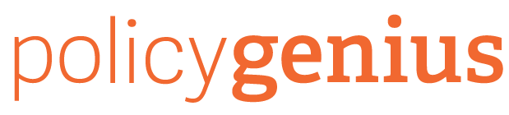




…With Broad Incumbent Support
$205M
$57M
$37M
$21M
$4M
Note: Total funding.
Source: Aon.
Notes:
Some examples of insurance company investments in InsurTech…. As you can see it is across a variety of themes or business concepts….
Metromile – Telematics
CoverHound and Policy Genius- Insurance Marketplaces
One Inc. – Cloud Based IT Platform and
Slice - Micro-Duration Coverage.
These investments create an opportunity to accelerate growth, improve efficiency, enhance the customer experience and “Speed to Market” for new products in emerging risk.

Slide 59
What Makes an Actuary?
It’s More Than Math

Slide 60

Actuary Saves Kitties!!!
Advises No-Kill Shelter

Slide 61

How to Win at Jeopardy!
Notes:
Lots of discussion about what actuaries do – rise of predictive modelers
Actuaries think actuaries do a lot of math
Managers and others think actuaries are problem solvers and communicators

Slide 62
Summary
The political scene is defined by divisiveness, and this makes it difficult to achieve progress.
Disruption provides opportunities and challenges throughout the value chain
Personal auto costs are rising (both frequency and severity), linked closely to the improving economy.
Actuaries have value far beyond the numbers.

Slide 63
Thank you for your time and your attention!
Read our auto White Paper on Rising Personal Auto Costs at
www.iii.org

