Slide 2

Insurance: Leading Through Disruption
SEAN KEVELIGHAN, CHIEF EXECUTIVE OFFICER
Insurance Information Institute  110 William Street  New York, NY 10038

Slide 3
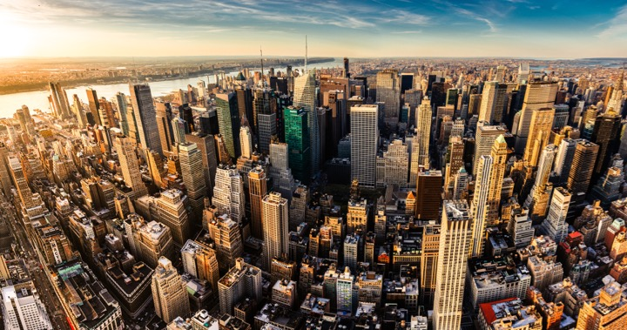
I.I.I. Mission Statement
Improving public understanding of insurance...
…what it does and how it works
3

Slide 4

Disruption is Everywhere

Slide 5
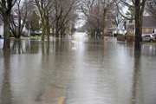
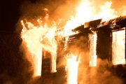

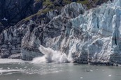
Disruption is Everywhere
Catastrophes – Increases in frequency and severity
Natural Catastrophes
Water
Fire
2016 Flood Loss 6x Greater
2015: Record Year
Wind
Climate Change
8 of 10 costliest since 2004
367 Tornados Q1/17

Slide 6
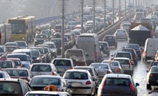

Disruption is Everywhere
Catastrophes – Increases in frequency and severity
Man-Made Catastrophes
Autos
Cyber
“Induced” Earthquakes
More cars on road
Distracted driving
$445 million/year
~950 3.0+
60% in OK

Slide 7



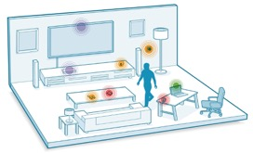

Technology / Digitalization
Sharing Economy
The Internet of Things
Big Data
Notes:
All industries being impacted

Slide 8
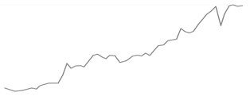
Economic Uncertainty
Global Growth...
US Growth...
*Since 2008 we've had the longest period of relative trade stagnation since World War II...
Investment Growth
GDP
1.6%
...Monetary vs. Fiscal Policy
Monetary: Low interest rates mean insurers are struggling to meet interest rate guarantees for life insurance and annuities must diversify their investment portfolios
Fiscal: Supply-side debate heating up, i.e., tax reform
* The Peterson Institute for International Economics
Notes:
GDP – Per Steve full year 2016 GDP is 1.6%

Slide 9




Globalization
Geopolitical Polarization
Rise of Nationalism
Regional Tensions
Global Trends Impacting Domestic Market
Regulatory Trends
"Conduct of Business"
TPP
Capital/Solvency
Dodd-Frank
* Mainland purchases of insurance and related investment policies in the nine months ended September 2016 surged to a record high.
Notes:
Elected Officials: "Rise of Nationalism" -- US, France, Germany
Neither US presidential candidate supports TPP
Regions: Europe (EU/Brexit/Russia), Asia (China/North-South Korea/Japan), Middle East (Syria/Iraq)
Global trends impacting domestic market
Regulatory trends:
"Conduct of Business"
Capital/Solvency
Climate Change

Slide 10
Geopolitics – US

Slide 11
P/C Insurance Industry ROE by Presidential Party Affiliation
1950-2016*
Truman
Eisenhower
Kennedy/ Johnson
Nixon/ Ford
Carter
Reagan/ Bush I
Clinton
Bush II
Obama
BLUE = Democratic President RED = Republican President
.
*2016 data is through Q3.
Source: Insurance Information Institute

Slide 12
But State Politics Drives Insurance
And Every State is Different
C-
WA
D
MT
D+
ND
A
ME
B+
OR
B
MN
NH A-
VT A+
MA D-
RI C+
CT C+
NJ B-
DE D
MD C+
A
ID
B-
SD
A-
WI
D+
NY
B
WY
C+
MI
B+
NV
B
NE
B+
IA
B-
PA
D
CA
A
UT
A
IL
B
IN
B
OH
C
CO
C
KS
C
WV
B
VA
B
MO
A-
KY
B- TN
F NC
A
AZ
B
NM
C
OK
C+
AR
B
SC
D
MS
C-
AL
C
GA
B-
TX
D
LA
= A
= B
= C
= D
= F
= NG
D-
AK
C
FL
D
HI
Not Graded: District of Columbia
Source: R Street Insurance Regulation Report Card, December 2016

Slide 13
State of Insurance
Top Issues
Catastrophe Costs
Consolidation/M&A
Insurance-related Deals Involving U.S. Firms²
Autonomous Vehicles
P/C Payouts / Property Losses¹
564
$101B
P2P insurance
2015
2016
2015
$15.4B
$21.6B
Cybersecurity
DEALS
VALUE
500 -11%
2016
$20B -80%
Sharing Economy
U.S. Insured Cat Losses
Workers Comp Regulation
2016 Loss Up Modestly Compared With 10-YearAaverage $19.1B
$6.3B
Politics
(JAPAN)
(BERMUDA)
pending or completed M&As involving U.S. insurance companies (2017)³
Overcapitalization (Reinsurance)
25
¹PCS; ²Conning Research; ³S&P Financial.
Notes:
According to the KPMG report called “The New Deal: Driving Insurance Transformation with Strategy-aligned M&A,” 84% of insurance companies plan to make between one and three acquisitions in 2017, while 94% plan at least one divestiture.
In 2015 Anthem’s announced purchase of Cigna, and Aetna’s planned purchase of Humana together totaled $83 billion, according to S&P Global Market Intelligence. The continued scrutiny of these two deals may have dampened merger activity in this sector in 2016.

Slide 14
The Economy Drives P/C Insurance Industry Premiums
Direct Premium Growth (All P/C Lines) vs. Nominal GDP
Direct written premiums track nominal GDP— not quarter by quarter but overall fairly well.
Sources: S&P Global Market Intelligence; U.S. Commerce Dept., Bureau of Economic Analysis; Insurance Information Institute.

Slide 15
Commercial & Personal Lines NPW Growth
5.7%
-1.3%
Commercial lines is prone to much more cyclical volatility than personal lines.
Note: Data include state funds beginning in 1998.
Sources: A.M. Best; Insurance Information Institute.

Slide 16
P/C Insurance Industry Combined Ratio, 2000-2017*
3 Consecutive Years of U/W Profits; 1st time since 1971-73
Heavy Use of Reinsurance Lowered Net Losses.
Higher CAT Losses, Shrinking Reserve Releases, Toll of Soft Market
Best Combined Ratio Since 1949 (87.6)
A return to more usual underwriting loss.
Sandy
*Excludes Mortgage & Financial Guaranty insurers 2008-2014. Including M&FG, 2008=105.1, 2009=100.7, 2010=102.4, 2011=108.1; 2012:=103.2; 2013: = 96.1; 2014: = 97.0.
Sources: A.M. Best; ISO, a Verisk Analytics company; I.I.I.

Slide 17
P/C Insurer Portfolio Yields, 2003-2016
P/C carrier yields have been falling for over a decade, reflecting the long downtrend in prevailing interest rates.
Even as prevailing rates rise in the next few years, portfolio yields are unlikely to rise quickly, since low yields of recent years are “baked in” to future returns.
Sources: NAIC data, sourced from S&P Global Market Intelligence; Insurance Information Institute.
Notes:
Likely to be some time before industry gets any relief – yields continue to be declining.
70’s – 80’s investment yields were in the double digits.
Seeing some – but not a lot – where they are looking for higher, but can only do so much because of the liability cover issue AND regulatory scrutiny
Hedge funds
Pension funds

Slide 18
Sources of P/C Insurer Profits, 2007-2016
Insurer gains from investments vary from year to year (they plunged in 2008-09) but in the last decade, excluding the effect of the Great Recession, ranged between $55 billion and $65 billion each year. In contrast, net underwriting gains have not exceeded $21 billion in any year and were actual losses in five of the 10 years.
Sources: NAIC data, sourced from S&P Global Market Intelligence; Insurance Information Institute.

Slide 19
CATASTROPHE CHANGE

Slide 20
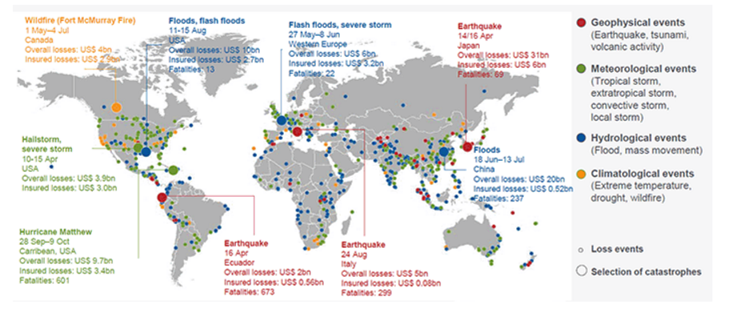
Natural Catastrophe Losses Totaled $175 Billion, Up From $103 Billion in 2015
World Natural Catastrophes, 2016
Source: © 2017 Munich Re, Geo Risks Research, NatCatSERVICE. As of February 2017.
Notes:
This Year so far (2017 first half) (source – Munich Re)
Global: $41B, of which $19.5B insured: Last year - $111B, $32B
Insured losses higher than normal (half) because they were concentrated in USA – usually only 1/3 is insured
USA: $18.5B, of which $13.5B insured
Worst event this year – Feb/March Peru floods - $3.1B, $0.38B insured
US worst – May T-storms, $2.2B/$1.8B, also bad tornado/hail in March
In 2016
Hurricane Matthew – insured loss relatively low vs. econ loss because most losses were from flooding, particularly inland flooding for North Carolina
No major floods in USA since Matthew
Last year’s LA floods were the fourth biggest flood event in NFIP (Katrina, Sandy, Ike) – average claim was almost $90,000!

Slide 21
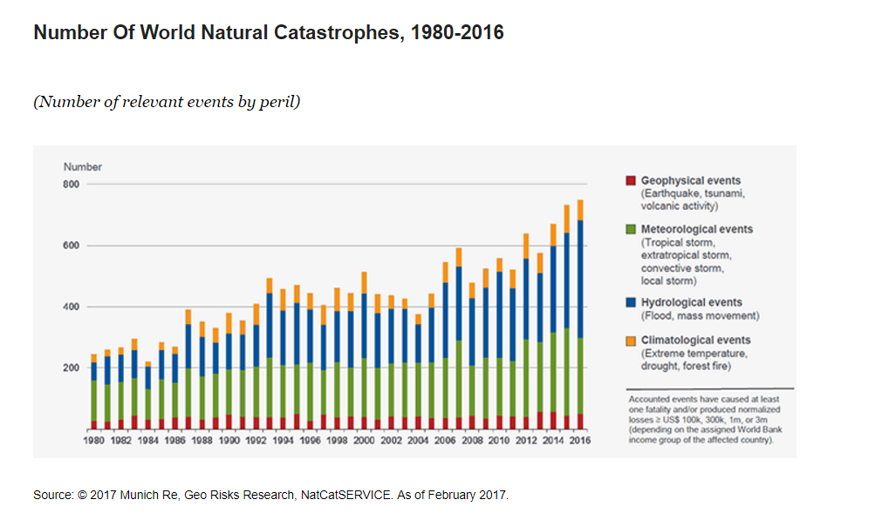
The Frequency of Extreme Weather Events Is Rising
Number of World Natural Catastrophes, 1980-2016
Source: © 2017 Munich Re, Geo Risks Research, NatCatSERVICE. As of February 2017.
Notes:
So far this year:

Slide 22
CAT Claims as a Percent of Total Claims*, First Quarter, 2011-2017
CAT claims are normally a small part of total claims in the first quarter, but that wasn’t true in 2017. Moreover, although it’s a small sample, the trend seems to be rising.
*Net of reinsurance and including Loss Adjustment Expenses Sources: ISO PCS; Insurance Information Institute calculations.
Notes:
First half – worst since 2011, highest number of events since 1980
4 events above $1B (CO, MN, TX – twice)
Hail is increasing problem

Slide 23
Induced Earthquakes
Includes 20 quakes M4.0-5.1; 1 quake M5.8
Oklahoma Earthquakes Magnitude 3.0 and Greater
Includes 30 quakes M4.0-4.7
Includes 15 quakes M4.0-4.4
Includes 3 quakes M4.0-4.8; 1 quake M5.6
~1.6/year
Earthquake insurance take-up rates increased by over 300 percent
from 2006 to 2015 in Oklahoma.
Source: USGS-NEIC ComCat & Oklahoma Geological Survey; preliminary as of July 4, 2017.
Notes:
From USGS web site, looks like five 4.0M+ quakes in OK this year

Slide 24
Cyber Attacks – No. 2 Global Risk
Source: Allianz Risk Barometer on Business Risks 2017.
Notes:
140 carriers wrote cyber last year
$1.35B in writings, up from $1.0B
Combined ratio estimated at 76.6% - very profitable, but four points worse than 2015
By company, results vary a lot – one fourth of insurers booked CR of about 30 or less (estimated) but 5% were over 120 CR (estimated)

Slide 25






Road Safety
Better Economy = More Drivers = More Accidents
18 Percent of Injury Crashes
Economic well-being
Distracted driving
Safety Devices Can Be Expensive
Why rates go up
Speed
Still
Kills
Expensive auto parts
Faster driving
Legalized marijuana
Driving While High
Source: Insurance Information Institute research.

Slide 26
INSURANCE AND THE FOURTH INDUSTRIAL REVOLUTION

Slide 27
Insurance Disruption Technology / Digitalization
Fundamental Changes
Opportunities
Challenges
Future of Auto
Future of Reduced Risk Pools
Automation / Efficiencies
New Product Lines (Cyber)
Emerging Technologies
Consumer Trust – Demonstrate the Societal Value
Big Data vs. Individual Privacy
New Market Entrants “Uber of Insurance”?
Regulatory Opportunities/Threats
Lemonade
Offered in CA, IL, NJ, NY
Barrier to Entry
US vs. Other Less Regulated Regions
Trust Pull-back – the Sandbox Approach
Notes:
Insurance Disruption
Technology / Digitalization
Fundamental changes
Future of auto insurance
Autonomous vehicles -- reduction of accidents
Future of reduced risk pools
Disparate Impact
Opportunities
Automation and efficiencies -- claims, underwriting, filings (?)
New product lines -- cyber, sharing economy
Emerging technologies -- cognitive computing, predictive analytics
Challenges
Consumer trust will be key -- demonstrate the societal value
Big data vs. personal/information privacy
New market entrants -- "Uber of Insurance"
Lemonade: Approved in State of New York
Regulatory -- Opportunity / Threat
Barrier to entry (for potential disrupters)
US -- 50+ individual regulatory bodies
Taxi vs. Insurance Regulator: One can put you in jail…
Pull back / curb
Consumer trust will play key role
Sandbox approach
US vs. other global regions with less regulatory burden
[TBD] Audience Relevance Section

Slide 28
InsurTech Disruption: Threat or Opportunity?
Automation efficiencies can have powerful impact on industry
Focus of InsurTech in the insurance value chain¹, %
Future profits as a % of today’s profits
Only nine percent of InsurTechs aim to oust incumbents
Digitizing the business, auto insurance example
Disrupting the value chain
Short-term gain
Long-term decline
120-200
220-300
-20 to -60
15-55
155-195
Disintermediating incumbents from customers
100
-60 to -100
Improvements in growth, and loss-and-expense ratio²
Impact from improved vehicle safety³⁻⁴
Shift in liability to commercial product lines⁴
Improved loss-and-expense ratio⁴
Enabling the value chain
Today’s profits
2025 profits
2035 profits⁵
¹Insurtechs are insurance businesses, usually startups, that use technologically innovative apps, processes, or business models; 2016 data based on some 500 commercially well-known cases. ²Assumes a 3 to 5 percentage point improvement in loss ratio, a 2 to 4 percentage point improvement in operating expenses, and a 6 to 8 percentage point improvement in direct sales conversions. ³Includes growth in investment income as well premiums. Investment income modeled as a ﬂat percentage of premium in each year. ⁴Includes impact of semi- and fully autonomous vehicles. ⁵Assumes a 25 percent reduction in premiums as a result of telematics and sensors and a 50 percent risk transfer to commercial product liability.
Source: Panorama by McKinsey; Digital and Auto Insurers Value at Stake Analysis, McKinsey, 2016.

Slide 29




























InsurTech Startups Have Broad Range…BUT…
Risk
Health
Insurance Marketplace
Digital Brokers
Peer to Peer
Health Navigators
Micro-duration Coverage
Telematics
Source: Aon.
Notes:
Based on our most recent count we are tracking over 500+ InsurTech Companies. Just a year ago that number was about half that. We are tracking companies across Risk and Health in a variety of themes. For us its more about business concepts than it is about individual companies.

Slide 30














…With Broad Incumbent Support
$205M
$57M
$37M
$21M
$4M
Note: Total funding.
Source: Aon.
Notes:
Some examples of insurance company investments in InsurTech…. As you can see it is across a variety of themes or business concepts….
Metromile – Telematics
CoverHound and Policy Genius- Insurance Marketplaces
One Inc. – Cloud Based IT Platform and
Slice - Micro-Duration Coverage.
These investments create an opportunity to accelerate growth, improve efficiency, enhance the customer experience and “Speed to Market” for new products in emerging risk.

Slide 31
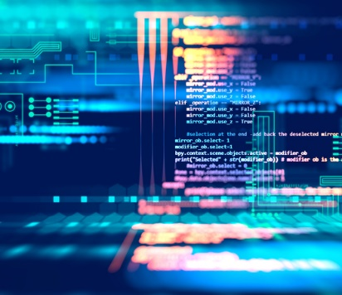






Successful Digital Transformation → Holistic Approach
Notes:
All industries being impacted

Slide 32
INSURANCE AND ECONOMIC LEADERSHIP

Slide 33
Insurance & Economic Leadership
Sustainable Business Model
Strong Jobs Pool/Provider
Economic Growth Promoter/Facilitator
2010
$507.7B
2.7%
US GDP³
Bank Failures: 157
2.8M Employed
Premium Taxes Paid⁴ $19.2B
Insurance Impairments¹: 8
Bond Investment⁵ $489B
Policyholder Surplus:
$700.9B
Need to Fill 400K+ by 2022²
End 2016
Charity/Volunteerism⁶ 15%
¹Life/Health and P/C Insurance; ²PC 360 http://www.propertycasualty360.com/2013/04/17/insurance-industry-crisis-400000-positions-to-fill?slreturn=1476304299; ³U.S. Bureau of Economic Analysis, 2016; ⁴U.S. Department of Commerce, 2015; ⁵Federal Reserve, 2015; ⁶2011–2014, Insurance Industry Charitable Foundation.

Slide 34
The Insurance Industry’s Contribution to GDP Now Nearly Equals Banks’
Sources: US Bureau of Economic Analysis; Insurance Information Institute.

Slide 35




Insurance Industry Snapshot: By the Numbers
2.8 million
People in the U.S. employed, in a wide variety of careers, from human resource administrators to public relations managers to financial analysts
$5.8 trillion
Assets under management at year-end 2016, including $1.5 trillion for the property/ casualty sector and $3.7 trillion for the life sector
$508 billion
Contributed to the U.S. gross domestic product in 2016, roughly 2.7% of the whole
$40.0 billion
Federal and foreign income taxes paid in 2016, plus U.S. premium taxes paid
Source: A Firm Foundation, Insurance Information Institute.

Slide 36

The Yearly Cash Flow to Rebuild Lives and Property is Substantial
Insurers annually pay over a trillion dollars in claims to rebuild lives, property, and businesses.
In 2016 alone, the industry paid
$ 386.4 billion P/C incurred claims (L + LAE)
554.7 Life/Annuity benefits
560.9 Health Insurance benefits
= $1.502 trillion
This is equivalent to $125 billion per month.
Notes:
36

Slide 37
Insurers Are Major Investors, 2015
Categories of investments ($billions)
Categories of bonds ($billions)
Total invested assets: $5.8 trillion
22% of corporate bonds outstanding 15% of municipal bonds outstanding
Sources: NAIC (the Center for Insurance Policy and Research, June 6, 2016) via SNL Financial; Insurance Information Institute.

Slide 38
As Economies Grow Wealthier, Insurance Market Penetration (Premium as % of GDP) Also Grows
Some wealthy countries have penetration rates of 10% and higher
Source: A.M. Best.

Slide 39
I.I.I Proactive Campaigns Framework
Proactively Position the Insurance Industry as an Economic Imperative
Pillar:
Financial & Community Resilience
Pillar:
Talent Recruitment & Retention
Pillar:
Innovation & Technology
Campaign 1:
A Day in the Life of Risk
Campaign 2:
Insurance Information Institute of Innovation
Actuary in Action
Conquering Life’s Obstacles
On-Air Actuary
Innovation Sessions
Insure-Tech Hackathon
Incubator

Slide 40
Summary
Disruption Causing Insurance Industry Inflection Point
Fundamentals Are Sound for Industry Leading Through Disruption
Opportunity/Risk: Define or Be Defined...

Slide 41
QUESTIONS

