Slide 1


I.I.I./ICM Presents Recruitment and Retention: Best Practices and Paths Not Taken
February 20, 2019 12:00 p.m. EST

Slide 2




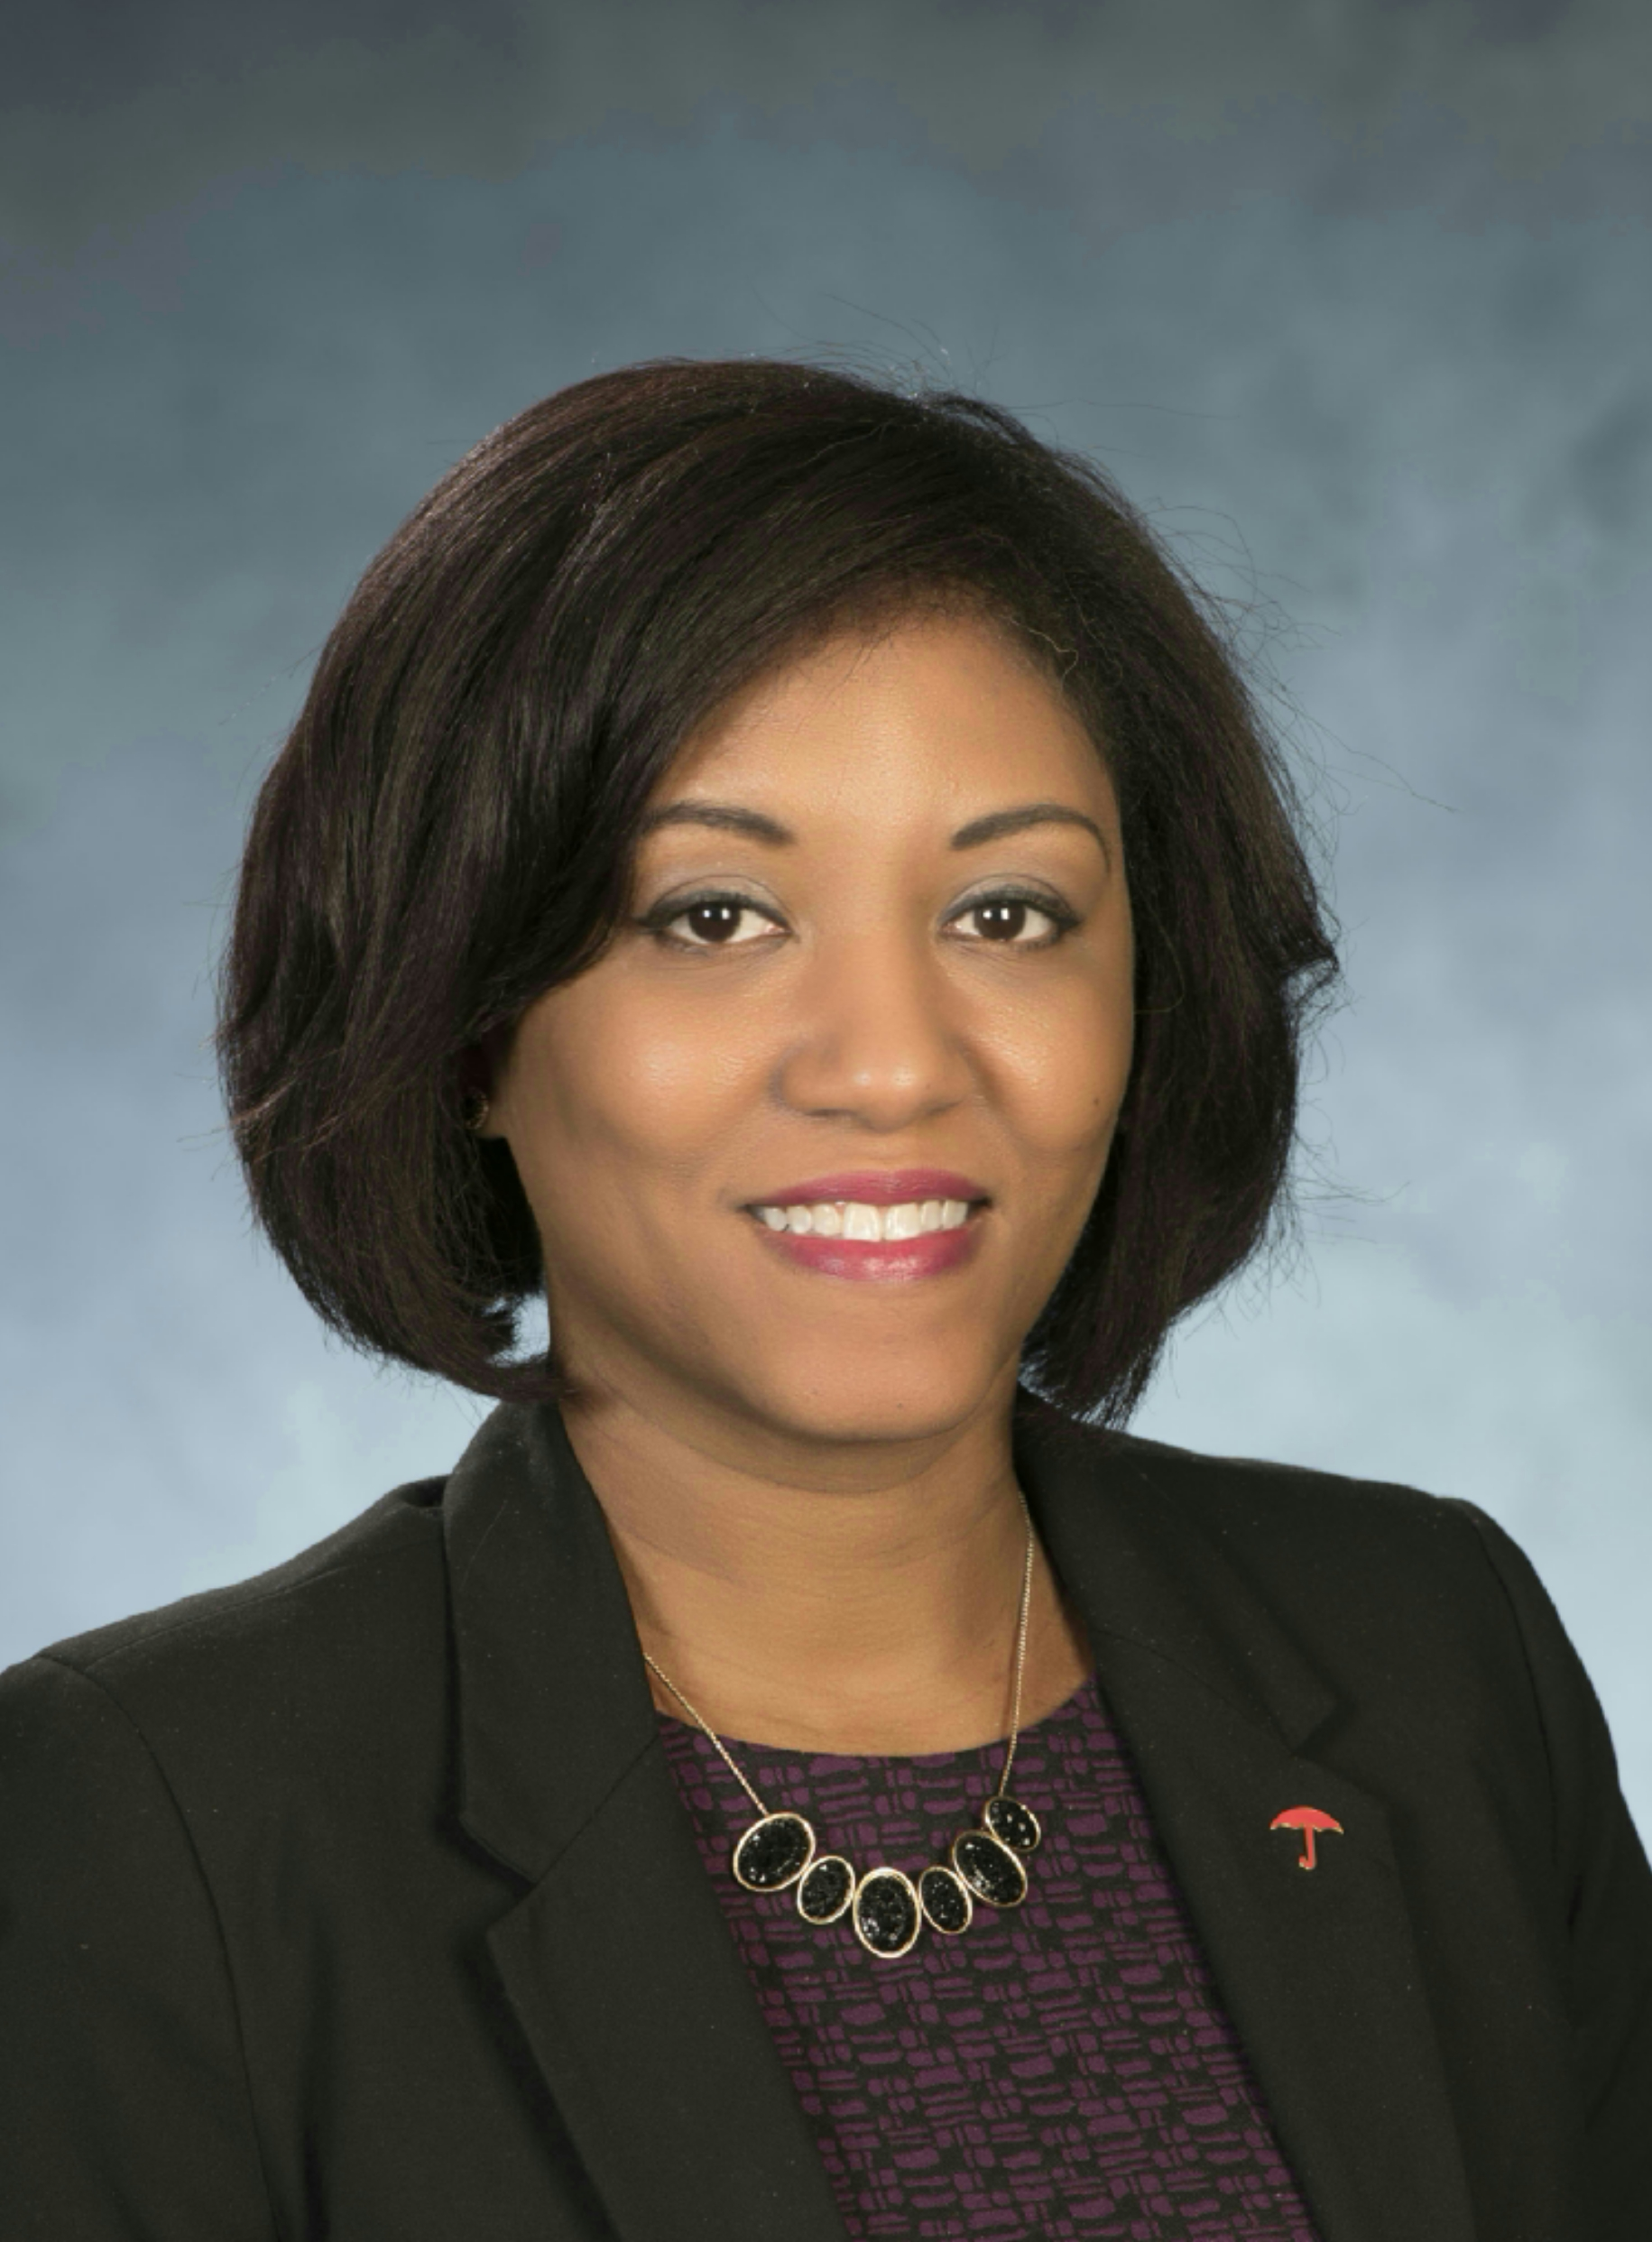


Presenters
Marguerite Tortorello (host)
Insurance Careers Movement
James Ballot (host)
Insurance Information Institute
Tony Cañas
The Jacobson Group
Bruce Soltys Travelers
Tara N. Spain Travelers
Dr. Steven Weisbart, CLU
Insurance Information Institute
Noelle Codispoti Gamma Iota Sigma

Slide 3
Hosts:
Marguerite Tortorello Insurance Careers Movement
James Ballot
Insurance Information Institute

Slide 4
Tony Cañas, CPCU, MBA The Jacobson Group

Slide 5



The Crucial Importance of Orientation
Understand the importance of insurance to society.
Internalize why your company is unique and special.
Learn how to grow within the company.
Remember, they didn’t grow up dreaming of insurance careers.
Notes:
“Remember, they didn’t grow up dreaming of insurance careers and likely didn’t study RMI.”
Start from an understanding they didn’t grow up wanting to work in insurance and likely didn’t study RMI
3 Key things:
Understand the importance of insurance to society
Internalize why your company is unique and special
Learn how to grow within the company

Slide 6

Mentoring and Reverse Mentoring
It’s what the Top 30 Places Millennials Want to Work have in common.
Notes:
Top 30 Places Millennials want to work at, it’s what they have in common
It’s easy to give your boss a 2 week notice, it’s very hard to tell your mentor
Reverse mentoring allows senior executives to see through the eyes of the entry level employees

Slide 7

Flexibility: No Longer Just Nice to Have
3.7 million employees work from home at least 50% of the time.
Telecommuting jobs have experienced 115% growth since 2015.
2/3 of managers report that WAH employees are more productive.
Source: “11 Surprising Working from Home Statistic,” Fundera
Notes:
As of 2017 3.7 million employees work from home at least half the time
Number of regular telecommuting jobs grown by 115% since 2015
Two thirds of managers report that work from home employees are more productive
*Source: “11 Surprising Working from Home Statistic” - Fundera

Slide 8
Tara N. Spain Travelers
Bruce Soltys Travelers

Slide 9
Keys to approaching Talent: What works
Do you have a readily available answer to the question of, “Why Insurance?”
It’s Limitless.
Careers range from actuaries to accountants, data scientists to computer technologists, finance analysts to fire investigators, product managers to programmers, underwriters to statisticians, just to name a few.
It’s Stable.
As of December 2018,the Bureau of Labor Statistics unemployment rate for the insurance industry was 1.9%, which is 2.1% lower than the national average of 4.0%, according to Jacobson.
It’s Growing.
By 2020 the industry will create more than 400,000 job opportunities according to the Insurance Industry Employment Outlook from the Griffith Insurance Education Foundation.
It’s Generous.
It donates more than $500 million a year to charity according to MyPath, a collaborative industry effort tasked with educating students.
It’s Innovative.
From drones to autonomous vehicles to artificial intelligence, just to name a few, our industry is leading in the development of some of the most advanced technologies in the marketplace.

Slide 10




Keys to approaching Talent: Lessons learned
The benefit of a talent “shortage”? New avenues of Talent!
https://careers.travelers.com/military/
https://disabilityin.org/what-we-do/autism-employer-roundtable/

Slide 11

Roadtrip Nation – Risk & Reward
Travelers sponsorship of Roadtrip Nation
Risk & Reward documentary on Public Television and Roadtripnation.com
Insurance Share Your Road Hub
Middle and High School Curriculum
Branding and Partnerships opportunities with industry peers and colleges/universities
https://roadtripnation.com/roadtrip/insurance

Slide 12
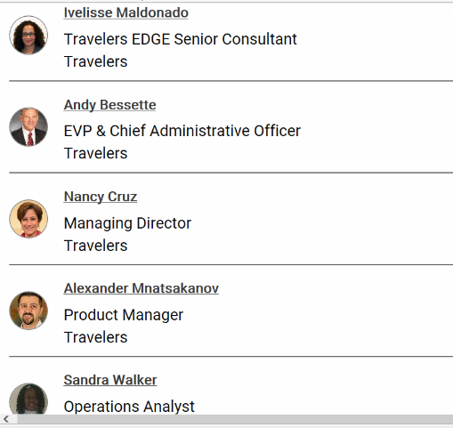
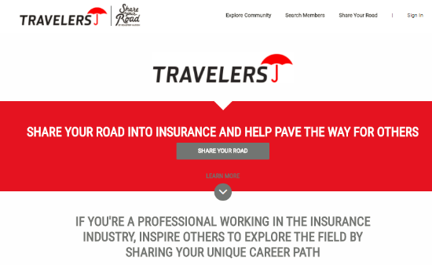
Insurance Share Your Road Hub
https://insurance.shareyourroad.com/
We invite you to Share Your Road!

Slide 13
Travelers EDGE® Empowering Dreams for Graduation & Employment
Objective: increase the number of underrepresented individuals who complete a bachelor’s degree and are prepared for a career at Travelers or in the Insurance & Financial Services industry
Goals:
Build the pipeline to college
Help students from underrepresented communities graduate from college
Build awareness of careers at Travelers and in insurance & financial services
Learn more at: https://www.travelers.com/about-travelers/edge10

Slide 14
Dr. Steven Weisbart, CLU Insurance Information Institute

Slide 15


Some jobs that everyone thinks of in the property/casualty insurance industry
Agents and brokers
Claims adjusters
Sources: www.bls.gov ; I.I.I.

Slide 16
Some jobs in property/casualty insurance
Liberal Arts Majors
STEM Majors
Event planner
Insurance underwriter¹
Art/design²
Media/communication
Technical writer
Broadcast engineering
Customer service/call centers
Actuary
Data scientist
Claims adjuster
Architect
Civil, mechanical, or industrial (health/safety) engineer
Statistician³
¹Median annual wage: $77,060. ²Median annual wage: $71,840. ³Median annual wage: $84,530.
Sources: www.bls.gov; I.I.I.

Slide 17
Some Jobs in Property/Casualty Insurance
Business Majors
IT Majors
Marketing/market research
Accountant/auditor¹
Credit analyst
Risk manager
Investment analyst
Software developer
Web developer
Information security analyst
Database, network, systems administrator²
User support specialist
¹Median annual wage: $78,910. ²Median annual wage: $96,650.
Sources: www.bls.gov; I.I.I.

Slide 18
Some Jobs in Property/Casualty Insurance
Lawyers
Medical Majors
Regulation and law compliance
Public policy advocacy (“lobbyist”)
Arbitrator, Mediator
Litigant (plaintiff/defense)
Medical claims review
Corporate medical
Medical investment analyst
Others
Construction
Electrician¹
¹Median annual wage: $68,460.
Sources: www.bls.gov; I.I.I.

Slide 19






Some jobs/skills you might not expect to find in the property/casualty insurance industry
Fine arts appraisal
Private detectives and investigators¹
Actors, directors, and producers
Interpreters, translators
Pilots; airplane and air travel safety
Ships: marine safety
For more ideas, visit www.insuremypath.org
¹Median annual wage: $63,340.
Sources: www.bls.gov; I.I.I.

Slide 20
Noelle Codispoti, CPCU, Gamma Iota Sigma

Slide 21

The Insurance Industry’s Premier Collegiate Talent Pipeline
<5%
Enter college as RMI Major
Top Drivers
Job Security
Variety of Options
Relationships
22%
Other than Risk or Actuarial Science
40%
Double Major or Minor in another field
Important Influencers
Faculty
Peers Already Pursuing Insurance Careers
Availability of Internships

Slide 22
Influences and Drivers in Employment Decisions
Top Three Considerations
Compensation
Future Growth
Culture
Extremely/Very Important
Having a Mentor
Balance Between Money and Type of Job
Access To Leadership

Slide 23
Thank you for attending!
Questions? Please send to:
Marguerite Tortorello (MT@TortCommunications.com) or
James Ballot (JamesB@iii.org)

