Slide 1
Industry Update:
Yesterday, Today and Tomorrow
CPCU I-Day
Columbia, Missouri
September 10, 2019
James Lynch, FCAS MAAA, Chief Actuary
Insurance Information Institute  110 William Street  New York, NY 10038
Tel: 212.346.5533  jamesl@iii.org  www.iii.org

Slide 2

I.I.I. Mission Statement
Improving public understanding
of insurance...
…what it does and how it works.
2

Slide 3










How Insurance Drives Economic Growth
Safety/
Security
Economic/
Financial Stability
Development
Insurers are financial first responders
Insurers are capital protectors
Insurance is a partner in social policy
Insurers are community builders
Insurance enables infrastructure improvements
Insurers
are risk mitigators
Insurance sustains the supply chain
Insurers are capital infusers
Insurers are innovation catalysts
Insurers are credit facilitators
Notes:
3

Slide 4
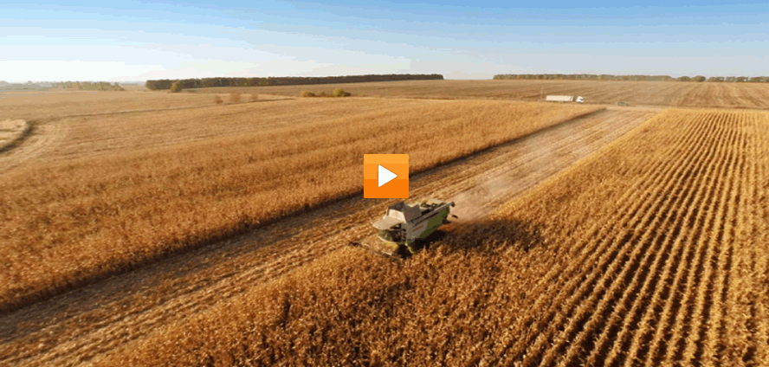
Insurance and Agriculture
Video: Insurance and Agriculture

Slide 5
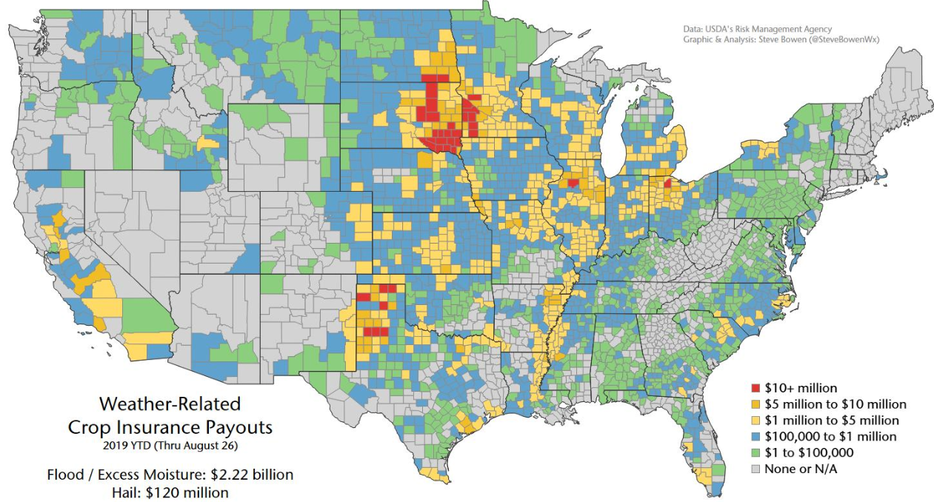
Protecting America’s Farms
Source: USDA, Aon (Steve Bowen).

Slide 6
Catastrophes
Extreme Weather Threatens Union

Slide 7
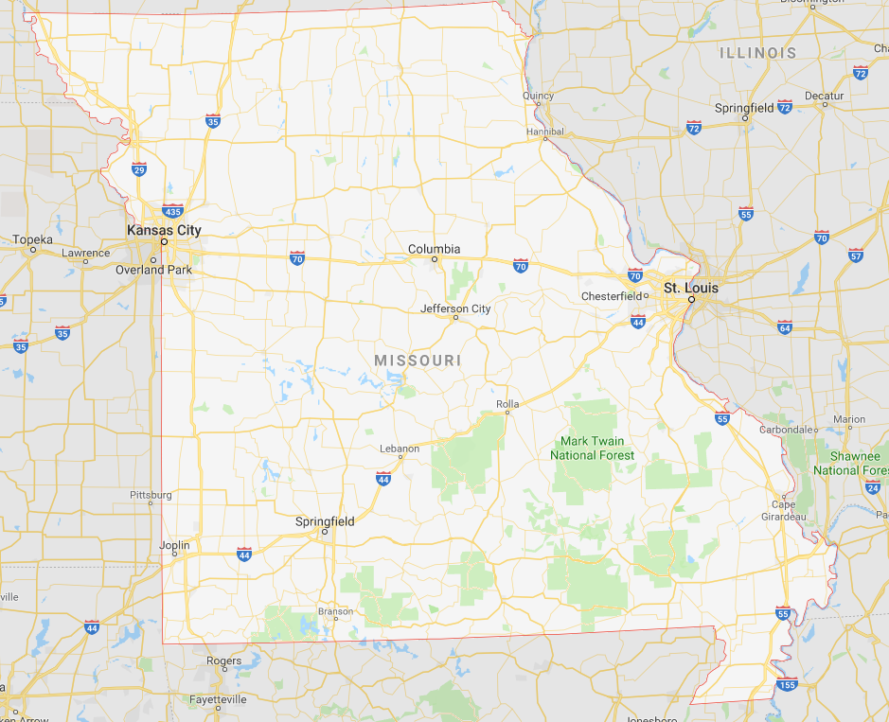
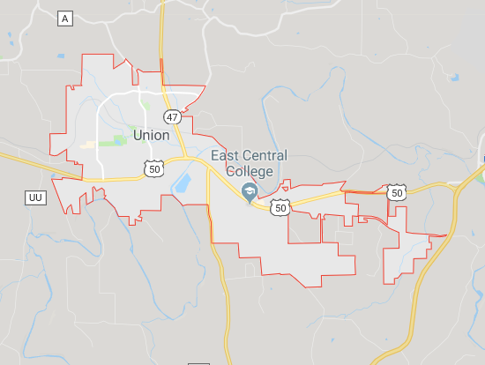
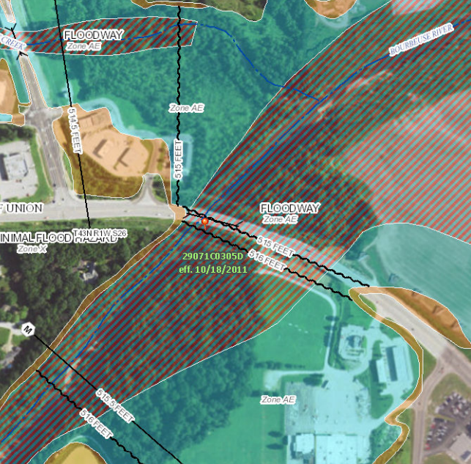
A Small Town in Missouri

Slide 8
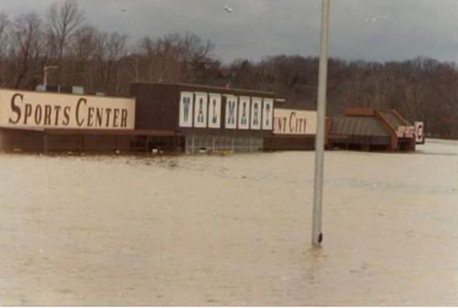
1982 Union, Missouri, Flood
A Storm for the Ages
Bourbeuse River
Record Crest
33.8 feet
12/5/1982
Source: Fox2News.com, @BoxxRadio.

Slide 9
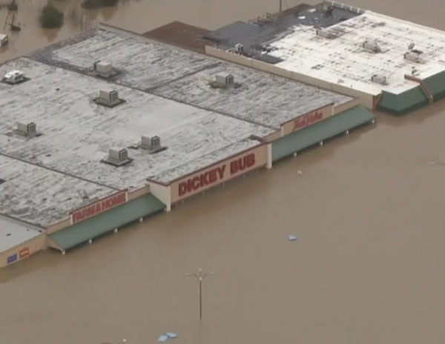
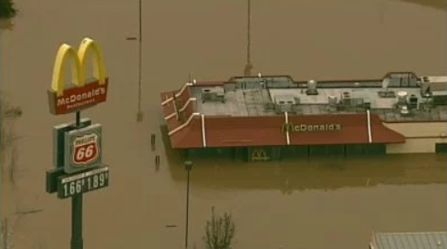
2015 Union, Missouri, Flood
A Storm for the Ages
Bourbeuse River
Record Crest
34.3 feet
12/29/2015
Sources: CBSnews.com; fox2news.com

Slide 10
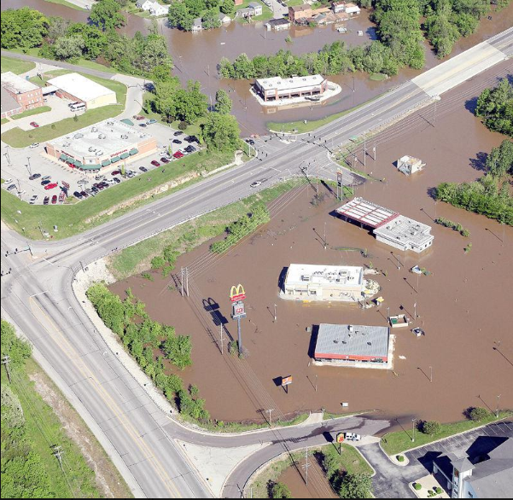
2017 Union, Missouri, Flood
Bourbeuse River
Crest
29.4 feet
May 2-3, 2017
“Unfortunately, it’s a river and Mother Nature.
And we can’t control her.”
 | Crest (feet) | Year
1 | 34.31 | 2015
2 | 33.80 | 1982
3 | 29.38 | 2017
4 | 28.50 | 1915
5 | 27.77 | 1994
6 | 26.37 | 1993
7 | 25.89 | 2008
8 | 24.53 | 2000
9 | 24.44 | 1957
10 | 23.89 | 2005
 | Crest (feet) | Year
1 | 0.40 | 1936
2 | 0.40 | 1948
3 | 0.40 | 1948
4 | 0.50 | 1976
5 | 0.55 | 2014
6 | 0.64 | 2012
7 | 0.68 | 2000
8 | 0.78 | 2001
9 | 0.80 | 1996
10 | 1.14 | 2007
Source: eMissourian.com, National Weather Service.

Slide 11
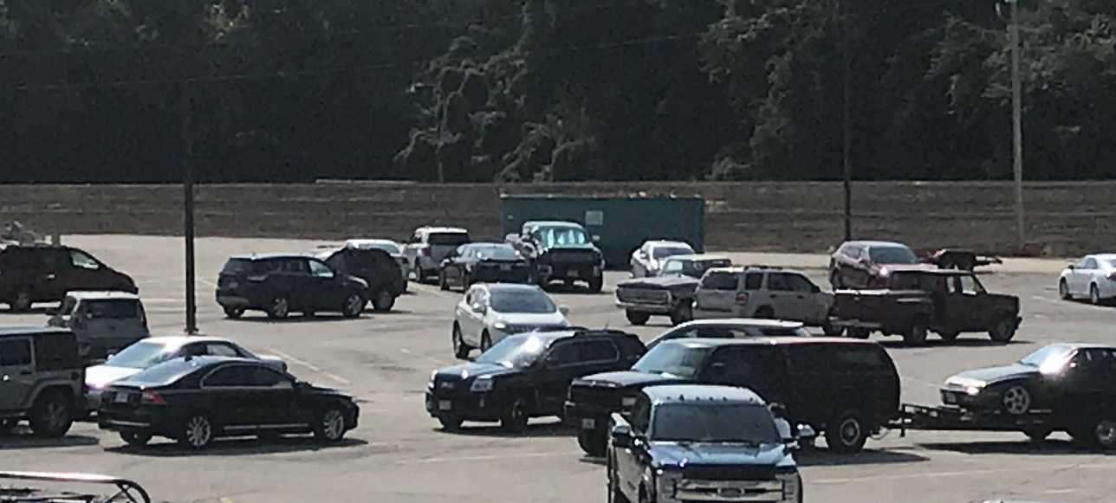


2019: Union, Missouri, Embraces Resilience
Community Hardening
Dickey Bub Berm
Shopping on One Side
Park on the Other

Slide 12
Extreme Events: A Troubling Trend
Rank | Date | Event | Cause | Insured Loss (1) ($ millions)
1 | Aug. 2005 | Hurricane Katrina | Hurricane | $41,100
2 | Sep. 2017 | Hurricane Maria (2) | Hurricane | 25,000-30,000
3 | Sep. 2017 | Hurricane Irma (2) | Hurricane | 20,000-25,000
4 | Sep. 2001 | September 11 Events | Terrorism | 18,779
5 | Oct. 2012 | Hurricane Sandy | Hurricane | 18,750
6 | Aug. 2017 | Hurricane Harvey (2) | Hurricane | 16,000-19,000
7 | Aug. 1992 | Hurricane Andrew | Hurricane | 15,500
8 | Jan. 1994 | Northridge, CA earthquake | Earthquake | 12,500
9 | Sep. 2008 | Hurricane Ike | Hurricane | 12,500
10 | Oct. 2005 | Hurricane Wilma | Hurricane | 10,300
(1) Dollars when occurred.
(2) Insurance Information Institute estimate based on data from catastrophe risk modelers, the Property Claims Services unit of Verisk Analytics, et al.
Source: Insurance Information Institute, catastrophe risk modelers, The Property Claim Services® (PCS®) unit of ISO®, a Verisk Analytics® company, et al.

Slide 13
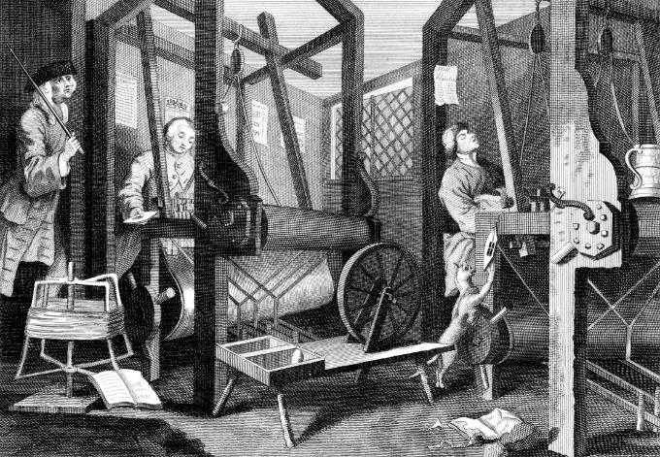
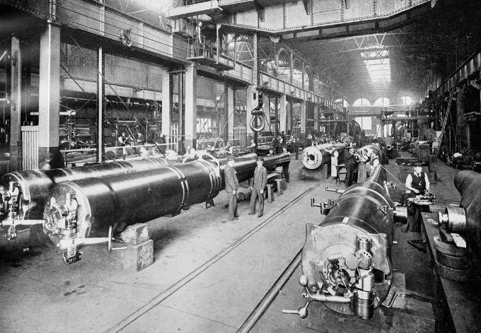
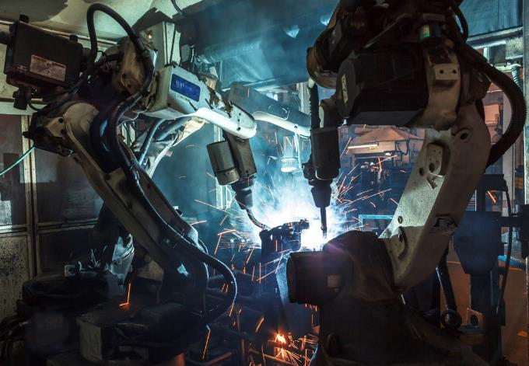

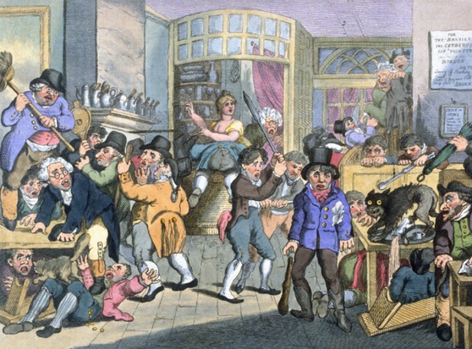
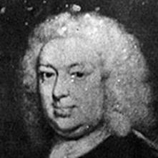
Insurance Leading Throughout History
???
1969
1870
1784
1648
Edward Lloyd’s Coffee House
Steam, Water, Mechanical Production
Division of Labor, Electricity, Mass Production
Electronics, IT, Automated Production
Cyber-Physical Systems

Slide 14
Yesterday: Industry Results
Higher Rates,
Moderating Claim Rates Buoy Results

Slide 15
Are Insurers Making Money?
Billions, 2019 dollars
Through first quarter. Adjusted for inflation using the BLS CPI calculator.
Sources: NAIC data, sourced from S&P Global Market Intelligence; Insurance Information Institute.

Slide 16
Is the Industry Strong?
Amount of Surplus
Change from Prior Quarter
($ Billions)
Stock Market Dip Explains Q4 2018 Drop. Q1 Recovery Explains Increase $0.78 Premium per $1 Surplus.
16
Sources: ISO, A.M .Best.
Notes:
16

Slide 17
P/C Insurance Industry
Combined Ratio*
3 Consecutive Years of U/W Profits; 1st time since 1971-73
Higher CAT Losses, Shrinking Reserve Releases, Toll of Soft Market
Hurricanes, Wildfires Drive CR Higher.
Best Combined Ratio Since 1949 (87.6)
Sandy
*Excludes Mortgage & Financial Guaranty insurers 2008-2014.
Including M&FG, 2008=105.1, 2009=100.7, 2010=102.4, 2011=108.1; 2012:=103.2; 2013: = 96.1; 2014: = 97.0.
Sources: A.M. Best; ISO, a Verisk Analytics company; 2019 based on Q1 data; 2019 projection: Insurance Information Institute.

Slide 18
U.S. Inflation-Adjusted Cat Losses
Harvey, Irma, Maria
2018 – Third worst year for U.S. Insured Catastrophe Losses. Average Insured Loss per Year for 1980-2018 is $19.3 B.
*2018: Inflation-adjusted estimate, subject to change. 2010s is average of 2010 to 2018. All losses are Direct.
Sources: Property Claims Service, a Verisk Analytics business; Insurance Information Institute.

Slide 19
Catastrophe Claims, by Season
Catastrophe Claims as % of Total Claims
Catastrophe Claims Hit Hardest in Second and Third Quarters.
* Preliminary, much of Q4 may be re-estimation of Harvey, Irma, Maria claims.
Losses are net of reinsurance but include Loss Adjustment Expenses
Sources: ISO PCS; Insurance Information Institute calculations.

Slide 20
Tornadoes by Quarter
2019 Second Quarter: Tornado Season – Anticipated Second Most In Past Nine Years
* Preliminary Version of Final Counts. ** Incomplete June Data
Source: http://www.spc.noaa.gov/climo/online/monthly/newm.html.

Slide 21
Auto Net Combined Ratio
Personal Auto Has Returned to Underwriting Profitability. In Commercial Auto the Fever May Have Broken.
Source: National Association of Insurance Commissioners data, sourced from S&P Global Market Intelligence;
Insurance Information Institute.

Slide 22
Loss Costs Have Tapered Off the Past 2 Years
After Several Years of Steep Increases the Cost of Accidents has Tapered Off. Consumer Prices Overall Rose 6.6 Percent from 2016 to 2018.
Source: Fast Track Monitoring System.

Slide 23
Workers Comp:
Soft Market Offsetting Exposure Growth
Private Carriers: Tax Law Changes Boosted Net Premiums.
Source: NCCI.

Slide 24
Workers Comp Net Combined Ratio
Favorable Loss Trends Let Private Carriers Post Lowest C.R. Since 1930s.
Source: NCCI..

Slide 25
Focus on Missouri
Growth and Profitability

Slide 26
Return on Net Worth and Direct Premiums Written All Lines
Missouri vs. USA
Premium Growth
Return on Net Worth
Annual % change
Sources: NAIC data sourced from S&P Market Intelligence; NAIC Profitability Report.

Slide 27
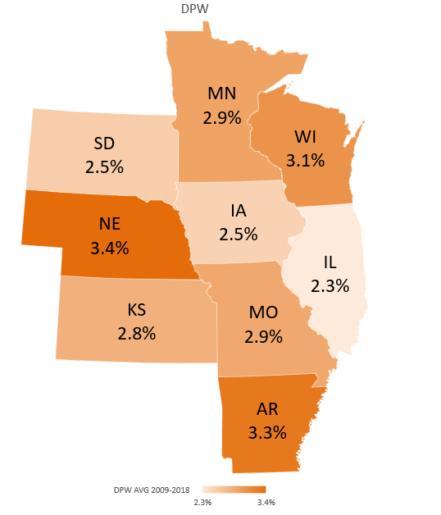
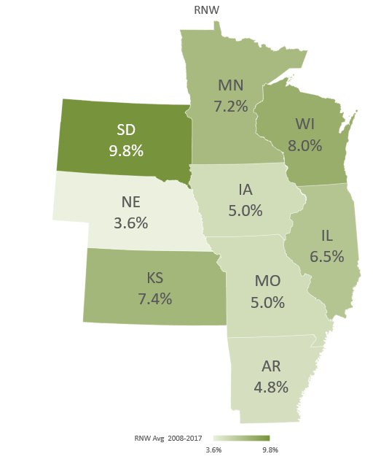
All Lines: 10-Year Average DPW Growth and Return on Net Worth
Sources: NAIC data sourced from S&P Market Intelligence; NAIC Profitability Report

Slide 28
Return on Net Worth and Direct Premiums Written PP Auto
Missouri vs. USA
Premium Growth
Return on Net Worth
Annual % change
Sources: NAIC data sourced from S&P Market Intelligence; NAIC Profitability Report.

Slide 29
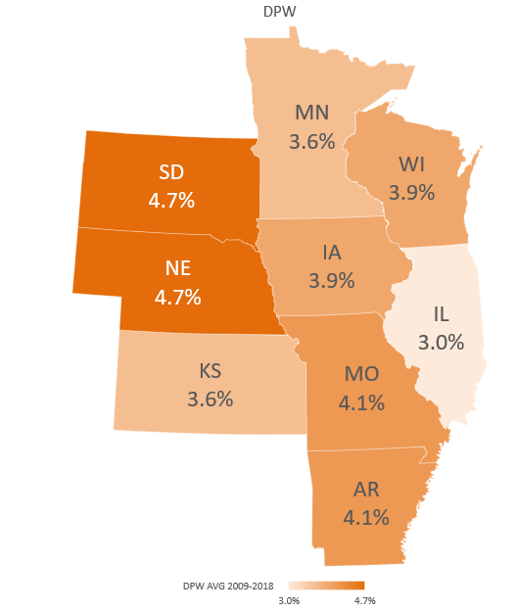
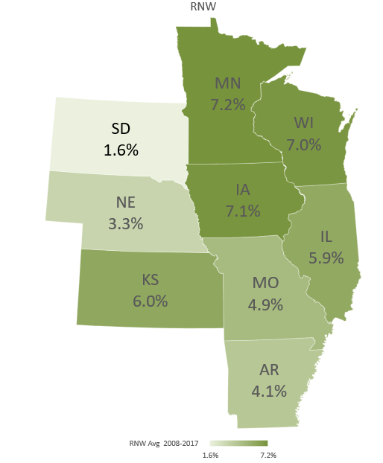
PP Auto: 10-Year Average DPW Growth and Return on Net Worth
Sources: NAIC data sourced from S&P Market Intelligence; NAIC Profitability Report

Slide 30
Return on Net Worth and Direct Premiums Written Commercial Auto
Missouri vs. USA
Premium Growth
Return on Net Worth
Annual % change
Sources: NAIC data sourced from S&P Market Intelligence; NAIC Profitability Report.

Slide 31
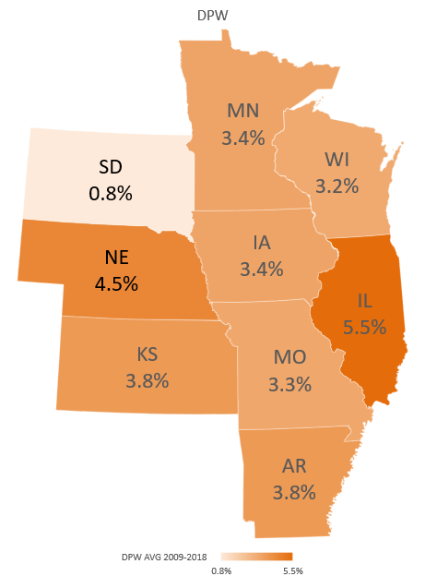
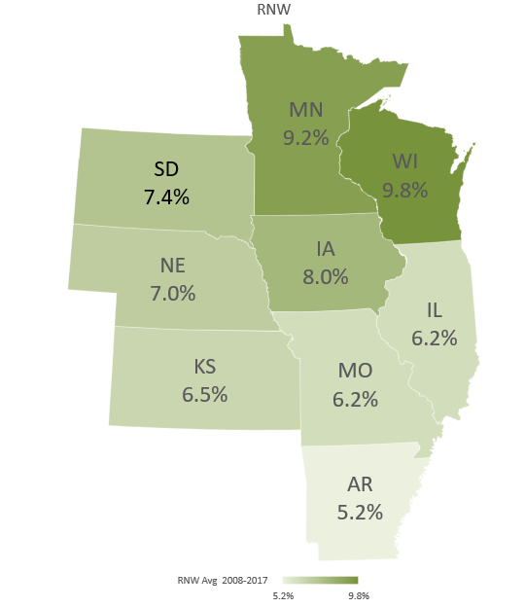
Comm. Auto: 10-Year Average DPW Growth and Return on Net Worth
Sources: NAIC data sourced from S&P Market Intelligence; NAIC Profitability Report

Slide 32
Return on Net Worth and Direct Premiums Written Workers Comp
Missouri vs. USA
Premium Growth
Return on Net Worth
Annual % change
Sources: NAIC data sourced from S&P Market Intelligence; NAIC Profitability Report.

Slide 33
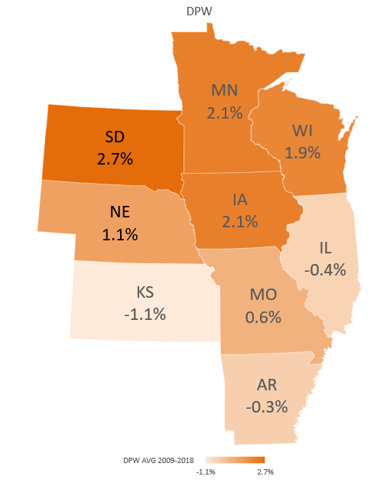
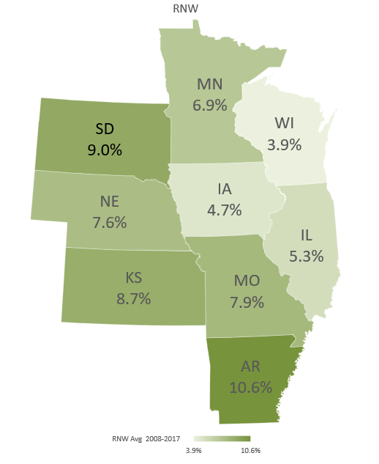
Workers Comp: 10-Year Average DPW Growth and Return on Net Worth
Sources: NAIC data sourced from S&P Market Intelligence; NAIC Profitability Report

Slide 34
Today: Emerging Issues

Slide 35
Auto Repair: Complexity Grows
More Cool Stuff to Fix
More Parts, More Labor:
Higher Costs
Electronics Add to Cost, Complexity
150
28% Increase!
Electronics: 40-50% of cost of vehicle
  Pre-repair scan: $63
  Post-repair scan: $93
  Calibration labor: sublet at $150
  OEM: 98% of camera/sensors
* Property Damage Only.
SOURCES: “2019 Crash Course,” CCC Information Services; Ford Motor Co.;

Slide 36

Cannabis & Insurance
The Science
Review of Literature
Conclusive evidence
  Improves the lot of adults in chronic pain.
Substantial evidence
  Increases the risk of motor vehicle crashes.
SOURCE: National Academy of Sciences, https://www.nap.edu/catalog/24625/the-health-effects-of-cannabis-and-cannabinoids-the-current-state

Slide 37
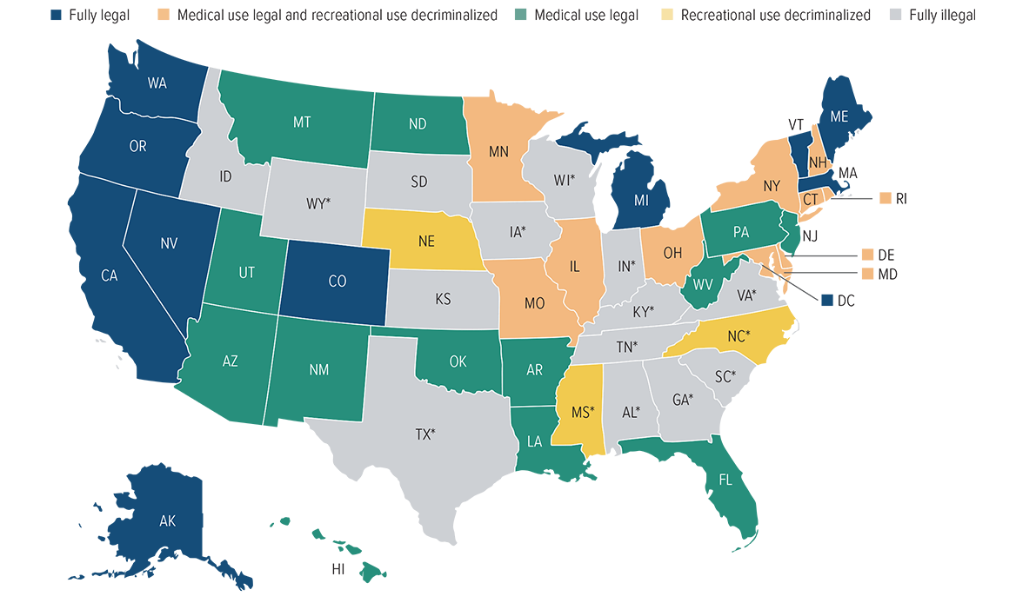
Current marijuana laws by state
*CBD/Low THC medical program.
Source: National Journal; Ballotpedia, 2019.

Slide 38
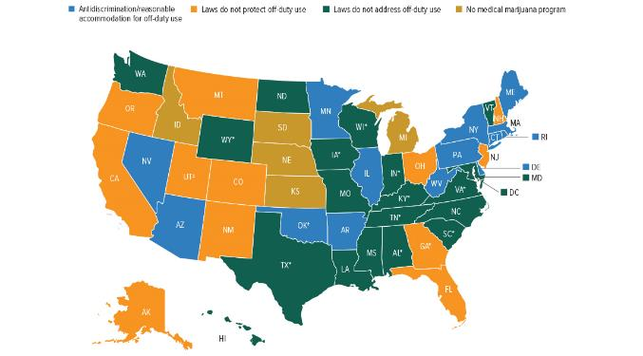
Workers Comp Issues: Can You Get Fired?
Only 13 states have anti-discrimination/reasonable accommodation for off-duty marijuana use
*CBD/Low THC medical program. †Oklahoma has not yet released its final medical marijuana rules. ‡Provides limited protections to state employees.
Source: Insurance Information Institute, 2019.

Slide 39
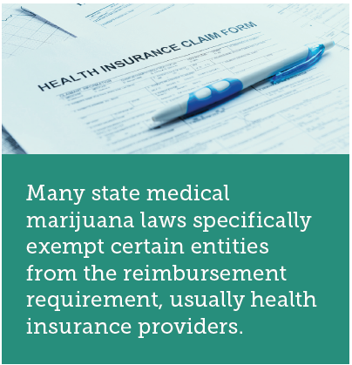
Is Medical Marijuana Covered by Comp?
Reimbursable in a handful of states
Unclear whether reimbursable in many states
Reimbursement not required
Reimbursement prohibited or ineligible

Slide 40
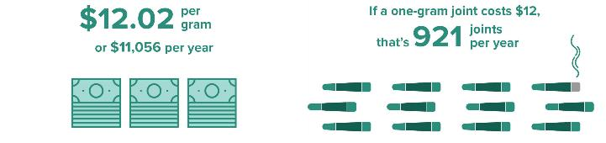
New Mexico is the Only State That Provides a Fee Schedule for Medical Marijuana¹
Maximum reimbursable amount
In context
¹“Healthcare Provider Fee Schedule and Billing Instructions,” State of New Mexico Workers’ Compensation Administration.

Slide 41
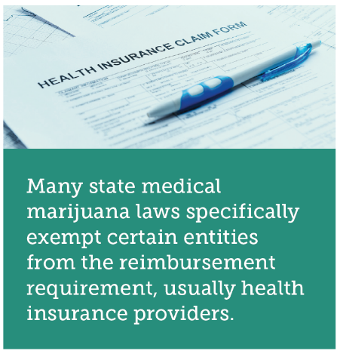
Reimbursement Complications
Cash-only business
Proper dosages poorly understood, non-standardized
No standardized “serving” of marijuana. Potency levels
non-standardized
Expenses can vary widely

Slide 42
Tomorrow
Is Recession Lurking?

Slide 43
Outlook: The Economy
Real GDP Growth Forecasts
Most Forecasters Predict Slow Growth Through 2020.
43
Source: Blue Chip Economic Indicators.
Source: Blue Chip

Slide 44
A Cloud: Interest Rates
Worries About Economy Have Sent Investors Into Treasuries.
Source: Federal Reserve Bank of St. Louis (FRED)

Slide 45
Summary
Insurance Industry Leads Through Disruption
Missouri Results Resemble the Rest of USA
2019 Results Promising, With Long-Awaited Improvement in Auto Lines and Workers Comp Setting Records
Emerging Issues: Marijuana, Auto Repair Costs
Economic Growth Steady – How Long Will it Last?

Slide 46
Thank you for your time and your attention!

