Slide 1
Insurance Information Institute
Overview of Catastrophe Response & Media
Presentation to Insurance Industry Philanthropic Roundtable (Session 1)
Tuesday January 20, 2015 - Wednesday, January 21, 2015
Hosted by – Farmers Insurance
8:30 a.m. – 2:00 p.m.
Janet Ruiz, III Spokesperson California
Insurance Information Institute ♦ 110 William Street ♦ New York, NY 10038

Slide 2
Presentation Outline
What Is the Mission of the I.I.I.?
Catastrophe Communications Outreach
Key Issues – Sub Committees
Member Benefits
Web, Social and Mobile Outreach
How to Work Effectively with the I.I.I.
Open Discussion
Open Discussion

Slide 3
OUR MISSION
3

Slide 4
What Is the Mission of the I.I.I.?
The mission of the Insurance Information Institute is to build public understanding of insurance—what it does and how it works—primarily through the media, but increasingly through direct to consumer outreach.
  The I.I.I. is dedicated to making sure the media covers our business fairly and accurately.
  I.I.I. assists its member companies with their communications, information, research and planning needs.

Slide 5
How the I.I.I. Fulfills its Mission: CAT Communications
Pre CAT, In the Midst, and Post CAT, the I.I.I. plays three key roles:
It is the go-to source for insurance information, educating the public on how insurance works by serving as the media’s basic source of record on insurance concerns, as well as doing direct outreach to consumers.
It serves as the industry’s public voice, devoting special attention to issues of critical importance to the industry.
It serves as an information resource to the industry, conducting research and analysis, assisting members with their research needs and helping national and state industry groups to communicate more effectively with the public.
.

Slide 6
How the I.I.I. Fulfills its Mission (cont.)
The I.I.I. is regarded as a primary source of factual information and credible analysis on insurance during a catastrophe.
I.I.I. staff are available as spokespeople to the media.
The I.I.I. sends out timely news releases and social media posts reaching media and consumers.
The I.I.I. maintains strategic partnerships with other insurance industry organizations, government and safety entities so it can quickly obtain information on specialized topics and refer inquiries to the appropriate experts.

Slide 7
2015 Communications Plan
In 2015, the I.I.I. will focus on three key areas:
1. Issues Management
2. New Initiatives for 2015
3. Ongoing “Core” Communications (CAT Comms)
Details on the key messages, tactics are in the plan (available in the Members Area). It also includes a calendar of seasonal news releases.

Slide 8
New Initiatives for 2015
Establish the I.I.I.’s Presence in California: Retained Janet Ruiz to be the I.I.I.’s representative in the state. The position is based on successful “Florida Model” implemented by Lynne McChristian. The I.I.I. will now have an immediate on-the-ground presence if there is an earthquake, wildfire or other disaster of national importance as well as someone to handle the many California-specific insurance issues.
Mark the 10-year Anniversary of Hurricane Katrina: Communicate the lessons learned from this historic storm with an eye toward the next disaster.
Create a Small Business Education Program: Plan to poll small and medium –sized business owners to develop educational materials, tactics and tools that will help businesses purchase the right amount and type of insurance and be better prepared for disasters – big and small. Poll results will also be used as news hooks to garner media attention.
Expanded Focus on Financial Planning: Life insurance video is in the works and more media outreach on annuities, long-term care and related topics.

Slide 9
CATASTROPHE COMMUNICATIONS
Focus on overcoming “disaster amnesia.” The lack of a major hurricane, earthquake or other disaster creates a variety of educational challenges.
▪ Focus on seniors as a new audience and approach to communicate important disaster preparedness messages.
▪ Reach widest audience possible through Satellite Media Tours, multi-media news releases, innovative news hooks and video communications tools.
▪ Enhance outreach to Hispanic populations as there is a high percentage of this demographic in disaster-prone states. More hotlines are planned in 2015.
▪ Use of surveys, statistics to communicate the risk of hurricanes, floods, earthquakes, tornados and wildfires.

Slide 10
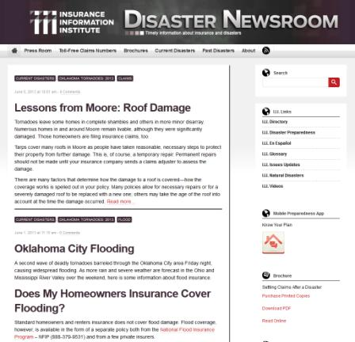
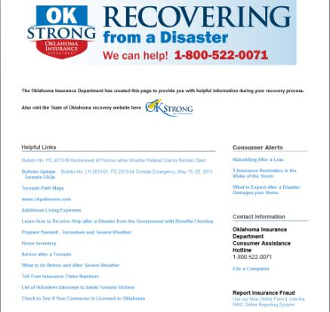
Disaster Newsroom: Post Catastrophe Communications
In the aftermath of the Moore, OK, tornado and the Napa EQ we were able to deliver insurance and recovery information to consumers and the media.
Many I.I.I. resources were featured on the Oklahoma Insurance Department post-tornado recovery page.

Slide 11
KEY ISSUES SUBCOMITTEES
11

Slide 12
Key Issues – Sub Committees
Catastrophe Communications – Earthquake, Flooding, Wildfires, Windstorms
California Issues
Commercial Insurance Issues
Diverse Markets
Emerging Auto Technology and Insurance Issues
Florida Issues
Life Insurance and Annuities
Social Media

Slide 13
MEMBER BENEFITS
13

Slide 14
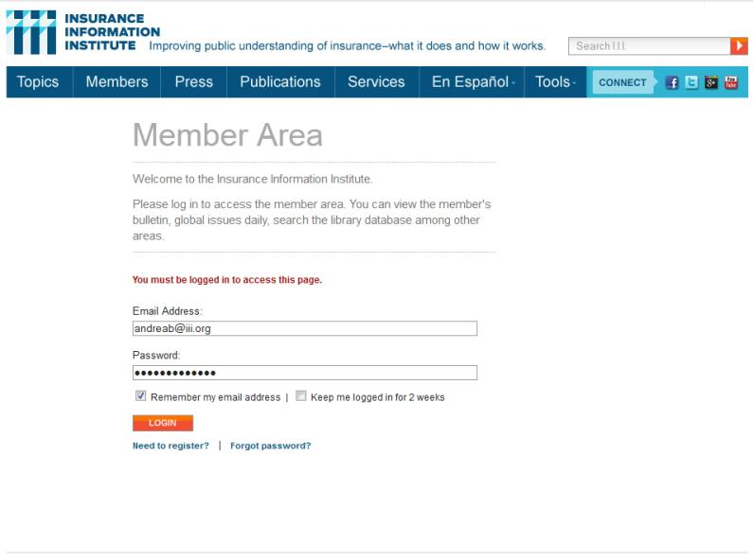
Membership Benefits
Members Area
All employees of I.I.I. member companies have access to the Members Area of the website, which provides a wide range of password-protected content. In order to register simply fill in the form and an activation email will be sent.
14
12/01/09 - 9pm
eSlide – P6466 – The Financial Crisis and the Future of the P/C
Notes:
14

Slide 15
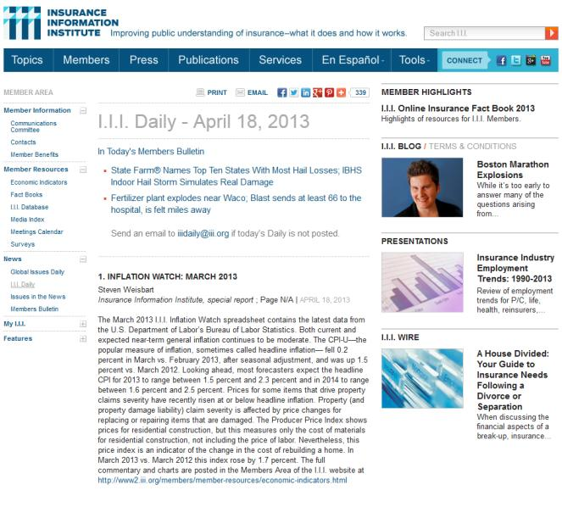
Membership Benefits
Members Area
Provides online access to:
I.I.I. Daily
Member Bulletin
White Papers
Library Database
Message Points on Key Issues
Online and Print Resources
15
12/01/09 - 9pm
eSlide – P6466 – The Financial Crisis and the Future of the P/C
Notes:
15

Slide 16
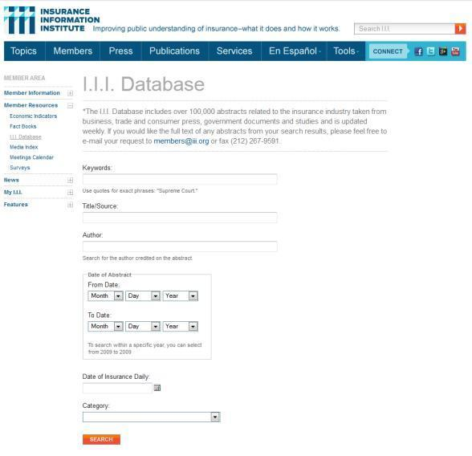
Members Database
Members have access to the I.I.I. Database, which includes over 100,000 abstracts of new stories and studies related to the insurance industry.

Slide 17
Membership Benefits
Research Center
The I.I.I. Information Center enhances the research capabilities of its members, who can tap into I.I.I.’s extensive collection of online and print resources and professional expertise.
Members can contact the Information Center for help with:
  Statistics
  Copies of articles
  Studies, database searches or other assistance
(Contact James Lynch: jamesl@iii.org)

Slide 18
I.I.I. Meetings, Committees and Subcommittees
The I.I.I. board of directors meets twice a year – in January and June.
The I.I.I. Communications Committee meets immediately after the board meeting in January and June, and in the November along with the Insurer Public Relations Council.
The I.I.I. and its Communications Committee have established several subcommittees: Catastrophe Communications; Emerging Auto Technology; Life Insurance and Annuities; Florida Issues; Social Media and Communications. The I.I.I. is also considering a subcommittee on multicultural communications, commercial insurance and we will eventually have one on California issues.
Notes:
Update this slide

Slide 19
PRODUCTS, PUBLICATIONS AND RESEARCH
19

Slide 20
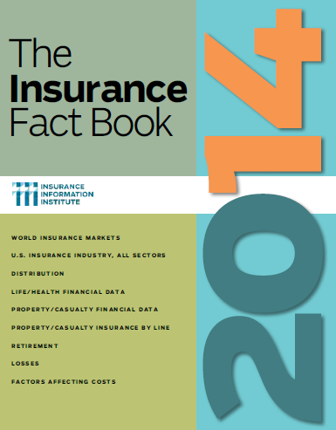

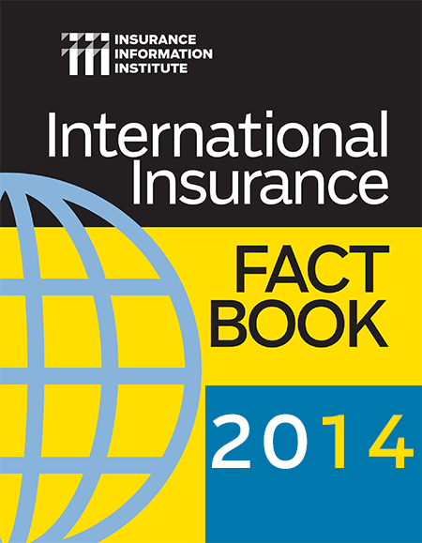
I.I.I. Publications

Slide 21
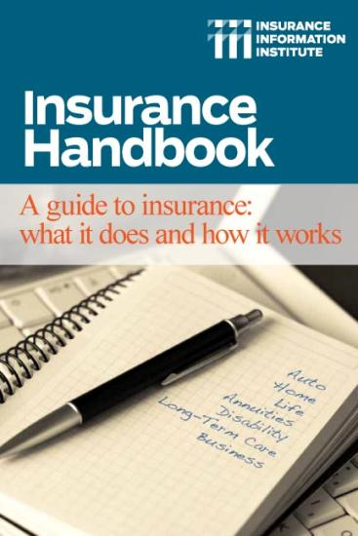
Insurance Handbook
The I.I.I. Insurance Handbook provides vital information for a wide variety of audiences:
  Public Policymakers
  Reporters
  Regulators
  Students
  Insurance Company Employees
  Academics
21
12/01/09 - 9pm
eSlide – P6466 – The Financial Crisis and the Future of the P/C

Slide 22
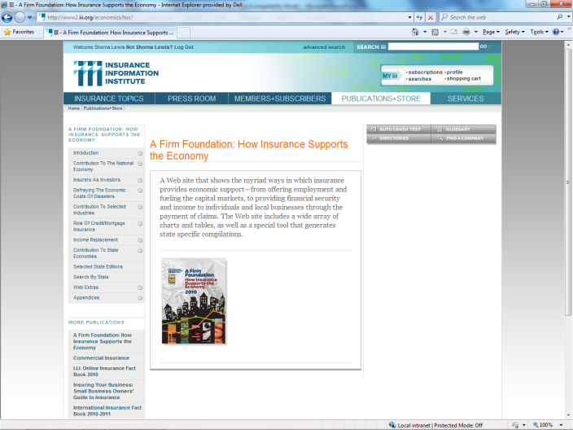
A Firm Foundation
A Firm Foundation provides details on the impact and importance of the insurance industry on national and state economies
Insurers Don’t Just Pay Claims; They Are:
Employers
Income Providers
Taxpayers
Investors
Engines of Growth & Recovery
Philanthropists
22
12/01/09 - 9pm
eSlide – P6466 – The Financial Crisis and the Future of the P/C

Slide 23

Impact: Documents Insurer Charitable and Volunteer Activities
In 2014 we will be updating the Impact website to allow for better sharing of content, and will make it a focus of our social media strategy.

Slide 24
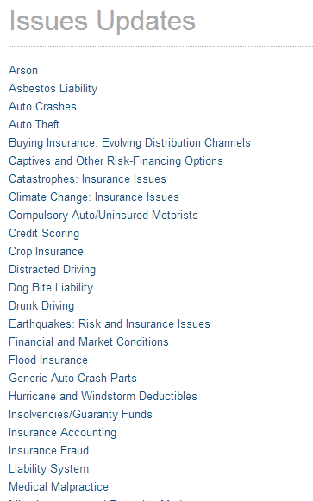
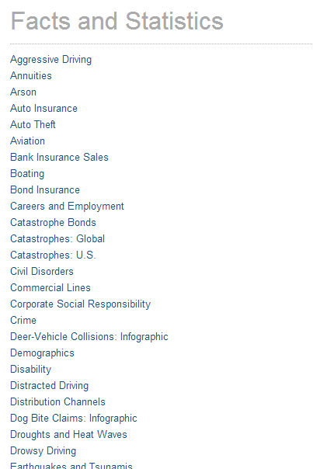
Issues Updates/Facts and Statistics
Background papers and statistical information are available on the I.I.I. website and are continually updated as new information becomes available

Slide 25

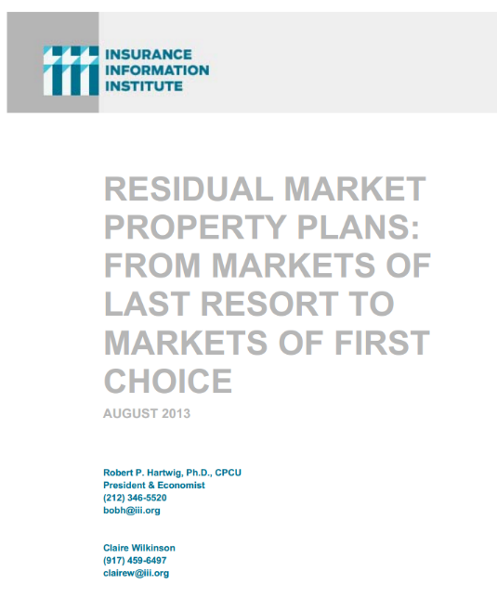
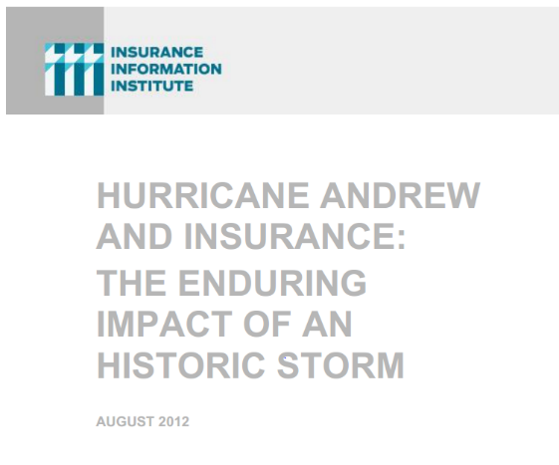
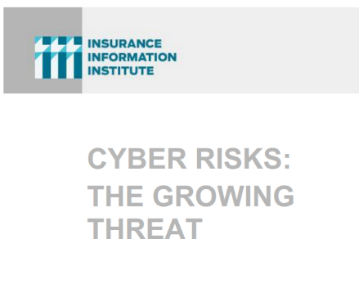
I.I.I. White Papers

Slide 26
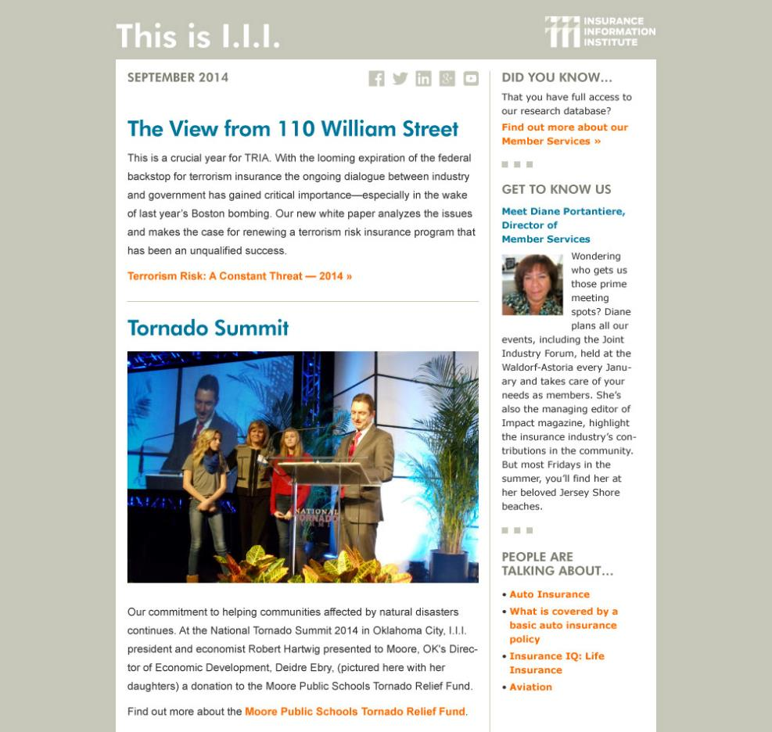
Member Newsletter
“This Is I.I.I.” will keep member companies informed of the organization’s latest activities—from conference appearances and testimony to the latest content updates and tools available to members. Emails will be sent monthly.

Slide 27
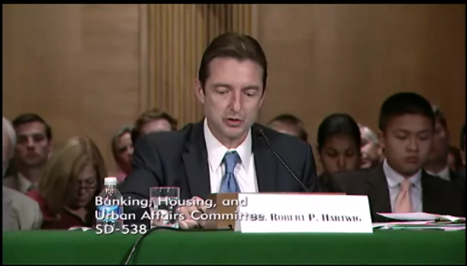
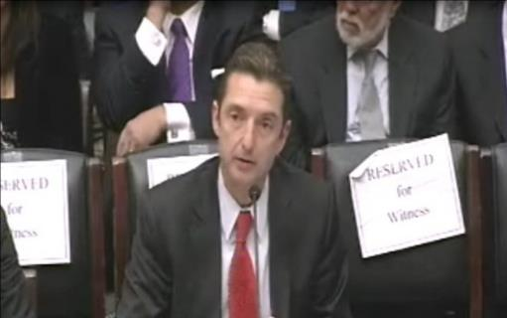
Terrorism Risk Insurance Program
Testified Before 3 Congressional Committees in 2012-13
Provided Capitol Hill Joint House/Senate Staff Briefing in April 2014
Spoke at Numerous Member Client/RM Panels on Issue
  More are scheduled
Published Updated Terrorism Risk and Insurance Report
Working with Trades, Congressional Staff, GAO & Others
House Financial Services Subcommittee, 11/13/13
Senate Banking Committee, 9/25/13
27
12/01/09 - 9pm
eSlide – P6466 – The Financial Crisis and the Future of the P/C
Notes:
27

Slide 28
TRADITIONAL MEDIA OUTREACH
28

Slide 29
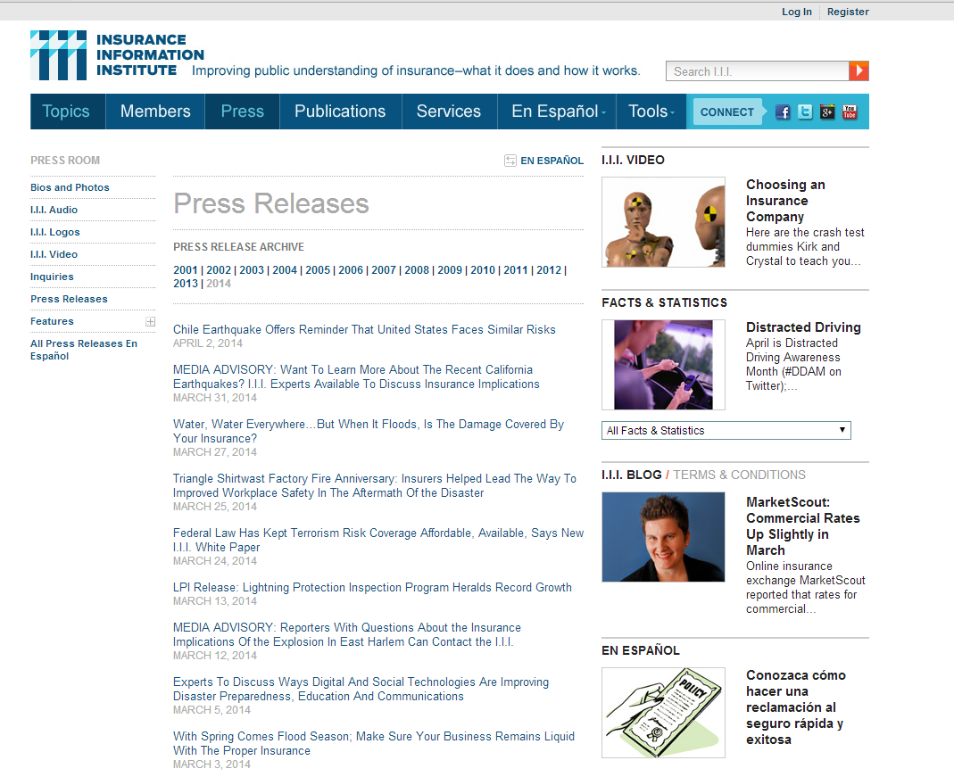

Slide 30
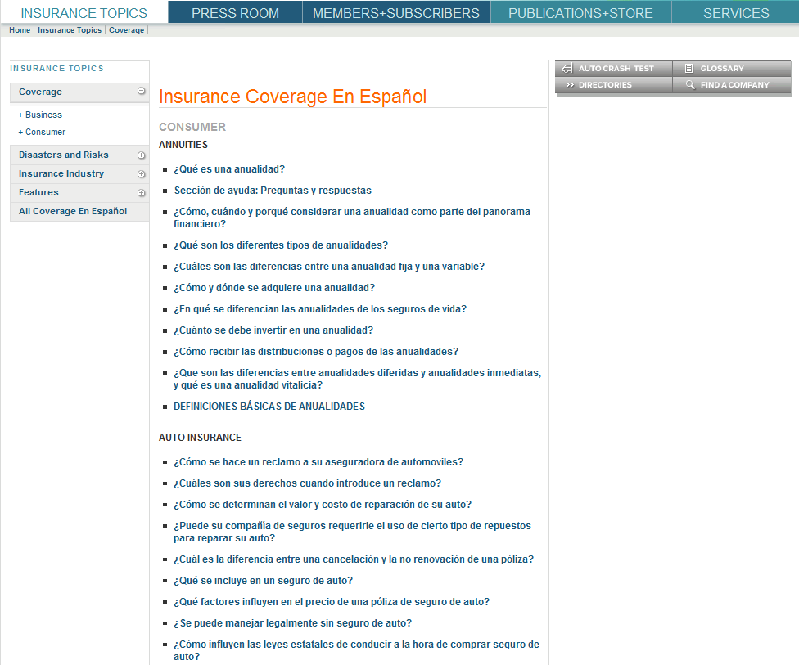
Much of the consumer information on the site is also available in Spanish

Slide 31
WEB, SOCIAL AND MOBILE OUTREACH
31

Slide 32
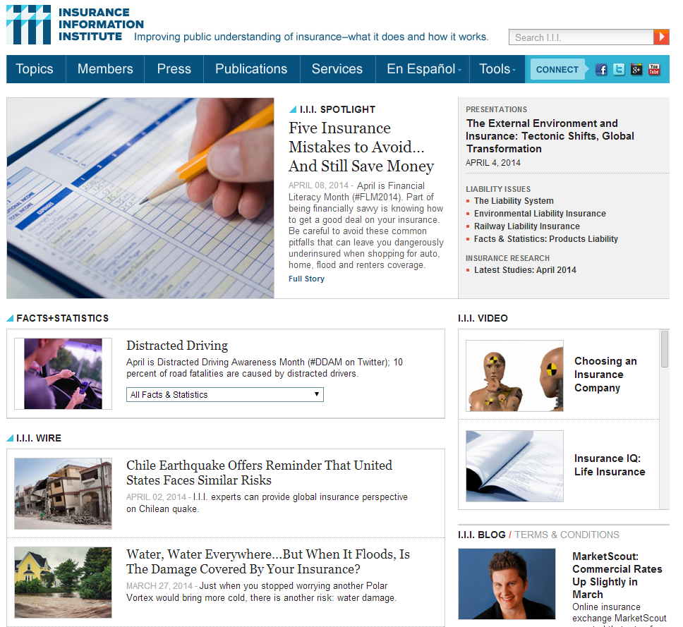
I.I.I. Website
The I.I.I. homepage is updated regularly with content relevant to what is happening in the news, or new content being promoted.
The Wire, Facts & Statistics, and Spotlight are all set up as widgets so that companies, agencies and insurance organizations can easily feature updated I.I.I. content on their websites.

Slide 33
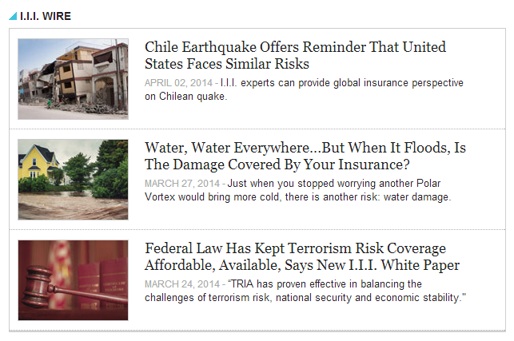
I.I.I. Website: Communications Outreach
The I.I.I. sends out 1-3 news releases a week; these are available on the I.I.I. Wire, through email, and are sometimes sent out using PR Newswire.
Notes:
Update this slide

Slide 34
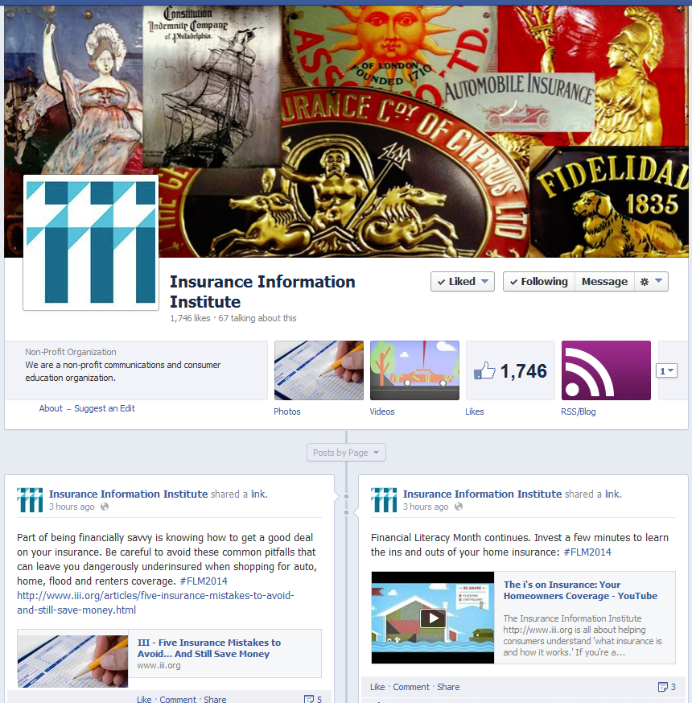
I.I.I. on Facebook

Slide 35
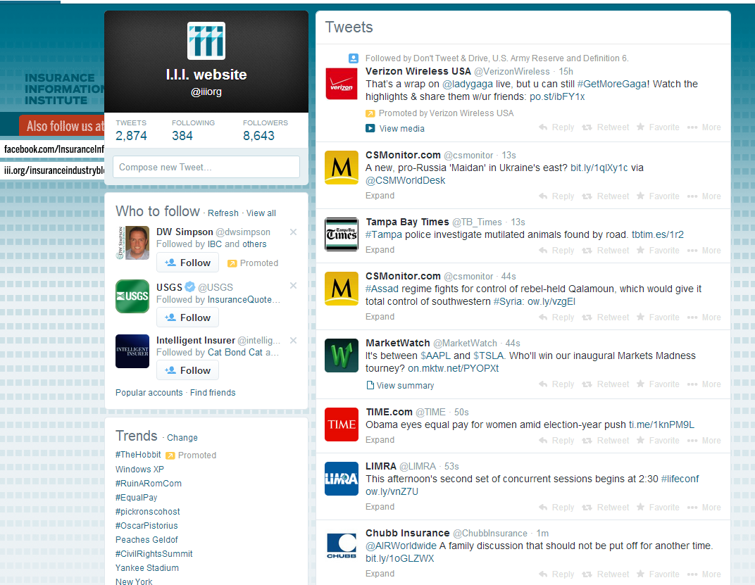
I.I.I. on Twitter

Slide 36
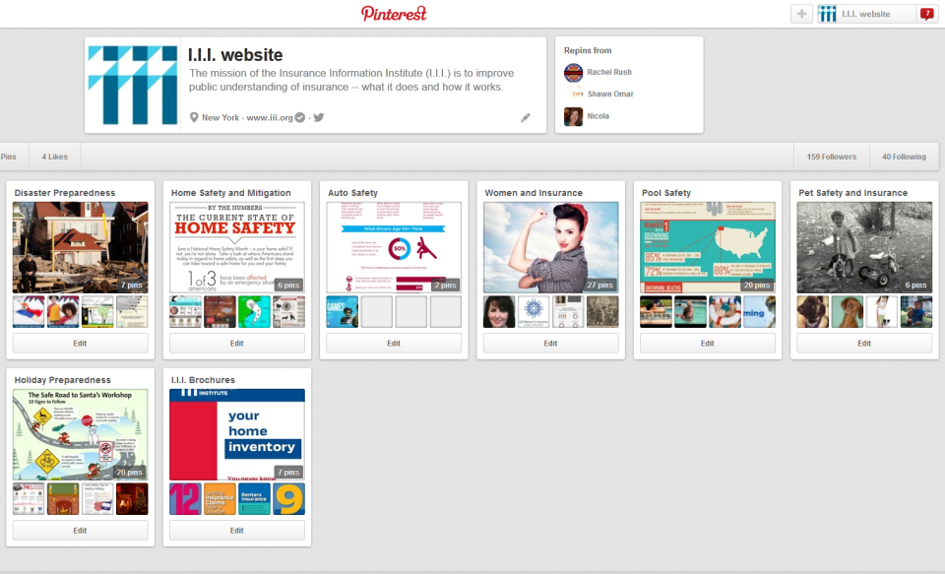
I.I.I. on Pinterest

Slide 37
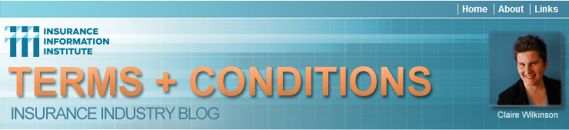



I.I.I. Blogs
Our blogs, including the new consumer blog, The Fine Print, will continue to form a key part of our content strategy, bringing information to a wide variety of audiences: consumers, industry and media, regional, and disaster victims.

Slide 38
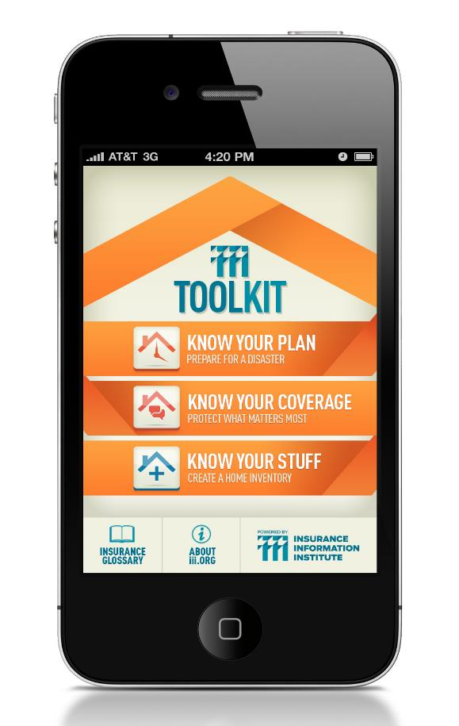
The iiiToolkit: Putting Insurance Tools into the Hands of Consumers
The iiiToolkit is a free mobile app suite that can help users put together a disaster plan, learn about selecting the right insurance for their needs and budget, and create and maintain a home inventory database.
Takes an action oriented approach: make a checklist; create an inventory; have a conversation with your insurance professional.

Slide 39
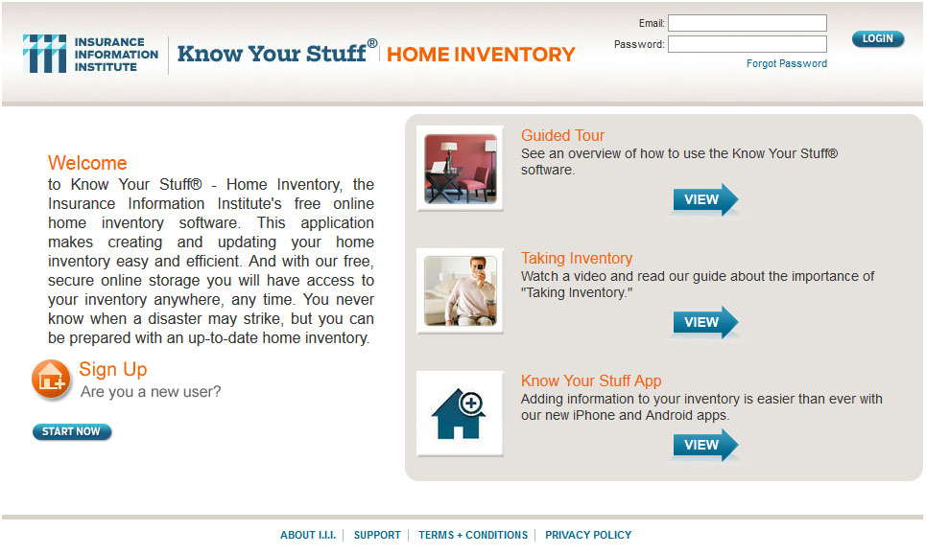
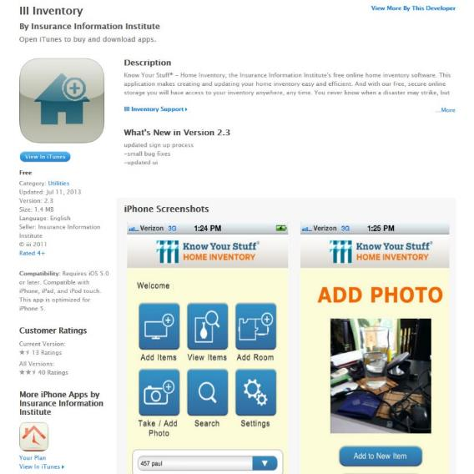
Know Your Stuff® - Home Inventory Software & App
Know Your Stuff is a free, online home inventory software—and integrated mobile app—that is highly regarded by the public and media, and represents the type of outreach by the industry that generates great PR.
We are planning a complete update of the software and app later this year.
39
12/01/09 - 9pm
eSlide – P6466 – The Financial Crisis and the Future of the P/C

Slide 40
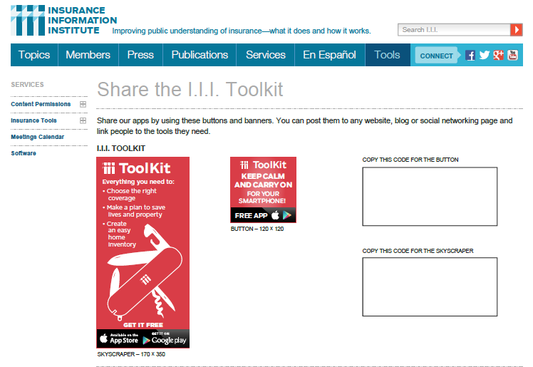
Sharing the I.I.I. Mobile Apps
Sharing our apps is as easy as hitting the copy-paste keys…

Slide 41
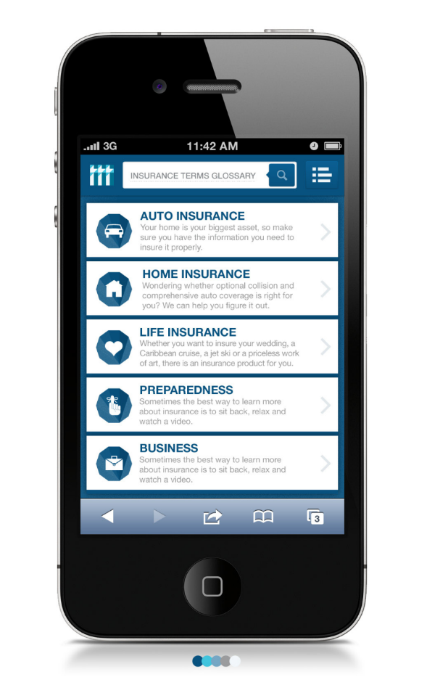
I.I.I. Mobile Website
The I.I.I. mobile website will be consumer-facing, providing users with the basic information and tools they need in the palm of their hand. With our information in hand, consumers will be well-placed to have a constructive conversation with their insurance professional.

Slide 42
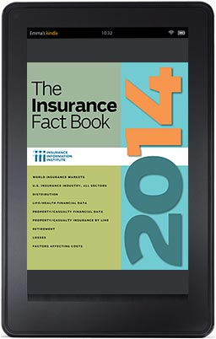
I.I.I. Digital Publications
The I.I.I. Fact Book is available digitally for Kindle e-readers.

Slide 43

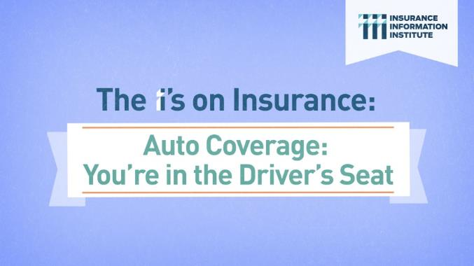
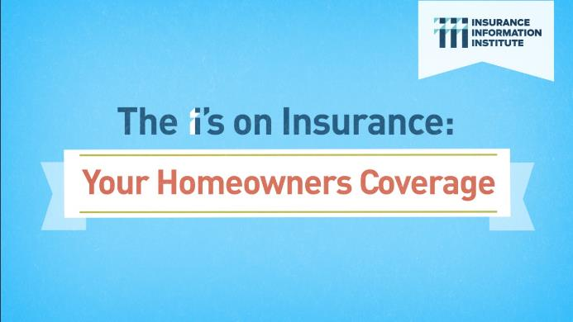
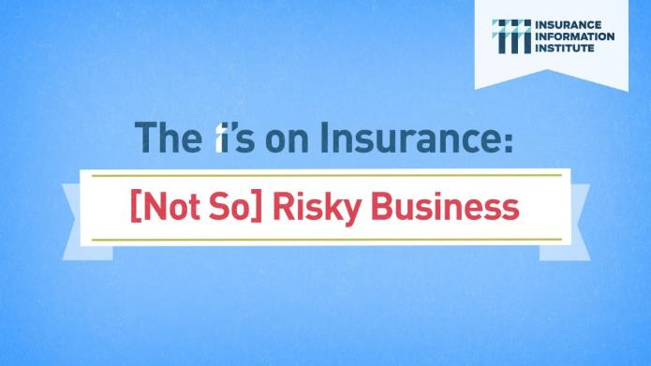
“The I’s on Insurance” Video Series
Animated video series focusing on Homeowners, Auto, Small Business and Claims Filing. The goal is to engage and encourage viewers to reach out to their agent, broker, or company representative to discuss insurance coverage.

Slide 44

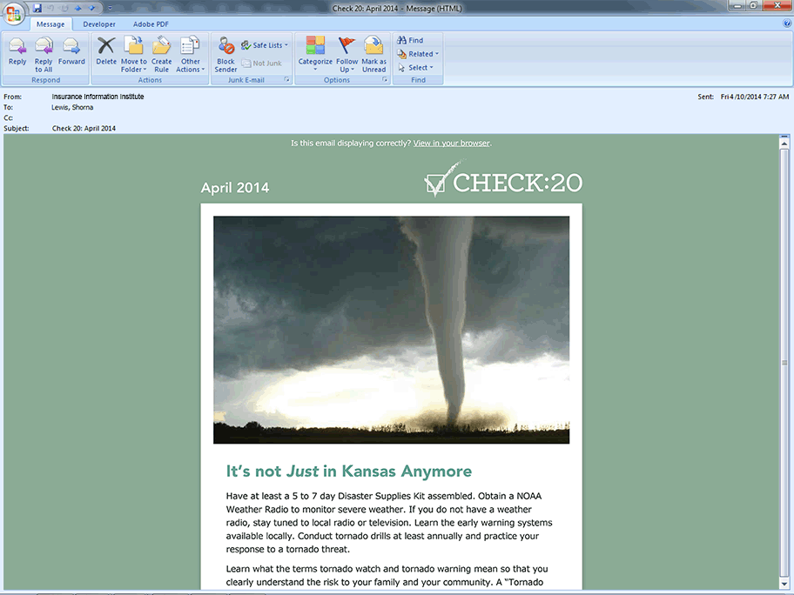
“Check20” Campaign
Check20 is an integrated cross-channel messaging campaign. The goal is to engage consumers and explain the basics of insurance: what they should look for in their policy documents; and how to have a constructive dialogue with their insurance professional.
The core of the program is the weekly email newsletter, focused on Home, Auto, and Financial Planning information.

Slide 45
HOW TO WORK WITH THE I.I.I?
45

Slide 46
What the I.I.I. Can Do to Support
Assist with company-specific media messaging.
Speak on the company’s behalf when you would prefer not to respond.
Generate media interest in your new products, services, educational or philanthropic endeavors.
Make I.I.I. research and analysis available for company-specific use.
Present insurance information and/or economic analysis at events and meetings, as well as brief your outside communications consultants.
Co-produce webinars and other events.
Arrange meetings with key media.
Special projects (strategic planning, marketing, op-eds, etc).
Notes:
Update this slide

Slide 47
Best Practices for Insurers to Work Effectively with the I.I.I.
Inform the I.I.I. of your communications goals and objectives.
Incorporate the I.I.I. into your overall communications strategy.
Provide CAT information to I.I.I. prior to Catastrophe
Provide a “heads up” on new products, issues and internal messaging.
Notify the I.I.I. of social media campaigns and outreach efforts.

Slide 48
QUESTIONS/DISCUSSION
48

Slide 49
Janet Ruiz janetr@iii.org / @insuringcalifornia
707-490-9365 (cell)
www.iii.org
Thank you for your time and attention!
Notes:
49

