Slide 1

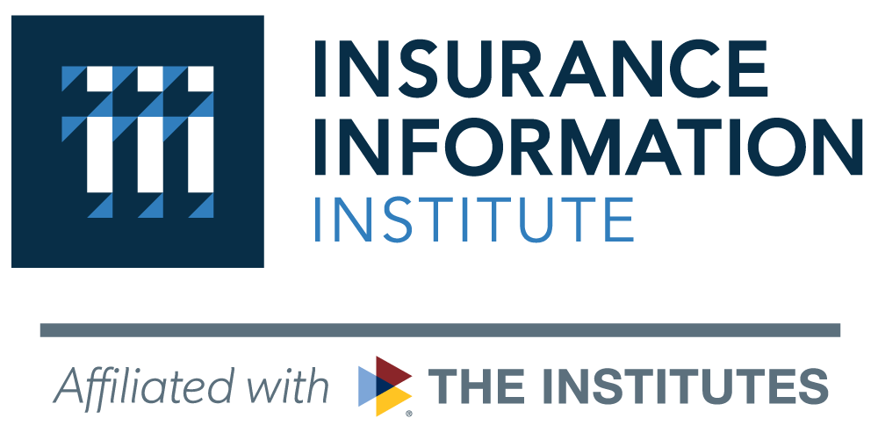
State of the Insurance Industry:
Key Risks and Opportunities
SEAN KEVELIGHAN
Chief Executive Officer, Insurance Information Institute

Slide 2

Triple-I and Its Mission
A world with MORE insurance
We are the trusted source of unique, data-driven insights on insurance
To inform and empower industry stakeholders and consumers
2
2

Slide 3
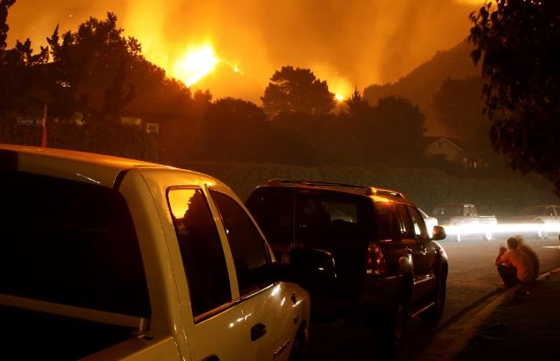

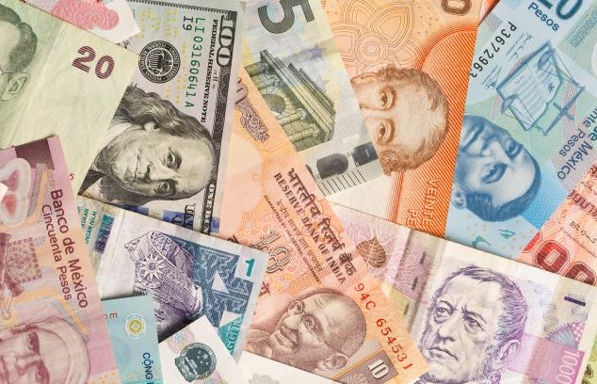
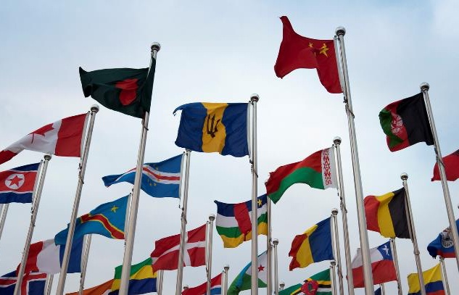


The Disruption Continuum
Catastrophes
COVID
Economics
INSURANCE
Geopolitical
Social Unrest
Technology

Slide 4
What’s News In Insurance…
The Triple-I continues to be top-of-mind as a resource for reporters, even amid changing news cycles and as new insurance-related topics emerge.
While 2021 news cycles surrounding natural catastrophes and cybersecurity falls off, topics including workers compensation and rental insurance are becoming more prominent. The Triple-I is capitalizing on expertise in these areas.
Media Citations By Category
Auto & Transportation
Homeowner/Rental
Natural Catastrophe
Cyber
Dog Bites & Pets
Workers Compensation
18
Flooding & NFIP
0
COVID-19 & Business Interruption
Life Insurance
General Industry
6/21-11/21
Civil Unrest
4
12/21-5/22
Source: Flag Media Analytics

Slide 5
Triple-I’s Issue Management
Inform
Own
Audiences
High
Insurance
Economics & Public Policy
Climate Risk
& Resilience
(including ESG)
B2B
Auto
B2C
Cyber
B2G
Legal System Abuse
Life
Campaign Initiative
Business Interruption
Reputation Alert
Public Discussion
Manage
Elevate
Home/Rental/ Condo
DEI &Talent
Fraud
Terror
Low
Low
Triple-I & Industry Oppty./Risk
High

Slide 6
Insurance Economics Outlook
Notes:
Michel video

Slide 7
Overall
Growth and replacement costs to remain challenging well into 2023 and 2024 as geopolitical risks reach new highs – constraining industry growth and combined ratios
Growth & Inflation (Change YoY%) | 2021 | 2022 YTD | 2023 | 2024 | Longer Range
Growth
U.S. Real GDP | 5.80% | 2.57% | 1.20% | 1.70% | 1.80%
Finance & Insurance Output | 3.40% | 2.13% | -1.51% | 0.37% | -0.06%
Inflation
U.S. Inflation | 7.10% | 7.7% | 2.80% | 2.30% | 2.00%
P&C Replacement Costs | 11.75% | 8.10% | 2.85% | 0.91% | 1.01%
MACROECONOMIC DRIVERS ONLY Source: BLS, BEA, FRED; As of CPI: 10/13; U.S. GDP Q3; Sectors Output: Q2; Analysis: Triple-I.

Slide 8
Homeowners
Rising interest rates and inflation bringing housing growth to a grind even though increases in cost of materials slowing down
Homeowners (Change YoY%) | 2021 | 2022 YTD | 2023 | 2024 | Longer Range
Underlying GDP Growth | -11.36% | 1.37% | 2.52% | 3.83% | 3.97%
Housing Units Starts | -13.00% | 0.25% | 3.26% | 4.18% | 4.18%
All Construction Employment | 6.80% | 3.60% | 3.73% | 3.78% | 4.10%
Retail Trade | -14.70% | 1.38% | -0.17% | 3.18% | 3.41%
Replacement Costs | 13.39% | 7.64% | 3.42% | 1.74% | 2.12%
Shelter | 3.20% | 6.60% | 4.06% | 3.33% | 3.35%
Household Furnishing & Supplies | 4.80% | 10.17% | 2.09% | -0.60% | -1.15%
Construction Materials | 22.77% | 6.15% | 4.11% | 2.49% | 4.17%
PROPERTY ONLY Source: BLS, BEA, FRED; As of CPI: 10/13; U.S. GDP Q3; Sectors Output: Q2; Analysis: Triple-I.

Slide 9
Personal Auto
Increases in costs of vehicles and repairs slowing down – softening the impact of the top (along with materials) driver of higher P&C replacement costs
Personal Auto (Change YoY%) | 2021 | 2022 YTD | 2023 | 2024 | Longer Range
Underlying GDP Growth | -16.94% | 3.84% | 2.69% | 2.41% | 1.05%
All Auto & Parts Retail Sales | 0.00% | 3.06% | 3.13% | 2.67% | 2.00%
Total Private Expenses | -18.42% | 5.35% | 1.82% | 1.89% | 3.08%
Replacement Costs | 11.80% | 9.99% | 2.52% | -0.11% | -0.28%
All New Vehicles | 8.74% | 9.40% | 2.44% | -0.10% | -0.16%
All Used Vehicles | 24.41% | 7.18% | 1.31% | -0.84% | -0.89%
All Parts & Equipment | 6.90% | 13.38% | 3.81% | 0.61% | 0.21%
PROPERTY ONLY Source: BLS, BEA, FRED; As of CPI: 10/13; U.S. GDP Q3; Sectors Output: Q2; Analysis: Triple-I.

Slide 10
Commercial Property
Business capital expenditures more resilient than consumers' spending on homes and content - while benefiting from similar reduction in materials' costs
Commercial Property (Change YoY%) | 2021 | 2022 YTD | 2023 | 2024 | Longer Range
Underlying GDP Growth | 3.51% | 2.16% | 2.53% | 2.45% | 2.60%
Real Estate, Rental & leasing | 4.24% | 1.79% | 2.08% | 1.87% | 1.78%
All Employees Commercial Buildings | 1.80% | 2.88% | 3.40% | 3.59% | 4.21%
Replacement Costs | 21.62% | 4.49% | 2.16% | 0.88% | 1.48%
Construction Materials | 35.09% | 6.15% | 4.11% | 2.49% | 4.17%
Equipment & Other Capital Goods | 6.39% | 11.61% | 4.60% | 2.00% | 2.29%
Information Technology Prices | 3.20% | -4.30% | -2.24% | -1.85% | -2.03%
PROPERTY ONLY Source: BLS, BEA, FRED; As of CPI: 10/13; U.S. GDP Q3; Sectors Output: Q2; Analysis: Triple-I.

Slide 11
Commercial Auto
Unexpectedly, corporate spending on vehicles is outright contracting - as opposed to investments in commercial property
Commercial Auto (Change YoY%) | 2021 | 2022 YTD | 2023 | 2024 | Longer Range
Underlying GDP Growth | -18.47% | -7.22% | 0.27% | 4.35% | 4.37%
Light & Heavy Truck Sales | 5.06% | -9.39% | 1.05% | 5.48% | 6.32%
All Autos Average Expenditures | -39.39% | -3.01% | -1.25% | 2.17% | 0.59%
Replacement Costs | 11.48% | 9.79% | 2.47% | -0.11% | -0.27%
All New Vehicles | 8.74% | 9.22% | 2.39% | -0.10% | -0.15%
All Used Vehicles | 24.41% | 7.04% | 1.29% | -0.82% | -0.87%
All Parts & Equipment | 6.90% | 13.11% | 3.73% | 0.60% | 0.20%
PROPERTY ONLY Source: BLS, BEA, FRED; As of CPI: 10/13; U.S. GDP Q3; Sectors Output: Q2; Analysis: Triple-I.

Slide 12
Underwriting Projection

Slide 13

P&C Industry Outlook
2022 Net Combined Ratio forecast to worsen by 6.1 pts from 2021, before recovering in 2023-2024
Forecast increased 4.9 pts this quarterly evaluation because of Hurricane Ian plus deterioration in Personal and Commercial Auto
Premium growth forecast to increase 8.8% in 2022 and 8.9% in 2023 primarily due to hard market conditions and exposure growth
2022 Catastrophe Losses forecast to be comparable to 2017, although significant uncertainty in Hurricane Ian forecast losses in total and by product line
Expect loss pressures and hard market to continue due to inflation, supply chain, and geopolitical risk
Sources: NAIC Statutory Financial Data through S&P Global Market Intelligence
Analysis (as of 11/3/2022): Insurance Information Institute, Milliman.
Notes:
Premium Growth – Exposure growth contributes 4 pts in 2022 and 3.6 pts in 2023
2022 Catastrophe Losses – Acknowledge uncertainty around our selection for Hurricane Ian ultimate losses, as well as the allocation to product lines

Slide 14
Personal Auto
2022 Net Combined Ratio forecast at 108.5, 7.1 pts worse than 2021 and 16.0 pts worse than low miles driven 2020
Premium growth expected to be higher in 2023–2024 primarily due to future rate activity
Loss pressures cause 2023–2024 to remain at an underwriting loss while expected rate increases are fully earned
Personal Auto | 2019 | 2020 | 2021 | 2022 Q1 | 2022 Q2 | 2022 Q3
Rate Change (YoY%) | 4.5% | 4.8% | 4.5% | 4.3% | 3.7% | 4.3%
Source: Market Scout (Q3 2022)
Sources: NAIC Statutory Financial Data through S&P Global Market Intelligence
Analysis (as of 11/3/2022): Insurance Information Institute, Milliman.
Notes:
Rate Changes – I am reading about higher amounts of rate changes by some carriers than reflected in either Market Scout or S&P industry averages.

Slide 15
Personal Auto Deeper Look at Deteriorating Trends
Quarterly loss ratio deteriorated rapidly from 2020Q2 at 47.5% to an average of 74.2% for the most recent 4 quarters
Recent deterioration driven by Physical Damage coverages, with average of 79.4% in the most recent 4 quarters being the worst in two decades, plus 7.6 pts increase in Liability coverages in 2022Q2
Low miles driven in the first year of the pandemic contributed to favorable experience, and industry returned $14B to policyholders
Miles driven now largely back to 2019 levels, but with riskier driving behaviors and higher inflation
Supply chain disruption, labor shortages, and costlier replacement parts all contributing to current and future loss pressures
Sources: NAIC Statutory Financial Data through S&P Global Market Intelligence
Analysis (as of 11/3/2022): Insurance Information Institute, Milliman.

Slide 16
Homeowners
115.4%
2022 Net Combined Ratio spiking to 115.4, highest since 2011, due to Hurricane Ian and replacement cost pressure
Forecast to improve in 2023 and 2024 but remain an underwriting loss throughout this horizon
Net Written Premium forecast to grow 10.3% in 2022 due to rate and exposure increases
Loss pressures and expected catastrophes indicate greater rate increases are needed to restore Homeowners to an underwriting profit
Homeowners | 2019 | 2020 | 2021 | 2022 Q1 | 2022 Q2 | 2022 Q3
Rate Change (YoY%) | 4.1% | 4.1% | 4.3% | 5.3% | 5.0% | 4.0%
Source: Market Scout (Q3 2022)
Sources: NAIC Statutory Financial Data through S&P Global Market Intelligence
Analysis (as of 11/3/2022): Insurance Information Institute, Milliman.

Slide 17
Commercial Auto
2022 Net Combined Ratio forecast at 104.7, nearly 6 pts worse than 2021
Forecast underwriting loss in 2023-2024 due to inflation, loss pressure, and prior year adverse loss development
Premium growth expected to remain elevated due to hard market conditions
Commercial Auto | 2019 | 2020 | 2021 | 2022 Q1 | 2022 Q2 | 2022 Q3
Rate Change (YoY%) | 6.6% | 7.2% | 8.4% | 7.3% | 9.0% | 7.7%
Source: Market Scout (Q3 2022)
Sources: NAIC Statutory Financial Data through S&P Global Market Intelligence
Analysis (as of 11/3/2022): Insurance Information Institute, Milliman.
Notes:
Dave

Slide 18
General Liability
Forecasting small underwriting profit for 2022-2024, but inflation and geopolitical risk put pressure on these forecasts
Premium growth remains strong from hard market
Rate Change (YoY%) | 2019 | 2020 | 2021 | 2022 Q1 | 2022 Q2 | 2022 Q3
General Liability | 2.5% | 5.0% | 5.9% | 5.0% | 5.3% | 6.0%
Professional Liability | 2.5% | 7.7% | 7.2% | 5.7% | 5.6% | 5.7%
D&O Liability | 2.3% | 10.0% | 11.1% | 8.7% | 8.3% | 7.0%
EPLI | 1.8% | 5.7% | 7.5% | 7.0% | 5.0% | 4.3%
Umbrella/Excess | 2.8% | 7.4% | 12.1% | 9.7% | 8.7% | 7.0%
Source: Market Scout (Q3 2022)
Sources: NAIC Statutory Financial Data through S&P Global Market Intelligence
Analysis (as of 11/3/2022): Insurance Information Institute, Milliman.
Notes:
Dave

Slide 19
Commercial Property
2022 Net Combined Ratio increasing to 99.1 due primarily to Hurricane Ian, 5.6 pts worse than prior quarterly forecast
Premium growth remaining strong at 14.5% in 2022 following 17.4% growth in 2021
Commercial Property | 2019 | 2020 | 2021 | 2022 Q1 | 2022 Q2 | 2022 Q3
Rate Change (YoY%) | 3.3% | 6.4% | 8.9% | 7.6% | 8.3% | 7.7%
Source: Market Scout (Q3 2022)
Sources: NAIC Statutory Financial Data through S&P Global Market Intelligence
Analysis (as of 11/3/2022): Insurance Information Institute, Milliman.
Notes:
Jason

Slide 20
Commercial Multi-Peril
2022 Net Combined Ratio worsening to 107.6 due primarily to Hurricane Ian
Underwriting losses expected to continue as more rate increases are needed to offset economic and social inflation loss pressures
Commercial Multi-Peril | 2019 | 2020 | 2021 | 2022 Q1 | 2022 Q2 | 2022 Q3
Rate Change (YoY%) | 2.3% | 4.8% | 4.7% | 6.3% | 6.0% | 5.0%
Source: Market Scout (Q3 2022)
Sources: NAIC Statutory Financial Data through S&P Global Market Intelligence
Analysis (as of 11/3/2022): Insurance Information Institute, Milliman.
Notes:
Jason

Slide 21
Workers Compensation
Underwriting profits continue, although margins expected to shrink through 2024
Pandemic, recession, remote work, and economic recovery impacted volume and location of WC risk
Workers Comp | 2019 | 2020 | 2021 | 2022 Q1 | 2022 Q2 | 2022 Q3
Rate Change (YoY%) | -0.5% | -0.0% | 0.7% | 1.0% | 1.0% | 0.3%
Source: Market Scout (Q3 2022)
Sources: NAIC Statutory Financial Data through S&P Global Market Intelligence
Analysis (as of 11/3/2022): Insurance Information Institute, Milliman.
Notes:
Jason

Slide 22
Key Industry Risks & Opportunities

Slide 23
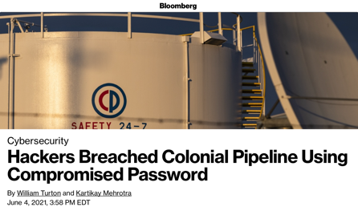
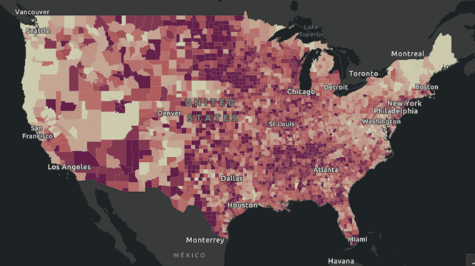
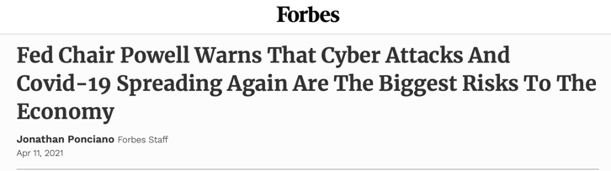
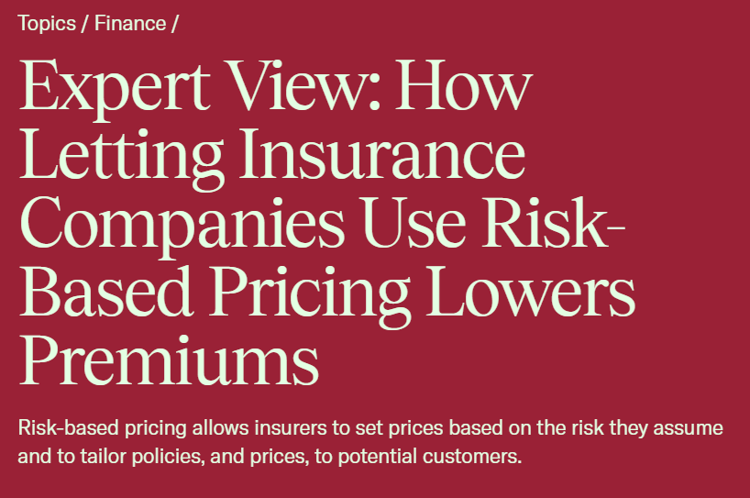
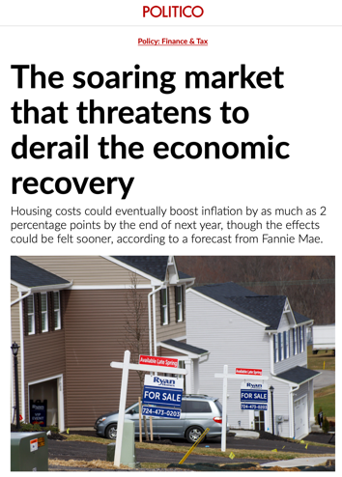
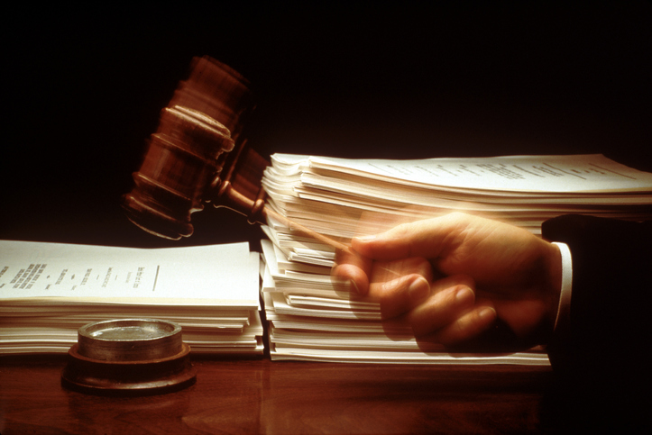
Risks & Opportunities
Climate & Resilience
Cyber
Risk-Based Pricing
Pandemic & Its Impacts
Legal System Abuse
23

Slide 24
Evolution of Climate Risk
Notes:
Polling Question – Word Cloud
When you discuss climate-related risk in your work or personal life, what specific topic is your highest priority?

Slide 25
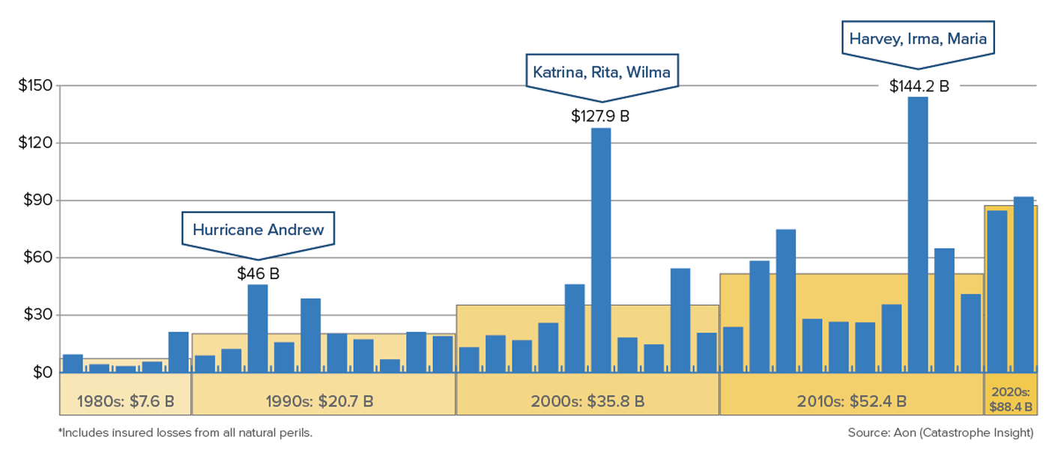
U.S. Catastrophe Losses Steadily Climbing
(U.S. Inflation-Adjusted Losses, $ Billions, 2021)
Insured Cat Losses are Increasing at an Alarming Rate – Nearly 700% Since 80's

Slide 26
Macro Solvency a.k.a. Policyholders Surplus 2009-2022 Quarterly
Surplus at end of Q4 2021 stood at $1,053B, an all-time high
Post-Global Financial Crisis Low
Billions
Policyholder Surplus: Positive
Sources: NAIC data sourced through S&P Global Intelligence; Insurance Information Institute.

Slide 27
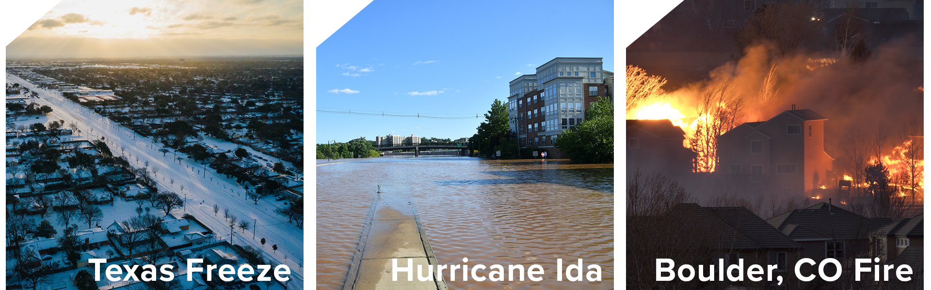
2021 was Preview of Evolving Climate Risk

Slide 28
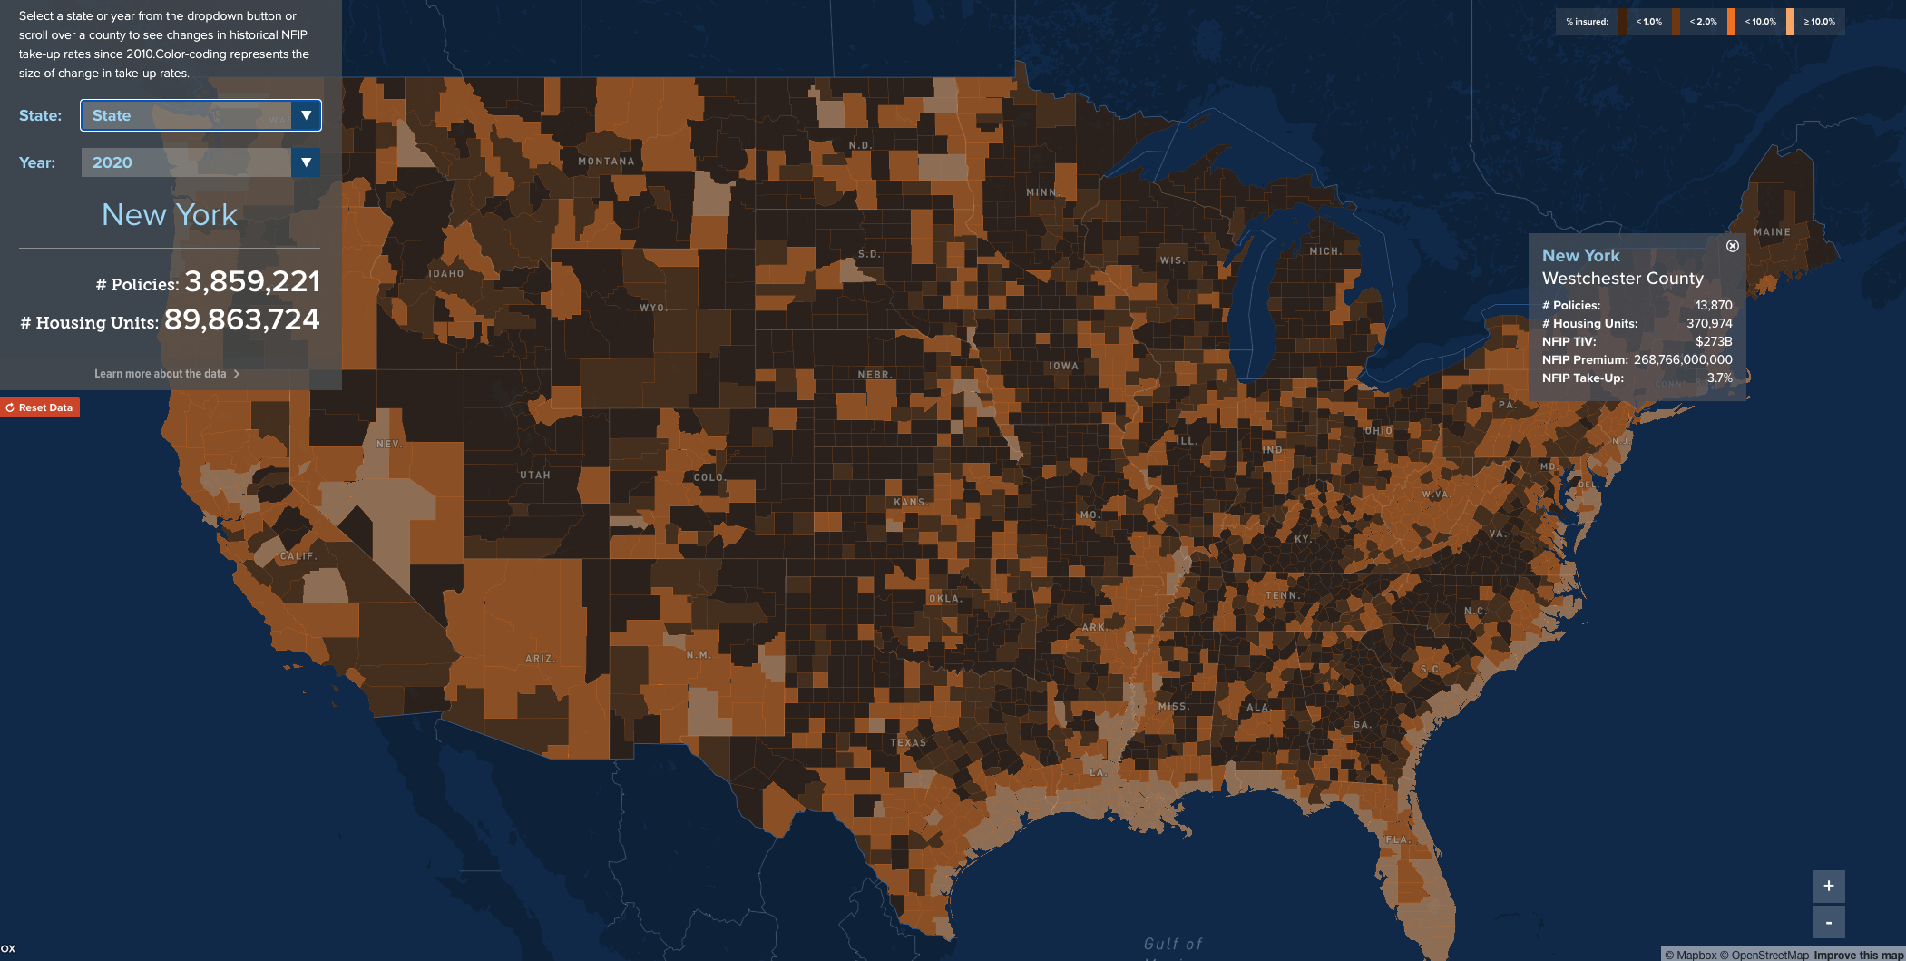
www.resilience.iii.org

Slide 29
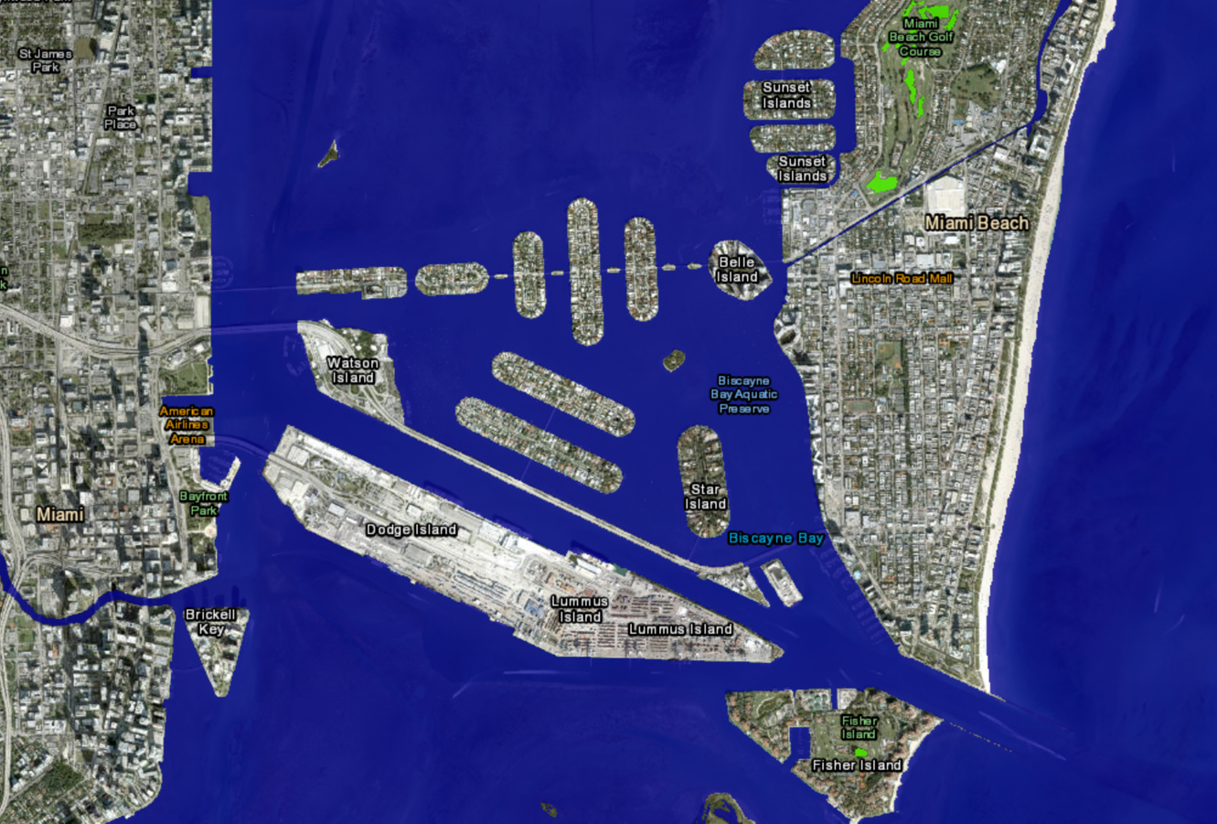
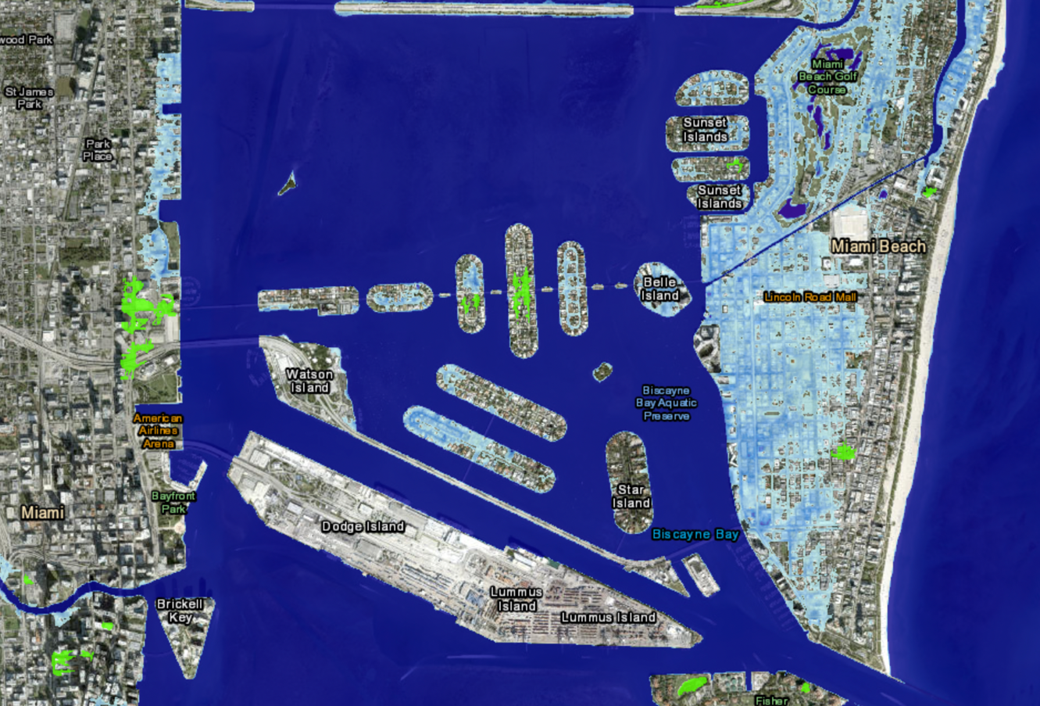
People are Living More In Harm's Way
Miami Beach: 2022
Miami Beach: +3’

Slide 30
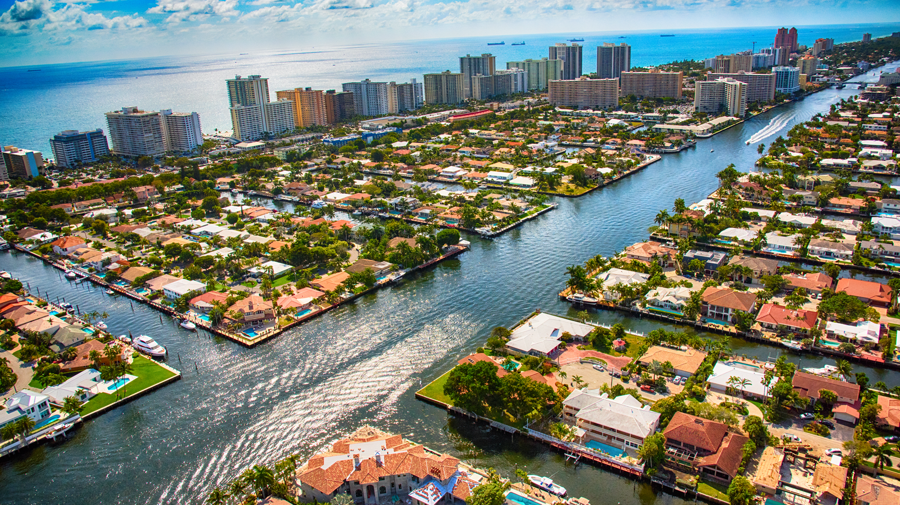


Climate Risk and Resilience
Notes:
For the last three years we have been building out our Resilience Accelerator
The project is really coming to life, and we have a video
VIDEO

Slide 31





Objective
Drive behavioral change to help people and communities better manage risk and become more resilient

Slide 32

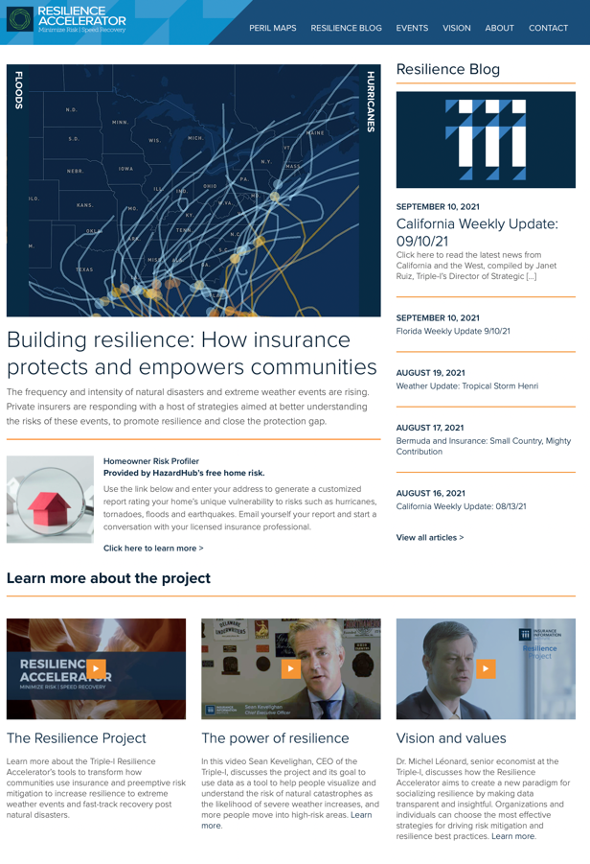
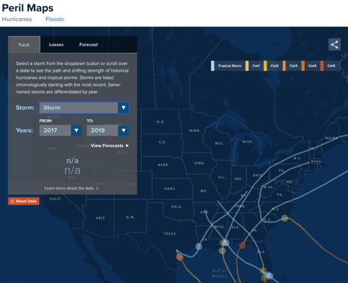
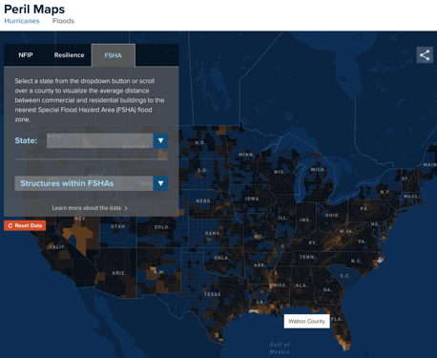
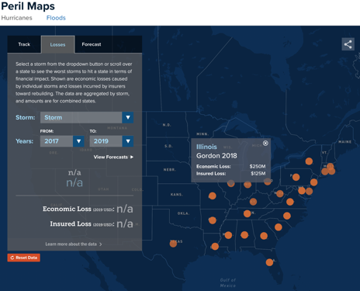
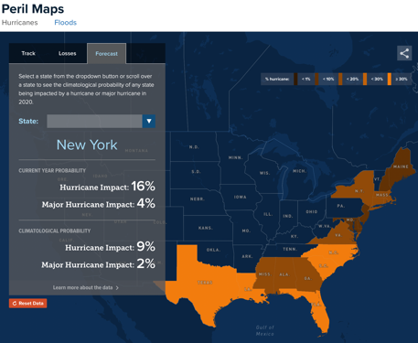
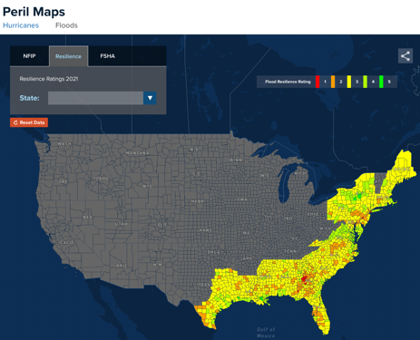
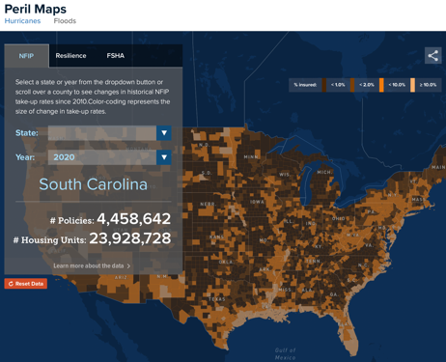
Data-driven resilience insight | resilience.iii.org
Hurricanes Tracker
Flood FSHA Exposure
Hurricanes Insured Losses
Hurricanes Forecasts
Resilience Ratings
NFIP Take-Up Rates
32

Slide 33
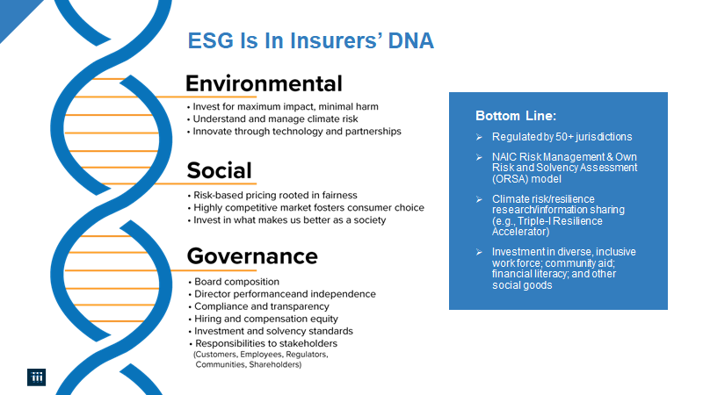

Slide 34

Climate Risk Considerations
Recognize insurance and its role
Remove the politics – focus on the solutions
Be responsible about the low carbon transformation
Balance out the long (carbon) and short (physical infrastructure) risks
Integrate new product options
Notes:
Polling Question:
Which aspect of mitigating climate risk do you consider most important?
Multi-decade carbon reduction commitments
Short-term mitigation of individual homes and businesses
Investments to improve resilience of communities and infrastructure

Slide 35
Evolution of Legal System Abuse

Slide 36
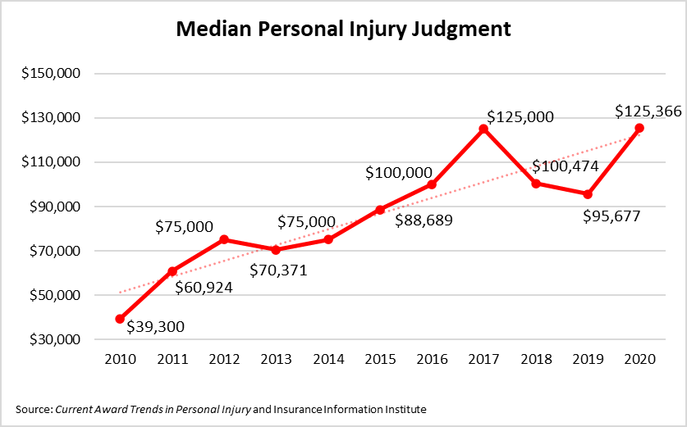
Legal System Abuse & Social Inflation
Social Inflation encapsulates how insurers' claims costs are rising above economic inflation
Social Inflation can arise from myriad sources
Increase in number of outsized jury awards
Legal proceedings taking longer than reasonably expected
Erosion of statutory limits on non-economic damages
Power in the Name – What do we call it?
Insurance professionals commonly use "Social Inflation" - but consumers cannot define it
No name is perfect – we are transitioning to "Legal System Abuse" outside the industry
36
Notes:
Evidence of similar trends found in Other Liability Occurrence and Medical Malpractice Claims-made
Polling Question:
Which term do you think best describes what the insurance industry has historically called “social inflation”?
Legal system abuse
Litigation abuse
Nuclear verdicts
Runaway litigation

Slide 37
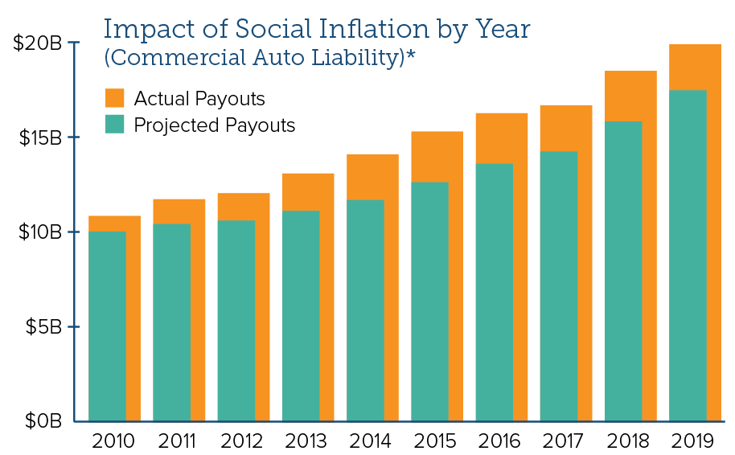
Financial Impact of Social Inflation
Triple-I published research in February 2022 to quantify the impact of social inflation.
Research was funded by CAS Research Grant, and update to be released later in 2022.
Key Findings
Social Inflation increased claims by an estimated $20B (14%) from 2010 to 2019 in Commercial Auto Liability
Evidence of similar trends found in Other Liability Occurrence and Medical Malpractice Claims-made
Issues Brief State of the Risk: Social Inflation
*Triple-I and Casualty Actuarial Society analysis of National Association of Insurance Commissioner (NAIC) data. Social Inflation and Loss Development, Lynch, J. and Moore, D., February 2022
37
Notes:
Absent a universal definition, Triple-I defines Social Inflation as “excessive inflation in claims related to litigation trends”
Study was performed using standard industrywide claim triangles through 2019
Polling Question:
In which product line are you seeing the impacts of social inflation?
Commercial auto
Other commercial liability
Personal auto
Medical Malpractice

Slide 38
And then there’s…Third-Party Litigation Funding
Hedge funds and others invest in lawsuits in exchange for a cut of any settlement
Swiss Re study:
More than half the $17 billion invested in litigation funding globally in 2020 was deployed in the U.S.
Despite the widespread court closures during the pandemic, third-party investment jumped 16% year-over-year in 2021.
$30+ billion industry by 2028, with U.S. market driving growth
Taking hold in U.S. as courts erode bans on "Champerty" and "Maintenance"
TPLF is a speculative financial industry and comparatively unregulated
"Original purpose of champerty prohibitions was to prevent financial speculation in lawsuits, and it was rooted in a general mistrust of litigation and money lending."
– Analysis by Steptoe, an international law firm

Slide 39
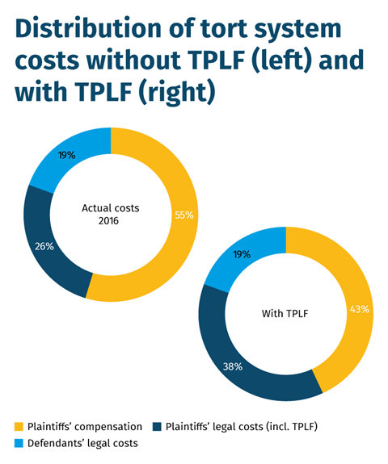
Third-Party Litigation Funding
Who typically provides this money?
Deep-pocketed investors – accredited investors, hedge funds, financial institutions, asset managers, other large funds – seeking above-average returns on their investments
What kinds of cases are funded?
Torts and contract breaches
Personal injury
Class Action
Intellectual Property
Whistleblower
Arbitration
Plaintiff compensation drops to 43% from 55% when TPLF involved
Source: Swiss Re, Institute for Legal Reform, Research Nester

Slide 40
Third-Party Litigation Funding: Key Takeaways
How it works to prolong litigation, boost legal costs, and contribute to social inflation
"David vs Goliath" is no longer primary dynamic
Moral hazard
Less about supporting the right to seek justice
More about speculative profit-seeking for affluent investors: what gets funded are the cases likely to reap big settlements
Sharing the settlement pie in exchange for funding can lead to wanting a bigger pie to resolve the claim
Siphoning of value
Lack of transparency
Plaintiffs: reap less at judgment/settlement
Consumers: absorb higher costs for goods and services due to higher commercial insurance premiums
It's about fair play—if attorneys can communicate across the table about insurance coverage, why not disclose presence of TPLF?

Slide 41
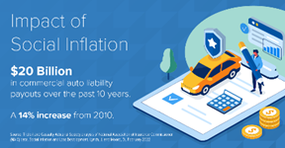
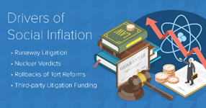
What can be done…Thought Leadership Campaign
Triple-I contracted with a public affairs firm to conduct 2022 thought leadership campaign
Approach starts by driving a substantive conversation with Triple-I members, opinion leaders, regulators, and policymakers
Expands the audience to consumers via social media
Leverages Triple-I content on social inflation, expanding to include industry allies, legal reform groups, and third parties
Target states: New York, Louisiana, Illinois, California
Goal: Lay the groundwork for legal reform in states that could pass third-party litigation funding legislation in coming years

Slide 42
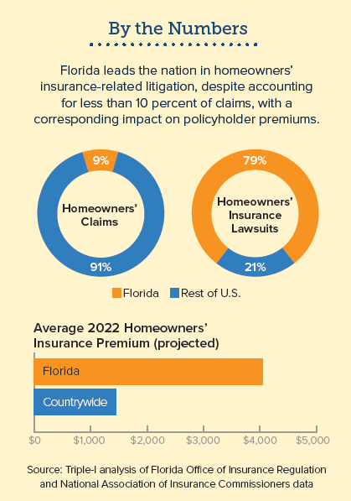
Climate Risk x Legal System Abuse = Property Crisis
Compounding of cats, fraud, and legal system abuse has led to a property crisis in key states
Florida
$51B was paid out by insurers over 10-year period, with 71% going to attorneys' fees and public adjustors*
Six companies have been declared insolvent in 2022 (so far)
Citizens Property Insurance Corp. now insures over 1M policies
Louisiana
2021 Industry Combined Ratio of 462 pts and Underwriting Loss of $7.2B due primarily to Hurricane Ida
Nine companies have been declared insolvent in 2022 (so far)
Lawsuit environment costs the state $3.9B in lost economic activity, imposing a "tort tax" of $451 per resident annually**
*Florida Office of Insurance Regulation
**American Tort Reform Association
42
Notes:
Legal system contributes to LA and FL topping the IRC's ranking of least affordable states for Personal Auto Insurance
Global reinsurers are reducing their appetite for US property risk
Polling Question:
Which mitigating action would you expect to have the greatest opportunity to reduce claim costs?
Curb exploitative attorney advertising
Increase transparency of third-party litigation funding
Reduce contingency rates for attorneys and public adjusters

Slide 43
Summary
STAY IN TOUCH:
www.iii.org
seank@iii.org
A lot of disruption in the world, but insurance is in the business of helping people and communities forge ahead
Economic growth and replacement costs to remain challenging well into 2023 and 2024 as geopolitical risks reach new highs – constraining industry growth and combined ratios
Climate risk and legal system abuse are beginning to compound into a property crisis. Proactively informing the discussion will be critical

Slide 44
THANK YOU!

