Slide 1
Overview & Outlook for the P/C Insurance Industry for 2014 and Beyond
Katie School CPCU Spring ERM Symposium
Illinois State University
Bloomington-Normal, IL
April 2, 2014
Download at www.iii.org/presentations
Robert P. Hartwig, Ph.D., CPCU, President & Economist
Insurance Information Institute ♦ 110 William Street ♦ New York, NY 10038
Tel: 212.346.5520 ♦ Cell: 917.453.1885 ♦ bobh@iii.org ♦ www.iii.org

Slide 2
Risk & Insurance
U.S. and Global Perspective
Is the World Becoming a Riskier, More Uncertain Place?
2

Slide 3

Uncertainty, Risk and Fear Abound: Insurance Can Help Mitigate Risk
Economic Issues in US, Europe
Weakness in China/Emerging Economies
Political Gridlock in the US, Europe, Japan
Fiscal Imbalances
Monetary Policy/Tapering/Low Interest Rates
Unemployment
Political Upheaval in the Ukraine, Middle East
Argentina, Venezuela, Thailand
Resurgent Terrorism Risk
Diffusion of Weapons of Mass Destruction
Cyber Attacks
Record Natural Disaster Losses
Climate Change
Environmental Degradation
Income Inequality
(Over)Regulation
Are “Black Swans” everywhere or does it just seem that way?

Slide 4





5 Major Categories for Global Risks, Uncertainties and Fears: Insurance Solutions
Economic Risks
Geopolitical Risks
Environmental Risks
Technological Risks
Societal Risks
While risks can be broadly categorized, none are mutually exclusive
Source: Adapted from World Economic Forum, Global Risks 2014; Insurance Information Institute.

Slide 5
Top 5 Global Risks in Terms of Likelihood, 2007—2014: Insurance Can Help With Most
In 2014, societal and environ-mental issues dominated frequency concerns
Concerns Shift Considerably Over Short Spans of Time. 2014 Includes a Mix of Environmental Economic, Social and Environmental Risks
Source: World Economic Forum, Global Risks 2014; Insurance Information Institute.
5
12/01/09 - 9pm
eSlide – P6466 – The Financial Crisis and the Future of the P/C
Notes:
5

Slide 6
Top 5 Global Risks in Terms of Impact, 2007—2014: Insurance Can Help With Most
In 2014, economic and environ-mental issues dominated severity concerns
Concerns Over the Impacts of Economics Risks Remained High in 2014, but Societal, Environment and Technological Risks Also Loom Large
Source: World Economic Forum, Global Risks 2014; Insurance Information Institute.
6
12/01/09 - 9pm
eSlide – P6466 – The Financial Crisis and the Future of the P/C
Notes:
6

Slide 7
P/C Insurance Industry Financial Overview
2013: Best Year in the Post-Crisis Era
Performance Improved with Lower CATs, Strong Markets
7

Slide 8
P/C Net Income After Taxes 1991–2013:Q3 ($ Millions)
2005 ROE*= 9.6%
2006 ROE = 12.7%
2007 ROE = 10.9%
2008 ROE = 0.1%
2009 ROE = 5.0%
2010 ROE = 6.6%
2011 ROAS¹ = 3.5%
2012 ROAS¹ = 5.9%
2013:9M ROAS¹ = 9.5%
Net income is up substantially (+54.7%) from 2012:Q3 $27.8B
2013:9M ROAS was 9.5%
ROE figures are GAAP; ¹Return on avg. surplus. Excluding Mortgage & Financial Guaranty insurers yields a 8.9% ROAS through 2013:Q3, 6.2% ROAS in 2012, 4.7% ROAS for 2011, 7.6% for 2010 and 7.4% for 2009.
Sources: A.M. Best, ISO, Insurance Information Institute

Slide 9
Profitability Peaks & Troughs in the P/C Insurance Industry, 1975 – 2013:Q3*
ROE
History suggests next ROE peak will be in 2016-2017
1977:19.0%
1987:17.3%
10 Years
2006:12.7%
1997:11.6%
2013:Q3 8.9%
10 Years
9 Years
2011: 4.7%
1975: 2.4%
1984: 1.8%
1992: 4.5%
2001: -1.2%
*Profitability = P/C insurer ROEs. 2011-13 figures are estimates based on ROAS data. Note: Data for 2008-2013 exclude mortgage and financial guaranty insurers.
Source: Insurance Information Institute; NAIC, ISO, A.M. Best.

Slide 10
A 100 Combined Ratio Isn’t What It Once Was: Investment Impact on ROEs
A combined ratio of about 100 generates an ROE of ~7.0% in 2012, ~7.5% ROE in 2009/10, 10% in 2005 and 16% in 1979
Combined Ratio / ROE
Lower CATs are improved ROEs in 2013
Combined Ratios Must Be Lower in Today’s Depressed Investment Environment to Generate Risk Appropriate ROEs
* 2008 -2013 figures are return on average surplus and exclude mortgage and financial guaranty insurers. 2013:9M combined ratio including M&FG insurers is 95.8; 2012 =103.2, 2011 = 108.1, ROAS = 3.5%.
Source: Insurance Information Institute from A.M. Best and ISO Verisk Analytics data.

Slide 11
RNW All Lines by State, 2003-2012 Average: Highest 25 States
The most profitable states over the past decade are widely distributed geographically, though none are in the Gulf region
Source: NAIC.

Slide 12
RNW All Lines by State, 2003-2012 Average:
Lowest 25 States
Some of the least profitable states over the past decade were hit hard by catastrophes
Source: NAIC.

Slide 13
THE CHALLENGE OF GROWTH
The Economy and Rate Trends the Primary Drivers of Growth
13

Slide 14
Distribution of Direct Premiums Written by Segment/Line, 2012
Personal/Commercial lines split has been about 50/50 for many years; Personal Lines overtook Commercial Lines in 2010
Pvt. Passenger Auto is by far the largest line of insurance and is currently the most important source of industry profits
Billions of additional dollars in homeowners insurance premiums are written by state-run residual market plans
Distribution Facts
2012
Commercial Lines
$215.9B/47%
Homeowners
$66.8B/15%
Pvt. Pass Auto
$167.9B/37%
Sources: A.M. Best; Insurance Information Institute research.

Slide 15
Net Premium Growth: Annual Change, 1971—2013:Q3
(Percent)
1975-78
1984-87
2000-03
Net Written Premiums Fell 0.7% in 2007 (First Decline Since 1943) by 2.0% in 2008, and 4.2% in 2009, the First 3-Year Decline Since 1930-33.
2013:9M = 4.2%
2012 growth was +4.3%
Shaded areas denote “hard market” periods
Sources: A.M. Best (historical and forecast), ISO, Insurance Information Institute.

Slide 16
Distribution of Global Insurance Premiums, 2012 ($ Trillions)
Total Premium Volume = $4.613 Trillion*
Life insurance accounted for nearly 57% of global premium volume in 2012 vs. 43% for Non-Life
Source: Swiss Re, sigma, No. 3/2013; Insurance Information Institute.

Slide 17
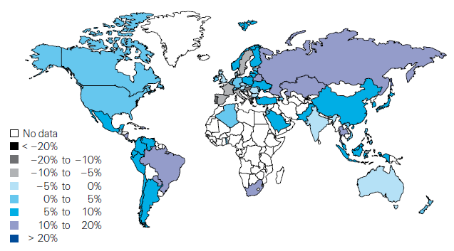
Global Real (Inflation Adjusted) Premium Growth (Life and Non-Life): 2012
Emerging markets in Asia, including China, showed faster growth an the US or Europe
Premium growth in emerging markets was 4 times that of advanced economies in 2012
Market | Life | Non-Life | Total
Advanced | 1.8 | 1.5 | 1.7
Emerging | 4.9 | 8.6 | 6.8
World | 2.3 | 2.6 | 2.4
Source: Swiss Re, sigma, No. 3/2013; Insurance Information Institute.
17
12/01/09 - 9pm
eSlide – P6466 – The Financial Crisis and the Future of the P/C
Notes:
17

Slide 18
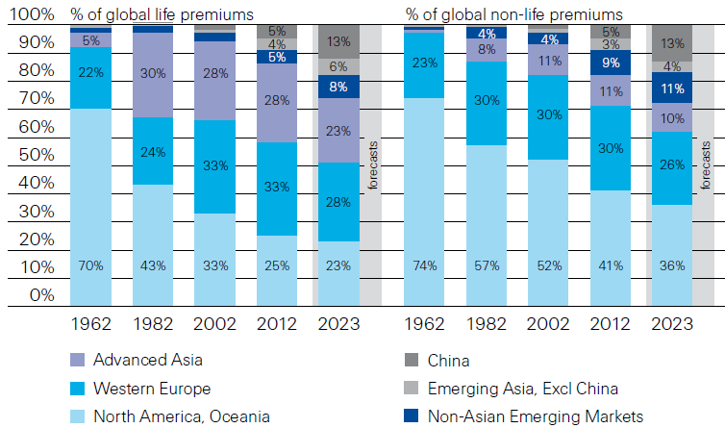
Premiums Written in Life and Non-Life, by Region: 1962-2012
Emerging market shares rose rapidly over the past 50 years
Source: Swiss Re, sigma, No. 3/2013.
18
12/01/09 - 9pm
eSlide – P6466 – The Financial Crisis and the Future of the P/C
Notes:
18

Slide 19
Growth in Direct Written Premium by Line, 2013-2015F*
(Percent)
P/C growth is expected to remain fairly stable through 2015
Source: Conning.

Slide 20
P/C Net Premiums Written: % Change, Quarter vs. Year-Prior Quarter
Premium growth in Q3 2013 was up 3.8% over Q3 2012, marking the 14th consecutive quarter of growth
Sustained Growth in Written Premiums (vs. the same quarter, prior year) Will Continue into 2014
Sources: ISO, Insurance Information Institute.
20
12/01/09 - 9pm
eSlide – P6466 – The Financial Crisis and the Future of the P/C
Notes:
20

Slide 21
Growth in Net Written Premium by Segment, 2013:9M vs. 2012:9M*
(Percent)
*Excludes mortgage and financial guaranty insurers.
Source: ISO/PCI; Insurance Information Institute

Slide 22
Average Commercial Rate Change, All Lines, (1Q:2004–3Q:2013)
Pricing as of Q3:2013 was positive for the 9th consecutive quarter. Gains are likely to continue into 2014.
(Percent)
Q2 2011 marked the last of 30th consecutive quarter of price declines
KRW Effect
Note: CIAB data cited here are based on a survey. Rate changes earned by individual insurers can and do vary, potentially substantially.
Source: Council of Insurance Agents & Brokers; Insurance Information Institute

Slide 23
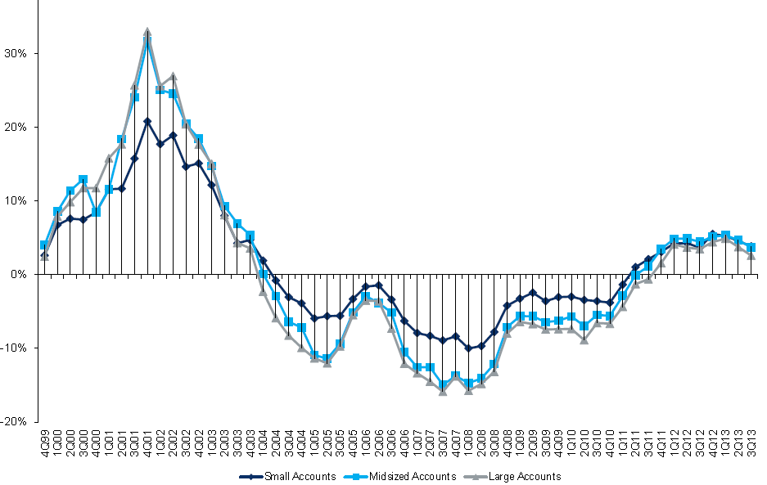
Change in Commercial Rate Renewals, by Account Size: 1999:Q4 to 2013:Q3
Percentage Change (%)
Peak = 2001:Q4 +28.5%
Pricing turned positive in Q3:2011, the first increase in nearly 8 years; Q3:2013 renewals were up 3.4%. Some insurers posted stronger numbers.
Pricing Turned Negative in Early 2004 and Remained that way for 7 ½ years
KRW : No Lasting Impact
Trough = 2007:Q3 -13.6%
Source: Council of Insurance Agents and Brokers; Barclay’s Capital; Insurance Information Institute.
Note: CIAB data cited here are based on a survey. Rate changes earned by individual insurers can and do vary, potentially substantially.

Slide 24
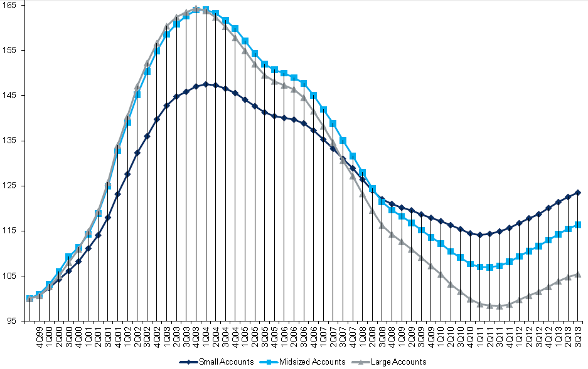
Cumulative Qtrly. Commercial Rate Changes, by Account Size: 1999:Q4 to 2013:Q3
1999:Q4 = 100
Despite 9 consecutive quarters of gains (Q3:2013 = 3.4%), pricing today is where is was in late 2001 (around 9/11), suggesting additional rate need going forward, esp. in light of record low interest rates
Note: CIAB data cited here are based on a survey. Rate changes earned by individual insurers can and do vary, potentially substantially.
Source: Council of Insurance Agents and Brokers; Barclay’s Capital; Insurance Information Institute.

Slide 25
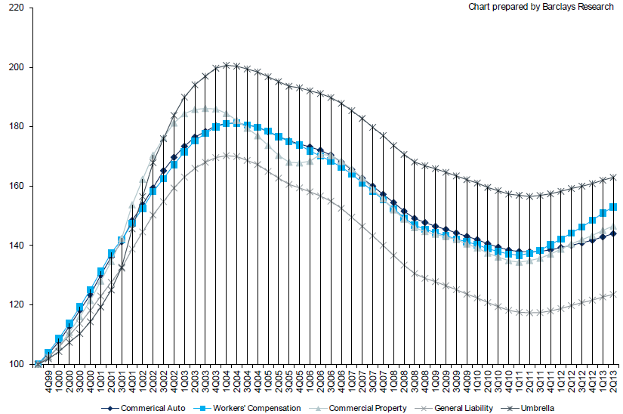
Cumulative Qtrly. Commercial Rate Changes, by Line: 1999:Q4 to 2013:Q2
1999:Q4 = 100
WC rate levels are rising and are now back to where they were in early 2008 and shortly after 9/11
Note: CIAB data cited here are based on a survey. Rate changes earned by individual insurers can and do vary, potentially substantially.
Source: Council of Insurance Agents and Brokers; Barclay’s Capital; Insurance Information Institute.

Slide 26
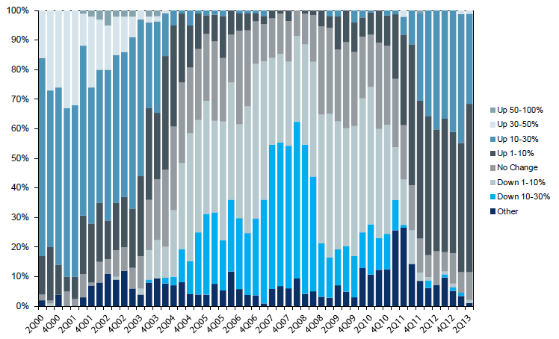
Workers Comp. Quarterly Rate Changes, by Line: 2000:Q1 to 2013:Q2
1999:Q4 = 100
Most accounts are now renewing upwards
Note: CIAB data cited here are based on a survey. Rate changes earned by individual insurers can and do vary, potentially substantially.
Source: Council of Insurance Agents and Brokers; Barclay’s Capital; Insurance Information Institute.

Slide 27
Change in Commercial Rate Renewals, by Line: 2013:Q3
Workers Comp rate increases are large than any other line, followed by Property lines
Percentage Change (%)
Major Commercial Lines Renewed Uniformly Upward in Q3:2013 for the 9th Consecutive Quarter; Property Lines & Workers Comp Leading the Way; Cat Losses and Low Interest Rates Provide Momentum Going Forward
Note: CIAB data cited here are based on a survey. Rate changes earned by individual insurers can and do vary, potentially substantially.
Source: Council of Insurance Agents and Brokers; Insurance Information Institute.

Slide 28
CLIPS: Change in Written Price Level: All Lines, 2010:Q2 – 2012:Q4
Rate changes have been positive for 8 consecutive quarters, longer than any other commercial line
(Percent Change)
Note: Towers Watson data cited here are based on a survey. Rate changes earned by individual insurers can and do vary, potentially substantially.
Source: Towers Watson; Information Institute.

Slide 29
Workers Comp Rate Changes, 2008:Q4 – 2013:Q3
WC rate changes have been positive for 10 consecutive quarters, longer than any other commercial line
(Percent Change)
Note: CIAB data cited here are based on a survey. Rate changes earned by individual insurers can and do vary, potentially substantially.
Source: Council of Insurance Agents and Brokers; Information Institute.

Slide 30
The Future of Healthcare in America
P/C Insurers Are Increasingly Along for the Ride in the American Health Care Saga
30

Slide 31
U.S. Health Care Expenditures, 1965–2022F
$ Billions
From 1965 through 2013, US health care expenditures had increased by 69 fold. Population growth over the same period increased by a factor of just 1.6. By 2022, health spending will have increased 119 fold.
U.S. health care expenditures have been on a relentless climb for most of the past half century, far outstripping population growth, inflation of GDP growth
Sources: Centers for Medicare & Medicaid Services, Office of the Actuary at http://www.cms.gov/Research-Statistics-Data-and-Systems/Statistics-Trends-and-Reports/NationalHealthExpendData/NationalHealthAccountsProjected.html accessed 3/14/14; Insurance Information Institute.

Slide 32
National Health Care Expenditures as a Share of GDP, 1965 – 2022F*
% of GDP
Health care expenditures as a share of GDP rose from 5.8% in 1965 to 18.0% in 2013 and are expected to reach 19.9% of GDP by 2022
2022 19.9%
2010: 17.9%
2000: 13.8%
1990: 12.5%
Since 2009, heath expenditures as a % of GDP have flattened out at about 18%--the question is why and will it last?
1980: 9.2%
1965 5.8%
Sources: Centers for Medicare & Medicaid Services, Office of the Actuary at http://www.cms.gov/Research-Statistics-Data-and-Systems/Statistics-Trends-and-Reports/NationalHealthExpendData/NationalHealthAccountsProjected.html accessed 3/14/14; Insurance Information Institute.

Slide 33
Rate of Health Care Expenditure Increase Compared to Population, CPI and GDP
Accelerating business investment will be a potent driver of commercial property and liability insurance exposures and should drive employment and WC payroll exposures as well (with a lag)
1965: $42.0 Bill
2013: $2,914.7 Bill
1965: $719.1 Bill
2013: $16,797.5 Bill
1965: 194.3 Mill
2013: 317.0 Mill
Source: Insurance Information Institute research.

Slide 34
Medical Cost Inflation vs. Overall CPI, 1995 - 2013
Though moderating, medical inflation will continue to exceed inflation in the overall economy
Average Annual Growth Average
Healthcare: 3.8%
Overall CPI: 2.4%
Sources: Med CPI from US Bureau of Labor Statistics, WC med severity from NCCI based on NCCI states.

Slide 35
States of Play | Management of Health-Insurance Exchanges
Some states are running new health-insurance exchanges on their own. Other are leaving some or all of the task to the federal government.
WA
Federally Run
exchange
MT
ND
ME
OR
MN
VT
State-run
exchange
ID
WI
NY
NH
SD
MA
Federal and
state joint-run
exchange
WY
MI
RI
IA
PA
CT
NV
NE
OH
NJ
UT
IL
IN
DE
CA
CO
WV
VA
MD
KS
MO
KY
TN
NC
AZ
NM
OK
AR
SC
MS
AL
GA
RI
AK
CT
TX
LA
NJ
FL
DE
HI
MD
DC
Source: Wall Street Journal, September 20, 2013.

Slide 36
WC Medical Severity Generally Outpaces the Medical CPI Rate
Average annual increase in WC medical severity form 1995 through 2011 was well above the medical CPI (6.8% vs. 3.8%), but the gap is narrowing.
Sources: Med CPI from US Bureau of Labor Statistics, WC med severity from NCCI based on NCCI states.

Slide 37
The Strength of the Economy Will Influence P/C Insurer Growth Opportunities
Growth Will Expand Insurer Exposure Base Across Most Lines
37

Slide 38
US Real GDP Growth*
The Q4:2008 decline was the steepest since the Q1:1982 drop of 6.8%
Real GDP Growth (%)
Recession began in Dec. 2007. Economic toll of credit crunch, housing slump, labor market contraction was severe
2014/15 are expected to see a modest acceleration in growth
Demand for Insurance Should Increase in 2014/15 as GDP Growth Accelerates Modestly and Gradually Benefits the Economy Broadly
* Estimates/Forecasts from Blue Chip Economic Indicators.
Source: US Department of Commerce, Blue Economic Indicators 3/14; Insurance Information Institute.

Slide 39
Real GDP by State Percent Change, 2012: Highest 25 States
North Dakota was the economic growth juggernaut of the US in 2012—by far
Only 10 states experienced growth in excess of 3%, which is what we would see nationally in a more typical recovery
Sources: US Bureau of Labor Statistics; Insurance Information Institute.

Slide 40
Real GDP by State Percent Change, 2012:
Lowest 25 States
Growth rates in 8 states (and DC) were still below 1% in 2012
Connecticut was the only state to shrink in 2012
Sources: US Bureau of Labor Statistics; Insurance Information Institute.

Slide 41
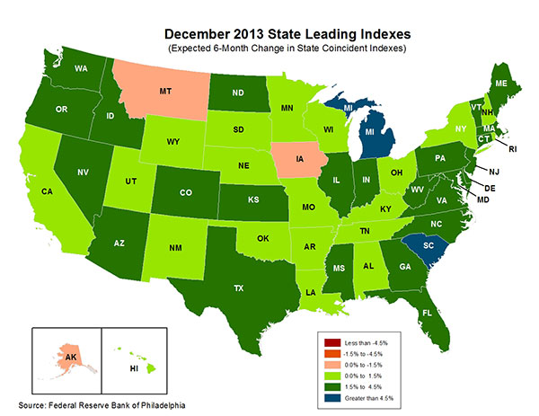
State-by-State Leading Indicators through 2014:Q2
The economic outlook for most of the US is positive for the first time in many years
Sources: Federal Reserve Bank of Philadelphia at http://www.philadelphiafed.org/index.cfm ;Insurance Information Institute.

Slide 42
Consumer Sentiment Survey (1966 = 100)
January 2010 through March 2014
Optimism among consumers dropped in Q3 2013 as the government shutdown created uncertainty, then rebounded though the harsh winter took a toll
Impact of 2011 budget impasse
Consumer confidence has been low for years amid high unemployment, falling home prices and other factors adversely impact consumers, but improved substantially over the past 2+ years, though uncertainty in Washington sometimes takes a toll.
Source: University of Michigan; Insurance Information Institute

Slide 43
Net Worth of Households* Recently Hit A Historic High
2008-09 recession: -15.7%
$ Trillions
Adjusted for population growth, net worth is slightly short of its prior peak
Housing “bubble”
2001 recession
1992 recession
1982 recession
Rising net worth fuels a “wealth affect” that helps fuel consumer spending, which accounts for 70% of spending in the U.S. economy
*and nonprofit organizations. Data are as of year-end, except in 2013:Q3 (data posted on Dec 9, 2013). Next release March 6, 2014. Data not seasonally adjusted or inflation-adjusted Source: Federal Reserve Board

Slide 44
Household Financial Obligations Ratio Recently Hit A Historic Low
Financial Obligations Ratio
Financial Obligations Ratio: debt service (mortgage and consumer debt), auto lease, residence rent, HO insurance, and property tax payments as % of personal disposable income.
Household balance sheets are stronger than they’ve been in many years, setting the stage for more consumer spending
Decline began in 2008:Q1.
15.23% in 2012:Q4 is lowest ratio since 1980:Q4 (15.09%).
*through 2013:Q3 (data posted on Dec 13, 2013) Source: Federal Reserve Board, at http://www.federalreserve.gov/releases/housedebt

Slide 45
Auto/Light Truck Sales, 1999-2019F
Job growth and improved credit market conditions will boost auto sales in 2014 and beyond
(Millions of Units)
New auto/light truck sales fell to the lowest level since the late 1960s. Forecast for 2013-14 is still below 1999-2007 average of 17 million units, but a robust recovery is well underway.
Truck purchases by contractors are especially strong
Car/Light Truck Sales Will Continue to Recover from the 2009 Low Point, Bolstering the Auto Insurer Growth and the Manufacturing Sector Along With Workers Comp Exposures
Source: U.S. Department of Commerce; Blue Chip Economic Indicators (3/14 and 3/13); Insurance Information Institute.

Slide 46
Personal Auto Insurance Direct Written Premiums vs. Recently-Registered Cars
$ Billions
4%/yr growth forecast for PP DWP from recovering new car/truck sales
In 2004-07 no growth in PP DWP despite strong new car/truck sales
New car/truck sales grow to 14-15M/year
Average age of registered cars rose as fewer new cars were bought (and insured)
PP DWP, flat from 2004-2009, is rising again. Conning forecasts growth at 3.5% in 2013 and 4.0% in 2014.
Sources: AIPSO Facts (various issues); SNL Financial; Conning Research & Consulting, Property-Casualty Forecast and Analysis, First Quarter 2012; Insurance Information Institute.

Slide 47
Average Age of Vehicles on the Road, 2006—2013
Average vehicle age continues to increase because the slow economy leads many drivers to keep cars on the road longer and because cars are becoming more reliable
The average vehicle age reached a record 11.4 years in 2013
Average Vehicle
Age (Years)
The average age of a vehicle on the road is is expected to continue to increase until 2018. By 2018, the number of vehicles 12+ years old is expected to rise 11.6% from 2013 and the number that are under 5 years old is expected to increase by 41%
Sources: Polk, August 2013 Survey; Insurance Information Institute.
47
12/01/09 - 9pm
eSlide – P6466 – The Financial Crisis and the Future of the P/C
Notes:
47

Slide 48
Monthly Change* in Auto Insurance Prices, 1991–2014*
Cyclical peaks in PP Auto tend to occur approximately every 10 years (early 1990s, early 2000s and likely the early 2010s)
Pricing peak occurred in late 2010 at 5.3%, falling to 2.8% by Mar. 2012
“Hard” markets tend to occur during recessionary periods
The Jan. 2014 reading of 3.4% down from 4.9% a year earlier
*Percentage change from same month in prior year; through January 2014; seasonally adjusted
Note: Recessions indicated by gray shaded columns.
Sources: US Bureau of Labor Statistics; National Bureau of Economic Research (recession dates); Insurance Information Institutes.
48
12/01/09 - 9pm
eSlide – P6466 – The Financial Crisis and the Future of the P/C
Notes:
48

Slide 49
Monthly Change* in Auto Insurance Prices, January 2005 - December 2013
Pricing weakened in 2011, strengthened in 2012/early 2013 but has since moderated
(Percent Change from same month, prior year)
Auto Insurance Price Increases Averaged 5.1% in 2010 over 2009, After Averaging 4.5% in 2009 over 2008.
PPA Auto, like most p/c lines, exhibits strong cyclicality in pricing. Prices rose from 2000 to late 2005, were flat/falling in 2006 and 2007 before beginning to rise gain in 2008.
Underwriting performance remained strong even when prices were flat or falling due to improvements in underlying frequency and severity trends
* Percentage change from same month in prior year, seasonally adjusted.
Sources: US Bureau of Labor Statistics; Insurance Information Institute

Slide 50
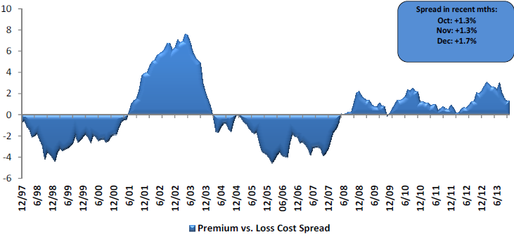
Private Passenger Auto: Premium Growth vs. Loss Cost Spread
Premium growth has generally exceeded underlying loss cost trends since mid-2008
Sources: Evercore Equity Research, Jan. 2014.

Slide 51
Average Expenditures* on Auto Insurance, 1994-2014F
Annual Pct Changes 2001: 5.2% 2002: 8.6% 2003: 5.6%
2004: 1.5% 2005: -1.3% 2006: -1.8% 2007: -2.1% 2008: -1.0% 2009: -0.5% 2010: 0.6% 2011: 0.6%
The average expenditure on auto insurance is lower today than it was in 2004
Across the U.S., auto insurance expenditures fell by 0.8% in 2008 and 0.5% in 2009 but rose 0.5% in 2010 and 0.8% in 2011. I.I.I. estimates for 2012-2014 are each +2.0%.
* The NAIC data are per-vehicle (actually, per car-year)
Sources: NAIC for 1994-2011; Insurance Information Institute estimates for 2012-2014 based on CPI and other data.

Slide 52
Annual Pct. Change in Avg. Expenditures on Auto Insurance, vs. Auto Insurance Prices, 1995-2011
Annual auto insurance price changes, as measured by the BLS, have been 2 to 4 percentage points higher than NAIC data since 2005
Annual auto insurance price changes, as measured by the BLS, roughly matched NAIC expenditure data from 1995-2004
The gap since 2005 between price changes and expenditures on auto insurance might be due to buyers increasing deductibles, obtaining discounts, and other premium-reducing behavior.
Sources: NAIC for 1994-2011; BLS for auto price changes; I.I.I.

Slide 53
New Private Housing Starts, 1990-2019F
Job growth, low inventories of existing homes, low mortgage rates and demographics should continue to stimulate new home construction for several more years
(Millions of Units)
New home starts plunged 72% from 2005-2009; A net annual decline of 1.49 million units, lowest since records began in 1959
Insurers Are Continue to See Meaningful Exposure Growth in the Wake of the “Great Recession” Associated with Home Construction: Construction Risk Exposure, Surety, Commercial Auto; Potent Driver of Workers Comp Exposure
Source: U.S. Department of Commerce; Blue Chip Economic Indicators (3/14 and 3/13); Insurance Information Institute.

Slide 54
Average Premium for Home Insurance Policies**
Annual Pct Changes 2001: 5.5% 2002: 10.6% 2003: 12.7%
2004: 9.1% 2005: 4.8% 2006: 5.2% 2007: 2.2% 2008: 1.0% 2009: 6.0% 2010: 3.3% 2011: 7.6%
Across the U.S., home insurance expenditures rose by an estimated 4.0% in 2012-2014
* Insurance Information Institute Estimates/Forecasts **Excludes state-run insurers.
Sources: NAIC; Insurance Information Institute estimates for 2012-2014 based on CPI data and other data.

Slide 55
Homeowners Insurance Net Written Premium, 2000–2015F
$ Billions
Homeowners insurance NWP continues to rise (up 128% 2000-2013) despite very little unit growth during the real estate crash. Reasons include rate increases, especially in coastal zones, ITV endorsements (e.g., “inflation guards”), and inelastic demand
Sources: A.M. Best; Insurance Information Institute.

Slide 56
Average Premiums For Home Insurance By State, 2011* (1)
Top 25 States and DC
*Latest available.
(1) Based on the HO-3 homeowner package policy for owner-occupied dwellings, 1 to 4 family units. Provides “all risks” coverage (except those specifically excluded in the policy) on buildings and broad named-peril coverage on personal property, and is the most common package written.
Note: Average premium=Premiums/exposure per house years. A house year is equal to 365 days insured coverage for a single dwelling. Source: NAIC; Insurance Information Institute.

Slide 57
Average Premiums For Home Insurance By State, 2011* (1)
Bottom 25 States
Latest available
(1) Based on the HO-3 homeowner package policy for owner-occupied dwellings, 1 to 4 family units. Provides “all risks” coverage (except those specifically excluded in the policy) on buildings and broad named-peril coverage on personal property, and is the most common package written.
Note: Average premium=Premiums/exposure per house years. A house year is equal to 365 days insured coverage for a single dwelling. Source: © 2013 National Association of Insurance Commissioners (NAIC). Reprinted with permission. Further reprint or distribution strictly prohibited without written permission of NAIC.

Slide 58
Estimated Median Rate For Home Insurance By State, 2011* (1)
Top 25 States
Chart answers question: What is the rate to insure the average home in the state?
*Latest available.
(1) Based on the HO-3 homeowner package policy for owner-occupied dwellings, 1 to 4 family units. Provides “all risks” coverage (except those specifically excluded in the policy) on buildings and broad named-peril coverage on personal property, and is the most common package written.
Note: Estimated median = average premium in median insurance range/estimated average insurance value in that range. Source: Insurance Information Institute estimate from NAIC data.

Slide 59
Estimated Median Rate For Home Insurance By State, 2011* (1)
Bottom 25 States and DC
*Latest available.
(1) Based on the HO-3 homeowner package policy for owner-occupied dwellings, 1 to 4 family units. Provides “all risks” coverage (except those specifically excluded in the policy) on buildings and broad named-peril coverage on personal property, and is the most common package written.
Note: Estimated median = average premium in median insurance range/estimated average insurance value in that range. Source: Insurance Information Institute estimate from NAIC data.

Slide 60
Interest Rate on Convention 30-Year Mortgages: Headed Back Up, 1990–2014*
Yields on 30-Year Mortgages in the U.S. plunged to all time record lows in late 2012 and early 2013 but have risen as the Fed proceeds with tapering of its QE program
Yields on 30-Year mortgages have been below 6% for a five years
30-yr. mortgage rates are up 80 basis points over the past 12 months
High mortgage interest should have only a marginal impact on home buying
*Monthly, through February 2014. Note: Recessions indicated by gray shaded columns.
Sources: Federal Reserve Bank at http://www.federalreserve.gov/releases/h15/data.htm. National Bureau of Economic Research (recession dates); Insurance Information Institutes.
60
12/01/09 - 9pm
eSlide – P6466 – The Financial Crisis and the Future of the P/C
Notes:
60

Slide 61
30-Year Mortgages in 2013 Are Rising: What Will Be the Impact on Construction?
30-year mortgage rates were up sharply from their lows earlier in the year
Mortgage Interest Rates Will Rise as Expectations Over the Fed’s Tapering of QE3 Persist; Still Low by Historical Standards
*Weekly through November 14, 2013.
Sources: Federal Reserve Bank at http://www.federalreserve.gov/releases/h15/data.htm.; Insurance Information Institutes.
61
12/01/09 - 9pm
eSlide – P6466 – The Financial Crisis and the Future of the P/C
Notes:
61

Slide 62
Commercial & Industrial Loans Outstanding at FDIC-Insured Banks, Quarterly, 2006-2013*
$Trillions
Recession
In nominal dollar terms, this is an all-time high.
Outstanding loan volume has been growing for over two years and (as of year-end 2012) surpassed previous peak levels.
*Latest data as of 2/2/2014.
Source: FDIC at http://www2.fdic.gov/qbp/ (Loan Performance spreadsheet); Insurance Information Institute.

Slide 63
Percent of Non-Current Commercial & Industrial Loans Outstanding at FDIC-Insured Banks, Quarterly, 2006-2013:Q3*
Recession
Almost back to “normal” levels of noncurrent industrial & commercial loans
Non-current loans (those past due 90 days or more or in nonaccrual status) are nearly back to early-recession levels, fueling bank willingness to lend.
*Latest data as of 2/2/2014.
Source: FDIC at http://www2.fdic.gov/qbp/ (Loan Performance spreadsheet); Insurance Information Institute.

Slide 64
ISM Manufacturing Index
(Values > 50 Indicate Expansion)
January 2010 through February 2014
Manufacturing continued to expand in early 2014
The manufacturing sector expanded for 48 of the 50 months from Jan. 2010 through February 2014. Weakness in early 2014 stems largely from harsh winter weather and weakness in China.
Source: Institute for Supply Management at http://www.ism.ws/ismreport/mfgrob.cfm; Insurance Information Institute.

Slide 65
Dollar Value* of Manufacturers’ Shipments Monthly, Jan. 1992—Dec. 2013
$ Millions
The value of Manufacturing Shipments in Dec. 2013 was $492.7B—a near record high.
Monthly shipments in Dec. 2013 exceeded the pre-crisis (July 2008) peak. Manufacturing is energy-intensive and growth leads to gains in many commercial exposures: WC, Commercial Auto, Marine, Property, and various Liability Coverages.
*seasonally adjusted; Dec. 2013 is preliminary; data published February 4, 2014. Source: U.S. Census Bureau, Full Report on Manufacturers’ Shipments, Inventories, and Orders, http://www.census.gov/manufacturing/m3/
65
12/01/09 - 9pm
eSlide – P6466 – The Financial Crisis and the Future of the P/C
Notes:
65

Slide 66
Manufacturing Employment, Jan. 2010—February 2014*
(Thousands)
Since Jan 2010, manufacturing employment is up (+605,000 or +5.3%) and still growing.
Manufacturing employment is a surprising source of strength in the economy. Employment in the sector is at a multi-year high.
*Seasonally adjusted; Jan. and Feb. 2014 are preliminary
Sources: US Bureau of Labor Statistics at http://data.bls.gov; Insurance Information Institute.
66
12/01/09 - 9pm
eSlide – P6466 – The Financial Crisis and the Future of the P/C
Notes:
66

Slide 67
Business Investment: Expected to Accelerate, Fueling Commercial Exposure Growth
Accelerating business investment will be a potent driver of commercial property and liability insurance exposures and should drive employment and WC payroll exposures as well (with a lag)
Source: IHS Global Insights as of Jan. 13, 2014; Insurance Information Institute.

Slide 68
Manufacturing Growth for Selected Sectors, 2013 vs. 2012*
Growth (%)
Durables: +3.4%
Non-Durables: +0.2%
Manufacturing of durable goods was especially strong in 2012 but weakened in 2013
Manufacturing Is Expanding—Albeit Slowly—Across a Number of Sectors that Will Contribute to Growth in Insurable Exposures Including: WC, Commercial Property, Commercial Auto and Many Liability Coverages
*Seasonally adjusted; Date are YTD comparing data through November 2013 to the same period in 2012. Source: U.S. Census Bureau, Full Report on Manufacturers’ Shipments, Inventories, and Orders, http://www.census.gov/manufacturing/m3/

Slide 69
Durable Manufacturing: New Order Growth and Shipments, 2013
Most manufacturing sectors indicate order growth outstripping shipments, a favorable indicator for investment and expansion
Growth (%)
Manufacturing Is Expanding: New orders exceed shipments which suggests the industry is in an expansionary phase
*Seasonally adjusted; Date are advance report YTD data comparing data through December 2013 to the same period in 2012. Source: U.S. Census Bureau, Full Report on Manufacturers’ Shipments, Inventories, and Orders, http://www.census.gov/manufacturing/m3/

Slide 70
Recovery in Capacity Utilization is a Positive Sign for Commercial Exposures
March 2001 through December 2013
“Full Capacity”
The US operated at 79.2% of industrial capacity in Dec. 2013, well above the June 2009 low of 66.9% but is still below pre-recession levels.
Percent of Industrial Capacity
Hurricane Katrina
The closer the economy is to operating at “full capacity,” the greater the inflationary pressure
March 2001-November 2001 recession
December 2007- June 2009 Recession
70
Source: Federal Reserve Board statistical releases at http://www.federalreserve.gov/releases/g17/Current/default.htm.
Notes:
70

Slide 71
Nonfarm Payroll (Wages and Salaries): Quarterly, 2005–2013:Q4
Billions
Latest (2013:Q4) was $7.23 trillion, a new peak--$980B above 2009 trough
Prior Peak was 2008:Q1 at $6.60 trillion
Payrolls are 15.7% above their 2009 trough and up 2.0% over the past year
Recent trough (2009:Q3) was $6.25 trillion, down 5.3% from prior peak
Note: Recession indicated by gray shaded column. Data are seasonally adjusted annual rates.
Sources: http://research.stlouisfed.org/fred2/series/WASCUR; National Bureau of Economic Research (recession dates); Insurance Information Institute.
71
12/01/09 - 9pm
eSlide – P6466 – The Financial Crisis and the Future of the P/C
Notes:
71

Slide 72
ISM Non-Manufacturing Index
(Values > 50 Indicate Expansion)
January 2010 through February 2014
Optimism among non-manufacturers was hurt by the uncertainty in Washington, but remains resilient
Non-manufacturing industries have been expanding and adding jobs. This trend is likely to continue through 2014.
Source: Institute for Supply Management at http://www.ism.ws/ismreport/nonmfgrob.cfm; Insurance Information Institute.

Slide 73
Business Bankruptcy Filings, 1980-2013
% Change Surrounding Recessions
1980-82 58.6%
1980-87 88.7%
1990-91 10.3%
2000-01 13.0%
2006-09 208.9%
2013 bankruptcies totaled 33,212, down 17.1% from 2012—the fourth consecutive year of decline. Business bankruptcies more than tripled during the financial crisis.
Significant Exposure Implications for All Commercial Lines as Business Bankruptcies Begin to Decline
Sources: American Bankruptcy Institute (1980-2012) at http://www.abiworld.org/AM/AMTemplate.cfm?Section=Home&TEMPLATE=/CM/ContentDisplay.cfm&CONTENTID=61633; 2013 data from United States Courts at http://news.uscourts.gov; Insurance Information Institute.
73
12/01/09 - 9pm
eSlide – P6466 – The Financial Crisis and the Future of the P/C
Notes:
73

Slide 74
Private Sector Business Starts, 1993:Q2 – 2012:Q4*
Business Starts 2006: 872,000 2007: 843,000 2008: 790,000 2009: 697,000 2010: 742,000 2011: 748,000 2012: 769,000
(Thousands)
Business starts were up 2.8% in 2012 to 769,000 following a 2.2% gain to 748,000 in 2011. Start-ups could accelerate in 2013.
Business Starts Were Down Nearly 20% in the Recession, Holding Back Most Types of Commercial Insurance Exposure, But Are Recovering Slowly
* Data through Dec. 30, 2012 are the latest available as of Nov. 21, 2013; Seasonally adjusted.
Source: Bureau of Labor Statistics, http://www.bls.gov/news.release/cewbd.t08.htm.
74
12/01/09 - 9pm
eSlide – P6466 – The Financial Crisis and the Future of the P/C
Notes:
74

Slide 75
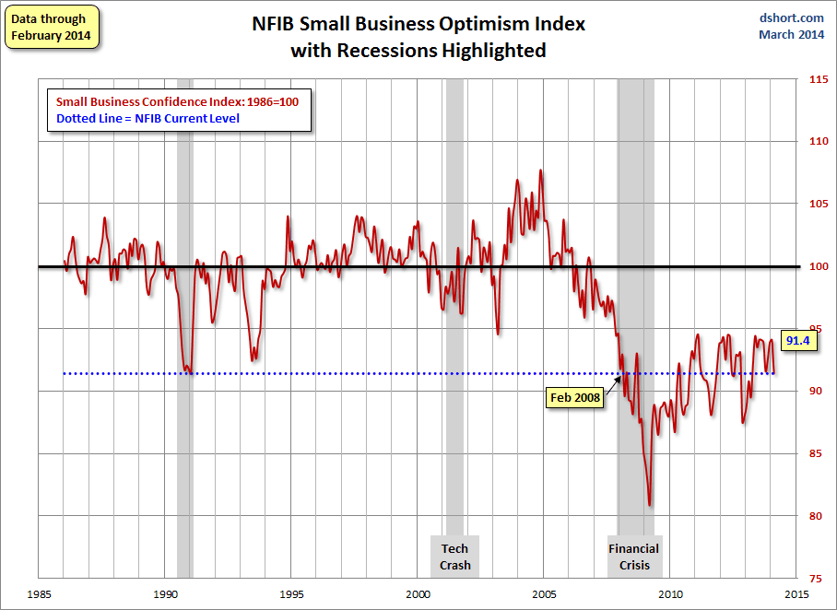
NFIB Small Business Optimism Index
January 1985 through February 2014
Small business optimism is off crisis lows but still suffering from economic and regulatory uncertainty. Confidence today is basically where it was when the crisis began in Dec. 2007.
Source: National Federation of Independent Business at http://www.advisorperspectives.com/dshort/charts/indicators/Sentiment.html?NFIB-optimism-index.gif ; Insurance Information Institute.

Slide 76
12 Industries for the Next 10 Years: Insurance Solutions Needed
Health Care
Health Sciences
Energy (Traditional)
Many industries are poised for growth, though insurers’ ability to capitalize on these industries varies widely
Alternative Energy
Petrochemical
Agriculture
Natural Resources
Technology (incl. Biotechnology)
Light Manufacturing
Insourced Manufacturing
Export-Oriented Industries
Shipping (Rail, Marine, Trucking, Pipelines)

Slide 77
U.S. Electricity Generation by Fuel,
1990 - 2040
Trillions of kilowatt Hours
Electricity consumption in the US will rise steadily along with the fuel shares of natural gas and renewables
Sources: US Energy Information Administration, Annual Energy Outlook 2014 Early Release Overview; ;Insurance Information Institute.

Slide 78
U.S. Primary Energy Consumption by Fuel, 1990 - 2040
Quadrillion BTUs
Energy consumption in the US will rise steadily with natural gas fueling most of the additional consumption
Sources: US Energy Information Administration, Annual Energy Outlook 2014 Early Release Overview; ;Insurance Information Institute.

Slide 79
U.S. Petroleum and Other Liquid Fuel Supplies by Source, 1990 - 2040
Millions of Barrels per Day
Liquid fuel consumption is expected to change little through 2040, though “tight” oil will account for a much larger share thereby reducing imports of petroleum products
Sources: US Energy Information Administration, Annual Energy Outlook 2014 Early Release Overview; ;Insurance Information Institute.

Slide 80
U.S. Natural Has Imports and Exports, 1990 - 2040
Trillions of Cubic Feet
The US is now the largest gas producer in the world, though Russia is the largest exporter. The US needs to invest in its pipeline and LNG infrastructure and expedite regulatory approval to realize its full export potential
Sources: US Energy Information Administration, Annual Energy Outlook 2014 Early Release Overview; ;Insurance Information Institute.

Slide 81
CONSTRUCTION INDUSTRY OVERVIEW & OUTLOOK
The Construction Sector Is Critical to the Economy and the P/C Insurance Industry
81

Slide 82
Value of New Private Construction: Residential & Nonresidential, 2003-2013*
2013: Value of new pvt. construction hits $667.5B, up 33% from the 2010 trough but still 27% below 2006 peak
New Construction peaks at $911.8. in 2006
Billions of Dollars
Trough in 2010 at $500.6B, after plunging 55.1% ($411.2B)
$15.0
$613.7
$311.5
$298.1
$261.8
$238.8
$356.0
Private Construction Activity Is Moving in a Positive Direction though Remains Well Below Pre-Crisis Peak; Residential Dominates
*2013 figure is a seasonally adjusted annual rate as of December.
Sources: US Department of Commerce; Insurance Information Institute.
82
12/01/09 - 9pm
eSlide – P6466 – The Financial Crisis and the Future of the P/C
Notes:
82

Slide 83
New Home Inventories and Rental Vacancy Rates, 2003-2013*
(Thousands)
Low new home inventories and falling vacancy rates bode well for residential construction
*2013 figure is a seasonally adjusted annual rate as of June.
Sources: US Department of Commerce; Insurance Information Institute.

Slide 84
Change from Peak in New Construction Expenditures to 2013*
Change (%)
Residential
Nonresidential
Govt.
Despite Recent Improvements, Construction Activity (and Employment) Remains Far Below Pre-Crisis Peaks
Note: Year in parentheses is the year of peak expenditure.
*2013 figure is a seasonally adjusted annual rate as of June.
Sources: US Department of Commerce; Insurance Information Institute.

Slide 85
Value of Construction Put in Place, January 2014 vs. January 2013*
Growth (%)
Private: +12.3%
Public: +2.5%
Private sector construction activity is now up in the residential and nonresidential segments
Public sector construction activity remains low but is no longer contracting
Overall Construction Activity is Up, But Growth Is Almost Entirely in the Private Sector as State/Local Government Budget Woes Continue
*seasonally adjusted Source: U.S. Census Bureau, http://www.census.gov/construction/c30/c30index.html ; Insurance Information Institute.

Slide 86
Value of Private Construction Put in Place, by Segment, Jan. 2014 vs. Jan. 2013*
Growth (%)
Led by the Residential Construction, Lodging, Communication and Office segments, Private sector construction activity is rising after plunging during the “Great Recession.”
Private Construction Activity is Up in Most Segments, Including the Key Residential Construction Sector; Bodes Well for Early 2014
*seasonally adjusted Source: U.S. Census Bureau, http://www.census.gov/construction/c30/c30index.html ; Insurance Information Institute.

Slide 87
Private Construction by Segment/Project Type, Jan. 2014 vs. Jan. 2013*
Shopping malls/centers and warehouse construction are among the strongest nonresidential segments
Growth (%)
Private Construction Activity is Up in Many Segments, Including the Key Residential Construction Sector, But Down in a Few
*seasonally adjusted Source: U.S. Census Bureau, http://www.census.gov/construction/c30/c30index.html ; Insurance Information Institute.

Slide 88
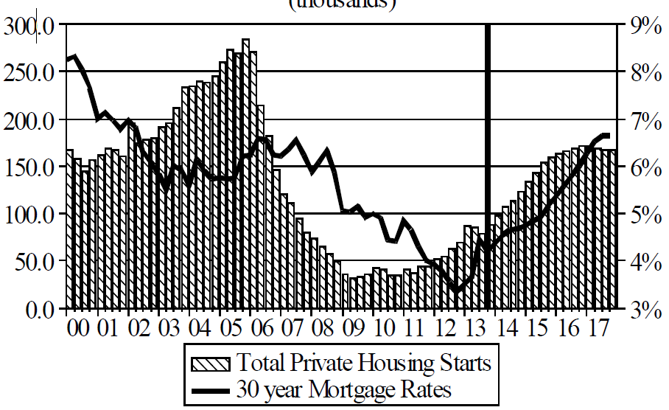
Florida Total Private Housing Starts, 2000 – 2017F
(Thousands of Units)
CRASH, CRATER, RECOVERY Homebuilding in FL continues to recover, adding substantially to coastal exposures.
The economic outlook for most of the US is positive for the first time in many years
Source: University of Central Florida Institute for Economic Competitiveness: http://iec.ucf.edu/post/2014/01/07/Florida-Metro-Forecast-December-2013.aspx

Slide 89
Value of New Federal, State and Local Government Construction: 2003-2013*
Construction across all levels of government peaked at $314.9B in 2009
Austerity Reigns
Govt. construction is still shrinking, down $40.5B or 12.9% since 2009 peak
($ Billions)
Government Construction Spending Peaked in 2009, Helped by Stimulus Spending, but Continues to Contract As State/Local Governments Grapple with Deficits and Federal Sequestration Takes Hold
*2013 figure is a seasonally adjusted annual rate as of December.
Sources: US Department of Commerce; Insurance Information Institute.

Slide 90
Value of Public Construction Put in Place, by Segment, Jan. 2014 vs. Jan. 2013*
Public sector construction activity is down substantially in most segments, a situation that will likely persist, dragging on public entity risk exposures
Highway, Transport, and Power projects lead public sector construction
Growth (%)
Public Construction Activity is Down in Many Segments as State and Local Budgets Remain Under Stress; Improvement Possible in 2014.
*seasonally adjusted Source: U.S. Census Bureau, http://www.census.gov/construction/c30/c30index.html ; Insurance Information Institute.

Slide 91
Public Construction by Segment/Project Type, Jan. 2014 vs. Jan. 2013*
Growth (%)
State and local public sector construction spending could begin a slow recovery in 2014; Federal spending will languish.
Public Construction Activity is Down in Most Segments as Governments Grapple with Budget Deficits and Pension Shortfalls
*seasonally adjusted Source: U.S. Census Bureau, http://www.census.gov/construction/c30/c30index.html ; Insurance Information Institute.

Slide 92
Surety, Net Premiums Written, 1990-2013E, ($ millions)
Surety premium growth has been negative/flat ever since the “Great Recession” began
Note: 1990-1992 includes Financial Guaranty.
Source: A.M. Best; Insurance Information Institute estimate for 2013 based on 9-month data from SNL Financial.

Slide 93
Surety Combined Ratio, 1990-2012*
Underwriting performance in the surety line has been strong since 2006
*Net basis.
Note: 1990-1992 includes Financial Guaranty.
Source: A.M. Best; Insurance Information Institute.

Slide 94
Construction Employment, Jan. 2010—February 2014*
(Thousands)
Construction employment is +506,000 above Jan. 2011 (+9.3%) trough
Construction and manufacturing employment constitute 1/3 of all payroll exposure.
*Seasonally adjusted.
Sources: US Bureau of Labor Statistics at http://data.bls.gov; Insurance Information Institute.
94
12/01/09 - 9pm
eSlide – P6466 – The Financial Crisis and the Future of the P/C
Notes:
94

Slide 95
Construction Employment, Jan. 2003–February 2014
(Thousands)
Construction employment as of Feb. 2014 totaled 5.941 million, an increase of 506,000 jobs or 9.3% from the Jan. 2011 trough
Construction employment peaked at 7.726 million in April 2006
Construction employment troughed at 5.435 million in Jan. 2011, after a loss of 2.291 million jobs, a 29.7% plunge from the April 2006 peak
The “Great Recession” and housing bust destroyed 2.3 million constructions jobs
The Construction Sector Could Be a Growth Leader in 2014 as the Housing Market, Private Investment and Govt. Spending Recover. WC Insurers Will Benefit.
Note: Recession indicated by gray shaded column.
Sources: U.S. Bureau of Labor Statistics; Insurance Information Institute.
95
12/01/09 - 9pm
eSlide – P6466 – The Financial Crisis and the Future of the P/C
Notes:
95

Slide 96
Labor Market Trends
Massive Job Losses Sapped the Economy and Commercial/Personal Lines Exposure, But Trend is Improving
96

Slide 97
Unemployment and Underemployment Rates: Still Too High, But Falling
January 2000 through February 2014, Seasonally Adjusted (%)
U-6 went from 8.0% in March 2007 to 17.5% in October 2009; Stood at 12.6% in Feb. 2014. 8% to 10% is “normal.”
As the unemployment rate approaches 6%, the Fed will begin signaling on short-term rates
“Headline” unemployment was 6.7% in February 2014. 4% to 6% is “normal.”
Stubbornly high unemployment and underemployment constrain overall economic growth, but the job market is now clearly improving.
Source: US Bureau of Labor Statistics; Insurance Information Institute.
97
12/01/09 - 9pm
eSlide – P6466 – The Financial Crisis and the Future of the P/C
Notes:
97

Slide 98
US Unemployment Rate Forecast
2007:Q1 to 2015:Q4F*
Rising unemployment eroded payrolls and WC’s exposure base.
Unemployment peaked at 10% in late 2009.
Jobless figures have been revised slightly downwards for 2014/15
Unemployment forecasts have been revised slightly downwards. Optimistic scenarios put the unemployment as low as 6.0% by Q4 of this year.
* = actual; = forecasts
Sources: US Bureau of Labor Statistics; Blue Chip Economic Indicators (3/14 edition); Insurance Information Institute.

Slide 99
Monthly Change in Private Employment
January 2007 through February 2014 (Thousands, Seasonally Adjusted)
162,000 private sector jobs were created in February
Jobs Created
2013: 2.368 Mill
2012: 2.294 Mill
2011: 2.400 Mill
2010: 1.277 Mill
Monthly losses in Dec. 08–Mar. 09 were the largest in the post-WW II period
Private Employers Added 8.64 million Jobs Since Jan. 2010 After Having Shed 5.01 Million Jobs in 2009 and 3.76 Million in 2008 (State and Local Governments Have Shed Hundreds of Thousands of Jobs)
Source: US Bureau of Labor Statistics: http://www.bls.gov/ces/home.htm; Insurance Information Institute

Slide 100
Cumulative Change in Private Employment: Dec. 2007—Dec. 2013
December 2007 through December 2013 (Millions)
Cumulative job losses as of Dec. 2013 totaled 587,000.
Cumulative job losses peaked at 8.765 million in February 2010
Private Employers Added 8.14 million Jobs Since Jan. 2010 After Having Shed 4.98 Million Jobs in 2009 and 3.80 Million in 2008 (State and Local Governments Have Shed Hundreds of Thousands of Jobs)
Source: US Bureau of Labor Statistics: http://www.bls.gov/ces/home.htm; Insurance Information Institute

Slide 101
Cumulative Change in Private Sector Employment: Jan. 2010—Feb. 2014
January 2010 through February 2014* (Millions)
Job gains and pay increases have added nearly $1 trillion to payrolls since Jan. 2010
Cumulative job gains through Feb. 2014 totaled 8.64 million
Private Employers Added 8.64 million Jobs Since Jan. 2010 After Having Shed 4.98 Million Jobs in 2009 and 3.80 Million in 2008 (State and Local Governments Have Shed Hundreds of Thousands of Jobs)
Source: US Bureau of Labor Statistics: http://www.bls.gov/ces/home.htm; Insurance Information Institute

Slide 102
Cumulative Change in Government Employment: Jan. 2010—Dec. 2013
Government at all levels has shed more than 600,000 jobs since Jan. 2010 even as private employers created 8.14 million jobs, though losses may now be stabilizing.
January 2010 through Dec. 2013* (Millions)
Cumulative job losses through Dec. 2013 totaled 631,000
Temporary Census hiring distorted 2010 figures
Governments at All Levels are Under Severe Fiscal Strain As Tax Receipts Plunged and Pension Obligations Soared During the Financial Crisis: Sequestration Will Add to this Toll
Source: US Bureau of Labor Statistics http://www.bls.gov/data/#employment; Insurance Information Institute

Slide 103
Net Change in Government Employment: Jan. 2010—Dec. 2013*
State government employment fell by 1.9% since the end of 2009 but is recovering while Federal employment is down by 3.8% and deteriorating
(Thousands)
Local government employment shrank by 424,000 from Jan. 2010 through Dec. 2013, accounting for 67% of all government job losses, negatively impacting WC exposures for those cities and counties that insure privately
*Cumulative change from prior month; Base employment date is Dec. 2009.
Source: US Bureau of Labor Statistics http://www.bls.gov/data/#employment; Insurance Information Institute

Slide 104
Unemployment Rates by State, February 2014: Highest 25 States*
In February, 29 states had over-the-month unemployment rate decreases, 10 states had increases, and 11 states and the District of Columbia had no change.
*Provisional figures for February 2014, seasonally adjusted.
Sources: US Bureau of Labor Statistics; Insurance Information Institute.

Slide 105
Unemployment Rates by State, February 2014:
Lowest 25 States*
In February, 29 states had over-the-month unemployment rate decreases, 10 states had increases, and 11 states and the District of Columbia had no change.
*Provisional figures for February 2014, seasonally adjusted.
Sources: US Bureau of Labor Statistics; Insurance Information Institute.

Slide 106

Oil & Gas Extraction Employment, Jan. 2010—Feb. 2014*
Oil and gas extraction employment is up 32.9% since Jan. 2010 as the energy sector booms. Domestic energy production is essential to any robust economic recovery in the US.
Highest since Aug. 1986
(Thousands)
*Seasonally adjusted
Sources: US Bureau of Labor Statistics at http://data.bls.gov; Insurance Information Institute.
106
12/01/09 - 9pm
eSlide – P6466 – The Financial Crisis and the Future of the P/C
Notes:
106

Slide 107
US Unemployment Rate Forecasts
Quarterly, 2013:Q1 to 2014:Q4
Unemployment will remain high even under the most optimistic of scenarios, but forecasts are being revised downwards
Sources: Blue Chip Economic Indicators (May 2013); Insurance Information Institute

Slide 108
Nonfarm Payroll (Wages and Salaries): Quarterly, 2005–2013:Q4
Billions
Latest (2013:Q4) was $7.23 trillion, a new peak--$980B above 2009 trough
Prior Peak was 2008:Q1 at $6.60 trillion
Payrolls are 15.7% above their 2009 trough and up 2.0% over the past year
Recent trough (2009:Q3) was $6.25 trillion, down 5.3% from prior peak
Note: Recession indicated by gray shaded column. Data are seasonally adjusted annual rates.
Sources: http://research.stlouisfed.org/fred2/series/WASCUR; National Bureau of Economic Research (recession dates); Insurance Information Institute.
108
12/01/09 - 9pm
eSlide – P6466 – The Financial Crisis and the Future of the P/C
Notes:
108

Slide 109
Payroll vs. Workers Comp Net Written Premiums, 1990-2013E
Payroll Base* WC NWP
$Billions $Billions
7/90-3/91
3/01-11/01
12/07-6/09
WC premium volume dropped two years before the recession began
WC net premiums written were down $14B or 29.3% to $33.8B in 2010 after peaking at $47.8B in 2005
+8.5% in 2013E
Continued Payroll Growth and Rate Increases Suggest WC NWP Will Grow Again in 2014; +8.6% Growth Estimated for 2013
*Private employment; Shaded areas indicate recessions. WC premiums for 2012 are I.I.I. estimate based YTD 2013 actuals.
Sources: NBER (recessions); Federal Reserve Bank of St. Louis at http://research.stlouisfed.org/fred2/series/WASCUR ; NCCI; I.I.I.

Slide 110
Insurance Industry Employment Trends: 1990-2014
Insurance Information Institute
March 2014
Robert P. Hartwig, Ph.D., CPCU, President & Economist
Insurance Information Institute ♦ 110 William Street ♦ New York, NY 10038
Tel: 212.346.5520 ♦ Cell: 917.453.1885 ♦ bobh@iii.org ♦ www.iii.org

Slide 111
Overview of Insurance Sector Employment Changes*
Insurance Subsector | Dec 2013 Employment | Jan 2014 Employment | Change
CARRIERS
P-C Direct | 526,600 | 527,900 | +1,300
Life Direct | 338,300 | 339,800 | +1,500
Health/Medical Direct | 480,600 | 481,500 | +900
Title & other Direct | 75,200 | 75,000 | -200
Reinsurers | 27,900 | 27,900 | 0
OTHERS
Agents/Brokers | 674,100 | 675,500 | +1,400
3rd-Party Administration | 162,000 | 161,500 | -500
Claims Adjusters | 50,900 | 51,700 | +800
*Data are through January 2014 and are preliminary (i.e., subject to later revision); seasonally adjusted.
111
12/01/09 - 9pm
eSlide – P6466 – The Financial Crisis and the Future of the P/C
Notes:
111

Slide 112
Baselines: U.S. Employment Trends
112
Notes:
112

Slide 113
U.S. Nonfarm Employment, Monthly, 1990–2014*
Millions
*As of February 2014; not seasonally adjusted.
Note: Recessions indicated by gray shaded columns.
Sources: U.S. Bureau of Labor Statistics; National Bureau of Economic Research (recession dates); Insurance Information Institute.
113
12/01/09 - 9pm
eSlide – P6466 – The Financial Crisis and the Future of the P/C
Notes:
113

Slide 114
U.S. Employment in Service Industries, Monthly, 1990–2014*
Millions
*As of February 2014; not seasonally adjusted.
Note: Recessions indicated by gray shaded columns.
Sources: U.S. Bureau of Labor Statistics; National Bureau of Economic Research (recession dates); Insurance Information Institute.
114
12/01/09 - 9pm
eSlide – P6466 – The Financial Crisis and the Future of the P/C
Notes:
114

Slide 115
Insurance Industry Employment Trends
For the last 15 years, total industry employment has stayed in a narrow band of 2.3-2.4 million
115

Slide 116
U.S. Employment in the Direct P/C Insurance Industry: 1990–2014*
Thousands
Sometimes the BLS reclassifies employment within industries. When this happens, the change is spread evenly over a 12-month period (in this case March 2010-March 2011.
*As of January 2014; not seasonally adjusted; Does not including agents & brokers.
Note: Recessions indicated by gray shaded columns.
Sources: U.S. Bureau of Labor Statistics; National Bureau of Economic Research (recession dates); Insurance Information Institute.
116
12/01/09 - 9pm
eSlide – P6466 – The Financial Crisis and the Future of the P/C
Notes:
116

Slide 117
U.S. Employment in the Direct Life Insurance Industry: 1990–2014*
Thousands
Every 4-5 years BLS reconciles its data with census data; sometimes this reclassifies employment within industries. This drop, spread over March 2004-March 2005, moved some people to the Health/Medical Expense sector.
*As of January 2014; not seasonally adjusted; Does not including agents & brokers.
Note: Recessions indicated by gray shaded columns.
Sources: U.S. Bureau of Labor Statistics; National Bureau of Economic Research (recession dates); Insurance Information Institute.
117
12/01/09 - 9pm
eSlide – P6466 – The Financial Crisis and the Future of the P/C
Notes:
117

Slide 118
U.S. Employment in the Direct Health- Medical Insurance Industry: 1990–2014*
Thousands
*As of January 2014; not seasonally adjusted; Does not including agents & brokers.
Note: Recessions indicated by gray shaded columns.
Sources: U.S. Bureau of Labor Statistics; National Bureau of Economic Research (recession dates); Insurance Information Institute.
118
12/01/09 - 9pm
eSlide – P6466 – The Financial Crisis and the Future of the P/C
Notes:
118

Slide 119
U.S. Employment in the Reinsurance Industry: 1990–2014*
Thousands
*As of January 2014; not seasonally adjusted; Does not including agents & brokers.
Note: Recessions indicated by gray shaded columns.
Sources: U.S. Bureau of Labor Statistics; National Bureau of Economic Research (recession dates); Insurance Information Institute.
119
12/01/09 - 9pm
eSlide – P6466 – The Financial Crisis and the Future of the P/C
Notes:
119

Slide 120
U.S. Employment in Insurance Agencies & Brokerages: 1990–2014*
Thousands
*As of January 2014; not seasonally adjusted. Includes all types of insurance.
Note: Recessions indicated by gray shaded columns.
Sources: U.S. Bureau of Labor Statistics; National Bureau of Economic Research (recession dates); Insurance Information Institute.
120
12/01/09 - 9pm
eSlide – P6466 – The Financial Crisis and the Future of the P/C
Notes:
120

Slide 121
U.S. Employment in Insurance Claims Adjusting: 1990–2014*
Thousands
*As of January 2014; not seasonally adjusted.
Note: Recessions indicated by gray shaded columns.
Sources: U.S. Bureau of Labor Statistics; National Bureau of Economic Research (recession dates); Insurance Information Institute.
121
12/01/09 - 9pm
eSlide – P6466 – The Financial Crisis and the Future of the P/C
Notes:
121

Slide 122
U.S. Employment in Third-Party Administration of Insurance Funds: 1990–2014*
Thousands
*As of January 2014; not seasonally adjusted. Includes all types of insurance.
Note: Recessions indicated by gray shaded columns.
Sources: U.S. Bureau of Labor Statistics; National Bureau of Economic Research (recession dates); Insurance Information Institute.
122
12/01/09 - 9pm
eSlide – P6466 – The Financial Crisis and the Future of the P/C
Notes:
122

Slide 123
U.S. Insured Catastrophe Loss Update
2013 Was a Welcome Respite from the High Catastrophe Losses in Recent Years
123

Slide 124

U.S. Insured Catastrophe Losses
($ Billions, $ 2012)
2012 was the third most expensive year ever for insured CAT losses
2012 Was the 3rd Highest Year on Record for Insured Losses in U.S. History on an Inflation-Adj. Basis. 2011 Losses Were the 6th Highest. YTD 2013 Running Well Below 2011 and 2012 YTD Totals.
Record tornado losses caused 2011 CAT losses to surge
*Through 12/31/13.
Note: 2001 figure includes $20.3B for 9/11 losses reported through 12/31/01 ($25.9B 2011 dollars). Includes only business and personal property claims, business interruption and auto claims. Non-prop/BI losses = $12.2B ($15.6B in 2011 dollars.)
Sources: Property Claims Service/ISO; Insurance Information Institute.
124
12/01/09 - 9pm
eSlide – P6466 – The Financial Crisis and the Future of the P/C
Notes:
124

Slide 125
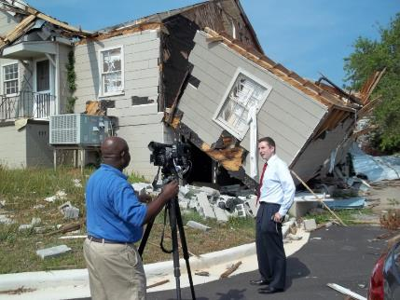
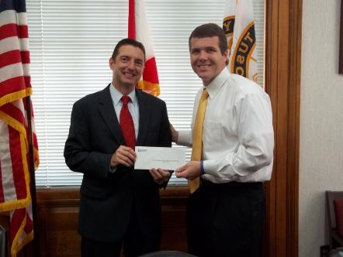

Insurers Making a Difference in Impacted Communities
Destroyed home in Tuscaloosa. Insurers will pay some 165,000 claims totaling $2 billion in the Tuscaloosa/ Birmingham areas alone.
Presentation of a check to Moore, OK, Public School Relief Fund
Presentation of a check to Tuscaloosa Mayor Walt Maddox to the Tuscaloosa Storm Recovery Fund
Source: Insurance Information Institute
125

Slide 126
Combined Ratio Points Associated with Catastrophe Losses: 1960 – 2013*
Avg. CAT Loss Component of the Combined Ratio by Decade
1960s: 1.04 1970s: 0.85 1980s: 1.31 1990s: 3.39 2000s: 3.52 2010s: 6.1E*
Catastrophe losses as a share of all losses reached a record high in 2012
Combined Ratio Points
The Catastrophe Loss Component of Private Insurer Losses Has Increased Sharply in Recent Decades
*2010s represent 2010-2013.
Notes: Private carrier losses only. Excludes loss adjustment expenses and reinsurance reinstatement premiums. Figures are adjusted for losses ultimately paid by foreign insurers and reinsurers.
Source: ISO (1960-2011); A.M. Best (2012E) Insurance Information Institute.

Slide 127
Top 10 States for Insured Catastrophe Losses, 2013
$ Millions
Oklahoma let the country in insured CAT losses in 2013
Source: The Property Claim Services (PCS) unit of ISO, a Verisk Analytics company.

Slide 128
Top 5 States by Insured Catastrophe Losses in 2012*
(2012, $ Billions)
NY and NJ let the US in CAT losses in 2012 due Sandy
*Includes catastrophe losses of at least $25 million.
Sources: PCS unit of ISO; Insurance Information Institute.

Slide 129
Top States by Inflation-Adjusted Insured Catastrophe Losses, 1983–2012
Over the Past 30 Years Florida Has Accounted for the Largest Share of Catastrophe Losses in the U.S., Followed by Texas and Louisiana
FL is the most costly state for CATs, with nearly $67B in insured losses over the past 30 years
Louisiana
$42.0B
Texas
$48.8B
Rest of the U.S.
$309.9B
Florida
$66.7B
Total: $467.5 Billion, an average of $16.6B per year or $1.3B per month
Source: PCS unit of ISO, Verisk Company.; Insurance Information Institute.

Slide 130
Inflation Adjusted U.S. Catastrophe Losses by Cause of Loss, 1993–2012¹
Wind/Hail/Flood (3), $14.9
Fires (4), $6.5
Other (5), $0.2
Insured cat losses from 1993-2012 totaled $391.7B, an average of $19.6B per year or $1.6B per month
Geological Events, $18.4
Terrorism, $24.8
Winter Storms, $27.8
Hurricanes & Tropical Storms, $158.2
Tornado share of CAT losses is rising
Wind losses are by far cause the most catastrophe losses, even if hurricanes/TS are excluded.
Tornadoes (2), $140.9
Catastrophes are defined as events causing direct insured losses to property of $25 million or more in 2012 dollars.
Excludes snow.
Does not include NFIP flood losses
Includes wildland fires
Includes civil disorders, water damage, utility disruptions and non-property losses such as those covered by workers compensation.
Source: ISO’s Property Claim Services Unit.

Slide 131
Top 16 Most Costly Disasters in U.S. History
(Insured Losses, 2012 Dollars, $ Billions)
Hurricane Sandy became the 5th costliest event in US insurance history
Includes Tuscaloosa, AL, tornado
Includes Joplin, MO, tornado
Hurricane Irene became the 12th most expense hurricane in US history in 2011
12 of the 16 Most Expensive Events in US History Have Occurred Over the Past Decade
*PCS estimate as of 4/12/13.
Sources: PCS; Insurance Information Institute inflation adjustments to 2012 dollars using the CPI.

Slide 132
Top 16 Most Costly World Insurance Losses, 1970-2013*
(Insured Losses, 2012 Dollars, $ Billions)
5 of the top 14 most expensive catastrophes in world history have occurred within the past 3 years (2010-2012)
2012 insured CAT Losses totaled $60B; Economic losses totaled $140B, according to Swiss Re
Hurricane Sandy is now the 6th costliest event in global insurance history
*Figures do not include federally insured flood losses.
**Estimate based on PCS value of $18.75B as of 4/12/13.
Sources: Munich Re; Swiss Re; Insurance Information Institute research.

Slide 133
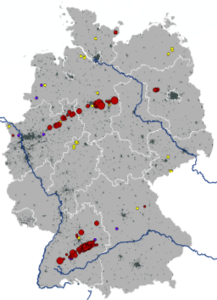
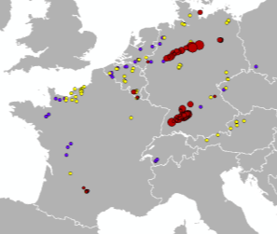
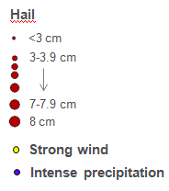
Hailstorm on July 27-28 in Germany Was Most Expensive CAT Worldwide in 2013!
Hailstones with diameters up to 8 cm (tennis ball ≈ 7 cm)
July 27
July 28
Region | Overall losses | Insured losses | Fatalities
Southwestern and Northern Germany | US$ 4.8bn | US$ 3.7bn | 0
Source: Munich Re Geo Risks Research, NatCatSERVICE – as of January 2014.
133

Slide 134
Top 12 Most Costly Hurricanes in U.S. History
(Insured Losses, 2012 Dollars, $ Billions)
10 of the 12 most costly hurricanes in insurance history occurred over the past 9 years (2004—2012)
Hurricane Sandy became the 3rd costliest hurricane in US insurance history
Hurricane Irene became the 12th most expensive hurricane in US history in 2011
*PCS estimate as of 4/12/13.
Sources: PCS; Insurance Information Institute inflation adjustments to 2012 dollars using the CPI.

Slide 135
Total Value of Insured Coastal Exposure in 2012
(2012, $ Billions)
NY and FL lead the US in the value of insured coastal exposure at $2.9 Trillion
In 2012, New York Ranked as the #1 Most Exposed State to Hurricane Loss, Overtaking Florida with $2.862 Trillion. Texas is very exposed too, and ranked #3 with $1.175 Trillion in insured coastal exposure
The Insured Value of All Coastal Property Was $10.6 Trillion in 2012 , Up 20% from $8.9 Trillion in 2007 and Up 48% from $7.2 Trillion in 2004
Source: AIR Worldwide

Slide 136
Total Value of Insured Coastal Exposure in 2007
(2007, $ Billions)
In 2007, Florida Still Ranked as the #1 Most Exposed State to Hurricane Loss, with $2.459 Trillion Exposure, but Texas is very exposed too, and ranked #3 with $895B in insured coastal exposure
The Insured Value of All Coastal Property Was $8.9 Trillion in 2007, Up 24% from $7.2 Trillion in 2004
Source: AIR Worldwide

Slide 137
Hurricane Sandy: Average Claim Payment by Type of Claim
Commercial (i.e., business claims) are more expensive because the value of property is often higher as well as the impact of insured business interruption losses
The average insured flood loss was nearly 9 times larger than the average non-flood insured loss (mostly wind)
Post-Sandy, the I.I.I. worked very hard to make help media, consumers and regulators understand the distinction between a flood claim and a standard homeowners claim. NFIP is $24B in debt.
*Includes rental and condo policies (excludes NFIP flood). **As of Oct. 31, 2013.
Sources: Catastrophe loss data is for Catastrophe Serial No. 90 (Oct. 28 – 31, 2012) from PCS as of March 2013; Insurance Information Institute.

Slide 138
Total Potential Home Value Exposure to Storm Surge Risk in 2013*
($ Billions)
Florida is by the state most vulnerable to storm surge.
The Value of Homes Exposed to Storm Surge was $1.147 Trillion in 2013.* Only a fraction of this is insured, hence the huge demand for federal aid following major coastal flooding events.
*Insured and uninsured property. Based on estimated property values as of April 2013.
Source: Storm Surge Report 2013, CoreLogic.

Slide 139
Top 10 Winter Storm and Winter Damage Events in the US and Canada, 1980-2013*
Ranked by Insured Loss, in Millions of $ 2013*
Period | Area | Economic Loss (in inflation-adjusted 2013 $US mill) | Insured Loss (in inflation-adjusted 2013 $US mill) | Fatalities
Mar. 11-14, 1993 | CAN, USA | 8,061 | 3,224 | 270
Dec. 17-30,1983 | USA | 2,339 | 2,058 | 500
Apr. 13-17, 2007 | CAN, USA | 2,247 | 1,775 | 23
Dec. 10-13, 1992 | USA | 4,981 | 1,660 | 19
Jan. 5-12, 1998 | CAN, USA | 4,145 | 1,644 | 45
Feb. 10-12, 1994 | USA | 4,716 | 1,258 | 9
Jan. 17-20, 1994 | USA | 1,572 | 1,258 | 70
Apr. 7-11, 2013 | USA | 1,600 | 1,200 | N/A
Jan. 1-4, 1999 | CAN, USA | 1,398 | 1,084 | 25
Jan. 31-Feb. 2, 2011 | USA | 1,346 | 1,010 | 36
*Top 10 events in original insured loss dollars were adjusted to and ranked by the Insurance Information Institute to 2013 inflation-adjusted values.
Sources: Munich Re NatCatSERVICE; Insurance Information Institute.

Slide 140
Winter Storm and Winter Damage Events in the US and Canada, 1980-2013 (2013 US$)
Three of the four most costly years ever for insured losses from winter storms and damage occurred in the 1990s, led by the “Storm of the Century” in 1993.
Insured Losses (Millions, $ 2013)
5-year running average
Insured losses from severe winter events totaled $2 billion in 2013.
Insured winter storm and damage losses in Jan. 2014 already totaled $1.5 billion. Continued severe weather since then makes it likely that 2014 will become one of the top 5 costliest winters since 1980.
Sources: Munich Re NatCatSERVICE; Insurance Information Institute.
140

Slide 141
Insured Homeowners Losses Due Dog Bite Liability Claims, 2003-2012
$ Millions
Dog bite liability claims cost insurers an estimated $489.7 million in 2012, up 51.0% from $324.2 million in 2003
The Increased Average Cost per Dog Bite Claim is Pushing Total Dog Bite Liabiity Claim Costs Higher Even as the Number of Claims Remains Relatively Flat
Source: Insurance Information Institute.

Slide 142
Natural Disaster Losses in the United States, by Type, 2013
As of December 31, 2013 | Number of Events | Fatalities | Estimated Overall Losses (US $m) | Estimated Insured Losses (US $m)
Severe Thunderstorm | 69 | 110 | 16,341 | 10,274
Winter Storm | 11 | 43 | 2,935 | 1,895
Flood | 19 | 23 | 1,929 | 240
Earthquake & Geophysical | 6 | 1 | Minor | Minor
Tropical Cyclone | 1 | 1 | Minor | Minor
Wildfire, Heat, & Drought | 22 | 29 | 620 | 385
Totals | 128 | 207 | 21,825 | 12,794
Source: Munich Re NatCatSERVICE
142
142

Slide 143
Significant Natural Catastrophes, 2013 (Events with $1 billion economic loss and/or 50 fatalities)
Date | Event | Estimated Economic Losses (US $m) | Estimated Insured Losses (US $m)
February 24 – 25 | Winter Storm | 1,300 | 690
March 18 – 19 | Thunderstorms | 2,200 | 1,600
April 7 – 11 | Winter Storm | 1,600 | 1,200
April 16 – 18 | Thunderstorms | 1,100 | 560
May 18 – 20 | Thunderstorms | 3,100 | 1,800
May 28 – 31 | Thunderstorms | 2,800 | 1,400
August 6 – 7 | Thunderstorms | 1,300 | 740
September 9 – 16 | Flooding | 1,500 | 160
November 17 - 18 | Thunderstorms | 1,300 | 931
Source: Munich Re NatCatSERVICE
143

Slide 144
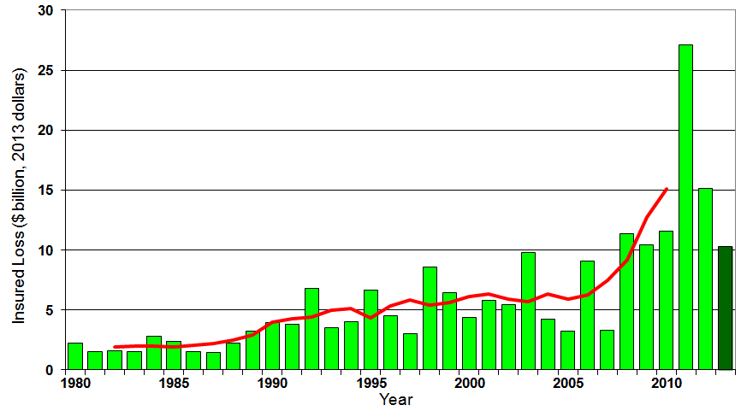
U.S. Thunderstorm Insured Loss Trends, 1980 – 2013
Hurricanes get all the headlines, but thunderstorms are consistent producers of large scale loss. 2008-2013 are the most expensive years on record.
Average thunderstorm losses are up 7 fold since the early 1980s. The 5-year running average loss is up sharply
Thunderstorm losses in 2013 totaled $10.3 billion, the 6th highest on record
Source: Property Claims Service, and MR NatCatSERVICE
144

Slide 145
Insured Homeowners Losses Due to Lightning, 2004-2012
$ Millions
Lightning claims cost insurers an estimated $969 million in 2012, 31.7% from $735.5 million in 2004
The Increased Number and Value of Expensive Electronic Devices in Homes is Pushing the Total Lightning Claim Costs Up Even as the Number of Lightning Claims Falls
Source: Insurance Information Institute.

Slide 146
Natural Disasters in the United States, 1980 – 2013 Number of Events (Annual Totals 1980 – 2013)
There were 128 natural disaster events in 2013
Number
22
19
81
6
Geophysical
(earthquake, tsunami,
volcanic activity)
Meteorological (storm)
Climatological
(temperature extremes,
drought, wildfire)
Hydrological
(flood, mass movement)
Source: MR NatCatSERVICE
146

Slide 147
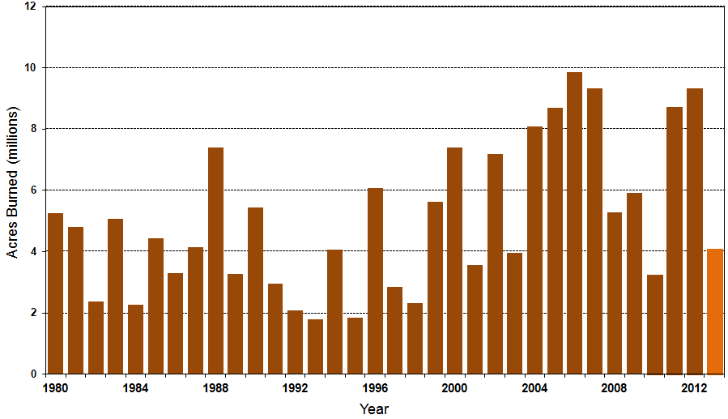
Number of Acres Burned in Wildfires, 1980 – 2013
TX experienced significant wildfire losses in 2011 (Bastrop fire insured losses ~$500 million)
Source: National Interagency Fire Center
147

Slide 148
Losses Due to Natural Disasters in the US, 1980–2013
(Overall and Insured Losses)
(2013 Dollars, $ Billions)
2013 CAT Losses
Overall : $21.8B
Insured: $12.8B
Indicates a great deal of losses are uninsured (~40%-50% in the US) = Growth Opportunity
2013 losses were far below 2011 and 2012 and were 44% lower than the average from 2000-2012
Overall losses (in 2012 values)
Insured losses (in 2013 values)
Source: MR NatCatSERVICE
148

Slide 149
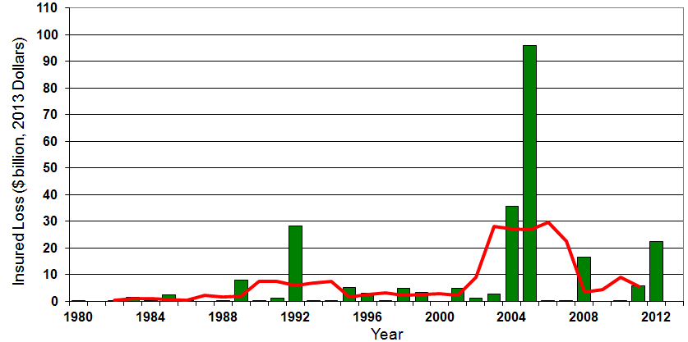

Insured US Tropical Cyclone Losses, 1980 - 2013
The current 5-year average (2008 - 2013) insured tropical cyclone loss is $5.6 billion per year.
Sources: Property Claims Service, Munich Re NatCatSERVICE, NFIP
149

Slide 150
The combined ratios for both personal and commercial lines improved substantially in 2013:H1

Slide 152
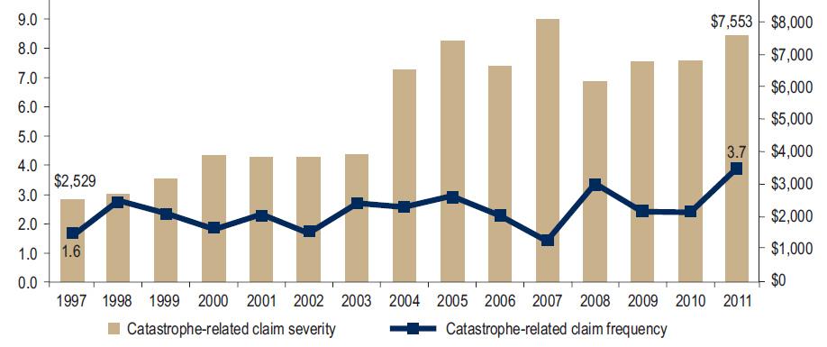
Homeowners Insurance Catastrophe-Related Claim Frequency and Severity, 1997—2012*
Avg. catastrophe claim cost rose approximately 200% from 1997-2011
Cat claim frequency in 2011 was at historic highs and more than double the rate in 1997
*All policy forms combined, countrywide.
Source: Insurance Research Council, Trends in Homeowners Insurance Claims, Sept. 2012 from ISO Fast Track data.
152

Slide 153
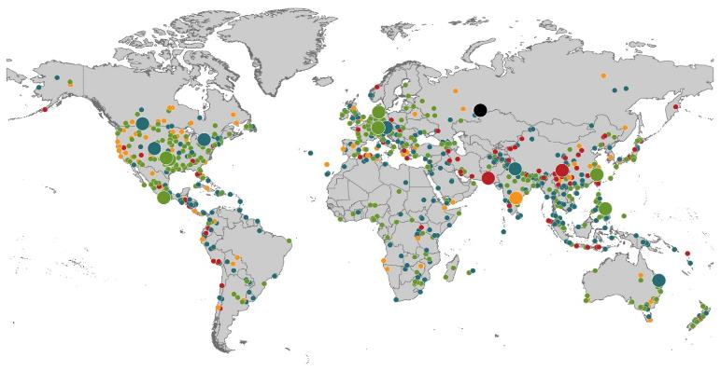
Natural Loss Events:
Full Year 2013 World Map
Winter Storm Christian (St. Jude)
Europe, 27–30 October
Floods
Europe,
30 May–19 June
Meteorite impact
Russian Federation, 15 February
Flash floods
Canada, 8–9 July
Floods
Canada, 19–24 June
Earthquake
China, 20 April
Hailstorms
Germany,
27–28 July
Floods
USA, 9–16 September
Typhoon Fitow
China, Japan,
5–9 October
Severe storms, tornadoes
USA, 18–22 May
Typhoon Haiyan
Philippines,
8–12 November
Severe storms, tornadoes
USA, 28–31 May
Floods
India, 14–30 June
Hurricanes Ingrid & Manuel
Mexico, 12–19 September
Floods
Australia,
21–31 January
880
Loss events
Earthquake (series)
Pakistan, 24–28 September
Heat wave
India, April–June
Geophysical events (earthquake, tsunami, volcanic activity)
Hydrological events (flood, mass movement)
Natural catastrophes
Geophysical events (earthquake, tsunami, volcanic activity)
Hydrological events (flood, mass movement)
Selection of significant
Natural catastrophes
Meteorological events (storm)
Climatological events (extreme temperature, drought, wildfire)
Meteorological events (storm)
Climatological events (extreme temperature, drought, wildfire)
Extraterrestrial events (Meteorite impact)
Source: Munich Re Geo Risks Research, NatCatSERVICE – as of January 2014.
153

Slide 154
Natural Disasters Worldwide, 1980 – 2013 (Number of Events)
There were 880 natural disaster events globally in 2013 compared to 905 in 2012
Number
Geophysical
(earthquake, tsunami,
volcanic activity)
Meteorological (storm)
Climatological
(temperature extremes,
drought, wildfire)
Hydrological
(flood, mass movement)
Source: MR NatCatSERVICE
154

Slide 155
Losses Due to Natural Disasters Worldwide, 1980–2013 (Overall & Insured Losses)
(Overall and Insured Losses)
(2013 Dollars, $ Billions)
10-Yr. Avg. Losses
Overall : $184B
Insured: $56B
2013 Losses
Overall : $125B
Insured: $34B
There is a clear upward trend in both insured and overall losses over the past 30+ years
Overall losses (in 2013 values)
Insured losses (in 2013 values)
Source: MR NatCatSERVICE
155

Slide 156
Flood Insurance
I.I.I. Survey: Public Conflicted on Flood
Flood Should Reflect True Risk
Keep the Subsidies
Would Prefer to Purchase from Private Insurers
156

Slide 157
Biggert-Waters: Media and Congressional Maelstrom
BW-12 Rate Increases to Phase Out Subsidies Began in 2013
Note: Only 20% of NFIP policies are subsidized
Jan. 1, 2013: Non-Primary/Secondary Residences
Increases of 25% per year until full-risk rate achieved
Reaction: Very muted; Vacation homes/wealthier owners
Oct. 1, 2013: Subsidized Severe or Repetitive Loss Policies and Owners of Business/Non-Residential Properties
Increases of 25% per year until full-risk rate achieved
Reaction: Huge consumer backlash, intense media coverage leading to a Congressional effort to delay BW-12 by 4 years (effectively killing it). Even Maxine Waters supports delay…
Subsidy Lost if Policy Lapses, Severe Repeated, New Policy
House and Senate Bills to Reduce Burden Need to be Reconciled
Future Pvt. Insurer Flood Participation Impacted by BW-12 Debate
157
12/01/09 - 9pm
eSlide – P6466 – The Financial Crisis and the Future of the P/C
Notes:
157

Slide 158
Summary of House Bill (Passed March 4, 2014)
9 Premium classifications with increases capped at 18%
$25 surcharge on primary residences; $250 for non-primary
Restoration of “grandfather” clause allowing continued subsidies for homes that were compliant under old FEMA maps but no longer are
Eliminates property sales trigger
Reimburses home owners for successful FEMA map challenges
Creates a “flood insurance advocate”
Refunds policyholders who were charged higher rates under BW-12 for homes built before FEMA established flood-risk maps
CBO scoring of bill said that it will not increase the deficit
Didn’t say that it would eliminate the current $24 bill deficit
158
12/01/09 - 9pm
eSlide – P6466 – The Financial Crisis and the Future of the P/C
Notes:
158

Slide 159
I.I.I. Poll: Flood Insurance
Q. Do you think it is fair that flood insurance premium increases are higher if people who live in high flood risk areas and rebuild their homes do not elevate them?
Don’t know
No
Yes
Almost two-thirds of Americans think that it is fair that flood insurance premiums be raised for people who live in high flood risk areas and rebuild their homes after a flood but do not elevate them.
Source: Insurance Information Institute Annual Pulse Survey.

Slide 160
I.I.I. Poll: Flood Insurance
Q. Do you think flood insurance premiums should reflect the risk of flooding no matter what the cost or do you think the government should subsidize the cost of flood insurance with taxpayers’ dollars?
Don’t know
Government should subsidize cost with taxpayers’ dollars
Premiums should reflect flood risk
Almost two-thirds of Americans think flood insurance premiums should be raised to reflect the risk of flooding.
Source: Insurance Information Institute Annual Pulse Survey (Nov. 2013).

Slide 161
I.I.I. Poll: Flood Insurance
Q. The federal government provides insurance coverage at taxpayer-subsidized rates for damage from floods through the National Flood Insurance Plan. A new law eliminates the subsidy and raises rates. Do you think the rate increase should be repealed?
It is inconsistent for the public to support full-risk rates but maintain subsidies, but this exactly mirrors Congressional sentiments, with supporters of BW-12 and even Tea Party conservatives supporting continuation of the subsidies
Don’t know
No
Yes
More than half of Americans polled for the November 2013 Pulse thought that hikes in National Flood Insurance premiums should be repealed.
Source: Insurance Information Institute Annual Pulse Survey.

Slide 162
I.I.I. Poll: Flood Insurance
Q. If the costs were similar, would you prefer to buy flood insurance from a private insurance company or from the federal government through the National Flood Insurance Program?
Don’t know
The federal government through the NFIP
Private insurance company
Six out of 10 Americans would prefer to buy flood insurance from a private insurance company as opposed to the federal government, if costs were similar.
Source: Insurance Information Institute Annual Pulse Survey.

Slide 163
The combined ratios for both personal and commercial lines improved substantially in 2013:H1

Slide 165
Homeowners Insurance Combined Ratio: 1990–2015F
Hurricane Andrew
Record tornado activity
Hurricane Sandy
Hurricane Ike
Homeowners Performance in 2011/12 Impacted by Large Cat Losses. Extreme Regional Variation Can Be Expected Due to Local Catastrophe Loss Activity
Sources: A.M. Best (1990-2011);Conning (2012E-2015F); Insurance Information Institute.

Slide 166
Federal Disaster Declarations Patterns: 1953-2013
Disaster Declarations Set New Records in Recent Years
166

Slide 167
Number of Federal Major Disaster Declarations, 1953-2014*
There have been 2,153 federal disaster declarations since 1953. The average number of declarations per year is 35 from 1953-2013, though there few haven’t been recorded since 1995.
The number of federal disaster declarations set a new record in 2011, with 99, shattering 2010’s record 81 declarations.
9 federal disasters were declared so far in 2014*
The Number of Federal Disaster Declarations Is Rising and Set New Records in 2010 and 2011 Before Dropping in 2012/13
*Through March 2, 2014.
Source: Federal Emergency Management Administration; http://www.fema.gov/disasters; Insurance Information Institute.

Slide 168
Federal Disasters Declarations by State, 1953 – 2014: Highest 25 States*
Over the past 60 years, Texas has had the highest number of Federal Disaster Declarations
*Through March 2, 2014. Includes Puerto Rico and the District of Columbia.
Source: FEMA: http://www.fema.gov/news/disaster_totals_annual.fema; Insurance Information Institute.

Slide 169
Federal Disasters Declarations by State, 1953 – 2014: Lowest 25 States*
Over the past 60 years, Wyoming and Rhode Island had the fewest number of Federal Disaster Declarations
*Through March 2, 2014. Includes Puerto Rico and the District of Columbia.
Source: FEMA: http://www.fema.gov/news/disaster_totals_annual.fema; Insurance Information Institute.

Slide 170
SEVERE WEATHER REPORT UPDATE: 2013
Damage from Tornadoes, Large Hail and High Winds Keep Insurers Busy
170

Slide 171
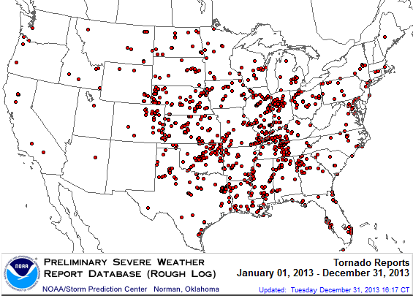
Location of Tornado Reports in 2013
A deadly EF-5 tornado in May in Moore, OK, produced insured losses of $1.575 billion. November tornadoes in the Midwest like produced $1B in insured losses.
There were 943 tornadoes through Dec. 31, causing extensive property damage in several states
Source: NOAA Storm Prediction Center; http://www.spc.noaa.gov/climo/online/monthly/2013_annual_summary.html#; PCS.
171

Slide 172
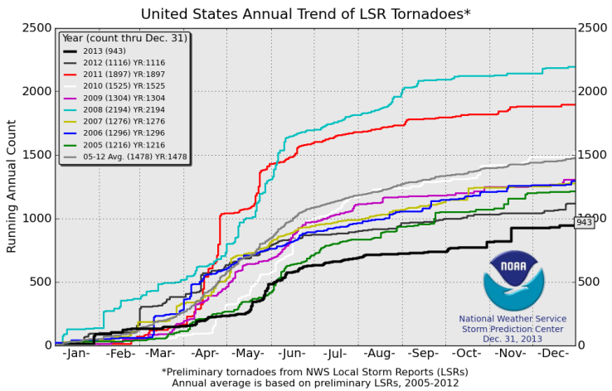
U.S. Tornado Count, 2005-2013*
There were 1,897 tornadoes in the U.S. in 2011 far above average, but well below 2008’s record
2013 count was the lowest in a decade
*Through Dec. 31, 2013.
Source: http://www.spc.noaa.gov/wcm/.
172

Slide 173
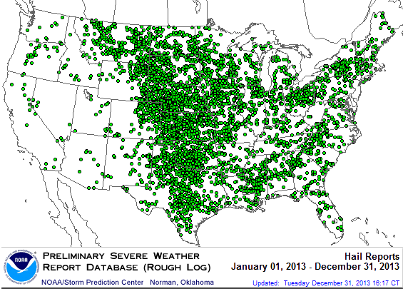
Location of Large Hail Reports: 2013
There were 5,457 “Large Hail” reports in 2013, causing extensive property and vehicle damage
Source: NOAA Storm Prediction Center; http://www.spc.noaa.gov/climo/online/monthly/2013_annual_summary.html#
173

Slide 174
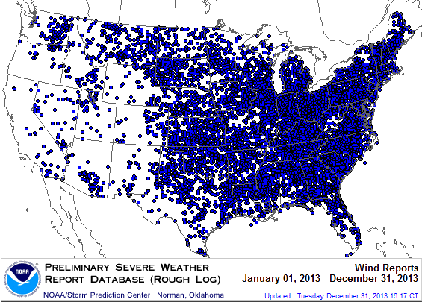
Location of High Wind Reports: 2013
There were 12,942 “Wind Damage” in 2013, causing extensive property damage
Source: NOAA Storm Prediction Center; http://www.spc.noaa.gov/climo/online/monthly/2013_annual_summary.html#
174

Slide 175
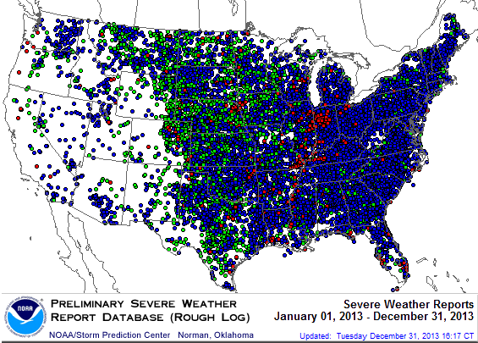
Severe Weather Reports: 2013
Severe weather reports are concentrated east of the Rockies
There were 19,342 severe weather reports in 2013; including 942 tornadoes; 5,457 “Large Hail” reports and 12,942 high wind events
Source: NOAA Storm Prediction Center; http://www.spc.noaa.gov/climo/online/monthly/2013_annual_summary.html#
175

Slide 176
Terrorism Update
Down to the Wire? Boston Bombings Underscore the Need for Extension of the Terrorism Risk Insurance Program
Download III’s Terrorism Insurance Report at: http://www.iii.org/white_papers/terrorism-risk-a-constant-threat-2013.html
176
Notes:
176

Slide 177

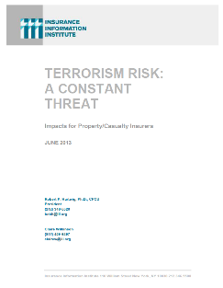
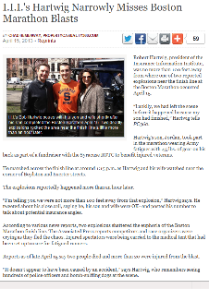
Terrorism Risk Insurance Program
Reauthorization Was a Major Industry Initiative for 2013 Even Before Boston
I.I.I. Testified at First Congressional Hearing on 9/11/12
Provided testimony at NYC hearing on 6/17/13
I.I.I. Accelerated Planned Study on Terrorism Risk and Insurance in the Wake of Boston and Was Well Received
Terrorism: A Constant Threat issued in June 2013
177
12/01/09 - 9pm
eSlide – P6466 – The Financial Crisis and the Future of the P/C
Notes:
177

Slide 178
Terrorism Risk Insurance Program
Boston Marathon Bombing Has Helped Focus Attention in Congress on TRIPRA and its Looming Expiration
Act expires 12/31/14
Exclusionary language will likely be inserted for post-1/1/2014 renewals and will likely lead to significant media interest (educational opportunity)
Numerous headwinds; not a priority issue in 2013 in Congress
3 extension bills introduced in 2013—2 since Boston
Media Interest Soared
I.I.I. was conducting its first interviews within minutes after live-tweeting (nearly) from the scene; TV interest was high
Local, national and international media focused on this topic for the first time in any significant way since TRIA’s inception in late 2002
Inquiries revealed very little/no understanding (or even awareness) outside insurance industry and business owners
Certification process caused confusion
178
12/01/09 - 9pm
eSlide – P6466 – The Financial Crisis and the Future of the P/C
Notes:
178

Slide 179
Loss Distribution by Type of Insurance from Sept. 11 Terrorist Attack ($ 2011)
($ Billions)
Total Insured Losses Estimate: $40.0B**
*Loss total does not include March 2010 New York City settlement of up to $657.5 million to compensate approximately 10,000 Ground Zero workers or any subsequent settlements.
**$32.5 billion in 2001 dollars.
Source: Insurance Information Institute.

Slide 180
TRIA Outlook
Difficult Reauthorization Battle Ahead
Very difficult to overcome antigovernment/small government, Tea Party forces in the House
Most Committee members in both houses weren’t around in 2007
House Hearings in 2012; House and Senate in Sept. 2013
If Reauthorized, Insurer Participation Likely Increased
Some Have Attacked TRIA as “Corporate Welfare”
In reality the taxpayer is 100% protected
NFIP, Crop programs have led to miscomprehensions
Emphasizing Benefits to Employees Under WC is Key
Misperception by Some that Terrorism is Urban Issue
Growth Opportunity: Standalone Cover if No Reauthorization
Though limited capacity will not be sufficient to meet need

Slide 181
Terrorism Insurance Take-up Rates, By Year, 2003-2012
Take-up rates for smaller commercial risks are lower—potentially very low in some areas and industries
In 2003, the first year TRIA was in effect, the terrorism take-up rate was 27 percent. Since then, it has increased steadily, remaining in the low 60 percent range since 2009.
Source: Marsh Global Analytics, 2013 Terrorism Risk Insurance Report, May 2013.
181
Notes:
181

Slide 182
TRIA Outlook
3 TRIA Reauthorization Bills Introduced in 2013
Bumpy Road to Reauthorization Ahead
Senate: Generally supportive based on 9/25 hearing
House: Democrats supportive; Republicans skeptical but some seem willing to support reauthorization based on 11/13 hearing
Analogies to Affordable Care Act often mentioned by Republicans
House Committee Proposals Likely to Involve:
Increase in trigger (from current $100 million)
Increasing individual comp. retentions (from current 20% of DPE)
Also possible: Simple industry aggregate or NBCR only proposal
I.I.I.: Success of Current Structure & Taxpayer Protections
Also Focused on Importance of Small/Medium Insurers
Limitations of Capacity in the Absence of TRIA
Media in 2014 Wants Stories of Economic Disruption

Slide 183
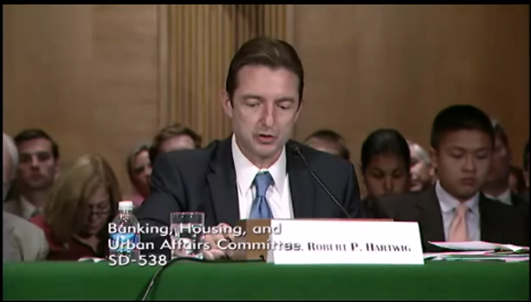
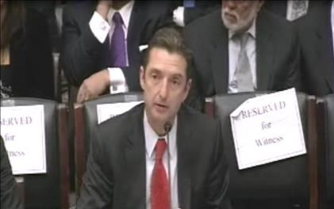
Terrorism Risk Insurance Program
Testified before Senate Banking Cmte. in Sept. 2013
Testified before House Financial Services Nov. 2013
Provided testimony at NYC hearing on June 2013
I.I.I. Accelerated Planned Study on Terrorism Risk and Insurance in the Wake of Boston and Hearings; Was Well Received and Widely Circulated
Working with Trades, Congressional Staff, GAO & Others
House Financial Services Subcommittee, 11/13/13
Senate Banking Committee, 9/25/13
183
12/01/09 - 9pm
eSlide – P6466 – The Financial Crisis and the Future of the P/C
Notes:
183

Slide 184
Pyramid of Taxpayer Protection: Strong, Stable, Sound and Secure
If TRIA is reauthorized, it is highly likely insurer retentions will be increased
Hard Cap
$100 Bill
Government Recoupment
Industry Aggregate
Retention: $27.5 Bill
Insurer Co-Payments
15% Above Retention
Individual Insurer Retention
20% of Premiums Earned
Program Dollar Threshold
$100 Million
Certification Dollar Threshold
$5 Million
Certification of Terrorist Act: Definition Must Be Met

Slide 185
Summary of Terrorism Risk Insurance Program Extension Bills Introduced in 2013
Bill | Summary
H.R. 508: “Terrorism Risk Insurance Act of 2002 Reauthorization Act of 2013” Introduced Feb. 5 by Rep. Michael Grimm (D-NY) | 5-Year Extension (through 2019) Extend recoupment period for any TRIA assistance from 2017 to 2019
H.R. 2146: “Terrorism Risk Insurance Program Reauthorization Act of 2013” Introduced May 23 by Rep. Michael Capuano (D-MA) | 10-Year Extension (through 2024) Extend recoupment period for any TRIA assistance from 2017 to 2024 Requires President’s Working Group on Financial Markets (PWGFM) to issue reports on long-term availability and affordability of terrorism insurance in 2017, 2020 and 2023 Reports to be drafted with consultation from NAIC and representatives of the insurance and securities industries and policyholders
H.R. 1945: “Fostering Resilience to Terrorism Act of 2013” Introduced May 9 by Rep. Benny Thompson (D-MS) | 10-Year Extension (through 2024) Recoupment period changed to 2024 Would transfer responsibility for certification of a “act of terrorism” to the Secretary of Homeland Security from Secretary of Treasury. PWGFM to issue reports in 2017, 2020 and 2023 Requires Sec. of DHS to provide insureds with “timely homeland security information, including terrorism risk information, at the appropriate level of classification and information on best practices to foster resilience to an act of terrorism.”
Source: Nelson, Levine, de Luca & Hamilton, FIO Focus, June 10, 2013; Insurance Information Institute.

Slide 186
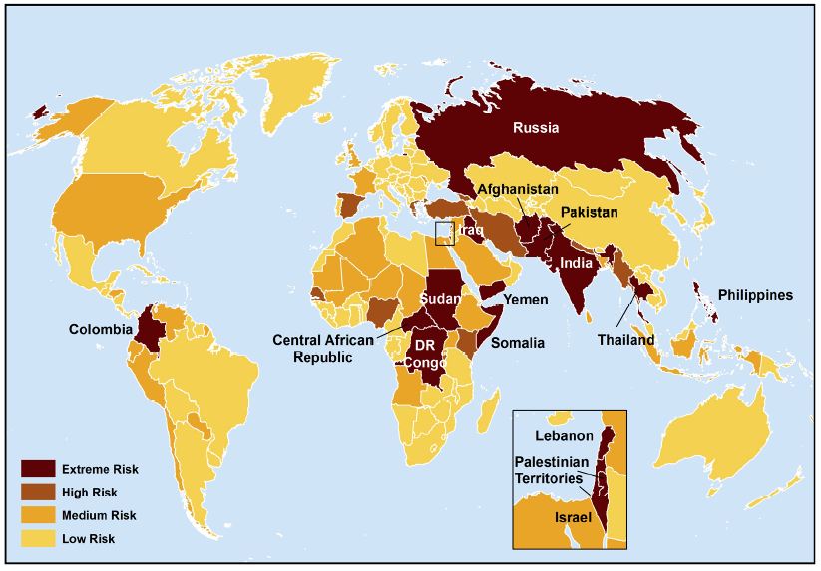
Terrorist Risk Index
The threat of terrorism is highest in South Asia, Russia, the Middle East and Central and East Africa
The US is still considered to be at “Medium Risk” for a terrorist attack
Sources: Maplecroft Terrorism Risk Index; (2011); Guy Carpenter; Insurance Information Institute.

Slide 187
Terrorism Violates Traditional Requirements for Insurability
Requirement | Definition | Violation
Estimable Frequency | Insurance requires large number of observations to develop predictive rate-making models (an actuarial concept known as credibility) | Very few data points Terror modeling still in infancy, untested. Inconsistent assessment of threat
Estimable Severity | Maximum possible/ probable loss must be at least estimable in order to minimize “risk of ruin” (insurer cannot run an unreasonable risk of insolvency though assumption of the risk) | Potential loss is virtually unbounded. Losses can easily exceed insurer capital resources for paying claims. Extreme risk in workers compensation and statute forbids exclusions.
Source: Insurance Information Institute

Slide 188
Terrorism Violates Traditional Requirements for Insurability (cont’d)
Requirement | Definition | Violation
Diversifiable Risk | Must be able to spread/distribute risk across large number of risks “Law of Large Numbers” helps makes losses manageable and less volatile | Losses likely highly concentrated geographically or by industry (e.g., WTC, power plants)
Random Loss Distribution/Fortuity | Probability of loss occurring must be purely random and fortuitous Events are individually unpredictable in terms of time, location and magnitude | Terrorism attacks are planned, coordinated and deliberate acts of destruction Dynamic target shifting from “hardened targets” to “soft targets” Terrorist adjust tactics to circumvent new security measures Actions of US and foreign govts. may affect likelihood, nature and timing of attack
Source: Insurance
Information Institute

Slide 189
Growth Analysis by State and Business Segment
Premium Growth Rates Vary Tremendously by State
189

Slide 190
Direct Premiums Written: Total P/C Percent Change by State, 2007-2012*
Top 25 States
North Dakota was the country’s growth leader over the past 5 years with premiums written expanding by 58.4%
Sources: SNL Financial LC.; Insurance Information Institute.

Slide 191
Direct Premiums Written: Total P/C Percent Change by State, 2007-2012*
Bottom 25 States
Growth was negative in 13 states and DC between 2007 and 2012
Sources: SNL Financial LC.; Insurance Information Institute.

Slide 192
Direct Premiums Written: PP Auto Percent Change by State, 2007-2012*
Top 25 States
Sources: SNL Financial LC.; Insurance Information Institute.

Slide 193
Direct Premiums Written: PP Auto Percent Change by State, 2007-2012*
Bottom 25 States
Sources: SNL Financial LC.; Insurance Information Institute.

Slide 194
Advertising Expenditures by P/C Insurance Industry, 1999-2012
$ Billions
P/C ad spend hit an all time record high of $6.088 billion in 2012, up 3.5% over 2011. The pace of growth has slowed from 15.8% in 2011 and 23.8% in 2010
P/C ad spending has more than tripled since 2002 (up 256% from 2002-2012)
Source: Insurance Information Institute from consolidated P/C Annual Statement data, Insurance Expense Exhibit (Part I).

Slide 195
Direct Premiums Written: Homeowners Percent Change by State, 2007-2012*
Top 25 States
Sources: SNL Financial LLC.; Insurance Information Institute.

Slide 196
Direct Premiums Written: Homeowners Percent Change by State, 2007-2012*
Bottom 25 States
Sources: SNL Financial LLC.; Insurance Information Institute.

Slide 197
Direct Premiums Written: Comm. Lines Percent Change by State, 2007-2012*
Top 25 States
Only 16 states showed any commercial lines growth 2007 and 2012
Sources: SNL Financial LLC.; Insurance Information Institute.

Slide 198
Direct Premiums Written: Comm. Lines Percent Change by State, 2007-2012*
Bottom 25 States
States with the poorest performing economies also produced the most negative net change in premiums of the past 5 years
Sources: SNL Financial LLC.; Insurance Information Institute.

Slide 199
Direct Premiums Written: Workers’ Comp Percent Change by State, 2007-2012*
Top 25 States
*Excludes monopolistic fund states: ND, OH, WA, WY as well as WV, which transitioned to a competitive structure during this period.
Sources: SNL Financial LC.; Insurance Information Institute.

Slide 200
Direct Premiums Written: Worker’s Comp Percent Change by State, 2007-2012*
Bottom 25 States
States with the poorest performing economies also produced the most negative net change in premiums of the past 5 years
*Excludes monopolistic fund states: ND, OH, WA, WY as well as WV, which transitioned to a competitive structure during this period.
Sources: SNL Financial LC.; Insurance Information Institute.

Slide 201
Distribution Trends
Distribution by Channel Type Continues to Evolve Around the World
201

Slide 202
All P/C Lines Distribution Channels, Direct vs. Independent Agents
Independent agents steadily lost market share from the early 1980s through the early 2000s across all P/C lines, but have gained or held generally steady in recent years. Direct channels include exclusive agency companies, direct marketers and direct sales (e.g., internet)
Source: Insurance Information Institute; based on data from Conning and A.M. Best.

Slide 203
Commercial P/C Distribution Channels, Direct vs. Independent Agents
Independent agents have seen only modest erosion in commercial lines market share in recent decades
Source: Insurance Information Institute; based on data from Conning and A.M. Best.

Slide 204
Personal Lines Distribution Channels, Direct vs. Independent Agents
Independent agents have lost significant personal lines market share since the early 1970s. Although the trend has slowed, it may be accelerating again.
Source: Insurance Information Institute; based on data from Conning and A.M. Best.

Slide 205
The BIG Question: Where Is the Market Heading?
Catastrophes and Other Factors Are Pressuring Insurance Markets
New Factor: Record Low Interest Rates Are Contributing to Underwriting and Pricing Pressures
205
Notes:
205

Slide 206
INVESTMENTS: THE NEW REALITY
Investment Performance is a Key Driver of Profitability
Depressed Yields Will Necessarily Influence Underwriting & Pricing
206

Slide 207
Property/Casualty Insurance Industry Investment Income: 2000–2013*¹
($ Billions)
Investment earnings are running below their 2007 pre-crisis peak
Investment Income Fell in 2012 and is Falling in 2013 Due to Persistently Low Interest Rates, Putting Additional Pressure on (Re) Insurance Pricing
¹ Investment gains consist primarily of interest and stock dividends..
*Estimate based on annualized actual 9M:2013 investment income of $34.338B.
Sources: ISO; Insurance Information Institute.

Slide 208
P/C Insurer Net Realized Capital Gains/Losses, 1990-2013:Q3
Realized capital gains in 2013 will eclipse 2012 gains
($ Billions)
Insurers Posted Net Realized Capital Gains in 2010, 2011 and 2012 Following Two Years of Realized Losses During the Financial Crisis. Realized Capital Losses Were the Primary Cause of 2008/2009’s Large Drop in Profits and ROE
Sources: A.M. Best, ISO, Insurance Information Institute.
208
12/01/09 - 9pm
eSlide – P6466 – The Financial Crisis and the Future of the P/C
Notes:
208

Slide 209
Property/Casualty Insurance Industry Investment Gain: 1994–2013:Q3¹
($ Billions)
Investment gains through 2013:Q3 were approximately double those through 2012:Q3
Investment Income Continued to Fall in 2013 Due to Low Interest Rates but Realized Investment Gains Were Up Sharply; The Financial Crisis Caused Investment Gains to Fall by 50% in 2008
¹ Investment gains consist primarily of interest, stock dividends and realized capital gains and losses.
* 2005 figure includes special one-time dividend of $3.2B;
Sources: ISO; Insurance Information Institute.

Slide 210
Reduction in Combined Ratio Necessary to Offset 1% Decline in Investment Yield to Maintain Constant ROE, by Line*
Lower Investment Earnings Place a Greater Burden on Underwriting and Pricing Discipline
*Based on 2008 Invested Assets and Earned Premiums
**US domestic reinsurance only
Source: A.M. Best; Insurance Information Institute.
210
12/01/09 - 9pm
eSlide – P6466 – The Financial Crisis and the Future of the P/C
Notes:
210
This shows the drop in Combined Ratio for each line of business that would be needed to maintain a constant ROE, given a 1-percentage-point drop in investment yield

Slide 211
U.S. 10-Year Treasury Note Yields: A Long Downward Trend, 1990–2014*
Yields on 10-Year U.S. Treasury Notes recently plunged to record modern-era lows in early 2013 but have since risen as the Fed begins “tapering” its QE program in 2014
Yields on 10-Year U.S. Treasury Notes have been essentially below 5% for a full decade.
Since roughly 80% of P/C bond/cash investments are in 10-year or shorter durations, most P/C insurer portfolios will have low-yielding bonds for years to come.
*Monthly, through February 2014. Note: Recessions indicated by gray shaded columns.
Sources: Federal Reserve Bank at http://www.federalreserve.gov/releases/h15/data.htm. National Bureau of Economic Research (recession dates); Insurance Information Institutes.
211
12/01/09 - 9pm
eSlide – P6466 – The Financial Crisis and the Future of the P/C
Notes:
211

Slide 212
U.S. Treasury Security Yields: A Long Downward Trend, 1990–2014*
Yields on 10-Year U.S. Treasury Notes have been essentially below 5% for a full decade.
U.S. Treasury yields plunged to historic lows in 2013. Only longer-term yields have rebounded.
Since roughly 80% of P/C bond/cash investments are in 10-year or shorter durations, most P/C insurer portfolios will have low-yielding bonds for years to come.
*Monthly, constant maturity, nominal rates, through February 2014.
Sources: Federal Reserve Bank at http://www.federalreserve.gov/releases/h15/data.htm. National Bureau of Economic Research (recession dates); Insurance Information Institute.
212
12/01/09 - 9pm
eSlide – P6466 – The Financial Crisis and the Future of the P/C
Notes:
212

Slide 213
Treasury Yield Curves: Pre-Crisis (July 2007) vs. Feb. 2014
Treasury yield curve remains near its most depressed level in at least 45 years. Investment income is falling as a result. Even as the Fed “tapers” rates are unlikely to return to pre-crisis levels anytime soon
The Fed Is Actively Signaling that it Is Determined to Keep Rates Low Until Unemployment Drops Below 6.5% or Until Inflation Expectations Exceed 2.5%; Low Rates Add to Pricing Pressure for Insurers.
Source: Federal Reserve Board of Governors; Insurance Information Institute.

Slide 214
Treasury Yield Curves: Pre-Crisis (July 2007) vs. Feb. 2014
Longer term yields are expected to rise in 2014 and 2015 while short-term yields will not begin to normalize until 2015
Higher longer-term yields will help insurers but short term yields are expected to lag behind
Source: Federal Reserve Board of Governors (2006-2013), Swiss Re (2014-2015); Insurance Information Institute.

Slide 215
Outlook for U.S. Treasury Bond Yields Through 2015
Long-term yields should begin to normalize in 2014 but short-term yields will remain very low until 2015
% Yield
Longer-tail lines like MPL and workers comp will benefit the most from the normalization of yields
Source: Federal Reserve Board of Governors (2012-2013), Swiss Re (2014-2015); Insurance Information Institute.
215
12/01/09 - 9pm
eSlide – P6466 – The Financial Crisis and the Future of the P/C
Notes:
215

Slide 216
Average Maturity of Bonds Held by US P/C Insurers, 2006—2011*
Average Maturity (Years)
The average bond maturity is down by a full year between 2007 and 2011
Falling Average Maturity (and Duration) of the P/C Industry’s Bond Portfolio is Contributing to the Drop in Investment Income Along With Lower Yields
*Year-end figures. Latest available.
Sources: Insurance Information Institute calculations based on A.M. Best data.
216
12/01/09 - 9pm
eSlide – P6466 – The Financial Crisis and the Future of the P/C
Notes:
216

Slide 217
Distribution of Bond Maturities, P/C Insurance Industry, 2003-2012
The main shift over these years has been from bonds with longer maturities to bonds with shorter maturities. The industry first trimmed its holdings of over-10-year bonds (from 24.6% in 2003 to 15.5% in 2012) and then trimmed bonds in the 5-10-year category (from 31.3% in 2003 to 27.6% in 2012) . Falling average maturity of the P/C industry’s bond portfolio is contributing to a drop in investment income along with lower yields.
Sources: SNL Financial; Insurance Information Institute.

Slide 218
Bonds Rated NAIC Quality Category 3-6 as a Percent of Total Bonds, 2003–2012
From 2006-07 to year-end 2012, the percentage of lower-quality bonds in P/C industry portfolios more than doubled
There are many ways to capture higher yields on bond portfolios. One is to accept greater risk, as measured by NAIC bond ratings. The ratings range from 1 to 6, with the highest quality rated 1. Even in 2012, over 95% of the industry’s bonds were rated 1 or 2.
Sources: SNL Financial; Insurance Information Institute.

Slide 219
1. UNDERWRITING
Underwriting Losses in 2013 Much Improved After High Catastrophe Losses in 2011/12
219

Slide 220
P/C Insurance Industry Combined Ratio, 2001–2013:Q3*
Relatively Low CAT Losses, Reserve Releases
Higher CAT Losses, Shrinking Reserve Releases, Toll of Soft Market
As Recently as 2001, Insurers Paid Out Nearly $1.16 for Every $1 in Earned Premiums
Heavy Use of Reinsurance Lowered Net Losses
Relatively Low CAT Losses, Reserve Releases
Avg. CAT Losses, More Reserve Releases
Best Combined Ratio Since 1949 (87.6)
Sandy Impacts
Cyclical Deterioration
Lower CAT Losses
* Excludes Mortgage & Financial Guaranty insurers 2008--2012. Including M&FG, 2008=105.1, 2009=100.7, 2010=102.4, 2011=108.1; 2012:=103.2; 2013:Q3 = 95.8.
Sources: A.M. Best, ISO.

Slide 221
Number of Years with Underwriting Profits by Decade, 1920s–2010s
Number of Years with Underwriting Profits
Underwriting Profits Were Common Before the 1980s (40 of the 60 Years Before 1980 Had Combined Ratios Below 100) – But Then They Vanished. Not a Single Underwriting Profit Was Recorded in the 25 Years from 1979 Through 2003
* 2009 combined ratio excl. mort. and finl. guaranty insurers was 99.3, which would bring the 2000s total to 4 years with an u/w profit.
**Data for the 2010s is for the period 2010 through 2013.
Note: Data for 1920–1934 based on stock companies only.
Sources: Insurance Information Institute research from A.M. Best Data.
221
12/01/09 - 9pm
eSlide – P6466 – The Financial Crisis and the Future of the P/C
Notes:
221

Slide 222
Underwriting Gain (Loss) 1975–2013:Q3*
Underwriting profit in 2013:Q3 totaled $10.5B
($ Billions)
Cumulative underwriting deficit from 1975 through 2012 is $510B
High cat losses in 2011 led to the highest underwriting loss since 2002
Large Underwriting Losses Are NOT Sustainable in Current Investment Environment
* Includes mortgage and financial guaranty insurers in all years.
Sources: A.M. Best, ISO; Insurance Information Institute.

Slide 223
Combined Ratios by Predominant Business Segment, 2013:9M vs. 2012:9M*
The combined ratios for both personal and commercial lines improved substantially through 2013:Q3
(Percent)
*Excludes mortgage and financial guaranty insurers.
Source: ISO/PCI; Insurance Information Institute

Slide 224
P/C Reserve Development, 1992–2015E
Note: 2005 reserve development excludes a $6 billion loss portfolio transfer between American Re and Munich Re. Including this transaction, total prior year adverse development in 2005 was $7 billion. The data from 2000 and subsequent years excludes development from financial guaranty and mortgage insurance.
Sources: A.M. Best, ISO, Barclays Research (estimates).

Slide 225
Questionable Claims:
On the Rise
Fraud Concerns:
More Questionable Claims in Most State and Across Most Lines of Insurance
225

Slide 226
Questionable Claims, Top 10 Loss States, All Lines: 2010–2012
California had the largest number of Questionable Claims in 2012, but Maryland led the way in growth, with the number of QCs up by 72.9% from 2010 to 2012
(Number of Questionable Claims)
+28.3%
IL saw a 0.8% increase in questionable claims from 2010 to 2012, one of the slowest growing states
+22.6%
+37.9%
+29.1%
+72.9%
+39.3%
+37.1%
+0.8
+53.3
+50.0
Source: National Insurance Crime Bureau, ForeCAST Report, May 10, 2013; Insurance Information Institute

Slide 227
Total Number of Questionable Claims by State, 2012: Highest 25 States
California had the largest number of Questionable Claims in 2012
Sources: NICB; Insurance Information Institute.

Slide 228
Total Number of Questionable Claims by State, 2012: Highest 25 States
North Dakota had the fewest number of Questionable Claims in 2012
Sources: NICB; Insurance Information Institute.

Slide 229
Total Number of Questionable Claims by State, per 100K Persons, 2012: Highest 25 States
DC followed by Maryland California had the highest rate of Questionable Claims in 2012
Sources: NICB; Insurance Information Institute.

Slide 230
Total Number of Questionable Claims by State, per 100K Persons, 2012: Lowest 25 States
North and South Dakota had the lowest rate of Questionable Claims in 2012
Sources: NICB; Insurance Information Institute.

Slide 231
Questionable Claims, Top 10 Loss Cities, All Lines: 2010–2012
New York City had the largest number of Questionable Claims in 2012, but Miami and Baltimore led the way in growth, with the number of QCs nearly doubling from 2010 to 2012
(Number of Questionable Claims)
+28.5%
+55.1%
Philadelphia saw a 63.8% increase in questionable claims from 2010 to 2012, one of the fastest growing states
+93.2%
+18.7%
+99.0%
+19.8%
-27.7%
+63.8
+82.8
+1.2
Source: National Insurance Crime Bureau, ForeCAST Report, May 10, 2013; Insurance Information Institute

Slide 232
Questionable Claims, Top 10 Policy Types: 2010–2012
Private Passenger Auto had the largest number of Questionable Claims in 2012, but Personal Property (Other) led the way in growth, with the number of QCs more than tripling from 2010 to 2012
(Number of Questionable Claims)
+24.9%
+47.1%
+38.4%
+2.4%
+15.3%
+205.1%
+34.8%
+30.0%
-10.1%
+6.0%
Source: National Insurance Crime Bureau, ForeCAST Report, May 10, 2013; Insurance Information Institute

Slide 233
Financial Strength & Underwriting
Cyclical Pattern is P-C Impairment History is Directly Tied to Underwriting, Reserving & Pricing
233

Slide 234
P/C Insurer Impairments, 1969–2012
Impairments among P/C insurers remain infrequent
The Number of Impairments Varies Significantly Over the P/C Insurance Cycle, With Peaks Occurring Well into Hard Markets
Source: A.M. Best Special Report “Pace of P/C Impairments Slowed in 2012; Auto Writers, RRGs Continued to Struggle,” June 2013; Insurance Information Institute.

Slide 235
P/C Insurer Impairment Frequency vs. Combined Ratio, 1969-2012
2012 impairment rate was 0.69%, down from 1.11% in 2011; the rate is lower than the 0.82% average since 1969
Impairment Rates Are Highly Correlated With Underwriting Performance and Reached Record Lows in 2007; Recent Increase Was Associated Primarily With Mortgage and Financial Guaranty Insurers and Not Representative of the Industry Overall
Source: A.M. Best; Insurance Information Institute

Slide 236
Reasons for US P/C Insurer Impairments, 1969–2012
Historically, Deficient Loss Reserves and Inadequate Pricing Are By Far the Leading Cause of P-C Insurer Impairments. Investment and Catastrophe Losses Play a Much Smaller Role
Reinsurance Failure
Sig. Change in Business
Misc.
Investment Problems (Overstatement of Assets)
Deficient Loss Reserves/ Inadequate Pricing
Affiliate Impairment
Catastrophe Losses
Alleged Fraud
Rapid Growth
Source: A.M. Best Special Report “Pace of P/C Impairments Slowed in 2012; Auto Writers, RRGs Continued to Struggle,” June 2013; Insurance Information Institute.

Slide 237
Rapid Growth ‘A Leading Cause’ of Impairment’
“The leading causes of impairment are deficient loss reserves (inadequate pricing) and rapid growth, together comprising more than 50 percent of annual impairments.”
- A.M. Best, 2013
Source: SNL Financial, Insurance Information Institute.

Slide 238
Top 10 Lines of Business for US P/C Impaired Insurers, 2000–2012
Workers Comp and Pvt. Passenger Auto Account for More Than 40 Percent of the Impaired Insurers Since 2000
Other
Title
Surety
Workers Comp
Med Mal
Other Liability
Pvt. Passenger Auto
Commercial Auto Liability
Commercial Multiperil
Homeowners
Source: A.M. Best Special Report “Pace of P/C Impairments Slowed in 2012; Auto Writers, RRGs Continued to Struggle,” June 2013; Insurance Information Institute.
.

Slide 239
Performance by Segment
239
Notes:
239

Slide 240
Private Passenger Auto Combined Ratio: 1993–2015F
Private Passenger Auto Accounts for 34% of Industry Premiums and Remains the Profit Juggernaut of the P/C Insurance Industry
Sources: A.M. Best (1990-2014F);Conning (2015F); Insurance Information Institute.

Slide 241
Homeowners Insurance Combined Ratio: 1990–2015F
Hurricane Andrew
Record tornado activity
Hurricane Sandy
Hurricane Ike
Homeowners Performance in 2011/12 Impacted by Large Cat Losses. Extreme Regional Variation Can Be Expected Due to Local Catastrophe Loss Activity
Sources: A.M. Best (1990-2014F);Conning (2015F); Insurance Information Institute.

Slide 242
Commercial Lines Combined Ratio, 1990-2015F*
Commercial lines underwriting performance is expected to improve as improvement in pricing environment persists
*2007-2012 figures exclude mortgage and financial guaranty segments.
Source: A.M. Best (1990-2014F); Conning (2015F) Insurance Information Institute.

Slide 243
Commercial Auto Combined Ratio: 1993–2015F
Commercial Auto is Expected to Improve as Rate Gains Outpace Any Adverse Frequency and Severity Trends
Sources: A.M. Best (1990-2014F);Conning (2015F); Insurance Information Institute.

Slide 244
Commercial Multi-Peril Combined Ratio: 1995–2015F
Commercial Multi-Peril Underwriting Performance is Expected to Improve in 2013 Assuming Normal Catastrophe Loss Activity
*2013F-2012F figures are Conning figures for the combined liability and non-liability components..
Sources: A.M. Best; Conning; Insurance Information Institute.

Slide 245
General Liability Combined Ratio: 2005–2015F
Commercial General Liability Underwriting Performance Has Been Volatile in Recent Years
Source: Conning Research and Consulting.

Slide 246
Inland Marine Combined Ratio: 1999–2015F
Inland Marine is Expected to Remain Among the Most Profitable of All Lines
Sources: A.M. Best (1999-2011); Conning (2012-2015F)

Slide 247
Other & Products Liability Combined Ratio: 1991–2013F
Liability Lines Have Performed Better in the Post-Tort Reform Era (~2005), but There Has Been Some Deterioration in Recent Years
Sources: A.M. Best ; Insurance Information Institute.

Slide 248
Medical Malpractice Combined Ratio vs. All Lines Combined Ratio, 1991-2015F
MPL insurers in 2013 paid out an estimated $0.96 in loss and expense for every $1 they earned in premiums
The dramatic improvement over the past decade has restored med mal’s viability, though some deterioration is anticipated
In 2001, med mal insurers paid out $1.55 for every dollar earned
Source: AM Best (1991-2014F); Conning (2015F) Insurance Information Institute.

Slide 249
2. SURPLUS/CAPITAL/CAPACITY
2013 Recorded Yet Another Record High
249

Slide 250
Policyholder Surplus, 2006:Q4–2013:Q3
Drop due to near-record 2011 CAT losses
($ Billions)
2007:Q3 Pre-Crisis Peak
Surplus as of 9/30/13 stood at a record high $624.4B
The industry now has $1 of surplus for every $0.78 of NPW, close to the strongest claims-paying status in its history.
2010:Q1 data includes $22.5B of paid-in capital from a holding company parent for one insurer’s investment in a non-insurance business .
The P/C insurance industry entered 2014 in very strong financial condition.
Sources: ISO, A.M .Best.
250
12/01/09 - 9pm
eSlide – P6466 – The Financial Crisis and the Future of the P/C
Notes:
250

Slide 251
US Policyholder Surplus: 1975–2013*
($ Billions)
Surplus as of 9/30/13 was a record $624.4, up 6.4% from $586.9 of 12/31/12, and up 42.9% ($187.3B) from the crisis trough of $437.1B at 3/31/09. Pre-crisis peak was $521.8 as of 9/30/07. Surplus as of 9/30/13 was 19.7% above 2007 peak.
“Surplus” is a measure of underwriting capacity. It is analogous to “Owners Equity” or “Net Worth” in non-insurance organizations
The Premium-to-Surplus Ratio Stood at $0.78:$1 as of 9/30/13, a Near Record Low (at Least in Recent History)*
* As of 9/30/13.
Source: A.M. Best, ISO, Insurance Information Institute.

Slide 252
U.S. INSURANCE MERGERS AND ACQUISITIONS, 2002-2012 (1)
($ Millions)
M&A activity has returned to its pre-crisis levels.
(1) Includes transactions where a U.S. company was the acquirer and/or the target.
Source: Conning proprietary database.

Slide 253
3. REINSURANCE MARKET CONDITIONS
Ample Capacity as Alternative Capital is Transforming the Market
253

Slide 254
Global Reinsurer Capital, 2007-2013:H1*
($ Billions)
+11%
+1%
+18%
-3%
+18%
-17%
Global Reinsurance Capital Has Been Trending Generally Upward Since the Global Financial Crisis, a Trend that Seems Likely to Continue
*Includes both traditional and non-traditional forms of reinsurance capital.
Source: Aon Benfield Aggregate study for the 6 months ending June 2013; Insurance Information Institute.

Slide 255
Long-Term Evolution of Shareholders’ Funds for the Guy Carpenter Global Reinsurance Composite
Source: Guy Carpenter

Slide 256
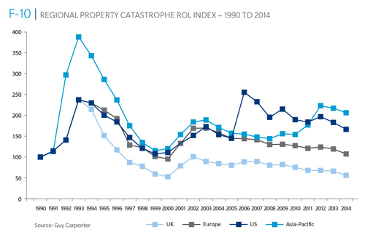
Reinsurance Pricing: Rate-on-Line Index by Region, 1990 – 2014*
Lower CATs and a flood of new capital has pushed reinsurance pricing down in most regions, including the US
*As of Jan. 1.
Source: Guy Carpenter

Slide 257
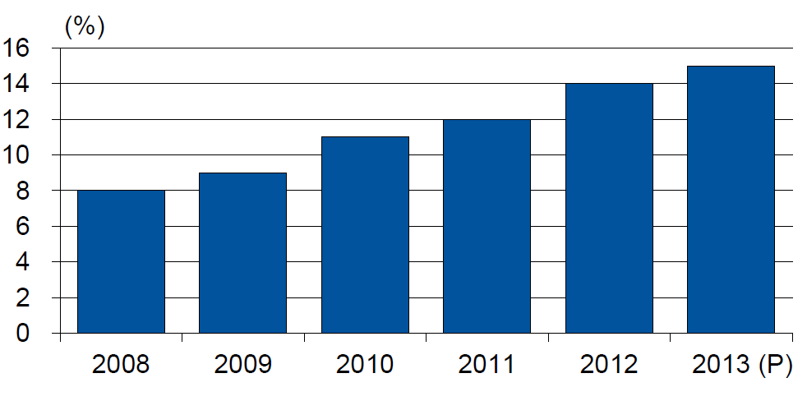
Alternative Capacity as a Percentage of Global Property Catastrophe Reinsurance Limit
(As of Year End)
Alternative Capacity accounted for approximately 14% or $45 billion of the $316 in global property catastrophe reinsurance capital as of mid-2013 (expected to rise to ~15% by year-end 2013)
Source: Guy Carpenter

Slide 258
Property Catastrophe Reinsurance Capacity by Source as of Mid-2013 ($ Bill)
Total = $316 Billion*
“Convergence Capital” accounted for an estimated $45B or 14% or total property catastrophe reinsurance capacity as of mid-2013, up $10B over the past 18 months (since 1/1/12). Penetration of this type of capacity is growing
Collateralized reinsurance (sidecars) is the fastest growing segment recently
Source: Guy Carpenter; Mid-Year Market Report, September 2013; Insurance Information Institute.

Slide 259
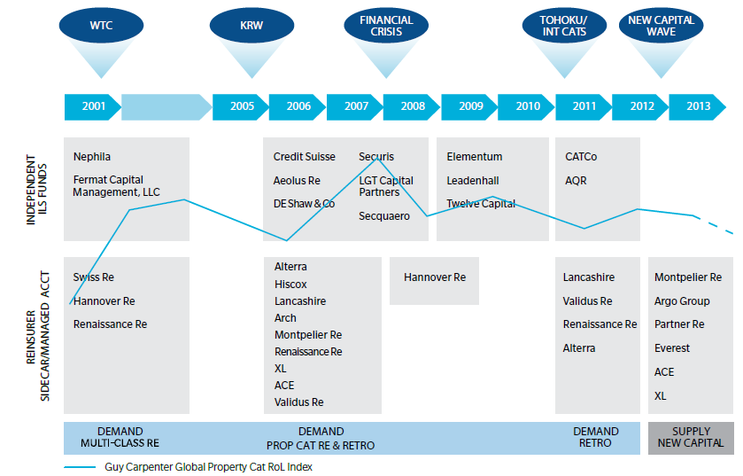
Alternative Capacity Development, 2001—2013:H1
Source: Guy Carpenter; Mid-Year Market Report, September 2013; Insurance Information Institute.

Slide 260
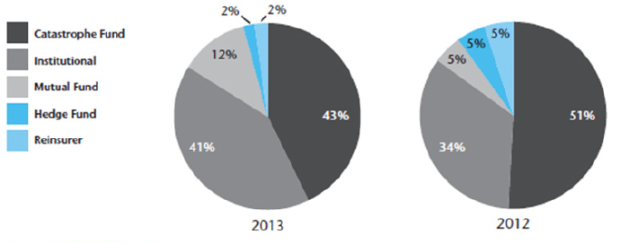
Investor by Category, 2013 vs. 2012*
Institutional Investors are accounting for a larger share of alternative reinsurance investors
*As of June 30 each year.
Source: Aon Benfield Securities; Insurance Information Institute.

Slide 261
Non-Traditional Property Catastrophe Limits by Type, YE 2012 vs. YE 2015E
Alternative capital is expected to rise by 30% by YE 2015 and will ultimately account for 20-30% of total reinsurance spend, according to Guy Carpenter
Source: Guy Carpenter; Reinsurance Association of America; Insurance Information Institute.

Slide 262
Catastrophe Bonds: Issuance and Outstanding, 1997- 2013*
Risk Capital Amount ($ Millions)
Risk capital outstanding reached a record high in 2013
Financial crisis depressed issuance
CAT bond issuance reached a record high in 2013
Catastrophe Bond Issuance Is Approaching Pre-Crisis Levels While Risk Capital Outstanding Stands at an All-Time Record
*Through Dec. 31, 2013.
Source: Guy Carpenter; Insurance Information Institute.

Slide 263
CATASTROPHE BONDS, ANNUAL RISK CAPITAL ISSUED, 2002-2012
($ Billions)
Note
Source: GC Securities and Guy Carpenter & Company, LLC.

Slide 264
CATASTROPHE BONDS, RISK CAPITAL OUTSTANDING, 2002-2012
($ Billions)
Note
Source: GC Securities and Guy Carpenter & Company, LLC.

Slide 265
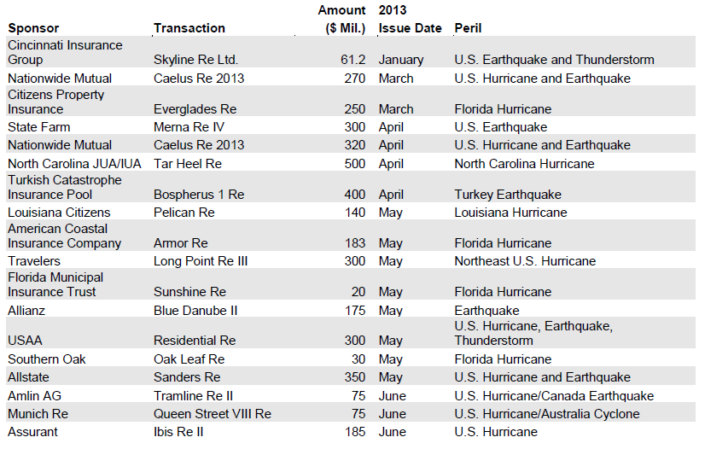
Catastrophe Bond Issuances, First Half 2013
Sources: Willis Capital Markets & Advisory, Fitch Ratings; Insurance Information Institute.

Slide 266
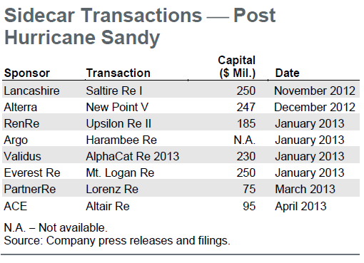
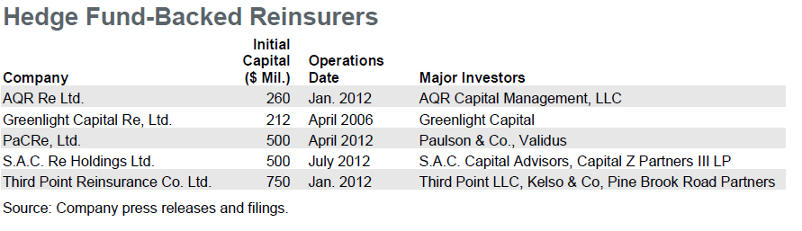
Sidecar Transactions (Post-Sandy) and Hedge Fund-Backed Reinsurers
Sidecars (collateralized reinsurance) are the fastest growing alternative capital segment, account for about 15% or $5 bill of total property catastrophe reinsurance capital
More hedge fund money is coming into the business
Sources: Willis Capital Markets & Advisory, Fitch Ratings; Insurance Information Institute.

Slide 267
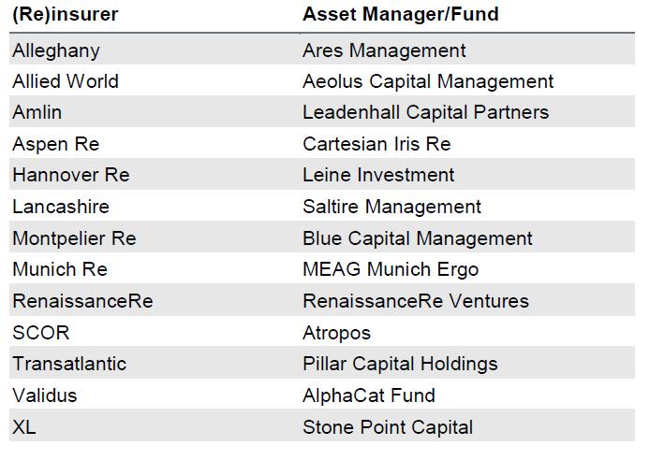
(Re) Insurers Investing in Insurance Linked Securities (ILS) Fund Managers
Several (re)insurers have formed asset managers or invested in independent asset managers that are focused on managing catastrophe/ILS funds for outside investors. These asset managers invest third party capital in instruments with returns linked to property catastrophe reinsurance retrocession and ILS contracts.
Sources: Willis Capital Markets & Advisory, Fitch Ratings; Insurance Information Institute.

Slide 268
Alternative Reinsurance Capital Summary
Alternative Reinsurance Here to Stay
Capital markets have effectively discovered reinsurance another “asset class,” in part due to Federal Reserve’s unprecedented actions since the financial crisis to keep interest rates low across the entire yield curve.
A convergence of the reinsurance and capital markets persists with many companies both providing and using alternative forms of risk transfer to supplement the traditional balance sheet, transforming several reinsurers into risk asset managers. These structures include catastrophe bonds (cat bonds), collateralized quota-share reinsurance vehicles (sidecars), industry loss warranties (ILWs), hedge fund-supported reinsurers and asset managers investing in insurance-linked securities (ILS).
Property Catastrophe Drives Market:
The nature of property catastrophe risk as being highly modeled and commoditized serves as an important economic force driving its transfer into the capital markets. Casualty (re)insurance lines have had limited movement into the alternative reinsurance market thus far, as the less standardized and more specialized nature of these longer term risks makes them better suited for more permanent traditional capacity providers.
Sources: Fitch Ratings, Alternative Reinsurance Market Update, September 5, 2013; Insurance Information Institute.

Slide 269
Alternative Reinsurance Capital Summary (continued)
Strong Investor Demand
Comparatively high potential returns of catastrophe risk through cat bonds and sidecar investments are particularly attractive to investors, although this spread has been shrinking due to increased investor demand. However, the lack of correlation between catastrophe losses and returns on other major asset classes should continue to contribute to strong demand from investors, which include hedge funds, private equity and institutional investors.
Shock (i.e., Large Loss) Event Could Alter Market
One area of uncertainty is how investors would react to an environment of less favorable catastrophe risk spreads or a large unexpected catastrophe loss, either of which could cause capital to retreat. This risk is likely higher for hedge fund capital, as pension fund capital tends to be more permanent, given their long-term investment outlook and more diversified risk exposure.
Mixed Impact to Reinsurers’ Ratings:
Fitch views the growth and acceptance of alternative reinsurance as a mixed impact for the credit quality of reinsurers’ ratings. Favorably, these products can be used to manage reinsurers’ exposure and capital and serve as a source of fee income. Negatively, alternative coverage represents competition for traditional reinsurers that, in conjunction with the strong overall capitalization of the reinsurance industry, have worked to notably dampen reinsurance pricing
Sources: Fitch Ratings, Alternative Reinsurance Market Update, September 5, 2013.

Slide 270
Alternative Reinsurance Capital Summary (continued)
Sponsors Benefit From New Issuance:
As investor demand has continued to grow for catastrophe bonds, sponsors have been able to offer deals at considerably lower coupon rates and with increasingly favorable structures that suit individual company needs. These market conditions are likely to drive further issuance of cat bonds in the near term if (re)insurers believe they can produce a cost-effective alternative to supplement their reinsurance program. As of midyear, 2013 is on track to produce a record amount of catastrophe bond issuance.
Sidecars Continue to Provide Capacity:
Several sidecars emerged late in 2012 and early into 2013 following Hurricane Sandy. These vehicles were opportunistically seeking to capitalize on any potential improvements in property catastrophe pricing. However, they also represented several newer entrants into the alternative reinsurance space looking to participate in what continues to be an important and growing segment of the reinsurance market.
Sources: Fitch Ratings, Alternative Reinsurance Market Update, September 5, 2013.

Slide 271
Questions Arising from Influence of Alternative Capital
Could Pension Fund Money Swamp Traditional Capacity?
US private pension funds hold ~$7 trillion in assets
2% allocation = $140 billion
Global property cat capital = ~$316 bill as of mid-2013
Do New Investors Have a Lower Cost of Capital?
New capacity expects 6-8% rate of return compared to 8-10% for traditional reinsurance, according to Dowling & Partners
Will Reinsurance Pricing Become More Closely Linked to Interest Rates?
Terms and Conditions Could Weaken
Multi-year deals

Slide 272
Reinsurer Share of Recent Significant Market Losses
Billions of 2011 Dollars
40% Reinsurance share of total insured loss
$37.5
$15.0
73%
60%
95%
$13.0
44%
$10.0
$22.5
$8.3
$9.5
$6.0
$5.0
$7.9
$2.2
$3.5
$4.0
$2.8
$0.4
Reinsurers Paid a High Proportion of Insured Losses Arising from Major Catastrophic Events Around the World in Recent Years
Source: Insurance Information Institute from reinsurance share percentages provided in RAA, ABIR and CEA press release, Jan. 13, 2011.
272
12/01/09 - 9pm
eSlide – P6466 – The Financial Crisis and the Future of the P/C
Notes:
272

Slide 273
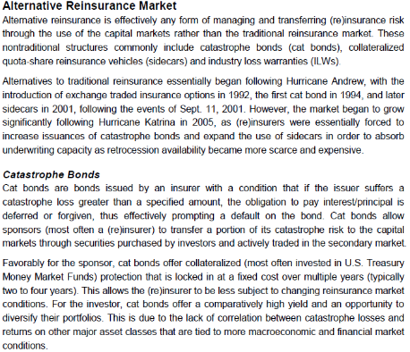
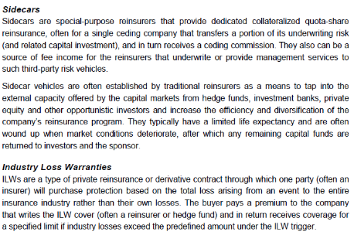
Alternative Capital: Important Definitions
Sources: Fitch Ratings; Insurance Information Institute.

Slide 274
Shifting Legal Liability & Tort Environment
Is the Tort Pendulum Swinging Against Insurers?
274

Slide 275
Over the Last Three Decades, Total Tort Costs as a % of GDP Appear Somewhat Cyclical, 1980-2013E
($ Billions)
2.21% of GDP in 2003 = pre-tort reform peak
Deepwater Horizon Spike in 2010
Tort costs in dollar terms have remained high but relatively stable since the mid-2000s., but are down substantially as a share of GDP
1.68% of GDP in 2013
Sources: Towers Watson, 2011 Update on US Tort Cost Trends, Appendix 1A

Slide 276
Commercial Lines Tort Costs: Insured vs. Self-(Un)Insured Shares, 1973-2010
2005: $143.5B 66.4% insured, 33.6% self-(un)insured
Billions of Dollars
$15.0
1995: $83.6B 69.5% insured, 30.5% self-(un)insured
1973: Commercial Tort Costs Totaled $6.49B, 94% was insured, 6% self-(un)insured
1985: $46.6B 74.5% insured, 25.5% self-(un)insured
$9.5
$6.0
2009: $126.5B 64.4% insured, 35.6% self-(un)insured
Tort Costs and the Share Retained by Risks Both Grew Rapidly from the mid-1970s to mid-2000s, When Tort Costs Began to Fall But Self-Insurance Shares Continued to Rise
Sources: Towers Watson, 2011 Update on US Tort Cost Trends, III Calculations based on data from Appendix 4.
276
12/01/09 - 9pm
eSlide – P6466 – The Financial Crisis and the Future of the P/C
Notes:
276

Slide 277
Commercial Lines Tort Costs: Insured vs. Self-(Un)Insured Shares, 1973-2010
Percent
2010: $138.1B 56.6% insured, 44.4% self-(un)insured (distorted by Deepwater Horizon event with most losses retained by BP)
1973: 94% was insured, 6% self-(un)insured
1985:74.5% insured, 25.5% self-(un)insured
1995: 69.5% insured, 30.5% self-(un)insured
2005: 66.4% insured, 33.6% self-(un)insured
The Share of Tort Costs Retained by Risks Has Been Steadily Increasing for Nearly 40 Years. This Trend Contributes Has Left Insurers With Less Control Over Pricing.
Sources: Towers Watson, 2011 Update on US Tort Cost Trends, III Calculations based on data from Appendix 4.
277
12/01/09 - 9pm
eSlide – P6466 – The Financial Crisis and the Future of the P/C
Notes:
277

Slide 278
Business Leaders Ranking of Liability Systems in 2012
Best States
Delaware
Nebraska
Wyoming
Minnesota
Kansas
Idaho
Virginia
North Dakota
Utah
Iowa
Worst States
Florida
Oklahoma
Alabama
New Mexico
Montana
Illinois
California
Mississippi
Louisiana
West Virginia
New in 2012
Wyoming
Minnesota
Kansas
Idaho
Newly Notorious
Oklahoma
Drop-offs
Rising Above
Indiana
Colorado
Massachusetts
South Dakota
Arkansas
Source: US Chamber of Commerce 2012 State Liability Systems Ranking Study; Insurance Info. Institute.

Slide 279
The Nation’s Judicial Hellholes: 2012/2013
Watch List
Illinois
Madison County
West Virginia
Maryland
Baltimore
Philadelphia, Pennsylvania
South Florida
Cook County, Illinois
New Jersey
Nevada
Louisiana
California
Dishonorable Mention
New York
Albany and NYC
MO Supreme Court
WA Supreme Court
Source: American Tort Reform Association; Insurance Information Institute

Slide 280
CYBER RISK
Cyber Risk is a Rapidly Emerging Exposure for Businesses Large and Small in Every Industry
NEW III White Paper: http://www.iii.org/assets/docs/pdf/paper_CyberRisk_2013.pdf
280

Slide 281





Data Breaches 2005-2013, by Number of Breaches and Records Exposed
# Data Breaches/Millions of Records Exposed
Millions
The Total Number of Data Breaches (+38%) and Number of Records Exposed (+408%) in 2013 Soared
* 2013 figures as of Jan. 1, 2014 from the ITRC updated to an additional 30 million records breached (Target) as disclosed in Jan. 2014.
Source: Identity Theft Resource Center.

Slide 282
2012 Data Breaches By Business Category, By Number of Breaches
The majority of the 447 data breaches in 2012 affected business and medical/healthcare organizations, according to the Identity Theft Resource Center.
Banking/Credit/Financial, 17 (3.8%)
Govt/Military, 50 (11.2%)
Business, 165 (36.9%)
Educational, 61 (13.6%)
Medical/Healthcare, 154 (34.5%)
Source: Identity Theft Resource Center, http://www.idtheftcenter.org/ITRC%20Breach%20Report%202012.pdf.

Slide 283
2012 Data Breaches By Category, By Number of Records Exposed
Government/Military and Business organizations accounted for the majority of records exposed by data breaches during 2012.
Banking/Credit/Financial, 470,048 (2.7%)
Medical/Healthcare, 2.2 million (12.9%)
Govt/Military, 7.7 million (44.4%)
Educational, 2.3 million (13.3%)
Business, 4.6 million (26.7%)
Source: Identity Theft Resource Center, http://www.idtheftcenter.org/ITRC%20Breach%20Report%202012.pdf.

Slide 284
AIG Survey: Cyber Attacks Top Concern Among Execs
While companies are focused on managing a variety of business risks, cyber attacks are a top concern. Some 85% of 258 executives surveyed said they were very or somewhat concerned about cyber attacks on their businesses.
Source: Penn Schoen Berland on behalf of American International Group.
284
Notes:
284

Slide 285
The Most Costly Cyber Crimes, Fiscal Year 2012
Malicious code, denial of service and web-based attacks account for more than 58 percent of the total annualized cost of cyber crime experienced by 56 companies.
Malware
Botnets
Malicious code
Viruses, Worms, Trojans
Phishing + social engineering
Malicious insiders
Stolen devices
Denial of service
Web-based attacks
Source: 2012 Cost of Cyber Crime: United States, Ponemon Institute.

Slide 286
External Cyber Crime Costs: Fiscal Year 2012
Information loss (44%) and business disruption or lost productivity (30%) account for the majority of external costs due to cyber crime.
Other costs*
Equipment damages
Information loss
Revenue loss
Business disruption
* Other costs include direct and indirect costs that could not be allocated to a main external cost category
Source: 2012 Cost of Cyber Crime: United States, Ponemon Institute.

Slide 287
High Profile Data Breaches, 2012-2013
Date | Company | Description of Breach
Mar 2013* | South Korean banks, media cos | Cyber attack causes computers to crash at South Korean banks and media companies, paralyzing bank machines across the country. No immediate reports of records compromised.
July 2012 | Yahoo | Security breach at Yahoo in which some 450,000 passwords lifted and posted to the Internet.
July 2012 | eHarmony | Online dating site eHarmony confirms security breach in which some 1.5 million user names and passwords compromised.
July 2012 | LinkedIn | Social networking site LinkedIn reportedly targeted in hacker attack that saw 6.5 million hashed passwords posted to the Internet.
April 2012 | Utah Dept of Technology Services | Utah Department of Technology notifies of a March 30 breach of a server containing personal data including social security numbers for about 780,000 Medicaid patient claims. Breach traced to Eastern Europe hackers.
Mar 2012 | Global Payments | Credit card processor Global Payments confirms hacker attack has compromised the payment card numbers of around 1.5 million cardholders.
Mar 2012 | CA Dept of Child Support Services | Officials announce that four computer storage devices containing personal information for about 800,000 adults and children in California’s child support system were lost by IBM and Iron Mountain Inc.
Jan 2012 | Zappos | Online shoe retailer Zappos announces that information, such as names, addresses and passwords on as many as 24 million customers illegally accessed.
Jan 2012 | NY State Electric + Gas Co | Security breach at NYSEG that allowed unauthorized access to NYSEG customer data, containing social security numbers, dates of birth and bank account numbers, exposing 1.8 million records.
*March 2013 attack is not part of ITRC research.
Sources: Identity Theft Resource Center, http://www.idtheftcenter.org/ITRC%20Breach%20Report%202012.pdf; Insurance Information Institute (I.I.I.) research.

Slide 288
Average Organizational Cost of a Data Breach, 2008-2011* ($ Millions)
The average organizational cost of a data breach in 2011 was $5.5 million, down 24% from $7.2 million in 2010. Companies have improved steps taken in both preparing for and responding to a data breach.
($ Millions)
*Findings of this benchmark study pertain to the actual data breach experiences of 49 U.S. companies from 14 different industry sectors, all of which participated in the 2011 study. Total breach costs include: lost business resulting from diminished trust or confidence of customers ;costs related to detection, escalation, and notification of the breach; and ex-post response activities, such as credit report monitoring.
Source: 2011 Annual Study: U.S. Cost of a Data Breach, the Ponemon Institute.
288
Notes:
288

Slide 289
Main Causes of Data Breach
Negligent employees and malicious attacks are most often the cause of the data breach. Some 39 percent of incidents involve a negligent employee or contractor, while 37 percent concern a malicious or criminal attack.
Negligence
System glitch
Malicious or criminal attack
Source: 2011 Cost of Data Breach Study: United States, Ponemon Institute, March 2012

Slide 290
Marsh: Increase in Purchase of Cyber Insurance Among U.S. Companies, 2012
Interest in cyber insurance continues to climb. The number of companies purchasing cyber insurance increased 33 percent from 2011 to 2012.
Source: Marsh Global Analytics, Marsh Risk Management Research Briefing, March 2013
290
Notes:
290

Slide 291
Marsh: Total Limits Purchased, By Industry – Cyber Liability, All Revenue Size
Cyber insurance limits purchased in 2012 averaged $16.8 million across all industries, an increase of nearly 20% over 2011.
($ Millions)
Source: Marsh Global Analytics, Marsh Risk Management Research Briefing, March 2013
291
Notes:
291

Slide 292
Marsh: Total Limits Purchased, By Industry – Cyber Liability, Revenue $1 Billion+
Among larger companies, average cyber insurance limits purchased in 2012 increased nearly 30% over 2011.
($ Millions)
Source: Marsh Global Analytics, Marsh Risk Management Research Briefing, March 2013
292
Notes:
292

Slide 293
Cyber Liability: Historical Rate (price per million) Changes
Overall, rates for cyber insurance were essentially flat in the fourth quarter of 2012.
Source: Marsh Global Analytics, Marsh Risk Management Research Briefing, March 2013

Slide 294
New Waves of Regulations
2008 - Present
Global Crisis and Regulatory Response
294

Slide 295
The Global Financial Crisis: The Pendulum Swings Again: Dodd-Frank & Systemic Risk
Dodd-Frank Act of 2010: The implosion of the housing bubble and virtual collapse of the US banking system, the seizure of credit markets and massive government bailouts of US financial institutions led to calls for sweeping regulatory reforms of the financial industry
Limiting Systemic Risk is at the Core of Dodd-Frank
Designation as a Systemically Important Financial Institutional (SIFI) Will Result in Greater Regulatory Scrutiny and Heightened Capital Requirements
Dodd-Frank Established Several Entities Impacting Insurers
Federal Insurance Office
Financial Stability Oversight Council
Office of Financial Research
Consumer Financial Protection Bureau

Slide 296
The Global Financial Crisis: The Pendulum Swings Again: Dodd-Frank & Systemic Risk
Insurers—as Non-Bank Financial Institutions—Have Escaped Some, though Not All of the Most Draconian Provision of Dodd-Frank
In particular, small number of large insurers will (are) receiving a designations as Systemically Important Financial Institutions (SIFIs)
Insurers Generally Reject the Notion that Insurance Is Systemically Risky (or that any Individual Insurer is Systemically Important)
Such a Designation Makes the Fed the Penultimate Regulator
To Date: AIG, Prudential Have Been Designated as non-bank SIFIs by the FSOC
MetLife is still under evaluation
Fed Reserve Seems Open to Developing a Tailored Capital Requirement Approach for Insurers
Conflicting language in the DFA make this somewhat difficult
SIFIs may need Fed approval to repurchase shares on increase dividend

Slide 297
Global Financial Crises & Global Systemic Risk
The Global Financial Crisis Prompted the G-20 Leaders to Request that the Financial Stability Board (FSB) Assess the Systemic Risks Associated with SIFIs, Global-SIFIs in Particular
In July 2013, the FSB Endorsed the International Association of Insurance Supervisors Methodology for Identifying Globally Systemically Important Insurers (G-SIIs)
For Each G-SII, the Following Will Be Required:
(i) Recovery and resolution plans
(ii) Enhanced group-wide supervision
(iii) Higher loss absorbency (HLA) requirements
G-SIIs as Designated by the FSB as of July 2013:
Allianz SE AIG Assicurazioni Generali
Aviva Axa MetLife
Ping An Prudential Financial Prudential plc

Slide 298
Global Financial Crises & Global Systemic Risk: Key Dates
Implementation Date | Action
July 2013 | Designation of G-SIIs (annual updates thereafter beginning Nov. 2014)
July 2014 | FSB to make a decision on the G-SII status of, and appropriate risk mitigating measures for major reinsurers
By G-20 Summit 2014 | IAIS to develop backstop capital requirements to apply to all group activities, incl. non-ins. subs.
End 2015 | IAIS to develop HLA requirements that will apply to G-SIIs staring in 2019
January 2019 | G-SIIs to apply HLA requirements
Sources: Financial Stability Board, “Globally Systemically Important Insurers (G-SIIs) and the Policy Measures that Will Apply to Them,” July 18, 2013.

Slide 299
Global Financial Crises & Global Systemic Risk…There’s More…
IAIS Also Plans to Develop the First-Ever Risk-Based Global Insurance Capital Standards by 2016
Would be Tested in 2017-2018; Implemented in 2019
Would Be Included as Part of ComFrame and Apply to Internationally Active Insurance Groups (IAIGs): ~50 IAIGs Designations Likely
While Flexibility May Exist within the Standards, Doubts in the US Are Likely to Be Strong
Concern that the standards may be bank-centric
Questions as to whether such standards are even needed:
“Although US state insurance regulators continue to have doubts about the timing, necessity and complexity of developing a global capital standard given regulatory differences around the globe, we intend to remain fully engaged in the process to ensure that any development augments the strong legal entity capital requirements in the US that have provided proven and tested security for US policyholders and stable insurance markets for consumers and industry.” --NAIC President Ben Nelson (P/C 360, Oct. 16, 2013)

Slide 300
Insurance Information Institute Online:
www.iii.org
Thank you for your time and your attention!
Twitter: twitter.com/bob_hartwig
Download at www.iii.org/presentations

