Slide 1
Lightning Safety Awareness Week
Media Briefing and Workshop
“Lightning and Property Insurance”
University of Maryland’s
Earth System Science Interdisciplinary Center
College Park, Maryland, Tuesday, June 24, 2014
Jeanne M. Salvatore, Senior Vice President, Chief Communications Officer, Insurance Information Institute (I.I.I.)
@JeanneSalvatore
I.I.I.♦ 110 William Street ♦ New York, NY 10038
Tel: 212.346.5520 ♦ www.iii.org

Slide 2
Lightning & Insurance

Slide 3
Lightning Coverage
Damage caused by lightning, such as fire is covered by standard home and business insurance policies.
Some home and business policies provide coverage for power surges that are a direct result of a lightning strike.
The optional comprehensive portion of an auto insurance policy provides coverage for lightning damage.

Slide 4
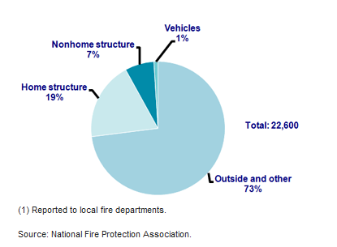
Fires Started by Lightning by Type of Structure, 2007-2011

Slide 5
Good News – Lightning Losses Dropped!
Insured losses to homes from lightning strikes in the U.S. fell to their lowest level in a decade last year as severe thunderstorm activity eased from near-record levels.
Despite the respite, insurers still paid $673.5 million in lightning claims to more than 100,000 policyholders in 2013.
Although total losses from lightning were down by nearly one-third in 2013, the decline since 2004 is a much more modest 8.4 percent. In the prior three years, 2010 to 2012, home insurers paid approximately 1 billion per year on average to policyholders.

Slide 6
The Number of Lightning Claims are Down Too!
The number of lightning claims were down by 24 percent from 2013 to 2012.
The average lightning claims amount was also down in 2013 by 8.30 percent to $5,869 in 2013 from $6,400 in 2012.
The incidence of lightning claims last year is a continuation of a downward trend. Since 2004, the number of paid lightning claims is down nearly 60 percent over the nine-year period through 2013.
The decline in the number of claims may be attributed to an increased use of lightning protection systems, technological advances, awareness of lightning safety, as well as fewer storms. While this is good news for homeowners, lightning is still and extremely costly weather event.

Slide 7
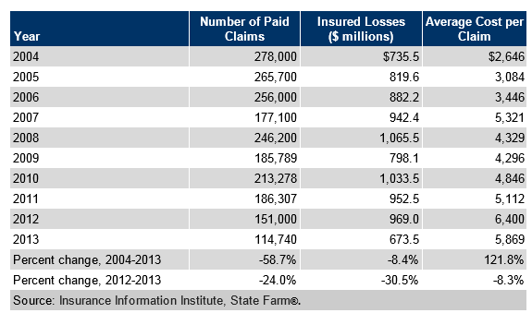
Homeowners Insurance Claims and Payouts for Lightning Losses, 2004-2013

Slide 8
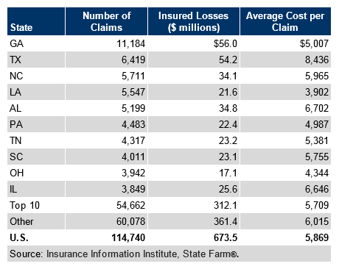
Top Ten States with Estimated Number and Cost of Lightning Claims, 2013
Georgia was the top state for lightning claims in 2013. But, Texas had the highest average cost per claim.

Slide 9
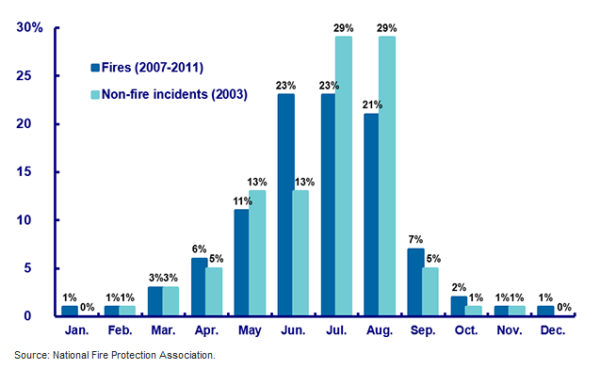
Lightning Incidents by Month, 2007-2011

Slide 10
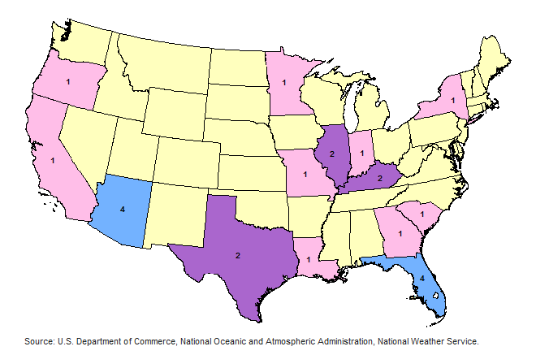
Lightning Fatalities by State, 2013

Slide 11
I.I.I. Resources www.iii.org

Slide 12
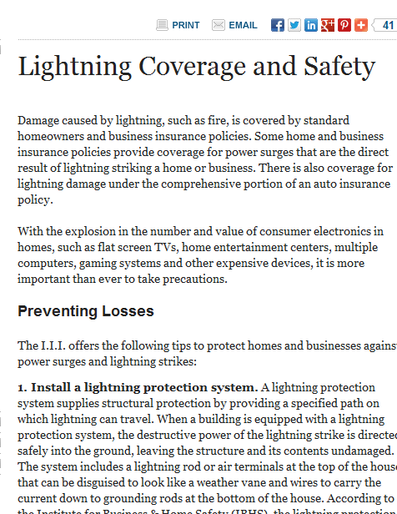
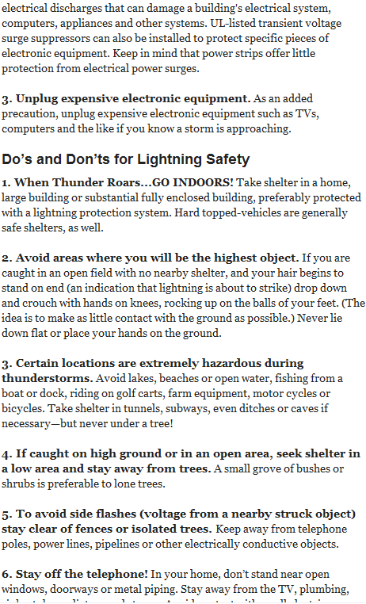
Consumer Articles

Slide 13
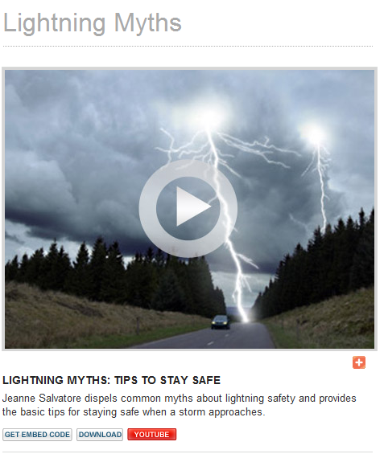
Web Video
Watch Video

Slide 14
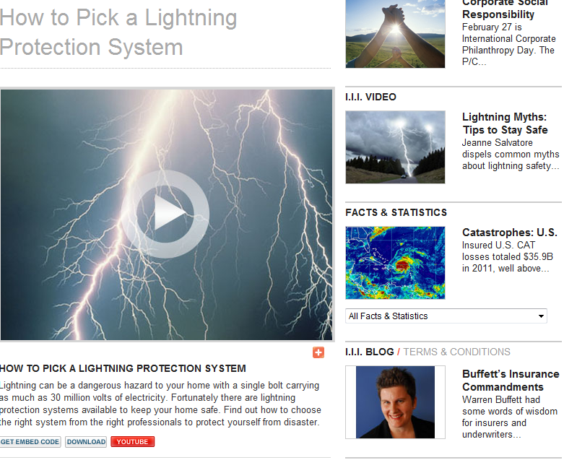
Podcasts and Video
Watch Video

Slide 15
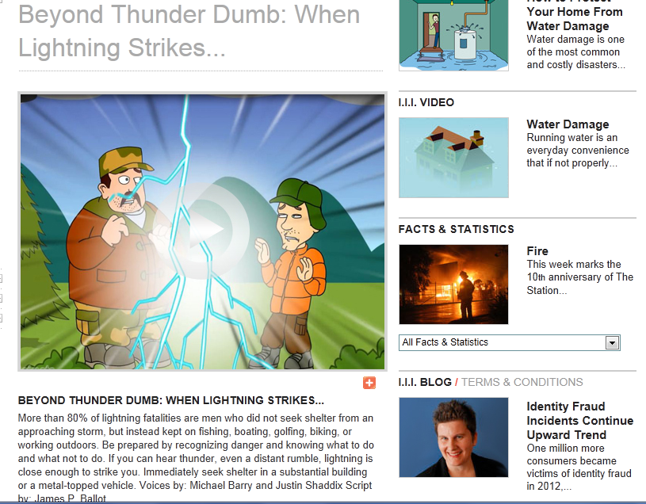
Fun and Entertaining Videos
http://www2.iii.org/video/beyond-thunder-dumb-when-lightning-strikes.html

Slide 16
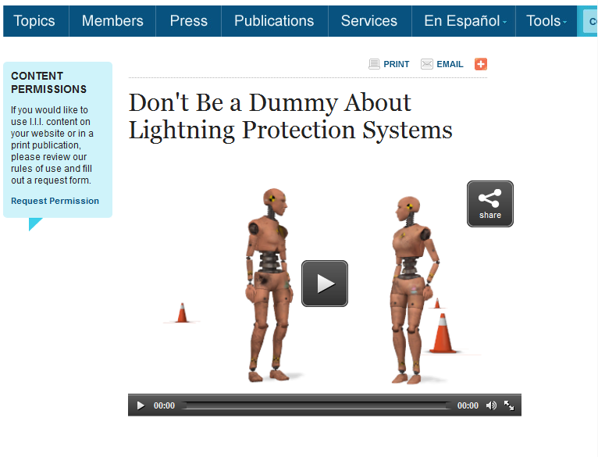
Web videos
Watch Video

Slide 17
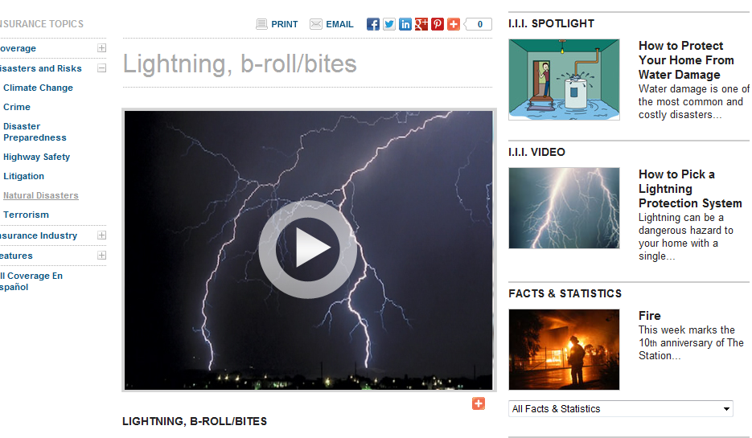
Video: b-roll/bites

Slide 18
Insurance Information Institute Website
www.iii.org
Notes:
18

