Slide 1
2017 Conference of United Lightning Protection Association and Lightning Protection Institute Woodlands, Texas February 10, 2017
Partnership with the LPI/ULPA An Overview of Communications Strategies
Jeanne Salvatore, Senior Vice President, 212-346-5555, jeannes@iii.org
Insurance Information Institute  www.iii.org  110 William Street  New York, NY 10038

Slide 2
Agenda
Who Is the Insurance Information Institute.
Overview of Partnership Between the I.I.I. and LPI/ULPA
Insurance Coverage Information
Lightning Data and Statistics
Educational Videos
2017 Activities Planned
Questions

Slide 3
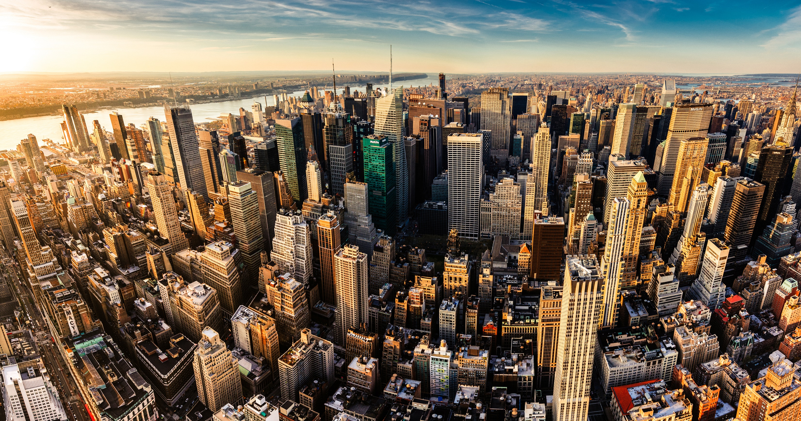
I.I.I. Mission Statement
Improving public understanding of insurance...
…what it does and how it works
3

Slide 4
Overview of I.I.I. and LPI/ Relationship
Mutually Beneficial

Slide 5
Update: Partnership Between the I.I.I. and the LPI/ULPA
The I.I.I. and the LPI/ULPA have been working together for several years now.
I.I.I. has benefited from the resources and expertise on lightning safety and lightning protection systems.
LPI/ULPA content saved and highlighted on the I.I.I. website and promoted via social engagement.
Promoted the Lightning Safety Awareness week with updated insured lightning stats.
Reissue news releases promoting the three videos (How to Pick a Lightning Protection System, Lightning Myths and Lightning Safety).

Slide 6
Update: Partnership
Made Kim Loehr available to speak to I.I.I. member companies at the I.I.I.’s all-industry weekly call, as well as the I.I.I. Communications Committee meeting.
Distributed LPI materials to senior communicators at I.I.I. member companies.
Incorporated lightning protection systems in the home buyers checklist.
Provided Media Training at the 2015 LPI/ULPA Conference, as well as follow-up assistance with media inquiries as needed. This includes putting LPI members in touch with state insurance trades as required.

Slide 7
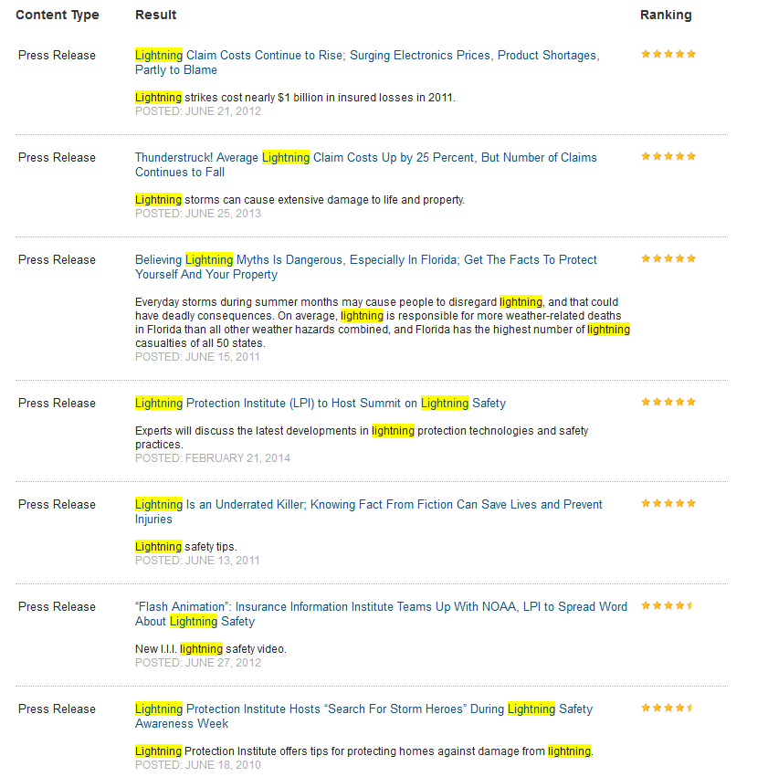
Issue News Releases – Over 25 releases were issued and posted to the I.I.I. website
Notes:
Can we have a new screen caption here? Please just go to news release and do a search with the word lightning. The latest news release should show up.

Slide 8
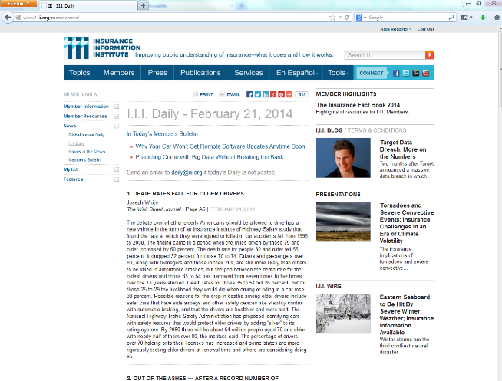
Use I.I.I. website to promote LPI to insurance companies

Slide 9
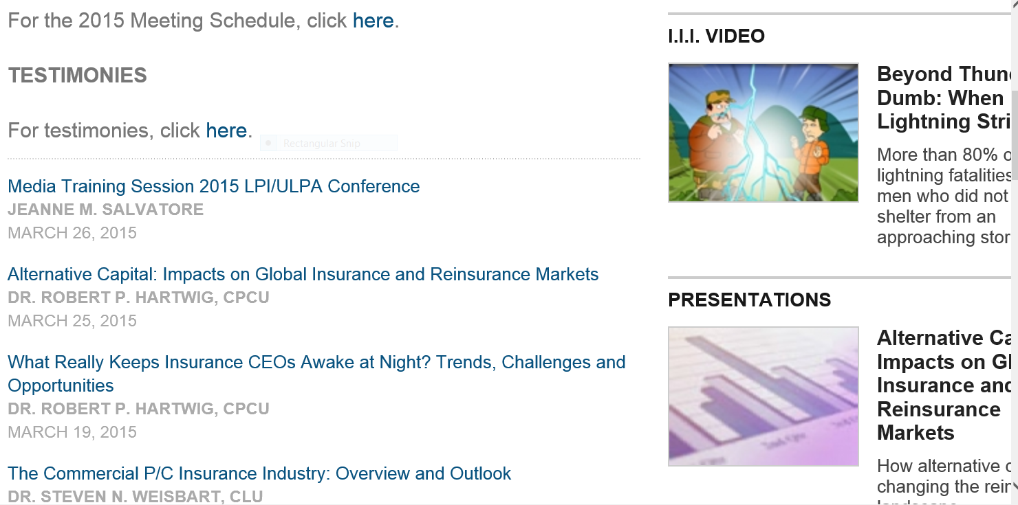
Media Training PowerPoint

Slide 10
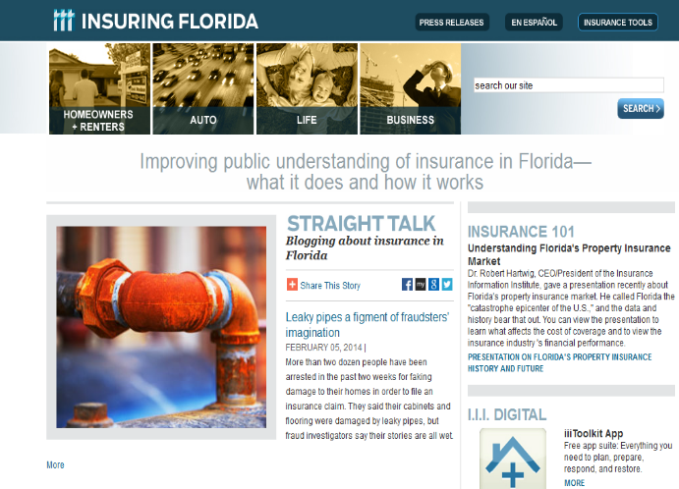
Lightning information Promoted to Florida Residents and Business Owners
Notes:
Is there something more up-to-date on the Florida site? Was there a news release in 2013? If not, let’s take the press release out. – No release in 2013.

Slide 11
Insurance Coverage Information
Lightning

Slide 12
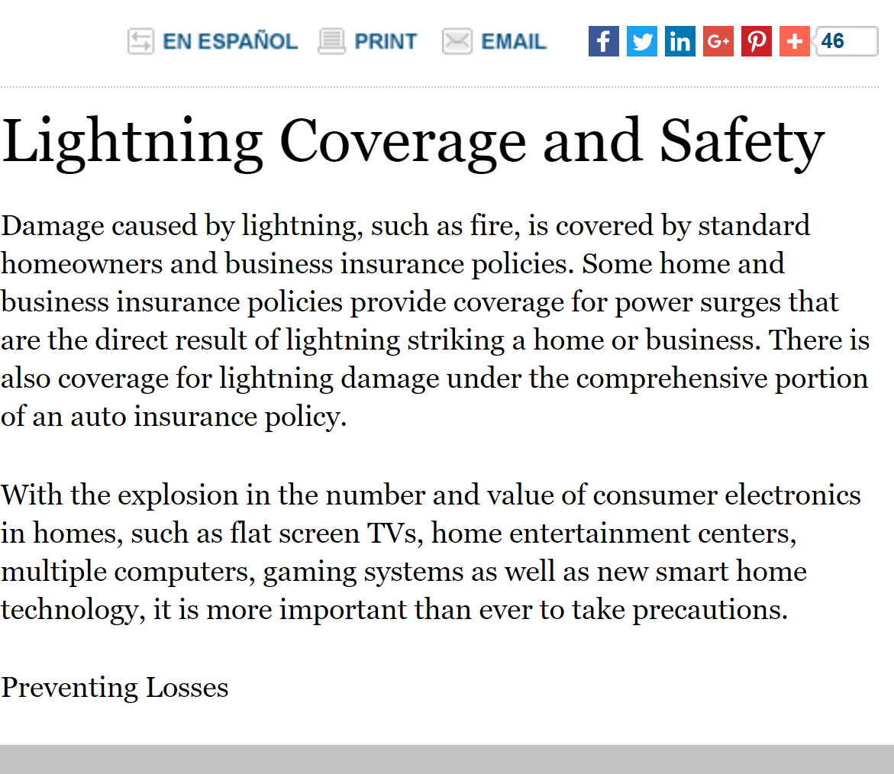
Coverage Information

Slide 13
Lightning Data

Slide 14
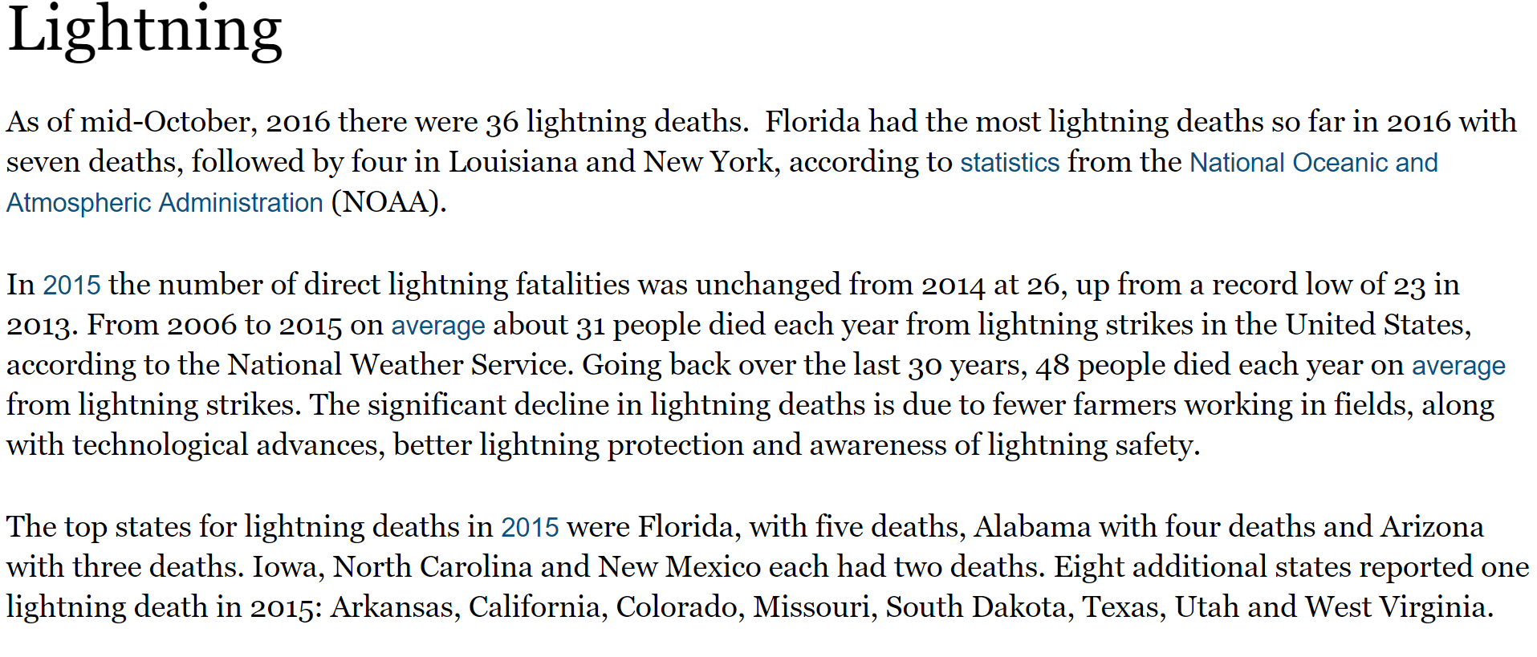
Overview: Lighting Facts and Statistics

Slide 15
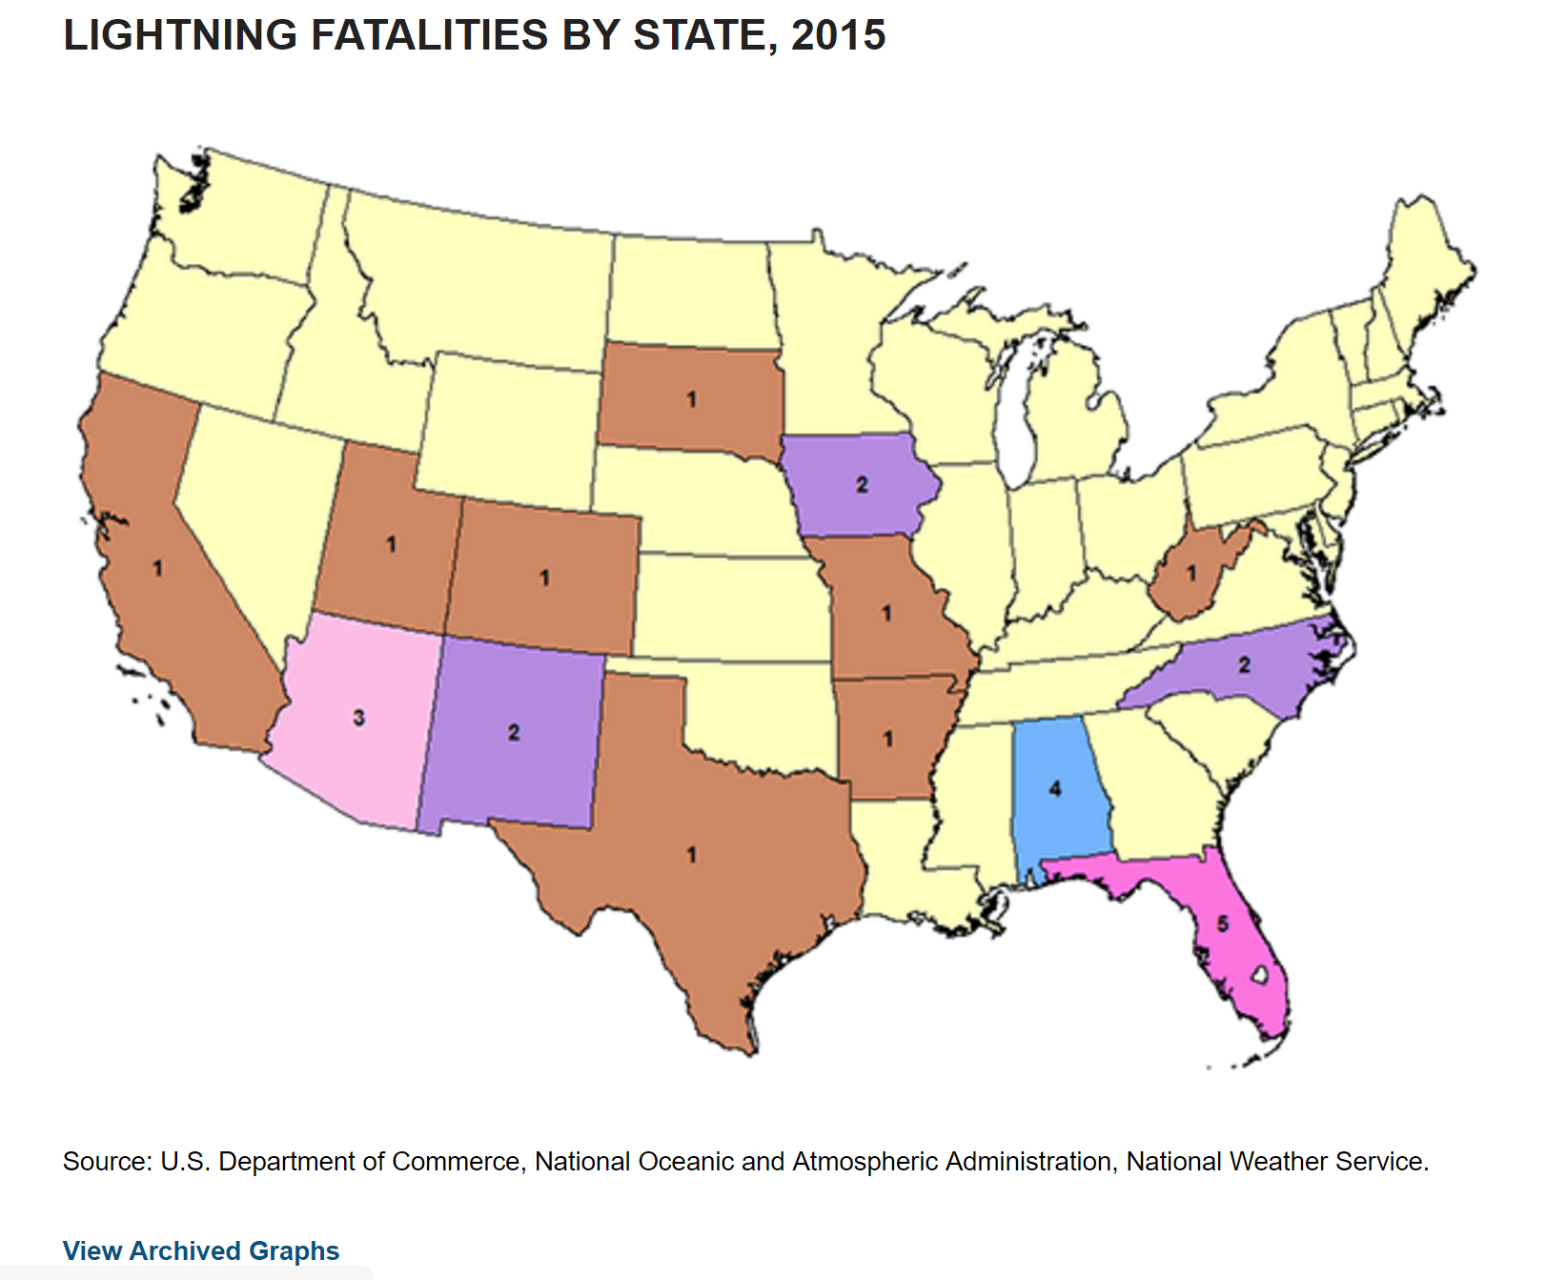
U.S. Map of Lightning Deaths
Historical Data is also available on the I.I.I. Website

Slide 16
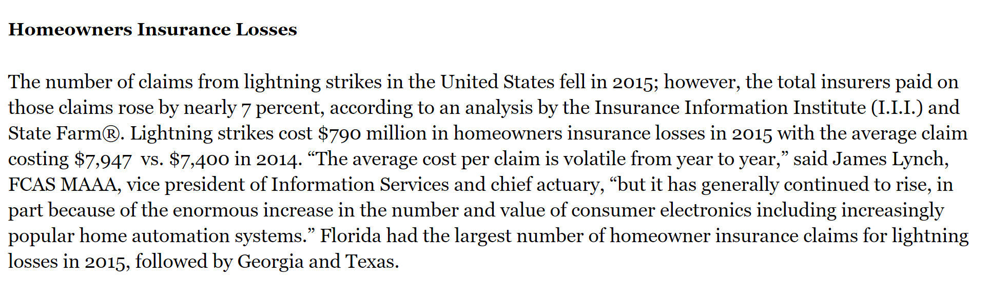
Home Insurance Losses
Number of claims decreased, but the cost increased due to increasing value of consumer electronics and automated or smart homes… a trend that is likely to continue.

Slide 17
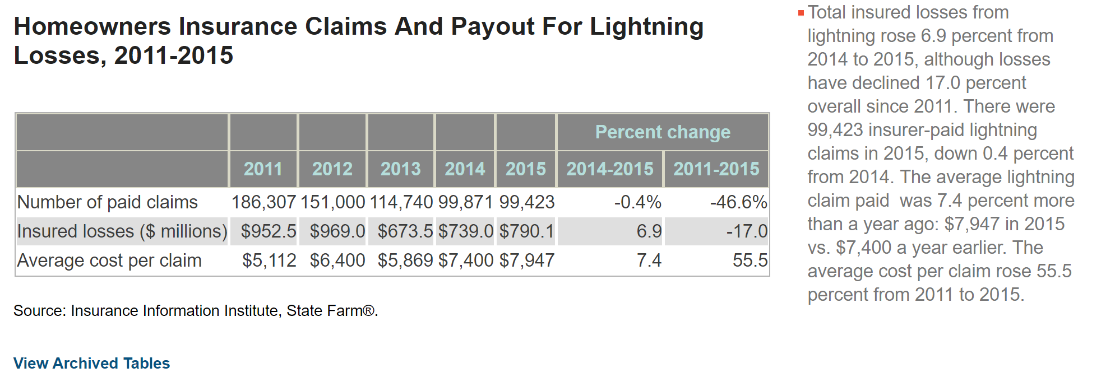
Lightning Claims and Payouts

Slide 18
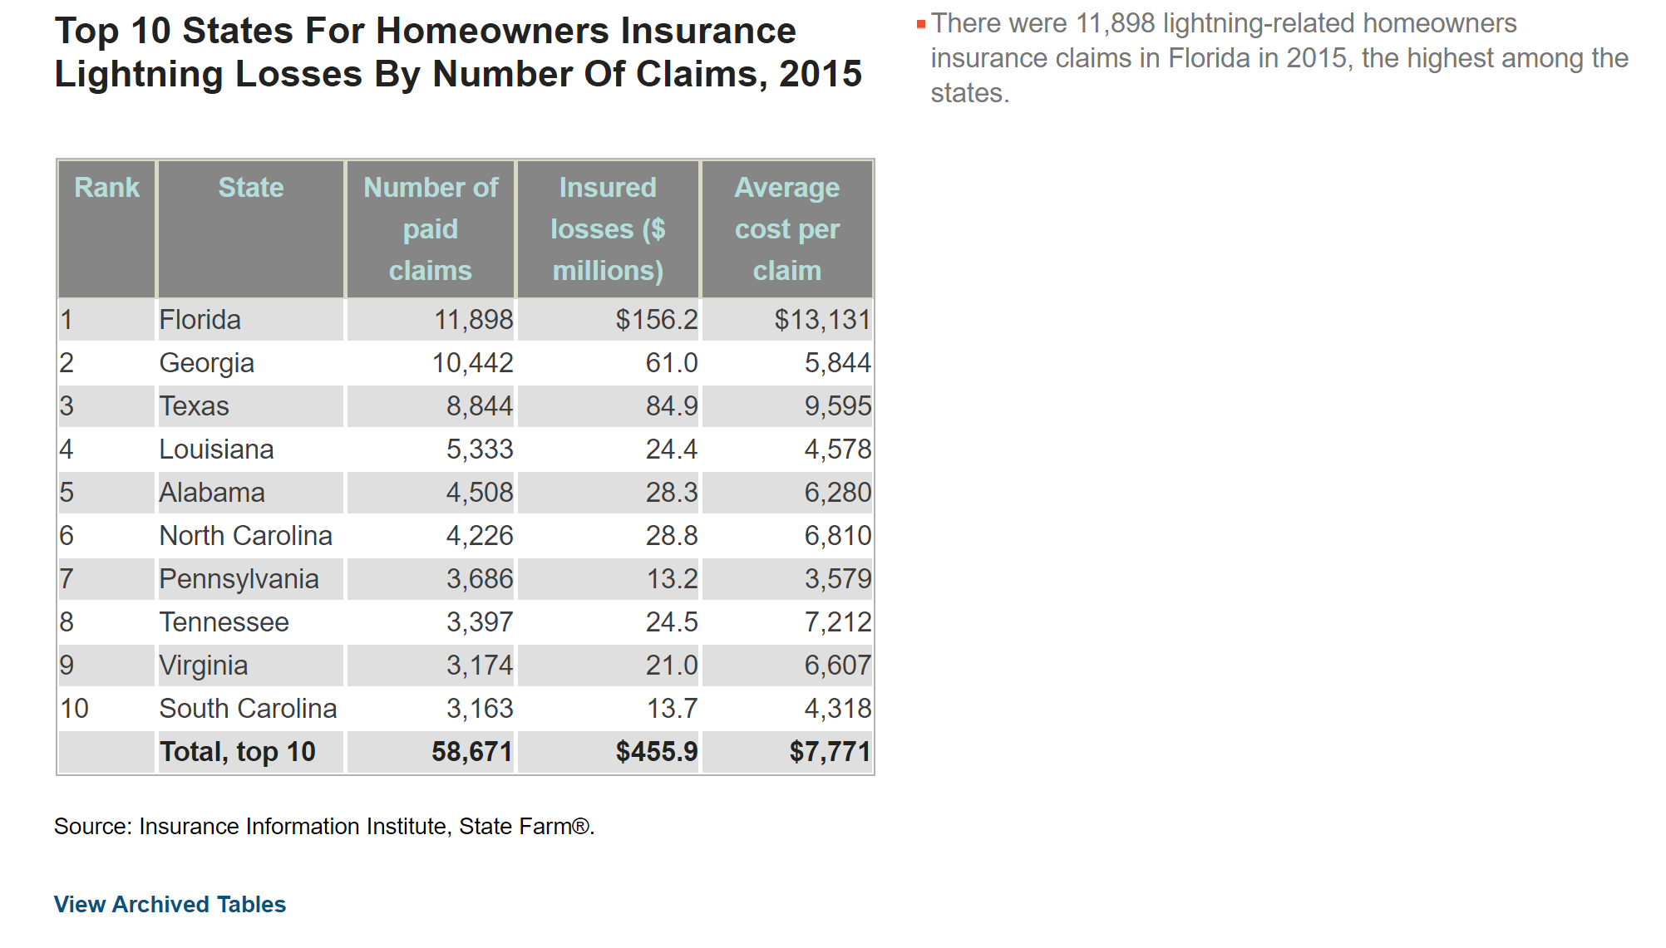
Top States for Homeowners Lightning Losses

Slide 19
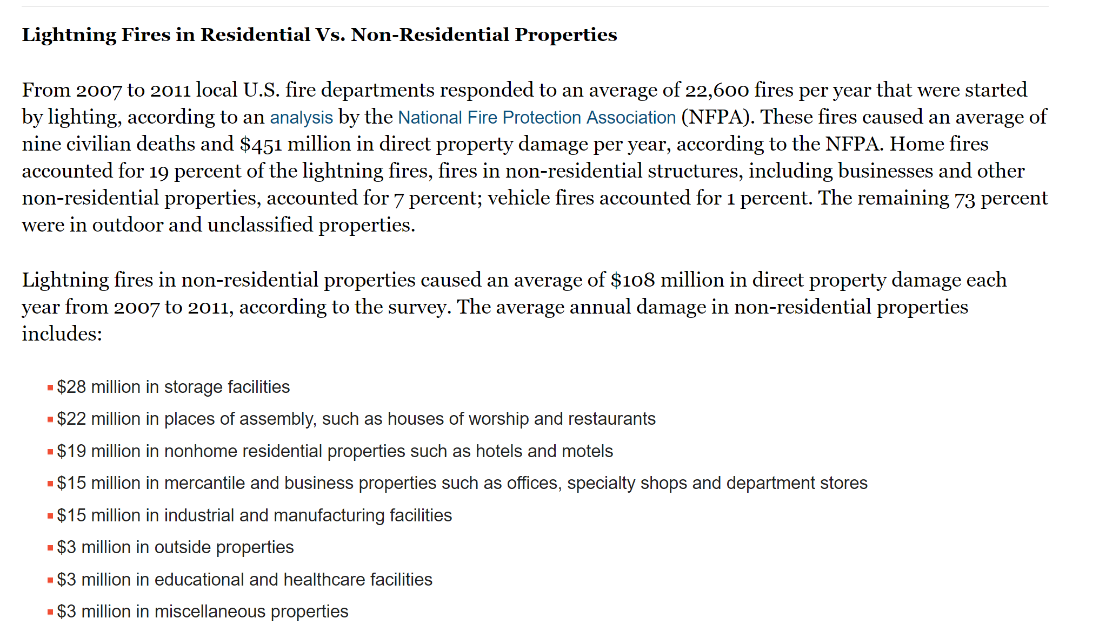
Residential and Commercial Lightning Fires

Slide 20
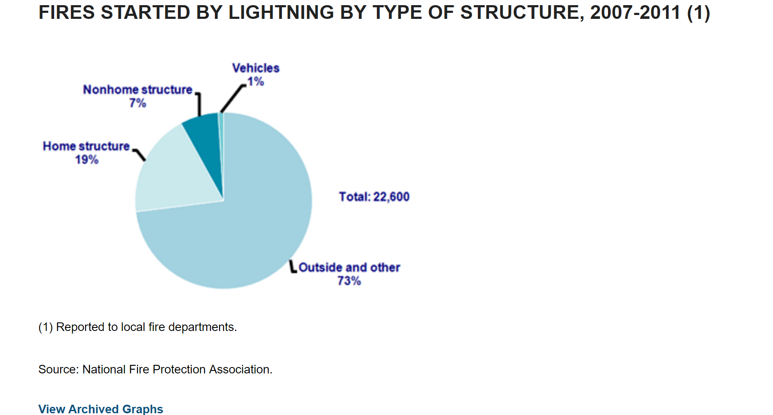
Location of Fires Started by Lightning

Slide 21
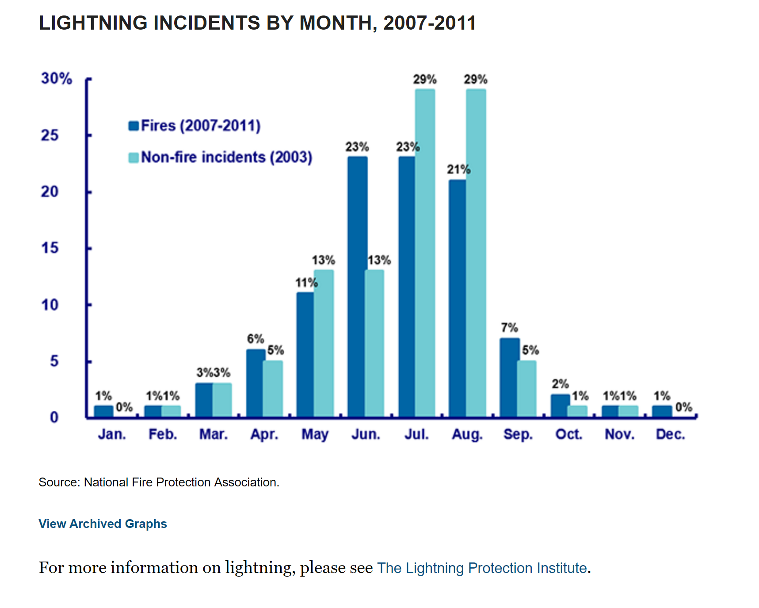
Spring and Summer Highest Incidents of Lightning Incidents

Slide 22
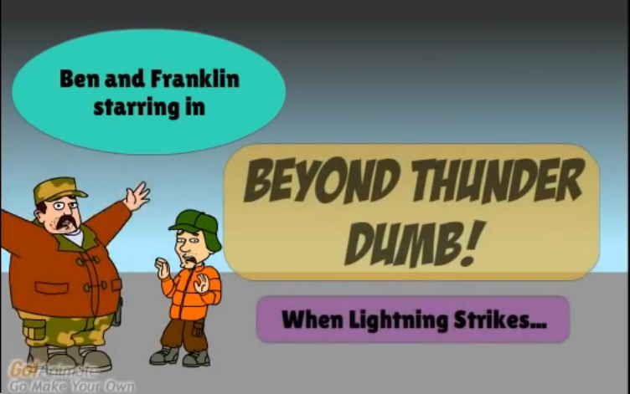
Beyond Thunder Dumb: When Lightning Strikes…
View on I.I.I. Site: http://www.iii.org/video/beyond-thunder-dumb-when-lightning-strikes
View on YouTube: https://www.youtube.com/watch?v=QR78RB52ggw

Slide 23
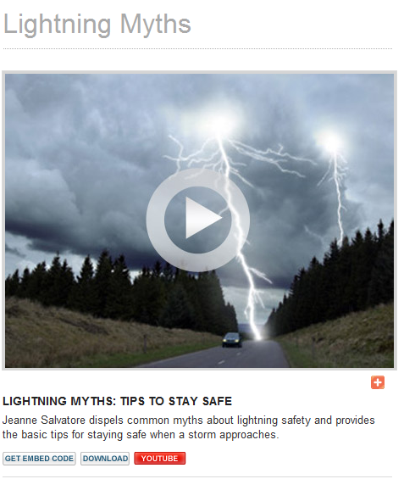
Web Video
Watch Video

Slide 24
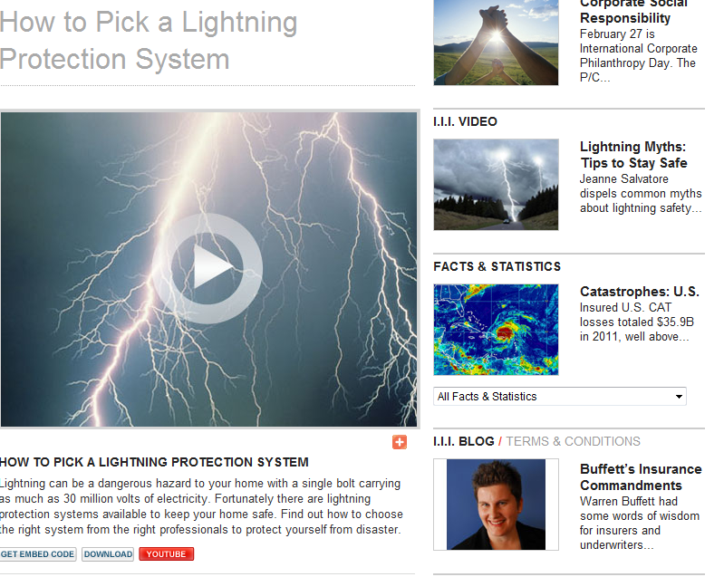
Podcasts and Video
Watch Video

Slide 25
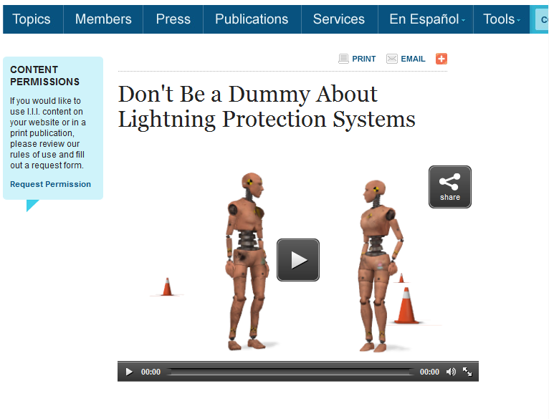
Web videos
Watch Video

Slide 26
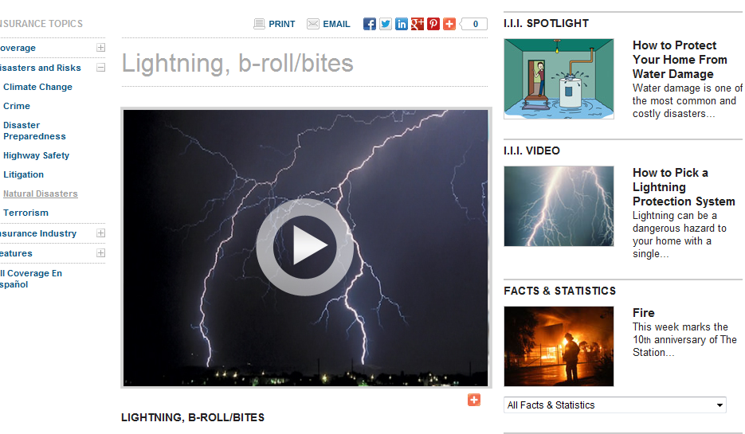
Video: b-roll/bites

Slide 27
2017 Partnership
Continue to work closely together
Create infographics for both residential and commercial structures
Promote lightning safety week
Participate in small business conference
Include the importance on installing a lightning protection system when rebuilding a structure after a disaster

Slide 28
Questions/Discussion

