Slide 1
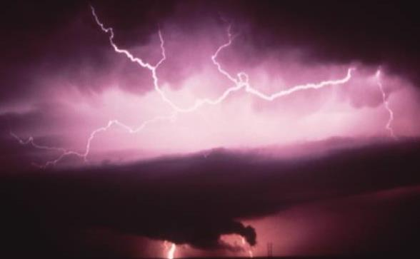
Media Training Session
2015 LPI/ULPA Conference
Thursday, March 26
Jeanne Salvatore & Kim Loehr

Slide 2
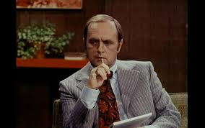
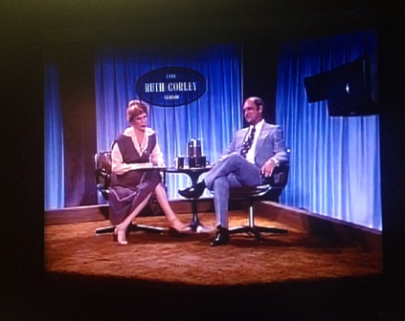
Bob Newhart Example
https://www.youtube.com/watch?v=5DlPpi0yuqI
Bob’s in the bag interview goes terribly wrong!

Slide 3
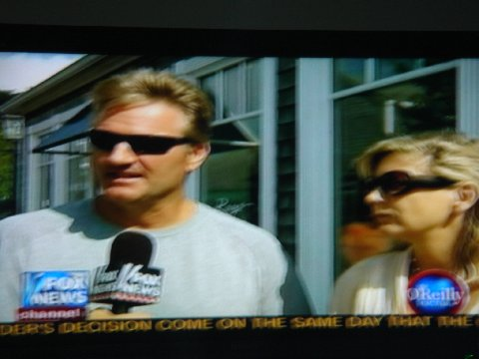
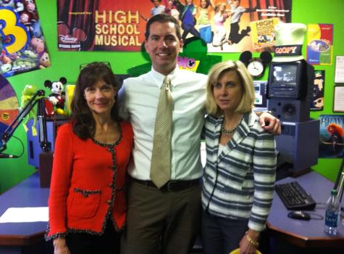
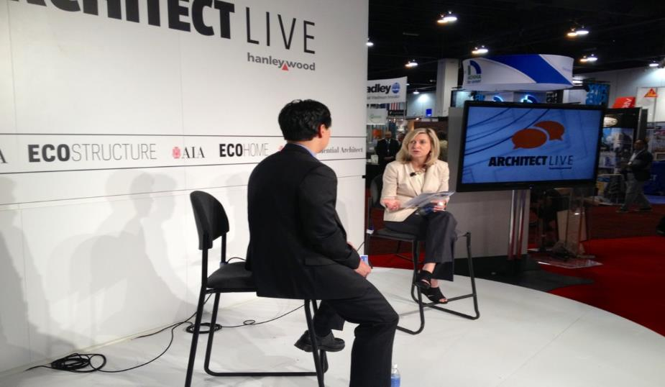
Every Interview is an Opportunity!
Take Advantage of the Interview Opportunity!
Prior to the Interview, Get the Name of Reporter & Media Outlet
Familiarize Yourself with Media Outlet & Reporter to Get an Idea of News Format & What to Expect
Make Sure Reporter has Your Name, Title & Affiliation/s Correct, Too
Refer Reporter to Kim or Jeanne if LPI /I.I.I. Follow-up is Needed (stats/facts)

Slide 4
Be a Media Resource!
Be Responsive When Media Asks for Info
Be Accessible
Be Prepared
Have a Customized Pitch/Story in Mind
Have Testimonials or Customer/Project References On-hand & Ready to Share
The best lightning bugs are
accessible, responsive & ready to enlighten about lightning!

Slide 5
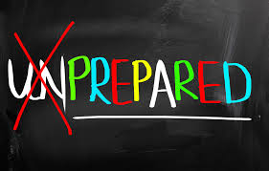
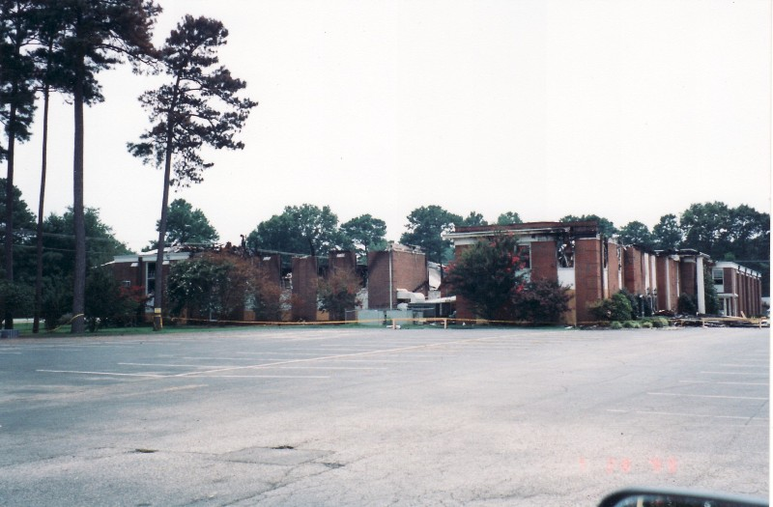
Prepare, Prepare, Prepare!
Concentrate on 3 Key Points you Want to Convey in Interview.
Understand the Media Outlet and Audience; Tailor Your Message Accordingly.
Have an Awareness and Knowledge of Local and National Issues Relevant to Your Industry and Topic.
Be Prepared for the Most Likely Question as Well as the Toughest Question.
Franklin’s quote: “An ounce of prevention is worth a pound of cure.” Applies to media interviews, too!

Slide 6
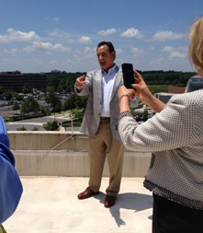
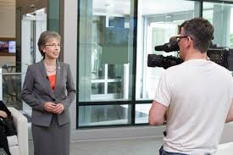
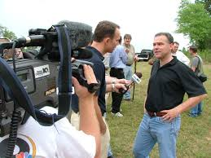
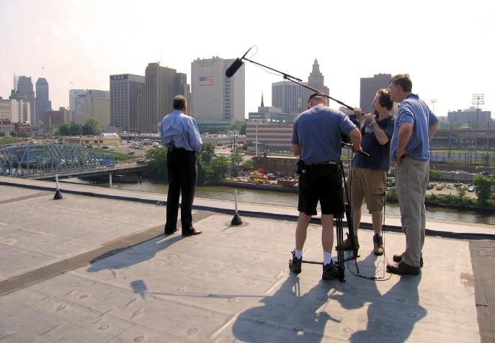
Presentation Matters!
!
Remember to be “Camera Ready.”
Dress Appropriately for the Interview Location & Bring Applicable “Props.”
Have a Game Plan In Mind for Job Site or Project Location Interviews.
Remember Importance of Portraying Industry Best Practices/Safety Measures During Interview and on Camera.

Slide 7
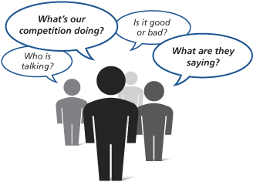
Position Yourself as an Industry “Expert” by Providing Insight & Value
Know What’s Happening in the Industry (Trends, Issues, News, etc.)
Be a Knowledgeable & Credible “Industry” Source (Pitch your trade rather than your trademark)
Be “Visual” by Using Anecdotes & Examples to Create Picture for Reporter & Audience.
Share Background Info, Facts & Statistics to Provide Understanding of Lightning Protection & Industry.
Help Take the Story Where it “Needs” To Go (Dispel Myths, etc.)

Slide 8
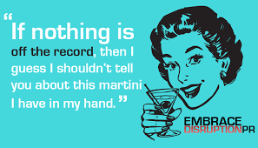
Quotes Can Make or Break an Interview
Everything you say is “on the record” and can be used by the reporter.
Don’t feel you need to fill an awkward silence—that’s the interviewer’s job. (Try not to ramble on or babble!)
Don’t be caught off-guard. Anything you say to a reporter can be quoted, even if the cameras or recorders are not running.
Don’t volunteer information unless it supports a positive point you want to make.
Try to avoid overuse of “in-house” language or industry jargon not understood by general public.

Slide 9
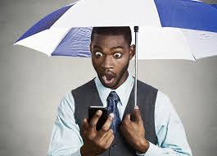
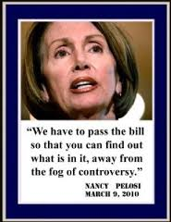
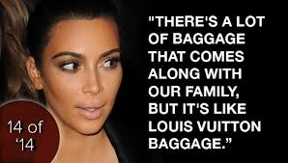
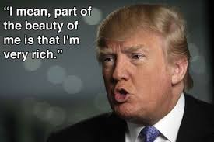
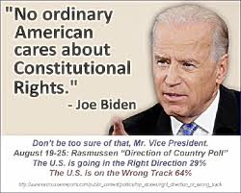
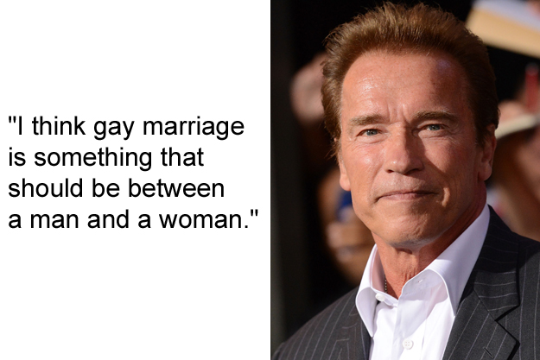
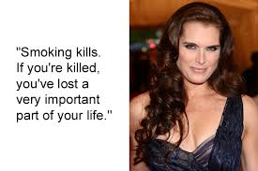
And Quotes Can Leave a Lasting Impression!

Slide 10
Crisis PR Tips!
* Actively monitor not just your company’s reputation, but the activities of your competition and the industry.
* Have a plan ahead of time and appoint an official company spokesperson in the event of a crisis.
* Never say “No comment.” This implies you may be guilty or hiding something. Reporters instinctively will want to pursue even more.
* Be sure you know what you are talking about when commenting on a crisis! It’s okay to be honest and say,“I don’t know,” if you don’t know or can’t find an answer. The only thing worse than saying nothing is saying the wrong thing!
* Don’t try to guess or speculate when you don’t know a fact. Tell the reporter that someone will be back in touch ASAP and be sure to follow through.
* Have clear policy for social media and engagement and make sure your employees know the rules of the road for social media sharing and postings.

Slide 11
How to Prepare for a Media Interview
Determine the key points you want to make and then draft full sentences for each. Practice. Eliminate any words that may give you difficulty.
If it is a taped interview, make sure that all of your answers are succinct and can’t be edited. You do this by speaking is short, concise sound bites. Once again, practice.
Write down all possible questions. And, have answers for everyone. And, consider, topics related to your business but not necessarily the focus of the interview.
If it is a consumer-oriented interview, have three to four tips. Write them up and give them to reporter.
Give the reporter as much information as possible. Consider providing a Q and A on the topic. They will likely use this as the basis for the interview.
Remember, you are not there to answer questions but to provide information.

Slide 12
Questions?
Time for Audience Participation
Volunteers Needed for Role Play!
Handouts of Sample Interview
Questions for LPI Members
Media Kit Zip Drives for Attendees
To Take Home

Slide 13
LPI & I.I.I. Put Resources at Your Fingertips!
The Lightning Protection Institute is a not-for-profit nationwide group founded in 1955 to promote lightning safety, awareness and education. LPI is a
leading resource for system requirements. Visit www.lightning.org for more information.
The Insurance Information Institute is a nonprofit, communications organization supported by the insurance industry. Visit www.iii.org for more information.

