Slide 1
The P/C Insurance Industry and the U.S. Economy:
Issues & Outlook
Midwest Actuarial Forum Fall Meeting
Bloomington, IL
September 16, 2016
Steven N. Weisbart, Ph.D., CLU, Senior Vice President & Chief Economist
Insurance Information Institute ♦ 110 William Street ♦ New York, NY 10038
Tel: 212.346.5540 ♦ Cell: 917.494.5945 ♦ stevenw@iii.org ♦ www.iii.org

Slide 2
First, the Good News about
the P/C Insurance Industry:
2013-15 Were
Three Good Years in a Row
2016 Could Be the Fourth
2

Slide 3
P/C Insurance Industry
Combined Ratio, 2001–2016:1H*
Insurers Paid Nearly $1.16 for Every $1 in Earned Premiums
Higher CAT Losses, Shrinking Reserve Releases, Toll of Soft Market
Best Combined Ratio Since 1949 (87.6)
Heavy Use of Reinsurance Lowered Net Losses
Excludes Mortgage & Financial Guaranty insurers 2008--2014. Including M&FG, 2008=105.1, 2009=100.7, 2010=102.4, 2011=108.1; 2012:=103.2; 2013: = 96.1; 2014: = 97.0. Note: 2015:1H combined ratio was 97.6
Sources: A.M. Best, ISO.

Slide 4
Net Written Premium Growth:
Annual Change, 1971—2016:1H
16 Years
16 Years?
1975-78
1984-87
2000-03
2016-19
Net Written Premiums Fell 0.7% in 2007 (First Decline Since 1943) by 2.0% in 2008, and 4.2% in 2009, the First 3-Year Decline Since 1930-33.
2016*: 2.6%
2015: 3.4%
2014: 4.2%
2013: 4.6%
2012: 4.3%
Shaded areas denote “hard market” periods *first half
Sources: A.M. Best (historical), ISO, Insurance Information Institute.

Slide 5
P/C Industry Net Income After Taxes
1991–2016:1H
$ Millions
2006 ROE = 12.7%
2007 ROE = 10.9%
2008 ROE = 0.1%
2009 ROE = 5.0%
2010 ROE = 6.6%
2011 ROAS¹ = 3.5%
2012 ROAS¹ = 5.9%
2013 ROAS¹ = 10.2%
2014 ROAS¹ = 8.4%
2015:ROAS = 8.4%
ROE figures are GAAP; ¹Return on avg. surplus. Excluding Mortgage & Financial Guaranty insurers yields a 8.2% ROAS in 2014, 9.8% ROAS in 2013, 6.2% ROAS in 2012, 4.7% ROAS for 2011, 7.6% for 2010 and 7.4% for 2009.
Sources: A.M. Best, ISO; Insurance Information Institute.

Slide 6
Profitability Peaks & Troughs in the P/C Insurance Industry, 1975 – 2016F
ROE
1977:19.0%
History suggests next ROE peak will be in 2016-2017, but that seems unlikely
1987:17.3%
10 Years
2006:12.7%
1997:11.6%
10 Years
2013 9.8%
2015=8.4%
2016F=6.3%
9 Years
2014 8.4%
1975: 2.4%
1984: 1.8%
1992: 4.5%
2001: -1.2%
*Profitability = P/C insurer ROEs. 2011-14 figures are estimates based on ROAS data. Note: Data for 2008-2014 exclude mortgage and financial guaranty insurers.
Source: Insurance Information Institute; NAIC, ISO, A.M. Best, Conning

Slide 7
Return on Net Worth (RNW)
Largest Lines: 2005-2014 Average
Percent
Commercial lines have tended to be more profitable
than personal lines over the past decade
Source: NAIC; Insurance Information Institute.

Slide 8
RNW All Lines, 2005-2014 Average, Vary Widely by State and Region
Southwest
Mountain
Far West
Great Lakes
Great Plains
Sources: NAIC; Insurance Information Institute
8
12/01/09 - 9pm
eSlide – P6466 – The Financial Crisis and the Future of the P/C
Notes:
8
In May for the first time in 2 years, Nevada overtook Michigan as the state with the highest unemployment rate

Slide 9
RNW All Lines, 2005-2014 Average, Vary Widely by State and Region
Southeast
Mid-Atlantic
New England
Sources: Sources: NAIC; Insurance Information Institute.
9
12/01/09 - 9pm
eSlide – P6466 – The Financial Crisis and the Future of the P/C
Notes:
9
This chart and the succeding one show that unemployment rates vary widely, not only by region, but within regions.

Slide 10
Policyholder Surplus,
2006:Q4–2016:1H
($ Billions)
2007:Q3
Pre-Crisis Peak
Drop due to near-record 2011 CAT losses
Surplus as of 6/30/16 stood at $688.3B
The industry now has $1 of surplus for every $0.75 of NPW,
close to the strongest claims-paying status in its history.
2010:Q1 data includes $22.5B of paid-in capital from a holding company parent for one insurer’s investment in a non-insurance business.
The P/C insurance industry entered 2016
in very strong financial condition.
Sources: ISO, A.M .Best.
10
12/01/09 - 9pm
eSlide – P6466 – The Financial Crisis and the Future of the P/C
Notes:
10

Slide 11
U.S. Employment in the Direct
P/C Insurance Industry: 1990–2016*
Sometimes the BLS Reclassifies Employment Within Industries.
When This Happens, the Change is Spread Evenly Over a 12-month Period (in This Case March 2010–March 2011)
*As of June 2016; not seasonally adjusted; Does not include agents & brokers.
Note: Recessions indicated by gray shaded columns.
Sources: U.S. Bureau of Labor Statistics; National Bureau of Economic Research (recession dates); Insurance Information Institute.
Notes:
11

Slide 12
U.S. Employment in the
Reinsurance Industry: 1990–2016*
*As of June 2016; not seasonally adjusted; Does not include agents & brokers.
Note: Recessions indicated by gray shaded columns.
Sources: U.S. Bureau of Labor Statistics; National Bureau of Economic Research (recession dates); Insurance Information Institute.
Notes:
12

Slide 13
U.S. Employment in Insurance
Agencies & Brokerages: 1990–2016*
*As of June 2016; not seasonally adjusted. Includes all types of insurance.
Note: Recessions indicated by gray shaded columns.
Sources: U.S. Bureau of Labor Statistics; National Bureau of Economic Research (recession dates); Insurance Information Institute.
Notes:
13

Slide 14
Investment Performance:
A Key Driver of Profitability
Depressed Yields Will Continue
to Affect Underwriting & Pricing
14

Slide 15
US Treasury Note 10-Year Yields:
A Long Downward Trend, 2000–2016*
Yields on 10-Year US Treasury Notes have been below 3% for 5 years: bonds bought in 2006 at 5% will be reinvested at 1.5% for 10 more years
US Treasury yields plunged to historic lows in 2013, then rebounded but are sinking again
Since roughly 80% of P/C bond/cash investments are in 5-to-10-year durations, most P/C insurer portfolios will have low-yielding bonds for years to come.
*Monthly, constant maturity, nominal rates, through July 2016.
Sources: Federal Reserve Bank at http://www.federalreserve.gov/releases/h15/data.htm; National Bureau of Economic Research (recession dates); Insurance Information Institute.
15
12/01/09 - 9pm
eSlide – P6466 – The Financial Crisis and the Future of the P/C
Notes:
15

Slide 16
Property/Casualty Insurance Industry Net Investment Income: 2005–2016:1H
Investment Income
($ Billions)
Invested Assets
($ Billions)
Due mainly to persistently low interest rates,
investment income has not risen as invested assets grew.
Investment income consists primarily of bond interest and stock dividends.
Sources: SNL Financial; Insurance Information Institute

Slide 17
Distribution of Bond Maturities,
P/C Insurance Industry, 2006-2015
Two main shifts over these years. From 2008 to 2011-12, from bonds with longer maturities to bonds with shorter maturities. But beginning in 2013, the reverse. Note, however, that the percentages in bonds with maturities over 10 years continues to drop.
Sources: SNL Financial; Insurance Information Institute.

Slide 18
P/C Insurer Net Realized
Capital Gains/Losses, 2005-2016:1H
($ Billions)
Realized Capital losses were a main cause of 2008/2009’s large drop in profits and ROE
Insurers consistently posted 6 years of Net Realized Capital Gains
in 2010 - 2015 following the Financial Crisis.
If (when?) interest rates rise, this streak might end.
Sources: SNL Financial, Insurance Information Institute.
18
12/01/09 - 9pm
eSlide – P6466 – The Financial Crisis and the Future of the P/C
Notes:
18

Slide 19
P/C Insurer Portfolio Yields,
2005-2015
P/C carrier yields have been falling for over a decade, reflecting the long downtrend in prevailing interest rates. Even if prevailing rates rise in the next few years, portfolio yields are unlikely to rise quickly,
since low yields of recent years are “baked in” to future returns.
Sources: NAIC, via SNL Financial; Insurance Information Institute.

Slide 20
Forecasts of Avg. Yield of 10-Year US Treasury Notes
Yield (%)
Virtually every one of the 53 forecasts in the Blue Chip survey
anticipates that long-term interest rates
will stay at unusually low levels through 2017
Sources: Blue Chip Economic Indicators (8/16); Insurance Information Institute

Slide 21
The Strength of the Economy Will Influence P/C Insurer Growth Opportunities
Growth, Although Weak,
Will Expand Insurer Exposure Base Across Most Lines
21

Slide 22
Real U.S. Quarterly GDP Growth
Since the “Great Recession
“Second” estimate
“GDP now” estimate as of Sept. 2
Since the Great Recession ended, even 3% real growth (at an annual rate) in a quarter has been unusual. Through 2016:Q2, it happened only 7 times in 28 quarters—and not once in the most recent 7 quarters.
Data are quarterly changes at annualized rates.
Sources: US Department of Commerce, at http://www.bea.gov/national/index.htm#gdp ; Insurance Information Institute.

Slide 23
Quarterly US Real GDP for 2016-17:
September 2016 Forecasts
Real GDP
Growth Rate (%)
Many of the 53 forecasts in the Blue Chip survey expect
good growth in the third quarter of 2016 and slower growth in 2017.
Sources: Blue Chip Economic Indicators (9/16); Insurance Information Institute

Slide 24
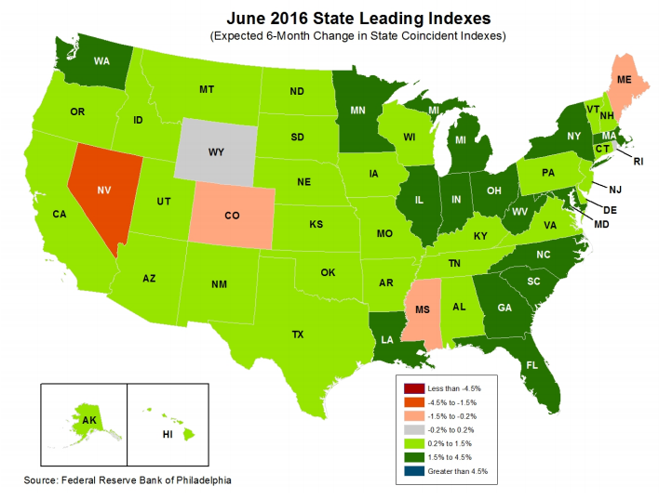
State-by-State Leading Indicators
through December 2016
Near-term growth forecasts vary widely by state.
Strongest
growth =
dark green
(1.5%-4.5%);
then light green;
then gray;
weakest = red
Sources: Federal Reserve Bank of Philadelphia at www.philadelphiafed.org/index.cfm , released August 1, 2016; Insurance Information Institute.
Next release is August 29, 2016

Slide 25
ISM Manufacturing Index (Values > 50
Indicate Expansion), Jan. 2010-Aug. 2016
Index
As of July,
5 Consecutive Months of Expansion
The Manufacturing Sector Expanded for 68 of the 72 Months
from January 2010 Through December 2015.
Manufacturing Contracted in 2015:Q4 and 2016:Q1
but was Expanding until August.
Sources: Institute for Supply Management; Insurance Information Institute.

Slide 26
ISM Non-Manufacturing Index (Values > 50
Indicate Expansion), January 2010-August 2016
Index
The Non-Manufacturing (Services) Sector
Expanded in Every Month After January 2010. Compared to 2014-15,
the Pace of Expansion Has Slowed in 2016 But Not Ended.
Sources: Institute for Supply Management via https://research.stlouisfed.org/fred2/data/NMFCI.txt; Insurance Information Institute.

Slide 27
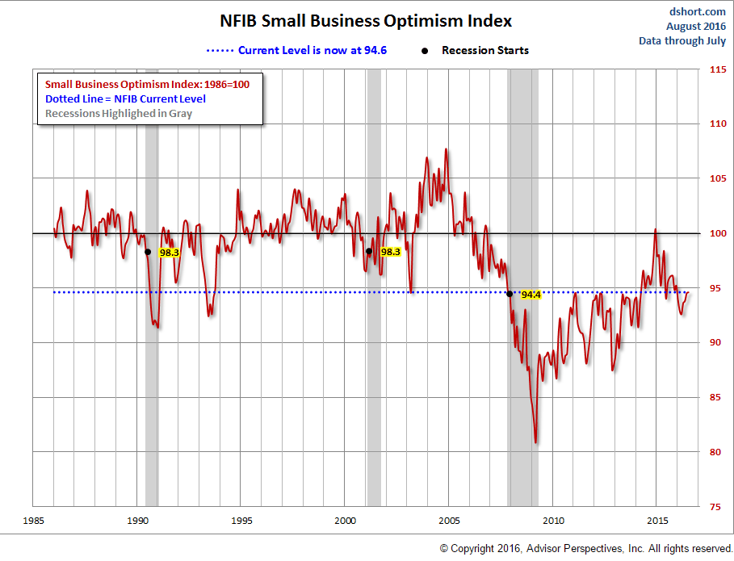
NFIB Small Business Optimism Index
January 1985 through July 2016
Growing pessimism in last 18 months
Source: National Federation of Independent Business at http://www.advisorperspectives.com/dshort/charts/indicators/Sentiment.html?NFIB-optimism-index.gif ; Insurance Information Institute.

Slide 28
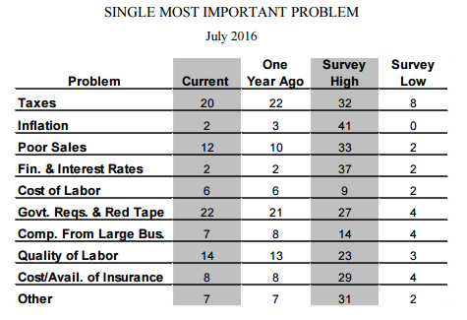
NFIB Small Business Survey: Single Most Important Problem, July 2016
Percent
Source: National Federation of Independent Business at http://www.advisorperspectives.com/dshort/charts/indicators/Sentiment.html?NFIB-optimism-index.gif ; Insurance Information Institute.

Slide 29
Business Bankruptcy Filings: Two Years at a Remarkably Low Level (1994:Q1 – 2016:Q2)
New Bankruptcy Law Takes Effect
(Thousands)
Recessions in orange
Below pre-recession level
Business bankruptcies in 2014-16 were below both the Great Recession levels and the 2003:Q3-2005:Q1 period (the best five-quarter stretch in the last 20 years). Bankruptcies restrict exposure growth in all commercial lines.
Sources: U.S. Courts at http://www.uscourts.gov/uscourts/Statistics/BankruptcyStatistics/BankruptcyFilings/2013/0913_f2q.pdf ; Insurance Information Institute
29
12/01/09 - 9pm
eSlide – P6466 – The Financial Crisis and the Future of the P/C
Notes:
29

Slide 30
Index of Total Industrial Production:*
A Peak in November 2014
Index
New Peak: November 2014 Index at 106.7
Peak at 105.73 in December 2007 (officially the 1st month of the Great Recession)
Some of the downturn in industrial production in 2015 and 2016 is due to slow growth in exports, thanks to the rise in the value of the U.S. dollar and slowing economies world-wide. Little relief is forecast for the near term.
*Monthly, seasonally adjusted, through July 2016 (which is preliminary). Index based on year 2012 = 100
Sources: Federal Reserve Board at http://www.federalreserve.gov/releases/g17/ipdisk/ip_sa.txt .
National Bureau of Economic Research (recession dates); Insurance Information Institute.
30
12/01/09 - 9pm
eSlide – P6466 – The Financial Crisis and the Future of the P/C
Notes:
30

Slide 31
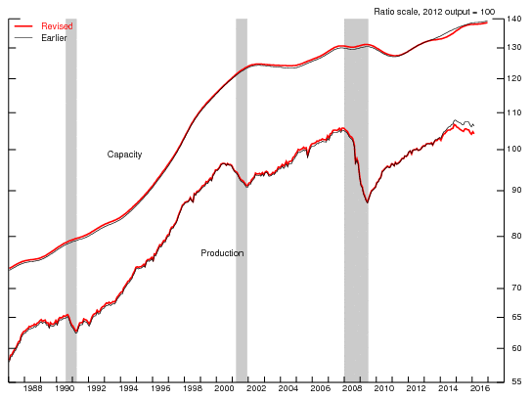
The Gap Between Industrial Production and Capacity Appears to be Widening
Even in boom times, we never use all of our industrial capacity, but lately the gap appears to be widening
Sources: Federal Reserve Board at http://www.federalreserve.gov/releases/g17/ipdisk/ip_sa.txt .
National Bureau of Economic Research (recession dates); Insurance Information Institute.

Slide 32
Labor Market Trends
We’re Now Gaining Jobs at a Good Pace,
but We’re Not at “Full Employment” Yet,
and There are Signs of Softening
32

Slide 33
Nonfarm Employment, Quarterly Change, 2011 – 2016*
Thousands
After a strong 2014-15, the pace of job growth has slowed somewhat.
*Seasonally adjusted; 2016:Q3 is July and August projected to the full quarter. August and July 2016 data are preliminary
Sources: US Bureau of Labor Statistics; Insurance Information Institute

Slide 34
Unemployment and
Underemployment Rates: Still Falling
January 2000 through August 2016, Seasonally Adjusted (%)
U-6 went from 8.0%
in March 2007 to 17.5% in October 2009
For U-6, 8.0% to 9.5% is “normal.”
U-6 was 9.7% in August 2016.
“Headline” unemployment was 4.9% in August 2016. 4.5% to 5.5% is “normal.”
Based on the latest readings,
it appears that the job market is now close to “normal”
Source: US Bureau of Labor Statistics; Insurance Information Institute.
34
12/01/09 - 9pm
eSlide – P6466 – The Financial Crisis and the Future of the P/C
Notes:
34

Slide 35
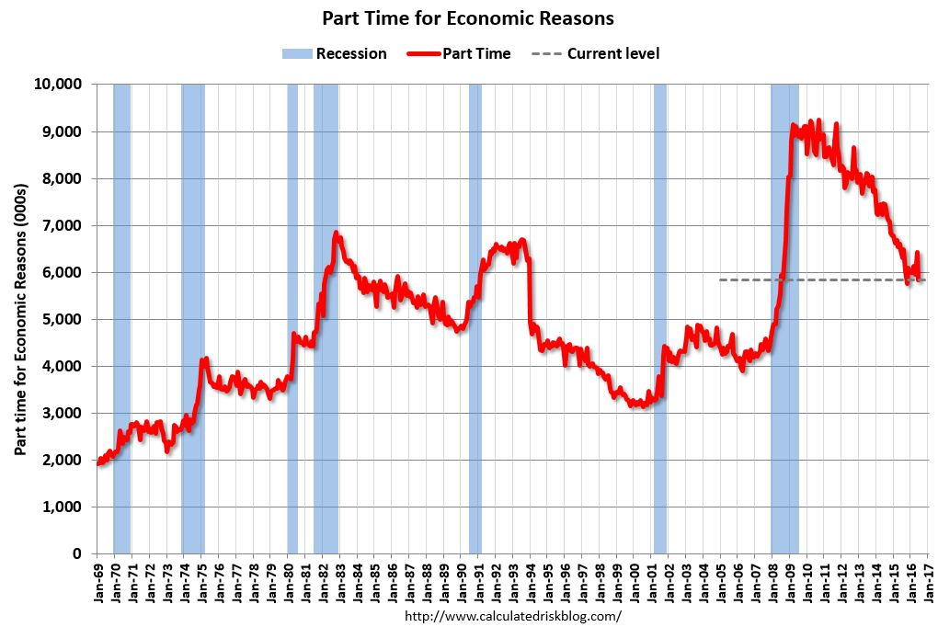
Labor Market Slack: Elevated Number of Involuntary Part-time Workers
Aug. 2016:
6.05 million
In less than 18 months, 4.5 million additional people were involuntarily working part time
The “normal” range
(since 1992)

Slide 36
Number of “Discouraged Workers”:
Elevated, but Dropping Jan 1994 – August 2016
Thousands
A “discouraged worker” in a month did not actively look for work in the prior month
for reasons such as
--thinks no work available,
--could not find work,
--lacks schooling or training,
--thinks employer thinks too young or old, and other types of discrimination.
Latest reading: 576,000
in Aug. 2016.
Normal
In recent good times, the number of discouraged workers ranged from 200,000-400,000 (1995-2000) or from 300,000-500,000 (2002-2007).
Notes: Recessions indicated by gray shaded columns. Data are seasonally adjusted.
Sources: Bureau of Labor Statistics; National Bureau of Economic Research (recession dates).
36
12/01/09 - 9pm
eSlide – P6466 – The Financial Crisis and the Future of the P/C
Notes:
36

Slide 37
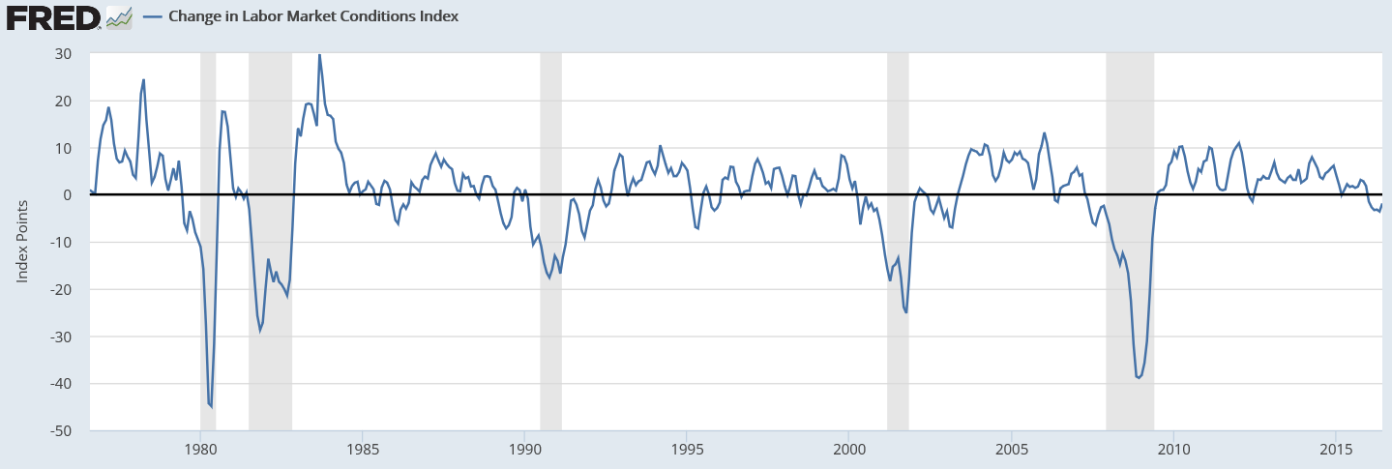
The Fed’s Labor Market Conditions Index
Combines 19 Labor Market Indicators
Since 1976, we’ve had a recession whenever the Index drops below -17.6.
As of June 2016 the Index was at -1.9 and appeared to be heading up.
Source: https://fred.stlouisfed.org/series/FRBLMCI#0

Slide 38
Labor Market Conditions Index
Since the Recession Ended
Index Value
Decline began in November 2015.
Based on history of the last 40 years, there’s no recession in sight.
Notes: Data are seasonally adjusted. The entire dataset is subject to revision, but that usually affects only the most recent 6 months.
Sources: https://research.stlouisfed.org/fred2/series/FRBLMCI
38
12/01/09 - 9pm
eSlide – P6466 – The Financial Crisis and the Future of the P/C
Notes:
38

Slide 39
Full-time vs. Part-time Employment,
Quarterly, 2003-2016:Q2
Full time, millions
Part-time, millions
Recession
New full-time peak
Pre-recession, most new jobs were full-time
Recession shifted employment growth from full-time to part-time
The Great Recession shifted employment from full-time to part-time.
Full-time employment is finally above its pre-recession peak,
but part-time hasn’t receded.
Data are seasonally-adjusted. Sources: US Bureau of Labor Statistics, US Department of Labor; Insurance Information Institute.

Slide 40
Nonfarm Payroll (Wages and Salaries):
Quarterly, 2005–2016:Q2
Billions
Latest (2016:Q2) was $8.06 trillion, a new peak--$1.83T above 2009 trough
Prior Peak was 2008:Q3 at $6.54 trillion
Y-o-Y Growth rates
2011:Q2 over 2010:Q2: 3.9%
2012:Q2 over 2011:Q2: 4.0%
2013:Q2 over 2012:Q2: 3.3%
2014:Q2 over 2013:Q2: 4.3%
2015:Q2 over 2014:Q2: 5.4%
2016:Q2 over 2015:Q2: 3.3%
Recent trough (2009:Q1) was $6.23 trillion, down 5.3% from prior peak
Note: Recession indicated by gray shaded column. Data are seasonally adjusted annual rates.
Sources: http://research.stlouisfed.org/fred2/series/WASCUR; National Bureau of Economic Research (recession dates); Insurance Information Institute.
40
12/01/09 - 9pm
eSlide – P6466 – The Financial Crisis and the Future of the P/C
Notes:
40

Slide 41
Average Weekly Hours Worked,*
Yearly, 2006—2015
The average work-week rose sharply in 2010-2012 and is now above levels prevailing before the Great Recession (which began in December 2007). Note that service-providing workers work a 7-hour shorter week than goods-producing workers.
*Seasonally adjusted. Data for 2016 are based on Jan-July; June and July are prelimnary
Note: Recessions indicated by gray shaded columns.
Sources: US Bureau of Labor Statistics at http://www.bls.gov/data/#employment;
National Bureau of Economic Research (recession dates); Insurance Information Institute.

Slide 42
Average Weekly Hours of All Private Workers, Mar. 2006—July 2016
Hours Worked*
The average hours worked per week was 34.5 in July 2016
Hours worked plunged during the recession, affecting payroll exposures
*Seasonally adjusted
Note: Recessions indicated by gray shaded columns.
Sources: US Bureau of Labor Statistics at http://www.bls.gov/data/#employment;
National Bureau of Economic Research (recession dates); Insurance Information Institute.
42
12/01/09 - 9pm
eSlide – P6466 – The Financial Crisis and the Future of the P/C
Notes:
42

Slide 43
Since 2012-13, Wages Have Grown Faster Than Inflation,* 2007-2016
Y-o-Y Change
Wage growth accelerating
The Fed raised rates for the first time in 7 years
*Seasonally adjusted; year-over-year; Shaded area indicates recession.
Sources: NBER (recessions); https://www.frbatlanta.org/chcs/wage-growth-tracker.aspx?panel=1 ; I.I.I.

Slide 44
U.S. Insured Catastrophe Loss Update
2014-15 Had Below-Average CAT Activity
44

Slide 45
U.S. Insured Catastrophe Losses
2012 was the 3rd most expensive year ever for insured CAT losses
($ Billions, $ 2015)
2013/14/15 were welcome respites from 2011/12—the latter being among the costliest years for insured disaster losses in US history. The longer-term trend is for more costly events.
*Estimate through 3/31/16 in 2015 dollars.
Note: 2001 figure includes $20.3B for 9/11 losses reported through 12/31/01 ($25.9B 2011 dollars). Includes only business and personal property claims, business interruption and auto claims. Non-prop/BI losses = $12.2B ($15.6B in 2011 dollars.)
Sources: Property Claims Service/ISO; Insurance Information Institute.
45
12/01/09 - 9pm
eSlide – P6466 – The Financial Crisis and the Future of the P/C
Notes:
45

Slide 46
Combined Ratio Points Associated with Catastrophe Losses: 1960 – 2015E*
Avg. CAT Loss Component of the Combined Ratio by Decade
1960s: 1.04 1970s: 0.85 1980s: 1.31 1990s: 3.39 2000s: 3.52 2010s: 5.46*
Catastrophe losses as a share of all losses reached a record high in 2011
Combined Ratio Points
The Catastrophe Loss Component of Private Insurer Losses Has Increased Sharply in Recent Decades
*2010s represent 2010-2015E.
Notes: Private carrier losses only. Excludes loss adjustment expenses and reinsurance reinstatement premiums. Figures are adjusted for losses ultimately paid by foreign insurers and reinsurers.
Source: ISO (1960-2009); A.M. Best (2010-15E) Insurance Information Institute.

Slide 47
Inflation
Inflation Affects P/C Pricing, Reserving, Investing, and Compensation.
So What to Watch For?
47

Slide 48
Change* in the Consumer Price Index, 2004–2016
For two months in 2008, led by gasoline, the general price level was rising at a 5.5% pace
Lately, the CPI is rising at a 0.8%
y-o-y pace
When gas prices dropped, the general price level was briefly lower than a year prior
Over the last decade, prices generally rose about 2% per year.
*Monthly, year-over-year, through July 2016. Not seasonally adjusted.
Sources: US Bureau of Labor Statistics; National Bureau of Economic Research (recession dates); Insurance Information Institutes.
48
12/01/09 - 9pm
eSlide – P6466 – The Financial Crisis and the Future of the P/C
Notes:
48

Slide 49
Change* in the Consumer Price Index, 2004–2016
Since 2004, the core CPI never rose faster than a 3% y-o-y pace
Lately, core CPI is rising at a 2.2%
y-o-y pace
Definition: The Core CPI: the CPI minus the effect of food and energy price changes
Over the last decade, “core” prices generally rose about 2% per year.
*Monthly, year-over-year, through July 2016. Not seasonally adjusted.
Sources: US Bureau of Labor Statistics; National Bureau of Economic Research (recession dates); Insurance Information Institutes.
49
12/01/09 - 9pm
eSlide – P6466 – The Financial Crisis and the Future of the P/C
Notes:
49

Slide 50
Change* in the Core CPI vs. Core PCE deflator, 2004–2016
Since 2011, the Core PCE deflator has been even with, or below, the Core CPI.
Since October 2008, except for 2 months, it has been below 2%.
*Monthly, year-over-year, through Jun 2016 (PCE deflator) and July 2016 (Core CPI). Seasonally adjusted.
Sources: US Bureau of Labor Statistics; Federal Reserve Bank of St. Louis; National Bureau of Economic Research (recession dates); Insurance Information Institutes.
50
12/01/09 - 9pm
eSlide – P6466 – The Financial Crisis and the Future of the P/C
Notes:
50

Slide 51
Change* in the Core CPI vs. Core PCE deflator, 2004–2016
Since 2011, the Core PCE deflator has been even with, or below, the Core CPI.
Since October 2008, except for 2 months, it has been below 2%.
*Monthly, year-over-year, through Jun 2016 (PCE deflator) and July 2016 (Core CPI). Seasonally adjusted.
Sources: US Bureau of Labor Statistics; Federal Reserve Bank of St. Louis; National Bureau of Economic Research (recession dates); Insurance Information Institutes.
51
12/01/09 - 9pm
eSlide – P6466 – The Financial Crisis and the Future of the P/C
Notes:
51

Slide 52
Change* in the Core PCE deflator, 2004–2016
The Fed’s Open Market Committee wants to wait until this line is consistently above 2% so that it is averaging 2%
Since October 2008, except for 2 months, it has been below 2%.
*Monthly, year-over-year, through Jun 2016 (PCE deflator). Seasonally adjusted.
Sources: Federal Reserve Bank of St. Louis; National Bureau of Economic Research (recession dates); Insurance Information Institute.
52
12/01/09 - 9pm
eSlide – P6466 – The Financial Crisis and the Future of the P/C
Notes:
52

Slide 53
Price Changes* for Medical Care
(the Medical CPI): 1998–2016
July 2016: +4.0%
Prices for all medical services rose at an annual rate of 4% (and sometimes more) until the Great Recession; since then it’s generally risen at 3% or less
*Percentage change from same month in prior year; through July 2016; seasonally adjusted
Sources: US Bureau of Labor Statistics; National Bureau of Economic Research (recession dates); Insurance Information Institute.
53
12/01/09 - 9pm
eSlide – P6466 – The Financial Crisis and the Future of the P/C
Notes:
53

Slide 54
WC Medical Severity vs. the Medical CPI Rate, 2002-2016
Is a 4% increase an outlier vs. recent trend?
Sources: Med CPI from US Bureau of Labor Statistics, WC med severity from NCCI based on NCCI states.

Slide 55
WC Indemnity Severity Growth vs. Wage Inflation, 2002 -2015p
Since 2009, WC indemnity severity growth has been slower than wage gains, except in 2013
15
2.3%
2014: Indemnity cost is preliminary based on data valued as of 12/31/2014; 1991-2010: Based on data through 12/31/2010, developed to ultimate. Based on the states where NCCI provides ratemaking services. Excludes the effects of deductible policies. CPS = Current Population Survey.
Source: NCCI; Insurance Information Institute

Slide 56
Prices for Hospital Services:
12-Month Change,* 1998–2016
July 2016
Inpatient services +5.3%
July 2016
Outpatient services +2.9%
Prices for Hospital Services have risen at an annual rate of 4% (and often more) for the last 15 years, while the general price level rose by 2%/year.
*Percentage change from same month in prior year; through July 2016; seasonally adjusted
Sources: US Bureau of Labor Statistics; National Bureau of Economic Research (recession dates); Insurance Information Institute.
56
12/01/09 - 9pm
eSlide – P6466 – The Financial Crisis and the Future of the P/C
Notes:
56

Slide 57
Insurance Information Institute Online:
www.iii.org
Thank you for your time
and your attention!

