Slide 1
Trends and Topics in the Property/Casualty Industry
Midwest Actuarial Forum, Chicago, IL
March 10, 2017
James Lynch, FCAS MAAA, Chief Actuary
Insurance Information Institute  110 William Street  New York, NY 10038
Tel: 212.346.5533  jamesl@iii.org  www.iii.org

Slide 2
The P/C Insurance Industry:
Financial Update & Outlook
Higher Cats Create Slight U/W Loss
Rising Rates May Help A Little

Slide 3
P/C Industry Net Income After Taxes,
First Three Quarters, 2007-2016
Surplus Has Grown $15B Through Q3, to $688B
ROE: 6.2% (8.4% in 2014, 2015)
Sources: A.M. Best; ISO, a Verisk Analytics company; Insurance Information Institute.

Slide 4
P/C Insurer Portfolio Yields,
2002-2016
(Yield on Invested Assets)
P/C Carrier Yields Have Been Falling for Over a Decade, Reflecting the Long Downtrend in Prevailing Interest Rates.
Sources: NAIC data, sourced from S&P Global Market Intelligence; ISO, a Verisk Analytics company; Insurance Information Institute.

Slide 5
10-Year Treasury Forecast
Yield (%)
On March 1 the yield was 2.46%.
Virtually all of the 53 forecasts in the Blue Chip survey expect
continual increases in the yield of long-term bonds in 2017-18.
Sources: Blue Chip Economic Indicators (2/17); Insurance Information Institute

Slide 6
New Money vs. Embedded Yields,
U.S. Insurers, 1985-2015
Falling yields means less investment income, putting upward pressure on rates.
As long as new money rates are below the rates of maturing bonds,
the portfolio yield will continue to sink.
p: Preliminary
Sources: NCCI, ISO, a Verisk Analytics company, U.S. Treasury (5-year note as proxy for new money yield);
Insurance Information Institute.
6
12/01/09 - 9pm
eSlide – P6466 – The Financial Crisis and the Future of the P/C
Notes:
6

Slide 7
Underwriting Performance

Slide 8
Net Premium Growth (All P/C Lines) vs. Nominal GDP: Annual Change, 1971-2016
Except for the three “hard markets” in this 45-year period,
Net Written Premiums track Nominal GDP—not year by year but fairly well.
Sources: A.M. Best (1971-2013), ISO (2014-15).

Slide 9
Net Written Premium Growth (All P/C Lines):
First Three Quarters, 2006-2016
Total Net Written Premiums for the first nine months
rose more slowly in 2016 than in any year since 2010.
Sources: A.M. Best (1971-2013), ISO (2014-16).
Notes:
About $400M NWP through Q3

Slide 10
Commercial & Personal Lines NPW Growth:
1996-2016E
5.7%
-1.3%
Commercial Lines is Prone to
Much More Cyclical Volatility Than Personal Lines.
Note: Data include state funds beginning in 1998. 16E is first three quarters.
Sources: A.M. Best; Insurance Information Institute.

Slide 11
P/C Insurance Industry
Combined Ratio, 2001-2016*
3 Consecutive Years of U/W Profits; 1st time since 1971-73
An UW Loss, Actually.
*Excludes Mortgage & Financial Guaranty insurers 2008-2014. 2016 is first nine months
Including M&FG, 2008=105.1, 2009=100.7, 2010=102.4, 2011=108.1; 2012:=103.2; 2013: = 96.1; 2014: = 97.0.
Sources: A.M. Best; ISO, a Verisk Analytics company; 2010-2015E is from A.M. Best P&C Review and Preview, February 16, 2016.
Notes:
Drivers: Higher cats than older years
Development on Prior is trending the wrong way ($5B favorable is half what was posted last year; 2015 already trending higher)

Slide 12
U.S. Insured Catastrophe Losses, 1989-2016
($ billions, 2016 dollars)
2013/14/15 Were Welcome Respites from 2011/12, Which Were
Among the Costliest Years for Insured Disaster Losses in U.S. History.
Longer-term Trend is for More – Not Fewer – Costly Events.
*2016 estimate is subject to change
Note: 2001 figure includes $20.3B for 9/11 losses reported through 12/31/01 ($25.9B 2011 dollars). Includes only business and personal property claims, business interruption and auto claims. Non-prop/BI losses = $12.2B ($15.6B in 2011 dollars).
Sources: Property Claims Service, a Verisk Analytics business; Insurance Information Institute.

Slide 13
P/C Direct Written Premium by Line
(Billions of Dollars)
LOB | 2015 | 2016
Personal Auto Liab | 89.5 | 95.8
Homeowners | 70.5 | 72.4
Auto PhysDam* | 65.8 | 70.9
GL (incl Products) | 47.8 | 49.6
WC | 42.5 | 43.6
Fire & Allied Lines | 30.7 | 30.1
CMP | 29.9 | 30.1
Comm Auto Liab | 18.0 | 19.0
Other | 47.5 | 50.3
Total | 442.4 | 461.7
Commercial/ Personal Premiums Are Rising . . .
* Personal (~90+%) and Commercial (~10%) combined.
Data through Q3.
Sources: NAIC Data, sourced from S&P Global Market Intelligence, Insurance Information Institute.

Slide 14
P/C Direct Incurred LR by Line
(Billions of Dollars)
LOB | 2015 | 2016
Personal Auto Liab | 69% | 73%
Homeowners | 53% | 55%
Auto PhysDam* | 63% | 68%
GL (incl Products) | 52% | 53%
WC | 58% | 55%
Fire & Allied Lines | 57% | 64%
CMP | 47% | 50%
Comm Auto Liab | 65% | 67%
Other | 42% | 45%
Total | 57% | 60%
But Not Fast Enough. . .
* Personal (~90+%) and Commercial (~10%) combined.
Data through Q3.
Sources: NAIC Data, sourced from S&P Global Market Intelligence, Insurance Information Institute.

Slide 15
Personal Auto
Rising Frequency, Severity Pinching
the Largest P/C Line

Slide 16
Personal Auto Net Combined Ratio, 2005-2015
Loss Ratios Have Been Rising for a Decade.
2015 Return on Net Worth is Likely Close to Zero or Negative.
Source: National Association of Insurance Commissioners data, sourced from S&P Global Market Intelligence;
Insurance Information Institute.

Slide 17





Rising Personal Auto Costs
Auto Insurance
Increase in Loss Costs, 2014:Q3–2016:Q3
Bodily Injury
11.7%
Property
Damage
15.1%
Personal Injury Protection
15.1%
Collision
13.6%
Comprehensive
21.0%
From 2014 to 2016, the cost of accidents
has risen dramatically. By contrast, consumer prices overall
rose 1.7 percent during 2014 and 2015.
Source: Fast Track Monitoring System.
Notes:
The amount of claim costs per vehicle insured - known as loss costs in the industry - is the primary cost in auto insurance rates. Those have been rising across all major coverages.

Slide 18
Claim Trends by Coverage
Focus on Collision

Slide 19
Collision Claims: Frequency Trending
Higher in 2010s
Annual Change, 2005 through 2016
For a Long Time, Claim Frequency Was Falling,
But Since 2010 This Trend Seems to Have Reversed.
*Four Quarters Ending in September.
Source: ISO, a Verisk Analytics company; Insurance Information Institute.

Slide 20
Collision Claims: Severity Trending Higher in 2009-2016
Annual Change, 2005 through 2016
The Great Recession and High Fuel Prices Helped to Temper
Claim Severity, But These forces Have Clearly Reversed,
Consistent with Experience from Past Recoveries.
*Four Quarters Ended in September.
Source: ISO, a Verisk Analytics company; Insurance Information Institute.

Slide 21
What’s Driving These Trends?
Frequency; Severity; Distraction?

Slide 22
America is Driving More Again: 2000-2016
Percent Change, Miles Driven*
Fastest Growth Since Early 1990s
Tremendous Growth In Miles Driven. The More People Drive, The More Frequently They Get Into Accidents.
*Moving 12-month total vs. prior year.
Sources: Federal Highway Administration; Insurance Information Institute.
Notes:
22

Slide 23
More Miles Driven
=> More Collisions, 2006-2016
Billions of Miles Driven in Prior Year
Overall Collision Claims Per 100 Insured Vehicles
Recession
The More Miles People Drive, the More Likely They are to
Get in an Accident, Helping Drive Claim Frequency Higher.
Sources: Federal Highway Administration; Rolling four-quarter average frequency from ISO, a Verisk Analytics company; Insurance Institute for Highway Safety; Insurance Information Institute.
Notes:
23

Slide 24
Why Are People Driving More Miles?
Cheap Gas?
Billions of Miles Driven in Prior Year
Average Price Per Gallon
Recession
Gas Prices Don’t Seem Correlated With Miles Driven.
Sources: Federal Highway Administration; Energy Information Administration (All Grades All Formulations Retail Gas Prices); Insurance Institute for Highway Safety; Insurance Information Institute.
Notes:
24

Slide 25
Why Are People Driving More Miles?
Jobs?
Billions of Miles Driven in Prior Year
Millions Employed
Recession
People Drive to and from Work and Drive to Entertainment.
Out of Work, They Curtail Their Movement.
Sources: Federal Highway Administration; Seasonally Adjusted Employed from Bureau of Labor Statistics via FRED; Insurance Institute for Highway Safety; Insurance Information Institute.
Notes:
25

Slide 26
More People Working and Driving
=> More Collisions, 2006-2016
Number Employed, Millions
Overall Collision Claims Per 100 Insured Vehicles
Recession
When People are Out of Work, They Drive Less. When They Get Jobs,
They Drive to Work, Helping Drive Claim Frequency Higher.
Sources: Seasonally Adjusted Employed from Bureau of Labor Statistics; Rolling four-quarter average frequency from ISO, a Verisk Analytics company; Insurance Information Institute.
Notes:
26

Slide 27
Comparing Gas Prices, Employment on
Collision Frequency Through 2015
Gas Price vs.
Collision Frequency
Number Employed vs.
Collision Frequency
Sources: Seasonally Adjusted Employed from Bureau of Labor Statistics; Energy Information Administration; Rolling Four-Qtr Avg. Frequency from Insurance Services Office; Insurance Information Institute.

Slide 28
Severity: Driving Fatalities are Rising
Annual Change in Motor Vehicle Deaths
Seatbelt Use Rose to 62% of Drivers, From 49% in ‘90
Big Drop-off Due to the Great Recession
Driving Has Been Getting Safer for Decades, But Recent Trend is Discouraging—38,300 Deaths in 2015.
Sources: National Safety Council, Insurance Information Institute.
Notes:
Source: http://www.nsc.org/NewsDocuments/2017/12-month-estimates.pdf

Slide 29
Does Spending on Vehicles Affect Claim Severity?
Annual Change, 2005 through 2016
As the Economy Has Gotten Better, People Are Spending More on Vehicles – When Those Cars Wreck, Severity Increases.
* Claim Frequency Through Third Quarter.
Source: ISO, a Verisk Analytics company; Bureau of Labor Statistics Consumer Expenditure Survey (vehicle purchases – net outlay) Insurance Information Institute.

Slide 30
Fixing a Bumper
. . . On an Entry-Level Luxury Car (~$35K)
2014 Cost vs. 2016 Cost
What Has Changed?
 | 2014 | 2016
Grille: Distance Sensor | $0 | $2,818
Headlamp Assembly | 394 | 918
Mechanical Labor | 0 | 108
Fewer Accidents, Higher Costs
Parts: 130% Higher
Labor: 18% Higher
Total cost: $1,705 higher
2016 vehicle has LED headlights and adaptive cruise control.
SOURCE: Liberty Mutual Insurance.

Slide 31
What About Distractions?
It’s A Problem. Is It Growing?
What We Do Behind The Wheel
But Impact Is Not Clear
Talking Less . . .
Most Recent Year
* Property Damage Only.
SOURCES: State Farm, National Highway Transportation Safety Administration (distraction.gov)

Slide 32
Commercial Auto
The Long Burn

Slide 33
Comm Auto Net Combined Ratio, 2005-2015
Loss Ratios Have Been Rising for a Decade.
2015 Return on Net Worth is Likely Close to Zero or Negative.
Source: National Association of Insurance Commissioners data, sourced from S&P Global Market Intelligence;
Insurance Information Institute.

Slide 34
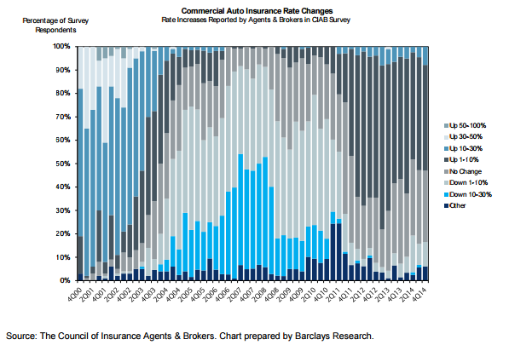
Soft Market: 2006 to 2008
Rate Decreases from 10% to 30% for Three Years

Slide 35
Comm Auto Liab Development, 2005-2015
(Development on Prior as % of NEP)
Insurers Have Struggled to Estimate Loss Reserves.
Source: National Association of Insurance Commissioners data, sourced from S&P Global Market Intelligence;
Insurance Information Institute.

Slide 36
Commercial Auto Rates Since Late 2008
(Rate Index: December 2008 = 100)
Commercial Auto Rates Fell Less in Soft Cycle and Have Risen More Than Overall Property/Casualty Market.
Sources: MarketScout, Insurance Information Institute.

Slide 37
Vehicles in Crashes Per 100
Registered Vehicles (Government Data)
(% Change From Year Earlier)
Signs Frequency May Have Peaked
Fast Track Data Lag Government Data.
Commercial Auto Claim Frequency Began Growing Before Personal Auto.
Property Damage Only (PDO) claims involving passenger vehicles and large trucks, respectively. Large trucks: GVW > 10,000 lbs.
SOURCES: Federal Highway Administration, National Highway Traffic Safety Administration, Insurance Information Institute.
Notes:
The chart on the left:
What is it?
For passenger vehicles (blue), it shows the change in the number of non-injury crashes involving passenger vehicles for every 100 passenger vehicles registered.
For large trucks (orange), it shows the change in the number of non-injury crashes involving large trucks for every 100 large trucks registered.
What does it say?
It says that after the great recession, people got in fewer accidents. In large part this is because people drive fewer miles when the economy is weak. Fewer people have jobs, and those without jobs drive less. When they drive less, they get in fewer accidents.
Also note that the accident rate is more volatile for large trucks. This makes sense because a falloff in trucking is a leading or coincident economic indicator while a falloff in employment is a lagging indicator.
The chart on the right
What is it?
It’s a lot like the chart on the left, showing passenger vehicle and large truck crash rates. Now, it is the crash rate per 100 million miles driven
What does it say?
Well, if number of miles driven falls, it makes sense that the crash rate per vehicle would fall. That is what the chart on the left shows.
However, it is not at all clear that accident rates should rise or fall once we’ve accounted for miles driven, which we do in the right hand chart. All else being equal, there should be little or no change in accidents per mile driven – or they should fall, as highways and vehicles get safer.
Instead, the accident rate falls per mile driven. This means in the recession and aftermath, drivers got safer and as the recovery accelerates, they are getting worse
Again notice that large trucks are more volatile than passenger vehicles.
Thoughts:
Driving more miles increases congestion, which increases the accident rate.
The people driven off the road may have been the worst drivers. IIHS has studied how the growth in teen employment seems to have accelerated the accident rate. The same logic may apply even more to commercial auto. If you lay off drivers, you’ll typically lay off the one who is the worst driver.

Slide 38
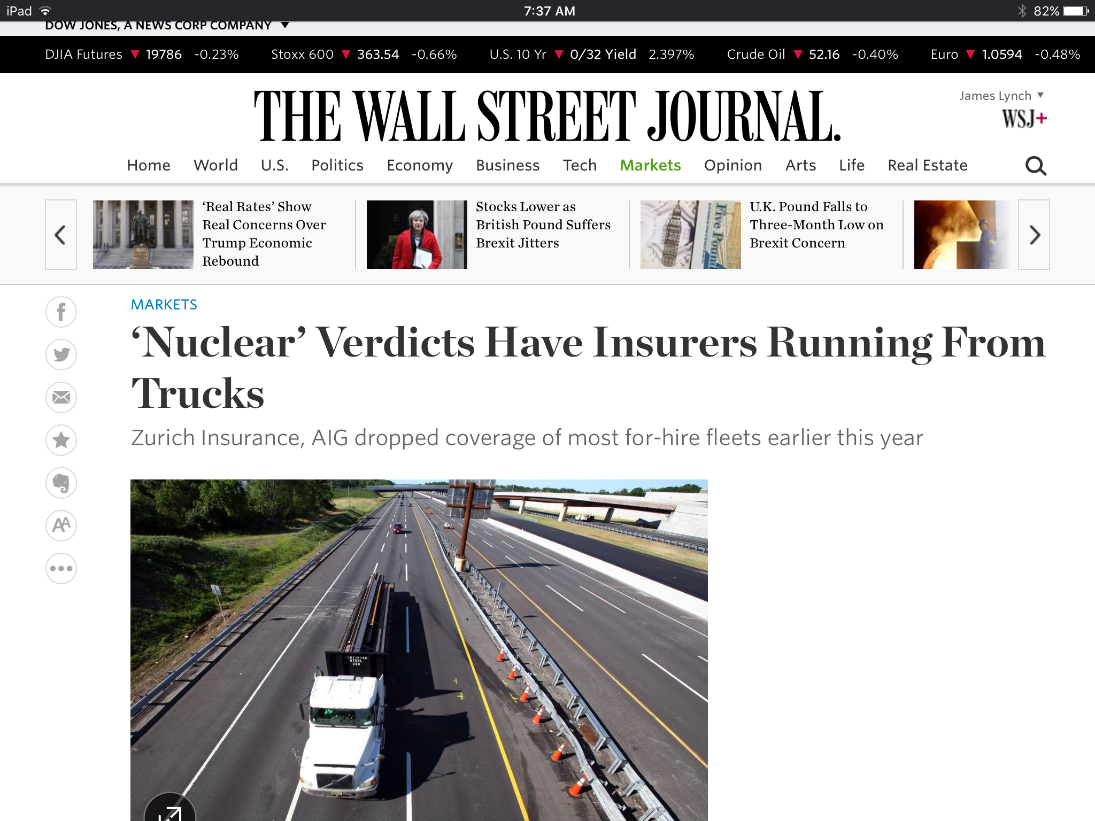
Trucking Trends
Driver Shortage
  Laid-off Drivers Aren’t Returning
  Older, Inexperienced Drivers Entering Force
  High Turnover Exacerbates Problem
‘Super Lawyers’
  “Insured Indifference to Safety”
  Lots of Data
  Cases Settle Faster

Slide 39
Disruption
Challenges to the Value Chain

Slide 40
The (Re)Insurance Value Chain
Where Could Disruption Lie?
Create Policy/ Treaty
Brains + Bank Account
Write Risk
Perform Loss Control
Settle Claims
Market Policy/ Treaty
Improve World
Price Risk
Protecting People & Organizations
Most Links in the Value Chain Have the Potential
to Be Disrupted in Next 10 Years.

Slide 41
Insurance Technology Financing – Change Is Coming
More Than Half This Funding Was in Two Deals (Zenefits/ Zhong An)
Investment ($ Millions)
Deals
Investment In Insurance Tech Is Rising. Number of Deals Set A Record Last Year.
SOURCES: CB Insights, Insurance Information Institute.

Slide 42
Alternative Capital
Potentially Disrupting the Bank Account
Collateralized Reinsurance and Catastrophe Bonds Currently Dominate the Alternative Capital Market.
Source: Aon Benfield Analytics; Insurance Information Institute.

Slide 43






Pricing Disruptor: The Fragmented Risk
43
12/01/09 - 9pm
eSlide – P6466 – The Financial Crisis and the Future of the P/C
Notes:
43
The Insurance Contract Is Being Split into Tiny Pieces.
The Sharing/“On-Demand” Economy – Personal → Commercial → Personal
By-peril HO insurance
Ride-sharing insurance
Pay By Mile Insurance
Expect More As
Computers Get Stronger
Data Storage Gets Cheaper
Information Collection Grows
Workers comp – adjust rates for travel?

Slide 44


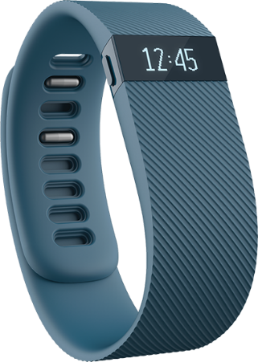
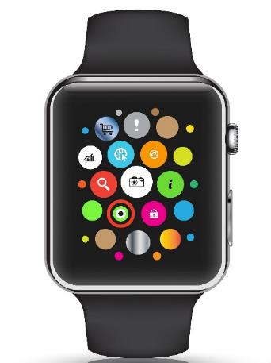
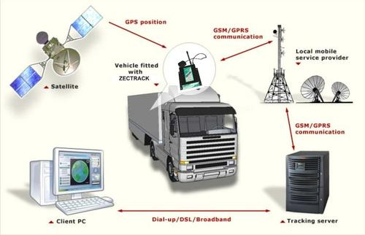

Loss Control Disruptor
The Internet of Things
Telematics Today
Telematics Tomorrow
44
12/01/09 - 9pm
eSlide – P6466 – The Financial Crisis and the Future of the P/C
Notes:
44
Gathering Big Data Affects
Underwriting
Pricing
Monitoring Could Affect
Loss Control
Pricing?

Slide 45
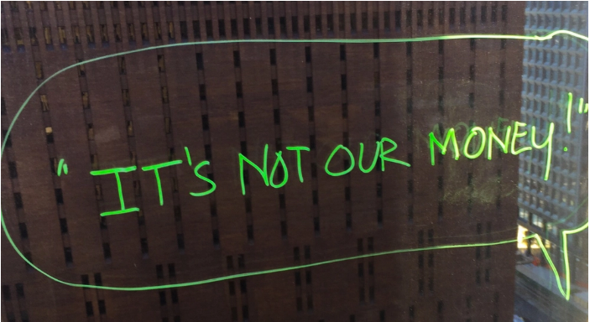


Claims Disruptor
Artificial Intelligence + Behavioral Economics
Notes:
AI Jim
IDs suspicious activity
Marries Artificial Intelligence, Behavioral Economics (file via video)
Bot handles simplest claims

Slide 46
Summary
The industry has posted a modest underwriting loss through Q3.
Interest rates may be climbing a bit, but investment income will continue to lag prior years.
Personal auto costs are rising (both frequency and severity), linked closely to the improving economy.
Commercial auto results continue to vex the industry.
Disruption provides opportunities and challenges throughout the value chain

Slide 47
Thank you for your time and your attention!
Read our auto White Paper on Rising Personal Auto Costs at
www.iii.org

