Slide 1
The Global Economy, Rising Risk and Marine Insurance Markets
Risk and Reward in a Troubled World
San Francisco Board of Marine Underwriters
San Francisco, CA
April 21, 2016
Download at www.iii.org/presentations
Robert P. Hartwig, Ph.D., CPCU, President & Economist
Insurance Information Institute ♦ 110 William Street ♦ New York, NY 10038
Tel: 212.346.5520 ♦ Cell: 917.453.1885 ♦ bobh@iii.org ♦ www.iii.org

Slide 2
Outlook: Property/Casualty & Economy
Modest growth will continue in 2016 (~ 3.5% DPW in US)
  Exposure growth tied primarily to overall GDP growth/key sector drivers
  Rates remain flat to marginally negative for commercial lines in 2016
  Reinsurance pricing under pressure—more so for property risks
Underlying loss cost trends remain manageable
Industry is very well capitalized on a global scale
Continued pressure from alternative capital
Anti-trade, nationalistic sentiments bad for marine ins.
Sluggish growth abroad impacts trade flows
Strong dollar has hurt US manufacturing, exports
Commodity prices remain weak but have likely bottomed

Slide 3
Risk & Insurance
U.S. and Global Perspective
Marine Insurance Is Very Sensitive to the Global Economic and Political Environment
3

Slide 4
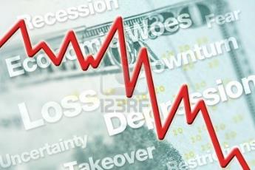




5 Major Categories for External Global Risks, Uncertainties and Fears: Insurance Solutions
Economic Risks
Geopolitical Risks
Environmental Risks
Technological Risks
Societal Risks
While risks can be broadly categorized, none are mutually exclusive
Source: Adapted from World Economic Forum, Global Risks 2014; Insurance Information Institute.

Slide 5
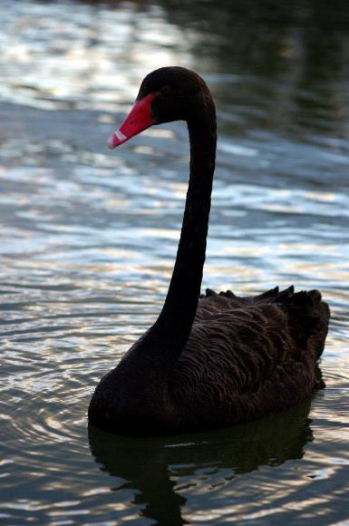
Multitude of Exogenous Factors Influence Growth, Performance & Cyclicality
Tepid growth in US, Europe
Weakness in China/Emerging Economies
Political uncertainty in the US, Brazil, Argentina
UK “Brexit” concern
Low/Negative Interest Rates
Resurgent Terrorism Risk: ISIS & Other Groups
Cyber Attacks
Sabre Rattling (e.g., US-China, Russia)
Severe Natural Disaster Losses→Supply Chain
Nationalism
International trade deals under siege
(Over)Regulation: Systemic Risk?
Strong dollar has impacted manufacturing
Are “Black Swans” everywhere or does it just seem that way?

Slide 6
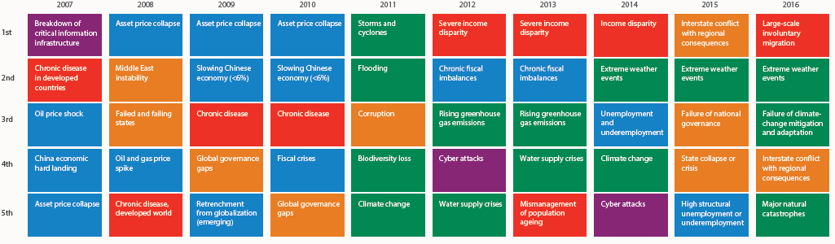
Top 5 Global Risks in Terms of Likelihood, 2007—2016: Insurance Can Help With Most
In 2016, societal and environ-mental issues dominated frequency concerns
Concerns Shift Considerably Over Short Spans of Time. 2016 Includes a Mix of Environmental Economic, Social and Environmental Risks
Source: World Economic Forum, Global Risks 2016; Insurance Information Institute.
6
12/01/09 - 9pm
eSlide – P6466 – The Financial Crisis and the Future of the P/C
Notes:
6

Slide 7
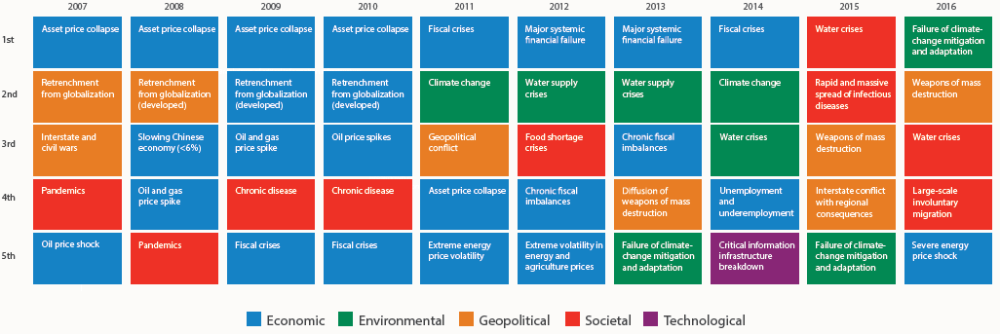
Top 5 Global Risks in Terms of Impact,
2007—2016: Insurance Can Help With Most
In 2016, societal issues dominated severity concerns
Concerns Over the Impacts of Societal Risks Remained High in 2016, but Economic, Environment and Geopolitical Risks Also Loom Large
Source: World Economic Forum, Global Risks 2016; Insurance Information Institute.
7
12/01/09 - 9pm
eSlide – P6466 – The Financial Crisis and the Future of the P/C
Notes:
7

Slide 8
Globalization:
The Global Economy Creates and Transmits Cycles & Risks
Globalization Is a Double Edged Sword—Creating Opportunity and Wealth But Potentially Creating and Amplifying Risk
Emerging vs. “Advanced” Economies
8

Slide 9
Commercial Lines Outlook: 2016
Flat to modest deceleration in premium growth in 2016
Rate environment suggests flat-to-slightly negative renewals in 2016
Economic growth continues at a modest pace but unevenly across industries and regions; Nearly full employment and tighter labor market conditions are pluses and should drive new exposures
Construction, Service sectors are positives but manufacturing, energy, commodities face headwinds
Loss costs driven by modest frequency and severity trends, but helped by reserve releases, low cats, low infl.
Property cat reinsurance costs continue to fall
Investment income still under pressure from low yields

Slide 10
GDP Growth: Advanced & Emerging Economies vs. World, 1970-2016F
Emerging economy growth rates are expected to increase to 4.3% in 2016 and 4.7% in 2017
GDP Growth (%)
World output is forecast to grow by 3.4% in 2016 and 3.6% in 2017. The world economy shrank by 0.6% in 2009 amid the global financial crisis
Advanced economies are expected to grow at a modest pace of 2.1% in 2016 and 2017.
Source: International Monetary Fund, World Economic Outlook, Jan. 2016; Insurance Information Institute.

Slide 11
Real GDP Growth Forecasts:
Major Economies: 2014 – 2017F
US growth should acceleratein 2016
The Eurozone remains weak but should improve
Growth in China has slowed but outpaces the US and Europe
“Brexit” impact will be negative
Growth in the UK is stronger than in the Eurozone
Germany’s growth mirrors the Eurozone overall
Growth Prospects Vary Widely by Region; US and the UK Lead the Advanced Economies; Germany Leads in the Euro Area; China Has Slowed
Sources: Blue Chip Economic Indicators (2/2016 issue); IMF ( Jan. 2016); Insurance Information Institute.
11
Notes:
11

Slide 12
Non-Life Insurance: Global Real (Inflation Adjusted) Premium Growth, 2014
Real nonlife premium growth was stronger in the US in 2014 than in most of Europe
Market | Life | Non-Life | Total
Advanced | 3.8 | 1.8 | 2.9
Emerging | 6.9 | 8.0 | 7.4
World | 4.3 | 2.9 | 3.7
Source: Swiss Re, sigma, No. 4/2015.
12
12/01/09 - 9pm
eSlide – P6466 – The Financial Crisis and the Future of the P/C
Notes:
12

Slide 13
World Trade Volume Growth*,
2012 – 2017F
World trade volume growth is expected to accelerate modestly by 2017 after dipping in 2015, 2016
*Goods and services.
Source: International Monetary Fund, World Economic Outlook, April 2016; Insurance Information Institute.

Slide 14
World Trade Volume: IMPORTS
2010 – 2017F
Growth (%)
Advanced Economies
Emerging Economies
Import growth in Advanced Economies is expected to decelerate in 2016
Import growth in emerging economies outpaces Advanced Economies has been hit hard
Sources: IMF World Economic Outlook (April 2016 ); Insurance Information Institute.

Slide 15
World Trade Volume: EXPORTS
2010 – 2017F
Growth (%)
Advanced Economies
Emerging Economies
Export growth in emerging economies has struggled but should improve in 2016-17
Export growth in advanced economies is expected to decelerate in 2016 before accelerating in 2017
Sources: IMF World Economic Outlook (April 2016); Insurance Information Institute.

Slide 16
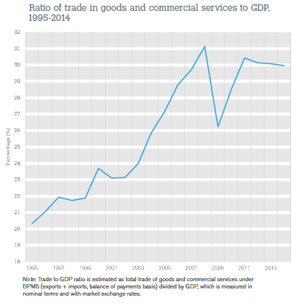
World Trade is an Increasingly Important Part of Global Economic Output
Two decades ago, world trade powered just 20 percent of global economic activity—now it’s 30 percent but has struggled recently
Sources: World Trade Organization data through 2014 from International Trade Statistics 2015; Insurance Information Institute

Slide 17
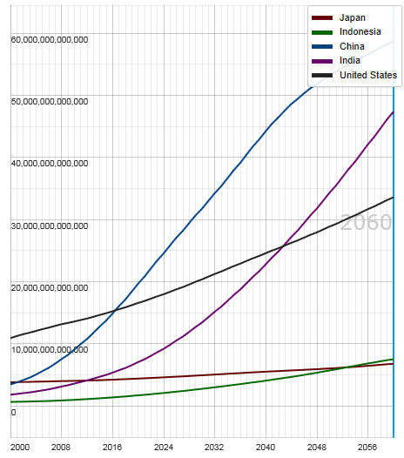
Potential Output of Total Economy: US, China, India, Indonesia and Japan, 2000-2060F
$ 2005 PPP
Growth in economic output will be concentrated in certain developing economies such as China and India
China will likely become the world’s largest economy between 2025 and 2030
Source: OECD; Insurance Information Institute .
17
12/01/09 - 9pm
eSlide – P6466 – The Financial Crisis and the Future of the P/C
Notes:
17

Slide 18
Ocean Marine Overview
Underwriting is Historically Volatile But Improved in Recent Years
18

Slide 19
U.S. Ocean Marine Combined Ratio:
2004–2014
Ocean Marine results have improved markedly in 2013 and 2014
Ocean Marine Results Have Been Quite Volatile Over the Past Decade, with the Combined Ratio Ranging by More than 20 Points
Sources: A.M. Best; Insurance Information Institute.

Slide 20
Ocean Marine vs. Commercial Lines Combined Ratio: 1989–2014
Average: 1989-2014
Ocean Marine: 104.3
All Commercial Lines: 106.0
Ocean Marine has marginally outperformed Commercial Lines overall over the period from 1989 – 2014
Sources: A.M. Best; Insurance Information Institute.

Slide 21
U.S. Ocean Marine Direct Written Premiums: 2004–2014
$ Billions
Ocean Marine premium volume has been volatile
Ocean Marine Premium Volume Fell During the Global Financial Crisis, Increased but Is Now Falling Again
Sources: A.M. Best; Insurance Information Institute.

Slide 22
Global Insurance Premium Growth Trends
Growth Is Uneven Across Regions and Market Segments
22

Slide 23
Distribution of Global Insurance Premiums, 2012 ($ Trillions)
Total Premium Volume = $4.613 Trillion*
Life insurance accounted for nearly 57% of global premium volume in 2012 vs. 43% for Non-Life
Source: Swiss Re, sigma, No. 3/2013; Insurance Information Institute.

Slide 24
Non-Life Insurance: Global Real (Inflation Adjusted) Premium Growth, 2014
Real nonlife premium growth was stronger in the US in 2014 than in most of Europe
Market | Life | Non-Life | Total
Advanced | 3.8 | 1.8 | 2.9
Emerging | 6.9 | 8.0 | 7.4
World | 4.3 | 2.9 | 3.7
Source: Swiss Re, sigma, No. 4/2015.
24
12/01/09 - 9pm
eSlide – P6466 – The Financial Crisis and the Future of the P/C
Notes:
24

Slide 25
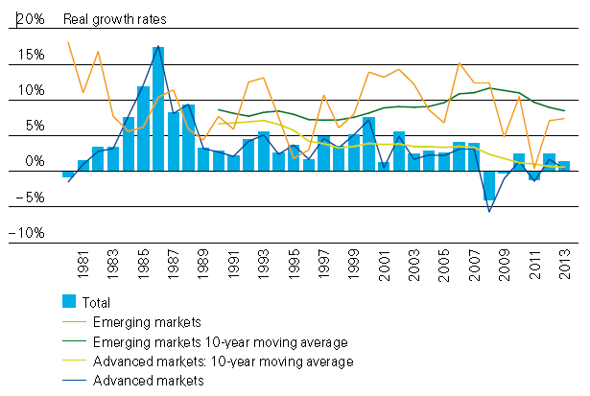
Global Real (Inflation Adjusted)
Premium Growth: 1980-2013
Premium growth is very erratic in part to inflation volatility in emerging markets as well as a lack of consistent cyclicality
Emerging market growth has exceeded that of industrialized countries in 30 of the past 34 years, including the entirety of the global financial crisis and subsequent recovery
Source: Swiss Re, sigma, No. 3/2014.
25
12/01/09 - 9pm
eSlide – P6466 – The Financial Crisis and the Future of the P/C
Notes:
25

Slide 26
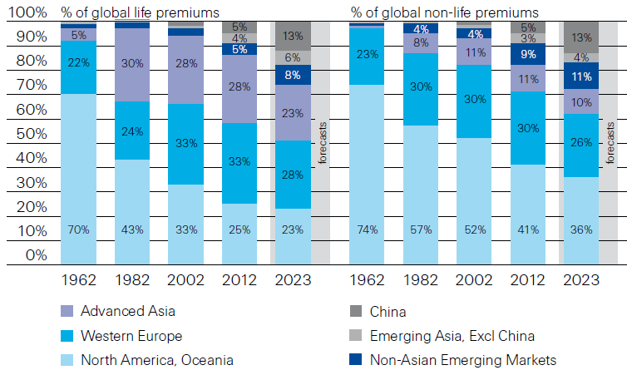
Premiums Written in Life and Non-Life, by Region: 1962-2012
Emerging market shares rose rapidly over the past 50 years
Source: Swiss Re, sigma, No. 3/2013.
26
12/01/09 - 9pm
eSlide – P6466 – The Financial Crisis and the Future of the P/C
Notes:
26

Slide 27
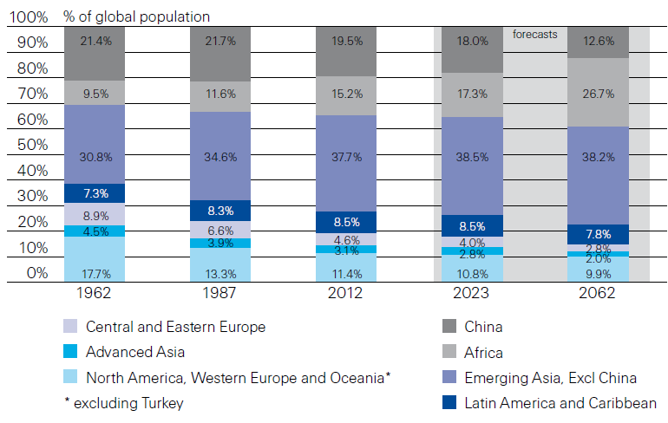
Population Distribution, by Region:
1962-2062F
Enormous population shifts will impact insurance demand over the next half century
Africa is expected to be the fastest population growth over the next 50 years, but no expectation now of Asia-like growth in economies or insurance demand
Source: Swiss Re, sigma, No. 3/2013 from United Nations Department of Economic and Sovial Affairs, Population Division.
27
12/01/09 - 9pm
eSlide – P6466 – The Financial Crisis and the Future of the P/C
Notes:
27

Slide 28
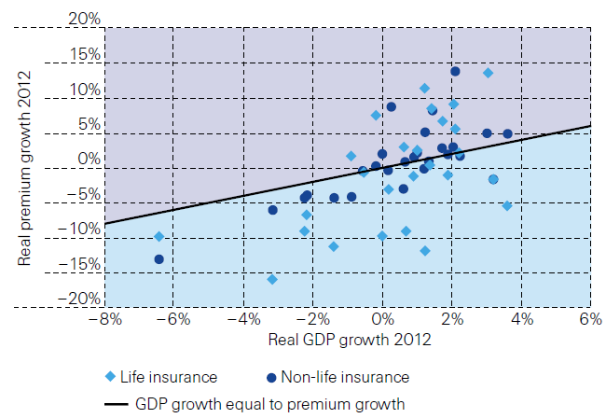
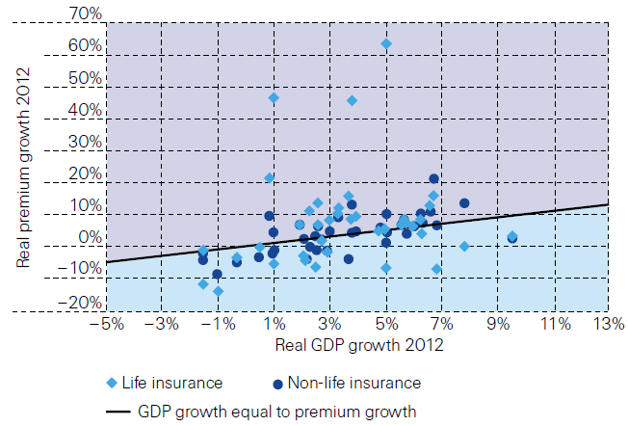
Relationship Between Real GDP and Real Life and Non-Life Premium Growth, 2012
Advanced Markets
Emerging Markets
The was a clear but highly relationship between real GDP growth and real premium growth in advance markets in 2012
The correlation between real GDP growth and real premium growth in emerging markets was much stronger than in advanced markets in 2012
Source: Swiss Re, sigma, No. 3/2013.
28
12/01/09 - 9pm
eSlide – P6466 – The Financial Crisis and the Future of the P/C
Notes:
28

Slide 29
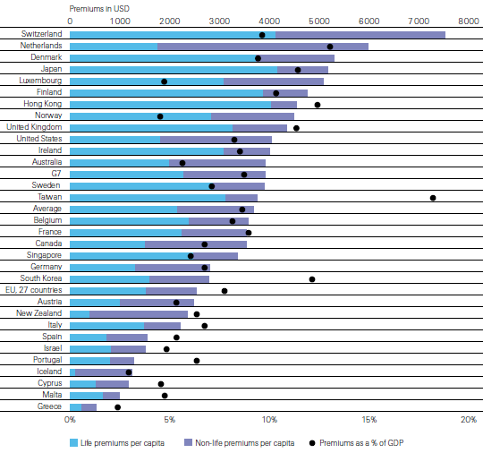
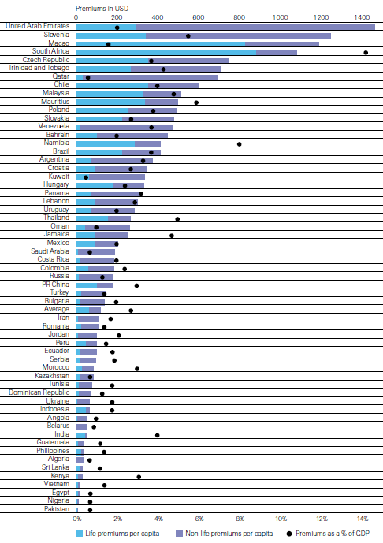
Insurance Density and Penetration for Advanced and Emerging Markets, 2012
Advanced Markets
Emerging Markets
Spending and penetration are generally much higher in advanced markets, though growth is fastest in emerging markets
Chinese spending on insurance is very similar to Russia, but Russian spending is mostly non-life and in China the majority is life
Source: Swiss Re, sigma, No. 3/2013.
29
12/01/09 - 9pm
eSlide – P6466 – The Financial Crisis and the Future of the P/C
Notes:
29

Slide 30
The Unfortunate Nexus: Opportunity, Risk & Instability
Most of the Global Economy’s Future Gains Will be Fraught with Much Greater Risk and Uncertainty than in the Past
30

Slide 31
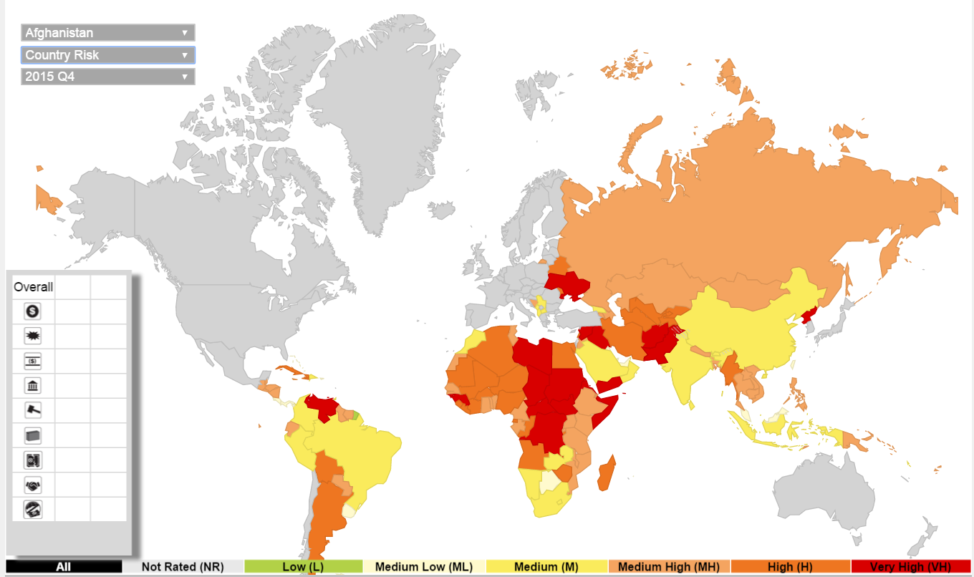
Political Risk: Greatest Opportunities Often in Risky Nations
As of 2015:Q4
Latin and South America have modest terrorist threats though Brazil is elevated
Terrorism remains a greater concern in the Middle East, Africa and South Asia
Source: Aon PLC; Insurance Information Institute.

Slide 32
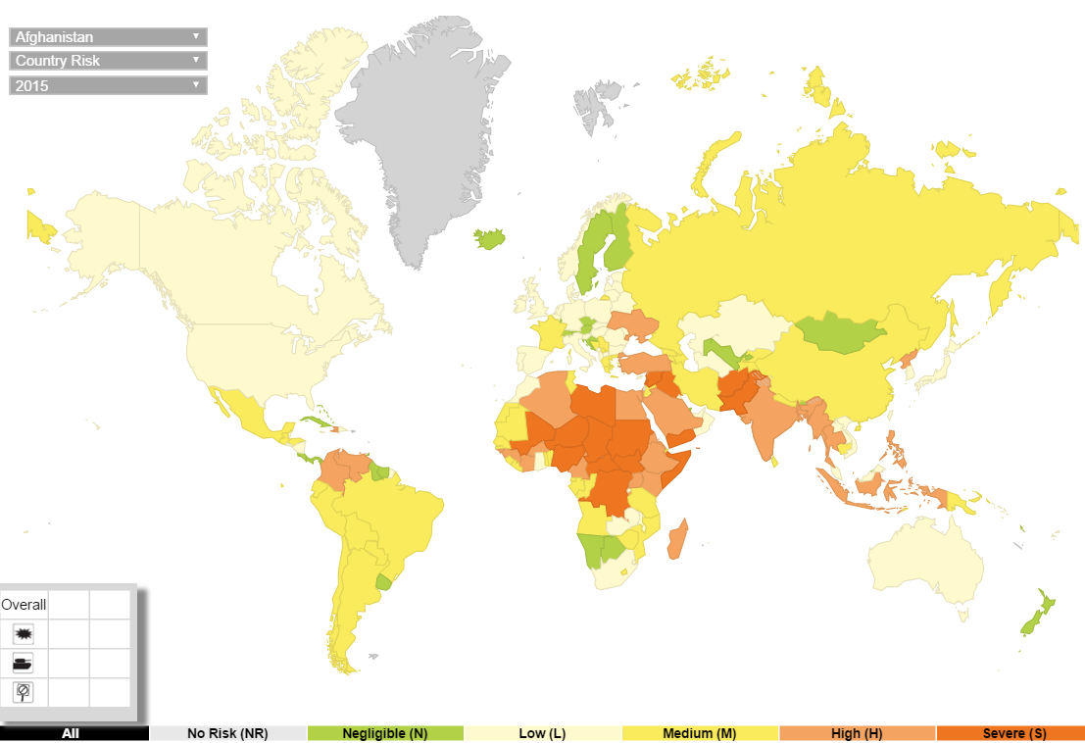
Terrorism Risk: Greatest Opportunities Are Often in Risky Nations
As of 2015:Q4
Problems in the Ukraine will intensify political risk in several former Soviet republics
Latin and South America also present insurers with growth opportunities but political instability has increased markedly
The fastest growing markets are generally also among the politically riskiest, including East and South Asia and Africa
Source: Aon PLC; Insurance Information Institute.

Slide 33
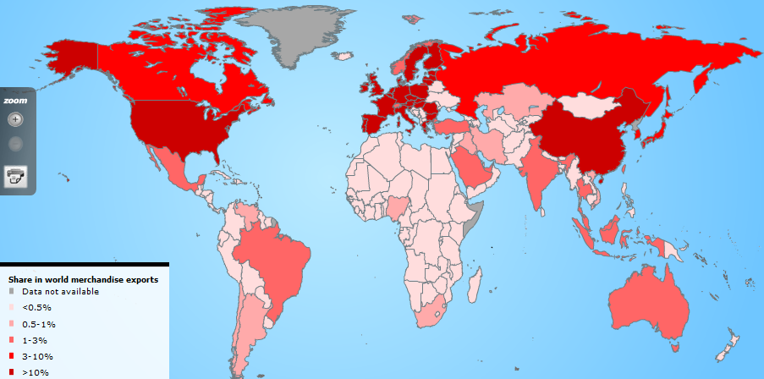
Country Shares of World
Merchandise Exports
The US, China, Japan and Western Europe lead the world in merchandise exports
Source: World Trade Organization accessed 4/30/14 at: http://www.wto.org/english/res_e/statis_e/statis_e.htm ; Insurance Information Institute.
33
12/01/09 - 9pm
eSlide – P6466 – The Financial Crisis and the Future of the P/C
Notes:
33

Slide 34
Loss Distribution by Type of Insurance from Sept. 11 Terrorist Attack ($ 2015)
($ Billions)
Total Insured Losses Estimate: $43.7B**
*Loss total does not include March 2010 New York City settlement of up to $657.5 million to compensate approximately 10,000 Ground Zero workers or any subsequent settlements.
**$32.5 billion in 2001 dollars.
Source: Insurance Information Institute.

Slide 35
P/C (Re)Insurance Industry Financial Overview
2015 Was a Reasonably Good Year and Very Similar to 2014
35

Slide 36
Commercial Lines Outlook: 2016
Flat to modest deceleration in premium growth in 2016
Rate environment suggests flat-to-slightly negative renewals in 2016
Economic growth continues at a modest pace but unevenly across industries and regions; Nearly full employment and tighter labor market conditions are pluses and should drive new exposures
Construction, Service sectors are positives but manufacturing, energy, commodities face headwinds
Loss costs driven by modest frequency and severity trends, but helped by reserve releases, low cats, low infl.
Property cat reinsurance costs continue to fall
Investment income still under pressure from low yields

Slide 37
P/C Industry Net Income After Taxes
1991–2015
$ Millions
2005 ROE*= 9.6%
2006 ROE = 12.7%
2007 ROE = 10.9%
2008 ROE = 0.1%
2009 ROE = 5.0%
2010 ROE = 6.6%
2011 ROAS¹ = 3.5%
2012 ROAS¹ = 5.9%
2013 ROAS¹ = 10.2%
2014 ROAS¹ = 8.4%
2015 ROAS = 8.4%
Net income in 2015 was on par with 2014; ROE unchanged at 8.4%
ROE figures are GAAP; ¹Return on avg. surplus. Excluding Mortgage & Financial Guaranty insurers yields a 8.2% ROAS in 2014, 9.8% ROAS in 2013, 6.2% ROAS in 2012, 4.7% ROAS for 2011, 7.6% for 2010 and 7.4% for 2009; 2015E is annualized figure based actual figure through Q3 of $44.0
Sources: A.M. Best, ISO; Insurance Information Institute

Slide 38
Profitability Peaks & Troughs in the P/C Insurance Industry, 1975 – 2015
ROE
1977:19.0%
History suggests next ROE peak will be in 2016-2017
1987:17.3%
10 Years
1997:11.6%
2006:12.7%
10 Years
2015: 8.4%
2013 9.8%
9 Years
2014 8.4%
1975: 2.4%
1984: 1.8%
1992: 4.5%
2001: -1.2%
*Profitability = P/C insurer ROEs. 2011-15 figures are estimates based on ROAS data. Note: Data for 2008-2014 exclude mortgage and financial guaranty insurers.
Source: Insurance Information Institute; NAIC, ISO, A.M. Best, Conning

Slide 39
ROE: Property/Casualty Insurance by Major Event, 1987–2015
(Percent)
P/C Profitability Is Both by
Cyclicality and Ordinary Volatility
Modestly higher CATs
Katrina, Rita, Wilma
Low CATs
Sept. 11
Hugo
Lowest CAT Losses in
15 Years
4 Hurricanes
Sandy
Andrew, Iniki
Record Tornado Losses
Northridge
Financial Crisis*
* Excludes Mortgage & Financial Guarantee in 2008 – 2014.
Sources: ISO, Fortune; Insurance Information Institute.

Slide 40
P/C Insurance Industry
Combined Ratio, 2001–2015*
Heavy Use of Reinsurance Lowered Net Losses
Relatively Low CAT Losses, Reserve Releases
Higher CAT Losses, Shrinking Reserve Releases, Toll of Soft Market
As Recently as 2001, Insurers Paid Out Nearly $1.16 for Every $1 in Earned Premiums
Relatively Low CAT Losses, Reserve Releases
Avg. CAT Losses, More Reserve Releases
Sandy Impacts
Best Combined Ratio Since 1949 (87.6)
Cyclical Deterioration
Lower CAT Losses
* Excludes Mortgage & Financial Guaranty insurers 2008--2014. Including M&FG, 2008=105.1, 2009=100.7, 2010=102.4, 2011=108.1; 2012:=103.2; 2013: = 96.1; 2014: = 97.0.
Sources: A.M. Best, ISO; Figure for 2010-2014 is from A.M. Best P&C Review and Preview, Feb. 16, 2016.

Slide 41
Number of Years with Underwriting Profits by Decade, 1920s–2010s
Number of Years with Underwriting Profits
Underwriting Profits Were Common Before the 1980s
(40 of the 60 Years Before 1980 Had Combined Ratios Below 100) –
But Then They Vanished. Not a Single Underwriting Profit Was
Recorded in the 25 Years from 1979 Through 2003
* 2009 combined ratio excl. mort. and finl. guaranty insurers was 99.3, which would bring the 2000s total to 4 years with an u/w profit.
**Data for the 2010s is for the period 2010 through 2015.
Note: Data for 1920–1934 based on stock companies only.
Sources: Insurance Information Institute research from A.M. Best Data.
41
12/01/09 - 9pm
eSlide – P6466 – The Financial Crisis and the Future of the P/C
Notes:
41

Slide 42
P/C Insurance Loss Reserve Development, 1992 – 2017E*
Reserve releases are expected to gradually taper off slowly, but will continue to benefit the bottom line and combined ratio through at least 2017
Reserve Change
Source: A.M. Best; Barclays research for estimates.

Slide 43
Policyholder Surplus,
2006:Q4–2015:Q4
($ Billions)
2007:Q3
Pre-Crisis Peak
Drop due to near-record 2011 CAT losses
Surplus as of 12/31/15 stood at a near-record high $673.7B
The industry now has $1 of surplus for every $0.76 of NPW,
close to the strongest claims-paying status in its history.
2010:Q1 data includes $22.5B of paid-in capital from a holding company parent for one insurer’s investment in a non-insurance business .
The P/C insurance industry entered 2016
in very strong financial condition.
Sources: ISO, A.M .Best.
43
12/01/09 - 9pm
eSlide – P6466 – The Financial Crisis and the Future of the P/C
Notes:
43

Slide 44
US Policyholder Surplus:
1975–2015*
($ Billions)
Surplus as of 12/31/15 was a near-record $673.7, down 0.2% from $675.2 of 12/31/14, and up 54.1% ($236.6B) from the crisis trough of $437.1B at 3/31/09
“Surplus” is a measure of underwriting capacity. It is analogous to “Owners Equity” or “Net Worth” in non-insurance organizations
The Premium-to-Surplus Ratio Stood at $0.76:$1 as of
12/31/15, a Near Record Low (at Least in Recent History)
* As of 12/31/15.
Source: A.M. Best, ISO, Insurance Information Institute.

Slide 45
RNW All Lines, 2005-2014 Average:
Highest 25 States
(Percent)
The most profitable states over the past decade are widely distributed geographically, though none are in the Gulf region
Profitability Benchmark: All P/C
US: 7.7%
Source: NAIC; Insurance Information Institute.

Slide 46
RNW All Lines, 2005-2014 Average:
Lowest 25 States
(Percent)
Some of the least profitable states over the past decade were hit hard by catastrophes
Source: NAIC; Insurance Information Institute.

Slide 47
Net Premium Growth (All P/C Lines): Annual Change, 1971—2015
(Percent)
1975-78
1984-87
2000-03
Net Written Premiums Fell 0.7% in 2007 (First Decline Since 1943) by 2.0% in 2008, and 4.2% in 2009, the First 3-Year Decline Since 1930-33.
Outlook
2016F: 3.9%
2017F: 3.8%
2015: 3.4%
2014: 4.2%
2013: 4.4%
2012: +4.2%
Shaded areas denote “hard market” periods
Sources: A.M. Best (1971-2013), ISO (2014-15).

Slide 48
NPW Premium Growth: Peaks & Troughs in the P/C Insurance Industry, 1926 – 2015
ROE
Post WW II Peak:
1947: 26.2%
1970-90: Peak premium growth was much higher in this period while troughs were comparable. Rapid inflation, economic volatility, high interest rates, tort environment all played roles
Start of WW II
1941: 15.8%
Economic Shocks, Inflation:
1976: 22.0%
Tort Crisis
1985/86: 22.2%
Post-9/11
2002:15.3%
1988-2000: Period of inter-cycle stability
2015 3.4%
1950-70: Extended period of stability in growth and profitability. Low interest rates, low inflation, “Bureau” rate regulation all played a role
2010-20XX? Post-recession period of stable growth?
Twin Recessions; Interest Rate Hikes
1987: 3.7%
Great Recession:2010: -4.9%
Great Depression
1932: -15.9% max drop
Note: Data through 1934 are based on stock companies only. Data include state funds beginning in 1998.
Source: A.M. Best; Insurance Information Institute.

Slide 49
Direct Premiums Written: Total P/C
Percent Change by State, 2007-2014
Top 25 States
North Dakota was the country’s growth leader over the past 7 years with premiums written expanding by 70.7%, fueled by the state’s energy boom
Growth Benchmarks: Total P/C
US: 13.0%
Sources: SNL Financial LC.; Insurance Information Institute.

Slide 50
Direct Premiums Written: Total P/C
Percent Change by State, 2007-2014
Bottom 25 States
Growth was negative in 4 states and DC between 2007 and 2014
Sources: SNL Financial LC.; Insurance Information Institute.

Slide 51
Direct Premiums Written: Comm. Lines
Percent Change by State, 2007-2014
Top 25 States
43 states showed commercial lines growth from 2007 through 2014
Growth Benchmarks: Commercial
US: 5.9%
Sources: SNL Financial LLC.; Insurance Information Institute.

Slide 52
Direct Premiums Written: Comm. Lines
Percent Change by State, 2007-2014
Bottom 25 States
Nearly half the states have yet to see commercial lines premium volume return to pre-crisis levels
Sources: SNL Financial LLC.; Insurance Information Institute.

Slide 53
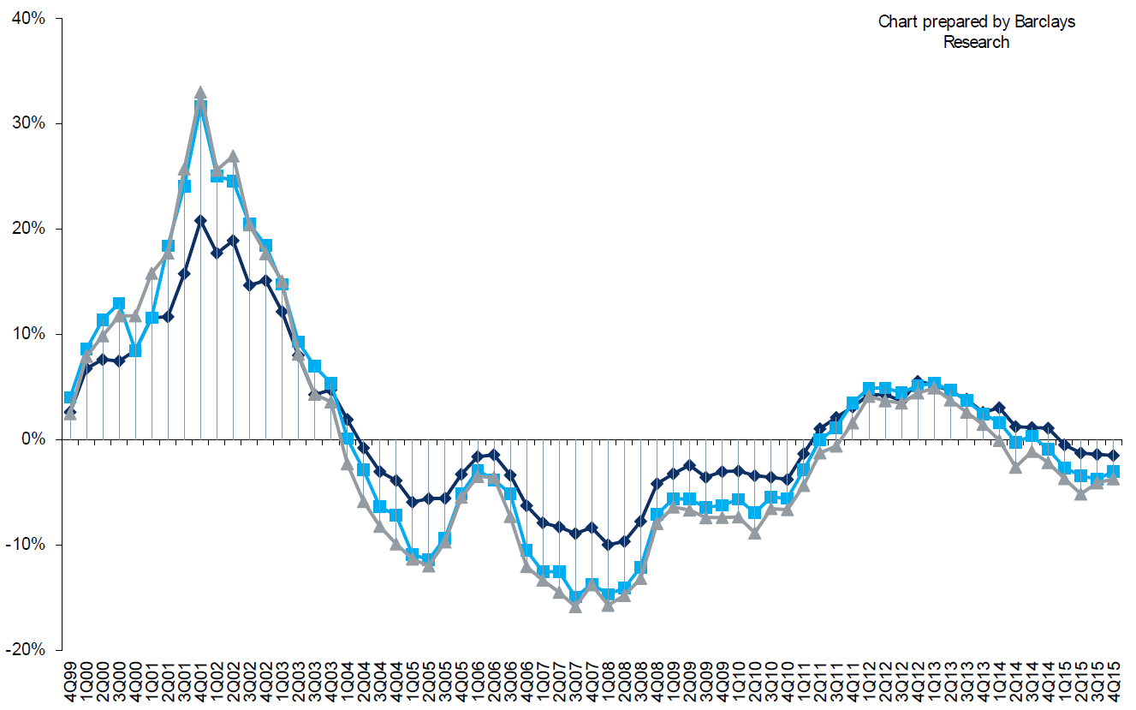
Change in Commercial Rate Renewals, by Account Size: 1999:Q4 to 2015:Q4
Percentage Change (%)
Peak = 2001:Q4 +28.5%
Pricing turned positive in Q3:2011, the first increase in nearly 8 years; Q4:2015 renewals were down 2.8%; Some insurers posted stronger numbers.
Pricing Turned Negative in Early 2004 and Remained that way for 7 ½ years
KRW : No Lasting Impact
Trough = 2007:Q3 -13.6%
Source: Council of Insurance Agents and Brokers; Barclay’s Capital; Insurance Information Institute.
Note: CIAB data cited here are based on a survey. Rate changes earned by individual insurers can and do vary, potentially substantially.

Slide 54
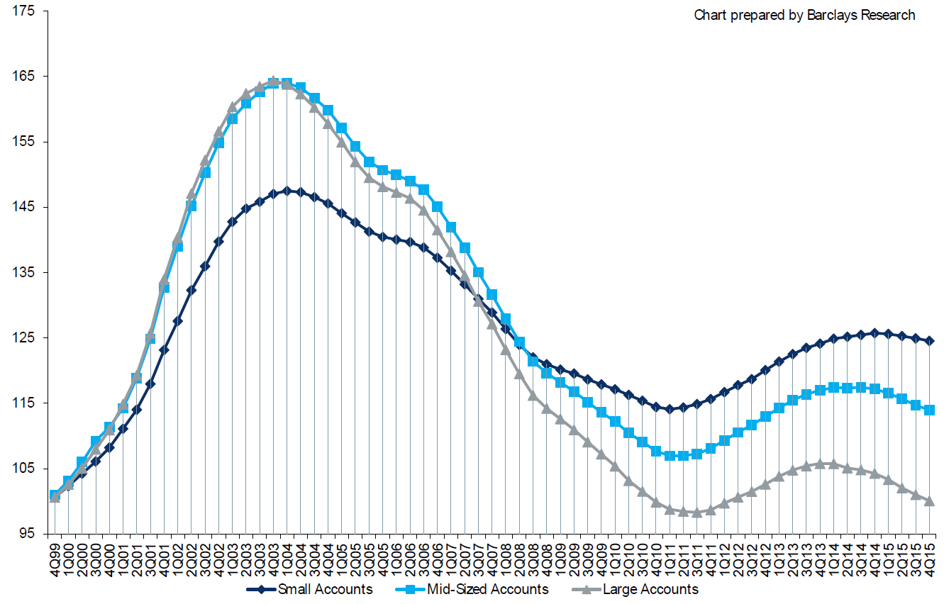
Cumulative Qtrly. Commercial Rate Changes, by Account Size: 1999:Q4 to 2015:Q4
1999:Q4 = 100
Pricing for smaller accounts has more stable than for larger accounts
Note: CIAB data cited here are based on a survey. Rate changes earned by individual insurers can and do vary, potentially substantially.
Source: Council of Insurance Agents and Brokers; Barclay’s Capital; Insurance Information Institute.

Slide 55
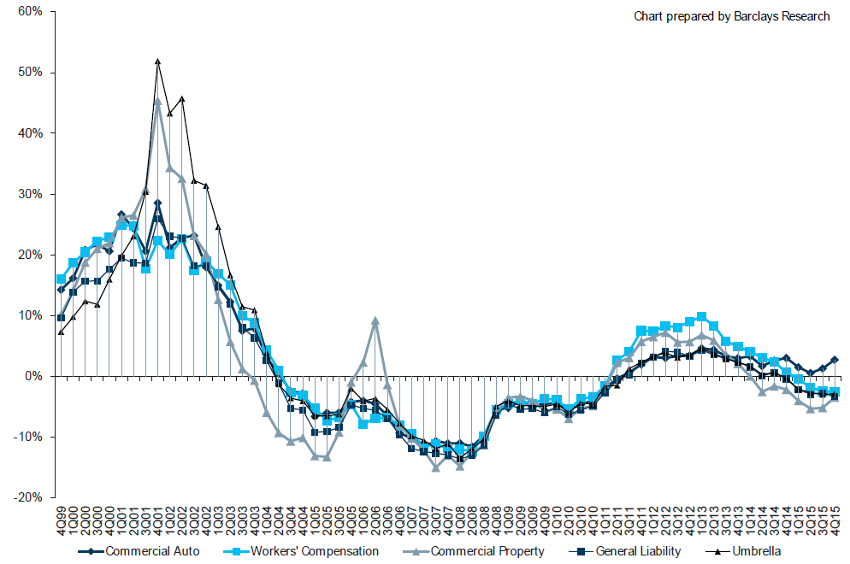
Change in Commercial Rate Renewals, by Line: 1999:Q4 to 2015:Q4
Percentage Change (%)
Peak = 2001:Q4
Commercial Auto is currently experiencing the strongest rate trend, supplanting WC
Source: Council of Insurance Agents and Brokers; Barclay’s Capital; Insurance Information Institute.
Note: CIAB data cited here are based on a survey. Rate changes earned by individual insurers can and do vary, potentially substantially.

Slide 56
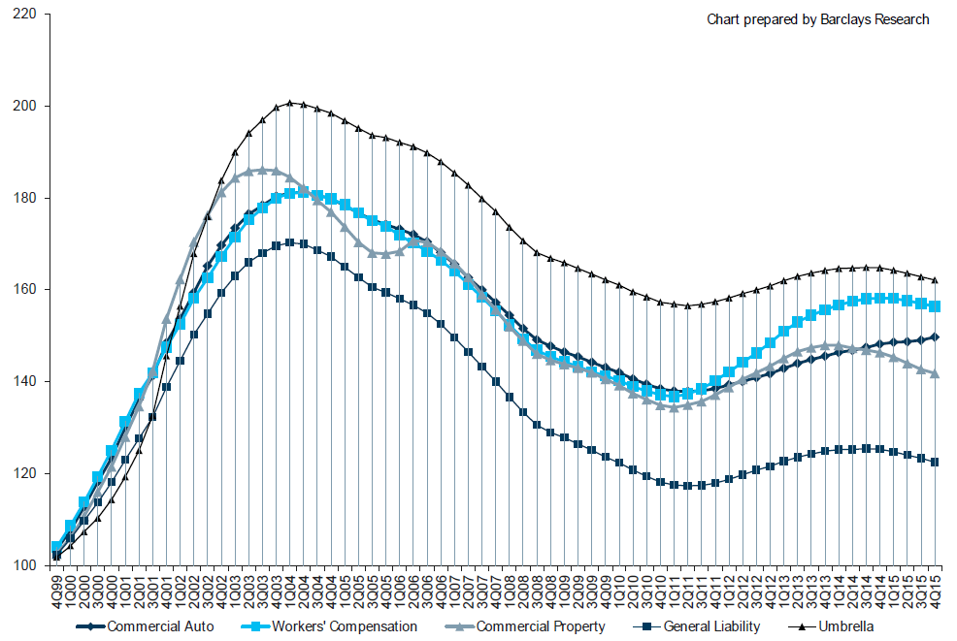
Cumulative Qtrly. Rate Changes, by Line: 1999:Q4 to 2015:Q4
1999:Q4 = 100
Commercial Auto is currently experiencing the strongest rate trend, supplanting WC
Note: CIAB data cited here are based on a survey. Rate changes earned by individual insurers can and do vary, potentially substantially.
Source: Council of Insurance Agents and Brokers; Barclay’s Capital; Insurance Information Institute.

Slide 57
CIAB: Average Commercial Rate Change, All Lines, (1Q:2004–4Q:2015)
(Percent)
Q2 2011 marked the last of 30th consecutive quarter of price declines
Pricing as of Q4:2015 remained somewhat negative
KRW Effect
Note: CIAB data cited here are based on a survey. Rate changes earned by individual insurers can and do vary, potentially substantially.
Source: Council of Insurance Agents & Brokers; Insurance Information Institute

Slide 58
Change in Commercial Rate Renewals, by Line: 2015:Q4
Commercial Auto rate increases are larger than any other line, followed by D&O and EPL
Percentage Change (%)
Major Commercial Lines Renewals Were Mixed to Down in Q4:2015; EPL, D&O and Commercial Auto Saw Gains
Note: CIAB data cited here are based on a survey. Rate changes earned by individual insurers can and do vary, potentially substantially.
Source: Council of Insurance Agents and Brokers; Insurance Information Institute.

Slide 59
INVESTMENTS:
THE NEW REALITY
Investment Performance is a Key Driver of Profitability
Depressed Yields Will Necessarily Influence Underwriting & Pricing
59

Slide 60
S&P 500 Index Returns, 1950 – 2016*
Annual Return
Stock market is off to its worst start ever but volatility is endemic to stock markets—and may be increasing—but there is no persistent downward trend over long periods of time
Fed Raises Rate
Tech Bubble Implosion
2016*:
+1.8%
Energy Crisis
Financial Crisis
*Through Apr. 15, 2016.
Source: NYU Stern School of Business: http://pages.stern.nyu.edu/~adamodar/New_Home_Page/datafile/histretSP.html Ins. Info. Inst.

Slide 61
Property/Casualty Insurance Industry Investment Income: 2000–2015E¹
Investment earnings are still below their 2007 pre-crisis peak
($ Billions)
Due to persistently low interest rates,
investment income fell in 2012, 2013 and 2014.
¹ Investment gains consist primarily of interest and stock dividends. *2015 figure is estimated based on annualized data through Q3.
Sources: ISO; Insurance Information Institute.

Slide 62
U.S. Treasury Security Yields:
A Long Downward Trend, 1990–2016*
Yields on 10-Year U.S. Treasury Notes have been essentially below 5% for more than a decade.
Despite the Fed’s December 2015 rate hike, yield remain low though short-term yields have seen some gains
Since roughly 80% of P/C bond/cash investments are in 10-year or shorter durations, most P/C insurer portfolios will have low-yielding bonds for years to come.
*Monthly, constant maturity, nominal rates, through March 2016.
Sources: Federal Reserve Bank at http://www.federalreserve.gov/releases/h15/data.htm. National Bureau of Economic Research (recession dates); Insurance Information Institute.
62
12/01/09 - 9pm
eSlide – P6466 – The Financial Crisis and the Future of the P/C
Notes:
62

Slide 63
Distribution of Invested Assets: P/C Insurance Industry, 2013
$ Billions
Total Invested Assets = $1.5 Trillion
Source: Insurance Information Institute Fact Book 2015, A.M. Best.

Slide 64
Net Yield on Property/Casualty Insurance Invested Assets, 2007–2015*
(Percent)
Book yield in 2015 is down 77 BP from pre-crisis levels
The yield on invested assets remains low relative to pre-crisis yields. The Fed’s plan to raise interest rates in late 2015 has already pushed up some yields, albeit quite modestly.
*2015 figure is the average of the four quarters ending in 2015:Q2.
Sources: SNL Financial; Insurance Information Institute

Slide 65
Net Investment Yield on Property/ Casualty Insurance Invested Assets, 2007–2016P*
(Percent)
Estimated book yield in 2016 is down about 140 BP from pre-crisis levels
The yield on invested assets remains low relative to pre-crisis yields. The Fed’s plan to raise interest rates in late 2015 has pushed up some yields, albeit quite modestly.
Sources: A.M. Best; 2015E-2016P figures from A.M. Best P/C Review and Preview, Feb. 2016; Insurance Information Institute

Slide 66
P/C Insurer Portfolio Yields,
2002-2015:Q3
P/C carrier yields have been falling for over a decade, reflecting the long downtrend in prevailing interest rates. Even as prevailing rates rise in the next few years, portfolio yields are unlikely to rise quickly,
since low yields of recent years are “baked in” to future returns.
Sources: NAIC, via SNL Financial; Insurance Information Institute.

Slide 67
Interest Rate Forecasts: 2016 – 2021
Yield (%)
3-Month Treasury
10-Year Treasury
The end of the Fed’s QE program in 2014 and a stronger economy have yet to push longer-term yields much higher
A full normalization of interest rates is unlikely until 2019, more than a decade after the onset of the financial crisis.
Sources: Blue Chip Economic Indicators (4/16 for 2016 and 2017; for 2018-2021 3/16 issue); Insurance Info. Institute.

Slide 68
Annual Inflation Rates, (CPI-U, %),
1990–2017F
Annual Inflation Rates (%)
Inflation peaked at 5.6% in August 2008 on high energy and commodity crisis. The recession and the collapse of the commodity bubble reduced inflationary pressures in 2009/10
Inflationary expectations have slipped (due in part to falling energy costs) allowing the Fed to maintain low interest rates
Slack in the U.S. economy and falling energy prices suggests that inflationary pressures should remain subdued for an extended period of times
Sources: US Bureau of Labor Statistics; Blue Chip Economic Indicators, 4/16 (forecasts).

Slide 69
P/C Insurer Net Realized
Capital Gains/Losses, 1990-2015:Q3*
Realized capital gains rose sharply as equity markets rallied in 2013-14
($ Billions)
Insurers Posted Net Realized Capital Gains in 2010 - 2014 Following Two Years of Realized Losses During the Financial Crisis. Realized Capital Losses Were a Primary Cause of 2008/2009’s Large Drop in Profits and ROE.
*Through Q3 2015.
Sources: A.M. Best, ISO, SNL, Insurance Information Institute.
69
12/01/09 - 9pm
eSlide – P6466 – The Financial Crisis and the Future of the P/C
Notes:
69

Slide 70
Property/Casualty Insurance Industry Investment Gain: 1994–2015:Q3¹
($ Billions)
Investment gains in 2015 will be similar to those earned in 2014 but still well below the pre-crisis highs
Total Investment Gains Were Down Slightly in 2014 as Low Interest Rates Pressured Investment Income but Realized Capital Gains Remained Robust
¹ Investment gains consist primarily of interest, stock dividends and realized capital gains and losses.
* 2005 figure includes special one-time dividend of $3.2B; 2015 figure is through Q3 2015.
Sources: ISO, SNL; Insurance Information Institute.

Slide 71
Reduction in Combined Ratio Necessary to Offset 1% Decline in Investment Yield to Maintain Constant ROE, by Line*
Lower Investment Earnings Place a Greater Burden on Underwriting and Pricing Discipline
*Based on 2008 Invested Assets and Earned Premiums
**US domestic reinsurance only
Source: A.M. Best; Insurance Information Institute.
71
12/01/09 - 9pm
eSlide – P6466 – The Financial Crisis and the Future of the P/C
Notes:
71
This shows the drop in Combined Ratio for each line of business that would be needed to maintain a constant ROE, given a 1-percentage-point drop in investment yield

Slide 72
Profitability & Politics
How Is Profitability Affected by the President’s Political Party?
72

Slide 73
P/C Insurance Industry ROE by Presidential Administration, 1950-2015*
OVERALL RECORD: 1950-2015*
Democrats 7.72%
Republicans 7.85%
Party of President has marginal bearing on profitability of P/C insurance industry
*Truman administration ROE of 6.97% based on 3 years only, 1950-52;.
Source: Insurance Information Institute

Slide 74
P/C insurance Industry ROE by Presidential Party Affiliation, 1950- 2015
BLUE = Democratic President RED = Republican President
Nixon/Ford
Carter
Reagan/Bush I
Clinton
Bush II
Obama
Truman
Eisenhower
Kennedy/ Johnson
.
Source: Insurance Information Institute

Slide 75
Trump vs. Clinton:
Issues that Matter to P/C Insurers
Issue | Trump | Clinton
Economy | Supply Side-Like Philosophy: Lower taxes→Faster real GDP growth; Deficits likely grow as tax cuts are combined with targeted increased spending on Homeland Security, Defense, etc. | Keynesian Philosophy: More government spending on infrastructure, education, social services; Deficits likely increase as tax increases likely difficult to pass
Interest Rates | May trend higher with larger deficits; Shift from monetary policy to fiscal focus (tax cuts, government spending) | Status quo at the Fed; Net impact on interest rates unclear
Taxes | Favors lower tax rates for corporate and personal income tax rates; Tax code overhaul? | Unlikely to reduce taxes or embark on major overhaul of tax code
International Trade | Protectionist Tendencies | Has criticized Trans-Pacific Partnership but is a realist on international matters
Tort System | Doesn’t like trial lawyers but seems to like filing lawsuits | Status Quo

Slide 76
GLOBAL M&A UPDATE:
A PATH TO GROWTH?
Are Capital Accumulation, Drive for Growth and Scale Stimulating M&A Activity?
76

Slide 77
U.S. INSURANCE MERGERS AND ACQUISITIONS,
P/C SECTOR, 1994-2015E (1)
M&A activity in 2015 will likely reach its highest level since 1998. Globally, across all sectors, M&A activity exceeded $200B
($ Millions)
M&A activity in the P/C sector was up sharply in 2015
(1) Includes transactions where a U.S. company was the acquirer and/or the target.
Source: Conning proprietary database; 2015 I.I.I. estimate.

Slide 78
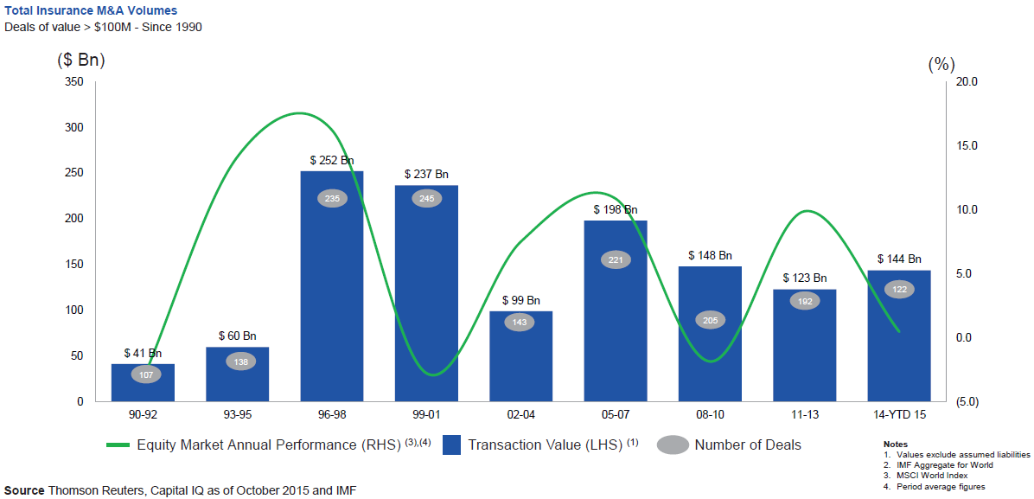
Global M&A Activity Tends to Follow Equity Market Performance
The number and volume of insurance M&A deals was up globally in 2015
.
Source: Thomson Reuters, Capital IQ as of Oct. 2015 and IMF from Geneva Association Newsletter Insurance and Finance, Jan. 2016, presentation “Facts vs. Sentiment: Deals in the Insurance Sector,” by Aviva CEO Mark Wilson.

Slide 79
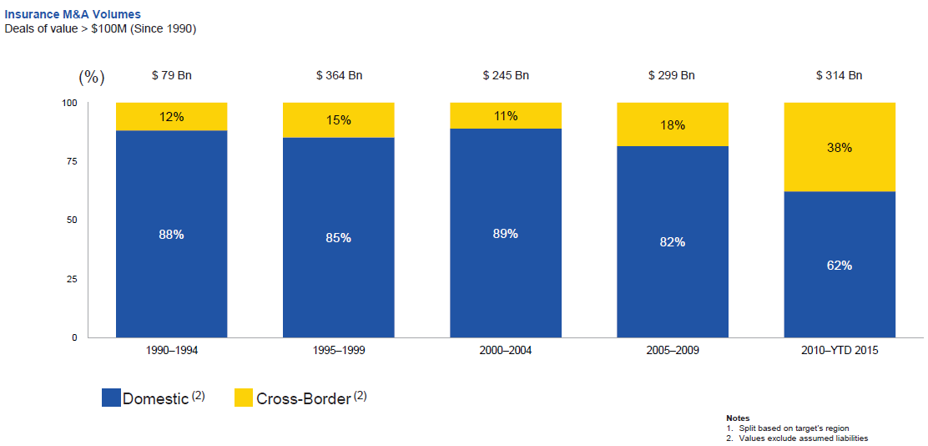
Huge Shift from Domestic M&A Activity to Cross-Border
The share of M&A deal volume that was cross-border more than doubled in 2015
.
Source: Thomson Reuters as of Oct. 2015 from Geneva Association Newsletter Insurance and Finance, Jan. 2016, presentation “Facts vs. Sentiment: Deals in the Insurance Sector,” by Aviva CEO Mark Wilson.

Slide 80
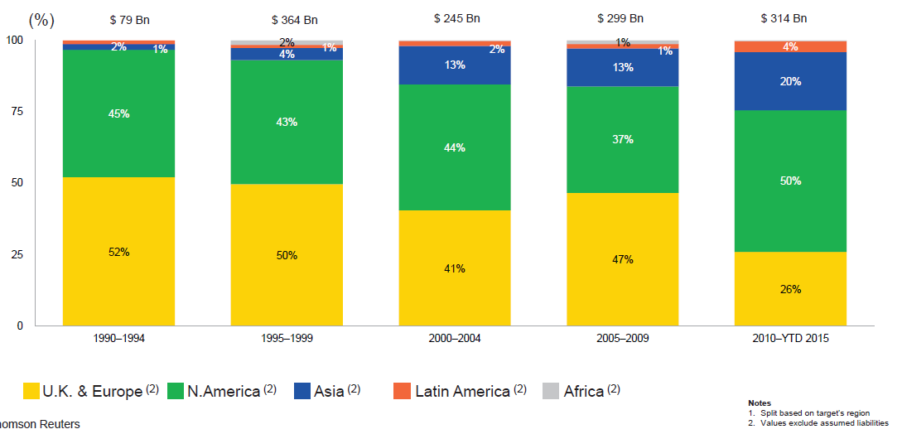
M&A Activity Has Shifted Away from Europe and Towards Asia and N. America
Asian, N. American deal volumes were up sharply in 2015
.
Source: Thomson Reuters as of Oct. 2015 from Geneva Association Newsletter Insurance and Finance, Jan. 2016, presentation “Facts vs. Sentiment: Deals in the Insurance Sector,” by Aviva CEO Mark Wilson.

Slide 81
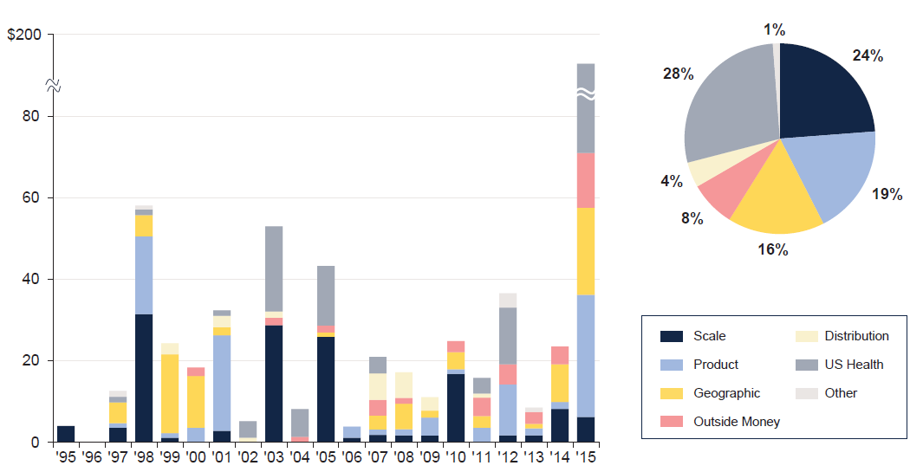
M&A: Deal Rationale by Dollar Amount
Scale drives most deals (excluding health sector)
Source: SNL Financial and WCMA estimates from Geneva Association Newsletter Insurance and Finance, Jan. 2016, presentation “What is the Logic Behind Consolidation? And Does It Create Value? A View from Outside,” by Brian Shea, Head of Willis Capital Markets & Advisory Europe (WCMA).
.

Slide 82
Some Key Drivers in the US Economy
Economic Factors Driving Exposure Growth and Insurer Performance
82

Slide 83
US Real GDP Growth*
The Q4:2008 decline was the steepest since the Q1:1982 drop of 6.8%
Real GDP Growth (%)
Recession began in Dec, 2007
Q1 2014/15 GDP data were hit hard by this year’s “Polar Vortex” and harsh winter
Demand for Insurance Should Increase in 2016 as GDP Growth Continues at a Steady, Albeit Moderate Pace and Gradually Benefits the Economy Broadly
* Estimates/Forecasts from Blue Chip Economic Indicators.
Source: US Department of Commerce, Blue Economic Indicators 3/16; Insurance Information Institute.

Slide 84
US Unemployment Rate Forecast
Rising unemployment
eroded payrolls
and WC’s
exposure base.
Unemployment peaked at 10% in late 2009.
2007:Q1 to 2017:Q4F*
Jobless figures have been revised downwards for 2016
Unemployment forecasts have been revised modestly downwards. Optimistic scenarios put the unemployment as low as 4.3% by Q4 of 2016.
* = actual; = forecasts
Sources: US Bureau of Labor Statistics; Blue Chip Economic Indicators (3/16 edition); Insurance Information Institute.

Slide 85
Continued Business Investment Will
Spur Commercial Exposure Growth
The level and direction of interest rates is likely to affect these growth rates.
Continued business investment will be a potent driver of commercial property and liability insurance exposures. It should drive employment and WC payroll exposures as well (with a lag).
Sources: Blue Chip Economic Indicators, 2/2016 (history and forecasts for 2016 and 2017, 10/2015 for forecasts for 2018 and 2019; Insurance Information Institute.

Slide 86
Annual Inflation Rates, (CPI-U, %),
1990–2017F
Annual Inflation Rates (%)
Inflation peaked at 5.6% in August 2008 on high energy and commodity crisis. The recession and the collapse of the commodity bubble reduced inflationary pressures in 2009/10
Inflationary expectations have slipped (due in part to falling energy costs) allowing the Fed to maintain low interest rates
Slack in the U.S. economy and falling energy prices suggests that inflationary pressures should remain subdued for an extended period of times
Sources: US Bureau of Labor Statistics; Blue Chip Economic Indicators, 4/16 (forecasts).

Slide 87
Commodity Prices Have Plunged to Lowest Levels Since 2000
Bank of Canada, Commodity price indices, weekly data, (indexed to Jan 2000=100)
Energy and other commodity prices have tumbled
Note: Total index includes energy, metals & minerals, agriculture, forestry and fish.
Upside for most advanced economies, but a downside for commodity exporters
Source: Datastream from IUMI Hamburg 2016 presentation by Doug Harrell, Aspen Insurance.
Notes:
http://www.bankofcanada.ca/rates/price-indexes/bcpi/
Energy
Crude Oil [WTI, Brent, Western Canada Crude 1], Natural Gas, Coal
Metals and Minerals
Potash, Aluminum, Gold, Nickel, Iron, Copper, Silver, Zinc, Lead
Forestry
Lumber, Pulp, Newsprint
Agriculture
Cattle, Canola, Wheat, Hogs, Corn, Barley, Potatoes
Fisheries
Finfish, Shellfish 2

Slide 88
MANUFACTURING SECTOR OVERVIEW & OUTLOOK
The U.S. Manufacturing Sector Is Being Buffeted by a High Dollar, Weak Export Markets and Plunging Oil Prices
88

Slide 89
ISM Manufacturing Index
(Values > 50 Indicate Expansion)
January 2010 through December 2015
Manufacturing began to contract in late 2015
The manufacturing sector expanded for 68 of the 72 months from Jan. 2010 through Dec. 2015. Manufacturing sector now appears to be in contraction due to weakness abroad, strong dollar and collapse in oil prices
Source: Institute for Supply Management at http://www.ism.ws/ismreport/mfgrob.cfm; Insurance Information Institute.

Slide 90
Dollar Value* of Manufacturers’ Shipments Monthly, Jan. 1992—December 2015
$ Millions
The value of Manufacturing Shipments in Dec. 2015 was $467.0B—down 8% from the July 2014 record high of $508.1B
Monthly shipments in Nov. 2014 exceeded the pre-crisis (July 2008) peak but has declined in recent months. Weakness abroad, falling energy prices and a strong dollar are hurting the sector, especially exports. Manufacturing growth leads to gains in many commercial exposures: WC, Commercial Auto, Marine, Property, and various Liability Coverages.
* Seasonally adjusted; Data published Feb. 4, 2016.
Source: U.S. Census Bureau, Full Report on Manufacturers’ Shipments, Inventories, and Orders, http://www.census.gov/manufacturing/m3/
90
12/01/09 - 9pm
eSlide – P6466 – The Financial Crisis and the Future of the P/C
Notes:
90

Slide 91
Manufacturing Growth for Selected Sectors, 2015 vs. 2014*
Growth (%)
Durables: +1.8%
Non-Durables: -9.6%
Manufacturing of non-durable goods is weaker than for durables
Manufacturing Is Contracting Across a Number of Sectors, Especially Petroleum. Adverse Exposure Impacts Are Likely for: WC, Commercial Property, Commercial Auto and Certain Liability Coverages
*Seasonally adjusted; Date are YTD comparing data through November 2015 to the same period in 2014.
Source: U.S. Census Bureau, Full Report on Manufacturers’ Shipments, Inventories, and Orders, http://www.census.gov/manufacturing/m3/

Slide 92
CYBER RISK AND INSURANCE
Cyber Risk is a Rapidly Emerging Exposure for Businesses Large and Small in Every Industry
92

Slide 93








Data Breaches 2005-2015, by Number of Breaches and Records Exposed
# Data Breaches/Millions of Records Exposed
Millions
The 781 reported data breaches in 2015 was virtually unchanged form the record 783 reported in 2014. The number of exposed records soared to 169.1 million, and increase of 97.5%.
Source: Identity Theft Resource Center (updated as of Jan. 6, 2016);
http://www.idtheftcenter.org/images/breach/ITRCBreachReport2015.pdf

Slide 94
Data/Privacy Breach:
Many Potential Costs Can Be Insured
Data Breach Event
Costs of notifying affecting individuals
Defense and settlement costs
Lost customers and damaged reputation
Cyber extortion payments
Costs of notifying regulatory authorities
Regulatory fines at home & abroad
Business Income Loss
Forensic costs to discover cause
94

Slide 95
Estimated Cyber Insurance Premiums Written, 2014 – 2020F
Cyber insurance premiums written could more than triple to $7.5 billion by 2020
$ Billions
I.I.I.’s Cyber Risk paper issued Oct. 2015
Source: Advisen (2014 est.); PwC (2015, 2020); Insurance Information Institute.

Slide 96
Insured Catastrophe Losses
2013/14 and YTD 2015 Experienced Below Average CAT Activity After Very High CAT Losses in 2011/12
2016: Cat Activity Rising
96

Slide 97
U.S. Insured Catastrophe Losses
($ Billions, $ 2015)
2012 was the 3rd most expensive year ever for insured CAT losses
2013/14 Were Welcome Respites from 2011/12, among the Costliest Years for Insured Disaster Losses in US History. Longer-term Trend is for more—not fewer—Costly Events
$15B in insured CAT losses though 12/31/15 (est.)
*Estimate hrough 12/31/15 in 2015 dollars.
Note: 2001 figure includes $20.3B for 9/11 losses reported through 12/31/01 ($25.9B 2011 dollars). Includes only business and personal property claims, business interruption and auto claims. Non-prop/BI losses = $12.2B ($15.6B in 2011 dollars.)
Sources: Property Claims Service/ISO; Insurance Information Institute.
97
12/01/09 - 9pm
eSlide – P6466 – The Financial Crisis and the Future of the P/C
Notes:
97

Slide 98
Combined Ratio Points Associated with Catastrophe Losses: 1960 – 2015E*
Avg. CAT Loss Component of the Combined Ratio by Decade
1960s: 1.04 1970s: 0.85 1980s: 1.31 1990s: 3.39 2000s: 3.52 2010s: 5.46*
Catastrophe losses as a share of all losses reached a record high in 2011
Combined Ratio Points
The Catastrophe Loss Component of Private Insurer Losses Has Increased Sharply in Recent Decades
*2010s represent 2010-2015E.
Notes: Private carrier losses only. Excludes loss adjustment expenses and reinsurance reinstatement premiums. Figures are adjusted for losses ultimately paid by foreign insurers and reinsurers.
Source: ISO (1960-2009); A.M. Best (2010-15E) Insurance Information Institute.

Slide 99
Inflation Adjusted U.S. Catastrophe Losses by Cause of Loss, 1995–2014¹
Wind/Hail/Flood (3), $21.4
Fires (4), $6.0
Winter storm losses were much above average in 2014/15 are will push this share up
Other (5), $0.2
Insured cat losses from 1995-2014 totaled $395.6B, an average of $19.8B per year or $1.65B per month
Geological Events, $0.5
Terrorism, $24.5
Winter Storms, $26.9
Hurricanes & Tropical Storms, $161.2
Tornado share of CAT losses is rising
Wind losses are by far cause the most catastrophe losses, even if hurricanes/TS are excluded.
Events Involving Tornadoes (2), $154.9
Catastrophes are defined as events causing direct insured losses to property of $25 million or more in 2014 dollars.
Excludes snow.
Does not include NFIP flood losses
Includes wildland fires
Includes civil disorders, water damage, utility disruptions and non-property losses such as those covered by workers compensation.
Source: ISO’s Property Claim Services Unit.

Slide 100
Top 16 Most Costly Disasters in U.S. History—Katrina Still Ranks #1
(Insured Losses, 2014 Dollars, $ Billions)
Storm Sandy in 2012 was the last mega-CAT to hit the US; Northridge still ranks as the 4th costliest disaster of all time
Includes Tuscaloosa, AL, tornado
Includes Joplin, MO, tornado
12 of the 16 Most Expensive Events in US History Have Occurred Since 2004
Sources: PCS; Insurance Information Institute inflation adjustments to 2014 dollars using the CPI.

Slide 101
Catastrophe Bond Issuance and Outstanding: 1997-2015
Risk Capital Amount ($ Millions)
Cat Bond Issuance Declined Slightly in 2015 from 2014’s Record Pace. Lower Yields on Bonds Explain Some of the Contraction.
Source: Guy Carpenter, Artemis accessed at http://www.artemis.bm/deal_directory/cat_bonds_ils_issued_outstanding.html .

Slide 102
US Property CAT Rate on Line Index & Global Reinsurance ROE
US Property CAT ROL
Global Reinsurance ROE
Record traditional capacity, alternative capital and low CAT activity have pressured reinsurance prices; ROEs are own only very modestly
Source: Barclays PLC from Guy Carpenter; Insurance Information Institute.

Slide 103
Alternative Capital
New Investors Continue to Change the Reinsurance Landscape
First I.I.I. White Paper on Issue Was Released in March 2015
103

Slide 104
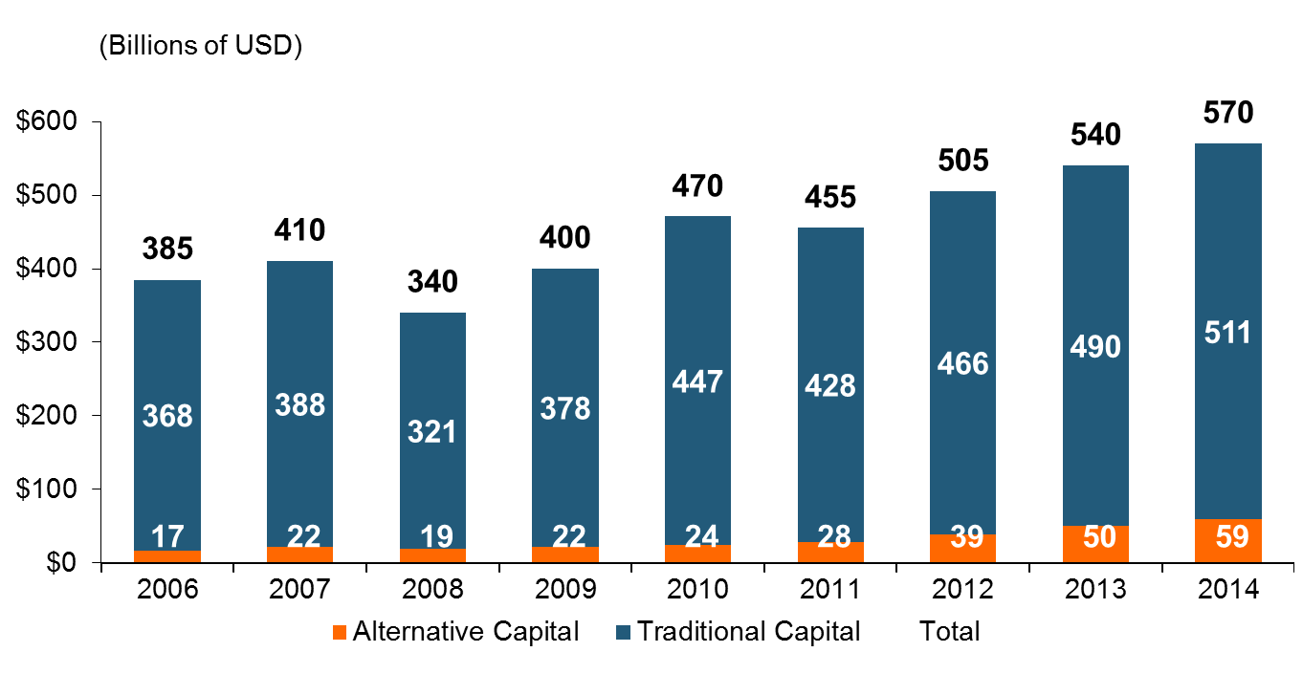
Global Reinsurance Capital (Traditional and Alternative), 2006 - 2014
Total reinsurance capital reached a record $570B in 2013, up 68% from 2008.
But alternative capacity has grown 210% since 2008, to $50B. It has more than doubled in the past three years.
2014 data is as of June 30, 2014.
Source: Aon Benfield Analytics; Insurance Information Institute.

Slide 105
Alternative Capital as a Percentage of Traditional Global Reinsurance Capital
Alternative Capital’s Share of Global Reinsurance Capital Has More Than Doubled Since 2010.
2014 data is as of June 30, 2014.
Source: Aon Benfield Analytics; Insurance Information Institute.

Slide 106
Catastrophe Bond Issuance and Outstanding: 1997-2015
Risk Capital Amount ($ Millions)
Cat Bond Issuance Declined Slightly in 2015 from 2014’s Record Pace. Lower Yields on Bonds Explain Some of the Contraction.
Source: Guy Carpenter, Artemis accessed at http://www.artemis.bm/deal_directory/cat_bonds_ils_issued_outstanding.html .

Slide 107
US Property CAT Rate on Line Index & Global Reinsurance ROE
US Property CAT ROL
Global Reinsurance ROE
Record traditional capacity, alternative capital and low CAT activity have pressured reinsurance prices; ROEs are own only very modestly
Source: Barclays PLC from Guy Carpenter; Insurance Information Institute.

Slide 108
Insurance Information Institute Online:
www.iii.org
Thank you for your time
and your attention!
Twitter: twitter.com/bob_Hartwig
Download at www.iii.org/presentations

