Slide 1
The Marine Insurance Market
Board of Marine Underwriters of San Francisco San Francisco, CA
May 3, 2018
James Lynch, FCAS MAAA, Chief Actuary
Insurance Information Institute  110 William Street  New York, NY 10038 Tel: 212.346.5533  jamesl@iii.org  www.iii.org

Slide 2

What is the Insurance Information Institute?
Improving public understanding of insurance...
…what it does and how it works
2

Slide 3
Who We Are and What We Do
The mission of the Insurance Information Institute is to improve public understanding of insurance—what it does and how it works.
We Are…
A voice for the property/casualty insurance industry.
The go-to source for credible and unbiased insurance information for the media, the industry and consumers.
Dedicated to ensuring the media covers our business fairly and accurately.
Ready to assist our member companies with their communications, research and planning needs.
We do not lobby.

Slide 4
Financial Results Q4 2017

Slide 5
Net Premium Growth, Annual Change
Premium Growth Continues to Follow Economic Growth and Inflation Trends.
Sources: A.M. Best (2007-2013), ISO (2014-16), Federal Reserve Bank of St. Louis (FRED), Insurance Information Institute.

Slide 6
P/C industry net income after taxes
Billions, 2017 dollars
Catastrophes Drove Earnings Down in 2017, Continuing a Four-Year Slide in Inflation-Adjusted Profits.
Through fourth quarter. Adjusted for inflation using the BLS CPI calculator, to 2017 dollars. Sources: NAIC data, sourced from S&P Global Market Intelligence; Insurance Information Institute.
Notes:
OVERALL HEADLINE [H2]: P/C industry results
The chart shows: Industry net income after taxes for the first three quarters of the year (adjusted for inflation).
The takeaway: Three major hurricanes and the California wildfires, took their toll on profits.
http://www3.ambest.com/bestweek/DisplayBinary.aspx?TY=P&record_code=268075&URatingId=2515991

Slide 7
P/C Insurance Industry Combined Ratio, 2000-2019*
3 Consecutive Years of U/W Profits; 1st time since 1971-73
Hurricanes, Wildfires Drive CR Higher.
Best Combined Ratio Since 1949 (87.6)
*Excludes Mortgage & Financial Guaranty insurers 2008-2014. Including M&FG, 2008=105.1, 2009=100.7, 2010=102.4, 2011=108.1; 2012:=103.2; 2013: = 96.1; 2014: = 97.0.
Sources: A.M. Best; ISO, a Verisk Analytics company; I.I.I. estimate for 2017; I.I.I. projections for 2018 and 2019.

Slide 8
Catastrophes

Slide 9
U.S. Insured Catastrophe Losses, 1989–2017
($ billions, 2016 dollars)
2017 was one of the costliest years for insured disaster losses on record. Longer-term trend is for more costly events.
*PCS estimate, subject to change, in 2016 dollars
Note: 2001 figure includes $20.3B for 9/11 losses reported through 12/31/01 ($25.9B 2011 dollars). Includes only business and personal property claims, business interruption and auto claims. Non-prop/BI losses = $12.2B ($15.6B in 2011 dollars).
Sources: Property Claims Service, a Verisk Analytics business; Insurance Information Institute.
Notes:
The I.I.I. estimate for the 2017 insured cat loss - $55billion – here is how it was determined:
To start with ISO/PCS at Q3: $36B to $40B of direct insured losses. That would include the hurricanes. To that we can add the wildfires for a total of $50 billion give or take.
As part of the projection of combined ratios for AmFam, Jim estimated net cat losses for full year 2017 as $43 billion, but that number is net of reinsurance. I think the table is direct, and between the cat bonds, Lloyd’s, Munich and Swiss, there were another $10 billion or more, but some of that was offshore.
AM Best had 8.8 points of cat losses. (Our NEP number is about $550 billion, and 8.8 percent of that is $48.4 B)
So if you look at all those, they hover around $55 billion.

Slide 10
Estimated Ultimate Gross Losses from Hurricane Harvey
Other
Automobile
($ Billions)
Flood Insurance
Commercial Property
Source: Texas Department of Insurance, Hurricane Harvey Data Call, January 23, 2018.

Slide 11
Top 10 Most Costly Disasters in U.S. History—Katrina Still Ranks #1
(Insured Losses, 2016 Dollars, $ Billions)
Source: The Property Claim Services (PCS) unit of ISO, a Verisk Analytics company.
Notes:
2017 hurricanes estimates not available from PCS

Slide 12
Inflation Adjusted U.S. Catastrophe Losses by Cause of Loss, 1997–2016¹
Terrorism, $25.0
Fires (3), $8.4
Other (4), $0.8
Winter Storms, $28.2
Wind/Hail/Flood, $29.7
Events Including Tornadoes (2), $168.1
Hurricanes & Tropical Storms, $161.1
(1) Adjusted for inflation through 2016 by ISO using the GDP implicit price deflator. Excludes catastrophes causing direct losses less than $25 million in 1997 dollars. Does not include flood damage covered by the federally administered National Flood Insurance Program. (2) Includes other wind, hail, and/or flood losses associated with catastrophes involving tornadoes. (3) Includes wildland fires. (4) Includes losses from civil disorders, water damage, utility service disruptions, and any workers compensation catastrophes generating losses in excess of PCS's threshold after adjusting for inflation. Source: Property Claim Services (PCS)®, a unit of ISO®,a Verisk Analytics® business.

Slide 13
Investments

Slide 14
Key sources of P/C insurer profits, 2008-2017
$ Billions
Data are before taxes and exclude extraordinary items.
Source: NAIC data, sourced from S&P Global Market Intelligence.
Notes:
OVERALL HEADLINE: [none]
The chart shows: The green bars are underwriting profit or loss for the first nine months of each year. The blue bars are net investment gains (investment income net of capital gains or losses) for the same period.
The back story: A long-term downtrend in interest rates has been offset by steadily growing investment amounts, yielding generally increasing interest income.
The takeaway: Three-quarter-year profits come mainly from net investment gains; underwriting losses in occurred in 7 of the 11 three-quarter-years shown.

Slide 15
P/C Insurer Portfolio Yields, 2005-2017
Yields Have Been Falling for Over a Decade, Reflecting the Long Downward Trend in Prevailing Interest Rates.
Sources: NAIC data, sourced from S&P Global Market Intelligence.

Slide 16
Sources of investment gains, 2008-2017
$ Billions
2017 Was a Great Year for the Stock Market.
Source: NAIC data, sourced from S&P Global Market Intelligence.
Notes:
OVERALL HEADLINE: [none]
The chart shows: The blue shows net investment income for the first nine months of each year. The green shows realized capital gains or losses for the same period.
The takeaway: Net investment income, the heart of insurer profits, has been declining steadily for more than a decade.

Slide 17
Marine Results Underwriting is Historically Volatile; Has the Market Turned?

Slide 18
U.S. Ocean Marine Direct Written Premiums, 2008-2017
($ Billions)
Ocean Marine Premium Volume Fell During the Global Financial Crisis, but is Falling Again.
Source: NAIC data, sourced from S&P Global Market Intelligence. Note: U.S. and territories
Notes:
18

Slide 19
Has the Market Bottomed Out?
(U.S. Ocean Marine DWP as % of GDP)
Economy Grows Faster Than Premium – Sign of Soft Market (30% Decline Since 2006 Peak)
Sources: Federal Reserve Economic Data; NAIC data, sourced from S&P Global Market Intelligence

Slide 20
Total losses by type of vessel 2007 vs. 2016
(Vessels Lost)
While Exposures Grow, the Number of Vessels Lost Has Declined.
Source: Source: Lloyd’s List Intelligence Casualty Statistics; Allianz Global Safety & Shipping Review 2017
Notes:
20

Slide 21
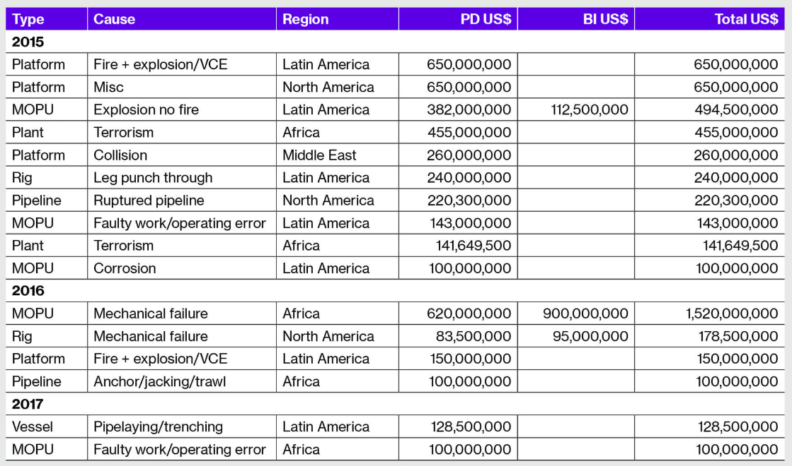
Major Energy Losses
Heaviest Upstream 2017 Losses Were Outside USA.
Source: Willis Towers Watson Energy Loss Database (February 12, 2018).

Slide 22
U.S. Marine Results, 2007-2017
Combined Ratio After Dividends
Rate Pressures Create Drag on Results.
Source: Ocean and Inland Marine combined. A.M. Best’s Aggregates and Averages, 2017
Notes:
22
2012 Sandy – cargo losses

Slide 23
Offshore Energy
Source: Willis Towers Watson
Notes:
23
Dieter’s slide number 17 updated from here: https://willistowerswatson.turtl.co/story/5abcec67fff3a271bb9d96e4
Green is theoretical capacity in market – 8B, but realistically programs are unlikely to place more than 6.5 billion
Purple is rate vs. 1992 levels. Note the slight uptick in 2018 – 5 to 10 percent. Driven not by losses (HIM didn’t hurt)

Slide 24
Economic Factors

Slide 25

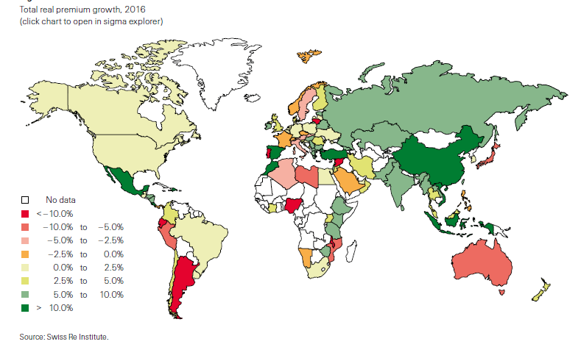
Global Premium Growth, 2016
Growth in the non-life sector is likely to grow robustly but at a slower pace than in the recent past in the emerging markets, mainly supported by healthy growth in China (and India to some extent.)
Source: Swiss Re sigma, 3/2017

Slide 26
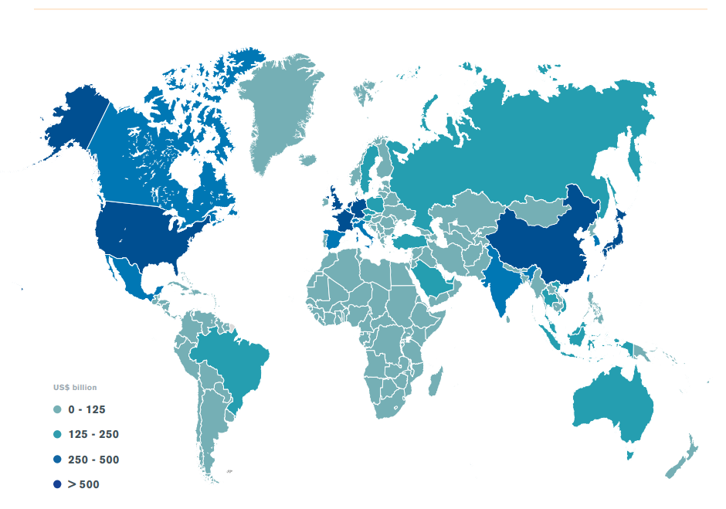
Economies by size of merchandise trade, 2016
Merchandise exports of WTO members totaled US$ 15.71 trillion in 2016
Source: World Trade Statistical Review 2017

Slide 27
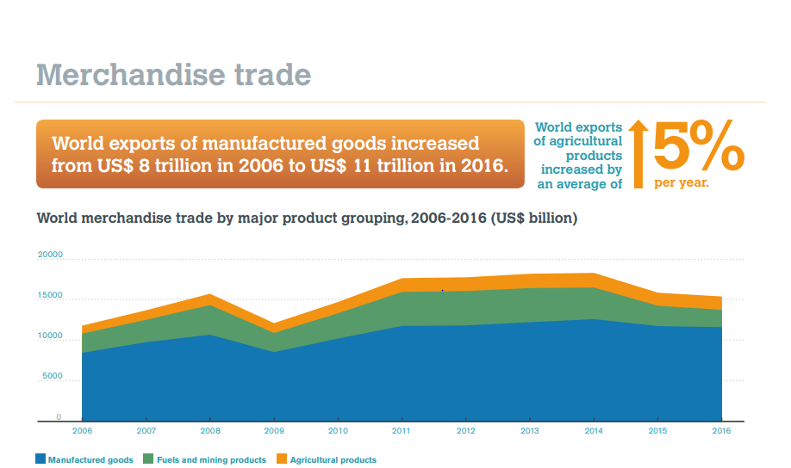
World Merchandise Trade
Source: World Trade Statistical Review 2017
Notes:
World exports of fuels and mining products have declined by 10% since 2006

Slide 28
World Trade Volume Growth* 2012-2019P
Trade is Expected to Remain at Current Highs.
Sources: International Monetary Fund, World Economic Outlook, October 2017 Statistical Appendix * Goods and services
Notes:
28

Slide 29
World Trade Volume: IMPORTS, 2012–2019P
Growth (%)
Advanced Economies
Emerging Economies
Sources: IMF World Economic Outlook (April 2018)

Slide 30
World Trade Volume: EXPORTS, 2012–2019P
Growth (%)
Advanced Economies
Emerging Economies
Sources: IMF World Economic Outlook (April 2018)

Slide 31
Global Risk

Slide 32
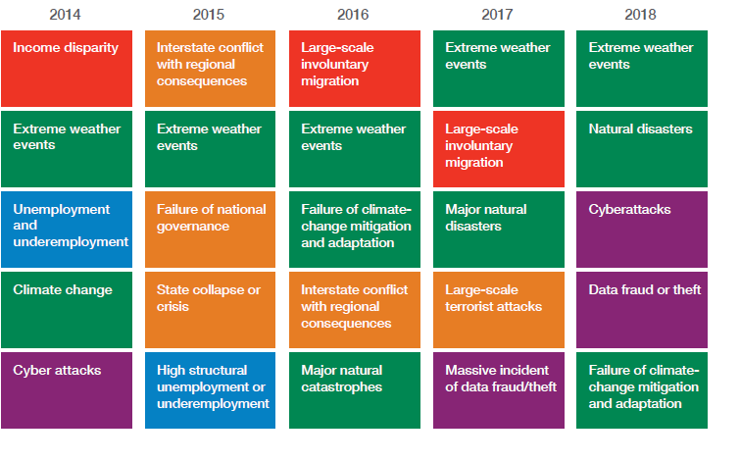

Top 5 Global Risks in Terms of Likelihood, 2014—2018: Insurance Can Help With Most
Environmental & Tech Issues Dominate
Concerns Shift Considerably Over Short Spans of Time.
Sources: World Economic Forum, Global Risks 2018; Insurance Information Institute.

Slide 33
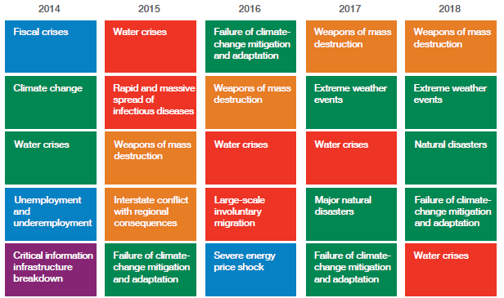
Top 5 Global Risks in Terms of Impact, 2014—2018: Insurance Can Help With Most
Marine Underwriters Have a Lot to Worry About.
Sources: World Economic Forum, Global Risks 2018; Insurance Information Institute.

Slide 34
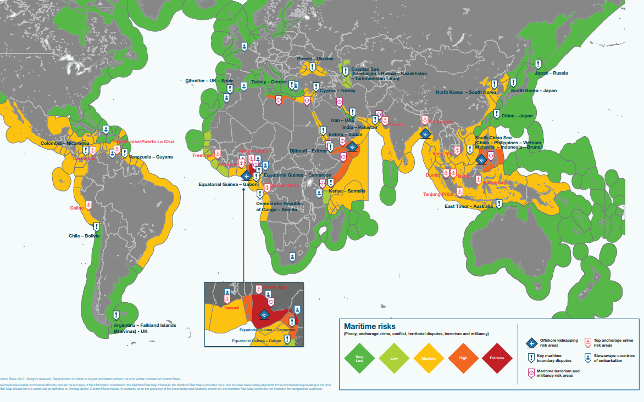
Maritime Risk
Source: ControlRisks, 2018 Risk Map
Notes:
Use maritime risk instead -

Slide 35
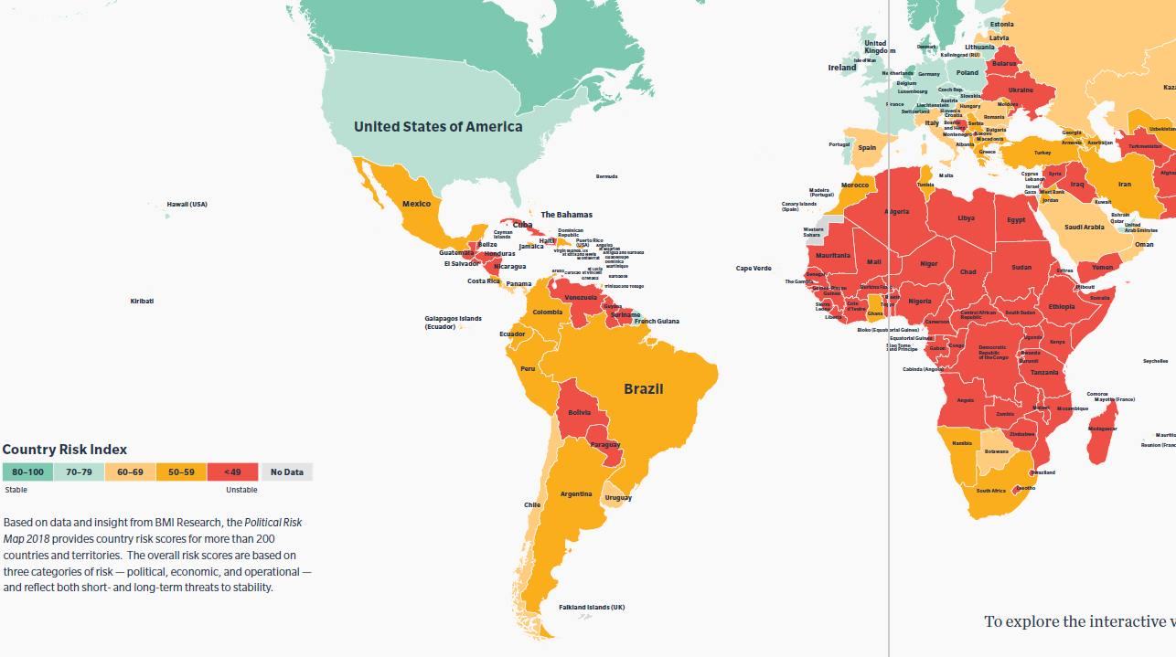
Political Risk
In 2018 the risk of
increased global trade protectionism
continues. Trade giants — such as the US — will seek further restrictions
Source: Marsh, 2018 Political Risk Map

Slide 36
The Future: Trump, Taxes and Tariffs

Slide 37

Total value of recreational boats sold in the U.S.
($ Millions in Sales)
Boat Sales Grew > 7% in ’17. But What About Tax Reform?
*National Marine Manufacturers Association.
SOURCE: Statista, 2018.

Slide 38
West Coast Trade With China
(Billions of dollars)
Port of Los Angeles Receives by Far the Most Imports From China.

Slide 39
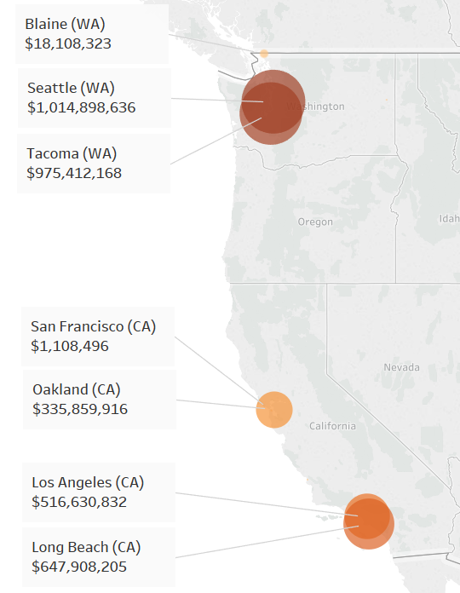
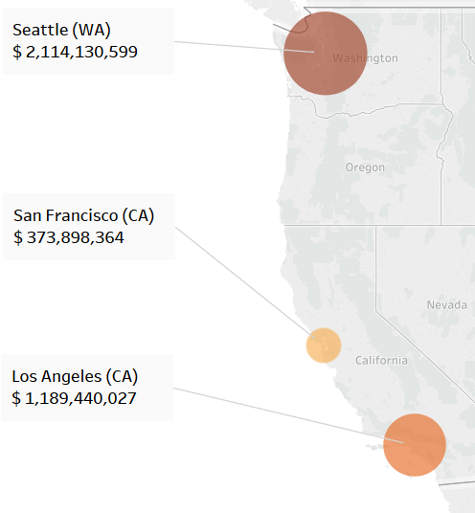
China Tariffs: Seattle and Tacoma Hit Hard
Total value of major exports subject
to tariffs by port, 2017*
Total value of major exports subject
to tariffs by district, 2017*
Size and color of each circle corresponds to the port’s total export value of a sample of goods exported to China in 2017
*Total export value is calculated by summing totals for almonds, beef, cherries, corn, cotton, fresh apricots, peaches, plums, sloes, grapes, oranges, pistachios, pork, sorghum, soybeans, walnuts, whiskies and wine. Exports are to China, not China and Hong Kong.
Sources: USA Trade; National Journal Research.

Slide 40
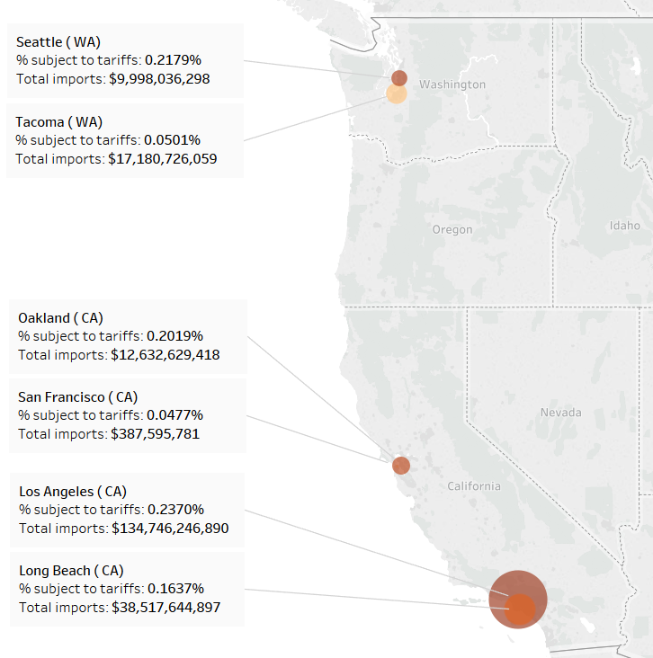
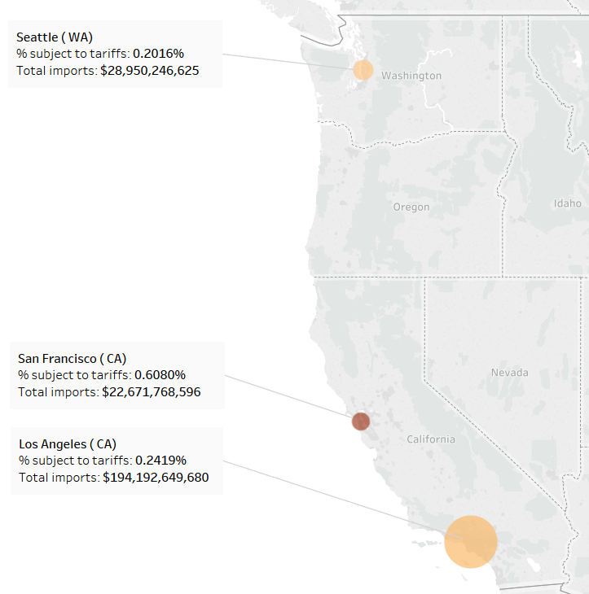

US Solar Cell Tariffs: Los Angeles
Total value and percentage of major imports subject to tariffs by port and district, 2017*
By port
By district
Percentage of major imports subject to tariffs
Size of each circle corresponds to the port or district’s total imports value ($)
Percentage of major imports subject to tariffs
0.047%
0.237%
0.2%
0.61%
*Total import value of solar panels is based on the import value of photosensitive semiconductor devices (including photovoltaic cells, both cells that are assembled in modules or made up into panels) and light-emitting diodes.

Slide 41
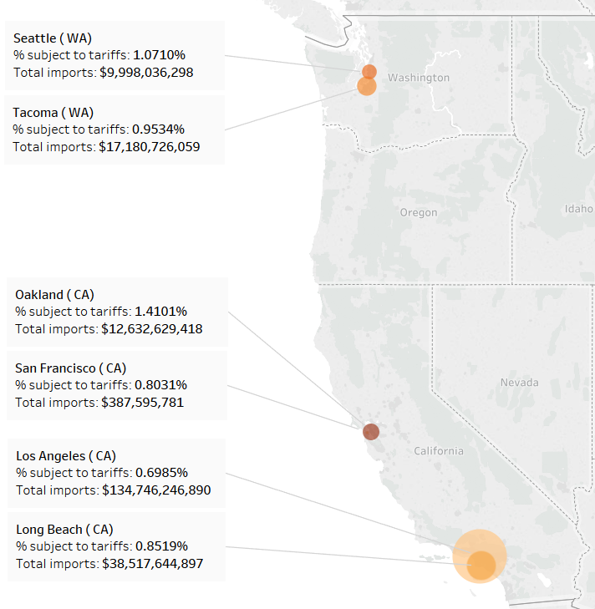
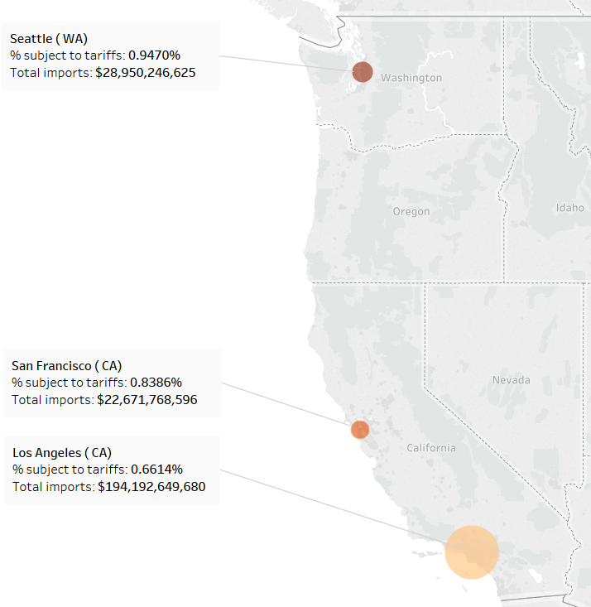
US Aluminum Tariffs: Oakland
Total value and percentage of major imports subject to tariffs by port and district, 2017*
By port
By district
Percentage of major imports subject to tariffs
Size of each circle corresponds to the port or district’s total imports value ($)
Percentage of major imports subject to tariffs
0.69%
1.41%
0.66%
0.95%
*The total import value of aluminum imports includes aluminum bars and rods, wire, plates, sheets, strips, foil, tubes and pipes.

Slide 42
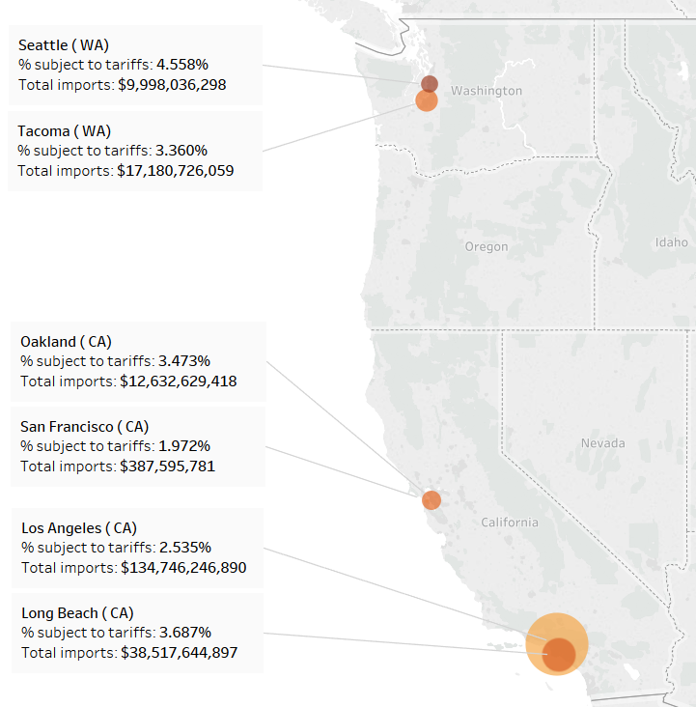
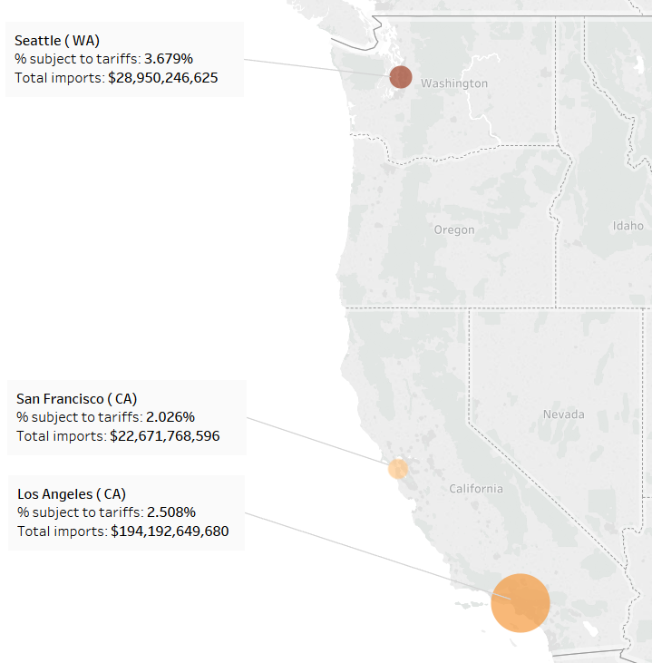
US Steel Tariffs: Seattle
Total value and percentage of major imports subject to tariffs by port and district, 2017*
By port
By district
Percentage of major imports subject to tariffs
Size of each circle corresponds to the port or district’s total imports value ($)
Percentage of major imports subject to tariffs
1.97%
4.56%
0.6%
1%
*The total import value of iron and steel imports includes major raw, intermediate and finished iron and steel goods.

Slide 43
China’s new tariffs would hit imports to the LA area hardest
Total value of major iron and steel imports subject to China’s new tariffs, 2017*
In billions of dollars
Total value of major solar panel imports subject to China’s new tariffs, 2017*
In millions of dollars
Total value of
major iron and steel
imports subject to
China’s new tariffs
Total value of
major solar panel
imports subject to
China’s new tariffs
*Total import value of iron and steel imports includes major raw, intermediate and finished iron and steel goods. Total import value of solar panel imports is based on the import value of photosensitive semiconductor devices (including photovoltaic cells, both cells that are assembled in modules or made up into panels) and light-emitting diodes.

Slide 44
Los Angeles imports far more from China than any other West Coast port
Total imports and exports, 2017
In billions of dollars
Total value of major exports subject to
China’s new tariffs, 2017*
In millions of dollars
*Total export value is calculated by summing totals for almonds, beef, cherries, corn, cotton, fresh apricots, peaches, plums, sloes, grapes, oranges, pistachios, pork, sorghum, soybeans, walnuts, whiskies and wine. Exports are to China, not China and Hong Kong.
Sources: USA Trade; National Journal Research.

Slide 45
China’s Tariffs: Who Feels the Pain?
Total value of major exports subject to tariffs by product & port, 2017*
 | Almonds | Cotton | Grapes | Pork | Soybeans | Cherries
Long Beach | $9,747,994 | $468,715,365 | $3,805,203 | $33,076,125 | $68,384,952 | $0
Los Angeles | $7,003,506 | $310,280,259 | $2,463,856 | $53,392,068 | $70,695,719 | $37,500
Oakland | $82,389,373 | $34,223,972 | $71,609,280 | $17,182,806 | $0 | $0
Seattle | $0 | $0 | $0 | $6,964,874 | $976,578,445 | $11,665,281
Tacoma | $0 | $36,651 | $6,330 | $4,845,719 | $913,800,785 | $9,823,324
*Total export value is calculated by summing totals for almonds, beef, cherries, corn, cotton, fresh apricots, peaches, plums, sloes, grapes, oranges, pistachios, pork, sorghum, soybeans, walnuts, whiskies and wine. Exports are to China, not China and Hong Kong.
Sources: USA Trade; National Journal Research.

Slide 46
Summary
2017 Was Tough Year for Insurers, Thanks to HIM
Growing World Economy Is a Plus for Trade
Significant Risks Touch on Marine Insurance
Trump’s Tax Changes and Tariff Plans – What’s Next?

Slide 47
Thank You!

