Slide 1
The Global Economy, Rising Risk and Marine Insurance Markets Risk and Reward in a Troubled World
Houston Marine Insurance Seminar
Houston, TX
September 22, 2014
Download at www.iii.org/presentations
Robert P. Hartwig, Ph.D., CPCU, President & Economist
Insurance Information Institute ♦ 110 William Street ♦ New York, NY 10038
Tel: 212.346.5520 ♦ Cell: 917.453.1885 ♦ bobh@iii.org ♦ www.iii.org

Slide 2
Outlook: Property/Casualty
Modest growth will continue in 2014 (~ 4.0% DPW in US)
Exposure growth tied primarily to overall GDP growth/key sector drivers
Rates remain marginally in positive territory though more concern for commercial lines in late 2014 and into 2015
Reinsurance pricing under pressure—more so for property risks
Underlying loss cost trends remain manageable
Very well capitalized (record)
For primary insurers, falling reinsurance pricing and alternative capital are benefits
Traditional reinsurers challenged by continued entry of new capital and accumulation of “organic” capital
Regulatory/Legislative concerns manageable
TRIA, Systemic risk, International Regulation; Ex-Im Bank
Personal Lines: Stable
Commercial Lines: Negative
Reinsurance: Negative*
*Outlook assessment from A.M. Best.

Slide 3
Risk & Insurance
U.S. and Global Perspective
Marine Insurance Is Very Sensitive to the Global Economic and Political Environment
3

Slide 4
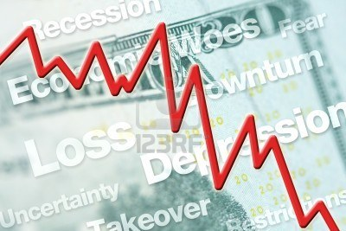




5 Major Categories for External Global Risks, Uncertainties and Fears: Insurance Solutions
Economic Risks
Geopolitical Risks
Environmental Risks
Technological Risks
Societal Risks
While risks can be broadly categorized, none are mutually exclusive
Source: Adapted from World Economic Forum, Global Risks 2014; Insurance Information Institute.

Slide 5
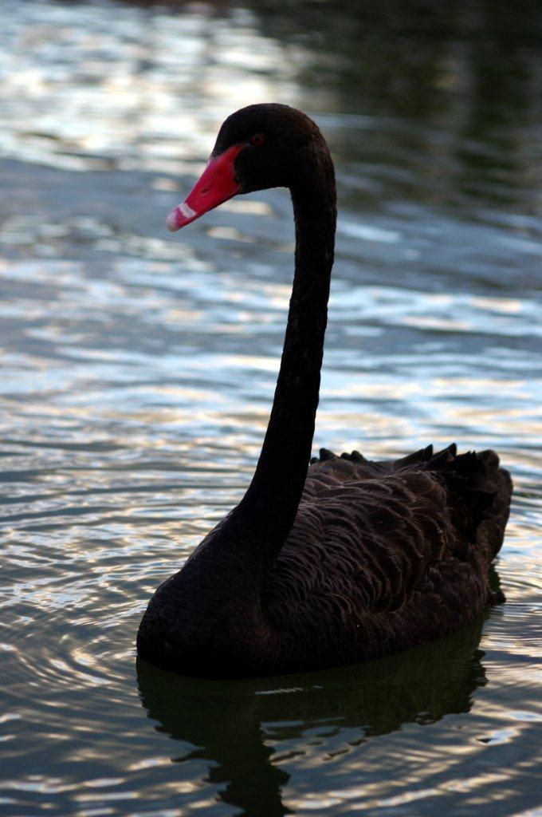
Multitude of Exogenous Factors Influence Growth, Performance & Cyclicality
Economic Issues in US, Europe
Weakness in China/Emerging Economies
Political Upheaval in the Ukraine, Middle East
Argentina, Venezuela, Thailand, Syria, Iraq
→Trade sanctions (e.g., Iran, Russia)
Political Gridlock in the US, Europe, Japan
Fiscal/Monetary Imbalances/Low Interest Rates
Unemployment
Resurgent Terrorism Risk: ISIS & Other Groups
Cyber Attacks (theft, espionage, terrorism)
Ebola Crisis
Sabre Rattling (e.g., US-China, Russia-Ukraine)
Separatist Fever (UK/Scotland, Spain)
Severe Natural Disaster Losses
Climate Change/Sea Level Rise
Environmental Degradation
(Over)Regulation: Systemic Risk?
Are “Black Swans” everywhere or does it just seem that way?

Slide 6
Top 5 Global Risks in Terms of Likelihood, 2007—2014: Insurance Can Help With Most
In 2014, societal and environ-mental issues dominated frequency concerns
Concerns Shift Considerably Over Short Spans of Time. 2014 Includes a Mix of Environmental Economic, Social and Environmental Risks
Source: World Economic Forum, Global Risks 2014; Insurance Information Institute.
6
12/01/09 - 9pm
eSlide – P6466 – The Financial Crisis and the Future of the P/C
Notes:
6

Slide 7
Top 5 Global Risks in Terms of Impact, 2007—2014: Insurance Can Help With Most
In 2014, economic and environ-mental issues dominated severity concerns
Concerns Over the Impacts of Economics Risks Remained High in 2014, but Societal, Environment and Technological Risks Also Loom Large
Source: World Economic Forum, Global Risks 2014; Insurance Information Institute.
7
12/01/09 - 9pm
eSlide – P6466 – The Financial Crisis and the Future of the P/C
Notes:
7

Slide 8
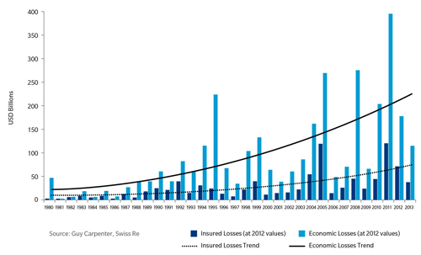
Gap Between Economic and Insured Losses: 1980—2013
The gap between economic and insured losses is growing—suggesting both a problem and an opportunity
Sources: Guy Carpenter, Swiss Re; Insurance Information Institute .
8
12/01/09 - 9pm
eSlide – P6466 – The Financial Crisis and the Future of the P/C
Notes:
8

Slide 9
Globalization: The Global Economy Creates and Transmits Cycles & Risks
Globalization Is a Double Edged Sword—Creating Opportunity and Wealth But Potentially Creating and Amplifying Risk
Emerging vs. “Advanced” Economies
9

Slide 10
GDP Growth: Advanced & Emerging Economies vs. World, 1970-2015F
Emerging economies (led by China) are expected to grow by 4.6% in 2014 and 5.2% in 2015.
GDP Growth (%)
World output is forecast to grow by 3.4% in 2014 and 4.0% in 2015. The world economy shrank by 0.6% in 2009 amid the global financial crisis
Advanced economies are expected to grow at a modest pace of 1.8% in 2014 and to 2.4% in 2015.
Source: International Monetary Fund, World Economic Outlook , July 2014; Insurance Information Institute.

Slide 11
Real GDP Growth Forecasts: Major Economies: 2011 – 2015F
US growth should acceleratein 2014
Growth in China has outpaced the US and Europe
The Eurozone is ending
Growth Prospects Vary Widely by Region: Growth Returns to Most Areas Even as China Slows; Some strengthening in Latin America
Sources: Blue Chip Economic Indicators (9/2014 issue); IMF; Insurance Information Institute.
11
Notes:
11

Slide 12
Real GDP Growth Forecasts: Selected Economies: 2011 – 2015F
Strong economies in smaller industrialized nations will bolster demand for products, services, international trade and insure
Growth in Russia is being hit hard by sanctions
Growth Is Expected Accelerate Modestly in Most of the World in 2014 and 2015
Sources: Blue Chip Economic Indicators (9/2014 issue); Insurance Information Institute.
12
Notes:
12

Slide 13
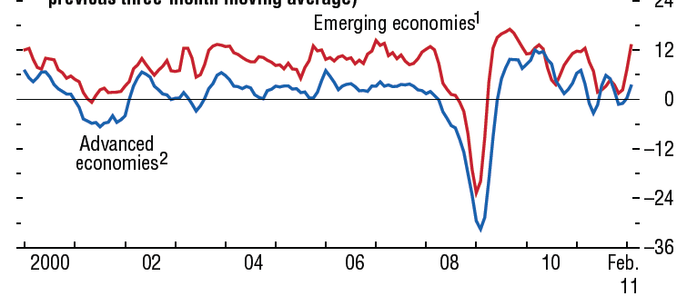
Global Industrial Production (2000-Feb. 2012)
Global industrial production has been volatile but is growing
12
Source: IMF, World Economic Outlook, April 2012; Insurance Information Institute.
13
12/01/09 - 9pm
eSlide – P6466 – The Financial Crisis and the Future of the P/C
Notes:
13

Slide 14
World GDP and Industrial Production (2005-Feb. 2015F)
Global industrial production should continue to rise as should exports and imports of manufactured goods
Source: IMF, World Economic Outlook, April 2014; Insurance Information Institute.
14
12/01/09 - 9pm
eSlide – P6466 – The Financial Crisis and the Future of the P/C
Notes:
14

Slide 15
World Trade Volume: 1948—2015F
Global trade volume will exceed $19 trillion in 2014, an increase of nearly 160% over the past decade
$ Billions
Insurance Regulation Will Necessarily Become More Transnational, Following Patterns of Global Economic Growth, the Creation of New Insurable Exposures and International Capital Flows
Sources: World Trade Organization data through 2012 from International Trade Statistics 2013; Insurance Information Institute estimates and forecasts for 2013-2015 based on IMF World Economic Outlook forecasts as of July 2014.
15
12/01/09 - 9pm
eSlide – P6466 – The Financial Crisis and the Future of the P/C
Notes:
15

Slide 16
World Trade Volume Growth*, 2012 – 2015F
World trade volume growth is expected to accelerate modestly through 2015—translating into $2.25 trillion in net trade growth
*Goods and services.
Source: International Monetary Fund, World Economic Outlook, July 2014; Insurance Information Institute.

Slide 17
World Trade Volume: IMPORTS 2010 – 2015F
Growth (%)
Advanced Economies
Emerging Economies
Import growth in Advanced Economies is expected to accelerate in 2014
Import growth in emerging economies outpaces Advanced Economies by a wide margin but will slow in 2014
Sources: IMF World Economic Outlook (July 2014 ); Insurance Information Institute.

Slide 18
World Trade Volume: EXPORTS 2010 – 2015F
Growth (%)
Advanced Economies
Emerging Economies
Export growth in emerging economies has decelerated sharply
Export growth in advanced economies should accelerate in 2014
Sources: IMF World Economic Outlook (April 2014); Insurance Information Institute.

Slide 19
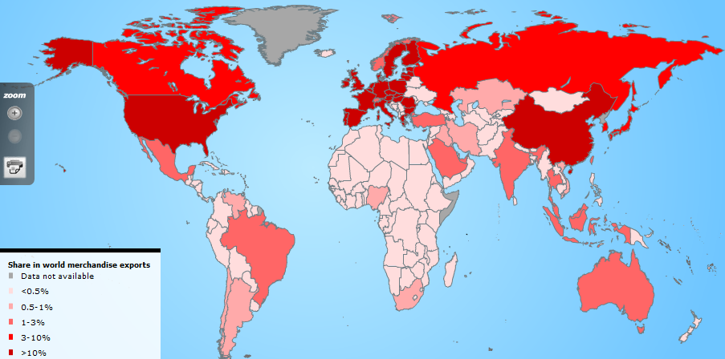
Country Shares of World Merchandise Exports
The US, China, Japan and Western Europe lead the world in merchandise exports
Source: World Trade Organization accessed 4/30/14 at: http://www.wto.org/english/res_e/statis_e/statis_e.htm ; Insurance Information Institute.
19
12/01/09 - 9pm
eSlide – P6466 – The Financial Crisis and the Future of the P/C
Notes:
19

Slide 20
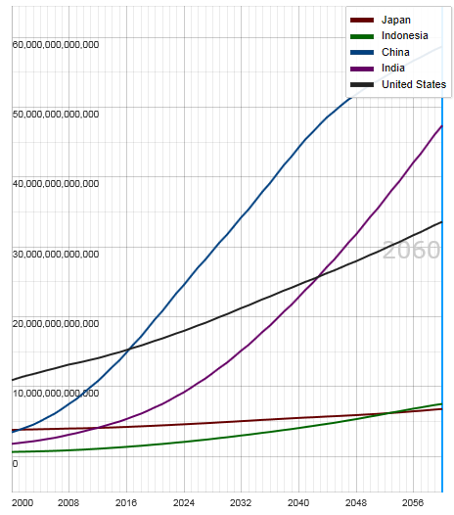
Potential Output of Total Economy: US, China, India, Indonesia and Japan, 2000-2060F
$ 2005 PPP
Growth in economic output will be concentrated in certain developing economies such as China and India
China will likely become the world’s largest economy between 2025 and 2030
Source: OECD; Insurance Information Institute .
20
12/01/09 - 9pm
eSlide – P6466 – The Financial Crisis and the Future of the P/C
Notes:
20

Slide 21
Ocean Marine Overview
Vessel Losses Have Dropped though Underwriting Performance Remains Volatile
21

Slide 22
U.S. Ocean Marine Combined Ratio: 2004–2013
Ocean Marine results have improved markedly in 2013
Ocean Marine Results Have Been Quite Volatile Over the Past Decade, with the Combined Ratio Ranging by More than 20 Points
Sources: A.M. Best; Insurance Information Institute.

Slide 23
U.S. Ocean Marine Direct Written Premiums: 2004–2013
$ Billions
Ocean Marine premium volume has been volatile
Ocean Marine Premium Volume Fell During the Global Financial Crisis, Increased but Are Now Falling Again
Sources: A.M. Best; Insurance Information Institute.

Slide 24
Total Vessel Losses by Top 10 Regions: 2002 – 2013
S. China, Indo China, Indonesia and the Philippines was the region that saw the most losses (296) from 2002 through 2013. The U.S. eastern seaboard dropped of the list as there were no total losses last year.
Total Vessel Losses
There were 1,673 total vessel losses from 2002 through 2013. The top 10 regions account for about 75% of all total losses
Sources: Lloyd’s List Intelligence Casualty Statistics as published in Safety and Shipping Review 2014, Allianz Global Corporate and Specialty; Insurance Information Institute.
24
12/01/09 - 9pm
eSlide – P6466 – The Financial Crisis and the Future of the P/C
Notes:
24

Slide 25
Vessel Losses by Region, 2002 – 2013
Asia accounts for the largest share of total losses, followed by the Middle East and E. Mediterranean
Sources: Lloyd’s List Intelligence Casualty Statistics as published in Safety and Shipping Review 2014, Allianz Global Corporate and Specialty; Insurance Information Institute.
25
12/01/09 - 9pm
eSlide – P6466 – The Financial Crisis and the Future of the P/C
Notes:
25

Slide 26

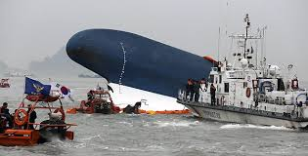

Ferry Sewol Sinking in South Korea Is One of the Greatest Maritime Tragedies in Recent History
The Sewol and Costa Concordia disasters will impact risk management in the maritime sector
26
12/01/09 - 9pm
eSlide – P6466 – The Financial Crisis and the Future of the P/C
Notes:
26

Slide 27
Total Vessel Losses by Year: 2002 – 2013
Total losses have declined by nearly 46% over the past 11 years
Total Vessel Losses
While total vessel losses are down sharply over the past decade, the question is whether this trend will continue
Sources: Lloyd’s List Intelligence Casualty Service as published in Safety and Shipping Review 2014, Allianz Global Corporate and Specialty; Insurance Information Institute.
27
12/01/09 - 9pm
eSlide – P6466 – The Financial Crisis and the Future of the P/C
Notes:
27

Slide 28
Total Vessel Losses by Top 10 Regions: 2013
S. China, Indo China, Indonesia and the Philippines was the region that saw the most losses (18) in 2013, but this was down from 29 in 2012
Total Vessel Losses
There were 94 total vessel losses in 2013—about 8 per month
Sources: Lloyd’s List Intelligence Casualty Statistics as published in Safety and Shipping Review 2014, Allianz Global Corporate and Specialty; Insurance Information Institute.
28
12/01/09 - 9pm
eSlide – P6466 – The Financial Crisis and the Future of the P/C
Notes:
28

Slide 29
Total Losses by Type of Vessel: 2013
Cargo vessels accounted for more than 1/3 of 94 total vessel losses in 2013
Sources: Lloyd’s List Intelligence Casualty Statistics as published in Safety and Shipping Review 2014, Allianz Global Corporate and Specialty; Insurance Information Institute.
29
12/01/09 - 9pm
eSlide – P6466 – The Financial Crisis and the Future of the P/C
Notes:
29

Slide 30
Causes of Total Losses: 2002 – 2013
Foundered vessels accounted for 45% of the 1,673 total vessel losses from 2002-2103
Sources: Lloyd’s List Intelligence Casualty Statistics as published in Safety and Shipping Review 2014, Allianz Global Corporate and Specialty; Insurance Information Institute.
30
12/01/09 - 9pm
eSlide – P6466 – The Financial Crisis and the Future of the P/C
Notes:
30

Slide 31
Global Insurance Premium Growth Trends
Growth Is Uneven Across Regions and Market Segments
31

Slide 32
Distribution of Global Insurance Premiums, 2012 ($ Trillions)
Total Premium Volume = $4.613 Trillion*
Life insurance accounted for nearly 57% of global premium volume in 2012 vs. 43% for Non-Life
Source: Swiss Re, sigma, No. 3/2013; Insurance Information Institute.

Slide 33
Distribution of Nonlife Premium: Industrialized vs. Emerging Markets, 2012
Emerging market’s share of nonlife premiums increased to 17.3% in 2012 from 14.3% in 2009. The share of premiums written in the $2 trillion global nonlife market remains much larger (82.7%) but continues to shrink.
The financial crisis and sluggish recovery in the major insurance markets will accelerate the expansion of the emerging market sector
Premium Growth Facts
2012, $Billions
Industrialized Economies
$1, 647.5
Emerging Markets
$344.1
Developing markets now account for about 40% of global GDP but just 17.3% of nonlife premiums
Sources: Swiss Re sigma No.3/2013; Insurance Information Institute research.

Slide 34
Premium Growth by Region, 2012
Latin America growth was the strongest in 2012
Growth in Advanced Asia (incl. China) markets was third highest in 2012
Global Premium Volume Totaled $4.613 Trillion in 2012, up 2.4% from $4.566 Trillion in 2011. Global Growth Was Weighed Down by Slow Growth in N. America and W. Europe and Partially Offset by Emerging Markets
Source: Swiss Re, sigma, No. 3/2013.
34
Notes:
34

Slide 35
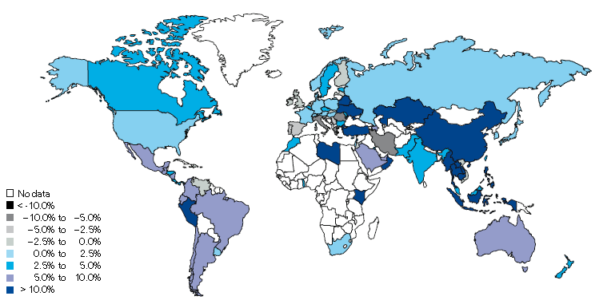
Non-Life Insurance: Global Real (Inflation Adjusted) Premium Growth, 2013
Real growth in non-life insurance premiums was faster in China and most of SE Asia than the US
Market | Life | Non-Life | Total
Advanced | -0.2 | 1.1 | 0.3
Emerging | 6.4 | 8.3 | 7.4
World | 0.7 | 2.3 | 1.4
Source: Swiss Re, sigma, No. 3/2014.
35
12/01/09 - 9pm
eSlide – P6466 – The Financial Crisis and the Future of the P/C
Notes:
35

Slide 36
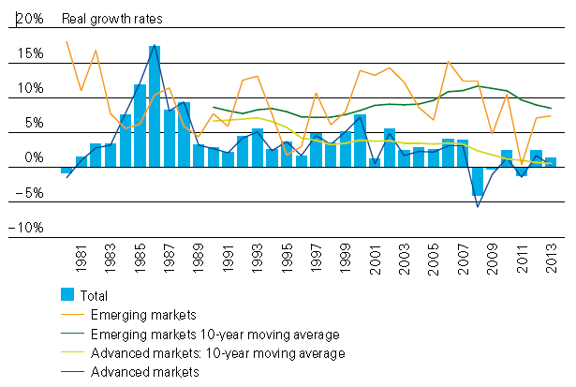
Global Real (Inflation Adjusted) Premium Growth: 1980-2013
Premium growth is very erratic in part to inflation volatility in emerging markets as well as a lack of consistent cyclicality
Emerging market growth has exceeded that of industrialized countries in 30 of the past 34 years, including the entirety of the global financial crisis and subsequent recovery
Source: Swiss Re, sigma, No. 3/2014.
36
12/01/09 - 9pm
eSlide – P6466 – The Financial Crisis and the Future of the P/C
Notes:
36

Slide 37
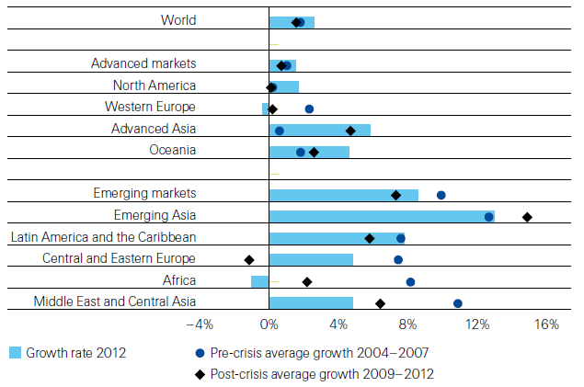
Non-Life Insurance: Global Real (Inflation Adjusted) Premium Growth, 2012
Global Non-Life growth in 2012 exceeded the pre-crisis and post-crisis average. The same is true for advanced Asia economies like China
Source: Swiss Re, sigma, No. 3/2013.
37
12/01/09 - 9pm
eSlide – P6466 – The Financial Crisis and the Future of the P/C
Notes:
37

Slide 38
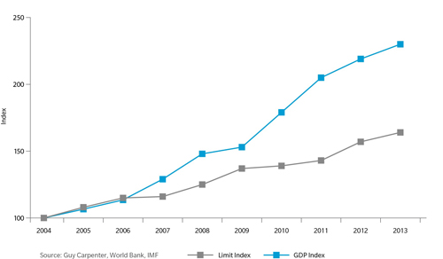
Gap Between GDP Growth and Reinsurance Limit in Asia-Pacific Region: 2004—2013
The gap between GDP and reinsurance limit in Asia is growing—suggesting the region is “under-reinsured”
Sources: Guy Carpenter, World Bank, IMF; Insurance Information Institute .
38
12/01/09 - 9pm
eSlide – P6466 – The Financial Crisis and the Future of the P/C
Notes:
38

Slide 39
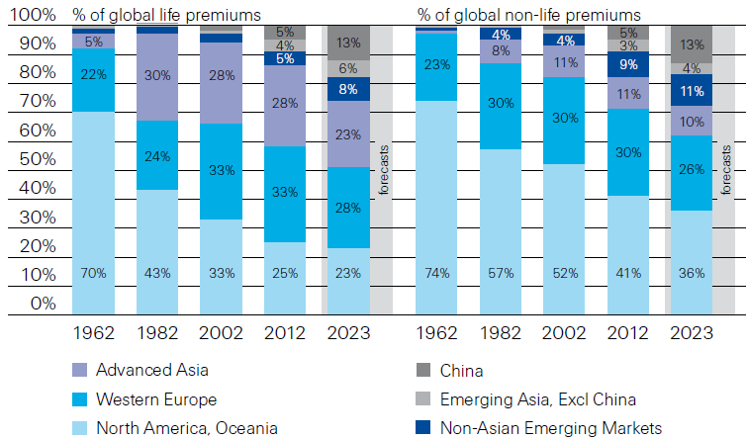
Premiums Written in Life and Non-Life, by Region: 1962-2012
Emerging market shares rose rapidly over the past 50 years
Source: Swiss Re, sigma, No. 3/2013.
39
12/01/09 - 9pm
eSlide – P6466 – The Financial Crisis and the Future of the P/C
Notes:
39

Slide 40
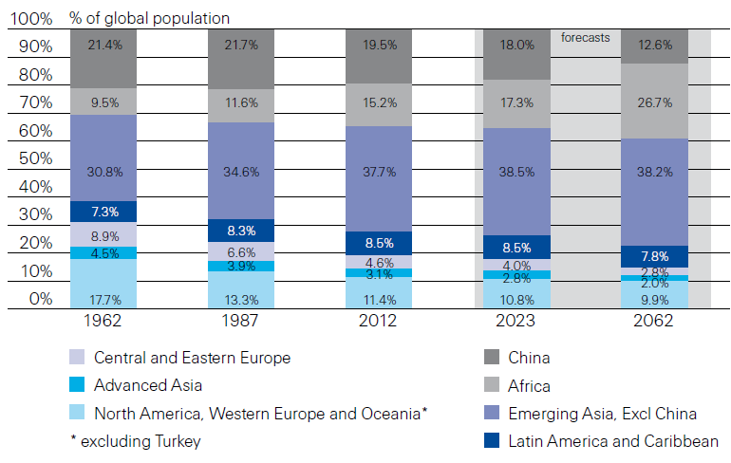
Population Distribution, by Region: 1962-2062F
Enormous population shifts will impact insurance demand over the next half century
Africa is expected to be the fastest population growth over the next 50 years, but no expectation now of Asia-like growth in economies or insurance demand
Source: Swiss Re, sigma, No. 3/2013 from United Nations Department of Economic and Sovial Affairs, Population Division.
40
12/01/09 - 9pm
eSlide – P6466 – The Financial Crisis and the Future of the P/C
Notes:
40

Slide 41
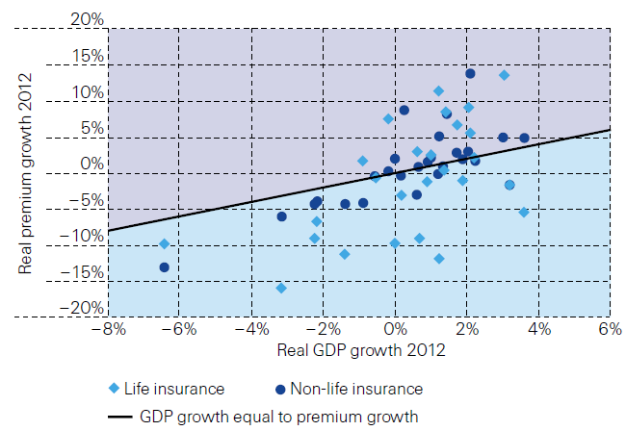
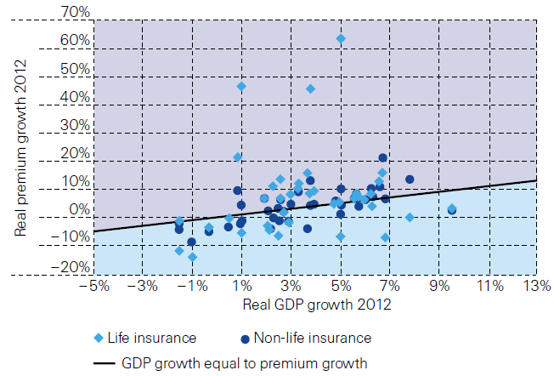
Relationship Between Real GDP and Real Life and Non-Life Premium Growth, 2012
Advanced Markets
Emerging Markets
The was a clear but highly relationship between real GDP growth and real premium growth in advance markets in 2012
The correlation between real GDP growth and real premium growth in emerging markets was much stronger than in advanced markets in 2012
Source: Swiss Re, sigma, No. 3/2013.
41
12/01/09 - 9pm
eSlide – P6466 – The Financial Crisis and the Future of the P/C
Notes:
41

Slide 42
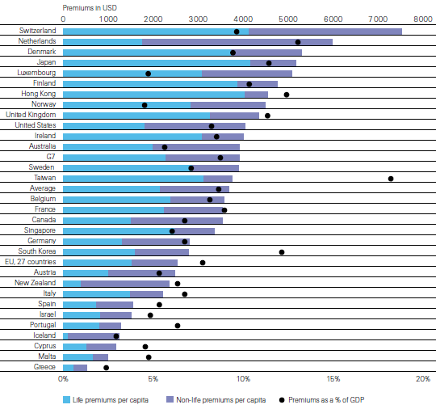
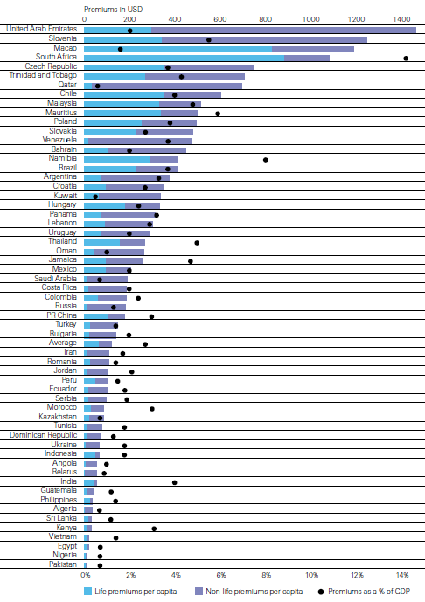
Insurance Density and Penetration for Advanced and Emerging Markets, 2012
Advanced Markets
Emerging Markets
Spending and penetration are generally much higher in advanced markets, though growth is fastest in emerging markets
Chinese spending on insurance is very similar to Russia, but Russian spending is mostly non-life and in China the majority is life
Source: Swiss Re, sigma, No. 3/2013.
42
12/01/09 - 9pm
eSlide – P6466 – The Financial Crisis and the Future of the P/C
Notes:
42

Slide 43
The Unfortunate Nexus: Opportunity, Risk & Instability
Most of the Global Economy’s Future Gains Will be Fraught with Much Greater Risk and Uncertainty than in the Past
43

Slide 44
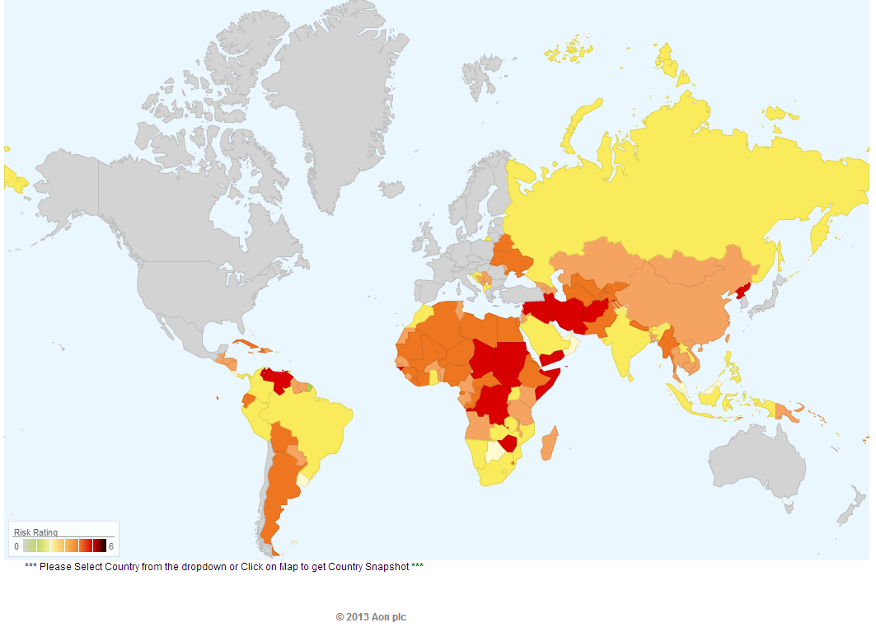
Political Risk in 2013: Greatest Business Opportunities Are Often in Risky Nations
Problems in the Ukraine will intensify political risk in several former Soviet republics
Latin and South America also present insurers with growth opportunities but political instability has increased markedly
The fastest growing markets are generally also among the politically riskiest, including East and South Asia and Africa
Source: Aon PLC; Insurance Information Institute.

Slide 45
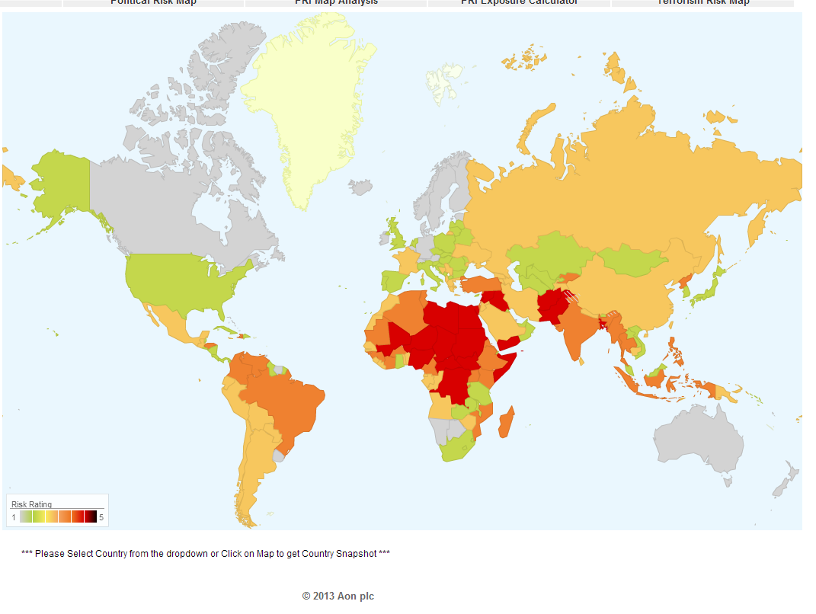
Terrorism Risk in 2013: Greatest Business Opportunities Are Often in Risky Nations
Latin and South America have modest terrorist threats though Brazil is elevated
Terrorism remains a greater concern in the Middle East, Africa and South Asia
Source: Aon PLC; Insurance Information Institute.

Slide 46
P/C (Re)Insurance Industry Financial Overview
2014: Reasonably Good Year
2013: Best Year in the Post-Crisis Era with Lower CATs, Strong Markets
46

Slide 47
P/C Industry Net Income After Taxes 1991–2014:Q1
2005 ROE*= 9.6%
2006 ROE = 12.7%
2007 ROE = 10.9%
2008 ROE = 0.1%
2009 ROE = 5.0%
2010 ROE = 6.6%
2011 ROAS¹ = 3.5%
2012 ROAS¹ = 5.9%
2013 ROAS¹ = 10.3%
2014 ROAS¹ = 8.4%
Net income rose strongly (+81.9%) in 2013 vs. 2012 on lower cats, capital gains
$ Millions
2014 is off to a slower start
ROE figures are GAAP; ¹Return on avg. surplus. Excluding Mortgage & Financial Guaranty insurers yields an 8.2% ROAS through 2014:Q1, 9.8% ROAS in 2013, 6.2% ROAS in 2012, 4.7% ROAS for 2011, 7.6% for 2010 and 7.4% for 2009.
Sources: A.M. Best, ISO; Insurance Information Institute

Slide 48
Profitability Peaks & Troughs in the P/C Insurance Industry, 1975 – 2014:Q1*
ROE
1977:19.0%
History suggests next ROE peak will be in 2016-2017
1987:17.3%
10 Years
2006:12.7%
1997:11.6%
10 Years
2013 10.4%
9 Years
2014:Q1 8.2%
1975: 2.4%
1984: 1.8%
1992: 4.5%
2001: -1.2%
*Profitability = P/C insurer ROEs. 2011-14 figures are estimates based on ROAS data. Note: Data for 2008-2014 exclude mortgage and financial guaranty insurers.
Source: Insurance Information Institute; NAIC, ISO, A.M. Best.

Slide 49
ROE: Property/Casualty Insurance by Major Event, 1987–2014:Q1
(Percent)
P/C Profitability Is Both by Cyclicality and Ordinary Volatility
Katrina, Rita, Wilma
Low CATs
Sept. 11
Hugo
Lowest CAT Losses in 15 Years
4 Hurricanes
Sandy
Andrew
Record Tornado Losses
Northridge
Financial Crisis*
* Excludes Mortgage & Financial Guarantee in 2008 – 2014. 2014 figure is through Q1:2014.
Sources: ISO, Fortune; Insurance Information Institute.

Slide 50
Policyholder Surplus, 2006:Q4–2014:Q1
Drop due to near-record 2011 CAT losses
($ Billions)
2007:Q3 Pre-Crisis Peak
Surplus as of 3/31/14 stood at a record high $662.0B
The industry now has $1 of surplus for every $0.73 of NPW, close to the strongest claims-paying status in its history.
2010:Q1 data includes $22.5B of paid-in capital from a holding company parent for one insurer’s investment in a non-insurance business .
The P/C insurance industry entered 2014 in very strong financial condition.
Sources: ISO, A.M .Best.
50
12/01/09 - 9pm
eSlide – P6466 – The Financial Crisis and the Future of the P/C
Notes:
50

Slide 51
US Policyholder Surplus: 1975–2014*
($ Billions)
Surplus as of 3/31/14 was a record $662.0, up 1.3% from $653.3 of 12/31/13, and up 51.5% ($224.9B) from the crisis trough of $437.1B at 3/31/09
“Surplus” is a measure of underwriting capacity. It is analogous to “Owners Equity” or “Net Worth” in non-insurance organizations
The Premium-to-Surplus Ratio Stood at $0.73:$1 as of 3/31/14, a Near Record Low (at Least in Recent History)
* As of 3/31/14.
Source: A.M. Best, ISO, Insurance Information Institute.

Slide 52
A 100 Combined Ratio Isn’t What It Once Was: Investment Impact on ROEs
A combined ratio of about 100 generates an ROE of ~7.0% in 2012/13, ~7.5% ROE in 2009/10, 10% in 2005 and 16% in 1979
Combined Ratio / ROE
Lower CATs helped ROEs in 2013
Combined Ratios Must Be Lower in Today’s Depressed Investment Environment to Generate Risk Appropriate ROEs
* 2008 -2014 figures are return on average surplus and exclude mortgage and financial guaranty insurers. 2014:Q1 combined ratio including M&FG insurers is 97.3; 2013 = 96.1; 2012 =103.2, 2011 = 108.1, ROAS = 3.5%.
Source: Insurance Information Institute from A.M. Best and ISO Verisk Analytics data.

Slide 53
RNW All Lines by State, 2003-2012 Average: Highest 25 States
The most profitable states over the past decade are widely distributed geographically, though none are in the Gulf region
Source: NAIC.

Slide 54
RNW All Lines by State, 2003-2012 Average:
Lowest 25 States
Some of the least profitable states over the past decade were hit hard by catastrophes
Source: NAIC.

Slide 55
Net Premium Growth: Annual Change, 1971—2014F
(Percent)
1975-78
1984-87
2000-03
Net Written Premiums Fell 0.7% in 2007 (First Decline Since 1943) by 2.0% in 2008, and 4.2% in 2009, the First 3-Year Decline Since 1930-33.
2014F: 4.0%
2013: 4.6%
2012: +4.3%
Shaded areas denote “hard market” periods
Sources: A.M. Best (historical and forecast), ISO, Insurance Information Institute.

Slide 56
Growth in Direct Written Premium by Line, 2013-2015F*
(Percent)
P/C growth is expected to remain fairly stable through 2015
Source: Conning.

Slide 57
P/C UNDERWRITING
Underwriting Losses in 2013 Much Improved After High Catastrophe Losses in 2011/12
57

Slide 58
P/C Insurance Industry Combined Ratio, 2001–2014:Q1*
Relatively Low CAT Losses, Reserve Releases
Higher CAT Losses, Shrinking Reserve Releases, Toll of Soft Market
As Recently as 2001, Insurers Paid Out Nearly $1.16 for Every $1 in Earned Premiums
Heavy Use of Reinsurance Lowered Net Losses
Relatively Low CAT Losses, Reserve Releases
Avg. CAT Losses, More Reserve Releases
Sandy Impacts
Best Combined Ratio Since 1949 (87.6)
Cyclical Deterioration
Lower CAT Losses
* Excludes Mortgage & Financial Guaranty insurers 2008--2012. Including M&FG, 2008=105.1, 2009=100.7, 2010=102.4, 2011=108.1; 2012:=103.2; 2013: = 96.1; 2014:Q1 = 97.3.
Sources: A.M. Best, ISO.

Slide 59
Ocean Marine vs. Commercial Lines Combined Ratio: 1989–2012
Average: 1989-2012
Ocean Marine: 104.9
All Commercial Lines: 107.0
Ocean Marine has marginally outperformed Commercial Lines overall over the period from 1989 – 2012
Sources: A.M. Best; Insurance Information Institute.

Slide 60
Number of Years with Underwriting Profits by Decade, 1920s–2010s
Number of Years with Underwriting Profits
Underwriting Profits Were Common Before the 1980s (40 of the 60 Years Before 1980 Had Combined Ratios Below 100) – But Then They Vanished. Not a Single Underwriting Profit Was Recorded in the 25 Years from 1979 Through 2003
* 2009 combined ratio excl. mort. and finl. guaranty insurers was 99.3, which would bring the 2000s total to 4 years with an u/w profit.
**Data for the 2010s is for the period 2010 through 2013.
Note: Data for 1920–1934 based on stock companies only.
Sources: Insurance Information Institute research from A.M. Best Data.
60
12/01/09 - 9pm
eSlide – P6466 – The Financial Crisis and the Future of the P/C
Notes:
60

Slide 61
Underwriting Gain (Loss) All Lines Combined, 1975–2014*
Underwriting profit in 2013 was $15.5B
($ Billions)
$2.24B 2014:Q1 profit
High CAT losses in 2011 led to the highest underwriting loss since 2001. Lower CAT losses in 2013 led to the highest underwriting profit since 2007.
* Includes mortgage and financial guaranty insurers in all years.
Sources: A.M. Best, ISO, Insurance Information Institute.

Slide 62
Combined Ratios by Predominant Business Segment, 2013 vs. 2012*
The combined ratios for both personal and commercial lines improved substantially in 2013
(Percent)
*Excludes mortgage and financial guaranty insurers.
Source: ISO/PCI; Insurance Information Institute

Slide 63
P/C Reserve Development, 1992–2015E
Note: 2005 reserve development excludes a $6 billion loss portfolio transfer between American Re and Munich Re. Including this transaction, total prior year adverse development in 2005 was $7 billion. The data from 2000 and subsequent years excludes development from financial guaranty and mortgage insurance.
Sources: A.M. Best, ISO, Barclays Research (estimates for 2013-2015).

Slide 64
P/C Estimated Loss Reserve Deficiency/ (Redundancy), Excl. Statutory Discount
Line of Business | 2013
Personal Auto Liability | -$3.9B
Homeowners | -$0.4
Other Liab (incl. Prod Liab) | $7.5
Workers Compensation | $11.1
Commercial Multi Peril | $1.9
Commercial Auto Liability | $0.7
Medical Professional Liab. | -$3.5
Reinsurance—Nonprop Assumed | $1.0
All Other Lines* | -$4.6
Total Core Reserves | $9.8
Asbestos & Environmental | $11.2
Total P/C Industry | $21.0B
Source: A.M. Best, P/C Review/Preview 2014; Insurance Information Institute. *Excluding mortgage and financial guaranty segments.

Slide 65
Some Key Drivers in the US Economy
Economic Factors Driving Exposure Growth and Insurer Performance
65

Slide 66
US Real GDP Growth*
The Q4:2008 decline was the steepest since the Q1:1982 drop of 6.8%
Real GDP Growth (%)
Recession began in Dec. 2007. Economic toll of credit crunch, housing slump, labor market contraction was severe
Q1 2014 GDP data were hit hard by this year’s “Polar Vortex” and harsh winter
Demand for Insurance Should Increase in 2014/15 as GDP Growth Accelerates Modestly and Gradually Benefits the Economy Broadly
* Estimates/Forecasts from Blue Chip Economic Indicators.
Source: US Department of Commerce, Blue Economic Indicators 9/14; Insurance Information Institute.

Slide 67
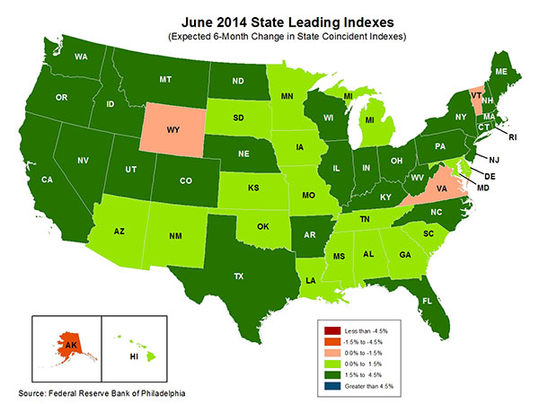
State-by-State Leading Indicators through 2014:Q4
The economic outlook for most of the US is generally positive, though flat-to-negative for 4 states
Sources: Federal Reserve Bank of Philadelphia at http://www.philadelphiafed.org/index.cfm ;Insurance Information Institute.

Slide 68
Real GDP by State Percent Change, 2013: Highest 25 States
North Dakota was the economic growth juggernaut of the US in 2013—by far
Only 9 states experienced growth in excess of 3%, which is what we would see nationally in a more typical recovery
Sources: U.S. Bureau of Economic Analysis; Insurance Information Institute.

Slide 69
Real GDP by State Percent Change, 2013:
Lowest 25 States
Growth rates in 11 states were still below 1% in 2013
DC and Alabama were the only states to shrink in 2013
Sources: US Bureau of Economic Analysis; Insurance Information Institute.

Slide 70
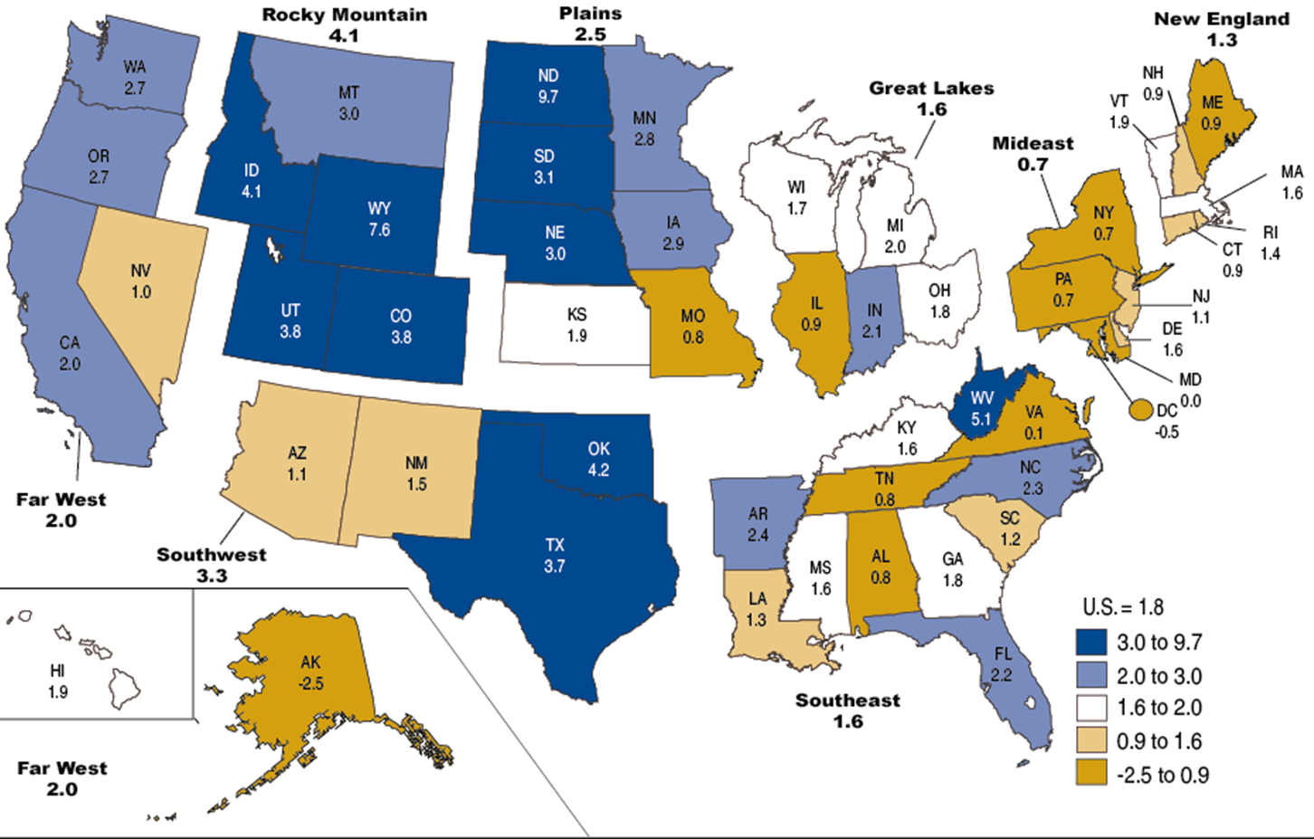
Percent Change in Real GDP by State, 2013
Sources: US Bureau of Economic Analysis; Insurance Information Institute.

Slide 71
Annual Inflation Rates, (CPI-U, %), 1990–2015F
Annual Inflation Rates (%)
Inflation peaked at 5.6% in August 2008 on high energy and commodity crisis. The recession and the collapse of the commodity bubble reduced inflationary pressures in 2009/10
Inflationary expectations have edged up but remain quite low, allowing the Fed to maintain low interest rates
The slack in the U.S. economy suggests that inflationary pressures should remain subdued for an extended period of times. Energy, health care and commodity prices, plus U.S. debt burden, remain longer-run concerns
Sources: US Bureau of Labor Statistics; Blue Chip Economic Indicators, 9/14 (forecasts).

Slide 72
Unemployment and Underemployment Rates: Still Too High, But Falling
January 2000 through Aug. 2014, Seasonally Adjusted (%)
U-6 went from 8.0% in March 2007 to 17.5% in October 2009; Stood at 12.0% in Aug. 2014. 8% to 10% is “normal.”
“Headline” unemployment was 6.1% in Aug. 2014. 4.5% to 6% is “normal.”
Stubbornly high unemployment and underemployment constrain overall economic growth, but the job market is now clearly improving.
Source: US Bureau of Labor Statistics; Insurance Information Institute.
72
12/01/09 - 9pm
eSlide – P6466 – The Financial Crisis and the Future of the P/C
Notes:
72

Slide 73
US Unemployment Rate Forecast
2007:Q1 to 2015:Q4F*
Rising unemployment eroded payrolls and WC’s exposure base.
Unemployment peaked at 10% in late 2009.
Jobless figures have been revised modestly downwards for 2014/15
Unemployment forecasts have been revised modestly downwards. Optimistic scenarios put the unemployment as low as 5.1% by Q4 of this year.
* = actual; = forecasts
Sources: US Bureau of Labor Statistics; Blue Chip Economic Indicators (9/14 edition); Insurance Information Institute.

Slide 74
Value of New Private Construction: Residential & Nonresidential, 2003-2014*
2014: Value of new pvt. construction hits $685.5B as of June 2014, up 37% from the 2010 trough but still 25% below 2006 peak
New Construction peaks at $911.8. in 2006
Billions of Dollars
Trough in 2010 at $500.6B, after plunging 55.1% ($411.2B)
$15.0
$613.7
$329.5
$298.1
$261.8
$355.9
$238.8
Private Construction Activity Is Moving in a Positive Direction though Remains Well Below Pre-Crisis Peak; Residential Dominates
*2014 figure is a seasonally adjusted annual rate as of June.
Sources: US Department of Commerce; Insurance Information Institute.
74
12/01/09 - 9pm
eSlide – P6466 – The Financial Crisis and the Future of the P/C
Notes:
74

Slide 75
Dollar Value* of Manufacturers’ Shipments Monthly, Jan. 1992—July 2014
$ Millions
The value of Manufacturing Shipments in July 2014 was $507.4.B—a new record high.
Monthly shipments in July 2014 exceeded the pre-crisis (July 2008) peak. Manufacturing is energy-intensive and growth leads to gains in many commercial exposures: WC, Commercial Auto, Marine, Property, and various Liability Coverages.
* Seasonally adjusted; Data published Sept. 4, 2014. Source: U.S. Census Bureau, Full Report on Manufacturers’ Shipments, Inventories, and Orders, http://www.census.gov/manufacturing/m3/
75
12/01/09 - 9pm
eSlide – P6466 – The Financial Crisis and the Future of the P/C
Notes:
75

Slide 76
Manufacturing Growth for Selected Sectors, 2014 vs. 2013*
Growth (%)
Durables: +4.8%
Non-Durables: +0.9%
Manufacturing of durable goods is stronger than nondurables in 2014
Manufacturing Is Expanding—Albeit Slowly—Across a Number of Sectors that Will Contribute to Growth in Insurable Exposures Including: WC, Commercial Property, Commercial Auto and Many Liability Coverages
*Seasonally adjusted; Date are YTD comparing data through July 2014 to the same period in 2013. Source: U.S. Census Bureau, Full Report on Manufacturers’ Shipments, Inventories, and Orders, http://www.census.gov/manufacturing/m3/

Slide 77
ISM Manufacturing Index
(Values > 50 Indicate Expansion)
January 2010 through August 2014
Manufacturing continues to expand in 2014—now at its highest level since early 2011
The manufacturing sector expanded for 54 of the 56 months from Jan. 2010 through Aug. 2014. Pace of recovery has been uneven due to economic turbulence in the U.S., Europe and China.
Source: Institute for Supply Management at http://www.ism.ws/ismreport/mfgrob.cfm; Insurance Information Institute.

Slide 78
Business Investment: Expected to Accelerate, Fueling Commercial Exposure Growth
Accelerating business investment will be a potent driver of commercial property and liability insurance exposures and should drive employment and WC payroll exposures as well (with a lag)
Source: IHS Global Insights as of Jan. 13, 2014; Insurance Information Institute.

Slide 79
12 Industries for the Next 10 Years: Insurance Solutions Needed
Health Care
Health Sciences
Energy (Traditional)
Many industries are poised for growth, though insurers’ ability to capitalize on these industries varies widely
Alternative Energy
Petrochemical
Agriculture
Natural Resources
Technology (incl. Biotechnology)
Light Manufacturing
Insourced Manufacturing
Export-Oriented Industries
Shipping (Rail, Marine, Trucking, Pipelines)

Slide 80
ENERGY SECTOR: OIL, GAS & EXPORTS ARE BRIGHT
US Is Becoming an Energy Powerhouse; Exports Are Key
Need Infrastructure Investment
80

Slide 81
U.S. Natural Gas Production, 2000-2013
Trillions of Cubic Ft. per Year
The U.S. is already the world’s largest natural gas producer—recently overtaking Russia. This is a potent driver of commercial insurance exposures
Source: Energy Information Administration, Short-Term Energy Outlook (April 8, 2014) , Insurance Information Institute.

Slide 82
U.S. Crude Oil Production, 2005-2015P
Millions of Barrels per Day
Crude oil production in the U.S. is expected to increase by 82.6% from 2008 through 2015—and could overtake Saudi Arabia as the world’s largest oil producer
Source: Energy Information Administration, Short-Term Energy Outlook (April 8, 2014) , Insurance Information Institute.

Slide 83
U.S. Natural Has Imports and Exports, 1990 - 2040
Trillions of Cubic Feet
The US is now the largest gas producer in the world, though Russia is the largest exporter. The US needs to invest in its pipeline and LNG infrastructure and expedite regulatory approval to realize its full export potential
Sources: US Energy Information Administration, Annual Energy Outlook 2014 Early Release Overview; ;Insurance Information Institute.

Slide 84
U.S. Electricity Generation by Fuel,
1990 - 2040
Trillions of kilowatt Hours
Electricity consumption in the US will rise steadily along with the fuel shares of natural gas and renewables
Sources: US Energy Information Administration, Annual Energy Outlook 2014 Early Release Overview; ;Insurance Information Institute.

Slide 85
U.S. Primary Energy Consumption by Fuel, 1990 - 2040
Quadrillion BTUs
Energy consumption in the US will rise steadily with natural gas fueling most of the additional consumption
Sources: US Energy Information Administration, Annual Energy Outlook 2014 Early Release Overview; ;Insurance Information Institute.

Slide 86
U.S. Petroleum and Other Liquid Fuel Supplies by Source, 1990 - 2040
Millions of Barrels per Day
Liquid fuel consumption is expected to change little through 2040, though “tight” oil will account for a much larger share thereby reducing imports of petroleum products
Sources: US Energy Information Administration, Annual Energy Outlook 2014 Early Release Overview; ;Insurance Information Institute.

Slide 87
CYBER RISK
Cyber Risk is a Rapidly Emerging Exposure for Businesses Large and Small in Every Industry
NEW III White Paper: http://www.iii.org/assets/docs/pdf/paper_CyberRisk_2014.pdf
87

Slide 88






Data Breaches 2005-2013, by Number of Breaches and Records Exposed
# Data Breaches/Millions of Records Exposed
Millions
The Total Number of Data Breaches (+38%) and Number of Records Exposed (+408%) in 2013 Soared
* 2013 figures as of Jan. 1, 2014 from the ITRC updated to an additional 30 million records breached (Target) as disclosed in Jan. 2014.
Source: Identity Theft Resource Center.

Slide 89
Shifting Legal Liability & Tort Environment
Is the Tort Pendulum Swinging Against Insurers?
89

Slide 90
Over the Last Three Decades, Total Tort Costs as a % of GDP Appear Somewhat Cyclical, 1980-2013E
($ Billions)
2.21% of GDP in 2003 = pre-tort reform peak
Deepwater Horizon Spike in 2010
Tort costs in dollar terms have remained high but relatively stable since the mid-2000s., but are down substantially as a share of GDP
1.68% of GDP in 2013
Sources: Towers Watson, 2011 Update on US Tort Cost Trends, Appendix 1A

Slide 91
Commercial Lines Tort Costs: Insured vs. Self-(Un)Insured Shares, 1973-2010
2005: $143.5B 66.4% insured, 33.6% self-(un)insured
Billions of Dollars
$15.0
1995: $83.6B 69.5% insured, 30.5% self-(un)insured
1973: Commercial Tort Costs Totaled $6.49B, 94% was insured, 6% self-(un)insured
1985: $46.6B 74.5% insured, 25.5% self-(un)insured
$9.5
$6.0
2009: $126.5B 64.4% insured, 35.6% self-(un)insured
Tort Costs and the Share Retained by Risks Both Grew Rapidly from the mid-1970s to mid-2000s, When Tort Costs Began to Fall But Self-Insurance Shares Continued to Rise
Sources: Towers Watson, 2011 Update on US Tort Cost Trends, III Calculations based on data from Appendix 4.
91
12/01/09 - 9pm
eSlide – P6466 – The Financial Crisis and the Future of the P/C
Notes:
91

Slide 92
Commercial Lines Tort Costs: Insured vs. Self-(Un)Insured Shares, 1973-2010
Percent
2010: $138.1B 56.6% insured, 44.4% self-(un)insured (distorted by Deepwater Horizon event with most losses retained by BP)
1973: 94% was insured, 6% self-(un)insured
1985:74.5% insured, 25.5% self-(un)insured
1995: 69.5% insured, 30.5% self-(un)insured
2005: 66.4% insured, 33.6% self-(un)insured
The Share of Tort Costs Retained by Risks Has Been Steadily Increasing for Nearly 40 Years. This Trend Contributes Has Left Insurers With Less Control Over Pricing.
Sources: Towers Watson, 2011 Update on US Tort Cost Trends, III Calculations based on data from Appendix 4.
92
12/01/09 - 9pm
eSlide – P6466 – The Financial Crisis and the Future of the P/C
Notes:
92

Slide 93
Business Leaders Ranking of Liability Systems in 2012
Best States
Delaware
Nebraska
Wyoming
Minnesota
Kansas
Idaho
Virginia
North Dakota
Utah
Iowa
Worst States
Florida
Oklahoma
Alabama
New Mexico
Montana
Illinois
California
Mississippi
Louisiana
West Virginia
New in 2012
Wyoming
Minnesota
Kansas
Idaho
Newly Notorious
Oklahoma
Drop-offs
Rising Above
Indiana
Colorado
Massachusetts
South Dakota
Arkansas
Source: US Chamber of Commerce 2012 State Liability Systems Ranking Study; Insurance Info. Institute.

Slide 94
The Nation’s Judicial Hellholes: 2012/2013
Watch List
Illinois
Madison County
West Virginia
Maryland
Baltimore
Philadelphia, Pennsylvania
South Florida
Cook County, Illinois
New Jersey
Nevada
Louisiana
California
Dishonorable Mention
New York
Albany and NYC
MO Supreme Court
WA Supreme Court
Source: American Tort Reform Association; Insurance Information Institute

Slide 95
U.S. Insured Catastrophe Loss Update
2013 Was a Welcome Respite from the High Catastrophe Losses in Recent Years
95

Slide 96
U.S. Insured Catastrophe Losses
($ Billions, $ 2013)
2012 was the 3rd most expensive year ever for insured CAT losses
2013 Was a Welcome Respite from 2012, the 3rd Costliest Year for Insured Disaster Losses in US History. Longer-term Trend is for more—not fewer—Costly Events
$9.5 billion in insured CAT losses through June 30
*Through 6/30/14.
Note: 2001 figure includes $20.3B for 9/11 losses reported through 12/31/01 ($25.9B 2011 dollars). Includes only business and personal property claims, business interruption and auto claims. Non-prop/BI losses = $12.2B ($15.6B in 2011 dollars.)
Sources: Property Claims Service/ISO; Insurance Information Institute.
96
12/01/09 - 9pm
eSlide – P6466 – The Financial Crisis and the Future of the P/C
Notes:
96

Slide 97
Inflation Adjusted U.S. Catastrophe Losses by Cause of Loss, 1994–2013¹
Wind/Hail/Flood (3), $14.6
Fires (4), $5.5
Other (5), $0.2
Insured cat losses from 1993-2012 totaled $386.7B, an average of $19.3B per year or $1.6B per month
Geological Events, $18.4
Terrorism, $24.8
Winter Storms, $24.7
Hurricanes & Tropical Storms, $159.1
Tornado share of CAT losses is rising
Wind losses are by far cause the most catastrophe losses, even if hurricanes/TS are excluded.
Events Involving Tornadoes (2), $139.3
Catastrophes are defined as events causing direct insured losses to property of $25 million or more in 2013 dollars.
Excludes snow.
Does not include NFIP flood losses
Includes wildland fires
Includes civil disorders, water damage, utility disruptions and non-property losses such as those covered by workers compensation.
Source: ISO’s Property Claim Services Unit.

Slide 98
Top States by Inflation-Adjusted Insured Catastrophe Losses, 1983–2012
Over the Past 30 Years Florida Has Accounted for the Largest Share of Catastrophe Losses in the U.S., Followed by Texas and Louisiana
TX is the 2nd costliest state for CATs, with nearly $50B in insured losses over the past 30 years
Louisiana
$42.0B
Texas
$48.8B
Rest of the U.S.
$309.9B
Florida
$66.7B
Total: $467.5 Billion, an average of $16.6B per year or $1.3B per month
Source: PCS unit of ISO, Verisk Company.; Insurance Information Institute.

Slide 99
Top 16 Most Costly World Insurance Losses, 1970-2013*
(Insured Losses, 2013 Dollars, $ Billions)
5 of the top 14 most expensive catastrophes in world history have occurred within the most recent 4 years (2010-2013)
2012 insured CAT Losses totaled $60B; Economic losses totaled $140B, according to Swiss Re
Hurricane Sandy is now the 6th costliest event in global insurance history
*Figures do not include federally insured flood losses.
Sources: Munich Re; Swiss Re; Insurance Information Institute research.

Slide 100
Top 10 States for Insured Catastrophe Losses, 2013
$ Millions
Oklahoma let the country in insured CAT losses in 2013
Source: The Property Claim Services (PCS) unit of ISO, a Verisk Analytics company.

Slide 101
Top 12 Most Costly Hurricanes in U.S. History
(Insured Losses, 2012 Dollars, $ Billions)
10 of the 12 most costly hurricanes in insurance history occurred over the past 9 years (2004—2012)
Hurricane Sandy became the 3rd costliest hurricane in US insurance history
Hurricane Irene became the 12th most expensive hurricane in US history in 2011
*PCS estimate as of 4/12/13.
Sources: PCS; Insurance Information Institute inflation adjustments to 2012 dollars using the CPI.

Slide 102
Total Value of Insured Coastal Exposure in 2012
(2012, $ Billions)
NY and FL lead the US in the value of insured coastal exposure at $2.9 Trillion
In 2012, New York Ranked as the #1 Most Exposed State to Hurricane Loss, Overtaking Florida with $2.862 Trillion. Texas is very exposed too, and ranked #3 with $1.175 Trillion in insured coastal exposure
The Insured Value of All Coastal Property Was $10.6 Trillion in 2012 , Up 20% from $8.9 Trillion in 2007 and Up 48% from $7.2 Trillion in 2004
Source: AIR Worldwide

Slide 103
Total Value of Insured Coastal Exposure in 2007
(2007, $ Billions)
In 2007, Florida Still Ranked as the #1 Most Exposed State to Hurricane Loss, with $2.459 Trillion Exposure, but Texas is very exposed too, and ranked #3 with $895B in insured coastal exposure
The Insured Value of All Coastal Property Was $8.9 Trillion in 2007, Up 24% from $7.2 Trillion in 2004
Source: AIR Worldwide

Slide 104
Hurricane Sandy: Average Claim Payment by Type of Claim
Commercial (i.e., business claims) are more expensive because the value of property is often higher as well as the impact of insured business interruption losses
The average insured flood loss was nearly 9 times larger than the average non-flood insured loss (mostly wind)
Post-Sandy, the I.I.I. worked very hard to make help media, consumers and regulators understand the distinction between a flood claim and a standard homeowners claim. NFIP is $24B in debt.
*Includes rental and condo policies (excludes NFIP flood). **As of Oct. 31, 2013.
Sources: Catastrophe loss data is for Catastrophe Serial No. 90 (Oct. 28 – 31, 2012) from PCS as of March 2013; Insurance Information Institute.

Slide 105
Total Potential Home Value Exposure to Storm Surge Risk in 2013*
($ Billions)
Florida is by the state most vulnerable to storm surge.
The Value of Homes Exposed to Storm Surge was $1.147 Trillion in 2013.* Only a fraction of this is insured, hence the huge demand for federal aid following major coastal flooding events.
*Insured and uninsured property. Based on estimated property values as of April 2013.
Source: Storm Surge Report 2013, CoreLogic.

Slide 106
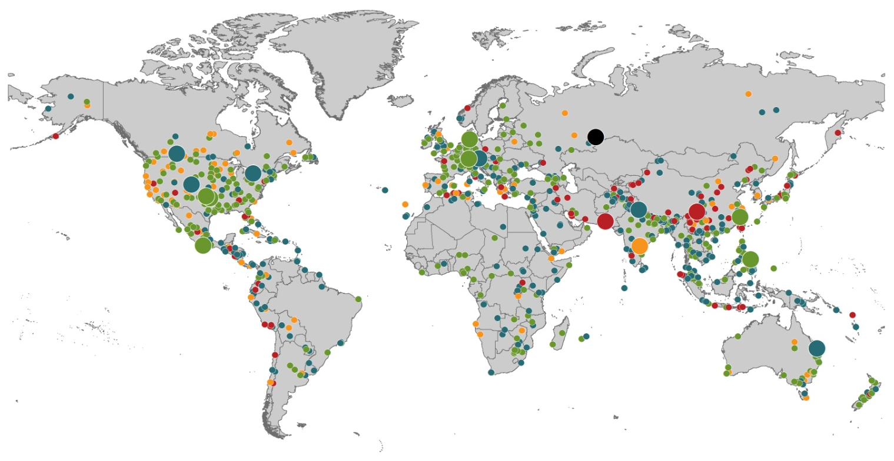
Natural Loss Events:
Full Year 2013 World Map
Winter Storm Christian (St. Jude)
Europe, 27–30 October
Floods
Europe,
30 May–19 June
Meteorite impact
Russian Federation, 15 February
Flash floods
Canada, 8–9 July
Floods
Canada, 19–24 June
Earthquake
China, 20 April
Hailstorms
Germany,
27–28 July
Floods
USA, 9–16 September
Typhoon Fitow
China, Japan,
5–9 October
Severe storms, tornadoes
USA, 18–22 May
Typhoon Haiyan
Philippines,
8–12 November
Severe storms, tornadoes
USA, 28–31 May
Floods
India, 14–30 June
Hurricanes Ingrid & Manuel
Mexico, 12–19 September
Floods
Australia,
21–31 January
880
Loss events
Earthquake (series)
Pakistan, 24–28 September
Heat wave
India, April–June
Geophysical events (earthquake, tsunami, volcanic activity)
Hydrological events (flood, mass movement)
Natural catastrophes
Geophysical events (earthquake, tsunami, volcanic activity)
Hydrological events (flood, mass movement)
Selection of significant
Natural catastrophes
Meteorological events (storm)
Climatological events (extreme temperature, drought, wildfire)
Meteorological events (storm)
Climatological events (extreme temperature, drought, wildfire)
Extraterrestrial events (Meteorite impact)
Source: Munich Re Geo Risks Research, NatCatSERVICE – as of January 2014.
106

Slide 107
Natural Disasters Worldwide, 1980 – 2013 (Number of Events)
There were 880 natural disaster events globally in 2013 compared to 905 in 2012
Number
Geophysical
(earthquake, tsunami,
volcanic activity)
Meteorological (storm)
Climatological
(temperature extremes,
drought, wildfire)
Hydrological
(flood, mass movement)
Source: MR NatCatSERVICE
107

Slide 108
Losses Due to Natural Disasters Worldwide, 1980–2013 (Overall & Insured Losses)
(Overall and Insured Losses)
(2013 Dollars, $ Billions)
10-Yr. Avg. Losses
Overall : $184B
Insured: $56B
2013 Losses
Overall : $125B
Insured: $34B
There is a clear upward trend in both insured and overall losses over the past 30+ years
Overall losses (in 2013 values)
Insured losses (in 2013 values)
Source: MR NatCatSERVICE
108

Slide 109
Terrorism Update
TRIA’s Success
Consequences of Expiration
Download III’s Terrorism Insurance Report at: http://www.iii.org/white_papers/terrorism-risk-a-constant-threat-2014.html
109
Notes:
109

Slide 110
Loss Distribution by Type of Insurance from Sept. 11 Terrorist Attack ($ 2013)
($ Billions)
Total Insured Losses Estimate: $42.9B**
*Loss total does not include March 2010 New York City settlement of up to $657.5 million to compensate approximately 10,000 Ground Zero workers or any subsequent settlements.
**$32.5 billion in 2001 dollars.
Source: Insurance Information Institute.

Slide 111
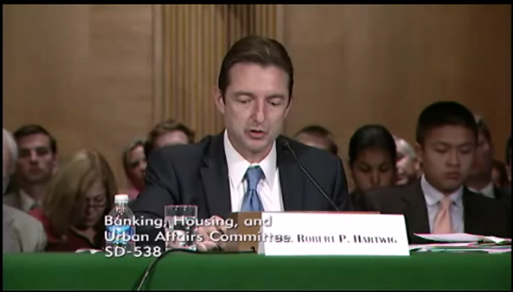
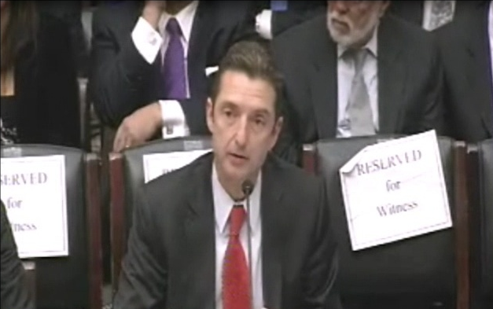
Terrorism Risk Insurance Program
Testified before House Financial Services Nov. 2013
Testified before Senate Banking Cmte. in Sept. 2013
Provided testimony at NYC hearing in June 2013
Provided Capitol Hill Joint House/Senate Staff Briefing in April 2014
I.I.I. Published Several Updates to its Study on Terrorism Risk and Insurance
Working with Trades, Congressional Staff, GAO & Others
House Financial Services Subcommittee, 11/13/13
Senate Banking Committee, 9/25/13
111
12/01/09 - 9pm
eSlide – P6466 – The Financial Crisis and the Future of the P/C
Notes:
111

Slide 112
I.I.I. White Paper (March 2014): Terrorism Risk: A Constant Threat
Detailed history of TRIA
How TRIA works
Assessing the threat of terrorism
Terrorism market conditions
Global perspective
Download at http://www.iii.org/white_papers/terrorism-risk-a-constant-threat-2014.html
112
12/01/09 - 9pm
eSlide – P6466 – The Financial Crisis and the Future of the P/C
Notes:
112

Slide 113
Terrorism Risk in 2013: Greatest Business Opportunities Are Often in Risky Nations
Latin and South America have modest terrorist threats though Brazil is elevated
Terrorism remains a greater concern in the Middle East, Africa and South Asia
Source: Aon PLC; Insurance Information Institute.

Slide 114
Terrorism Insurance Take-up Rates, By Year, 2003-2013
TRIA’s high take-up rates, availability and affordability have benefitted businesses, workers and the entire US economy since the program’s enactment
In 2003, the first year TRIA was in effect, the terrorism take-up rate was 27 percent. Since then, it has increased steadily, remaining in the low 60 percent range since 2009.
Source: Marsh Global Analytics, 2014 Terrorism Risk Insurance Report, April 2014 and earlier editions.
114
Notes:
114

Slide 115
Terrorism Insurance Take-Up Rates by State for 2013*
The overall US take-up rate for terrorism coverage was 62% in 2013 and ranged from a lows of 41% in Michigan to a high of 84% in Massachusetts (where demand likely increased due to the April 2013 Boston Marathon bombing)
*Data for 27 states with sufficient data.
Source: Marsh 2014 Terrorism Risk Insurance Report; Insurance Information Institute.

Slide 116
Framing the Issue and Educating Policymakers: A Timeline
Education Efforts Pay Off
Senate Banking Committee unanimously reports out TRIA bill 22-0
House Financial Services Committee passes bill
Senate passes bill with strong support; Votes 93-4 to reauthorize on 7/17
Key addition to bills: clarification on certification process, cyber terrorism
Where do we go from here? Are difference between the bills bridgeable?
Reauthorization terms differ (Senate: 7yrs; House: 5yrs)
Bifurcation of NBCR and conventional
Trigger points ($100M vs. $500M)
Clock is running: After July 31, the House is in session for only 12 days before the election
Lame duck for enactment? Even that’s in jeopardy!
Source: Marsh

Slide 117
Summary of President’s Working Group Report on TRIA (April 2014)
Insurance for terrorism risk is available and affordable
Availability/affordability have has not changed appreciably since 2010
Prices for terrorism risk insurance vary considerably depending on the policyholder’s industry and location of risk
Prices have declined since TRIA was enacted
Currently ~3% to 5% of commercial property insurance premiums
Take-up rates have improved since adoption of TRIA
Overall take-up rate is steady at ~60% (62% in 2013 per Marsh)
Market capacity is currently tightening given uncertainty over TRIA reauthorization
The private market does not have the capacity to provide reinsurance for terror risk to the extent currently provided by TRIA
In the absence of TRIA, terrorism risk insurance would likely be less available. Coverage that would be available likely would be more costly and/or limited in scope
Source: Report of the President’s Working Group on Financial Markets,The Long-Term Availability and Affordability of Insurance for Terrorism Risk,
April 2014.

Slide 118
Top 3 Key Facts About TRIA
TRIA costs taxpayers virtually nothing
TRIA as currently structured continues to provide tangible benefits to the U.S. economy in the form of:
Terrorism insurance market stability, affordability and availability
Smooth functioning of commercial lending activity
Employment stimulus
TRIA is now clearly a critical part of the U.S. national economic security infrastructure
A primary goal of terrorism is to destabilize the U.S. economy
Terrorism risk insurance is critical to ensure a swift recovery in the event of future attacks
Bottom Line: TRIA is an unambiguous, unmitigated success

Slide 119
Pyramid of Taxpayer Protection: Strong, Stable, Sound and Secure
TRIA in its current form provides at least 8 levels of taxpayer protection
Hard Cap
$100 Bill
Government Recoupment
Industry Aggregate
Retention: $27.5 Bill
Insurer Co-Payments
15% Above Retention
Individual Insurer Retention
20% of Premiums Earned
Program Dollar Threshold
$100 Million
Certification Dollar Threshold
$5 Million
Certification of Terrorist Act: Definition Must Be Met
Source: Insurance Information Institute.

Slide 120
Consequences of Substantially Restructuring TRIA
Increases in required insurer retentions/deductibles do not “create” new capacity
New capacity has entered primarily because:
TRIA remains in place
No major successful attack has occurred since 9/11
Modest improvement in modeling/understanding terror risk
Many smaller/medium-sized insurers are likely already at or near their exposure limits, so increasing required retentions will not incentivize them to write more coverage
A.M. Best: 19% of insurers with < $500 million in surplus failed stress tests; 11% of those with $500 to $1 billion failed
Insurance Information Institute: Insurers with <$500 million in surplus wrote 16.8% of TRIA-back lines in 2012; those with less than $1 billion in surplus wrote 23.6% of TRIA-backed coverages

Slide 121
Consequences of a Failure to Reauthorize TRIA Followed by a Major Terrorist Attack
If TRIA is not reauthorized, only limited private insurance would be available to cover losses arising from future attacks
Potentially large gap between insured and economic losses
The federal government would be called upon to provide very large amounts of aid (tens of billions of dollars +)
Federal govt. has no delivery mechanism for post-attack aid
Under TRIA, federal response largely piggybacks on an efficient pvt. Insurer claims adjusting and payment system
The existing standalone market would likely seize and contract
Depletion of capital→Availability crunch, Prices soar
Uncertainty over likelihood of future attacks
Terrorism exclusions would become ubiquitous
Congress would likely be compelled to legislate TRIA anew

Slide 122
ALTERNATIVE CAPITAL & REINSURANCE MARKETS
Ample Capacity as Alternative Capital is Transforming the Market—And Pushing Down Prices
122

Slide 123
Global Reinsurance Capital (Traditional and Alternative), 2007 - 2013
Total reinsurance capital reached a record $540B in 2013, up 58.8% from 2008.
But alternative capacity has grown 163% since 2008, to $50B. It has grown 79% in the past two years.
Source: Aon Benfield Reinsurance Market Outlook, April 1, 2014; Insurance Information Institute.

Slide 124
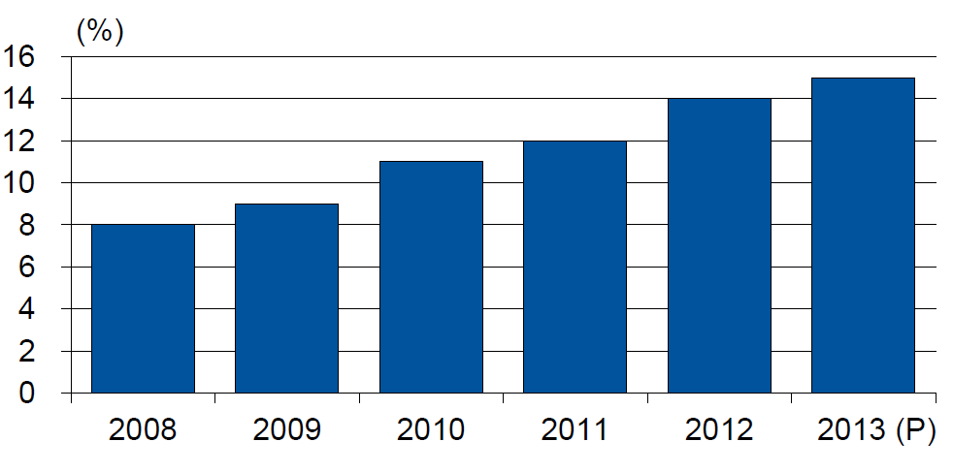
Alternative Capacity as a Percentage of Global Property Catastrophe Reinsurance Limit
(As of Year End)
Alternative Capacity accounted for approximately 14% or $45 billion of the $316 in global property catastrophe reinsurance capital as of mid-2013 (expected to rise to ~15% by year-end 2013)
Source: Guy Carpenter

Slide 125
Investor by Category
Institutional investors are accounting for a larger share of alternative reinsurance investors
Years ended June 30.
Source: Aon Benfield Securities; Insurance Information Institute.

Slide 126
Alternative Risk Transfer: Market Growth
Since 2009, market share of collateralized reinsurance has grown faster than cat bonds or other forms of risk transfer
Source: Aon Benfield Insurance-Linked Securities: Capital Revolution, August 30, 2013; Insurance Information Institute.

Slide 127
Catastrophe Bonds: Issuance and Outstanding, 1997- 2014:Q1
Risk Capital Amount ($ Millions)
Risk capital outstanding reached a record high in first quarter
Financial crisis depressed issuance
CAT bond issuance reached a record high in 2013.
Second Quarter 2014 Will Set a Record – Nearly $4.6 Billion Issued
Sources: Guy Carpenter (Aon Benfield for 2014:Q1); Artemis for 2014:Q2 estimate; Insurance Information Institute.

Slide 128
Catastrophe Bonds: Issuance and Outstanding, 1997- 2014:Q2*
Risk Capital Amount ($ Millions)
Risk capital outstanding reached a record high in 2013
Financial crisis depressed issuance
CAT bond issuance reached a record high in 2013 and could set a new record in 2014
Catastrophe Bond Issuance Is Approaching Pre-Crisis Levels While Risk Capital Outstanding Stands at an All-Time Record
*Through June 30, 2014.
Source: Guy Carpenter; Insurance Information Institute.

Slide 129
Catastrophe Bonds Outstanding, Q1 2014
Catastrophe bonds are heavily concentrated in U.S. hurricane exposures. Two-thirds of catastrophe risks outstanding cover U.S. wind risks.
Source: Willis Capital Markets.

Slide 130
U.S. Wind-Exposed Risk Premium* 2010:Q1 to 2014: Q1
Risk spreads dropped – equivalent to lower rates – low cat losses, capital entering market.
* Trailing 12-month average
SOURCE: Willis Capital Markets, Insurance Information Institute.

Slide 131
Non-U.S. Wind-Exposed Risk Premium* 2010:Q1-2014: Q1
Spreads are also falling in non-U.S. wind exposures, but less sharply and in line with expected losses
* Trailing 12-month average.
SOURCE: Willis Capital Markets, Insurance Information Institute.

Slide 132
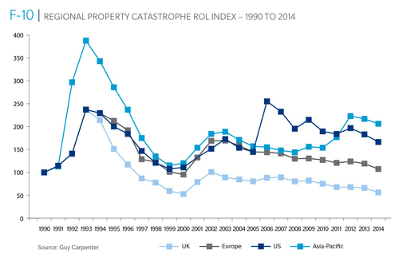
Reinsurance Pricing: Rate-on-Line Index by Region, 1990 – 2014*
Lower CATs and a flood of new capital has pushed reinsurance pricing down in most regions, including the U.S.
*As of Jan. 1.
Source: Guy Carpenter

Slide 133
Questions Arising from Influence of Alternative Capital
Could Pension Fund Money Swamp Traditional Capacity?
US private pension funds hold ~$7 trillion in assets
2% allocation = $140 billion
Global property cat capital = ~$316 bill as of mid-2013
Do New Investors Have a Lower Cost of Capital?
New capacity expects 6-8% rate of return compared to 8-10% for traditional reinsurance, according to Dowling & Partners
Will Reinsurance Pricing Become More Closely Linked to Interest Rates?
What happens when interest rates rise?
Terms and Conditions Could Weaken
Multi-year deals

Slide 134
Questions Arising from Influence of Alternative Capital
What Will Happen When Investors Face Large-Scale Losses?
Does ILS Have a Higher Propensity to Litigate?
Short-term focus could contribute to disputes
Large share of triggered transactions ended up in dispute
How Low Will ROLs Be Pushed?
Does the New Interconnectedness with Capital Markets Lend Credence to the Suggestion that Reinsurance Is a Systemic Risky Business?
Will Alternative Capital Drive Consolidation Among Traditional Reinsurers?
Has the mating dance begun? → Endurance/Aspen

Slide 135
INVESTMENTS: THE NEW REALITY
Investment Performance is a Key Driver of Profitability
Depressed Yields Will Necessarily Influence Underwriting & Pricing
135

Slide 136
Property/Casualty Insurance Industry Investment Income: 2000–2014¹
Investment earnings are still below their 2007 pre-crisis peak
($ Billions)
Due to persistently low interest rates, investment income fell in 2012 and in 2013 and is falling again in 2014.
¹ Investment gains consist primarily of interest and stock dividends. *2014 investment income is estimated Q1, annualized.
Sources: ISO; Insurance Information Institute.

Slide 137
P/C Insurer Net Realized Capital Gains/Losses, 1990-2014:Q1
Realized capital gains rose sharply as equity markets rallied
($ Billions)
Insurers Posted Net Realized Capital Gains in 2010 - 2013 Following Two Years of Realized Losses During the Financial Crisis. Realized Capital Losses Were a Primary Cause of 2008/2009’s Large Drop in Profits and ROE
Sources: A.M. Best, ISO, Insurance Information Institute.
137
12/01/09 - 9pm
eSlide – P6466 – The Financial Crisis and the Future of the P/C
Notes:
137

Slide 138
Property/Casualty Insurance Industry Investment Gain: 1994–2014:Q1¹
($ Billions)
Investment gains in 2013 were their highest in the post-crisis era
Investment Income Continued to Fall in 2013 Due to Low Interest Rates but Realized Investment Gains Were Up Sharply; The Financial Crisis Caused Investment Gains to Fall by 50% in 2008
¹ Investment gains consist primarily of interest, stock dividends and realized capital gains and losses.
* 2005 figure includes special one-time dividend of $3.2B;
Sources: ISO; Insurance Information Institute.

Slide 139
U.S. 10-Year Treasury Note Yields: A Long Downward Trend, 1990–2014*
Yields on 10-Year U.S. Treasury Notes recently plunged to record modern-era lows in early 2013 but have since risen as the Fed begins “tapering” its QE program in 2014
Yields on 10-Year U.S. Treasury Notes have been essentially below 5% for a full decade.
Since roughly 80% of P/C bond/cash investments are in 10-year or shorter durations, most P/C insurer portfolios will have low-yielding bonds for years to come.
*Monthly, through June 2014. Note: Recessions indicated by gray shaded columns.
Sources: Federal Reserve Bank at http://www.federalreserve.gov/releases/h15/data.htm. National Bureau of Economic Research (recession dates); Insurance Information Institutes.
139
12/01/09 - 9pm
eSlide – P6466 – The Financial Crisis and the Future of the P/C
Notes:
139

Slide 140
U.S. Treasury Security Yields: A Long Downward Trend, 1990–2014*
Yields on 10-Year U.S. Treasury Notes have been essentially below 5% for a full decade.
U.S. Treasury yields plunged to historic lows in 2013. Longer-term yields have rebounded a bit.
Since roughly 80% of P/C bond/cash investments are in 10-year or shorter durations, most P/C insurer portfolios will have low-yielding bonds for years to come.
*Monthly, constant maturity, nominal rates, through Aug. 2014.
Sources: Federal Reserve Bank at http://www.federalreserve.gov/releases/h15/data.htm. National Bureau of Economic Research (recession dates); Insurance Information Institute.
140
12/01/09 - 9pm
eSlide – P6466 – The Financial Crisis and the Future of the P/C
Notes:
140

Slide 141
Reduction in Combined Ratio Necessary to Offset 1% Decline in Investment Yield to Maintain Constant ROE, by Line*
Lower Investment Earnings Place a Greater Burden on Underwriting and Pricing Discipline
*Based on 2008 Invested Assets and Earned Premiums
**US domestic reinsurance only
Source: A.M. Best; Insurance Information Institute.
141
12/01/09 - 9pm
eSlide – P6466 – The Financial Crisis and the Future of the P/C
Notes:
141
This shows the drop in Combined Ratio for each line of business that would be needed to maintain a constant ROE, given a 1-percentage-point drop in investment yield

Slide 142
Distribution of Bond Maturities, P/C Insurance Industry, 2003-2013
The main shift over these years has been from bonds with longer maturities to bonds with shorter maturities. The industry first trimmed its holdings of over-10-year bonds (from 24.6% in 2003 to 15.5% in 2012) and then trimmed bonds in the 5-10-year category (from 31.3% in 2003 to 27.6% in 2012) . Falling average maturity of the P/C industry’s bond portfolio is contributing to a drop in investment income along with lower yields.
Sources: SNL Financial; Insurance Information Institute.

Slide 143
New Waves of Regulations
2008 - Present
Global Crisis and Regulatory Response
143

Slide 144
The Global Financial Crisis: The Pendulum Swings Again: Dodd-Frank & Systemic Risk
Dodd-Frank Act of 2010: The implosion of the housing bubble and virtual collapse of the US banking system, the seizure of credit markets and massive government bailouts of US financial institutions led to calls for sweeping regulatory reforms of the financial industry
Limiting Systemic Risk is at the Core of Dodd-Frank
Designation as a Systemically Important Financial Institutional (SIFI) Will Result in Greater Regulatory Scrutiny and Heightened Capital Requirements
Dodd-Frank Established Several Entities Impacting Insurers
Federal Insurance Office
Financial Stability Oversight Council
Office of Financial Research
Consumer Financial Protection Bureau

Slide 145
The Global Financial Crisis: The Pendulum Swings Again: Dodd-Frank & Systemic Risk
Insurers—as Non-Bank Financial Institutions—Have Escaped Some, though Not All of the Most Draconian Provision of Dodd-Frank
In particular, small number of large insurers will (are) receiving a designations as Systemically Important Financial Institutions (SIFIs)
Insurers Generally Reject the Notion that Insurance Is Systemically Risky (or that any Individual Insurer is Systemically Important)
Such a Designation Makes the Fed the Penultimate Regulator
To Date: AIG, Prudential Have Been Designated as non-bank SIFIs by the FSOC
MetLife is still under evaluation
Fed Reserve Seems Open to Developing a Tailored Capital Requirement Approach for Insurers
Conflicting language in the DFA make this somewhat difficult
SIFIs may need Fed approval to repurchase shares on increase dividend

Slide 146
Global Financial Crises & Global Systemic Risk
The Global Financial Crisis Prompted the G-20 Leaders to Request that the Financial Stability Board (FSB) Assess the Systemic Risks Associated with SIFIs, Global-SIFIs in Particular
In July 2013, the FSB Endorsed the International Association of Insurance Supervisors Methodology for Identifying Globally Systemically Important Insurers (G-SIIs)
For Each G-SII, the Following Will Be Required:
(i) Recovery and resolution plans
(ii) Enhanced group-wide supervision
(iii) Higher loss absorbency (HLA) requirements
G-SIIs as Designated by the FSB as of July 2013:
Allianz SE AIG Assicurazioni Generali
Aviva Axa MetLife
Ping An Prudential Financial Prudential plc

Slide 147
Global Financial Crises & Global Systemic Risk: Key Dates
Implementation Date | Action
July 2013 | Designation of G-SIIs (annual updates thereafter beginning Nov. 2014)
July 2014 | FSB to make a decision on the G-SII status of, and appropriate risk mitigating measures for major reinsurers
By G-20 Summit 2014 | IAIS to develop backstop capital requirements to apply to all group activities, incl. non-ins. subs.
End 2015 | IAIS to develop HLA requirements that will apply to G-SIIs staring in 2019
January 2019 | G-SIIs to apply HLA requirements
Sources: Financial Stability Board, “Globally Systemically Important Insurers (G-SIIs) and the Policy Measures that Will Apply to Them,” July 18, 2013.

Slide 148
Global Financial Crises & Global Systemic Risk…There’s More…
IAIS Also Plans to Develop the First-Ever Risk-Based Global Insurance Capital Standards by 2016
Would be Tested in 2017-2018; Implemented in 2019
Would Be Included as Part of ComFrame and Apply to Internationally Active Insurance Groups (IAIGs): ~50 IAIGs Designations Likely
While Flexibility May Exist within the Standards, Doubts in the US Are Likely to Be Strong
Concern that the standards may be bank-centric
Questions as to whether such standards are even needed:
“Although US state insurance regulators continue to have doubts about the timing, necessity and complexity of developing a global capital standard given regulatory differences around the globe, we intend to remain fully engaged in the process to ensure that any development augments the strong legal entity capital requirements in the US that have provided proven and tested security for US policyholders and stable insurance markets for consumers and industry.” --NAIC President Ben Nelson (P/C 360, Oct. 16, 2013)

Slide 149
Financial Strength & Underwriting
Cyclical Pattern is P-C Impairment History is Directly Tied to Underwriting, Reserving & Pricing
149

Slide 150
P/C Insurer Impairments, 1969–2012
Impairments among P/C insurers remain infrequent
The Number of Impairments Varies Significantly Over the P/C Insurance Cycle, With Peaks Occurring Well into Hard Markets
Source: A.M. Best Special Report “Pace of P/C Impairments Slowed in 2012; Auto Writers, RRGs Continued to Struggle,” June 2013; Insurance Information Institute.

Slide 151
P/C Insurer Impairment Frequency vs. Combined Ratio, 1969-2012
2012 impairment rate was 0.69%, down from 1.11% in 2011; the rate is lower than the 0.82% average since 1969
Impairment Rates Are Highly Correlated With Underwriting Performance and Reached Record Lows in 2007; Recent Increase Was Associated Primarily With Mortgage and Financial Guaranty Insurers and Not Representative of the Industry Overall
Source: A.M. Best; Insurance Information Institute

Slide 152
Reasons for US P/C Insurer Impairments, 1969–2012
Historically, Deficient Loss Reserves and Inadequate Pricing Are By Far the Leading Cause of P-C Insurer Impairments. Investment and Catastrophe Losses Play a Much Smaller Role
Reinsurance Failure
Sig. Change in Business
Misc.
Investment Problems (Overstatement of Assets)
Deficient Loss Reserves/ Inadequate Pricing
Affiliate Impairment
Catastrophe Losses
Alleged Fraud
Rapid Growth
Source: A.M. Best Special Report “Pace of P/C Impairments Slowed in 2012; Auto Writers, RRGs Continued to Struggle,” June 2013; Insurance Information Institute.

Slide 153
Rapid Growth ‘A Leading Cause’ of Impairment’
“The leading causes of impairment are deficient loss reserves (inadequate pricing) and rapid growth, together comprising more than 50 percent of annual impairments.”
- A.M. Best, 2013
Source: SNL Financial, Insurance Information Institute.

Slide 154
Top 10 Lines of Business for US P/C Impaired Insurers, 2000–2012
Workers Comp and Pvt. Passenger Auto Account for More Than 40 Percent of the Impaired Insurers Since 2000
Other
Title
Surety
Workers Comp
Med Mal
Other Liability
Pvt. Passenger Auto
Commercial Auto Liability
Commercial Multiperil
Homeowners
Source: A.M. Best Special Report “Pace of P/C Impairments Slowed in 2012; Auto Writers, RRGs Continued to Struggle,” June 2013; Insurance Information Institute.
.

Slide 155
Insurance Information Institute Online:
www.iii.org
Thank you for your time and your attention!
Twitter: twitter.com/bob_hartwig

