Slide 1
Briefing on the Property/Casualty Insurance Industry: Function and Financial Overview
Maryland Economic Matters Committee
Maryland House of Delegates
Annapolis, MD
January 29, 2015
Robert P. Hartwig, Ph.D., CPCU, President & Economist
Insurance Information Institute ♦ 110 William Street ♦ New York, NY 10038
Tel: 212.346.5520 ♦ Cell: 917.453.1885 ♦ bobh@iii.org ♦ www.iii.org

Slide 2
Presentation Outline
The Structure of the Property/Casualty Insurance Industry
Organizational & Marketing Structure of Insurers
Facts about the P/C Insurance Industry
How Property/Casualty Insurance Works
Insurance Cycles
Drivers of, and Importance of, Profits
P/C Insurance: Performance Overview

Slide 3
Structure Overview of the P/C Insurance Industry
Very Diverse, Competitive & Innovative Industry
3

Slide 4
How Many? What Types?
2,718 P/C insurance companies in US in 2013*
These 2,718 companies consolidate to 1,266 groups
Some larger insurance groups have dozens of subsidiaries
Baltimore Equitable is the 3rd oldest insurer in the US, est. in 1794 (George Washington was its president!)
Most insurers are small, operate regionally
A highly competitive business in most areas and for most types of coverage
Lines of Business
Personal, Commercial, Multi-Line
Primary vs. Reinsurance
Maryland in 2013
820 insurers wrote $9.95B in P/C premiums in MD
132 wrote pvt. pass. auto
158 wrote homeowners
284 wrote workers comp
*Best’s Aggregates and Averages, Property/Casualty, 2014 Edition, p. 2.

Slide 5
What is Reinsurance?
Reinsurance is insurance for insurance companies
Essential to helping spread risk globally
Very important in CAT risk
Critical for liability coverages, especially when large awards or settlements are possible
Stabilizes results of, and expands capacity of primary insurers
Especially important to smaller companies but used by all
Supplemented by “alternative” market which includes structures such as Catastrophe Bonds

Slide 6
Organizational Structure of Insurers
Shareholder-owned (Stock) insurers: 776 organizations
Policyholder-owned insurers
Mutual companies: 397 organizations
Reciprocals: 70 organizations
Business-owned insurers
Captive: Insurance subsidiary wholly owned by a single company whose primary business is not insurance
Risk Retention Groups: Businesses (or other organizations) in same/similar industry form and own an insurer
Self-Insurance: assumption of its own risk by a business
Government-owned insurers: ~20 organizations
“Partner”-owned insurers: (Lloyds): 11 US organizations

Slide 7
Federal Government Insurance Programs Where Government Bears Risk
Flood: National Flood Insurance Program
HO and most commercial policies exclude flood
Crop: National Crop Insurance Program
Available for virtually all perils on most crops
Basically a federal subsidy to farmers
Nuclear: Price-Anderson Act
Insures nuclear power facilities
Terrorism: Terrorism Risk Insurance Act (TRIA)
Just reauthorized for 6 years through 12/31/20
Political Risk: Overseas Private Investment Corporation
Pensions: Pension Benefit Guarantee Corporation

Slide 8
Differences in Focus and Strategy Among Insurers
Personal Lines (many also sell Life)
Sells only/mostly auto and homeowners insurance
Examples: State Farm, Allstate, USAA
Commercial Lines (some sell Life)
Sells only/mostly business insurance
Examples : AIG, CNA, ACE
Multi-Line (many also sell Life)
Sells many different types of insurance
Examples : Hartford, Liberty Mutual, Travelers
Mono-Line
Sells only 1 type of insurance
Examples: GEICO, Progressive, Zenith

Slide 9
Why Do Strategies Differ?
Some insurers believe that specializing yields certain advantages:
Underwriting edge/experience
Price advantage since can keep expenses low
Customer loyalty
Some emphasize wide range of products
One brand for many customer needs
Product/customer diversification as a business strategy
Some emphasize price
Some emphasize quality (e.g., service, claims approach) over price
Some emphasize long-term financial strength
Distribution strategies may vary

Slide 10
What Determines in Which Markets an Insurer Operates?
Most insurers started as a regional/niche “player”
E.g., note “Farm” in many insurance company names
Note geographic reference in many company names
Note special nature of risk in name (Church Mutual)
Some have local reputations—and do little advertising
Risk Appetite
Different insurers are willing/able to accept varying amounts of CAT exposure (may depend on capitalization, expertise, etc.)
Some insurers specialize in certain industries
E.g., Aviation, marine, energy, medical malpractice

Slide 11
What Determines in Which Markets an Insurer Operates? (cont’d)
Tort Environment
Regulatory Environment
If viewed as onerous, rigid, capricious, unfair, hostile, or confiscatory, fewer insurers participate
Size of Market
Growth Opportunities/Demographics
Synergies with Other Types of Products Offered

Slide 12
How Is Insurance Regulated?
States Remain the Principal Regulator of Insurers in the Wake of Dodd-Frank
Solvency, rate & form approval, licensing, product approval, consumer protection and education
A Small Number of Insurers Have Received “Systemically Important Financial Institution” (SIFI) Designations
Their ultimate regulator is the Federal Reserve and are subject to more stringent capital requirements
Federal Insurance Office (FIO) Is Not a Regulatory Agency

Slide 13
The P/C Insurance Industry (as of year-end 2013)
$467.9 billion in Earned Premiums
About 51% personal lines, 49% commercial
An “earned premium” is a premium dollar for which insurance coverage has already been provided
$1.5 trillion in assets (compared to $3.5 trillion for life insurers)
$663.3 billion in Policyholder Surplus (in other industries, this would be called “Net Worth”)
Surplus is a primary measure of claims-paying ability because it is assets in excess of known obligations

Slide 14
Economic Facts About the Insurance Industry in Maryland
Employment
Insurers employed 47,930 people in Maryland in 2013
Generated $3.7 billion in payroll
Gross State Product
Insurers contributed $7.2 billion to Maryland GSP in 2012, accounting for 2.15% of total state GSP
Taxes
Premium taxes alone totaled $429.4 million in 2013
Claims Payouts
P/C insurers paid (or incurred) claims totaling $5.6 billion in 2
L/H claims and benefits paid totaled $8.7

Slide 15
Characteristics of the P/C Insurance Industry
Cyclical and Sometimes Volatile, but Financially Conservative & Strong
15

Slide 16
Profitability Peaks & Troughs in the P/C Insurance Industry, 1975 – 2016F
ROE
1977:19.0%
1987:17.3%
10 Years
2006:12.7%
1997:11.6%
10 Years
2013 10.4%
2015F=6.5%
2016F=6.3%
9 Years
2014E 7.6%
1975: 2.4%
1984: 1.8%
1992: 4.5%
2001: -1.2%
*Profitability = P/C insurer ROEs. 2011-14 figures are estimates based on ROAS data. Note: Data for 2008-2014 exclude mortgage and financial guaranty insurers.
Source: Insurance Information Institute; NAIC, ISO, A.M. Best, Conning

Slide 17
ROE: Property/Casualty Insurance by Major Event, 1987–2014E
(Percent)
P/C Profitability Is Impacted by Both Cyclicality and Ordinary Volatility
Modestly higher CATs
Katrina, Rita, Wilma
Low CATs
Sept. 11
Hugo
Lowest CAT Losses in 15 Years
4 Hurricanes
Sandy
Andrew
Record Tornado Losses
Northridge
Financial Crisis*
* Excludes Mortgage & Financial Guarantee in 2008 – 2014. 2014 figure is through Q3:2014.
Sources: ISO, Fortune; Insurance Information Institute.

Slide 18
Back to the Future: Profitability Peaks & Troughs in the P/C Insurance Industry, 1950 – 2014*
ROE
1970-90: Peak ROEs were much higher in this period while troughs were comparable. High interest rates, rapid inflation, economic volatility all played roles
1950-70: ROEs were lower in this period. Low interest rates, low inflation, “Bureau” rate regulation all played a role
1990-2010s: Déjà vu. Excluding mega-CATs, this period is very similar to the 1950-1970 period
1977:19.0%
1987:17.3%
2006:12.7%
1972:13.7%
1997:11.6%
2013 10.4%
1950:8.0%
1966-67: 5.5%
1959:6.8%
2014:H1 7.6%
1969: 3.9%
1957: 1.8%
1965: 2.2%
1975: 2.4%
1984: 1.8%
1992: 4.5%
2001: -1.2%
*Profitability = P/C insurer ROEs. 2011-14 figures are estimates based on ROAS data. Note: Data for 2008-2014 exclude mortgage and financial guaranty insurers. 2014 figure is through Q3.
Source: Insurance Information Institute; NAIC, ISO, A.M. Best.

Slide 19
RNW All Lines by State, 2004-2013 Average: Highest 25 States
The most profitable states over the past decade are widely distributed geographically, though none are in the Gulf region
Source: NAIC; Insurance Information Institute.

Slide 20
RNW All Lines by State, 2004-2013 Average:
Lowest 25 States
Some of the least profitable states over the past decade were hit hard by catastrophes
Source: NAIC; Insurance Information Institute.

Slide 21
Three Key Drivers of Profits
Underwriting Results – Insurance operations
Companies sometimes lose money on insurance operations, especially from catastrophic losses
Investment Results – Earned on money held until needed for claims or expenses
Adequacy of Reserves and Capital/Surplus –
Reserves -- assets dedicated to known/expected claims
Capital/surplus -- assets dedicated to unknown/unexpected claims
Insurers may need to use profits to strengthen reserves and/or build surplus

Slide 22
U.S. Insured Catastrophe Loss Update
2014 Experiencing Below Average CAT Activity Following a Welcome Respite in 2013 from Very High CAT Losses in 2011/12
22

Slide 23
U.S. Insured Catastrophe Losses
($ Billions, $ 2013)
2012 was the 3rd most expensive year ever for insured CAT losses
2013 Was a Welcome Respite from 2012, the 3rd Costliest Year for Insured Disaster Losses in US History. Longer-term Trend is for more—not fewer—Costly Events
$15.3 billion in insured CAT losses estimated for 2014
*Through 12/31/14.
Note: 2001 figure includes $20.3B for 9/11 losses reported through 12/31/01 ($25.9B 2011 dollars). Includes only business and personal property claims, business interruption and auto claims. Non-prop/BI losses = $12.2B ($15.6B in 2011 dollars.)
Sources: Property Claims Service/ISO; Insurance Information Institute.
23
12/01/09 - 9pm
eSlide – P6466 – The Financial Crisis and the Future of the P/C
Notes:
23

Slide 24
Inflation Adjusted U.S. Catastrophe Losses by Cause of Loss, 1994–2013¹
Wind/Hail/Flood (3), $14.6
Fires (4), $5.5
Other (5), $0.2
Insured cat losses from 1993-2012 totaled $386.7B, an average of $19.3B per year or $1.6B per month
Geological Events, $18.4
Terrorism, $24.8
Winter Storms, $24.7
Hurricanes & Tropical Storms, $159.1
Tornado share of CAT losses is rising
Wind losses are by far cause the most catastrophe losses, even if hurricanes/TS are excluded.
Events Involving Tornadoes (2), $139.3
Catastrophes are defined as events causing direct insured losses to property of $25 million or more in 2013 dollars.
Excludes snow.
Does not include NFIP flood losses
Includes wildland fires
Includes civil disorders, water damage, utility disruptions and non-property losses such as those covered by workers compensation.
Source: ISO’s Property Claim Services Unit.

Slide 25
Top 16 Most Costly Disasters in U.S. History
(Insured Losses, 2013 Dollars, $ Billions)
Superstorm Sandy in 2012 was the last mega-CAT to hit the US
Includes Tuscaloosa, AL, tornado
Includes Joplin, MO, tornado
12 of the 16 Most Expensive Events in US History Have Occurred Over the Past Decade
Sources: PCS; Insurance Information Institute inflation adjustments to 2013 dollars using the CPI.

Slide 26
Total Value of Insured Coastal Exposure in 2012
(2012, $ Billions)
In 2012, New York Ranked as the #1 Most Exposed State to Hurricane Loss, Overtaking Florida with $2.862 Trillion. Texas is very exposed too, and ranked #3 with $1.175 Trillion in insured coastal exposure
The Insured Value of All Coastal Property Was $10.6 Trillion in 2012 , Up 20% from $8.9 Trillion in 2007 and Up 48% from $7.2 Trillion in 2004
MD = $17.3B
Source: AIR Worldwide

Slide 27
I.I.I. Poll: Homes Near Hazards
Q. If you were to purchase a home today, which of the following summarizes your views on that home’s risk of damage from natural disasters . . . and your decision to purchase that home?
Don’t Know
Willing to Accept Risk
Risk Not a Major Consideration
Risk a Significant Influence on Purchase
More Than Half of the Public Would Be Significantly Influenced by Risk of Damage from Natural Disasters. Close to a Third Do Not Regard Such a Risk To Be a Major Consideration.
Source: Insurance Information Institute Annual Pulse Survey.

Slide 28
Federal Disaster Declarations Patterns: 1953-2014
Disaster Declarations Set New Records in Recent Years
28

Slide 29
Number of Federal Major Disaster Declarations, 1953-2014*
There have been 2,180 federal disaster declarations since 1953. The average number of declarations per year is 35 from 1953-2013, though there few haven’t been recorded since 1995.
The number of federal disaster declarations set a new record in 2011, with 99, shattering 2010’s record 81 declarations.
54 federal disasters were declared in 2014*
The Number of Federal Disaster Declarations Is Rising and Set New Records in 2010 and 2011 Before Dropping in 2012-2014
*Through December 31, 2014.
Source: Federal Emergency Management Administration; http://www.fema.gov/disasters; Insurance Information Institute.

Slide 30
Federal Disasters Declarations by State, 1953 – 2014: Highest 25 States*
Over the past 60 years, Texas has had the highest number of Federal Disaster Declarations
*Through December 31, 2014. Includes Puerto Rico and the District of Columbia.
Source: FEMA: http://www.fema.gov/news/disaster_totals_annual.fema; Insurance Information Institute.

Slide 31
Federal Disasters Declarations by State, 1953 – 2014: Lowest 25 States*
Over the past 60 years, Wyoming and Rhode Island had the fewest number of Federal Disaster Declarations
*Through December 31, 2014. Includes Puerto Rico and the District of Columbia.
Source: FEMA: http://www.fema.gov/news/disaster_totals_annual.fema; Insurance Information Institute.

Slide 32
GROWTH & CAPACITY
P/C Insurance Industry Is Growing Modestly and Capacity Is Increasing
32

Slide 33
Net Premium Growth: Annual Change, 1971—2016F
(Percent)
1975-78
1984-87
2000-03
Net Written Premiums Fell 0.7% in 2007 (First Decline Since 1943) by 2.0% in 2008, and 4.2% in 2009, the First 3-Year Decline Since 1930-33.
2015-16F: 4.0%
2014E: 3.9%*
2013: 4.6%
2012: +4.3%
*Actual figure based on data through Q3 2014.
Shaded areas denote “hard market” periods
Sources: A.M. Best (historical and forecast), ISO, Insurance Information Institute.

Slide 34
Direct Premiums Written: Total P/C Percent Change by State, 2007-2013
Top 25 States
North Dakota was the country’s growth leader over the past 6 years with premiums written expanding by 74.6%, fueled by the state’s energy boom
Sources: SNL Financial LC.; Insurance Information Institute.

Slide 35
Direct Premiums Written: Total P/C Percent Change by State, 2007-2013
Bottom 25 States
Growth was negative in 7 states and DC between 2007 and 2013
Sources: SNL Financial LC.; Insurance Information Institute.

Slide 36
US Policyholder Surplus: 1975–2014*
($ Billions)
Surplus as of 9/30/14 was a record $673.9, up 3.2% from $653.3 of 12/31/13, and up 53.6% ($234.5B) from the crisis trough of $437.1B at 3/31/09
“Surplus” is a measure of underwriting capacity. It is analogous to “Owners Equity” or “Net Worth” in non-insurance organizations
The Premium-to-Surplus Ratio Stood at $0.73:$1 as of 9/30/14, a Near Record Low (at Least in Recent History)
* As of 9/30/14.
Source: A.M. Best, ISO, Insurance Information Institute.

Slide 37
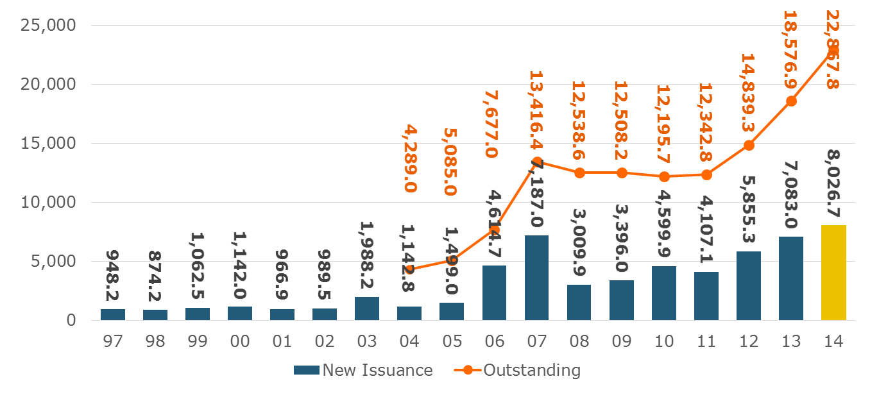
Catastrophe Bond Issuance and Outstanding: 1997-2014
Risk Capital Amount ($ Millions)
2014 Has Seen the Largest Cat Bond Ever - $1.5 Billion (Florida Citizens). Bond Issuance Set a Record.
Source: Guy Carpenter.

Slide 38
INVESTMENTS: THE NEW REALITY
Investment Performance is a Key Driver of Profitability
Depressed Yields Will Necessarily Influence Underwriting & Pricing
38

Slide 39
Distribution of Invested Assets: P/C Insurance Industry, 2013
$ Billions
Total Invested Assets = $1.5 Trillion
Source: Insurance Information Institute Fact Book 2015, A.M. Best.

Slide 40
Property/Casualty Insurance Industry Investment Income: 2000–2014¹
Investment earnings are still below their 2007 pre-crisis peak
($ Billions)
Due to persistently low interest rates, investment income fell in 2012, 2013 and 2014.
¹ Investment gains consist primarily of interest and stock dividends. *2014 figure is estimated based on annualized data through Q3.
Sources: ISO; Insurance Information Institute.

Slide 41
U.S. Treasury Security Yields: A Long Downward Trend, 1990–2014*
Yields on 10-Year U.S. Treasury Notes have been essentially below 5% for a full decade.
U.S. Treasury yields plunged to historic lows in 2013. Longer-term yields have rebounded a bit.
Since roughly 80% of P/C bond/cash investments are in 10-year or shorter durations, most P/C insurer portfolios will have low-yielding bonds for years to come.
*Monthly, constant maturity, nominal rates, through Dec. 2014.
Sources: Federal Reserve Bank at http://www.federalreserve.gov/releases/h15/data.htm. National Bureau of Economic Research (recession dates); Insurance Information Institute.
41
12/01/09 - 9pm
eSlide – P6466 – The Financial Crisis and the Future of the P/C
Notes:
41

Slide 42
Book Yield on Property/Casualty Insurance Invested Assets, 2007–2016F
(Percent)
Book yield in 2014 is down 114 BP from pre-crisis levels
The yield on invested assets continues to decline as returns on maturing bonds generally still exceed new money yields. The end of the Fed’s QE program in Oct. 2014 should allow some increase in longer maturities while short term interest rate increases are unlikely until mid-to-late 2015
Sources: Conning.

Slide 43
CYBER RISK & CYBER INSURANCE
P/C Insurance Is an Innovative Industry
Cyber Insurance Is a Recent Example
43

Slide 44
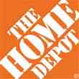
Data Breaches 2005-2014, by Number of Breaches and Records Exposed
# Data Breaches/Millions of Records Exposed
Millions
The Total Number of Data Breaches Rose 28% While the Number of Records Exposed Was Relatively Flat (-2.6%)
44
* 2014 figures as of Jan. 12, 2014 from the ITRC.
Source: Identity Theft Resource Center.

Slide 45
Data/Privacy Breach: Many Potential Costs Can Be Insured
Data Breach Event
Costs of notifying affecting individuals
Defense and settlement costs
Lost customers and damaged reputation
Cyber extortion payments
Costs of notifying regulatory authorities
Regulatory fines at home & abroad
Business Income Loss
Forensic costs to discover cause
Source: Zurich Insurance; Insurance Information Institute
45

Slide 46
The Three Basic Elements of Cyber Coverage: Prevention, Transfer, Response
Loss Prevention
Post-Breach Response
(Insurable)
Loss Transfer (Insurance)
Cyber risk management today involves three essential components, each designed to reduce, mitigate or avoid loss. An increasing number of cyber risk products offered by insurers today provide all three.
Source: Insurance Information Institute research.
46

Slide 47
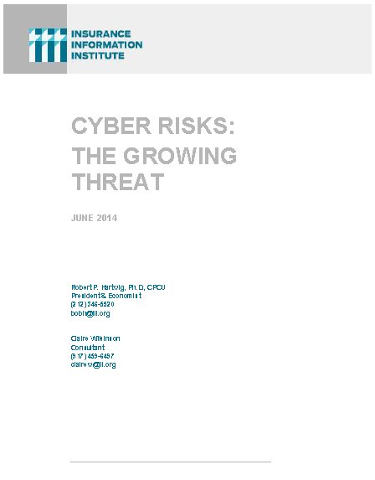
I.I.I. Released its Second Cyber Report in 2014: Cyber Risk: The Growing Threat
I.I.I.’s 2nd report on cyber risk released June 2014
Provides information on cyber threats and insurance market solutions
Global cyber risk overview
Quantification of threats by type and industry
Cyber security and cost of attacks
Cyber terrorism
Cyber liability
Insurance market for cyber risk
3rd Report in Q2 2015

Slide 48
Conclusion
The P/C insurance industry is highly competitive
It’s a highly cyclical/volatile business
The industry is financially very strong
Profitability depends not only on claims activity but also investment returns and other factors
Many factors influence price (rate) and availability
General & individual risk rating factors
Nature of regulation has significant impact on competition, consumer choice, and price

Slide 49
Q & A
49

Slide 50
Insurance Information Institute Online:
www.iii.org
Thank you for your time and your attention!
Twitter: twitter.com/bob_hartwig
Download at www.iii.org/presentations

