Slide 1
Overview & Outlook for the P/C Insurance Industry:
Focus on Minnesota Markets
PIA of Minnesota
Prior Lake, MN
September 4, 2014
Download at www.iii.org/presentations
Robert P. Hartwig, Ph.D., CPCU, President & Economist
Insurance Information Institute ♦ 110 William Street ♦ New York, NY 10038
Tel: 212.346.5520 ♦ Cell: 917.453.1885 ♦ bobh@iii.org ♦ www.iii.org

Slide 2
P/C Insurance Industry:
Financial Update
2013 Was the Industry’s Best Year
in the Post-Crisis Era
2014 Is Off to a Good Start
2

Slide 3
P/C Industry Net Income After Taxes
1991–2014:Q1
2005 ROE*= 9.6%
2006 ROE = 12.7%
2007 ROE = 10.9%
2008 ROE = 0.1%
2009 ROE = 5.0%
2010 ROE = 6.6%
2011 ROAS¹ = 3.5%
2012 ROAS¹ = 5.9%
2013 ROAS¹ = 10.3%
2014 ROAS¹ = 8.4%
Net income rose strongly (+81.9%) in 2013 vs. 2012 on lower cats, capital gains
$ Millions
2014 is off to a slower start
ROE figures are GAAP; ¹Return on avg. surplus. Excluding Mortgage & Financial Guaranty insurers yields an 8.2% ROAS through 2014:Q1, 9.8% ROAS in 2013, 6.2% ROAS in 2012, 4.7% ROAS for 2011, 7.6% for 2010 and 7.4% for 2009.
Sources: A.M. Best, ISO; Insurance Information Institute

Slide 4
Profitability Peaks & Troughs in the P/C Insurance Industry, 1975 – 2014:Q1*
ROE
1977:19.0%
History suggests next ROE peak will be in 2016-2017
1987:17.3%
10 Years
2006:12.7%
1997:11.6%
10 Years
2013 10.4%
9 Years
2014:Q1 8.2%
1975: 2.4%
1984: 1.8%
1992: 4.5%
2001: -1.2%
*Profitability = P/C insurer ROEs. 2011-14 figures are estimates based on ROAS data. Note: Data for 2008-2014 exclude mortgage and financial guaranty insurers.
Source: Insurance Information Institute; NAIC, ISO, A.M. Best.

Slide 5
ROE: Property/Casualty Insurance by Major Event, 1987–2014:Q1
(Percent)
P/C Profitability Is Both by
Cyclicality and Ordinary Volatility
Katrina, Rita, Wilma
Low CATs
Sept. 11
Hugo
Lowest CAT Losses in
15 Years
4 Hurricanes
Sandy
Andrew
Record Tornado Losses
Northridge
Financial Crisis*
* Excludes Mortgage & Financial Guarantee in 2008 – 2014. 2014 figure is through Q1:2014.
Sources: ISO, Fortune; Insurance Information Institute.

Slide 6
P/C Insurance Industry
Combined Ratio, 2001–2014:Q1*
Relatively Low CAT Losses, Reserve Releases
Higher CAT Losses, Shrinking Reserve Releases, Toll of Soft Market
As Recently as 2001, Insurers Paid Out Nearly $1.16 for Every $1 in Earned Premiums
Heavy Use of Reinsurance Lowered Net Losses
Relatively Low CAT Losses, Reserve Releases
Avg. CAT Losses, More Reserve Releases
Sandy Impacts
Best Combined Ratio Since 1949 (87.6)
Cyclical Deterioration
Lower CAT Losses
* Excludes Mortgage & Financial Guaranty insurers 2008--2012. Including M&FG, 2008=105.1, 2009=100.7, 2010=102.4, 2011=108.1; 2012:=103.2; 2013: = 96.1; 2014:Q1 = 97.3.
Sources: A.M. Best, ISO.

Slide 7
A 100 Combined Ratio Isn’t What It
Once Was: Investment Impact on ROEs
A combined ratio of about 100 generates an ROE of ~7.0% in 2012/13, ~7.5% ROE in 2009/10,
10% in 2005 and 16% in 1979
Combined Ratio / ROE
Lower CATs helped ROEs in 2013
Combined Ratios Must Be Lower in Today’s Depressed
Investment Environment to Generate Risk Appropriate ROEs
* 2008 -2014 figures are return on average surplus and exclude mortgage and financial guaranty insurers. 2014:Q1 combined ratio including M&FG insurers is 97.3; 2013 = 96.1; 2012 =103.2, 2011 = 108.1, ROAS = 3.5%.
Source: Insurance Information Institute from A.M. Best and ISO Verisk Analytics data.

Slide 8
RNW All Lines by State, 2003-2012 Average:
Highest 25 States
The most profitable states over the past decade are widely distributed geographically, though none are in the Gulf region
Source: NAIC; Insurance Information Institute.

Slide 9
RNW All Lines by State, 2003-2012 Average:
Lowest 25 States
Some of the least profitable states over the past decade were hit hard by catastrophes
Source: NAIC; Insurance Information Institute.

Slide 10
Policyholder Surplus,
2006:Q4–2014:Q1
Drop due to near-record 2011 CAT losses
($ Billions)
2007:Q3
Pre-Crisis Peak
Surplus as of 3/31/14 stood at a record high $662.0B
The industry now has $1 of surplus for every $0.73 of NPW,
close to the strongest claims-paying status in its history.
2010:Q1 data includes $22.5B of paid-in capital from a holding company parent for one insurer’s investment in a non-insurance business .
The P/C insurance industry entered 2014
in very strong financial condition.
Sources: ISO, A.M .Best.
10
12/01/09 - 9pm
eSlide – P6466 – The Financial Crisis and the Future of the P/C
Notes:
10

Slide 11
US Policyholder Surplus:
1975–2014*
($ Billions)
Surplus as of 3/31/14 was a record $662.0, up 1.3% from $653.3 of 12/31/13, and up 51.5% ($224.9B) from the crisis trough of $437.1B at 3/31/09
“Surplus” is a measure of underwriting capacity. It is analogous to “Owners Equity” or “Net Worth” in non-insurance organizations
The Premium-to-Surplus Ratio Stood at $0.73:$1 as of
3/31/14, a Near Record Low (at Least in Recent History)
* As of 3/31/14.
Source: A.M. Best, ISO, Insurance Information Institute.

Slide 12
ALTERNATIVE CAPITAL & REINSURANCE MARKETS
Ample Capacity as Alternative Capital is Transforming the Market—And Pushing Down Reinsurance Prices
12

Slide 13
Global Reinsurance Capital (Traditional and Alternative), 2007 - 2013
Total reinsurance capital reached a record $540B in 2013, up 58.8% from 2008.
But alternative capacity has grown 163% since 2008, to $50B. It has grown 79% in the past two years.
Source: Aon Benfield Reinsurance Market Outlook, April 1, 2014; Insurance Information Institute.

Slide 14
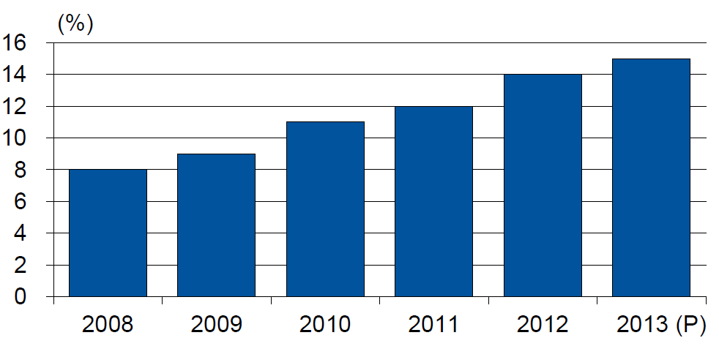
Alternative Capacity as a Percentage of Global Property Catastrophe Reinsurance Limit
(As of Year End)
Alternative Capacity accounted for approximately 14% or $45 billion of the $316 in global property catastrophe reinsurance capital as of mid-2013 (expected to rise to ~15% by year-end 2013)
Source: Guy Carpenter

Slide 15
Investor by Category
Institutional investors are accounting for a larger share of alternative reinsurance investors
Years ended June 30.
Source: Aon Benfield Securities; Insurance Information Institute.

Slide 16
Alternative Risk Transfer: Market Growth
Since 2009, market share of collateralized reinsurance has grown faster than cat bonds or other forms of risk transfer
Source: Aon Benfield Insurance-Linked Securities: Capital Revolution, August 30, 2013; Insurance Information Institute.

Slide 17
Catastrophe Bonds: Issuance and Outstanding, 1997- 2014:Q1
Risk Capital Amount ($ Millions)
Risk capital outstanding reached a record high in first quarter
Financial crisis depressed issuance
CAT bond issuance reached a record high in 2013.
Second Quarter 2014 Will Set a Record – Nearly $4.6 Billion Issued
Sources: Guy Carpenter (Aon Benfield for 2014:Q1); Artemis for 2014:Q2 estimate; Insurance Information Institute.

Slide 18
Catastrophe Bonds: Issuance and Outstanding, 1997- 2014:Q2*
Risk Capital Amount ($ Millions)
Risk capital outstanding reached a record high in 2013
Financial crisis depressed issuance
CAT bond issuance reached a record high in 2013 and could set a new record in 2014
Catastrophe Bond Issuance Is Approaching Pre-Crisis Levels While Risk Capital Outstanding Stands at an All-Time Record
*Through June 30, 2014.
Source: Guy Carpenter; Insurance Information Institute.

Slide 19
Catastrophe Bonds Outstanding, Q1 2014
Catastrophe bonds are heavily concentrated in U.S. hurricane exposures. Two-thirds of catastrophe risks outstanding cover U.S. wind risks.
Source: Willis Capital Markets.

Slide 20
U.S. Wind-Exposed Risk Premium* 2010:Q1 to 2014: Q1
Risk spreads dropped – equivalent to lower rates – low cat losses, capital entering market.
* Trailing 12-month average
SOURCE: Willis Capital Markets, Insurance Information Institute.

Slide 21
Non-U.S. Wind-Exposed Risk Premium*
2010:Q1-2014: Q1
Spreads are also falling in non-U.S. wind exposures, but less sharply and in line with expected losses
* Trailing 12-month average.
SOURCE: Willis Capital Markets, Insurance Information Institute.

Slide 22
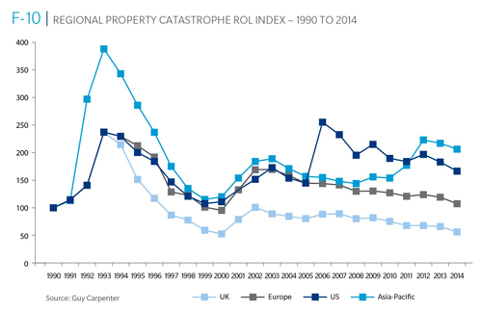
Reinsurance Pricing: Rate-on-Line Index by Region, 1990 – 2014*
Lower CATs and a flood of new capital has pushed reinsurance pricing down in most regions, including the U.S.
*As of Jan. 1.
Source: Guy Carpenter

Slide 23
Notable Cat Bond Events
Bond | Sponsor | Event(s) | Loss to Investors
Kelvin Ltd. | Koch Energy | U.S. Winter 2000-01 | $5 million
George Town Re | St. Paul Re | 9/11, Hurricane Floyd, European wind | $1 million
KAMP Re | Zurich | Hurricane Katrina (2005) | $144 million
Avalon Re | Oil Casualty | Katrina, 2005 fuel depot explosion, NYC street collapse | $13 million
Ajax | Aspen Re | 2008 Lehman bankruptcy | $72 million
Carillon | Munich Re | 2008 Lehman bankruptcy | $31 million
Newton Re | Catlin | 2008 Lehman bankruptcy | $4 million
Willow | Allstate | 2008 Lehman bankruptcy | $10 million
Muteki Ltd. | Munich Re for Zenkyoren | 2011 Tohuku earthquake | $300 million
Vega Capital | Swiss Re | 2011 Tohuku earthquake | $16 million
Mariah Re | American Family | 2011 tornadoes | $200 million¹
Vega Capital | Swiss Re | Superstorm Sandy (2012) | $7 million
Successor X | Swiss Re | Superstorm Sandy (2012) | $15 million²
Most events have been relatively small. Four were counterparty risks related to the Lehman Brothers bankruptcy in 2008.
1 (In litigation) 2 Estimated
Source: Munich Re

Slide 24
Questions Arising from Influence of Alternative Capital
What Will Happen When Investors Face Large-Scale Losses?
What Happens When Interest Rates Rise?
Does ILS Have a Higher Propensity to Litigate?
How Much Lower Will Risk Premiums Shrink/ROLs Fall?
Will There Be Spillover Into Casualty Reinsurance?
Will Alternative Capital Drive Consolidation?

Slide 25
Profitability and Growth in Minnesota P/C Insurance Markets
Analysis by Line and Nearby State Comparisons
25

Slide 26
RNW All Lines: MN vs. U.S., 2003-2012
(Percent)
P/C insurers operating in MN have been slightly more profitable than in the US overall
Average 2003-2012
US: 7.9%
MN: 8.5%
Sources: NAIC.
26
Notes:
26

Slide 27
RNW PP Auto: MN vs. U.S., 2003-2013
Average 2003-2012
US: 7.6%
MN: 12.0%
Sources: NAIC.
27
Notes:
27

Slide 28
RNW Comm. Auto: MN vs. U.S.,
2003-2012
(Percent)
Average 2003-2012
US: 9.8%
MN: 15.8%
Sources: NAIC.
28
Notes:
28

Slide 29
RNW Comm. Multi-Peril: MN vs. U.S., 2003-2012
(Percent)
Average 2003-2012
US: 9.0%
MN: 4.2%
Sources: NAIC.
29
Notes:
29

Slide 30
RNW Homeowners: MN vs. U.S.,
2003-2012
(Percent)
Average 2003-2012
US: 6.0%
MN: -3.0%
Sources: NAIC.
30
Notes:
30

Slide 31
RNW Workers Comp: MN vs. U.S.,
2003-2012
(Percent)
Average 2003-2012
US: 7.1%
MN: 6.8%
Sources: NAIC.
31
Notes:
31

Slide 32
All Lines: 10-Year Average RNW MN & Nearby States
2003-2012
Minnesota All Lines profitability is above the US and below the regional average.
Source: NAIC, Insurance Information Institute.

Slide 33
PP Auto: 10-Year Average RNW MN & Nearby States
2003-2012
Minnesota Private Passenger Auto profitability is above the US and regional average.
Source: NAIC, Insurance Information Institute.

Slide 34
Top Ten Most Expensive And Least Expensive States For Automobile Insurance, 2011 (1)
Rank | Most expensive states | Average expenditure | Rank | Least expensive states | Average expenditure
1 | New Jersey | $1,183.95 | 1 | Idaho | $525.15
2 | District of Columbia | 1,138.03 | 2 | South Dakota | 540.04
3 | Louisiana | 1,110.68 | 3 | North Dakota | 549.81
4 | New York | 1,108.64 | 4 | Iowa | 552.54
5 | Florida | 1,090.65 | 5 | Maine | 577.38
6 | Delaware | 1,052.28 | 6 | North Carolina | 600.33
7 | Rhode Island | 1,004.14 | 7 | Wisconsin | 601.40
8 | Michigan | 983.60 | 8 | Nebraska | 602.57
9 | Connecticut | 970.22 | 9 | Wyoming | 619.88
10 | Maryland | 956.17 | 10 | Ohio | 619.96
Minnesota ranked 31st as the most expensive state in 2011, with an average expenditure for auto insurance of $696.00.
Based on average automobile insurance expenditures.
Source: © 2013 National Association of Insurance Commissioners.

Slide 35
Comm. Auto: 10-Year Average RNW
MN & Nearby States
2003-2012
Minnesota Commercial Auto profitability is above the US and the regional average.
Source: NAIC, Insurance Information Institute.

Slide 36
Comm. M-P: 10-Year Average RNW MN & Nearby States
2003-2012
Minnesota Commercial MP profitability is below the US and regional averages.
Source: NAIC, Insurance Information Institute.

Slide 37
Homeowners: 10-Year Average RNW
MN & Nearby States
2003-2012
Minnesota Homeowners profitability is below the US and regional averages.
Source: NAIC, Insurance Information Institute.

Slide 38
Top Ten Most Expensive And Least Expensive States For Homeowners Insurance, 2011 (1)
Minnesota ranked as the 14th most expensive state for homeowners insurance in 2011, with an average expenditure of $1,056.
Rank | Most expensive states | HO average premium | Rank | Least expensive states | HO average premium
1 | Florida | $1,933 | 1 | Idaho | $518
2 | Louisiana | 1,672 | 2 | Oregon | 559
3 | Texas (2) | 1,578 | 3 | Utah | 563
4 | Mississippi | 1,409 | 4 | Wisconsin | 592
5 | Oklahoma | 1,386 | 5 | Washington | 626
6 | Alabama | 1,163 | 6 | Ohio | 644
7 | Rhode Island | 1,139 | 7 | Delaware | 664
8 | Kansas | 1,103 | 8 | Arizona | 675
9 | New York | 1,097 | 9 | Nevada | 689
10 | Connecticut | 1,096 | 10 | Iowa | 713
Includes policies written by Citizens Property Insurance Corp. (Florida) and Citizens Property Insurance Corp. (Louisiana), Alabama Insurance Underwriting Association, Mississippi Windstorm Underwriting Association, North Carolina Joint Underwriting Association and South Carolina Wind and Hail Underwriting Association. Other southeastern states have wind pools in operation and their data may not be included in this chart. Based on the HO-3 homeowner package policy for owner-occupied dwellings, 1 to 4 family units. Provides “all risks” coverage (except those specifically excluded in the policy) on buildings and broad named-peril coverage on personal property, and is the most common package written.
The Texas Department of Insurance developed home insurance policy forms that are similar but not identical to the standard forms. In addition, due to the Texas Windstorm Association (which writes wind-only policies) classifying HO-1, 2 and 5 premiums as HO-3, the average premium for homeowners insurance is artificially high.
Note: Average premium=Premiums/exposure per house years. A house year is equal to 365 days of insured coverage for a single dwelling. The NAIC does not rank state average expenditures and does not endorse any conclusions drawn from this data.
Source: ©2013 National Association of Insurance Commissioners (NAIC). Reprinted with permission. Further reprint or distribution strictly prohibited without written permission of NAIC.

Slide 39
All Lines DWP Growth: MN vs. U.S., 2004-2013
(Percent)
Average 2004-2013
US: 2.2%
MN: 2.0%
Growth in MN has outpaced the US in recent years
Source: SNL Financial.
39
Notes:
39

Slide 40
Comm. Lines DWP Growth: MN vs. U.S., 2004-2013
(Percent)
Average 2004-2013
US: 2.0%
MN: 2.3%
Source: SNL Financial.
40
Notes:
40

Slide 41
Personal Lines DWP Growth: MN vs. U.S., 2004-2013
(Percent)
Average 2004-2013
US: 2.6%
MN: 2.0%
Source: SNL Financial.
41
Notes:
41

Slide 42
Private Passenger Auto DWP Growth: MN vs. U.S., 2004-2013
(Percent)
Average 2004-2013
US: 1.5%
MN: 0.1%
Source: SNL Financial.
42
Notes:
42

Slide 43
Homeowners DWP Growth: MN vs. U.S., 2004-2013
(Percent)
Average 2004-2013
US: 5.4%
MN: 5.8%
Source: SNL Financial.
43
Notes:
43

Slide 44
Growth Analysis by State and Business Segment
Post-Crisis Paradox?
Premium Growth Rates Vary Tremendously by State
44

Slide 45
Net Premium Growth: Annual Change,
1971—2014F
(Percent)
1975-78
1984-87
2000-03
Net Written Premiums Fell 0.7% in 2007 (First Decline Since 1943) by 2.0% in 2008, and 4.2% in 2009, the First 3-Year Decline Since 1930-33.
2014F: 4.0%
2013: 4.6%
2012: +4.3%
Shaded areas denote “hard market” periods
Sources: A.M. Best (historical and forecast), ISO, Insurance Information Institute.

Slide 46
Direct Premiums Written: Total P/C
Percent Change by State, 2007-2013
Top 25 States
North Dakota was the country’s growth leader over the past 6 years with premiums written expanding by 74.6%
Sources: SNL Financial LC.; Insurance Information Institute.

Slide 47
Direct Premiums Written: Total P/C
Percent Change by State, 2007-2013
Bottom 25 States
Growth was negative in 7 states and DC between 2007 and 2013
Sources: SNL Financial LC.; Insurance Information Institute.

Slide 48
Direct Premiums Written: PP Auto
Percent Change by State, 2007-2013
Top 25 States
Sources: SNL Financial LC.; Insurance Information Institute.

Slide 49
Direct Premiums Written: PP Auto
Percent Change by State, 2007-2013
Bottom 25 States
Sources: SNL Financial LC.; Insurance Information Institute.

Slide 50
Advertising Expenditures by P/C Insurance Industry, 1999-2013
$ Billions
P/C ad spend hit an all time record high of $6.175 billion in 2013, up 1.5% over 2012. The pace of growth has slowed from 15.8% in 2011 and 23.8% in 2010
P/C ad spending has more than tripled since 2002 (up 256% from 2002-2013)
Source: Insurance Information Institute from consolidated P/C Annual Statement data, Insurance Expense Exhibit (Part I).

Slide 51
I.I.I. Poll: Ads Are Everywhere
Q. How long has it been since you have seen or heard an advertisement for auto insurance?
More Than 6 Months
Never Seen Or Heard Ad
1 to 6 months
1 week to 1 month
Less Than a Week
Four Out of Five Respondents Have Seen An Auto Insurance Ad in the Past Week.
Source: Insurance Information Institute Annual Pulse Survey, May 2014.

Slide 52
Direct Premiums Written: Homeowners
Percent Change by State, 2007-2013
Top 25 States
Sources: SNL Financial LLC.; Insurance Information Institute.

Slide 53
Direct Premiums Written: Homeowners
Percent Change by State, 2007-2013
Bottom 25 States
Sources: SNL Financial LLC.; Insurance Information Institute.

Slide 54
Direct Premiums Written: Comm. Lines
Percent Change by State, 2007-2013
Top 25 States
Only 30 states showed any commercial lines growth from 2007 through 2013
Sources: SNL Financial LLC.; Insurance Information Institute.

Slide 55
Direct Premiums Written: Comm. Lines
Percent Change by State, 2007-2013
Bottom 25 States
Nearly half the states have yet to see commercial lines premium volume return to pre-crisis levels
States with the poorest performing economies also produced the most negative net change in premiums of the past 6 years
Sources: SNL Financial LLC.; Insurance Information Institute.

Slide 56
Direct Premiums Written: Workers’ Comp
Percent Change by State, 2007-2013*
Top 25 States
Only 13 states have seen works comp premium volume return to pre-crisis levels
*Excludes monopolistic fund states: ND, OH, WA, WY as well as WV, which transitioned to a competitive structure during this period.
Sources: SNL Financial LC.; Insurance Information Institute.

Slide 57
Direct Premiums Written: Worker’s Comp
Percent Change by State, 2007-2013*
Bottom 25 States
States with the poorest performing economies also produced some of the most negative net change in premiums of the past 6 years
*Excludes monopolistic fund states: ND, OH, WA, WY as well as WV, which transitioned to a competitive structure during this period.
Sources: SNL Financial LC.; Insurance Information Institute.

Slide 58
Percentage of Carriers Using Predictive Analytics by Major P/C Line, 2013
Predictive analytics is more like to be used in personal lines, but commercial lines use is growing
82% of insurers report using predicative analytics in at least one line. 18% do not use it all.
Benefits Cited
Drive Profitability: 85%
Reduce Risk: 55%
Grow Revenue: 52%
Improve Op. Efficiency: 39%
Source: ISO/Earnix Survey, September 2013; Insurance Information Institute.

Slide 59
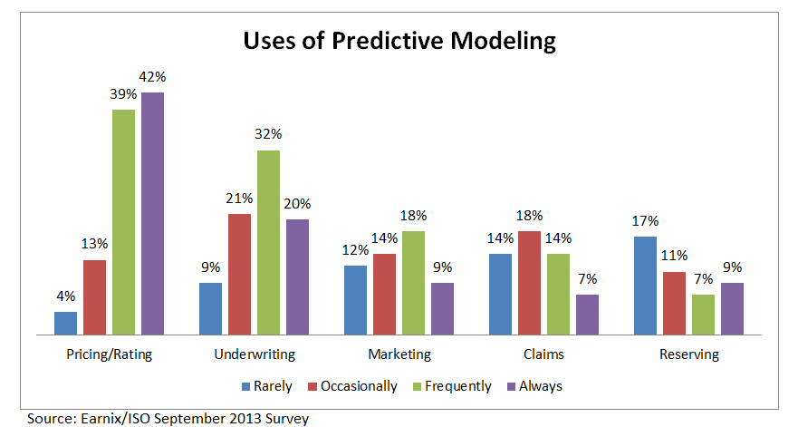
Uses of Predictive Analytics by Function
Pricing and Underwriting are the leading uses for predictive analytics

Slide 60
The Strength of the Economy Will Influence P/C Insurer Growth Opportunities
Growth Will Expand Insurer Exposure Base Across Most Lines
Texas Remains a Growth Leader
60

Slide 61
US Real GDP Growth*
The Q4:2008 decline was the steepest since the Q1:1982 drop of 6.8%
Real GDP Growth (%)
Recession began in Dec. 2007. Economic toll of credit crunch, housing slump, labor market contraction was severe
Q1 2014 GDP data were hit hard by this year’s “Polar Vortex” and harsh winter
Demand for Insurance Should Increase in 2014/15 as GDP Growth Accelerates Modestly and Gradually Benefits the Economy Broadly
* Estimates/Forecasts from Blue Chip Economic Indicators.
Source: US Department of Commerce, Blue Economic Indicators 8/14; Insurance Information Institute.

Slide 62
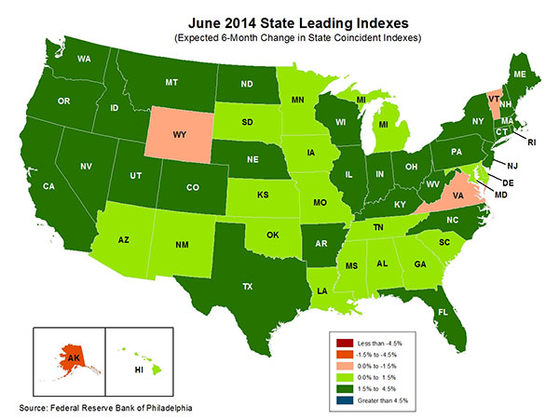
State-by-State Leading Indicators
through 2014:Q4
The economic outlook for most of the US is generally positive, though flat-to-negative for 4 states
Sources: Federal Reserve Bank of Philadelphia at http://www.philadelphiafed.org/index.cfm ;Insurance Information Institute.

Slide 63
Real GDP by State Percent Change, 2013:
Highest 25 States
North Dakota was the economic growth juggernaut of the US in 2013—by far
Only 9 states experienced growth in excess of 3%, which is what we would see nationally in a more typical recovery
Sources: U.S. Bureau of Economic Analysis; Insurance Information Institute.

Slide 64
Real GDP by State Percent Change, 2013:
Lowest 25 States
Growth rates in 11 states were still below 1% in 2013
DC and Alabama were the only states to shrink in 2013
Sources: US Bureau of Economic Analysis; Insurance Information Institute.

Slide 65
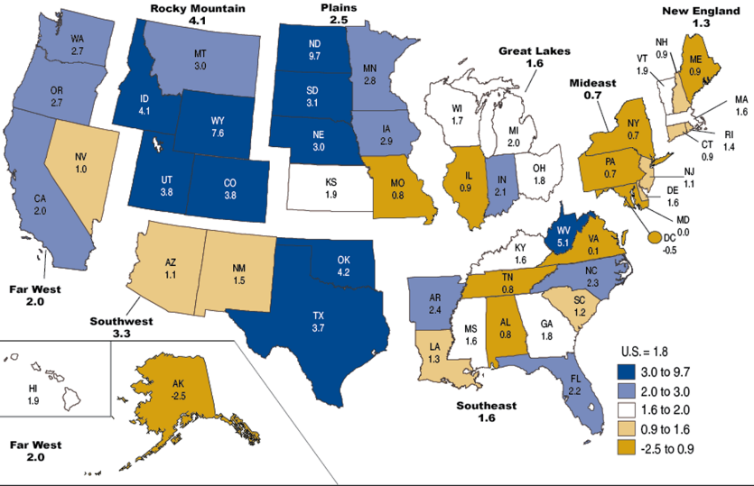
Percent Change in Real GDP by State, 2013
Sources: US Bureau of Economic Analysis; Insurance Information Institute.

Slide 66
Annual Inflation Rates, (CPI-U, %),
1990–2015F
Annual Inflation Rates (%)
Inflation peaked at 5.6% in August 2008 on high energy and commodity crisis. The recession and the collapse of the commodity bubble reduced inflationary pressures in 2009/10
Inflationary expectations have edged up but remain quite low, allowing the Fed to maintain low interest rates
The slack in the U.S. economy suggests that inflationary pressures should remain subdued for an extended period of times. Energy, health care and commodity prices, plus U.S. debt burden, remain longer-run concerns
Sources: US Bureau of Labor Statistics; Blue Chip Economic Indicators, 8/14 (forecasts).

Slide 67
Consumer Sentiment Survey (1966 = 100)
January 2010 through August 2014
Optimism among consumers has generally improved in 2014
Impact of 2011 budget impasse
Consumer confidence has been low for years amid high unemployment, falling home prices and other factors adversely impact consumers, but improved substantially over the past 2+ years, though uncertainty in Washington sometimes takes a toll.
Source: University of Michigan; Insurance Information Institute

Slide 68
Net Worth of Households*
Recently Hit A Historic High
2008-09 recession: -15.7%
$ Trillions
Housing “bubble”
2001 recession
1992 recession
1982 recession
Rising net worth fuels a “wealth affect” that helps fuel consumer spending, which accounts for 70% of spending in the U.S. economy
*Includes nonprofit organizations. Data are not seasonally adjusted or inflation-adjusted.
Source: Federal Reserve Board: http://www.federalreserve.gov/releases/z1/current/z1r-5.pdf ; Insurance Information Institute.

Slide 69
Household Financial Obligations
Ratio Recently Hit A Historic Low
Financial Obligations Ratio
Financial Obligations Ratio: debt service (mortgage and consumer debt), auto lease, residence rent, HO insurance, and property tax payments as % of personal disposable income.
Household balance sheets are stronger than they’ve been in many years, setting the stage for more consumer spending
Decline began in 2008:Q1.
15.23% in 2012:Q4
is lowest ratio since 1980:Q4 (15.09%).
*through 2013:Q3 (data posted on Dec 13, 2013)
Source: Federal Reserve Board, at http://www.federalreserve.gov/releases/housedebt

Slide 70
Auto/Light Truck Sales, 1999-2019F
Job growth and improved credit market conditions will boost auto sales in 2014 and beyond
(Millions of Units)
New auto/light truck sales fell to the lowest level since the late 1960s. Forecast for 2014-15 is still below 1999-2007 average of 17 million units, but a robust recovery is well underway.
Truck purchases by contractors are especially strong
Car/Light Truck Sales Will Continue to Recover from the 2009 Low Point, Bolstering the Auto Insurer Growth and the Manufacturing Sector Along With Workers Comp Exposures
Source: U.S. Department of Commerce; Blue Chip Economic Indicators (8/14 and 3/13); Insurance Information Institute.

Slide 71
Monthly Change* in Auto Insurance Prices, 1991–2014*
Cyclical peaks in PP Auto tend to occur roughly every 10 years (early 1990s, early 2000s and likely the early 2010s)
Pricing peak occurred in late 2010 at 5.3%, falling to 2.8% by Mar. 2012
“Hard” markets tend to occur during recessionary periods
The July 2014 reading of 3.9% is down from 4.8%
a year earlier
*Percentage change from same month in prior year; through May 2014; seasonally adjusted
Note: Recessions indicated by gray shaded columns.
Sources: US Bureau of Labor Statistics; National Bureau of Economic Research (recession dates); Insurance Information Institutes.
71
12/01/09 - 9pm
eSlide – P6466 – The Financial Crisis and the Future of the P/C
Notes:
71

Slide 72
Average Expenditures on Auto Insurance
The average expenditure on auto insurance is lower today than it was in 2004
Countrywide Auto Insurance Expenditures Decreased by 0.8% in 2008 and 0.5% in 2009 and Increased 0.5% in 2010, 1.5% in 2011 (est.), 2.0% in 2012 and 2.2% in 2013 (forecast)
* Insurance Information Institute Estimates/Forecasts
Source: NAIC, Insurance Information Institute estimate for 2011-2013 based on CPI and other data.

Slide 73
Top Ten Most Expensive And Least Expensive States For Automobile Insurance, 2011 (1)
Rank | Most expensive states | Average expenditure | Rank | Least expensive states | Average expenditure
1 | New Jersey | $1,183.95 | 1 | Idaho | $525.15
2 | District of Columbia | 1,138.03 | 2 | South Dakota | 540.04
3 | Louisiana | 1,110.68 | 3 | North Dakota | 549.81
4 | New York | 1,108.64 | 4 | Iowa | 552.54
5 | Florida | 1,090.65 | 5 | Maine | 577.38
6 | Delaware | 1,052.28 | 6 | North Carolina | 600.33
7 | Rhode Island | 1,004.14 | 7 | Wisconsin | 601.40
8 | Michigan | 983.60 | 8 | Nebraska | 602.57
9 | Connecticut | 970.22 | 9 | Wyoming | 619.88
10 | Maryland | 956.17 | 10 | Ohio | 619.96
Minnesota ranked 31st as the most expensive state in 2011, with an average expenditure for auto insurance of $696.00.
Based on average automobile insurance expenditures.
Source: © 2013 National Association of Insurance Commissioners.

Slide 74
Personal Auto Insurance Direct Written Premiums vs. Recently-Registered Cars
$ Billions
4%/yr growth forecast for PP DWP from recovering new car/truck sales
In 2004-07 no growth in PP DWP despite strong new car/truck sales
New car/truck sales grow to 14-15M/year
Average age of registered cars rose as fewer new cars were bought (and insured)
PP DWP, flat from 2004-2009, is rising again.
Conning forecasts growth at 3.5% in 2013 and 4.0% in 2014.
Sources: AIPSO Facts (various issues); SNL Financial; Conning Research & Consulting, Property-Casualty Forecast and Analysis, First Quarter 2012; Insurance Information Institute.

Slide 75
Average Age of Vehicles on the Road, 2006—2013
Average vehicle age continues to increase because the slow economy leads many drivers to keep cars on the road longer and because cars are becoming more reliable
The average vehicle age reached a record 11.4 years in 2013
Average Vehicle
Age (Years)
The average age of a vehicle on the road is is expected to continue to increase until 2018. By 2018, the number of vehicles 12+ years old is expected to rise 11.6% from 2013 and the number that are under 5 years old is expected to increase by 41%
Sources: Polk, August 2013 Survey; Insurance Information Institute.
75
12/01/09 - 9pm
eSlide – P6466 – The Financial Crisis and the Future of the P/C
Notes:
75

Slide 76
Auto Insurance Price Index vs. CPI, 1994–2014*
Index: Jan 1994 = 100
Annual average growth rate of the CPI from 1994 to now: 2.5%.
Annual average growth rate of auto insurance prices from 1994 to now: 3.3%.
*Seasonally adjusted, through March 2014
Sources: US Bureau of Labor Statistics; National Bureau of Economic Research (recession dates); Insurance Information Institute.
76
12/01/09 - 9pm
eSlide – P6466 – The Financial Crisis and the Future of the P/C
Notes:
76

Slide 77
Yearly Change in Auto Insurance Prices vs. Median Weekly Earnings
Sources: US Bureau of Labor Statistics; Insurance Information Institute

Slide 78
Monthly Change* in Auto Insurance Prices, January 2005 - December 2013
Pricing weakened in 2011, strengthened in 2012/early 2013 but has since moderated
(Percent Change
from same month,
prior year)
Auto Insurance Price Increases Averaged 5.1% in 2010 over 2009, After Averaging 4.5% in 2009 over 2008.
PPA Auto, like most p/c lines, exhibits strong cyclicality in pricing. Prices rose from 2000 to late 2005, were flat/falling in 2006 and 2007 before beginning to rise gain in 2008.
Underwriting performance remained strong even when prices were flat or falling due to improvements in underlying frequency and severity trends
* Percentage change from same month in prior year, seasonally adjusted.
Sources: US Bureau of Labor Statistics; Insurance Information Institute

Slide 79
New Private Housing Starts, 1990-2019F
Job growth, low inventories of existing homes, low mortgage rates and demographics should continue to stimulate new home construction for several more years
(Millions of Units)
New home starts plunged 72% from 2005-2009; A net annual decline of 1.49 million units, lowest since records began in 1959
Insurers Are Continue to See Meaningful Exposure Growth in the Wake of the “Great Recession” Associated with Home Construction: Construction Risk Exposure, Surety, Commercial Auto; Potent Driver of Workers Comp Exposure
Source: U.S. Department of Commerce; Blue Chip Economic Indicators (8/14 and 3/13); Insurance Information Institute.

Slide 80
Average Premium for
Home Insurance Policies**
Countrywide Home Insurance Expenditures Increased by an Estimated 4.0% in 2011-2013
* Insurance Information Institute Estimates/Forecasts **Excludes state-run insurers.
Source: NAIC, Insurance Information Institute estimates for 2011-2013 based on CPI data and other data.

Slide 81
Top Ten Most Expensive And Least Expensive States For Homeowners Insurance, 2011 (1)
Minnesota ranked as the 14th most expensive state for homeowners insurance in 2011, with an average expenditure of $1,056.
Rank | Most expensive states | HO average premium | Rank | Least expensive states | HO average premium
1 | Florida | $1,933 | 1 | Idaho | $518
2 | Louisiana | 1,672 | 2 | Oregon | 559
3 | Texas (2) | 1,578 | 3 | Utah | 563
4 | Mississippi | 1,409 | 4 | Wisconsin | 592
5 | Oklahoma | 1,386 | 5 | Washington | 626
6 | Alabama | 1,163 | 6 | Ohio | 644
7 | Rhode Island | 1,139 | 7 | Delaware | 664
8 | Kansas | 1,103 | 8 | Arizona | 675
9 | New York | 1,097 | 9 | Nevada | 689
10 | Connecticut | 1,096 | 10 | Iowa | 713
Includes policies written by Citizens Property Insurance Corp. (Florida) and Citizens Property Insurance Corp. (Louisiana), Alabama Insurance Underwriting Association, Mississippi Windstorm Underwriting Association, North Carolina Joint Underwriting Association and South Carolina Wind and Hail Underwriting Association. Other southeastern states have wind pools in operation and their data may not be included in this chart. Based on the HO-3 homeowner package policy for owner-occupied dwellings, 1 to 4 family units. Provides “all risks” coverage (except those specifically excluded in the policy) on buildings and broad named-peril coverage on personal property, and is the most common package written.
The Texas Department of Insurance developed home insurance policy forms that are similar but not identical to the standard forms. In addition, due to the Texas Windstorm Association (which writes wind-only policies) classifying HO-1, 2 and 5 premiums as HO-3, the average premium for homeowners insurance is artificially high.
Note: Average premium=Premiums/exposure per house years. A house year is equal to 365 days of insured coverage for a single dwelling. The NAIC does not rank state average expenditures and does not endorse any conclusions drawn from this data.
Source: ©2013 National Association of Insurance Commissioners (NAIC). Reprinted with permission. Further reprint or distribution strictly prohibited without written permission of NAIC.

Slide 82
Interest Rate on Convention 30-Year Mortgages: Up a Bit, 1990–2014*
Mortgages rates plunged to near-record lows in early 2013 but rose as the Fed initiated tapering in its QE program, but have come down a bit through mid-2014
Yields on 30-Year mortgages have been below 6% for a six years
Rising mortgage interest rates have impacted home sales but are unlikely to derail the recovery on housing
*Monthly, through June 2014. Note: Recessions indicated by gray shaded columns.
Sources: Federal Reserve Bank at http://www.federalreserve.gov/releases/h15/data.htm.
National Bureau of Economic Research (recession dates); Insurance Information Institutes.
82
12/01/09 - 9pm
eSlide – P6466 – The Financial Crisis and the Future of the P/C
Notes:
82

Slide 83
30-Year Mortgages in 2014 Are Falling! What Will Be the Impact on Construction?
30-year mortgage rates are down nearly 40 basis points since early January
Mortgage Interest Rates Were Expected to Continue to Rise as the Fed Pursued Tapering and the Economy Recovered; Rates Are Still Low by Historical Standards
*Weekly through June 5, 2014.
Sources: Federal Reserve Bank at http://www.federalreserve.gov/releases/h15/data.htm.; Insurance Information Institutes.
83
12/01/09 - 9pm
eSlide – P6466 – The Financial Crisis and the Future of the P/C
Notes:
83

Slide 84
Commercial & Industrial Loans Outstanding at FDIC-Insured Banks, Quarterly, 2006-2013*
$Trillions
Recession
In nominal dollar terms, this is an all-time high.
Outstanding loan volume has been growing for over two years
and (as of year-end 2012) surpassed previous peak levels.
*Latest data as of 9/8/2013.
Source: FDIC at http://www2.fdic.gov/qbp/ (Loan Performance spreadsheet); Insurance Information Institute.

Slide 85
Percent of Non-Current Commercial & Industrial Loans Outstanding at FDIC-Insured Banks,
Quarterly, 2006-2013:Q2*
Almost back to “normal” levels of noncurrent industrial & commercial loans
Recession
Non-current loans (those past due 90 days or more or in nonaccrual status) are nearly back to early-recession levels, fueling bank willingness to lend.
*Latest data as of 9/8/2013.
Source: FDIC at http://www2.fdic.gov/qbp/ (Loan Performance spreadsheet); Insurance Information Institute.

Slide 86
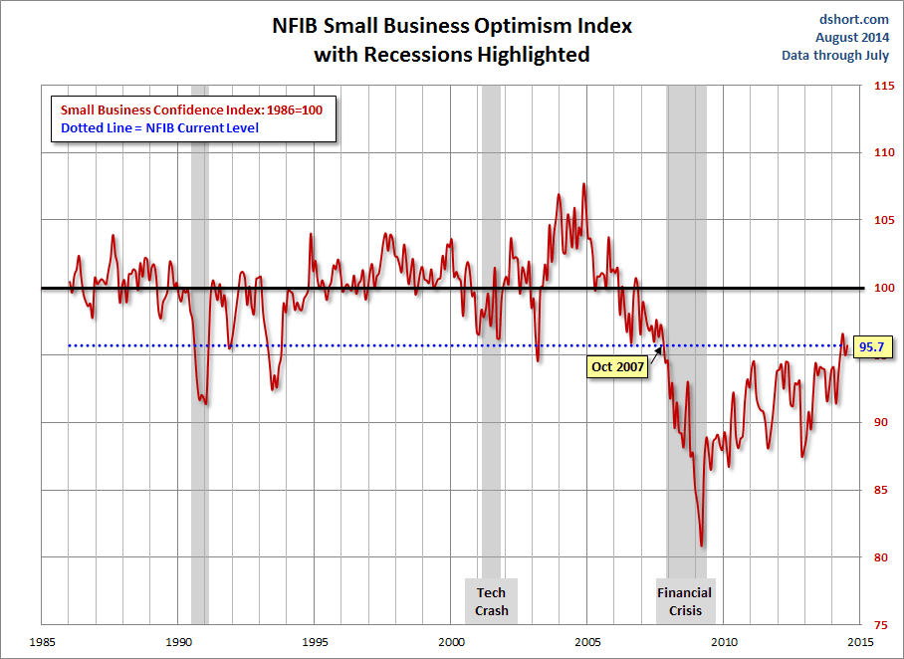
NFIB Small Business Optimism Index
January 1985 through July 2014
Small business optimism in July was nearly at its level since the crisis began in Dec. 2007.
Source: National Federation of Independent Business at http://www.advisorperspectives.com/dshort/charts/indicators/Sentiment.html?NFIB-optimism-index.gif ; Insurance Information Institute.

Slide 87
Business Bankruptcy Filings,
1980-2013
% Change Surrounding Recessions
1980-82 58.6%
1980-87 88.7%
1990-91 10.3%
2000-01 13.0%
2006-09 208.9%
2013 bankruptcies totaled 33,212, down 17.1% from 2012—the fourth consecutive year of decline. Business bankruptcies more than tripled during the financial crisis.
Significant Exposure Implications for All Commercial Lines as Business Bankruptcies Begin to Decline
Sources: American Bankruptcy Institute (1980-2012) at http://www.abiworld.org/AM/AMTemplate.cfm?Section=Home&TEMPLATE=/CM/ContentDisplay.cfm&CONTENTID=61633; 2013 data from United States Courts at http://news.uscourts.gov; Insurance Information Institute.
87
12/01/09 - 9pm
eSlide – P6466 – The Financial Crisis and the Future of the P/C
Notes:
87

Slide 88
Private Sector Business Starts:
1993:Q2 – 2013:Q4* As Strong as Ever?
Business Starts
2006: 861,000
2007: 844,000
2008: 787,000
2009: 701,000 2010: 742,000 2011: 781,000
2012: 800,000
2013: 870,000**
Recessions in orange
2013:Q1 578,000 business starts*
Thousands
*Data posted Apr 29, 2014, the latest available; a classification change in 2013:Q1 resulted in a report of 578,000 businesses started in that quarter. Seasonally adjusted. **2014 number assumes 1st quarter equaled average of other three quarters
Sources: Bureau of Labor Statistics, http://www.bls.gov/news.release/cewbd.t08.htm. NBER (recession dates)
88
12/01/09 - 9pm
eSlide – P6466 – The Financial Crisis and the Future of the P/C
Notes:
88

Slide 89
ISM Non-Manufacturing Index
(Values > 50 Indicate Expansion)
January 2010 through July 2014
Optimism among non-manufacturers has been generally increasing in 2014
Non-manufacturing industries have been expanding and adding jobs. This trend is likely to continue through 2014.
Source: Institute for Supply Management at http://www.ism.ws/ismreport/nonmfgrob.cfm; Insurance Information Institute.

Slide 90
12 Industries for the Next 10 Years: Insurance Solutions Needed
Health Care
Health Sciences
Energy (Traditional)
Many industries are poised for growth, though insurers’ ability to capitalize on these industries varies widely
Alternative Energy
Petrochemical
Agriculture
Natural Resources
Technology (incl. Biotechnology)
Light Manufacturing
Insourced Manufacturing
Export-Oriented Industries
Shipping (Rail, Marine, Trucking, Pipelines)

Slide 91
CONSTRUCTION INDUSTRY OVERVIEW & OUTLOOK
The Construction Sector Is Critical to the Economy and the P/C Insurance Industry
91

Slide 92
Value of New Private Construction: Residential & Nonresidential, 2003-2014*
2014: Value of new pvt. construction hits $685.5B as of June 2014, up 37% from the 2010 trough but still 25% below 2006 peak
New Construction peaks at $911.8. in 2006
Billions of Dollars
Trough in 2010 at $500.6B, after plunging 55.1% ($411.2B)
$15.0
$613.7
$329.5
$298.1
$261.8
$355.9
$238.8
Private Construction Activity Is Moving in a Positive Direction though Remains Well Below Pre-Crisis Peak; Residential Dominates
*2014 figure is a seasonally adjusted annual rate as of June.
Sources: US Department of Commerce; Insurance Information Institute.
92
12/01/09 - 9pm
eSlide – P6466 – The Financial Crisis and the Future of the P/C
Notes:
92

Slide 93
Value of Construction Put in Place, June 2014 vs. June 2013*
Growth (%)
Private: +9.2%
Public: -2.9%
Public sector construction activity remains depressed
Private sector construction activity is up in the residential and nonresidential segments
Overall Construction Activity is Up, But Growth Is Almost Entirely in the Private Sector as State/Local Government Budget Woes Continue
*seasonally adjusted
Source: U.S. Census Bureau, http://www.census.gov/construction/c30/c30index.html ; Insurance Information Institute.

Slide 94
Value of Private Construction Put in Place, by Segment, June 2014 vs. June 2013*
Led by the Office, Lodging and Power/Utility segments, Private sector construction activity is rising after plunging during the “Great Recession.”
Growth (%)
Private Construction Activity is Up in Many Segments, Including the Key Residential Construction Sector; Bodes Well for the Remainder of 2014
*seasonally adjusted
Source: U.S. Census Bureau, http://www.census.gov/construction/c30/c30index.html ; Insurance Information Institute.

Slide 95
Value of Public Construction Put in Place, by Segment, June 2014 vs. June 2013*
Growth (%)
Public sector construction activity is down substantially in many segments, a situation that will likely persist, dragging on public entity risk exposures
Amusement & Recreation, Sewage & Waste Disposal and Conservation projects lead public sector construction
Public Construction Activity is Down in Many Segments as State and Local Budgets Remain Under Stress; Improvement Possible in 2015.
*seasonally adjusted
Source: U.S. Census Bureau, http://www.census.gov/construction/c30/c30index.html ; Insurance Information Institute.

Slide 96
Real (Inflation-Adjusted)
Nonresidential Construction, 2000-2014*
(Bar = CAGR; Line = Y/Y Growth Rate)
Construction activity has generally been positive since late 2010 but has occasionally be erratic. Forecast is for slowing improving growth
*Through Q1 2014.
Source: US Dept. of Commerce; Wells Fargo Securities (June 6, 2014 research report).
96
12/01/09 - 9pm
eSlide – P6466 – The Financial Crisis and the Future of the P/C
Notes:
96

Slide 97
Commercial & Industrial Loans Outstanding at FDIC-Insured Banks, Quarterly, 2006-2014:Q1
$Trillions
Commercial lending activity exceeds pre-crisis levels (+36.75% or $430B above mid-2010 trough)
Commercial lending plunged by 21.2% ($330B) during the financial crisis and ensuing period of tight credit
Outstanding Commercial Loan Volume Has Been Growing for Over Two Years and Is Now Nearly Back to Early Recession Levels. Bodes Very Well for the Creation of Current and Future Commercial Insurance Exposures
Source: FDIC at http://www2.fdic.gov/qbp/ (Loan Performance spreadsheet); Insurance Information Institute.

Slide 98
Percent of Non-current Commercial & Industrial Loans Outstanding at FDIC-Insured Banks,
Quarterly, 2006-2014:Q1
Recession
Back to “normal” levels of noncurrent industrial & commercial loans
Non-current loans (those past due 90 days or more or in nonaccrual status) are below even pre-recession levels, fueling bank willingness to lend.
Source: FDIC at http://www2.fdic.gov/qbp/ (Loan Performance spreadsheet); Insurance Information Institute.

Slide 99
Change from Peak in New Construction Expenditures to 2013*
Change (%)
Residential
Nonresidential
Govt.
Despite Recent Improvements, Construction Activity (and Employment) Remains Far Below Pre-Crisis Peaks
Note: Year in parentheses is the year of peak expenditure.
*2013 figure is a seasonally adjusted annual rate as of June.
Sources: US Department of Commerce; Insurance Information Institute.

Slide 100
Value of New Federal, State and Local Government Construction: 2003-2014*
Construction across all levels of government peaked at $314.9B in 2009
Austerity Reigns
Govt. construction is still shrinking, down $50.2B or 15.9% since 2009 peak
($ Billions)
Government Construction Spending Peaked in 2009, Helped by Stimulus Spending, but Continues to Contract As State/Local Governments Grapple with Deficits and Federal Sequestration Takes Hold
*2014 figure is a seasonally adjusted annual rate as of June; http://www.census.gov/construction/c30/historical_data.html
Sources: US Department of Commerce; Insurance Information Institute.

Slide 101
New Private Housing Starts, 1990-2019F
Job growth, low inventories of existing homes, low mortgage rates and demographics should continue to stimulate new home construction for several more years
(Millions of Units)
New home starts plunged 72% from 2005-2009; A net annual decline of 1.49 million units, lowest since records began in 1959
Insurers Are Continue to See Meaningful Exposure Growth in the Wake of the “Great Recession” Associated with Home Construction: Construction Risk Exposure, Surety, Commercial Auto; Potent Driver of Workers Comp Exposure
Source: U.S. Department of Commerce; Blue Chip Economic Indicators (8/14 and 3/13); Insurance Information Institute.

Slide 102
Construction Employment,
Jan. 2010—July 2014*
(Thousands)
Construction employment is +606,000 above
Jan. 2011 (+11.1%) trough
Construction and manufacturing employment constitute 1/3 of all payroll exposure.
*Seasonally adjusted.
Sources: US Bureau of Labor Statistics at http://data.bls.gov; Insurance Information Institute.
102
12/01/09 - 9pm
eSlide – P6466 – The Financial Crisis and the Future of the P/C
Notes:
102

Slide 103
Construction Employment,
Jan. 2003–July 2014
(Thousands)
Construction employment as of July 2014 totaled 6.041 million, an increase of 606,000 jobs or 11.1% from the Jan. 2011 trough
Construction employment peaked at 7.726 million in April 2006
Gap between pre-recession construction peak and today: 1.69 million jobs
The “Great Recession” and housing bust destroyed 2.3 million constructions jobs
Construction employment troughed at 5.435 million in Jan. 2011, after a loss of 2.291 million jobs, a 29.7% plunge from the April 2006 peak
The Construction Sector Could Be a Growth Leader in 2014 as the Housing Market, Private Investment and Govt. Spending Recover. WC Insurers Will Benefit.
Note: Recession indicated by gray shaded column.
Sources: U.S. Bureau of Labor Statistics; Insurance Information Institute.
103
12/01/09 - 9pm
eSlide – P6466 – The Financial Crisis and the Future of the P/C
Notes:
103

Slide 104
Construction Jobs: Largest Gains & Losses by Metro Area, May 2014 vs. May 2013*
Change
Largest Increases
Largest Losses
+10%
+4%
Construction employment expanded in 218 out of the 339 metro areas in the US in May 2014
Construction Employment Is Expanding—Albeit Modestly—in Much of the US
*Seasonally adjusted;
Source: Associated General Contractors: http://www.agc.org/galleries/news/Metro_Empl_1404_Rank.pdf; Ins. Information Institute.

Slide 105
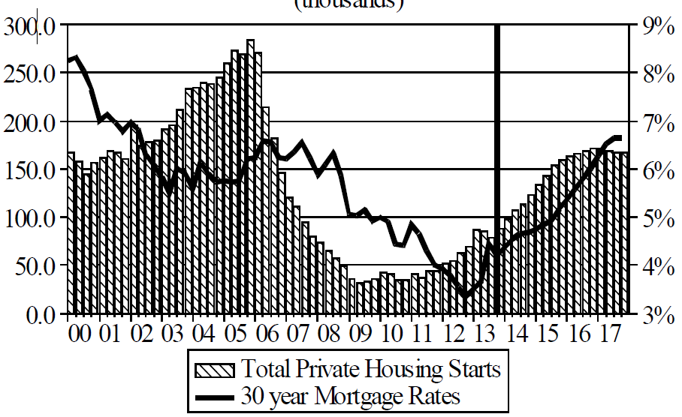
Florida Total Private Housing Starts,
2000 – 2017F
(Thousands of Units)
CRASH, CRATER, RECOVERY Homebuilding in FL continues to recover, adding substantially to coastal exposures.
The economic outlook for most of the US is positive for the first time in many years
Source: University of Central Florida Institute for Economic Competitiveness: http://iec.ucf.edu/post/2014/01/07/Florida-Metro-Forecast-December-2013.aspx

Slide 106
Interest Rate on Convention 30-Year Mortgages: Up a Bit, 1990–2014*
Mortgages rates plunged to near-record lows in early 2013 but rose as the Fed initiated tapering in its QE program
Yields on 30-Year mortgages have been below 6% for a six years
Rising mortgage interest rates have impacted home sales but are unlikely to derail the recovery on housing
*Monthly, through May 2014. Note: Recessions indicated by gray shaded columns.
Sources: Federal Reserve Bank at http://www.federalreserve.gov/releases/h15/data.htm.
National Bureau of Economic Research (recession dates); Insurance Information Institutes.
106
12/01/09 - 9pm
eSlide – P6466 – The Financial Crisis and the Future of the P/C
Notes:
106

Slide 107
30-Year Mortgages in 2014 Are Falling! What Will Be the Impact on Construction?
30-year mortgage rates are down nearly 40 basis points since early January
Mortgage Interest Rates Were Expected to Continue to Rise as the Fed Pursued Tapering and the Economy Recovered; Rates Are Still Low by Historical Standards
*Weekly through June 5, 2014.
Sources: Federal Reserve Bank at http://www.federalreserve.gov/releases/h15/data.htm.; Insurance Information Institutes.
107
12/01/09 - 9pm
eSlide – P6466 – The Financial Crisis and the Future of the P/C
Notes:
107

Slide 108
New Home Inventories and Rental Vacancy Rates, 2003-2013*
(Thousands)
Low new home inventories and falling vacancy rates bode well for residential construction
*2013 figure is a seasonally adjusted annual rate as of June.
Sources: US Department of Commerce; Insurance Information Institute.

Slide 109
Change from Peak in New Construction Expenditures to 2013*
Change (%)
Residential
Nonresidential
Govt.
Despite Recent Improvements, Construction Activity (and Employment) Remains Far Below Pre-Crisis Peaks
Note: Year in parentheses is the year of peak expenditure.
*2013 figure is a seasonally adjusted annual rate as of June.
Sources: US Department of Commerce; Insurance Information Institute.

Slide 110
ENERGY SECTOR: OIL & GAS INDUSTRY FUTURE IS BRIGHT
US Is Becoming an Energy Powerhouse; Domestic Demand and Exports Are Key
Need Infrastructure Investment
110

Slide 111
U.S. Natural Gas Production, 2000-2013
Trillions of Cubic Ft. per Year
The U.S. is already the world’s largest natural gas producer—recently overtaking Russia. This is a potent driver of commercial insurance exposures
Source: Energy Information Administration, Short-Term Energy Outlook (April 8, 2014) , Insurance Information Institute.

Slide 112
U.S. Crude Oil Production, 2005-2015P
Millions of Barrels per Day
Crude oil production in the U.S. is expected to increase by 82.6% from 2008 through 2015—and could overtake Saudi Arabia as the world’s largest oil producer
Source: Energy Information Administration, Short-Term Energy Outlook (April 8, 2014) , Insurance Information Institute.

Slide 113

Oil & Gas Extraction Employment,
Jan. 2010—July 2014*
Oil and gas extraction employment is up 35.7% since Jan. 2010 as the energy sector booms. Domestic energy production is essential to any robust economic recovery in the US.
Highest since July 1986
(Thousands)
*Seasonally adjusted
Sources: US Bureau of Labor Statistics at http://data.bls.gov; Insurance Information Institute.
113
12/01/09 - 9pm
eSlide – P6466 – The Financial Crisis and the Future of the P/C
Notes:
113

Slide 114
World Primary Energy Consumption, 1990-2040P
Quadrillion BTUs
Growth in worldwide energy consumption will create more risk and vulnerabilities (natural and manmade); Innovations in risk management and insurance are needed.
Between 2010 and 2040, energy consumption in projected to increase by 56.4% worldwide
Source: Energy Information Administration, 2013 International Energy Outlook, Insurance Information Institute.

Slide 115
Cumulative Projected Investment in Global Energy Infrastructure, 2011-2035 ($ Trill.)
Projected energy infrastructure investment through 2035 total $38 trillion; Implies substantial incurrence of risk.
Source: International Energy Agency, World Energy Outlook 2011.

Slide 116
US Electric Power Generation by Fuel Source, 2010-2035F (Billions of Kilowatt Hours)
4,279
4,427
3,937
4,118
3,806
3,796
Demand for Electricity Is Expected to Grow at a 0.6% Annual Rate Through 2035. Renewables and Natural Gas Will Account for an Increasing Share of Fuel Source
Source: US Energy Information Administration, Annual Energy Outlook 2012, Appendix A7.
116
12/01/09 - 9pm
eSlide – P6466 – The Financial Crisis and the Future of the P/C
Notes:
116

Slide 117
U.S. Electricity Generation by Fuel,
1990-2040F (Trillions of Kilowatt Hours)
Natural gas share of fossil fired generation will grow rapidly (more investment needed). Coal fired generation will remain flat but its share will fall due to abundant gas and EPA carbon regulations
Source: US Energy Information Administration, 2014 Annual Energy Outlook Early Release Overview; Insurance Information Institute.
117
12/01/09 - 9pm
eSlide – P6466 – The Financial Crisis and the Future of the P/C
Notes:
117

Slide 118
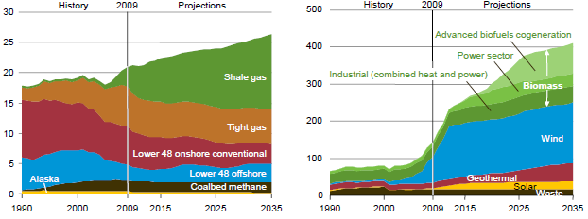
US Natural Gas Production and Non-Hydro Renewable Electricity Generation, 1990-2035P
Shale gas production is expected to grow rapidly in the US
Wind is expected to account for the majority of renewable electricity generation
Tight gas production involves controversial hydraulic fracturing (fracking) techniques
Source: US Energy Information Administration, Annual Energy Outlook 2011; Insurance Information Institute.
118
12/01/09 - 9pm
eSlide – P6466 – The Financial Crisis and the Future of the P/C
Notes:
118

Slide 119
U.S. Private Power Construction,
2000-2014* (% Change, 3-Month Moving Avg.)
Power construction accounts for a large share of all construction activity. The recent slowdown was in part due to the expiration of renewable production tax credits. Going forward, about 75% of new capacity will be for gas fired plants
*Through April 2014.
Source: US Dept. of Commerce; Energy Information Administration, Wells Fargo Securities (June 6, 2014 research report).
119
12/01/09 - 9pm
eSlide – P6466 – The Financial Crisis and the Future of the P/C
Notes:
119

Slide 120
MANUFACTURING SECTOR OVERVIEW & OUTLOOK
The U.S. Is Experiencing a Mini Manufacturing Renaissance That Is Benefitting the US Economy and the P/C Insurance Industry
120

Slide 121
Manufacturing Growth for Selected Sectors, 2014 vs. 2013*
Growth (%)
Durables: +3.9%
Non-Durables: +0.9%
Manufacturing of durable goods was stronger than nondurables in 2013
Manufacturing Is Expanding—Albeit Slowly—Across a Number of Sectors that Will Contribute to Growth in Insurable Exposures Including: WC, Commercial Property, Commercial Auto and Many Liability Coverages
*Seasonally adjusted; Date are YTD comparing data through May 2014 to the same period in 2013.
Source: U.S. Census Bureau, Full Report on Manufacturers’ Shipments, Inventories, and Orders, http://www.census.gov/manufacturing/m3/

Slide 122
Dollar Value* of Manufacturers’ Shipments Monthly, Jan. 1992—Apr. 2014
$ Millions
The value of Manufacturing Shipments in Apr. 2014 was $497.6B—a new record high.
Monthly shipments in Apr. 2014 exceeded the pre-crisis (July 2008) peak. Manufacturing is energy-intensive and growth leads to gains in many commercial exposures: WC, Commercial Auto, Marine, Property, and various Liability Coverages.
* Seasonally adjusted; Data published June 3, 2014.
Source: U.S. Census Bureau, Full Report on Manufacturers’ Shipments, Inventories, and Orders, http://www.census.gov/manufacturing/m3/
122
12/01/09 - 9pm
eSlide – P6466 – The Financial Crisis and the Future of the P/C
Notes:
122

Slide 123
Manufacturing Employment,
Jan. 2010—July 2014*
(Thousands)
Since Jan 2010, manufacturing employment is up (+700,000 or +6.1%)
and still growing.
Manufacturing employment is a surprising source of strength in the economy. Employment in the sector is at a multi-year high.
*Seasonally adjusted.
Sources: US Bureau of Labor Statistics at http://data.bls.gov; Insurance Information Institute.
123
12/01/09 - 9pm
eSlide – P6466 – The Financial Crisis and the Future of the P/C
Notes:
123

Slide 124
ISM Manufacturing Index
(Values > 50 Indicate Expansion)
January 2010 through August 2014
Manufacturing continues to expand in 2014—now at its highest level since early 2011
The manufacturing sector expanded for 54 of the 56 months from Jan. 2010 through Aug. 2014. Pace of recovery has been uneven due to economic turbulence in the U.S., Europe and China.
Source: Institute for Supply Management at http://www.ism.ws/ismreport/mfgrob.cfm; Insurance Information Institute.

Slide 125
Business Investment: Expected to Accelerate, Fueling Commercial Exposure Growth
Accelerating business investment will be a potent driver of commercial property and liability insurance exposures and should drive employment and WC payroll exposures as well (with a lag)
Source: IHS Global Insights as of Jan. 13, 2014; Insurance Information Institute.

Slide 126
Recovery in Capacity Utilization is a Positive Sign for Commercial Exposures
March 2001 through April 2013
“Full Capacity”
The US operated at 77.8% of industrial capacity in Apr. 2013, well above the June 2009 low of 66.9% but is still below pre-recession levels.
Percent of Industrial Capacity
Hurricane Katrina
The closer the economy is to operating at “full capacity,” the greater the inflationary pressure
March 2001-November 2001 recession
December 2007-
June 2009 Recession
126
Source: Federal Reserve Board statistical releases at http://www.federalreserve.gov/releases/g17/Current/default.htm.
Notes:
126

Slide 127
Labor Market Trends
Massive Job Losses Sapped the Economy and Commercial/Personal Lines Exposure, But Trend is Improving
127

Slide 128
Unemployment and Underemployment Rates: Still Too High, But Falling
January 2000 through July 2014, Seasonally Adjusted (%)
U-6 went from 8.0% in March 2007 to 17.5% in
October 2009; Stood at 12.2% in July 2014.
8% to 10% is “normal.”
“Headline” unemployment was 6.2% in July 2014. 4.5% to 6% is “normal.”
Stubbornly high unemployment and underemployment constrain overall economic growth, but the job market is now clearly improving.
Source: US Bureau of Labor Statistics; Insurance Information Institute.
128
12/01/09 - 9pm
eSlide – P6466 – The Financial Crisis and the Future of the P/C
Notes:
128

Slide 129
US Unemployment Rate Forecast
2007:Q1 to 2015:Q4F*
Rising unemployment
eroded payrolls
and WC’s
exposure base.
Unemployment peaked at 10% in late 2009.
Jobless figures have been revised modestly downwards for 2014/15
Unemployment forecasts have been revised modestly downwards. Optimistic scenarios put the unemployment as low as 5.1% by Q4 of this year.
* = actual; = forecasts
Sources: US Bureau of Labor Statistics; Blue Chip Economic Indicators (8/14 edition); Insurance Information Institute.

Slide 130
Unemployment Rates by State, June 2014:
Highest 25 States*
In June, 22 states and the District of Columbia had over-the-month unemployment rate decreases, 14 states had increases, and 14 states and had no change.
*Provisional figures for June 2014, seasonally adjusted.
Sources: US Bureau of Labor Statistics; Insurance Information Institute.

Slide 131
Unemployment Rates by State, June 2014:
Lowest 25 States*
In June, 22 states and the District of Columbia had over-the-month unemployment rate decreases, 14 states had increases, and 14 states and had no change.
*Provisional figures for June 2014, seasonally adjusted.
Sources: US Bureau of Labor Statistics; Insurance Information Institute.

Slide 132
Monthly Change in Private Employment
1,541,000 jobs created so far in 2014
January 2007 through July 2014 (Thousands, Seasonally Adjusted)
198,000 private sector jobs were created in July. In March 2014, the last of the private jobs lost in the Great Recession were recovered
Jobs Created
2013: 2.368 Mill
2012: 2.294 Mill
2011: 2.400 Mill
2010: 1.277 Mill
Monthly losses in Dec. 08–Mar. 09 were the largest in the
post-WW II period
Private Employers Added 9.88 million Jobs Since Jan. 2010 After Having Shed 5.01 Million Jobs in 2009 and 3.76 Million in 2008 (State and Local Governments Have Shed Hundreds of Thousands of Jobs)
Source: US Bureau of Labor Statistics: http://www.bls.gov/ces/home.htm; Insurance Information Institute

Slide 133
Cumulative Change in Private Employment: Dec. 2007—May 2014
Pvt. employment hit 116.6 million in April 2014—617,000 above its pre-crisis peak of 116.0 million
December 2007 through May 2014 (Millions)
Cumulative job losses peaked at 8.765 million in February 2010
It took more than 6 ½ years (79 months) to recover all of the private sector jobs lost in the Great Recession
Private Employers Added 9.39 million Jobs Since Jan. 2010 After Having Shed 4.98 Million Jobs in 2009 and 3.80 Million in 2008 (State and Local Governments Have Shed Hundreds of Thousands of Jobs)
Source: US Bureau of Labor Statistics: http://www.bls.gov/ces/home.htm; Insurance Information Institute

Slide 134
Cumulative Change in Private Sector Employment: Jan. 2010—May 2014
(Millions)
Job gains and pay increases have added more than $1 trillion in new payrolls since 2009 trough
Cumulative job gains through Apr. 2014 totaled 9.39 million
Private Employers Added 9.39 million Jobs Since Jan. 2010 After Having Shed 4.98 Million Jobs in 2009 and 3.80 Million in 2008 (State and Local Governments Have Shed Hundreds of Thousands of Jobs)
Source: US Bureau of Labor Statistics: http://www.bls.gov/ces/home.htm; Insurance Information Institute

Slide 135
Net Change in Government Employment: Jan. 2010—Apr. 2014
State government employment fell by 1.5% since the end of 2009 but is recovering while Federal employment is down by 5.3% and deteriorating
(Thousands)
Local government employment shrank by 380,000 from Jan. 2010 through Apr. 2014, accounting for 62% of all government job losses, negatively impacting WC exposures for those cities and counties that insure privately
Source: US Bureau of Labor Statistics http://www.bls.gov/data/#employment; Insurance Information Institute

Slide 136
Cumulative Change in Government Employment: Jan. 2010—Dec. 2013
Government at all levels has shed more than 600,000 jobs since Jan. 2010 even as private employers created 8.14 million jobs, though losses may now be stabilizing.
January 2010 through Dec. 2013* (Millions)
Cumulative job losses through Dec. 2013 totaled 631,000
Temporary Census hiring distorted 2010 figures
Governments at All Levels are Under Severe Fiscal Strain As Tax Receipts Plunged and Pension Obligations Soared During the Financial Crisis: Sequestration Will Add to this Toll
Source: US Bureau of Labor Statistics http://www.bls.gov/data/#employment; Insurance Information Institute

Slide 137
Oil & Gas Extraction Employment,
Jan. 2010—June 2014*
Oil and gas extraction employment is up 35.2% since Jan. 2010 as the energy sector booms. Domestic energy production is essential to any robust economic recovery in the US.
Highest since Aug. 1986
(Thousands)
*Seasonally adjusted
Sources: US Bureau of Labor Statistics at http://data.bls.gov; Insurance Information Institute.
137
12/01/09 - 9pm
eSlide – P6466 – The Financial Crisis and the Future of the P/C
Notes:
137

Slide 138
Nonfarm Payroll (Wages and Salaries):
Quarterly, 2005–2014:Q2
Billions
Latest (2014:Q2) was $7.46 trillion, a new peak--$1.21 trillion above 2009 trough
Prior Peak was 2008:Q1 at $6.60 trillion
Payrolls are 19.4% above their 2009 trough and up 4.9% over the past year
Recent trough (2009:Q3) was $6.25 trillion, down 5.3% from prior peak
Note: Recession indicated by gray shaded column. Data are seasonally adjusted annual rates.
Sources: http://research.stlouisfed.org/fred2/series/WASCUR; National Bureau of Economic Research (recession dates); Insurance Information Institute.
138
12/01/09 - 9pm
eSlide – P6466 – The Financial Crisis and the Future of the P/C
Notes:
138

Slide 139
Payroll vs. Workers Comp Net Written Premiums, 1990-2013P
Payroll Base* WC NWP
$Billions $Billions
7/90-3/91
3/01-11/01
12/07-6/09
WC premium volume dropped two years before the recession began
WC net premiums written were down $14B or 29.3% to $33.8B in 2010 after peaking at $47.8B in 2005
Continued Payroll Growth and Rate Gains Suggest WC NWP Will Grow Again in 2014; +8.6% Growth Estimated for 2013
*Private employment; Shaded areas indicate recessions. WC premiums for 2012 are I.I.I. estimate based YTD 2013 actuals.
Sources: NBER (recessions); Federal Reserve Bank of St. Louis at http://research.stlouisfed.org/fred2/series/WASCUR ; NCCI; I.I.I.

Slide 140
Workers Compensation Operating Environment
Workers Comp Results Have Improved Substantially in Recent Years
140

Slide 141
Workers Compensation Combined Ratio: 1994–2015F
WC results have improved markedly since 2011
Workers Comp Results Began to Improve in 2012. Underwriting Results Deteriorated Markedly from 2007-2010/11 and Were the Worst They Had Been in a Decade.
Sources: A.M. Best (1994-2009); NCCI (2010-2013P) and are for private carriers only; Insurance Information Institute (2014-15).

Slide 142
Workers Compensation Premium:
Third Consecutive Year of Increase
Net Written Premium
$ Billions
p Preliminary
Source: 1990–2013p Private Carriers, Annual Statement Data, NCCI.
1996–2013p State Funds: AZ, CA, CO, HI, ID, KY, LA, MD, MO, MT, NM, OK, OR, RI, TX, UT Annual Statements
State Funds available for 1996 and subsequent
Calendar Year

Slide 143
2013 Workers Compensation Direct Written Premium Growth, by State*
PRIVATE CARRIERS: Overall 2013 Growth = +5.4%
While growth rates varied widely, all states experienced positive growth in 2013
*Excludes monopolistic fund states (in white): OH, ND, WA and WY.
Source: NCCI.

Slide 144
Workers Compensation Lost-Time
Claim Frequency Declined in 2013
Lost-Time Claims
Percent
Cumulative Change of –55.4%
(1991–2011 adj.)
*Adjustments primarily due to significant audit activity.
2013p: Preliminary based on data valued as of 12/31/2013
1991–2012: Based on data through 12/31/2012, developed to ultimate
Based on the states where NCCI provides ratemaking services, including state funds; excludes high deductible policies
Frequency is the number of lost-time claims per $1M pure premium at current wage and voluntary loss cost level
Source: NCCI.
Accident Year

Slide 145
Workers Compensation Medical Severity
Moderate Increase in 2013
Medical
Claim Cost ($000s)
Average Medical Cost per Lost-Time Claim
Annual Change 1991–1993: +1.9%
Annual Change 1994–2001: +8.9%
Annual Change 2002–2010: +6.0%
Annual Change 1991–1993: +1.9%
Annual Change 1994–2001: +8.9%
Annual Change 2002–2013: +5.2%
Cumulative Change = 256%
(1991-2013p)
Accident Year
Accident Year
2013p: Preliminary based on data valued as of 12/31/2013.
1991-2012: Based on data through 12/31/2012, developed to ultimate
Based on the states where NCCI provides ratemaking services including state funds, excluding WV; Excludes high deductible policies.

Slide 146
U.S. Insured Catastrophe Loss Update
2013 Was a Welcome Respite from the High Catastrophe Losses in Recent Years
2014 Is Off to a Modest Beginning
146

Slide 147
U.S. Insured Catastrophe Losses
($ Billions, $ 2013)
2012 was the 3rd most expensive year ever for insured CAT losses
2013 Was a Welcome Respite from 2012, the 3rd Costliest Year for Insured Disaster Losses in US History. Longer-term Trend is for more—not fewer—Costly Events
$9.5 billion in insured CAT losses through June 30
*Through 6/30/14.
Note: 2001 figure includes $20.3B for 9/11 losses reported through 12/31/01 ($25.9B 2011 dollars). Includes only business and personal property claims, business interruption and auto claims. Non-prop/BI losses = $12.2B ($15.6B in 2011 dollars.)
Sources: Property Claims Service/ISO; Insurance Information Institute.
147
12/01/09 - 9pm
eSlide – P6466 – The Financial Crisis and the Future of the P/C
Notes:
147

Slide 148
Combined Ratio Points Associated with Catastrophe Losses: 1960 – 2013*
Avg. CAT Loss Component of the Combined Ratio by Decade
1960s: 1.04 1970s: 0.85 1980s: 1.31 1990s: 3.39 2000s: 3.52 2010s: 6.1E*
Catastrophe losses as a share of all losses reached a record high in 2012
Combined Ratio Points
The Catastrophe Loss Component of Private Insurer Losses Has Increased Sharply in Recent Decades
*2010s represent 2010-2013.
Notes: Private carrier losses only. Excludes loss adjustment expenses and reinsurance reinstatement premiums. Figures are adjusted for losses ultimately paid by foreign insurers and reinsurers.
Source: ISO (1960-2011); A.M. Best (2012E) Insurance Information Institute.

Slide 149
Top 8 States for Insured
Catastrophe Losses, 2013
$ Millions
Minnesota had the 4th highest CAT losses in 2013
Source: The Property Claim Services (PCS) unit of ISO, a Verisk Analytics company.

Slide 150
Top 5 States by Insured Catastrophe Losses in 2012*
(2012, $ Billions)
Texas is almost always one of the top 5 states for insured CAT losses
*Includes catastrophe losses of at least $25 million.
Sources: PCS unit of ISO; Insurance Information Institute.

Slide 151
Top States by Inflation-Adjusted Insured Catastrophe Losses, 1983–2012
Over the Past 30 Years Florida Has Accounted for the Largest Share of Catastrophe Losses in the U.S., Followed by Texas and Louisiana
TX is the 2nd costliest state for CATs, with nearly $50B in insured losses over the past 30 years
Louisiana
$42.0B
Texas
$48.8B
Rest of the U.S.
$309.9B
Florida
$66.7B
Total: $467.5 Billion, an average of $16.6B per year or $1.3B per month
Source: PCS unit of ISO, Verisk Company.; Insurance Information Institute.

Slide 152
Inflation Adjusted U.S. Catastrophe Losses by Cause of Loss, 1994–2013¹
Wind/Hail/Flood (3), $14.6
Fires (4), $5.5
Other (5), $0.2
Insured cat losses from 1993-2012 totaled $386.7B, an average of $19.3B per year or $1.6B per month
Geological Events, $18.4
Terrorism, $24.8
Winter Storms, $24.7
Hurricanes & Tropical Storms, $159.1
Tornado share of CAT losses is rising
Wind losses are by far cause the most catastrophe losses, even if hurricanes/TS are excluded.
Events Involving Tornadoes (2), $139.3
Catastrophes are defined as events causing direct insured losses to property of $25 million or more in 2013 dollars.
Excludes snow.
Does not include NFIP flood losses
Includes wildland fires
Includes civil disorders, water damage, utility disruptions and non-property losses such as those covered by workers compensation.
Source: ISO’s Property Claim Services Unit.

Slide 153
Top 16 Most Costly Disasters in U.S. History
(Insured Losses, 2013 Dollars, $ Billions)
Hurricane Ike and other storms have hot TX hard over the past decade
Includes Tuscaloosa, AL, tornado
Includes Joplin, MO, tornado
12 of the 16 Most Expensive Events in US History Have Occurred Over the Past Decade
Sources: PCS; Insurance Information Institute inflation adjustments to 2013 dollars using the CPI.

Slide 154
Natural Disasters in the United States, 1980 – 2013
Number of Events (Annual Totals 1980 – 2013)
There were 128 natural disaster events in 2013
Number
22
19
81
6
Geophysical
(earthquake, tsunami,
volcanic activity)
Meteorological (storm)
Climatological
(temperature extremes,
drought, wildfire)
Hydrological
(flood, mass movement)
Source: MR NatCatSERVICE
154

Slide 155
Losses Due to Natural Disasters in the US, 1980–2013
(Overall and Insured Losses)
(2013 Dollars, $ Billions)
2013 CAT Losses
Overall : $21.8B
Insured: $12.8B
Indicates a great deal of losses are uninsured (~40%-50% in the US) = Growth Opportunity
2013 losses were far below 2011 and 2012 and were 44% lower than the average from 2000-2012
Overall losses (in 2012 values)
Insured losses (in 2013 values)
Source: MR NatCatSERVICE
155

Slide 156
Top 16 Most Costly World Insurance Losses, 1970-2013*
(Insured Losses, 2013 Dollars, $ Billions)
5 of the top 14 most expensive catastrophes in world history have occurred within the most recent 4 years (2010-2013)
2012 insured CAT Losses totaled $60B; Economic losses totaled $140B, according to Swiss Re
Hurricane Sandy is now the 6th costliest event in global insurance history
*Figures do not include federally insured flood losses.
Sources: Munich Re; Swiss Re; Insurance Information Institute research.

Slide 157
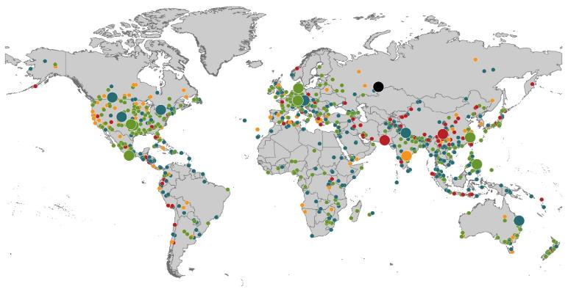
Natural Loss Events:
Full Year 2013
World Map
Winter Storm Christian (St. Jude)
Europe, 27–30 October
Floods
Europe,
30 May–19 June
Meteorite impact
Russian Federation, 15 February
Flash floods
Canada, 8–9 July
Floods
Canada, 19–24 June
Earthquake
China, 20 April
Hailstorms
Germany,
27–28 July
Floods
USA, 9–16 September
Typhoon Fitow
China, Japan,
5–9 October
Severe storms, tornadoes
USA, 18–22 May
Typhoon Haiyan
Philippines,
8–12 November
Severe storms, tornadoes
USA, 28–31 May
Floods
India, 14–30 June
Hurricanes Ingrid & Manuel
Mexico, 12–19 September
Floods
Australia,
21–31 January
880
Loss events
Earthquake (series)
Pakistan, 24–28 September
Heat wave
India, April–June
Geophysical events
(earthquake, tsunami, volcanic activity)
Hydrological events
(flood, mass movement)
Natural catastrophes
Geophysical events
(earthquake, tsunami, volcanic activity)
Hydrological events
(flood, mass movement)
Selection of significant
Natural catastrophes
Meteorological events
(storm)
Climatological events
(extreme temperature, drought, wildfire)
Meteorological events
(storm)
Climatological events
(extreme temperature, drought, wildfire)
Extraterrestrial events
(Meteorite impact)
Source: Munich Re Geo Risks Research, NatCatSERVICE – as of January 2014.
157

Slide 158
Natural Disasters Worldwide,
1980 – 2013 (Number of Events)
There were 880 natural disaster events globally in 2013 compared to 905 in 2012
Number
Geophysical
(earthquake, tsunami,
volcanic activity)
Meteorological (storm)
Climatological
(temperature extremes,
drought, wildfire)
Hydrological
(flood, mass movement)
Source: MR NatCatSERVICE
158

Slide 159
Losses Due to Natural Disasters Worldwide, 1980–2013 (Overall & Insured Losses)
(Overall and Insured Losses)
(2013 Dollars, $ Billions)
10-Yr. Avg. Losses
Overall : $184B
Insured: $56B
2013 Losses
Overall : $125B
Insured: $34B
There is a clear upward trend in both insured and overall losses over the past 30+ years
Overall losses (in 2013 values)
Insured losses (in 2013 values)
Source: MR NatCatSERVICE
159

Slide 160
Natural Disasters Worldwide,
1980 – 2013 (Number of Events)
There were 880 natural disaster events globally in 2013 compared to 905 in 2012
Number
Geophysical
(earthquake, tsunami,
volcanic activity)
Meteorological (storm)
Climatological
(temperature extremes,
drought, wildfire)
Hydrological
(flood, mass movement)
Source: MR NatCatSERVICE
160

Slide 161
Losses Due to Natural Disasters Worldwide, 1980–2013 (Overall & Insured Losses)
(Overall and Insured Losses)
(2013 Dollars, $ Billions)
10-Yr. Avg. Losses
Overall : $184B
Insured: $56B
2013 Losses
Overall : $125B
Insured: $34B
There is a clear upward trend in both insured and overall losses over the past 30+ years
Overall losses (in 2013 values)
Insured losses (in 2013 values)
Source: MR NatCatSERVICE
161

Slide 162
Natural Disaster Losses in the US, by Type, Jan. 1 – June 30, 2014
As of July 1, 2014 | Number of Events | Fatalities | Estimated Overall Losses (US $m) | Estimated Insured Losses (US $m)
Severe Thunderstorm | 33 | 65 | 9,100 | 6,700
Winter Storms & Cold Waves | 11 | 84 | 3,400 | 2,400
Flood, flash flood | 10 | 1 | 10 | -
Earthquake & Geophysical, landslides | 5 | 44 | 20 | -
Tropical Cyclone | - | - | - | -
Wildfire, Heat Waves, & Drought | 8 | 1 | 770 | -
Totals | 67 | 195 | 13,300 | 9,100
Source: Munich Re NatCatSERVICE
162
162

Slide 163
Natural Disaster Losses in the United States, by Type, 2013
As of December 31, 2013 | Number of Events | Fatalities | Estimated Overall Losses (US $m) | Estimated Insured Losses (US $m)
Severe Thunderstorm | 69 | 110 | 16,341 | 10,274
Winter Storm | 11 | 43 | 2,935 | 1,895
Flood | 19 | 23 | 1,929 | 240
Earthquake & Geophysical | 6 | 1 | Minor | Minor
Tropical Cyclone | 1 | 1 | Minor | Minor
Wildfire, Heat, & Drought | 22 | 29 | 620 | 385
Totals | 128 | 207 | 21,825 | 12,794
Source: Munich Re NatCatSERVICE
163
163

Slide 164
Significant Natural Catastrophes, 2013
(Events with $1 billion economic loss and/or 50 fatalities)
Date | Event | Estimated Economic Losses (US $m) | Estimated Insured Losses (US $m)
February 24 – 25 | Winter Storm | 1,300 | 690
March 18 – 19 | Thunderstorms | 2,200 | 1,600
April 7 – 11 | Winter Storm | 1,600 | 1,200
April 16 – 18 | Thunderstorms | 1,100 | 560
May 18 – 20 | Thunderstorms | 3,100 | 1,800
May 28 – 31 | Thunderstorms | 2,800 | 1,400
August 6 – 7 | Thunderstorms | 1,300 | 740
September 9 – 16 | Flooding | 1,500 | 160
November 17 - 18 | Thunderstorms | 1,300 | 931
Source: Munich Re NatCatSERVICE
164

Slide 165
Top 12 Most Costly Hurricanes in U.S. History
(Insured Losses, 2012 Dollars, $ Billions)
10 of the 12 most costly hurricanes in insurance history occurred over the past 9 years (2004—2012)
Hurricane Sandy became the 3rd costliest hurricane in US insurance history
Hurricane Irene became the 12th most expensive hurricane in US history in 2011
*PCS estimate as of 4/12/13.
Sources: PCS; Insurance Information Institute inflation adjustments to 2012 dollars using the CPI.

Slide 166
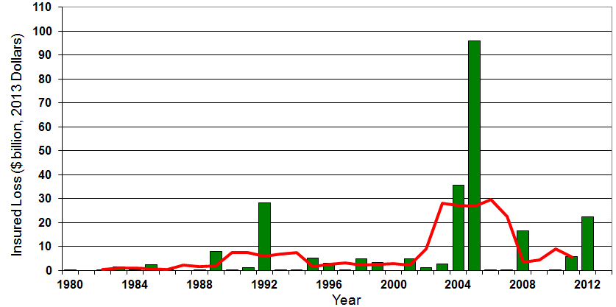

Insured US Tropical Cyclone Losses, 1980 - 2013
The current 5-year average (2008 - 2013) insured tropical cyclone loss is $5.6 billion per year.
Sources: Property Claims Service, Munich Re NatCatSERVICE, NFIP
166

Slide 167
Total Value of Insured Coastal Exposure in 2012
(2012, $ Billions)
The value of insured coastal exposure in TX is 3rd highest in US.
In 2012, New York Ranked as the #1 Most
Exposed State to Hurricane Loss, Overtaking Florida with $2.862 Trillion. Texas is very exposed too, and ranked #3 with $1.175 Trillion
in insured coastal exposure
The Insured Value of All Coastal Property Was $10.6 Trillion in 2012 , Up 20% from $8.9 Trillion in 2007 and Up 48% from $7.2 Trillion in 2004
Source: AIR Worldwide

Slide 168
The combined ratios for both personal and commercial lines improved substantially in 2013:H1

Slide 170
Convective Loss Events in the U.S.
Number of events 1980 – 2012 and First Half 2013
Number
The frequency of convective events has rising tremendously over the past 30+ years
Convective events are those caused by straight-line winds, tornadoes, hail, heavy precipitation, flash floods and lightning
Source: Geo Risks Research, NatCatSERVICE – As at July 2013
170

Slide 171
Convective Loss Events in the U.S.
Overall and insured losses 1980 – 2013 and First Half 2014
(Bill. US$)
Average thunderstorm losses are up 7 fold since the early 1980s. The 5-year running average loss is up sharply
Hurricanes get all the headlines, but thunderstorms are consistent producers of large scale loss. 2008-2013 are the most expensive years on record.
First half 2014 convective event insured losses totaled $6.7B ($9.1B overall economic loss)
Analysis contains: straight-line winds, tornadoes, hail, heavy precipitation, flash floods, lightning.
Overall losses (in 2013 values)
Insured losses (in 2013 values)
Source: Geo Risks Research, Munich Re NatCatSERVICE – As at July 2014
171

Slide 172
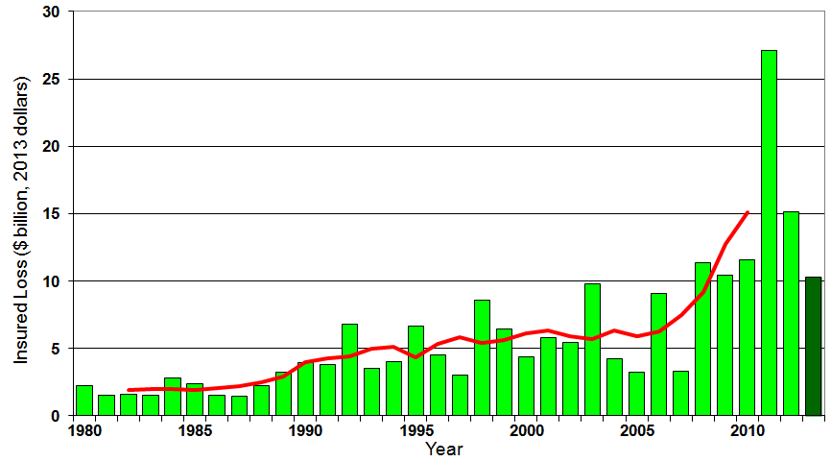
U.S. Thunderstorm Insured Loss Trends, 1980 – 2013
Hurricanes get all the headlines, but thunderstorms are consistent producers of large scale loss. 2008-2013 are the most expensive years on record.
Average thunderstorm losses are up 7 fold since the early 1980s. The 5-year running average loss is up sharply
Thunderstorm losses in 2013 totaled $10.3 billion, the 6th highest on record
Source: Property Claims Service, MR NatCatSERVICE
172

Slide 173
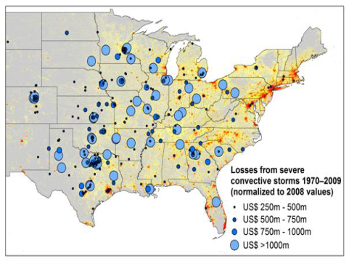
New Research Suggests Increase in Convective Activity Is Costly for Insurers
Study examines convective (hail, tornado, thundersquall and heavy rainfall) events in the US with losses exceeding US$ 250m in the period 1970–2009 (80% of all losses)
Past losses are normalized (i.e., adjusted) to currently exposed values
After normalization there are still increases of losses
Increases are correlated with
the increase in the meteorological
potential for severe thunderstorms
and its variability
For the first time research shows
that climatic changes have already
influenced US thunderstorm losses
Source: Munich Re research paper, Marhc 18, 2013: Rising Variability in Thunderstorm-Related U.S. Losses as a Reflection of Changes in Large-Scale Thunderstorm Forcing.
173

Slide 174
Natural Loss Events:
Full Year 2013
World Map
Winter Storm Christian (St. Jude)
Europe, 27–30 October
Floods
Europe,
30 May–19 June
Meteorite impact
Russian Federation, 15 February
Flash floods
Canada, 8–9 July
Floods
Canada, 19–24 June
Earthquake
China, 20 April
Hailstorms
Germany,
27–28 July
Floods
USA, 9–16 September
Typhoon Fitow
China, Japan,
5–9 October
Severe storms, tornadoes
USA, 18–22 May
Typhoon Haiyan
Philippines,
8–12 November
Severe storms, tornadoes
USA, 28–31 May
Floods
India, 14–30 June
Hurricanes Ingrid & Manuel
Mexico, 12–19 September
Floods
Australia,
21–31 January
880
Loss events
Earthquake (series)
Pakistan, 24–28 September
Heat wave
India, April–June
Geophysical events
(earthquake, tsunami, volcanic activity)
Hydrological events
(flood, mass movement)
Natural catastrophes
Geophysical events
(earthquake, tsunami, volcanic activity)
Hydrological events
(flood, mass movement)
Selection of significant
Natural catastrophes
Meteorological events
(storm)
Climatological events
(extreme temperature, drought, wildfire)
Meteorological events
(storm)
Climatological events
(extreme temperature, drought, wildfire)
Extraterrestrial events
(Meteorite impact)
Source: Munich Re Geo Risks Research, NatCatSERVICE – as of January 2014.
174

Slide 175
Total Value of Insured Coastal Exposure in 2007
(2007, $ Billions)
In 2007, Florida Still Ranked as the #1 Most
Exposed State to Hurricane Loss, with
$2.459 Trillion Exposure, but Texas is very exposed too, and ranked #3 with $895B
in insured coastal exposure
The Insured Value of All Coastal Property Was $8.9 Trillion in 2007, Up 24% from $7.2 Trillion in 2004
Source: AIR Worldwide

Slide 176
Total Potential Home Value Exposure to Storm Surge Risk in 2013*
($ Billions)
Florida is by the state most vulnerable to storm surge.
The Value of Homes Exposed to Storm Surge was $1.147 Trillion in 2013.* Only a fraction of this is insured, hence the huge demand for federal aid following major coastal flooding events.
*Insured and uninsured property. Based on estimated property values as of April 2013.
Source: Storm Surge Report 2013, CoreLogic.

Slide 177
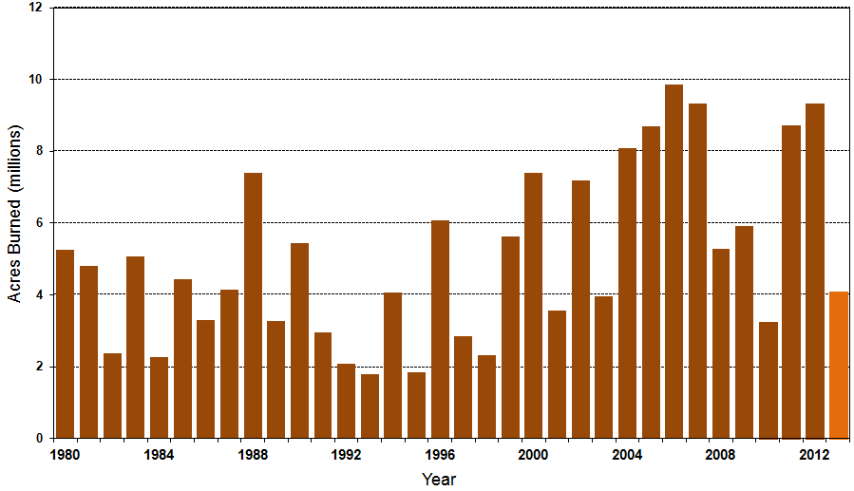
Number of Acres Burned in Wildfires, 1980 – 2013
TX experienced significant wildfire losses in 2011 (Bastrop fire insured losses ~$500 million)
Source: National Interagency Fire Center
177

Slide 178
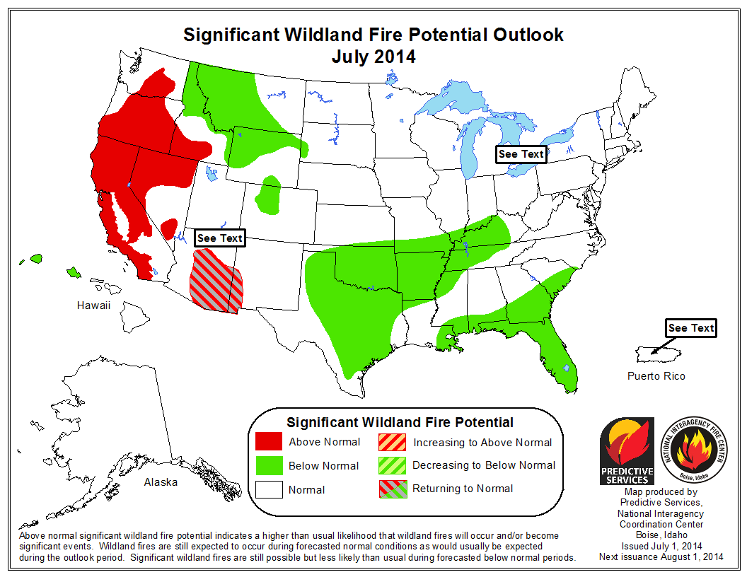
Wildfire Outlook for the Western US is Grave but Better in the East
Much of the West and Northwest US is at an elevated risk for wildfire due to prolonged drought and high temperatures
Source: National Interagency Fire Center
178

Slide 179
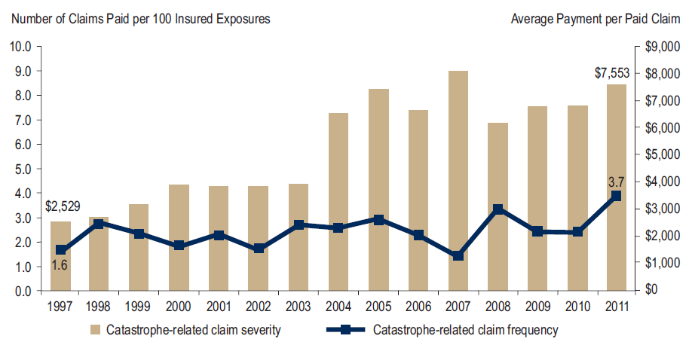
Homeowners Insurance Catastrophe-Related Claim Frequency and Severity, 1997—2012*
Avg. catastrophe claim cost rose approximately 200% from 1997-2011
Cat claim frequency in 2011 was at historic highs and more than double the rate in 1997
*All policy forms combined, countrywide.
Source: Insurance Research Council, Trends in Homeowners Insurance Claims, Sept. 2012 from ISO Fast Track data.
179

Slide 180
Homeowners Insurance Combined Ratio: 1990–2015F
Hurricane Andrew
Record tornado activity
Hurricane Sandy
Hurricane Ike
Homeowners Performance in 2011/12 Impacted by Large Cat Losses. Extreme Regional Variation Can Be Expected Due to Local Catastrophe Loss Activity
Sources: A.M. Best (1990-2011);Conning (2012E-2015F); Insurance Information Institute.

Slide 181
Federal Disaster Declarations Patterns: 1953-2014
Disaster Declarations Set New Records in Recent Years
181

Slide 182
Number of Federal Major Disaster Declarations, 1953-2014*
There have been 2,176 federal disaster declarations since 1953. The average number of declarations per year is 35 from 1953-2013, though there few haven’t been recorded since 1995.
The number of federal disaster declarations set a new record in 2011, with 99, shattering 2010’s record 81 declarations.
40 federal disasters were declared so far in 2014*
The Number of Federal Disaster Declarations Is Rising and Set New Records in 2010 and 2011 Before Dropping in 2012/13
*Through September 2, 2014.
Source: Federal Emergency Management Administration; http://www.fema.gov/disasters; Insurance Information Institute.

Slide 183
Federal Disasters Declarations by State,
1953 – 2014: Highest 25 States*
Over the past 60 years, Texas has had the highest number of Federal Disaster Declarations (none so far in 2014; 2 in in 2013)
*Through Sept. 2, 2014. Includes Puerto Rico and the District of Columbia.
Source: FEMA: http://www.fema.gov/news/disaster_totals_annual.fema; Insurance Information Institute.

Slide 184
Federal Disasters Declarations by State,
1953 – 2014: Lowest 25 States*
Over the past 60 years, Wyoming and Rhode Island had the fewest number of Federal Disaster Declarations
*Through Sept. 2, 2014. Includes Puerto Rico and the District of Columbia.
Source: FEMA: http://www.fema.gov/news/disaster_totals_annual.fema; Insurance Information Institute.

Slide 185
SEVERE WEATHER REPORT UPDATE: 2014
Damage from Tornadoes, Large Hail and High Winds Keep Insurers Busy
185

Slide 186
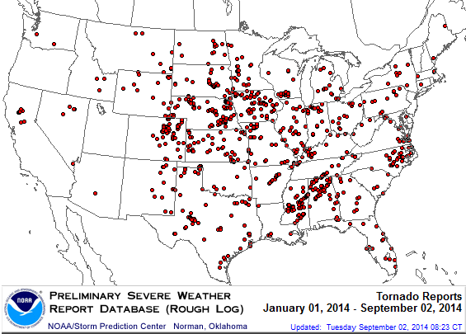
Location of Tornado Reports in 2014:
Through September 2, 2014
There have been 894 tornadoes so far in 2014, causing extensive property damage in several states
Source: NOAA Storm Prediction Center; http://www.spc.noaa.gov/climo/online/monthly/2014_annual_summary.html#; PCS.
186

Slide 187
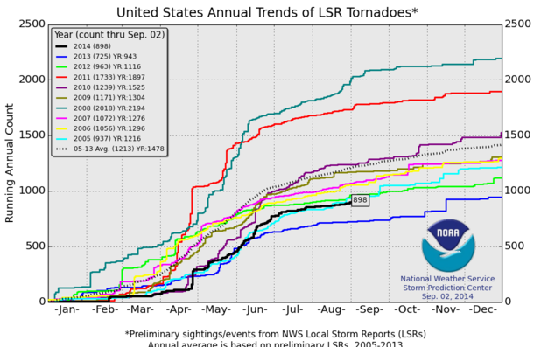
U.S. Tornado Count, 2005-2014*
There were 1,897 tornadoes in the U.S. in 2011 far above average, but well below 2008’s record
2013 count was the lowest in a decade
2014 count (898 though Sep. 2) is running below avg.
*Through Sept. 2, 2014.
Source: http://www.spc.noaa.gov/wcm/.
187

Slide 188
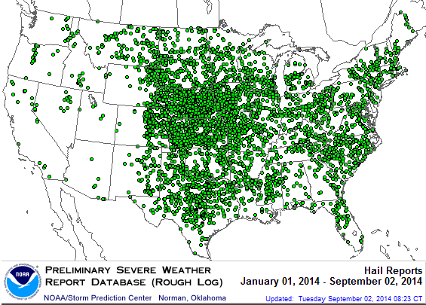
Location of Large Hail Reports:
Through September 2, 2014
There have been 4,972 “Large Hail” reports in the US so far in 2014, causing extensive property and vehicle damage
Source: NOAA Storm Prediction Center; http://www.spc.noaa.gov/climo/online/monthly/2014_annual_summary.html#
188

Slide 189
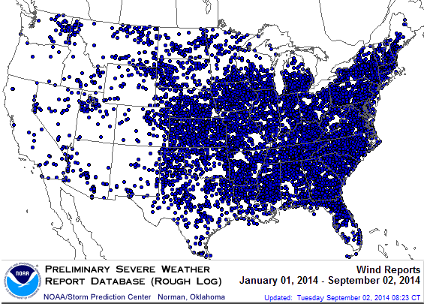
Location of High Wind Reports:
Through September 2, 2014
There have been 10,294 “Wind Damage” so far in 2014, causing extensive property damage
Source: NOAA Storm Prediction Center; http://www.spc.noaa.gov/climo/online/monthly/2014_annual_summary.html#
189

Slide 190
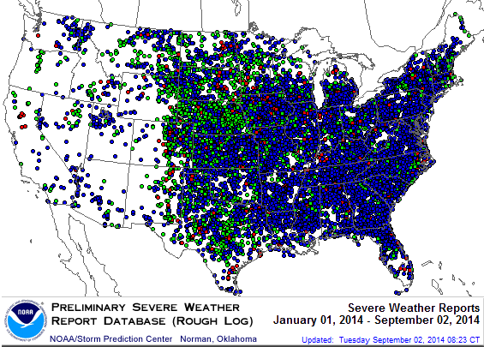
Severe Weather Reports:
Through September 2, 2014
Severe weather reports are concentrated east of the Rockies
There were 16,161 severe weather reports so far in 2014; including 894 tornadoes; 4,972 “Large Hail” reports and 10,294 high wind events
Source: NOAA Storm Prediction Center; http://www.spc.noaa.gov/climo/online/monthly/2014_annual_summary.html#
190

Slide 191
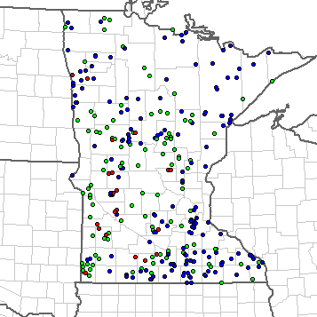
Severe Weather Reports in Minnesota: Through September 2, 2014
308 severe weather reports through 9/2/14
23 Tornadoes
126 Large Hail Reports
159 High Wind Events
Source: NOAA Storm Prediction Center; http://www.spc.noaa.gov/climo/online/monthly/2014_annual_summary.html#
191

Slide 192
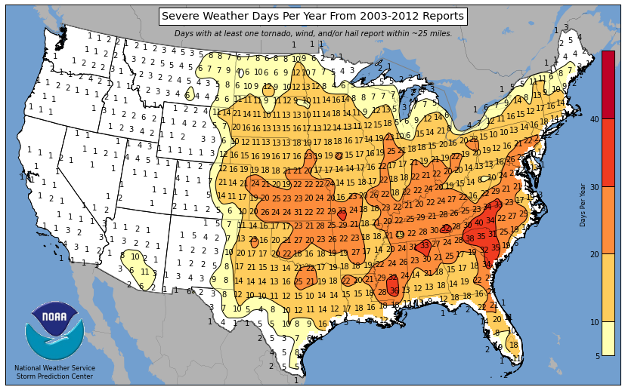
Severe Weather Days in Minnesota: Annual Average, 2003-2012
Much of MN experiences 12-16 severe weather days per year
Source: National Weather Service Storm Prediction Center at http://www.spc.noaa.gov/wcm/; Insurance Information Institute.
192

Slide 193
Historical Tornado Frequency per Year, 1950-2012
Tornado frequency in MN is highest in the south central parts of the state
Source: Minnesota All Hazards Mitigation Plan, p.120; Insurance Information Institute.
193

Slide 194
Annual Frequency of Winds Speeds Greater than 65 Knots, 1955-2012
The highest winds in MN tend to occur in and around the more densely populated MSP area, where property values are the highest
Source: Minnesota All Hazards Mitigation Plan, p.120; Insurance Information Institute.
194

Slide 195
Occurrences of Hail Storms
Within 50 Miles
Hail storms events occur most commonly in the densely populated MSP area and in the extreme southwest of the state
Source: Minnesota All Hazards Mitigation Plan; Insurance Information Institute.
195

Slide 196
I.I.I. Poll: Homes Near Hazards
Q. If you were to purchase a home today, which of the following summarizes your views on that home’s risk of damage from natural disasters . . . and your decision to purchase that home?
Don’t Know
Willing to Accept Risk
Risk Not a Major Consideration
Risk a Significant Influence on Purchase
More Than Half of the Public Would Be Significantly Influenced by Risk of Damage from Natural Disasters. Close to a Third Do Not Regard Such a Risk To Be a Major Consideration.
Source: Insurance Information Institute Annual Pulse Survey.

Slide 197
I.I.I. Poll: Flood Insurance Rates
Q. Congress recently passed a law that will roll back some of the rate increases it put in place for homeowers who purchase subsidized flood insurance from the government . . . . Do you think the recent rate rollback and subsidies should remain in place for most homeowners who purchase flood insurance; or the rollbacks and subsidies should be eliminated; or don’t know?
Don’t Know
Eliminated
Remain in Place
Most Americans Support the Flood Insurance Rate Rollback.
Source: Insurance Information Institute Annual Pulse Survey.

Slide 198
Outlook for the 2014 Atlantic Hurricane Season
Somewhat Below Average Activity, Fewer Landfalls Expected
198

Slide 199
Outlook for 2014 Hurricane Season: 30% Less Active Than Typical Year
 | Median* | 2005 (Katrina Year) | 2014F
Named Storms | 12.0 | 28 | 10
Named Storm Days | 60.1 | 115.5 | 40
Hurricanes | 6.5 | 14 | 4
Hurricane Days | 21.3 | 47.5 | 15
Major Hurricanes | 2.0 | 7 | 1
Major Hurricane Days | 3.9 | 7 | 3
Accumulated Cyclone Energy | 92.0 | NA | 65
Net Tropical Cyclone Activity | 103% | 275% | 70%
*Over the period 1981-2010.
Source: Dr. Philip Klotzbach and Dr. William Gray, Colorado State University, June 2, 2014.

Slide 200
Probability of Major Hurricane Landfall (CAT 3, 4, 5) in 2014
 | Average* | 2014F
Entire US Coast | 52% | 40%
US East Coast Including Florida Peninsula | 31% | 22%
Gulf Coast from FL Panhandle to Brownsville, TX | 30% | 23%
ALSO…Above-Average Major Hurricane Landfall Risk in Caribbean for 2011 (32% vs. 42%)
*Average over the past century.
Source: Dr. Philip Klotzbach and Dr. William Gray, Colorado State University, June 2, 2014.

Slide 201
Total Value of Insured Coastal Exposure in 2012
(2012, $ Billions)
The value of insured coastal exposure in FL and NY is close to $3 trillion
In 2012, New York Ranked as the #1 Most
Exposed State to Hurricane Loss, Overtaking Florida with $2.862 Trillion. Texas is very exposed too, and ranked #3 with $1.175 Trillion
in insured coastal exposure
The Insured Value of All Coastal Property Was $10.6 Trillion in 2012 , Up 20% from $8.9 Trillion in 2007 and Up 48% from $7.2 Trillion in 2004
Source: AIR Worldwide

Slide 202
Total Value of Insured Coastal Exposure in 2007
(2007, $ Billions)
In 2007, Florida Still Ranked as the #1 Most
Exposed State to Hurricane Loss, with
$2.459 Trillion Exposure, but Texas is very exposed too, and ranked #3 with $895B
in insured coastal exposure
The Insured Value of All Coastal Property Was $8.9 Trillion in 2007, Up 24% from $7.2 Trillion in 2004
Source: AIR Worldwide

Slide 203
Terrorism Update
TRIA’s Success
Consequences of Expiration
Download III’s Terrorism Insurance Report at: http://www.iii.org/white_papers/terrorism-risk-a-constant-threat-2014.html
203
Notes:
203

Slide 204
Loss Distribution by Type of Insurance from Sept. 11 Terrorist Attack ($ 2013)
($ Billions)
Total Insured Losses Estimate: $42.9B**
*Loss total does not include March 2010 New York City settlement of up to $657.5 million to compensate approximately 10,000 Ground Zero workers or any subsequent settlements.
**$32.5 billion in 2001 dollars.
Source: Insurance Information Institute.

Slide 205
Terrorism Insurance Take-up Rates,
By Year, 2003-2013
TRIA’s high take-up rates, availability and affordability have benefitted businesses, workers and the entire US economy since the program’s enactment
In 2003, the first year TRIA was in effect, the terrorism take-up rate was 27 percent. Since then, it has increased steadily, remaining in the low 60 percent range since 2009.
Source: Marsh Global Analytics, 2014 Terrorism Risk Insurance Report, April 2014 and earlier editions.
205
Notes:
205

Slide 206
Terrorism Insurance Take-Up Rates by State for 2013*
Take-up rate for terrorism insurance in MN is 54%
The overall US take-up rate for terrorism coverage was 62% in 2013 and ranged from a lows of 41% in Michigan to a high of 84% in Massachusetts (where demand likely increased due to the April 2013 Boston Marathon bombing)
*Data for 27 states with sufficient data.
Source: Marsh 2014 Terrorism Risk Insurance Report; Insurance Information Institute.

Slide 207
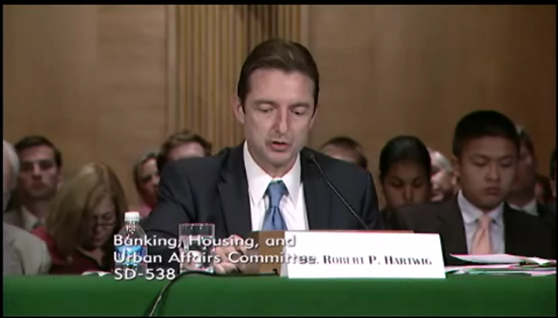
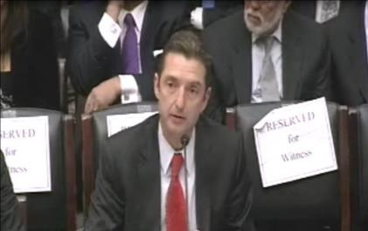
Terrorism Risk Insurance Program
Testified before House Financial Services Nov. 2013
Testified before Senate Banking Cmte. in Sept. 2013
Provided testimony at NYC hearing in June 2013
Provided Capitol Hill Joint House/Senate Staff Briefing in April 2014
I.I.I. Published Several Updates to its Study on Terrorism Risk and Insurance
Working with Trades, Congressional Staff, GAO & Others
House Financial Services Subcommittee, 11/13/13
Senate Banking Committee, 9/25/13
207
12/01/09 - 9pm
eSlide – P6466 – The Financial Crisis and the Future of the P/C
Notes:
207

Slide 208
I.I.I. White Paper (March 2014):
Terrorism Risk: A Constant Threat
Detailed history of TRIA
How TRIA works
Assessing the threat of terrorism
Terrorism market conditions
Global perspective
Download at http://www.iii.org/white_papers/terrorism-risk-a-constant-threat-2014.html
208
12/01/09 - 9pm
eSlide – P6466 – The Financial Crisis and the Future of the P/C
Notes:
208

Slide 209
Summary of President’s Working Group Report on TRIA (April 2014)
Insurance for terrorism risk is available and affordable
  Availability/affordability have has not changed appreciably since 2010
Prices for terrorism risk insurance vary considerably depending on the policyholder’s industry and location of risk
Prices have declined since TRIA was enacted
  Currently ~3% to 5% of commercial property insurance premiums
Take-up rates have improved since adoption of TRIA
  Overall take-up rate is steady at ~60% (62% in 2013 per Marsh)
Market capacity is currently tightening given uncertainty over TRIA reauthorization
The private market does not have the capacity to provide reinsurance for terror risk to the extent currently provided by TRIA
In the absence of TRIA, terrorism risk insurance would likely be less available. Coverage that would be available likely would be more costly and/or limited in scope
Source: Report of the President’s Working Group on Financial Markets,The Long-Term Availability and Affordability of Insurance for Terrorism Risk,
April 2014.

Slide 210
Framing the Issue and Educating Policymakers: A Timeline
Education Efforts Pay Off
  Senate Banking Committee unanimously reports out TRIA bill 22-0
  House Financial Services Committee passes bill
  Senate passes bill with strong support; Votes 93-4 to reauthorize on 7/17
Key addition to bills: clarification on certification process, cyber terrorism
Where do we go from here? Are difference between the bills bridgeable?
  Reauthorization terms differ (Senate: 7yrs; House: 5yrs)
  Bifurcation of NBCR and conventional
  Trigger points ($100M vs. $500M)
Clock is running: After July 31, the House is in session for only 12 days before the election
  Lame duck for enactment
Source: Marsh

Slide 211
Initial Market Response to Potential
TRIA Expiration
Carriers monitoring and modeling WC exposure aggregations across their portfolio and correlated lines of business such as property or life and health (both on an individual client basis and in the aggregate)
Carrier declinations have occurred because they are “overlined” in a particular zip code or city
Many carriers attached NCCI Endorsement WC00 01 14 (Notification Endorsement of Pending Law Change to Terrorism Risk Insurance Program Reauthorization Act of 2007) or an equivalent for non-NCCI states.
For some high-profile clients or those in urban areas and/or with high employee concentrations, carriers issued short term policies set to expire at the same time as TRIPRA
Regarding non-WC lines (including select XSWC placements), policyholders were faced with new or broadened exclusionary wording on GL, umbrella, and XS forms
Source: Marsh

Slide 212
CAT OF THE FUTURE?
CYBER RISK
Cyber Risk is a Rapidly Emerging Exposure for Businesses Large and Small in Every Industry
NEW III White Paper: http://www.iii.org/assets/docs/pdf/paper_CyberRisk_2013.pdf
212

Slide 213





Data Breaches 2005-2013, by Number of Breaches and Records Exposed
# Data Breaches/Millions of Records Exposed
Millions
The Total Number of Data Breaches (+38%) and Number of Records Exposed (+408%) in 2013 Soared
* 2013 figures as of Jan. 1, 2014 from the ITRC updated to an additional 30 million records breached (Target) as disclosed in Jan. 2014.
Source: Identity Theft Resource Center.

Slide 214
2013 Data Breaches By Business Category, By Number of Breaches
The majority of the 614 data breaches in 2013 affected business and medical/healthcare organizations, according to the Identity Theft Resource Center.
Banking/Credit/Financial, 23 (3.7%)
Govt/Military, 56 (9.1%)
Business, 211 (34.4%)
Educational, 55 (9.0%)
Medical/Healthcare, 269 (43.8%)
Source: Identity Theft Resource Center, http://www.idtheftcenter.org/images/breach/2013/UpdatedITRCBreachStatsReport.pdf

Slide 215
The Most Costly Cyber Crimes, Fiscal Year 2013
Denial of service, malicious code and web-based attacks account for more than 55 percent of all cyber costs per U.S. organization on an annual basis.
Botnets
Viruses, Worms, Trojans
Malicious code
Malware
Malicious insiders
Stolen devices
Denial of service
Phishing + social engineering
Web-based attacks
Source: 2013 Cost of Cyber Crime: United States, Ponemon Institute.

Slide 216
External Cyber Crime Costs: Fiscal Year 2013
Information loss (43%) and business disruption or lost productivity (36%) account for the majority of external costs due to cyber crime.
Equipment damages
Information loss
Revenue loss
Business disruption
Other costs* 0%
* Other costs include direct and indirect costs that could not be allocated to a main external cost category
Source: 2013 Cost of Cyber Crime: United States, Ponemon Institute.

Slide 217
Distribution Trends
Distribution by Channel Type Continues to Evolve Around the World
217

Slide 218
All P/C Lines Distribution Channels, Direct vs. Independent Agents
Independent agents steadily lost market share from the early 1980s through the early 2000s across all P/C lines, but have gained or held generally steady in recent years. Direct channels include exclusive agency companies, direct marketers and direct sales (e.g., internet)
Source: Insurance Information Institute; based on data from Conning and A.M. Best.

Slide 219
Commercial P/C Distribution Channels, Direct vs. Independent Agents
Independent agents have seen only modest erosion in commercial lines market share in recent decades
Source: Insurance Information Institute; based on data from Conning and A.M. Best.

Slide 220
Personal Lines Distribution Channels, Direct vs. Independent Agents
Independent agents have lost significant personal lines market share since the early 1970s. Although the trend has slowed, it may be accelerating again.
Source: Insurance Information Institute; based on data from Conning and A.M. Best.

Slide 221
INVESTMENTS:
THE NEW REALITY
Investment Performance is a Key Driver of Profitability
Depressed Yields Will Necessarily Influence Underwriting & Pricing
221

Slide 222
Property/Casualty Insurance Industry Investment Income: 2000–2014¹
Investment earnings are still below their 2007 pre-crisis peak
($ Billions)
Due to persistently low interest rates,
investment income fell in 2012 and in 2013
and is falling again in 2014.
¹ Investment gains consist primarily of interest and stock dividends. *2014 investment income is estimated Q1, annualized.
Sources: ISO; Insurance Information Institute.

Slide 223
P/C Insurer Net Realized
Capital Gains/Losses, 1990-2014:Q1
Realized capital gains rose sharply as equity markets rallied
($ Billions)
Insurers Posted Net Realized Capital Gains in 2010 - 2013 Following Two Years of Realized Losses During the Financial Crisis. Realized Capital Losses Were a Primary Cause of 2008/2009’s Large Drop in Profits and ROE
Sources: A.M. Best, ISO, Insurance Information Institute.
223
12/01/09 - 9pm
eSlide – P6466 – The Financial Crisis and the Future of the P/C
Notes:
223

Slide 224
Property/Casualty Insurance Industry Investment Gain: 1994–2014:Q1¹
($ Billions)
Investment gains in 2013 were their highest in the post-crisis era
Investment Income Continued to Fall in 2013 Due to Low Interest Rates but Realized Investment Gains Were Up Sharply; The Financial Crisis Caused Investment Gains to Fall by 50% in 2008
¹ Investment gains consist primarily of interest, stock dividends and realized capital gains and losses.
* 2005 figure includes special one-time dividend of $3.2B;
Sources: ISO; Insurance Information Institute.

Slide 225
U.S. 10-Year Treasury Note Yields:
A Long Downward Trend, 1990–2014*
Yields on 10-Year U.S. Treasury Notes recently plunged to record modern-era lows in early 2013 but have since risen as the Fed begins “tapering” its QE program in 2014
Yields on 10-Year U.S. Treasury Notes have been essentially below 5% for a full decade.
Since roughly 80% of P/C bond/cash investments are in 10-year or shorter durations, most P/C insurer portfolios will have low-yielding bonds for years to come.
*Monthly, through June 2014. Note: Recessions indicated by gray shaded columns.
Sources: Federal Reserve Bank at http://www.federalreserve.gov/releases/h15/data.htm.
National Bureau of Economic Research (recession dates); Insurance Information Institutes.
225
12/01/09 - 9pm
eSlide – P6466 – The Financial Crisis and the Future of the P/C
Notes:
225

Slide 226
U.S. Treasury Security Yields:
A Long Downward Trend, 1990–2014*
Yields on 10-Year U.S. Treasury Notes have been essentially below 5% for a full decade.
U.S. Treasury yields plunged to historic lows in 2013. Longer-term yields have rebounded a bit.
Since roughly 80% of P/C bond/cash investments are in 10-year or shorter durations, most P/C insurer portfolios will have low-yielding bonds for years to come.
*Monthly, constant maturity, nominal rates, through July 2014.
Sources: Federal Reserve Bank at http://www.federalreserve.gov/releases/h15/data.htm. National Bureau of Economic Research (recession dates); Insurance Information Institute.
226
12/01/09 - 9pm
eSlide – P6466 – The Financial Crisis and the Future of the P/C
Notes:
226

Slide 227
Reduction in Combined Ratio Necessary to Offset 1% Decline in Investment Yield to Maintain Constant ROE, by Line*
Lower Investment Earnings Place a Greater Burden on Underwriting and Pricing Discipline
*Based on 2008 Invested Assets and Earned Premiums
**US domestic reinsurance only
Source: A.M. Best; Insurance Information Institute.
227
12/01/09 - 9pm
eSlide – P6466 – The Financial Crisis and the Future of the P/C
Notes:
227
This shows the drop in Combined Ratio for each line of business that would be needed to maintain a constant ROE, given a 1-percentage-point drop in investment yield

Slide 228
Distribution of Bond Maturities,
P/C Insurance Industry, 2003-2013
The main shift over these years has been from bonds with longer maturities to bonds with shorter maturities. The industry first trimmed its holdings of over-10-year bonds (from 24.6% in 2003 to 15.5% in 2012) and then trimmed bonds in the 5-10-year category (from 31.3% in 2003 to 27.6% in 2012) . Falling average maturity of the P/C industry’s bond portfolio is contributing to a drop in investment income along with lower yields.
Sources: SNL Financial; Insurance Information Institute.

Slide 229
Shifting Legal Liability &
Tort Environment
Is the Tort Pendulum
Swinging Against Insurers?
229

Slide 230
Over the Last Three Decades, Total Tort Costs as a % of GDP Appear Somewhat Cyclical, 1980-2013E
($ Billions)
2.21% of GDP in 2003 = pre-tort reform peak
Deepwater Horizon Spike in 2010
Tort costs in dollar terms have remained high but relatively stable since the mid-2000s., but are down substantially as a share of GDP
1.68% of GDP in 2013
Sources: Towers Watson, 2011 Update on US Tort Cost Trends, Appendix 1A

Slide 231
Commercial Lines Tort Costs: Insured vs. Self-(Un)Insured Shares, 1973-2010
2005: $143.5B 66.4% insured, 33.6% self-(un)insured
Billions of Dollars
$15.0
1995: $83.6B 69.5% insured, 30.5% self-(un)insured
1973: Commercial Tort Costs Totaled $6.49B, 94% was insured, 6% self-(un)insured
1985: $46.6B 74.5% insured, 25.5% self-(un)insured
$9.5
$6.0
2009: $126.5B 64.4% insured, 35.6% self-(un)insured
Tort Costs and the Share Retained by Risks Both Grew Rapidly from the mid-1970s to mid-2000s, When Tort Costs Began to Fall But Self-Insurance Shares Continued to Rise
Sources: Towers Watson, 2011 Update on US Tort Cost Trends, III Calculations based on data from Appendix 4.
231
12/01/09 - 9pm
eSlide – P6466 – The Financial Crisis and the Future of the P/C
Notes:
231

Slide 232
Commercial Lines Tort Costs: Insured vs. Self-(Un)Insured Shares, 1973-2010
Percent
2010: $138.1B 56.6% insured, 44.4% self-(un)insured (distorted by Deepwater Horizon event with most losses retained by BP)
1973: 94% was insured, 6% self-(un)insured
1985:74.5% insured, 25.5% self-(un)insured
1995: 69.5% insured, 30.5% self-(un)insured
2005: 66.4% insured, 33.6% self-(un)insured
The Share of Tort Costs Retained by Risks Has Been Steadily Increasing for Nearly 40 Years. This Trend Contributes Has Left Insurers With Less Control Over Pricing.
Sources: Towers Watson, 2011 Update on US Tort Cost Trends, III Calculations based on data from Appendix 4.
232
12/01/09 - 9pm
eSlide – P6466 – The Financial Crisis and the Future of the P/C
Notes:
232

Slide 233
Business Leaders Ranking of Liability Systems in 2012
Best States
Delaware
Nebraska
Wyoming
Minnesota
Kansas
Idaho
Virginia
North Dakota
Utah
Iowa
Worst States
Florida
Oklahoma
Alabama
New Mexico
Montana
Illinois
California
Mississippi
Louisiana
West Virginia
New in 2012
Wyoming
Minnesota
Kansas
Idaho
Newly Notorious
Oklahoma
Drop-offs
Rising Above
Indiana
Colorado
Massachusetts
South Dakota
Arkansas
Source: US Chamber of Commerce 2012 State Liability Systems Ranking Study; Insurance Info. Institute.

Slide 234
The Nation’s Judicial Hellholes: 2012/2013
Watch List
Illinois
Madison County
West Virginia
Maryland
Baltimore
Philadelphia, Pennsylvania
South Florida
Cook County, Illinois
New Jersey
Nevada
Louisiana
California
Dishonorable Mention
New York
Albany and NYC
MO Supreme Court
WA Supreme Court
Source: American Tort Reform Association; Insurance Information Institute

Slide 235
Insurance Information Institute Online:
www.iii.org
Thank you for your time
and your attention!
Twitter: twitter.com/bob_hartwig
Download at www.iii.org/presentations

