Slide 1
Property/Casualty Insurance: A Brief Tour
University of Missouri
Columbia, Missouri
September 9, 2019
James Lynch, FCAS MAAA, Chief Actuary
Insurance Information Institute  110 William Street  New York, NY 10038 Tel: 212.346.5533  jamesl@iii.org  www.iii.org

Slide 2
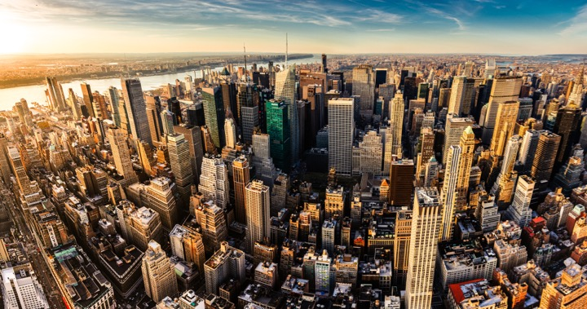
I.I.I. Mission Statement
Improving public understanding of insurance...
…what it does and how it works.
2

Slide 3










How Insurance Drives Economic Growth
Safety/
Security
Economic/ Financial Stability
Development
Insurers are financial first responders
Insurers are capital protectors
Insurance is a partner in social policy
Insurers are community builders
Insurance enables infrastructure improvements
Insurers are risk mitigators
Insurance sustains the supply chain
Insurers are capital infusers
Insurers are innovation catalysts
Insurers are credit facilitators
Notes:
3

Slide 4
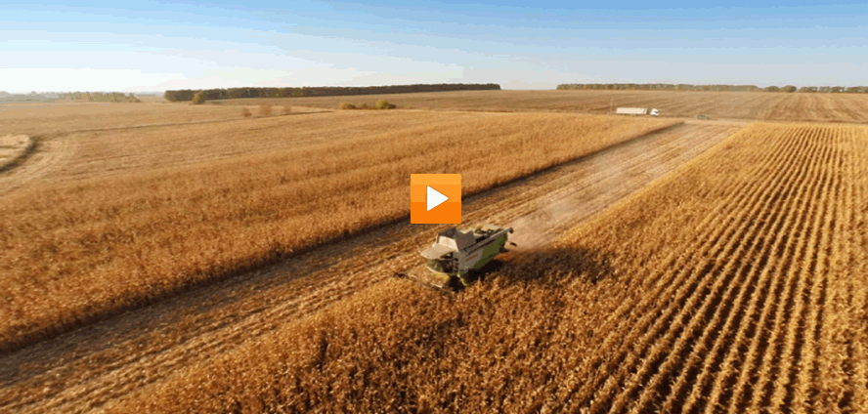
Insurance and Agriculture
Video: Insurance and Agriculture

Slide 5
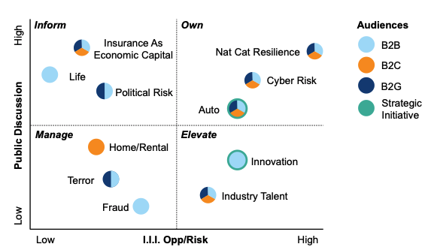
Our Priorities In 2019 Continue To Reflect Where Industry & Customer Conversations Are Focused

Slide 6
The Need for Resilience
Extreme Weather Threatens Union

Slide 7
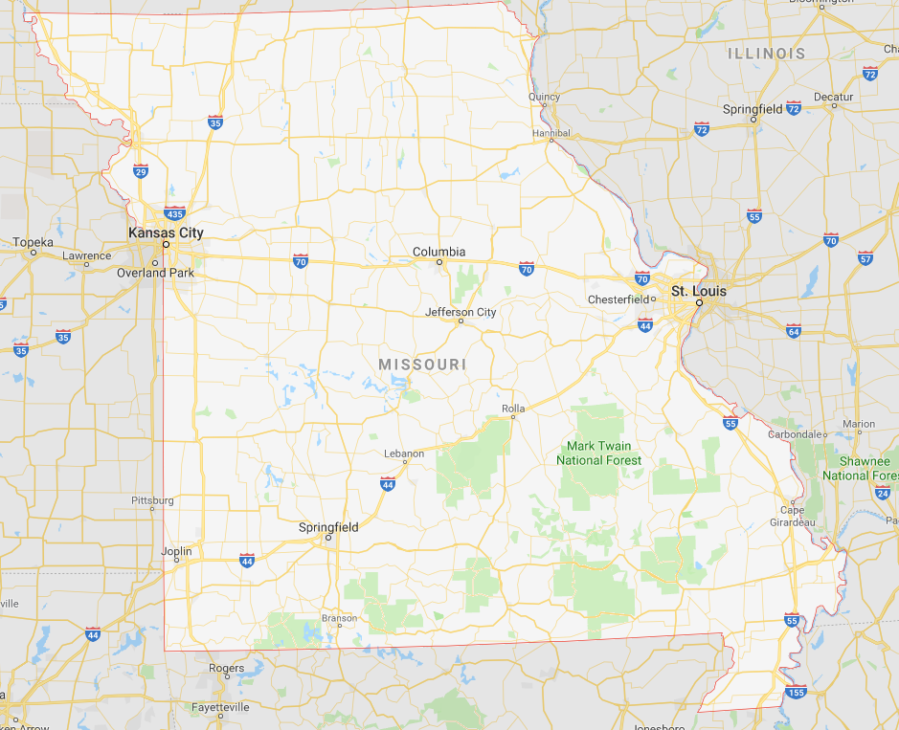
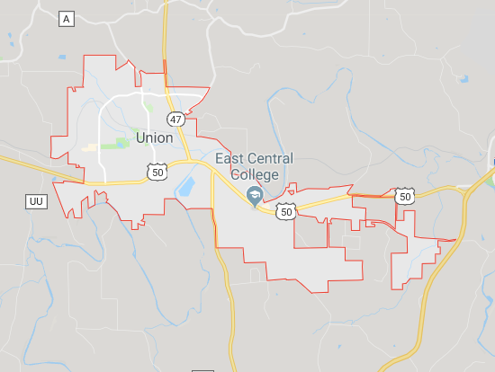
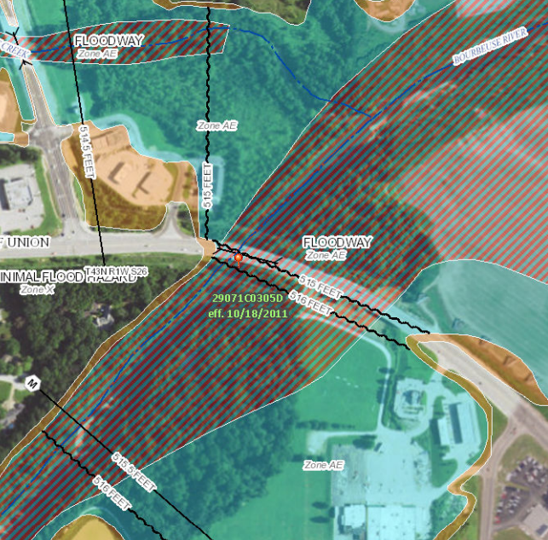
A Small Town in Missouri

Slide 8
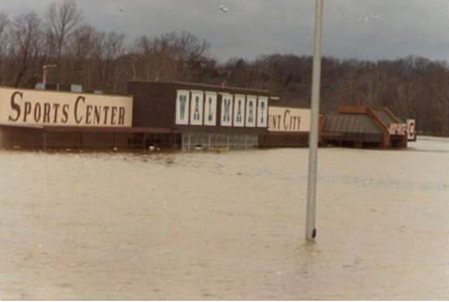
1982 Union, Missouri, Flood
A Storm for the Ages
Bourbeuse River
Record Crest
33.8 feet
12/5/1982
Source: Fox2News.com, @BoxxRadio.

Slide 9
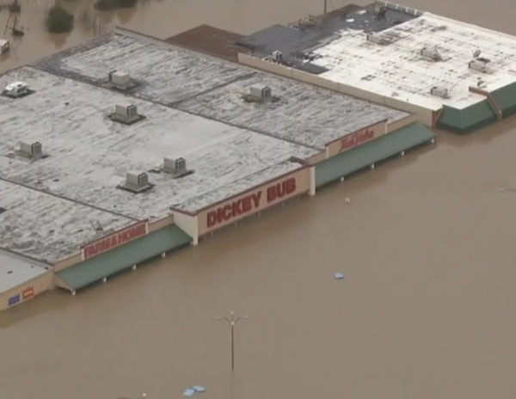
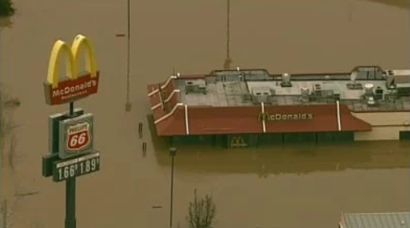
2015 Union, Missouri, Flood
A Storm for the Ages
Bourbeuse River
Record Crest
34.3 feet
12/29/2015
Sources: CBSnews.com; fox2news.com

Slide 10
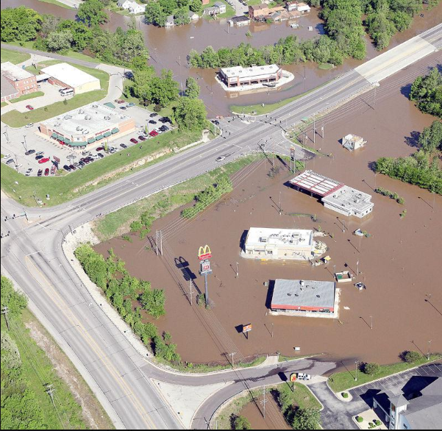
2017 Union, Missouri, Flood
Bourbeuse River
Crest
29.4 feet
May 2-3, 2017
“Unfortunately, it’s a river and Mother Nature.
And we can’t control her.”
 | Crest (feet) | Year
1 | 34.31 | 2015
2 | 33.80 | 1982
3 | 29.38 | 2017
4 | 28.50 | 1915
5 | 27.77 | 1994
6 | 26.37 | 1993
7 | 25.89 | 2008
8 | 24.53 | 2000
9 | 24.44 | 1957
10 | 23.89 | 2005
 | Crest (feet) | Year
1 | 0.40 | 1936
2 | 0.40 | 1948
3 | 0.40 | 1948
4 | 0.50 | 1976
5 | 0.55 | 2014
6 | 0.64 | 2012
7 | 0.68 | 2000
8 | 0.78 | 2001
9 | 0.80 | 1996
10 | 1.14 | 2007
Source: eMissourian.com, National Weather Service.

Slide 11
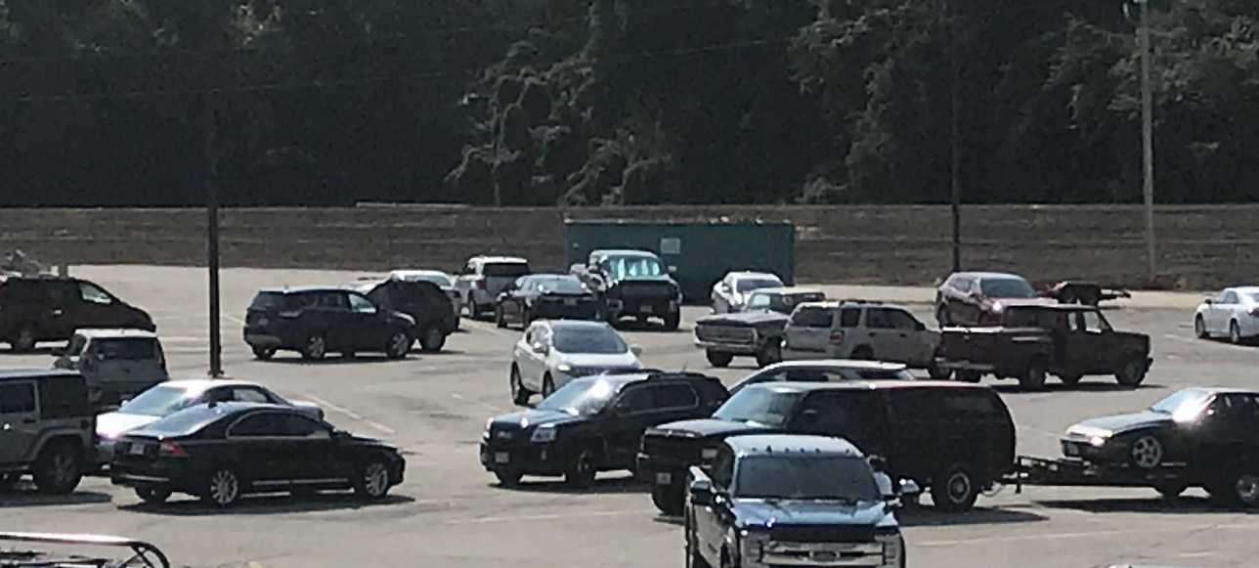
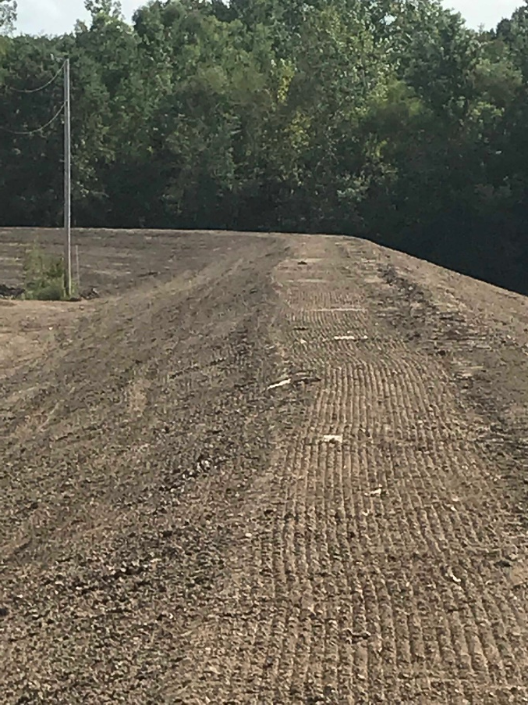

2019: Union, Missouri, Embraces Resilience
Community Hardening
Dickey Bub Berm
Shopping on One Side
Park on the Other

Slide 12
Extreme Events: A Troubling Trend
Rank | Date | Event | Cause | Insured Loss (1) ($ millions)
1 | Aug. 2005 | Hurricane Katrina | Hurricane | $41,100
2 | Sep. 2017 | Hurricane Maria (2) | Hurricane | 25,000-30,000
3 | Sep. 2017 | Hurricane Irma (2) | Hurricane | 20,000-25,000
4 | Sep. 2001 | September 11 Events | Terrorism | 18,779
5 | Oct. 2012 | Hurricane Sandy | Hurricane | 18,750
6 | Aug. 2017 | Hurricane Harvey (2) | Hurricane | 16,000-19,000
7 | Aug. 1992 | Hurricane Andrew | Hurricane | 15,500
8 | Jan. 1994 | Northridge, CA earthquake | Earthquake | 12,500
9 | Sep. 2008 | Hurricane Ike | Hurricane | 12,500
10 | Oct. 2005 | Hurricane Wilma | Hurricane | 10,300
(1) Dollars when occurred.
(2) Insurance Information Institute estimate based on data from catastrophe risk modelers, the Property Claims Services unit of Verisk Analytics, et al.
Source: Insurance Information Institute, catastrophe risk modelers, The Property Claim Services® (PCS®) unit of ISO®, a Verisk Analytics® company, et al.

Slide 13
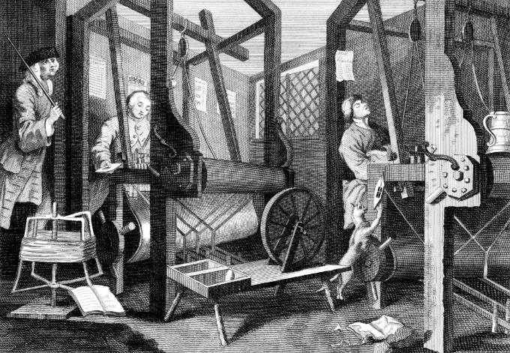
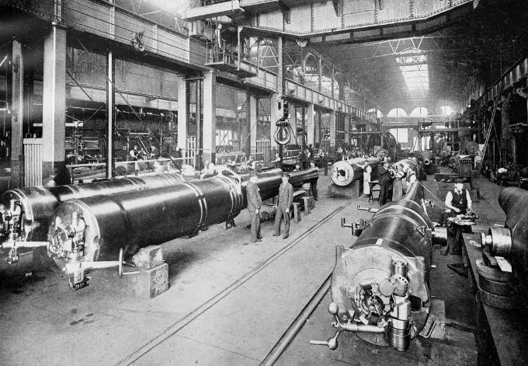
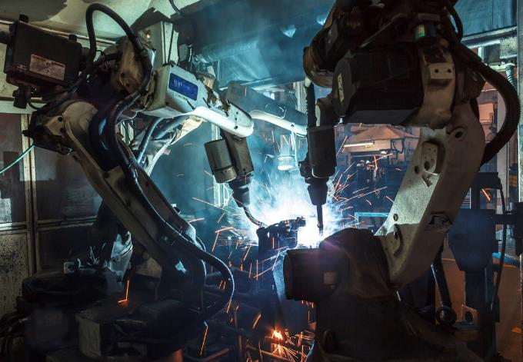

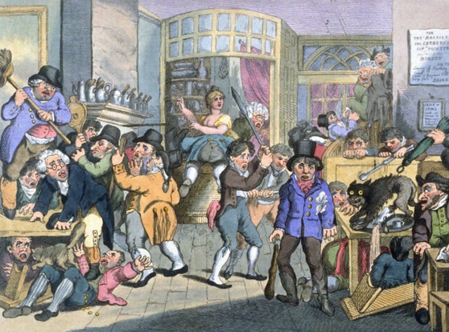
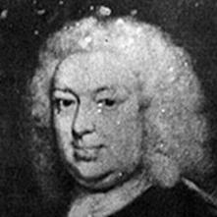
Insurance Leading Throughout History
???
1969
1870
1784
1648
Edward Lloyd’s Coffee House
Steam, Water, Mechanical Production
Division of Labor, Electricity, Mass Production
Electronics, IT, Automated Production
Cyber-Physical Systems

Slide 14
Case Study: Offshore Wind Power

Slide 15
Growth of Wind Power Capacity in the U.S.
Gigawatts
By 2050 total wind power capacity across 48 states will be 404.25 gigawatts, an increase of 180.15 gigawatts from 2030
Source: Energy.gov
Notes:
15

Slide 16
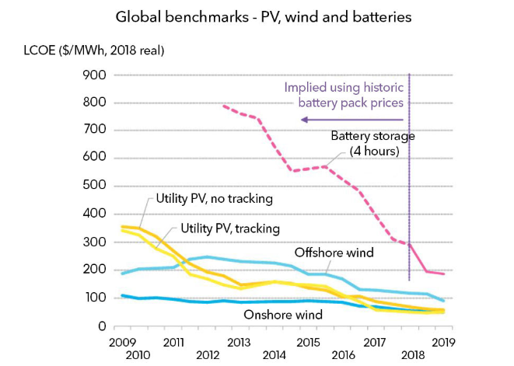
Cost of Alternative Energies is Falling
LOCO: Levelized cost of energy – cost of producing MWh of electricity, accounting for cost of development, construction and equipment, financing, feedstock, operation and maintenatnce
Source: BloombergNEF.

Slide 17
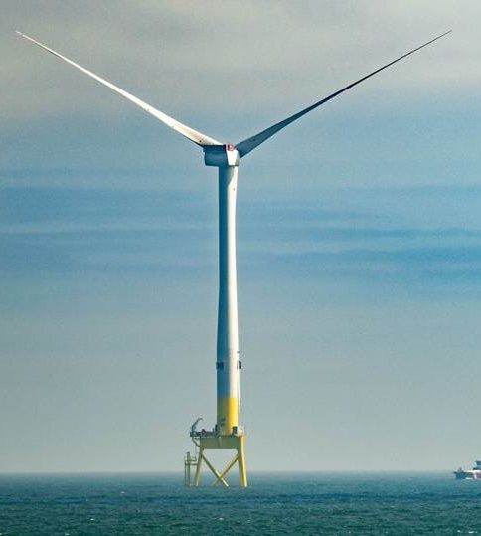
Offshore wind farms pros and cons
Pros
Offshore wind speeds are faster and steadier than on land
Meet energy needs of high-density coastal areas
Renewable energy with no pollution
Domestic energy source
Jobs
Cons
Expensive and difficult to build and maintain
Effects on marine animals and birds are not fully understood
May be unpopular with residents
Source American Geosciences Institute
Notes:
17

Slide 18
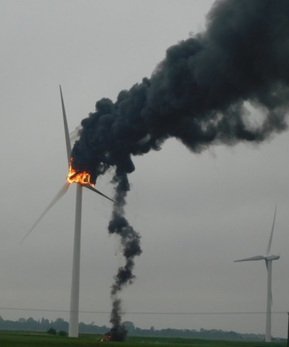
Key risks faced by wind farms
Risk | Insurance
Cargo in transit | Marine
Construction problems | Construction delay cover
Mechanical, cable issues | Property damage cover
Lightning strike | Business interruption
Terrorism | Political risk
‘Wind drought’ | Weather hedge
Source: Willis Towers Watson, WindPower, JLT Group.
Notes:
18

Slide 19
Cannabis and Insurance

Slide 20
Support for Legalization Grows
% Saying Yes
“Do You Think the Use of Marijuana Should Be Made Legal, Or Not?”
No survey in years where no data appears.
SOURCES: Gallup Poll Social Series, http://news.gallup.com/file/poll/221027/171025Marijuana.pdf.

Slide 21
Support for Legalization Grows
% Saying Yes
“Do You Think the Use of Marijuana Should Be Made Legal, Or Not?”
SOURCES: Gallup Poll Social Series, http://news.gallup.com/poll/221018/record-high-support-legalizing-marijuana.aspx

Slide 22

Driving While High
The Science
Review of Literature
Conclusive evidence
Improves the lot of adults in chronic pain.
Substantial evidence
Increases the risk of motor vehicle crashes.
SOURCE: National Academy of Sciences, https://www.nap.edu/catalog/24625/the-health-effects-of-cannabis-and-cannabinoids-the-current-state

Slide 23
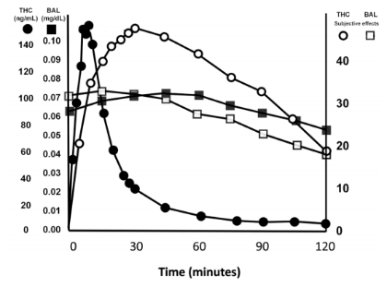
THC Levels not an Accurate Indication of Impairment
BAC and ‘feeling drunk’ rise and fall in lockstep
THC levels in blood and ‘feeling high’ rise and fall at different rates
Source: Sewell, Poling, Sofuoglu, “The Effect of Cannabis Compared with Alcohol on Driving,” American Journal on Addictions, 2009.

Slide 24
Weed Spreads Like Wildfire. Insurers Caught in the Middle
Current marijuana laws by state
■ Fully legal ■ Medical use legal and recreational use decriminalized ■ Medical use legal ■ Recreational use decriminalized ■ Fully illegal
WA
MT
ND
VT
ME
OR
MN
ID
SD
WI
NY
NH
WY
MI
NV
NE
IA
PA
UT
IL
IN
OH
WV
CA
CO
KS
MO
VA
MA
KY
TN
NC
RI
AZ
NM
OK
AR
CT
SC
MS
AL
GA
NJ
AK
TX
LA
DE
FL
MD
DC
HI
Sources: – Map - National Journal; Ballotpedia, 2019 Collision Frequency – IIHS, LEGAL POT: Crashes are up in states with retail sales, October 18, 2018

Slide 25
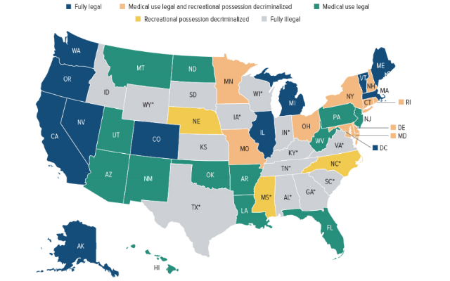
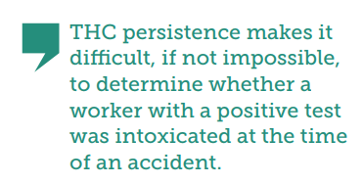
Current Marijuana Laws by State
*CBC/Low THC medical program.
Source: National Journal, Ballotpedia, 2019.

Slide 26
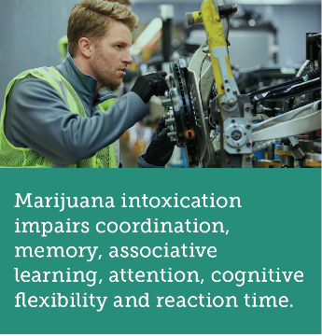
What Do We Know About Workplace Safety in the Age of Legal Marijuana?
Many factors influence impairment onset, intensity, and duration
Product potency – THC levels
Method of consumption and type of product
User characteristics
Source: Insurance Information Institute, Haze of confusion: How employers and insurers are affected by a patchwork of state marijuana laws, June 2019

Slide 27
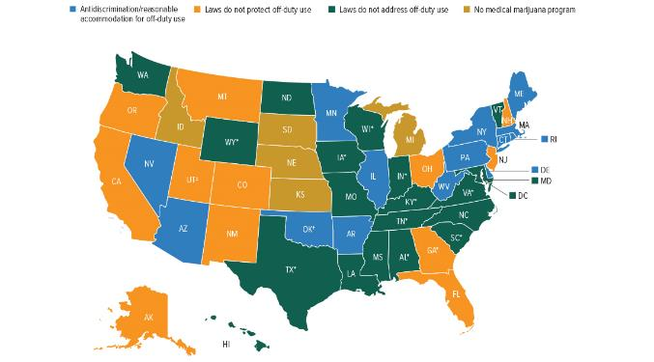
Off-duty Medical Marijuana Use and Employment Protections
Only 13 states have anti-discrimination/reasonable accommodation for off-duty marijuana use
*CBD/Low THC medical program. †Oklahoma has not yet released its final medical marijuana rules. ‡Provides limited protections to state employees.
Source: Insurance Information Institute, 2019.

Slide 28
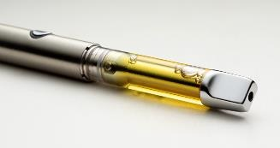
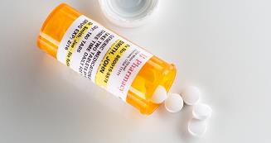
Medical Marijuana is not a Prescription Drug
Medical marijuana is:
Prescription drugs are:
Not prescribed but recommended for a qualifying patient by a physician.
Not approved by the FDA as a safe and effective drug.
Not dispensed through pharmacies.
Supported by research that identifies dosages and plans of care.
Regulated by the FDA.
Procured from a licensed pharmacist.

Slide 29
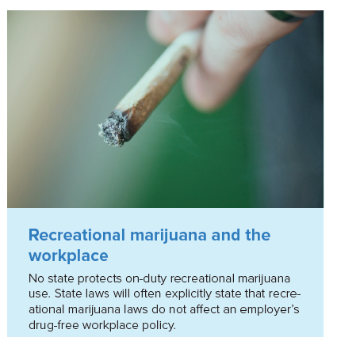
Marijuana And Workplace Accidents
Most states restrict benefits if employee was intoxicated or if intoxication was proximate cause of injury
Some states limit compensation if employee refuses drug test
Presumption of positive drug test indicating impairment
Rebuttable presumption

Slide 30
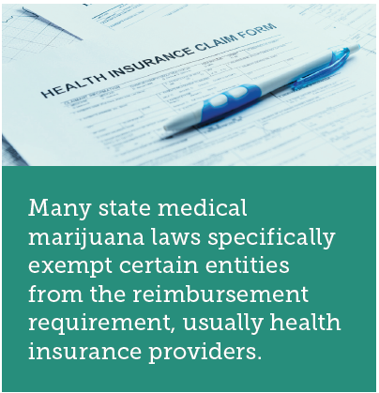
Is Medical Marijuana Covered by Comp?
Reimbursable in a handful of states
Unclear whether reimbursable in many states
Reimbursement not required
Reimbursement prohibited or ineligible

Slide 31
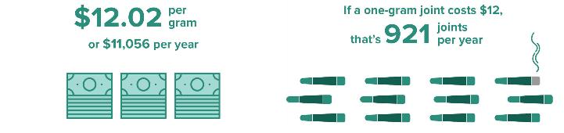
New Mexico is the Only State That Provides a Fee Schedule for Medical Marijuana¹
Maximum reimbursable amount
In context
¹“Healthcare Provider Fee Schedule and Billing Instructions,” State of New Mexico Workers’ Compensation Administration.

Slide 32
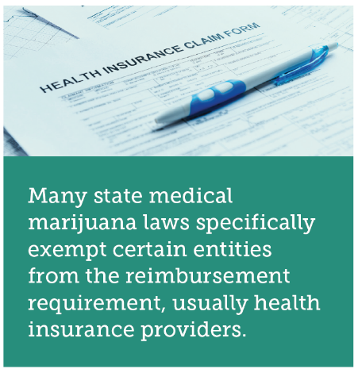
Reimbursement Complications
Cash-only business
Proper dosages poorly understood, non-standardized
No standardized “serving” of marijuana. Potency levels non-standardized
Expenses can vary widely

Slide 33
Thank you for your time and your attention!

