Slide 1
NAT CATS 2014: What's going on with the weather?
January 7, 2015

Slide 2
Agenda
Introduction
Sharon Cooper
Press Spokesperson, Munich Re America
US/Global Natural Catastrophe Update
Carl Hedde
Head of Risk Accumulation, Munich Re America
Special Topic: Heavy downpours. Severe droughts. What's going on with the weather?
Ernst Rauch
Head of Corporate Climate Centre, Munich Re
Economic Implications of Natural Catastrophe Losses
Dr. Robert Hartwig
President & Economist, Insurance Information Institute
2

Slide 3
Webinar Interactivity
Questions and Answers
You will have an opportunity to ask questions at the conclusion of the presentation.
An operator will facilitate your participation.
Live Tweeting
@Munichre_US @lworters @iii
#NATCAT2014
3

Slide 4
Global & US Natural Catastrophes in 2014
Carl Hedde, Head of Risk Accumulation
Munich Reinsurance America, Inc.

Slide 5

MR NatCatSERVICE
The world‘s largest database on natural catastrophes
The Loss Database Today
From 1980 until today all loss events; for USA and selected countries in Europe all loss events since 1970.
Retrospectively, all great disasters since 1950.
In addition, all major historical events starting from 79 AD – eruption of Mt. Vesuvio (3,000 historical data sets).
Currently more than 35,000 events
5

Slide 6
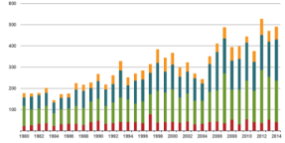
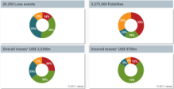
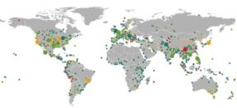
NatCatSERVICE Downloadcenter
for statistics and analyses on natural disasters
The downloadcenter provides free access:
Annual statistics
Long-term statistics
Information on significant natural disasters
Focus analyses
NatCatSERVICE methodology, info brochure
Publication Topics Geo
www.munichre.com/natcatservice/downloadcenter/en
Source: Geo Risks Research, NatCatSERVICE – As at January 2015
6

Slide 7
Natural disaster losses in 2014
US Headlines
US Natural Catastrophe Update
Insured losses in the United States in 2014 totaled $15.3 billion – far below the 2000 to 2013 average loss of $29 billion.
Despite late onset of tornado season, insured thunderstorm losses exceeded $12.3 billion, the fourth highest annual total on record.
The eastern United States experienced its coldest winter in over a decade; resulting 2014 insured damages are estimated to exceed $2.3 billion.
Napa, California, earthquake caused economic losses of $700 million and insured losses of $150 million, becoming the largest earthquake loss in the United States since 2001.
Several instances of damaging extreme precipitation events in heavily populated regions in 2014; Severe drought conditions persist in California despite recent heavy rainfalls.
7

Slide 8
Natural disaster losses in the US 2014
Based on perils
US Natural Catastrophe Update
As of January, 2015 | Number of Events | Fatalities | Estimated Overall Losses (US $m) | Estimated Insured Losses (US $m)
Severe Thunderstorm | 62 | 98 | 17,000 | 12,300
Winter Storm, winter damage, cold wave, snow storm | 13 | 115 | 3,700 | 2,300
Flood, flash flood, storm surge | 20 | 5 | 1,800 | 500
Earthquake & Geophysical, landslides | 11 | 45 | 750 | 150
Tropical Cyclone | 2 | 1 | 95 | Minor market losses
Wildfire, Heat, & Drought | 11 | 2 | 1,700 | Minor market losses
Totals | 119 | 266 | 25,000 | 15,300
8

Slide 9

American Canyon (Napa) Earthquake
US Natural Catastrophe Update
August 24: Despite being only a moderate earthquake, its shallow depth allowed for strong ground shaking in the immediate region, particularly on soft soils. Although structural damage was primarily limited to older masonry buildings and chimneys, contents damage, including to some wineries, was extensive. Insured losses are estimated at about $150 million.
Source: Munich Re America
9

Slide 10
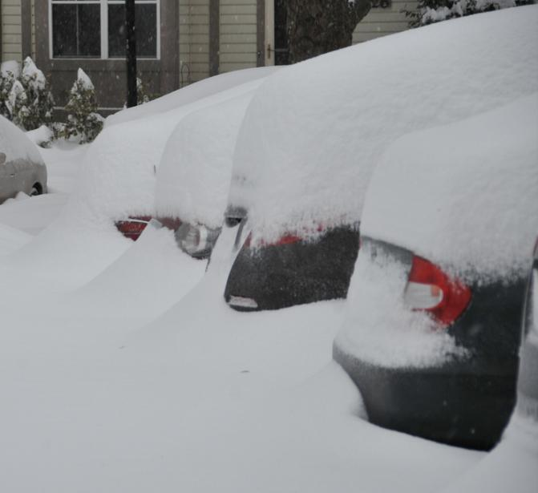
Extreme precipitation events in the US, 2014
US Natural Catastrophe Update
Pensacola, Florida: 20” of rain over April 29 & 30
Detroit, Michigan: 4-6” of rain in in a 4-hour period on August 11.
Islip, New York: 13” of rain in a single day on August 13.
Phoenix, Arizona: 4-5” of rain on September 7.
Buffalo, New York: Over 6 feet of snow over the
course of 4 days.
Northern California: averaged of 2-4” of rain over region during first week of December.
Source: FEMA
10

Slide 11
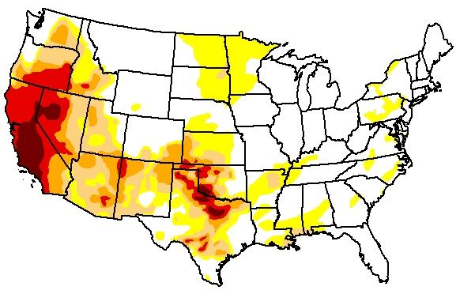
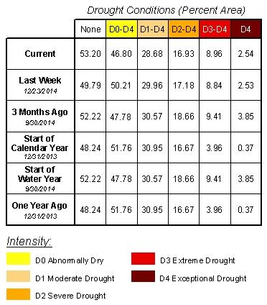
Current US drought conditions
US Natural Catastrophe Update
As of December 30, 2014
Source: The National Drought Mitigation Center
11

Slide 12
Natural disaster losses in 2014
Global Headlines
Global Natural Catastrophe Update
In 2014, losses from natural catastrophes summed up to US$ 110bn for direct economic losses and US$ 31bn for insured losses, both well below the average of the last 10 years (US$ 190 bn/US$ 58 bn).
No single natural catastrophe event stands out as the worst event of the year, and no natural disasters in 2014 had economic losses that exceeded $10 billion dollars.
At 7,700, the number of fatalities was much lower than in 2013 (21,000) and also well below the average figures of the past ten and 30 years (97,000 and 56,000 respectively).
58% of all insured losses occurred in North America. This is in the range of the long-term average from 1980 – 2013 (63%).
12

Slide 13
Loss events worldwide 2014
Overview and comparison with previous years
Global Natural Catastrophe Update
 | 2014 | 2013 | Average of the last 10 years 2004-2013 (Losses adjusted to inflation based on country CPI) | Average of the last 30 years 1984-2013 (Losses adjusted to inflation based on country CPI) | Top Year 1984 -2013
Number of events | 980 | 920 | 830 | 640 | 980 (2014)
Overall losses in US$ m (original values) | 110,000 | 140,000 | 190,000 | 130,000 | 424,000 (2011, e.g. EQ Japan)
Insured losses in US$ m (original values) | 31,000 | 39,000 | 58,000 | 33,000 | 132,000 (2011, e.g. EQ Japan)
Fatalities | 7,700 | 21,000 | 97,000 | 56,000 | 296,000 (2010, e.g. EQ Haiti)
13

Slide 14
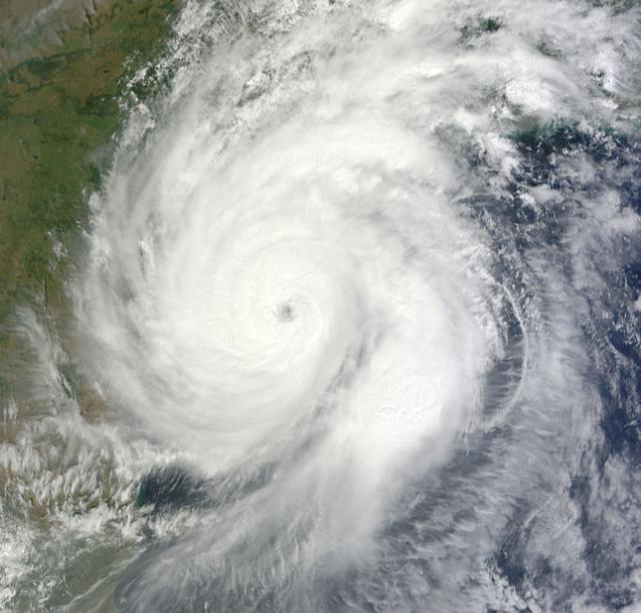
Notable Global Events
2014
Global Natural Catastrophe Update
India: Cyclone Huhhud made landfall as a powerful Saffir-Simpson category 4 hurricane on October 12. Over 80,000 buildings were damaged during the storm, along with severe agricultural and infrastructure damage. Economic losses from the cyclone are estimated at $7 billion.
Source: NASA
14

Slide 15
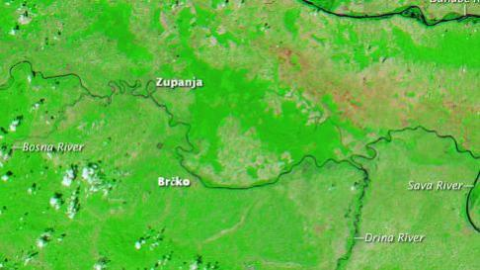
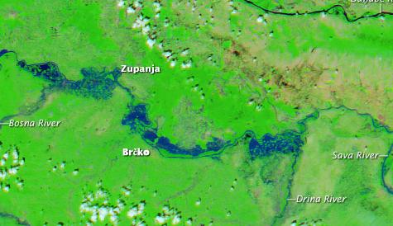
Notable Global Events
2014
Global Natural Catastrophe Update
Eastern Europe: Torrential rains over two weeks in May produced some of the worst flooding on record in the Serbia, Bosnia and Herzegovina, and Croatia. Over 100,000 buildings were damaged or destroyed by the flooding, and several villages were destroyed from landslides. Economic losses from the low pressure system Yvette are estimated at $3.6 billion.
Source: NASA
15

Slide 16
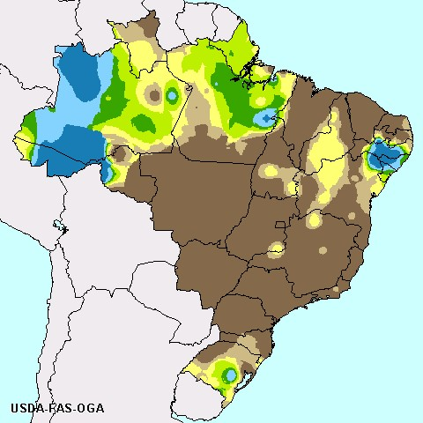
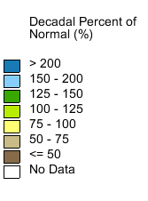
Notable Global Events
2014
Global Natural Catastrophe Update
Brazil: Over the course of 2014, southeastern Brazil entered one of its worst droughts in history. Over 27 million people were affected by the drought, which brought heat waves and severe losses to water-intensive crops, like sugar cane. Economic losses from the drought are estimated at $5 billion.
16

Slide 17
Special topic: Heavy downpours. Severe droughts. What's going on with the weather?
Ernst Rauch
Head of Corporate Climate Centre, Munich Re

Slide 18
Events in 2014 with “too much rain” or “too little rain”
Examples: Global and US
Heavy precipitation and inundation in Europe/Balkan region in April-May
(EU- flooding events already in 2002, 2013)
Drought in South America/Brazil
Several heavy precipitation events in large US population centers, including Phoenix and Detroit.
Drought in the Western US
18

Slide 19
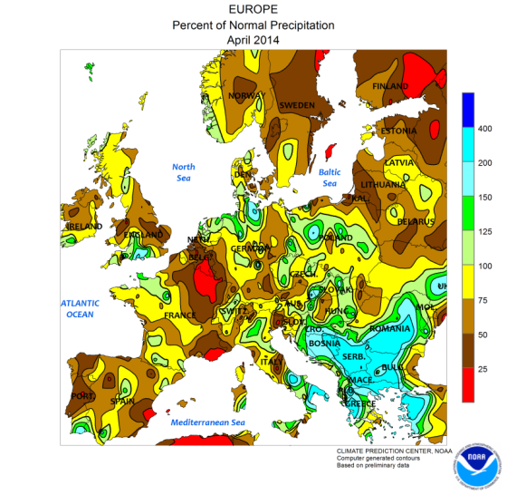
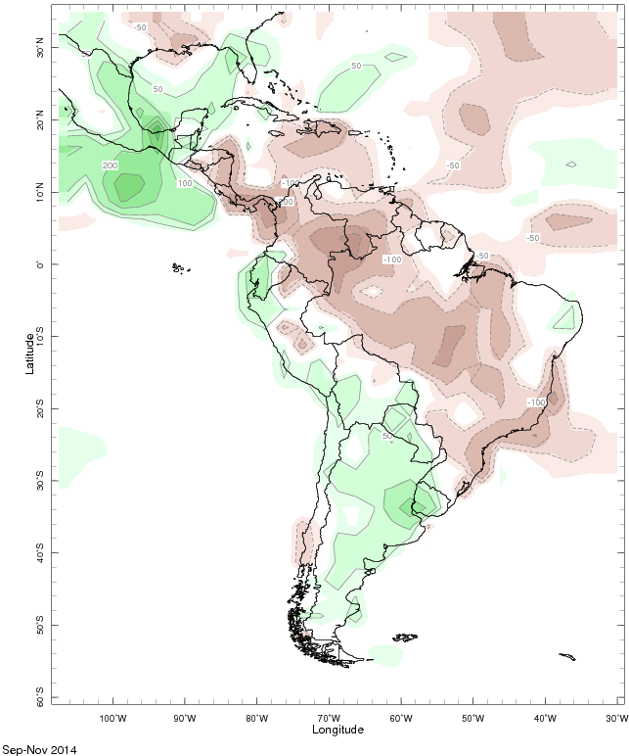
2014 Precipitation anomalies in Europe and South America
Flooding in the Balkan region; Drought in Brazil
Sep – Nov 2014
Source: CPC/NOAA, 2014
Percent of normal precipitation
April 2014
Source: IRI/Columbia University, 2014
19

Slide 20
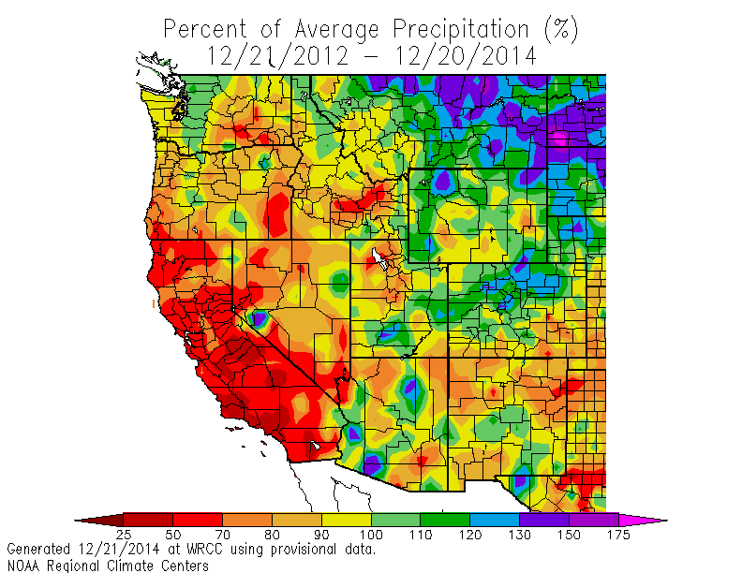
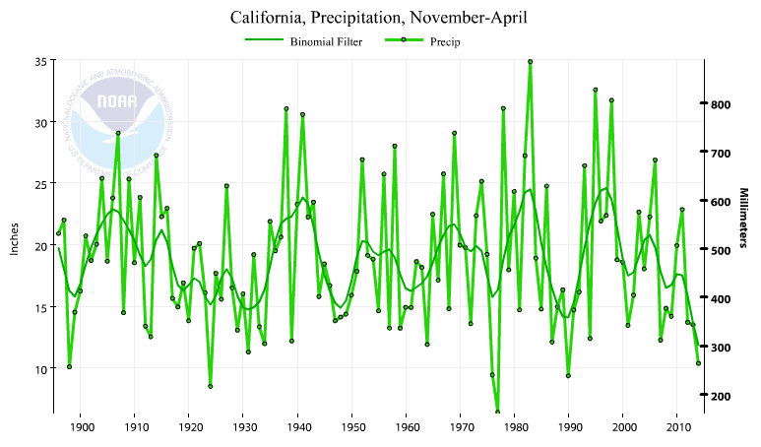
2012 – 2014 precipitation anomalies in the Western US
Current severe precipitation deficit in California: no long-term trend observed
Last 2 years: 21 Dec 2012 – 20 Dec 2014
Significant annual variability in California winter precipitation (November – April) since 1895.
Source: Western Regional Climate Center (WRCC), 2014
20

Slide 21
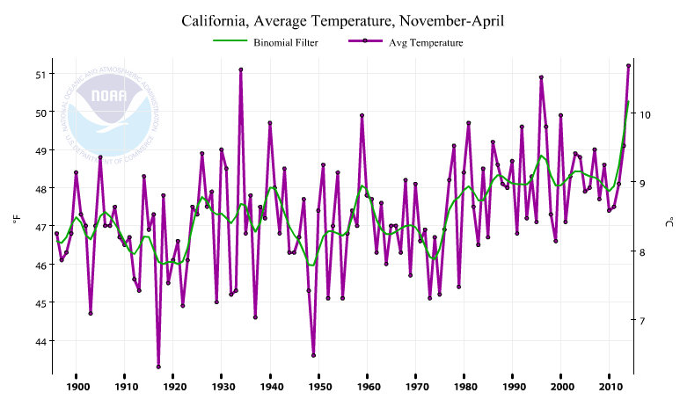
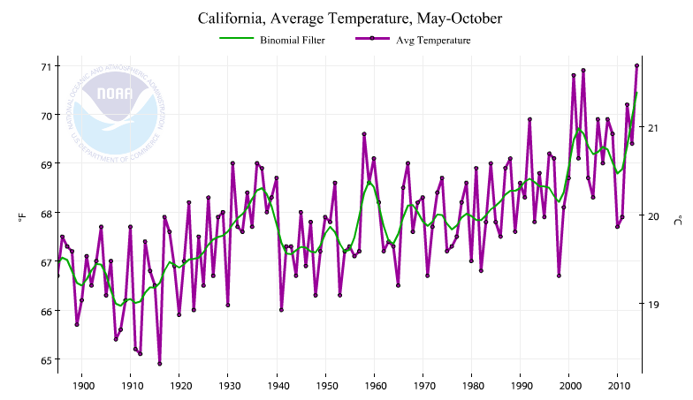
Summer and winter temperatures in California since 1895
Substantial increase contributed to the drought through elevated evapotranspiration
Source: National Climatic Data Center, 2014
Source: National Climatic Data Center, 2014
Although the lack of precipitation in California over recent years has to be explained by natural climate variability (NOAA assessment report, 2014), the substantial increase in temperature contributed to the drought through increasing evapotranspiration. In that sense, anthropogenic climate change has also contributed to drought severity.
21

Slide 22
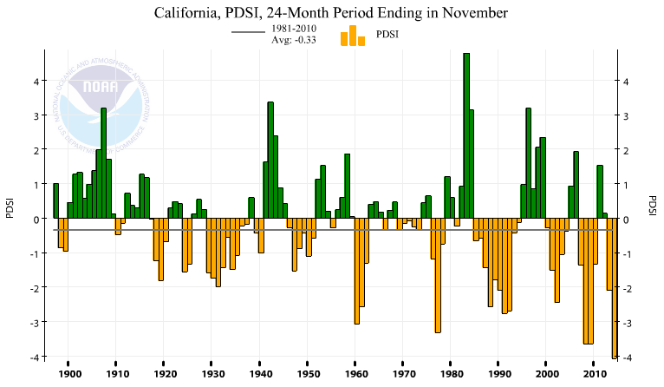
California Palmer Drought Severity Index (PDSI)
Record low index value for 24 month period since 1895
PDSI: parameter measuring dryness based on precipitation and temperature, developed by US meteorologist Wayne Palmer in 1965.
Source: National Climatic Data Center, 2014
22

Slide 23
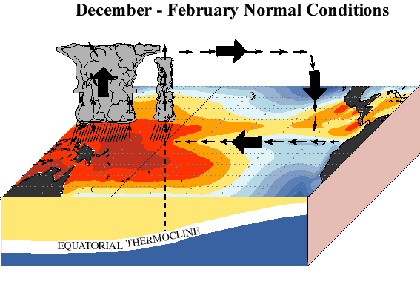
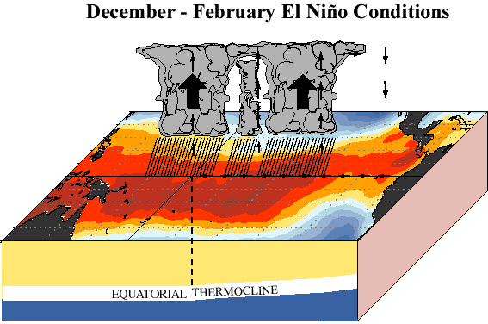
Global Natural Climate Variability in December 2014
Transition from neutral ENSO to El Niño conditions expected to continue
Along the equator Central and East Pacific waters get warmer, convective clouds and rainfall follow change in warm pool. Trade winds from easterly directions vanish or even reverse direction.
Source: NOAA, USA
23

Slide 24
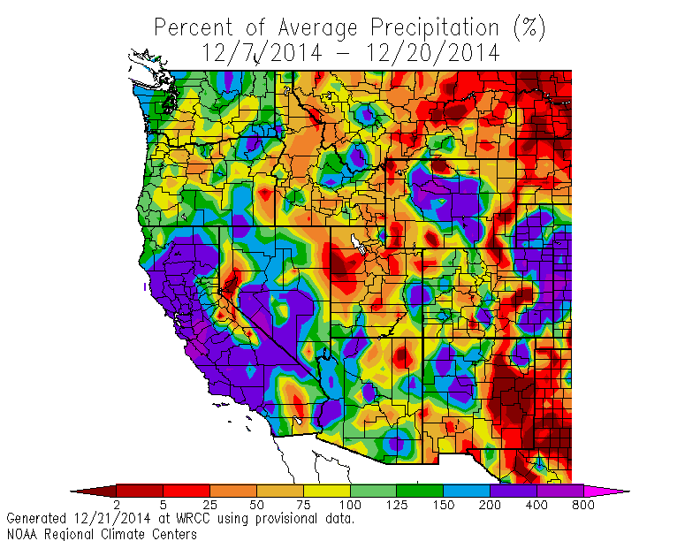
December 2014 precipitation anomalies in the Western US
Matches typical El Niño patterns
7 Dec – 20 Dec 2014
Source: Western Regional Climate Center (WRCC), 2014
24

Slide 25
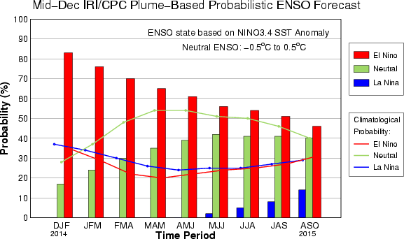
2015 ENSO forecast by climate model simulations
Weak El Nino conditions likely to continue
The synopsis of available international forecast runs supports the expectatioin of a weak El Niño event to prevail over the first months of 2015 (status: December 2014)
25

Slide 26
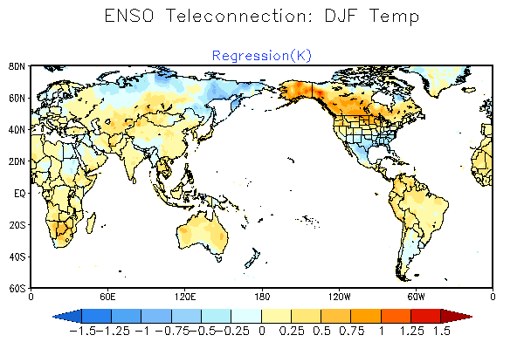
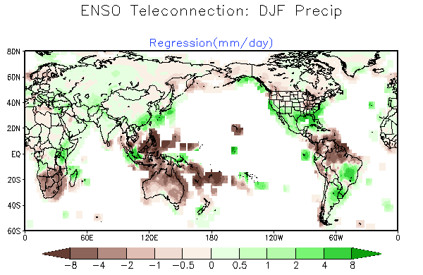
El Niño temperature/precipitation anomalies (Dec-Feb)
US: Cool and wet in the South and Southeast
Typical El Nino consequences, globally (among others):
Dry in Indonesia, northeast Australia, northern South America, southern Africa.
Wet in southern North America (including California), northeastern Argentina and southern Brazil,
parts of China.
Source: CPC/NCEP/NOAA, 2014
26

Slide 27
Market & Financial Impact of Catastrophe Losses:
2014 Summary
Insurance Information Institute
January 7, 2015
Robert P. Hartwig, Ph.D., CPCU, President & Economist
Insurance Information Institute ♦ 110 William Street ♦ New York, NY 10038
Tel: 212.346.5520 ♦ Cell: 917.453.1885 ♦ bobh@iii.org ♦ www.iii.org

Slide 28
WINTER STORM LOSSES:
Significant Economic Impact
Losses from Snow, Ice, Freezing and Related Causes Typical Cost Insurers Between $1 Billion and $2 Billion Annually ($2.3B+ in 2014)
28

Slide 29
US Real GDP Growth*
The Q4:2008 decline was the steepest since the Q1:1982 drop of 6.8%
Real GDP Growth (%)
Recession began in Dec. 2007. Economic toll of credit crunch, housing slump, labor market contraction was severe
Q1 2014 GDP data were hit hard by this year’s “Polar Vortex” and harsh winter
Some of the Losses from Harsh Winter Weather Are Insured, Offsetting Adverse Economic Impacts; Other Losses Were Uninsured and Some Losses Were Transient (Economic Activity Pushed to Later in 2014)
* Estimates/Forecasts from Blue Chip Economic Indicators.
Source: US Department of Commerce, Blue Economic Indicators 12/14; Insurance Information Institute.

Slide 30
Inflation Adjusted U.S. Catastrophe Losses by Cause of Loss, 1994–2013¹
Wind/Hail/Flood (3), $14.6
Fires (4), $5.5
Other (5), $0.2
Insured cat losses from 1994-2013 totaled $386.7B, an average of $20.6B per year or $1.7B per month
Geological Events, $18.4
Terrorism, $24.8
Winter Storms, $24.7
Winter storms are tied with terrorism as the 3rd leading cause of insured CAT losses
Hurricanes & Tropical Storms, $159.1
Winter storm losses totaled $24.7B or $1.24B/yr. on average from 1994-2013 accounting for 6.4% of all CAT losses; 2014 losses est. to exceed $2.3B = 15% of cat loss total
Events Involving Tornadoes (2), $139.3
Catastrophes are defined as events causing direct insured losses to property of $25 million or more in 2013 dollars.
Excludes snow.
Does not include NFIP flood losses
Includes wildland fires
Includes civil disorders, water damage, utility disruptions and non-property losses such as those covered by workers compensation.
Source: ISO’s Property Claim Services Unit.

Slide 31
P/C Insurance Industry:
Financial Update
P/C Insurance Industry:
Financial Update
2014 Was the 2nd Best Year
in the Post-Recession Era
(2013 Was First)
31

Slide 32
P/C Industry Net Income After Taxes
1991–2014E
$ Millions
2005 ROE*= 9.6%
2006 ROE = 12.7%
2007 ROE = 10.9%
2008 ROE = 0.1%
2009 ROE = 5.0%
2010 ROE = 6.6%
2011 ROAS¹ = 3.5%
2012 ROAS¹ = 5.9%
2013 ROAS¹ = 10.3%
2014 ROAS¹ = 7.6%
Net income rose strongly (+81.9%) in 2013 vs. 2012 on lower cats, capital gains
2014 was the 2nd best year since the financial crisis
ROE figures are GAAP; ¹Return on avg. surplus. Excluding Mortgage & Financial Guaranty insurers yields a 7.7% ROAS through 2014:Q2, 9.8% ROAS in 2013, 6.2% ROAS in 2012, 4.7% ROAS for 2011, 7.6% for 2010 and 7.4% for 2009.
Sources: A.M. Best, ISO; Insurance Information Institute

Slide 33
ROE: Property/Casualty Insurance by Major Event, 1987–2014E
(Percent)
P/C Profitability Is Subject to
Cyclicality and Ordinary Volatility, Typically Due to CAT Activity
Katrina, Rita, Wilma
Low CATs
Somewhat higher CAT activity in 2014 had a modest negative impact on ROE
Sept. 11
Hugo
Lowest CAT Losses in
15 Years
4 Hurricanes
Sandy
Andrew
Record Tornado Losses
Northridge
Financial Crisis*
* Excludes Mortgage & Financial Guarantee in 2008 – 2014. 2014 is estimated based on data through Q3.
Sources: ISO; Insurance Information Institute.

Slide 34
A 100 Combined Ratio Isn’t What It
Once Was: Investment Impact on ROEs
Combined Ratio / ROE
A combined ratio of about 100 generates an ROE of ~7.0% in 2012/13, ~7.5% ROE in 2009/10,
10% in 2005 and 16% in 1979
Lower CATs (relative to 2011/12) helped ROEs in 2013/14
Combined Ratios Must Be Lower in Today’s Depressed
Investment Environment to Generate Risk Appropriate ROEs
* 2008 -2014 figures are return on average surplus and exclude mortgage and financial guaranty insurers. 2014:Q1 combined ratio including M&FG insurers is 97.3; 2013 = 96.1; 2012 =103.2, 2011 = 108.1, ROAS = 3.5%.
Source: Insurance Information Institute from A.M. Best and ISO Verisk Analytics data.

Slide 35
SURPLUS/CAPITAL/CAPACITY
Industry Claims Paying Capital Stands at Record High in 2014
(Re)Insurance Industry is Well Positioned to Manage Large Scale Catastrophe Losses
35

Slide 36
Policyholder Surplus,
2006:Q4–2014:Q4E
($ Billions)
2007:Q3
Pre-Crisis Peak
Drop due to near-record 2011 CAT losses
Low CAT losses are a driver of increased capital
The P/C insurance industry finished 2014 in very strong financial shape.
The industry now has $1 of surplus for every $0.73 of NPW,
the strongest claims-paying status in its history.
Note: 2010:Q1 data includes $22.5B of paid-in capital from a holding company parent for one insurer’s investment in a non-insurance business .
Sources: ISO, A.M .Best.
12/01/09 - 9pm
eSlide – P6466 – The Financial Crisis and the Future of the P/C
Notes:
36

Slide 37
Investments: The New Reality
Investment Income Offsets Less Loss than in the Past, Including Losses from Catastrophes
37

Slide 38
Property/Casualty Insurance Industry Investment Income: 2000–2014E¹
($ Billions)
Investment earnings are still below their 2007 pre-crisis peak due to low yields
Due to persistently low interest rates,
investment income fell in 2012 and in 2013
and is projected to register another small decline in 2014.
¹ Investment gains consist primarily of interest and stock dividends. *2014 figure is estimated based on annualized data through Q3.
Sources: ISO; Insurance Information Institute.

Slide 39
Book Yield on Property/Casualty Insurance Invested Assets, 2007–2014E
(Percent)
Book yield in 2014 is down 114 BP from pre-crisis levels
The yield on invested assets continues to decline as returns on maturing bonds generally still exceed new money yields. The end of the Fed’s QE program in Oct. 2014 should allow some increase in longer maturities while short term interest rate increases are unlikely until mid-to-late 2015
Sources: Conning.

Slide 40
UNDERWRITING
Underwriting Results in 2014 (and 2013) Were Helped by Generally Modest Catastrophe Losses
Welcome Respites from 2011/2012
40

Slide 41
P/C Insurance Industry
Combined Ratio, 2001–2014E
As Recently as 2001, Insurers Paid Out Nearly $1.16 for Every $1 in Earned Premiums
Relatively Low CAT Losses, Reserve Releases
Relatively Low CAT Losses, Reserve Releases
Higher CAT Losses, Shrinking Reserve Releases, Toll of Soft Market
Heavy Use of Reinsurance Lowered Net Losses
Avg. CAT Losses, More Reserve Releases
Best Combined Ratio Since 1949 (87.6)
Sandy Impacts
Cyclical Deterioration
Lower CAT Losses
Modestly Higher CAT Losses
* Excludes Mortgage & Financial Guaranty insurers 2008--2014. Including M&FG, 2008=105.1, 2009=100.7, 2010=102.4, 2011=108.1; 2012:=103.2; 2013: = 96.1; 2014E = 97.6.
Sources: A.M. Best, ISO.

Slide 42
Underwriting Gain (Loss)
All Lines Combined, 1975–2014*
($ Billions)
2013 underwriting profit totaled $15.5B
Underwriting profit in 2014 estimated at $5.7B
High CAT losses in 2011 led to the highest underwriting loss since 2001. Lower CAT losses in 2013 and so far in 2014.
First underwriting profits since 2007.
Note: Includes mortgage and financial guaranty insurers in all years.
Sources: A.M. Best, ISO, Insurance Information Institute.

Slide 43
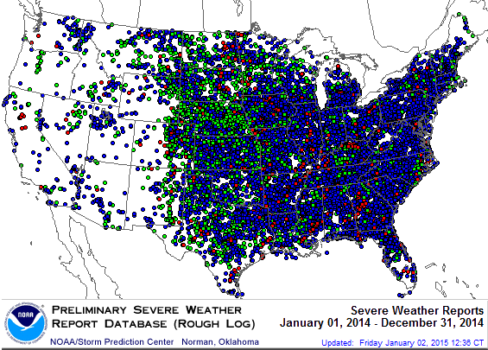
Severe Weather Reports: Jan. 1 – Dec. 31, 2014
Severe weather reports are concentrated east of the Rockies
There were 18,581 severe weather reports in 2014; including 1,057 tornadoes; 5,536 “Large Hail” reports and 11,985 high wind events
Source: NOAA Storm Prediction Center; http://www.spc.noaa.gov/climo/online/monthly/2014_annual_summary.html#

Slide 44
Number of Federal Major Disaster Declarations, 1953 - December 31, 2014*
There have been 2,187 federal disaster declarations since 1953. The average number of declarations per year is 35 from 1953-2013, though there few haven’t been recorded since 1995.
The number of federal disaster declarations set a new record in 2011, with 99, shattering 2010’s record 81 declarations.
51 federal disasters were declared in 2014
The Number of Federal Disaster Declarations Is Rising and Set New Records in 2010 and 2011 Before Dropping in 2012 - 2014
*Through December 31, 2014.
Source: Federal Emergency Management Administration; http://www.fema.gov/disasters; Insurance Information Institute.

Slide 45
Combined Ratio Points Associated with
Catastrophe Losses: 1960 – 2014E*
Combined Ratio
Points
Avg. CAT Loss Component of the Combined Ratio by Decade
1960s: 1.04 1970s: 0.85 1980s: 1.31 1990s: 3.39 2000s: 3.52 2010s: 5.6E*
Catastrophe losses as a share of all losses reached a record high in 2011
Catastrophe losses as a share of all losses were down substantially in 2013 and so far in 2014
The Catastrophe Loss Component of Private Insurer Losses Has Increased Sharply in Recent Decades
*2010s represent 2010-2014E.
Notes: Private carrier losses only. Excludes loss adjustment expenses and reinsurance reinstatement premiums. Figures are adjusted for losses ultimately paid by foreign insurers and reinsurers.
Source: ISO (1960-2011); A.M. Best (2012-2013); Insurance Information Institute.

Slide 46
Premium Growth
Premium Growth
Catastrophe Losses Impact Trajectory of Premium Growth
46

Slide 47
Net Premium Growth: Annual Change,
1971—2014E
(Percent)
1975-78
1984-87
2000-03
Net Written Premiums Fell 0.7% in 2007 (First Decline Since 1943) by 2.0% in 2008, and 4.2% in 2009, the First 3-Year Decline Since 1930-33.
2014E: 4.0%
2013: 4.6%
2012: +4.3%
Shaded areas denote “hard market” periods
Sources: A.M. Best (historical and forecast), ISO, Insurance Information Institute.

Slide 48
Insurance Information Institute Online:
www.iii.org
Thank you for your time
and your attention!
Twitter: twitter.com/bob_hartwig

Slide 49

Question and Answer

Slide 50

Press Question and Answer Process
To ask a question, please dial 1 4 on your phone.
An operator will facilitate your participation.
50

Slide 51
NatCatSERVICE Downloadcenter
for statistics and analyses on natural disasters
The downloadcenter provides free access:
Annual statistics
Long-term statistics
Information on significant natural disasters
Focus analyses
NatCatSERVICE methodology, info brochure
Publication Topics Geo
www.munichre.com/natcatservice/downloadcenter/en
Source: Geo Risks Research, NatCatSERVICE – As at January 2015
51

Slide 52
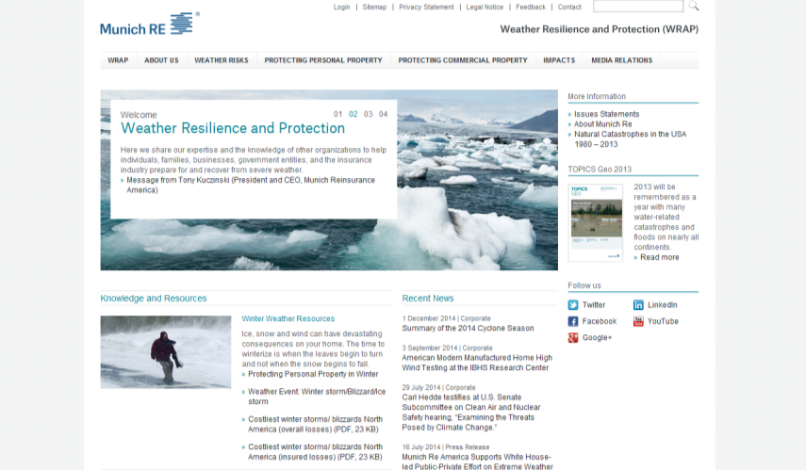
Weather Resilience and Protection (WRAP)
Website
Describe the impact of severe weather and how individuals, businesses, government, and insurers can work together to prepare for and mitigate weather risks.
Includes data, publications, preparation tips and other useful information for the press.
www.munichre.us/wrap
52

Slide 53
More Information
 | Connect with Munich Re | Connect with I.I.I.
Twitter | @Munichre_US @Munichre | @iiiorg
LinkedIn | munich-reinsurance-america-inc. | Insurance Information Institute
Google+ | Munich Re (US) Munich Re | Insurance Information Institute
YouTube | MunichReUs MunichReVideo | iiivideo
Facebook | Munichreus1 Munichre | InsuranceInformationInstitute
Flickr |  | iiiorg
53

Slide 54
Press Inquiries
Sharon Cooper
Phone: +1 (609) 243-8821
scooper@munichreamerica.com
54

Slide 55
Thank you
January 7, 2015

Slide 56
© Copyright 2015 Munich Reinsurance America, Inc. All rights reserved. "Munich RE" and the Munich Re logo are internationally protected registered trademarks. The material in this presentation is provided for your information only, and is not permitted to be further distributed without the express written permission of Munich Reinsurance America, Inc. This material is not intended to be legal, underwriting, financial, or any other type of professional advice. Any descriptions of coverage reflected in this presentation are meant to be general in nature and do not include and are not intended to include all of the actual terms, benefits and limitations found in an insurance policy. Only the insurance policy will form the contract between the insured and insurance company, and governs in all cases.

Slide 57
Appendix - 2014 Year End Natural Catastrophe Review
Photo: NASA

Slide 58
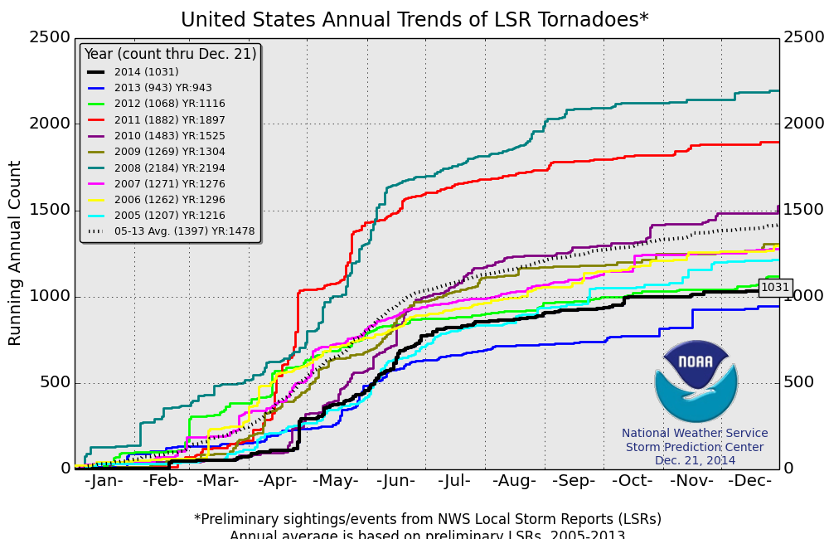
Thunderstorms
Tornado Count for 2014
US Natural Catastrophe Update
The preliminary tornado counts for 2014 are about 400 below the 2005-2013 average.
Despite fewer tornadoes, insured convective storm losses were still the second highest on record, including 4 outbreaks that incurred at least $1 billion in insured loss.
*Preliminary sightings/events from NWS Local Storm Reports (LSRs)
Annual average is based on preliminary LSRs 2005-2013
58

Slide 59
Convective loss events in the US
Overall and insured losses 1980 – 2014
US Natural Catastrophe Update
bn US$
Overall losses
(in 2014 values)*
Insured losses
(in 2014 values)*
Analysis contains:
severe storm, tornado, hail, flash flood and lightning
*Losses adjusted to inflation based on country CPI
Source: Geo Risks Research, NatCatSERVICE
59

Slide 60
Loss events in the US 1980 – 2014
Number of events
US Natural Catastrophe Update
Number
Geophysical events
(Earthquake, tsunami,
volcanic activity)
2014 Total:
119 Events
Meteorological events
(Tropical storm, extratropical storm, convective storm,
local storm)
Hydrological events
(Flood,
mass movement)
16
Climatological events
(Extreme temperature,
drought, forest fire)
24
72
7
Source: Geo Risks Research, NatCatSERVICE
60

Slide 61
Loss events in the US 1980 – 2014
Overall and insured losses
US Natural Catastrophe Update
Overall losses totaled US$ 25bn; Insured losses totaled US$ 15.3bn
bn US$
Overall losses
(in 2013 values)*
Insured losses
(in 2013 values)*
*Losses adjusted to inflation based on country CPI
Source: Property Claim Services, MR NatCatSERVICE.
61

Slide 62
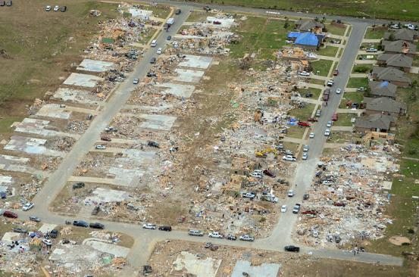
Notable thunderstorm events
US Natural Catastrophe Update
April 27 – May 1: Large severe cyclonic storm (SCS) outbreak over the Central Plains and Deep South. A total of 80 tornadoes have been confirmed, causing 35 fatalities. Worst hit were Mayflower, Arkansas, and Louisville, Mississippi, both hit by EF4 tornadoes. Insured losses from the outbreak are estimated at $1.2 billion.
Source: NOAA
Source: Property Claims Service
MR NatCatSERVICE
62

Slide 63
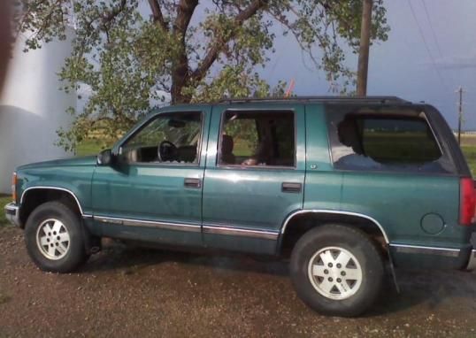
Notable thunderstorm events
US Natural Catastrophe Update
May 18 – May 23: Large hail and non-tornadic wind event stretching from Montana to New York. Hail the size of golf balls impacted sections of Chicago and Denver, and baseball-sized hail impacted parts of Indiana and Ohio. Further east, wind gusts in excess of hurricane force felled trees and power lines across the Mid-Atlantic. Insured losses are estimated at $2.9 billion.
Source: NOAA
Source: Property Claims Service
MR NatCatSERVICE
63

Slide 64
Loss events in the US 1980 – 2014
Insured losses due to winter storms*
US Natural Catastrophe Update
Overall losses totaled US$ 3.7bn; Insured losses totaled US$ 2.4bn
Insured losses
(in 2014 values)**
5 year Mean
US$m
*Winter storms include winter damage, blizzard, snow storm and cold wave
**Losses adjusted to inflation based on country CPI
Source: Munich Re, NatCatSERVICE
Source: Property Claim Services, MR NatCatSERVICE.
64

Slide 65
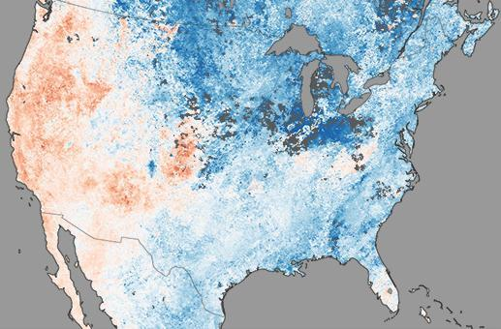

Winter storms
US Natural Catastrophe Update
Throughout the winter months, a persistent “Omega Block” pattern, combined with a weakened Polar Vortex, allowed frigid air to stream southward into eastern United States & Canada. Minimum temperatures in some locations were the lowest in 20 years. Due to the cold conditions, several significant frozen precipitation events occurred across the eastern U.S., reaching as far south as the Florida panhandle.
Source: NASA
Source: Property Claims Service
MR NatCatSERVICE
65

Slide 66
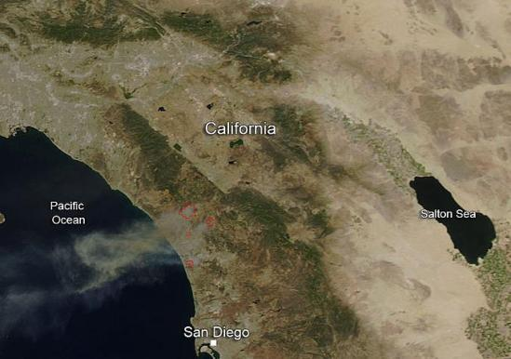
Notable wildfires
US Natural Catastrophe Update
A heat wave and strong Santa Ana winds triggered eight wildfires in San Diego County in May. Over 29,000 acres were burned, with about 60 properties destroyed. Luckily, the continued dry conditions did not lead to a severe autumn fire season as some expected, resulting in a light wildfire year in the U.S.
Source: NASA
66

Slide 67
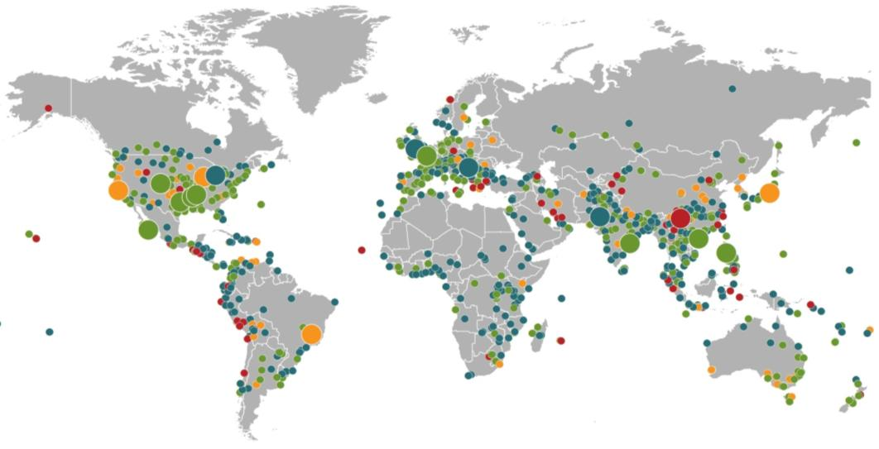
NatCatSERVICE
Loss events worldwide 2014
Geographical overview
Winter damage
USA, Canada, 5–8 Jan
Flash floods
USA,11–13 Aug
Floods
United Kingdom,
Dec 2013–Feb 2014
Floods
Bosnia and Herzegovina,
Serbia, Croatia, Romania,
13–30 May
Typhoon Rammasun
China, Philippines, Vietnam,
11–22 Jul
Severe storms
USA, 18–23 May
Severe storms
France, Belgium,
Germany, 7–10 Jun
Winter damage
Japan, 7–16 Feb
Drought
USA, 2014
Typhoon Kalmaegi
China, Philippines, Vietnam,
12–20 Sep
Hurricane Odile
Mexico, 11–17 Sep
Severe storms
USA, 2–4 Apr
Severe storms
USA, 27 Apr–1 May
Cyclone Hudhud
India,
11–13 Oct
Loss events
980
Loss events
Selection of
Catastrophes
Overall losses
≥ US$ 1,500m
Drought
Brazil, 2014
Floods
India, Pakistan,
3–15 Sep
Earthquake
China, 3 Aug
Severe storms
USA, 3–5 Jun
Source: Munich Re, NatCatSERVICE, 2015
As at January 2015

Slide 68
NatCatSERVICE
Loss events worldwide 1980 – 2014
Number of events
Number
Geophysical events
(Earthquake, tsunami,
volcanic activity)
Meteorological events
(Tropical storm, extratropical storm, convective storm,
local storm)
Hydrological events
(Flood,
mass movement)
Climatological events
(Extreme temperature,
drought, forest fire)
Source: Munich Re, NatCatSERVICE
Source: Geo Risks Research, NatCatSERVICE – As at January 2015

Slide 69
NatCatSERVICE
Loss events worldwide 1980 – 2014
Overall and insured losses
US$ bn
Overall losses
(in 2014 values)*
Insured losses
(in 2014 values)*
*Losses adjusted to inflation based on country CPI
Source: Geo Risks Research, NatCatSERVICE – As at January 2015

Slide 70
Loss events worldwide 2014
The five costliest natural catastrophes for the insurance industry
NatCatSERVICE
Date | Region | Event | Fatalities | Overall losses US$ m | Insured losses US$ m
7-16.2.2014 | Japan | Winter damage | 37 | 5,900 | 3,100
18-23.5.2014 | United States | Severe storms | - | 3,900 | 2,900*
7-10.6.2014** | France, Belgium, Germany | Severe storms | 6 | 3,500 | 2,800
5-8.1.2014 | United States, Canada | Winter damage | - | 2,500 | 1,700*
3-5.6.2014 | United States | Severe storms | - | 1,600 | 1,300*
*Source: Munich Re NatCatSERVICE, Property Claim Services.
**Time period for several severe storm events.
70

Slide 71
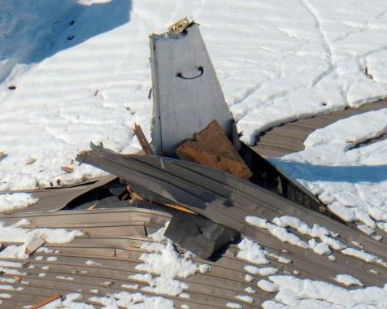
Notable global events
Global Natural Catastrophe Update
Japan: A pair of heavy snowfall events caused significant infrastructure disruptions and damage across the country in mid-February. Four auto manufacturing plants had to suspend operations due to the conditions. Hundreds of residential and commercial buildings collapsed due to snow loads, and over 270,000 lost power due to snow and wind gusts to hurricane force. In large part due to business interruption losses, insured losses from this winter storm outbreak are estimated at $3.1bn.
Source: Reuters
Source: MR NatCatSERVICE
71

Slide 72
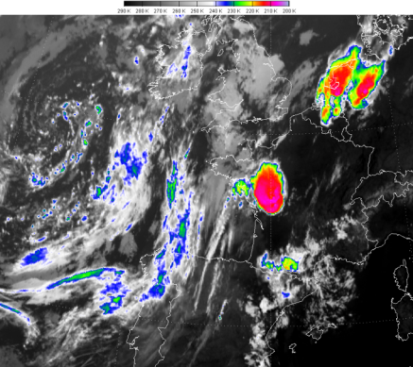
Notable global events
Global Natural Catastrophe Update
France, Germany, Netherlands: Several severe thunderstorms developed between
June 7-10 that produced several swaths of large hail. Tile roofs, windows, and skylights were shattered by the tennis-ball sized hail, and heavy rains flooding thousands of. Agricultural activities were also severely impacted. Although not as damaging as the $3.7 billion loss from the last year’s hail events in Germany, this event still caused estimated insured losses of $2.8 billion across four countries.
Source: copyright 2014 EUMETSAT
Source: MR NatCatSERVICE
72

Slide 73
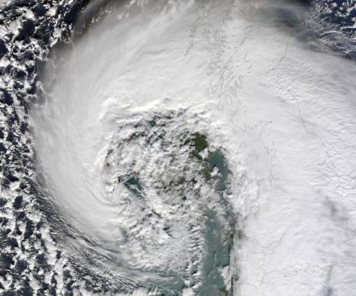
Notable global events
Global Natural Catastrophe Update
United Kingdom: A series of intense extratropical storms brought several bouts of heavy rains during the winter of 2014, causing widespread flooding around the country. Access to some villages was cut off for a month, and over 6,500 properties were flooded. Coastal flooding and erosion was also caused by the persistent storms. Insured losses from the flooding are estimated at about $1.1 billion.
Source: NASA
Source: MR NatCatSERVICE
73

Slide 74
Costliest natural catastrophes since 1950
Ranked by insured losses
Global Natural Catastrophe Update
Year | Event | Region | Insured losses US$ m (in original values)
2005 | Hurricane Katrina | USA | 62,200
2011 | EQ, tsunami | Japan | 40,000
2012 | Hurricane Sandy | USA, Caribbean | 29,500
2008 | Hurricane Ike | USA, Caribbean | 18,500
1992 | Hurricane Andrew | USA | 17,000
2011 | Floods | Thailand | 16,000
1994 | EQ Northridge | USA | 15,300
2011 | EQ Christchurch | New Zealand | 14,600
2004 | Hurricane Ivan | USA, Caribbean | 13,800
2005 | Hurricane Wilma | USA, Caribbean | 12,500

