Slide 1
Natural Catastrophe Review Webinar First Half of 2015
July 14, 2015

Slide 2
Agenda
Introduction Sharon Cooper
Press Spokesperson, Munich Re America
US Natural Catastrophe Update Carl Hedde
Head of Risk Accumulation, Munich Re America
Update on El Niño & Global Natural Catastrophes Dr. Peter Höppe
Head of Geo Risks Research, Munich Re
Economic Implications of Natural Catastrophe Losses Dr. Robert Hartwig
President & Economist, Insurance Information Institute
2

Slide 3
Webinar Interactivity
Questions and Answers
You will have an opportunity to ask questions at the conclusion of the presentation.
An operator will facilitate your participation.
Live Tweeting
@Munichre_US @lworters @iii
#NATCAT2015
3

Slide 4
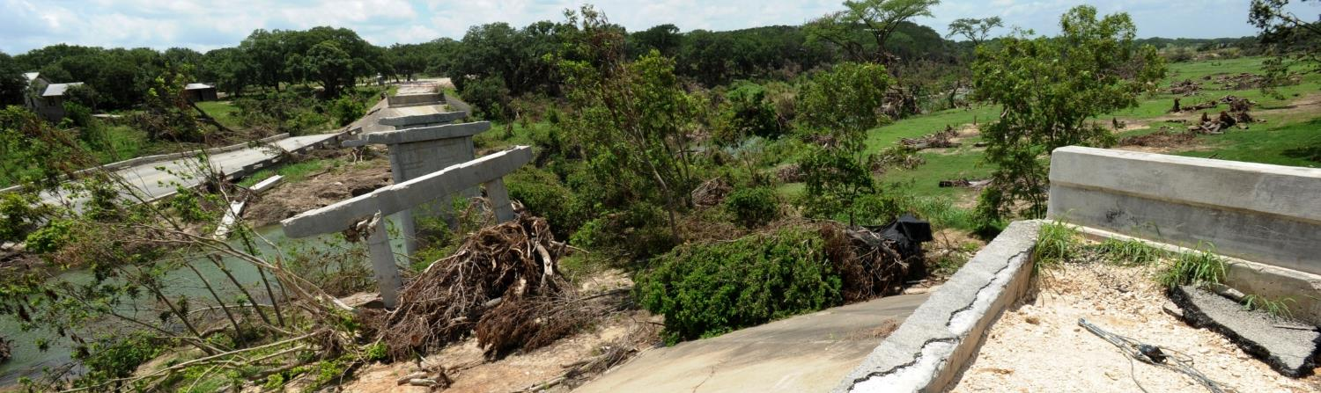
US Natural Catastrophes - First Half of 2015 Carl Hedde, Head of Risk Accumulation Munich Reinsurance America, Inc.
Source: FEMA

Slide 5
US Headlines – First Half 2015
US Natural Catastrophe Update
Insured losses in US totaled $8.2 billion – far below 2000 - 2014 average loss of $11.2 billion (Jan-June)
Drought conditions in California continue to worsen, creating increased risk of wildfires. El Niño conditions may bring much needed rains this winter
Record rainfall in Texas and Oklahoma alleviate drought, but cause severe flash flooding in Houston and Texas Hill Country
Eastern U.S. experienced second winter of brutal cold/snow; damage estimated to exceed $2.9 billion, a new record (in terms of original loss dollars)
Severe thunderstorm events caused estimated $5.1 billion in insured loss, lowest half-year total since 2006
5

Slide 6
Natural disaster losses in the U.S. 2015
Based on perils (January – June only)
US Natural Catastrophe Update
As of July 1, 2015 | Number of Events | Fatalities | Estimated Overall Losses (US $m) | Estimated Insured Losses (US $m)*
Severe Thunderstorm | 38 | 66 | 7,000 | 5,100
Winter Storms & Cold Waves | 11 | 80 | 3,800 | 2,900
Flood, Flash Flood | 10 | 4 | 500 | 150
Earthquake & Geophysical | 1 | - | - | -
Tropical Cyclone | 2 | 4 | 100 | 60
Wildfire, Heat Waves, & Drought | 18 | - | 1,300 | Minor market loss
Totals | 80 | 154 | 12,600 | 8,200
*Source: Property Claim Services (PCS) as of 7.7.2015
6

Slide 7
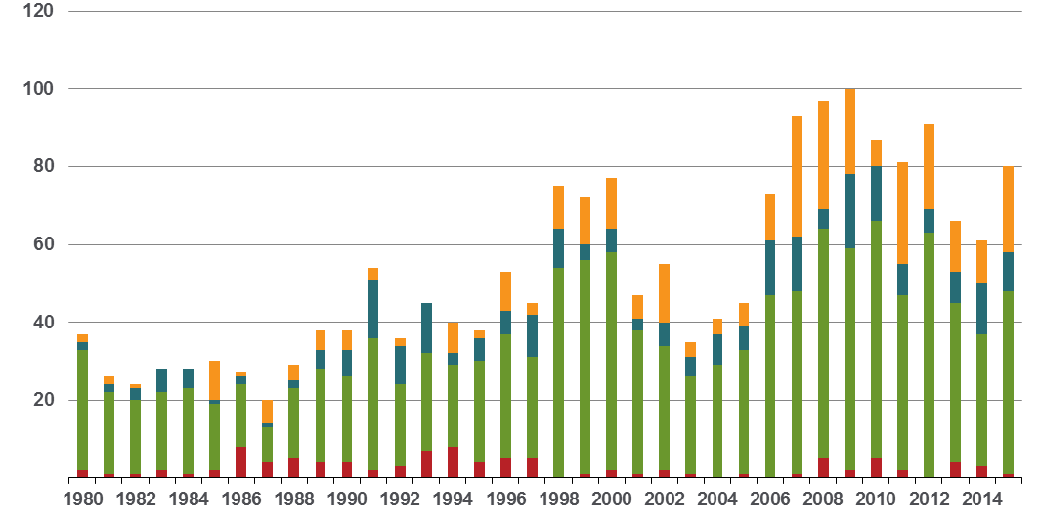
Loss events in the U.S. 1980 – 2015 Number of events (January – June only)
US Natural Catastrophe Update
Number
Geophysical events (Earthquake, tsunami, volcanic activity)
First Six Months in 2015
80 Events
Meteorological events
(Tropical storm, extratropical storm, convective storm,
local storm)
22
Hydrological events
(Flood,
mass movement)
10
Climatological events (Extreme temperature,
drought, forest fire)
47
1
Source: Munich Re, NatCatSERVICE
7

Slide 8
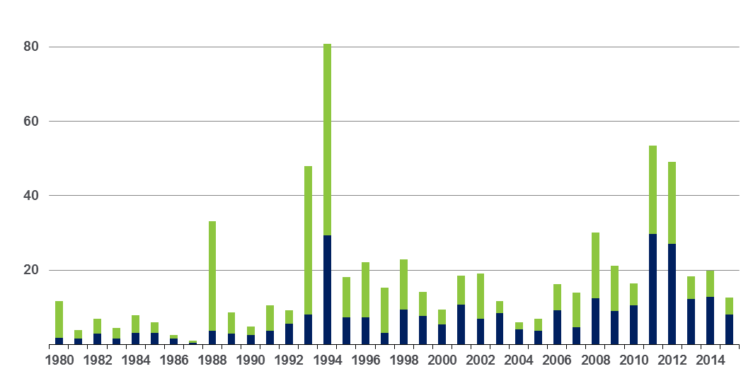
Loss events in the U.S. 1980 – 2015 Overall and insured losses (January – June only)
US Natural Catastrophe Update
Overall losses totaled US$ 12.6bn; Insured losses totaled US$ 8.2bn
bn US$
Overall losses
(in 2015 values)*
Insured losses
(in 2015 values)*
*Losses adjusted to inflation based on country CPI
Source: Munich Re, NatCatSERVICE
8

Slide 9
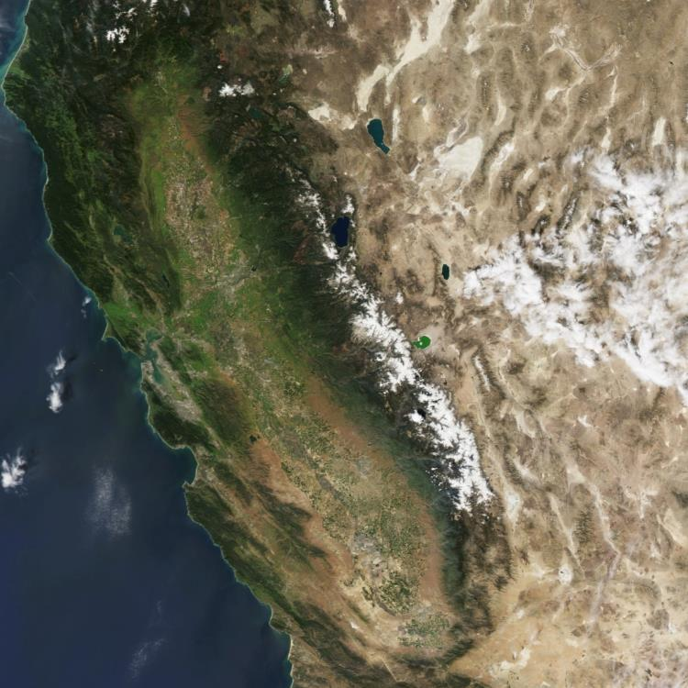
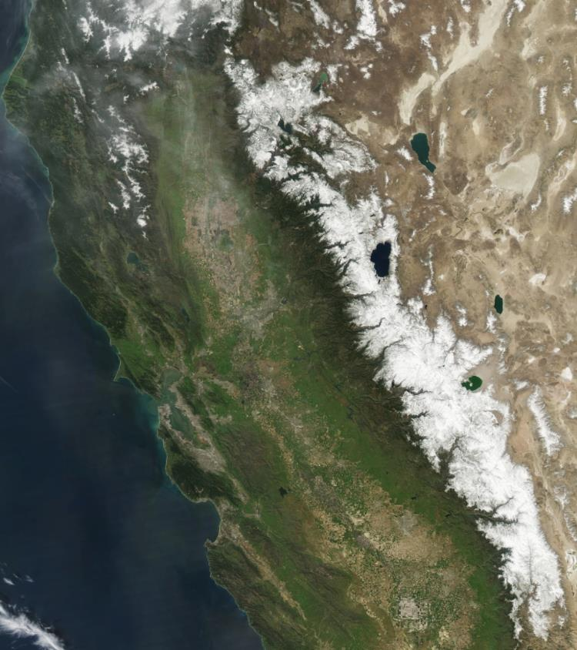
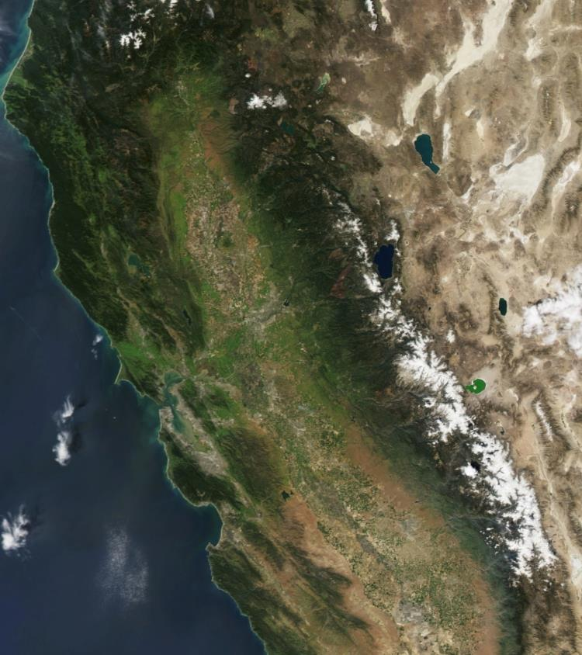
Notable U.S. Events First Half of 2015
March 2010
March 2015
Photos: NASA

Slide 10
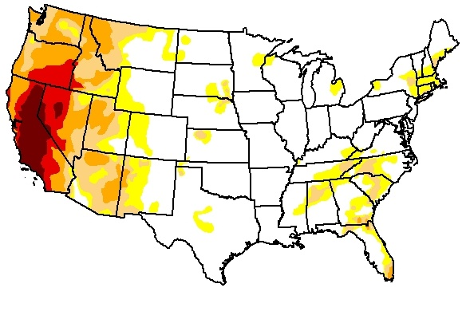
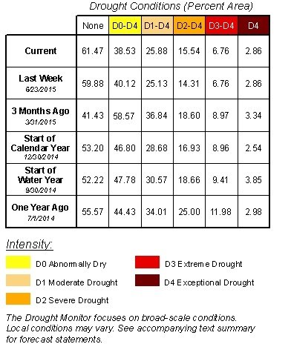

Drought Conditions as of 30 June 2015
US Natural Catastrophe Update
10

Slide 11
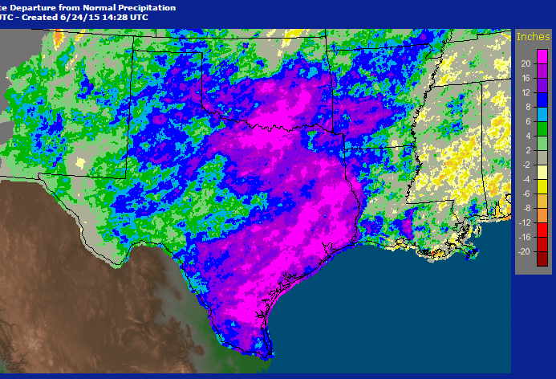

Extreme Precipitation in Texas & Oklahoma
US Natural Catastrophe Update
The United States saw its wettest month of May on record.
May 2015 was also the wettest month in the history of Oklahoma and Texas, in terms of statewide average rainfall.
OK: 14.18” (Previous 10.75”, October 1941)
TX: 7.54” (Previous 6.66”, June 2004)
11

Slide 12
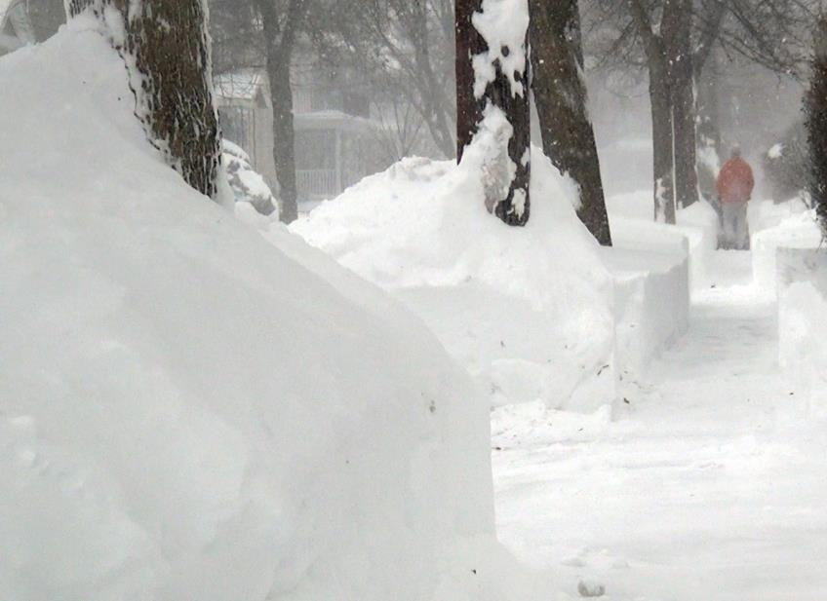
Winter storms First Half 2015
US Natural Catastrophe Update
For second straight year, persistent ridge over western North America caused frigid air to stream southward into eastern US
Record snowfalls across New England, caused numerous roof collapses, while frigid temperatures burst pipes
Aggregate insured losses estimated at $2.9 billion, largest total in terms of original loss dollars
Source: FEMA
Source: Property Claims Service; MR NatCatSERVICE
12

Slide 13
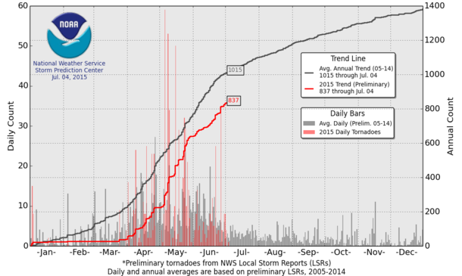
Thunderstorms Tornado Count for First Half 2015
US Natural Catastrophe Update
Preliminary tornado counts for first half of 2015 about 200 below the 2005-2014 average.
Tornado counts in April (185) and May 2015 (414) were much higher than in 2014.
Source: NOAA
13

Slide 14
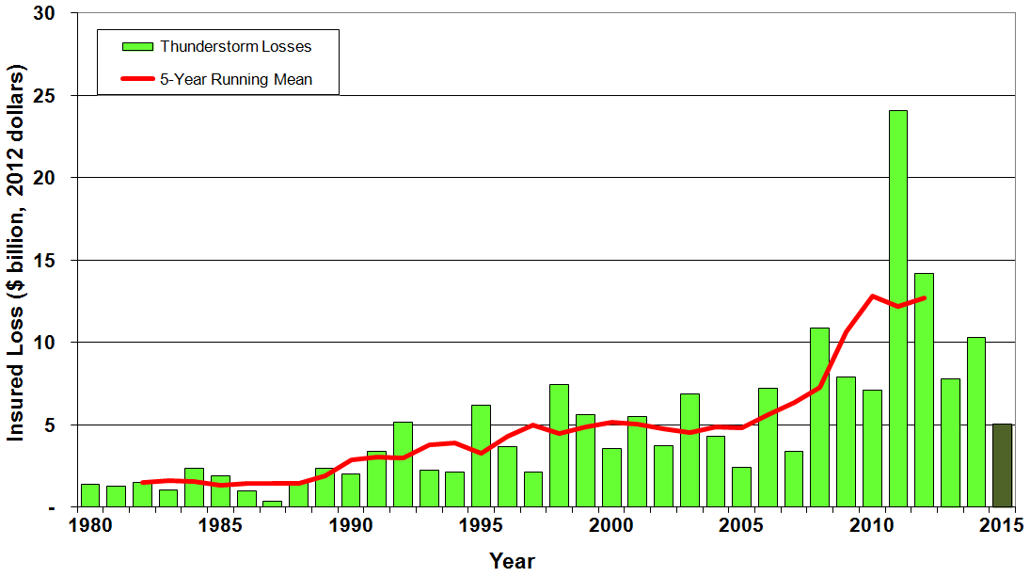
Insured Loses Due to Convective Storms* January – June Only, 1980 - 2015
US Natural Catastrophe Update
Overall losses totaled US$ 7.0bn; Insured losses totaled US$ 5.1bn
Insured losses
(in 2014 values)**
US$m
5 year Mean
*Convective storms include tornadoes, hail, and straight-line winds
**Losses adjusted to inflation based on country CPI
14

Slide 15
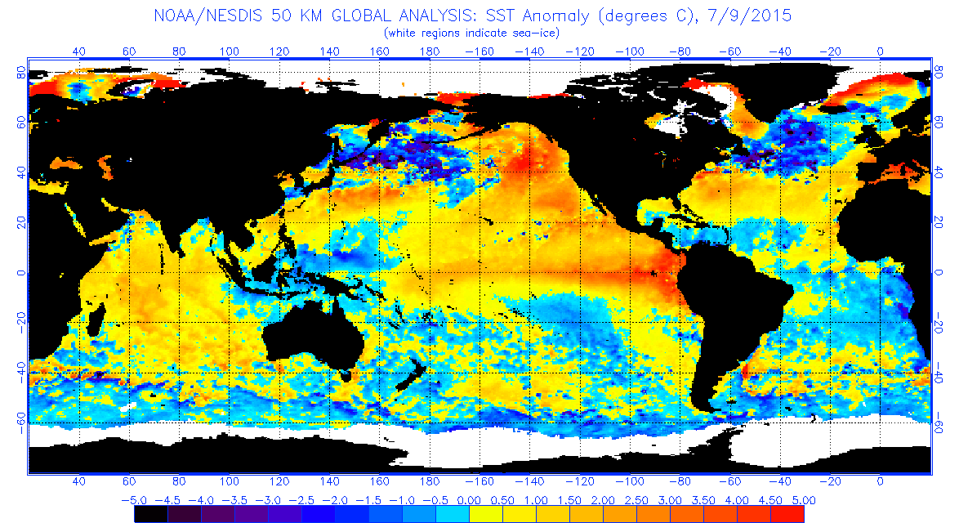
Update on El Niño Dr. Peter Höppe, Head of Geo Risks Research Munich Re
Source: NOAA

Slide 16
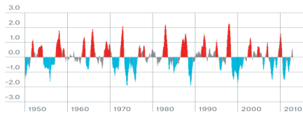
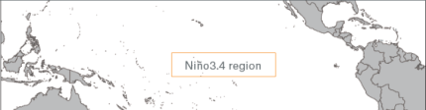
ENSO (El Niño/Southern Oscillation) Definitions
Update on El Niño
ENSO (El Niño/Southern Oscillation): natural climate oscillation in tropical Pacific Ocean, which affects both ocean and atmosphere.
Anomaly of sea surface temperature in so called Niño3.4-Region (= Niño3.4-Index) is used to define ENSO-Phases:
El Niño (Niño3.4-Index >0,5)
Anomalies of sea surface temperatures in
Niño3.4-region since 1950
Neutral Phase (Niño3.4-Index <0,5 und >-0,5)
La Niña (Niñno3.4-Index <-0,5)
Location of Niño 3.4-region
Source: Climate Prediction Center/NOAA
16

Slide 17
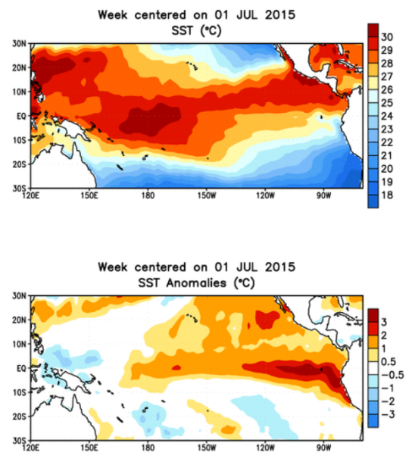
The 2015-2016 El Niño
Update on El Niño
Moderate El Niño conditions have developed over past 6 months over eastern equatorial Pacific
Forecasts indicate this will likely be strongest El Niño event since 1997-1998
If strong El Niño develops, there is high probability for a La Niña next year
Current Impacts:
Record amount of Accumulated Cyclone Energy (ACE) released by northern hemisphere tropical cyclones so far this year (166 vs. normal of 54 through 30 June)
Disruption of monsoons in South Asia; has contributed to the record heat wave there.
Source: NOAA/CPC
17

Slide 18
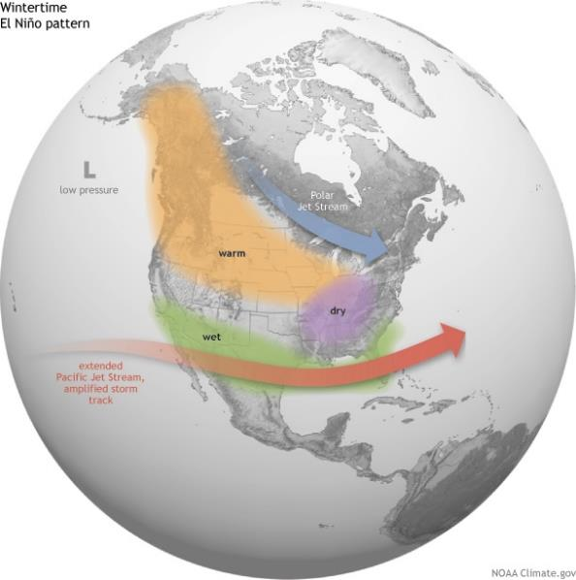
The 2015-2016 El Niño
Update on El Niño
Expected U.S. Impacts:
Cooler and wetter than normal along southern third of nation
Drier than normal in Pacific Northwest and Ohio River valley; warmer than normal from Alaska to Northern Plains
Reduced tropical cyclone risk in Atlantic; increased risk in Eastern Pacific and Hawaii.
Potential for heavy rains, mudslides in California
Potential for reduced winter tornado outbreaks over south-central U.S. ; increased risk of winter tornadoes over Florida peninsula
18

Slide 19
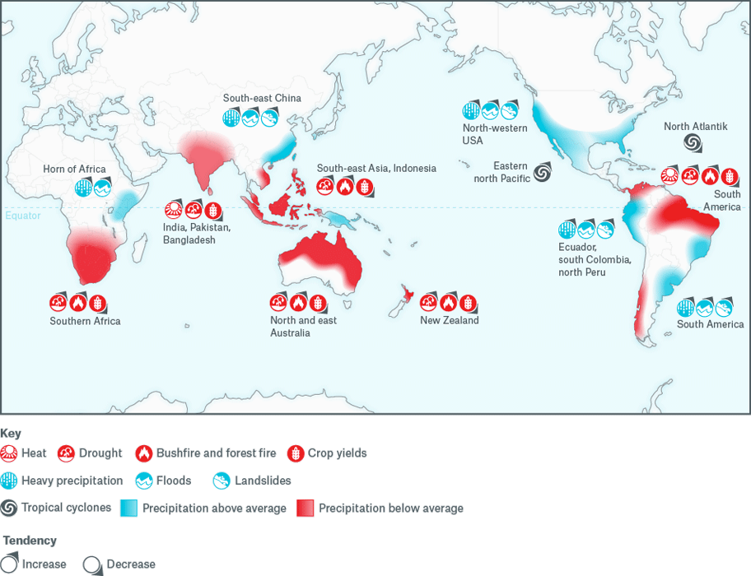
Global characteristic changes in El Niño phases
Update on El Niño
Lower TS activity in Atlantic ocean; higher in East-Pacific
Increased flood risks in South America; Southeast China
Increased drought risk in East and North Australia; Southeast and South Asia; Southern Africa; North/Northeast Brazil
19

Slide 20
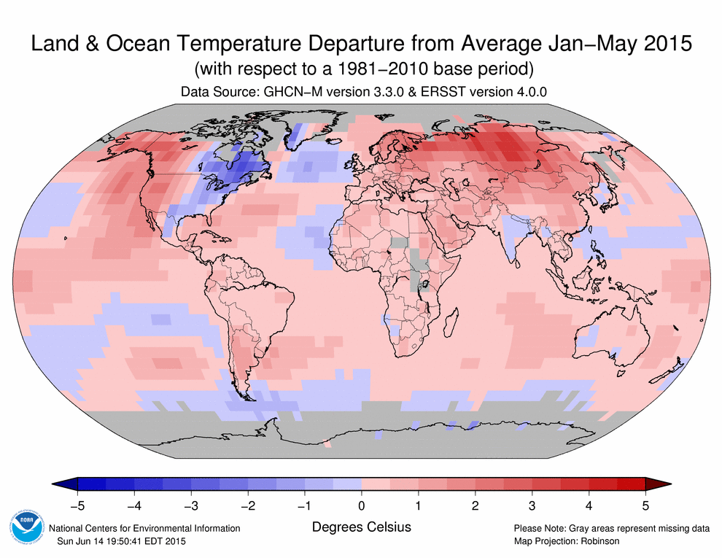
State of Climate (NOAA): 2014 warmest year on record! 2015 starts with new record!
Update on El Niño
2014 was the warmest year across global land and ocean surfaces since records began in 1880
9 of 10 warmest years in 135-year period of record have occurred in 21st century
1998 currently ranks as fourth warmest year on record.
January to May 2015 warmest first five months on record!
20

Slide 21
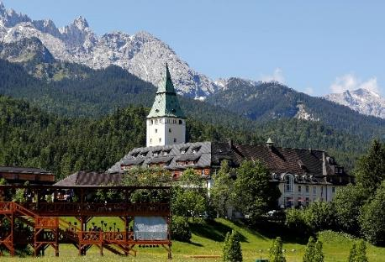
G7 Climate Risk Insurance Initiative
Update on El Niño
G7 decided to support people in developing countries to protect themselves against economic consequences of more intense and frequent extreme weather events
Target: extra 400 million people earning less than US$ 2 per day get access to direct (100 m) or indirect (300 m) insurance of losses caused by weather extremes
German Government already pledged € 150 million for first two project years with option of more to follow later
Munich Re has been involved w/German government in preparation of G7 initiative: directly with in house geo risks research expertise and indirectly by Munich Climate Insurance Initiative (MCII)
CRII has high potential to become milestone on climate change adaptation and resilience for poor countries.
21

Slide 22
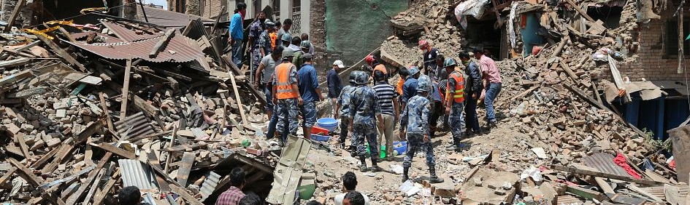
Global Natural Catastrophes - First Half of 2015

Slide 23
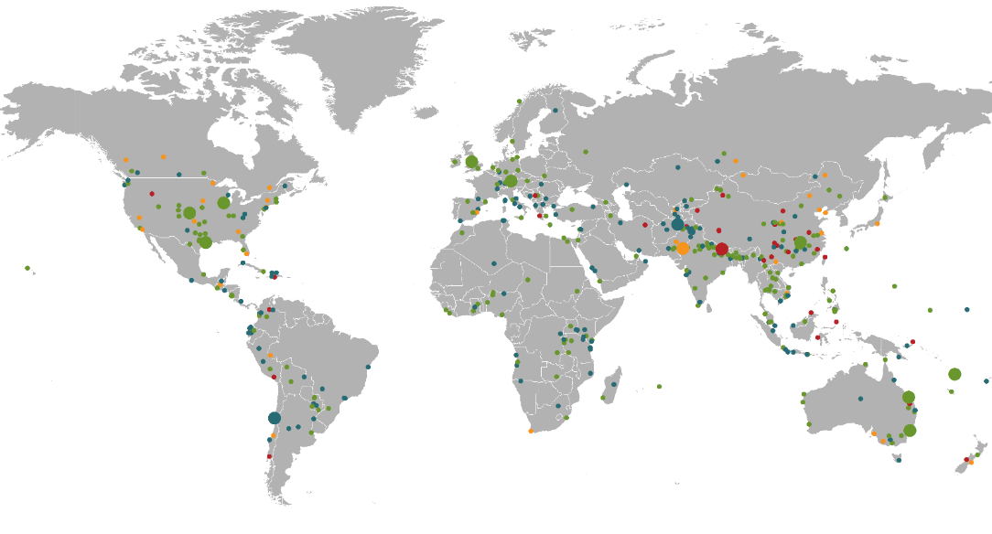
Loss events worldwide Jan – June 2015 Geographical overview
Global Natural Catastrophe Update
Avalanche, winter damage
Afghanistan, February–March
Winter Storm Niklas
Europe, 30 March–1 April
Earthquake
Nepal, China, India, Bangladesh
25 April
Winter storms Elon and Felix
Europe, 8–11
January
Winter storm
USA, Canada
16–25 February
Cyclone Marcia
Australia,
18–20 February
Severe storms
USA, 7–10 April
Cyclone Pam
Vanuatu,
9–16 March
Severe storms
USA, 18–21 April
Severe storm,
tornado
China, 1 June
Loss events
510
Loss events
Heatwave
India, Pakistan
May–June
Selection of
Catastrophes
Flash floods
Chile, 23–26 March
Winter storm
Australia, 19–24 April
Source: Munich Re, NatCatSERVICE, 2015
Source: Geo Risks Research, NatCatSERVICE – As at July 2015
23

Slide 24
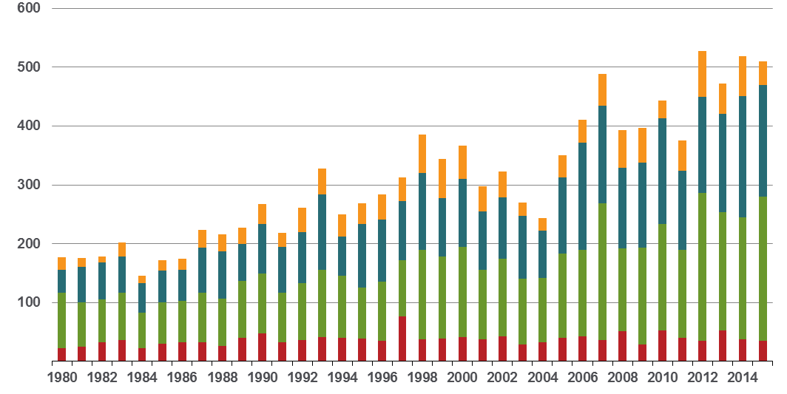
Loss events worldwide 1980 – 2015 Number of events (January – June only)
Global Natural Catastrophe Update
Number
Geophysical events (Earthquake, tsunami, volcanic activity)
Meteorological events
(Tropical storm, extratropical storm, convective storm,
local storm)
Hydrological events
(Flood,
mass movement)
Climatological events (Extreme temperature,
drought, forest fire)
Source: Munich Re, NatCatSERVICE – As at July 2015
24

Slide 25
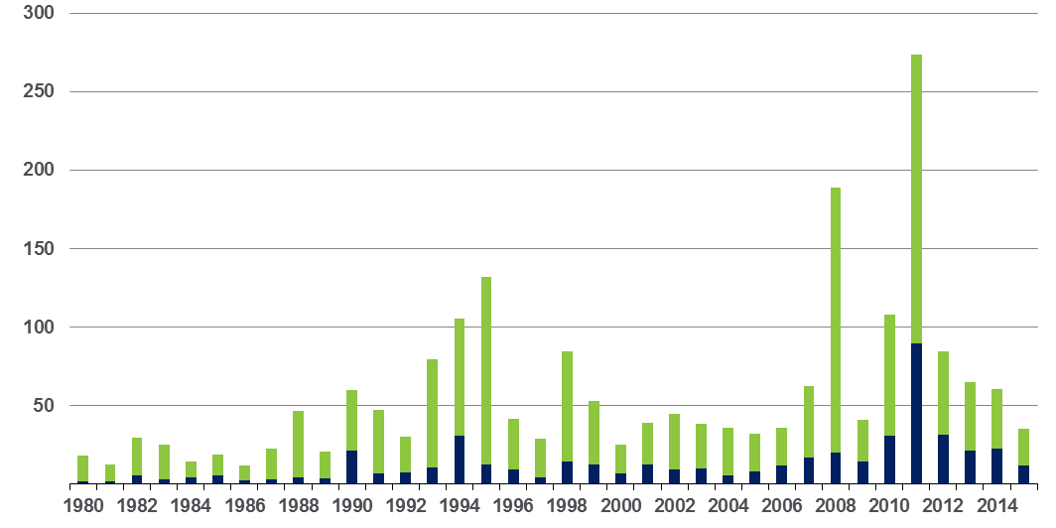
Loss events worldwide 1980 – 2015 Overall and insured losses (January – June only)
Global Natural Catastrophe Update
US$ bn
Overall losses
(in 2015 values)*
Insured losses
(in 2015 values)*
*Losses adjusted to inflation based on country CPI
Source: Munich Re, NatCatSERVICE – As at July 2015
25

Slide 26
Loss events worldwide 2015 Overview and comparison with previous years
Global Natural Catastrophe Update
 | 2015 (Jan – June) | 2014 (Jan – June) | Average of the last 10 years 2005-2014 (Jan – June) | Average of the last 30 years 1985-2014 (Jan – June) | Top Year 1985 -2014 (Jan – June)
Number of events | 510 | 520 | 440 | 330 | 620 (2012)
Overall losses in US$ m (original values) | 35,000 | 60,000 | 95,000 | 64,000 | 302,000 (2011, EQ Japan)
Insured losses in US$ m (original values) | 12,000 | 23,000 | 27,000 | 15,000 | 82,000 (2011, EQ Japan)
Fatalities | 16,200 | 2,800 | 46,000 | 27,000 | 230,000 (2010, EQ Haiti)
26

Slide 27
Loss events worldwide 2015 The five costliest natural catastrophes for the insurance industry
Global Natural Catastrophe Update
Date | Region | Event | Fatalities | Overall losses US$ m | Insured losses US$ m
16-25.2.2015 | United States, Canada | Winter storm | 39 | 2,400 | 1,800*
30.3-1.4.2015 | Europe | Winter Storm Niklas | 11 | 1,400 | 1,000
7-10.4.2015 | United States | Severe storms | 3 | 1,400 | 990*
18-21.4.2015 | United States | Severe storms | - | 1,100 | 780*
23-28.5.2015 | United States | Severe storms | 32 | 1,300 | 750*
*Date based on information from PCS
27

Slide 28
Costliest natural catastrophes since 1980 Ranked by insured losses
Global Natural Catastrophe Update
Year | Event | Region | Insured loss US$m (in original values)
2005 | Hurricane Katrina | USA | 60,500
2011 | EQ, tsunami | Japan | 40,000
2012 | Hurricane Sandy | USA, Caribbean | 29,500
2008 | Hurricane Ike | USA, Caribbean | 18,500
1992 | Hurricane Andrew | USA | 17,000
2011 | EQ Christchurch | New Zealand | 16,500
2011 | Floods | Thailand | 16,000
1994 | EQ Northridge | USA | 15,300
2005 | Hurricane Wilma | USA, Caribbean | 12,500
2012 | Drought | USA | 12,000
28

Slide 29
Market & Financial Impact of Catastrophe Losses: First Half 2015 Summary
Insurance Information Institute
July 14, 2015
Robert P. Hartwig, Ph.D., CPCU, President & Economist
Insurance Information Institute ♦ 110 William Street ♦ New York, NY 10038
Tel: 212.346.5520 ♦ Cell: 917.453.1885 ♦ bobh@iii.org ♦ www.iii.org
29

Slide 30
WINTER STORM LOSSES: Significant Economic Impact—Again!
Losses from Snow, Ice, Freezing and Related Causes Typical Cost Insurers Between $1 Billion and $2 Billion Annually ($2.3B+ in 2014/15)
30

Slide 31
US Real GDP Growth*
The Q4:2008 decline was the steepest since the Q1:1982 drop of 6.8%
Real GDP Growth (%)
Q1 2015 GDP data were again hit hard by harsh winter weather
Q1 2014 GDP data were hit hard by that year’s “Polar Vortex” and harsh winter
Great Recession Dec. 2007- June 2009
Demand for Insurance Should Increase in 2015 as GDP Growth Accelerates Modestly and Gradually Benefits the Economy Broadly
* Estimates/Forecasts from Blue Chip Economic Indicators.
Source: US Department of Commerce, Blue Economic Indicators 7/15; Insurance Information Institute.

Slide 32
Inflation Adjusted U.S. Catastrophe Losses by Cause of Loss, 1995–2014¹
Wind/Hail/Flood (3), $21.4
Fires (4), $6.0
Winter storm losses were much above average in 2014/15 are will push this share up
Other (5), $0.2
Insured cat losses from 1995-2014 totaled $395.6B, an average of $19.8B per year or $1.65B per month
Geological Events, $0.5
Terrorism, $24.5
Winter Storms, $26.9
Hurricanes & Tropical Storms, $161.2
Tornado share of CAT losses is rising
Wind losses are by far cause the most catastrophe losses, even if hurricanes/TS are excluded.
Events Involving Tornadoes (2), $154.9
Catastrophes are defined as events causing direct insured losses to property of $25 million or more in 2014 dollars.
Excludes snow.
Does not include NFIP flood losses
Includes wildland fires
Includes civil disorders, water damage, utility disruptions and non-property losses such as those covered by workers compensation.
Source: ISO’s Property Claim Services Unit.

Slide 33
Top 16 Most Costly Disasters in U.S. History—Katrina Still Ranks #1
(Insured Losses, 2014 Dollars, $ Billions)
Storm Sandy in 2012 was the last mega-CAT to hit the US
12 of the 16 Most Expensive Events in US History Have Occurred Since 2004
Includes Joplin, MO, tornado
Includes Tuscaloosa, AL, tornado
Sources: PCS; Insurance Information Institute inflation adjustments to 2014 dollars using the CPI.

Slide 34
I.I.I. Poll: 10 Years After Katrina, Most Understand Flood Is Not Covered Under Standard HO Policies
Q. Does your homeowners policy cover damage from flooding during a hurricane?¹
Don’t know
Yes
No
More Than Half of Homeowners Know Their HO Insurance Does Not Cover Flood From a Hurricane, But A Significant Proportion Either Think It Does Or Do Not Know.
¹Asked of those who have home insurance.
Source: Insurance Information Institute Annual Pulse Survey.

Slide 35
I.I.I. Poll: Flooding from Hurricanes
Q. Does your homeowners policy cover damage from flooding during a hurricane?¹
Respondents answering “yes”.
Homeowners in the South and Northeast Were Most Likely to Think Home Insurance Pays for Flood Damage.
¹Asked of those who have home insurance.
Source: Insurance Information Institute Annual Pulse Survey.

Slide 36
P/C Insurance Industry: Financial Update
2015 Is Likely to Be One of the Strongest Years in the Post-Recession Era
(2013 Was Best)
36

Slide 37
P/C Industry Net Income After Taxes 1991–2015:Q1
$ Millions
2005 ROE*= 9.6%
2006 ROE = 12.7%
2007 ROE = 10.9%
2008 ROE = 0.1%
2009 ROE = 5.0%
2010 ROE = 6.6%
2011 ROAS¹ = 3.5%
2012 ROAS¹ = 5.9%
2013 ROAS¹ = 10.2%
2014 ROAS¹ = 8.4%
2015:Q1E ROAS = 10.5%
Net income fell modestly (-12.5%) in 2014 vs. 2013
Net income was up sharply in Q1, lower cats were one factor
ROE figures are GAAP; ¹Return on avg. surplus. Excluding Mortgage & Financial Guaranty insurers yields a 8.2% ROAS in 2014, 9.8% ROAS in 2013, 6.2% ROAS in 2012, 4.7% ROAS for 2011, 7.6% for 2010 and 7.4% for 2009.
Sources: A.M. Best, ISO; Insurance Information Institute

Slide 38
ROE: Property/Casualty Insurance by Major Event, 1987–2015:Q1
(Percent)
P/C Profitability Is Subject to Cyclicality and Ordinary Volatility, Typically Due to CAT Activity
Katrina, Rita, Wilma
Low CATs
2015 similar to 2013-14
Sept. 11
Somewhat higher CAT activity in 2014 had a modest negative impact on ROE
Hugo
Lowest CAT Losses in 15 Years
4 Hurricanes
Sandy
Andrew
Record Tornado Losses
Northridge
Financial Crisis*
* Excludes Mortgage & Financial Guarantee in 2008 – 2014.
Sources: ISO; Insurance Information Institute.

Slide 39
A 100 Combined Ratio Isn’t What It Once Was: Investment Impact on ROEs
Lower CATs (relative to 2011/12) helped ROEs in 2013/14/15
Combined Ratio / ROE
A combined ratio of about 100 generates an ROE of ~7.0% in 2012/13, ~7.5% ROE in 2009/10, 10% in 2005 and 16% in 1979
Combined Ratios Must Be Lower in Today’s Depressed Investment Environment to Generate Risk Appropriate ROEs
* 2008 -2014 figures are return on average surplus and exclude mortgage and financial guaranty insurers. 2014: combined ratio including M&FG insurers is 97.0; 2013 = 96.1; 2012 =103.2, 2011 = 108.1, ROAS = 3.5%.
Source: Insurance Information Institute from A.M. Best and ISO Verisk Analytics data.

Slide 40
SURPLUS/CAPITAL/CAPACITY
Industry Claims Paying Capital Stands at Near Record High as of mid-2015
(Re)Insurance Industry is Well Positioned to Manage Large Scale Catastrophe Losses
40

Slide 41
Policyholder Surplus, 2006:Q4–2015:Q1E
Drop due to near-record 2011 CAT losses
($ Billions)
2007:Q3 Pre-Crisis Peak
The P/C insurance industry entered 2015 (and the 2015 hurricane season on June 1) in very strong financial condition.
Surplus as of 3/31/15 stood at a near-record high of $671B
The industry now has $1 of surplus for every $0.73 of NPW, close to the strongest claims-paying status in its history.
2010:Q1 data includes $22.5B of paid-in capital from a holding company parent for one insurer’s investment in a non-insurance business.
Sources: ISO, A.M .Best; I.I.I. estimate for Q1:2015
12/01/09 - 9pm
eSlide – P6466 – The Financial Crisis and the Future of the P/C
Notes:
41

Slide 42
Investments: The New Reality
Investment Income Offsets Less Loss than in the Past, Including Losses from Catastrophes
42

Slide 43
Property/Casualty Insurance Industry Investment Income: 2000–2015E¹
($ Billions)
Investment earnings are still below their 2007 pre-crisis peak
Due to persistently low interest rates, investment income fell in 2012, 2013 and 2014. A small increase in 2015 is possible as interest rates slowly increase.
¹ Investment gains consist primarily of interest and stock dividends. *2015 figure is estimated based on annualized data through Q1.
Sources: ISO; Insurance Information Institute.

Slide 44
Book Yield on Property/Casualty Insurance Invested Assets, 2007–2015*
(Percent)
Book yield in 2015 is down 74 BP from pre-crisis levels
The yield on invested assets remains low relative to pre-crisis yields. The Fed’s plan to raise interest rates in late 2015 has already pushed up some yields, albeit quite modestly.
*2015 figure is the average of the four quarters ending in 2015:Q1.
Sources: SNL Financial; Insurance Information Institute

Slide 45
UNDERWRITING
Underwriting Results in 2015 (and 2013-14) Were Helped by Generally Modest Catastrophe Losses
Welcome Respites from 2011/2012
45

Slide 46
P/C Insurance Industry Combined Ratio, 2001–2015:H1*
Heavy Use of Reinsurance Lowered Net Losses
Relatively Low CAT Losses, Reserve Releases
Higher CAT Losses, Shrinking Reserve Releases, Toll of Soft Market
As Recently as 2001, Insurers Paid Out Nearly $1.16 for Every $1 in Earned Premiums
Relatively Low CAT Losses, Reserve Releases
Avg. CAT Losses, More Reserve Releases
Sandy Impacts
Best Combined Ratio Since 1949 (87.6)
Cyclical Deterioration
Modest CATs
Lower CAT Losses
Somewhat higher CAT Losses
* Excludes Mortgage & Financial Guaranty insurers 2008--2014. Including M&FG, 2008=105.1, 2009=100.7, 2010=102.4, 2011=108.1; 2012:=103.2; 2013: = 96.1; 2014: = 97.0.
Sources: A.M. Best, ISO; I.I.I. estimate for H1:2015.

Slide 47
Underwriting Gain (Loss) All Lines Combined, 1975–2015*
($ Billions)
2014 underwriting profit totaled $12.3B
Underwriting profit in 2014 estimated at $14B
High CAT losses in 2011 led to the highest underwriting loss since 2001. Lower CAT losses in 2013, 2014 and modest losses so far in 2015. First underwriting profits since 2007.
Note: Includes mortgage and financial guaranty insurers in all years.
Sources: A.M. Best, ISO, Insurance Information Institute.

Slide 48
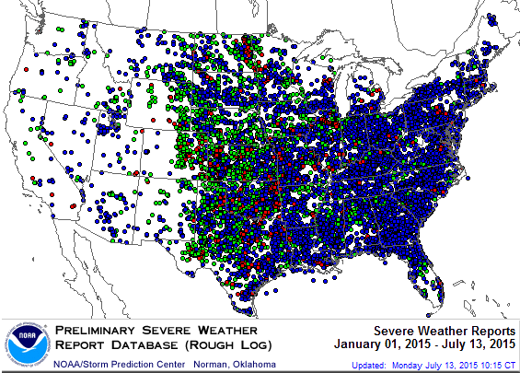
Severe Weather Reports: Jan. 1 – July 13, 2015
Severe weather reports are concentrated east of the Rockies
There were 12,360 severe weather reports through July 13, 2015; including 874 tornadoes; 3,921 “Large Hail” reports and 7,564 high wind events
Source: NOAA Storm Prediction Center; http://www.spc.noaa.gov/climo/online/monthly/2015_annual_summary.html
48

Slide 49
Number of Federal Major Disaster Declarations, 1953-2015*
There have been 2,228 federal disaster declarations since 1953. The average number of declarations per year is 35 from 1953-2014, though there few haven’t been recorded since 1995.
The number of federal disaster declarations set a new record in 2011, with 99, shattering 2010’s record 81 declarations.
23 federal disasters have declared so far in 2015*
The Number of Federal Disaster Declarations Is Rising and Set New Records in 2010 and 2011 Before Dropping in 2012-2014
*Through July 12, 2015.
Source: Federal Emergency Management Administration; http://www.fema.gov/disasters; Insurance Information Institute.

Slide 50
Combined Ratio Points Associated with Catastrophe Losses: 1960 – 2015E*
Combined Ratio
Points
Avg. CAT Loss Component of the Combined Ratio by Decade
1960s: 1.04 1970s: 0.85 1980s: 1.31 1990s: 3.39 2000s: 3.52 2010s: 5.6E*
Catastrophe losses as a share of all losses reached a record high in 2011
Catastrophe losses as a share of all losses have been down substantially since 2013
The Catastrophe Loss Component of Private Insurer Losses Has Increased Sharply in Recent Decades
*2010s represent 2010-2015E.
Notes: Private carrier losses only. Excludes loss adjustment expenses and reinsurance reinstatement premiums. Figures are adjusted for losses ultimately paid by foreign insurers and reinsurers.
Source: ISO (1960-2011); A.M. Best (2012-2014); Insurance Information Institute.

Slide 51
Premium Growth
Catastrophe Losses Impact Trajectory of Premium Growth
51

Slide 52
Net Premium Growth: Annual Change, 1971—2015E
(Percent)
1975-78
1984-87
2000-03
Net Written Premiums Fell 0.7% in 2007 (First Decline Since 1943) by 2.0% in 2008, and 4.2% in 2009, the First 3-Year Decline Since 1930-33.
Post-Andrew spike
2015E: 3.9%
2014: 4.1%
2013: 4.4%
2012: +4.3%
Post-Katrina spike
Shaded areas denote “hard market” periods
Sources: A.M. Best (historical and forecast), ISO, Insurance Information Institute.

Slide 53
Insurance Information Institute Online:
www.iii.org
Thank you for your time and your attention!
Twitter: twitter.com/bob_hartwig

Slide 54
Follow-up Information Sharon Cooper – Media Spokesperson Munich Reinsurance America, Inc.
Source: FEMA

Slide 55

Question and Answer

Slide 56

Press Question and Answer Process
To ask a question, please dial 1 4 on your phone.
An operator will facilitate your participation.
56

Slide 57
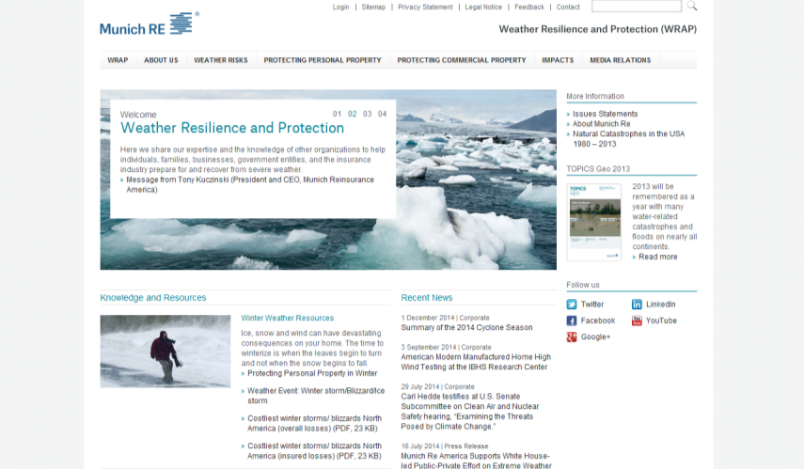
Weather Resilience and Protection (WRAP)
Website
Describe the impact of severe weather and how individuals, businesses, government, and insurers can work together to prepare for and mitigate weather risks.
Includes data, publications, preparation tips and other useful information for the press.
www.munichre.us/wrap
57

Slide 58
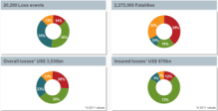
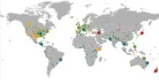
MR NatCatSERVICE The world‘s largest database on natural catastrophes
NatCatSERVICE Downloadcenter
Annual statistics
Long-term statistics
Information on significant natural disasters
Focus analyses
NatCatSERVICE methodology, info brochure
Publication Topics Geo
www.munichre.com/natcatservice/downloadcenter/en
58

Slide 59
More Information
 | Connect with Munich Re | Connect with I.I.I.
Twitter | @Munichre_US @MunichRe_In | @iiiorg
LinkedIn | munich-reinsurance-america-inc. | Insurance Information Institute
Google+ | Munich Re (US) Munich Re | Insurance Information Institute
YouTube | MunichReUs MunichReVideo | iiivideo
Facebook | Munichreus1 Munichre | InsuranceInformationInstitute
Flickr |  | iiiorg
59

Slide 60
Press Inquiries
Sharon Cooper
Phone: +1 (609) 243-8821 scooper@munichreamerica.com
60

Slide 61
Natural Catastrophe Review Webinar First Half of 2015
July 14, 2015

Slide 62
© Copyright 2015 Munich Reinsurance America, Inc. All rights reserved. "Munich RE" and the Munich Re logo are internationally protected registered trademarks. The material in this presentation is provided for your information only, and is not permitted to be further distributed without the express written permission of Munich Reinsurance America, Inc. This material is not intended to be legal, underwriting, financial, or any other type of professional advice. Any descriptions of coverage reflected in this presentation are meant to be general in nature and do not include and are not intended to include all of the actual terms, benefits and limitations found in an insurance policy. Only the insurance policy will form the contract between the insured and insurance company, and governs in all cases.

