Slide 1
National Association of Insurance Commissioners (NAIC) Insurance Summit
Consumer Engagement from an Industry Perspective
Sheraton Kansas City at Crown Center
Kansas City, Missouri
May 25, 2017
Michael Barry, Vice President, Media Relations
Jeanne M. Salvatore, Senior Vice President, Chief Engagement Officer and Sr. Spokesperson
Insurance Information Institute  110 William Street  New York, NY 10038
Tel: 212.346.5555  Cell: 917.612.4088  Jeannes@iii.org  www.iii.org

Slide 2
Presentation Overview
Consumer Engagement from an Industry Perspective
What is the Insurance Information Institute?
What do Consumers Know About Insurance?
What Should We Be Communicating?
What does the I.I.I. do to Educate Consumers?
What are other Sources of Insurance Information?
How Should We Communicate?
Questions

Slide 3

I.I.I. Mission Statement
Simple and succinct; and should stay that way…
Improving public understanding
of insurance...
…what it does and how it works
3

Slide 4
What do Consumers Know About Insurance?
And what don’t they understand?

Slide 5
Homeowners and Renters Insurance
Most Homeowners Purchase Coverage, and Growing Number of Renters do too!
A 2016 Insurance Information Institute poll conducted by ORC International found that 93 percent of homeowners had homeowners insurance.
And 41 percent of renters had renters insurance. This number has been growing over the last decade.
But only 12 percent had a flood insurance policy, despite the fact that flooding is the most common natural disaster in the U.S.
And, although earthquakes have caused damage in all 50 states, only 8 percent of American homeowners purchase separate earthquake insurance or add an earthquake endorsement to their homeowners policy.

Slide 6
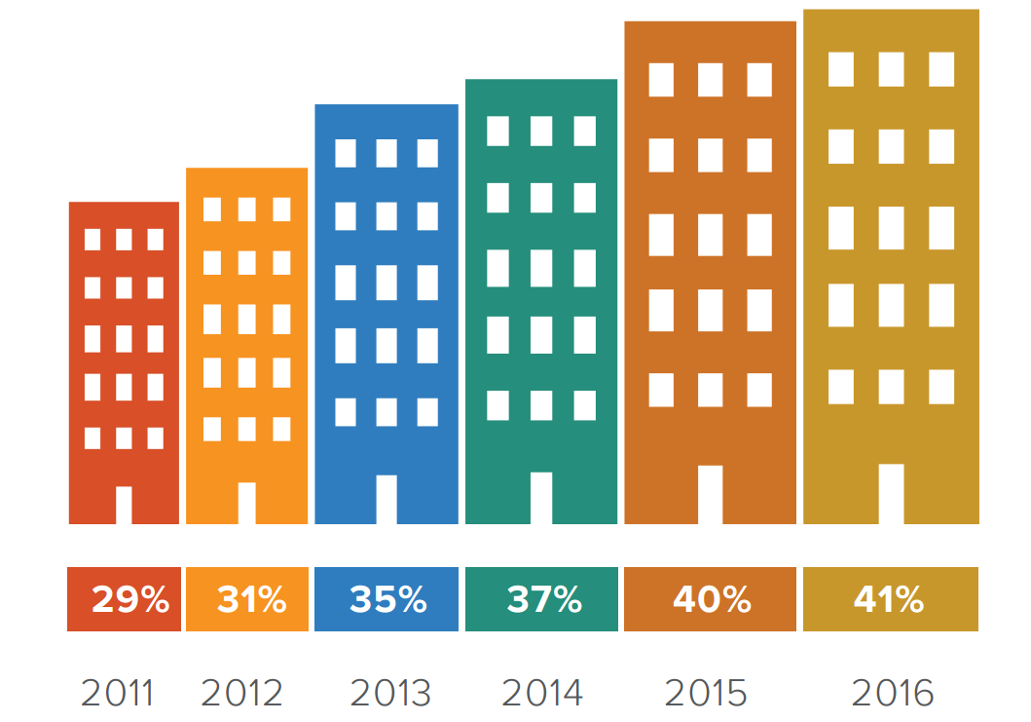
Growing Number of Renters Insure Their Home

Slide 7
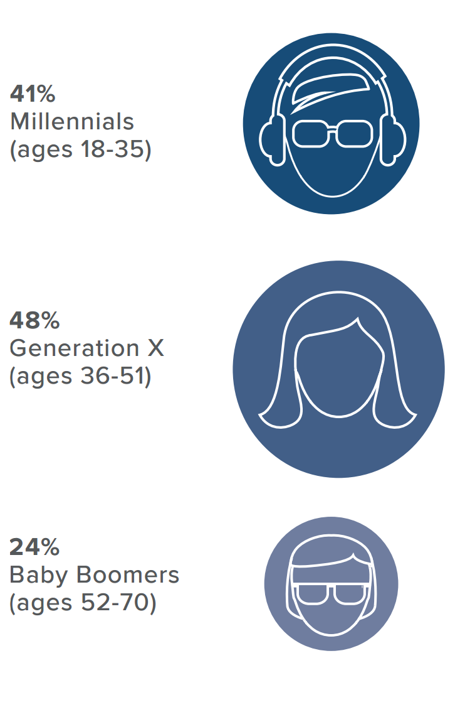
Renters Insurance - Age Matters
In one surprising twist, the I.I.I. found that younger generations are more likely to purchase renters insurance than older Americans.
A greater percentage of both Millennials and Generation Xers purchase renters insurance than Baby Boomers.

Slide 8
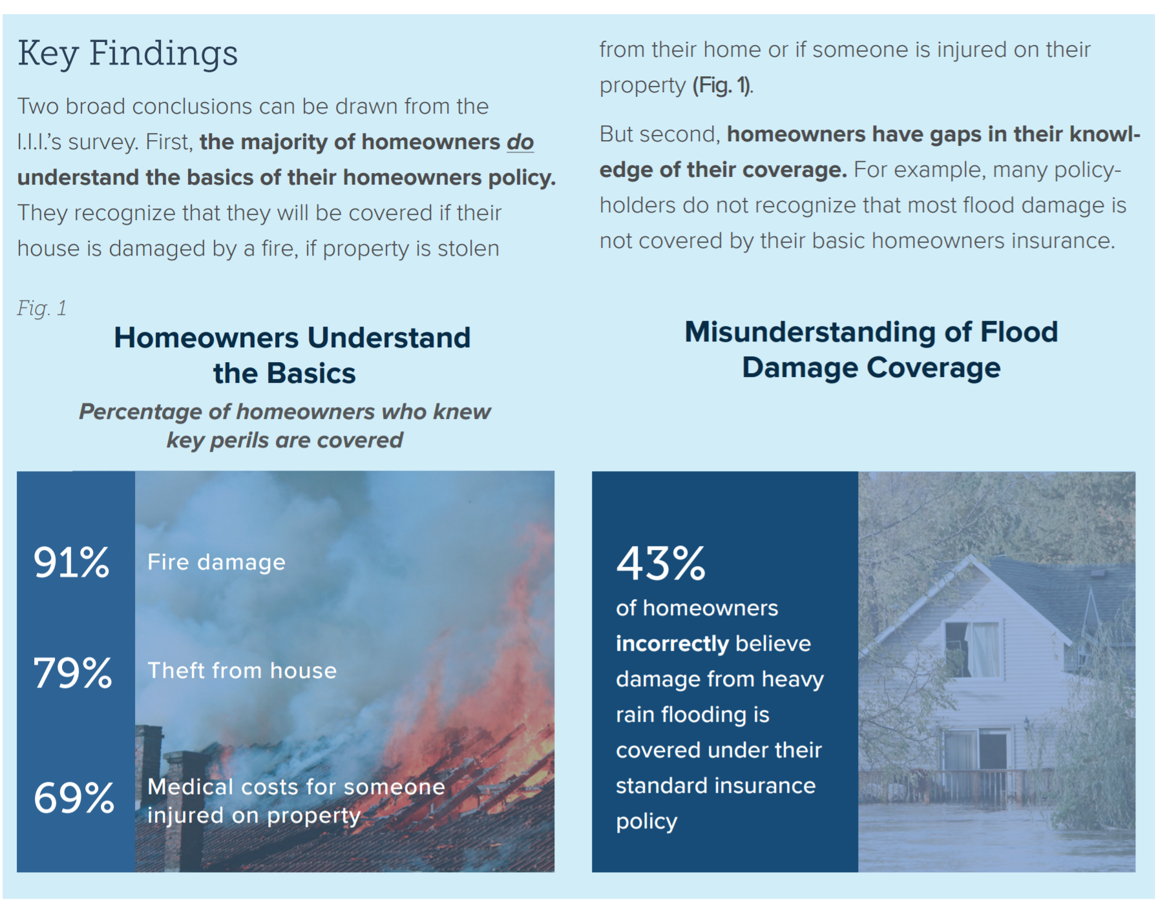
Consumer Understanding of Home and Flood Insurance: Good News and Bad News
Most homeowners understand the basics in a home insurance policy but don’t understand water damage and flooding
Insurance Information Institute, 2016 Consumer Insurance Survey, Homeowners Insurance: Understanding, Attitudes, and Shopping Practices, February 2017, p. 2.

Slide 9
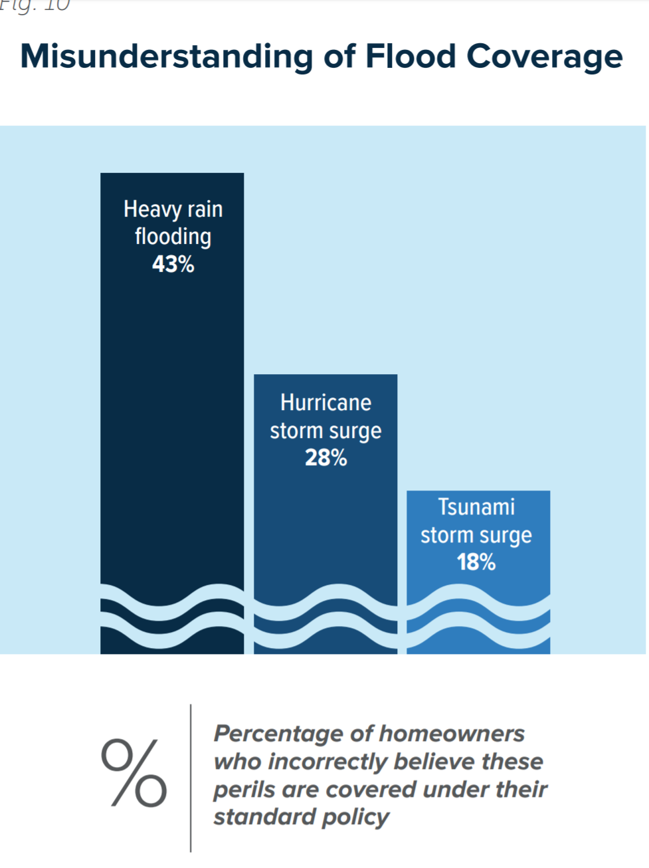
Misconceptions Regarding Flood Coverage
Troubling Results

Slide 10
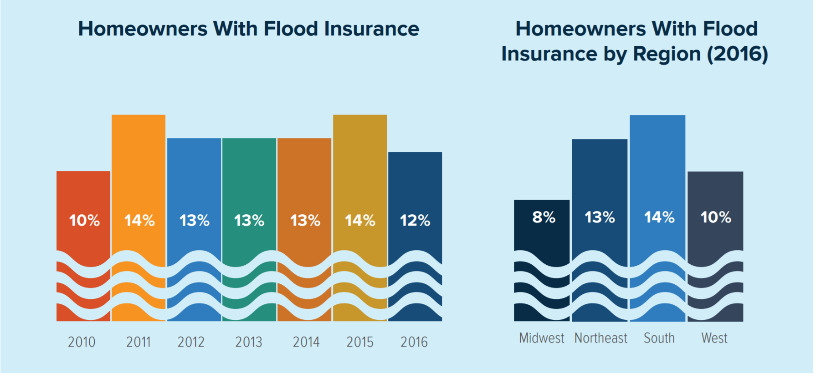
Flood Insurance by Year and By Region

Slide 11
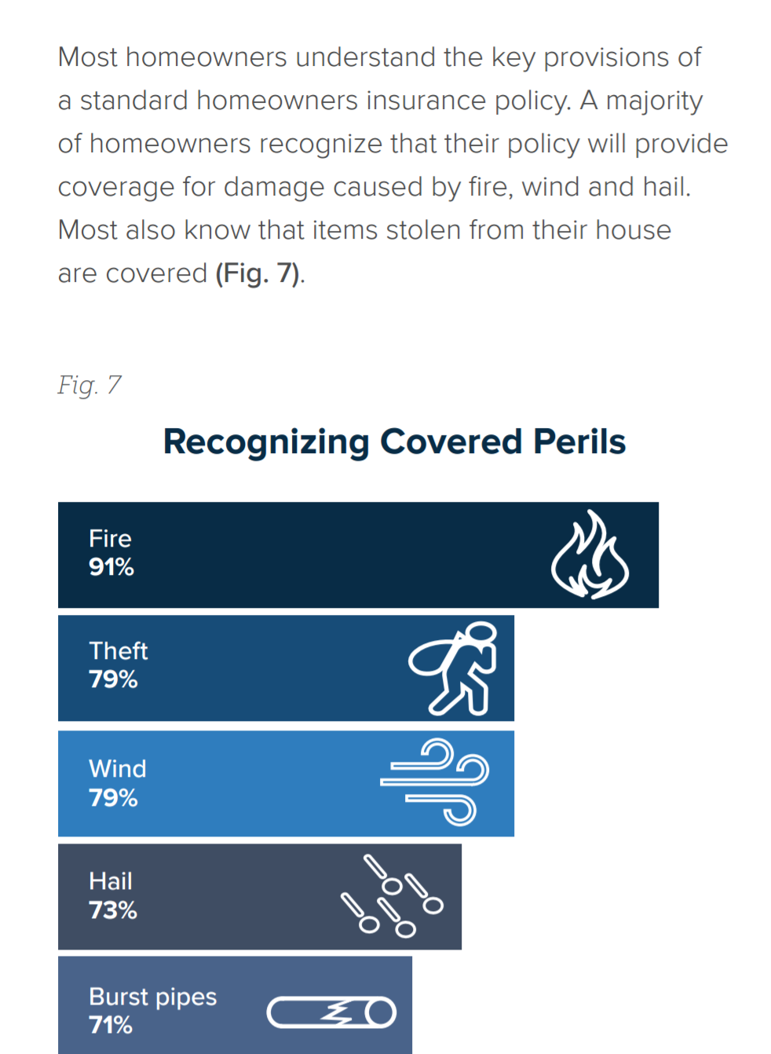
Homeowners Understand the Key Provisions in A Policy
Most consumers understand that
Fire
Theft
Wind
Hail
Burst Pipes
ARE covered by standard home policies

Slide 12
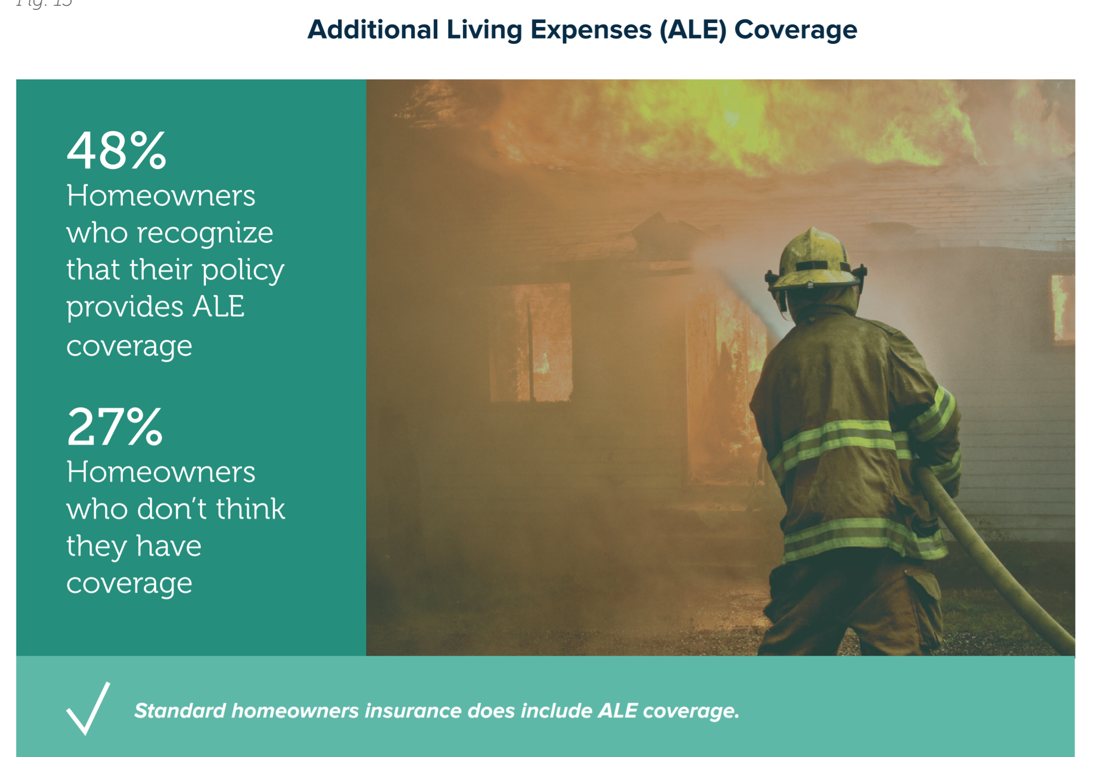
Most Know that there is ALE Coverage in a Home Insurance Policy
No ALE in Flood Insurance Policy – A Source of Confusion
Consumers
are also
confused by
coverage for
basements.

Slide 13
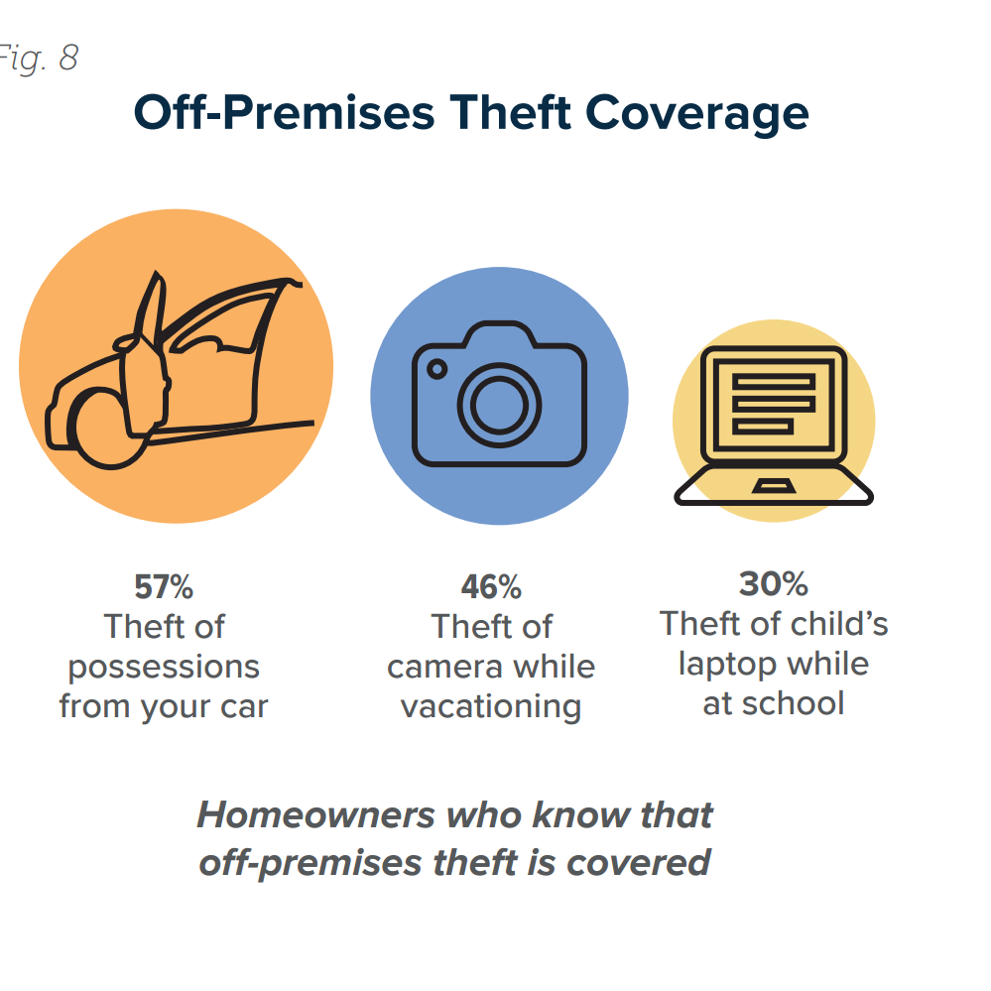
Consumers are Fuzzy on the Details
While homeowners understand the basics, the I.I.I. found that many were not aware of some additional coverages included in their policy.
For example, 79 percent recognize that homeowners insurance provides coverage for stolen possessions in their home, but don’t always know that they are covered away from home too.

Slide 14
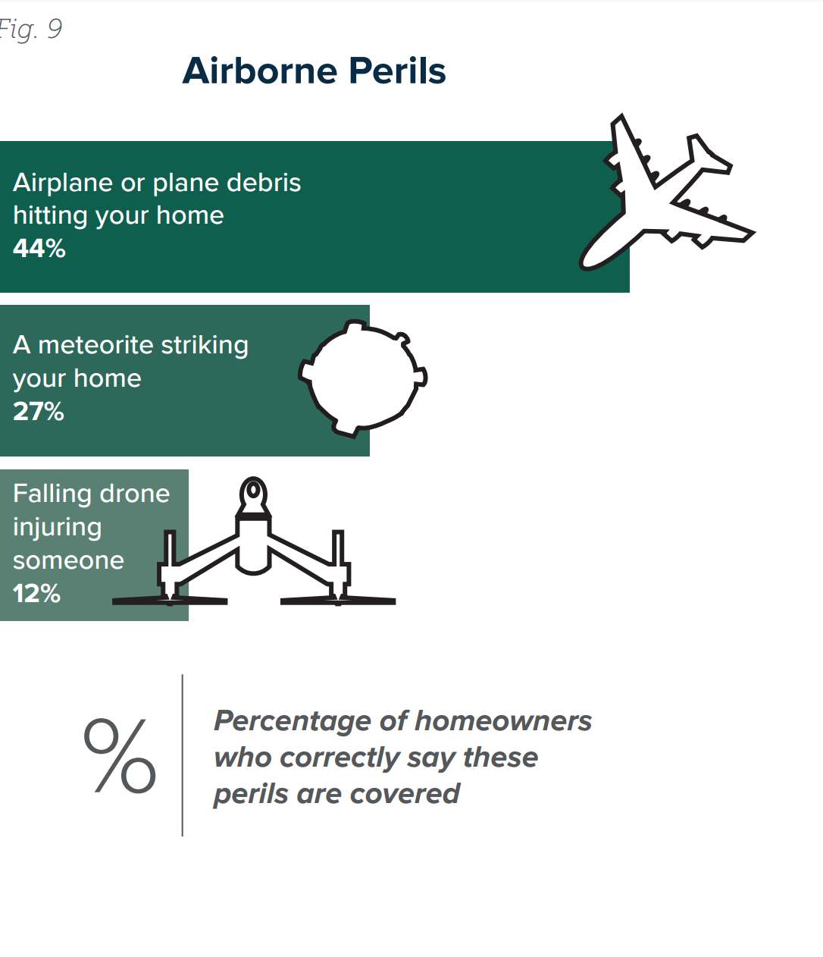
Consumers are Unaware that Fallen Objects are Covered!
Only 27 percent of homeowners said their policy covered a meteorite striking their home.
They also don’t know they are covered against falling airplane debris or if their drone falls and injures someone.

Slide 15
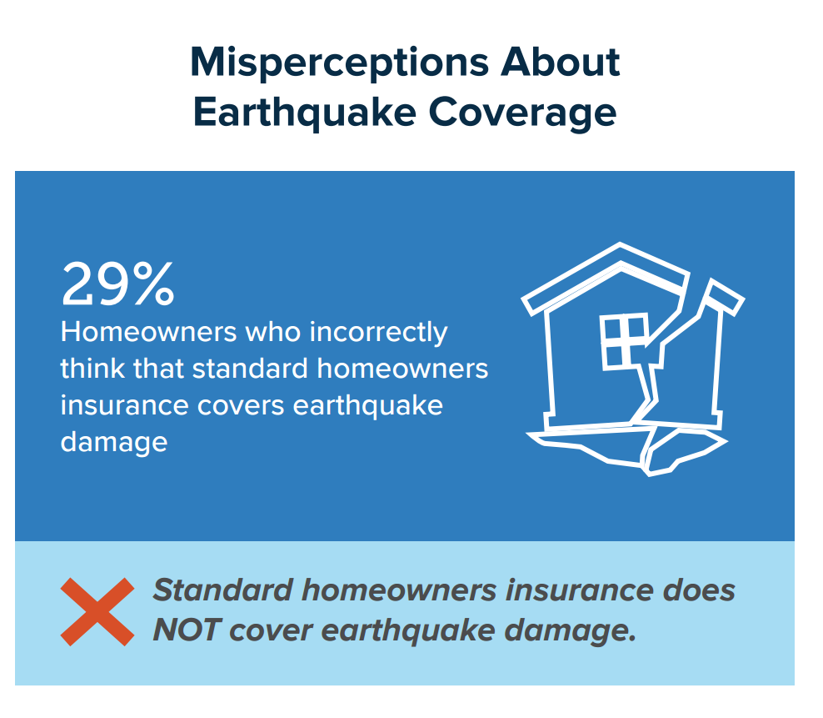
Lack of Knowledge about Earthquake Coverage
Property damage caused by earthquakes is also not covered by a standard homeowners policy, though fire damage following an earthquake will usually be covered.

Slide 16
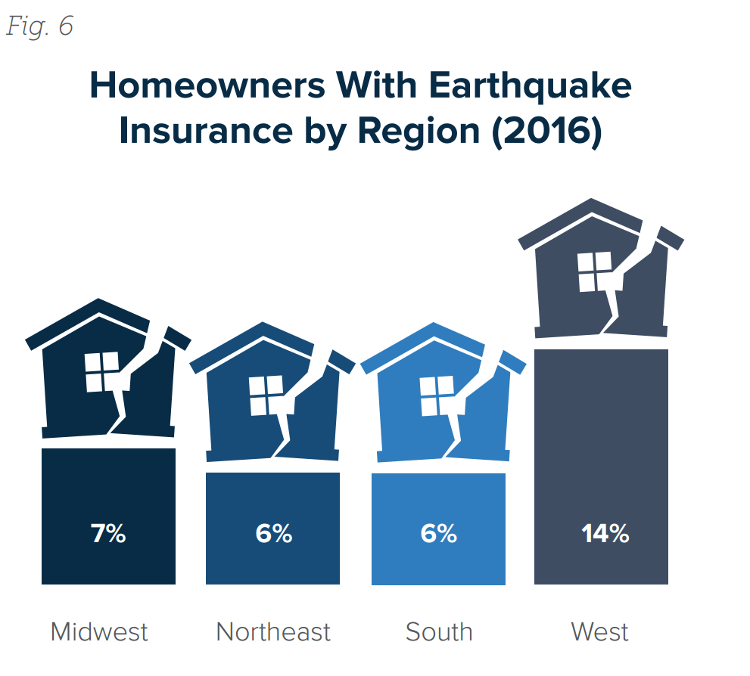
Earthquake Insurance and Risk by Region
There has been increased seismic activity in the Midwest and South. Earthquakes occurred in Kansas, Oklahoma and Texas, as well as Alaska, Arizona, Idaho, Nevada and California.
The U.S. Geological Survey reports increased seismic activity in Oklahoma caused by underground wastewater disposal associated with oil and natural gas production.

Slide 17
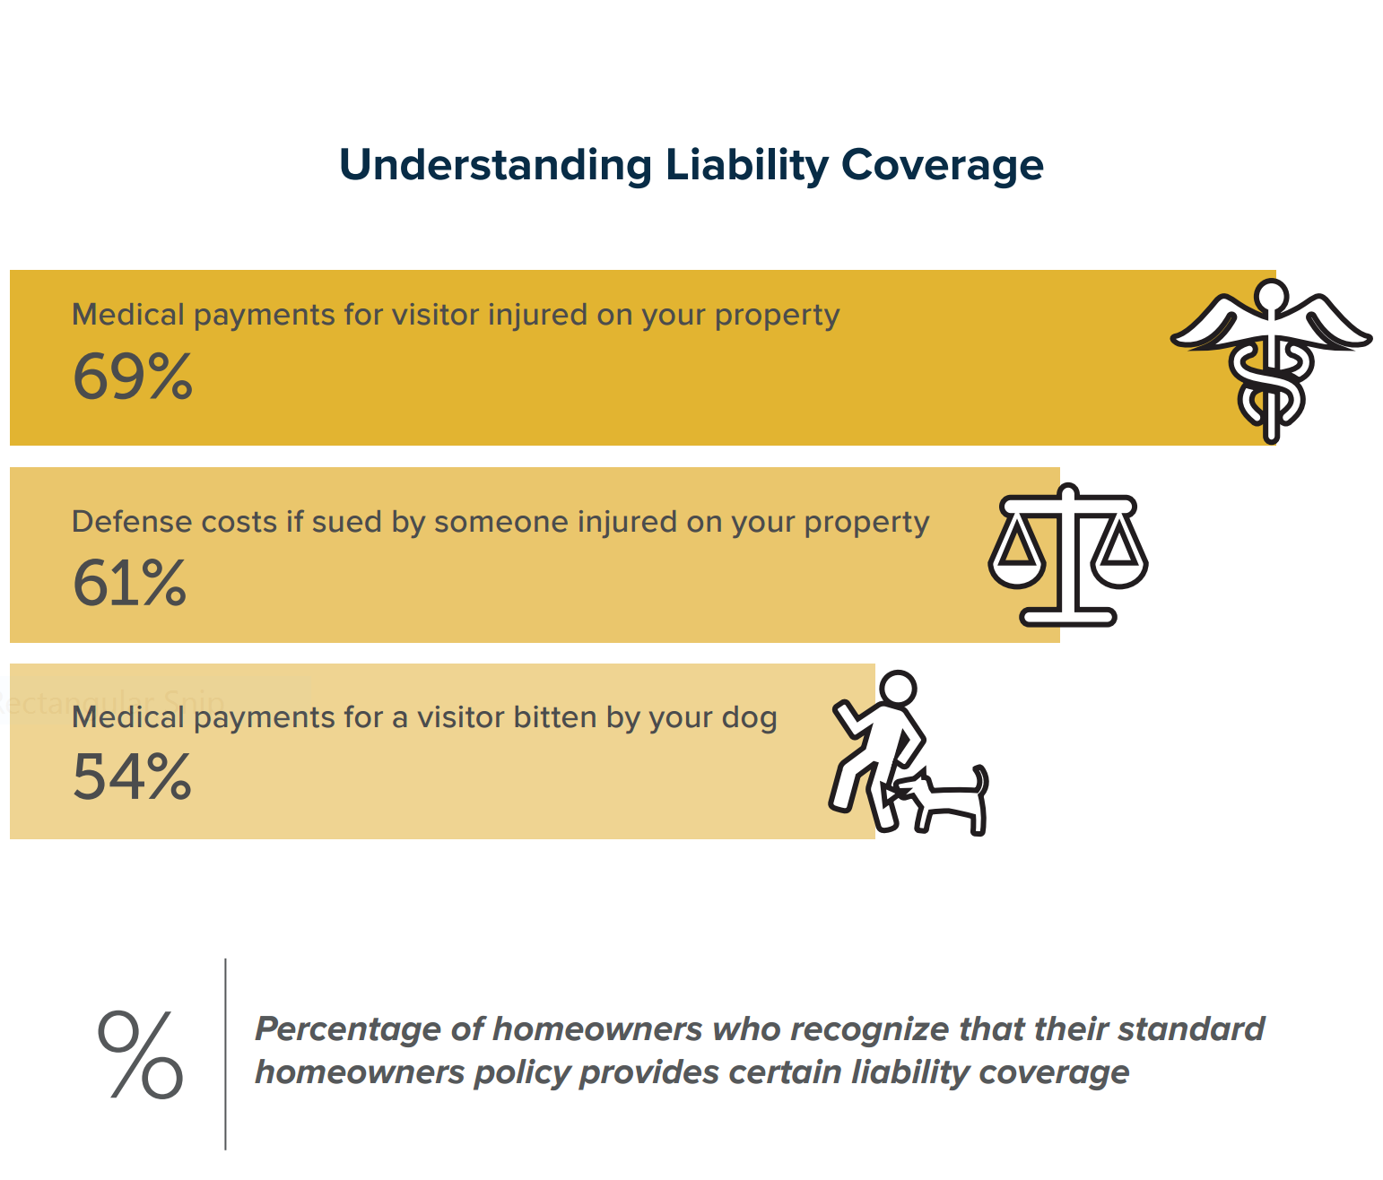
Consumer Understanding of Liability Coverage
Most policyholders recognize that standard homeowners insurance provides liability coverage.

Slide 18
What Should We Be Communicating?

Slide 19
Need to Communicate the Basics As Often as Possible
Key Messages Include:
Standard home, renters and business insurance policies clearly list the disasters that are covered and the disasters that are not.
Everyone needs to get enough insurance to rebuild their home, replace their possession and protect their assets.
The two biggest disasters that are not covered are floods and earthquakes.
Flood coverage is available from the National Flood Insurance Program (NFIP) and a few private insurance companies. Excess flood insurance is available from private insurers.
Flood damage to an auto is covered under the optional comprehensive portion of an auto insurance policy.
Earthquake insurance is available from private insurance companies and through the CEA in California.

Slide 20
Focus on Renters – Encourage to get both a Renters Insurance Policy and a Flood Insurance Policy
We are increasingly becoming a Nation that Eschews
Home Ownership at Every Demographic!
The U.S. homeownership rate was 63 percent in second-quarter 2016, the lowest rate since the third quarter of 1965, according to data from the U.S. Census Bureau.
Renters account for a majority of households in NYC (69 percent), LA (62 percent), Chicago and Houston (55 percent).

Slide 21
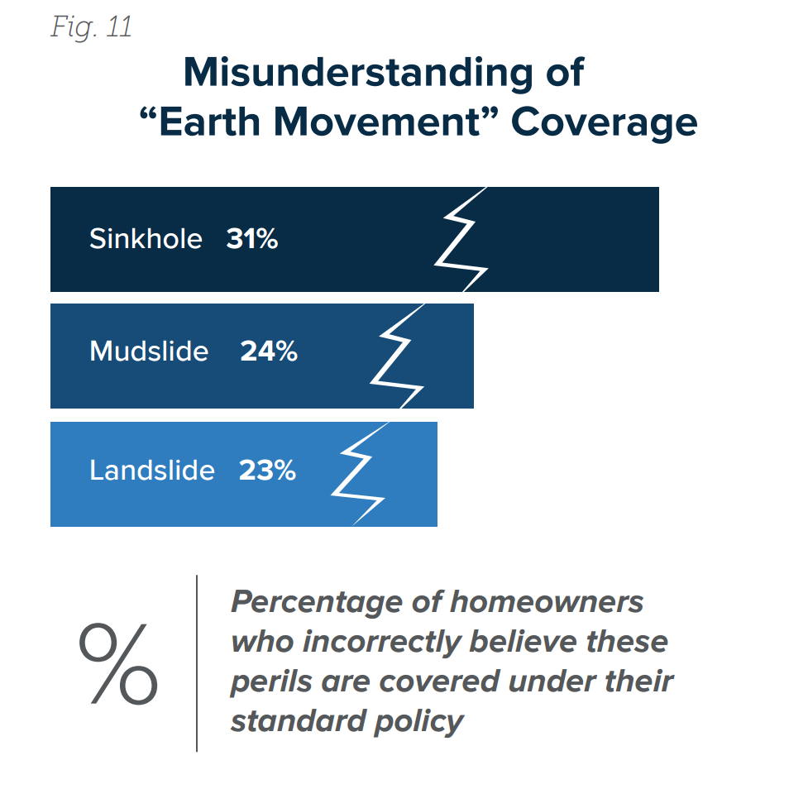
Need to Clear Up Confusion About Coverage
For example, the industry needs to do a better job of explaining water damage coverage.
Need to communicate that homeowners insurance includes coverage for damage caused by wind-driven rain, burst pipes and water leaking into a house because of an ice dam.
Also need to clearly explain coverage for mudslides, landslides and back-up of sewers and drains, as well as “law and ordinance” coverage.

Slide 22
Need to Point out Limitations of the Flood Insurance Policy
Important to Not Sugar Coat it!
Stress the following:
There is no ALE coverage.
Coverage for Basements is limited.
There are limits on the amount and type of coverage under an NFIP flood insurance policy. Homes are covered for up to $250,000 on a replacement cost basis and the contents for up to $100,000 on an actual cash value basis.
Coverage limits for commercial property are $500,000 for the structure and another $500,000 for its contents.

Slide 23
What does the I.I.I. do to Educate Consumers?
Different Tactics for Different Audiences

Slide 24
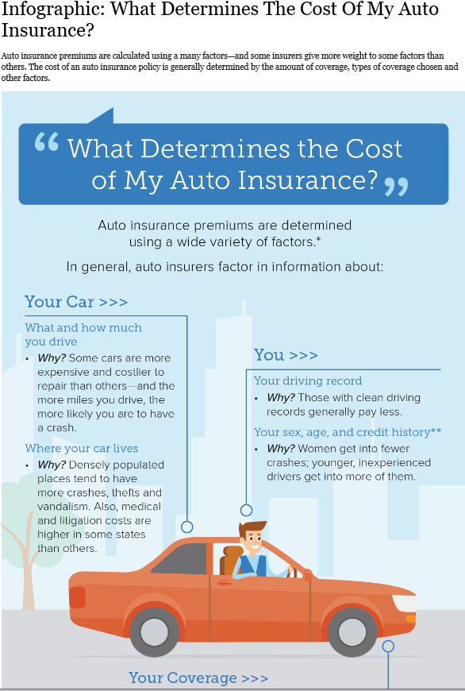
Approaches as Different As Individuals
Apps
Blogs
Checklists
Consumer Articles
Infographics
Media Interviews
Social Engagement
Videos

Slide 25
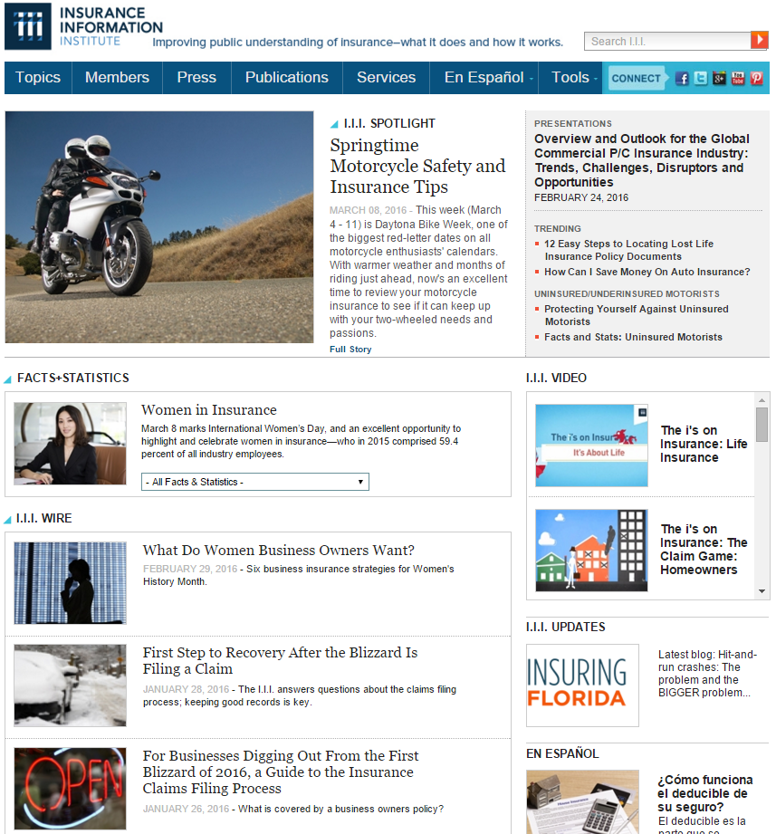
I.I.I. Website
The I.I.I. homepage is updated regularly with content relevant to consumers.

Slide 26
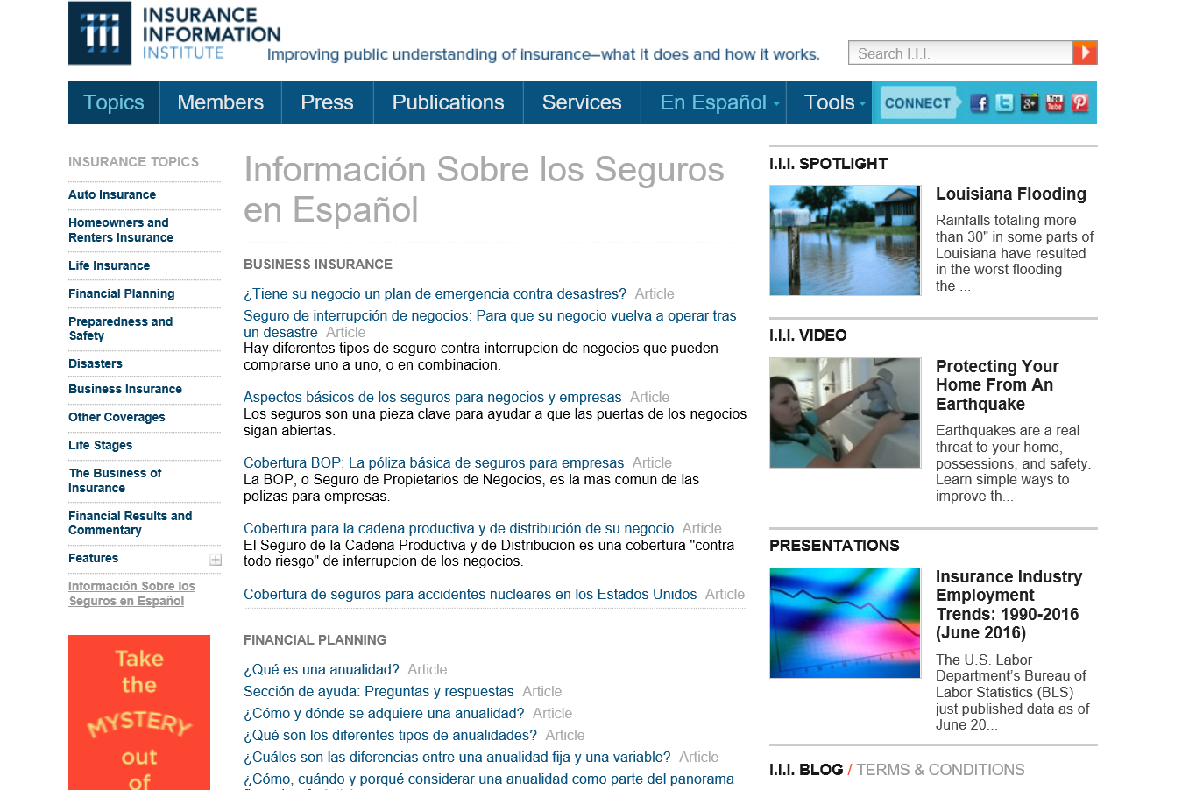
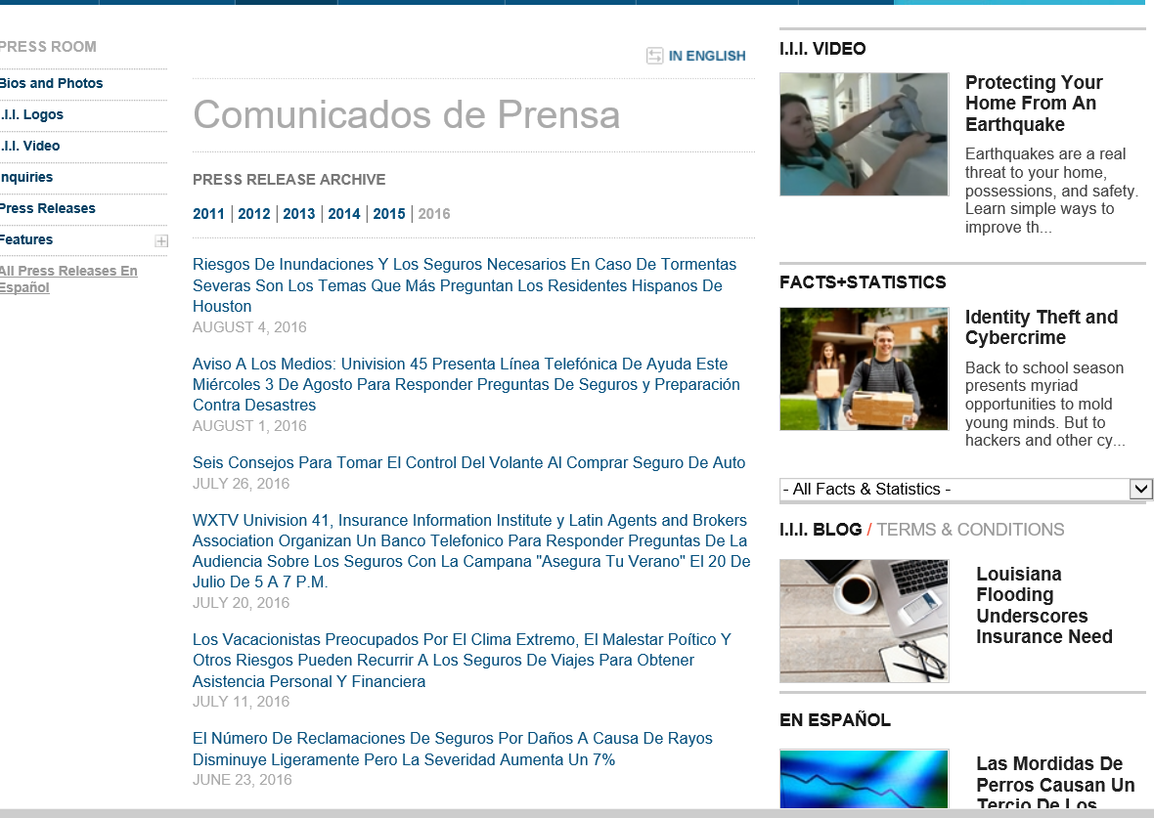
I.I.I.’s Spanish Language Resources
Consumer News Releases Translated into Spanish
Articles
News Releases

Slide 27
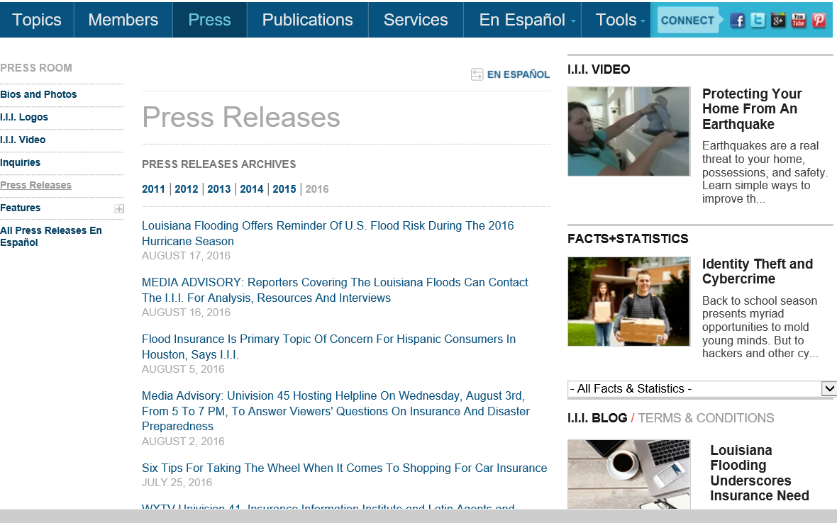
I.I.I. Press Page

Slide 28
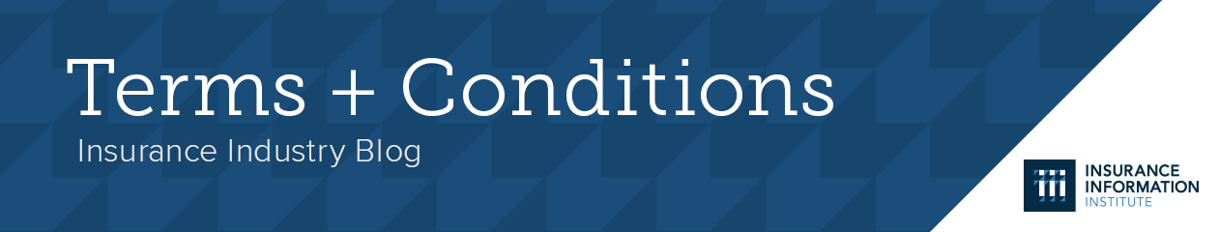
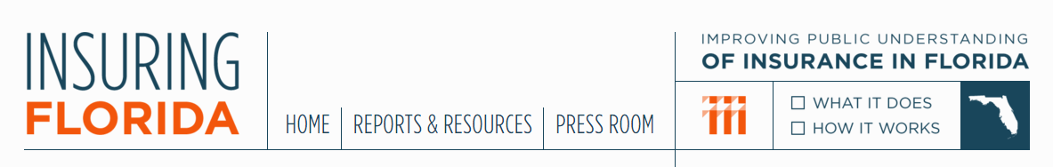
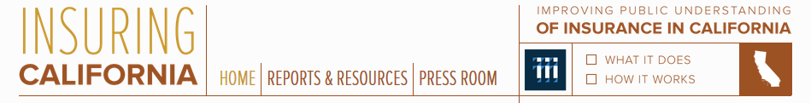
I.I.I. Blogs

Slide 29

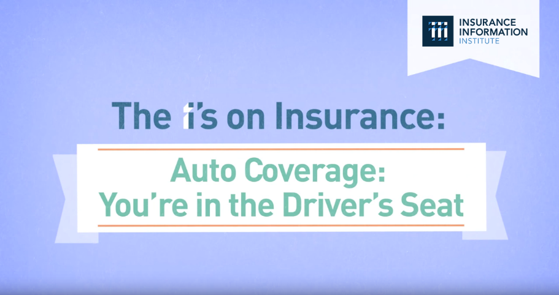

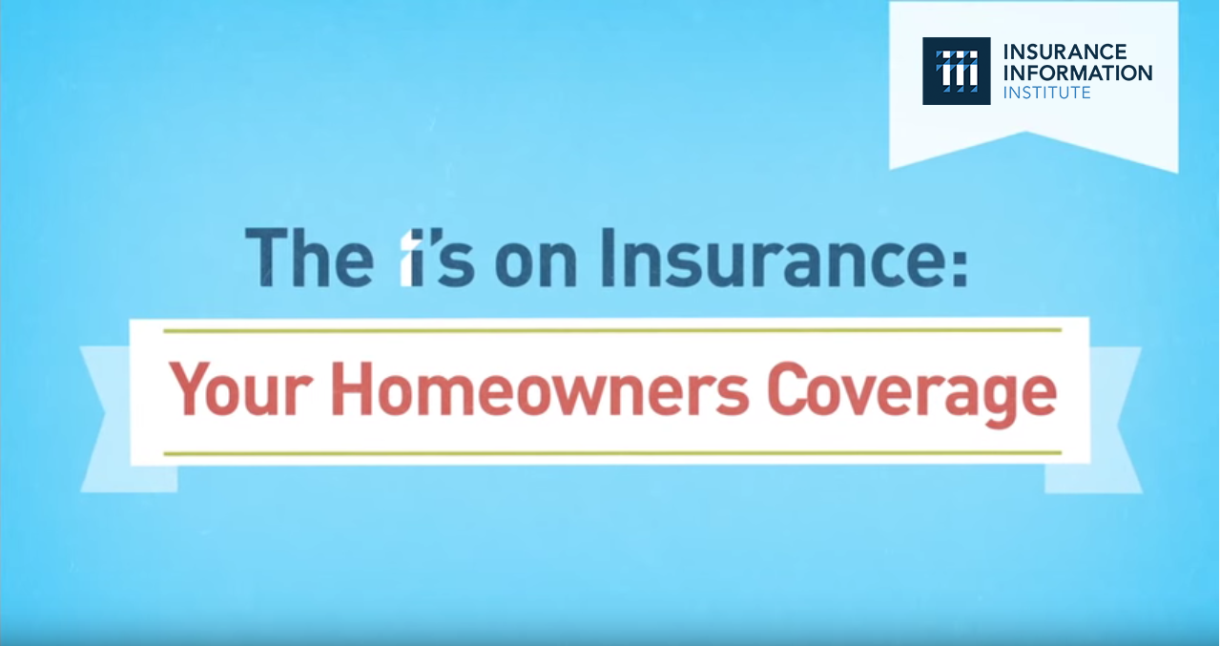
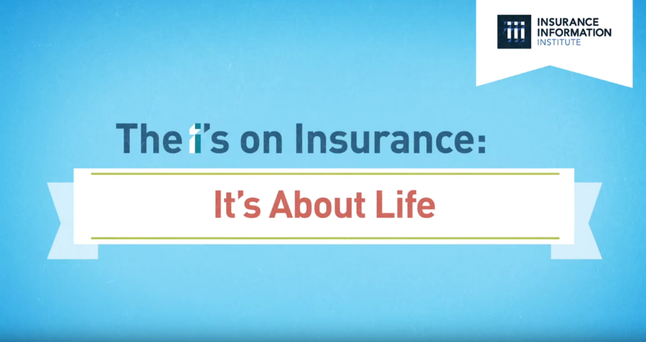
“The I’s on Insurance” Video Series
Animated video series covering Homeowners, Auto, Small Business and Life Insurance.
Goal: To engage and encourage viewers to reach out to their agent, broker, or company representative to discuss insurance coverage.

Slide 30
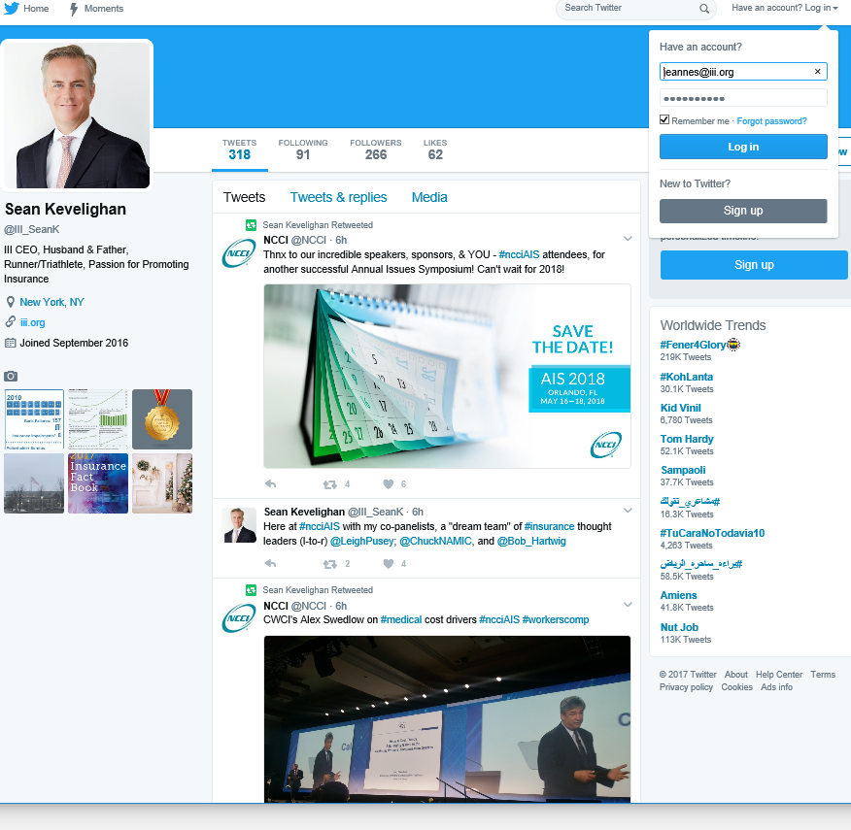
Social Engagement

Slide 31
What are other Sources of Insurance Information?

Slide 32
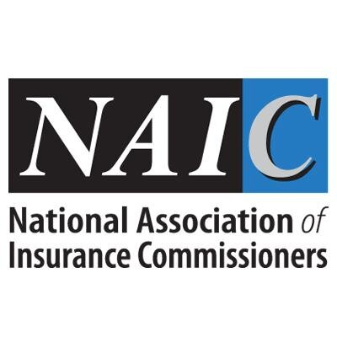



Entities Which Educate Consumers

Slide 33

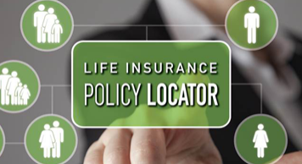
NAIC’s Consumer-Focused Web Content

Slide 34




Insurer-Funded Trade Groups

Slide 35
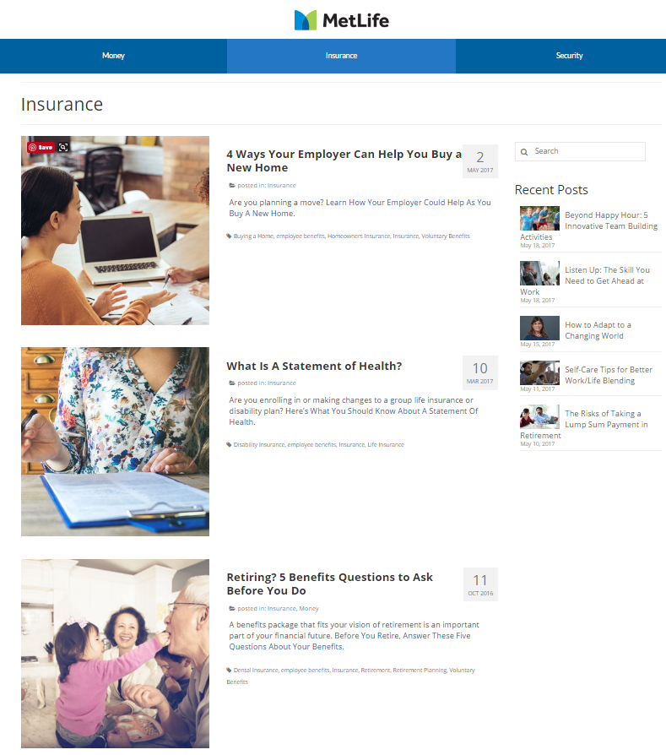
How MetLife Educates Consumers

Slide 36
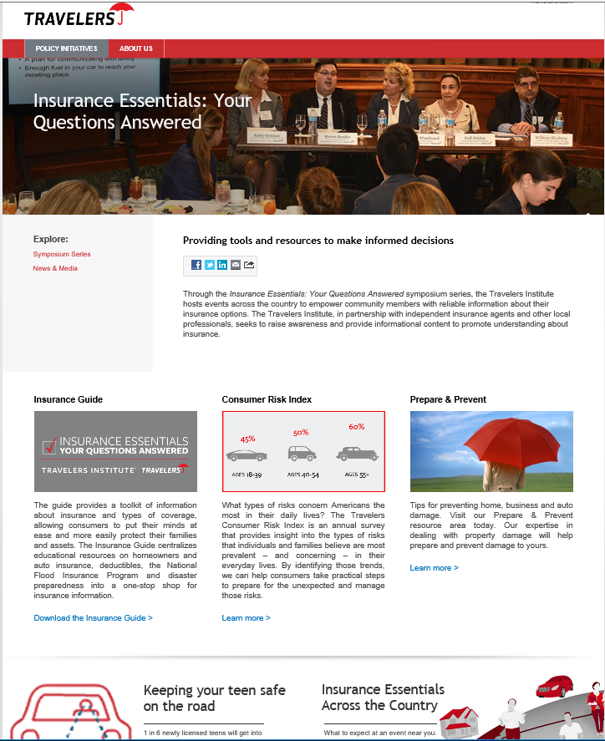
How Travelers Educates Consumers

Slide 37
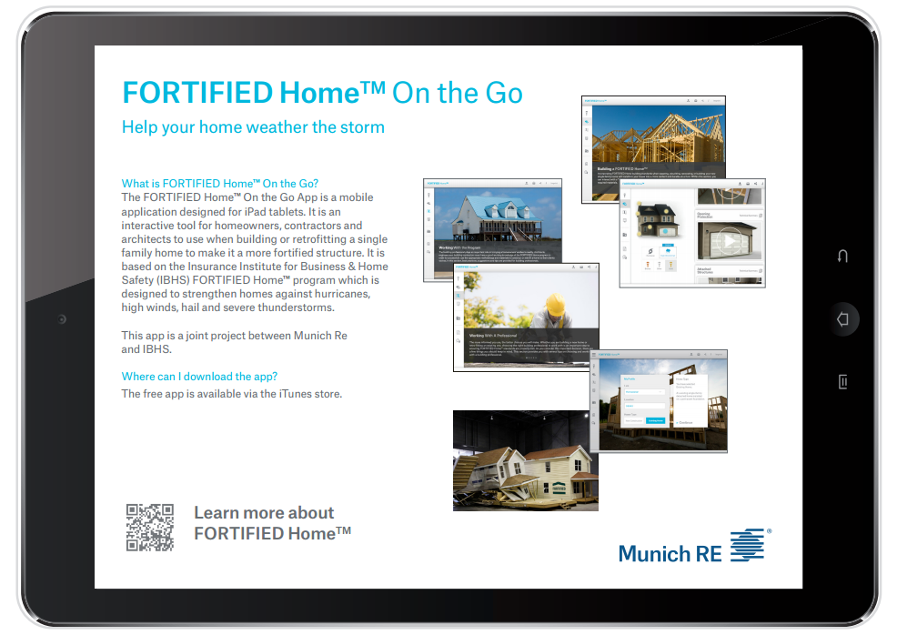
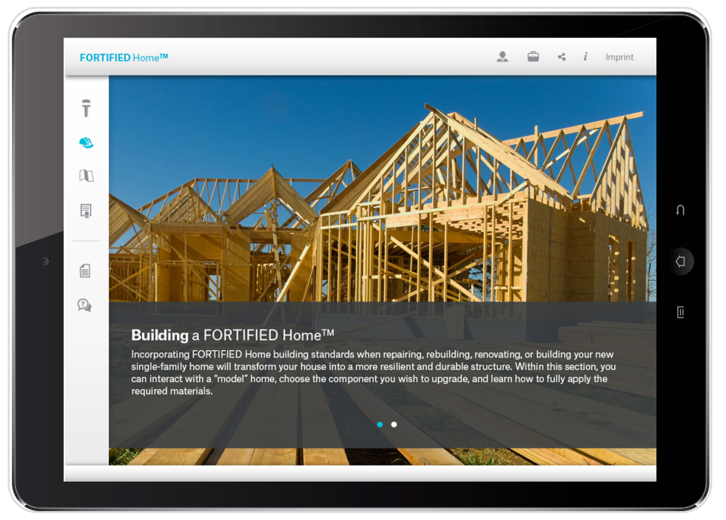
How MunichRe Educates Consumers

Slide 38
How Should We Communicate?

Slide 39

“Surround Sound” Approach to Consumer Communications
Consumers
Consumers
Industry
Policymakers
Media
Relevant
Experts
Relevant
Experts
Industry
Media
Policymakers

Slide 40
Questions?
And, Thank You!
@JeanneSalvatore
212-346-5555
917-612-4088
Jeannes@iii.org
jeannes@iii.org
Michael Barry
212-346-5542
917-923-8245
Michaelb@iii.org

