Slide 1
NAIC 2020 Insurance Summit Financial Keynote Presentation
Sean Kevelighan
Chief Executive Officer
September 8, 2020
Insurance Information Institute  110 William Street  New York, NY 10038 seank@iii.org  212.346.5520  www.iii.org

Slide 2

The Triple-I & Its Mission
A world with MORE insurance
We are the trusted source of unique, data-driven insights on insurance…
……to inform and empower consumers.
2
2

Slide 3
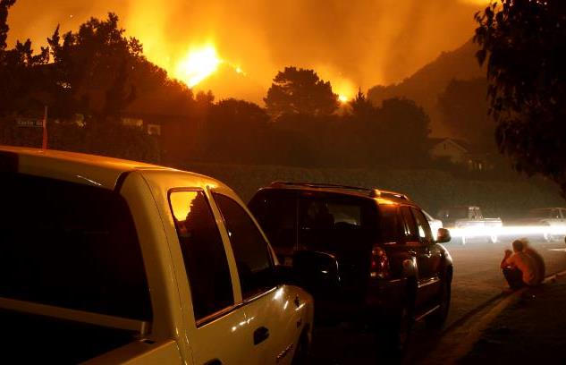

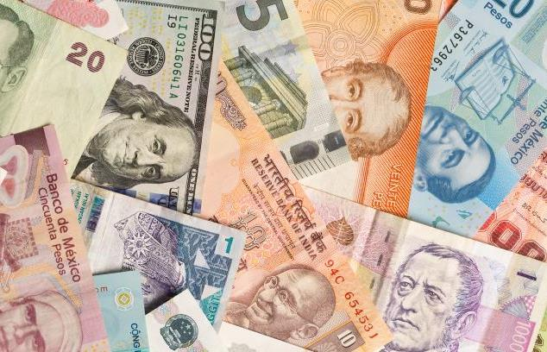



The Disruption Continuum
Catastrophes
COVID
Economics
INSURANCE
Geopolitical
Social Unrest
Technology

Slide 4
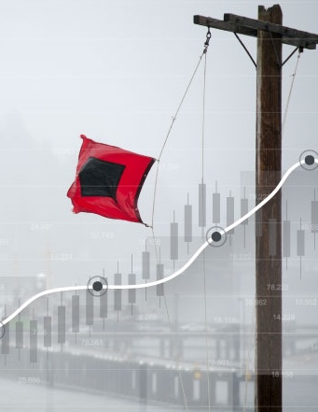

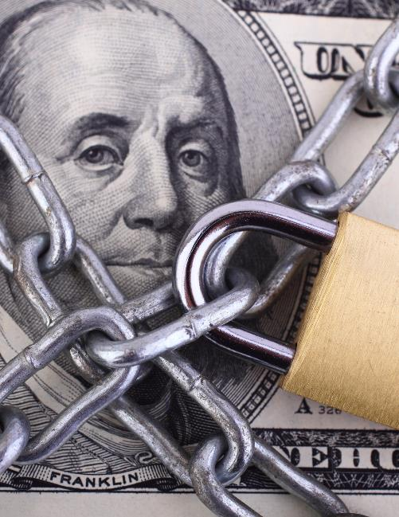




How Insurance Defines Success
Economic Growth
Community Well-being
Capital Protections
Resilience

Slide 5
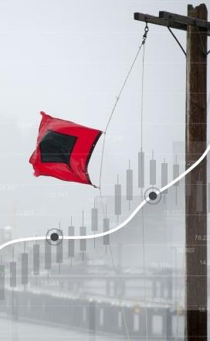

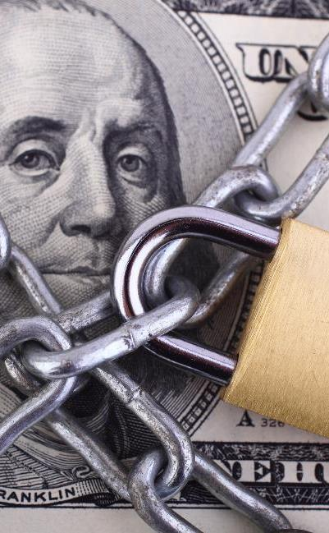




A New Milestone for Measuring Success
Economic Growth
Community Well-being
Capital Protections
Resilience
Fairness & Equality

Slide 6










How Insurance Drives Economic Growth
Safety/
Security
Economic/ Financial Stability
Development
1
Insurers are financial first responders
3
Insurers are capital protectors
4
Insurance is a partner in social policy
7
Insurers are community builders
8
Insurance enables infrastructure improvements
2
Insurers are risk mitigators
5
Insurance sustains the supply chain
6
Insurers are capital infusers
9
Insurers are innovation catalysts
10
Insurers are credit facilitators

Slide 7
Insurance & Economic Leadership
Sustainable Business Model
Strong Jobs Pool/ Provider
Economic Growth Promoter/Facilitator
2010
$630B
3.0%
US GDP³
Bank Failures: 157
2.8M Employed
Premium Taxes Paid⁴ $23.6B
Insurance Impairments¹: 4
Muni Bond Investment⁵ $500B
Policyholder Surplus:
~$772B
Need to Fill 400K+ by 2022²
End Q1/20
Charity/Volunteerism⁶ $280M
¹AM Best and FDIC; ²PC 360, Insurance Industry Crisis; ³U.S. Bureau of Economic Analysis, 2020; ⁴U.S. Department of Commerce, 2020; ⁵Federal Reserve, 2019; ⁶2011–2014, Insurance Industry Charitable Foundation – amount donated so far to fight Covid-19.

Slide 8
Stepping Up
America's Insurers:
for Customers, Communities, and Employees
The insurance Industry is Applying Forward-thinking Solutions to Take Care of Its Customers, Communities, and Employees During the COVID-19 Crisis
Customers
Community
Employees
Industry
Auto insurers have returned $14 billion so far to customers' pockets around the country through premium relief
Insurers have pledged more than an estimated $280 million (according to III/Insurance Industry Charitable Foundation) in donations to the national and local organizations fighting this pandemic on the frontlines
Employing more than 2.8 million Americans, Insurers are taking care of their employees–many pledging no layoffs during the ongoing crisis
Insurers are implementing innovative solutions to carrying out daily operations while respecting social distancing

Slide 9

Underwriting Trends

Slide 10
COVID-19’s Impact
Unprecedented Spread of Loss, Deterioration of Exposure
Potential Loss Impact
Exposure Impact
$14B auto premium
Employment related exposures (GL, WC)
Loss estimates range from $30B (≈ bad hurricane) to $140B (2-3 Katrinas)
Investment
Volatile stocks, bond yields plunging
Lloyd’s estimate: $96B in investment losses
Source: Willis Towers Watson, Insurance Information Institute..

Slide 11
Industry Outlook
Commercial Lines Rate Change
Calendar Year Written Premium and Net Combined Ratio Projections
Growth in Nominal GDP (Real GDP + Inflation)
2020 Commentary
Overall premium projected to be flat. Underwriting result deteriorates.
Pandemic and recession reduce exposure in personal auto, several commercial lines.
Rate increases make up for lower exposures somewhat.
Tremendous uncertainty due to pandemic’s impact on several lines.
We assume normal cat year, despite bleak hurricane forecast.
Data sources: NAIC data sourced through S&P Global Market Intelligence, MarketScout, Blue Chip Economic Indicators, Congressional Budget Office, PCS, Aon, Munich Re, Energy Information Agency, FRED (Federal Reserve Bank of St. Louis).
Analysis: Insurance Information Institute, Milliman.

Slide 12
U.S. Inflation-Adjusted Insured Cat Losses
Harvey, Irma, Maria
Katrina, Rita, Wilma
WTC
2019 Was a Relatively Mild Year; 2020 Faces Pandemic, Above-average Hurricane Forecast
*Aon estimate through April. 2010s is average of 2010 to 2019. All losses are Direct.
Sources: Property Claims Service, a Verisk Analytics business; Aon; Insurance Information Institute.

Slide 13
Hurricane Forecast
Grim
Source: Colorado State University Tropical Meteorology Project.

Slide 14
Commercial Lines Rate Changes
Rates Have Been Rising. Is It A Hard Market?
Sources: Willis Towers Watson, MarketScout, Marsh.

Slide 15
Commercial Rate Changes
By Line, as of Second Quarter
Source: MarketScout.

Slide 16

Financial Trends

Slide 17
Key Sources of P/C Insurer Profits
$ Billions
Steady Investment Gains, Good Underwriting Results Lifted Profits in Most Years
Through first quarter.
Data are before taxes and exclude extraordinary items.
Source: NAIC data, sourced from S&P Global Market Intelligence.

Slide 18
Policyholder Surplus by Quarter
Amount of Surplus ($ Billions)
Change from Prior Quarter
Surplus Has Rebounded from Q1 Decline Caused by Unrealized Capital Losses (Stock Declines). 78 Cents of Premium per Dollar of Surplus.
Sources: ISO, A.M. Best, Insurance Information Institute.
18
Notes:
18

Slide 19
P/C Insurer Portfolio Yields, 2002–2020:Q1
P/C Carrier Yields Have Been Falling for Over a Decade, Reflecting the Long Downtrend in Prevailing Interest Rates.
Even if Rates Rise in the Next Few Years, Portfolio Yields Are Unlikely to Rise Quickly Since Low Yields of Recent Years Are “Baked In” to Future Returns.
Sources: NAIC data, sourced from S&P Global Market Intelligence; Insurance Information Institute.

Slide 20
Interest Rates Tumbled, Will Recover Slowly
(10-Year Treasury Yield)
The Forecasts in the Blue Chip Survey See a Common Direction for the Yield of 10-year T-bonds in 2020–21 But Not Much Relief.
Sources: Federal Reserve Economic Data (FRED); Blue Chip Economic Indicators (8/20); Insurance Information Institute.
Notes:
Insurer investment income will continue to flatten or fall because of the sharp drop-off in interest rates starting in second quarter of this year. And the bounceback will be slow, according to the consensus of economists surveyed by Blue Chip Economic Indicators.

Slide 21
Employment in Major Subsectors of the Insurance Industry: A Surprise
Over the Last Two Years, All Four Major Insurance Industry Subsectors Have Grown Employment Despite the Recession That Began in February 2020
Thousands
2,319.5
2,238.9
Data are seasonally adjusted
Sources: BLS; Triple-I

Slide 22

COVID-19
Economic and Cultural Impacts: An Industry’s Response

Slide 23


Global Pandemics Are Uninsurable
Economic Impact of 9/11

Slide 24

Global Pandemics Are Uninsurable
Economic Impact of Coronavirus

Slide 25
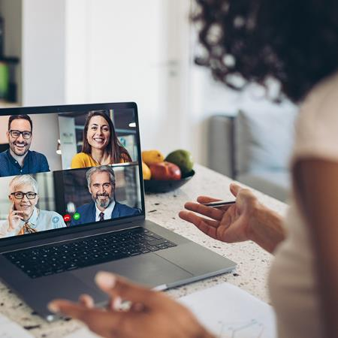
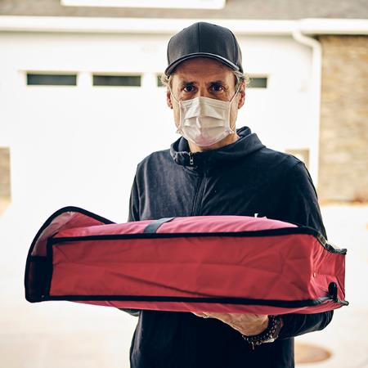

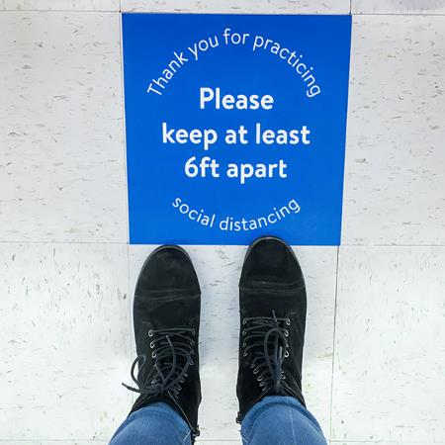
Adopting and Adapting: Workarounds in the Workflow
Zoom Meetings
Restaurant
Take Out
Staying Home
Social Distancing

Slide 26
Monthly Costs of Retroactive Changes to SME BI Policies
Regardless of Scenario, Retroactive Attempts to Include Pandemics in BI Causes Bankruptcy
Retroactive BI Scenarios
Higher
Median
Lower
Higher
Median
Lower
1
Virus / Bacteria Exclusion Removal
2
Expanded BI to All SMEs
Key Assumptions
Scenario 1: 40% take-up rate
Scenario 2: 100% take-up rate
Loss basis: Compensation, profits, adjustment costs 7 days waiting period
Retained loss of 10% of total loss
Median estimates are model-driven. The higher and lower estimates assume a standard distribution for BI losses anchored in the mode-driven median loss estimates.

Slide 27
The Surge in Business Interruption Media Coverage Created an Opportunity for Triple-I to Serve as Industry Voice and Educator
Count of Stories Mentioning Business Interruption Insurance & COVID-19
Source: Meltwater

Slide 28
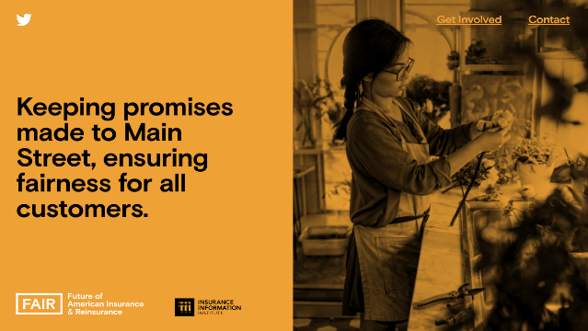


With Increased Attention and Scrutiny on Industry, Triple-I Identified the Need to Launch an Industry Campaign
The ‘Future of American Insurance & Reinsurance’ campaign launched in May and has served as a source of education and information surrounding pivotal industry activity, including Congressional hearings, White House roundtables, state legislation, and media stories.
With a separate website and public presences, this campaign provides the Triple-I with a separate platform and voice.
The campaign will take on overarching industry issues and emphasize its essential role in supporting and rebuilding communities in these uncertain times.
www.fairinsure.org

Slide 29
Six Months into COVID-19, News Coverage Continues to Shine Light on Growing Need for a Federal Policy Solution
Number of Stories
Source: Meltwater

Slide 30
FAIR Guiding Principles: A Defined Perspective on Potential Policy Solutions
Given their universal scope, pandemics are largely uninsurable. Therefore, only the government has the financial capacity to provide the relief small and large businesses need to weather this crisis.
Proposed solutions must:
Maintain the federal government as a primary provider of relief, reflecting the reality that pandemic risks are not privately insurable.
Provide widely accessible relief payments to businesses in a fast and efficient manner once a pandemic is declared by the government, with minimal chance of abuse.
Protect businesses from losses, and incentivize businesses to retain employees, without jeopardizing insurers' existing commitments.

Slide 31



Summer 2020
An initiative of the

Slide 32





Objective
Drive behavioral change to help people and communities better manage risk and become more resilient

Slide 33
Strategies
Create a resilience movement giving households and communities a stake in risk mitigation
Educate and empower stakeholders about protection gaps and their impact on their recovery
Fast-track the use of cost effective tools to drive risk mitigation, transfer and retention

Slide 34





Success Metrics
Quantify, track and improve resilience ratings for 50 cities
Connect 5,000 decision-makers
Bring-to-market 5 resilience tools
Change how 50,000 businesses and households manage risk
Integrate risk mitigation into 5% of residential and commercial policies
“Five by 2025”
Five by 2025

Slide 35


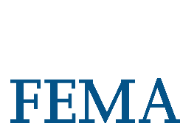









Action Partners
Triple-I Members
Carriers, Reinsurers and Brokers
Insurance Trade Associations
Non-Profits and Foundations
Regulators
Academia

Slide 36


Toolkit
Hubs, Blog, and Updates
Ratings Tracker
Media Outreach and Rapid Response
Virtual Townhalls
Lightning Rounds
Insurance Programs
Scholars and Fellows

Slide 37

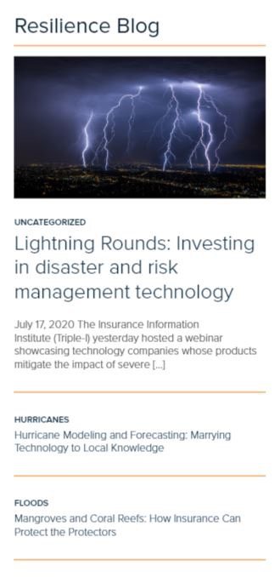
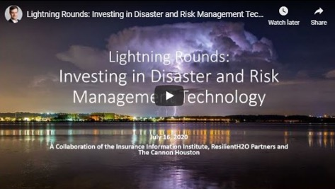
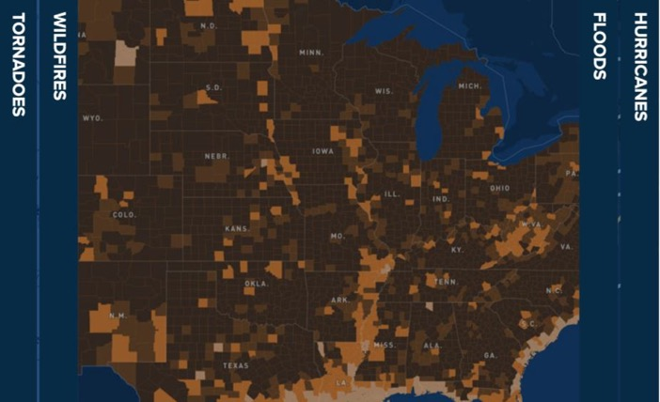
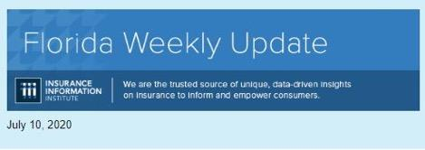
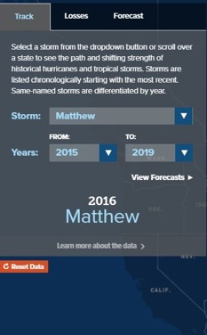
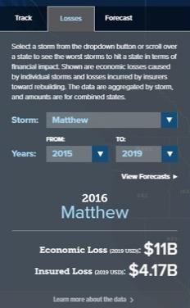
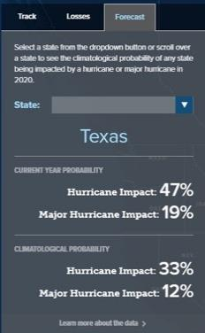


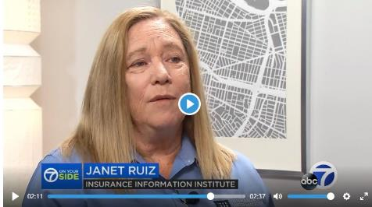

Slide 38

Fairness and Equality

Slide 39

Fairness and Equality:
In the Workplace

Slide 40
Employed Persons by Occupation, Sex, Race, and Hispanic or Latino Ethnicity, 2019
Occupation | Total Employed (in 000s) | % of Total Employed
 |  | Women | Black or African American | Asian | Hispanic or Latino
Total, 16 Years and Over | 157,538 | 47.0% | 12.3% | 6.5% | 17.6%
Business and Financial Operations Occupations | 7,996 | 54.0% | 9.9% | 9.0% | 9.5%
Insurance Sales Agents | 595 | 50.6% | 10.1% | 5.6% | 13.4%
Claims Adjusters, Appraisers, Examiners, and Investigators | 318 | 62.1% | 19.5% | 4.4% | 9.5%
Insurance Claims and Policy Processing Clerks | 269 | 81.7% | 21.8% | 2.4% | 15.5%
Insurance Underwriters | 105 | 51.1% | 5.9% | 5.4% | 6.2%
Actuaries | 33 | N/A | N/A | N/A | N/A
The Industry is More Diverse and Inclusive Than It Was 20 Years Ago, But Women, People of Color and Other Minority Groups Are Still Significantly Underrepresented at Senior Levels
Source: Bureau of Labor Statistics

Slide 41
African-Americans Are Particularly Under-represented
There Are Greater Obstacles for African Americans in the Insurance Industry Compared to Those for Other Minorities or Under-represented Groups
70%
that there are greater obstacles for African Americans compared with other minorities
Strongly Disagree
Agreed or Strongly Agreed
Somewhat Disagree
Somewhat Agree
Neutral
Strongly Agree
Source: Source: Marsh, Journey of African American Insurance Professionals, 2018

Slide 42

Key Barriers for Minorities in Insurance
Lack of exposure
Lack of networks
Lack of experience
Racial bias
Gender bias
Lack of educational preparation
Source: Marsh, Journey of African American Insurance Professionals, 2018

Slide 43

The Higher Up One Goes the Less Diverse It Gets
Two percent of established agencies have at least one African American principal
Four percent of independent agencies have an African American Principal or Senior Manager
Source: Independent Insurance Agents Study, 2018

Slide 44

Fairer Outcomes for All

Slide 45

Solutions?
The NAIC's newly formed committee on race and insurance will address practices that potentially disadvantage minorities – the industry will engage with the NAIC to review the recommended steps
SOLUTION

Slide 46
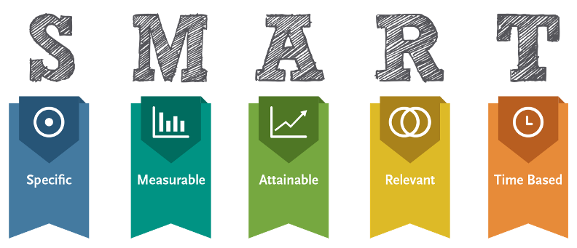
Where Do We Go from Here?
Without targets that are clearly articulated around initiatives and strategies, it’s hard to conceive that diversity, equity or inclusion will really be achieved
– Dr. Leroy D. Nunery II, Founder and Principal, PlusUltré LLC
Sources: P/C 360, D&I study: Issues, opportunities for women in insurance, May 28, 2020

Slide 47

Final Thoughts

Slide 48

Insurers Are Financially Sound and Have the Resources* to Keep America Resilient
Despite setbacks due to COVID-19, the insurance industry stands ready to live up to its promises to keep households, communities and the American economy more secure, productive and stronger.
*See COVID-19 “Final Thought”

Slide 49

It Takes a Movement to Build a Stronger, More Resilient America
Greater catastrophe risks demand greater mitigation and resilience tools to reduce loss of lives and money. The Resilience Accelerator and its partners advance this cause by building a Resilience Movement to empower all.

Slide 50

Commitment to Creating and Empowering Structure to Ensure Diversity and Inclusion at All Levels
Diversity and inclusion in our industry won’t just “happen.” We’ve made organic gains in the 21st century and are creating new structures by devoting energy and resources necessary to make the insurance industry a leader in breaking down barriers and building truly inclusive workforce.

Slide 51

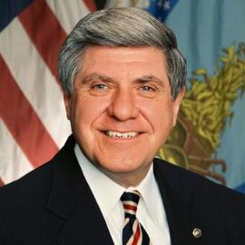
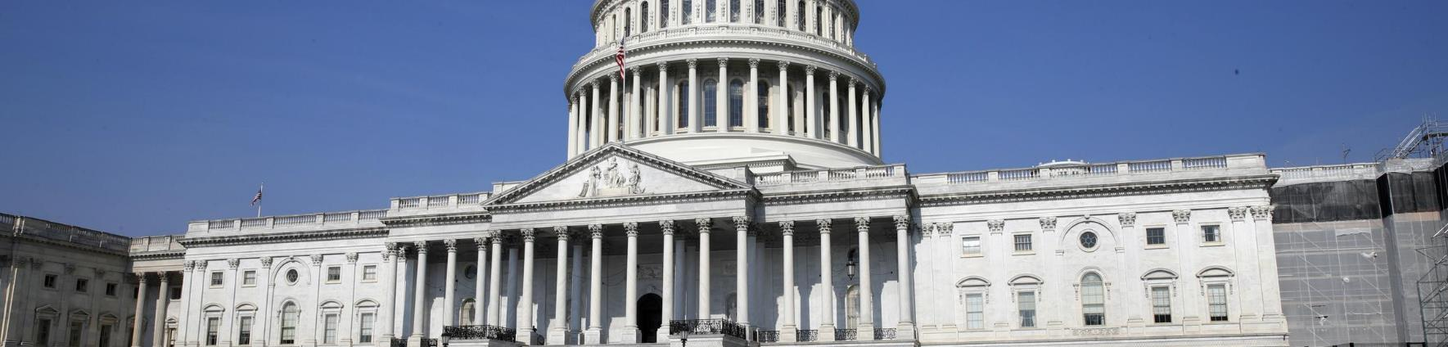
COVID-19 is Beyond the Scope of Insurers/Reinsurers
Senator Ben Nelson (D-NE)

Slide 52

Working in Tandem to Overcome Unprecedented Challenges
The insurance industry is proud of its continued success in these areas—in large part because this success is built on a foundation of working in close partnership with consumers and regulators

