Slide 1
National Association of Latino Elected and Appointed Officials Education Fund (NALEO)
Policy Institute on Emergency Planning and Preparedness
Identifying the Hazards and Mitigation Planning
El Paso, Texas
April 21, 2017
Jeanne M. Salvatore, Senior Vice President, Chief Engagement Officer and Spokesperson
Insurance Information Institute  110 William Street  New York, NY 10038
Tel: 212.346.5555  Cell: 917.612.4088  Jeannes@iii.org  www.iii.org

Slide 2
Presentation Overview
Insuring Against a Disaster
What is the Insurance Information Institute
What do Policymakers and their Constituents Need to Know about Insurance and Disasters
Key Questions to Ask Prior to a Disaster
Public Perceptions about Insurance Coverage
Key Disaster Resources
Questions

Slide 3

I.I.I. Mission Statement
Simple and succinct; and should stay that way…
Improving public understanding
of insurance...
…what it does and how it works
3

Slide 4

“Surround Sound” Approach to Disaster Communications
Consumers
Consumers
Industry
Policymakers
Media
Relevant
Experts
Relevant
Experts
Industry
Media
Policymakers

Slide 5
What Policymakers Need to Know
Disaster Happen. It is Not if a Disaster Will Strike
It is When!

Slide 6
Catastrophes in the United States – Some Basic Facts
The term “catastrophe” in the property insurance industry denotes a natural or man-made disaster that is expected to reach a certain dollar amount. Currently, set at $25 million.
Disaster losses along the coast are likely to escalate in the coming years, in part, because of huge increases in development.
Catastrophe losses will double every decade or so due to growing residential and commercial density and more expensive buildings.
The 2010 census showed that 39 percent of the population is concentrated in less than 10 percent of the nation’s land area excluding Alaska.
Using 2010 U.S. census, in 2013, the National Oceanic and Atmospheric Administration (NOAA) said an additional 11 million people will be living along the coast by 2020, bringing the total to nearly 134 million.

Slide 7
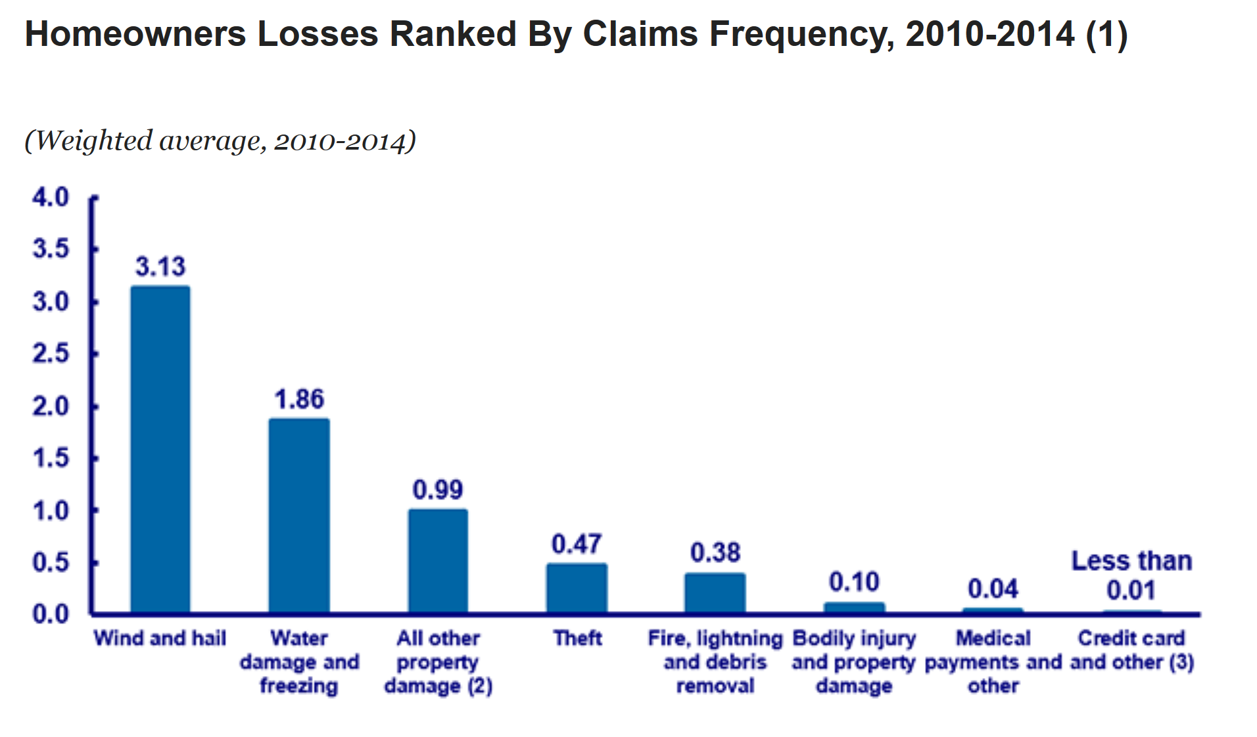
Wind Damage is the Biggest Cause of Loss

Slide 8
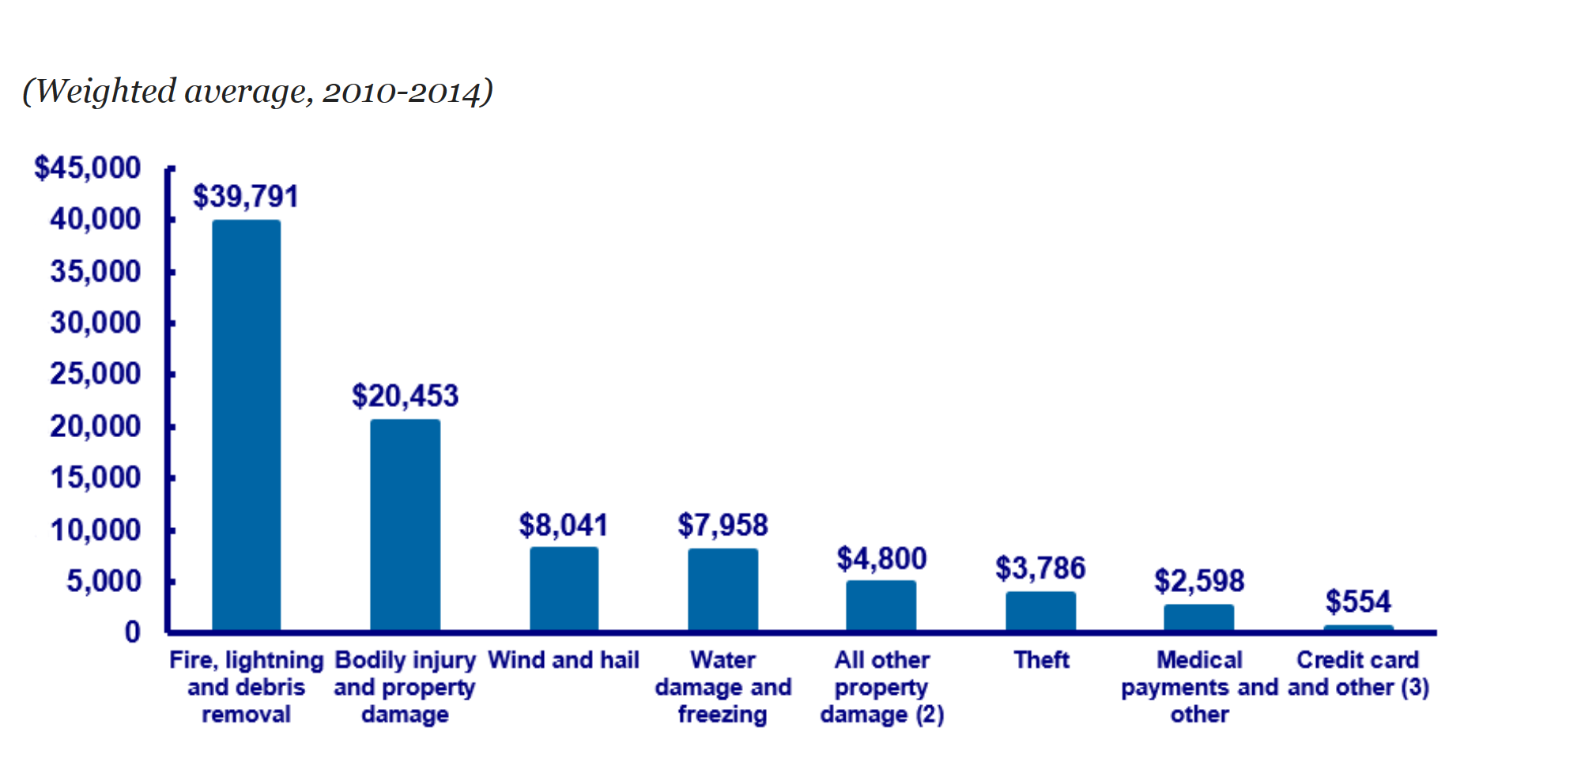
Fire Losses are the Most Expensive

Slide 9
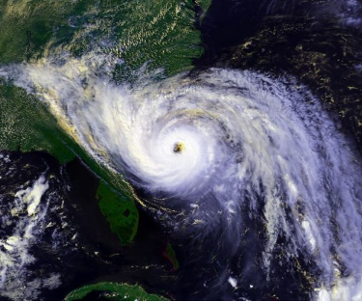
2017 Atlantic Hurricane Season
A Demographic Perfect Storm
I.I.I.’s Goal
Massive influx of new coastal residents who have never experienced a major storm.
Combined with an existing population that has been lulled into complacency by the lack of a hurricane over the last several years.
Resulting in large numbers of coastal residents from Maine to Texas who are unprepared for the 2017 hurricane season.
Educate coastal residents about what they need to do now to financially protect themselves with the right amount and type of insurance.
* NOAA’s National Coastal Population Reprt

Slide 10
What do Policymakers Need to Know About Disasters
Five Key Messages
Residents need to financially protect themselves from the disasters where they live.
They need to get the right amount and type of insurance, including flood and earthquake.
Have an up-to-date home inventory
Should know where to go and what to take if they need to evacuate.
And, should take steps to make their home disaster-resistant.

Slide 11
Insuring Against a Disaster
What is Covered and What is Not!
Standard home, renters and business insurance policies clearly list the disasters that are covered and the disasters that are not. The two biggest disasters that are not covered are floods and earthquakes.
Flooding is the most common and costly natural disaster in the United States, causing billions in economic losses each year. Most U.S. natural disasters declared by the president involve flooding.
Flooding is available from the National Flood Insurance Program (NFIP) and a few private insurance companies. Excess flood insurance is available from private insurance.
Earthquake insurance is available from private insurance companies and in California from the California Earthquake Authority (CEA)

Slide 12
Flood Insurance
The Basics
Flood insurance covers direct physical losses by flood and losses resulting from flood-related erosion caused by heavy or prolonged rain, coastal storm surge, snow melt, blocked storm drainage systems, levee dam failure or other similar causes.
Homes are covered for up to $250,000 on a replacement cost basis and the contents for up to $100,000 on an actual cash value basis. (Excess flood insurance is available in all risk zones from some private insurers for NFIP policyholders who want additional coverage or where the homeowner’s community does not participate in the NFIP.)
Coverage for the contents of basements is limited. Coverage limits for commercial property are $500,000 for the structure and another $500,000 for its contents.

Slide 13
Flood Insurance Background
Congress created the NFIP in 1968 in response to the rising cost of taxpayer-funded disaster relief for flood victims and the increasing amount of damage caused by floods. The NFIP makes federally backed flood insurance available in communities that agree to adopt and enforce floodplain management ordinances to reduce future flood damage.
The NFIP provides coverage for up to $250,000 for the structure of the home on a replacement cost basis and up to $100,000 for personal possessions on an actual cash value basis.
Private flood insurance is available for those who need additional insurance protection, known as excess coverage, over and above the basic policy or for people whose communities do not participate in the NFIP. Some insurers have introduced special policies for high-value properties.

Slide 14
Percentage of Homeowners with Flood insurance
Far too Few People Purchase Flood Insurance
A 2016 poll by the Insurance Information Institute found that 12 percent of American homeowners had a flood insurance policy, lower than the 14 percent who had the coverage in 2015.
The percentage of homeowners with flood insurance was highest in the South, at 14 percent.
Thirteen percent of homeowners in the Northeast had a flood insurance policy,
10 percent of homeowners in the West had a flood insurance policy,
while 8 percent of homeowners in the Midwest had flood insurance.

Slide 15
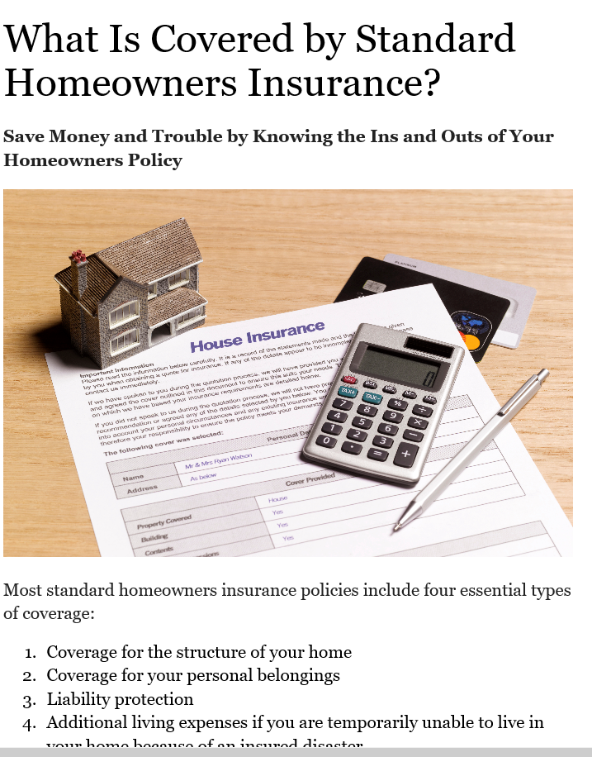
Need to Get the Right Amount of Insurance
Important to Get the Right Amount of Insurance
I.I.I. Web Content Explaining Coverage In Standard Home Ins.
Need enough insurance rebuild your home.
Replace all of your personal possessions.
Have sufficient ALE or additional living expense coverage in case you are unable to live in your home due to an insured catastrophe such as a fire or hurricane.
Liability protection in the event of a lawsuit.

Slide 16
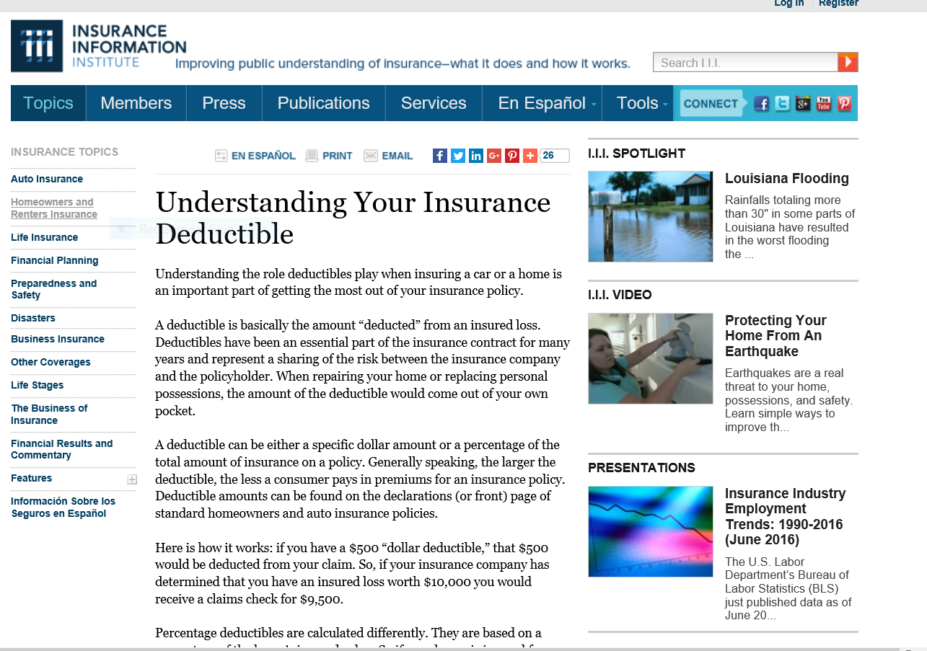
Role of Deductibles is Extremely Important to Understand

Slide 17
19 States and the District of Columbia have Hurricane Deductibles
There are two kinds of deductibles: hurricane deductibles, which apply to damage solely from hurricanes, and windstorm or wind/hail deductibles, which apply to any kind of wind damage.
Percentage deductibles typically vary from 1 percent of a home's insured value to 5 percent. The amount that the homeowner will pay depends on the home's insured value and the "trigger" which determines under what circumstances the deductible applies.
In some states, policyholders have the option of paying a higher premium in return for a traditional dollar deductible, depending on how close to the shore they live.
Alabama, Connecticut, Delaware, Florida, Georgia, Hawaii, Louisiana, Maine, Maryland, Massachusetts, Mississippi, New Jersey, New York, North Carolina, Pennsylvania, Rhode Island, South Carolina, Texas, Virginia and Washington DC have deductibles

Slide 18
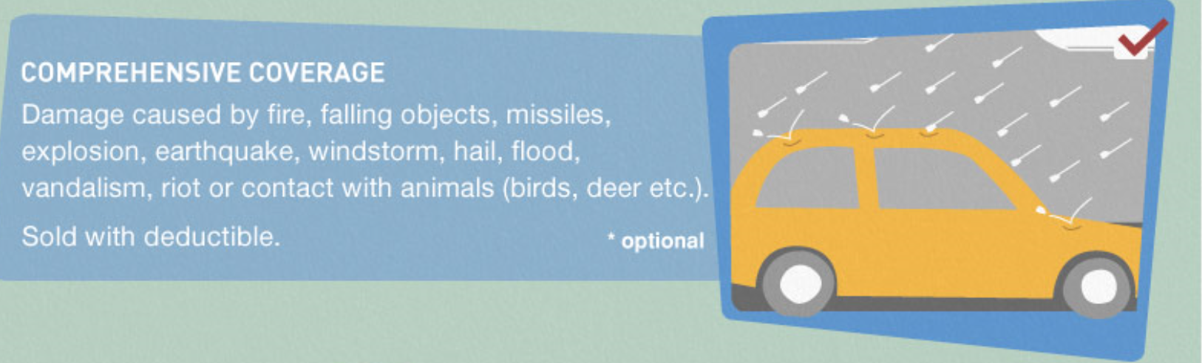
Vehicles are Covered for Wide Variety of Disasters Under Optional “Comprehensive” Coverage
70 Percent of Insured Drivers Purchase this Coverage

Slide 19
Public Understanding About Insurance
Misperceptions about Insurance are rampant

Slide 20
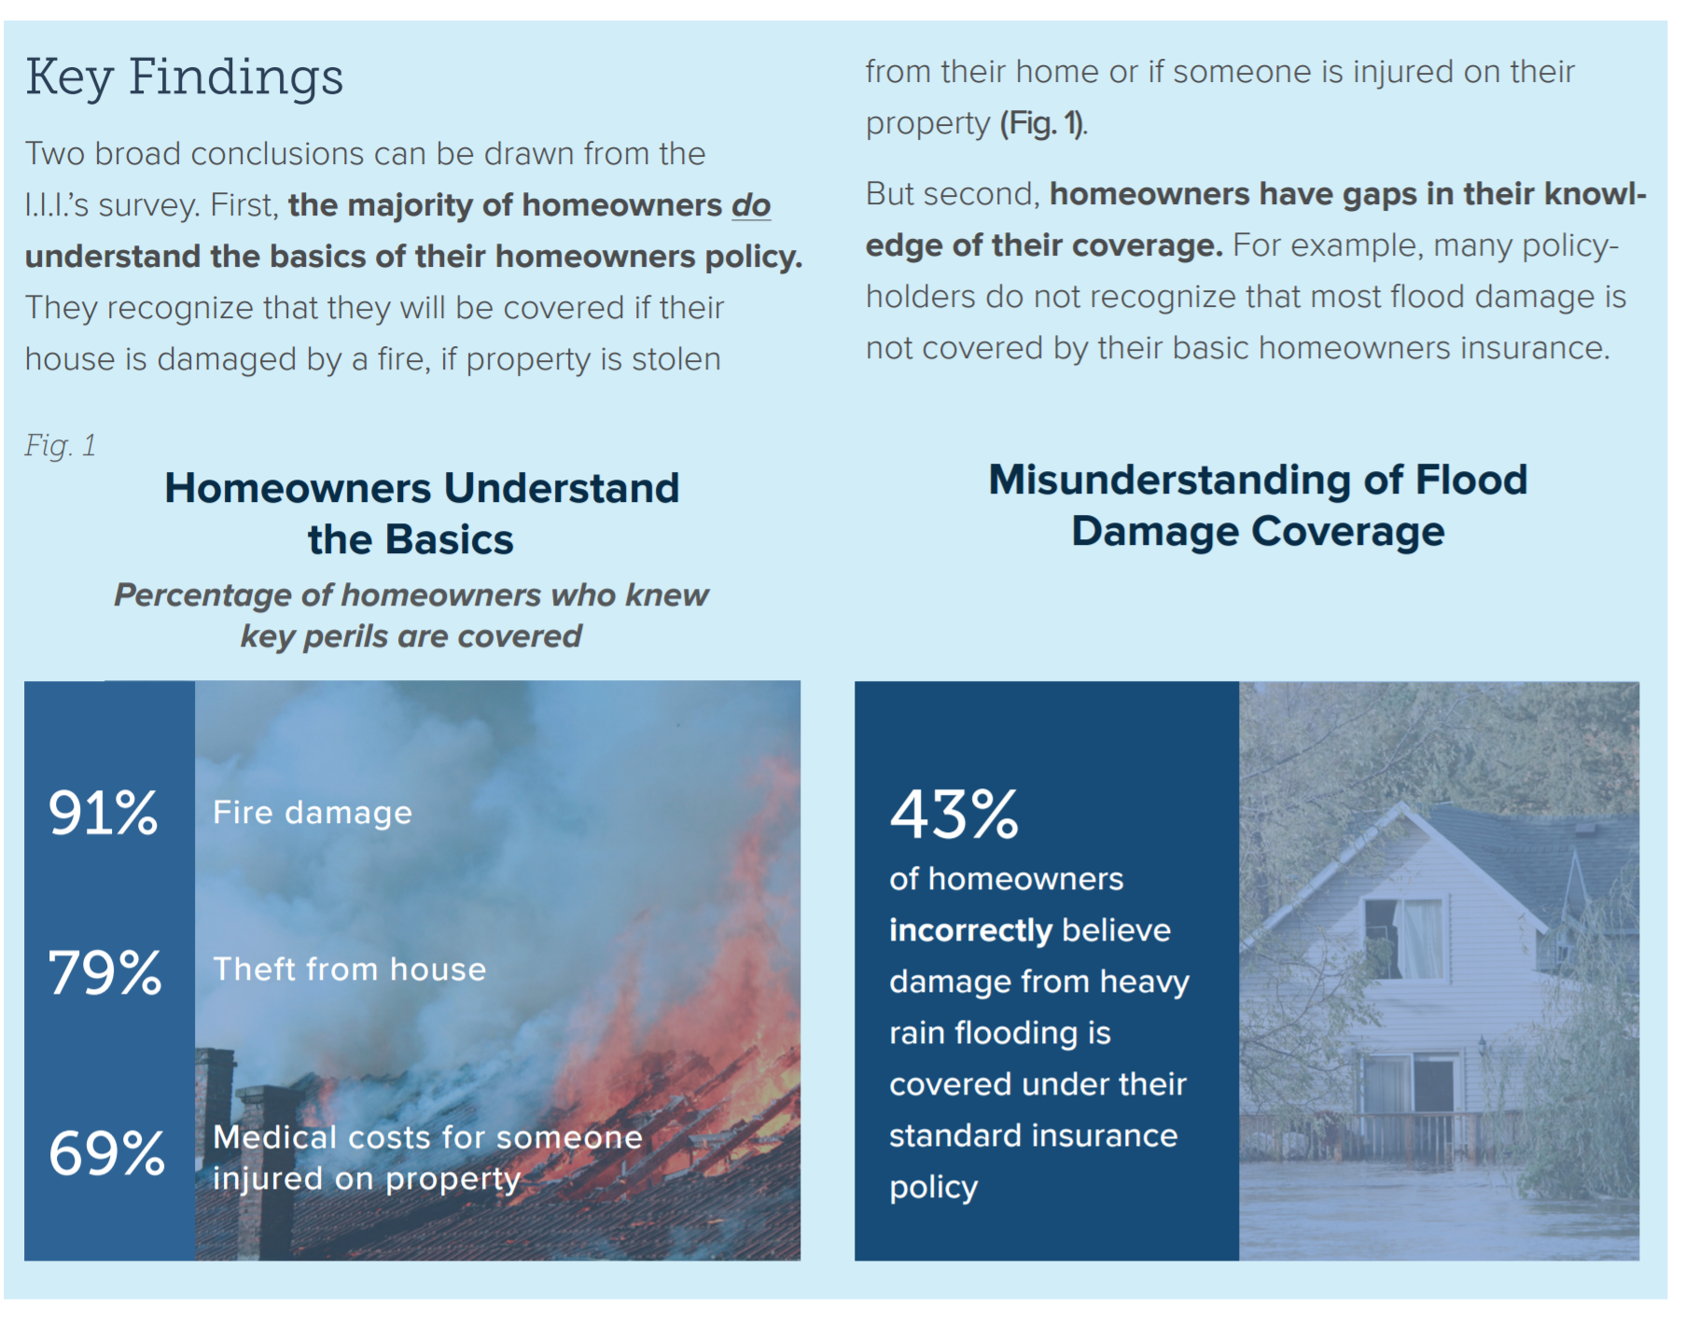
Consumer Understanding of Home and Flood Insurance
Good News and Bad News
Most homeowners
understand the
basics In a home
insurance policy,
but don’t understand
Water damage and
flooding

Slide 21
I.I.I. Poll: Flood Insurance
Percentage of Homeowners Who Have Flood Insurance,
2007–2016
The Take-up Rate Continues a Slow Decline.
Source: Insurance Information Institute Annual Pulse Survey.

Slide 22
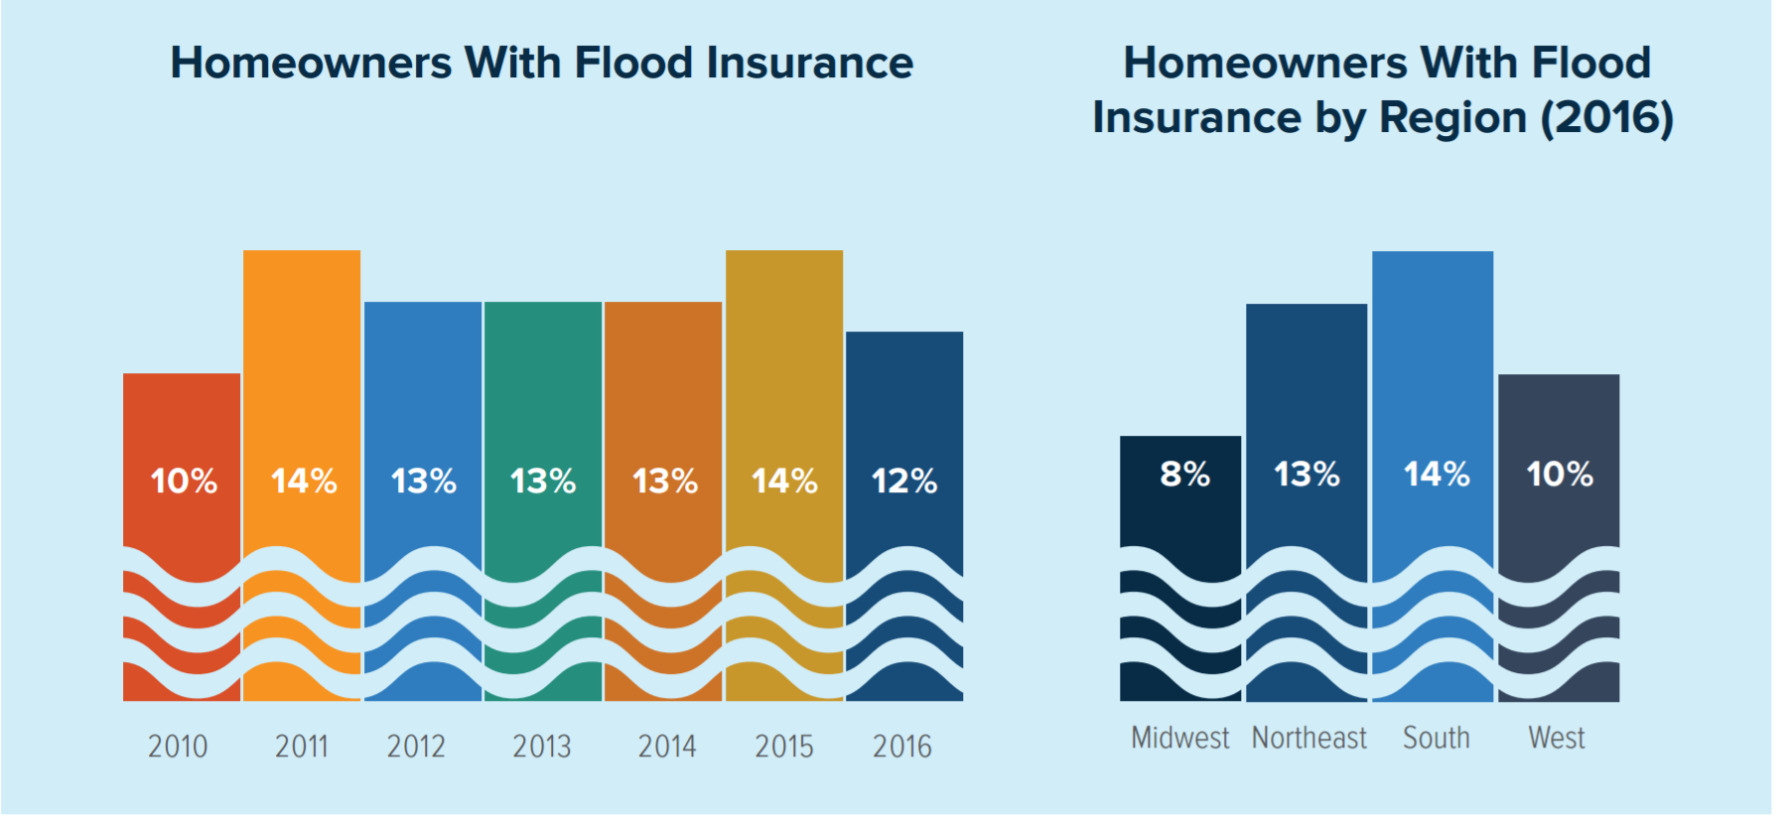
Flood Insurance by Year and By Region

Slide 23
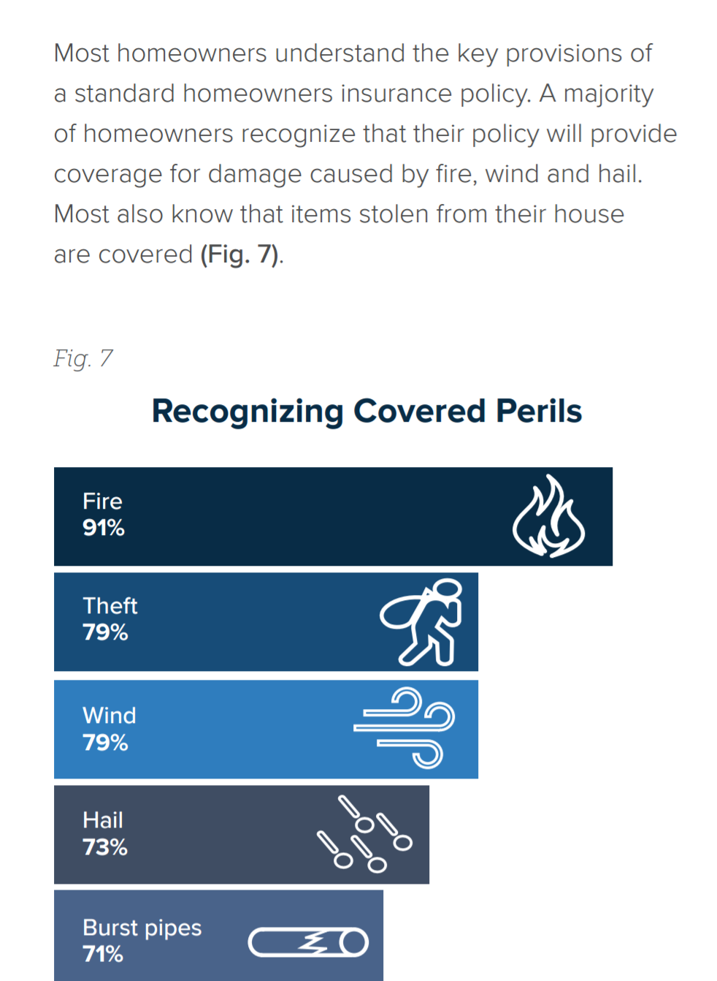
Homeowners Understand the Basics
Know the basics

Slide 24
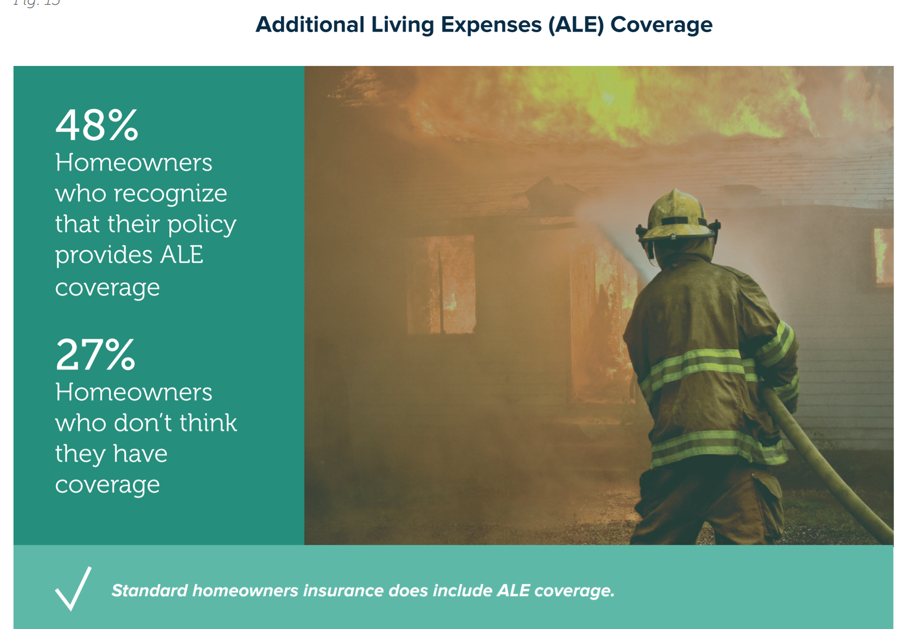
Most Know that there is ALE Coverage in a Home Insurance Policy
No ALE in Flood Insurance Policy – Another Source of Confusion

Slide 25
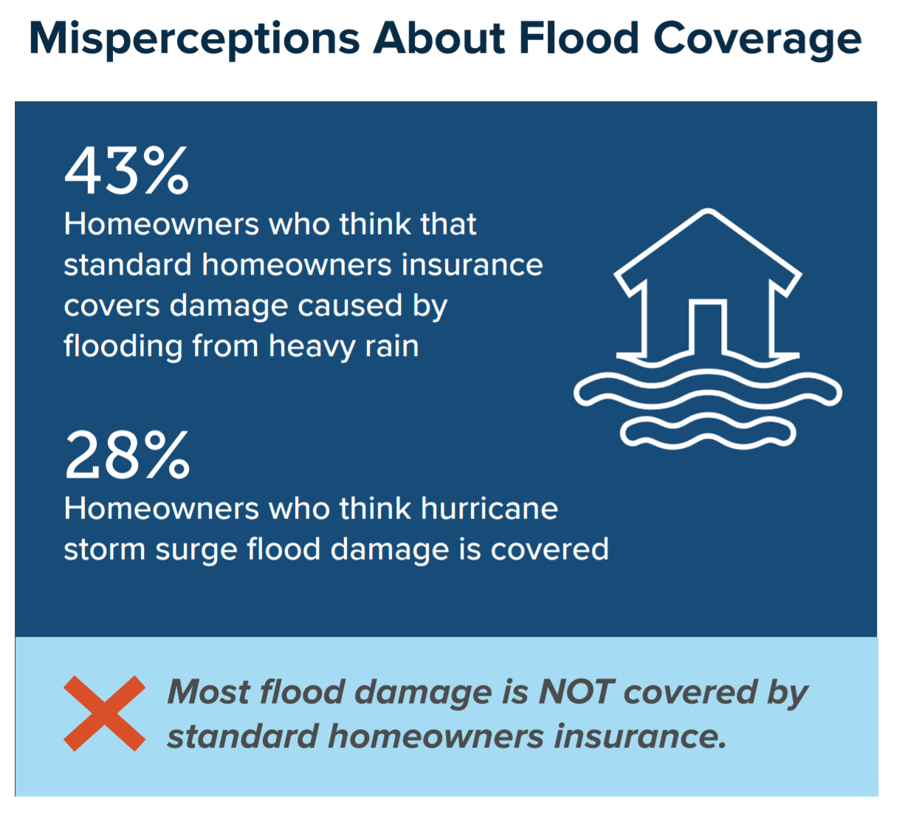
Public is confused by flood insurance Coverage
Misperceptions Abound

Slide 26
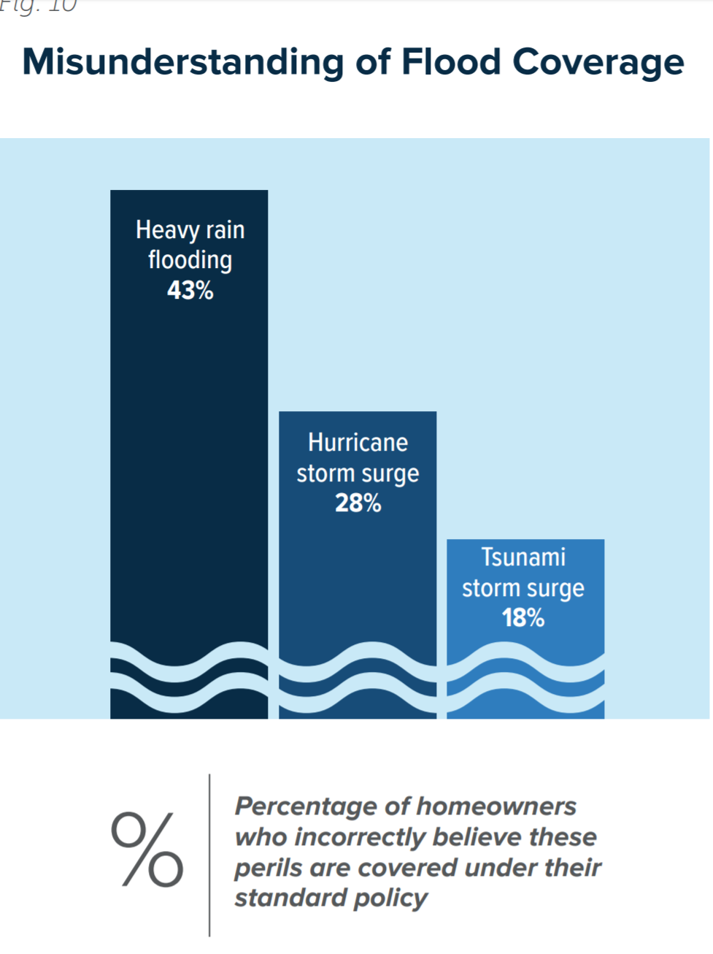
Misconceptions Regarding Flood Coverage
Troubling Results

Slide 27
Reason for Confusion
What can be done?
Confusion about flood coverage may arise from the fact that some types of water and storm-related damage are covered by a standard homeowners policy.
For example, most homeowners insurance includes coverage for damage caused by wind-driven rain, burst pipes and water leaking into your house because of a roofline ice dam.
The insurance industry has an opportunity to serve its customers and improve consumer understanding of its products and services by increasing educational outreach to homeowners.
Consumer advocates, public policy experts, the media can also help close the knowledge gap by bringing attention to the need for homeowners to learn more about their insurance coverage and seek professional guidance when they purchase insurance

Slide 28
Disaster-Related Resources
And Insurance Coverage Information

Slide 29
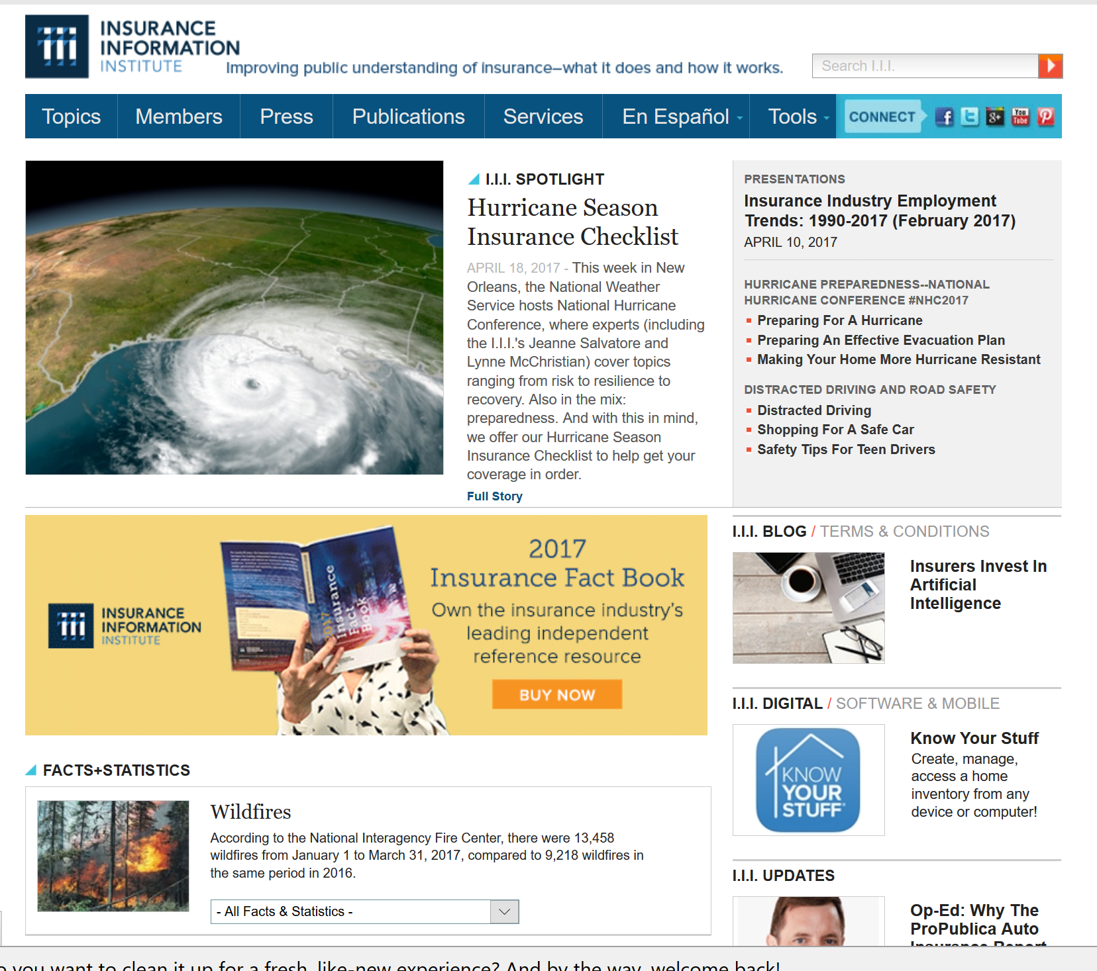
Great Resources – I.I.I. Website
www.I.I.I.org
Consumer Articles
Tips for Business owners
Educational Videos
Infographics
Apps
Research
Statistics

Slide 30
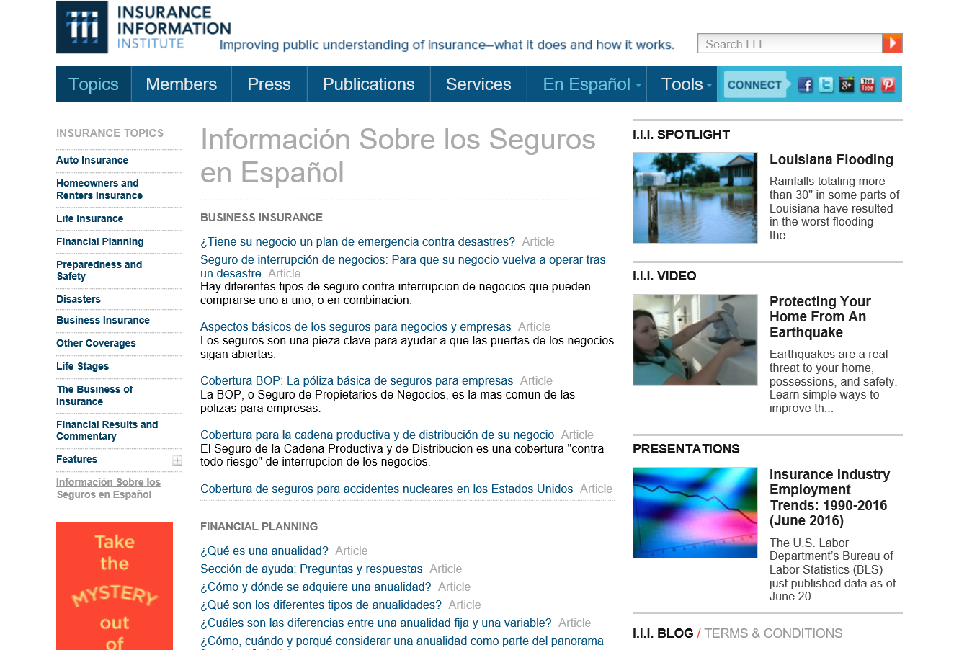
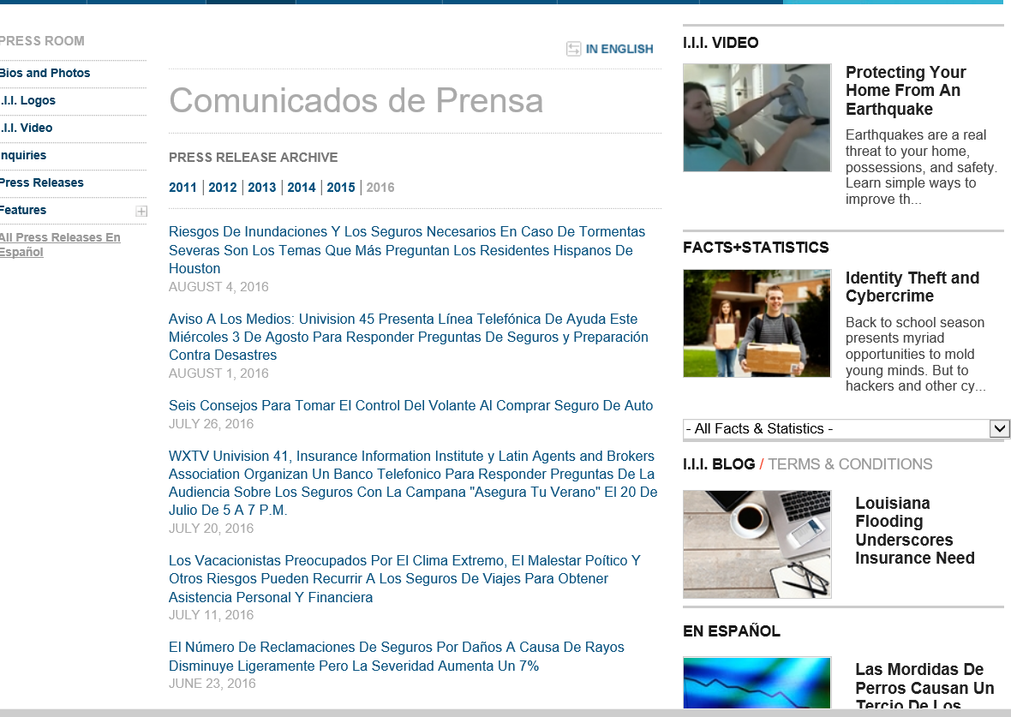
I.I.I.’s Spanish Language Resources
Consumer News Releases Translated into Spanish
Articles
News Releases

Slide 31
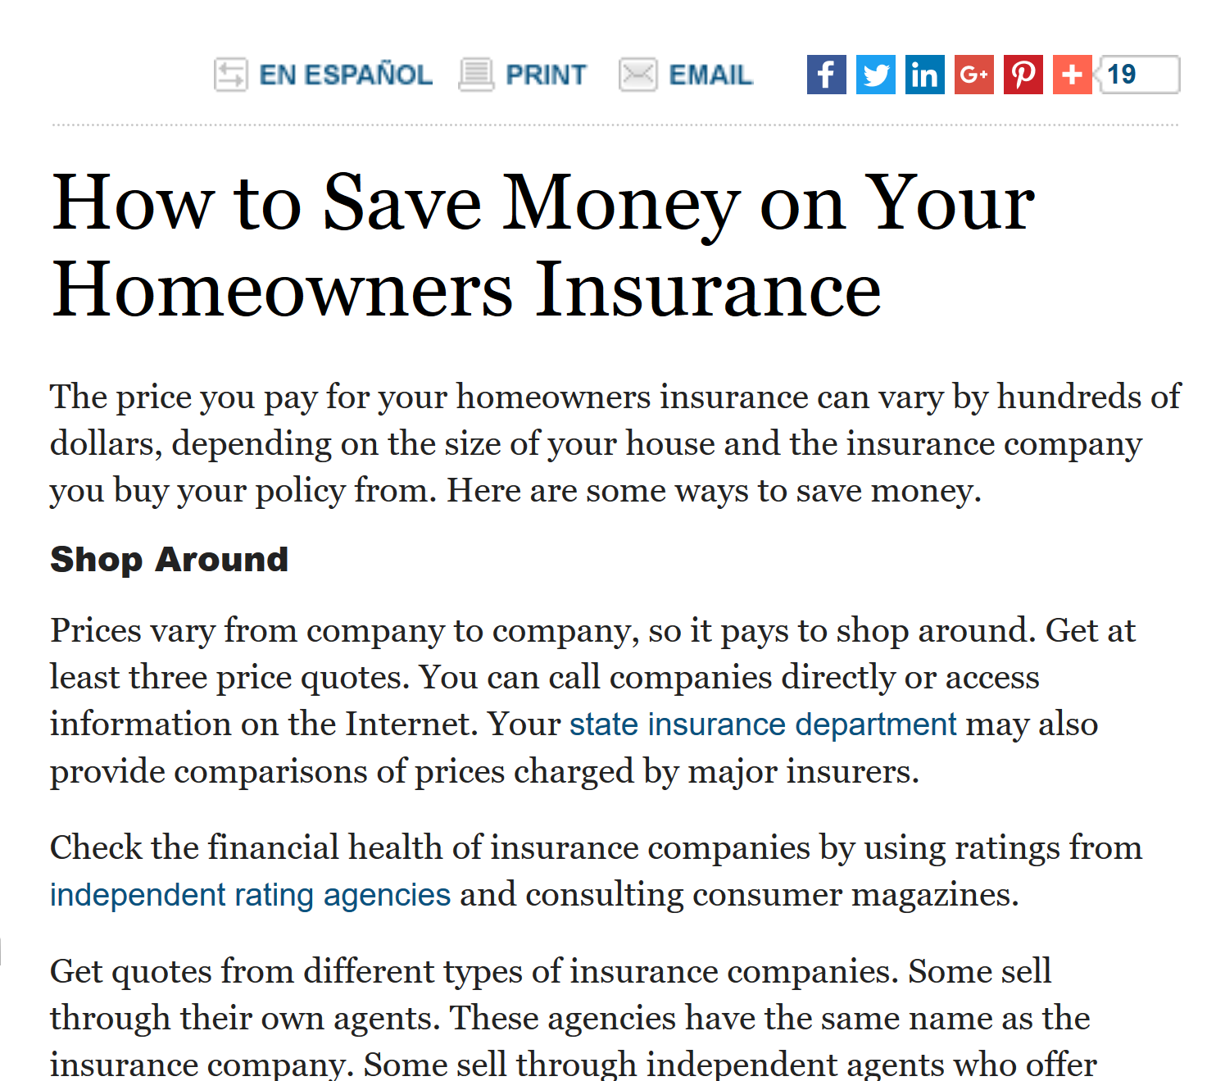
Auto, Home and Business Insurance is Highly Competitive
Comparison Shopping Encouraged

Slide 32
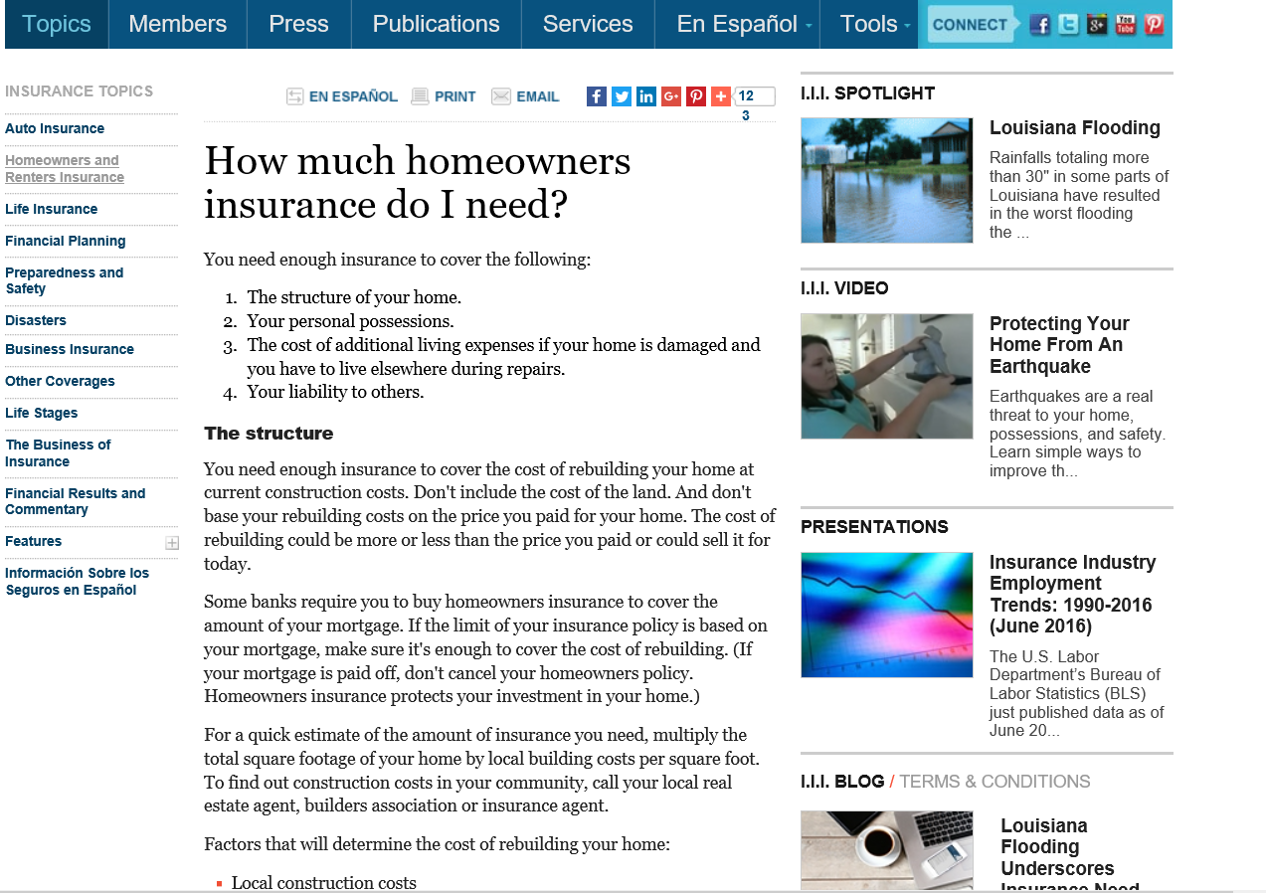
Specific Details to Determine How Much to Purchase

Slide 33
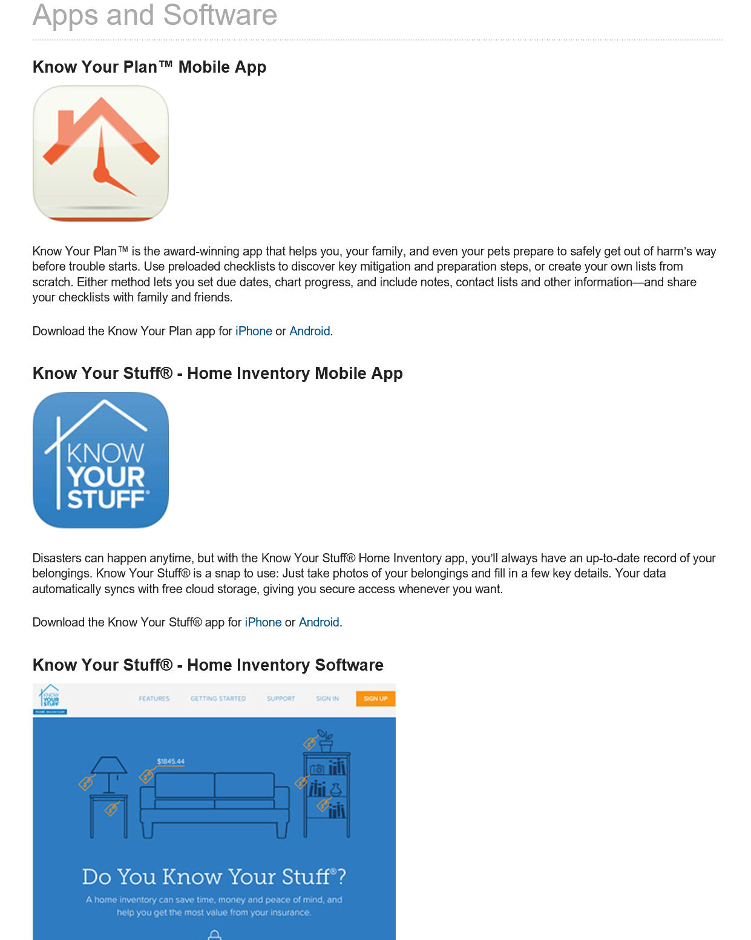
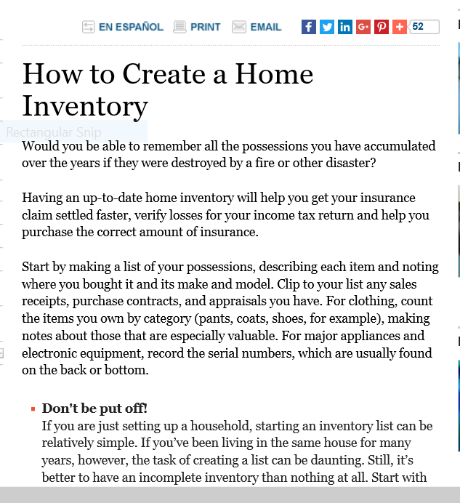
I.I.I. Offers Free Apps to Plan for a Disaster and Conduct a Home Inventory, Articles too!
Free Apps
Easy to Understand Articles and Brochures, too!

Slide 34
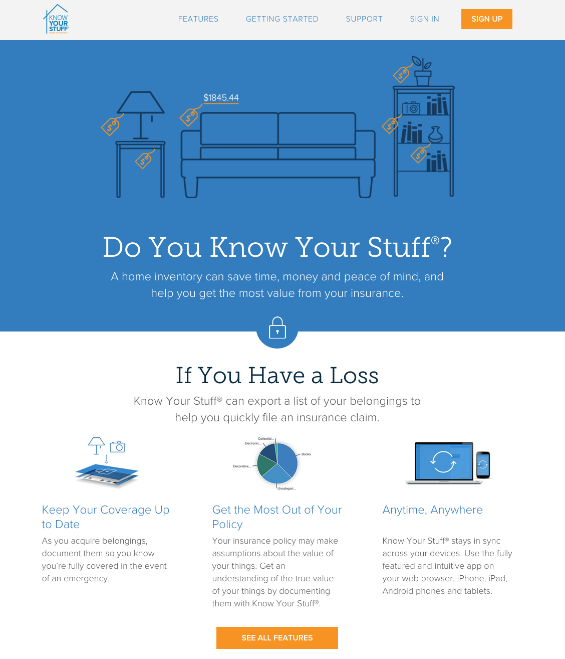
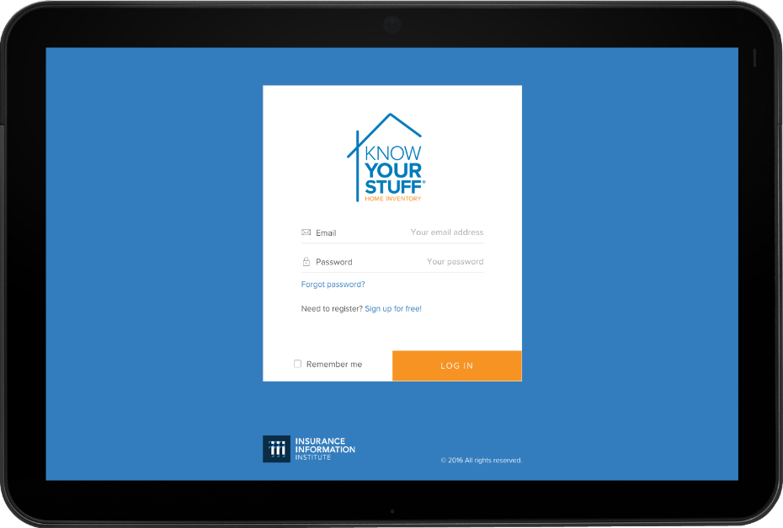
Know Your Stuff® - Home Inventory App
A home inventory can save time, and money. It is am important way to be prepared in the event of a loss or disaster.
The I.I.I.’s Know Your Stuff® home inventory app for desktop and mobile ensures your inventory is available anywhere, any time, and from any device
Available at: www.knowyourstuff.org
34

Slide 35

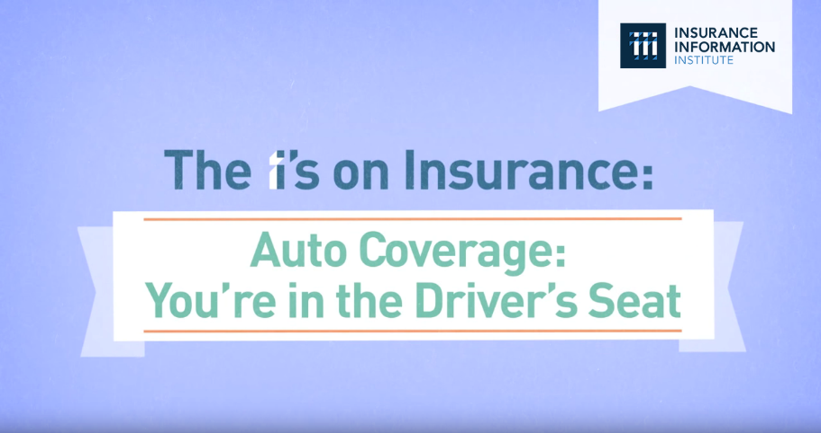

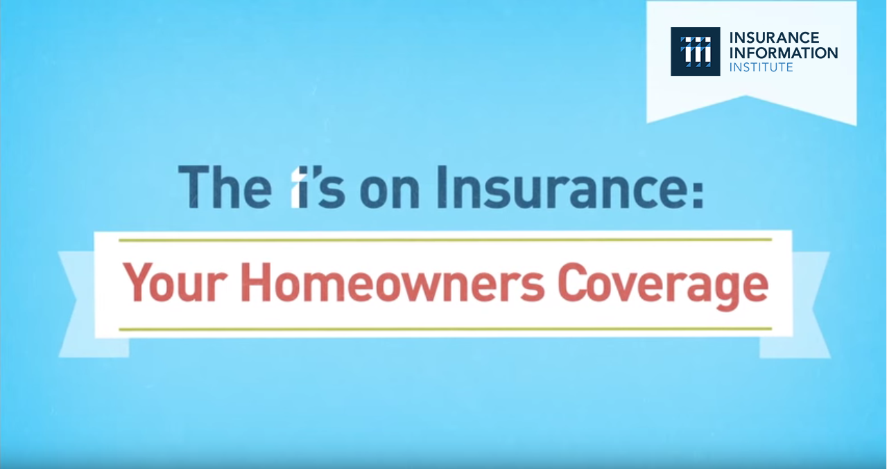
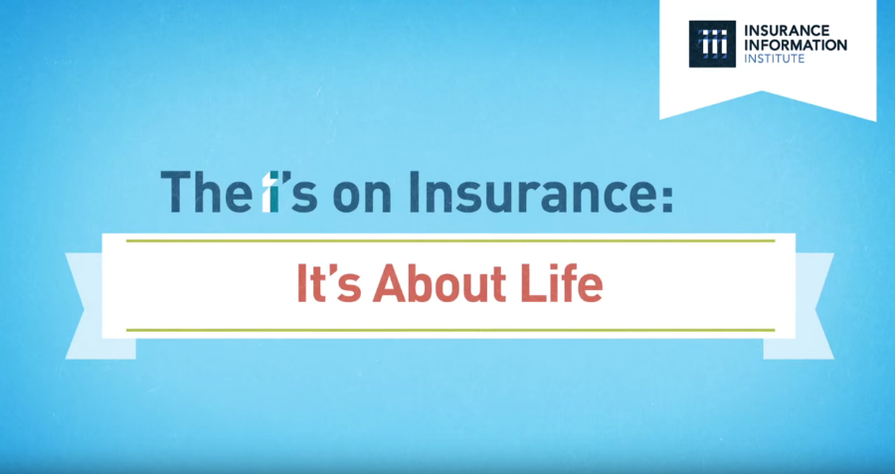
“The I’s on Insurance” Video Series
Animated video series covering Homeowners, Auto, Small Business and Life Insurance.
Goal: To engage and encourage viewers to reach out to their agent, broker, or company representative to discuss insurance coverage.

Slide 36
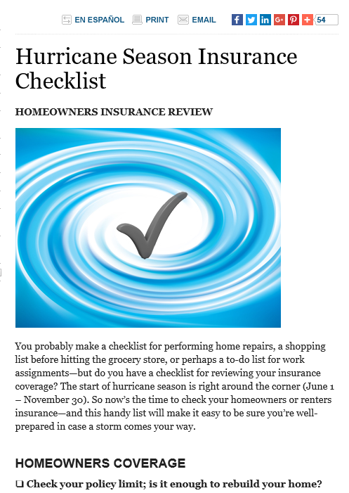
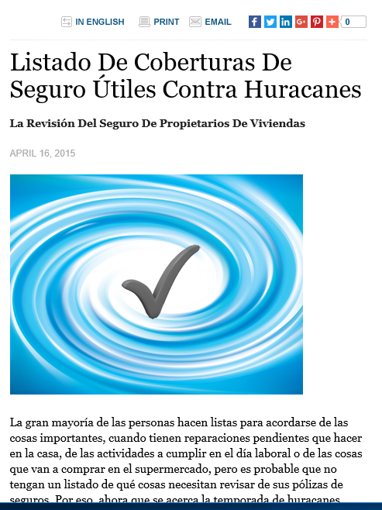
Hurricane Season Insurance Checklist
Detailed Tips
In Spanish, too!

Slide 37
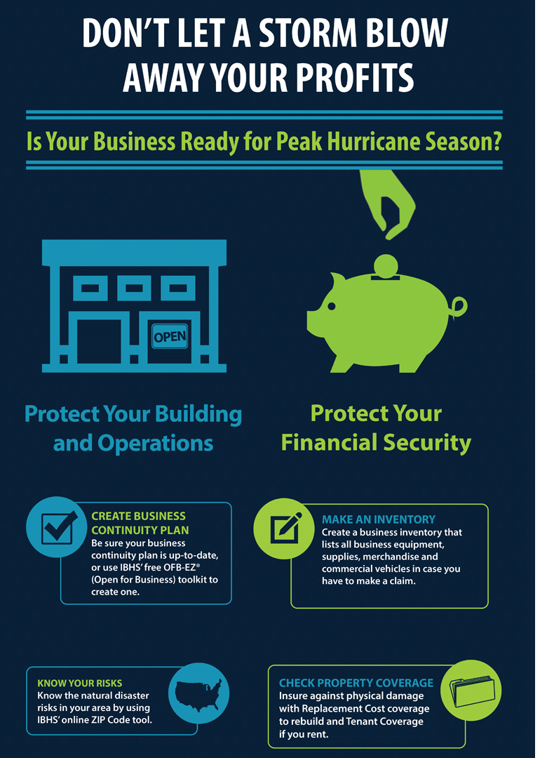
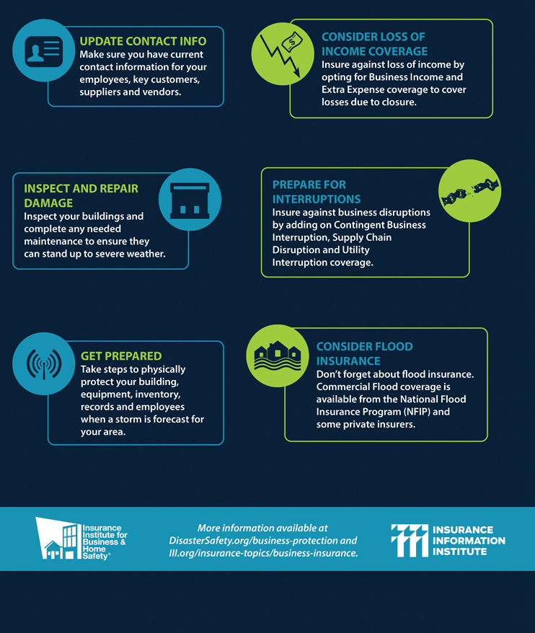
Tips to Help Business Survive A Disaster
I.I.I. & Insurance Institute for Business and Home Safety Partner
Protect Property
Protect Financial Security

Slide 38
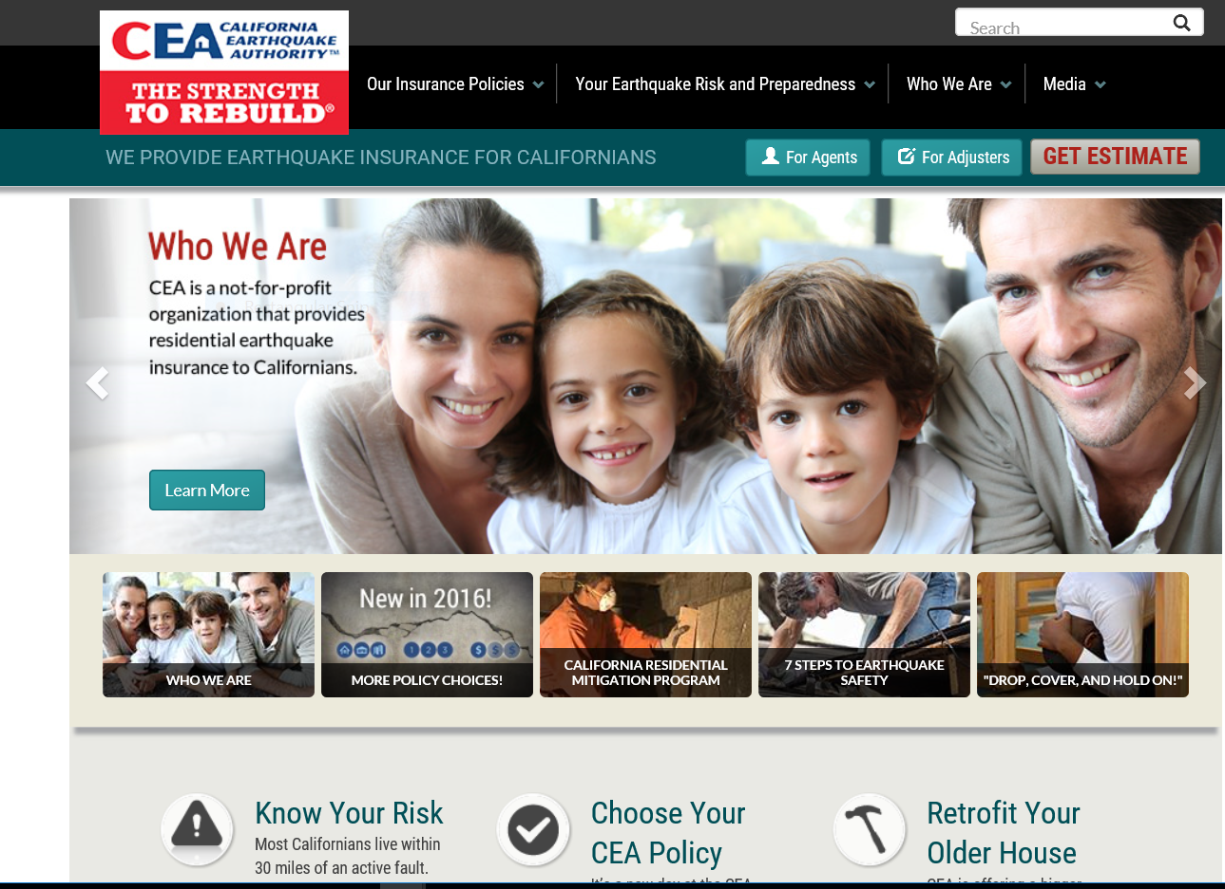
California Earthquake Authority
Provides Detailed Information on Earthquake Insurance
I.I.I. Website has white papers, facts and stats, consumer articles and educational videos on earthquake risk, insurance and preparedness for a national audience

Slide 39
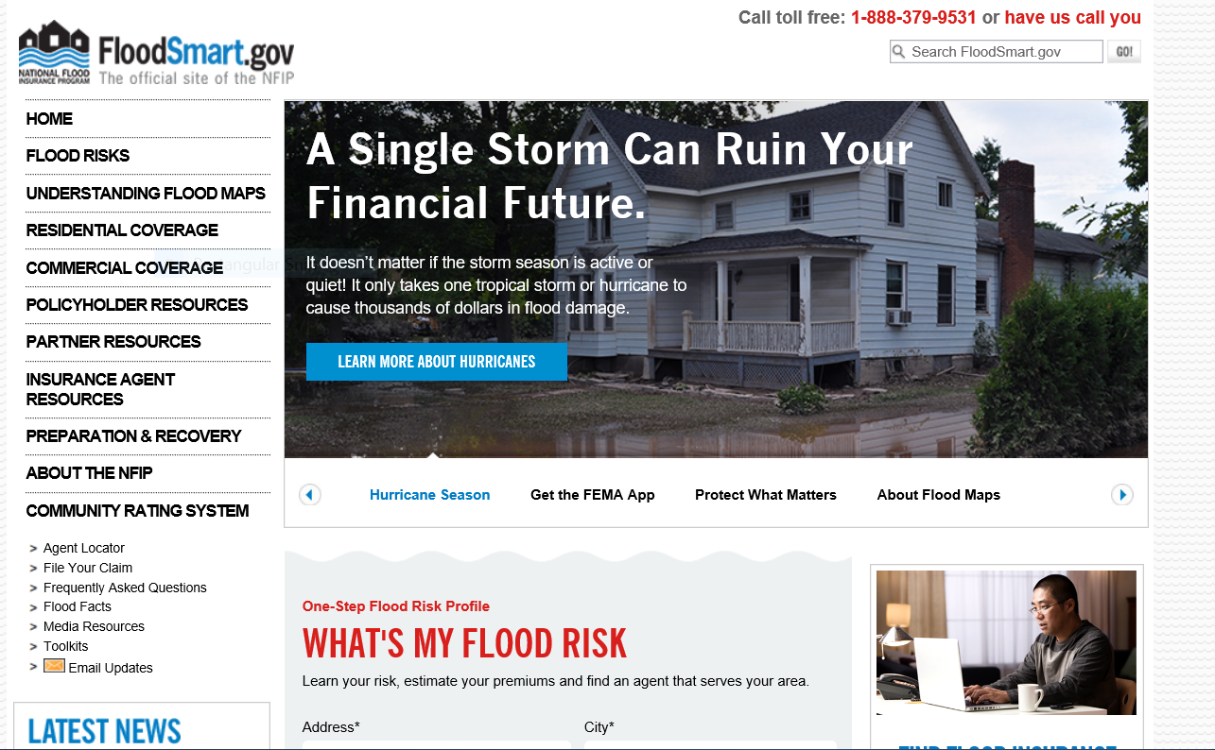
FloodSmart.gov – “Go To” Place for Information on Risk of Flooding and Cost of a Policy
Important to also understand limitations of the Policy – No Additional Living Expenses and Limited Coverage for Basements.

Slide 40
Thank You!
@JeanneSalvatore
212-346-5555
917-612-4088
jeannes@iii.org

