Slide 1
National Association of Latino Elected and Appointed Officials
National Policy Institute on Emergency Planning and Preparedness
August 19-20, 2016
Sheraton Hotel, Boston, MA
Jeanne M. Salvatore, Senior Vice President, Public Affairs & Chief Communications Officer
Insurance Information Institute  110 William Street  New York, NY 10038
Tel: 212.346.5555  Cell: 917.612.4088  Jeannes@iii.org  www.iii.org

Slide 2
Presentation Overview
Insuring Against a Disaster
What is the Insurance Information Institute
Overview of Catastrophes in the United States
What do Policymakers and their Constituents Need to Know about Insurance and Disasters
Key Questions to Ask Prior to a Disaster
Key Disaster Resources
Questions

Slide 3
Who We Are and What We Do
The mission of the Insurance Information Institute is to build public understanding of insurance—what it does and how it works.
We Are…
  A voice for the property/casualty insurance industry.
  The go-to source for credible and unbiased insurance information for the media, the industry and consumers.
  Dedicated to ensuring the media covers our business fairly and accurately.
We do not lobby.

Slide 4
Catastrophes in the United States – Some Basic Facts
The term “catastrophe” in the property insurance industry denotes a natural or man-made disaster that is expected to reach a certain dollar amount. Currently, set at $25 million.
Disaster losses along the coast are likely to escalate in the coming years, in part, because of huge increases in development.
Catastrophe losses will double every decade or so due to growing residential and commercial density and more expensive buildings.
The 2010 census showed that 39 percent of the population is concentrated in less than 10 percent of the nation’s land area excluding Alaska.
Using 2010 U.S. census, in 2013, the National Oceanic and Atmospheric Administration (NOAA) said an additional 11 million people will be living along the coast by 2020, bringing the total to nearly 134 million.

Slide 5
Catastrophes in the United States: Property Exposed to Disasters
A 2012 study by AIR Worldwide put the value of insured coastal property in hurricane-prone states—states bordering the Atlantic Ocean and Gulf of Mexico—at $10.64 trillion.
Exposure to windstorms and high property values combine to make Florida the state with the highest potential for losses and New York's Long Island the second highest.
The value of residential and commercial coastal property in Florida alone was almost $2.86 trillion. This represented 79 percent of the state’s total insured property values.
In New York it was $2.92 trillion, representing 62 percent of the total.
Other states where insured coastal property values exceeded 50 percent of the state’s total are Connecticut, Maine and Massachusetts.

Slide 6
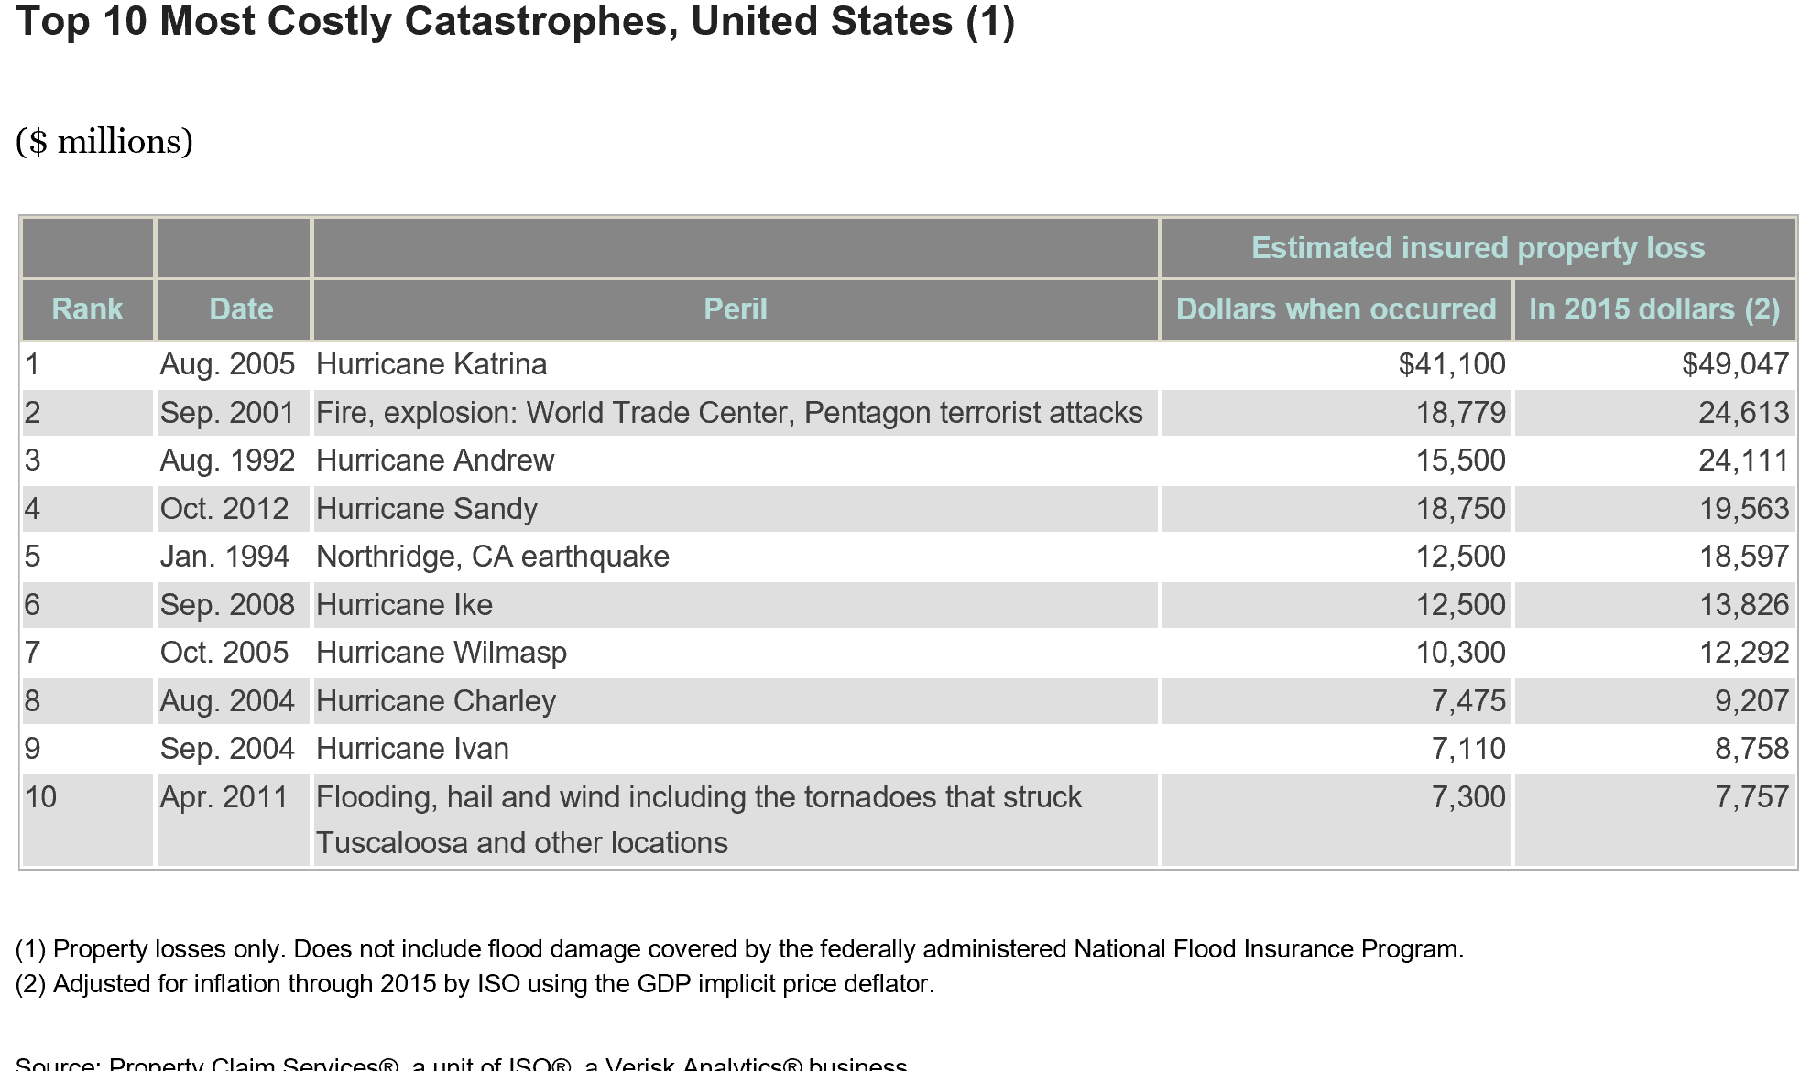
Top Ten Most Costly Catastrophes in the U.S.
Seven of the Top Ten Disasters Were Due to Hurricane/Wind Damage

Slide 7
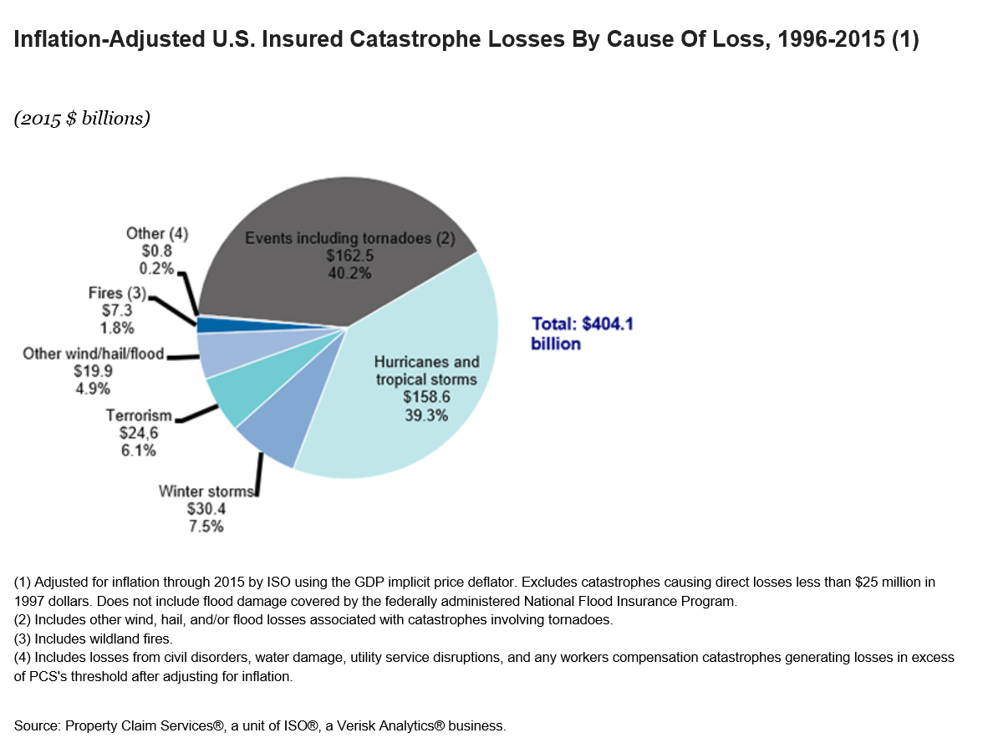
Catastrophe Losses by Type of Disaster
Wind is the most costly and Frequent Cause of Loss
Over the 20-year period, 1993 to 2012
Each year about 6 percent of homeowners file claims.
Hurricanes and tropical storms made up 40.4 percent
Tornado losses 36.0 percent
Winter storms 7.1 percent
Terrorism 6.3 percent
Earthquakes 4.7 percent
Wind/hail/flood 3.8 percent and fire 1.7 percent
Civil disorders, water damage and utility disruption combined represented less than 1 percent.

Slide 8
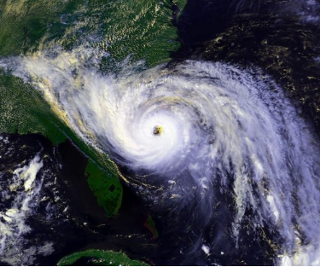
2016 Atlantic Hurricane Season
A Demographic Perfect Storm
I.I.I.’s Goal
Massive influx of new coastal residents who have never experienced a major storm.
Combined with an existing population that has been lulled into complacency by the lack of a hurricane over the last several years.
Resulting in large numbers of coastal residents from Maine to Texas who are unprepared for the 2016 hurricane season.
Educate coastal residents about what they need to do now to financially protect themselves with the right amount and type of insurance.
* NOAA’s National Coastal Population Reprt

Slide 9
Five Key Ways to Prepare For A Disaster…Any Disaster
Have the Right Amount and Type of Insurance for your Home, Car or Business
Consider Flood and/or Earthquake Insurance
Have an Up-to-date Home Inventory
Take Reasonable Steps to Protect Your Property Against the Disasters where you live
Know what to take and where to go if you need to evacuate

Slide 10
Insuring Against a Disaster
What is Covered and What is Not!
Standard home, renters and business insurance policies clearly list the disasters that are covered and the disasters that are not.
The two biggest disasters that are not covered are floods and earthquakes.
Flooding is available from the National Flood Insurance Program (NFIP) and a few private insurance companies. Excess flood insurance is available from private insurance.
Earthquake insurance is available from private insurance companies and in California from the California Earthquake Authority (CEA)

Slide 11
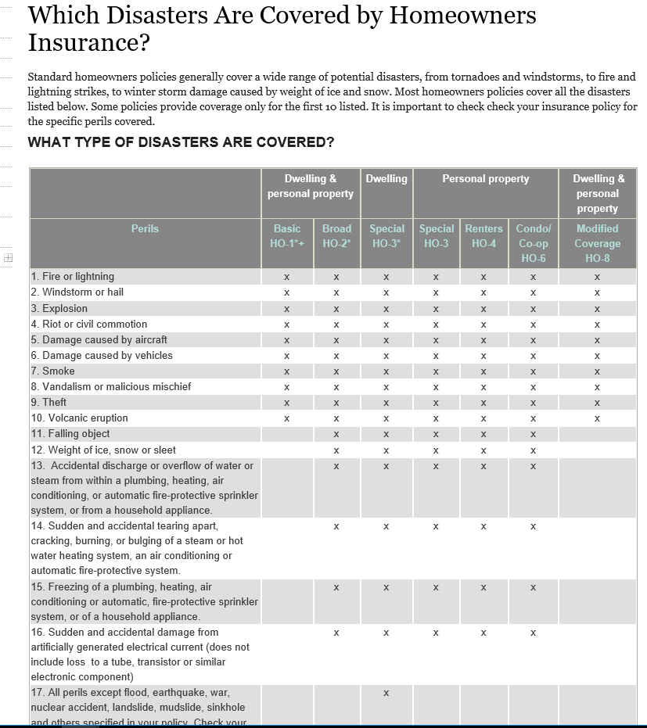
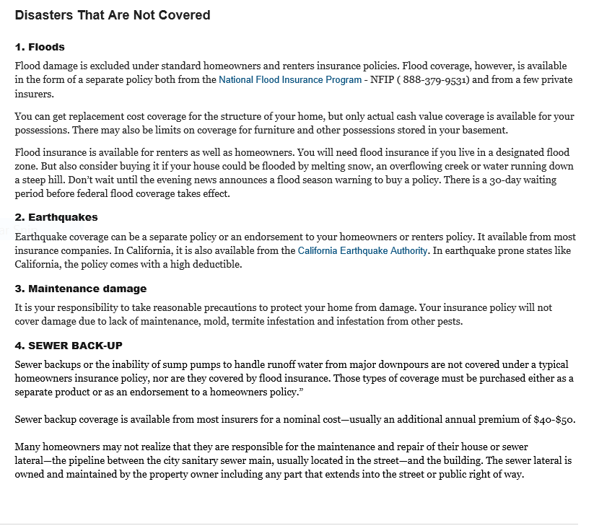
I.I.I. Web Content on Standard Home Insurance
Polices Clearly List Disasters Covered and Disasters Not Covered
Renters, Condo, Single Family Homes Policies Coverage
Separate Insurance Is Needed for these Disasters

Slide 12
Flood Insurance Background
Congress created the NFIP in 1968 in response to the rising cost of taxpayer-funded disaster relief for flood victims and the increasing amount of damage caused by floods. The NFIP makes federally backed flood insurance available in communities that agree to adopt and enforce floodplain management ordinances to reduce future flood damage.
The NFIP provides coverage for up to $250,000 for the structure of the home on a replacement cost basis and up to $100,000 for personal possessions on an actual cash value basis.
Private flood insurance is available for those who need additional insurance protection, known as excess coverage, over and above the basic policy or for people whose communities do not participate in the NFIP. Some insurers have introduced special policies for high-value properties.

Slide 13
Too Few People Purchase Flood Insurance
People Underestimate the Risk of Flooding
A 2016 poll by the Insurance Information Institute found that 12 percent of American homeowners had a flood insurance policy, lower than the 14 percent who had the coverage in 2015.
The percentage of homeowners with flood insurance was highest in the South, at 14 percent.
Thirteen percent of homeowners in the Northeast had a flood insurance policy, 10 percent of homeowners in the West had a flood insurance policy, while 8 percent of homeowners in the Midwest had flood insurance.
Flooding is the most common natural disaster in the U.S. with over 90 Percent of all Natural Disasters having some form of Flooding.

Slide 14
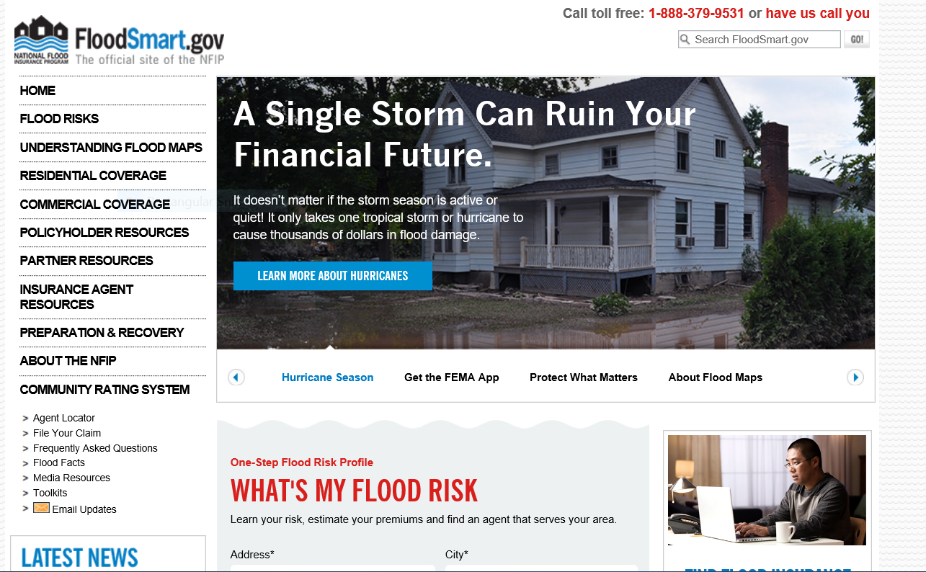
FloodSmart.gov – Go to Place for Information on Risk of Flooding and Cost of a Policy
Important to also understand limitations of the Policy – No Additional Living Expenses and Limited Coverage for Basements.

Slide 15
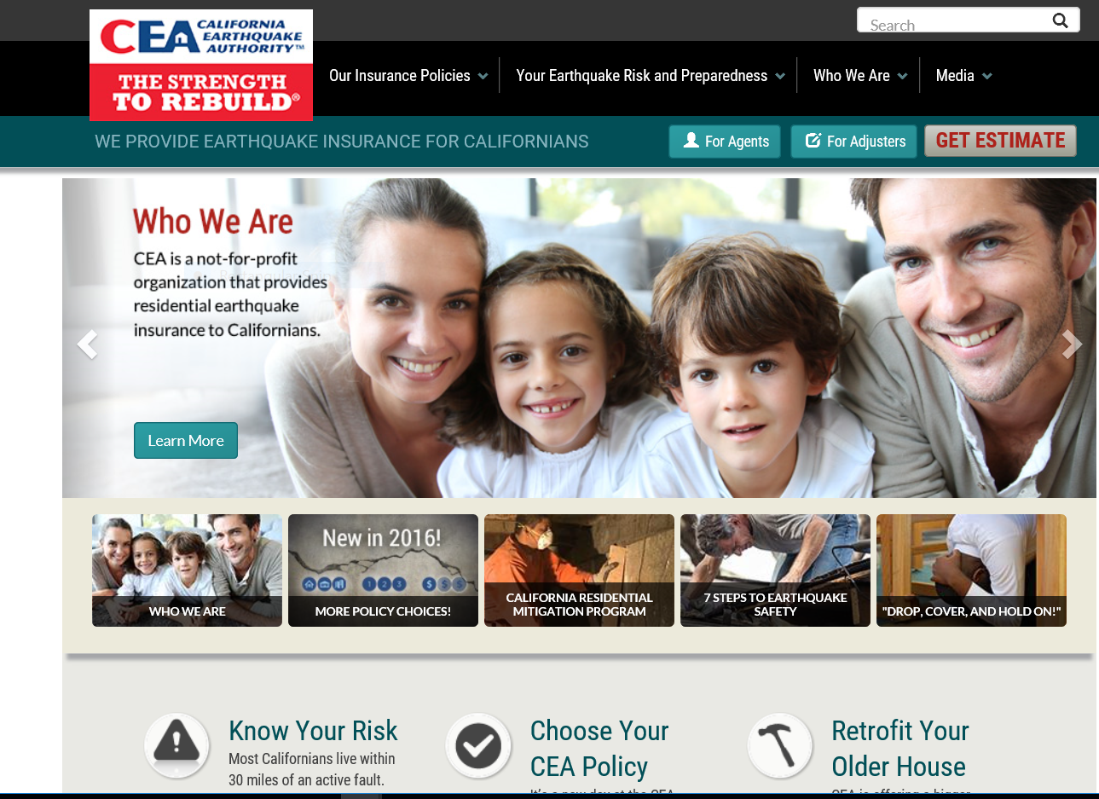
California Earthquake Authority
Provides Detailed Information on Earthquake Insurance
I.I.I. Website has white papers, facts and stats, consumer articles and educational videos on earthquake risk, insurance and preparedness for a national audience

Slide 16
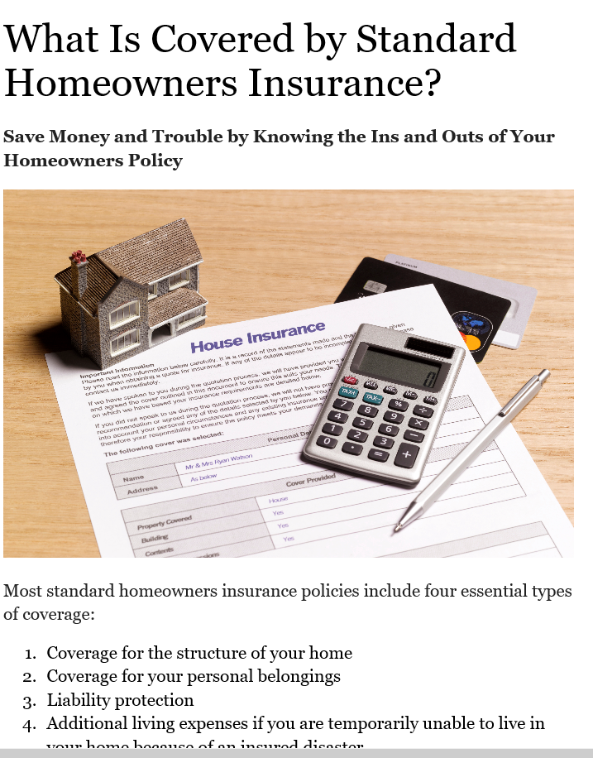
Need to Get the Right Amount of Insurance
Important to Get the Right Amount of Insurance
I.I.I. Web Content Explaining Coverage In Standard Home Ins.
Need enough insurance rebuild your home.
Replace all of your personal possessions.
Have sufficient ALE or additional living expense coverage in case you are unable to live in your home due to an insured catastrophe such as a fire or hurricane.
Liability protection in the event of a lawsuit.

Slide 17
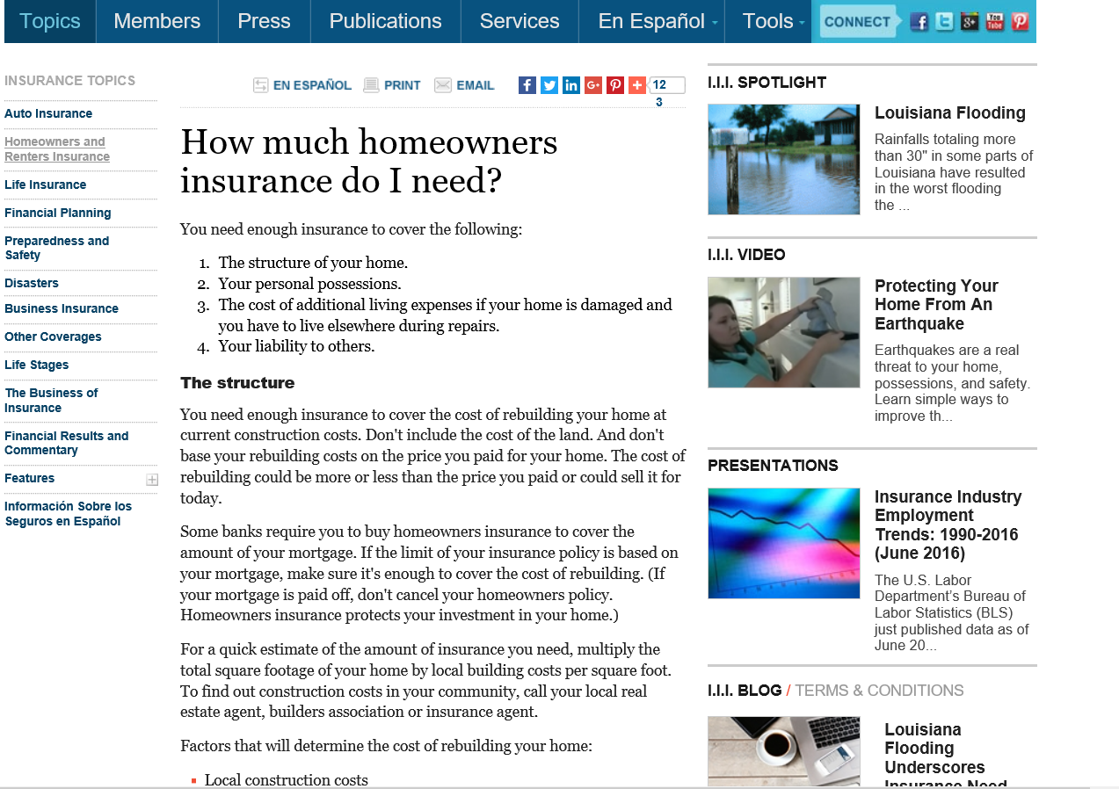
Specific Details to Determine How Much to Purchase

Slide 18
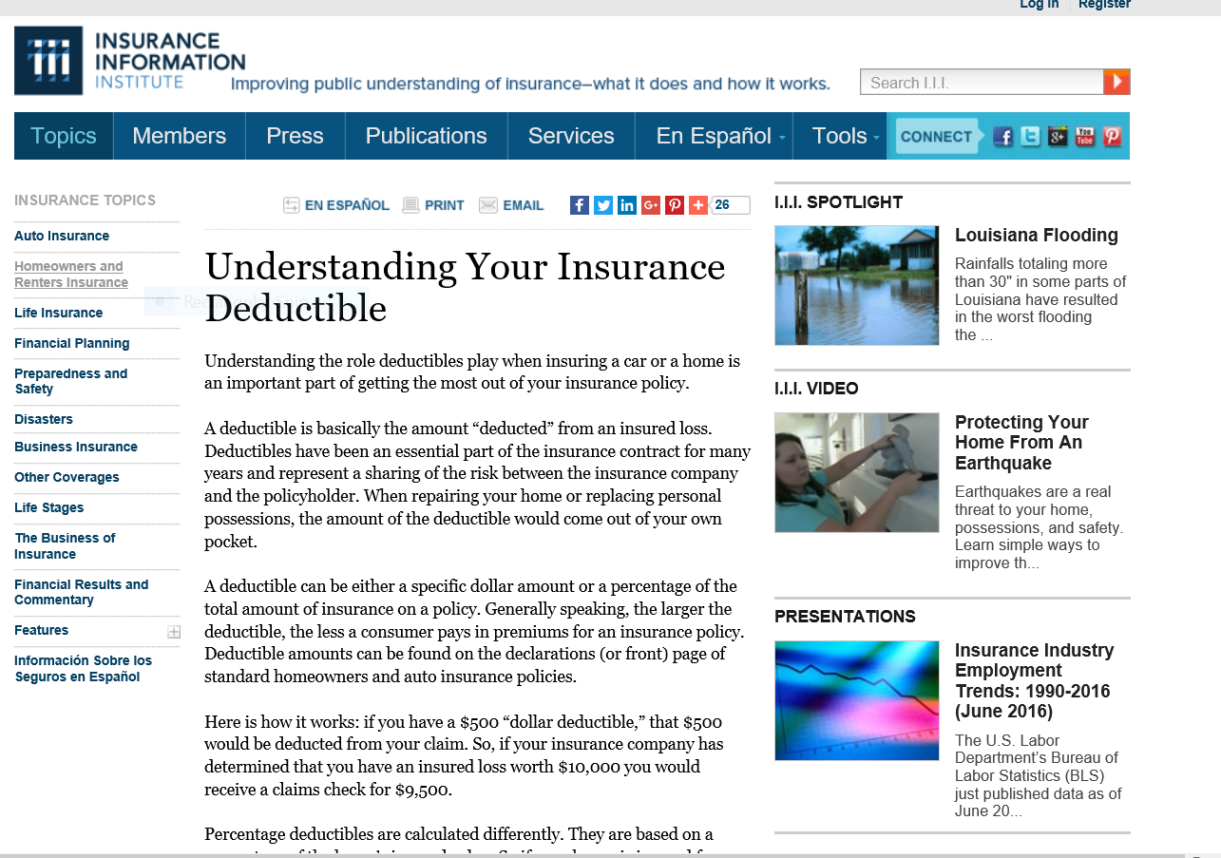
Role of Deductibles is Extremely Important to Understand

Slide 19
19 States and the District of Columbia have Hurricane Deductibles
There are two kinds of deductibles: hurricane deductibles, which apply to damage solely from hurricanes, and windstorm or wind/hail deductibles, which apply to any kind of wind damage.
Percentage deductibles typically vary from 1 percent of a home's insured value to 5 percent. The amount that the homeowner will pay depends on the home's insured value and the "trigger" which determines under what circumstances the deductible applies.
In some states, policyholders have the option of paying a higher premium in return for a traditional dollar deductible, depending on how close to the shore they live.
Alabama, Connecticut, Delaware, Florida, Georgia, Hawaii, Louisiana, Maine, Maryland, Massachusetts, Mississippi, New Jersey, New York, North Carolina, Pennsylvania, Rhode Island, South Carolina, Texas, Virginia and Washington DC have deductibles

Slide 20
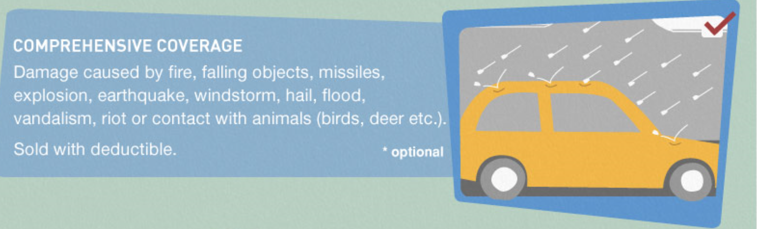
Vehicles are Covered for Wide Variety of Disasters Under Optional “Comprehensive” Coverage
70 Percent of Insured Drivers Purchase this Coverage

Slide 21
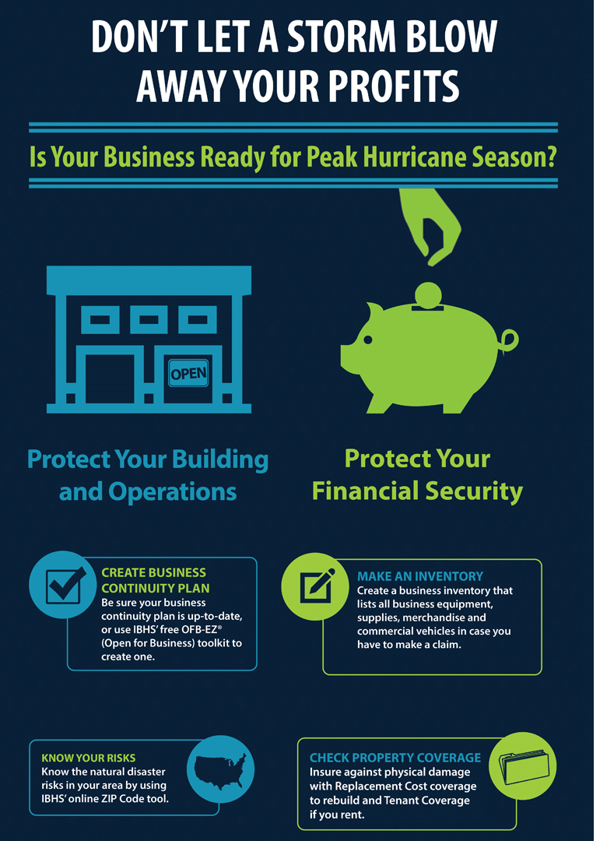
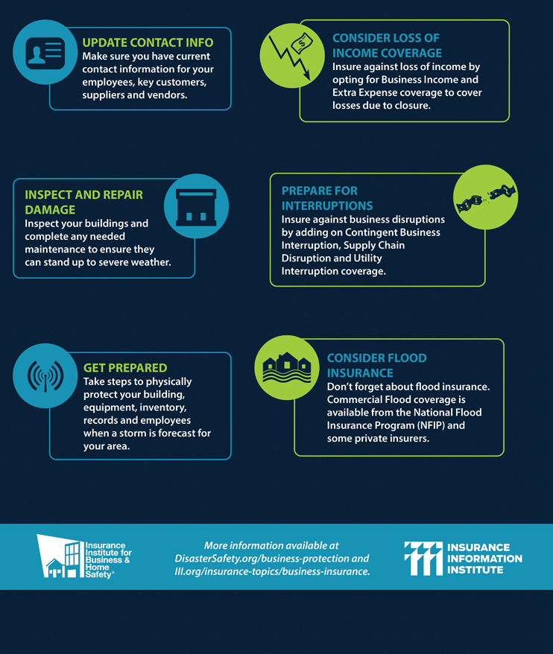
Tips to Help Business Survive A Disaster
I.I.I. & Insurance Institute for Business and Home Safety Partner
Protect Property
Protect Financial Security

Slide 22
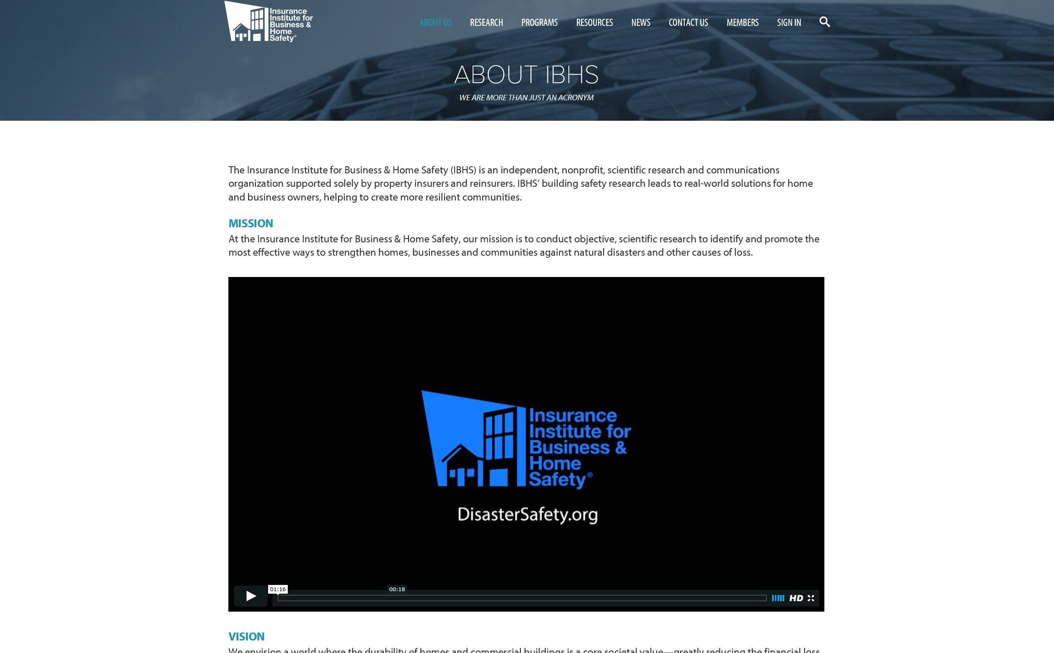
Insurance Institute for Business & Home Safety
Offers Detailed Information on How to Make Structures Safer

Slide 23
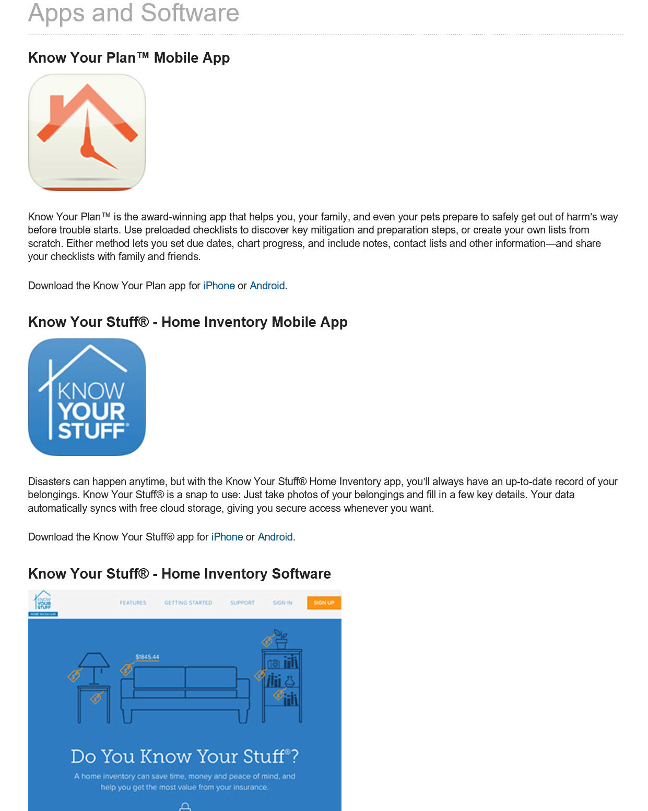
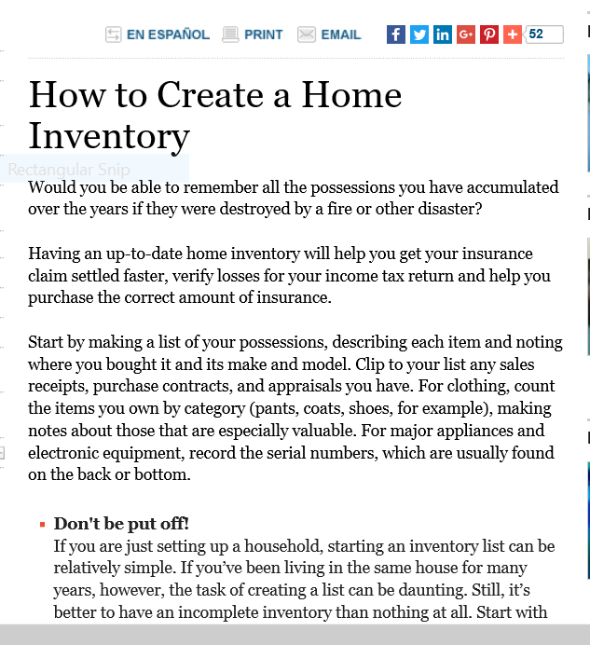
I.I.I. Offers Free Apps to Plan for a Disaster and Conduct a Home Inventory, Articles too!
Free Apps
Easy to Understand Articles and Brochures, too!

Slide 24
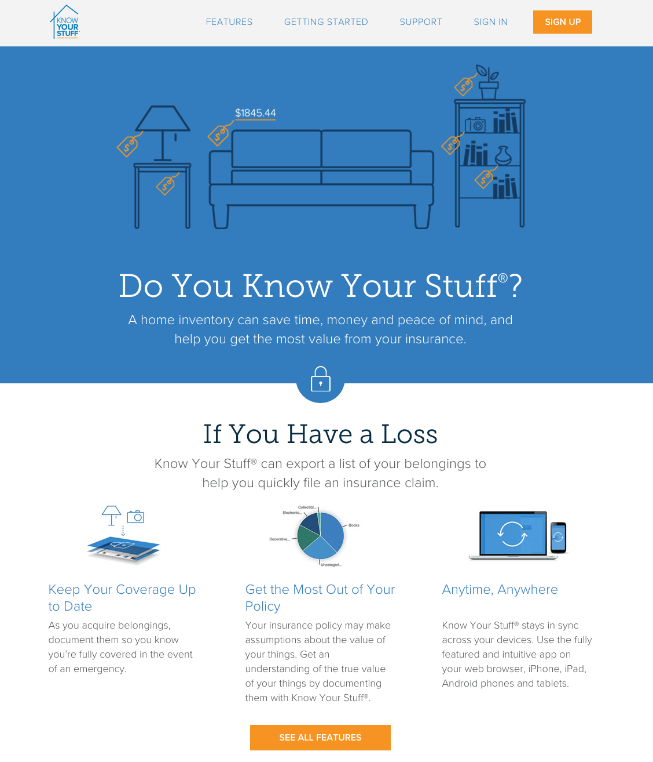
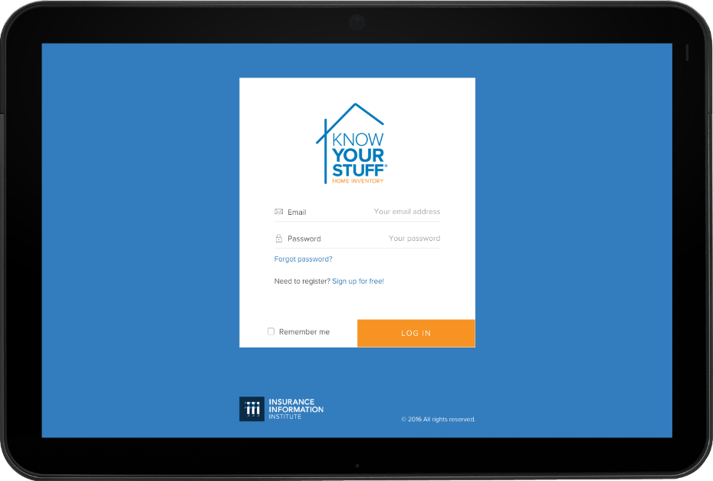
Know Your Stuff® - Home Inventory App
A home inventory can save time, and money. It is am important way to be prepared in the event of a loss or disaster.
The I.I.I.’s Know Your Stuff® home inventory app for desktop and mobile ensures your inventory is available anywhere, any time, and from any device
Available at: www.knowyourstuff.org
24

Slide 25

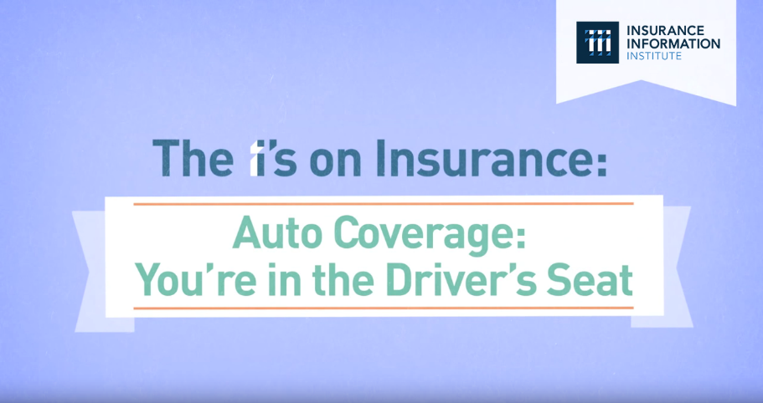

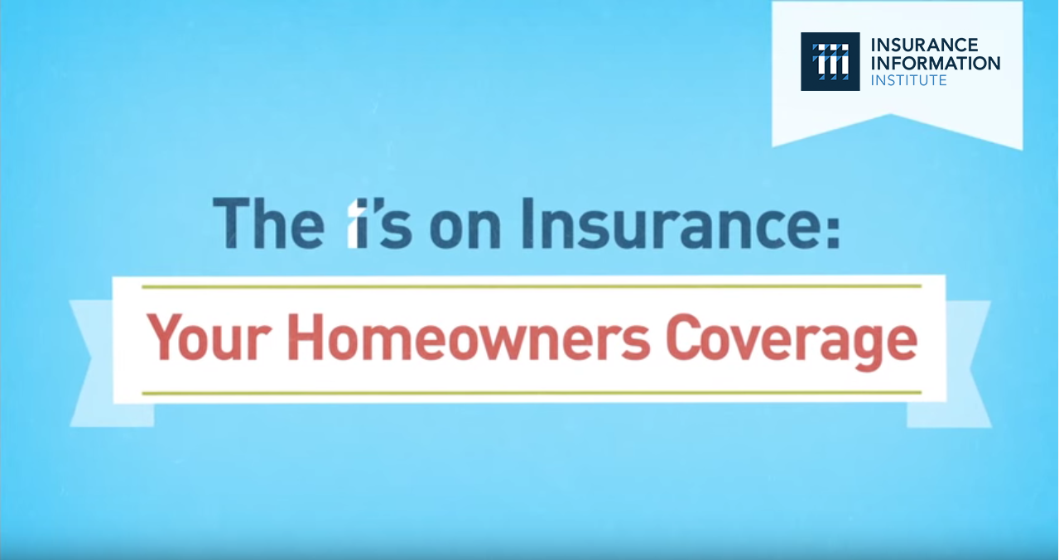
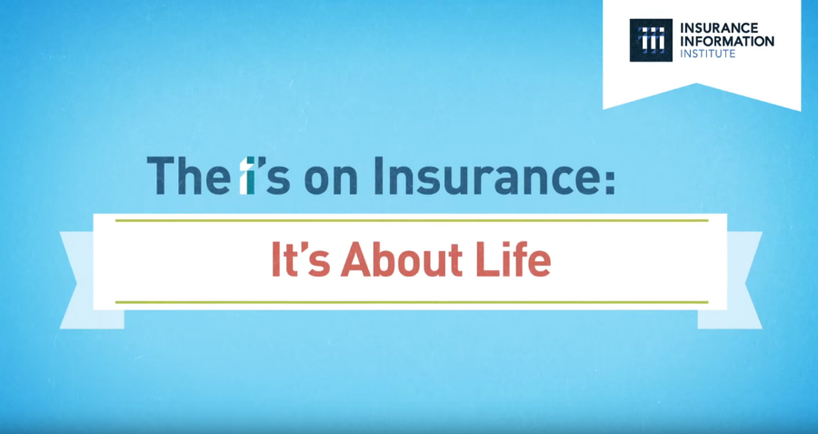
“The I’s on Insurance” Video Series
Animated video series covering Homeowners, Auto, Small Business and Life Insurance.
Goal: To engage and encourage viewers to reach out to their agent, broker, or company representative to discuss insurance coverage.

Slide 26
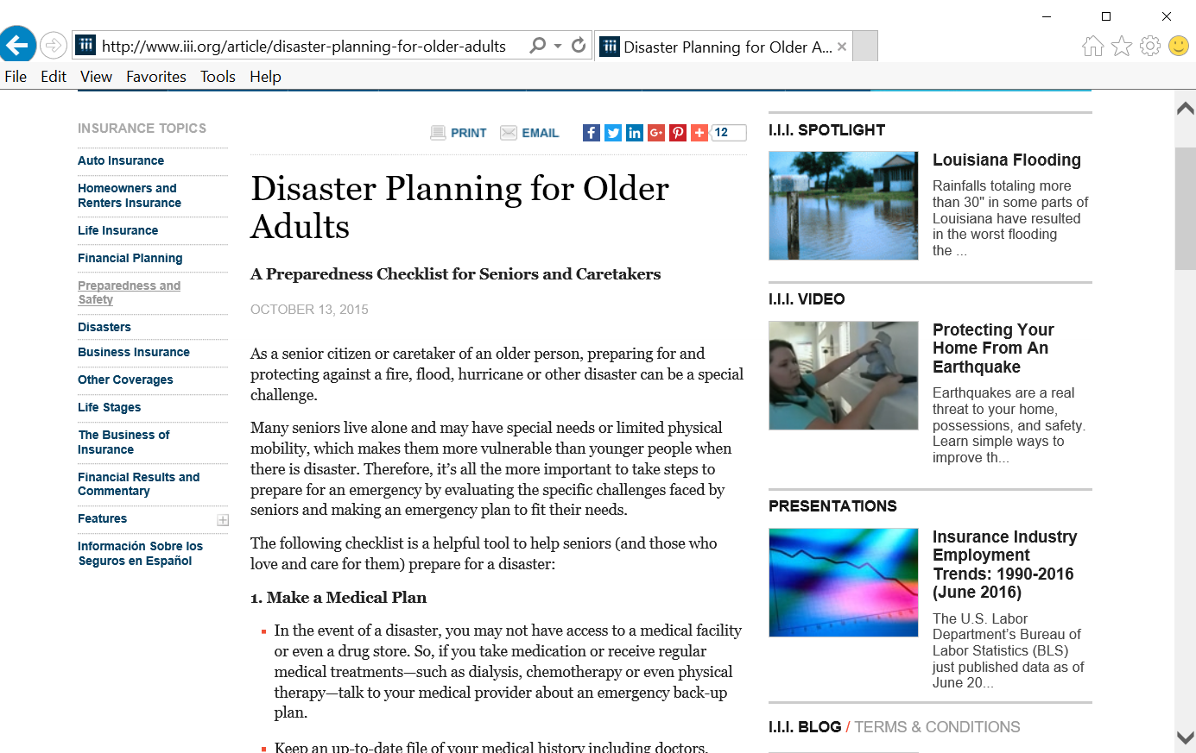
I.I.I. Targets Specific Demographics
Significant Success with Pets too!

Slide 27
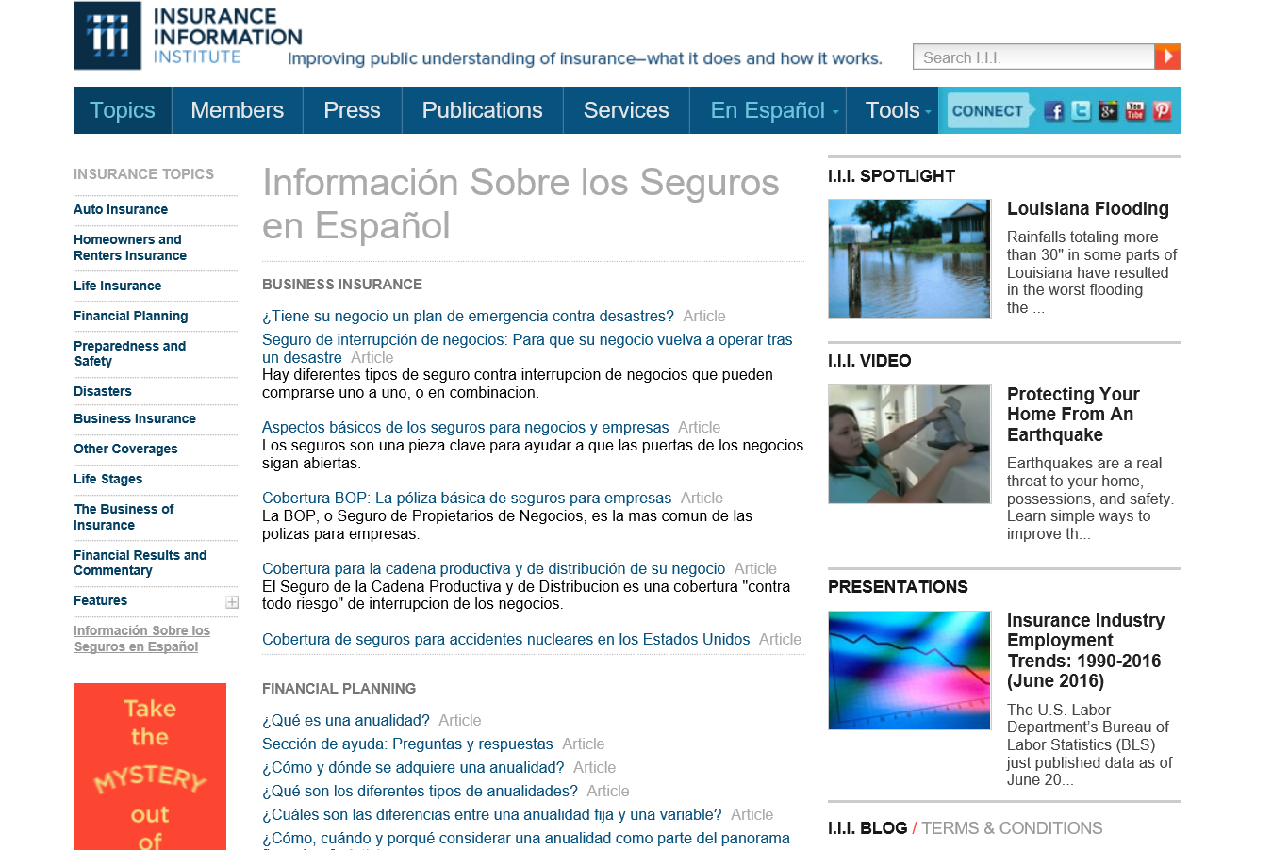
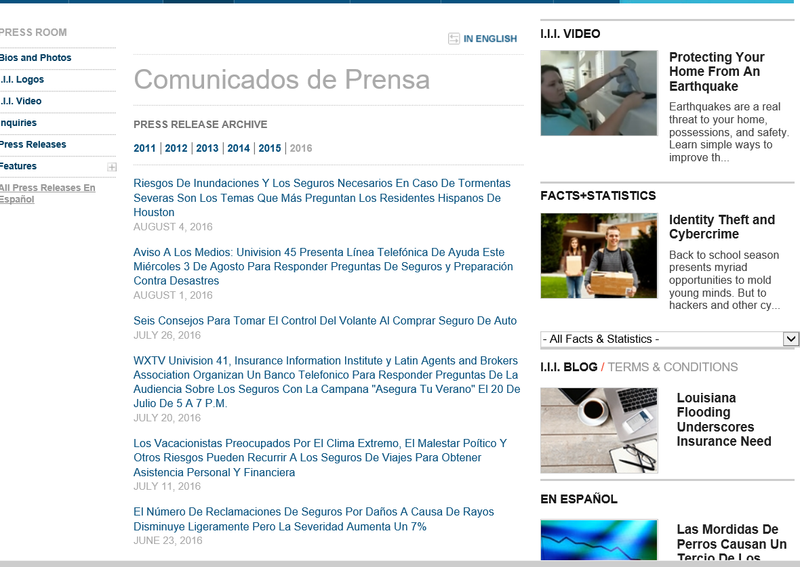
I.I.I.’s Spanish Language Resources
Consumer News Releases Translated into Spanish
Articles
News Releases

Slide 28
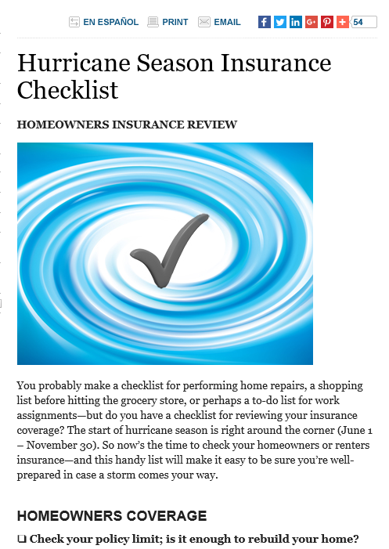
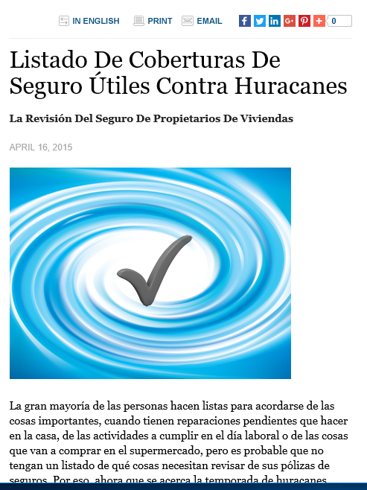
Hurricane Season Insurance Checklist
Detailed Tips
In Spanish, too!

Slide 29
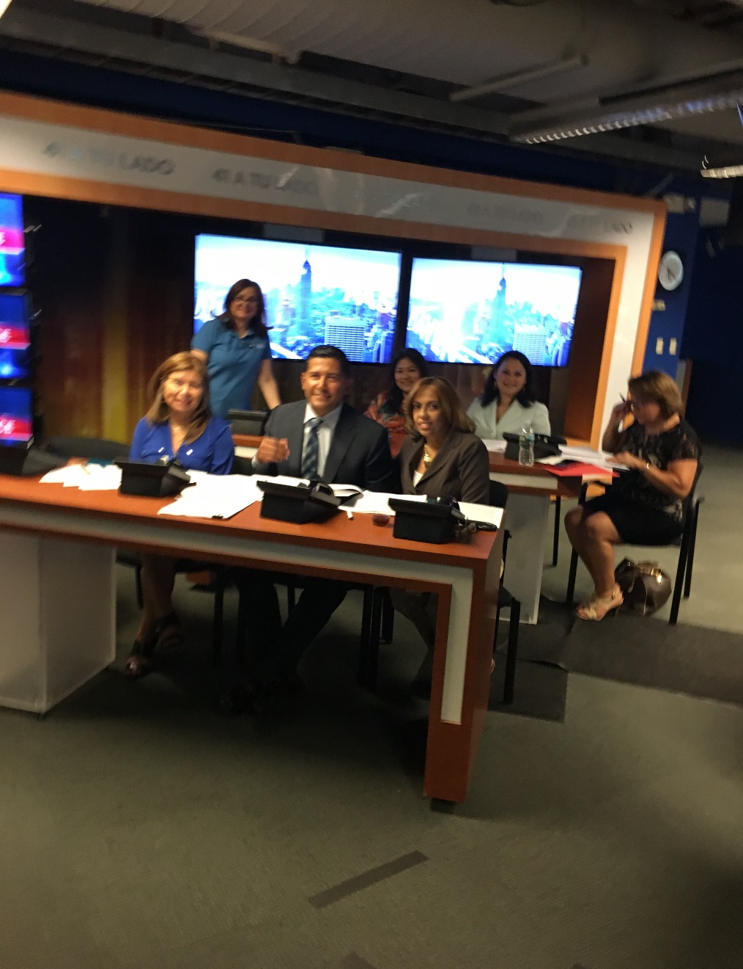
Spanish Language Helpline at Univision
For Several Years the I.I.I. has Organized Insurance Helplines in
New York, Texas and California
Learn a lot about Questions People have about Insurance
Confusion about when insurance is required and when it is not.
Need information about how to pick an agent or company
Don’t understand flood insurance
Many dangerously think they don’t need insurance if they own their home.
Looking for money saving tips.

Slide 30
Thank you for your time and your attention!
And, feel free to contact me at jeannes@iii.org or
212-346-5555. Or tweet me @JeanneSalvatore
www.iii.org
Download at www.iii.org/presentations

