Slide 1
Trends, Challenges and Opportunities in Personal Lines Insurance
2016 and Beyond
NAMIC Personal Lines Seminar
Chicago, IL
April 13, 2016
Robert P. Hartwig, Ph.D., CPCU, President & Economist
Insurance Information Institute ♦ 110 William Street ♦ New York, NY 10038
Tel: 212.346.5520 ♦ Cell: 917.453.1885 ♦ bobh@iii.org ♦ www.iii.org

Slide 2
Distribution of Direct Premiums Written by Segment/Line, 2014
Personal/Commercial lines split has been about 50/50 for many years
Pvt. Passenger Auto is by far the largest line of insurance and is currently the most important source of industry profits
Billions of additional dollars in homeowners insurance premiums are written by state-run residual market plans
Distribution Facts
2014
Commercial Lines
$282.5B/51%
Homeowners
$86.1B/15%
Pvt. Pass Auto
$190.3B/34%
Sources: A.M. Best; Insurance Information Institute research.

Slide 3
P/C Industry Net Income After Taxes
1991–2015E
$ Millions
2005 ROE*= 9.6%
2006 ROE = 12.7%
2007 ROE = 10.9%
2008 ROE = 0.1%
2009 ROE = 5.0%
2010 ROE = 6.6%
2011 ROAS¹ = 3.5%
2012 ROAS¹ = 5.9%
2013 ROAS¹ = 10.2%
2014 ROAS¹ = 8.4%
2015:Q3 ROAS = 8.8%
Net income in 2015 is on par with 2014
ROE figures are GAAP; ¹Return on avg. surplus. Excluding Mortgage & Financial Guaranty insurers yields a 8.2% ROAS in 2014, 9.8% ROAS in 2013, 6.2% ROAS in 2012, 4.7% ROAS for 2011, 7.6% for 2010 and 7.4% for 2009; 2015E is annualized figure based actual figure through Q3 of $44.0
Sources: A.M. Best, ISO; Insurance Information Institute

Slide 4
Profitability Peaks & Troughs in the P/C Insurance Industry, 1975 – 2015E
ROE
1977:19.0%
History suggests next ROE peak will be in 2016-2017
1987:17.3%
10 Years
1997:11.6%
2006:12.7%
10 Years
2015E: 8.8%
2013 9.8%
9 Years
2014 8.2%
1975: 2.4%
1984: 1.8%
1992: 4.5%
2001: -1.2%
*Profitability = P/C insurer ROEs. 2011-14 figures are estimates based on ROAS data. Note: Data for 2008-2014 exclude mortgage and financial guaranty insurers.
Source: Insurance Information Institute; NAIC, ISO, A.M. Best, Conning

Slide 5
ROE: Property/Casualty Insurance by Major Event, 1987–2015E
(Percent)
P/C Profitability Is Both by
Cyclicality and Ordinary Volatility
Modestly higher CATs
Katrina, Rita, Wilma
Low CATs
Sept. 11
Hugo
Lowest CAT Losses in
15 Years
4 Hurricanes
Sandy
Andrew
Record Tornado Losses
Northridge
Financial Crisis*
* Excludes Mortgage & Financial Guarantee in 2008 – 2014.
Sources: ISO, Fortune; Insurance Information Institute.

Slide 6
P/C Insurance Industry
Combined Ratio, 2001–2015 (Est.)*
Heavy Use of Reinsurance Lowered Net Losses
Relatively Low CAT Losses, Reserve Releases
Higher CAT Losses, Shrinking Reserve Releases, Toll of Soft Market
As Recently as 2001, Insurers Paid Out Nearly $1.16 for Every $1 in Earned Premiums
Relatively Low CAT Losses, Reserve Releases
Avg. CAT Losses, More Reserve Releases
Sandy Impacts
Best Combined Ratio Since 1949 (87.6)
Cyclical Deterioration
Lower CAT Losses
* Excludes Mortgage & Financial Guaranty insurers 2008--2014. Including M&FG, 2008=105.1, 2009=100.7, 2010=102.4, 2011=108.1; 2012:=103.2; 2013: = 96.1; 2014: = 97.0.
Sources: A.M. Best, ISO; Figure for 2010-2015E is from A.M. Best P&C Review and Preview, Feb. 16, 2016.

Slide 7
Return on Equity by Financial Services Sector vs. Fortune 500, 2004-2014*
(Percent)
Average: 2004 - 2014
Fortune 500: 13.9% Commercial Bank: 9.8% Life: 8.2% P/C: 7.1%
Banks and Insurers Have Substantially Underperformed the Fortune 500 Since the Financial Crisis
*GAAP basis.
Sources: ISO, Fortune; Insurance Information Institute.
7
Notes:
7

Slide 8
Top Insurance Issues:
What’s Hot, What’s Not
Technology Spiked, Catastrophes Crashed
Attacks on Pricing Methodologies & Underwriting Criteria Increased
8

Slide 9
I.I.I. Media Index, P/C, 2014 vs 2015*
Percent increase/decrease from previous year
Interest in Technology issues impacting the insurance industry are surging; Trend will continue in 2016.
Coverage of Catastrophe issues plunged (except for Riots, Wildfire)
*Based on a search of Lexis/Nexis (January 1-December15)

Slide 10
Auto & Home Insurance:
State of the Personal Lines Market
Results Have Been Fairly Strong and Stable in Recent Years
Dearth of Major CATs, Pricing Discipline Has Helped
10

Slide 11
Personal Lines Profitability
Profitability of Auto and Homeowners Lines Varies Tremendously Over Time and Across States
11

Slide 12
Return on Net Worth (RNW) All Lines:
2005-2014 Average
Commercial lines have tended to be more profitable than personal lines over the past decade, but Homeowners is on the rise due to the dearth of major catastrophes in recent years
Source: NAIC; Insurance Information Institute.

Slide 13
Return on Net Worth: All P-C Lines vs. Homeowners & Pvt. Pass. Auto, 1990-2014*
(Percent)
Average RNW: 1990-2014*
All P-C Lines: 7.8% PP Auto: 8.1% Homeowners: 1.9%**
Hurricane Andrew
Pvt.Pass. Auto Has Consistently Outperformed the P-C Industry as a Whole. Homeowners Volatility is Associated Primarily With Coastal Exposure Issues
*Latest available.
**If 1992, the year of Hurricane Andrew is excluded, the resulting homeowners RNW is 4.3%.
Sources: NAIC; Insurance Information Institute.
13
Notes:
13

Slide 14
Return on Net Worth: All P-C Lines vs. Homeowners & Pvt. Pass. Auto, 1990-2014*
(Percent)
Average RNW: 1990-2013*
All P-C Lines: 7.8% PP Auto: 8.1% Homeowners: 4.3%**
Excluding 1992’s Hurricane Andrew
Pvt.Pass. Auto Has Consistently Outperformed the P-C Industry as a Whole. Homeowners Volatility is Associated Primarily With Coastal Exposure Issues
*Latest available.
**Excludes 1992, the year of Hurricane Andrew. If 1992 is included the resulting homeowners RNW is 1.9%
Sources: NAIC; Insurance Information Institute.
14
Notes:
14

Slide 15
RNW Pvt. Passenger Auto, 2005-2014 Average: Highest 25 States
(Percent)
Hawaii was the most profitable state for auto insurers from 2005-2014
Sources: NAIC; Insurance Information Institute

Slide 16
RNW Pvt. Passenger Auto,
2005-2014 Average: Lowest 25 States
(Percent)
Michigan was the least profitable state for auto insurers from 2005-2014
Sources: NAIC; Insurance Information Institute

Slide 17
RNW Homeowners Insurance,
2005-2014 Average: Highest 25 States
(Percent)
Hawaii was the most profitable state for home insurers from 2005-2014 due to the absence of hurricanes during this period
Sources: NAIC; Insurance Information Institute

Slide 18
RNW Homeowners Insurance,
2005-2014 Average: Lowest 25 States
(Percent)
Hurricanes Katrina and Rita made Louisiana and Mississippi the least profitable states for home insurers from 2005-2014
Sources: NAIC; Insurance Information Institute

Slide 19
INVESTMENTS:
THE NEW REALITY
Investment Performance is a Key Driver of Profitability
Depressed Yields Will Necessarily Influence Underwriting & Pricing
19

Slide 20
S&P 500 Index Returns, 1950 – 2016*
Annual Return
Stock market is off to its worst start ever but volatility is endemic to stock markets—and may be increasing—but there is no persistent downward trend over long periods of time
Fed Raises Rate
Tech Bubble Implosion
2016*:
-0.1%
Energy Crisis
Financial Crisis
*Through Apr. 11, 2016.
Source: NYU Stern School of Business: http://pages.stern.nyu.edu/~adamodar/New_Home_Page/datafile/histretSP.html Ins. Info. Inst.

Slide 21
Property/Casualty Insurance Industry Investment Income: 2000–2015E¹
Investment earnings are still below their 2007 pre-crisis peak
($ Billions)
Due to persistently low interest rates,
investment income fell in 2012, 2013 and 2014.
¹ Investment gains consist primarily of interest and stock dividends. *2015 figure is estimated based on annualized data through Q3.
Sources: ISO; Insurance Information Institute.

Slide 22
U.S. Treasury Security Yields:
A Long Downward Trend, 1990–2016*
Yields on 10-Year U.S. Treasury Notes have been essentially below 5% for more than a decade.
Despite the Fed’s December 2015 rate hike, yield remain low though short-term yields have seen some gains
Since roughly 80% of P/C bond/cash investments are in 10-year or shorter durations, most P/C insurer portfolios will have low-yielding bonds for years to come.
*Monthly, constant maturity, nominal rates, through March 2016.
Sources: Federal Reserve Bank at http://www.federalreserve.gov/releases/h15/data.htm. National Bureau of Economic Research (recession dates); Insurance Information Institute.
22
12/01/09 - 9pm
eSlide – P6466 – The Financial Crisis and the Future of the P/C
Notes:
22

Slide 23
Distribution of Invested Assets: P/C Insurance Industry, 2013
$ Billions
Total Invested Assets = $1.5 Trillion
Source: Insurance Information Institute Fact Book 2015, A.M. Best.

Slide 24
Net Yield on Property/Casualty Insurance Invested Assets, 2007–2015*
(Percent)
Book yield in 2015 is down 77 BP from pre-crisis levels
The yield on invested assets remains low relative to pre-crisis yields. The Fed’s plan to raise interest rates in late 2015 has already pushed up some yields, albeit quite modestly.
*2015 figure is the average of the four quarters ending in 2015:Q2.
Sources: SNL Financial; Insurance Information Institute

Slide 25
Net Investment Yield on Property/ Casualty Insurance Invested Assets, 2007–2016P*
(Percent)
Estimated book yield in 2016 is down about 140 BP from pre-crisis levels
The yield on invested assets remains low relative to pre-crisis yields. The Fed’s plan to raise interest rates in late 2015 has pushed up some yields, albeit quite modestly.
Sources: A.M. Best; 2015E-2016P figures from A.M. Best P/C Review and Preview, Feb. 2016; Insurance Information Institute

Slide 26
P/C Insurer Portfolio Yields,
2002-2015:Q3
P/C carrier yields have been falling for over a decade, reflecting the long downtrend in prevailing interest rates. Even as prevailing rates rise in the next few years, portfolio yields are unlikely to rise quickly,
since low yields of recent years are “baked in” to future returns.
Sources: NAIC, via SNL Financial; Insurance Information Institute.

Slide 27
Interest Rate Forecasts: 2016 – 2021
Yield (%)
3-Month Treasury
10-Year Treasury
The end of the Fed’s QE program in 2014 and a stronger economy have yet to push longer-term yields much higher
A full normalization of interest rates is unlikely until 2019, more than a decade after the onset of the financial crisis.
Sources: Blue Chip Economic Indicators (4/16 for 2016 and 2017; for 2018-2021 3/16 issue); Insurance Info. Institute.

Slide 28
Annual Inflation Rates, (CPI-U, %),
1990–2017F
Annual Inflation Rates (%)
Inflation peaked at 5.6% in August 2008 on high energy and commodity crisis. The recession and the collapse of the commodity bubble reduced inflationary pressures in 2009/10
Inflationary expectations have slipped (due in part to falling energy costs) allowing the Fed to maintain low interest rates
Slack in the U.S. economy and falling energy prices suggests that inflationary pressures should remain subdued for an extended period of times
Sources: US Bureau of Labor Statistics; Blue Chip Economic Indicators, 4/16 (forecasts).

Slide 29
P/C Insurer Net Realized
Capital Gains/Losses, 1990-2015:Q3*
Realized capital gains rose sharply as equity markets rallied in 2013-14
($ Billions)
Insurers Posted Net Realized Capital Gains in 2010 - 2014 Following Two Years of Realized Losses During the Financial Crisis. Realized Capital Losses Were a Primary Cause of 2008/2009’s Large Drop in Profits and ROE.
*Through Q3 2015.
Sources: A.M. Best, ISO, SNL, Insurance Information Institute.
29
12/01/09 - 9pm
eSlide – P6466 – The Financial Crisis and the Future of the P/C
Notes:
29

Slide 30
Property/Casualty Insurance Industry Investment Gain: 1994–2015:Q3¹
($ Billions)
Investment gains in 2015 will be similar to those earned in 2014 but still well below the pre-crisis highs
Total Investment Gains Were Down Slightly in 2014 as Low Interest Rates Pressured Investment Income but Realized Capital Gains Remained Robust
¹ Investment gains consist primarily of interest, stock dividends and realized capital gains and losses.
* 2005 figure includes special one-time dividend of $3.2B; 2015 figure is through Q3 2015.
Sources: ISO, SNL; Insurance Information Institute.

Slide 31
Reduction in Combined Ratio Necessary to Offset 1% Decline in Investment Yield to Maintain Constant ROE, by Line*
Lower Investment Earnings Place a Greater Burden on Underwriting and Pricing Discipline
*Based on 2008 Invested Assets and Earned Premiums
**US domestic reinsurance only
Source: A.M. Best; Insurance Information Institute.
31
12/01/09 - 9pm
eSlide – P6466 – The Financial Crisis and the Future of the P/C
Notes:
31
This shows the drop in Combined Ratio for each line of business that would be needed to maintain a constant ROE, given a 1-percentage-point drop in investment yield

Slide 32
Profitability & Politics
How Is Profitability Affected by the President’s Political Party?
32

Slide 33
P/C Insurance Industry ROE by Presidential Administration, 1950-2014*
OVERALL RECORD: 1950-2015*
Democrats 7.72%
Republicans 7.85%
Party of President has marginal bearing on profitability of P/C insurance industry
*Truman administration ROE of 6.97% based on 3 years only, 1950-52;.
Source: Insurance Information Institute

Slide 34
P/C insurance Industry ROE by Presidential Party Affiliation, 1950- 2015*
BLUE = Democratic President RED = Republican President
Nixon/Ford
Carter
Reagan/Bush I
Clinton
Bush II
Obama
Truman
Eisenhower
Kennedy/ Johnson
.
*2015 data is through Q3.
Source: Insurance Information Institute

Slide 35
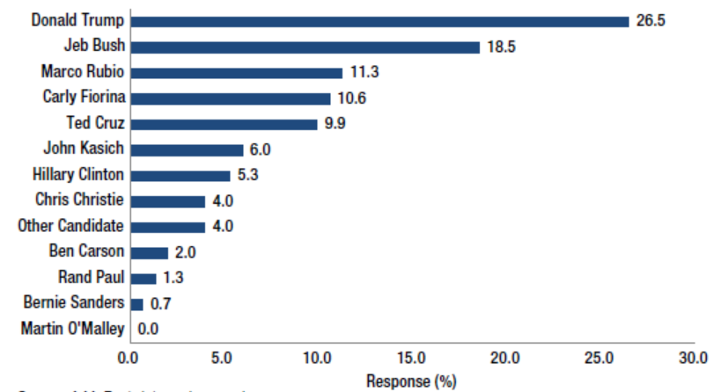
Presidential Candidate Anticipated as Having the Most Favorable Policies for the P/C Insurance Industry
*
*
Commercial Lines
$282.5B/51%
*
*
Homeowners
$86.1B/15%
Pvt. Pass Auto
$190.3B/34%
*
*Still in the race as of March 31, 2016.
Sources: A.M. Best Winter 2015/2016 Insurance Industry Survey, March 2016; Insurance Information Institute.

Slide 36
Trump vs. Clinton:
Issues that Matter to P/C Insurers
Issue | Trump | Clinton
Economy | Supply Side-Like Philosophy: Lower taxes→Faster real GDP growth; Deficits likely grow as tax cuts are combined with targeted increased spending on Homeland Security, Defense, etc. | Keynesian Philosophy: More government spending on infrastructure, education, social services; Deficits likely increase as tax increases likely difficult to pass
Interest Rates | May trend higher with larger deficits; Shift from monetary policy to fiscal focus (tax cuts, government spending) | Status quo at the Fed; Net impact on interest rates unclear
Taxes | Favors lower tax rates for corporate and personal income tax rates; Tax code overhaul? | Unlikely to reduce taxes or embark on major overhaul of tax code
International Trade | Protectionist Tendencies | Has criticized Trans-Pacific Partnership but is a realist on international matters
Tort System | Doesn’t like trial lawyers but seems to like filing lawsuits | Status Quo

Slide 37
2015 Property and Casualty Insurance
Regulatory Report Card
C
AK
AL
A
WA
ME
C
MT
B
ND
C
VT
D
MN
D
NH
B
OR
ID
C+
C
NY
MA
= A
= B
= C
= D
= F
= NG
B
SD
B+
WI
MI
CT
RI C+
B
B
NJ
WY
PA
C
B
B+
IA
B
C-
A
C+
OH
MD
NV
NE
A-
IL
IN
DE
B+
WV
B
UT
B
C
VA
CO
C+
A
B
A
B
KS
MO
KY
CA
B
A
F
D
A-
TN
NC
C
AZ
NM
OK
C
AR
C
SC
Source: James Madison Institute, February 2008.
A-
D
HI
B
B
AL
B
MS
C
GA
LA
D+
TX
D
Not Graded: District of Columbia
FL
D
D
Source: R Street Insurance Regulation Report Card, December 2015

Slide 38
Personal Lines Underwriting Performance
Auto, Home Underwriting Performance Exhibit Periods of Both Stability and Volatility
38

Slide 39
Private Passenger Auto Combined Ratio: 1993–2017F
Private Passenger Auto Underwriitng Performance Is Exhibiting Remarkable Stability
Sources: A.M. Best (1990-2016F); Conning (2017F); Insurance Information Institute.

Slide 40
Homeowners Insurance Combined Ratio: 1990–2017F
Hurricane Andrew
Record tornado activity
Hurricane Ike
Hurricane Sandy
Homeowners Performance Has Improved Markedly Since the 2011/12’s Large Cat Losses. Extreme Regional Variation Can Be Expected Due to Local Catastrophe Loss Activity
Sources: A.M. Best (1990-2016F); Insurance Information Institute (2017F).

Slide 41
Homeowners Multi-Peril Loss & ALAE Ratio, 2014:
Highest 25 States
MT had the worst loss ratio in 2014, followed by NE and SD…
Sources: SNL Financial; Insurance Information Institute.

Slide 42
Homeowners Multi-Peril Loss & ALAE Ratio, 2014:
Lowest 25 States and DC
OK and FL had the best performances in 2014! Traditionally high cat-loss states did well last year due to unusually low cat activity
Sources: SNL Financial; Insurance Information Institute.

Slide 43
Insured Catastrophe Losses
2013/14 and YTD 2015 Experienced Below Average CAT Activity After Very High CAT Losses in 2011/12
Winter Storm Losses Far Above Average in 2014 and 2015
43

Slide 44
U.S. Insured Catastrophe Losses
($ Billions, $ 2015)
2012 was the 3rd most expensive year ever for insured CAT losses
2013/14 Were Welcome Respites from 2011/12, among the Costliest Years for Insured Disaster Losses in US History. Longer-term Trend is for more—not fewer—Costly Events
$15B in insured CAT losses though 12/31/15 (est.)
*Estimate hrough 12/31/15 in 2015 dollars.
Note: 2001 figure includes $20.3B for 9/11 losses reported through 12/31/01 ($25.9B 2011 dollars). Includes only business and personal property claims, business interruption and auto claims. Non-prop/BI losses = $12.2B ($15.6B in 2011 dollars.)
Sources: Property Claims Service/ISO; Insurance Information Institute.
44
12/01/09 - 9pm
eSlide – P6466 – The Financial Crisis and the Future of the P/C
Notes:
44

Slide 45
Combined Ratio Points Associated with Catastrophe Losses: 1960 – 2015E*
Avg. CAT Loss Component of the Combined Ratio by Decade
1960s: 1.04 1970s: 0.85 1980s: 1.31 1990s: 3.39 2000s: 3.52 2010s: 5.46*
Catastrophe losses as a share of all losses reached a record high in 2011
Combined Ratio Points
The Catastrophe Loss Component of Private Insurer Losses Has Increased Sharply in Recent Decades
*2010s represent 2010-2015E.
Notes: Private carrier losses only. Excludes loss adjustment expenses and reinsurance reinstatement premiums. Figures are adjusted for losses ultimately paid by foreign insurers and reinsurers.
Source: ISO (1960-2009); A.M. Best (2010-15E) Insurance Information Institute.

Slide 46
Inflation Adjusted U.S. Catastrophe Losses by Cause of Loss, 1995–2014¹
Wind/Hail/Flood (3), $21.4
Fires (4), $6.0
Winter storm losses were much above average in 2014/15 are will push this share up
Other (5), $0.2
Insured cat losses from 1995-2014 totaled $395.6B, an average of $19.8B per year or $1.65B per month
Geological Events, $0.5
Terrorism, $24.5
Winter Storms, $26.9
Hurricanes & Tropical Storms, $161.2
Tornado share of CAT losses is rising
Wind losses are by far cause the most catastrophe losses, even if hurricanes/TS are excluded.
Events Involving Tornadoes (2), $154.9
Catastrophes are defined as events causing direct insured losses to property of $25 million or more in 2014 dollars.
Excludes snow.
Does not include NFIP flood losses
Includes wildland fires
Includes civil disorders, water damage, utility disruptions and non-property losses such as those covered by workers compensation.
Source: ISO’s Property Claim Services Unit.

Slide 47
Top 16 Most Costly Disasters in U.S. History—Katrina Still Ranks #1
(Insured Losses, 2014 Dollars, $ Billions)
Storm Sandy in 2012 was the last mega-CAT to hit the US
Includes Tuscaloosa, AL, tornado
Includes Joplin, MO, tornado
12 of the 16 Most Expensive Events in US History Have Occurred Since 2004
Sources: PCS; Insurance Information Institute inflation adjustments to 2014 dollars using the CPI.

Slide 48
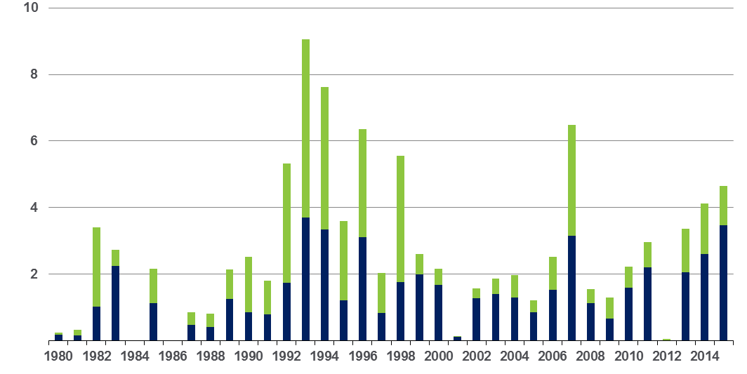
Winter Storm Losses in the US
1980 – 2015 (Overall and Insured Losses)*
$ Billions
Winter storm losses have been increasing rapidly in recent years
Overall losses
(in 2015 values)*
Insured losses
(in 2015 values)*
*Winter storms include also winter damages, blizzards and cold waves
Source: Property Claim Services, MR NatCatSERVICE.
*Losses adjusted to inflation based on CPI.
48

Slide 49
Loss Events in the US, 1980 – 2014
Overall and Insured Losses
Overall losses totaled $25bn; Insured losses totaled $15.3bn
Uninsured loss component is large and could get larger. Vast majority of economic loss from SC floods is uninsured
$ Billions
Overall losses
(in 2013 values)*
Insured losses
(in 2013 values)*
*Losses adjusted to inflation based on CPI.
Source: Property Claim Services, MR NatCatSERVICE.
49

Slide 50
Convective Loss Events in the US
Overall and insured losses, 1980 – 2014
Overall losses
(in 2014 values)*
$ Billions
The period from 2008-2014 has been the most expensive on record for insured losses from “Convective Events” (severe thunderstorms, tornado, hail, lightning and flash flood)
Insured losses
(in 2014 values)*
*Losses adjusted to inflation based on CPI
Analysis contains:
severe storm, tornado, hail, flash flood and lightning
50
Source: Geo Risks Research, NatCatSERVICE

Slide 51
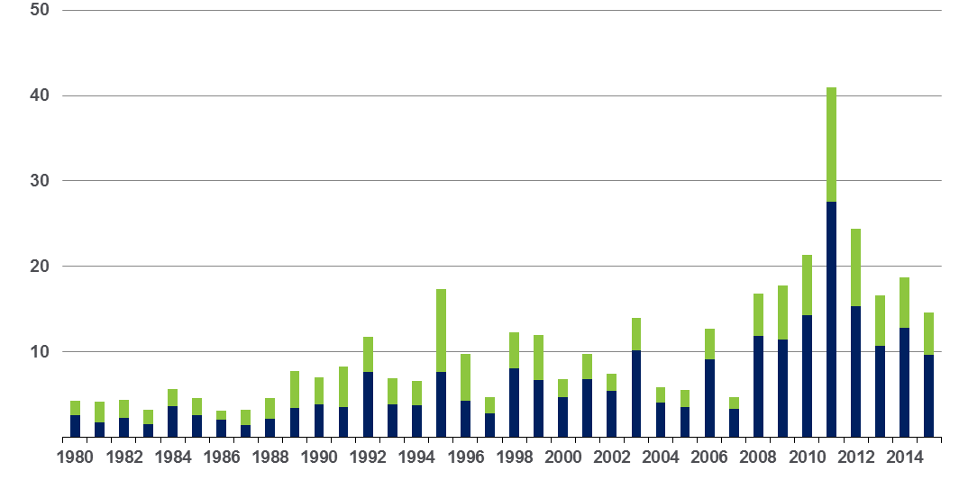
Convective Loss Events in the US
Overall and insured losses, 1980 – 2015
Overall losses
(in 2015 values)*
$ Billions
Insured losses
(in 2015 values)*
The period from 2008-2015 has been the most expensive on record for insured losses from “Convective Events” (severe thunderstorms, tornado, hail, lightning and flash flood)
*Losses adjusted to inflation based on CPI
Analysis contains:
severe storm, tornado, hail, flash flood and lightning
51
Source: Geo Risks Research, NatCatSERVICE

Slide 52
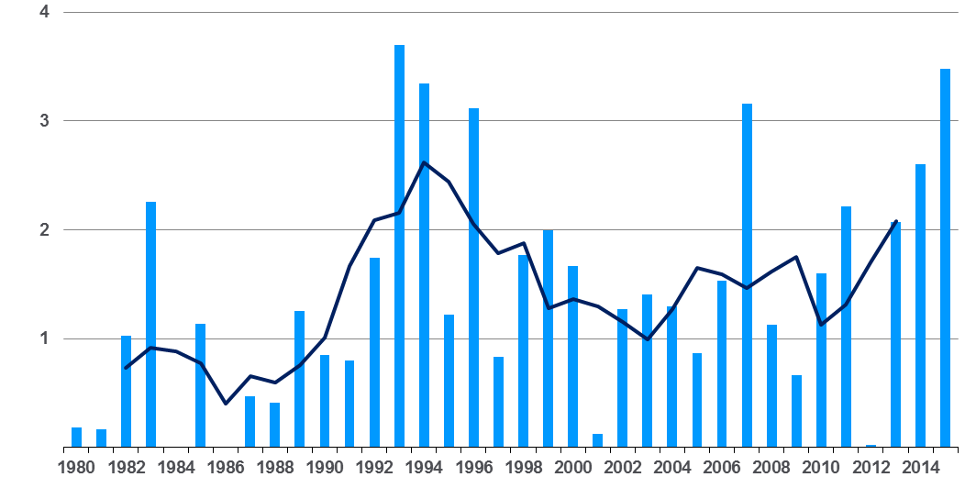
NatCatSERVICE
Loss events in the U.S. 1980 – 2015
Insured losses of winter storms*
US$bn
Insured losses
(in 2015 values)**
5 year Mean
*Winter storms include also winter damages, blizzards and cold waves
**Losses adjusted to inflation based on country CPI
Source: Munich Re NatCatSERVICE, Property Claim Services, PCS
© 2016 Münchener Rückversicherungs-Gesellschaft, Geo Risks Research – As at January 2016

Slide 53
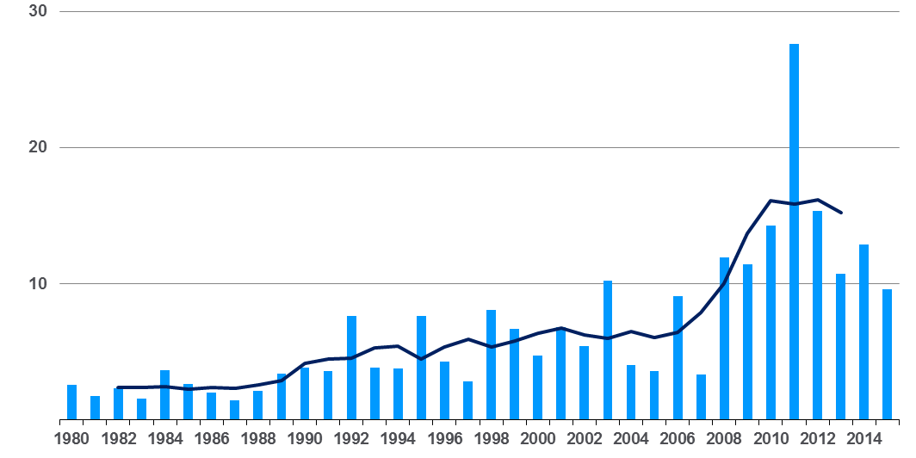
NatCatSERVICE
Loss events in the U.S. 1980 – 2015
Insured losses of convective events*
US$bn
Insured losses
(in 2015 values)**
5 year Mean
*Convective events include severe storm, hail, tornado, flash flood, lightning
***
**Losses adjusted to inflation based on country CPI
***2015 figures without the Christmas events
Source: Munich Re NatCatSERVICE, Property Claim Services, PCS
© 2016 Münchener Rückversicherungs-Gesellschaft, Geo Risks Research – As at January 2016

Slide 54
Number of National Flood Insurance Program Policies in Force at Year-End, 1980-2015*
(millions)
The number of NFIP policies in force has plunged by 549,000 or 9.6% since 2009, even as coastal development surges and sea levels rise
Source: National Flood Insurance Program.
* As of July, 2015

Slide 55
Catastrophe Bond Issuance and Outstanding: 1997-2015
Risk Capital Amount ($ Millions)
Cat Bond Issuance Declined Slightly in 2015 from 2014’s Record Pace. Lower Yields on Bonds Explain Some of the Contraction.
Source: Guy Carpenter, Artemis accessed at http://www.artemis.bm/deal_directory/cat_bonds_ils_issued_outstanding.html .

Slide 56
US Property CAT Rate on Line Index & Global Reinsurance ROE
US Property CAT ROL
Global Reinsurance ROE
Record traditional capacity, alternative capital and low CAT activity have pressured reinsurance prices; ROEs are own only very modestly
Source: Barclays PLC from Guy Carpenter; Insurance Information Institute.

Slide 57
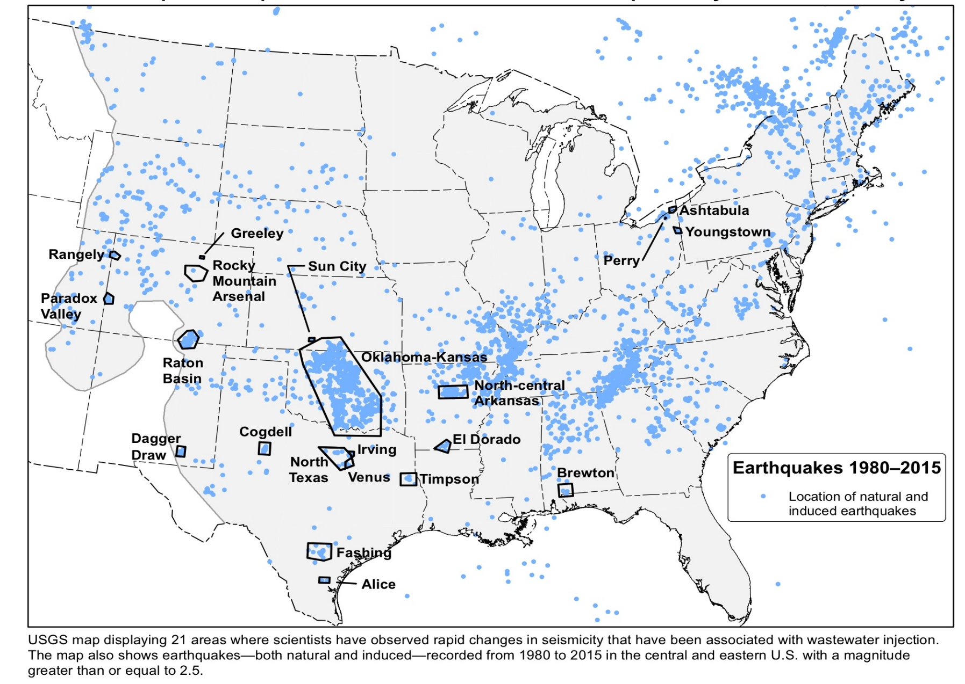
Earthquakes Since 1980 and Recent Area Impacted by Induced Seismicity
Commercial Lines
$282.5B/51%
Homeowners
$86.1B/15%
Pvt. Pass Auto
$190.3B/34%
Sources: http://www.usgs.gov/blogs/features/usgs_top_story/induced-earthquakes-raise-chances-of-damaging-shaking-in-2016/?from=title; Insurance Information Institute.

Slide 58
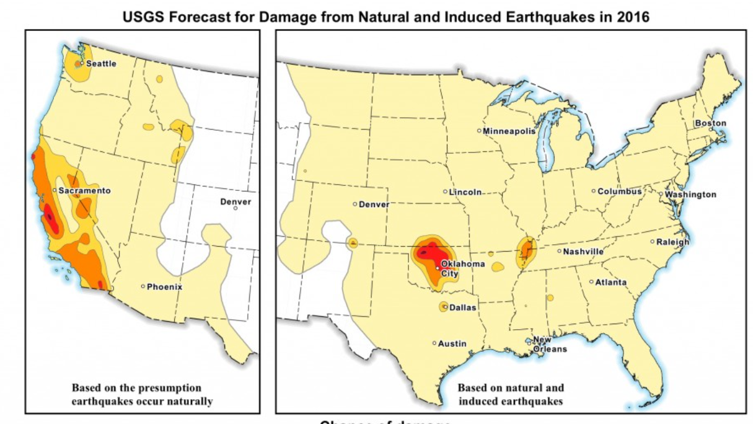
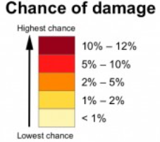
2016 Natural and Induced Earthquake Damage Forecast
Commercial Lines
$282.5B/51%
Homeowners
$86.1B/15%
Pvt. Pass Auto
$190.3B/34%
Sources: USGS at http://www.usgs.gov/blogs/features/usgs_top_story/induced-earthquakes-raise-chances-of-damaging-shaking-in-2016/?from=title; Insurance Information Institute.

Slide 59
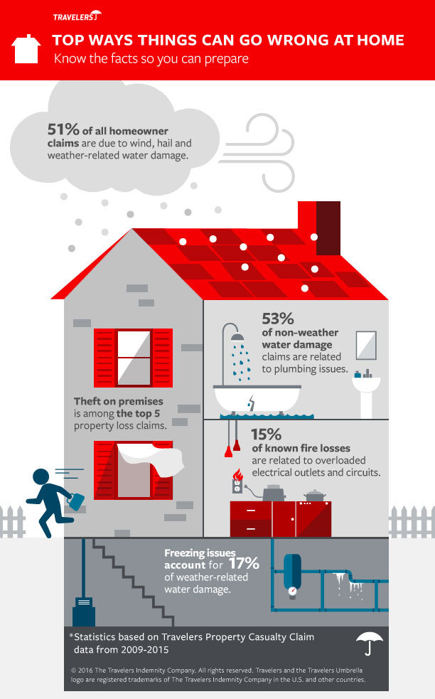
Effective Use of Data, Infographics to Get Out a Key Message
Top 5 Most Common Causes of Homeowners Insurance Claims
Exterior wind damage – 25 percent of all losses.
Non-weather-related water damage (e.g., plumbing or appliance issues) – 19 percent.
Hail – 15 percent.
Weather-related water damage (e.g., rain, melting ice, snow) – 11 percent.
Theft – 6 percent.
Commercial Lines
$282.5B/51%
Homeowners
$86.1B/15%
Pvt. Pass Auto
$190.3B/34%
Sources: Travelers; Infographic accessed at: http://mms.businesswire.com/media/20160406005833/en/517883/5/Home_Dangers_Infographic_Final.jpg?download=1

Slide 60
Claim Trends in Private Passenger Auto Insurance
Rising Frequencies and Severities in Many Coverages
Will that Pattern Be Sustained?
60

Slide 61
Auto Severity & Frequency by Coverage: Trending Up in 2015
Annual Change, 2015 Over 2014
Frequency and Severity Were Up Across Most Coverage Types in 2015; A Trend Likely to Continue in 2016
Source: ISO/PCI Fast Track data; Insurance Information Institute

Slide 62
Collision Coverage: Severity & Frequency Trends Are Both Higher in 2015
Annual Change, 2005 through 2015
The Recession, High Fuel Prices Helped Temper Frequency and Severity, But this Trend Has Clearly Reversed, Consistent with Experience from Past Recoveries
Source: ISO/PCI Fast Track data; Insurance Information Institute

Slide 63
Collision Loss Ratio Trending Upward:
Private Passenger Auto, 2010 – 2015
Loss Ratio
Collision Loss Ratios are Trending Steadily Upward
Source: ISO/PCI Fast Track data; Insurance Information Institute

Slide 64
Bodily Injury: Severity Trend Is Up, Frequency Decline Has Ended—Rising?
Annual Change, 2005 through 2015
Cost Pressures Will Increase if BI Frequency and Severity Trends Persist
Source: ISO/PCI Fast Track data; Insurance Information Institute

Slide 65
Property Damage Liability: Severity and Frequency Are Up
Annual Change, 2005 through 2015
Severity/Frequency Trends Have Been Volatile, But Rising Severity since 2011 Is a Concern
Source: ISO/PCI Fast Track data; Insurance Information Institute

Slide 66
No-Fault (PIP) Liability: Severity is Up, Frequency Relatively Flat*
Annual Change, 2005 through 2015
No-Fault Systems Are Less Problematic in Some States but Still of Concern in Some, Such as MI
*No-fault states included are: FL, HI, KS, KY, MA, MI, MN, NY, ND and UT.
Source: ISO/PCI Fast Track data; Insurance Information Institute

Slide 67
Comprehensive Coverage: Frequency and Severity Trends Are Volatile
Severe weather is a principal cause of the spikes in both frequency and severity
Annual Change, 2005 through 2015
Weather Creates Volatility for Comprehensive Coverage
Source: ISO/PCI Fast Track data; Insurance Information Institute

Slide 68
Death Rates per 100,000,000 Vehicle miles, 1990-2015*
The recession and high gas prices reduced miles driven, accelerating the drop in death rates
Motor vehicle fatality rates appear to be ticking up in 2015
Vehicle death rates fell by nearly half between 1990 and 2010
*Projected rate for 2015 based on date through June 2015.
Source: National Safety Council; Insurance Information Institute.
68
Notes:
68

Slide 69
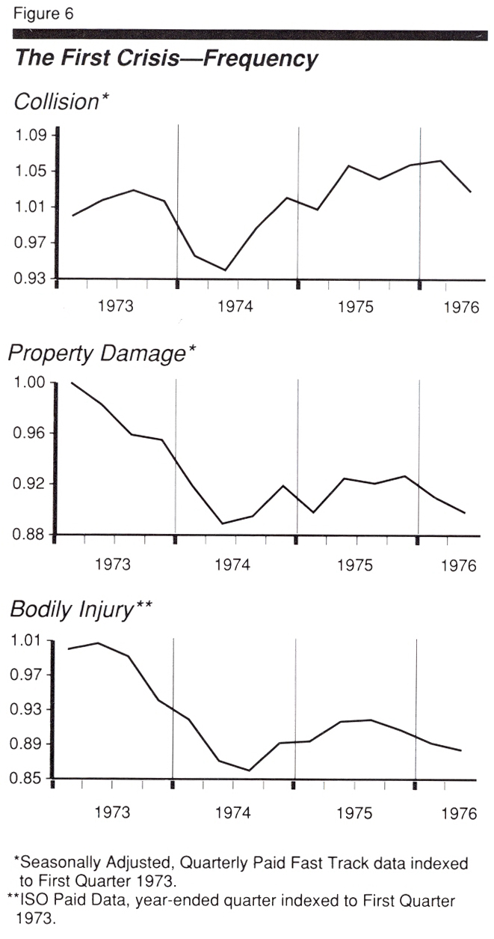
Auto Insurance: Claim Frequency Impacts of Energy Crisis of 1973/4
Oct. 17, 1973: Arab oil embargo begins
March 17, 1974: Arab oil states announce end to embargo
Frequency Impacts
Collision: -7.7%
PD: -9.5%
BI: -13.3%
Frequency began to rebound almost immediately after the embargo ended
Driving Stats
Gas prices rose 35-40%
Miles driven fell 6.7% in 1974
Source: ISO, US DOT.

Slide 70
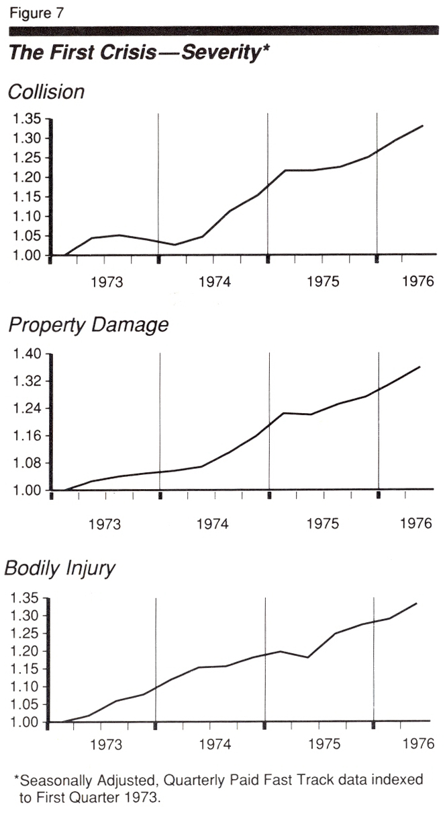
Auto Insurance: Claim Severity Impacts of Energy Crisis of 1973/4
Oct. 17, 1973: Arab oil embargo begins
March 17, 1974: Arab oil states announce end to embargo
Severity Impacts
Collision: -7.5%
PD: +15.9%
BI: N/A*
Collision severity began to rebound almost immediately after the embargo ended; PD accelerated as inflation rose; No discernable trend change in BI.
Driving Stats
Gas prices rose 35-40%
Miles driven fell 6.7% in 1974
Source: ISO.

Slide 71
Auto Insurance Claim Cost Drivers Continue to Grow Faster than CPI
Price Level Change: December 2015 vs. December 2014
Excludes Food and Energy
Healthcare costs are a major cost driver and are expected to accelerate in the years ahead
Sources: Bureau of Labor Statistics; Insurance Information Institute.
71

Slide 72
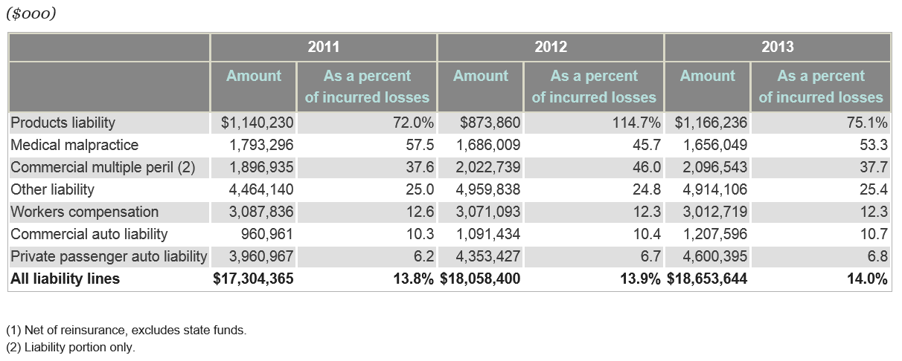
Defense Costs and Cost Containment Expenses as a Percent of Incurred Losses, 2011 – 2013*
Defense and Cost Containment expenses in Pvt. Passenger Auto Liability have edged up slightly in recent years, from 6.2% of incurred losses to 6.8%
*Latest available.
Source: SNL Financial; Insurance Information Institute.

Slide 73
Median and Average Personal Injury Jury Award by Type of Liability, 2013
Porducts Liability and Medical Malpractice cases tend to have among the highest jury awards
Source: Current Award Trends in Personal Injury, 54th Edition; Insurance Information Institute.
73
Notes:
73

Slide 74
Personal Lines Growth Analysis
Growth Trajectories Differ Substantially by State and Over Time
74

Slide 75
Auto & Home vs. All Lines, Net Written
Premium Growth, 2000–2018F
While homeowners insurance has grown faster than auto for many years, auto is generally more profitable, though not recently
Average 2000-2014
Auto = 3.0%
Home = 6.4%
All Lines = 3.8%
Sources: A.M. Best (2000-2014); Conning/Insurance Information Institute (2015F-2018F); Insurance Information Institute.

Slide 76
Private Passenger Auto Insurance
Net Written Premium, 2000–2017F
PP Auto premiums written continue to recover from a period of flat growth attributable to the weak economy impacting new vehicle sales, car choice, and increased price sensitivity among consumers
PPA will generate $6B - $8B in new premiums annually through 2017
$ Billion
PPA NWP volume in 2014 was up $26.3B or 16.7% since the 2009 trough; By 2017 the gain is expected to be $46.8B or 29.7%
Sources: A.M. Best (1990-2014); Conning (2015-17F); Insurance Information Institute.

Slide 77
Commercial Auto Insurance
Net Written Premium, 2000–2015F
In contrast to positive PP Auto NPW growth, Commercial Auto premiums fell 21.3% between 2005 and 2011 due to soft market conditions in commercial lines and negative exposure trends, though growth resumed in 2012
$ Billion
Sources: A.M. Best (2000-2014); Conning (2015F); Insurance Information Institute.

Slide 78
Direct Premiums Written: PP Auto
Percent Change by State, 2007-2014
Top 25 States
Growth Benchmarks: PPA
US: 16.4%
Sources: SNL Financial LC.; Insurance Information Institute.

Slide 79
Direct Premiums Written: PP Auto
Percent Change by State, 2007-2014
Bottom 25 States
Pvt. Passenger Auto premium growth was negative in Hawaii between 2007 and 2014
Sources: SNL Financial LC.; Insurance Information Institute.

Slide 80
Homeowners Insurance
Net Written Premium, 2000–2016F
$ Billions
Homeowners insurance NWP continues to rise (up 150% 2000-2015F) despite very little unit growth during the real estate crash. Reasons include rate increases, especially in coastal zones, ITV endorsements (e.g., “inflation guards”), compulsory for mortgaged properties and resumption of home building activity
The Homeowners line will generate about $4B in new premiums annually through 2016
Sources: A.M. Best; Insurance Information Institute.

Slide 81
Personal Lines Growth Drivers
Rate and Exposure are Both Presently Important Growth Drivers
81

Slide 82
Monthly Change in Auto Insurance Prices, 1991–2015*
Cyclical peaks in PP Auto tend to occur roughly every 10 years (early 1990s, early 2000s and likely the early 2010s)
Pricing peak occurred in late 2010 at 5.3%, falling to 2.8% by Mar. 2012
“Hard” markets tend to occur during recessionary periods
Dec. 2015 reading of 5.5% is up from 4.7%
a year earlier
*Percentage change from same month in prior year; through Dec. 2015; seasonally adjusted
Note: Recessions indicated by gray shaded columns.
Sources: US Bureau of Labor Statistics; National Bureau of Economic Research (recession dates); Insurance Information Institutes.
82
12/01/09 - 9pm
eSlide – P6466 – The Financial Crisis and the Future of the P/C
Notes:
82

Slide 83
Private Passenger Auto: Premium Growth vs. Loss Cost Spread
The Pure Premium Spread is the difference between price increases and loss cost inflation adjusted for frequency trends
Pure Premium Spread in 2015 Q1 was 0.0% meaning that rate gains were exactly offset by loss cost inflation
Sources: Barclays Capital, August 2015.

Slide 84
Average Expenditures* on Auto Insurance, 1994-2015E
Annual Pct Changes
2001: 5.2%
2002: 8.6%
2003: 5.6%
2004: 1.5%
2005: -1.3%
2006: -1.8%
2007: -2.1%
2008: -1.0%
2009: -0.5%
2010: 0.6%
2011: 0.6%
2012: 2.3%
2013: 3.3%
The average expenditure on auto insurance now finally exceeds the pre-crisis high of $842 recorded in 2004, taking a full decade to recover, but on an inflation-adjusted basis premiums are still below 2004 levels
Across the U.S., auto insurance expenditures fell by 0.8% in 2008
and 0.5% in 2009 but rose 0.5% in 2010, 0.8% in 2011, 2.3% in 2012 and 3.3% in 2013; I.I.I. estimate is for +3.4% in 2014 and 2015.
* The NAIC data are per-vehicle (actually, per insured car-year)
Sources: NAIC for 1994-2013; Insurance Information Institute estimates for 2014-2015 based on CPI and other data.

Slide 85
M&A UPDATE:
A PATH TO GROWTH?
Are Capital Accumulation, Drive for Growth and Scale Stimulating M&A Activity?
Not Currently Focused on Personal Lines
85

Slide 86
U.S. INSURANCE MERGERS AND ACQUISITIONS,
P/C SECTOR, 1994-2015E (1)
M&A activity in 2015 will likely reach its highest level since 1998
($ Millions)
M&A activity in the P/C sector was up sharply in 2015
Newsflash: WR Berkley to enter high net worth personal lines market!
(1) Includes transactions where a U.S. company was the acquirer and/or the target.
Source: Conning proprietary database; 2015 I.I.I. estimate.

Slide 87
Personal Lines: Economic and Demographic Considerations
Auto, Home Are Sensitive to Underlying Economic Conditions
87

Slide 88
New Private Housing Starts, 1990-2021F
Job growth, low inventories of existing homes, still-low mortgage rates and demographics should continue to stimulate new home construction for several more years
(Millions of Units)
New home starts plunged 72% from 2005-2009; A net annual decline of 1.49 million units, lowest since records began in 1959
Insurers Are Continue to See Meaningful Exposure Growth in the Wake of the “Great Recession” Associated with Home Construction: Construction Risk Exposure, Surety, Commercial Auto; Potent Driver of Workers Comp Exposure
Source: U.S. Department of Commerce; Blue Chip Economic Indicators (4/16 for 2016-17; 3/16 for 2018-21F; Insurance Information Institute.

Slide 89
Rental-Occupied Housing Units as % of Total Occupied Units, Quarterly, 1990:Q1-2015*
Trend down began in 1994:Q3 from 36.2% in Q2
Increasing percent of renters
Increasing percent of owners
Latest was 36.3% in 2015
Trough in 2004:Q2 and Q4 at 30.8%
Since the Great Recession ended in June 2009, renters occupied 5.7 million more units (+15.6%).
Sources: US Census Bureau, Residential Vacancies & Home Ownership in the First Quarter of 2015 (released April 28, 2015) and earlier issues; Insurance Information Institute. Next Census Bureau report to be released on July 28, 2015. *As of Q1.
89
12/01/09 - 9pm
eSlide – P6466 – The Financial Crisis and the Future of the P/C
Notes:
89

Slide 90
I.I.I. Poll: Renter’s Insurance
Q. Do you have renters insurance? ¹
Americans are increasingly choosing to rent, but are slow to understand the need to insure, exacerbating the underinsurance gap
The Percentage of Renters Who Have Renters Insurance Has Been Rising Since 2011.
¹Asked of those who rent their home.
Source: Insurance Information Institute Annual Pulse Survey.

Slide 91
Auto/Light Truck Sales, 1999-2021F
Job growth and improved credit market conditions will boost auto sales in 2015 and beyond
Sales have returned to pre-crisis levels
(Millions of Units)
New auto/light truck sales fell to the lowest level since the late 1960s. Forecast for 2014-15 is still below 1999-2007 average of 17 million units, but a robust recovery is well underway.
Truck, SUV purchases by contractors are especially strong
Yearly car/light truck sales will likely continue at current levels, in part replacing cars that were held onto in 2008-12. PP Auto premium might grow by 3.5% - 5%.
Source: U.S. Department of Commerce; Blue Chip Economic Indicators (4/16 for 2016-17; 3/16 for 2018-21F; Insurance Information Institute.

Slide 92
Number of Registered Passenger Vehicles in US, 1999 – 2015E
Vehicle registrations are growing once again and now finally exceed pre-crisis peak
Vehicle registrations are expected to increase at an annual rate of about 1.5% per year in 2015 and 2016
Sources: Bureau of Transportation Statistics; Barclays Capital estimates, August 2015.

Slide 93
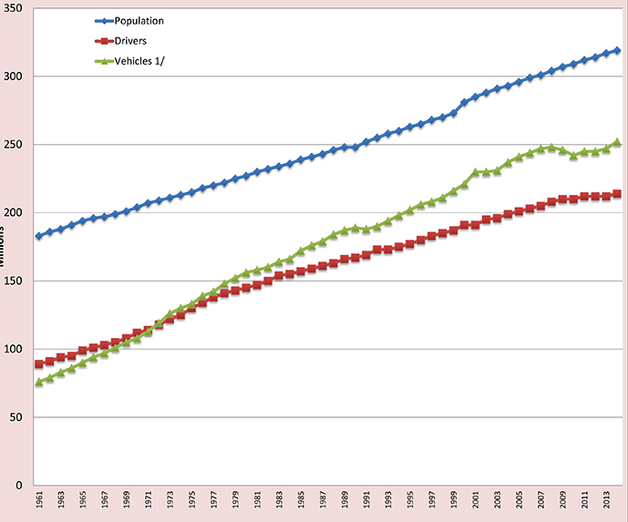
Licensed Drivers, Vehicle Registrations and Resident Population: All UP!
The recession temporarily interrupted growth, but the number of drivers and registered is rising!
Source: Federal Highway Administration: http://www.fhwa.dot.gov/policyinformation/statistics/2014/dv1c.cfm accessed 2/1/16; Insurance Information Institute.

Slide 94
America is Driving More Again (Finally!): Total Miles Driven*, 1990–2015*
Billions
Some of the 1990-2007 growth in miles driven (+43.9%) is due to population growth (+20.7%)…
…but the population grew by 6.6% from 2007-2015 and miles driven didn’t grow at all until 2015 itself.
New records in 2015 = 3.14 billion miles; Up 6.7% from Feb. 2012 trough
From November 2007 until January 2015, miles driven was below the prior peak for 87 straight months—
over 7 years! Previous record was in the early 1980s (39 months).
*Moving 12-month total. The 2015 data are through November 2015, the latest available.
Note: Recessions indicated by gray shaded columns.
Sources: Federal Highway Administration (http://www.fhwa.dot.gov/policyinformation/travel_monitoring/tvt.cfm );
National Bureau of Economic Research (recession dates); Insurance Information Institute.
94
12/01/09 - 9pm
eSlide – P6466 – The Financial Crisis and the Future of the P/C
Notes:
94

Slide 95
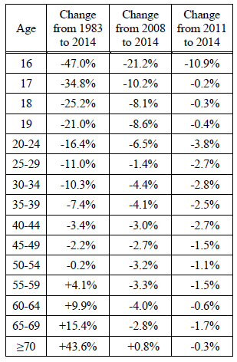
Change in Proportion of Persons with Driver Licenses in the US, by Age, 1983-2014
Smaller proportions of younger drivers have licenses but not because they’re all taking Uber.
The AARP crowd can’t be pried away from the cars
Source: University of Michigan Transportation Research Institute, “Recent Decreases in the Proportion of Persons with a Driver’s License Across All Age Groups,” M. Sivak and B. Schoettle., Jan. 2016; Insurance Information Institute.

Slide 96
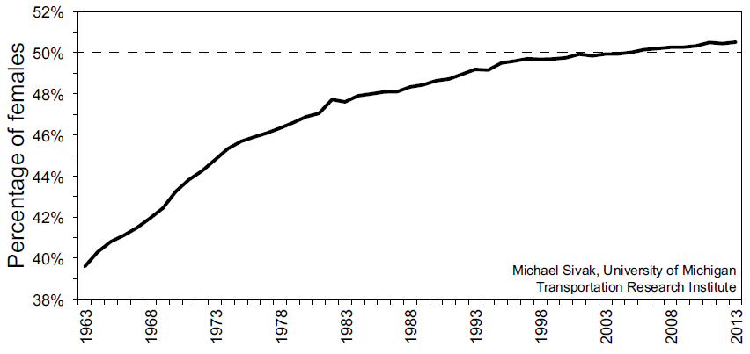
Girl Power: Females with a Driver’s License as a % of All Licensed Drivers
Boys with No Toys
Women now account for the majority of licensed drivers
Frequency/Severity Impacts: Woman are more likely to drive less, buy smaller cars, buy safer cars and less likely to be involved in accidents
Source: University of Michigan Transportation Research Institute, “Female Drivers in the United States: From Minority to Majority?” by M. Sivak,, UMTRI-2016-16, May 2015; Insurance Information Institute.

Slide 97
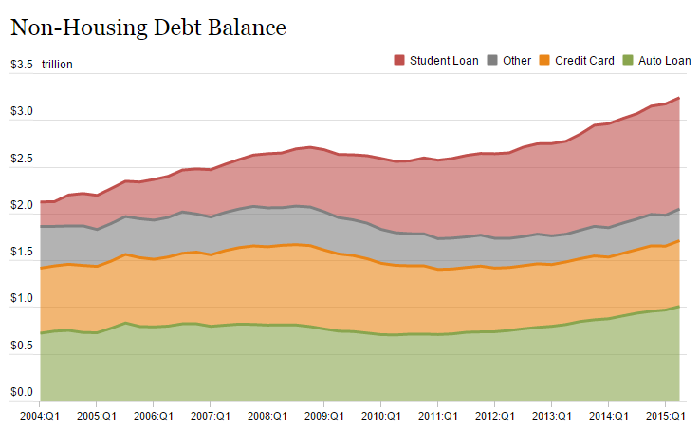
Auto Loans and Other Non-Housing Debt, 2004 – 2015*
Auto loan debt outstanding reached $1T for the first time ever in Q1 2015
Banks are becoming increasingly aggressive in marketing auto loans
*As of Q1 2015.
Source: Federal Reserve Bank of NY Consumer Credit Panel/Equifax; l. I.I.

Slide 98
INDUSTRY DISRUPTORS
Technology, Society and the Economy Are All Changing at a Rapid Pace
Thoughts on the Future
98

Slide 99

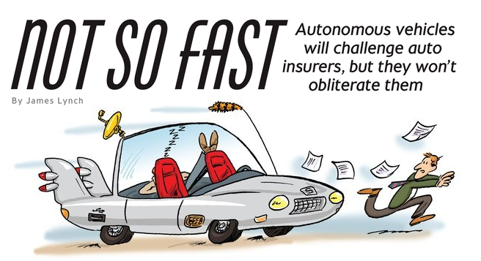
Media is Obsessed with Driverless Vehicles: Often Predicting the Demise of Auto Insurance
By 2035, it is estimated that 25% of new vehicle sales could be fully autonomous models
Questions
Are auto insurers monitoring these trends?
How are they reacting?
Will Google take over the industry?
Will the number of auto insurers shrink?
How will liability shift?
Source: Boston Consulting Group.

Slide 100




On-Demand/Sharing/Peer-to-Peer Economy Impacts Many Lines of Insurance
The “On-Demand” Economy is or will impact many segments of the economy important to P/C insurers
  Auto (personal and commercial)
  Homeowners/Renters
  Many Liability Coverages
  Professional Liability
  Workers Comp
Many unanswered insurance questions
Insurance solutions are increasingly available to fill the many insurance gaps that arise
100
12/01/09 - 9pm
eSlide – P6466 – The Financial Crisis and the Future of the P/C
Notes:
100

Slide 101
TNC Ridesharing Arrangements: Insurance Applicability
The concern was that TNCs were seeking to offload risk on to personal auto insurers. An increasing number of personal auto insurers have developed solutions to ensure that coverage gaps are minimized
*From publically available sources as of June 2, 2015.
Source: ISO/Verisk.
101

Slide 102
Ridesharing Regulation/Legislation and Status of ISO Filings as of 9/30/15
Status Ride Sharing Legislation/Regulation
Status of ISO Filings
102
Source: ISO.

Slide 103
Homesharing Arrangements: Potential Host Exposure Concerns (Receives Rental Income)
Source: ISO/Verisk.
103

Slide 104
Homesharing Arrangements: Potential Traveler Exposure Concerns
.
Source: ISO/Verisk.
104

Slide 105
Homesharing: ISO’s Proposed Changes*
.
*As of Oct. 6, 2015.
Source: ISO/Verisk.
105

Slide 106
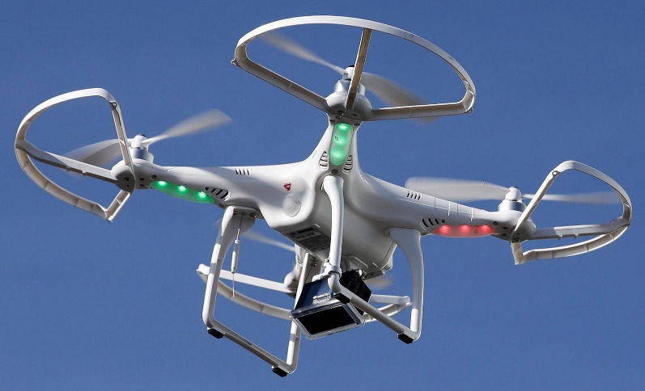

Send in the Drones: Potential Rapid
Adoption in Industry; Media Loves It
Drones or Unmanned Aerial Vehicle (UAV) technology is seeing rapid adoption rate in many industries, including insurance
~700,000 drones in US by year-end
FAA granting Section 333 exemptions for commercial use and testing of UAS
FAA will require most drones to be registered by year-end 2015.
At least 5 insurers have received permission to test
Wide variety of applications: claims, pre-event property inspections…
Insurers partnering with construction industry to guide R&D and regulation of UAV use via Property Drone Consortium: www.propertydrone.org

Slide 107






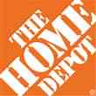

Data Breaches 2005-2015, by Number of Breaches and Records Exposed
# Data Breaches/Millions of Records Exposed
Millions
The total number of data breaches (+27.5%) hit a record high of 783 in 2014, exposing 85.6 million records. Through June 30, this year has seen 117.6 million records exposed in 400 breaches.*
*Figures as of June 30, 2015, from the Identity Theft Resource Center,
http://www.idtheftcenter.org/images/breach/ITRCBreachReport2015.pdf

Slide 108
The Three Basic Elements of Cyber Coverage: Prevention, Transfer, Response
Loss Prevention
Post-Breach Response
(Insurable)
Loss Transfer (Insurance)
Cyber risk management today involves three essential components, each designed to reduce, mitigate or avoid loss. An increasing number of cyber risk products offered by insurers today provide all three.
Source: Insurance Information Institute research.
108

Slide 109
AUTO TECHNOLOGY &
THE FUTURE OF AUTO INSURANCE
Technology Promises Safer Cars and Highways, BUT Some Analysts, Media and Many in Silicon Valley Are Predicting Doom for Auto Insurers
109

Slide 110
THE ‘INTERNET OF THINGS’
Capturing Economic Value Amid a Shifting Insurer Value Chain
110

Slide 111
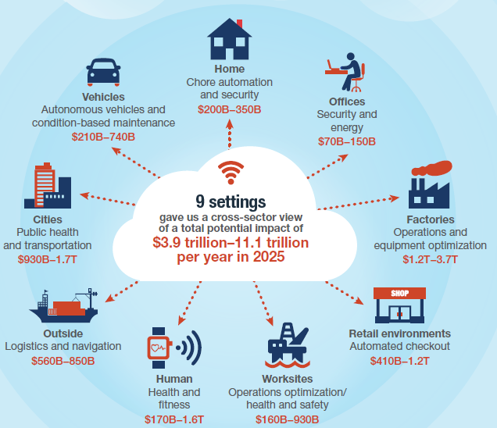
The Internet of Things and the Insurance Industry
The “Internet of Things” will create trillions in economic value throughout the global economy by 2025
What opportunities, challenges will this create for insurers?
What are the impact on the insurance industry “value chain”?
Sources: McKinsey Global Institute, The Internet of Things: Mapping the Value Beyond the Hype,
June 2015; Insurance Information Institute.
111
12/01/09 - 9pm
eSlide – P6466 – The Financial Crisis and the Future of the P/C
Notes:
111

Slide 112
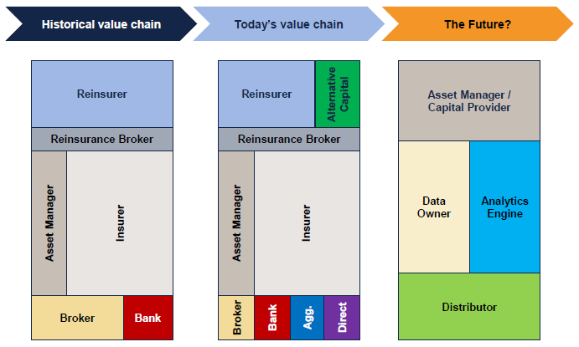
The Internet of Things and the Insurance Industry Value Chain
The Insurance Industry Value Chain Is Changing for Many Reasons
Source: Willis Capital Markets & Advisory; Insurance Information Institute.
112
12/01/09 - 9pm
eSlide – P6466 – The Financial Crisis and the Future of the P/C
Notes:
112

Slide 113
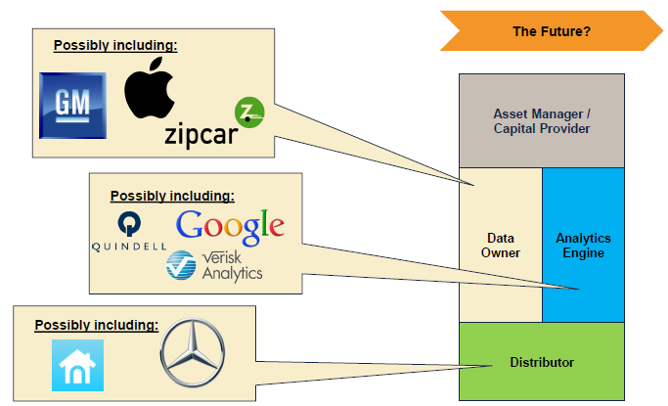
The Internet of Things and the Insurance Industry Value Chain
Who owns the data? Where does It flow? Who does the analytics? Who is the capital provider?
Source: Willis Capital Markets & Advisory; Insurance Information Institute.
113
12/01/09 - 9pm
eSlide – P6466 – The Financial Crisis and the Future of the P/C
Notes:
113

Slide 114

A NEST Case Study
Nest: A Leader in the “Internet of Things”
Collision Course or Cooperation with the Insurance Industry?
114

Slide 115


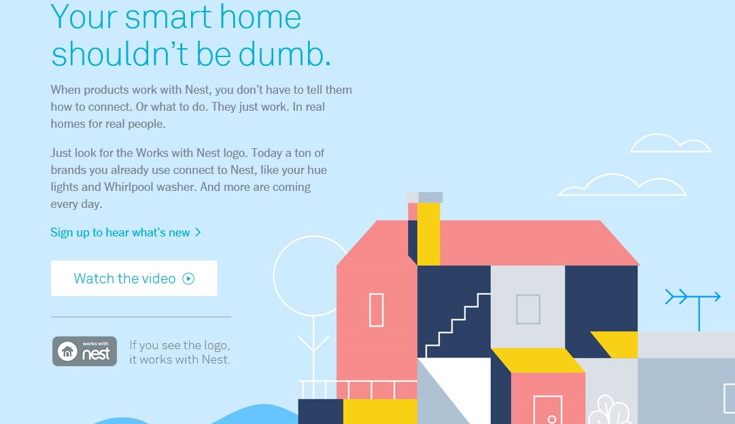
Telematics for Your Home:
The Internet of Things
The home is the next frontier for telematics
Rapidly becoming a crowded space
How and with whom will insurers partner?
Can control increasing array of household systems remotely
  Heat, A/C
  Fire, CO detection
  Security Systems
  Cameras/Monitors
  Appliances
  Lighting
Technology is adaptive
  Uses sensors and algorithms to learn about you
115
12/01/09 - 9pm
eSlide – P6466 – The Financial Crisis and the Future of the P/C
Notes:
115

Slide 116
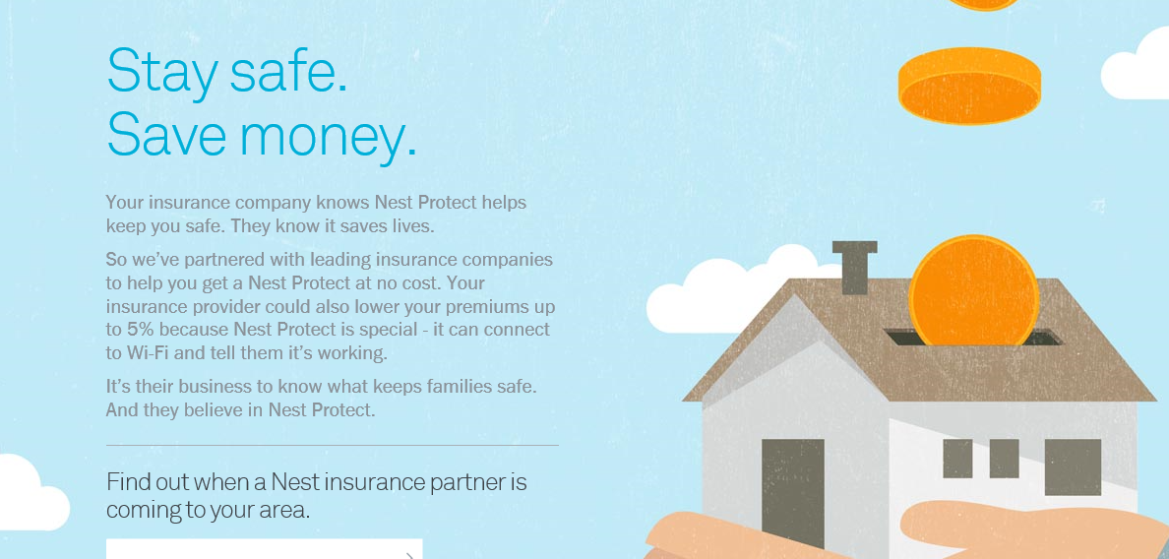
Partnerships with Insurers: Selling Safety and Savings Simultaneously
Nest is actively seeking to partner with insurers. As of Jan. 10, 2016, Nest listed 2 insurance partners offering discounts in a number of states
Source: https://nest.com/insurance-partners/ accessed 1/10/16; Insurance Information Institute research.
116
12/01/09 - 9pm
eSlide – P6466 – The Financial Crisis and the Future of the P/C
Notes:
116

Slide 117
Recent Attacks on the Insurance Industry
Why Are Critics Suddenly More Aggressive?
117

Slide 118
What’s Driving Attacks on the Insurance Industry?
Recent Surge in Attacks is Associated with Income Inequality Debate in the United States
  Attacks not confined to auto insurance (e.g., Workers Comp, Health)
  Not confined to insurance (banks, lending in general, student loans)
Politics, Economics, Regulation & Demographics Are Principal Drivers
  CFA/CR and others (ProPublica) emboldened in current environment
  Dodd-Frank Act stuffed with income inequality mandates and studies
  FIO now studying auto insurance affordability; Wants to create index.
  Definition of “fairness” is shifting
CFA Has Been Able to Attack Certain Rating Factors Based on New Perception of Fairness (which is independent of actual risk)
  Education Occupation Marital Status Gender
  Age Credit Profile Location “Price Optimization”
All of These Are Vulnerable to Attack in the Current Environment
Infinite Number of Quotes Online→CFA Uses to Highlight Perceived Inequities

Slide 119
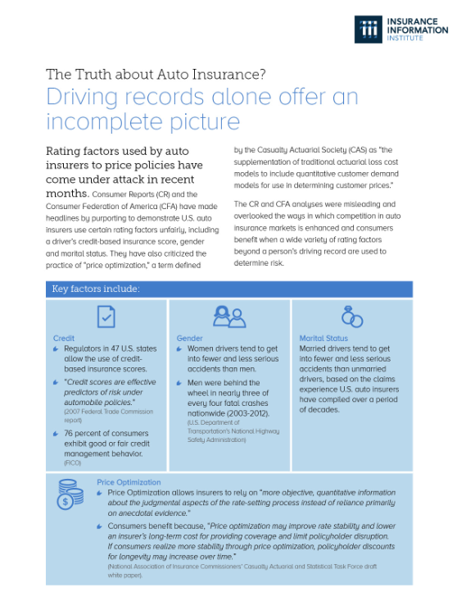
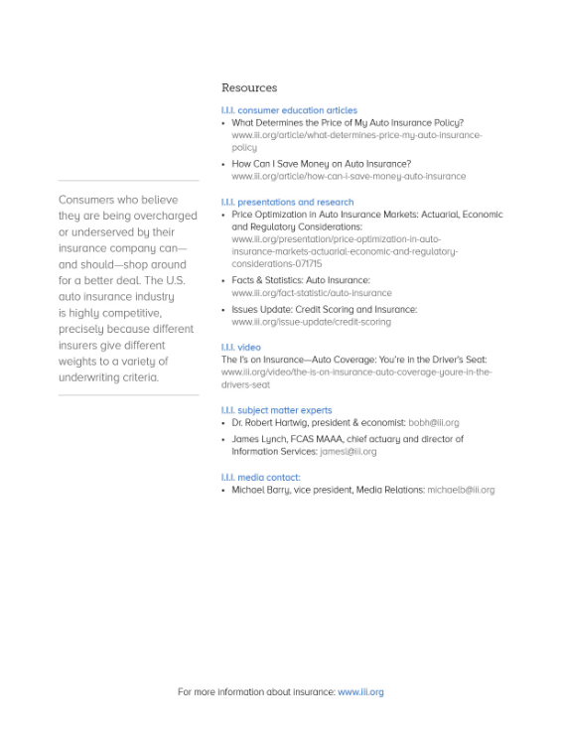
Handout for Government Affairs Staff Attending NAIC Meeting

Slide 120
PRICE OPTIMIZATION
Price Optimization Was the Sharpest Area of Attack the Industry Faced in 2015
120

Slide 121
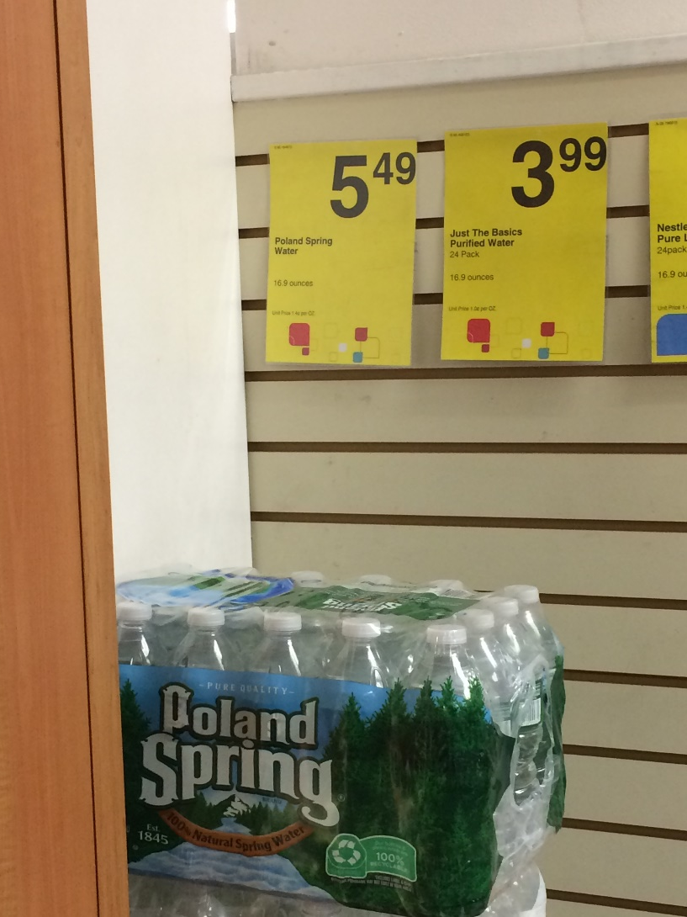
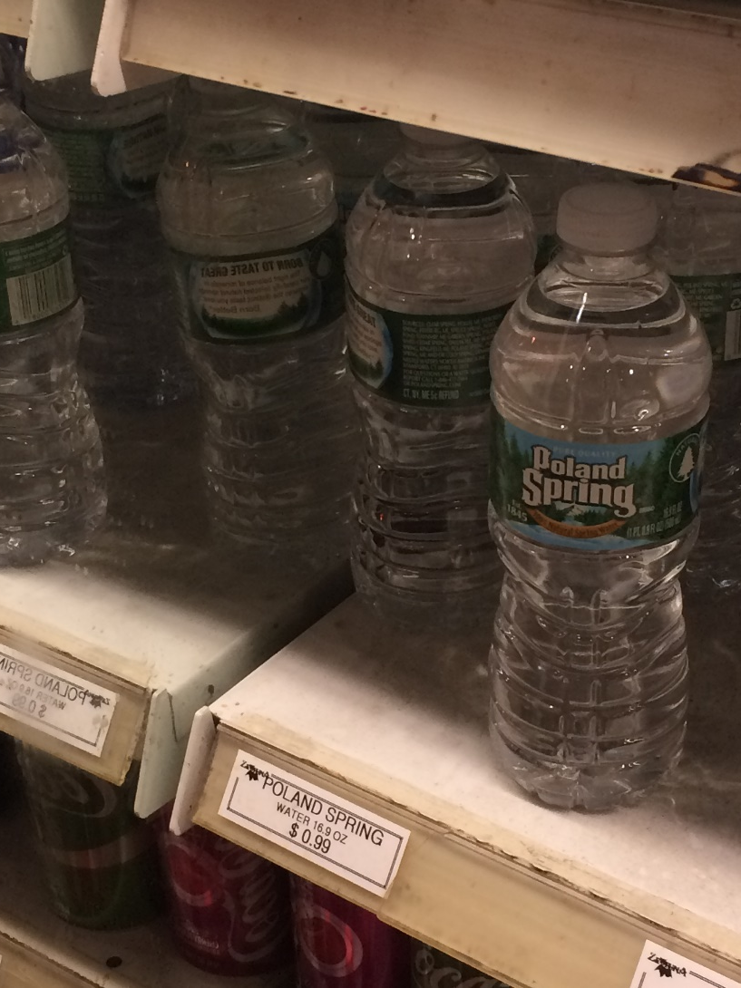
Price Optimization: What Is It?
1.4 Cents Per Ounce ($5.49 for 24 Bottles)
5.9 Cents Per Ounce ($23.76 for 24 Bottles)
U.S. Insurers Don’t Do This!!!
320% Price Difference! Does It Cost $18.25 to Unpack the Bottles and Keep Them Cold?

Slide 122
Price Optimization: What Is It?
Who Knows?
  No One Has Successfully Defined It
  At Least Seven Definitions From States, Vendors, NAIC, Others
  Some Have Talked About
    Price Elasticity of Demand
    ‘Loyalty Penalty’
  Use of ‘Sophisticated Tools and Models to Quantify Other Business Considerations’ (profitability/retention) (NAIC/I.I.I.)

Slide 123
Price Optimization:
What Is The Objection?
What Is the Objection? Detractors Say . . . .
  ‘Systematic Component to Rate Setting Unrelated to Expected Losses or Expenses’ (It’s a Rating Variable, and It’s Not Based on Likelihood of Loss, So It’s Illegal.)
  ‘Price Gouging’
    Poor Get Overcharged
    Most Loyal Customers Get Mistreated

Slide 124
FOUR FACTS ABOUT PRICE OPTIMIZATION
124

Slide 125
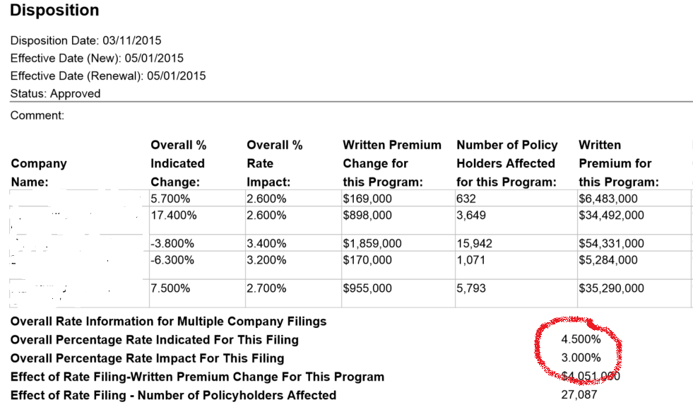
1. Insurers Have Always ‘Optimized’ – With Regulator Knowledge & Approval
Companies Temper Increases Based on ‘Market Judgment’
Regulators Have Approved of the Practice for Decades
REDACTED
Sources: System for Electronic Rate and Form Filing (SERFF) via SNL Financial; Insurance Information Institute.
Other Examples: Rate Capping, Teen Drivers

Slide 126
2. Optimization Is Not Price Gouging
Traditional Practice
  Used ‘Seat-of-the-Pants’ Judgment to Discount Off Indication
What’s New
  Software Informs the Judgment
Never Exceeds Actuarial Indication
Indicated: +6%
Selected: +3%

Slide 127
3. Optimization Doesn’t Raise Rates; It Distributes the Rate Change
As Practiced in U.S.
  Remains True to Cost-Based Price
  Applied to Classes,
  Not Individuals
Rates Don’t Exceed Actuarial Indication
Example (cont’d): There Are Many Reasonable Ways to Achieve Reasonable Rates.

Slide 128
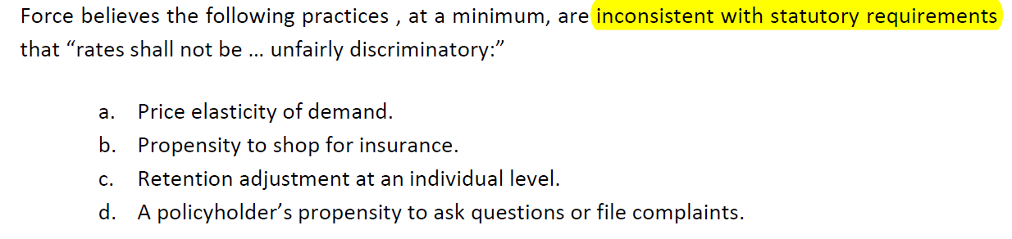
The Latest
NAIC Task Force Concluded (November)
Focus Appears to Be On Potential Use of Tool on Individuals
Restrictions/bans in 16+ States, D.C.
Illinois Declined to Issue Regulation
‘Illinois has a highly competitive auto and homeowners’ insurance market … I would be delighted to host any members of … consumer organizations to visit with me, in person, to share the data they cite as it is inconsistent with what I have reviewed.’
- Acting Insurance Director Anne Melissa Dowling
January 2016

Slide 129
4. Low Income Drivers Are Just as Likely to Shop As Anyone Else
Percent of Those With Auto Insurance Who Said
They Compared Prices on Renewal, by Income, 2014-2015
Low- to Moderate-Income Respondents Were More Likely to Say They Compare Prices.
Source: Insurance Information Institute Annual Pulse Survey.

Slide 130
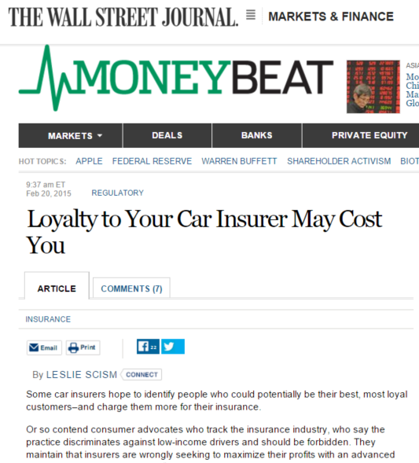
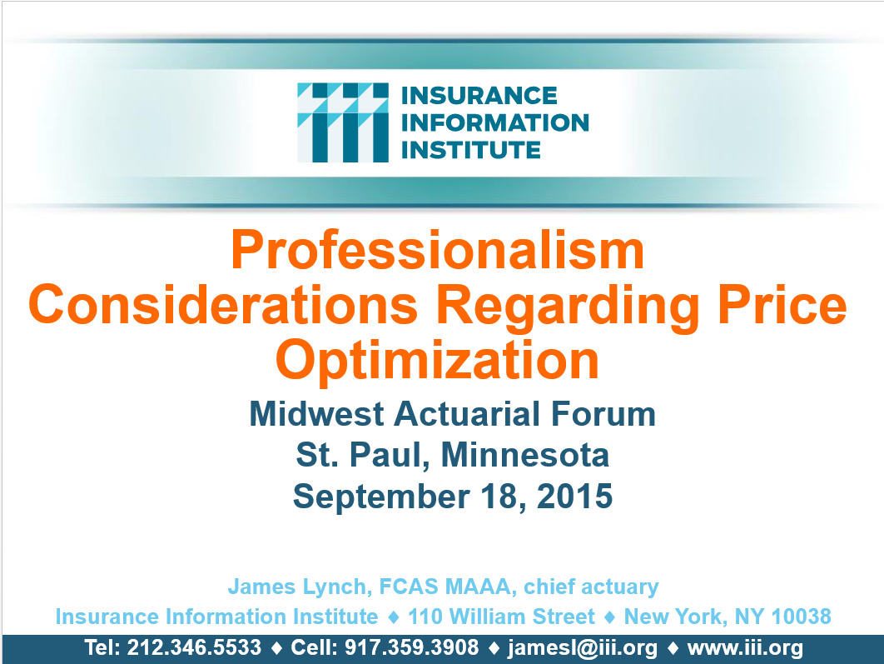
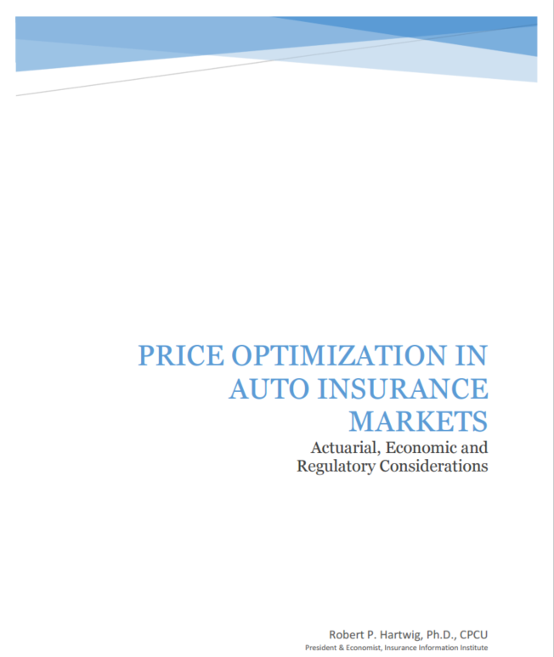
What Has I.I.I. Done?
Media
Industry
Policymakers
The Message:
  ‘the optimal way … is not through prohibitions but through observation, learning and studying the impacts on insurance markets and consumers and only then making recommendations as necessary.’
  - Robert Hartwig,
  NCOIL, July 17, 2015

Slide 131
Insurance Information Institute Online:
www.iii.org
Thank you for your time
and your attention!
Twitter: twitter.com/bob_Hartwig

