Slide 1
Trends, Challenges and Opportunities in the P/C Insurance Industry in 2016 & Beyond
NAMIC Management Conference
Hilton Head, SC
June 27, 2016
Download at www.iii.org/presentations
Robert P. Hartwig, Ph.D., CPCU, President & Economist
Insurance Information Institute ♦ 110 William Street ♦ New York, NY 10038
Tel: 212.346.5520 ♦ Cell: 917.453.1885 ♦ bobh@iii.org ♦ www.iii.org

Slide 2
P/C Industry Net Income After Taxes 1991–2016:Q1
$ Millions
2005 ROE*= 9.6%
2006 ROE = 12.7%
2007 ROE = 10.9%
2008 ROE = 0.1%
2009 ROE = 5.0%
2010 ROE = 6.6%
2011 ROAS¹ = 3.5%
2012 ROAS¹ = 5.9%
2013 ROAS¹ = 10.2%
2014 ROAS¹ = 8.4%
2015 ROAS = 8.4%
Net income in Q1:2016 on an annualized basis was on track to match full-year 2015
ROE figures are GAAP; ¹Return on avg. surplus. Excluding Mortgage & Financial Guaranty insurers yields a 8.2% ROAS in 2014, 9.8% ROAS in 2013, 6.2% ROAS in 2012, 4.7% ROAS for 2011, 7.6% for 2010 and 7.4% for 2009; 2015E is annualized figure based actual figure through Q3 of $44.0
Sources: A.M. Best, ISO; Insurance Information Institute

Slide 3
Profitability Peaks & Troughs in the P/C Insurance Industry, 1975 – 2015
ROE
1977:19.0%
History suggests next ROE peak will be in 2016-2017
1987:17.3%
10 Years
1997:11.6%
2006:12.7%
10 Years
2015: 8.4%
2013 9.8%
9 Years
2014 8.4%
1975: 2.4%
1984: 1.8%
1992: 4.5%
2001: -1.2%
*Profitability = P/C insurer ROEs. 2011-15 figures are estimates based on ROAS data. Note: Data for 2008-2014 exclude mortgage and financial guaranty insurers.
Source: Insurance Information Institute; NAIC, ISO, A.M. Best, Conning

Slide 4
ROE: Property/Casualty Insurance by Major Event, 1987–2015
(Percent)
P/C Profitability Is Both by Cyclicality and Ordinary Volatility
Modestly higher CATs
Katrina, Rita, Wilma
Low CATs
Sept. 11
Hugo
Lowest CAT Losses in 15 Years
4 Hurricanes
Sandy
Andrew, Iniki
Record Tornado Losses
Northridge
Financial Crisis*
* Excludes Mortgage & Financial Guarantee in 2008 – 2014.
Sources: ISO, Fortune; Insurance Information Institute.

Slide 5
P/C Insurance Industry ROE: Magnitude of Cyclicality, Volatility Changes Over Time, 1950-2015
1950 - 1970
Low
Volatility
1971 - 1992
Extreme
Volatility
1993 - 2008
Moderate
Volatility
2009 - Present
Modest
Volatility
.
Source: Insurance Information Institute

Slide 6
P/C Insurance Industry Combined Ratio, 2001–2016:Q1*
Heavy Use of Reinsurance Lowered Net Losses
Relatively Low CAT Losses, Reserve Releases
Higher CAT Losses, Shrinking Reserve Releases, Toll of Soft Market
As Recently as 2001, Insurers Paid Out Nearly $1.16 for Every $1 in Earned Premiums
Relatively Low CAT Losses, Reserve Releases
Avg. CAT Losses, More Reserve Releases
3 Consecutive Years of U/W Profits: First Time Since 1971-73
Sandy Impacts
Best Combined Ratio Since 1949 (87.6)
Cyclical Deterioration
Lower CAT Losses
Elevated CATs
* Excludes Mortgage & Financial Guaranty insurers 2008--2014. Including M&FG, 2008=105.1, 2009=100.7, 2010=102.4, 2011=108.1; 2012:=103.2; 2013: = 96.1; 2014: = 97.0.
Sources: A.M. Best, ISO (2014-2015); Figure for 2010-2013 is from A.M. Best P&C Review and Preview, Feb. 16, 2016.

Slide 7
NPW Premium Growth: Peaks & Troughs in the P/C Insurance Industry, 1926 – 2015
ROE
Post WW II Peak:
1947: 26.2%
1970-90: Peak premium growth was much higher in this period while troughs were comparable. Rapid inflation, economic volatility, high interest rates, tort environment all played roles
Start of WW II
1941: 15.8%
Economic Shocks, Inflation:
1976: 22.0%
Tort Crisis
1985/86: 22.2%
Post-9/11
2002:15.3%
1988-2000: Period of inter-cycle stability
2015 3.4%
1950-70: Extended period of stability in growth and profitability. Low interest rates, low inflation, “Bureau” rate regulation all played a role
2010-20XX? Post-recession period of stable growth?
Twin Recessions; Interest Rate Hikes
1987: 3.7%
Great Recession:2010: -4.9%
Great Depression
1932: -15.9% max drop
Note: Data through 1934 are based on stock companies only. Data include state funds beginning in 1998.
Source: A.M. Best; Insurance Information Institute.

Slide 8
Policyholder Surplus, 2006:Q4–2015:Q4
($ Billions)
2007:Q3 Pre-Crisis Peak
Drop due to near-record 2011 CAT losses
Surplus as of 12/31/15 stood at a near-record high $673.7B
The industry now has $1 of surplus for every $0.76 of NPW, close to the strongest claims-paying status in its history.
2010:Q1 data includes $22.5B of paid-in capital from a holding company parent for one insurer’s investment in a non-insurance business .
The P/C insurance industry entered 2016 in very strong financial condition.
Sources: ISO, A.M .Best.
8
12/01/09 - 9pm
eSlide – P6466 – The Financial Crisis and the Future of the P/C
Notes:
8

Slide 9
INVESTMENTS: THE NEW REALITY
Investment Performance is a Key Driver of Profitability
Depressed Yields Will Necessarily Influence Underwriting & Pricing
9

Slide 10
Property/Casualty Insurance Industry Investment Income: 2000–2015¹
Investment earnings are still below their 2007 pre-crisis peak
($ Billions)
Due to persistently low interest rates, investment income fell in 2012, 2013 and 2014 but showed a small (1.9%) increase in 2015—a trend that may continue.
¹ Investment gains consist primarily of interest and stock dividends. Sources: ISO; Insurance Information Institute.

Slide 11
U.S. Treasury Security Yields: A Long Downward Trend, 1990–2016*
Yields on 10-Year U.S. Treasury Notes have been essentially below 5% for more than a decade.
Despite the Fed’s December 2015 rate hike, yields remain low though short-term yields have seen some gains; Yield curve is flattening.
Since roughly 80% of P/C bond/cash investments are in 10-year or shorter durations, most P/C insurer portfolios will have low-yielding bonds for years to come.
*Monthly, constant maturity, nominal rates, through May 20, 2016.
Sources: Federal Reserve Bank at http://www.federalreserve.gov/releases/h15/data.htm. National Bureau of Economic Research (recession dates); Insurance Information Institute.
11
12/01/09 - 9pm
eSlide – P6466 – The Financial Crisis and the Future of the P/C
Notes:
11

Slide 12
Net Investment Yield on Property/ Casualty Insurance Invested Assets, 2007–2016P*
(Percent)
Estimated book yield in 2016 is down about 140 BP from pre-crisis levels
The yield on invested assets remains low relative to pre-crisis yields. The Fed’s plan to raise interest rates in late 2015 has pushed up some yields, albeit quite modestly.
Sources: A.M. Best; 2015E-2016P figures from A.M. Best P/C Review and Preview, Feb. 2016; Insurance Information Institute

Slide 13
THE ECONOMY
The Strength of the Economy Will Greatly Influence Insurer Exposure Base Across Most Lines
13

Slide 14
US Real GDP Growth*
The Q4:2008 decline was the steepest since the Q1:1982 drop of 6.8%
Real GDP Growth (%)
Recession began in Dec, 2007
Q1 2014/15 GDP data were hit hard by this year’s “Polar Vortex” and harsh winter
Demand for Insurance Should Increase in 2016 as GDP Growth Continues at a Steady, Albeit Moderate Pace and Gradually Benefits the Economy Broadly
* Estimates/Forecasts from Blue Chip Economic Indicators.
Source: US Department of Commerce, Blue Economic Indicators 6/16; Insurance Information Institute.

Slide 15

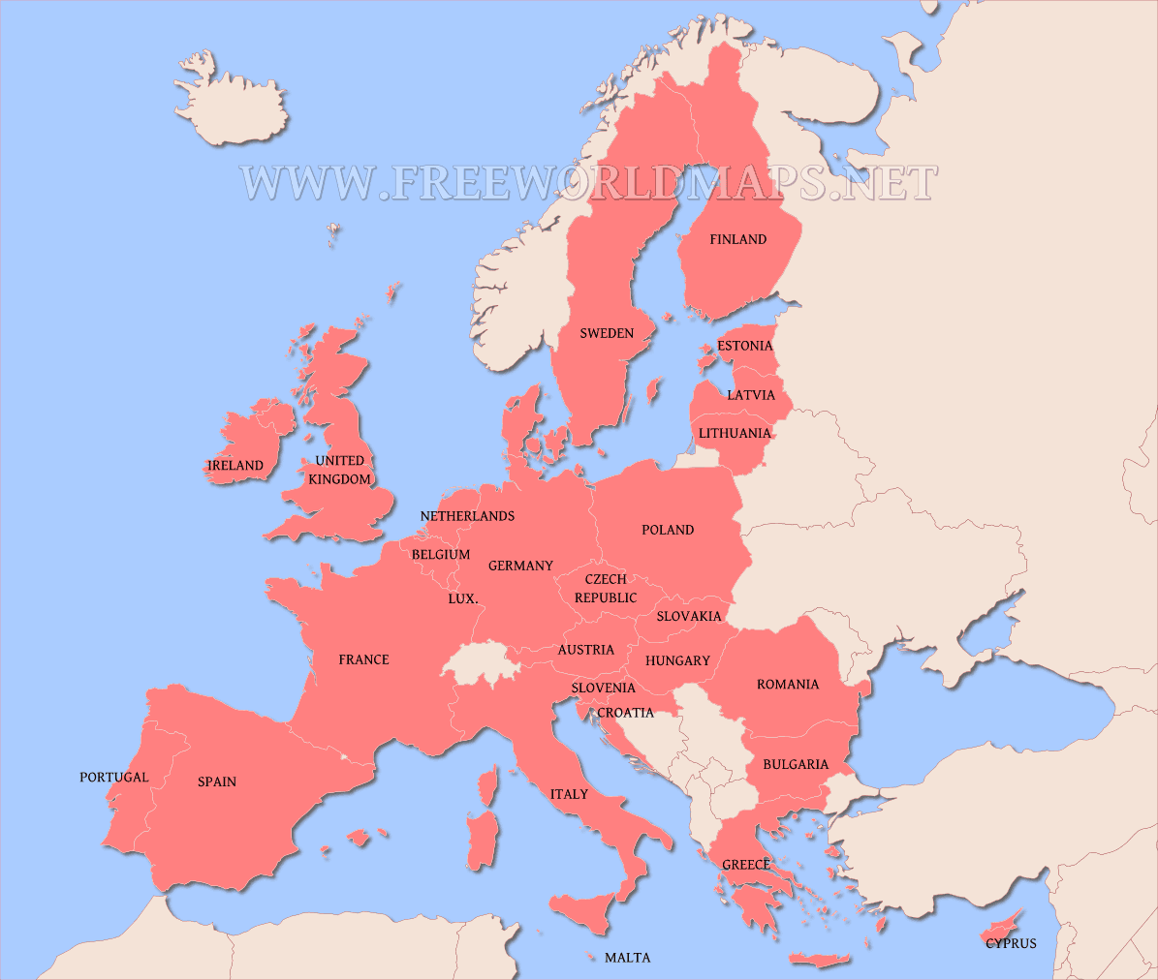
Brexit: Potential Impacts on the Global (Re)Insurance Industry
Brexit is a net negative for the global (re)insurance industry
Fundamentally, Brexit is a protectionist measure and antithetical to free trade; Economic negative
Dollar appreciates
Delays Fed rate hikes
Free flow of financial capital, human capital and coordinated regulatory policy across EU states is on net good for Europe’s economy
Concern that UK’s action could initiate a domino effect
Economic integration is the cornerstone of keeping (most of) Europe free of war
Does Brexit weaken Solvency II and efforts to implement European-like regulations in the US?
15
12/01/09 - 9pm
eSlide – P6466 – The Financial Crisis and the Future of the P/C
Notes:
15

Slide 16

The Economy, Millennials and Careers in the Insurance Industry
Some 400,000 job openings in the insurance industry through 2020 will need to be filled, mostly by Millennials
I.I.I. created a video featuring actual Millennials who work for I.I.I. member organizations
Also created individual videos profiling each person featured
Free for you to use!
Link: https://www.youtube.com/playlist?list=PL8QsOg2Byw0nTF6DCUNF5McZgd4T_1WYV
16
12/01/09 - 9pm
eSlide – P6466 – The Financial Crisis and the Future of the P/C
Notes:
16

Slide 17
Profitability & Politics
How Is Profitability Affected by the President’s Political Party?
17

Slide 18
P/C Insurance Industry ROE by Presidential Administration, 1950-2014*
OVERALL RECORD: 1950-2015*
Democrats 7.72%
Republicans 7.85%
Party of President has marginal bearing on profitability of P/C insurance industry
*Truman administration ROE of 6.97% based on 3 years only, 1950-52;.
Source: Insurance Information Institute

Slide 19
P/C insurance Industry ROE by Presidential Party Affiliation, 1950- 2015*
BLUE = Democratic President RED = Republican President
Nixon/Ford
Carter
Reagan/Bush I
Clinton
Bush II
Obama
Truman
Eisenhower
Kennedy/ Johnson
.
*2015 data is through Q3.
Source: Insurance Information Institute

Slide 20
Trump vs. Clinton: Issues that Matter to P/C Insurers
Issue | Trump | Clinton
Economy | Supply Side-Like Philosophy: Lower taxes→Faster real GDP growth; Deficits likely grow as tax cuts are combined with targeted increased spending on Homeland Security, Defense, etc. | Keynesian Philosophy: More government spending on infrastructure, education, social services; Deficits likely increase as tax increases likely difficult to pass
Interest Rates | May trend higher with larger deficits; Shift from monetary policy to fiscal focus (tax cuts, government spending) | Status quo at the Fed; Net impact on interest rates unclear
Taxes | Favors lower tax rates for corporate and personal income tax rates; Tax code overhaul? | Unlikely to reduce taxes or embark on major overhaul of tax code
International Trade | Protectionist Tendencies (appeal primarily to manufacturing sector) | Has criticized Trans-Pacific Partnership but is a realist on international matters
Tort System | Doesn’t like trial lawyers but seems to like filing lawsuits | Status Quo
Health Care | ACA should be repealed & replaced | Incremental Change

Slide 21
2015 Property and Casualty Insurance Regulatory Report Card
C
AK
AL
A
WA
ME
C
MT
B
ND
C
VT
D
MN
D
NH
B
OR
ID
C+
C
NY
MA
= A
= B
= C
= D
= F
= NG
B
SD
B+
WI
MI
CT
RI C+
B
B
NJ
WY
PA
C
B
B+
IA
B
C-
A
C+
OH
MD
NV
NE
A-
IL
IN
DE
B+
WV
B
UT
B
C
VA
CO
C+
A
B
A
B
KS
MO
KY
CA
B
A
F
D
A-
TN
NC
C
AZ
NM
OK
C
AR
C
SC
Source: James Madison Institute, February 2008.
A-
D
HI
B
B
AL
B
MS
C
GA
LA
D+
TX
D
Not Graded: District of Columbia
FL
D
D
Source: R Street Insurance Regulation Report Card, December 2015

Slide 22
Top Insurance Issues:
What’s Hot, What’s Not
Eclectic Mix of Issues Garnered Media Attention So Far in 2016
Interest in Tech Issues Remains High
22

Slide 23
I.I.I. Media Index, P/C, First Five Months 2015 vs. First Five Months* 2016¹
Percent Increase/Decrease from Previous Year
*Through May 15.
¹Based on a search of Meltwater News

Slide 24
Auto & Home Insurance:
State of the Personal Lines Market
Auto Frequency and Severity Are an Immediate Challenge
Dearth of Major CATs (Until Recently), Pricing Discipline Has Helped Home
24

Slide 25
Return on Net Worth (RNW) All Lines: 2005-2014 Average
Commercial lines have tended to be more profitable than personal lines over the past decade, but Homeowners is on the rise due to the dearth of major catastrophes in recent years
Source: NAIC; Insurance Information Institute.

Slide 26
Return on Net Worth: All P-C Lines vs. Homeowners & Pvt. Pass. Auto, 1990-2014*
(Percent)
Average RNW: 1990-2013*
All P-C Lines: 7.8% PP Auto: 8.1% Homeowners: 4.3%**
Excluding 1992’s Hurricane Andrew
Pvt.Pass. Auto Has Consistently Outperformed the P-C Industry as a Whole. Homeowners Volatility is Associated Primarily With Coastal Exposure Issues
*Latest available.
**Excludes 1992, the year of Hurricane Andrew. If 1992 is included the resulting homeowners RNW is 1.9%
Sources: NAIC; Insurance Information Institute.
26
Notes:
26

Slide 27
RNW Pvt. Passenger Auto, 2005-2014 Average: Highest 25 States
(Percent)
Hawaii was the most profitable state for auto insurers from 2005-2014
Sources: NAIC; Insurance Information Institute

Slide 28
RNW Pvt. Passenger Auto,
2005-2014 Average: Lowest 25 States
(Percent)
Michigan was the least profitable state for auto insurers from 2005-2014
Sources: NAIC; Insurance Information Institute

Slide 29
RNW Homeowners Insurance,
2005-2014 Average: Highest 25 States
(Percent)
Hawaii was the most profitable state for home insurers from 2005-2014 due to the absence of hurricanes during this period
Sources: NAIC; Insurance Information Institute

Slide 30
RNW Homeowners Insurance,
2005-2014 Average: Lowest 25 States
(Percent)
Hurricanes Katrina and Rita made Louisiana and Mississippi the least profitable states for home insurers from 2005-2014
Sources: NAIC; Insurance Information Institute

Slide 31
Personal Lines Underwriting Performance
Auto, Home Underwriting Performance Exhibit Periods of Both Stability and Volatility
31

Slide 32
Private Passenger Auto Combined Ratio: 1993–2017F
Private Passenger Auto Underwriting Performance Is Showing the Strains of Rising Frequency (and Severity) Trends in Many States
Sources: A.M. Best (1990-2014); Conning (2015E-17F); Insurance Information Institute.

Slide 33
Homeowners Insurance Combined Ratio: 1990–2017F
Hurricane Andrew
Record tornado activity
Hurricane Ike
Hurricane Sandy
Homeowners Performance Has Improved Markedly Since the 2011/12’s Large Cat Losses. Extreme Regional Variation Can Be Expected Due to Local Catastrophe Loss Activity. Results in 2016 Will Be Impacted by Severe Spring Weather
Sources: A.M. Best (1990-2014); Insurance Information Institute (2015E-17F).

Slide 34
Claim Trends in Private Passenger Auto Insurance
Rising Frequencies and Severities in Many Coverages
Will that Pattern Be Sustained?
34

Slide 35
Auto Severity & Frequency by Coverage: Trending Up in 2015
Annual Change, 2015 Over 2014
Frequency and Severity Were Up Across Most Coverage Types in 2015; A Trend Likely to Continue in 2016
Source: ISO/PCI Fast Track data; Insurance Information Institute

Slide 36
Collision Coverage: Severity & Frequency Trends Are Both Higher in 2015
Annual Change, 2005 through 2015
The Recession, High Fuel Prices Helped Temper Frequency and Severity, But this Trend Has Clearly Reversed, Consistent with Experience from Past Recoveries
Source: ISO/PCI Fast Track data; Insurance Information Institute

Slide 37
Collision Loss Ratio Trending Upward: Private Passenger Auto, 2010 – 2015
Loss Ratio
Collision Loss Ratios are Trending Steadily Upward
Source: ISO/PCI Fast Track data; Insurance Information Institute

Slide 38
Bodily Injury: Severity Trend Is Up, Frequency Decline Has Ended—Rising?
Annual Change, 2005 through 2015
Cost Pressures Will Increase if BI Frequency and Severity Trends Persist
Source: ISO/PCI Fast Track data; Insurance Information Institute

Slide 39
Property Damage Liability: Severity and Frequency Are Up
Annual Change, 2005 through 2015
Severity/Frequency Trends Have Been Volatile, But Rising Severity since 2011 Is a Concern
Source: ISO/PCI Fast Track data; Insurance Information Institute

Slide 40
Comprehensive Coverage: Frequency and Severity Trends Are Volatile
Severe weather is a principal cause of the spikes in both frequency and severity
Annual Change, 2005 through 2015
Weather Creates Volatility for Comprehensive Coverage
Source: ISO/PCI Fast Track data; Insurance Information Institute

Slide 41
A Few Factors Driving Adverse Private Passenger Auto Loss Trends
More People Driving, Lower Gas Prices, Higher Speed Limits…
41

Slide 42
Why Are People Driving More Miles? Jobs?
Billions of Miles Driven in Prior Year
Millions Employed
Recession
People Drive To and From Work and Drive to Entertainment. Out of Work, They Curtail Their Movement.
Sources: Federal Highway Administration (http://www.fhwa.dot.gov/policyinformation/travel_monitoring/tvt.cfm ); Seasonally Adjusted Employed from Bureau of Labor Statistics; Insurance Institute for Highway Safety; Insurance Information Institute.
42
12/01/09 - 9pm
eSlide – P6466 – The Financial Crisis and the Future of the P/C
Notes:
42

Slide 43
More People Working and Driving => More Collisions, 2006-2016
Overall Collision Claims Per 100 Insured Vehicles
Number Employed, Millions
Recession
When people are out of work, they drive less. When they get jobs, they drive to work, helping drive claim frequency higher.
Sources: Seasonally Adjusted Employed from Bureau of Labor Statistics; Rolling Four-Qtr Avg. Frequency from Insurance Services Office; Insurance Information Institute.
43
12/01/09 - 9pm
eSlide – P6466 – The Financial Crisis and the Future of the P/C
Notes:
43

Slide 44
Change in Auto Fatalities by State: Especially Severe in Georgia
GA’s auto fatality rate has increased at a pace nearly 3 times that of the US overall and far in excess of any other state in the region
2015 vs. 2014
Fatalities in Southeast Rising Faster Than USA as a Whole
SOURCE: Estimates from National Safety Council.

Slide 45
Personal Lines Growth Drivers
Rate and Exposure are Both Presently Important Growth Drivers
45

Slide 46
Monthly Change in Auto Insurance Prices, 1991–2015*
Cyclical peaks in PP Auto tend to occur roughly every 10 years (early 1990s, early 2000s and likely the early 2010s)
Pricing peak occurred in late 2010 at 5.3%, falling to 2.8% by Mar. 2012
“Hard” markets tend to occur during recessionary periods
Dec. 2015 reading of 5.5% is up from 4.7% a year earlier
*Percentage change from same month in prior year; through Dec. 2015; seasonally adjusted
Note: Recessions indicated by gray shaded columns.
Sources: US Bureau of Labor Statistics; National Bureau of Economic Research (recession dates); Insurance Information Institutes.
46
12/01/09 - 9pm
eSlide – P6466 – The Financial Crisis and the Future of the P/C
Notes:
46

Slide 47
Average Expenditures* on Auto Insurance, 1994-2015E
Annual Pct Changes 2001: 5.2% 2002: 8.6% 2003: 5.6%
2004: 1.5% 2005: -1.3% 2006: -1.8% 2007: -2.1% 2008: -1.0% 2009: -0.5% 2010: 0.6% 2011: 0.6%
2012: 2.3%
2013: 3.3%
The average expenditure on auto insurance now finally exceeds the pre-crisis high of $842 recorded in 2004, taking a full decade to recover, but on an inflation-adjusted basis premiums are still below 2004 levels
Across the U.S., auto insurance expenditures fell by 0.8% in 2008 and 0.5% in 2009 but rose 0.5% in 2010, 0.8% in 2011, 2.3% in 2012 and 3.3% in 2013; I.I.I. estimate is for +3.4% in 2014 and 2015.
* The NAIC data are per-vehicle (actually, per insured car-year)
Sources: NAIC for 1994-2013; Insurance Information Institute estimates for 2014-2015 based on CPI and other data.

Slide 48
Private Passenger Auto Insurance Net Written Premium, 2000–2017F
PP Auto premiums written continue to recover from a period of flat growth attributable to the weak economy impacting new vehicle sales, car choice, and increased price sensitivity among consumers
PPA will generate $6B - $8B in new premiums annually through 2017
$ Billion
PPA NWP volume in 2014 was up $26.3B or 16.7% since the 2009 trough; By 2017 the gain is expected to be $46.8B or 29.7%
Sources: A.M. Best (1990-2014); Conning (2015-17F); Insurance Information Institute.

Slide 49
Homeowners Insurance Net Written Premium, 2000–2016F
$ Billions
Homeowners insurance NWP continues to rise (up 150% 2000-2015F) despite very little unit growth during the real estate crash. Reasons include rate increases, especially in coastal zones, ITV endorsements (e.g., “inflation guards”), compulsory for mortgaged properties and resumption of home building activity
The Homeowners line will generate about $4B in new premiums annually through 2016
Sources: A.M. Best; Insurance Information Institute.

Slide 50
Personal Lines: Economic and Demographic Considerations
Auto, Home Are Sensitive to Underlying Economic Conditions
50

Slide 51
New Private Housing Starts, 1990-2021F
Job growth, low inventories of existing homes, still-low mortgage rates and demographics should continue to stimulate new home construction for several more years
(Millions of Units)
New home starts plunged 72% from 2005-2009; A net annual decline of 1.49 million units, lowest since records began in 1959
Insurers Are Continue to See Meaningful Exposure Growth in the Wake of the “Great Recession” Associated with Home Construction: Construction Risk Exposure, Surety, Commercial Auto; Potent Driver of Workers Comp Exposure
Source: U.S. Department of Commerce; Blue Chip Economic Indicators (5/16 for 2016-17; 3/16 for 2018-21F; Insurance Information Institute.

Slide 52
I.I.I. Poll: Renter’s Insurance
Q. Do you have renters insurance? ¹
Americans are increasingly choosing to rent, but are slow to understand the need to insure, exacerbating the underinsurance gap
The Percentage of Renters Who Have Renters Insurance Has Been Rising Since 2011.
¹Asked of those who rent their home.
Source: Insurance Information Institute Annual Pulse Survey.

Slide 53
Auto/Light Truck Sales, 1999-2021F
Job growth and improved credit market conditions will boost auto sales in 2015 and beyond
Sales have returned to pre-crisis levels
(Millions of Units)
New auto/light truck sales fell to the lowest level since the late 1960s. Forecast for 2014-15 is still below 1999-2007 average of 17 million units, but a robust recovery is well underway.
Truck, SUV purchases by contractors are especially strong
Yearly car/light truck sales will likely continue at current levels, in part replacing cars that were held onto in 2008-12. PP Auto premium might grow by 3.5% - 5%.
Source: U.S. Department of Commerce; Blue Chip Economic Indicators (5/16 for 2016-17; 3/16 for 2018-21F; Insurance Information Institute.

Slide 54
Number of Registered Passenger Vehicles in US, 1999 – 2015E
Vehicle registrations are growing once again and now finally exceed pre-crisis peak
Vehicle registrations are expected to increase at an annual rate of about 1.5% per year in 2015 and 2016
Sources: Bureau of Transportation Statistics; Barclays Capital estimates, August 2015.

Slide 55
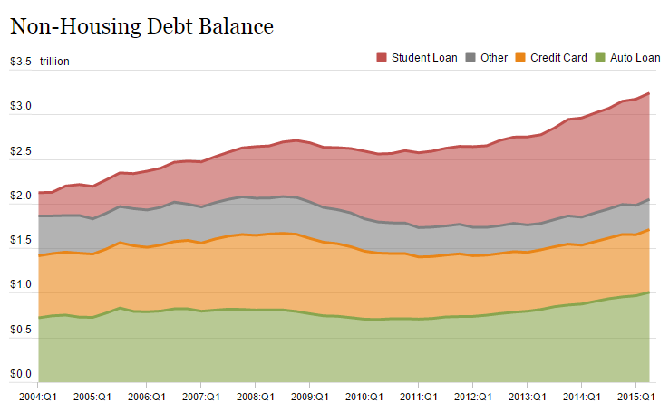
Auto Loans and Other Non-Housing Debt, 2004 – 2015*
Auto loan debt outstanding reached $1T for the first time ever in Q1 2015
Banks are becoming increasingly aggressive in marketing auto loans
*As of Q1 2015.
Source: Federal Reserve Bank of NY Consumer Credit Panel/Equifax; l. I.I.

Slide 56
Commercial Lines Underwriting Performance
56
Notes:
56

Slide 57
Commercial Lines Combined Ratio, 1990-2017F*
Commercial lines underwriting performance improved in 2013/14 but higher cats, diminishing prior year reserves and rising loss cost trends in some lines could push combined ratios higher
*2007-2012 figures exclude mortgage and financial guaranty segments.
Source: A.M. Best (1990-2014); Conning (2015E-17F) Insurance Information Institute.

Slide 58
Commercial Property Combined Ratio: 2007–2017F
Commercial Property Underwriting Performance Has Improved in Recent Years, Largely Due to Diminished CAT Activity
Source: Conning Research and Consulting.

Slide 59
General Liability Combined Ratio: 2005–2017F
Commercial General Liability Underwriting Performance Has Been Volatile in Recent Years
Source: Conning Research and Consulting.

Slide 60
Commercial Auto Combined Ratio: 1993–2017F
Commercial Auto Results Are Challenged as Rate Gains Barely Have Yet to Offset Adverse Frequency and Severity Trends
Sources: A.M. Best (1990-2014);Conning (2015E-2017F); Insurance Information Institute.

Slide 61
Workers Compensation Combined Ratio: 1994–2015P
WC results have improved markedly since 2011
Workers Comp Results Began to Improve in 2012. Underwriting Results Deteriorated Markedly from 2007-2010/11 and Were the Worst They Had Been in a Decade.
Sources: A.M. Best (1994-2009); NCCI (2010-2015P) and are for private carriers only; Insurance Information Institute.

Slide 62
Workers Compensation Premium: Fifth Consecutive Year of Increase Net Written Premium
$ Billions
p Preliminary
Source: NCCI from Annual Statement Data.
Includes state insurance fund data for the following states: AZ, CA, CO, HI, ID, KY, LA, MD, MO, MT, NM, OK, OR, RI, TX, UT.
Each calendar year total for State Funds includes all funds operating as a state fund that year.
Calendar Year

Slide 63
2015 Workers Compensation Direct Written Premium Growth, by State*
PRIVATE CARRIERS: Overall 2015 Growth = +4.3%
While growth rates varied widely, most states experienced modest positive growth in 2015
*Excludes monopolistic fund states (in gray): OH, ND, WA and WY.
Source: NCCI.

Slide 64
Workers Compensation Lost-Time Claim Frequency Declined in 2015
Percent
Average Annual Change = –3.6%
(1994–2014)
*Adjustments primarily due to significant audit activity.
2015p: Preliminary based on data valued as of 12/31/2015.
Source: NCCI Financial Call data, developed to ultimate and adjusted to current wage an voluntary loss cost level; Excludes high deductible policies; 1994-2014: Based on data through 12/31/14. Data for all states where NCCI provides ratemaking services, excluding WV.
Frequency is the number of lost-time claims per $1M pure premium at current wage and voluntary loss cost level
Accident Year

Slide 65
Workers Compensation Medical Severity: Small Decrease in 2015
Medical
Claim Cost ($000s)
Average Medical Cost per Lost-Time Claim
Medical severity for lost time claims was down 1% in 2015, the first decline in at least 20 years
Annual Change 1991–1993: +1.9%
Annual Change 1994–2001: +8.9%
Annual Change 2002–2010: +6.0%
Cumulative Change = 252%
(1991-2015p)
Accident Year
Accident Year
2015p: Preliminary based on data valued as of 12/31/2015.
1991-2013: Based on data through 12/31/2014, developed to ultimate
Based on the states where NCCI provides ratemaking services including state funds, excluding WV; Excludes high deductible policies.

Slide 66
Insured Catastrophe Losses
2013/14 and YTD 2015 Experienced Below Average CAT Activity After Very High CAT Losses in 2011/12
Winter Storm Losses Far Above Average in 2014 and 2015
66

Slide 67
U.S. Insured Catastrophe Losses
($ Billions, $ 2015)
2012 was the 3rd most expensive year ever for insured CAT losses
2013/14/15 Were Welcome Respites from 2011/12, among the Costliest Years for Insured Disaster Losses in US History. 2016 Is Off to a Costlier Start.
$10.3B in insured CAT losses though 6/12/16
*Through 6/12/16. 2016 figure stated in 2015 dollars.
Note: 2001 figure includes $20.3B for 9/11 losses reported through 12/31/01 ($25.9B 2011 dollars). Includes only business and personal property claims, business interruption and auto claims. Non-prop/BI losses = $12.2B ($15.6B in 2011 dollars.)
Sources: Property Claims Service/ISO; Insurance Information Institute.
67
12/01/09 - 9pm
eSlide – P6466 – The Financial Crisis and the Future of the P/C
Notes:
67

Slide 68
Combined Ratio Points Associated with Catastrophe Losses: 1960 – 2015E*
Avg. CAT Loss Component of the Combined Ratio by Decade
1960s: 1.04 1970s: 0.85 1980s: 1.31 1990s: 3.39 2000s: 3.52 2010s: 5.46*
Catastrophe losses as a share of all losses reached a record high in 2011
Combined Ratio Points
The Catastrophe Loss Component of Private Insurer Losses Has Increased Sharply in Recent Decades
*2010s represent 2010-2015E.
Notes: Private carrier losses only. Excludes loss adjustment expenses and reinsurance reinstatement premiums. Figures are adjusted for losses ultimately paid by foreign insurers and reinsurers.
Source: ISO (1960-2009); A.M. Best (2010-15E) Insurance Information Institute.

Slide 69
Inflation Adjusted U.S. Catastrophe Losses by Cause of Loss, 1995–2014¹
Wind/Hail/Flood (3), $21.4
Fires (4), $6.0
Winter storm losses were much above average in 2014/15 are will push this share up
Other (5), $0.2
Insured cat losses from 1995-2014 totaled $395.6B, an average of $19.8B per year or $1.65B per month
Geological Events, $0.5
Terrorism, $24.5
Winter Storms, $26.9
Hurricanes & Tropical Storms, $161.2
Tornado share of CAT losses is rising
Wind losses are by far cause the most catastrophe losses, even if hurricanes/TS are excluded.
Events Involving Tornadoes (2), $154.9
Catastrophes are defined as events causing direct insured losses to property of $25 million or more in 2014 dollars.
Excludes snow.
Does not include NFIP flood losses
Includes wildland fires
Includes civil disorders, water damage, utility disruptions and non-property losses such as those covered by workers compensation.
Source: ISO’s Property Claim Services Unit.

Slide 70
Top 16 Most Costly Disasters in U.S. History—Katrina Still Ranks #1
(Insured Losses, 2014 Dollars, $ Billions)
Storm Sandy in 2012 was the last mega-CAT to hit the US
Includes Tuscaloosa, AL, tornado
Includes Joplin, MO, tornado
12 of the 16 Most Expensive Events in US History Have Occurred Since 2004
Sources: PCS; Insurance Information Institute inflation adjustments to 2014 dollars using the CPI.

Slide 71
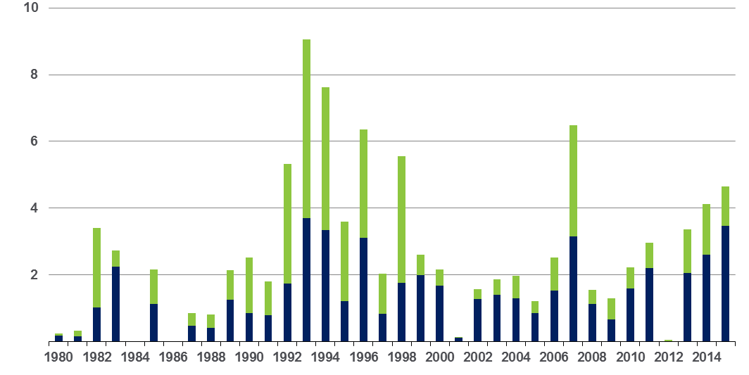
Winter Storm Losses in the US 1980 – 2015 (Overall and Insured Losses)*
$ Billions
Winter storm losses have been increasing rapidly in recent years
Overall losses
(in 2015 values)*
Insured losses
(in 2015 values)*
*Winter storms include also winter damages, blizzards and cold waves
*Losses adjusted to inflation based on CPI.
Source: Property Claim Services, MR NatCatSERVICE.
71

Slide 72
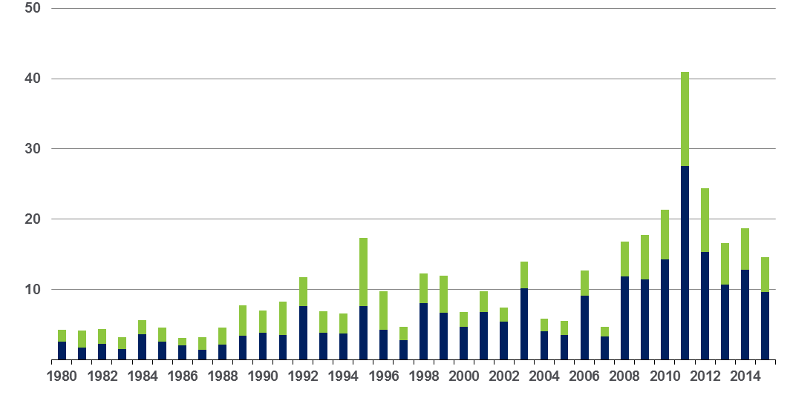
Convective Loss Events in the US Overall and insured losses, 1980 – 2015
Overall losses
(in 2015 values)*
$ Billions
Insured losses
(in 2015 values)*
The period from 2008-2015 has been the most expensive on record for insured losses from “Convective Events” (severe thunderstorms, tornado, hail, lightning and flash flood)
*Losses adjusted to inflation based on CPI
Analysis contains:
severe storm, tornado, hail, flash flood and lightning
72
Source: Geo Risks Research, NatCatSERVICE

Slide 73
US Property CAT Rate on Line Index & Global Reinsurance ROE
US Property CAT ROL
Global Reinsurance ROE
Record traditional capacity, alternative capital and low CAT activity have pressured reinsurance prices; ROEs are own only very modestly
Source: Barclays PLC from Guy Carpenter; Insurance Information Institute.

Slide 74
INDUSTRY DISRUPTORS
Technology, Society and the Economy Are All Changing at a Rapid Pace
Thoughts on the Future
74

Slide 75
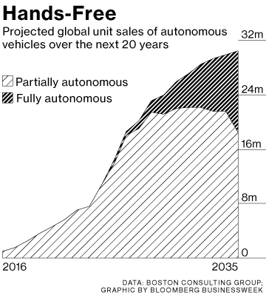
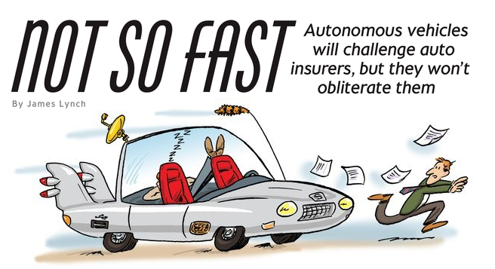
Media is Obsessed with Driverless Vehicles: Often Predicting the Demise of Auto Insurance
By 2035, it is estimated that 25% of new vehicle sales could be fully autonomous models
Questions
Are auto insurers monitoring these trends?
How are they reacting?
Will Google take over the industry?
Will the number of auto insurers shrink?
How will liability shift?
Source: Boston Consulting Group.

Slide 76




On-Demand/Sharing/Peer-to-Peer Economy Impacts Many Lines of Insurance
The “On-Demand” Economy is or will impact many segments of the economy important to P/C insurers
Auto (personal and commercial)
Homeowners/Renters
Many Liability Coverages
Professional Liability
Workers Comp
Many unanswered insurance questions
Insurance solutions are increasingly available to fill the many insurance gaps that arise
76
12/01/09 - 9pm
eSlide – P6466 – The Financial Crisis and the Future of the P/C
Notes:
76

Slide 77






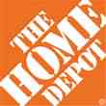

Data Breaches 2005-2015, by Number of Breaches and Records Exposed
# Data Breaches/Millions of Records Exposed
Millions
The total number of data breaches (+27.5%) hit a record high of 783 in 2014, exposing 85.6 million records. Through June 30, this year has seen 117.6 million records exposed in 400 breaches.*
*Figures as of June 30, 2015, from the Identity Theft Resource Center,
http://www.idtheftcenter.org/images/breach/ITRCBreachReport2015.pdf

Slide 78
The Sharing Economy: An Update
The On-Demand Economy Will Transform the American Workforce and the P/C Insurance Industry Too
78

Slide 79

The Sharing Economy Has Grown— And Attracted Political Scrutiny

Slide 80

Political Skepticism About the ‘Gig’ Economy
"Many Americans are making extra money renting out a spare room, designing a website ... even driving their own car. This on demand or so called 'gig' economy is creating exciting opportunities and unleashing innovation, but it's also raising hard questions about workplace protections and what a good job will look like in the future."
--Hillary Clinton,
July 13, 2015
80
12/01/09 - 9pm
eSlide – P6466 – The Financial Crisis and the Future of the P/C
Notes:
80

Slide 81
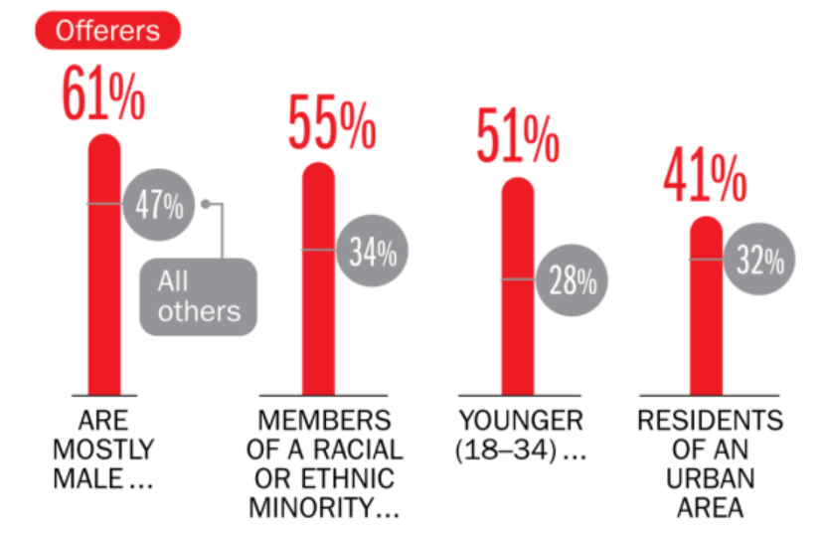
Americans Who Offer Services in the Sharing/Gig Economy Are Statistically More Prone to Workplace Injury
Young, urban minority males are the most likely to offer their services in the sharing economy.
Sources: The SelfEmployed.com accessed at https://www.theselfemployed.com/gig-economy/infographic-inside-the-new-economy/ based on a poll by Time magazine, Bursten-Marsteller and The Aspen Institute; Insurance Information Institute.

Slide 82
THE ‘INTERNET OF THINGS’
Capturing Economic Value Amid a Shifting Insurer Value Chain
82

Slide 83
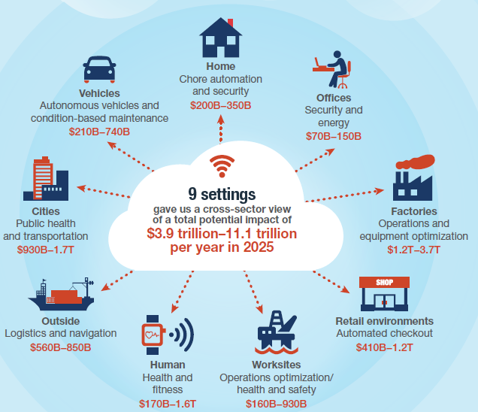
The Internet of Things and the Insurance Industry
The “Internet of Things” will create trillions in economic value throughout the global economy by 2025
What opportunities, challenges will this create for insurers?
What are the impact on the insurance industry “value chain”?
Sources: McKinsey Global Institute, The Internet of Things: Mapping the Value Beyond the Hype,
June 2015; Insurance Information Institute.
83
12/01/09 - 9pm
eSlide – P6466 – The Financial Crisis and the Future of the P/C
Notes:
83

Slide 84
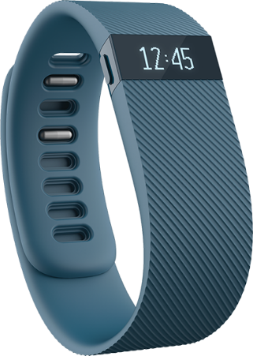

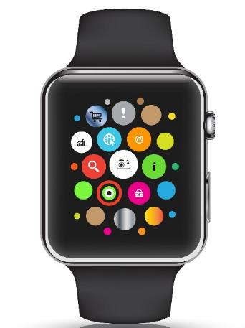

Wearables Show Significant Potential to Reduce Workplace Injury, Death
Wearables Today Can Monitor:
Location
Heart rate
Temperature
Steps/Exertion
Sweat
Sleep
In the Near Future Could Monitor:
Glucose level
Oxygen levels
Pain
Nausea
84
12/01/09 - 9pm
eSlide – P6466 – The Financial Crisis and the Future of the P/C
Notes:
84

Slide 85
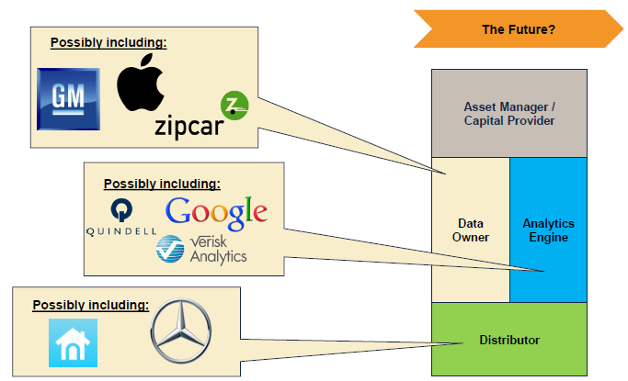
The Internet of Things and the Insurance Industry Value Chain
Who owns the data? Where does It flow? Who does the analytics? Who is the capital provider?
Source: Willis Capital Markets & Advisory; Insurance Information Institute.
85
12/01/09 - 9pm
eSlide – P6466 – The Financial Crisis and the Future of the P/C
Notes:
85

Slide 86
INSURANCE TECHNOLOGY:
FIN TECH ZEROES IN
Number and Value of Deals Is Increasing
In Search of the Elusive Insurance ‘Unicorn’
86

Slide 87
Insurance Technology Financing Trend: Change Is Coming
Insurance tech deals reached a new record in 2016:Q1
($ Millions)
Investment in insurance tech is rising
Source: CB Insights at https://www.cbinsights.com/blog/insurance-tech-overview-q1-2016/; Insurance Information Institute.

Slide 88
Insurance Tech Activity by Area of Interest, 2013 – 2016:Q1
With the ACA in the rear view window, non-health insurance tech accounts for the majority of investment
(Percent)
Silicon Valley and the venture capital community have the insurance industry in their sights. Most will fail. Some will succeed.
Source: CB Insights at https://www.cbinsights.com/blog/insurance-tech-overview-q1-2016/; Insurance Information Institute.

Slide 89
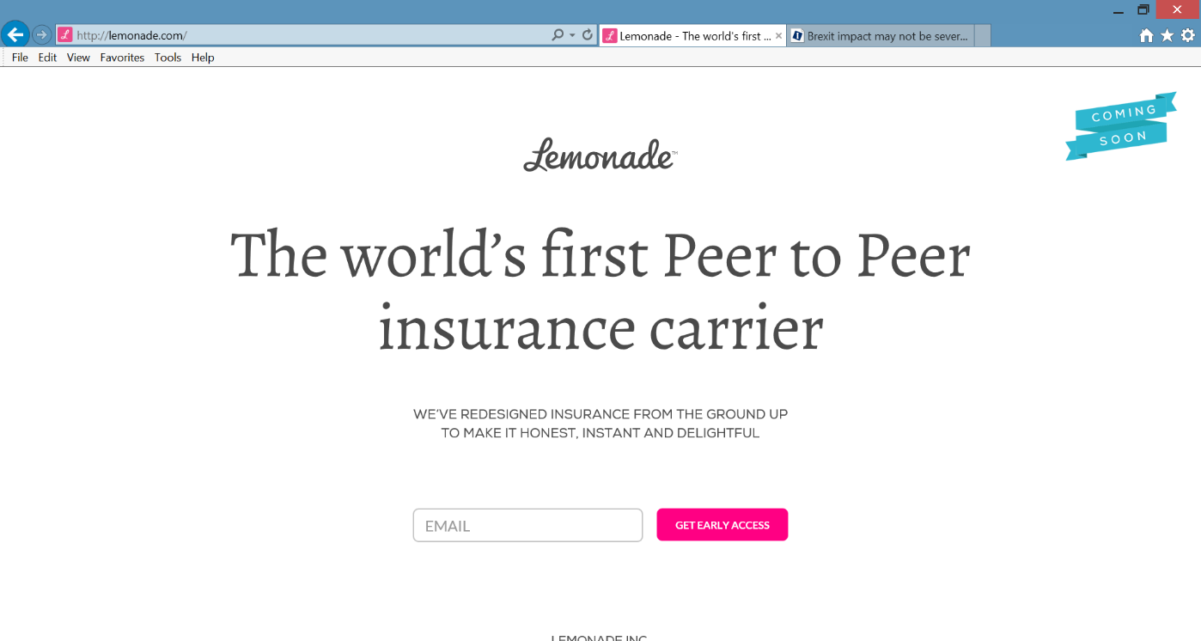
Lemonade: Peer-to-Peer (P2P) Insurance
Source: Lemonade.com accessed June 24, 2016.
89

Slide 90
Lemonade: Sour Words About Insurance
Daniel Schreiber here, with updates from Lemonade.
I’m thrilled to report that a few days ago, by unanimous vote of our board and shareholders, Lemonade became a Public Benefit Corporation, and was also awarded provisional ‘B-Corp’ certification. Both are firsts for an insurance carrier, and are points of tremendous pride for our team.
Rebuilding insurance as a social good, rather than a necessary evil, is now part of our legal mission. Our Chief Behavioral Officer, Professor Dan Ariely, says that “If you tried to create a system to bring out the worst in humans, it would look a lot like the insurance of today.” Working in partnership with nonprofits, and baking giving-back into our business model, holds the promise of a better insurance experience, and a more valuable insurance company.
In other news, I’m happy to say that we’re putting finishing touches on our product and will be ready to launch in New York within weeks. The final step is for us to get our license, and if all goes to plan, we’ll have that shortly.
Be sure to follow us on Twitter, Facebook, and LinkedIn to stay in the know.
Until next time,
Daniel @daschreiber
90
Source: Email from Lemonade CEO Danieal Schreibeir, May 17, 2016.

Slide 91
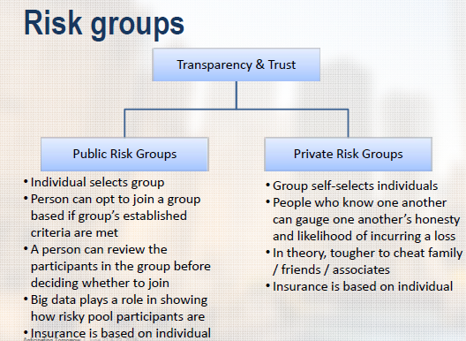
Risk Groups in P2P Structures
P2P model is predicated in part that view that individuals who know one another are likely to have better loss experience
Source: “UberX-ing Insurance : Is Peer-to-Peer Insurance Viable?”, presentation by Jay Sarzen, Aite Group at DrinkerBiddle Insurance Conference, June 21, 2016.
91

Slide 92
Insurance Information Institute Online:
www.iii.org
Thank you for your time and your attention!
Twitter: twitter.com/bob_Hartwig
Download at www.iii.org/presentations

