Slide 1
Financial Literacy and P/C Insurance
NAMIC Merit Society
Washington, DC
September 22, 2014
Steven N. Weisbart, Ph.D., CLU, Senior Vice President & Chief Economist
Insurance Information Institute ♦ 110 William Street ♦ New York, NY 10038
Tel: 212.346.5540 ♦ Cell: 917.494.5945 ♦ stevenw@iii.org ♦ www.iii.org

Slide 2
Financial Literacy is the Skills Necessary to…
Assess financial risks and opportunities
Make informed choices, and
Take effective action to improve one’s financial well-being

Slide 3
Financial Literacy: A 3-Question Test
This test has been administered world-wide to provide a rough indicator of financial literacy among many populations.
3
Notes:
3

Slide 4
The First Financial Literacy Question
If you had $100 in a savings account with an interest rate of 2 percent per year, after 5 years, how much do you think you would have in the account if you left the money to grow?
More than $102
Exactly $102
Less than $102
Don’t know
Refuse to answer

Slide 5
The Second Financial Literacy Question
If the interest rate on your savings account was 1 percent per year and inflation was 2 percent per year, after 1 year with the money in this account would you be able to buy
More than today
Exactly the same as today
Less than today
Don’t know
Refuse to answer

Slide 6
The Third Financial Literacy Question
“Buying a single company stock usually provides a safer return than a stock mutual fund.” This statement is
True
False
Don’t know
Refuse to answer

Slide 7
Financial Literacy by Age Group and Education
Financial literacy is defined here as correctly answering all three questions.*
*The questions ask about interest rates, inflation, and risk diversification (by comparing individual stocks and stock mutual funds). The details are on page 10 of the cited article and in other articles cited by the authors.
Source: Lusardi and Mitchell, “The Economic Importance of Financial Literacy: Theory and Evidence,” Journal of Economic Literature, 2014 (pp. 5-44).

Slide 8
Financial Literacy and P/C Insuracne
A Low Level of Financial Literacy is Probably At Least Partly Responsible for Low Ownership of Flood Insurance
8
Notes:
8

Slide 9
Even Frequent & Severe Floods Haven’t Changed Flood Insurance Ownership Much
Q. Do you have a separate flood insurance policy?¹
After Hurricane Irene
After SuperStorm Sandy
Despite extensive flooding (and wide publicity), few U.S. homeowners say they have a flood insurance policy; moreover, there is no upward trend.
¹Asked of those who have homeowners insurance and who responded “yes”.
Source: Insurance Information Institute Annual Pulse Survey.

Slide 10
Flood Insurance: It’s Not “Fair” for Premiums to Reflect Expected Claims
Q. The federal government plans to raise the price of flood insurance so it reflects the costs of paying claims. Do you believe this is fair?
Q. Do you think that it is fair that people who live in areas affected by record storms in 2011 and 2012 should pay more for their homeowners insurance in the future?
[% Responding “NO”]
Don’t Know
No
Yes
A majority of Americans do not think it is fair for the federal government to raise its flood insurance premiums to better reflect claims payouts or to charge people who live in high-risk areas actuarially-fair premiums.
Source: Insurance Information Institute Annual Pulse Survey.

Slide 11
Why Buy Flood Insurance?
Q. Will the government provide you with funds to pay some of the disaster costs to your property?
Q. Have recent flooding events such as Hurricane Sandy or Hurricane Irene motivated you to buy flood coverage?¹
Don’t know
Percent saying “yes”
Yes
No
30% of Americans believe the government will pay some of their disaster costs.
Source: Insurance Information Institute Annual Pulse Survey.

Slide 12
Can/Should Financial Literacy Be Taught?
The State of Oklahoma is Trying
12
Notes:
12

Slide 13
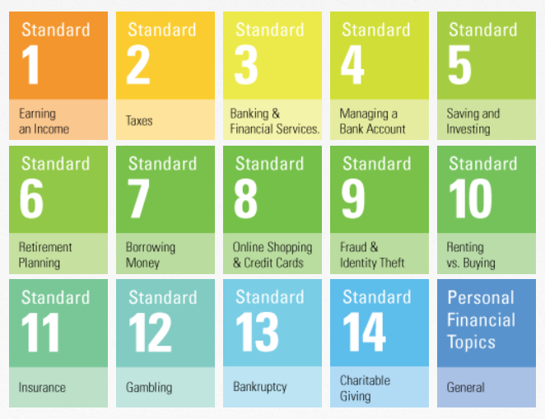
Oklahoma’s 14 Financial Literacy Standards Required for High School Graduation

Slide 14
What Oklahoma’s Insurance Literacy Standard Requires of High School Graduates

Slide 15
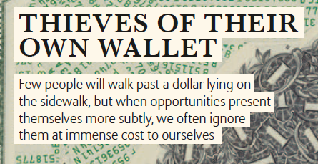
But Instinct and Long-Held Habits Often Dominate Financial Decision-Making
Sources: Allianz, Project M, #18, pp.6 and 22; Insurance Information Institute

Slide 16
Does Education for Financial Literacy Work? Research Is Mixed
A January 2014 report by the World Bank reviewed 188 studies of financial literacy education.
Most showed some improvement in financial decision-making, but many studies were judged to be not rigorous.
Nearly 1 in 4 studies showed little or no benefit from the education
“Financial education will not lead to improved financial behavior, Dan Ariely* believes.”
“The real improvement will come from designing or enforcing mechanisms that make it easy for us to make the right decision, or prevent us from making big mistakes.”
*Dan Ariely, James B. Duke Professor, Duke University, is a leading thinker and writer in the field of behavioral economics Sources: The World Bank Development Research Group, “Can You Help Someone Become Financially Capable?” Policy Research Working Paper #6745; The Ariely quotes are from Allianz, Project M, #18, pp. 22-24; Insurance Information Institute

Slide 17
In Conclusion
17
Notes:
17

Slide 18
Why the Issue of Financial Literacy Is Important for P/C Insurance
Increasingly severe weather increases the likelihood that policyowners will have a significant loss that could be insured.
Research shows that financially literate people are more likely to act, while less-financially-literate people procrastinate and often don’t act
This might help explain why so few people have flood insurance
When new types of exposures arise, financially-literate people are more likely to buy insurance against them

Slide 19
Why the Issue of Financial Literacy Is Important for P/C Insurance
People who don’t understand their policies—or the events they insure against—are likely to blame, or be antagonistic to, insurers and agents
Legislatures might create organizations like the federal Consumer Financial Protection Bureau to “protect” unsophisticated policyowners
Growing numbers of policyholders will be age 80 and over. Many will have cognitive limitations and might become financially illiterate even if they were previously financially literate. Agents and insurers will have to develop strategies for dealing with these people.

Slide 20
P/C Insurance Implications of Financial Illiteracy
It seems likely that financially illiterate people are…
Less likely to buy and renew P/C insurance when they are not required to do so
Less likely to buy and renew P/C insurance even when they are required to do so
Low financial literacy might help to explain high percentages of drivers who don’t have auto insurance
Less likely to buy appropriate policy limits
Less likely to understand policy terms and features (e.g., hurricane deductibles)
More likely to focus on price (because they don’t understand other aspects of the P/C insurance relationship)

Slide 21
Insurance Literacy: A Proposed 3-Question Test
This test has never been administered to anyone but if it were it might provide a rough indicator of property/casualty insurance literacy.
21
Notes:
21

Slide 22
The First Insurance Literacy Question
If you had $500 deductible in your insurance policy and you had $2,000 of damage covered by the policy, how much would the insurance company pay?
$2,000
$1,500
$500
Don’t know
Refuse to answer

Slide 23
The Second Insurance Literacy Question
If your insurance policy had a policy limit of $50,000 and you had $80,000 of damage covered by the policy, how much would the insurance company pay?
$80,000
$50,000
$30,000
Don’t know
Refuse to answer

Slide 24
The Third Insurance Literacy Question
“Insurance policies usually cover several different types of losses in a single policy.” This statement is
True
False
Don’t know
Refuse to answer

Slide 25
Insurance Information Institute Online:
www.iii.org
Thank you for your time and your attention!

