Slide 1
The Shape of Things to Come for P/C Insurance Markets and the American Workplace
NCCI Annual Issues Symposium
Orlando, FL
May 5, 2016
Download at www.iii.org/presentations
Robert P. Hartwig, Ph.D., CPCU, President & Economist
Insurance Information Institute ♦ 110 William Street ♦ New York, NY 10038
Tel: 212.346.5520 ♦ Cell: 917.453.1885 ♦ bobh@iii.org ♦ www.iii.org

Slide 2
P/C Insurance Industry Financial Overview
2015: Second-Best Year in the Post-Crisis Era & Carbon Copy of 2014
Modest CATs, Reserve Releases
Workers Comp Helped Too
2

Slide 3
P/C Industry Net Income After Taxes 1991–2015
$ Millions
2005 ROE*= 9.6%
2006 ROE = 12.7%
2007 ROE = 10.9%
2008 ROE = 0.1%
2009 ROE = 5.0%
2010 ROE = 6.6%
2011 ROAS¹ = 3.5%
2012 ROAS¹ = 5.9%
2013 ROAS¹ = 10.2%
2014 ROAS¹ = 8.4%
2015 ROAS = 8.4%
Net income in 2015 was on par with 2014; ROE unchanged at 8.4%
ROE figures are GAAP; ¹Return on avg. surplus. Excluding Mortgage & Financial Guaranty insurers yields a 8.2% ROAS in 2014, 9.8% ROAS in 2013, 6.2% ROAS in 2012, 4.7% ROAS for 2011, 7.6% for 2010 and 7.4% for 2009; 2015E is annualized figure based actual figure through Q3 of $44.0
Sources: A.M. Best, ISO; Insurance Information Institute

Slide 4
Profitability Peaks & Troughs in the P/C Insurance Industry, 1975 – 2015
ROE
1977:19.0%
History suggests next ROE peak will be in 2016-2017
1987:17.3%
10 Years
1997:11.6%
2006:12.7%
10 Years
2015: 8.4%
2013 9.8%
9 Years
2014 8.4%
1975: 2.4%
1984: 1.8%
1992: 4.5%
2001: -1.2%
*Profitability = P/C insurer ROEs. 2011-15 figures are estimates based on ROAS data. Note: Data for 2008-2014 exclude mortgage and financial guaranty insurers.
Source: Insurance Information Institute; NAIC, ISO, A.M. Best, Conning

Slide 5
P/C Insurance Industry Combined Ratio, 2001–2015*
Heavy Use of Reinsurance Lowered Net Losses
Relatively Low CAT Losses, Reserve Releases
Higher CAT Losses, Shrinking Reserve Releases, Toll of Soft Market
As Recently as 2001, Insurers Paid Out Nearly $1.16 for Every $1 in Earned Premiums
Relatively Low CAT Losses, Reserve Releases
Avg. CAT Losses, More Reserve Releases
3 Consecutive Years of U/W Profits: First Time Since 1971-73
Best Combined Ratio Since 1949 (87.6)
Sandy Impacts
Cyclical Deterioration
Lower CAT Losses
* Excludes Mortgage & Financial Guaranty insurers 2008--2014. Including M&FG, 2008=105.1, 2009=100.7, 2010=102.4, 2011=108.1; 2012:=103.2; 2013: = 96.1; 2014: = 97.0.
Sources: A.M. Best, ISO (2014-2015); Figure for 2010-2013 is from A.M. Best P&C Review and Preview, Feb. 16, 2016.

Slide 6
Number of Years with Underwriting Profits by Decade, 1920s–2010s
Number of Years with Underwriting Profits
Underwriting Profit in 2016?
Would be the first time since the 1970s with 4+ underwriting profits
Underwriting profits were common before the 1980s: 40 of the 60 years before 1980 had combined ratios below 100, but then they vanished. Not a single underwriting profit was recorded in the 25 years from 1979 through 2003.
* 2009 combined ratio excl. mort. and finl. guaranty insurers was 99.3, which would bring the 2000s total to 4 years with an u/w profit.
**Data for the 2010s is for the period 2010 through 2015.
Note: Data for 1920–1934 based on stock companies only.
Sources: Insurance Information Institute research from A.M. Best Data.
6
12/01/09 - 9pm
eSlide – P6466 – The Financial Crisis and the Future of the P/C
Notes:
6

Slide 7
P/C Insurance Loss Reserve Development, 1992 – 2017E*
Reserve releases are expected to gradually taper off slowly, but will continue to benefit the bottom line and combined ratio through at least 2017
Reserve Change
Source: A.M. Best; Barclays research for estimates.

Slide 8
Policyholder Surplus, 2006:Q4–2015:Q4
($ Billions)
2007:Q3 Pre-Crisis Peak
Drop due to near-record 2011 CAT losses
Surplus as of 12/31/15 stood at a near-record high $673.7B
The industry now has $1 of surplus for every $0.76 of NPW, close to the strongest claims-paying status in its history.
2010:Q1 data includes $22.5B of paid-in capital from a holding company parent for one insurer’s investment in a non-insurance business .
The P/C insurance industry entered 2016 in very strong financial condition.
Sources: ISO, A.M .Best.
8
12/01/09 - 9pm
eSlide – P6466 – The Financial Crisis and the Future of the P/C
Notes:
8

Slide 9
Net Premium Growth (All P/C Lines): Annual Change, 1971—2015
(Percent)
1975-78
1984-87
2000-03
Net Written Premiums Fell 0.7% in 2007 (First Decline Since 1943) by 2.0% in 2008, and 4.2% in 2009, the First 3-Year Decline Since 1930-33.
Outlook
2016F: 3.9%
2017F: 3.8%
2015: 3.4%
2014: 4.2%
2013: 4.4%
2012: +4.2%
Shaded areas denote “hard market” periods
Sources: A.M. Best (1971-2013), ISO (2014-15).

Slide 10
NPW Premium Growth: Peaks & Troughs in the P/C Insurance Industry, 1926 – 2015
ROE
Post WW II Peak:
1947: 26.2%
1970-90: Peak premium growth was much higher in this period while troughs were comparable. Rapid inflation, economic volatility, high interest rates, tort environment all played roles
Start of WW II
1941: 15.8%
Economic Shocks, Inflation:
1976: 22.0%
Tort Crisis
1985/86: 22.2%
Post-9/11
2002:15.3%
1988-2000: Period of inter-cycle stability
2015 3.4%
1950-70: Extended period of stability in growth and profitability. Low interest rates, low inflation, “Bureau” rate regulation all played a role
2010-20XX? Post-recession period of stable growth?
Twin Recessions; Interest Rate Hikes
1987: 3.7%
Great Recession:2010: -4.9%
Great Depression
1932: -15.9% max drop
Note: Data through 1934 are based on stock companies only. Data include state funds beginning in 1998.
Source: A.M. Best; Insurance Information Institute.

Slide 11
Direct Premiums Written: Comm. Lines Percent Change by State, 2007-2015
Top 25 States
44 states showed commercial lines growth from 2007 through 2015
Growth Benchmarks: Commercial
US: 9.0%
Sources: NAIC via SNL Financial; Insurance Information Institute.

Slide 12
Direct Premiums Written: Comm. Lines Percent Change by State, 2007-2015
Bottom 25 States
Eight states still write less commercial business than they did in 2007
Sources: NAIC via SNL Financial; Insurance Information Institute.

Slide 13
Direct Premiums Written: Workers’ Comp Percent Change by State, 2007-2015*
Top 25 States
27 states showed positive growth in the workers comp line from 2007 – 2015 (up from 13 through 2013 and 5 through 2012).
*Excludes monopolistic fund states: ND, OH, WA, WY as well as WV, which transitioned to a competitive structure during this period.
Sources: NAIC data, sourced from S&P Global Market Intelligence; Insurance Information Institute.

Slide 14
Direct Premiums Written: Worker’s Comp Percent Change by State, 2007-2015*
Bottom 25 States
States with the poorest performing economies also produced some of the most negative net change in premiums of the past 8 years
*Excludes monopolistic fund states: ND, OH, WA, WY as well as WV, which transitioned to a competitive structure during this period.
Sources: NAIC data, sourced from S&P Global Market Intelligence; Insurance Information Institute.

Slide 15
U.S. INSURANCE MERGERS AND ACQUISITIONS, P/C SECTOR, 1994-2015E (1)
M&A activity in 2015 will likely reach its highest level since 1998
($ Millions)
M&A activity in the P/C sector was up sharply in 2015
(1) Includes transactions where a U.S. company was the acquirer and/or the target.
Source: Conning proprietary database; 2015 I.I.I. estimate.

Slide 16
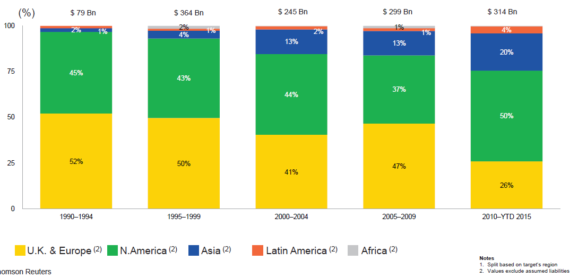
M&A Activity Is Shifting Toward North America and Asia and Away from Europe
Asian, N. American deal volumes were up sharply in 2015
.
Source: Thomson Reuters as of Oct. 2015 from Geneva Association Newsletter Insurance and Finance, Jan. 2016, presentation “Facts vs. Sentiment: Deals in the Insurance Sector,” by Aviva CEO Mark Wilson.

Slide 17
INVESTMENTS: THE NEW REALITY
Investment Performance is a Key Driver of Profitability
Depressed Yields Will Necessarily Influence Underwriting & Pricing
17

Slide 18
Property/Casualty Insurance Industry Investment Income: 2000–2015¹
Investment earnings are still below their 2007 pre-crisis peak
($ Billions)
Due to persistently low interest rates, investment income fell in 2012, 2013 and 2014 but showed a small (1.9%) increase in 2015—a trend that may continue.
¹ Investment gains consist primarily of interest and stock dividends. Sources: ISO; Insurance Information Institute.

Slide 19
U.S. Treasury Security Yields: A Long Downward Trend, 1990–2016*
Yields on 10-Year U.S. Treasury Notes have been essentially below 5% for more than a decade.
Despite the Fed’s December 2015 rate hike, yield remain low though short-term yields have seen some gains
Since roughly 80% of P/C bond/cash investments are in 10-year or shorter durations, most P/C insurer portfolios will have low-yielding bonds for years to come.
*Monthly, constant maturity, nominal rates, through March 2016.
Sources: Federal Reserve Bank at http://www.federalreserve.gov/releases/h15/data.htm. National Bureau of Economic Research (recession dates); Insurance Information Institute.
19
12/01/09 - 9pm
eSlide – P6466 – The Financial Crisis and the Future of the P/C
Notes:
19

Slide 20
Net Investment Yield on Property/ Casualty Insurance Invested Assets, 2007–2016P*
(Percent)
Estimated book yield in 2016 is down about 140 BP from pre-crisis levels
The yield on invested assets remains low relative to pre-crisis yields. The Fed’s plan to raise interest rates in late 2015 has pushed up some yields, albeit quite modestly.
Sources: A.M. Best; 2015E-2016P figures from A.M. Best P/C Review and Preview, Feb. 2016; Insurance Information Institute

Slide 21
Interest Rate Forecasts: 2016 – 2021
Yield (%)
3-Month Treasury
10-Year Treasury
The end of the Fed’s QE program in 2014 and a stronger economy have yet to push longer-term yields much higher
A full normalization of interest rates is unlikely until 2019, more than a decade after the onset of the financial crisis.
Sources: Blue Chip Economic Indicators (4/16 for 2016 and 2017; for 2018-2021 3/16 issue); Insurance Info. Institute.

Slide 22
Profitability & Politics
How Is Profitability Affected by the President’s Political Party?
22

Slide 23
P/C Insurance Industry ROE by Presidential Administration, 1950-2014*
OVERALL RECORD: 1950-2015*
Democrats 7.72%
Republicans 7.85%
Party of President has marginal bearing on profitability of P/C insurance industry
*Truman administration ROE of 6.97% based on 3 years only, 1950-52;.
Source: Insurance Information Institute

Slide 24
Trump vs. Clinton: Issues that Matter to P/C Insurers
Issue | Trump | Clinton
Economy | Supply Side-Like Philosophy: Lower taxes→Faster real GDP growth; Deficits likely grow as tax cuts are combined with targeted increased spending on Homeland Security, Defense, etc. | Keynesian Philosophy: More government spending on infrastructure, education, social services; Deficits likely increase as tax increases likely difficult to pass
Interest Rates | May trend higher with larger deficits; Shift from monetary policy to fiscal focus (tax cuts, government spending) | Status quo at the Fed; Net impact on interest rates unclear
Taxes | Favors lower tax rates for corporate and personal income tax rates; Tax code overhaul? | Unlikely to reduce taxes or embark on major overhaul of tax code
International Trade | Protectionist Tendencies (appeal primarily to manufacturing sector) | Has criticized Trans-Pacific Partnership but is a realist on international matters
Tort System | Doesn’t like trial lawyers but seems to like filing lawsuits | Status Quo
Health Care | ACA should be repealed & replaced | Incremental Change

Slide 25
2015 Property and Casualty Insurance Regulatory Report Card
C
AK
AL
A
WA
ME
C
MT
B
ND
C
VT
D
MN
D
NH
B
OR
ID
C+
C
NY
MA
= A
= B
= C
= D
= F
= NG
B
SD
B+
WI
MI
CT
RI C+
B
B
NJ
WY
PA
C
B
B+
IA
B
C-
A
C+
OH
MD
NV
NE
A-
IL
IN
DE
B+
WV
B
UT
B
C
VA
CO
C+
A
B
A
B
KS
MO
KY
CA
B
A
F
D
A-
TN
NC
C
AZ
NM
OK
C
AR
C
SC
Source: James Madison Institute, February 2008.
A-
D
HI
B
B
AL
B
MS
C
GA
LA
D+
TX
D
Not Graded: District of Columbia
FL
D
D
Source: R Street Insurance Regulation Report Card, December 2015

Slide 26
Labor Markets Trends:
Recovery Continues in 2016
2015
Largest Job Gains in Many Years
Unemployment Rate Fell to Lowest Level Since 2008
Payrolls Expanded to Record High
26

Slide 27
Unemployment and Underemployment Rates: Still Falling
January 2000 through March 2016, Seasonally Adjusted (%)
For U-6, 8% to 10% is “normal.”
U-6 went from 8.0% in March 2007 to 17.5% in October 2009
U-6 was 9.8% in March 2016.
“Headline” unemployment was 5.0% in March 2016. 4% to 6% is “normal.”
High unemployment and underemployment constrained overall economic growth for years, but the job market is clearly improving.
Source: US Bureau of Labor Statistics; Insurance Information Institute.
27
12/01/09 - 9pm
eSlide – P6466 – The Financial Crisis and the Future of the P/C
Notes:
27

Slide 28
US Unemployment Rate Forecast
Rising unemployment eroded payrolls and WC’s exposure base.
Unemployment peaked at 10% in late 2009.
2007:Q1 to 2017:Q4F*
Jobless figures have been revised downwards for 2016
Unemployment forecasts have been revised modestly downwards. Optimistic scenarios put the unemployment as low as 4.4% by Q4 of 2016.
* = actual; = forecasts
Sources: US Bureau of Labor Statistics; Blue Chip Economic Indicators (4/16 edition); Insurance Information Institute.

Slide 29
Unemployment Rates by State, March 2016: Highest 25 States*
In March, 21 states had over-the-month unemployment rate decreases, 15 states had increases, and 14 states and the District of Columbia had no change.
Residual impacts of the housing collapse, weak economies are holding back several states
*Provisional figures for March 2016, seasonally adjusted.
Sources: US Bureau of Labor Statistics; Insurance Information Institute.

Slide 30
Unemployment Rates by State, March 2016:
Lowest 25 States*
In March, 21 states had over-the-month unemployment rate decreases, 15 states had increases, and 14 states and the District of Columbia had no change.
Strength in Energy, Agricultural States-most also avoided housing bust
*Provisional figures for March 2016, seasonally adjusted.
Sources: US Bureau of Labor Statistics; Insurance Information Institute.

Slide 31
Nonfarm Payroll (Wages and Salaries): Quarterly, 2005–2016:Q1
Billions
Latest (2016:Q1) was $8.03 trillion, a new peak--$1.80 trillion (29%) above 2009 trough
Prior Peak was 2008:Q3 at $6.54 trillion
Growth rates 2011:Q1 over 2010:Q1: 5.5% 2012:Q1 over 2011:Q1: 4.2% 2013:Q1 over 2012:Q1: 2.5% 2014:Q1 over 2013:Q1: 4.3% 2015:Q1 over 2014:Q1: 4.5% 2016:Q1 over 2015:Q1: 4.5%
Recent trough (2009:Q1) was $6.23 trillion, down 5.3% from prior peak
Note: Recession indicated by gray shaded column. Data are seasonally adjusted annual rates.
Sources: http://research.stlouisfed.org/fred2/series/WASCUR; National Bureau of Economic Research (recession dates); Insurance Information Institute.
31
12/01/09 - 9pm
eSlide – P6466 – The Financial Crisis and the Future of the P/C
Notes:
31

Slide 32
Payroll vs. Workers Comp Net Written Premiums, 1990-2015E
Payroll Base* WC NWP
$Billions $Billions
7/90-3/91
3/01-11/01
12/07-6/09
WC premium volume dropped two years before the recession began
WC net premiums written were down $14B or 29.3% to $33.8B in 2010 after peaking at $47.8B in 2005
Continued payroll growth and rate gains suggest WC NWP will
grow again in 2016.
*Private employment; Shaded areas indicate recessions. WC premiums are from NCCI through 2014; I.I.I. estimate for 2015.
Sources: NBER (recessions); Federal Reserve Bank of St. Louis at http://research.stlouisfed.org/fred2/series/WASCUR (annualized as of Q4 2015); NCCI; I.I.I.

Slide 33
POSITIVE LABOR MARKET DEVELOPMENTS
Key Factors Driving Workers Compensation Exposure
33

Slide 34
Average Weekly Hours of All Private Workers, March 2006—March 2016
(Hours Worked)
Hours worked plunged during the recession, impacting payroll exposures
Hours worked totaled 34.4 per week in March, just shy of the 34.6 hours typically worked before the “Great Recession”
*Seasonally adjusted
Note: Recessions indicated by gray shaded columns.
Sources: US Bureau of Labor Statistics at http://www.bls.gov/data/#employment; National Bureau of Economic Research (recession dates); Insurance Information Institute.
34
12/01/09 - 9pm
eSlide – P6466 – The Financial Crisis and the Future of the P/C
Notes:
34

Slide 35
Average Hourly Wage of All Private Workers, March 2006—March 2016
(Hourly Wage)
Wage gains continued during the recession, despite massive job losses
The average hourly wage was $26.43 in March 2016, up 19.8% from $21.22 when the recession began in Dec. 2007
*Seasonally adjusted
Note: Recessions indicated by gray shaded columns.
Sources: US Bureau of Labor Statistics at http://www.bls.gov/data/#employment; National Bureau of Economic Research (recession dates); Insurance Information Institute.
35
12/01/09 - 9pm
eSlide – P6466 – The Financial Crisis and the Future of the P/C
Notes:
35

Slide 36
ADVERSE LONG-TERM
LABOR MARKET DEVELOPMENTS
Key Factors Harming Workers Compensation Exposure and the Overall Economy
36

Slide 37
Labor Force Participation Rate, Jan. 2002—March 2016*
Labor Force Participation as a % of Population
Labor force participation remains far below pre-recession levels but has improved modestly in recent months
Large numbers of people are exiting (or not returning to the labor force)
*Defined as the percentage of working age persons in the population who are employed or actively seeking work.
Note: Recessions indicated by gray shaded columns.
Sources: US Bureau of Labor Statistics at http://www.bls.gov/data/; National Bureau of Economic Research (recession dates); Insurance Information Institute.
37
12/01/09 - 9pm
eSlide – P6466 – The Financial Crisis and the Future of the P/C
Notes:
37

Slide 38
Number of “Discouraged Workers,” Jan. 2002—March 2016
Thousands
“Discouraged Workers” are people who have searched for work for so long in vain that they actually stop searching and drop out of the labor force
Large numbers of people exited the labor force and were slow to return
There were 585,000 discouraged workers in March 2016, down from 738,000 a year earlier
In recent good times, the number of discouraged workers ranged from 200,000-400,000 (1995-2000) or from 300,000-500,000 (2002-2007).
Notes: Recessions indicated by gray shaded columns. Data are seasonally adjusted.
Sources: Bureau of Labor Statistics http://www.bls.gov/news.release/empsit.a.htm ; NBER (recession dates); Ins. Info. Inst.
38
12/01/09 - 9pm
eSlide – P6466 – The Financial Crisis and the Future of the P/C
Notes:
38

Slide 39
CONSTRUCTION INDUSTRY OVERVIEW & OUTLOOK
The Construction Sector Is Critical to the Economy and the P/C Insurance Industry
39

Slide 40
Value of New Private Construction: Residential & Nonresidential, 2003-2016*
2016: Value of new pvt. construction hits $846.2B as of Feb. 2016, up 69.0% from the 2010 trough but still 7.2% below 2006 peak
New Construction peaks at $911.8. in 2006
Billions of Dollars
Trough in 2010 at $500.6B, after plunging 55.1% ($411.2B)
$613.7
$447.9
$298.1
$261.8
$398.3
$238.8
Private Construction Activity Is Moving in a Positive Direction though Remains Well Below Pre-Crisis Peak; Residential Dominates
*2016 figure is a seasonally adjusted annual rate as of February.
Sources: US Department of Commerce http://www.census.gov/construction/c30/c30index.html ; Insurance Information Institute.
40
12/01/09 - 9pm
eSlide – P6466 – The Financial Crisis and the Future of the P/C
Notes:
40

Slide 41
Value of Construction Put in Place, 2016 vs. 2015*
Growth (%)
Private: +10.6%
Public: +9.2%
Public sector construction activity is finally beginning to create less drag after years of decline
Private sector construction activity is up in both the residential and nonresidential segments
Overall construction activity is up again after languishing in early 2015; state/local government sector may be recovering as budget woes ease in some jurisdictions.
*seasonally adjusted data through February 2016. Source: U.S. Census Bureau, http://www.census.gov/construction/c30/c30index.html ; Insurance Information Institute.

Slide 42
New Private Housing Starts, 1990-2021F
Job growth, low inventories of existing homes, still-low mortgage rates and demographics should continue to stimulate new home construction for several more years
(Millions of Units)
New home starts plunged 72% from 2005-2009; A net annual decline of 1.49 million units, lowest since records began in 1959
Insurers are continuing to see meaningful exposure growth in the wake of the “Great Recession”; Construction is a potent driver of workers comp exposure.
Source: U.S. Department of Commerce; Blue Chip Economic Indicators (4/16 for 2016-17; 3/16 for 2018-21F; Insurance Information Institute.

Slide 43
Value of New Federal, State and Local Government Construction: 2003-2016*
Construction across all levels of government peaked at $314.9B in 2009
Austerity Reigns
Govt. construction MAY finally be turning around; still down $17.1B or 5.4% since 2009 peak
($ Billions)
Government construction spending peaked in 2009, helped by stimulus spending, but contracted as state/local governments grappled with deficits and federal sequestration--only now recovering.
*2016 figure is a seasonally adjusted annual rate as of February; http://www.census.gov/construction/c30/historical_data.html
Sources: US Department of Commerce; Insurance Information Institute.

Slide 44
Construction Employment, Jan. 2010—March 2016*
(Thousands)
Construction employment is +1.237 million above Jan. 2011 (+22.8%) trough
Construction and manufacturing employment constitute 1/3 of all WC payroll exposure.
*Seasonally adjusted.
Sources: US Bureau of Labor Statistics at http://data.bls.gov; Insurance Information Institute.
44
12/01/09 - 9pm
eSlide – P6466 – The Financial Crisis and the Future of the P/C
Notes:
44

Slide 45
Construction Employment, Jan. 2003–March 2016
(Thousands)
Construction employment as of March 2016 totaled 6.672 million, an increase of 1.237MM jobs or 22.8% from the Jan. 2011 trough
Construction employment peaked at 7.726 million in April 2006
Gap between pre-recession construction peak and today: 1.05 million jobs
The “Great Recession” and housing bust destroyed 2.3 million constructions jobs
Construction employment troughed at 5.435 million in Jan. 2011, after a loss of 2.291 million jobs, a 29.7% plunge from the April 2006 peak
The construction sector was a growth leader in 2014-16 as the housing market, private investment, and govt. spending recover. WC isurers continue to benefit.
Note: Recession indicated by gray shaded column.
Sources: U.S. Bureau of Labor Statistics; Insurance Information Institute.
45
12/01/09 - 9pm
eSlide – P6466 – The Financial Crisis and the Future of the P/C
Notes:
45

Slide 46
MANUFACTURING & ENERGY SECTOR OVERVIEW & OUTLOOK
The U.S. Manufacturing and Energy Sectors Are Being Buffeted by a High Dollar, Weak Export Markets and Plunging Oil Prices
46

Slide 47
ISM Manufacturing Index
(Values > 50 Indicate Expansion)
January 2010 through April 2016
Manufacturing began to contract in late 2015 but seems to be rebounding
The manufacturing sector expanded for 70 of the 76 months from Jan. 2010 through Apr. 2016. Manufacturing sector has weakened recently due to weakness abroad, strong dollar and collapse in oil prices.
Source: Institute for Supply Management at http://www.ism.ws/ismreport/mfgrob.cfm; Insurance Information Institute.

Slide 48
Dollar Value* of Manufacturers’ Shipments Monthly, Jan. 1992—Feb. 2016
$ Millions
The value of Manufacturing Shipments in Feb. 2016 was $462.8B—down 9% from the July 2014 record high of $508.1B
Weakness abroad, falling energy prices and a strong dollar are hurting the manufacturing sector, especially exports. Manufacturing growth leads to gains in many commercial exposures: WC, commercial auto, marine, property, and various liability coverages.
* Seasonally adjusted; Data published Apr. 4, 2016. Source: U.S. Census Bureau, Full Report on Manufacturers’ Shipments, Inventories, and Orders, http://www.census.gov/manufacturing/m3/
48
12/01/09 - 9pm
eSlide – P6466 – The Financial Crisis and the Future of the P/C
Notes:
48

Slide 49
Manufacturing Growth for Selected Sectors, 2016 vs. 2015*
Growth (%)
Durables: +1.3%
Non-Durables: -5.3%
Manufacturing of non-durable goods is weaker than for durables
Manufacturing is contracting across a number of sectors, especially petroleum and coal. Adverse exposure impacts are likely for: WC, commercial property, commercial auto and certain liability coverages.
*Seasonally adjusted; Date are YTD comparing data through February 2016 to the same period in 2015. Source: U.S. Census Bureau, Full Report on Manufacturers’ Shipments, Inventories, and Orders, http://www.census.gov/manufacturing/m3/

Slide 50
Manufacturing Employment, Jan. 2010—March 2016*
(Thousands)
Since Jan 2010, manufacturing employment is up (+831,000 or +7.3%) and is now falling
Manufacturing employment in March fell to its lowest level since Dec. 2014
Manufacturing employment has been a surprising source of strength in the economy. Global economic weakness, falling oil prices have hurt.
*Seasonally adjusted.
Sources: US Bureau of Labor Statistics at http://data.bls.gov; Insurance Information Institute.
50
12/01/09 - 9pm
eSlide – P6466 – The Financial Crisis and the Future of the P/C
Notes:
50

Slide 51
Employment in Oil & Gas Extraction, Jan. 2010—March 2016*
Employment peaked in Oct. 2014 at 201,500—its highest level since Dec. 1986.
(000)
Oil and gas extraction employment is down 11.2% since Oct. 2014 as oil prices sink
*Seasonally adjusted
Sources: US Bureau of Labor Statistics at http://data.bls.gov; Insurance Information Institute.
51
12/01/09 - 9pm
eSlide – P6466 – The Financial Crisis and the Future of the P/C
Notes:
51

Slide 52
The Sharing Economy: An Update
The On-Demand Economy Will Transform the American Workforce and the P/C Insurance Industry Too
52

Slide 53

The Sharing Economy Has Grown— And Attracted Political Scrutiny

Slide 54

Political Skepticism About the ‘Gig’ Economy
"Many Americans are making extra money renting out a spare room, designing a website ... even driving their own car. This on demand or so called 'gig' economy is creating exciting opportunities and unleashing innovation, but it's also raising hard questions about workplace protections and what a good job will look like in the future."
--Hillary Clinton,
July 13, 2015
54
12/01/09 - 9pm
eSlide – P6466 – The Financial Crisis and the Future of the P/C
Notes:
54

Slide 55


Regulatory Issues Abound as Well, With Implications for Insurance Coverages
A driver for Uber is an employee, not a
contractor, according to a California
Ruling that eventually could push up costs
‘for the smartphone-based ride hailing service
and hurt the closely watched start-up's valuation.
The California Labor Commissioner's decision could ripple through the burgeoning industry of providing services via smartphones, with potential implications for other “crowdsourced” services such as Uber rival Lyft, chore service TaskRabbit, and cleaning service Homejoy.
--Reuters, June 18, 2015
55
12/01/09 - 9pm
eSlide – P6466 – The Financial Crisis and the Future of the P/C
Notes:
55

Slide 56
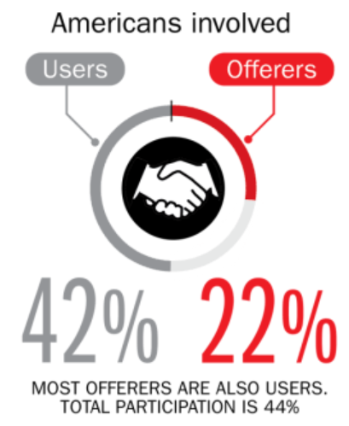
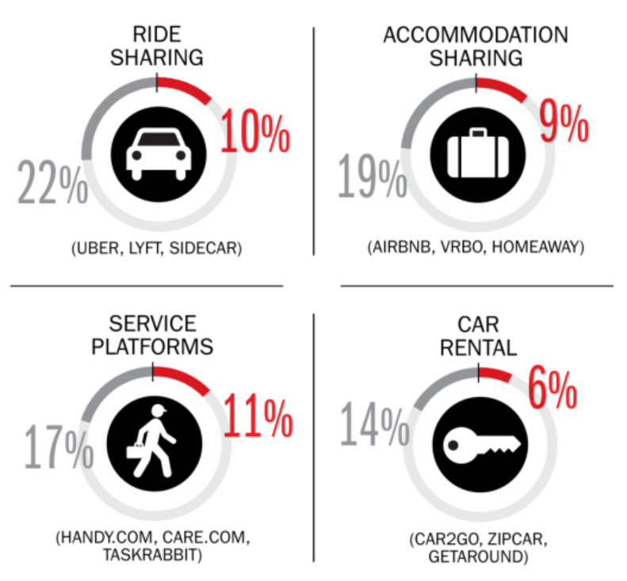
Percent of Americans Who Have Engaged in the “Gig/Sharing Economy” by Transaction
Drivers have significant WC exposures
Service platforms have the most direct link to WC; 11% of Americans have offered their services
About 22% of Americans have offered services in the sharing economy.
Sources: The SelfEmployed.com accessed at https://www.theselfemployed.com/gig-economy/infographic-inside-the-new-economy/ based on a poll by Time magazine, Bursten-Marsteller and The Aspen Institute; Insurance Information Institute.

Slide 57
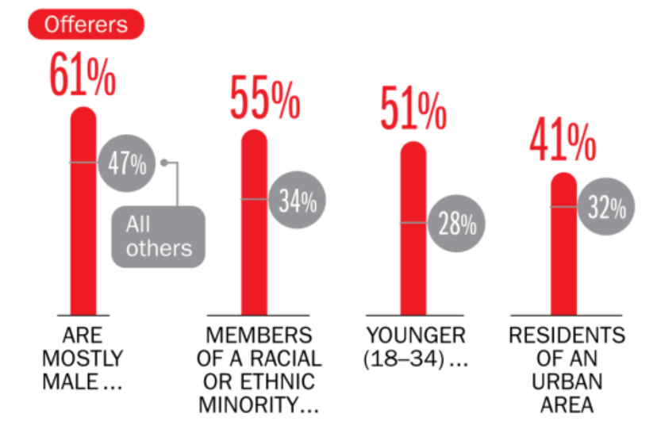
Americans Who Offer Services in the Sharing/Gig Economy Are Statistically More Prone to Workplace Injury
Young, urban minority males are the most likely to offer their services in the sharing economy.
Sources: The SelfEmployed.com accessed at https://www.theselfemployed.com/gig-economy/infographic-inside-the-new-economy/ based on a poll by Time magazine, Bursten-Marsteller and The Aspen Institute; Insurance Information Institute.

Slide 58
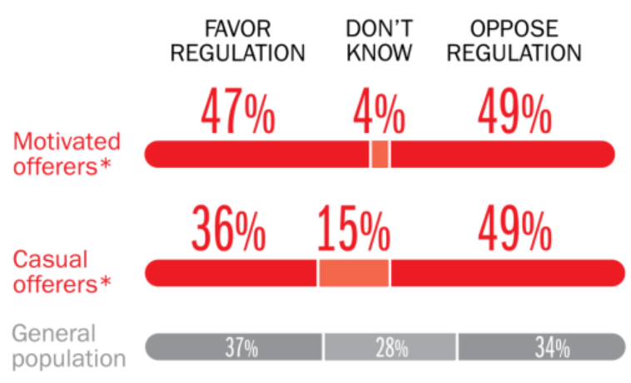
Opinions Are Split on Whether the Sharing Economy Needs More Regulation
The most frequent offerers of services though online platforms are equally divided over the need for more regulation
Sources: The SelfEmployed.com accessed at https://www.theselfemployed.com/gig-economy/infographic-inside-the-new-economy/ based on a poll by Time magazine, Bursten-Marsteller and The Aspen Institute; Insurance Information Institute.

Slide 59
THE ‘INTERNET OF THINGS’
Capturing Economic Value Amid a Shifting Insurer Value Chain
59

Slide 60
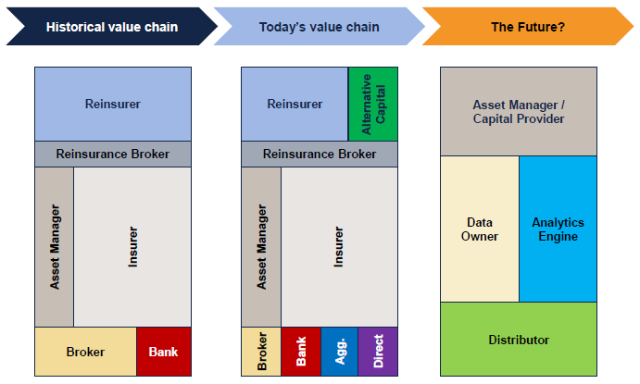
The Internet of Things and the Insurance Industry Value Chain
The insurance industry value chain Is changing for many reasons.
Source: Willis Capital Markets & Advisory; Insurance Information Institute.
60
12/01/09 - 9pm
eSlide – P6466 – The Financial Crisis and the Future of the P/C
Notes:
60

Slide 61
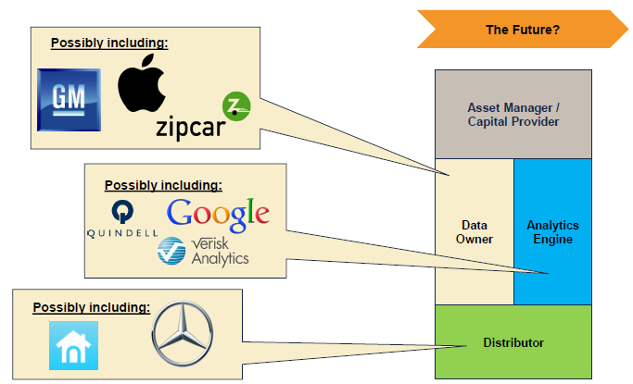

The Internet of Things and the Insurance Industry Value Chain
Who owns the data? Where does It flow? Who does the analytics? Who is the capital provider?
Source: Willis Capital Markets & Advisory; Insurance Information Institute.
61
12/01/09 - 9pm
eSlide – P6466 – The Financial Crisis and the Future of the P/C
Notes:
61

Slide 62
OCCUPATIONAL DEATHS IN TRANSPORTATION:
IS TECHNOLOGY THE SOLUTION?
Technology Promises Safer Vehicles, Highways But How Much of this Is Silicon Valley Hype?
62

Slide 63

#RiskyRide
SXSW
March 13, 2016, Austin, TX

Slide 64
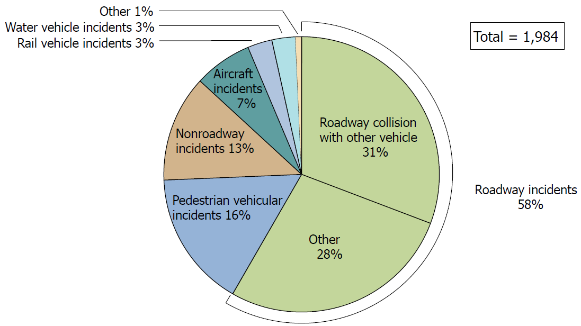
Fatal Occupational Injuries Due to Transportation Incidents
Roadway incidents accounted for nearly 60% of all transportation incidents in 2014
Source: US Bureau of Labor Statistics http://www.bls.gov/iif/oshwc/cfoi/cfch0013.pdf; Insurance Information Institute.

Slide 65
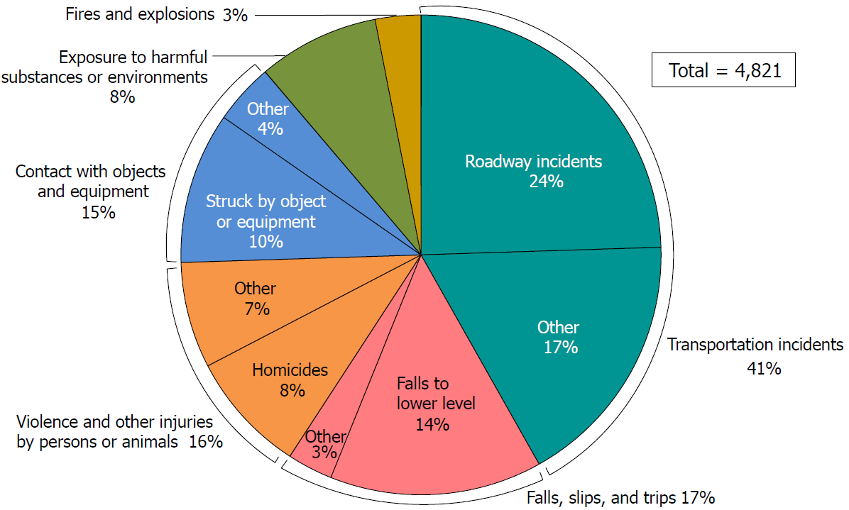
Fatal Occupational Injuries by Event: Transportation Accidents Lead by Far
Transportation incidents accounted for 41% all occupational deaths in 2014 (1,984 our of 4,821 total)
Source: US Bureau of Labor Statistics http://www.bls.gov/iif/oshwc/cfoi/cfch0013.pdf; Insurance Information Institute.

Slide 66
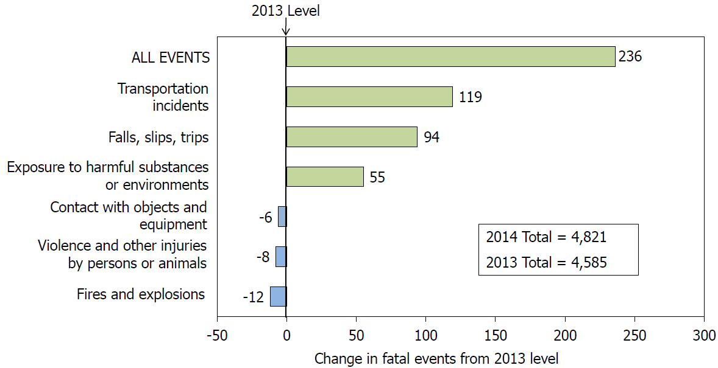
Transportation Incidents Accounted for the Majority of Occupation Deaths in 2014
Transportation incidents accounted for 50% of the net increase in work-related deaths in 2014
New technologies make reducing occupation deaths and injuries from transportation incidents relatively “low-hanging fruit.”
Source: US Bureau of Labor Statistics http://www.bls.gov/iif/oshwc/cfoi/cfch0013.pdf; Insurance Information Institute.

Slide 67
Deaths Involving Crashes with Large Trucks: Room for Improvement
Deaths
2004 = 5,099 Deaths
2014 = 3,660 Deaths
Trucks crashes killed 33% fewer passenger vehicle occupants and 21% fewer truck occupants but only 6% fewer pedestrians, cyclists, etc.
Future Shock in WC:
Cyber risks loom loom large
Despite improvements (-28% from 2004-2014), truck crashes kill thousands of people every year. New technology could radically reduce occupational and non-occupational injuries and deaths from truck crashes.
*includes Other and Unknown. Source: Source: IIHS analysis of data from the U.S. Department of Transportation's Fatality Analysis Reporting System (FARS) at http://www.iihs.org/iihs/topics/t/large-trucks/fatalityfacts/large-trucks; Insurance Information Institute.

Slide 68
INSURANCE TECHNOLOGY:
FIN TECH ZEROES IN
Number and Value of Deals Is Increasing
68

Slide 69
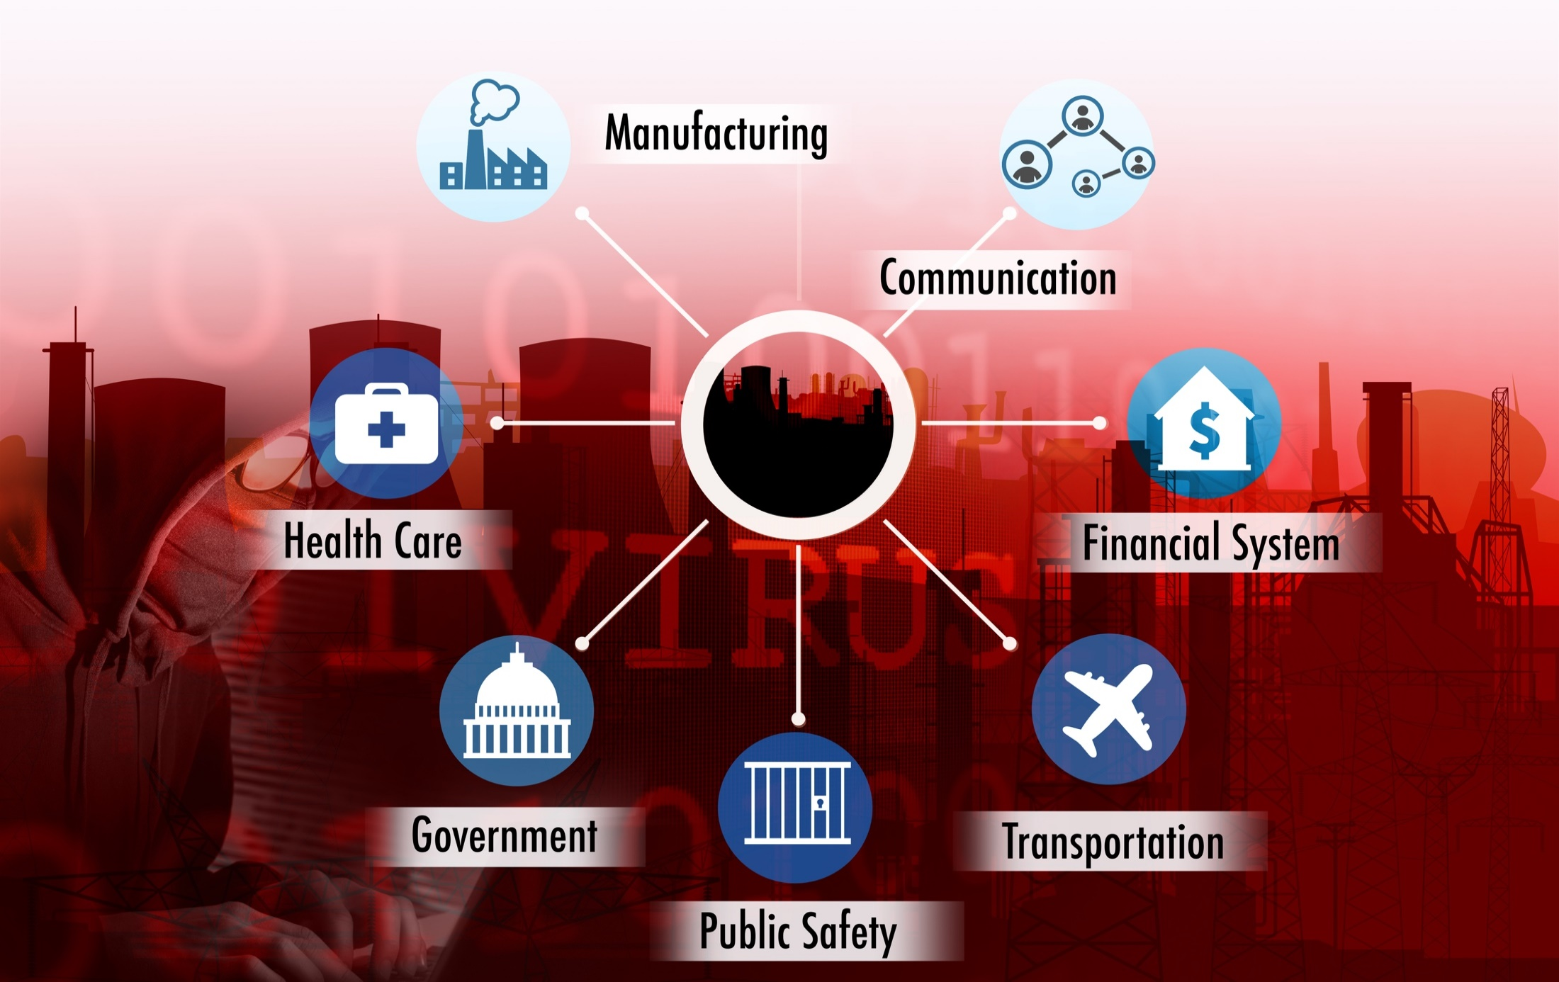
The ‘Internet of Things’ and ‘The Insurance-Net of Things’

Slide 70

The Insurance Industry’s Future Is in the Cloud…
Rail & Public
Transport
Aviation
The Cloud
Trucking & Fleet Vehicles
Marine Transport
Private Motor Vehicles

Slide 71


The Insurance Industry’s Future Is in the Cloud…
Human Beings
Rail & Public
Transport
Aviation
Trucking & Fleet Vehicles
The Cloud
Marine Transport
Private Motor Vehicles

Slide 72
Insurance Technology Financing Trend: Change Is Coming
Insurance tech deals reached a new record in 2016:Q1
($ Millions)
Investment in insurance tech is rising
Source: CB Insights at https://www.cbinsights.com/blog/insurance-tech-overview-q1-2016/; Insurance Information Institute.

Slide 73
Insurance Tech Activity by Area of Interest, 2013 – 2016:Q1
With the ACA in the rear view window, non-health insurance tech accounts for the majority of investment
(Percent)
Silicon Valley and the venture capital community have the insurance industry in their sights. Most will fail. Some will succeed.
Source: CB Insights at https://www.cbinsights.com/blog/insurance-tech-overview-q1-2016/; Insurance Information Institute.

Slide 74
Insurance Information Institute Online:
www.iii.org
Thank you for your time and your attention!
Twitter: twitter.com/bob_Hartwig
Download at www.iii.org/presentations

