Slide 1
Rating Automobile Insurance
Presentation to National Council of Insurance Legislators
April 15, 2021
James Lynch, chief actuary Insurance Information Institute  110 William Street  New York, NY 10038 Tel: 212.346.5533  jamesl@iii.org  www.iii.org

Slide 2
Looking for Rate Disparities: Illinois
Chicago
Rest of Illinois
Analysis Shows No Indication of Overcharging
Source: APCIA.

Slide 3
Looking for Rate Disparities: MO and TX
Missouri
Texas
Analysis Shows No Indication of Overcharging
Source: APCIA.

Slide 4
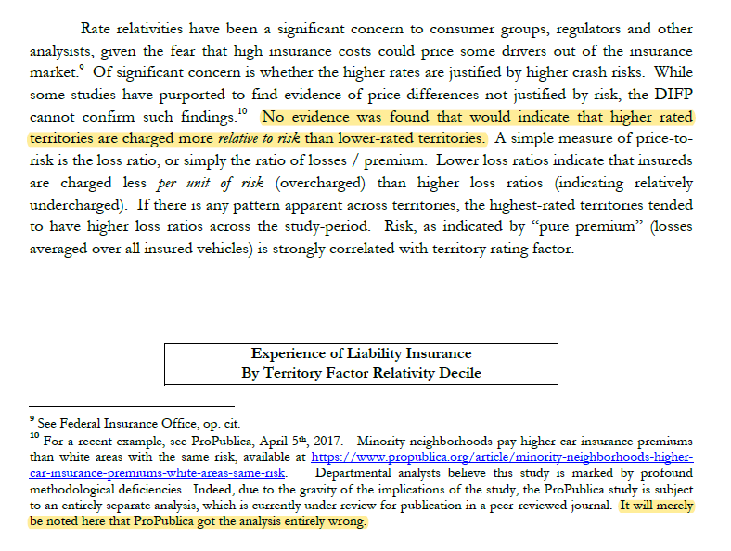
Missouri Regulator Critique
“No evidence was found that would indicate that higher rated territories are charged more relative to risk than lower-rated territories.”
“It will merely be noted here that ProPublica got the analysis entirely wrong.”

Slide 5
California Analysis
Using corrected model
“For [redacted], while the underserved are charged 25 percent more than the non-underserved, they also experience losses 40 percent more than the non-underserved.”
“For [redacted]’s book of business, while the underserved are charged 25 percent more than the non-underserved, the underserved also experience losses 27 percent more than the non-underserved.”
Source: California Department of Insurance.

Slide 6
Thank you for your time! Questions?

