Slide 1
The Terrorism Risk Insurance Authorization (TRIA) Program
NCOIL Annual Meeting, Austin, TX
December 12, 2019
James Lynch, FCAS MAAA, Chief Actuary
Insurance Information Institute  110 William Street  New York, NY 10038 Tel: 212.346.5533  jamesl@iii.org  www.iii.org

Slide 2
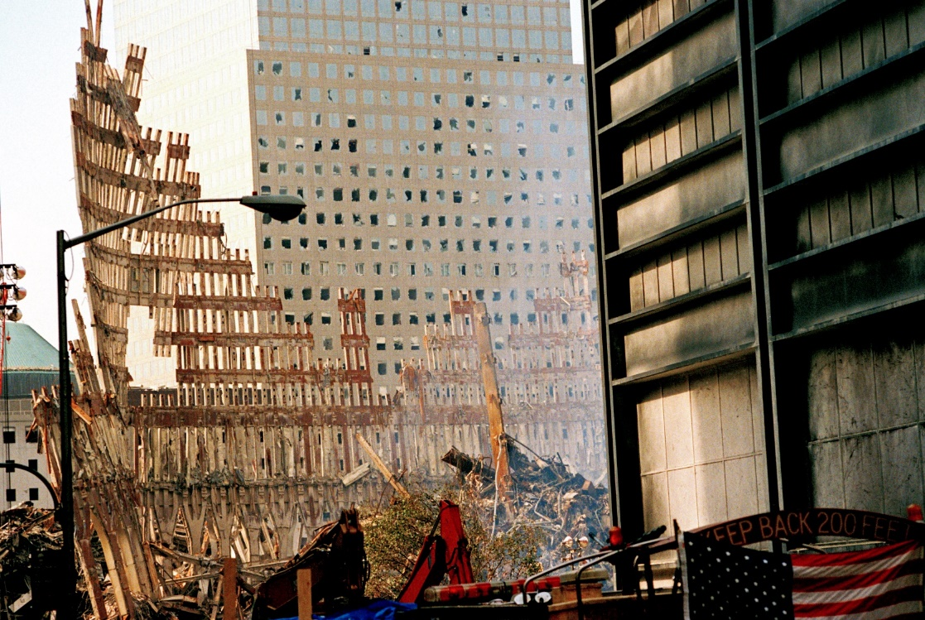
9/11 leads to the passage of TRIA
Insured Losses: About $47 Billion*
* I.I.I. estimate in 2019 dollars
2

Slide 3
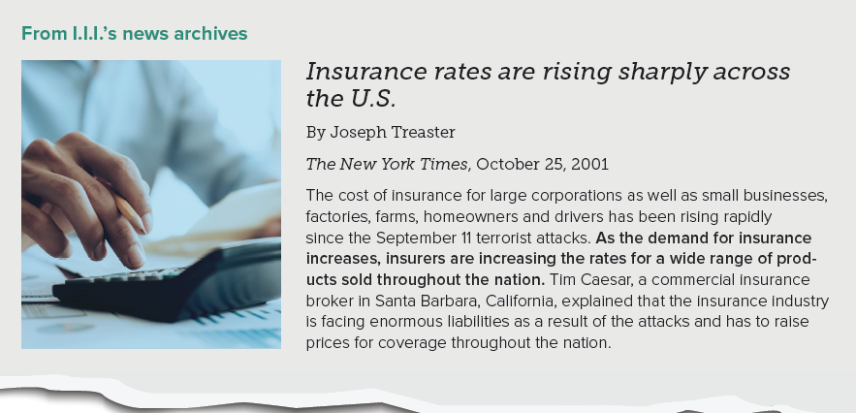
Post 9/11: Insurance Markets Freeze
The World Without TRIA
After 9/11, Reinsurers Stopped Covering Terrorism; Insurers Curtailed Coverage Where They Could

Slide 4
Why terrorism is hard to underwrite
Terrorism risk poses unique difficulties for insurers and other insurance service providers.
Historical loss data is scarce
Acts of terrorism are not random
There are many “attack modes”
Attacks are often geographically concentrated

Slide 5

How TRIA Works in One Slide
Mandatory Offer of Coverage in Most Commercial Lines
For Events > $200 Million in 2020
Each Insurer Can Recover from Government 80% of Loss in Excess of A Deductible
Government Must Recover 100% of Its Outlay from Policyholders

Slide 6
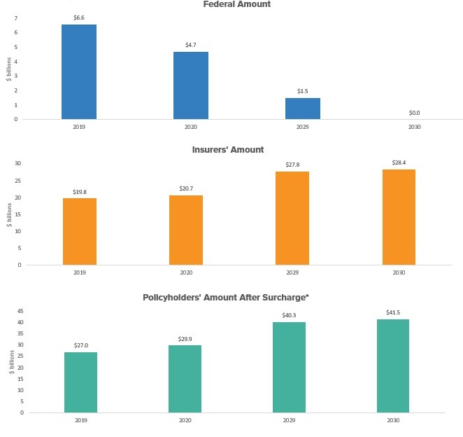
If 9/11 Losses Were Covered by TRIA
Law Has Changed Over Time
Federal Outlay Has Shrunk
Insurers Net Cost Has Increased
Policyholder Surcharge Has Increased
Source: Reinsurance Association of America *Mandatory surcharge on all policies covered by TRIA

Slide 7
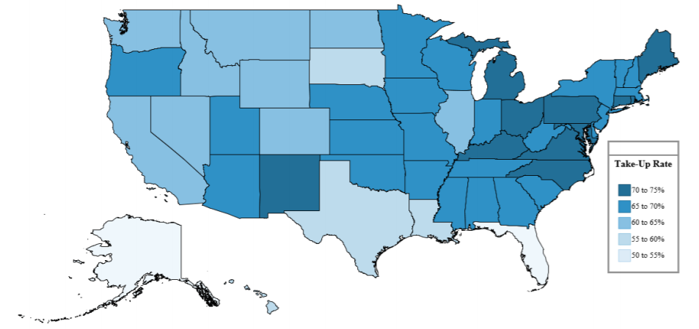
Has TRIA Met Its Goals?
Since 2003:
Cost of Risk Down > 80%
Take-up Rates
Source: Federal Insurance Office. State, regional data from FIO. Time series from Aon.

Slide 8
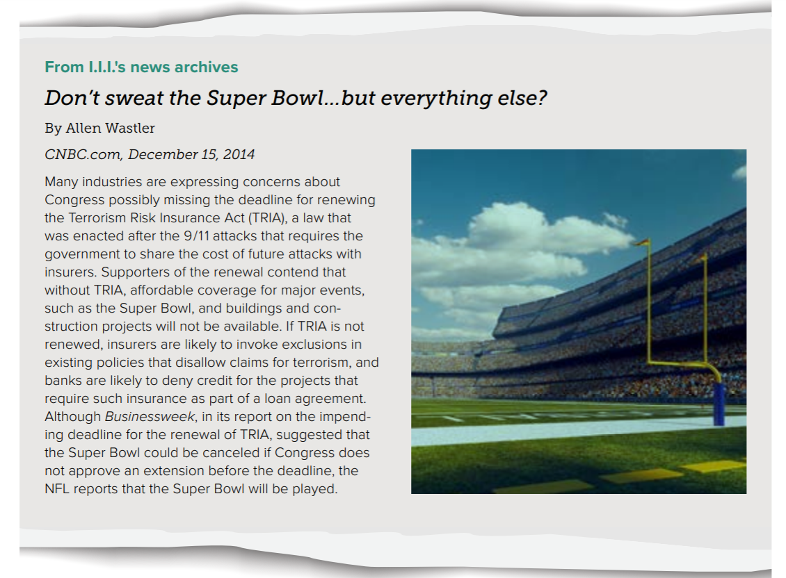
Is Backstop Still Necessary?
2015 – Two Weeks Without TRIA

Slide 9
The Drive to Renew
Why now?
Provisional Plans
Reinsurance Treaties
2020 Insurance Policies (Especially Workers Compensation)
Possible Rate Pressures: 30%-40%?
Conditional endorsements
Reinsurance treaties
Source: Willis Towers Watson

Slide 10
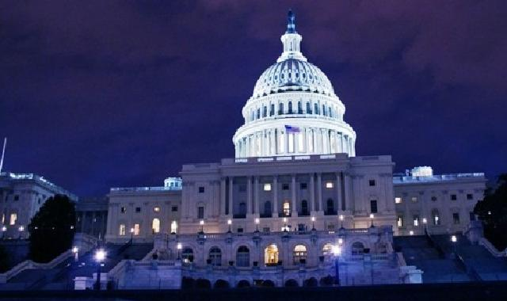
Pending Legislation
November 19: House Passes Reauthorization
November 20: Identical Legislation, Senate Committee on Banking, Housing, and Urban Affairs
Bipartisan Support, Major (Re)insurance Initiative
No Substantive Congressional Opposition
Passage by Early Next Year Likely

Slide 11
Thank you for your time and your attention!
Triple-I White Paper – A World Without TRIA: Incalculable Risk
Blog Post – How TRIA Would Handle 9/11 Today

