Slide 1
Overview & Outlook for the
P&C Insurance Industry
Erie and Niagara Insurance Association
Williamsville, NY
September 30, 2015
Download at www.iii.org/presentations
James Lynch, chief actuary
Insurance Information Institute ♦ 110 William Street ♦ New York, NY 10038
Tel: 212.346.5533 ♦ Cell: 917.359.3908 ♦ jamesl@iii.org ♦ www.iii.org

Slide 2
Insurance Industry:
Financial Update & Outlook
2014 Was a Reasonably Good Year
2015: A Repeat of 2014?
2

Slide 3
P/C Industry Net Income After Taxes
1991–2015:Q1
2015 on Pace to Approach 2005 Record
2005 ROE*= 9.6%
2006 ROE = 12.7%
2007 ROE = 10.9%
2008 ROE = 0.1%
2009 ROE = 5.0%
2010 ROE = 6.6%
2011 ROAS¹ = 3.5%
2012 ROAS¹ = 5.9%
2013 ROAS¹ = 10.2%
2014 ROAS¹ = 8.4%
2015:Q1 ROAS = 10.8%
$ Millions
Net income fell modestly (-12.5%) in 2014 vs. 2013
ROE figures are GAAP; ¹Return on avg. surplus. Excluding Mortgage & Financial Guaranty insurers yields a 8.2% ROAS in 2014, 9.8% ROAS in 2013, 6.2% ROAS in 2012, 4.7% ROAS for 2011, 7.6% for 2010 and 7.4% for 2009.
Sources: A.M. Best, ISO; SNL Financial; Insurance Information Institute

Slide 4
Profitability Peaks & Troughs in the P/C Insurance Industry, 1975 – 2015:Q1
ROE
1977:19.0%
History suggests next ROE peak will be in 2016-2017
1987:17.3%
10 Years
1997:11.6%
2006:12.7%
2015:Q1 10.8%
10 Years
2013 9.8%
9 Years
2014 8.2%
1975: 2.4%
1984: 1.8%
1992: 4.5%
2001: -1.2%
*Profitability = P/C insurer ROEs. 2011-14 figures are estimates based on ROAS data. Note: Data for 2008-2014 exclude mortgage and financial guaranty insurers.
Source: Insurance Information Institute; NAIC, ISO, A.M. Best, Conning

Slide 5
ROE: Property/Casualty Insurance by Major Event, 1987–2015:Q1
(Percent)
P/C Profitability Affected Both by
Cyclicality and Ordinary Volatility
Modestly higher CATs
Katrina, Rita, Wilma
Low CATs
Sept. 11
Hugo
Lowest CAT Losses in
15 Years
4 Hurricanes
Sandy
Andrew
Record Tornado Losses
Northridge
Financial Crisis*
* Excludes Mortgage & Financial Guarantee in 2008 – 2014.
Sources: ISO, Fortune; Insurance Information Institute.

Slide 6
NPW Premium Growth: Peaks & Troughs in the P/C Insurance Industry, 1926–2015
% Chg from Prior Yr
Post WW II Peak:
1947: 26.2%
1970-90: Peak premium growth was much higher in this period while troughs were comparable. Rapid inflation, economic volatility, high interest rates, tort environment all played roles
Start of WW II
1941: 15.8%
Economic Shocks, Inflation:
1976: 22.0%
Tort Crisis
1985/86: 22.2%
Post-9/11
2002:15.3%
1988-2000: Period of inter-cycle stability
2015 YTD 4.0%
1950-70: Extended period of stability in growth and profitability. Low interest rates, low inflation, “Bureau” rate regulation all played a role
2010-20XX? Post-recession period of stable growth?
Twin Recessions; Interest Rate Hikes
1987: 3.7%
Great Recession:2010: -4.9%
Great Depression
1932: -15.9% max drop
Note: Data through 1934 are based on stock companies only. Data include state funds beginning in 1998.
Source: A.M. Best; Insurance Information Institute.

Slide 7
P/C Insurance Industry
Combined Ratio, 2001–2015:Q2*
Heavy Use of Reinsurance Lowered Net Losses
Relatively Low CAT Losses, Reserve Releases
Higher CAT Losses, Shrinking Reserve Releases, Toll of Soft Market
As Recently as 2001, Insurers Paid Out Nearly $1.16 for Every $1 in Earned Premiums
Relatively Low CAT Losses, Reserve Releases
Avg. CAT Losses, More Reserve Releases
Sandy Impacts
Best Combined Ratio Since 1949 (87.6)
Cyclical Deterioration
Lower CAT Losses
* Excludes Mortgage & Financial Guaranty insurers 2008--2014. Including M&FG, 2008=105.1, 2009=100.7, 2010=102.4, 2011=108.1; 2012:=103.2; 2013: = 96.1; 2014: = 97.0.
Sources: A.M. Best, ISO.

Slide 8
RNW All Lines by State, 2004-2013 Average:
Highest 25 States
The most profitable states over the past decade are widely distributed geographically
Profitability Benchmark: All P/C
US: 7.9%
Source: NAIC; Insurance Information Institute.

Slide 9
RNW All Lines by State, 2004-2013 Average:
Lowest 25 States
NY: 10-Year Return Below National Average
Some of the least profitable states over the past decade were hit hard by catastrophes
Source: NAIC; Insurance Information Institute.

Slide 10
All Lines: 10-Year Average RNW NY & Nearby States
2004-2013
New York’s Profitability Lags Other States in Region
Source: NAIC, Insurance Information Institute

Slide 11
RNW All Lines: NY vs. U.S., 2004-2013
(Percent)
Average 2004-2013
U.S.: 7.9%
NY: 5.2%
Source: NAIC, Insurance Information Institute.
11
Notes:
11

Slide 12
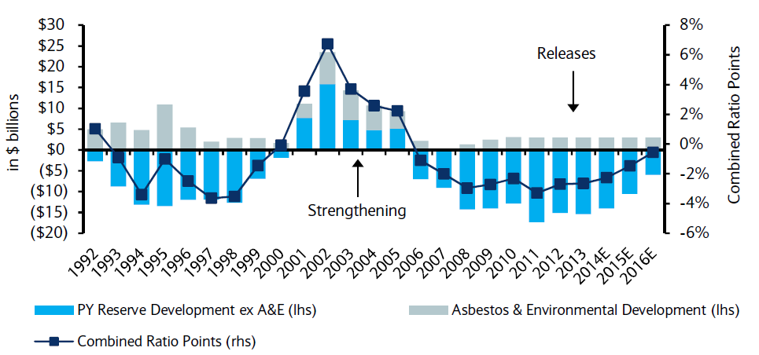
P/C Insurance Loss Reserve Development, 1992 – 2016E*
Reserve releases are expected to gradually taper off, but will continue to benefit the bottom line and combined ratio through at least 2016
Reserve Change
Source: A.M. Best; Barclays research for estimates.

Slide 13
CAPITAL/CAPACITY
Capital Accumulation Has Multiple Impacts
13

Slide 14
Policyholder Surplus,
2006:Q4–2015:Q1
($ Billions)
2007:Q3
Pre-Crisis Peak
Drop due to near-record 2011 CAT losses
Surplus as of 3/31/15 stood at a near-record high $671.7B
The industry now has $1 of surplus for every $0.73 of NPW,
close to the strongest claims-paying status in its history.
2010:Q1 data includes $22.5B of paid-in capital from a holding company parent for one insurer’s investment in a non-insurance business .
The P/C insurance industry entered 2015
in very strong financial condition.
Sources: ISO, A.M .Best.
14
12/01/09 - 9pm
eSlide – P6466 – The Financial Crisis and the Future of the P/C
Notes:
14

Slide 15
US Policyholder Surplus:
1975–2015:Q1*
($ Billions)
Surplus as of 3/31/15 was a near-record $671.7, down 0.4% from the record $674.7 of 12/31/14 but up 53.7% ($234.6B) from the crisis trough of $437.1B at 3/31/09
“Surplus” is a measure of underwriting capacity. It is analogous to “Owners Equity” or “Net Worth” in non-insurance organizations
The Premium-to-Surplus Ratio Stood at $0.73:$1 as of
3/31/15, a Near Record Low (at Least in Recent History)
* As of 3/31/15.
Source: A.M. Best, ISO, Insurance Information Institute.

Slide 16
Premium-to-Surplus Ratio:
1985–2014*
(Ratio of NWP to PHS)
The larger surplus is in relation to premiums—the lower the P:S ratio—and the great the industry’s capacity to handle the risk it has accepted
Surplus as of 12/31/14 was $0.73:$1, a near-record low (at least in modern history)
RBC requirements took effect with 1994 Annual Statement.
9/11, Recession & Hard Market
The Premium-to-Surplus Ratio Stood at $0.73:$1 as of
12/31/14, a Record Low (at Least in Recent History)
* As of 12/31/14.
Source: A.M. Best, ISO, Insurance Information Institute.

Slide 17
P/C Industry: Loss Reserve-to-Surplus Ratio, 1971-2014
Inflation, Liability Crisis Increased Reserves, Plunging Stock Prices Depleted Surplus
The Property/Casualty Industry Adjusted Its Risk Portfolio in Response to Risk-Based Capital Requirements Implemented in 1994.
Source: Calculations from A.M. Best and ISO data by Insurance Information Institute.

Slide 18
INVESTMENTS:
THE NEW REALITY
Investment Performance is a Key Driver of Profitability
Depressed Yields Will Necessarily Influence Underwriting & Pricing
18

Slide 19
Property/Casualty Insurance Industry Investment Income: 2000–2015E¹
Investment earnings are still below their 2007 pre-crisis peak
($ Billions)
Due to persistently low interest rates,
investment income fell in 2012, 2013 and 2014 – Despite Record Surplus.
¹ Investment gains consist primarily of interest and stock dividends. *2015 figure is estimated based on annualized data through Q1.
Sources: ISO; Insurance Information Institute.

Slide 20
Distribution of Invested Assets: P/C Insurance Industry, 2013
$ Billions
Total Invested Assets = $1.5 Trillion
Source: Insurance Information Institute Fact Book 2015, A.M. Best.

Slide 21
U.S. Treasury Security Yields:
A Long Downward Trend, 1990–2015*
Yields on 10-Year U.S. Treasury Notes have been essentially below 5% for a full decade.
U.S. Treasury yields plunged to historic lows in 2013. Longer-term yields rebounded then sank fell again.
Since roughly 80% of P/C bond/cash investments are in 10-year or shorter durations, most P/C insurer portfolios will have low-yielding bonds for years to come.
*Monthly, constant maturity, nominal rates, through July 2015.
Sources: Federal Reserve Bank at http://www.federalreserve.gov/releases/h15/data.htm. National Bureau of Economic Research (recession dates); Insurance Information Institute.
21
12/01/09 - 9pm
eSlide – P6466 – The Financial Crisis and the Future of the P/C
Notes:
21

Slide 22
Book Yield on Property/Casualty Insurance Invested Assets, 2007–2015*
(Percent)
Book yield in 2015 is down 74 BP from pre-crisis levels
The yield on invested assets remains low relative to pre-crisis yields. The Fed’s plan to raise interest rates in late 2015 has already pushed up some yields, albeit quite modestly.
*2015 figure is the average of the four quarters ending in 2015:Q1.
Sources: SNL Financial; Insurance Information Institute

Slide 23
Distribution of Bond Maturities,
P/C Insurance Industry, 2003-2013
The main shift over these years has been from bonds with longer maturities to bonds with shorter maturities. The industry first trimmed its holdings of over-10-year bonds (from 24.6% in 2003 to 15.5% in 2012) and then trimmed bonds in the 5-10-year category (from 31.3% in 2003 to 27.6% in 2012) . Falling average maturity of the P/C industry’s bond portfolio is contributing to a drop in investment income along with lower yields.
Sources: SNL Financial; Insurance Information Institute.

Slide 24
Alternative Capital
New Investors Continue to Change the Reinsurance Landscape
First I.I.I. White Paper on Issue Was Released in March 2015
24

Slide 25
Global Reinsurance Capital (Traditional and Alternative), 2006-2014
Total reinsurance capital reached a record $580B in 2014, up 71% from 2008.
But alternative capacity has grown 247% since 2008, to $66B. It has more than doubled in the past three years.
Source: Aon Benfield Analytics; Insurance Information Institute.

Slide 26
Global Reinsurance Capital (Traditional and Alternative), 2006 - 2014
Share of Global Reinsurance Capital Has More Than Doubled Since 2010. In Cat Reinsurance, Alternative Capital Holds Up to 50% of Market.
2014 data is as of December 31, 2014.
Source: Aon Benfield Analytics; Insurance Information Institute.

Slide 27
How a Catastrophe Bond Works
Investors supply capital.
Insurer cedes premium.
Investors
Insurer (Sponsor)
Reinsurer pays interest, returns principal at end of term.
Reinsurer (Special Purpose Vehicle)
Reinsurer pays losses.
Counterparty holds capital till needed, guarantees fixed return.
Reinsurer invests bond proceeds in swap.
Swap Counterparty

Slide 28
Growth in Traditional and Alternative Capital, 2007-2014
Post 2011, alternative capital is growing four and five times faster than traditional capital.
Alternative capital has grown 276% since 2006, vs. 39% growth in traditional capital.
Source: Aon Benfield Analytics; Insurance Information Institute.

Slide 29
Growth of Alternative Capital Structures, 2002 - 2014
Collateralized Re’s Growth Has Accelerated in the Past Six Years.
Collateralized Reinsurance and Catastrophe Bonds Currently Dominate the Alternative Capital Market.
* 2014 data are as of June 30, and 2015 data are as of March 31.
Source: Aon Benfield Analytics; Insurance Information Institute.

Slide 30
Catastrophe Bond Issuance and Outstanding: 1997-2015
Risk Capital Amount ($ Millions)
Q1 2015 Set A First-Quarter Record With $1.49 Billion in New Issues; Q2 Issuance Lagged Prior Two Years.
Source: Guy Carpenter.

Slide 31
Reinsurance Pricing: Change in Rate on Line for Global Cat Business
Alternative Capital, Low Levels of Catastrophes Drive Rates Down.
One Effect of Alternative Capital: Lower Cat Reinsurance Prices. Price is As Low Now as Before 9/11.
Source: Guy Carpenter, A.M. Best, Insurance Information Institute.

Slide 32
U.S. INSURANCE MERGERS AND ACQUISITIONS,
P/C SECTOR, 1994-2014 (1)
M&A activity in 2015 will likely reach its highest level since 1998
M&A activity in the P/C sector was up sharply in 2014 but remains well below pre-crisis or late 1990s levels.
($ Millions)
Another Effect of Alternative Capital: Merger Mania.
(1) Includes transactions where a U.S. company was the acquirer and/or the target.
Source: Conning proprietary database.

Slide 33
Another Result:
$68 Billion in Mergers, 2014-2015 YTD
Acquirer | Target | Value ($millions)
ACE (Switzerland) | Chubb (US) | $28,300
Tokio Marine Holdings (Japan) | HCC Insurance Holding (U.S.) | 7,500
Exor (Italy) | PartnerRe Ltd. (Bermuda) | 6,700
Mitsui Sumitomo | Amlin (UK) | 5,400
XL Group plc (Ireland) | Catlin Group Ltd. (Bermuda) | 4,200
Fosun International (China) | Ironshore (US) | 2,300
RenaissanceRe Holdings Ltd. (Bermuda) | Platinum Underwriters Holdings Ltd. (Bermuda) | 1,900
Endurance Specialty Hldgs Ltd. (Bermuda) | Montpelier Re Holdings Ltd. (Bermuda) | 1,800
Fairfax Financial Holdings Ltd. (Canada) | Brit Insurance Holdings NV (Netherlands) | 1,880
Desjardins Financial Corp. (Canada) | State Farm's P/C, Life (Canada) | 1,500
TPG Capital LP | The Warranty Group, Inc. (Canada) | 1,500
Fosun International Ltd. (China) | Caixa Seguros e Saude SGPA SA (Portugal) | 1,360
Progressive Corp. | ARX Holding Corp. | 875
Assured Guaranty Ltd. (Bermuda) | Radian Asset Assurance, Inc. | 810
Mapfre S.A. (Spain) | Direct Line Insurance Group plc (Germany/Italy only) | 701
Validus Holdings Ltd. (Bermuda) | Western World Insurance Group, Inc. | 690
ACE Ltd. (Switzerland) | P/C business from Itau Seguros S.A. (Brazil) | 685
Update: Alleghany Corp. announced in May 2015 that it is considering the sale of Transatlantic Holding Co. (TransRe).
*Source: Conning; Insurance information Institute.

Slide 34
What’s Driving Global Insurance M&A Activity and Will It Continue?
Excess Capital in Global Reinsurance and Primary Commercial Insurance in US
  (Re)Insurers, like corporations in many industry, are sitting are large amounts of cash accumulated since the Global Financial Crisis that earns very little
Alternative Capital
Slow Top Line (Premium) Growth
Slowdown in Pace of Earnings Growth/ROE
Desire to Achieve Economies of Scale
Peer Pressure/Momentum
  Management concerns about being “left out”

Slide 35
Performance by Segment
35
Notes:
35

Slide 36
Return on Net Worth (RNW) All Lines:
2004-2013 Average
Overall, NY Business Has Returned Slightly Less Than Rest of Country – With Some Exceptions
Source: NAIC; Insurance Information Institute.

Slide 37
RNW PP Auto: NY vs. U.S., 2004-2013
Deterioration Driven By No-Fault Fraud
Average 2004-2013
U.S.: 7.0%
NY: 8.3%
PIP Reforms Take Hold
Countrywide Increases in Frequency, Severity Force Rates Higher/Margins Lower While Consumer/Regulatory Challenges Emerge.
Source: NAIC, Insurance Information Institute
37
Notes:
37

Slide 38
Personal Auto Net Combined Ratio: 1990–2017F
Rising Frequency and Severity Since Fall 2014 Means Forecasts May Rise for 2015 and Later.
Sources: A.M. Best (1990-2014);Conning (2015F-2017F); Insurance Information Institute.

Slide 39
RNW Homeowners: NY vs. U.S.,
2004-2013
(Percent)
Average 2004-2013
U.S.: 6.6%
NY: 7.6%
Sandy
Katrina
Ike
MW Tornadoes
Gradual Decadelong Improvement in This Cat-Driven Line May Be Bringing in New Players from the Sidelines.
Source: NAIC, Insurance Information Institute
39
Notes:
39

Slide 40
Homeowners Insurance Net Combined Ratio: 1990–2017F
Hurricane Andrew
Record tornado activity
Hurricane Sandy
Hurricane Ike
Homeowners Performance in 2011/12 Impacted by Large Cat Losses. Extreme Regional Variation Can Be Expected Due to Local Catastrophe Loss Activity
Sources: A.M. Best (1990-2014);Conning (2015F-2014F); Insurance Information Institute.

Slide 41
Commercial Lines Combined Ratio, 1990-2017F*
Commercial lines underwriting performance is expected to improved in 2013/14 but higher cats, diminishing prior year reserves an rising loss cost trends in some lines could push combined ratios higher
*2007-2012 figures exclude mortgage and financial guaranty segments.
Source: A.M. Best (1990-2014E); Conning (2015-17F) Insurance Information Institute.

Slide 42
RNW Farmowners: NY vs. U.S.,
2004-2013
(Percent)
Average 2004-2013
U.S.: 3.2%
NY: 11.8%
Minimal Impact From Sandy
Ike
MW Tornadoes
Source: NAIC, Insurance Information Institute
42
Notes:
42

Slide 43
Farmowners Insurance Combined Ratio: 1990–2016F
Record Tornado Activity
Strong MW Tornadoes
Hurricane Ike
Hurricane Sandy
Results Vary (Extremely) By Region Due to Local Catastrophe Activity, Which Has Been Favorable Recently Countrywide.
Sources: A.M. Best (1990-2014);Conning (2015F-2016F); Insurance Information Institute.

Slide 44
RNW Fire: NY vs. U.S.,
2004-2013
(Percent)
Average 2004-2013
U.S.: 17.1%
NY: 33.8%
Source: NAIC, Insurance Information Institute
44
Notes:
44

Slide 45
Fire Combined Ratio:
1985–2014
WTC, End of Soft Market
Absent Wildfires and Conflagrations, Fire Results Vary But Have Generated Industrywide U/W Profit When Insurance Cycle Permits. Individual Company Results Vary.
Source: Insurance Information Institute calculations from A.M. Best.

Slide 46
RNW Commercial Multi-Peril: NY vs. U.S., 2004-2013
(Percent)
Average 2004-2013
U.S.: 6.3%
NY: 10.6%
Source: NAIC, Insurance Information Institute
46
Notes:
46

Slide 47
Commercial Multi-Peril Combined Ratio: 1995-2017F
Commercial Multi-Peril Underwriting Performance is Expected to Remains Stable in 2015 Assuming Normal Catastrophe Loss Activity
Sources: A.M. Best (1995-2014); Conning (2015F-2017F); Insurance Information Institute.

Slide 48
Growth Analysis by State and Business Segment
Post-Crisis Paradox?
Premium Growth Rates Vary Tremendously by State
48

Slide 49
Net Premium Growth (All P/C Lines): Annual Change, 1971—2015:Q2
(Percent)
1975-78
1984-87
2000-03
Net Written Premiums Fell 0.7% in 2007 (First Decline Since 1943) by 2.0% in 2008, and 4.2% in 2009, the First 3-Year Decline Since 1930-33.
2015:Q2: 4.0%
2014: 4.1%
2013: 4.4%
2012: +4.2%
Shaded areas denote “hard market” periods
Sources: A.M. Best (1971-2013), ISO (2014-15).

Slide 50
Direct Premiums Written: Total P/C
Percent Change by State, 2007-2014
Top States
North Dakota was the country’s growth leader over the past 7 years with premiums written expanding by 70.7%, fueled by the state’s energy boom
Growth Benchmarks: Total P/C
US: 13.0%
Sources: SNL Financial LC.; Insurance Information Institute.

Slide 51
Direct Premiums Written: Total P/C
Percent Change by State, 2007-2014
Bottom States
NY Growth Was Close to National Average.
Growth was negative in 4 states and DC between 2007 and 2014
Sources: SNL Financial LC.; Insurance Information Institute.

Slide 52
Direct Premiums Written: Comm. Lines
Percent Change by State, 2007-2014
Top States
43 states showed commercial lines growth from 2007 through 2014
Growth Benchmarks: Commercial
US: 5.9%
NY Exceeded National Average, About Same as Nearby States
Sources: SNL Financial LLC.; Insurance Information Institute.

Slide 53
Direct Premiums Written: Comm. Lines
Percent Change by State, 2007-2014
Bottom States
Nearly half the states have barely returned to pre-crisis levels
States with the poorest performing economies also produced the most negative net change in premiums of the past 6 years
Sources: SNL Financial LLC.; Insurance Information Institute.

Slide 54
Direct Premiums Written: Pers. Lines
Percent Change by State, 2007-2014
Top States
Personal Lines Growth Follows Commercial Growth – Same States
Growth Benchmarks: Commercial
US: 20.9%
Sources: SNL Financial LLC.; Insurance Information Institute.

Slide 55
Direct Premiums Written: Pers. Lines
Percent Change by State, 2007-2014
Bottom States
NY Growth Near the National Average
Weakest Performers Hurt by Housing Bust, Depressing HO Premium
Sources: SNL Financial LLC.; Insurance Information Institute.

Slide 56
Direct Premiums Written: Homeowners
Percent Change by State, 2007-2014
Top States
Sources: SNL Financial LLC.; Insurance Information Institute.

Slide 57
Direct Premiums Written: Homeowners
Percent Change by State, 2007-2014
Bottom States
Larger States Seeing Significant Increases (NY, NJ, PA) Driven by Cat Exposure
Sources: SNL Financial LLC.; Insurance Information Institute.

Slide 58
Direct Premiums Written: Farmowners
Percent Change by State, 2007-2014
Top States
Sources: SNL Financial LLC.; Insurance Information Institute.

Slide 59
Direct Premiums Written: Farmowners
Percent Change by State, 2007-2014
Bottom States
Note: No Premium in D.C.
Sources: SNL Financial LLC.; Insurance Information Institute.

Slide 60
Direct Premiums Written: Workers’ Comp
Percent Change by State, 2007-2014*
Top 25 States
Only 21 states have seen works comp premium volume return to pre-crisis levels
*Excludes monopolistic fund states: ND, OH, WA, WY as well as WV, which transitioned to a competitive structure during this period.
Sources: SNL Financial LC.; Insurance Information Institute.

Slide 61
Direct Premiums Written: Worker’s Comp
Percent Change by State, 2007-2014*
Bottom 25 States
States with the poorest performing economies also produced some of the most negative net change in premiums of the past 7 years
*Excludes monopolistic fund states: ND, OH, WA, WY as well as WV, which transitioned to a competitive structure during this period.
Sources: SNL Financial LC.; Insurance Information Institute.

Slide 62
Pricing Trends
Survey Results Suggest Commercial Pricing Has Flattened Out
62

Slide 63
Commercial Lines Rate Change by Qtr (vs. Year Earlier)
18 consecutive quarters of rate increases
Hard Market (Such As It Is) Appears to Have Passed Its Peak.
Sources: Towers Watson Commercial Lines Insurance Pricing Survey, Insurance Information Institute.
63
12/01/09 - 9pm
eSlide – P6466 – The Financial Crisis and the Future of the P/C
Notes:
63

Slide 64
Commercial Lines Rate Change by Month (vs. Year Earlier)
Not Much of A Soft Market, To Date
Not Much of A Hard Market, By Historic Standards
Overall, Rates Are As Stable As They Have Been in 15 Years, Though Individual Markets Often Vary Significantly.
SOURCE: MarketScout, Insurance Information Institute.

Slide 65
Commercial Property Rate Change by Month (vs. Year Earlier)
Commercial Property Rates Track Closely With Commercial Rates Overall.
SOURCE: MarketScout, Insurance Information Institute.
Interpolated Commercial Property Estimates for May, August, September 2010.

Slide 66
BOP Rate Change by Month
(vs. Year Earlier)
Rates on the BOP Have Been Flat, Like Much of the Market.

Slide 67
Loss Trends
Growth in Claim Size Continues to Outpace Inflation - Barely
67

Slide 68
An Example: NY Homeowners
Non-cat Paid Severity
Severity Rises Faster Than Frequency Falls. NY Frequency, Severity Close to CW Averages.
Sources: Insurance Research Council, “Trends in Homeowners Insurance Claims,” 2015 edition, pp. 41, 80.

Slide 69
Insurance Loss Trends vs. Inflation
* Preliminary claim cost estimates for 2014.
Source: Towers Watson.

Slide 70
Claim Inflation vs. CPI
In Recent Years, Claim Costs Have Risen at About the Inflation Rate.
Source: Insurance Information Institute calculation from Towers Watson data.

Slide 71
Homeowners: Severity, Frequency Trend Are Moderating
Annual Change, 2005 through 2014
Cost Pressures Will Increase if BI Severity Increases Continue or Frequency Ticks Up
Source: ISO/PCI Fast Track data; Insurance Information Institute

Slide 72
Insured Catastrophe Losses
2013/14 and YTD 2015 Experienced Below Average CAT Activity After Very High CAT Losses in 2011/12
Winter Storm Losses Far Above Average in 2014 and 2015
72

Slide 73
U.S. Insured Catastrophe Losses
($ Billions, $ 2014)
2012 was the 3rd most expensive year ever for insured CAT losses
2013/14 Were Welcome Respites from 2011/12, among the Costliest Years for Insured Disaster Losses in US History. Longer-term Trend is for more—not fewer—Costly Events
$8.2B in insured CAT losses though 6/30/15, up slightly from $7.3B in 2014
*Through 6/30/15 in 2015 dollars.
Note: 2001 figure includes $20.3B for 9/11 losses reported through 12/31/01 ($25.9B 2011 dollars). Includes only business and personal property claims, business interruption and auto claims. Non-prop/BI losses = $12.2B ($15.6B in 2011 dollars.)
Sources: Property Claims Service/ISO; AonBenfield Insurance Information Institute.
73
12/01/09 - 9pm
eSlide – P6466 – The Financial Crisis and the Future of the P/C
Notes:
73

Slide 74
Top 16 Most Costly Disasters in U.S. History—Katrina Still Ranks #1
(Insured Losses, 2014 Dollars, $ Billions)
Storm Sandy in 2012 was the last mega-CAT to hit the US
Includes Tuscaloosa, AL, tornado
Includes Joplin, MO, tornado
12 of the 16 Most Expensive Events in US History Have Occurred Since 2004
Sources: PCS; Insurance Information Institute inflation adjustments to 2014 dollars using the CPI.

Slide 75
Combined Ratio Points Associated with Catastrophe Losses: 1960 – 2015F*
Avg. CAT Loss Component of the Combined Ratio by Decade
1960s: 1.04 1970s: 0.85 1980s: 1.31 1990s: 3.39 2000s: 3.52 2010s: 5.82*
Catastrophe losses as a share of all losses reached a record high in 2011
Combined Ratio Points
The Catastrophe Loss Component of Private Insurer Losses Has Increased Sharply in Recent Decades
*2010s represent 2010-2014.
Notes: Private carrier losses only. Excludes loss adjustment expenses and reinsurance reinstatement premiums. Figures are adjusted for losses ultimately paid by foreign insurers and reinsurers.
Source: ISO (1960-2010); A.M. Best (2011-15E) Insurance Information Institute.

Slide 76
Inflation Adjusted U.S. Catastrophe Losses by Cause of Loss, 1995–2014¹
Wind/Hail/Flood (3), $21.4
Fires (4), $6.0
Winter storm losses were much above average in 2014/15 are will push this share up
Other (5), $0.2
Insured cat losses from 1995-2014 totaled $395.6B, an average of $19.8B per year or $1.65B per month
Geological Events, $0.5
Terrorism, $24.5
Winter Storms, $26.9
Hurricanes & Tropical Storms, $161.2
Tornado share of CAT losses is rising
Wind losses are by far cause the most catastrophe losses, even if hurricanes/TS are excluded.
Events Involving Tornadoes (2), $154.9
Catastrophes are defined as events causing direct insured losses to property of $25 million or more in 2014 dollars.
Excludes snow.
Does not include NFIP flood losses
Includes wildland fires
Includes civil disorders, water damage, utility disruptions and non-property losses such as those covered by workers compensation.
Source: ISO’s Property Claim Services Unit.

Slide 77
Convective Loss Events in the US
Overall and Insured Losses, 1980-2014
Overall losses
(in 2014 values)*
$ Billions
The period from 2008-2014 has been the most expensive on record for insured losses from “Convective Events” (severe thunderstorms, tornado, hail, lightning and flash flood)
Insured losses
(in 2014 values)*
2015 First Half:
$5.1 Billion Insured Losses
$7.0 Overall Losses
*Losses adjusted to inflation based on CPI
Analysis contains:
severe storm, tornado, hail, flash flood and lightning
77
Source: Geo Risks Research, NatCatSERVICE

Slide 78
The Strength of the Economy Will Influence P/C Insurer Growth Opportunities
Growth Will Expand Insurer Exposure Base Across Most Lines
78

Slide 79
US Real GDP Growth*
The Q4:2008 decline was the steepest since the Q1:1982 drop of 6.8%
Real GDP Growth (%)
Recession began in in June 2009
Q1 2014/15 GDP data were hit hard by this year’s “Polar Vortex” and harsh winter
Demand for Insurance Should Increase in 2015 as GDP Growth Accelerates Modestly and Gradually Benefits the Economy Broadly
* Estimates/Forecasts from Blue Chip Economic Indicators.
Source: US Department of Commerce, Blue Economic Indicators 8/15; Insurance Information Institute.

Slide 80
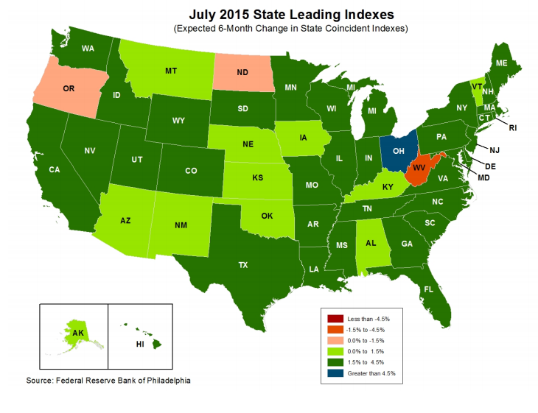
State Leading Economic Indicators through January 2016
Solid Growth Projected for Northeast.
Growth in the West is finally beginning to pick up
The economic outlook for most of the US is generally positive, though flat-to-negative for 10 states, several of them energy dependent
Sources: Federal Reserve Bank of Philadelphia at http://www.philadelphiafed.org/index.cfm ;Insurance Information Institute.

Slide 81
Real GDP by State Percent Change, 2014*:
Highest 25 States
North Dakota was the economic growth juggernaut of the US in 2014—by far
Only 7 states experienced growth in excess of 3% in 2014, which is a growth rate we would see nationally in a more typical recovery
Growth Benchmarks: Real GDP
US: 2.2%
*Advance statistics
Sources: U.S. Bureau of Economic Analysis; Insurance Information Institute.

Slide 82
Real GDP by State Percent Change, 2014*:
Lowest 25 States
Growth rates in 16 states were still below 1% in 2014
Mississippi and Alaska were the only states to shrink in 2014
*Advance statistics
Sources: US Bureau of Economic Analysis; Insurance Information Institute.

Slide 83
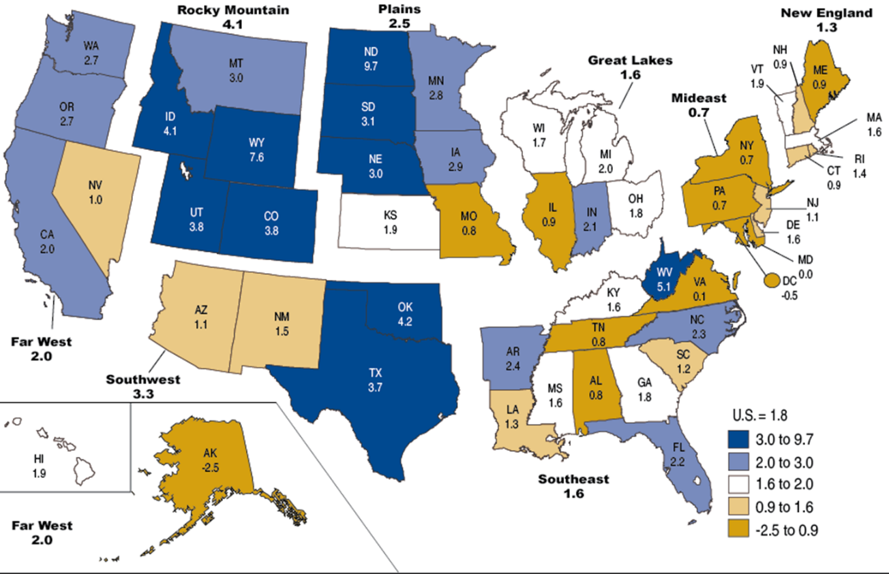
Percent Change in Real GDP by State, 2013
Sources: US Bureau of Economic Analysis; Insurance Information Institute.

Slide 84
Labor Market Trends
Massive Job Losses Sapped the Economy and Commercial/Personal Lines Exposure, But Trend Has Greatly Improved
84

Slide 85
Unemployment and Underemployment Rates: Still Too High, But Falling
January 2000 through July 2015, Seasonally Adjusted (%)
U-6 soared from 8.0% in March 2007 to 17.5% in
October 2009; Stood at 10.4% in June 2015.
8% to 10% is “normal.”
“Headline” unemployment was 5.3% in July 2015. 4.5% to 5.5% is “normal.”
Stubbornly high unemployment and underemployment constrain overall economic growth, but the job market is continuing to improve.
Source: US Bureau of Labor Statistics; Insurance Information Institute.
85
12/01/09 - 9pm
eSlide – P6466 – The Financial Crisis and the Future of the P/C
Notes:
85

Slide 86
Monthly Change in Private Employment
3,042,000 jobs were created in 2014, the most since 1997
January 2007 through July 2015 (000s, Seasonally Adj.)
Jobs Created
2014: 3.042 Mill
2013: 2.452 Mill
2012: 2.315 Mill
2011: 2.396 Mill
2010: 1.282 Mill
210,000 private sector jobs were created in July.
Monthly losses in Dec. 08–Mar. 09 were the largest in the
post-WW II period
Private Employers Added 12.84 Million Jobs Since Jan. 2010 After Having Shed 5.01 Million Jobs in 2009 and 3.76 Million in 2008 (State and Local Governments Have Shed Hundreds of Thousands of Jobs)
Source: US Bureau of Labor Statistics: http://www.bls.gov/ces/home.htm; Insurance Information Institute

Slide 87
CONSTRUCTION INDUSTRY OVERVIEW & OUTLOOK
The Construction Sector Is Critical to the Economy and the P/C Insurance Industry
87

Slide 88
Value of New Private Construction: Residential & Nonresidential, 2003-2015*
2015: Value of new pvt. construction hits $766.4B as of June 2015, up 53.1% from the 2010 trough but still 17.5% below 2006 peak
New Construction peaks at $911.8. in 2006
Billions of Dollars
Trough in 2010 at $500.6B, after plunging 55.1% ($411.2B)
$15.0
$613.7
$394.8
$298.1
$261.8
$371.6
$238.8
Private Construction Activity Is Moving in a Positive Direction though Remains Well Below Pre-Crisis Peak; Residential Dominates
*2015 figure is a seasonally adjusted annual rate as of June.
Sources: US Department of Commerce http://www.census.gov/construction/c30/c30index.html ; Insurance Information Institute.
88
12/01/09 - 9pm
eSlide – P6466 – The Financial Crisis and the Future of the P/C
Notes:
88

Slide 89
Value of Construction Put in Place, June 2015 vs. June 2014*
Growth (%)
Private: +13.7%
Public: +8.0%
Public sector construction activity is finally beginning to create less drag up after years of decline
Private sector construction activity is up in both the residential and nonresidential segments
Overall Construction Activity is Up Again After Languishing in Early 2015; State/Local Sector Government Sector May Be Recovering as Budget Woes Ease in Some Jurisdictions
*seasonally adjusted
Source: U.S. Census Bureau, http://www.census.gov/construction/c30/c30index.html ; Insurance Information Institute.

Slide 90
New Private Housing Starts, 1990-2021F
Job growth, low inventories of existing homes, low mortgage rates and demographics should continue to stimulate new home construction for several more years
(Millions of Units)
New home starts plunged 72% from 2005-2009; A net annual decline of 1.49 million units, lowest since records began in 1959
Insurers Are Continue to See Meaningful Exposure Growth in the Wake of the “Great Recession” Associated with Home Construction: Construction Risk Exposure, Surety, Commercial Auto; Potent Driver of Workers Comp Exposure
Source: U.S. Department of Commerce; Blue Chip Economic Indicators (8/15); Insurance Information Institute.

Slide 91
Construction Employment,
Jan. 2010—July 2015*
(Thousands)
Construction employment is +948,000 above
Jan. 2011 (+17.4%) trough
Construction and manufacturing employment constitute 1/3 of all WC payroll exposure.
*Seasonally adjusted.
Sources: US Bureau of Labor Statistics at http://data.bls.gov; Insurance Information Institute.
91
12/01/09 - 9pm
eSlide – P6466 – The Financial Crisis and the Future of the P/C
Notes:
91

Slide 92
ENERGY SECTOR: OIL & GAS INDUSTRY FUTURE IS BRIGHT BUT VOLATILE
US Is Becoming an Energy Powerhouse but Fall in Prices Will Have Negative Impact
92

Slide 93
Employment in Oil & Gas Extraction,
Jan. 2010—July 2015*
(000)
Oil and gas extraction employment was up 28.8% by Oct. 2014 but falling energy prices have taken their toll
Employment in the O&G segment is down 3.8% since its Oct. 2014 peak
*Seasonally adjusted
Sources: US Bureau of Labor Statistics at http://data.bls.gov; Insurance Information Institute.
93
12/01/09 - 9pm
eSlide – P6466 – The Financial Crisis and the Future of the P/C
Notes:
93

Slide 94
DISRUPTORS
Technology, Society and the Economy Are All Changing at a Rapid Pace
Thoughts on the Future
94

Slide 95
Cyber Risk & Cyber Insurance
Cyber Risk is a Rapidly Emerging Exposure for Businesses Large and Small in Every Industry
I.I.I. White Paper Coming Out in October
95

Slide 96






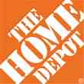

Data Breaches 2005-2015, by Number of Breaches and Records Exposed
# Data Breaches/Millions of Records Exposed
Millions
The total number of data breaches (+27.5%) hit a record high of 783 in 2014, exposing 85.6 million records. Through June 30, this year has seen 117.6 million records exposed in 400 breaches.*
*Figures as of June 30, 2015, from the Identity Theft Resource Center,
http://www.idtheftcenter.org/images/breach/ITRCBreachReport2015.pdf

Slide 97
High Profile Data Breaches, 2014-2015
Date | Company | Description of Breach
May 2015 | OPM | Hackers broke into U.S. Government Personnel Office stealing personal identifying information of as many as 14 million civilian U.S. government employees.
Mar 2015 | Premera Blue Cross | Data breach compromises financial and medical records of 11 million customers.
Feb 2015 | Anthem, Inc | Massive data breach after hackers gained access to corporate data base containing personal information of as many as 80 million current and former U.S. customers and employees.
Dec 2014 | Sony Pictures Entertainment | Hacker break-in involving theft of unreleased motion pictures, and theft of more than 25 gigabytes of sensitive data on tens of thousands of Sony employees, including social security numbers, medical and salary information.
Nov 2014 | Staples | Point-of-sale (POS) malware attack and breach exposing customer data, and resulting in compromise of 1.2 million records.
Sept 2014 | Home Depot | Huge data breach exposes 56 million credit and debit cards and 53 million email addresses.
Aug 2014 | Community Health Systems | Cyber attack originating in China resulted in data breach, compromising 4.5 million patient records. Hackers broke into company’s computer system by exploiting Heartbleed bug.
June/July 2014 | JP Morgan Chase | Massive data breach compromised data associated with 76 million household and 7 million small business accounts. Hackers obtained personal identifying nformation.
June 2014 | PF Changs | Security breach affected customers at 33 restaurants located in 16 states, with potential credit and debit card data stolen.
May 2014 | eBay | Massive data breach exposed records of site’s 233 million customers, including names, email addresses, physical addresses, phone numbers and birthdates.
Feb 2014 | Michaels Stores | Possible fraudulent activity on some U.S. payment cards used at Michaels stores suggests it may have experienced data security attack, exposing 2.6 million records.
Jan 2014 | Snapchat | Security breach compromises phone numbers and usernames for 4.6 million accounts.
Jan 2014 | Neiman Marcus | Hacker break-in exposed unknown no. of customer cards, compromising est. 1.1 million records.
Nov/Dec 2013 | Target | Malware stored on Target’s checkout registers led to theft of data from about 40 million credit and debit card accounts and the personal information of up to 70 million customers.
Sources: Identity Theft Resource Center; Insurance Information Institute (I.I.I.) research.

Slide 98
Top 10 Global Business Risks for 2015
Cyber is one of the most significant movers in this year’s Risk Barometer rankings, gaining five percentage points to move into the top 5 global business risks for the first time.
Source: Allianz Risk Barometer on Business Risks 2015
98
Notes:
98

Slide 99
Worldwide Cybersecurity Spending, 2011- 2016F
($ Billions)
Cybersecurity spending increased by an estimated $5.2B in 2014, $5.8B in 2015 and $6.3B in 2016
Cybersecurity Spending Is Rising Sharply, Up by About 8%+ Annually through 2016—a Projected Increase of $12.1 Billion from 2014 to 2016
99
Source: Gartner Group; Insurance Information Institute; Adapted from Wall Street Journal: “Financial Firms Boost Cybersecurity Funds,” Nov. 17, 2014.

Slide 100
2014 Data Breaches By Business Category, By Number of Breaches
The majority of the 783 data breaches in 2014 affected business and medical/healthcare organizations, according to the Identity Theft Resource Center.
Banking/Credit/Financial, 43 (5.5%)
Govt/Military, 92 (11.7%)
Business, 258 (33.3%)
Educational, 57 (7.3%)
Medical/Healthcare, 333 (42.5%)
Source: Identity Theft Resource Center, http://www.idtheftcenter.org/ITRC-Surveys-Studies/2014databreaches.html

Slide 101
Evolving Threats: Cyber Crime and Cyber Terrorism
State sponsored groups:
Foreign government sponsored
Sophisticated and well-funded
Organized cyber criminals:
Traditional organized crime groups
Loosely organized global hacker crews
Hacktivists:
Politically-motivated hackers
Increasing capabilities
Insiders:
Easy access to sensitive information
Difficult to detect
Terrorists:
Destruction of physical and digital assets
Source: Lewis Brisbois, Practical Strategies to Address Cyber Risk in Your Business, November 2014

Slide 102
Main Causes of Data Breach Globally
Malicious or criminal attacks are most often the cause of data breach globally. Some 42 percent of incidents concern a malicious or criminal attack, while 30 percent concern a negligent employee or contractor (human factor).
Malicious or criminal attack*
Human error
System glitch
*The most common types of malicious or criminal attacks include malware infections, criminal insiders, phishing/social engineering and SQL injection.
Source: 2014 Cost of a Data Breach Study: Global Analysis, the Ponemon Institute, sponsored by IBM, May 2014

Slide 103
US: Most Costly Types of Cyber Crimes, Fiscal Year 2014
Malicious code, denial of service and web-based attacks account for more than 55 percent of the total annualized cost of cyber crime experienced by 59 U.S. companies.
Viruses, Worms, Trojans
Botnets
Malicious code
Malware
Malicious insiders
Stolen devices
Denial of service
Phishing + social engineering
Web-based attacks
Source: 2014 Cost of Cyber Crime: United States, Ponemon Institute.

Slide 104
US: External Cyber Crime Costs: Fiscal Year 2014
Information theft (40%) and business disruption or lost productivity (38%) account for the majority of external costs due to cyber crime.
Equipment damages
Other costs*
Information theft
Revenue loss
Business disruption
* Other costs include direct and indirect costs that could not be allocated to a main external cost category
Source: 2014 Cost of Cyber Crime: United States, Ponemon Institute.

Slide 105
PWC Survey: Cybercrime Costs Greater for U.S. Companies
U.S. organizations are more at risk of suffering financial losses in excess of $1 million due to cybercrime.
Source: 2014 Global Economic Crime Survey, PWC.
105
Notes:
105

Slide 106
Marsh: Percentage of U.S. Companies Purchasing Cyber Insurance Increased in 2014
Take-Up Rate Edging Up, but Small Business, the “Soft Underbelly” Has Been Slow to Respond.
*Take-up rate refers to the overall percentage of clients that purchased standalone cyber insurance.
Source: Benchmarking Trends: As Cyber Concerns Broaden, Insurance Purchases Rise, Marsh Risk Management Research Briefing, March 2015
106
Notes:
106

Slide 107
Marsh: Total Limits Purchased, By Industry – Cyber Liability, All Revenue Size
Average limits purchased for cyber risk rose to $12.8 million for all industries and all company sizes in 2014. Power and utility companies witnessed the sharpest percentage increase in average limits, at 59 percent.
($ Millions)
Source: Benchmarking Trends: As Cyber Concerns Broaden, Insurance Purchases Rise, Marsh Risk Management Research Briefing, March 2015
107
Notes:
107

Slide 108
Marsh: Total Limits Purchased, By Industry – Cyber Liability, Revenue $1 Billion+
Among larger companies, average cyber insurance limits purchased increased by 22 percent to $34.1 million in 2014, from $27.8 million in 2013.
($ Millions)
Source: Benchmarking Trends: As Cyber Concerns Broaden, Insurance Purchases Rise, Marsh Risk Management Research Briefing, March 2015
108
Notes:
108

Slide 109
Cyber Liability: Historical Rate (price per million) Changes
Cyber insurance premiums were generally volatile in 2014 due to increased frequency and severity of losses. Average rate increases at renewal for both primary layers and total programs were lower in Q4 2014 than in Q1.
Source: Benchmarking Trends: As Cyber Concerns Broaden, Insurance Purchases Rise, Marsh Risk Management Research Briefing, March 2015

Slide 110
Data/Privacy Breach:
Many Potential Costs Can Be Insured
Data Breach Event
Costs of notifying affecting individuals
Defense and settlement costs
Lost customers and damaged reputation
Cyber extortion payments
Costs of notifying regulatory authorities
Regulatory fines at home & abroad
Business Income Loss
Forensic costs to discover cause
Source: Zurich Insurance; Insurance Information Institute
110

Slide 111
The Three Basic Elements of Cyber Coverage: Prevention, Transfer, Response
Loss Prevention
Post-Breach Response
(Insurable)
Loss Transfer (Insurance)
Cyber risk management today involves three essential components, each designed to reduce, mitigate or avoid loss. An increasing number of cyber risk products offered by insurers today provide all three.
Source: Insurance Information Institute research.
111

Slide 112
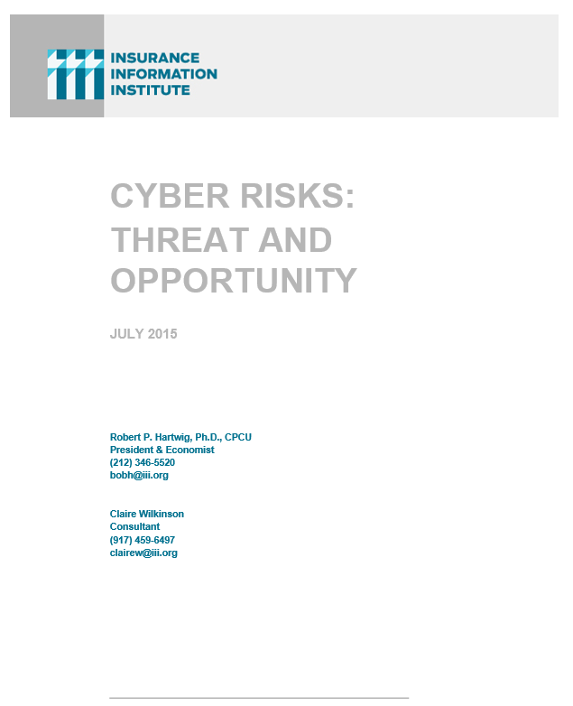
I.I.I. Will Release its Third Cyber Report in 2015: Cyber Risks Threat and Opportunity
I.I.I.’s 3rd report on cyber risk scheduled for Q3 2015
Provides information on cyber threats and insurance market solutions
Global cyber risk overview
  Quantification of threats by type and industry
Cyber security and cost of attacks
Cyber terrorism
Cyber liability
Insurance market for cyber risk

Slide 113

Technology and Insurance
Rapid Technological Innovations Are Impacting Many Segments of the P/C Insurance Industry
113

Slide 114

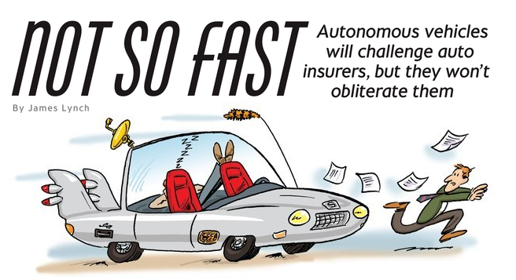
Media Are Obsessed with Driverless Vehicles: Often Predicting the Demise of Auto Insurance
By 2035, it is estimated that 25% of new vehicle sales could be fully autonomous models
Questions
Are auto insurers monitoring these trends?
How are they reacting?
Will Google take over the industry?
Will the number of auto insurers shrink?
How will liability shift?
Source: Boston Consulting Group.

Slide 115




On-Demand/Sharing/Peer-to-Peer Economy Impacts Many Lines of Insurance
The “On-Demand” Economy is or will impact many segments of the economy important to P/C insurers
  Auto (personal and commercial)
  Homeowners/Renters
  Many Liability Coverages
  Professional Liability
  Workers Comp
Many unanswered insurance questions
Insurance solutions are increasingly available to fill the many insurance gaps that arise
115
12/01/09 - 9pm
eSlide – P6466 – The Financial Crisis and the Future of the P/C
Notes:
115

Slide 116



Labor on Demand: Huge Implications for the US Economy, Workers & Insurers
Will YOUR job be reduced to an app?

Slide 117


Send in the Drones:
Potential Rapid Adoption in Industry
Drones or Unmanned Aerial Vehicle (UAV) technology is seeing rapid adoption rate in many industries, including insurance
FAA granting Section 333 exemptions for commercial use and testing of UAS
At least 5 insurers have received permission to test
Wide variety of applications: claims, pre-event property inspections…
Insurers partnering with construction industry to guide R&D and regulation of UAV use via Property Drone Consortium: www.propertydrone.org

Slide 118
Summary
Calm Eddies . . .
  Low Interest Rates . . .
  Flat Premium Rates . . .
  Light Catastrophes (so far)
  Underwriting Profits . . .
  Steady Economic Growth . . .
  Make 2015 Look Good (so far)

Slide 119
Summary
Turbulent Waters
  Excess Capital. . .
  Waves of Mergers and Acquisitions. . .
  Cybersecurity Risks . . .
  Disruptive Technology . . .
  Make the Future an Exciting Challenge

Slide 120
Insurance Information Institute Online:
www.iii.org
Thank you for your time
and your attention!
Twitter: twitter.com/III_Research
Download at www.iii.org/presentations

