Slide 1
Communication & Insurance:
Before, During & After Disaster
National Hurricane Conference
Orlando, FL
March 29, 2018
Lynne McChristian, Communications Consultant
Insurance Information Institute ♦ 110 William Street ♦ New York, NY 10038
Tel: 212.346.5540 ♦ Cell: 917.494.5945 ♦ stevenw@iii.org ♦ www.iii.org

Slide 2
What do Consumers Know About Insurance?
More important? What they don’t know

Slide 3
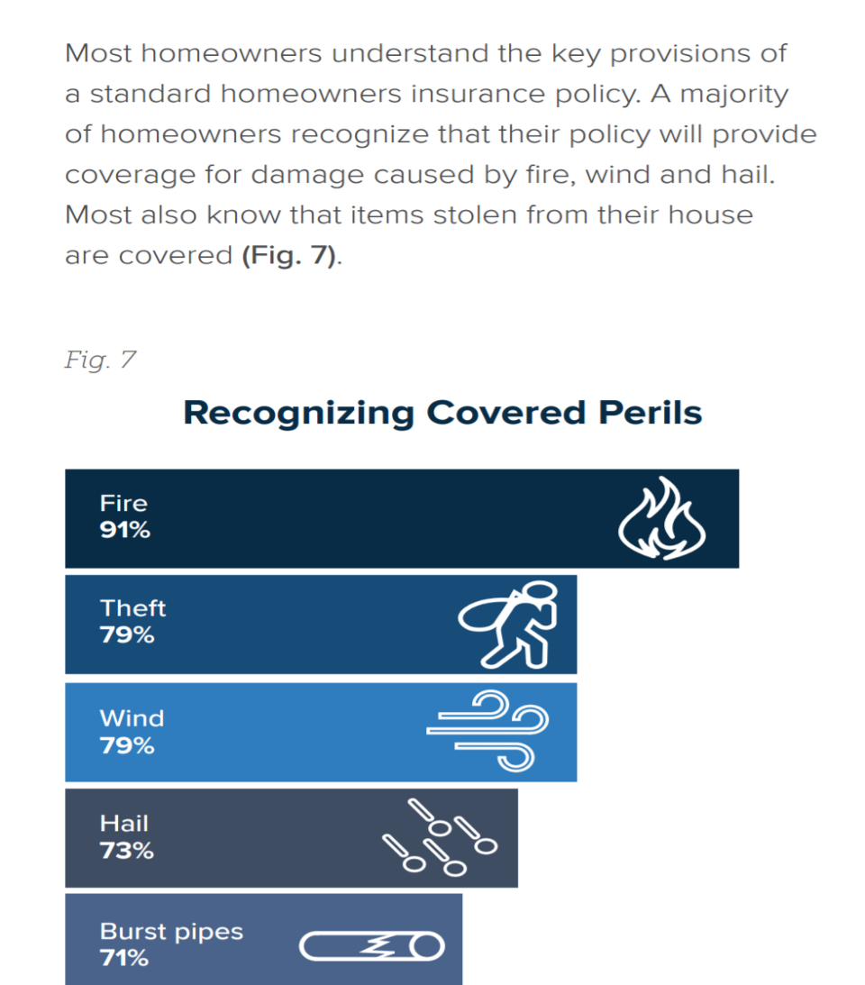
Homeowners Understand the Key Provisions in A Policy
Most consumers
understand these
perils are covered:
Fire
Theft
Wind
Hail
Burst Pipes

Slide 4
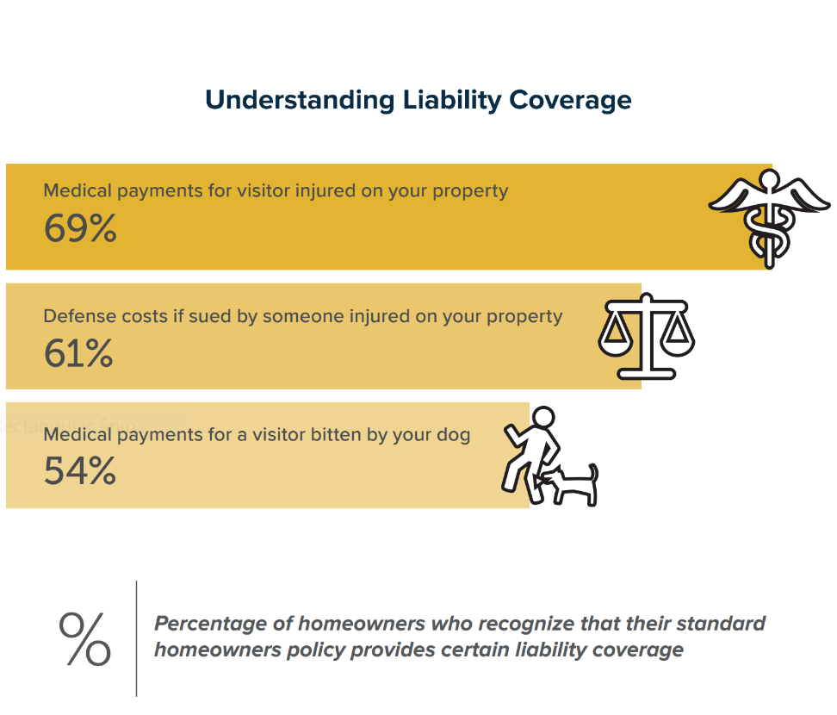
Consumer Understanding of Liability Coverage
Most policyholders know homeowners insurance provides liability protection.

Slide 5
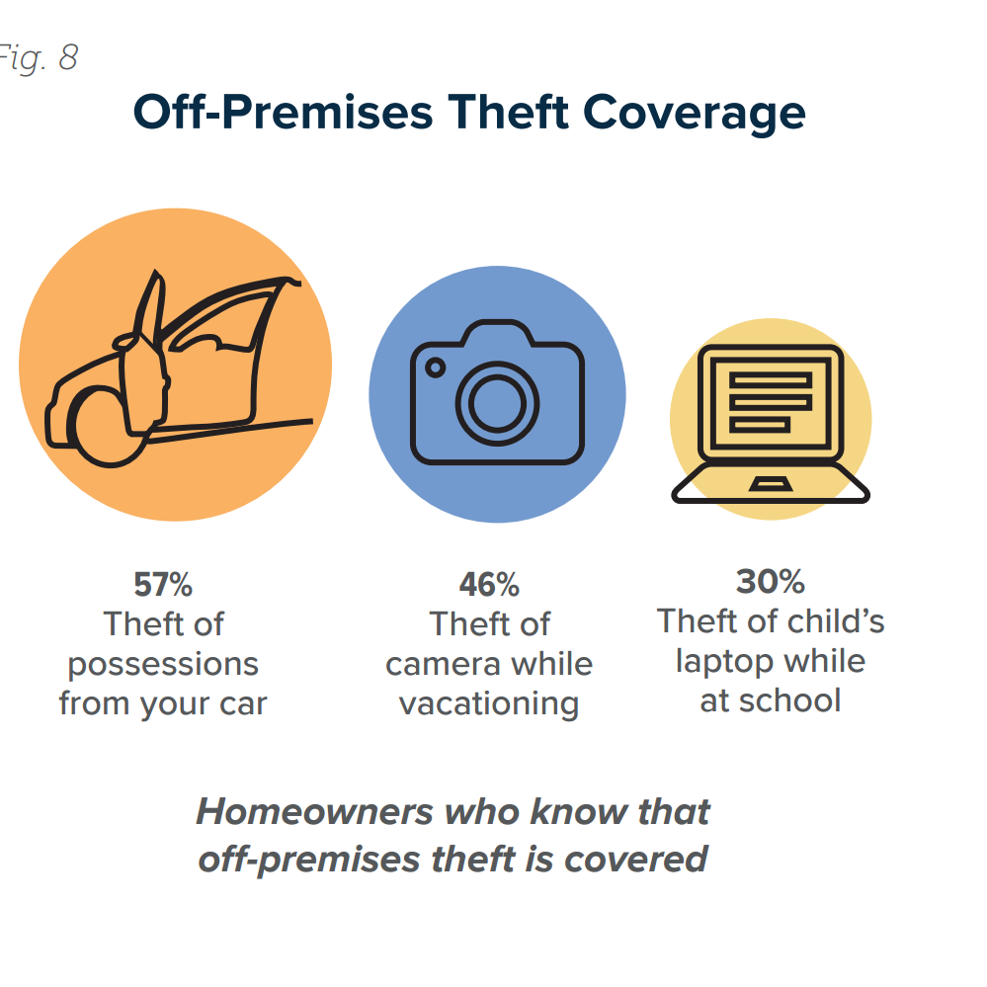
Consumers are Fuzzy on the Details
They understand the basics, yet many are unaware of some additional coverages included in their policy.
For example, 79% know homeowners insurance covers possessions stolen from their home, but don’t always know those items are covered if they are stolen from them outside the home.

Slide 6
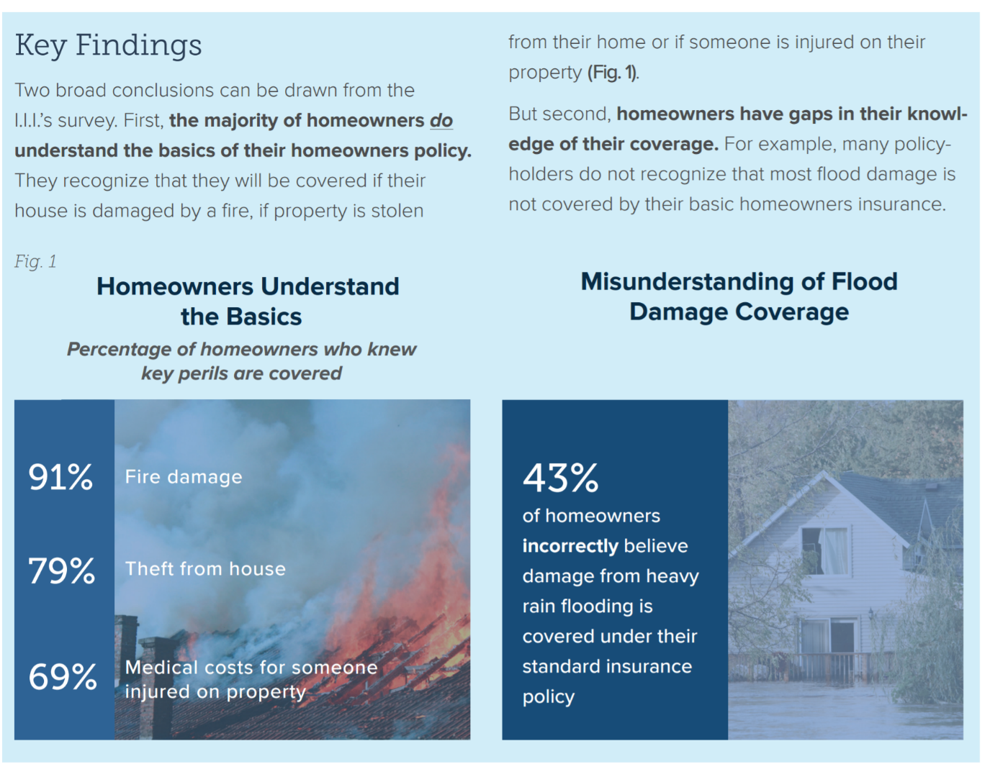
Confusion about water damage vs flood damage
A water heater burst feels like a “flood,” but it’s not.
Insurance Information Institute, 2016 Consumer Insurance Survey, Homeowners Insurance: Understanding, Attitudes, and Shopping Practices, February 2017, p. 2.

Slide 7
At Peak (2007), Only 5% of Occupied Residences Had an NFIP Flood Insurance Policy In Force
5.1%
4.3%
Since 2007 the number of occupied residences has grown by 7.25% but the number of flood policies in force fell by 10.25%.
Sources: https://www.fema.gov/total-policies-force-calendar-year ; https://www.census.gov/housing/hvs/data/histtabs.html Insurance Information Institute.

Slide 8
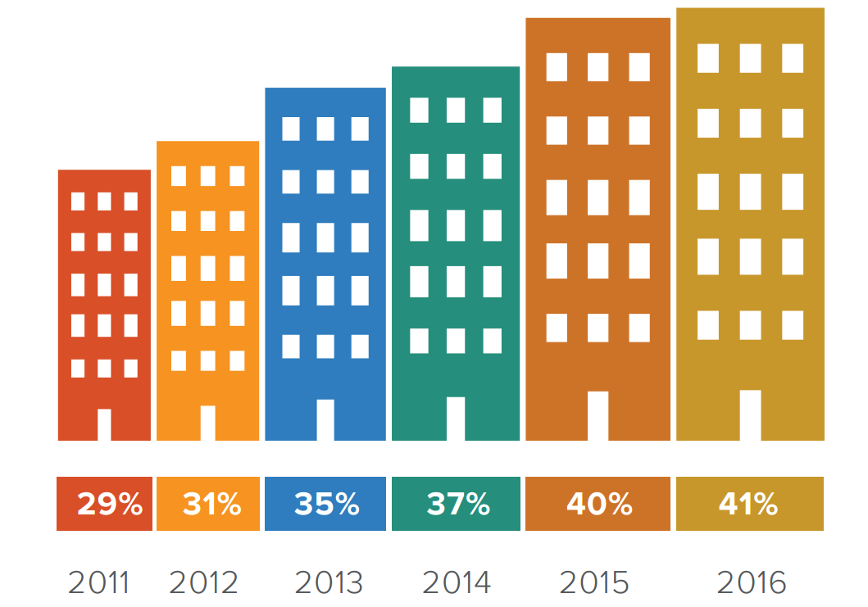
Homeowners and Renters Insurance
A 2016 Insurance Information Institute poll found that
93% of homeowners had homeowners insurance.
And 41% renters
had renters
insurance.
But only 12% had a flood insurance policy, despite the fact that flooding is the most common natural disaster in the U.S.

Slide 9
What Insurers Learned from the Hurricanes of 2017
Flood damage is the least understood peril, and yet it is the most common one.
  False sense of security in some high-risk areas, and overstated risks in other areas.
It’s not all about homes. Personal autos and business interruption coverage had larger-than-expected losses.
Trend is for consecutive disasters and increased losses.
There is a protection gap: Insured vs uninsured losses.
Proactively addressing risks isn’t an option; it’s an imperative.
  Partnerships, communication, preparedness mindset.

Slide 10
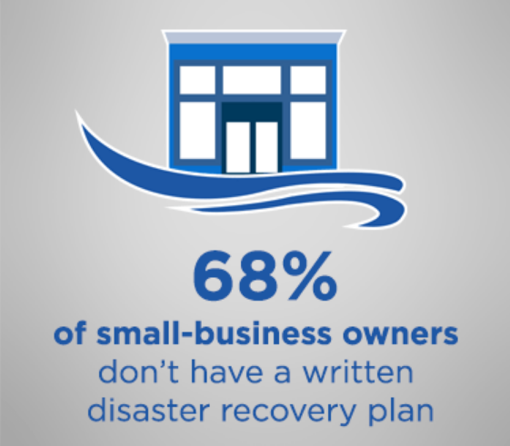
Business are Not Prepared for a Disaster
A Nationwide Insurance report shows a 26% increase in the average severity of commercial catastrophe claims.
Most small-business owners (68%) do not have a written disaster recovery plan — even though about half (49%) said it would take their business at least three months to recover from a natural disaster.
hose findings stem from Nationwide’s second annual Small Business Indicator, which was conducted online by Harris Poll on behalf of Nationwide from June 10-23 among 502 U.S. small-business owners with fewer than 300 employees.

Slide 11
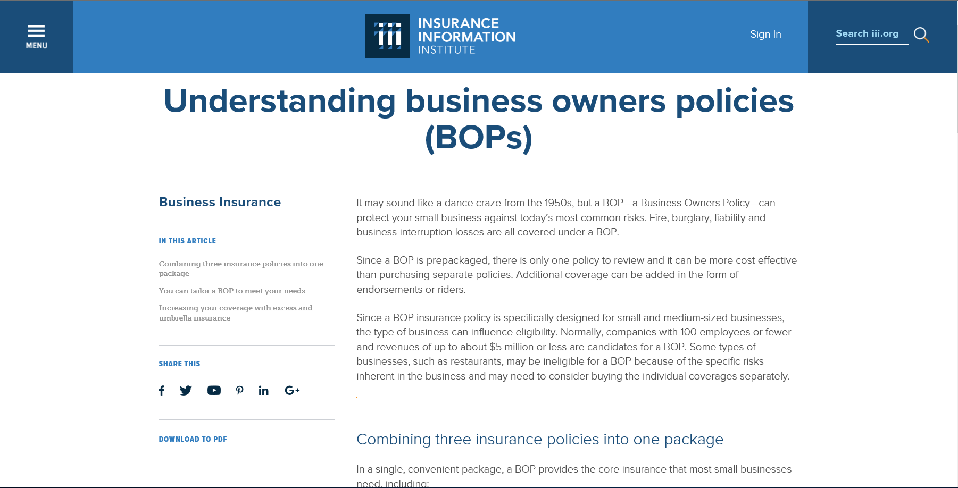
Critical Need for Small Business Owners to Understand their Options
Too often, they ask about coverage….after a disaster!

Slide 12
Home-based Businesses at Risk
Most of the 11 Million Home-based Businesses Do Not Have Proper Coverage
A survey, conducted by International Communications Research, reveals that one in 10 U.S. households operates some type of full or part-time home-based business. However, nearly 60% do not have insurance coverage.
Nearly 40% of home-based business owners say they thought they were protected by some other type of coverage, while almost 30% say their businesses are too small to insure.
Additionally, home-based businesses without insurance are slightly more likely (11%) to have experienced a financial loss than are those that do have insurance (9%).

Slide 13
Communicating When a Storm is Imminent

Slide 14
Responsiveness to Hurricane Messages
It depends……
Yale project on climate change communication, Marlon, et al, 2015

Slide 15
“You Are if You Think You Are”

Slide 16
Hurricane Response

Slide 17
Anchoring Observations
The brain gets stuck on a timeframe and misleading information.
  Most people consider a 1-in-100-in-a-year chance event quite unlikely, and many are unwilling to insure against it, even if it could cause a devastating loss.
    However, the chance of such an event happening over a 30-year period is 1-in-4.
  Perspective: From Aug. 2015-Aug. 2016, there were eight 500-year flood events, according to the National Weather Service. (Houston in 2017). In the five years prior, there were six 1,000 year flood events.*
Source: *http://www.jbarisk.com/5lessons
David Rolpeik, How Risky Is It Really?: Why Our Fears Don’t Always Match the Facts (New York: McGraw-Hill, 2010), p. 40, citing Kahneman and Tversky.

Slide 18
Messaging that Works
Something for Everyone
Present approach:
  Simple, instructive messages, which appeals to about 40-45% of the population.
  So, 55-60% are not as responsive.
A Better Approach:
  Multiple types of messages so important information is accessible to people of all kinds of personality types and cognitive dispositions

Slide 19
Considering Individual Differences
People are attentive to hurricane forecasts, get similar information, but react differently
Predictions – how likely a hurricane is to occur, and how bad it would be
Priorities – personal safety, guarding one’s possessions, staying with pets, or even watching the storm
Preparedness
Belief as to whether evacuating or staying was safer
Willingness to evacuate
THE CHALLENGE: How can we more effectively deliver (and design) critical information, especially if different people react differently to the same information (and need incentives to act)?
FSU Behavioral Research by Dr. Sarah Baisley and Dr. Lorilee Medders

Slide 20
Personal Circumstances Matter
Life Safety and Property Protection Decisions Depend Upon:
Financial situation
Access to transportation
Dependents (children, elderly relatives, pets, other)
Age
Religion
Language
WHO MATTERS MOST in delivering messages?
Experts and credible peers

Slide 21
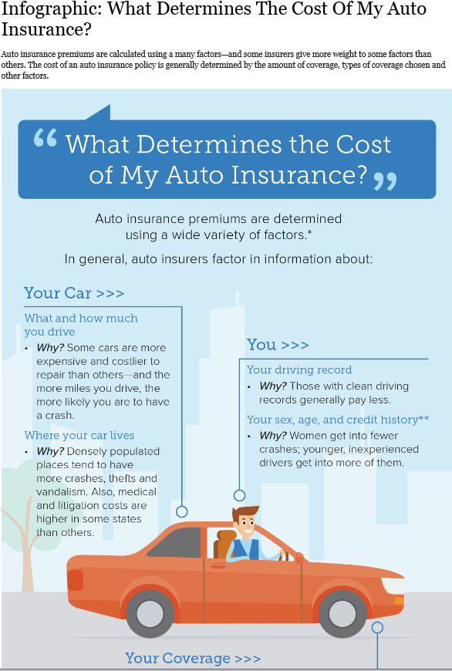
Approaches as Different As Individuals
Apps
Blogs
Checklists
Consumer Articles
Infographics
Media Interviews
Social Engagement
Videos

Slide 22
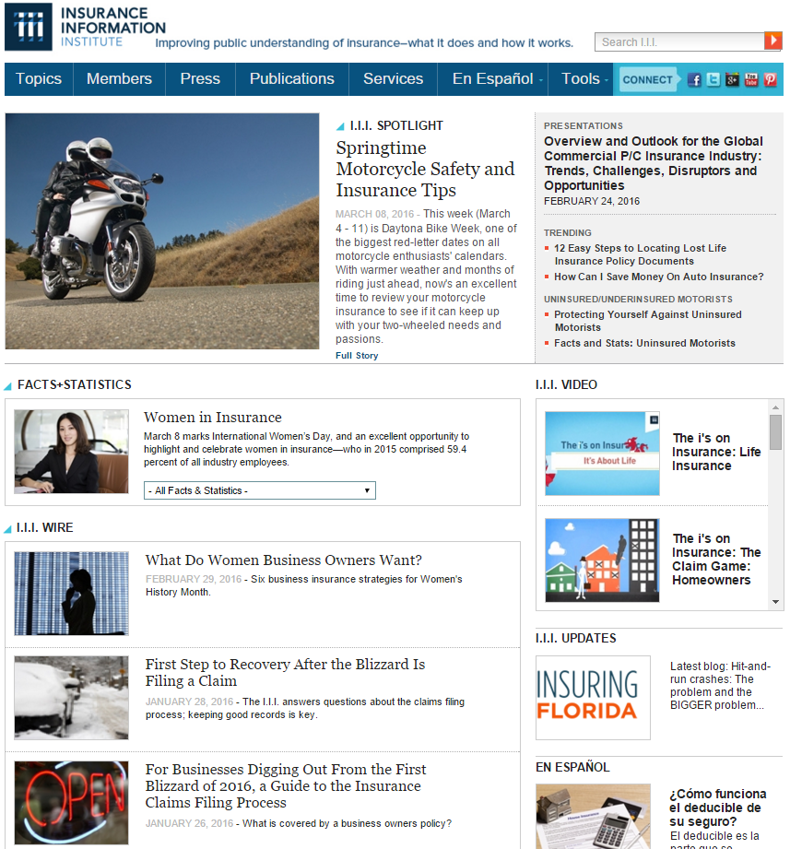
I.I.I. Website
The I.I.I. homepage is updated regularly with content relevant to consumers.

Slide 23
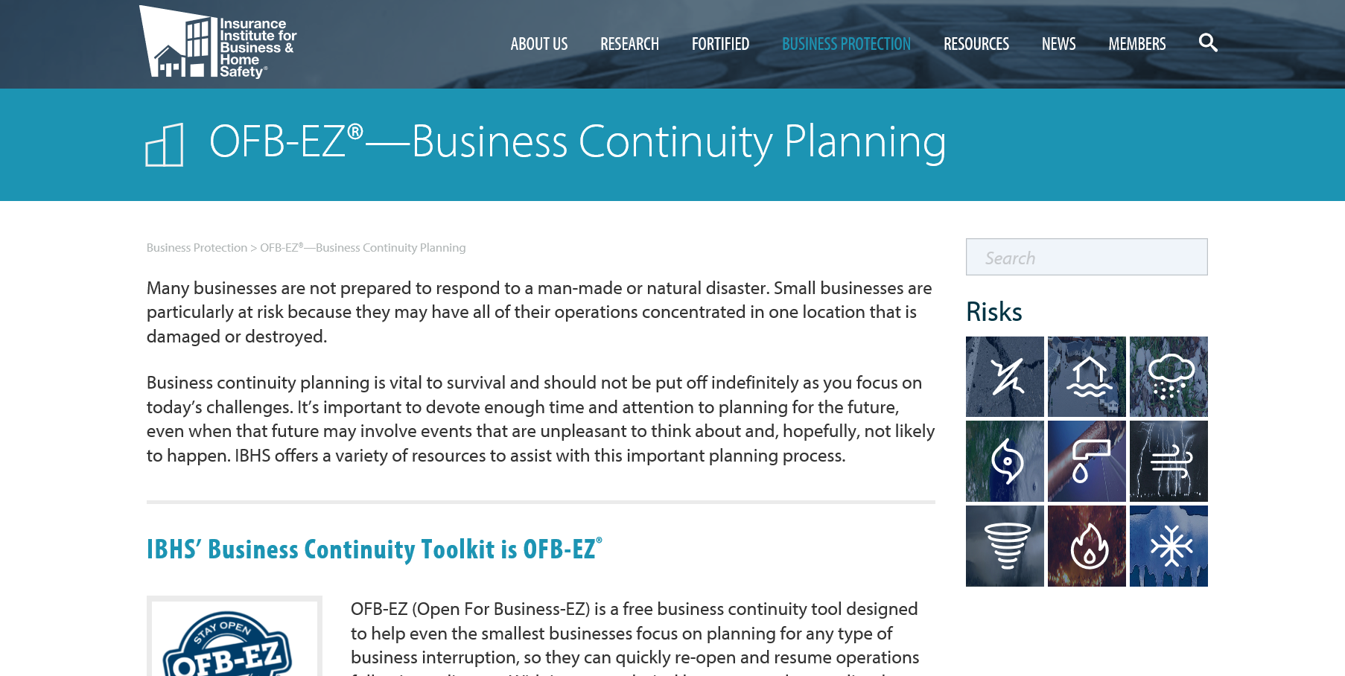
IBHS – Great Resources for a Small Business

Slide 24
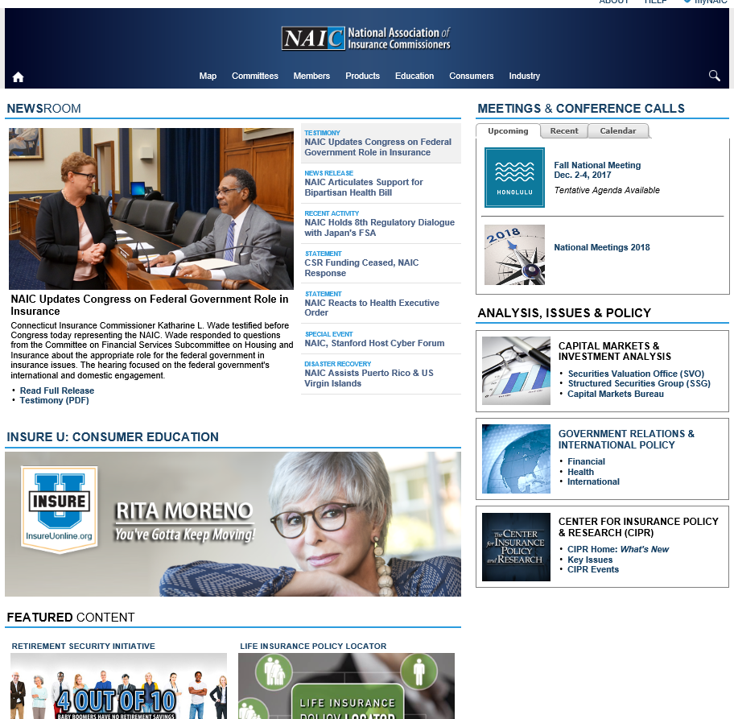
NAIC Resources for the Industry and Consumers

Slide 25
10 Rules of Successful Communication
Simplicity: Use small words.
  Simple, plain language is more easily understandable.
Brevity: Use short sentences.
  Consider how ad slogans of 2-3 words pack punch.
Credibility is as important as philosophy.
  The words you use become you.
Consistency matters.
  Repetition, repetition.
Novelty: Offer something new.
  Can your message generate an “I didn’t know that” response?

Slide 26
10 Rules of Successful Communication
(cont.)
Sound & Texture Matter.
  “Snap, Crackle, Pop”
Speak Aspirationally.
  “The only thing we have to fear is fear itself.”
Visualize.
  Paint a picture.
Ask a Question.
  “Can you hear me now?”
Provide Context & Explain Relevance.
  Give the “why” before the “”therefore” and “so that.”
Source: “Words That Work,” by Dr. Frank Luntz

Slide 27
I.I.I. Poll: Favorability
Percent of Public Rating Industry as Very or Mostly Favorable, 2016
Auto/Home Insurers Tie with Banks as Highest Rated of Industries Surveyed
Source: Insurance Information Institute Pulse survey, November 2016.
Notes:
What it is: We asked respondents to rate on a scale of 1 to 5, with 5 being the high, how favorable their opinion was for auto and home insurance vs. various other industries.
What it says: Auto and home insurers have the highest ratings, tied with banking, of all the industries we included in the survey.
Note: We ask this question regularly, and auto and home insurers inevitably come in first or second.

Slide 28
What Should We Be Communicating?

Slide 29
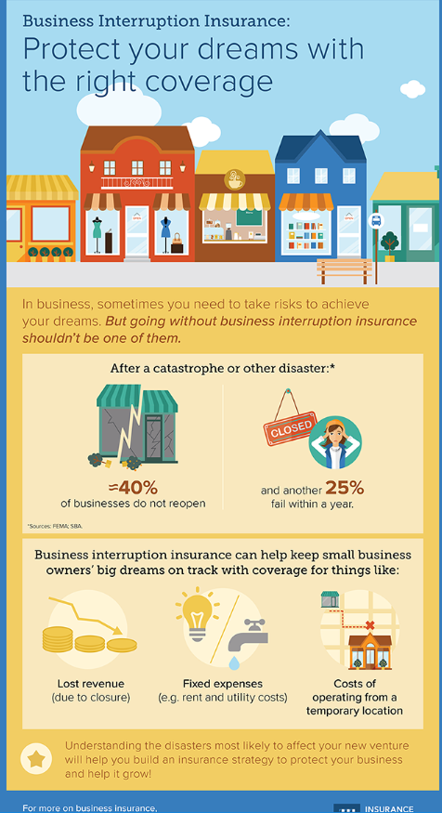
Need to Educate Business Owners
About all their options…so they can make sound financial decisions!
40 Percent Don’t Open After a Disaster
Another 25% Fail Within a Year!
Property insurance
Liability insurance
Business interruption insurance
And, Professional liability, Employee practices liability, Workers’ comp, Health and disability, Flood and sewer back-up, Cyber risk insurance, Terrorism insurance…

Slide 30
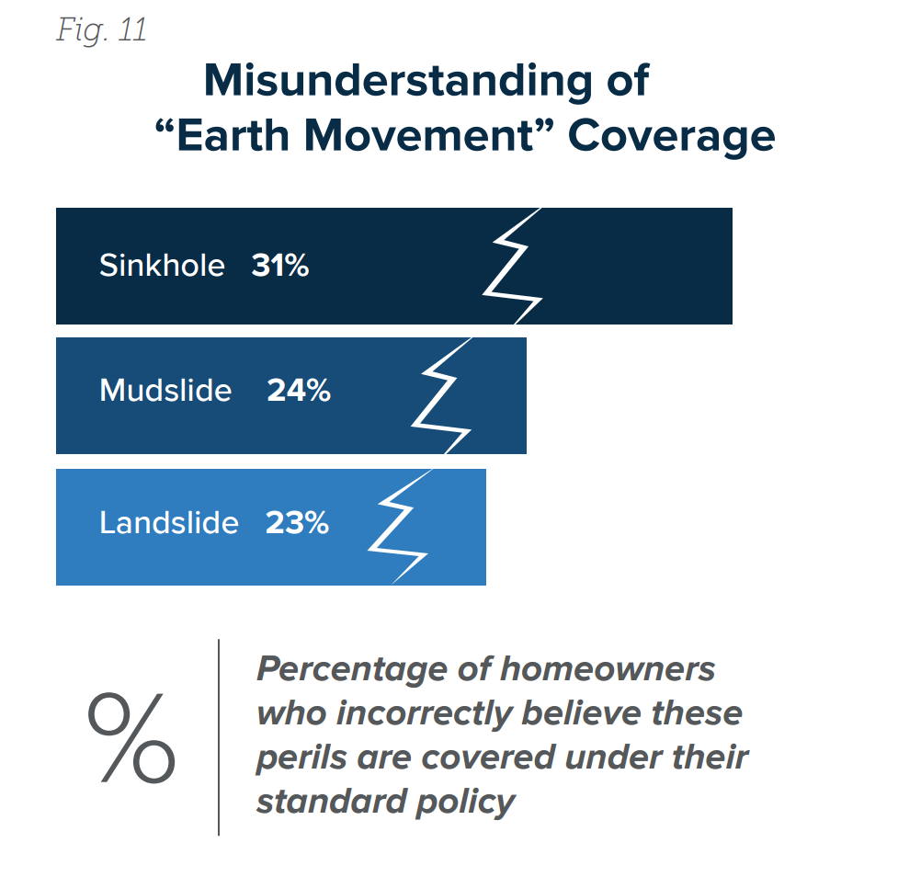
Need to Clear Up Confusion About Coverage
Explain water damage vs flood coverage.
Talk coverage AND limitations of flood coverage.
  No additional living expense.
  No coverage for basements.
  Also need to clearly explain coverage for mudslides, landslides and back-up of sewers and drains, as well as “law and ordinance” coverage.

Slide 31
Details
Conduct a home inventory
Explain deductibles AND hurricane deductibles
Actual Cash Value vs. Replacement Cost Value
Comprehensive auto insurance
“Optional coverage” – Flood, building ordinance & law, inflation guard, sewer backup, sinkhole
Flood insurance limitations
  30-day waiting period
  No coverage for basements
  No Additional Living Expenses
  Limits in coverage to $250,000 for home, $100,000 for contents
No coverage for tree damage, unless it hits an insured object

Slide 32

“Surround Sound” Approach to Consumer Communications
Consumers
Consumers
Industry
Policymakers
Media
Relevant
Experts
Relevant
Experts
Industry
Media
Policymakers

Slide 33
The Property Insurance “Protection Gap:” Definition and Measurement

Slide 34
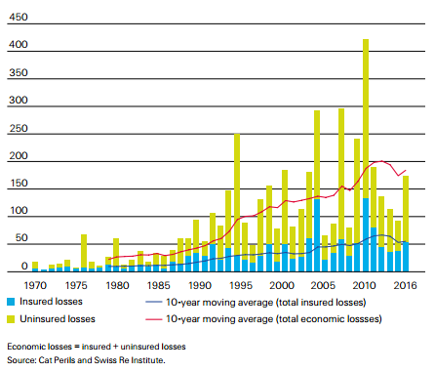
The Global “Protection Gap,” the difference between Economic Losses and Insured Losses generated by catastrophes, is growing
$Billions, in 2016 dollars
In terms of 10-year rolling averages, between 1991 and 2016, insured losses grew by 4.6% per year but economic losses by 5.6% per year.

Slide 35
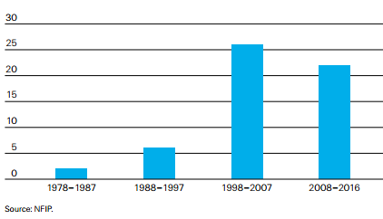
The Drop in Flood Coverage Isn’t Due to Lower Insured Flood Claims Payments
US Insured Flood Losses, $Billions
In 2016 there were 4 separate multi-billion-dollar inland flood events – the highest number in a single year since 1980.
Source: SwissRe Institute: Sigma No 2/2017 “Natural catastrophes and man-made disasters in 2016: a year of widespread damages”; Insurance Information Institute.

Slide 36
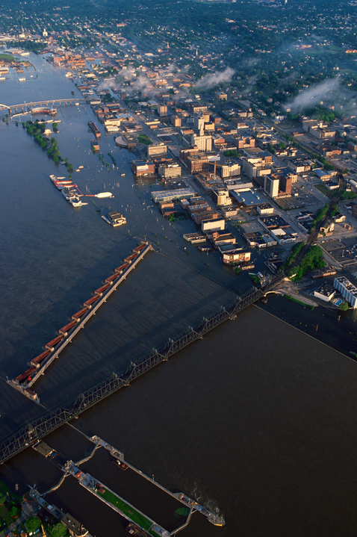
The $10 Billion Flood Protection Gap: What Can We Do?
Risk awareness
Simple insurance products (flood endorsement policies)
Continue to improve risk assessment tools
Public/private partnerships that support financial resilience
Source: SwissRe/III webinar, April 27, 2017.
Notes:
Keys to improving resilience and recovering faster
improve risk awareness
make insurance products simple (flood endorsement policies)
improved risk assessment tools
public/private partnerships that support financial resilience
Reinsurance can help
Recent NFIP reinsurance placement improves financial stability of NFIP program
Closing the protection gap requires the collaboration of all stakeholders
Sustainable flood coverage for the majority of homeowners and small commercial enterprises is well within our reach!

Slide 37
Helping consumers make good decisions
Helping them understand:
The types of losses/claims that they might sustain
The likelihood/probability of those various kinds of losses/claims—what we call “frequency”
The potential severity of those losses

Slide 38
Thank you

