Slide 1
Trends in Coastal Property Risk in the Post-Katrina Decade
National Hurricane Conference
Austin, TX
April 1, 2015
Steven N. Weisbart, Ph.D., CLU, Senior Vice President & Chief Economist
Insurance Information Institute ♦ 110 William Street ♦ New York, NY 10038
Tel: 212.346.5540 ♦ Cell: 917.494.5945 ♦ stevenw@iii.org ♦ www.iii.org

Slide 2
2005-2014: A Bust for Hurricane-Force Winds…
…but a BOOM in Catastrophe Exposure
2

Slide 3
In 2012, Total Value of Insured Atlantic & Gulf Coastal Exposure: $10.6 Trillion
(2012, $ Billions)
In terms of exposed value, over half is in Florida + New York.
Unlike Florida, the insured coastal exposure in northeast states is concentrated in a very small area
The insured value of all coastal property was estimated at $10.6 trillion
in 2012 , up 48% from $7.2 trillion in 2004.
Source: AIR Worldwide

Slide 4
Total Potential Home Value Exposure to Storm Surge Risk in 2014*
Florida’s “extreme” exposure is greater than any other state’s “extreme,” “very high,” and “high” exposure combined
CoreLogic estimated the reconstruction value of homes exposed to Storm Surge along the Atlantic and Gulf Coasts as $1.496 trillion in 2014 (assuming total losses). Only a fraction of this is insured for flood, hence the huge demand for federal aid following major coastal flooding events.
($ Billions)
*Insured and uninsured property, assuming total loss of the home.
Source: Storm Surge Report 2014, Table 2, CoreLogic, published July 2014.

Slide 5
Post-Katrina P/C Industry Homeowners
Claim Frequency, US, 2006-2013
Claims Paid per 100 Exposures
Frequency is up in years with greater CAT activity, but otherwise no obvious trend here
Sources: Insurance Research Council, “Trends in Homeowners Insurance Claims,” p.41; Insurance Information Institute

Slide 6
P/C Industry Homeowners Claim Frequency, US, 1997-2013
Claims Paid per 100 Exposures
Sources: Insurance Research Council, “Trends in Homeowners Insurance Claims,” p.41; Insurance Information Institute

Slide 7
P/C Industry Homeowners Average Claim Severity, Inflation-adjusted, 2006-2013
2013 dollars
Sources: Insurance Research Council, “Trends in Homeowners Insurance Claims,” 2015 edition, p. 41; BLS inflation calculator,
with Insurance Information Institute calculations

Slide 8
P/C Industry Homeowners Average Claim Severity, Inflation-adjusted, 1997-2013
2013 dollars
Inflation-adjusted, HO average claim severity is now over twice what it was in 1997.
Sources: Insurance Research Council, “Trends in Homeowners Insurance Claims,” 2015 edition, p. 41; BLS inflation calculator,
with Insurance Information Institute calculations

Slide 9
Pct. Change in Population, Forecast for 2010-2020, for Coastal Shoreline/Watershed Counties, by State
This population growth means not only more homes but more businesses, and more public buildings (schools, hospitals, etc.) and infrastructure in “harm’s way”
Source: http://stateofthecoast.noaa.gov/features/coastal-population-report.pdf Table 5 and Table 10

Slide 10
Pct. Change in Population, Forecast for 2010-2020, for Coastal Shoreline Counties, by State
This population growth means not only more homes but more businesses, and more public buildings (schools, hospitals, etc.) and infrastructure in “harm’s way”
Source: http://stateofthecoast.noaa.gov/features/coastal-population-report.pdf Table 5

Slide 11
Pct. Change in Population, Forecast for 2010-2020, for Coastal Watershed Counties, by State
This population growth means not only more homes but more businesses, and more public buildings (schools, hospitals, etc.) and infrastructure in “harm’s way”
Source: http://stateofthecoast.noaa.gov/features/coastal-population-report.pdf Table 10

Slide 12
Post-Katrina
U.S. Insured Catastrophe Losses
($ Billions, $ 2013)
Pvt Ins. Annual Data
Mean: $19.1B
Median: $14.6B
NFIP Annual Data
Mean: $2.24B
Median: $0.75B
These numbers are national, not coastal, but are often largely coastal in origin. The volatility is obvious.
Sources: Property Claims Service/ISO; https://www.fema.gov/statistics-calendar-year/loss-dollars-paid-calendar-year
Insurance Information Institute.
12
12/01/09 - 9pm
eSlide – P6466 – The Financial Crisis and the Future of the P/C
Notes:
12

Slide 13
U.S. Insured Catastrophe Losses
($ Billions, $ 2013)
2012 was the 3rd most expensive year ever for insured CAT losses
2013-14 were welcome respites from 2011-12, which were among the costliest years for insured disaster losses in U.S. history. Longer-term trend is for more—not fewer—costly events.
$15.3 billion in insured CAT losses estimated for 2014
*Through 12/31/14.
Note: 2001 figure includes $20.3B for 9/11 losses reported through 12/31/01 ($25.9B 2011 dollars). Includes only business and personal property claims, business interruption and auto claims. Non-prop/BI losses = $12.2B ($15.6B in 2011 dollars.)
Sources: Property Claims Service/ISO; Insurance Information Institute.
13
12/01/09 - 9pm
eSlide – P6466 – The Financial Crisis and the Future of the P/C
Notes:
13

Slide 14
10 Costliest Coastal Storms in U.S. History
(Insured Losses,
2013 Dollars, $ Billions)
Hurricane Ike and Superstorm Sandy (3rd and 4th costliest ever) occurred post-Katrina
2 of the 4 most expensive coastal storms in U.S. history
have occurred in the decade after Katrina (and Rita and Wilma).
A $15 or $20 billion storm isn’t that unusual anymore.
Sources: PCS; Insurance Information Institute inflation adjustments to 2013 dollars using the CPI.

Slide 15
Public Attitudes
About Flood Insurance
Too Many People
Are in Denial About the Risk
15
Notes:
15

Slide 16
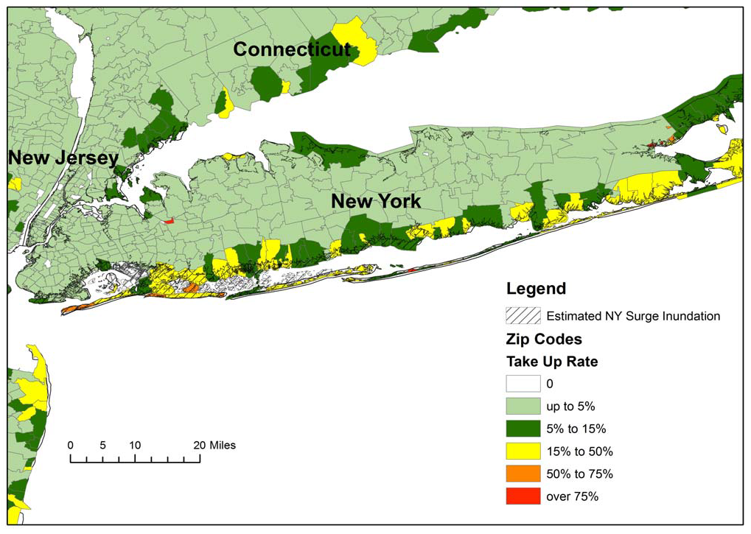
Residential NFIP Flood Take-Up Rates in NY, CT (2010) & Sandy Storm Surge
Flood coverage penetration rates were extremely low in many very vulnerable areas of NY and CT, with take-up rates far below 50% in many areas
Source: Wharton Center for Risk Management and Decision Processes, Issue Brief, Nov. 2012; Insurance Information Institute.
16

Slide 17
Share of Flood Damaged Structures with Flood Insurance: Long Island
Only 37.5% of flood damaged buildings in Nassau County were insured for flood, 62.5% uninsured
Number of buildings
74,736
$15.0
27.6% of flood damaged buildings in Suffolk County were insured for flood, 73.4% uninsured
43,106
20,798
52,428
5,747
$2.2
15,051
The Maximum FEMA Grant is $31,900. The Average Grant Award to Homeowners and Renters on Long Island is About $7,300
Source: Newsday, 1/14/13 from FEMA and Small Business Administration.
17
12/01/09 - 9pm
eSlide – P6466 – The Financial Crisis and the Future of the P/C
Notes:
17

Slide 18
Claims Management
Following KRW*, the P/C Insurance Industry learned that it needed more claims adjusters
*Hurricanes Katrina, Rita, and Wilma in 2005
18

Slide 19
Number of NFIP Claims Paid, Yearly,
2005-2013*
How many adjusters are needed each year to handle flood claims? Three times since 2005 NFIP has paid 75,000 claims in a calendar year; that never happened before. (And this excludes claims closed without payment.)
Average for 1997-2004: 39,100
Average for 2006-2013: 53,200
*calendar years
Source: http://www.fema.gov/statistics-calendar-year/number-losses-paid-calendar-year ; Insurance Information Institute

Slide 20
U.S. Employment in Claims Adjusting, 1990–2015*
Thousands
This is independent claims adjusting employment, not carrier-employed claims adjustment
Hurricane Andrew
Hurricanes Katrina, Rita, Wilma
Hurricanes Bertha, Gustav, Ike
*As of January, 2015; not seasonally adjusted.
Note: Recessions indicated by gray shaded columns.
Sources: U.S. Bureau of Labor Statistics; National Bureau of Economic Research (recession dates); Insurance Information Institute.
20
Notes:
20

Slide 21
U.S. Employment in Claims Adjusting 2005–2015*
Thousands
Employment rose from 48,600 (Jan 2011) to 54,700 (Jul 2012)
Hurricanes Katrina, Rita, Wilma
*As of January, 2015; not seasonally adjusted.
Note: Recessions indicated by gray shaded columns.
Sources: U.S. Bureau of Labor Statistics; National Bureau of Economic Research (recession dates); Insurance Information Institute.
21
Notes:
21

Slide 22
Number of NFIP Claims Paid, 2013-14,* Coastal New England and Mid-Atlantic States
The number of paid claims varies from one year to the next and the trend isn’t consistent from state to state.
*fiscal years, ending Sept 30 2013 and Sept 30 2014, respectively
Source: https://www.fema.gov/media-library/assets/documents/21075 ; Insurance Information Institute

Slide 23
Number of NFIP Claims Paid, 2013-14,* Coastal South Atlantic and Gulf States
The number of paid claims varies from one year to the next and the trend isn’t consistent from state to state.
*fiscal years, ending Sept 30 2013 and Sept 30 2014, respectively
Source: https://www.fema.gov/media-library/assets/documents/21075 ; Insurance Information Institute

Slide 24
Post-Katrina P/C Industry Homeowners
Claim Frequency, TX vs. US, 2006-2013
Claims Paid per 100 Exposures
The number of claims adjusters needed in Texas in 2008 in a short time was hard to meet; some storm victims would have to wait.
Sources: Insurance Research Council, “Trends in Homeowners Insurance Claims,” p.41; Insurance Information Institute

Slide 25
Capital/Capacity
Storm-Free Years Helped Insurers Build Financial Resources
for the Next Big One
25

Slide 26
Policyholder Surplus,
2006:Q4–2014:Q3
Drop due to near-record 2011 CAT losses
($ Billions)
2007:Q3
Pre-Crisis Peak
Surplus as of 9/30/14 stood at a record high $673.9B
The industry now has $1 of surplus for every $0.73 of Net Premiums Written, close to the strongest claims-paying status in its history.
2010:Q1 data includes $22.5B of paid-in capital from a holding company parent for one insurer’s investment in a non-insurance business .
The P/C insurance industry entered 2015
in very strong financial condition.
Sources: ISO, A.M .Best.
26
12/01/09 - 9pm
eSlide – P6466 – The Financial Crisis and the Future of the P/C
Notes:
26

Slide 27
Premium-to-Surplus Ratio:
1985–2014*
(Ratio of NWP to PHS)
The larger surplus is in relation to premiums—the lower the P:S ratio—and the greater the industry’s capacity to handle the risk it has accepted
Surplus as of 9/30/14 was $0.75:$1, a near-record low (at least in modern history)
9/11, Recession & Hard Market
The Premium-to-Surplus Ratio Stood at $0.75:$1 as of
9/30/14, a Record Low (at Least in Recent History)
* As of 9/30/14.
Source: A.M. Best, ISO, Insurance Information Institute.

Slide 28
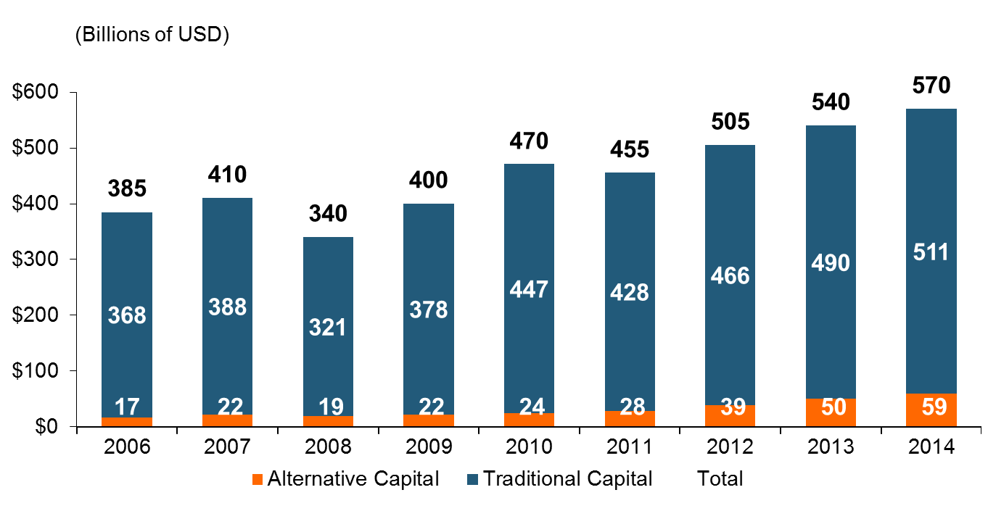
Global Reinsurance Capital (Traditional and Alternative), 2006 - 2014
Total reinsurance capital reached a record $570B in 2013, up 68% from 2008.
But alternative capacity has grown 210% since 2008, to $50B. It has more than doubled in the past three years.
2014 data is as of June 30, 2014.
Source: Aon Benfield Analytics; Insurance Information Institute.

Slide 29
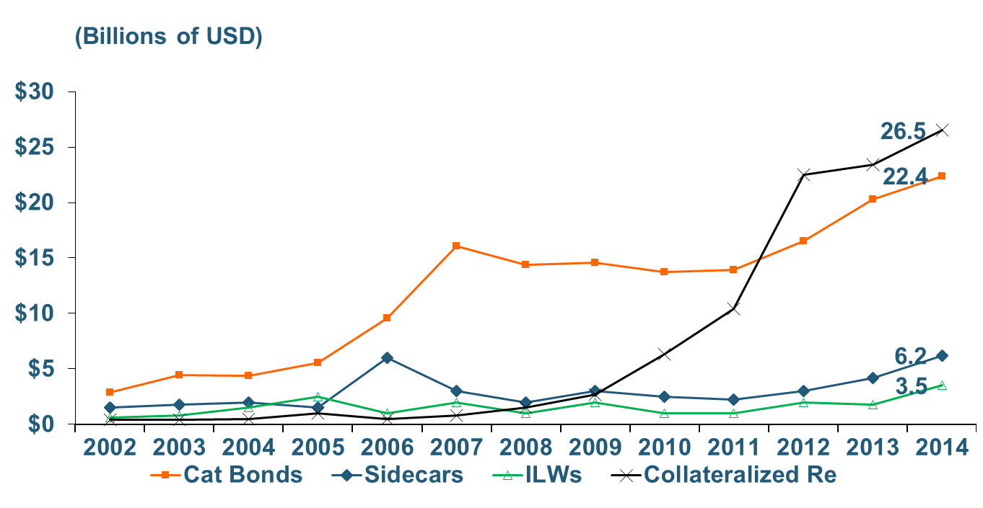
Growth of Alternative Capital Structures, 2002 - 2014
Collateralized Re’s Growth Has Accelerated in the Past Three Years.
Rapid Growth of Alternative Capital puts downward pressure
on Rates Charged by Traditional Reinsurers
2014 data is as of June 30, 2014.
Source: Aon Benfield Analytics; Insurance Information Institute.

Slide 30
Latest Developments
Just a little more than “60 Minutes”
30

Slide 31
The Role of Engineers:
New Lawsuits and NFIP Shake-up
When flood claims are adjusted, sometimes an engineer is assigned to help determine the cause of loss
Recently in New York lawsuits were filed alleging that engineering reports were fraudulently re-written to deny NFIP claims
The story got a big media boost when it was featured on CBS’ “60 Minutes”
NFIP subsequently announced significant personnel and structural changes, particularly regarding oversight of the claims process

Slide 32
Insurance Information Institute Online:
www.iii.org
Thank you for your time
and your attention!

