Slide 1
Presentation at the National Hurricane Conference
New Orleans, Louisiana
Thursday, April 20th, 2017
What it Looks Like From Here: Perspectives on the National Flood Insurance Program from an Insurance Adjuster’s Perspective
A Panel Discussion Between the I.I.I. and H2O Partners
Jeanne M. Salvatore, Chief Engagement Officer and Senior Spokesperson
Insurance Information Institute  110 William Street  New York, NY 10038
212.346.5555  Jeannes@iii.org  www.iii.org

Slide 2

I.I.I. Mission Statement
Simple and succinct; and should stay that way…
Improving public understanding
of insurance...
…what it does and how it works
2

Slide 3

“Surround Sound” Approach to Flood Insurance Communications
Consumers
Consumers
Industry
Policymakers
Media
Relevant
Experts
Relevant
Experts
Industry
Media
Policymakers

Slide 4
Everyone Needs to Work Together
Education about Coverage, Procedures, Rights and Responsibilities is Essential to Claims Process.
Insurers
Agents/Brokers, Company Representatives
Consumers
Claims Adjusters

Slide 5
Flooding
Background
Flooding is the most common and costly natural disaster in the United States, causing billions in economic losses each year. Most U.S. natural disasters declared by the president involve flooding.
There is no coverage for flooding in standard homeowners or renters policies or in most commercial property insurance policies.
Coverage is available in a separate policy from the National Flood Insurance Program (NFIP) and from a few private insurers.
Despite efforts to publicize this, many people exposed to the risk of floods still fail to purchase flood insurance.

Slide 6
Flood Insurance
The Basics
Flood insurance covers direct physical losses by flood and losses resulting from flood-related erosion caused by heavy or prolonged rain, coastal storm surge, snow melt, blocked storm drainage systems, levee dam failure or other similar causes.
Homes are covered for up to $250,000 on a replacement cost basis and the contents for up to $100,000 on an actual cash value basis. (Excess flood insurance is available in all risk zones from some private insurers for NFIP policyholders who want additional coverage or where the homeowner’s community does not participate in the NFIP.)
Coverage for the contents of basements is limited. Coverage limits for commercial property are $500,000 for the structure and another $500,000 for its contents.

Slide 7
Percentage of Homeowners with Flood insurance
Far too Few People Purchase Flood Insurance
A 2016 poll by the Insurance Information Institute found that 12 percent of American homeowners had a flood insurance policy, lower than the 14 percent who had the coverage in 2015.
The percentage of homeowners with flood insurance was highest in the South, at 14 percent.
Thirteen percent of homeowners in the Northeast had a flood insurance policy,
10 percent of homeowners in the West had a flood insurance policy,
while 8 percent of homeowners in the Midwest had flood insurance.

Slide 8
I.I.I. Poll: Flood Insurance
Percentage of Homeowners Who Have Flood Insurance,
2007–2016
The Take-up Rate Continues a Slow Decline.
Source: Insurance Information Institute Annual Pulse Survey.

Slide 9
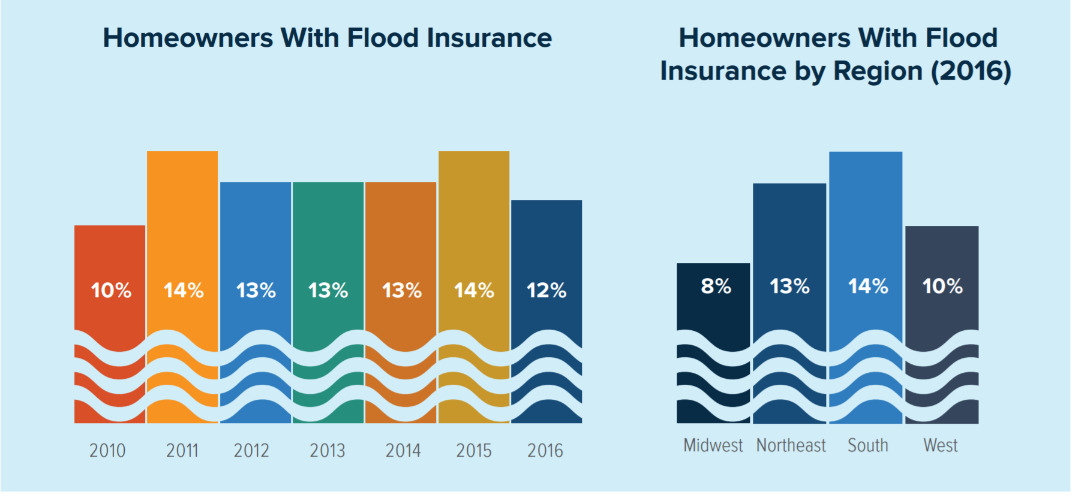
Flood Insurance by Year and By Region

Slide 10
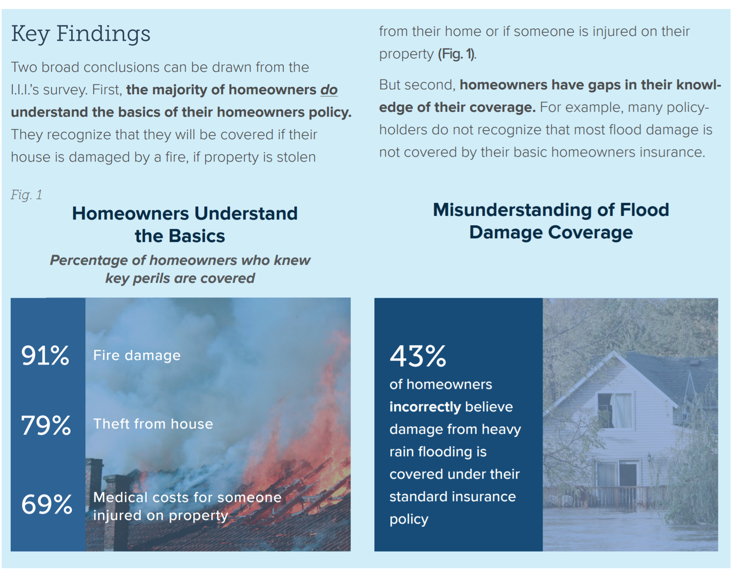
Consumer Understanding of Home and Flood Insurance
Good News and Bad News
Most homeowners
understand the
basics In a home
insurance policy,
but don’t understand
Water damage and
flooding

Slide 11
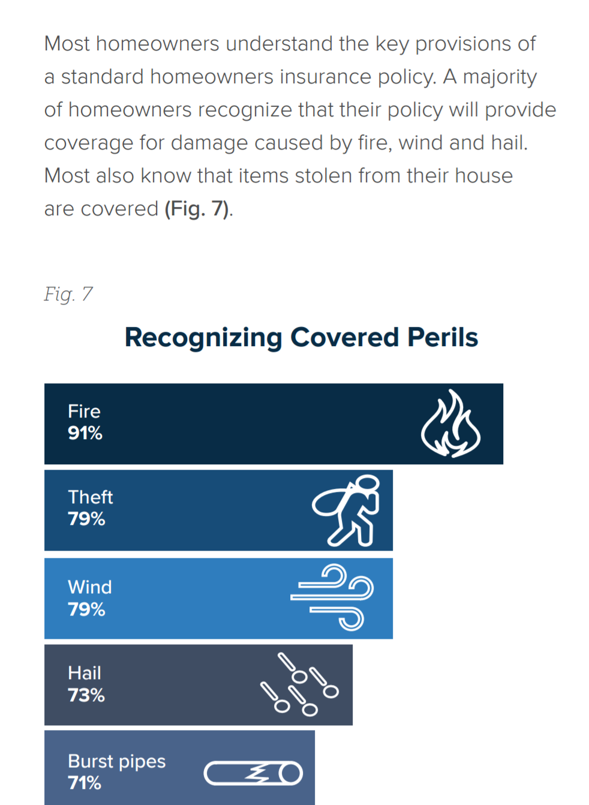
Homeowners Understand the Basics
Know the basics

Slide 12
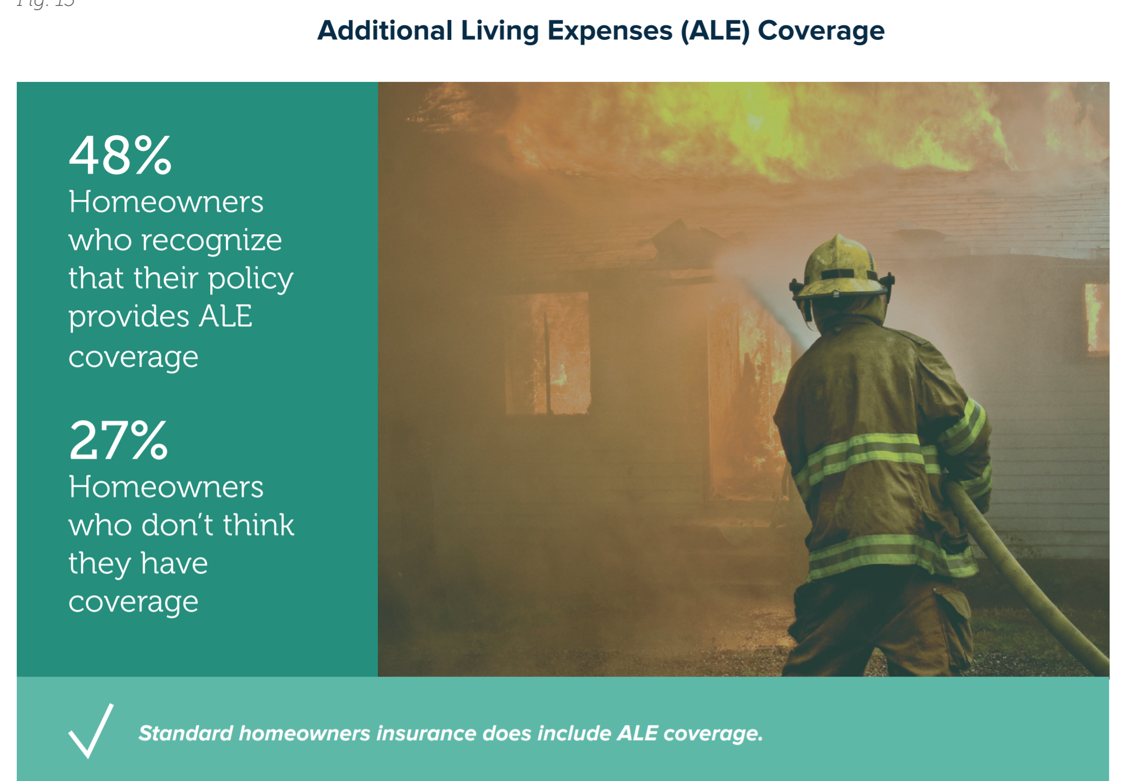
Most Know that there is ALE Coverage in a Home Insurance Policy
No ALE in Flood Insurance Policy – Another Source of Confusion

Slide 13
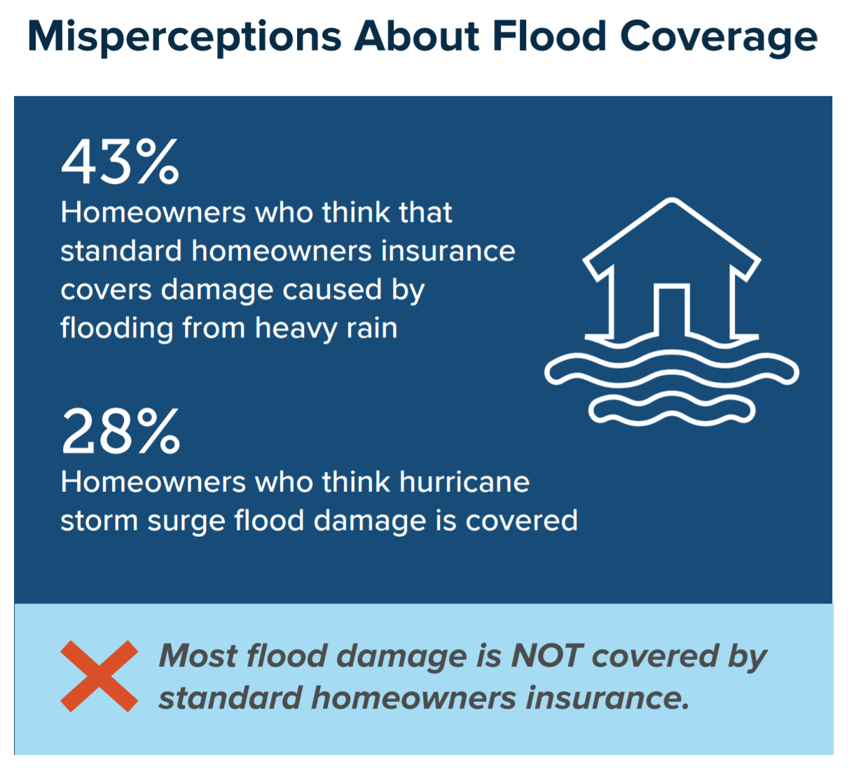
Public is confused by flood insurance Coverage
Misperceptions Abound

Slide 14
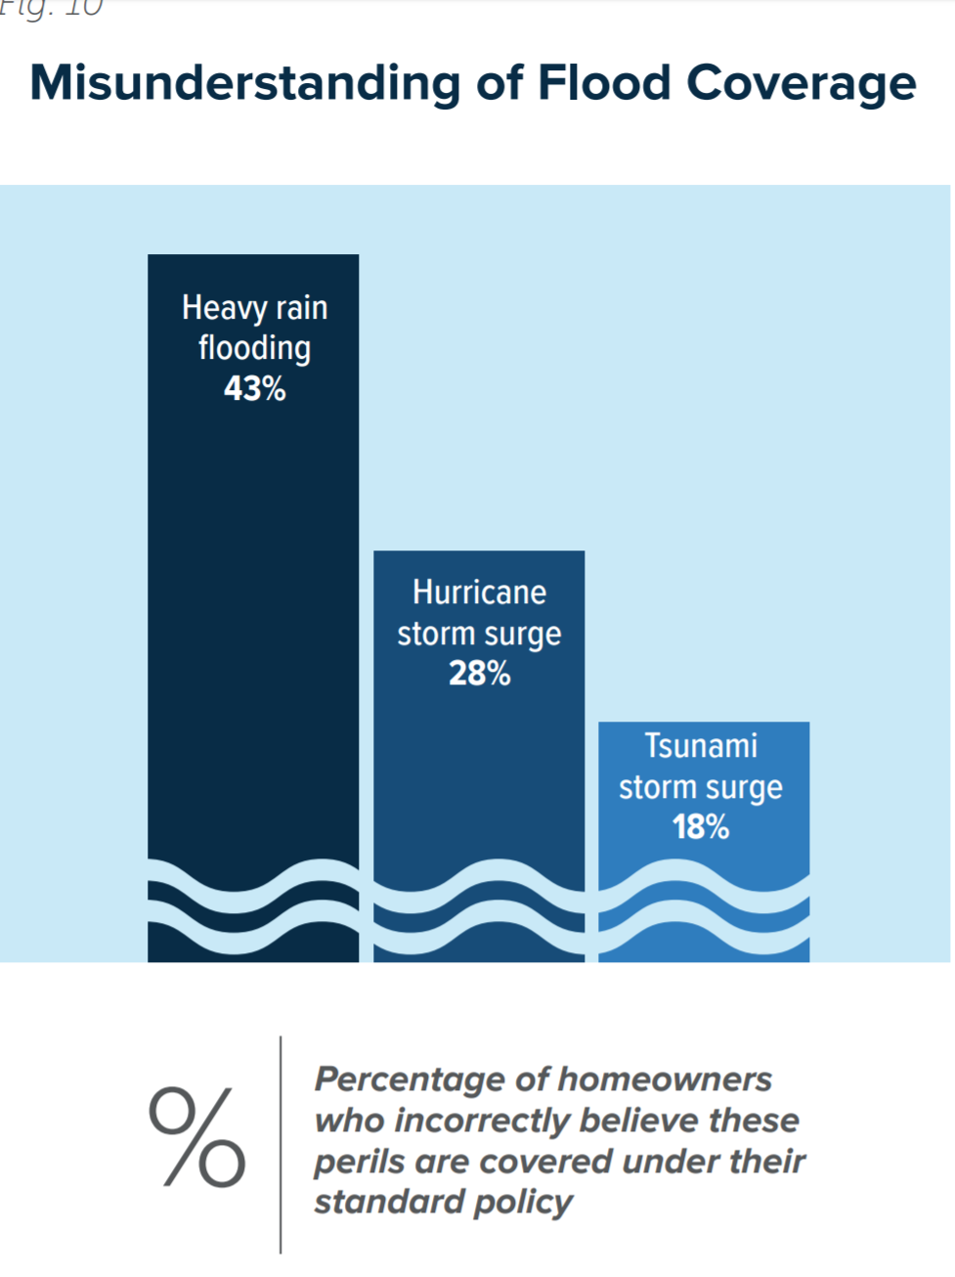
Misconceptions Regarding Flood Coverage
Troubling Results

Slide 15
Reason for Confusion
What can be done?
Confusion about flood coverage may arise from the fact that some types of water and storm-related damage are covered by a standard homeowners policy.
For example, most homeowners insurance includes coverage for damage caused by wind-driven rain, burst pipes and water leaking into your house because of a roofline ice dam.
The insurance industry has an opportunity to serve its customers and improve consumer understanding of its products and services by increasing educational outreach to homeowners.
Consumer advocates and the media can also help close the knowledge gap by bringing attention to the need for homeowners to learn more about their insurance coverage and seek professional guidance when they purchase insurance

Slide 16
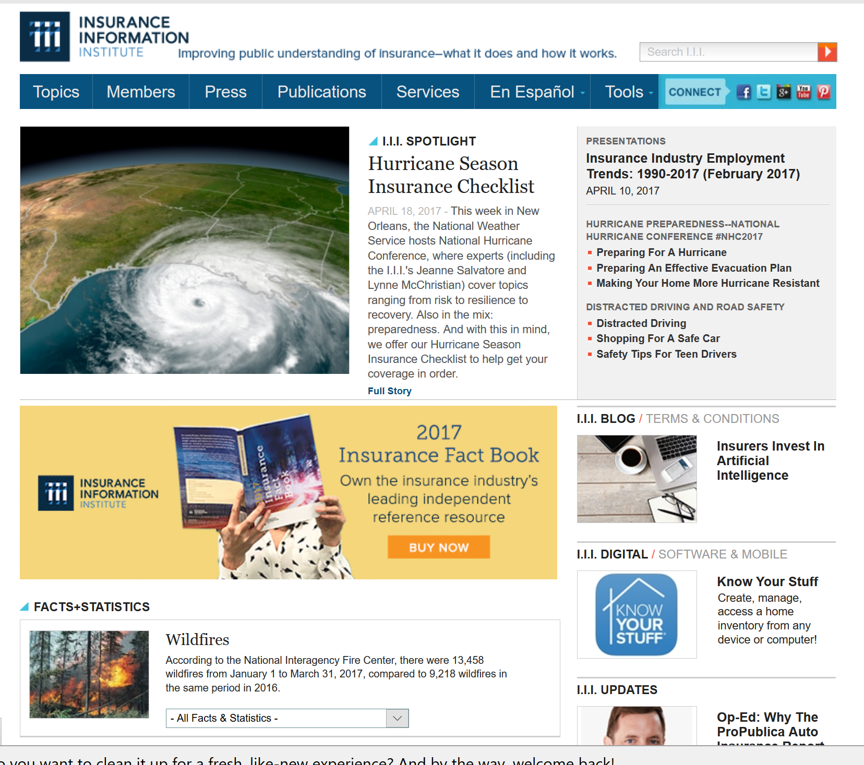
Great Resources –I.I.I. Website
www.I.I.I.org
Consumer Articles
Tips for Business owners
Educational Videos
Infographics
Apps
Research
Statistics

Slide 17
Thank You!
@JeanneSalvatore
212-346-5555
917-612-4088
jeannes@iii.org

