Slide 1
Hurricane Andrew’s Enduring Impact on the U.S. Insurance Industry
National Hurricane Conference
April 18, 2017
Lynne McChristian, Florida Representative and Catastrophe Response Director
Insurance Information Institute  110 William Street  New York, NY 10038 Tel: 813.480.6446  lynnem@iii.org  www.iii.org

Slide 2
Andrew’s Legacy:
Underestimated Costs and Underestimated Vulnerability to Natural Disasters

Slide 3
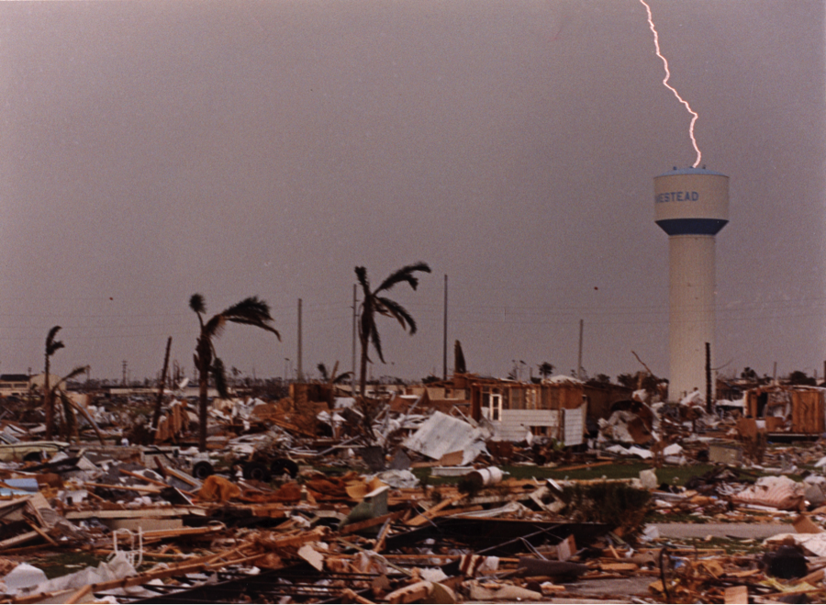
Hurricane Andrew: Aug. 24, 1992
Costliest storm in U.S. history – until Katrina in 2005
Insurance claims payouts totaled $15.5 billion
$27 billion in 2017 dollars
Hurricane Katrina losses: $41 billion

Slide 4
The Wake-Up Call
What we know now that we didn’t then
Need to manage coastal exposure.
Increasing role of government in insuring coastal risks.
Introduction of hurricane deductibles.
Greater use of reinsurance capital from around the world.
Rapid evolution needed for catastrophe modeling.
Necessity for strengthened building codes, and for them to be enforced.

Slide 5
U.S. Insured Catastrophe Losses, 1989-2016
($ billions, 2016 dollars)
Long-term trend is for more, not fewer, costly events.
*2016 estimate is subject to change
Note: 2001 figure includes $20.3B for 9/11 losses reported through 12/31/01 ($25.9B 2011 dollars). Includes only business and personal property claims, business interruption and auto claims. Non-prop/BI losses = $12.2B ($15.6B in 2011 dollars).
Sources: Property Claims Service, a Verisk Analytics business; Insurance Information Institute.

Slide 6
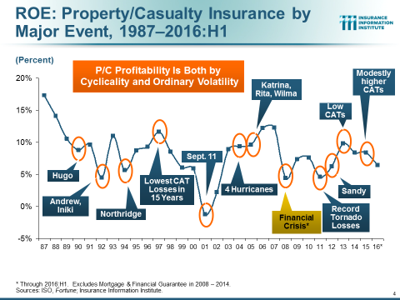

Slide 7
Learning from the past:
The risk has grown, not diminished.

Slide 8
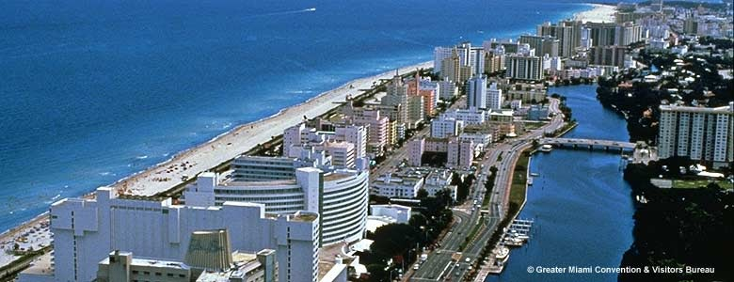
What’s the worst that could happen?

Slide 9
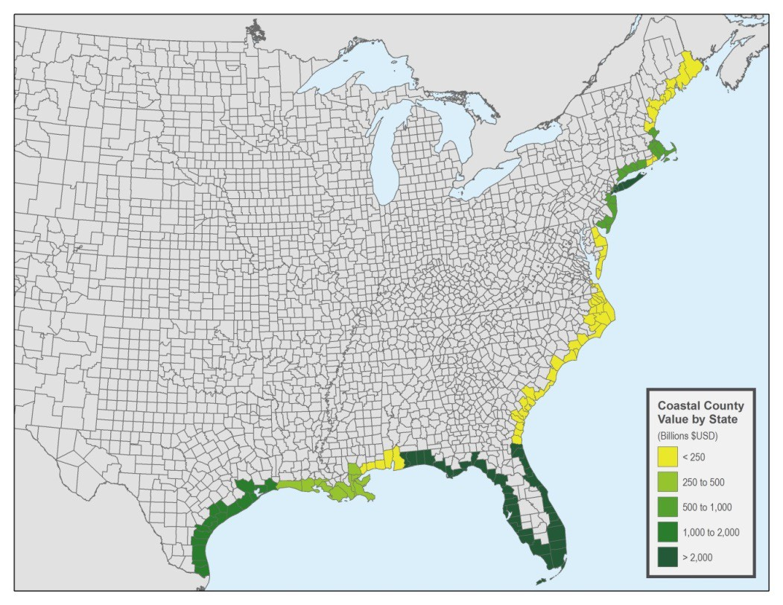
Total value of property in coastal counties
Includes residential and commercial property
AIR Worldwide 2016 report

Slide 10
Insured Coastal Exposure As a % Of Statewide Insured Exposure
Source: AIR Worldwide

Slide 11
Number of Owner-Occupied & Renter-Occupied Housing Units, US, Quarterly, 1990:Q1-2016:Q4
Millions of Renter-Occupied Housing Units
Millions of Owner-Occupied Housing Units
Number of owner-occupied units has been stuck at roughly 75 million units since 2005:Q4
Trough in 2004:Q2 at 32.61 million units.
Latest renter-occupied was 43.04 million units in 2016:Q4.
Since 2004 the number of renter-occupied housing units has grown by about 11 million units (+34.5%), but there has been no growth in the number of owner-occupied housing units in 12 years. When will this end?
Sources: US Census Bureau at http://www.census.gov/housing/hvs/data/histtabs.html , Table 8; Insurance Information Institute.
11
12/01/09 - 9pm
eSlide – P6466 – The Financial Crisis and the Future of the P/C
Notes:
11

Slide 12
US: Pct. Of Private Housing Unit Starts In Projects of 5+ Units, 1990-2017*
Units in Multiple-Unit Projects as Percent of Total
A NEW NORMAL? In 7 of the last 9 years, over 30% of housing unit starts were in 5+-unit projects
For the U.S. as a whole, the trend toward multi-unit housing projects (vs. single-unit homes) is recent.
*2017 is January and February, annualized; preliminary. Based on seasonally-adjusted data. Sources: U.S. Census Bureau; Insurance Information Institute calculations.

Slide 13
Summary
The challenge for insurers: managing exposure to catastrophic losses from hurricanes.
The challenge for coastal residents: recognizing their vulnerability and overcoming complacency.
Preparedness means is protecting people, property – and your finances.
Best defense is knowing that mitigation matters. Resiliency must be a forethought, not an afterthought.
The hurricane “dry spell” will end.

Slide 14
Thank you for your time and your attention!
www.iii.org
www. InsuringFlorida.org

