Slide 1
The Protection Gap – New Challenges for Insurers and Consumers
Northwest Insurance Council
Seattle, WA
June 26, 2017
Steven N. Weisbart, Ph.D., CLU, Senior Vice President & Chief Economist
Insurance Information Institute ♦ 110 William Street ♦ New York, NY 10038
Tel: 212.346.5540 ♦ Cell: 917.494.5945 ♦ stevenw@iii.org ♦ www.iii.org

Slide 2
The Property Insurance “Protection Gap:” Definition and Measurement

Slide 3
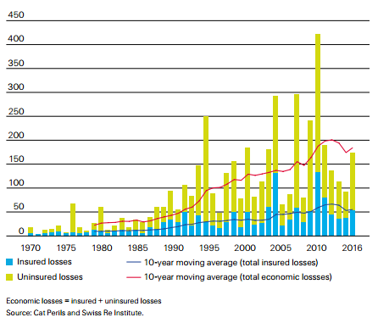
The Global “Protection Gap,” the difference between Economic Losses and Insured Losses generated by catastrophes, is growing
$Billions, in 2016 dollars
In terms of 10-year rolling averages, between 1991 and 2016, insured losses grew by 4.6% per year but economic losses by 5.6% per year.

Slide 4
U.S. Flood Insurance Policies In Force, 1989-2016
Millions of Policies in Force
Peak year: 2009
The number of NFIP policies in force grew every year during the two decades from 1989 through 2009 but was essentially flat through 2013 and declined in 2014-2016.
Sources: https://www.fema.gov/total-policies-force-calendar-year ; Insurance Information Institute.

Slide 5
At Peak (2007), Only 5% of Occupied Residences Had an NFIP Flood Insurance Policy In Force
5.1%
4.3%
Since 2007 the number of occupied residences has grown by 7.25% but the number of flood policies in force fell by 10.25%.
Sources: https://www.fema.gov/total-policies-force-calendar-year ; https://www.census.gov/housing/hvs/data/histtabs.html Insurance Information Institute.

Slide 6
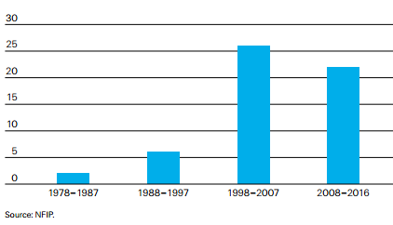
The Drop in Flood Coverage Isn’t Due to Lower Insured Flood Claims Payments
US Insured Flood Losses, $Billions
In 2016 there were 4 separate multi-billion-dollar inland flood events – the highest number in a single year since 1980.
Source: SwissRe Institute: Sigma No 2/2017 “Natural catastrophes and man-made disasters in 2016: a year of widespread damages”; Insurance Information Institute.

Slide 7
Even Frequent & Severe Floods Haven’t Changed Flood Insurance Ownership Much
Q. Do you have a separate flood insurance policy?¹
After Hurricane Irene
After SuperStorm Sandy
Despite extensive flooding (and wide publicity),
few U.S. homeowners say they have a flood insurance policy;
moreover, there is no upward trend.
¹Asked of those who have homeowners insurance and who responded “yes”.
Source: Insurance Information Institute Annual Pulse Survey.

Slide 8
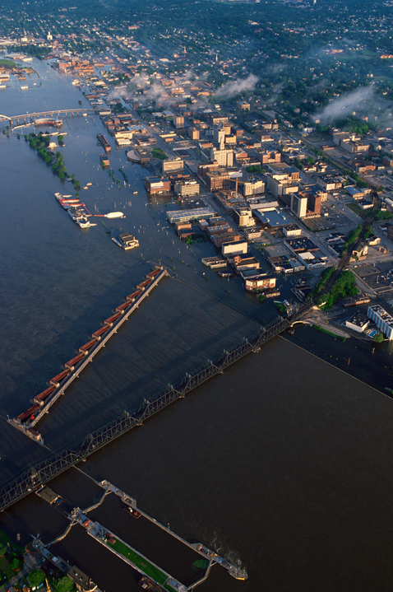
The $10 Billion Flood Protection Gap: What Can We Do?
Risk awareness
Simple insurance products (flood endorsement policies)
Continue to improve risk assessment tools
Public/private partnerships that support financial resilience
Source: SwissRe/III webinar, April 27, 2017.
Notes:
Keys to improving resilience and recovering faster
improve risk awareness
make insurance products simple (flood endorsement policies)
improved risk assessment tools
public/private partnerships that support financial resilience
Reinsurance can help
Recent NFIP reinsurance placement improves financial stability of NFIP program
Closing the protection gap requires the collaboration of all stakeholders
Sustainable flood coverage for the majority of homeowners and small commercial enterprises is well within our reach!

Slide 9
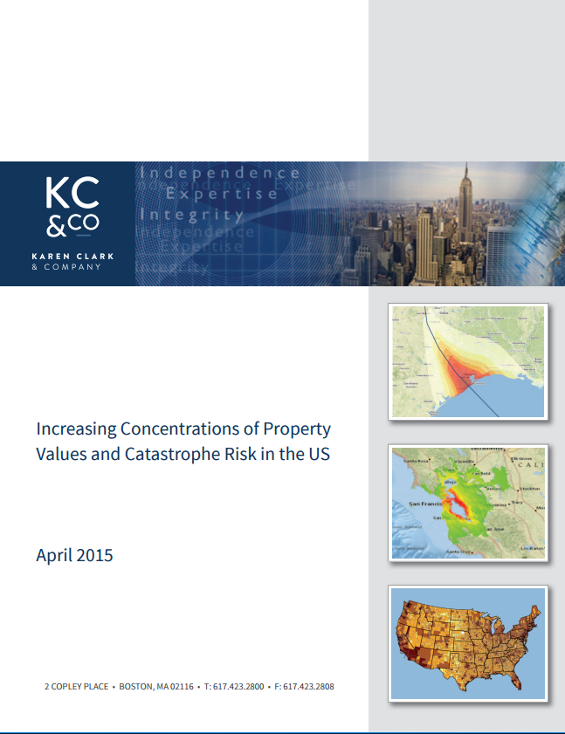
Karen Clark’s Report Says
We’re Mis-measuring Property PMLs
PMLs are based on storms making landfall at random locations, but
The worst losses are at specific locations not likely covered by standard PMLs
The worst losses are CAT-5 storms striking the most densely-populated areas
The worst losses are up to three times worse than the PMLs

Slide 10
Financial Literacy:
A 3-Question Test
This test has been administered world-wide to provide a rough indicator of financial literacy
among many populations.
10
Notes:
10

Slide 11
The First Financial Literacy Question
If you had $100 in a savings account with an interest rate of 2 percent per year, after 5 years, how much do you think you would have in the account if you left the money to grow?
More than $102
Exactly $102
Less than $102
Don’t know
Refuse to answer

Slide 12
The Second Financial Literacy Question
If the interest rate on your savings account was 1 percent per year and inflation was 2 percent per year, after 1 year with the money in this account would you be able to buy
More than today
Exactly the same as today
Less than today
Don’t know
Refuse to answer

Slide 13
The Third Financial Literacy Question
“Buying a single company stock usually provides a safer return than a stock mutual fund.” This statement is
True
False
Don’t know
Refuse to answer

Slide 14
Financial Literacy by Age Group and Education
Percent answering all three questions correctly
*The questions ask about interest rates, inflation, and risk diversification (comparing individual stocks vs. stock mutual funds). The details are on page 10 of the cited article and in other articles cited by the authors.
Source: Lusardi and Mitchell, “The Economic Importance of Financial Literacy: Theory and Evidence,” Journal of Economic Literature, 2014 (pp. 5-44).

Slide 15
Why Is This Important?
To make good decisions regarding the types and amounts of P/C insurance to buy, consumers should understand
The types of losses/claims that they might sustain
The likelihood/probability of those various kinds of losses/claims—what we call “frequency”
The potential severity of those losses

Slide 16
Do Financially Illiterate People Make Worse Financial Decisions?
How Do Economists Determine Whether a Person’s Financial Decisions
Are Good or Bad?
16
Notes:
16

Slide 17
Economists: Good Decisions
Are Consistent Decisions
The Concept: If your decisions are consistent, they’re likely based on an underlying and well-understood view of financial choices—in short, they’re “rational.”
For example, it a policyholder chose similar low deductibles for auto and HO, that’s consistent and could reflect little liquidity
But if the policyholder chose a small deductible for one policy and a large deductible in another, we suspect that the policyholder isn’t choosing based on his/her circumstances or preferences.
The Finding: Consistency in financial decisions is highly correlated with wealth, education, income, youth, and financial literacy.
Sources: S. Choi, S. Kariv, W. Muller, and D. Silverman, “Who is (More) Rational?” American Economic Review 104(6) [June 2014], pp. 1518-1550, and J. Brown, A. Kapteyn, E. Luttmer, and O. Mitchell, “Cognitive Constraints on Valuing Annuities,” Pension Research Council PRC WP 2014-21; Insurance Information Institute

Slide 18
Financial Literacy and P/C Insurance
A Low Level of Financial Literacy is
Probably At Least Partly Responsible
for a Number of Policyholder Problems
18
Notes:
18

Slide 19
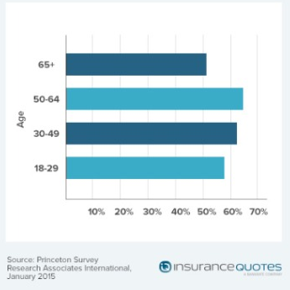
Percentages of Renters Who Don’t
Have Renters Insurance, by Age Group

Slide 20
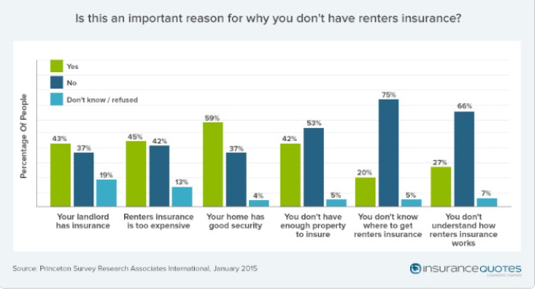
Why Renters
Don’t Have Renters Insurance

Slide 21
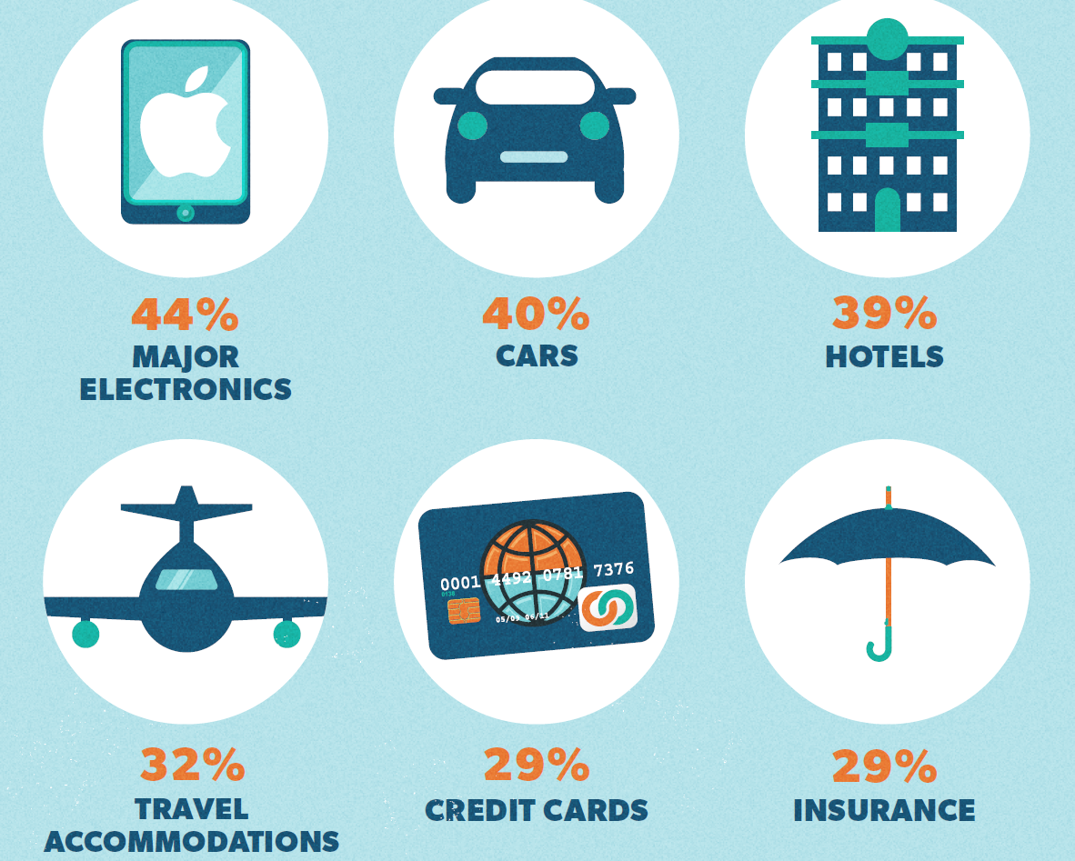
The Top Purchases Millennials Won’t Make Without User-Generated Content
Source: “Talking to Strangers: Millennials Trust People Over Brands,” Bazaarvoice, January 2012.

Slide 22
Insurance Coverage by Age Group
Compared to older generations, millennials are underinsured.
Source: IA Magazine, May 2017, p. 16, citing a study by Vertafore; Insurance Information Institute.

Slide 23
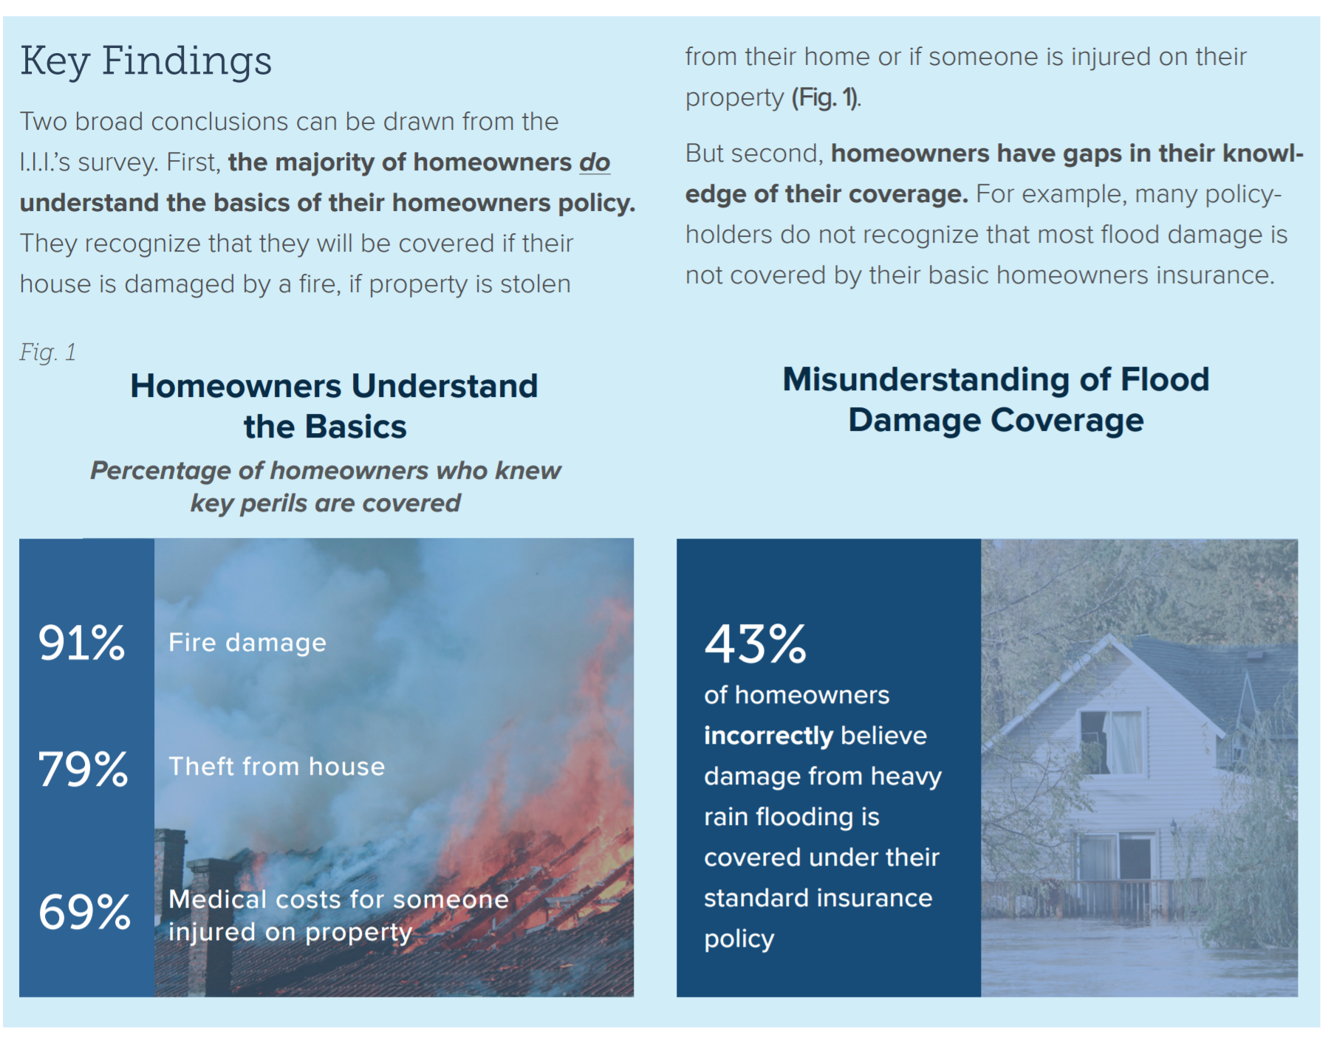
Consumer Understanding of Home and Flood Insurance: Good News and Bad News
The good news
The bad news
Most homeowners understand the basics in a home insurance policy. But many don’t understand its water damage and flooding coverage.
Insurance Information Institute, 2016 Consumer Insurance Survey, Homeowners Insurance: Understanding, Attitudes, and Shopping Practices, February 2017, p. 2.

Slide 24
One More Hurdle:
Loss Aversion
24
Notes:
24

Slide 25
What is Loss Aversion and
How Does it Affect Insurance Buying?
Loss aversion refers to people's tendency to prefer avoiding losses to acquiring equivalent gains
  one who loses $100 will lose more satisfaction than another person will gain satisfaction from a $100 gain
Research shows that people tend to consider a premium payment as a guaranteed “loss” and the rare receipt of an insurance claims payment—even of a much larger amount—as a less valuable gain.
  This might help explain why why many people and businesses don’t buy various types of insurance

Slide 26
A Famous Loss Aversion Experiment
Imagine you are a physician in an Asian village, and 600 people have a life-threatening disease.
Case 1. Two treatments exist: Treatment A will save exactly 200 people. With Treatment B, there is a 1/3 chance to save all 600 people and a 2/3 chance that you will save no one. Which treatment do you choose?
Case 2. Two treatments exist: With treatment C, exactly 400 people will die. With Treatment D, there is a 1/3 chance that no one will die, and a 2/3 chance that everyone will die. Which treatment do you choose?
In Case 1, the vast majority choose Treatment A. In Case 2, the vast majority choose Treatment D.

Slide 27
Insurance Literacy
27
Notes:
27

Slide 28
Why the Issue of Financial Literacy
Is Important for P/C Insurance
Increasingly severe weather increases the likelihood that policyowners will have a significant loss that could be insured.
Research shows that financially literate people are more likely to act, while less-financially-literate people procrastinate and often don’t act
  This might help explain why so few people have flood insurance
When new types of exposures arise, financially-literate people are more likely to buy insurance against them

Slide 29
Why the Issue of Financial Literacy
Is Important for P/C Insurance
People who don’t understand their policies—or the events they insure against—are likely to blame, or be antagonistic to, insurers and agents
  Legislatures might create organizations like the federal Consumer Financial Protection Bureau to “protect” unsophisticated policyowners
  Growing numbers of policyholders will be age 80 and over. Many will have cognitive limitations and might become financially illiterate even if they were previously financially literate. Agents and insurers will have to develop strategies for dealing with these people.

Slide 30
P/C Insurance Implications
of Financial Illiteracy
It seems likely that financially illiterate people are…
  Less likely to buy and renew P/C insurance when they are not required to do so
  Less likely to buy and renew P/C insurance even when they are required to do so
    Low financial literacy might help to explain high percentages of drivers who don’t have auto insurance
  Less likely to buy appropriate policy limits
  Less likely to understand policy terms and features (e.g., hurricane deductibles)
  More likely to focus on price (because they don’t understand other aspects of the P/C insurance relationship)

Slide 31
Insurance Literacy:
A Proposed 3-Question Test
This test has never been administered to anyone
but if it were it might provide a rough indicator
of property/casualty insurance literacy.
31
Notes:
31

Slide 32
The First Insurance Literacy Question
If you had $500 deductible in your insurance policy and you had $2,000 of damage covered by the policy, how much would the insurance company pay?
  $2,000
  $1,500
  $500
  Don’t know
  Refuse to answer

Slide 33
The Second Insurance Literacy Question
If your insurance policy had a policy limit of $50,000 and you had $80,000 of damage covered by the policy, how much would the insurance company pay?
  $80,000
  $50,000
  $30,000
  Don’t know
  Refuse to answer

Slide 34
The Third Insurance Literacy Question
“Insurance policies usually cover several different types of losses in a single policy.” This statement is
  True
  False
  Don’t know
  Refuse to answer

Slide 35
Questions?

Slide 36
Thank you

