Slide 1
Economic Perspectives on Coastal Property Insurance:
Focus on North Carolina
2015 Coastal Risk Retreat
Greenville, NC
April 14, 2015
Steven N. Weisbart, Ph.D., CLU, Senior Vice President & Chief Economist
Insurance Information Institute ♦ 110 William Street ♦ New York, NY 10038
Tel: 212.346.5540 ♦ Cell: 917.494.5945 ♦ stevenw@iii.org ♦ www.iii.org

Slide 2
Why the Fuss?
What’s the Worst
That Could Happen?
2

Slide 3
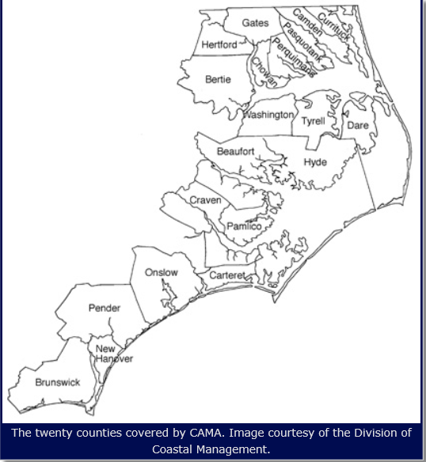
Coastal Counties in North Carolina

Slide 4
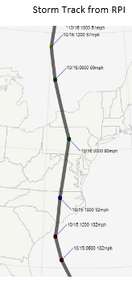
In 1954 Hurricane Hazel Struck the Carolinas With Destructive Force
On October 15, 1954, Hurricane Hazel—the 9th storm of that hurricane season—made landfall near the North Carolina/South Carolina border.
Winds were estimated at 132 mph, which would have made it a category 4 storm.
If the storm had hit in 2012, given the population growth and development that occurred in the 58 years after Hazel hit, insured claims would have been in the $20 billion range.
Sources: Karen Clark & Company, “Historical Hurricanes that Would Cause $10 Billion or More of Insured Losses Today,” August 2012, p. 10; Insurance Information Institute

Slide 5
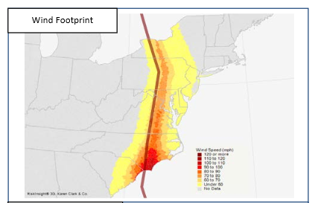
Hazel’s Highest Winds Struck the Lower Half of the NC Coast
Sources: Karen Clark & Company, “Historical Hurricanes that Would Cause $10 Billion or More of Insured Losses Today,” August 2012, p. 10; Insurance Information Institute

Slide 6
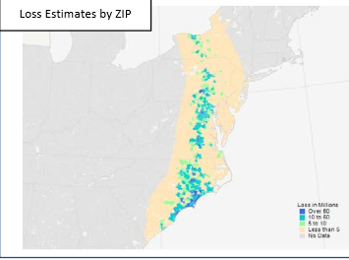
Hazel’s Damage Was Severe
Along the NC Shore
Sources: Karen Clark & Company, “Historical Hurricanes that Would Cause $10 Billion or More of Insured Losses Today,” August 2012, p. 10; Insurance Information Institute

Slide 7
Exposure to
Catastrophic Loss in North Carolina and Neighboring States
7

Slide 8
In 2012, Total Value of Insured Coastal Exposure, NC and Neighboring States
(2012, $ Billions)
The insured value of all Atlantic and Gulf coastal property
was estimated at $10.6 trillion in 2012 , up 48% from $7.2 trillion in 2004.
Source: AIR Worldwide

Slide 9
In 2012, Total Value of Insured Atlantic & Gulf Coastal Exposure: $10.6 Trillion
(2012, $ Billions)
In terms of exposed value, over half is in Florida + New York.
Unlike Florida, the insured coastal exposure in northeast states is concentrated in a very small area
The insured value of all coastal property was estimated at $10.6 trillion
in 2012 , up 48% from $7.2 trillion in 2004.
Source: AIR Worldwide

Slide 10
Total Potential Home Value Exposure to Storm Surge Risk in 2014*
Florida’s “extreme” exposure is greater than any other state’s “extreme,” “very high,” and “high” exposure combined
CoreLogic estimated the reconstruction value of homes exposed to Storm Surge along the Atlantic and Gulf Coasts as $1.496 trillion in 2014 (assuming total losses). Only a fraction of this is insured for flood, hence the huge demand for federal aid following major coastal flooding events.
($ Billions)
*Insured and uninsured property, assuming total loss of the home.
Source: Storm Surge Report 2014, Table 2, CoreLogic, published July 2014.

Slide 11
Total Potential Home Value Exposure to Storm Surge Risk in 2014*
($ Billions)
CoreLogic estimated the reconstruction value of homes exposed to Storm Surge (assuming total losses). Only a fraction is insured for flood, hence the huge demand for federal aid following major coastal flooding events.
*Insured and uninsured property, assuming total loss of the home.
Source: Storm Surge Report 2014, Table 2, CoreLogic, published July 2014.

Slide 12
Total Potential Home Value Exposure to Storm Surge Risk in 2014*
($ Billions)
CoreLogic estimated the reconstruction value of homes exposed to Storm Surge (assuming total losses). Only a fraction is insured for flood, hence the huge demand for federal aid following major coastal flooding events.
*Insured and uninsured property, assuming total loss of the home.
Source: Storm Surge Report 2014, Table 2, CoreLogic, published July 2014.

Slide 13
P/C Industry Homeowners Claim Frequency, US, 1997-2013
Claims Paid per 100 Exposures
Sources: Insurance Research Council, “Trends in Homeowners Insurance Claims,” p.41; Insurance Information Institute

Slide 14
P/C Industry Homeowners Claim Frequency, North Carolina, 1997-2013
Claims Paid per 100 Exposures
Sources: Insurance Research Council, “Trends in Homeowners Insurance Claims,” p.81; Insurance Information Institute

Slide 15
P/C Industry Homeowners Average Claim Severity, Inflation-adjusted, 2006-2013
2013 dollars
Sources: Insurance Research Council, “Trends in Homeowners Insurance Claims,” 2015 edition, p. 41; BLS inflation calculator,
with Insurance Information Institute calculations

Slide 16
P/C Industry HO Average Claim Severity,
Inflation-adjusted, North Carolina, 1997-2013
2013 dollars
Sources: Insurance Research Council, “Trends in Homeowners Insurance Claims,” 2015 edition, p. 81; BLS inflation calculator,
with Insurance Information Institute calculations

Slide 17
Pct. Change in Population, Forecast for 2010-2020, for Coastal Shoreline/Watershed Counties, by State
This population growth means not only more homes but more businesses, and more public buildings (schools, hospitals, etc.) and infrastructure in “harm’s way”
Source: http://stateofthecoast.noaa.gov/features/coastal-population-report.pdf Table 5 and Table 10

Slide 18
Pct. Change in Population, Forecast for 2010-2020, for Coastal Shoreline Counties, by State
This population growth means not only more homes but more businesses, and more public buildings (schools, hospitals, etc.) and infrastructure in “harm’s way”
Source: http://stateofthecoast.noaa.gov/features/coastal-population-report.pdf Table 5

Slide 19
Pct. Change in Population, Forecast for 2010-2020, for Coastal Watershed Counties, by State
This population growth means not only more homes but more businesses, and more public buildings (schools, hospitals, etc.) and infrastructure in “harm’s way”
Source: http://stateofthecoast.noaa.gov/features/coastal-population-report.pdf Table 10

Slide 20
Post-Katrina
U.S. Insured Catastrophe Losses
($ Billions, $ 2013)
Pvt Ins. Annual Data
Mean: $19.1B
Median: $14.6B
NFIP Annual Data
Mean: $2.24B
Median: $0.75B
These numbers are national, not coastal, but are often largely coastal in origin. The volatility is obvious.
Sources: Property Claims Service/ISO; https://www.fema.gov/statistics-calendar-year/loss-dollars-paid-calendar-year
Insurance Information Institute.
20
12/01/09 - 9pm
eSlide – P6466 – The Financial Crisis and the Future of the P/C
Notes:
20

Slide 21
U.S. Insured Catastrophe Losses
($ Billions, $ 2013)
2012 was the 3rd most expensive year ever for insured CAT losses
2013-14 were welcome respites from 2011-12, which were among the costliest years for insured disaster losses in U.S. history. Longer-term trend is for more—not fewer—costly events.
$15.3 billion in insured CAT losses estimated for 2014
*Through 12/31/14.
Note: 2001 figure includes $20.3B for 9/11 losses reported through 12/31/01 ($25.9B 2011 dollars). Includes only business and personal property claims, business interruption and auto claims. Non-prop/BI losses = $12.2B ($15.6B in 2011 dollars.)
Sources: Property Claims Service/ISO; Insurance Information Institute.
21
12/01/09 - 9pm
eSlide – P6466 – The Financial Crisis and the Future of the P/C
Notes:
21

Slide 22
10 Costliest Coastal Storms in U.S. History (Adjusted for Development into 2012)
(Insured Losses,
2012 Dollars, $ Billions)
Even today, Hurricane Hazel makes the list of ten costliest coastal storms ever
The $7.9 billion in today’s dollars doesn’t reflect the significant additional construction of homes and businesses adde since 1989.
Sources: Karen Clark & Company, “Historical Hurricanes that Would Cause $10 Billion or More of Insured Losses Today,” August 2012, p. 5; Insurance Information Institute

Slide 23
Many People Who Probably Should Buy Flood Insurance Don’t
23

Slide 24
Even Frequent & Severe Floods Didn’t Change Flood Insurance Ownership Much
Q. Do you have a separate flood insurance policy?¹
After Hurricane Irene
After SuperStorm Sandy
Despite extensive flooding (and wide publicity),
few U.S. homeowners say they have a flood insurance policy;
moreover, there is no upward trend.
¹Asked of those who have homeowners insurance and who responded “yes”.
Source: Insurance Information Institute Annual Pulse Survey.

Slide 25
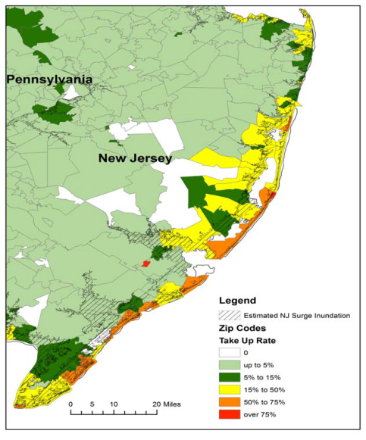
Residential NFIP Flood Take-Up Rates in NJ (2010) & Sandy Storm Surge
Flood coverage penetration rates were extremely low in many very vulnerable areas in NJ, with take-up rates far below 50% in many areas
Source: Wharton Center for Risk Management and Decision Processes, Issue Brief, Nov. 2012; Insurance Information Institute.
25

Slide 26
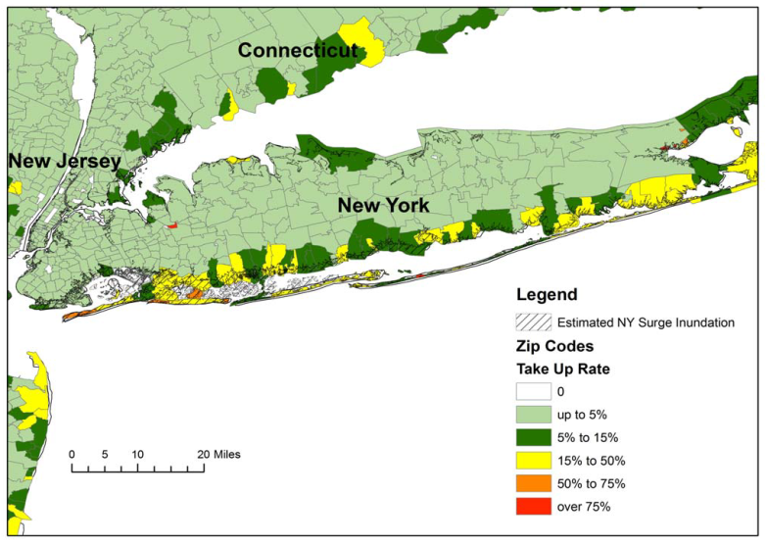
Residential NFIP Flood Take-Up Rates in NY, CT (2010) & Sandy Storm Surge
In many very vulnerable areas of NY and CT, take-up rates were far below 50%
Source: Wharton Center for Risk Management and Decision Processes, Issue Brief, Nov. 2012; Insurance Information Institute.
26

Slide 27
Share of Flood Damaged Structures with Flood Insurance: Long Island
Only 37.5% of flood damaged buildings in Nassau County were insured for flood, 62.5% uninsured
Number of buildings
74,736
$15.0
27.6% of flood damaged buildings in Suffolk County were insured for flood, 72.4% uninsured
28,055
20,798
46,681
5,747
$2.2
15,051
The Maximum FEMA Grant is $31,900. The Average Grant Award to Homeowners and Renters on Long Island is About $7,300
Source: Newsday, 1/14/13 from FEMA and Small Business Administration.
27
12/01/09 - 9pm
eSlide – P6466 – The Financial Crisis and the Future of the P/C
Notes:
27

Slide 28
Why Don’t They Buy? They Don’t Think They Will Ever Be Flooded
What are the odds of a 100-Year flood occurring?
  In any single year, 1 chance in a 100
  So why buy flood insurance, year after year, for an event that is highly unlikely to happen?
But suppose you own your home for 30 years. What is the chance of seeing a 100-year flood during the time you live there?
  1 chance in a 4
  And the longer you live there, the greater the odds of a flood hitting your home

Slide 29
Flood Insurance Policies in Brunswick County, NC (as of 1/31/2015)
Number of Policies in Force | 17,923
Amount of Insurance in Force | $5,423,191,100
Amount of Insurance per policy | $302,583
Annual Premium on in-Force Policies | $20,920,329
Annual Premium per policy | $1,167.23
Policies in Force as a Percent of Housing Units* | 22.6%
Total Number of Claims, 1/1/1978 – 1/31/2015 | 6,928
Total Payments, 1/1/1978 – 1/31/2015 | $46,071,518.99
Claims Closed without Payment, 1/1/1978 – 1/31/2015 | 2,853
Claims Closed with Payment | 4,075
Average Payment per Claim Closed with Payment | $11,305.89
Claims still open | 0
*number of housing units is for 2013
Sources: http://bsa.nfipstat.fema.gov/reports/1011.htm#NCT ; http://quickfacts.census.gov/qfd/states/37/37019.html (housing units); I.I.I.

Slide 30
Inconsistent Financial Behavior
30
Notes:
30

Slide 31
A Risk Preference Test, Part 1
Imagine you have this choice:
You may choose a gamble that offers an 80 chance of winning $4,000 and a 20% chance of winning nothing, or
You get a guaranteed $3,000.
Which choice do you make?
4 out of 5 people chose the $3,000.
Source: David Rolpeik, How Risky Is It Really?: Why Our Fears Don’t Always Match the Facts (New York: McGraw-Hill, 2010), p. 40, citing Kahneman and Tversky.

Slide 32
A Risk Preference Test, Part 2
Now imagine that you won the gamble and have $4,000 and you now have this choice:
You may choose a gamble that offers an 80 chance of losing the $4,000 and a 20% chance of not losing it, or
You pay $3,000 of your $4,000 to avoid the gamble.
Which choice do you make?
92% of people chose the gamble.
Source: David Rolpeik, How Risky Is It Really?: Why Our Fears Don’t Always Match the Facts (New York: McGraw-Hill, 2010), p. 40, citing Kahneman and Tversky.

Slide 33
Risk Preference Test Observations
In the first test, involving only positive (or at worst non-negative) outcomes, most people are risk-averse. They choose the “sure thing.”
  In part this is because the first dollars are more valuable to them than the higher amounts.
In the second test, involving only negative outcomes, most people are loss-averse. They choose the gamble, hoping the worse outcome doesn’t happen.
  In part this is because the first dollars lost are more valuable to them than the higher amounts
Source: David Rolpeik, How Risky Is It Really?: Why Our Fears Don’t Always Match the Facts (New York: McGraw-Hill, 2010), p. 40, citing Kahneman and Tversky.

Slide 34
What is a “Psychological Account”?
An amount of money a person considers acceptable spending for a particular purpose
  Classic example: you paid $100 for a ticket for a concert but when you arrive to see it the ticket is gone. Another ticket is available for another $100.
    Do you spend another $100 or
    Have you spent the money in “the concert account” and go home?
I argue that the reason why some people don’t buy certain insurance coverages is that they have a psychological or mental account that is too small
Source: Barry Schwartz, The Paradox of Choice: Why More is Less (New York: Harper, 2004), pp. 64-65

Slide 35
Public Attitudes
About Flood Insurance
Even with Subsidies,
Most People Weren’t Buying It
35
Notes:
35

Slide 36
1 in 4 with Homeowners Insurance Think That it covers Flood Claims
Q. Does your homeowners policy cover damage from flooding during a hurricane?¹
Sandy didn’t teach very well
You might think that homeowners in the South, with perhaps greater exposure to flooding from hurricanes and thunderstorms, would be more aware that homeowners insurance doesn’t cover flood claims.
¹Asked of those who have homeowners insurance and who responded “yes”.
Source: Insurance Information Institute Annual Pulse Survey.

Slide 37
Flood Insurance: It’s Not “Fair” for Premiums to Reflect Expected Claims
Q. The federal government plans to raise the price of flood insurance so it reflects the costs of paying claims. Do you believe this is fair?
Q. Do you think that it is fair that people who live in areas affected by record storms in 2011 and 2012 should pay more for their homeowners insurance in the future?
[% Responding “NO”]
Don’t Know
No
Yes
A majority of Americans do not think it is fair for the federal government to raise its flood insurance premiums to better reflect claims payouts or to charge people who live in high-risk areas actuarially-fair premiums.
Source: Insurance Information Institute Annual Pulse Survey.

Slide 38
I.I.I. Poll: Disaster Preparedness
Q. Will the government pay for damage to your home that is not covered in your homeowners policy?¹
Sixty-four percent of homeowners say that the government will not pay for damage to their homes that is not covered by their homeowners policy.
¹Asked of those who have homeowners insurance and who responded “yes”.
Source: Insurance Information Institute Annual Pulse Survey.

Slide 39
Why Buy Flood Insurance?
Q. Will the government provide you with funds to pay some of the disaster costs to your property?
Q. Have recent flooding events such as Hurricane Sandy or Hurricane Irene motivated you to buy flood coverage?¹
Don’t know
Yes
Percent saying “yes”
No
30% of Americans believe the government
will pay some of their disaster costs.
Source: Insurance Information Institute Annual Pulse Survey.

Slide 40
I.I.I. Poll: Should Flood Insurance Premiums Reflect Flood Risk?
Q. Is it fair that flood insurance premium increases are higher if people who live in high flood risk areas and rebuild their homes do not elevate them?
U.S. Overall
South
Don’t know
Don’t know
Yes
No
Yes
No
In the South, a somewhat smaller percentage (than in the U.S. overall) believe that higher flood insurance premium increases should apply to homes that aren’t elevated against flooding.
Source: Insurance Information Institute Annual Pulse Survey.

Slide 41
I.I.I. Poll: Should Flood Insurance Premiums Reflect Flood Risk?
Q. Should flood insurance premiums reflect the risk of flooding no matter what the cost or should the government subsidize the cost of flood insurance with taxpayers’ dollars?
South
Don’t know
Government should subsidize premiums with taxpayers’ dollars
Premiums should reflect flood risk and not be subsidized
Three-fifths of Americans in the U.S. South think flood insurance premiums should be raised to reflect the risk of flooding.
Source: Insurance Information Institute Annual Pulse Survey (Nov. 2013).

Slide 42
Congress Followed the Polls
It passed the Biggert-Waters Flood Insurance Reform Act in mid-2012
  The act had a 1-year wait to implement some provisions
  The act had a 2-year wait to implement some other provisions
During that period, we asked another poll question…

Slide 43
I.I.I. Poll: Should the Subsidies Be Restored?
Q. The federal government provides insurance coverage at taxpayer-subsidized rates for damage from floods through the National Flood Insurance Plan. A new law eliminates the subsidy and raises rates. Should the rate increase should be repealed?
Don’t know
It is inconsistent for the public to support full-risk rates while wanting to maintain subsidies, but this exactly mirrors Congressional sentiments.
No
Yes
More than half of Americans polled for the November 2013 survey said National Flood Insurance premium hikes should be repealed.
Source: Insurance Information Institute Annual Pulse Survey.

Slide 44
Claims Management
Following KRW, the P/C Insurance Industry learned that it needed more claims adjusters
44

Slide 45
Number of NFIP Claims Paid, Yearly,
2005-2013*
Average for 1997-2004: 39,100
Average for 2006-2013: 53,200
How many adjusters are needed each year to handle flood claims? Three times since 2005 NFIP has paid 75,000 claims in a calendar year; that never happened before. (And this excludes claims closed without payment.)
*calendar years; latest available (posted 7/24/2014)
Source: http://www.fema.gov/statistics-calendar-year/number-losses-paid-calendar-year ; Insurance Information Institute

Slide 46
U.S. Employment in Independent (Non-carrier) Claims Adjusting, 1990–2015*
Thousands
Tornado Devastation
Hurricane Andrew
Hurricanes Katrina, Rita, Wilma
Hurricanes Bertha, Gustav, Ike
*As of January, 2015; not seasonally adjusted.
Note: Recessions indicated by gray shaded columns.
Sources: U.S. Bureau of Labor Statistics; National Bureau of Economic Research (recession dates); Insurance Information Institute.
46
Notes:
46

Slide 47
Number of NFIP Claims Paid, 2013-14,* NC and Neighboring States
The number of paid claims varies from one year to the next.
*fiscal years, ending Sept 30 2013 and Sept 30 2014, respectively
Source: https://www.fema.gov/media-library/assets/documents/21075 ; Insurance Information Institute

Slide 48
Number of NFIP Claims Paid, 2013-14,* Coastal New England and Mid-Atlantic States
The number of paid claims varies from one year to the next and the trend isn’t consistent from state to state.
*fiscal years, ending Sept 30 2013 and Sept 30 2014, respectively
Source: https://www.fema.gov/media-library/assets/documents/21075 ; Insurance Information Institute

Slide 49
A [Really] Brief History
of Flood Insurance
in the U.S.
49

Slide 50
NFIP Premiums and Claims Payments
$ Billions
Claims payments exceeded premiums by over $3 billion in the most recent decade
Sources: Rawle King, “The National Flood Insurance Program: Status and Remaining Issues for Congress,” Congressional Research Service, Feb. 6, 2013, Table 3; Insurance Information Institute.

Slide 51
NFIP’s Cumulative Debt to the U.S. Treasury, 1994-2011
$ Millions
Effect of Hurricanes Katrina, Rita, and Wilma in 2005
Once the cumulative debt ballooned to over $16 billion (and made worse in 2008 by Hurricanes Gustav and Ike) it became clear that the NFIP would never be able to retire the debt
Sources: Rawle King, “The National Flood Insurance Program: Status and Remaining Issues for Congress,” Congressional Research Service, Feb. 6, 2013, Table 4; Insurance Information Institute.

Slide 52
People Don’t Buy Flood Insurance Because They Don’t Think They Will Ever Be Flooded, and Yet…
Before superstorm Sandy struck, there were about 240,000 flood policies in force in New Jersey
In the year after superstorm Sandy struck, 75,300 flood insurance claims were filed
So a little less than 1 in 4 flood insurance policyowners filed a claim in one year

Slide 53
The Flood Insurance Reform Act of 2012 (Biggert-Waters)
53

Slide 54
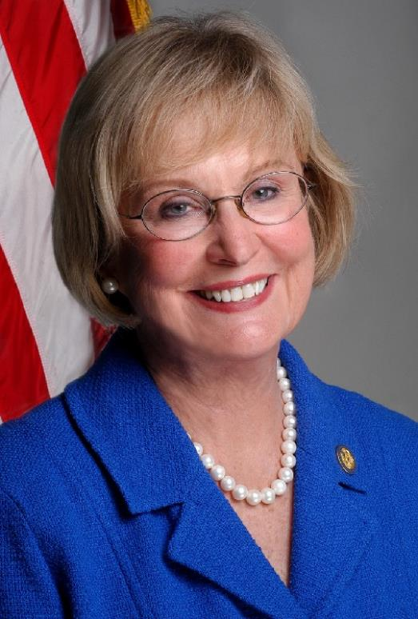
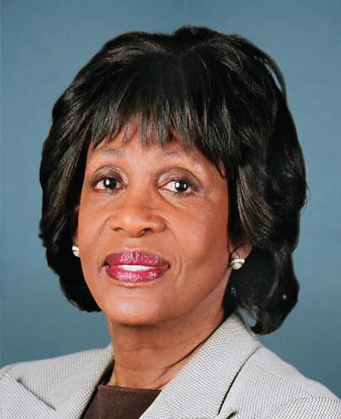
Who Are Biggert and Waters?
Judy Biggert, Republican, former congresswoman from Illinois’ 13th district
Maxine Waters, Democrat, congresswoman from California’s 43rd district

Slide 55
Biggert-Waters: Main Provisions
Eliminates subsidies on
  Second homes
  Commercial properties
  Properties with severe repetitive claims
  Properties that incurred damage in excess of fair market value
  Policies lapsed (not immediately renewed)
  Primary homes when sold
National Academy of Sciences to report on the “affordability” of NFIP premiums
55
12/01/09 - 9pm
eSlide – P6466 – The Financial Crisis and the Future of the P/C
Notes:
55

Slide 56
The Homeowner
Flood Insurance Affordability Act of 2014
Signed into law on March 21, 2014
Repeals and modifies some provisions of Biggert-Waters Flood Insurance Reform Act of 2012
Makes other changes not in B-W
56

Slide 57
Summary of the 2014 Law
Lowers recent rate increases on some policies
Prevents some future rate increases
Implements an annual surcharge on all policies
  $25 on primary residences
  $250 on all other properties
  Annual surcharges remain until all premiums are at actuarially appropriate levels and all subsidies are eliminated
Repeals certain rate increases that had already gone into effect
  Provides refunds
Increases maximum deductibles
Mandates that FEMA develop an installment plan for non-escrowed flood insurance premiums

Slide 58
Summary of the 2014 Law (cont’d)
Creates a “Flood Insurance Advocate” to advocate for fair treatment of NFIP policyholders
  Helps policyholders and property owners understand the procedures related to
    appealing preliminary flood maps and
    Implementing measures to mitigate evolving flood risks
  Educate property owners on
    measures to reduce flood insurance rates through effective mitigation
    The flood insurance rate map review and amendment process
  Help potential policyholders in obtaining and verifying accurate and reliable flood insurance rate information when buying or renewing a flood insurance policy

Slide 59
Summary of the 2014 Law (cont’d)
Authorizes additional resources for a study of affordability by the National Academy of Sciences
  Due September 2015
  The “affordability framework” must consider
    Accurate communication to consumers of the flood risk
    Targeted assistance based on financial ability to pay
    Individual and community actions to mitigate flood risk or lower the cost of flood insurance
    The effect of increases in premium rates on participation in NFIP
    The impact of mapping updates on affordability of flood insurance
  Must include proposals for ensuring that flood insurance is affordable among low-income populations.

Slide 60
Private Insurance Capacity Against Property Claims
Capital Accumulation in the Reinsurance Sector Exerts Downward Pressure on Windstorm Rates (for Now)
60

Slide 61
Return on Net Worth, Property Insurance, North Carolina, 2004-2013
Homeowners
Commercial Multiple-Peril
Sources: NAIC, Report on Profitabilty by Line by State in 2013; Insurance Information Institute.
61
12/01/09 - 9pm
eSlide – P6466 – The Financial Crisis and the Future of the P/C
Notes:
61

Slide 62
Return on Net Worth, Property Insurance, North Carolina, 2004-2013
Fire Insurance
Allied Lines
Sources: NAIC, Report on Profitabilty by Line by State in 2013; Insurance Information Institute.
62
12/01/09 - 9pm
eSlide – P6466 – The Financial Crisis and the Future of the P/C
Notes:
62

Slide 63
Policyholder Surplus,
2006:Q4–2014:Q3
Drop due to near-record 2011 CAT losses
($ Billions)
2007:Q3
Pre-Crisis Peak
Surplus as of 9/30/14 stood at a record high $673.9B
The industry now has $1 of surplus for every $0.73 of NPW,
close to the strongest claims-paying status in its history.
2010:Q1 data includes $22.5B of paid-in capital from a holding company parent for one insurer’s investment in a non-insurance business .
The P/C insurance industry entered 2015
in very strong financial condition.
Sources: ISO, A.M .Best.
63
12/01/09 - 9pm
eSlide – P6466 – The Financial Crisis and the Future of the P/C
Notes:
63

Slide 64
Premium-to-Surplus Ratio:
1985–2014*
(Ratio of NWP to PHS)
The larger surplus is in relation to premiums—the lower the P:S ratio—and the great the industry’s capacity to handle the risk it has accepted
Surplus as of 9/30/14 was $0.75:$1, a near-record low (at least in modern history)
9/11, Recession & Hard Market
The Premium-to-Surplus Ratio Stood at $0.75:$1 as of
9/30/14, a Record Low (at Least in Recent History)
* As of 9/30/14.
Source: A.M. Best, ISO, Insurance Information Institute.

Slide 65
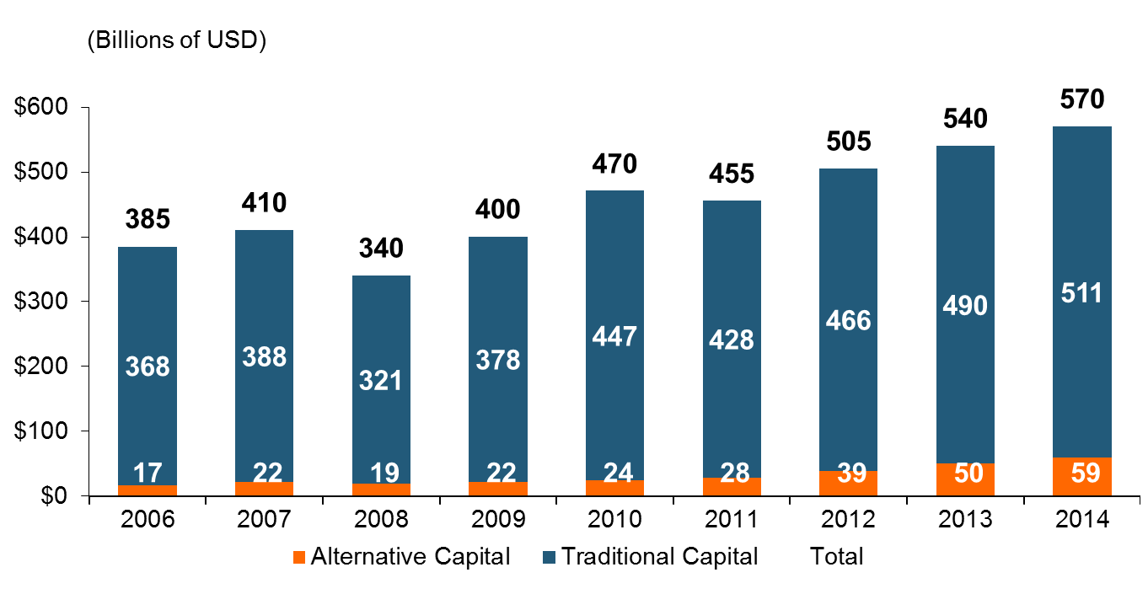
Global Reinsurance Capital (Traditional and Alternative), 2006 - 2014
Total reinsurance capital reached a record $570B in 2013, up 68% from 2008.
But alternative capacity has grown 210% since 2008, to $50B. It has more than doubled in the past three years.
2014 data is as of June 30, 2014.
Source: Aon Benfield Analytics; Insurance Information Institute.

Slide 66
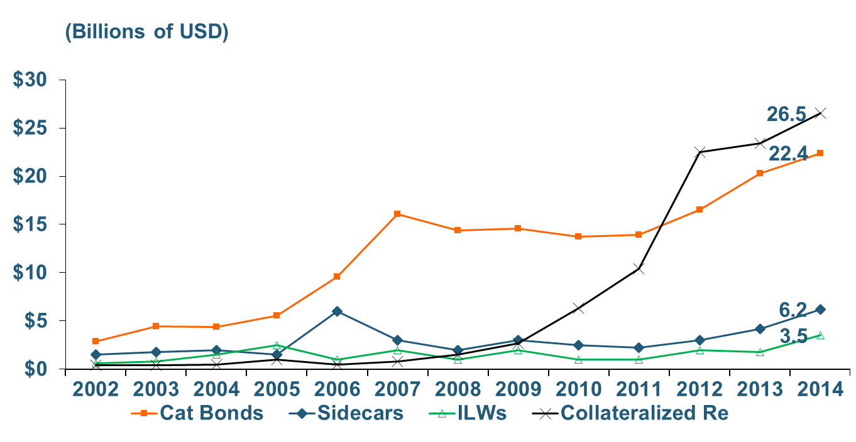
Growth of Alternative Capital Structures, 2002 - 2014
Collateralized Re’s Growth Has Accelerated in the Past Three Years.
Collateralized Reinsurance and Catastrophe Bonds Currently Dominate the Alternative Capital Market.
2014 data is as of June 30, 2014.
Source: Aon Benfield Analytics; Insurance Information Institute.

Slide 67
Final Thoughts
67

Slide 68
If We Believe More Coastal Property Should be Insured Against Flooding…
Extensive educational and outreach programs are needed
  Nature and extent of the risk
  Benefits of flood insurance over government loans and grants
  Cost-effective Mitigation strategies
Properties on which a subsidized flood insurance rate is “grandfathered” should be advertised as entitled to a flood insurance “sale”

Slide 69
Insurance Information Institute Online:
www.iii.org
Thank you for your time
and your attention!

