Slide 1
Overview & Outlook for the P/C Insurance Industry
Northwest Insurance Review & Forecast
Insurance Information Institute
September 25, 2014
Download at www.iii.org/presentations
Robert P. Hartwig, Ph.D., CPCU, President & Economist
Insurance Information Institute ♦ 110 William Street ♦ New York, NY 10038
Tel: 212.346.5520 ♦ Cell: 917.453.1885 ♦ bobh@iii.org ♦ www.iii.org

Slide 2
P/C Insurance Industry:
Financial Update
2013 Was the Industry’s Best Year
in the Post-Crisis Era
2014 Performance is Reasonably Good
2

Slide 3
P/C Industry Net Income After Taxes
1991–2014:Q1
2005 ROE*= 9.6%
2006 ROE = 12.7%
2007 ROE = 10.9%
2008 ROE = 0.1%
2009 ROE = 5.0%
2010 ROE = 6.6%
2011 ROAS¹ = 3.5%
2012 ROAS¹ = 5.9%
2013 ROAS¹ = 10.3%
2014 ROAS¹ = 8.4%
Net income rose strongly (+81.9%) in 2013 vs. 2012 on lower cats, capital gains
$ Millions
2014 is off to a slower start
ROE figures are GAAP; ¹Return on avg. surplus. Excluding Mortgage & Financial Guaranty insurers yields an 8.2% ROAS through 2014:Q1, 9.8% ROAS in 2013, 6.2% ROAS in 2012, 4.7% ROAS for 2011, 7.6% for 2010 and 7.4% for 2009.
Sources: A.M. Best, ISO; Insurance Information Institute

Slide 4
Profitability Peaks & Troughs in the P/C Insurance Industry, 1975 – 2014:Q1*
ROE
1977:19.0%
History suggests next ROE peak will be in 2016-2017
1987:17.3%
10 Years
2006:12.7%
1997:11.6%
10 Years
2013 10.4%
9 Years
2014:Q1 8.2%
1975: 2.4%
1984: 1.8%
1992: 4.5%
2001: -1.2%
*Profitability = P/C insurer ROEs. 2011-14 figures are estimates based on ROAS data. Note: Data for 2008-2014 exclude mortgage and financial guaranty insurers.
Source: Insurance Information Institute; NAIC, ISO, A.M. Best.

Slide 5
ROE: Property/Casualty Insurance by Major Event, 1987–2014:Q1
(Percent)
P/C Profitability Is Both by
Cyclicality and Ordinary Volatility
Katrina, Rita, Wilma
Low CATs
Sept. 11
Hugo
Lowest CAT Losses in
15 Years
4 Hurricanes
Sandy
Andrew
Record Tornado Losses
Northridge
Financial Crisis*
* Excludes Mortgage & Financial Guarantee in 2008 – 2014. 2014 figure is through Q1:2014.
Sources: ISO, Fortune; Insurance Information Institute.

Slide 6
P/C Insurance Industry
Combined Ratio, 2001–2014:Q1*
Relatively Low CAT Losses, Reserve Releases
Higher CAT Losses, Shrinking Reserve Releases, Toll of Soft Market
As Recently as 2001, Insurers Paid Out Nearly $1.16 for Every $1 in Earned Premiums
Heavy Use of Reinsurance Lowered Net Losses
Relatively Low CAT Losses, Reserve Releases
Avg. CAT Losses, More Reserve Releases
Sandy Impacts
Best Combined Ratio Since 1949 (87.6)
Cyclical Deterioration
Lower CAT Losses
* Excludes Mortgage & Financial Guaranty insurers 2008--2012. Including M&FG, 2008=105.1, 2009=100.7, 2010=102.4, 2011=108.1; 2012:=103.2; 2013: = 96.1; 2014:Q1 = 97.3.
Sources: A.M. Best, ISO.

Slide 7
A 100 Combined Ratio Isn’t What It
Once Was: Investment Impact on ROEs
A combined ratio of about 100 generates an ROE of ~7.0% in 2012/13, ~7.5% ROE in 2009/10,
10% in 2005 and 16% in 1979
Combined Ratio / ROE
Lower CATs helped ROEs in 2013
Combined Ratios Must Be Lower in Today’s Depressed
Investment Environment to Generate Risk Appropriate ROEs
* 2008 -2014 figures are return on average surplus and exclude mortgage and financial guaranty insurers. 2014:Q1 combined ratio including M&FG insurers is 97.3; 2013 = 96.1; 2012 =103.2, 2011 = 108.1, ROAS = 3.5%.
Source: Insurance Information Institute from A.M. Best and ISO Verisk Analytics data.

Slide 8
RNW All Lines by State, 2003-2012 Average:
Highest 25 States
Northwest states tend to have above average profitability
Source: NAIC; Insurance Information Institute.

Slide 9
RNW All Lines by State, 2003-2012 Average:
Lowest 25 States
Some of the least profitable states over the past decade were hit hard by catastrophes
Source: NAIC; Insurance Information Institute.

Slide 10
Profitability and Growth in Commercial Lines
Analysis by Line for WA,OR, MT, ID and UT
10

Slide 11
RNW All Lines: WA, OR, ID, MT and UT vs. U.S., 2003-2012
(Percent)
Average 2003-2012
US: 7.9% WA 12.0% OR 11.0%
ID 12.6% MT: 9.4% UT: 13.3%
Source: NAIC.
11
Notes:
11

Slide 12
RNW Comm. Auto: WA, OR, ID, MT and UT vs. U.S., 2003-2012
(Percent)
Average 2003-2012
US: 9.8% WA: 12.1% OR: 16.7%
ID: 15.4% MT: 8.1% UT: 11.6%
Source: NAIC.
12
Notes:
12

Slide 13
RNW Comm. MP: WA, OR, ID, MT and UT vs. U.S., 2003-2012
(Percent)
Average 2003-2012
US: 9.0% WA: 10.6% OR: 11.1%
ID: 16.5% MT: 10.6% UT: 18.4%
Source: NAIC.
13
Notes:
13

Slide 14
RNW Fire: WA, OR, ID, MT and UT vs. U.S., 2003-2012
(Percent)
Average 2003-2012
US: 26.5% WA: 30.0% OR 24.3%
ID: 36.2% MT 19.4% UT: 39.1%
Source: NAIC.
14
Notes:
14

Slide 15
All Lines: 10-Year Average RNW WA, OR, ID, MT and UT vs. U.S.
2003-2012
Sources: NAIC, Insurance Information Institute.

Slide 16
Comm. Auto: 10-Year Average RNW WA, OR, ID, MT and UT vs. U.S.
2003-2012
Sources: NAIC, Insurance Information Institute.

Slide 17
Comm. MP: 10-Year Average RNW WA, OR, ID, MT and UT vs. U.S.
2003-2012
Sources: NAIC, Insurance Information Institute.

Slide 18
Fire: 10-Year Average RNW WA,OR, ID, MT and UT vs. U.S.
2003-2012
Sources: NAIC, Insurance Information Institute.

Slide 19
Comm. Lines DWP Growth: WA vs. U.S 2004-2013
(Percent)
Average 2004-2013
US: 2.0%
WA: 1.4%
Source: SNL Financial.
19
Notes:
19

Slide 20
Comm. Lines DWP Growth: OR vs. U.S 2004-2013
(Percent)
Average 2004-2013
US: 2.0%
OR: 1.2%
Source: SNL Financial.
20
Notes:
20

Slide 21
Comm. Lines DWP Growth: ID vs. U.S 2004-2013
(Percent)
Average 2004-2013
US: 2.0%
ID: 5.2%
Source: SNL Financial.
21
Notes:
21

Slide 22
Comm. Lines DWP Growth: MT vs. U.S 2004-2013
(Percent)
Average 2004-2013
US: 2.0%
MT: 6.6%
Source: SNL Financial.
22
Notes:
22

Slide 23
Comm. Lines DWP Growth: UT vs. U.S 2004-2013
(Percent)
Average 2004-2013
US: 2.0%
UT: 3.3%
Source: SNL Financial.
23
Notes:
23

Slide 24
Growth Analysis by State and Business Segment
Post-Crisis Paradox?
Premium Growth Varies Tremendously by State
24

Slide 25
Net Premium Growth: Annual Change,
1971—2014F
(Percent)
1975-78
1984-87
2000-03
Net Written Premiums Fell 0.7% in 2007 (First Decline Since 1943) by 2.0% in 2008, and 4.2% in 2009, the First 3-Year Decline Since 1930-33.
2014F: 4.0%
2013: 4.6%
2012: +4.3%
Shaded areas denote “hard market” periods
Sources: A.M. Best (historical and forecast), ISO, Insurance Information Institute.

Slide 26
Direct Premiums Written: Total P/C
Percent Change by State, 2007-2013
Top 25 States
North Dakota was the country’s growth leader over the past 6 years with premiums written expanding by 74.6%
Sources: SNL Financial LC.; Insurance Information Institute.

Slide 27
Direct Premiums Written: Total P/C
Percent Change by State, 2007-2013
Bottom 25 States
Growth in Northwest states was below the US average between 2007 and 2013
Sources: SNL Financial LC.; Insurance Information Institute.

Slide 28
Direct Premiums Written: Comm. Lines
Percent Change by State, 2007-2013
Top 25 States
Only 30 states showed any commercial lines growth from 2007 through 2013
Sources: SNL Financial LLC.; Insurance Information Institute.

Slide 29
Direct Premiums Written: Comm. Lines
Percent Change by State, 2007-2013
Bottom 25 States
Nearly half the states have yet to see commercial lines premium volume return to pre-crisis levels
States with the poorest performing economies also produced the most negative net change in premiums of the past 6 years
Sources: SNL Financial LLC.; Insurance Information Institute.

Slide 30
Direct Premiums Written: Workers’ Comp
Percent Change by State, 2007-2013*
Top 25 States
Only 13 states have seen works comp premium volume return to pre-crisis levels
*Excludes monopolistic fund states: ND, OH, WA, WY as well as WV, which transitioned to a competitive structure during this period.
Sources: SNL Financial LC.; Insurance Information Institute.

Slide 31
Direct Premiums Written: Worker’s Comp
Percent Change by State, 2007-2013*
Bottom 25 States
States with the poorest performing economies also produced some of the most negative net change in premiums of the past 6 years
*Excludes monopolistic fund states: ND, OH, WA, WY as well as WV, which transitioned to a competitive structure during this period.
Sources: SNL Financial LC.; Insurance Information Institute.

Slide 32
Percentage of Carriers Using Predictive Analytics by Major P/C Line, 2013
Predictive analytics is more like to be used in personal lines, but commercial lines use is growing
82% of insurers report using predicative analytics in at least one line. 18% do not use it all.
Benefits Cited
Drive Profitability: 85%
Reduce Risk: 55%
Grow Revenue: 52%
Improve Op. Efficiency: 39%
Source: ISO/Earnix Survey, September 2013; Insurance Information Institute.

Slide 33
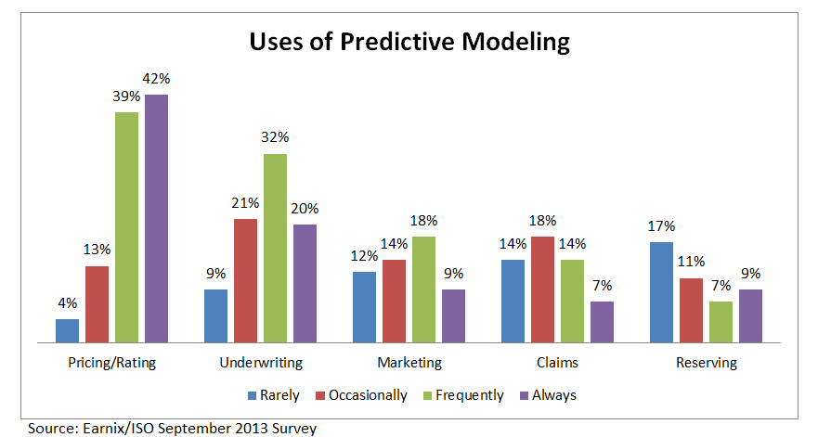
Uses of Predictive Analytics by Function
Pricing and Underwriting are the leading uses for predictive analytics

Slide 34
CAPITAL & CAPACITY
Primary Insurance and Reinsurance Markets Are Well Capitalized
34

Slide 35
Policyholder Surplus,
2006:Q4–2014:Q1
Drop due to near-record 2011 CAT losses
($ Billions)
2007:Q3
Pre-Crisis Peak
Surplus as of 3/31/14 stood at a record high $662.0B
The industry now has $1 of surplus for every $0.73 of NPW,
close to the strongest claims-paying status in its history.
2010:Q1 data includes $22.5B of paid-in capital from a holding company parent for one insurer’s investment in a non-insurance business .
The P/C insurance industry entered 2014
in very strong financial condition.
Sources: ISO, A.M .Best.
35
12/01/09 - 9pm
eSlide – P6466 – The Financial Crisis and the Future of the P/C
Notes:
35

Slide 36
US Policyholder Surplus:
1975–2014*
($ Billions)
Surplus as of 3/31/14 was a record $662.0, up 1.3% from $653.3 of 12/31/13, and up 51.5% ($224.9B) from the crisis trough of $437.1B at 3/31/09
“Surplus” is a measure of underwriting capacity. It is analogous to “Owners Equity” or “Net Worth” in non-insurance organizations
The Premium-to-Surplus Ratio Stood at $0.73:$1 as of
3/31/14, a Near Record Low (at Least in Recent History)
* As of 3/31/14.
Source: A.M. Best, ISO, Insurance Information Institute.

Slide 37
ALTERNATIVE CAPITAL & REINSURANCE MARKETS
Impact Is Focused on Well-Modelled Property Risks
37

Slide 38
Global Reinsurance Capital (Traditional and Alternative), 2007 - 2013
Total reinsurance capital reached a record $540B in 2013, up 58.8% from 2008.
But alternative capacity has grown 163% since 2008, to $50B. It has grown 79% in the past two years.
Source: Aon Benfield Reinsurance Market Outlook, April 1, 2014; Insurance Information Institute.

Slide 39
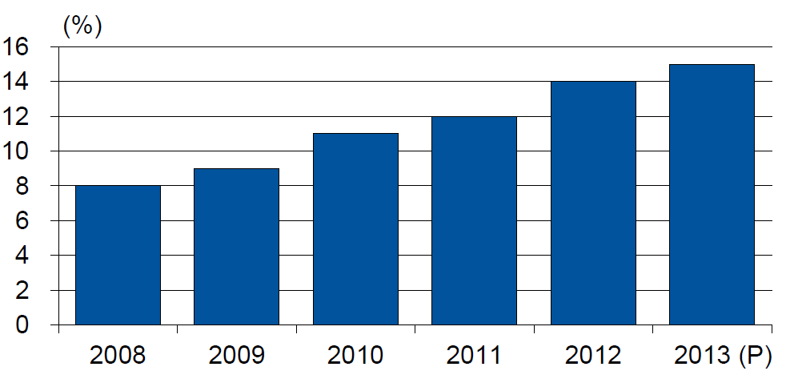
Alternative Capacity as a Percentage of Global Property Catastrophe Reinsurance Limit
(As of Year End)
Alternative Capacity accounted for approximately 14% or $45 billion of the $316 in global property catastrophe reinsurance capital as of mid-2013 (expected to rise to ~15% by year-end 2013)
Source: Guy Carpenter

Slide 40
Investor by Category
Institutional investors are accounting for a larger share of alternative reinsurance investors
Years ended June 30.
Source: Aon Benfield Securities; Insurance Information Institute.

Slide 41
Alternative Risk Transfer: Market Growth
Since 2009, market share of collateralized reinsurance has grown faster than cat bonds or other forms of risk transfer
Source: Aon Benfield Insurance-Linked Securities: Capital Revolution, August 30, 2013; Insurance Information Institute.

Slide 42
Catastrophe Bonds: Issuance and Outstanding, 1997- 2014:Q1
Risk Capital Amount ($ Millions)
Risk capital outstanding reached a record high in first quarter
Financial crisis depressed issuance
CAT bond issuance reached a record high in 2013.
Second Quarter 2014 Will Set a Record – Nearly $4.6 Billion Issued
Sources: Guy Carpenter (Aon Benfield for 2014:Q1); Artemis for 2014:Q2 estimate; Insurance Information Institute.

Slide 43
Catastrophe Bonds: Issuance and Outstanding, 1997- 2014:Q2*
Risk Capital Amount ($ Millions)
Risk capital outstanding reached a record high in 2013
Financial crisis depressed issuance
CAT bond issuance reached a record high in 2013 and could set a new record in 2014
Catastrophe Bond Issuance Is Approaching Pre-Crisis Levels While Risk Capital Outstanding Stands at an All-Time Record
*Through June 30, 2014.
Source: Guy Carpenter; Insurance Information Institute.

Slide 44
Catastrophe Bonds Outstanding, Q1 2014
Catastrophe bonds are heavily concentrated in U.S. hurricane exposures. Two-thirds of catastrophe risks outstanding cover U.S. wind risks.
Source: Willis Capital Markets.

Slide 45
U.S. Wind-Exposed Risk Premium* 2010:Q1 to 2014: Q1
Risk spreads dropped – equivalent to lower rates – low cat losses, capital entering market.
* Trailing 12-month average
SOURCE: Willis Capital Markets, Insurance Information Institute.

Slide 46
Non-U.S. Wind-Exposed Risk Premium*
2010:Q1-2014: Q1
Spreads are also falling in non-U.S. wind exposures, but less sharply and in line with expected losses
* Trailing 12-month average.
SOURCE: Willis Capital Markets, Insurance Information Institute.

Slide 47
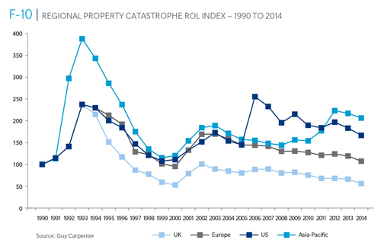
Reinsurance Pricing: Rate-on-Line Index by Region, 1990 – 2014*
Lower CATs and a flood of new capital has pushed reinsurance pricing down in most regions, including the U.S.
*As of Jan. 1.
Source: Guy Carpenter

Slide 48
Notable Cat Bond Events
Bond | Sponsor | Event(s) | Loss to Investors
Kelvin Ltd. | Koch Energy | U.S. Winter 2000-01 | $5 million
George Town Re | St. Paul Re | 9/11, Hurricane Floyd, European wind | $1 million
KAMP Re | Zurich | Hurricane Katrina (2005) | $144 million
Avalon Re | Oil Casualty | Katrina, 2005 fuel depot explosion, NYC street collapse | $13 million
Ajax | Aspen Re | 2008 Lehman bankruptcy | $72 million
Carillon | Munich Re | 2008 Lehman bankruptcy | $31 million
Newton Re | Catlin | 2008 Lehman bankruptcy | $4 million
Willow | Allstate | 2008 Lehman bankruptcy | $10 million
Muteki Ltd. | Munich Re for Zenkyoren | 2011 Tohuku earthquake | $300 million
Vega Capital | Swiss Re | 2011 Tohuku earthquake | $16 million
Mariah Re | American Family | 2011 tornadoes | $200 million¹
Vega Capital | Swiss Re | Superstorm Sandy (2012) | $7 million
Successor X | Swiss Re | Superstorm Sandy (2012) | $15 million²
Most events have been relatively small. Four were counterparty risks related to the Lehman Brothers bankruptcy in 2008.
1 (In litigation) 2 Estimated
Source: Munich Re

Slide 49
Questions Arising from Influence of Alternative Capital
What Will Happen When Investors Face Large-Scale Losses?
What Happens When Interest Rates Rise?
Does ILS Have a Higher Propensity to Litigate?
How Much Lower Will Risk Premiums Shrink/ROLs Fall?
Will There Be Spillover Into Casualty Reinsurance?
Will Alternative Capital Drive Consolidation?

Slide 50
Agent/Broker Consolidation Trends
M&A Activity is on the Rise Again in the Aftermath of the Great Recession
50

Slide 51
Agent/Broker M&A Deals, 2000-2014:6M
Number of Deals
Agent/Broker activity is running at a record pace in 2014 with 314 deals announced through June 30.
Source: Optis Partners, “Agent-Broker Merger & Acquisition Statistics: The New Normal?”, August 2014; Insurance Information Institute.

Slide 52
Announced Agent/Broker Transactions by Seller Type, 2008-2014:6M
Number of Deals
P/C Agent/Broker transactions lead the way, accounting for about 40% of deals
PC
PC/EB
EB
Other
Source: Optis Partners, “Agent-Broker Merger & Acquisition Statistics: The New Normal?”, August 2014, Insurance Information Institute.

Slide 53
Announced Agent/Broker Transactions by Buyer Type, 2008-2014:6M
Number of Deals
Broker-PE
Broker-Private Equity account for more than 40% of deals
Broker-Private
Broker-Public
Banks & Other
Source: Optis Partners, “Agent-Broker Merger & Acquisition Statistics: The New Normal?”, August 2014, Insurance Information Institute.

Slide 54
Agent/Broker Consolidators by Type, 2011 – 2014:6M
Private Equity and Privately Owned agencies/brokers accounted for 68% of the 1,042 transactions from 2011 through mid-2014
Source: Optis Partners, “Agent-Broker Merger & Acquisition Statistics: The New Normal?”, August 2014, Insurance Information Institute.

Slide 55
Top 10 Most Active Agent/Broker Buyers,
2011 – 2014:6M
(Number of Transactions)
Hub and Gallagher have been the most active consolidators over the past few years
Source: Optis Partners, “Agent-Broker Merger & Acquisition Statistics: The New Normal?”, August 2014, Insurance Information Institute.

Slide 56
The Strength of the Economy Will Influence P/C Insurer Growth Opportunities
Economic Growth in the Northwest Outpace the Overall US
56

Slide 57
US Real GDP Growth*
The Q4:2008 decline was the steepest since the Q1:1982 drop of 6.8%
Real GDP Growth (%)
Recession began in Dec. 2007. Economic toll of credit crunch, housing slump, labor market contraction was severe
Q1 2014 GDP data were hit hard by this year’s “Polar Vortex” and harsh winter
Demand for Insurance Should Increase in 2014/15 as GDP Growth Accelerates Modestly and Gradually Benefits the Economy Broadly
* Estimates/Forecasts from Blue Chip Economic Indicators.
Source: US Department of Commerce, Blue Economic Indicators 9/14; Insurance Information Institute.

Slide 58
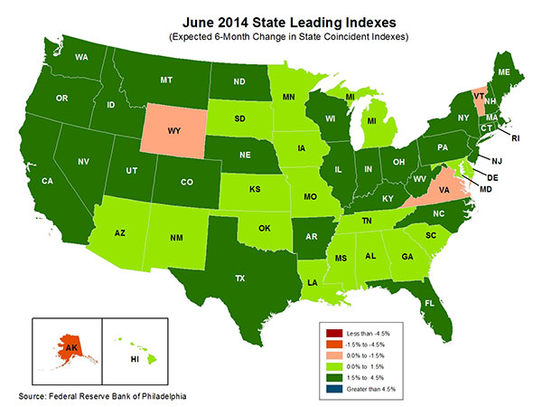
State-by-State Leading Indicators
through 2014:Q4
The economic outlook for most of the US is generally positive, though flat-to-negative for 4 states
Sources: Federal Reserve Bank of Philadelphia at http://www.philadelphiafed.org/index.cfm ;Insurance Information Institute.

Slide 59
Real GDP by State Percent Change, 2013:
Highest 25 States
North Dakota was the economic growth juggernaut of the US in 2013—by far
Only 9 states experienced growth in excess of 3%, which is what we would see nationally in a more typical recovery
Most Northwest states are doing better than the US overall
Sources: U.S. Bureau of Economic Analysis; Insurance Information Institute.

Slide 60
Real GDP by State Percent Change, 2013:
Lowest 25 States
Growth rates in 11 states were still below 1% in 2013
DC and Alabama were the only states to shrink in 2013
Sources: US Bureau of Economic Analysis; Insurance Information Institute.

Slide 61
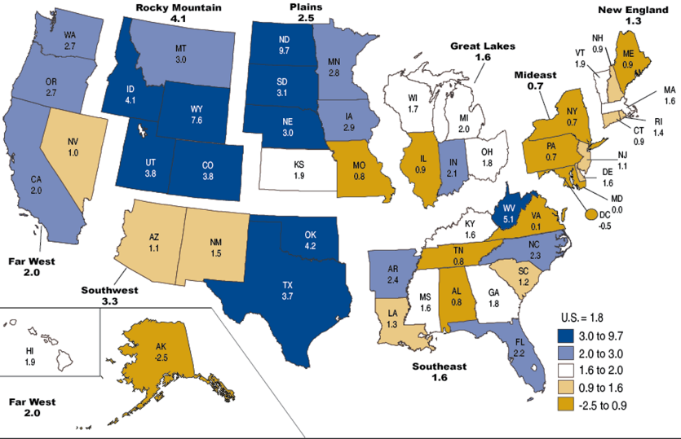
Percent Change in Real GDP by State, 2013
Sources: US Bureau of Economic Analysis; Insurance Information Institute.

Slide 62
State GDP Growth: WA, OR, ID, MT and UT vs. U.S., 2010-2013
(Percent)
Average 2010-2013
US: 2.0% WA 2.2% OR 4.1%
ID 1.4% MT: 2.8% UT: 3.5%
NW states have generally outperformed the US overall
Source: US Bureau of Economic Analysis; Insurance Information Institute..
62
Notes:
62

Slide 63
GDP: 4-Year Average WA, OR, ID, MT and UT vs. U.S.
2010-2013
Sources: US Bureau of Economic Analysis; Insurance Information Institute.

Slide 64
Annual Inflation Rates, (CPI-U, %),
1990–2015F
Annual Inflation Rates (%)
Inflation peaked at 5.6% in August 2008 on high energy and commodity crisis. The recession and the collapse of the commodity bubble reduced inflationary pressures in 2009/10
Inflationary expectations have edged up but remain quite low, allowing the Fed to maintain low interest rates
The slack in the U.S. economy suggests that inflationary pressures should remain subdued for an extended period of times. Energy, health care and commodity prices, plus U.S. debt burden, remain longer-run concerns
Sources: US Bureau of Labor Statistics; Blue Chip Economic Indicators, 9/14 (forecasts).

Slide 65
Consumer Sentiment Survey (1966 = 100)
January 2010 through September 2014
Optimism among consumers has generally improved in 2014
Impact of 2011 budget impasse
Consumer confidence had been low for years amid high unemployment, falling home prices and other factors adversely impact consumers, but improved substantially over the past 2+ years, though uncertainty in Washington sometimes takes a toll.
Source: University of Michigan; Insurance Information Institute

Slide 66
Net Worth of Households*
Recently Hit A Historic High
2008-09 recession: -15.7%
$ Trillions
Housing “bubble”
2001 recession
1992 recession
1982 recession
Rising net worth fuels a “wealth affect” that helps fuel consumer spending, which accounts for 70% of spending in the U.S. economy
*Includes nonprofit organizations. Data are not seasonally adjusted or inflation-adjusted.
Source: Federal Reserve Board: http://www.federalreserve.gov/releases/z1/current/z1r-5.pdf ; Insurance Information Institute.

Slide 67
Household Financial Obligations
Ratio Recently Hit A Historic Low
Financial Obligations Ratio
Financial Obligations Ratio: debt service (mortgage and consumer debt), auto lease, residence rent, HO insurance, and property tax payments as % of personal disposable income.
Household balance sheets are stronger than they’ve been in many years, setting the stage for more consumer spending
Decline began in 2008:Q1.
15.23% in 2012:Q4
is lowest ratio since 1980:Q4 (15.09%).
*through 2013:Q3 (data posted on Dec 13, 2013)
Source: Federal Reserve Board, at http://www.federalreserve.gov/releases/housedebt

Slide 68
Auto/Light Truck Sales, 1999-2019F
Job growth and improved credit market conditions will boost auto sales in 2014 and beyond
(Millions of Units)
New auto/light truck sales fell to the lowest level since the late 1960s. Forecast for 2014-15 is still below 1999-2007 average of 17 million units, but a robust recovery is well underway.
Truck purchases by contractors are especially strong
Car/Light Truck Sales Will Continue to Recover from the 2009 Low Point, Bolstering the Auto Insurer Growth and the Manufacturing Sector Along With Workers Comp Exposures
Source: U.S. Department of Commerce; Blue Chip Economic Indicators (9/14 and 3/13); Insurance Information Institute.

Slide 69
Monthly Change* in Auto Insurance Prices, January 2005 - December 2013
Pricing weakened in 2011, strengthened in 2012/early 2013 but has since moderated
(Percent Change
from same month,
prior year)
Auto Insurance Price Increases Averaged 5.1% in 2010 over 2009, After Averaging 4.5% in 2009 over 2008.
PPA Auto, like most p/c lines, exhibits strong cyclicality in pricing. Prices rose from 2000 to late 2005, were flat/falling in 2006 and 2007 before beginning to rise gain in 2008.
Underwriting performance remained strong even when prices were flat or falling due to improvements in underlying frequency and severity trends
* Percentage change from same month in prior year, seasonally adjusted.
Sources: US Bureau of Labor Statistics; Insurance Information Institute

Slide 70
New Private Housing Starts, 1990-2019F
Job growth, low inventories of existing homes, low mortgage rates and demographics should continue to stimulate new home construction for several more years
(Millions of Units)
New home starts plunged 72% from 2005-2009; A net annual decline of 1.49 million units, lowest since records began in 1959
Insurers Are Continue to See Meaningful Exposure Growth in the Wake of the “Great Recession” Associated with Home Construction: Construction Risk Exposure, Surety, Commercial Auto; Potent Driver of Workers Comp Exposure
Source: U.S. Department of Commerce; Blue Chip Economic Indicators (9/14 and 3/13); Insurance Information Institute.

Slide 71
Interest Rate on Convention 30-Year Mortgages: Up a Bit, 1990–2014*
Mortgages rates plunged to near-record lows in early 2013 but rose as the Fed initiated tapering in its QE program, but have come down a bit through mid-2014
Yields on 30-Year mortgages have been below 6% for a six years
Rising mortgage interest rates have impacted home sales but are unlikely to derail the recovery on housing
*Monthly, through June 2014. Note: Recessions indicated by gray shaded columns.
Sources: Federal Reserve Bank at http://www.federalreserve.gov/releases/h15/data.htm.
National Bureau of Economic Research (recession dates); Insurance Information Institutes.
71
12/01/09 - 9pm
eSlide – P6466 – The Financial Crisis and the Future of the P/C
Notes:
71

Slide 72
30-Year Mortgages in 2014 Are Falling! What Will Be the Impact on Construction?
30-year mortgage rates are down nearly 40 basis points since early January
Mortgage Interest Rates Were Expected to Continue to Rise as the Fed Pursued Tapering and the Economy Recovered; Rates Are Still Low by Historical Standards
*Weekly through June 5, 2014.
Sources: Federal Reserve Bank at http://www.federalreserve.gov/releases/h15/data.htm.; Insurance Information Institutes.
72
12/01/09 - 9pm
eSlide – P6466 – The Financial Crisis and the Future of the P/C
Notes:
72

Slide 73
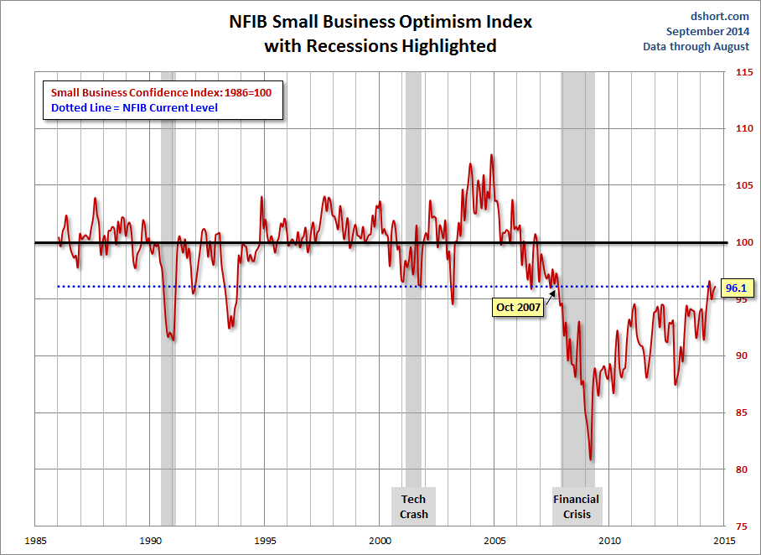
NFIB Small Business Optimism Index
January 1985 through August 2014
Small business optimism in August was nearly at its level since the crisis began in Dec. 2007.
Source: National Federation of Independent Business at http://www.advisorperspectives.com/dshort/charts/indicators/Sentiment.html?NFIB-optimism-index.gif ; Insurance Information Institute.

Slide 74
Business Bankruptcy Filings,
1980-2013
% Change Surrounding Recessions
1980-82 58.6%
1980-87 88.7%
1990-91 10.3%
2000-01 13.0%
2006-09 208.9%
2013 bankruptcies totaled 33,212, down 17.1% from 2012—the fourth consecutive year of decline. Business bankruptcies more than tripled during the financial crisis.
Significant Exposure Implications for All Commercial Lines as Business Bankruptcies Begin to Decline
Sources: American Bankruptcy Institute (1980-2012) at http://www.abiworld.org/AM/AMTemplate.cfm?Section=Home&TEMPLATE=/CM/ContentDisplay.cfm&CONTENTID=61633; 2013 data from United States Courts at http://news.uscourts.gov; Insurance Information Institute.
74
12/01/09 - 9pm
eSlide – P6466 – The Financial Crisis and the Future of the P/C
Notes:
74

Slide 75
Private Sector Business Starts:
1993:Q2 – 2013:Q4* As Strong as Ever?
Business Starts
2006: 861,000
2007: 844,000
2008: 787,000
2009: 701,000 2010: 742,000 2011: 781,000
2012: 800,000
2013: 870,000**
Recessions in orange
2013:Q1 578,000 business starts*
Thousands
*Data posted Apr 29, 2014, the latest available; a classification change in 2013:Q1 resulted in a report of 578,000 businesses started in that quarter. Seasonally adjusted. **2014 number assumes 1st quarter equaled average of other three quarters
Sources: Bureau of Labor Statistics, http://www.bls.gov/news.release/cewbd.t08.htm. NBER (recession dates)
75
12/01/09 - 9pm
eSlide – P6466 – The Financial Crisis and the Future of the P/C
Notes:
75

Slide 76
ISM Non-Manufacturing Index
(Values > 50 Indicate Expansion)
January 2010 through August 2014
Optimism among non-manufacturers has been generally increasing in 2014
Non-manufacturing industries have been expanding and adding jobs. This trend is likely to continue through 2014.
Source: Institute for Supply Management at http://www.ism.ws/ismreport/nonmfgrob.cfm; Insurance Information Institute.

Slide 77
12 Industries for the Next 10 Years: Insurance Solutions Needed
Health Care
Health Sciences
Energy (Traditional)
Many industries are poised for growth, though insurers’ ability to capitalize on these industries varies widely
Alternative Energy
Petrochemical
Agriculture
Natural Resources
Technology (incl. Biotechnology)
Light Manufacturing
Insourced Manufacturing
Export-Oriented Industries
Shipping (Rail, Marine, Trucking, Pipelines)

Slide 78
CONSTRUCTION INDUSTRY OVERVIEW & OUTLOOK
The Construction Sector Is Critical to the Economy and the P/C Insurance Industry
78

Slide 79
Value of New Private Construction: Residential & Nonresidential, 2003-2014*
2014: Value of new pvt. construction hits $685.5B as of June 2014, up 37% from the 2010 trough but still 25% below 2006 peak
New Construction peaks at $911.8. in 2006
Billions of Dollars
Trough in 2010 at $500.6B, after plunging 55.1% ($411.2B)
$15.0
$613.7
$329.5
$298.1
$261.8
$355.9
$238.8
Private Construction Activity Is Moving in a Positive Direction though Remains Well Below Pre-Crisis Peak; Residential Dominates
*2014 figure is a seasonally adjusted annual rate as of June.
Sources: US Department of Commerce; Insurance Information Institute.
79
12/01/09 - 9pm
eSlide – P6466 – The Financial Crisis and the Future of the P/C
Notes:
79

Slide 80
Value of Construction Put in Place, June 2014 vs. June 2013*
Growth (%)
Private: +9.2%
Public: -2.9%
Public sector construction activity remains depressed
Private sector construction activity is up in the residential and nonresidential segments
Overall Construction Activity is Up, But Growth Is Almost Entirely in the Private Sector as State/Local Government Budget Woes Continue
*seasonally adjusted
Source: U.S. Census Bureau, http://www.census.gov/construction/c30/c30index.html ; Insurance Information Institute.

Slide 81
Value of Private Construction Put in Place, by Segment, June 2014 vs. June 2013*
Led by the Office, Lodging and Power/Utility segments, Private sector construction activity is rising after plunging during the “Great Recession.”
Growth (%)
Private Construction Activity is Up in Many Segments, Including the Key Residential Construction Sector; Bodes Well for the Remainder of 2014
*seasonally adjusted
Source: U.S. Census Bureau, http://www.census.gov/construction/c30/c30index.html ; Insurance Information Institute.

Slide 82
Value of Public Construction Put in Place, by Segment, June 2014 vs. June 2013*
Growth (%)
Public sector construction activity is down substantially in many segments, a situation that will likely persist, dragging on public entity risk exposures
Amusement & Recreation, Sewage & Waste Disposal and Conservation projects lead public sector construction
Public Construction Activity is Down in Many Segments as State and Local Budgets Remain Under Stress; Improvement Possible in 2015.
*seasonally adjusted
Source: U.S. Census Bureau, http://www.census.gov/construction/c30/c30index.html ; Insurance Information Institute.

Slide 83
Real (Inflation-Adjusted)
Nonresidential Construction, 2000-2014*
(Bar = CAGR; Line = Y/Y Growth Rate)
Construction activity has generally been positive since late 2010 but has occasionally be erratic. Forecast is for slowing improving growth
*Through Q1 2014.
Source: US Dept. of Commerce; Wells Fargo Securities (June 6, 2014 research report).
83
12/01/09 - 9pm
eSlide – P6466 – The Financial Crisis and the Future of the P/C
Notes:
83

Slide 84
Commercial & Industrial Loans Outstanding at FDIC-Insured Banks, Quarterly, 2006-2014:Q2
$Trillions
Commercial lending activity exceeds pre-crisis levels (+42.2% or $440B above mid-2010 trough)
Commercial lending plunged by 21.2% ($330B) during the financial crisis and ensuing period of tight credit
Outstanding Commercial Loan Volume Has Been Growing for Over 3 Years and Is Now Nearly Back to Early Recession Levels. Bodes Very Well for the Creation of Current and Future Commercial Insurance Exposures
Source: FDIC at http://www2.fdic.gov/qbp/ (Loan Performance spreadsheet); Insurance Information Institute.

Slide 85
Percent of Non-current Commercial & Industrial Loans Outstanding at FDIC-Insured Banks,
Quarterly, 2006-2014:Q1
Recession
Back to “normal” levels of noncurrent industrial & commercial loans
Non-current loans (those past due 90 days or more or in nonaccrual status) are below even pre-recession levels, fueling bank willingness to lend.
Source: FDIC at http://www2.fdic.gov/qbp/ (Loan Performance spreadsheet); Insurance Information Institute.

Slide 86
Change from Peak in New Construction Expenditures to 2013*
Change (%)
Residential
Nonresidential
Govt.
Despite Recent Improvements, Construction Activity (and Employment) Remains Far Below Pre-Crisis Peaks
Note: Year in parentheses is the year of peak expenditure.
*2013 figure is a seasonally adjusted annual rate as of June.
Sources: US Department of Commerce; Insurance Information Institute.

Slide 87
Value of New Federal, State and Local Government Construction: 2003-2014*
Construction across all levels of government peaked at $314.9B in 2009
Austerity Reigns
Govt. construction MAY be turning a corner; still down $50.2B or 15.9% since 2009 peak
($ Billions)
Government Construction Spending Peaked in 2009, Helped by Stimulus Spending, but Contracted As State/Local Governments Grappled with Deficits and Federal Sequestration
*2014 figure is a seasonally adjusted annual rate as of July; http://www.census.gov/construction/c30/historical_data.html
Sources: US Department of Commerce; Insurance Information Institute.

Slide 88
New Private Housing Starts, 1990-2019F
Job growth, low inventories of existing homes, low mortgage rates and demographics should continue to stimulate new home construction for several more years
(Millions of Units)
New home starts plunged 72% from 2005-2009; A net annual decline of 1.49 million units, lowest since records began in 1959
Insurers Are Continue to See Meaningful Exposure Growth in the Wake of the “Great Recession” Associated with Home Construction: Construction Risk Exposure, Surety, Commercial Auto; Potent Driver of Workers Comp Exposure
Source: U.S. Department of Commerce; Blue Chip Economic Indicators (9/14 and 3/13); Insurance Information Institute.

Slide 89
Construction Employment,
Jan. 2010—August 2014*
(Thousands)
Construction employment is +633,000 above
Jan. 2011 (+11.6%) trough
Construction and manufacturing employment constitute 1/3 of all WC payroll exposure.
*Seasonally adjusted.
Sources: US Bureau of Labor Statistics at http://data.bls.gov; Insurance Information Institute.
89
12/01/09 - 9pm
eSlide – P6466 – The Financial Crisis and the Future of the P/C
Notes:
89

Slide 90
Construction Employment,
Jan. 2003–August 2014
(Thousands)
Construction employment as of Aug. 2014 totaled 6.068 million, an increase of 633,000 jobs or 11.6% from the Jan. 2011 trough
Construction employment peaked at 7.726 million in April 2006
Gap between pre-recession construction peak and today: 1.66 million jobs
The “Great Recession” and housing bust destroyed 2.3 million constructions jobs
Construction employment troughed at 5.435 million in Jan. 2011, after a loss of 2.291 million jobs, a 29.7% plunge from the April 2006 peak
The Construction Sector Could Be a Growth Leader in 2014 as the Housing Market, Private Investment and Govt. Spending Recover. WC Insurers Will Benefit.
Note: Recession indicated by gray shaded column.
Sources: U.S. Bureau of Labor Statistics; Insurance Information Institute.
90
12/01/09 - 9pm
eSlide – P6466 – The Financial Crisis and the Future of the P/C
Notes:
90

Slide 91
Construction Jobs: Largest Gains & Losses by Metro Area, May 2014 vs. May 2013*
Change
Largest Increases
Largest Losses
+10%
+4%
Construction employment expanded in 218 out of the 339 metro areas in the US in May 2014
Construction Employment Is Expanding—Albeit Modestly—in Much of the US
*Seasonally adjusted;
Source: Associated General Contractors: http://www.agc.org/galleries/news/Metro_Empl_1404_Rank.pdf; Ins. Information Institute.

Slide 92
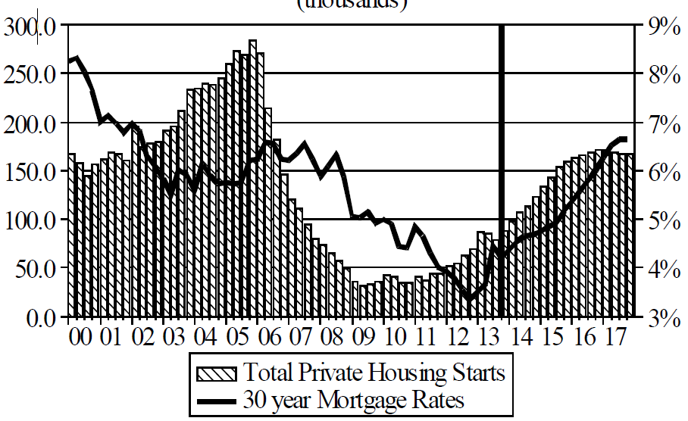
Florida Total Private Housing Starts,
2000 – 2017F
(Thousands of Units)
CRASH, CRATER, RECOVERY Homebuilding in FL continues to recover, adding substantially to coastal exposures.
The economic outlook for most of the US is positive for the first time in many years
Source: University of Central Florida Institute for Economic Competitiveness: http://iec.ucf.edu/post/2014/01/07/Florida-Metro-Forecast-December-2013.aspx

Slide 93
Interest Rate on Convention 30-Year Mortgages: Up a Bit, 1990–2014*
Mortgages rates plunged to near-record lows in early 2013 but rose as the Fed initiated tapering in its QE program
Yields on 30-Year mortgages have been below 6% for a six years
Rising mortgage interest rates have impacted home sales but are unlikely to derail the recovery on housing
*Monthly, through May 2014. Note: Recessions indicated by gray shaded columns.
Sources: Federal Reserve Bank at http://www.federalreserve.gov/releases/h15/data.htm.
National Bureau of Economic Research (recession dates); Insurance Information Institutes.
93
12/01/09 - 9pm
eSlide – P6466 – The Financial Crisis and the Future of the P/C
Notes:
93

Slide 94
30-Year Mortgages in 2014 Are Falling! What Will Be the Impact on Construction?
30-year mortgage rates are down nearly 40 basis points since early January
Mortgage Interest Rates Were Expected to Continue to Rise as the Fed Pursued Tapering and the Economy Recovered; Rates Are Still Low by Historical Standards
*Weekly through June 5, 2014.
Sources: Federal Reserve Bank at http://www.federalreserve.gov/releases/h15/data.htm.; Insurance Information Institutes.
94
12/01/09 - 9pm
eSlide – P6466 – The Financial Crisis and the Future of the P/C
Notes:
94

Slide 95
New Home Inventories and Rental Vacancy Rates, 2003-2013*
(Thousands)
Low new home inventories and falling vacancy rates bode well for residential construction
*2013 figure is a seasonally adjusted annual rate as of June.
Sources: US Department of Commerce; Insurance Information Institute.

Slide 96
Change from Peak in New Construction Expenditures to 2013*
Change (%)
Residential
Nonresidential
Govt.
Despite Recent Improvements, Construction Activity (and Employment) Remains Far Below Pre-Crisis Peaks
Note: Year in parentheses is the year of peak expenditure.
*2013 figure is a seasonally adjusted annual rate as of June.
Sources: US Department of Commerce; Insurance Information Institute.

Slide 97
ENERGY SECTOR: OIL, GAS & INFRASTRUCTURE IS BRIGHT
US Is Becoming an Energy Powerhouse; Domestic Demand and Exports Are Key
Need Infrastructure Investment
97

Slide 98
U.S. Natural Gas Production, 2000-2013
Trillions of Cubic Ft. per Year
The U.S. is already the world’s largest natural gas producer—recently overtaking Russia. This is a potent driver of commercial insurance exposures
Source: Energy Information Administration, Short-Term Energy Outlook (April 8, 2014) , Insurance Information Institute.

Slide 99
U.S. Crude Oil Production, 2005-2015P
Millions of Barrels per Day
Crude oil production in the U.S. is expected to increase by 82.6% from 2008 through 2015—and could overtake Saudi Arabia as the world’s largest oil producer
Source: Energy Information Administration, Short-Term Energy Outlook (April 8, 2014) , Insurance Information Institute.

Slide 100

Oil & Gas Extraction Employment,
Jan. 2010—August 2014*
Oil and gas extraction employment is up 35.4% since Jan. 2010 as the energy sector booms. Domestic energy production is essential to any robust economic recovery in the US.
Highest since mid-1986
(Thousands)
*Seasonally adjusted
Sources: US Bureau of Labor Statistics at http://data.bls.gov; Insurance Information Institute.
100
12/01/09 - 9pm
eSlide – P6466 – The Financial Crisis and the Future of the P/C
Notes:
100

Slide 101
World Primary Energy Consumption, 1990-2040P
Quadrillion BTUs
Growth in worldwide energy consumption will create more risk and vulnerabilities (natural and manmade); Innovations in risk management and insurance are needed.
Between 2010 and 2040, energy consumption in projected to increase by 56.4% worldwide
Source: Energy Information Administration, 2013 International Energy Outlook, Insurance Information Institute.

Slide 102
Cumulative Projected Investment in Global Energy Infrastructure, 2011-2035 ($ Trill.)
Projected energy infrastructure investment through 2035 total $38 trillion; Implies substantial incurrence of risk.
Source: International Energy Agency, World Energy Outlook 2011.

Slide 103
US Electric Power Generation by Fuel Source, 2010-2035F (Billions of Kilowatt Hours)
4,279
4,427
3,937
4,118
3,806
3,796
Demand for Electricity Is Expected to Grow at a 0.6% Annual Rate Through 2035. Renewables and Natural Gas Will Account for an Increasing Share of Fuel Source
Source: US Energy Information Administration, Annual Energy Outlook 2012, Appendix A7.
103
12/01/09 - 9pm
eSlide – P6466 – The Financial Crisis and the Future of the P/C
Notes:
103

Slide 104
U.S. Electricity Generation by Fuel,
1990-2040F (Trillions of Kilowatt Hours)
Natural gas share of fossil fired generation will grow rapidly (more investment needed). Coal fired generation will remain flat but its share will fall due to abundant gas and EPA carbon regulations
Source: US Energy Information Administration, 2014 Annual Energy Outlook Early Release Overview; Insurance Information Institute.
104
12/01/09 - 9pm
eSlide – P6466 – The Financial Crisis and the Future of the P/C
Notes:
104

Slide 105
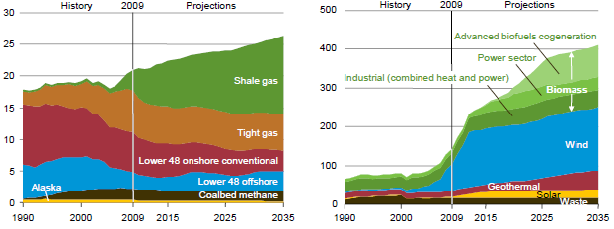
US Natural Gas Production and Non-Hydro Renewable Electricity Generation, 1990-2035P
Shale gas production is expected to grow rapidly in the US
Wind is expected to account for the majority of renewable electricity generation
Tight gas production involves controversial hydraulic fracturing (fracking) techniques
Source: US Energy Information Administration, Annual Energy Outlook 2011; Insurance Information Institute.
105
12/01/09 - 9pm
eSlide – P6466 – The Financial Crisis and the Future of the P/C
Notes:
105

Slide 106
U.S. Private Power Construction,
2000-2014* (% Change, 3-Month Moving Avg.)
Power construction accounts for a large share of all construction activity. The recent slowdown was in part due to the expiration of renewable production tax credits. Going forward, about 75% of new capacity will be for gas fired plants
*Through April 2014.
Source: US Dept. of Commerce; Energy Information Administration, Wells Fargo Securities (June 6, 2014 research report).
106
12/01/09 - 9pm
eSlide – P6466 – The Financial Crisis and the Future of the P/C
Notes:
106

Slide 107
MANUFACTURING SECTOR OVERVIEW & OUTLOOK
The U.S. Is Experiencing a Mini Manufacturing Renaissance That Is Benefitting the US Economy and the P/C Insurance Industry
107

Slide 108
Manufacturing Growth for Selected Sectors, 2014 vs. 2013*
Growth (%)
Durables: +4.8%
Non-Durables: +0.9%
Manufacturing of durable goods is stronger than nondurables in 2014
Manufacturing Is Expanding—Albeit Slowly—Across a Number of Sectors that Will Contribute to Growth in Insurable Exposures Including: WC, Commercial Property, Commercial Auto and Many Liability Coverages
*Seasonally adjusted; Date are YTD comparing data through July 2014 to the same period in 2013.
Source: U.S. Census Bureau, Full Report on Manufacturers’ Shipments, Inventories, and Orders, http://www.census.gov/manufacturing/m3/

Slide 109
Dollar Value* of Manufacturers’ Shipments Monthly, Jan. 1992—July 2014
$ Millions
The value of Manufacturing Shipments in July 2014 was $507.4.B—a new record high.
Monthly shipments in July 2014 exceeded the pre-crisis (July 2008) peak. Manufacturing is energy-intensive and growth leads to gains in many commercial exposures: WC, Commercial Auto, Marine, Property, and various Liability Coverages.
* Seasonally adjusted; Data published Sept. 4, 2014.
Source: U.S. Census Bureau, Full Report on Manufacturers’ Shipments, Inventories, and Orders, http://www.census.gov/manufacturing/m3/
109
12/01/09 - 9pm
eSlide – P6466 – The Financial Crisis and the Future of the P/C
Notes:
109

Slide 110
Manufacturing Employment,
Jan. 2010—August 2014*
(Thousands)
Since Jan 2010, manufacturing employment is up (+698,000 or +6.1%)
and still growing.
Manufacturing employment is a surprising source of strength in the economy. Employment in the sector is at a multi-year high.
*Seasonally adjusted.
Sources: US Bureau of Labor Statistics at http://data.bls.gov; Insurance Information Institute.
110
12/01/09 - 9pm
eSlide – P6466 – The Financial Crisis and the Future of the P/C
Notes:
110

Slide 111
ISM Manufacturing Index
(Values > 50 Indicate Expansion)
January 2010 through August 2014
Manufacturing continues to expand in 2014—now at its highest level since early 2011
The manufacturing sector expanded for 54 of the 56 months from Jan. 2010 through Aug. 2014. Pace of recovery has been uneven due to economic turbulence in the U.S., Europe and China.
Source: Institute for Supply Management at http://www.ism.ws/ismreport/mfgrob.cfm; Insurance Information Institute.

Slide 112
Business Investment: Expected to Accelerate, Fueling Commercial Exposure Growth
Accelerating business investment will be a potent driver of commercial property and liability insurance exposures and should drive employment and WC payroll exposures as well (with a lag)
Source: IHS Global Insights as of Jan. 13, 2014; Insurance Information Institute.

Slide 113
Recovery in Capacity Utilization is a Positive Sign for Commercial Exposures
March 2001 through Aug. 2014
“Full Capacity”
The US operated at 78.8% of industrial capacity in Aug. 2014, well above the June 2009 low of 66.9% but is still below pre-recession levels.
Percent of Industrial Capacity
Hurricane Katrina
The closer the economy is to operating at “full capacity,” the greater the inflationary pressure
March 2001-November 2001 recession
December 2007-
June 2009 Recession
113
Source: Federal Reserve Board statistical releases at http://www.federalreserve.gov/releases/g17/Current/default.htm.
Notes:
113

Slide 114
Labor Market Trends
Massive Job Losses Sapped the Economy and Commercial/Personal Lines Exposure, But Trend is Improving
114

Slide 115
Unemployment and Underemployment Rates: Still Too High, But Falling
January 2000 through Aug. 2014, Seasonally Adjusted (%)
U-6 went from 8.0% in March 2007 to 17.5% in
October 2009; Stood at 12.0% in Aug. 2014.
8% to 10% is “normal.”
“Headline” unemployment was 6.1% in Aug. 2014. 4.5% to 6% is “normal.”
Stubbornly high unemployment and underemployment constrain overall economic growth, but the job market is now clearly improving.
Source: US Bureau of Labor Statistics; Insurance Information Institute.
115
12/01/09 - 9pm
eSlide – P6466 – The Financial Crisis and the Future of the P/C
Notes:
115

Slide 116
US Unemployment Rate Forecast
2007:Q1 to 2015:Q4F*
Rising unemployment
eroded payrolls
and WC’s
exposure base.
Unemployment peaked at 10% in late 2009.
Jobless figures have been revised modestly downwards for 2014/15
Unemployment forecasts have been revised modestly downwards. Optimistic scenarios put the unemployment as low as 5.1% by Q4 of this year.
* = actual; = forecasts
Sources: US Bureau of Labor Statistics; Blue Chip Economic Indicators (9/14 edition); Insurance Information Institute.

Slide 117
Unemployment Rates by State, August 2014:
Highest 25 States*
In August, 24 states and the District of Columbia had over-the-month unemployment rate increases, 15 states had decreases, and 11 states and had no change.
*Provisional figures for August 2014, seasonally adjusted.
Sources: US Bureau of Labor Statistics; Insurance Information Institute.

Slide 118
Unemployment Rates by State, August 2014:
Lowest 25 States*
As of Aug. 2014, most states in the Northwest region had unemployment rates well below the 6.1% national rate.
*Provisional figures for August 2014, seasonally adjusted.
Sources: US Bureau of Labor Statistics; Insurance Information Institute.

Slide 119
Monthly Change in Private Employment
1,680,000 jobs created so far in 2014
January 2007 through August 2014 (Thousands, Seasonally Adjusted)
134,000 private sector jobs were created in July. In March 2014, the last of the private jobs lost in the Great Recession were recovered
Jobs Created
2013: 2.368 Mill
2012: 2.294 Mill
2011: 2.400 Mill
2010: 1.277 Mill
Monthly losses in Dec. 08–Mar. 09 were the largest in the
post-WW II period
Private Employers Added 10.02 million Jobs Since Jan. 2010 After Having Shed 5.01 Million Jobs in 2009 and 3.76 Million in 2008 (State and Local Governments Have Shed Hundreds of Thousands of Jobs)
Source: US Bureau of Labor Statistics: http://www.bls.gov/ces/home.htm; Insurance Information Institute

Slide 120
Cumulative Change in Private Employment: Dec. 2007—May 2014
Pvt. employment hit 116.6 million in April 2014—617,000 above its pre-crisis peak of 116.0 million
December 2007 through May 2014 (Millions)
Cumulative job losses peaked at 8.765 million in February 2010
It took more than 6 ½ years (79 months) to recover all of the private sector jobs lost in the Great Recession
Private Employers Added 9.39 million Jobs Since Jan. 2010 After Having Shed 4.98 Million Jobs in 2009 and 3.80 Million in 2008 (State and Local Governments Have Shed Hundreds of Thousands of Jobs)
Source: US Bureau of Labor Statistics: http://www.bls.gov/ces/home.htm; Insurance Information Institute

Slide 121
Cumulative Change in Private Sector Employment: Jan. 2010—May 2014
(Millions)
Job gains and pay increases have added more than $1 trillion in new payrolls since 2009 trough
Cumulative job gains through Apr. 2014 totaled 9.39 million
Private Employers Added 9.39 million Jobs Since Jan. 2010 After Having Shed 4.98 Million Jobs in 2009 and 3.80 Million in 2008 (State and Local Governments Have Shed Hundreds of Thousands of Jobs)
Source: US Bureau of Labor Statistics: http://www.bls.gov/ces/home.htm; Insurance Information Institute

Slide 122
Net Change in Government Employment: Jan. 2010—Apr. 2014
State government employment fell by 1.5% since the end of 2009 but is recovering while Federal employment is down by 5.3% and deteriorating
(Thousands)
Local government employment shrank by 380,000 from Jan. 2010 through Apr. 2014, accounting for 62% of all government job losses, negatively impacting WC exposures for those cities and counties that insure privately
Source: US Bureau of Labor Statistics http://www.bls.gov/data/#employment; Insurance Information Institute

Slide 123
Cumulative Change in Government Employment: Jan. 2010—Dec. 2013
Government at all levels has shed more than 600,000 jobs since Jan. 2010 even as private employers created 8.14 million jobs, though losses may now be stabilizing.
January 2010 through Dec. 2013* (Millions)
Cumulative job losses through Dec. 2013 totaled 631,000
Temporary Census hiring distorted 2010 figures
Governments at All Levels are Under Severe Fiscal Strain As Tax Receipts Plunged and Pension Obligations Soared During the Financial Crisis: Sequestration Will Add to this Toll
Source: US Bureau of Labor Statistics http://www.bls.gov/data/#employment; Insurance Information Institute

Slide 124
Oil & Gas Extraction Employment,
Jan. 2010—August 2014*
Oil and gas extraction employment is up 35.4% since Jan. 2010 as the energy sector booms. Domestic energy production is essential to any robust economic recovery in the US.
Highest since mid-1986
(Thousands)
*Seasonally adjusted
Sources: US Bureau of Labor Statistics at http://data.bls.gov; Insurance Information Institute.
124
12/01/09 - 9pm
eSlide – P6466 – The Financial Crisis and the Future of the P/C
Notes:
124

Slide 125
Nonfarm Payroll (Wages and Salaries):
Quarterly, 2005–2014:Q2
Billions
Latest (2014:Q2) was $7.46 trillion, a new peak--$1.21 trillion above 2009 trough
Prior Peak was 2008:Q1 at $6.60 trillion
Payrolls are 19.4% above their 2009 trough and up 4.9% over the past year
Recent trough (2009:Q3) was $6.25 trillion, down 5.3% from prior peak
Note: Recession indicated by gray shaded column. Data are seasonally adjusted annual rates.
Sources: http://research.stlouisfed.org/fred2/series/WASCUR; National Bureau of Economic Research (recession dates); Insurance Information Institute.
125
12/01/09 - 9pm
eSlide – P6466 – The Financial Crisis and the Future of the P/C
Notes:
125

Slide 126
Payroll vs. Workers Comp Net Written Premiums, 1990-2013P
Payroll Base* WC NWP
$Billions $Billions
7/90-3/91
3/01-11/01
12/07-6/09
WC premium volume dropped two years before the recession began
WC net premiums written were down $14B or 29.3% to $33.8B in 2010 after peaking at $47.8B in 2005
Continued Payroll Growth and Rate Gains Suggest WC NWP Will Grow Again in 2014; +8.6% Growth Estimated for 2013
*Private employment; Shaded areas indicate recessions. WC premiums for 2012 are I.I.I. estimate based YTD 2013 actuals.
Sources: NBER (recessions); Federal Reserve Bank of St. Louis at http://research.stlouisfed.org/fred2/series/WASCUR ; NCCI; I.I.I.

Slide 127
Workers Compensation Operating Environment
Workers Comp Results Have Improved Substantially in Recent Years
127

Slide 128
Workers Compensation Combined Ratio: 1994–2015F
WC results have improved markedly since 2011
Workers Comp Results Began to Improve in 2012. Underwriting Results Deteriorated Markedly from 2007-2010/11 and Were the Worst They Had Been in a Decade.
Sources: A.M. Best (1994-2009); NCCI (2010-2013P) and are for private carriers only; Insurance Information Institute (2014-15).

Slide 129
Workers Compensation Lost-Time
Claim Frequency Declined in 2013
Lost-Time Claims
Percent
Cumulative Change of –55.4%
(1991–2011 adj.)
*Adjustments primarily due to significant audit activity.
2013p: Preliminary based on data valued as of 12/31/2013
1991–2012: Based on data through 12/31/2012, developed to ultimate
Based on the states where NCCI provides ratemaking services, including state funds; excludes high deductible policies
Frequency is the number of lost-time claims per $1M pure premium at current wage and voluntary loss cost level
Source: NCCI.
Accident Year

Slide 130
Workers Compensation Medical Severity
Moderate Increase in 2013
Medical
Claim Cost ($000s)
Average Medical Cost per Lost-Time Claim
Annual Change 1991–1993: +1.9%
Annual Change 1994–2001: +8.9%
Annual Change 2002–2010: +6.0%
Annual Change 1991–1993: +1.9%
Annual Change 1994–2001: +8.9%
Annual Change 2002–2013: +5.2%
Cumulative Change = 256%
(1991-2013p)
Accident Year
Accident Year
2013p: Preliminary based on data valued as of 12/31/2013.
1991-2012: Based on data through 12/31/2012, developed to ultimate
Based on the states where NCCI provides ratemaking services including state funds, excluding WV; Excludes high deductible policies.

Slide 131
Change in Price Paid for Medical Professional Services in WC, 2002-2012*
%
Increases in WC med costs varied enormously over the past decade from a high of 56% in Wisconsin to a low of 2% in North Carolina
States in GOLD had no fee schedule in 2012. These generally saw larger increases in WC medical costs over the past decade.
*Data are preliminary as of 6/30/12.
Sources: Workers Compensation Research Institute, WCRI Medical Price Index for Workers Compensation, 5th Edition; Ins. Info. Institute.

Slide 132
WC Medical Severity Generally Outpaces the Medical CPI Rate
Average annual increase in WC medical severity form 1995 through 2011 was well above the medical CPI (6.8% vs. 3.8%), but the gap is narrowing.
Sources: Med CPI from US Bureau of Labor Statistics, WC med severity from NCCI based on NCCI states.

Slide 133
Medical Cost Inflation vs. Overall CPI, 1995 – 2014*
Though moderating, medical inflation will continue to exceed inflation in the overall economy
Average Annual Growth Average 1995 – 2013
Healthcare: 3.8%
Total Nonfarm: 2.4%
*July 2014 compared to July 2013.
Sources: Med CPI from US Bureau of Labor Statistics, WC med severity from NCCI based on NCCI states.

Slide 134
U.S. Health Care Expenditures,
1965–2022F
$ Billions
From 1965 through 2013, US health care expenditures had increased by 69 fold. Population growth over the same period increased by a factor of just 1.6. By 2022, health spending will have increased 119 fold.
U.S. health care expenditures have been on a relentless climb for most of the past half century, far outstripping population growth, inflation of GDP growth
Sources: Centers for Medicare & Medicaid Services, Office of the Actuary at http://www.cms.gov/Research-Statistics-Data-and-Systems/Statistics-Trends-and-Reports/NationalHealthExpendData/NationalHealthAccountsProjected.html accessed 3/14/14; Insurance Information Institute.

Slide 135
National Health Care Expenditures as a Share of GDP, 1965 – 2022F*
% of GDP
Health care expenditures as a share of GDP rose from 5.8% in 1965 to 18.0% in 2013 and are expected to reach 19.9% of GDP by 2022
2022 19.9%
2010: 17.9%
2000: 13.8%
1990: 12.5%
Since 2009, heath expenditures as a % of GDP have flattened out at about 18%--the question is why and will it last?
1980: 9.2%
1965 5.8%
Sources: Centers for Medicare & Medicaid Services, Office of the Actuary at http://www.cms.gov/Research-Statistics-Data-and-Systems/Statistics-Trends-and-Reports/NationalHealthExpendData/NationalHealthAccountsProjected.html accessed 3/14/14; Insurance Information Institute.

Slide 136
Workers Comp Indemnity Claim Costs: Small Increase in 2013
Average Indemnity Cost per Lost-Time Claim
Indemnity
Claim Cost ($ 000s)
Average indemnity costs per claim were up 2% in 2013 to $22,700
Annual Change 1991–1993: -1.7%
Annual Change 1994–2001: +7.3%
Annual Change 2002–2013: +3.3%
Accident Year
2013p: Preliminary based on data valued as of 12/31/2013.
1991-2011: Based on data through 12/31/2011, developed to ultimate
Based on the states where NCCI provides ratemaking services including state funds, excluding WV; Excludes high deductible policies.
Notes:
136
Exhibit 11 of Article

Slide 137
WC Indemnity Severity vs. Wage Inflation, 1995 -2013p
Indemnity severities usually outpace wage gains
WC indemnity severity and wage growth were approximately the same in 2013
Annual Change 1991–1993: -1.7%
Annual Change 1994–2001: +7.3%
Annual Change 2002–2011: +3.2%
2013p: Preliminary based on data valued as of 12/31/2013; 1991-2012: Based on data through 12/31/2012, developed to ultimate. Based on the states where NCCI provides ratemaking services. Excludes the effects of deductible policies. CPS = Current Population Survey.
Source: NCCI.

Slide 138
Average Approved Bureau
Rates/Loss Costs
Percent (%)
History of Average WC Bureau Rate/Loss Cost Level Changes
Cumulative 2000–2003
+17.1%
2012 experienced the largest increase since 2003
Cumulative 1994–1999
-27.8%
Cumulative 2004–2011
-25.9%
Cumulative
1990–1993
+36.3%
Calendar Year
*States approved through 4/15/123
Note: Countrywide approved changes in advisory rates, loss costs and assigned risk rates as filed by applicable rating organization.
Source: NCCI.

Slide 139
Impact of Discounting on Workers Compensation Premium
NCCI States—Private Carriers
Percent
p Preliminary
Dividend ratios are based on calendar year statistics
NCCI benchmark level does not include an underwriting contingency provision
Based on data through 12/31/2011 for the states where NCCI provides ratemaking services
Source: NCCI.
Policy Year

Slide 140
Workers Comp Rate Changes,
2008:Q4 – 2014:Q2
WC rate changes have been positive for 13 consecutive quarters, longer than any other commercial line
(Percent Change)
Note: CIAB data cited here are based on a survey. Rate changes earned by individual insurers can and do vary, potentially substantially.
Source: Council of Insurance Agents and Brokers; Information Institute.

Slide 141
U.S. Insured Catastrophe Loss Update
2013 Was a Welcome Respite from the High Catastrophe Losses in Recent Years
2014 Losses Are Running Above 2013
141

Slide 142
U.S. Insured Catastrophe Losses
($ Billions, $ 2013)
2012 was the 3rd most expensive year ever for insured CAT losses
2013 Was a Welcome Respite from 2012, the 3rd Costliest Year for Insured Disaster Losses in US History. Longer-term Trend is for more—not fewer—Costly Events
$9.5 billion in insured CAT losses through June 30
*Through 6/30/14.
Note: 2001 figure includes $20.3B for 9/11 losses reported through 12/31/01 ($25.9B 2011 dollars). Includes only business and personal property claims, business interruption and auto claims. Non-prop/BI losses = $12.2B ($15.6B in 2011 dollars.)
Sources: Property Claims Service/ISO; Insurance Information Institute.
142
12/01/09 - 9pm
eSlide – P6466 – The Financial Crisis and the Future of the P/C
Notes:
142

Slide 143
Combined Ratio Points Associated with Catastrophe Losses: 1960 – 2013*
Avg. CAT Loss Component of the Combined Ratio by Decade
1960s: 1.04 1970s: 0.85 1980s: 1.31 1990s: 3.39 2000s: 3.52 2010s: 6.1E*
Catastrophe losses as a share of all losses reached a record high in 2012
Combined Ratio Points
The Catastrophe Loss Component of Private Insurer Losses Has Increased Sharply in Recent Decades
*2010s represent 2010-2013.
Notes: Private carrier losses only. Excludes loss adjustment expenses and reinsurance reinstatement premiums. Figures are adjusted for losses ultimately paid by foreign insurers and reinsurers.
Source: ISO (1960-2011); A.M. Best (2012E) Insurance Information Institute.

Slide 144
Top 8 States for Insured
Catastrophe Losses, 2013
$ Millions
Oklahoma led the US in CAT losses in 2013
Source: The Property Claim Services (PCS) unit of ISO, a Verisk Analytics company.

Slide 145
Top 5 States by Insured Catastrophe Losses in 2012*
(2012, $ Billions)
Sandy impacted CAT losses in 2012
*Includes catastrophe losses of at least $25 million.
Sources: PCS unit of ISO; Insurance Information Institute.

Slide 146
Top States by Inflation-Adjusted Insured Catastrophe Losses, 1983–2012
Over the Past 30 Years Florida Has Accounted for the Largest Share of Catastrophe Losses in the U.S., Followed by Texas and Louisiana
TX is the 2nd costliest state for CATs, with nearly $50B in insured losses over the past 30 years
Louisiana
$42.0B
Texas
$48.8B
Rest of the U.S.
$309.9B
Florida
$66.7B
Total: $467.5 Billion, an average of $16.6B per year or $1.3B per month
Source: PCS unit of ISO, Verisk Company.; Insurance Information Institute.

Slide 147
Natural Hazard Risk Scores, 2014
Highest 25 States*
In the Northwest, properties in OR and ID are in the top half of states for natural disaster loss
Note: Score is based on data on 9 natural hazards: flood, wildfire, tornado, storm surge, earthquake, straight-line wind, hurricane, wind, hail and sinkhole.
*Analysis Includes DC. Excludes Alaska and Hawaii due to limited natural hazard risk data.
Sources: CoreLogic release “CoreLogic Identifies US States at Highest Risk of Property Damage Loss from Natural HAzards,” Sept. 10, 2014; Insurance Information Institute.

Slide 148
Natural Hazard Risk Scores, 2014
Bottom 24 States*
In the Northwest, properties in UT, WA and MT are in the bottomp half of states for natural disaster loss
Note: Score is based on data on 9 natural hazards: flood, wildfire, tornado, storm surge, earthquake, straight-line wind, hurricane, wind, hail and sinkhole.
*Analysis Includes DC. Excludes Alaska and Hawaii due to limited natural hazard risk data.
Sources: CoreLogic release “CoreLogic Identifies US States at Highest Risk of Property Damage Loss from Natural HAzards,” Sept. 10, 2014; Insurance Information Institute.

Slide 149
Top 16 Most Costly Disasters in U.S. History
(Insured Losses, 2013 Dollars, $ Billions)
Superstorm Sandy in 2012 was the last mega-CAT to hit the US
Includes Tuscaloosa, AL, tornado
Includes Joplin, MO, tornado
12 of the 16 Most Expensive Events in US History Have Occurred Over the Past Decade
Sources: PCS; Insurance Information Institute inflation adjustments to 2013 dollars using the CPI.

Slide 150
Inflation Adjusted U.S. Catastrophe Losses by Cause of Loss, 1994–2013¹
Wind/Hail/Flood (3), $14.6
Fires (4), $5.5
Other (5), $0.2
Insured cat losses from 1993-2012 totaled $386.7B, an average of $19.3B per year or $1.6B per month
Geological Events, $18.4
Terrorism, $24.8
Winter Storms, $24.7
Hurricanes & Tropical Storms, $159.1
Tornado share of CAT losses is rising
Wind losses are by far cause the most catastrophe losses, even if hurricanes/TS are excluded.
Events Involving Tornadoes (2), $139.3
Catastrophes are defined as events causing direct insured losses to property of $25 million or more in 2013 dollars.
Excludes snow.
Does not include NFIP flood losses
Includes wildland fires
Includes civil disorders, water damage, utility disruptions and non-property losses such as those covered by workers compensation.
Source: ISO’s Property Claim Services Unit.

Slide 151
Natural Disasters in the United States, 1980 – 2013
Number of Events (Annual Totals 1980 – 2013)
There were 128 natural disaster events in 2013
Number
22
19
81
6
Geophysical
(earthquake, tsunami,
volcanic activity)
Meteorological (storm)
Climatological
(temperature extremes,
drought, wildfire)
Hydrological
(flood, mass movement)
Source: MR NatCatSERVICE
151

Slide 152
Losses Due to Natural Disasters in the US, 1980–2013
(Overall and Insured Losses)
(2013 Dollars, $ Billions)
2013 CAT Losses
Overall : $21.8B
Insured: $12.8B
Indicates a great deal of losses are uninsured (~40%-50% in the US) = Growth Opportunity
2013 losses were far below 2011 and 2012 and were 44% lower than the average from 2000-2012
Overall losses (in 2012 values)
Insured losses (in 2013 values)
Source: MR NatCatSERVICE
152

Slide 153
Top 16 Most Costly World Insurance Losses, 1970-2013*
(Insured Losses, 2013 Dollars, $ Billions)
5 of the top 14 most expensive catastrophes in world history have occurred within the most recent 4 years (2010-2013)
2012 insured CAT Losses totaled $60B; Economic losses totaled $140B, according to Swiss Re
Hurricane Sandy is now the 6th costliest event in global insurance history
*Figures do not include federally insured flood losses.
Sources: Munich Re; Swiss Re; Insurance Information Institute research.

Slide 154
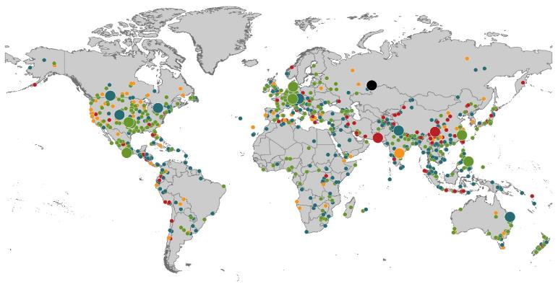
Natural Loss Events:
Full Year 2013
World Map
Winter Storm Christian (St. Jude)
Europe, 27–30 October
Floods
Europe,
30 May–19 June
Meteorite impact
Russian Federation, 15 February
Flash floods
Canada, 8–9 July
Floods
Canada, 19–24 June
Earthquake
China, 20 April
Hailstorms
Germany,
27–28 July
Floods
USA, 9–16 September
Typhoon Fitow
China, Japan,
5–9 October
Severe storms, tornadoes
USA, 18–22 May
Typhoon Haiyan
Philippines,
8–12 November
Severe storms, tornadoes
USA, 28–31 May
Floods
India, 14–30 June
Hurricanes Ingrid & Manuel
Mexico, 12–19 September
Floods
Australia,
21–31 January
880
Loss events
Earthquake (series)
Pakistan, 24–28 September
Heat wave
India, April–June
Geophysical events
(earthquake, tsunami, volcanic activity)
Hydrological events
(flood, mass movement)
Natural catastrophes
Geophysical events
(earthquake, tsunami, volcanic activity)
Hydrological events
(flood, mass movement)
Selection of significant
Natural catastrophes
Meteorological events
(storm)
Climatological events
(extreme temperature, drought, wildfire)
Meteorological events
(storm)
Climatological events
(extreme temperature, drought, wildfire)
Extraterrestrial events
(Meteorite impact)
Source: Munich Re Geo Risks Research, NatCatSERVICE – as of January 2014.
154

Slide 155
Natural Disasters Worldwide,
1980 – 2013 (Number of Events)
There were 880 natural disaster events globally in 2013 compared to 905 in 2012
Number
Geophysical
(earthquake, tsunami,
volcanic activity)
Meteorological (storm)
Climatological
(temperature extremes,
drought, wildfire)
Hydrological
(flood, mass movement)
Source: MR NatCatSERVICE
155

Slide 156
Losses Due to Natural Disasters Worldwide, 1980–2013 (Overall & Insured Losses)
(Overall and Insured Losses)
(2013 Dollars, $ Billions)
10-Yr. Avg. Losses
Overall : $184B
Insured: $56B
2013 Losses
Overall : $125B
Insured: $34B
There is a clear upward trend in both insured and overall losses over the past 30+ years
Overall losses (in 2013 values)
Insured losses (in 2013 values)
Source: MR NatCatSERVICE
156

Slide 157
Natural Disasters Worldwide,
1980 – 2013 (Number of Events)
There were 880 natural disaster events globally in 2013 compared to 905 in 2012
Number
Geophysical
(earthquake, tsunami,
volcanic activity)
Meteorological (storm)
Climatological
(temperature extremes,
drought, wildfire)
Hydrological
(flood, mass movement)
Source: MR NatCatSERVICE
157

Slide 158
Losses Due to Natural Disasters Worldwide, 1980–2013 (Overall & Insured Losses)
(Overall and Insured Losses)
(2013 Dollars, $ Billions)
10-Yr. Avg. Losses
Overall : $184B
Insured: $56B
2013 Losses
Overall : $125B
Insured: $34B
There is a clear upward trend in both insured and overall losses over the past 30+ years
Overall losses (in 2013 values)
Insured losses (in 2013 values)
Source: MR NatCatSERVICE
158

Slide 159
Natural Disaster Losses in the US, by Type, Jan. 1 – June 30, 2014
As of July 1, 2014 | Number of Events | Fatalities | Estimated Overall Losses (US $m) | Estimated Insured Losses (US $m)
Severe Thunderstorm | 33 | 65 | 9,100 | 6,700
Winter Storms & Cold Waves | 11 | 84 | 3,400 | 2,400
Flood, flash flood | 10 | 1 | 10 | -
Earthquake & Geophysical, landslides | 5 | 44 | 20 | -
Tropical Cyclone | - | - | - | -
Wildfire, Heat Waves, & Drought | 8 | 1 | 770 | -
Totals | 67 | 195 | 13,300 | 9,100
Source: Munich Re NatCatSERVICE
159
159

Slide 160
Natural Disaster Losses in the United States, by Type, 2013
As of December 31, 2013 | Number of Events | Fatalities | Estimated Overall Losses (US $m) | Estimated Insured Losses (US $m)
Severe Thunderstorm | 69 | 110 | 16,341 | 10,274
Winter Storm | 11 | 43 | 2,935 | 1,895
Flood | 19 | 23 | 1,929 | 240
Earthquake & Geophysical | 6 | 1 | Minor | Minor
Tropical Cyclone | 1 | 1 | Minor | Minor
Wildfire, Heat, & Drought | 22 | 29 | 620 | 385
Totals | 128 | 207 | 21,825 | 12,794
Source: Munich Re NatCatSERVICE
160
160

Slide 161
Significant Natural Catastrophes, 2013
(Events with $1 billion economic loss and/or 50 fatalities)
Date | Event | Estimated Economic Losses (US $m) | Estimated Insured Losses (US $m)
February 24 – 25 | Winter Storm | 1,300 | 690
March 18 – 19 | Thunderstorms | 2,200 | 1,600
April 7 – 11 | Winter Storm | 1,600 | 1,200
April 16 – 18 | Thunderstorms | 1,100 | 560
May 18 – 20 | Thunderstorms | 3,100 | 1,800
May 28 – 31 | Thunderstorms | 2,800 | 1,400
August 6 – 7 | Thunderstorms | 1,300 | 740
September 9 – 16 | Flooding | 1,500 | 160
November 17 - 18 | Thunderstorms | 1,300 | 931
Source: Munich Re NatCatSERVICE
161

Slide 162
Top 12 Most Costly Hurricanes in U.S. History
(Insured Losses, 2012 Dollars, $ Billions)
10 of the 12 most costly hurricanes in insurance history occurred over the past 10 years (2004—2013)
Hurricane Sandy became the 3rd costliest hurricane in US insurance history
*PCS estimate as of 4/12/13.
Sources: PCS; Insurance Information Institute inflation adjustments to 2012 dollars using the CPI.

Slide 163
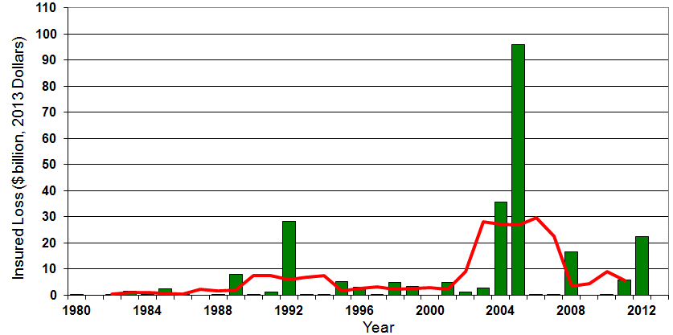

Insured US Tropical Cyclone Losses, 1980 - 2013
The current 5-year average (2008 - 2013) insured tropical cyclone loss is $5.6 billion per year.
Sources: Property Claims Service, Munich Re NatCatSERVICE, NFIP
163

Slide 164
Total Value of Insured Coastal Exposure in 2012
(2012, $ Billions)
The value of insured coastal exposure in TX is 3rd highest in US.
In 2012, New York Ranked as the #1 Most
Exposed State to Hurricane Loss, Overtaking Florida with $2.862 Trillion. Texas is very exposed too, and ranked #3 with $1.175 Trillion
in insured coastal exposure
The Insured Value of All Coastal Property Was $10.6 Trillion in 2012 , Up 20% from $8.9 Trillion in 2007 and Up 48% from $7.2 Trillion in 2004
Source: AIR Worldwide

Slide 165
Convective Loss Events in the U.S.
Number of events 1980 – 2012 and First Half 2013
Number
The frequency of convective events has rising tremendously over the past 30+ years
Convective events are those caused by straight-line winds, tornadoes, hail, heavy precipitation, flash floods and lightning
Source: Geo Risks Research, NatCatSERVICE – As at July 2013
165

Slide 166
Convective Loss Events in the U.S.
Overall and insured losses 1980 – 2013 and First Half 2014
(Bill. US$)
Average thunderstorm losses are up 7 fold since the early 1980s. The 5-year running average loss is up sharply
Hurricanes get all the headlines, but thunderstorms are consistent producers of large scale loss. 2008-2013 are the most expensive years on record.
First half 2014 convective event insured losses totaled $6.7B ($9.1B overall economic loss)
Analysis contains: straight-line winds, tornadoes, hail, heavy precipitation, flash floods, lightning.
Overall losses (in 2013 values)
Insured losses (in 2013 values)
Source: Geo Risks Research, Munich Re NatCatSERVICE – As at July 2014
166

Slide 167
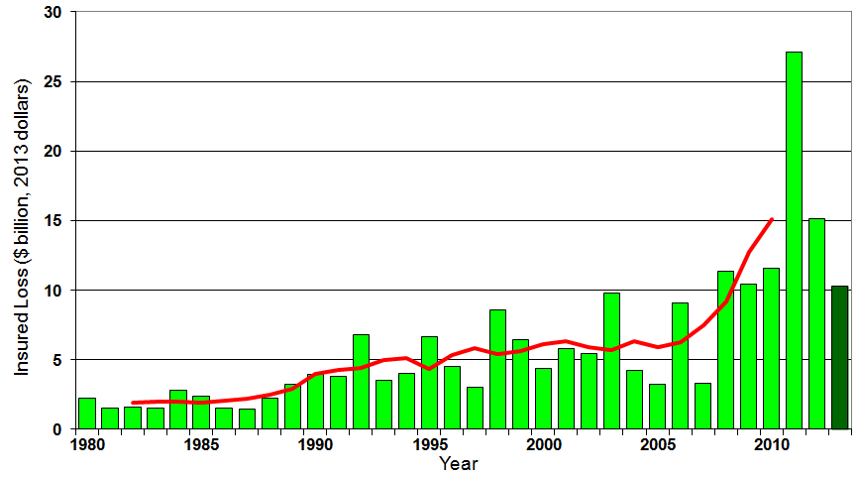
U.S. Thunderstorm Insured Loss Trends, 1980 – 2013
Hurricanes get all the headlines, but thunderstorms are consistent producers of large scale loss. 2008-2013 are the most expensive years on record.
Average thunderstorm losses are up 7 fold since the early 1980s. The 5-year running average loss is up sharply
Thunderstorm losses in 2013 totaled $10.3 billion, the 6th highest on record
Source: Property Claims Service, MR NatCatSERVICE
167

Slide 168
Federal Disaster Declarations Patterns: 1953-2014
Disaster Declarations Set New Records in Recent Years
168

Slide 169
Number of Federal Major Disaster Declarations, 1953-2014*
There have been 2,176 federal disaster declarations since 1953. The average number of declarations per year is 35 from 1953-2013, though there few haven’t been recorded since 1995.
The number of federal disaster declarations set a new record in 2011, with 99, shattering 2010’s record 81 declarations.
40 federal disasters were declared so far in 2014*
The Number of Federal Disaster Declarations Is Rising and Set New Records in 2010 and 2011 Before Dropping in 2012/13
*Through September 2, 2014.
Source: Federal Emergency Management Administration; http://www.fema.gov/disasters; Insurance Information Institute.

Slide 170
Federal Disasters Declarations by State,
1953 – 2014: Highest 25 States*
Over the past 60 years, Texas has had the highest number of Federal Disaster Declarations (none so far in 2014; 2 in in 2013)
*Through Sept. 2, 2014. Includes Puerto Rico and the District of Columbia.
Source: FEMA: http://www.fema.gov/news/disaster_totals_annual.fema; Insurance Information Institute.

Slide 171
Federal Disasters Declarations by State,
1953 – 2014: Lowest 25 States*
Over the past 60 years, Wyoming and Rhode Island had the fewest number of Federal Disaster Declarations
*Through Sept. 2, 2014. Includes Puerto Rico and the District of Columbia.
Source: FEMA: http://www.fema.gov/news/disaster_totals_annual.fema; Insurance Information Institute.

Slide 172
SEVERE WEATHER REPORT UPDATE: 2014
Damage from Tornadoes, Large Hail and High Winds Keep Insurers Busy
172

Slide 173
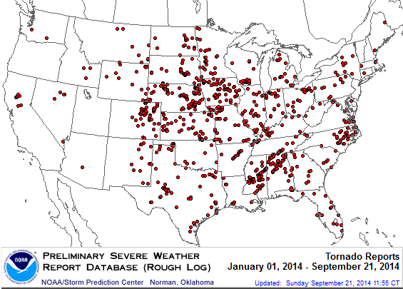
Location of Tornado Reports in 2014:
Through September 21, 2014
There have been 924 tornadoes so far in 2014, causing extensive property damage in several states
Source: NOAA Storm Prediction Center; http://www.spc.noaa.gov/climo/online/monthly/2014_annual_summary.html#; PCS.
173

Slide 174
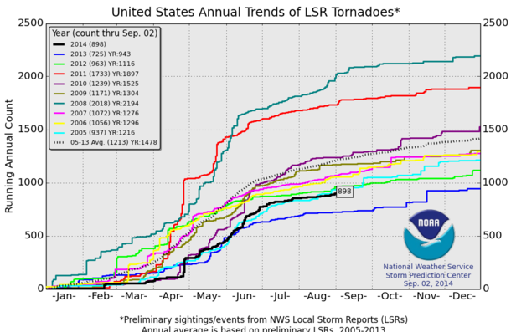
U.S. Tornado Count, 2005-2014*
There were 1,897 tornadoes in the U.S. in 2011 far above average, but well below 2008’s record
2013 count was the lowest in a decade
2014 count (898 though Sep. 2) is running below avg.
*Through Sept. 2, 2014.
Source: http://www.spc.noaa.gov/wcm/.
174

Slide 175
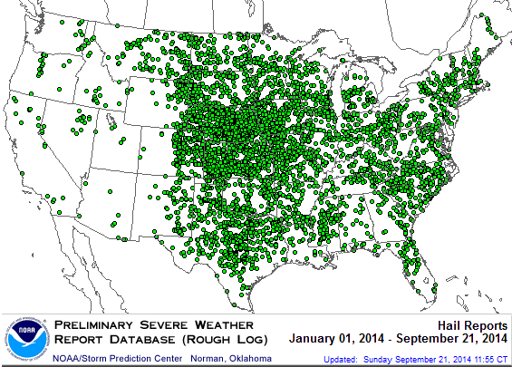
Location of Large Hail Reports:
Through September 21, 2014
There have been 5,162 “Large Hail” reports in the US so far in 2014, causing extensive property and vehicle damage
Source: NOAA Storm Prediction Center; http://www.spc.noaa.gov/climo/online/monthly/2014_annual_summary.html#
175

Slide 176
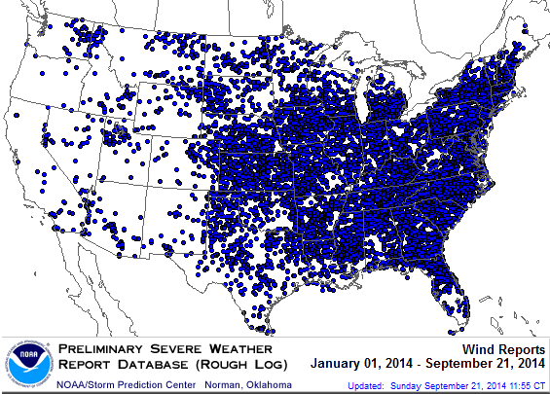
Location of High Wind Reports:
Through September 21, 2014
There have been 10,876 “Wind Damage” so far in 2014, causing extensive property damage
Source: NOAA Storm Prediction Center; http://www.spc.noaa.gov/climo/online/monthly/2014_annual_summary.html#
176

Slide 177
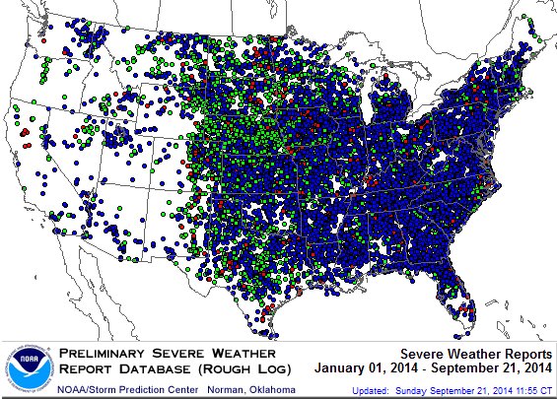
Severe Weather Reports:
Through September 21, 2014
Severe weather reports are concentrated east of the Rockies
There were 16,963 severe weather reports so far in 2014; including 924 tornadoes; 5,162 “Large Hail” reports and 10,876 high wind events
Source: NOAA Storm Prediction Center; http://www.spc.noaa.gov/climo/online/monthly/2014_annual_summary.html#
177

Slide 178
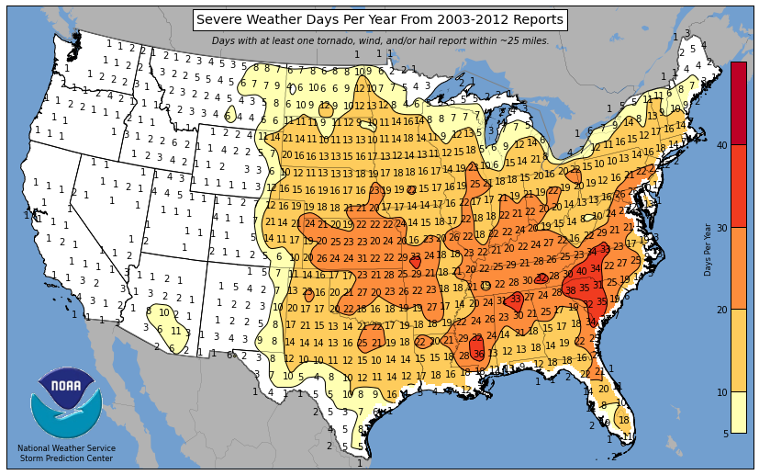
Severe Weather Days in the Northwest: Annual Average, 2003-2012
Much of the NW experiences only 1 - 3 severe weather days per year
Source: National Weather Service Storm Prediction Center at http://www.spc.noaa.gov/wcm/; Insurance Information Institute.
178

Slide 179
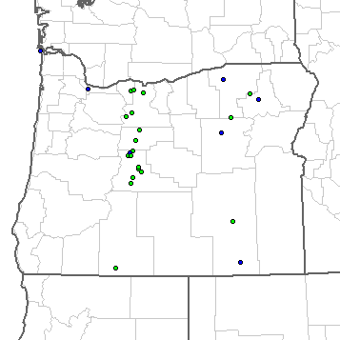
Severe Weather Reports in Oregon: Through September 21, 2014
27 severe weather reports through 9/21/14
0 Tornadoes
20 Large Hail Reports
7 High Wind Events
Source: NOAA Storm Prediction Center; http://www.spc.noaa.gov/climo/online/monthly/2014_annual_summary.html#
179

Slide 180
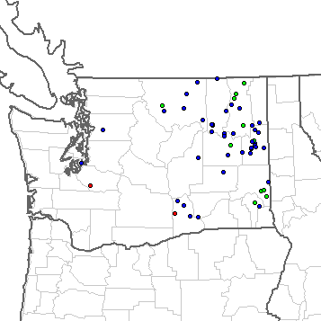
Severe Weather Reports in Washington: Through September 21, 2014
63 severe weather reports through 9/21/14
2 Tornadoes
12 Large Hail Reports
49 High Wind Events
Source: NOAA Storm Prediction Center; http://www.spc.noaa.gov/climo/online/monthly/2014_annual_summary.html#
180

Slide 181
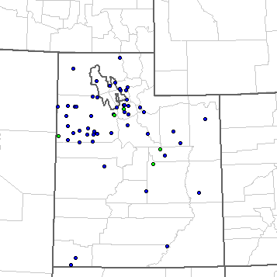
Severe Weather Reports in Utah: Through September 21, 2014
65 severe weather reports through 9/21/14
0 Tornadoes
5 Large Hail Reports
60 High Wind Events
Source: NOAA Storm Prediction Center; http://www.spc.noaa.gov/climo/online/monthly/2014_annual_summary.html#
181

Slide 182
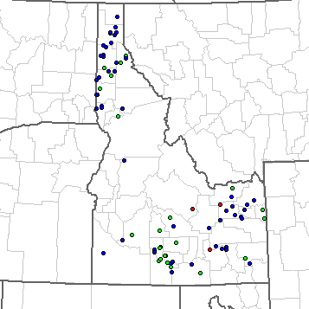
Severe Weather Reports in Idaho: Through September 21, 2014
90 severe weather reports through 9/21/14
3 Tornadoes
26 Large Hail Reports
61 High Wind Events
Source: NOAA Storm Prediction Center; http://www.spc.noaa.gov/climo/online/monthly/2014_annual_summary.html#
182

Slide 183
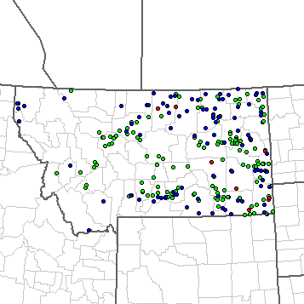
Severe Weather Reports in Montana: Through September 21, 2014
270 severe weather reports through 9/21/14
8 Tornadoes
147 Large Hail Reports
115 High Wind Events
Source: NOAA Storm Prediction Center; http://www.spc.noaa.gov/climo/online/monthly/2014_annual_summary.html#
183

Slide 184
Terrorism Update
TRIA’s Success
Consequences of Expiration
Download III’s Terrorism Insurance Report at: http://www.iii.org/white_papers/terrorism-risk-a-constant-threat-2014.html
184
Notes:
184

Slide 185
Loss Distribution by Type of Insurance from Sept. 11 Terrorist Attack ($ 2013)
($ Billions)
Total Insured Losses Estimate: $42.9B**
*Loss total does not include March 2010 New York City settlement of up to $657.5 million to compensate approximately 10,000 Ground Zero workers or any subsequent settlements.
**$32.5 billion in 2001 dollars.
Source: Insurance Information Institute.

Slide 186
Terrorism Insurance Take-up Rates,
By Year, 2003-2013
TRIA’s high take-up rates, availability and affordability have benefitted businesses, workers and the entire US economy since the program’s enactment
In 2003, the first year TRIA was in effect, the terrorism take-up rate was 27 percent. Since then, it has increased steadily, remaining in the low 60 percent range since 2009.
Source: Marsh Global Analytics, 2014 Terrorism Risk Insurance Report, April 2014 and earlier editions.
186
Notes:
186

Slide 187
Terrorism Insurance Take-Up Rates by State for 2013*
Take-up rate in the West is 55%
The overall US take-up rate for terrorism coverage was 62% in 2013 and ranged from a lows of 41% in Michigan to a high of 84% in Massachusetts (where demand likely increased due to the April 2013 Boston Marathon bombing)
*Data for 27 states with sufficient data.
Source: Marsh 2014 Terrorism Risk Insurance Report; Insurance Information Institute.

Slide 188
Terrorism Take-up Rates for Selected Western States: vs. US in 2013
TRIA’s take-up rates are lower in the West (including the Northwest) relative to the US overall
Note: Insufficient data available for ID and MT.
Source: Marsh Global Analytics, 2014 Terrorism Risk Insurance Report, April 2014; Insurance Information Institute.
188
Notes:
188

Slide 189
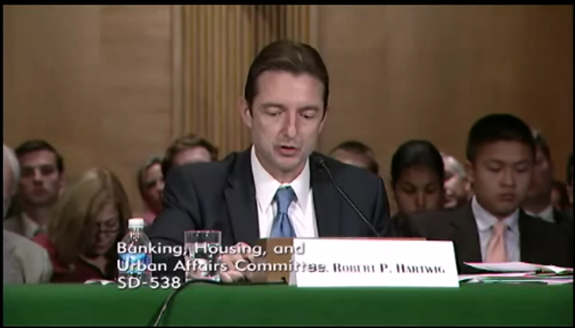
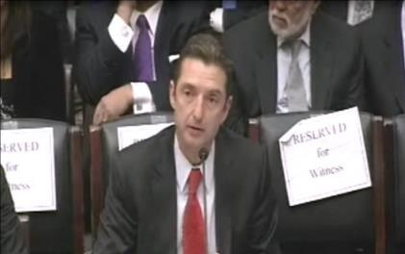
Terrorism Risk Insurance Program
Testified before House Financial Services Nov. 2013
Testified before Senate Banking Cmte. in Sept. 2013
Provided testimony at NYC hearing in June 2013
Provided Capitol Hill Joint House/Senate Staff Briefing in April 2014
I.I.I. Published Several Updates to its Study on Terrorism Risk and Insurance
Working with Trades, Congressional Staff, GAO & Others
House Financial Services Subcommittee, 11/13/13
Senate Banking Committee, 9/25/13
189
12/01/09 - 9pm
eSlide – P6466 – The Financial Crisis and the Future of the P/C
Notes:
189

Slide 190
I.I.I. White Paper (March 2014):
Terrorism Risk: A Constant Threat
Detailed history of TRIA
How TRIA works
Assessing the threat of terrorism
Terrorism market conditions
Global perspective
Download at http://www.iii.org/white_papers/terrorism-risk-a-constant-threat-2014.html
190
12/01/09 - 9pm
eSlide – P6466 – The Financial Crisis and the Future of the P/C
Notes:
190

Slide 191
Summary of President’s Working Group Report on TRIA
Insurance for terrorism risk is available and affordable
  Availability/affordability have has not changed appreciably since 2010
Prices for terrorism risk insurance vary considerably depending on the policyholder’s industry and location of risk
Prices have declined since TRIA was enacted
  Currently ~3% to 5% of commercial property insurance premiums
Take-up rates have improved since adoption of TRIA
  Overall take-up rate is steady at ~60% (62% in 2013 per Marsh)
Market capacity is currently tightening given uncertainty over TRIA reauthorization
The private market does not have the capacity to provide reinsurance for terror risk to the extent currently provided by TRIA
In the absence of TRIA, terrorism risk insurance would likely be less available. Coverage that would be available likely would be more costly and/or limited in scope
Source: Report of the President’s Working Group on Financial Markets,The Long-Term Availability and Affordability of Insurance for Terrorism Risk,
April 2014.

Slide 192
Framing the Issue and Educating Policymakers: A Timeline
Education Efforts Pay Off
  Senate Banking Committee unanimously reports out TRIA bill 22-0
  House Financial Services Committee passes bill
  Senate passes bill with strong support; Votes 93-4 to reauthorize on 7/17
Key addition to bills: clarification on certification process, cyber terrorism
Where do we go from here? Are difference between the bills bridgeable?
  Reauthorization terms differ (Senate: 7yrs; House: 5yrs)
  Bifurcation of NBCR and conventional
  Trigger points ($100M vs. $500M)
Clock is running: After July 31, the House is in session for only 12 days before the election
  Lame duck for enactment? Even that’s in jeopardy!
Source: Marsh

Slide 193
Initial Market Response to Potential
TRIA Expiration
Carriers monitoring and modeling WC exposure aggregations across their portfolio and correlated lines of business such as property or life and health (both on an individual client basis and in the aggregate)
Carrier declinations have occurred because they are “overlined” in a particular zip code or city
Many carriers attached NCCI Endorsement WC00 01 14 (Notification Endorsement of Pending Law Change to Terrorism Risk Insurance Program Reauthorization Act of 2007) or an equivalent for non-NCCI states.
For some high-profile clients or those in urban areas and/or with high employee concentrations, carriers issued short term policies set to expire at the same time as TRIPRA
Regarding non-WC lines (including select XSWC placements), policyholders were faced with new or broadened exclusionary wording on GL, umbrella, and XS forms
Source: Marsh

Slide 194
CAT OF THE FUTURE?
CYBER RISK
Cyber Risk is a Rapidly Emerging Exposure for Businesses Large and Small in Every Industry
NEW III White Paper: http://www.iii.org/assets/docs/pdf/paper_CyberRisk_2013.pdf
194

Slide 195





Data Breaches 2005-2013, by Number of Breaches and Records Exposed
# Data Breaches/Millions of Records Exposed
Millions
The Total Number of Data Breaches (+38%) and Number of Records Exposed (+408%) in 2013 Soared
* 2013 figures as of Jan. 1, 2014 from the ITRC updated to an additional 30 million records breached (Target) as disclosed in Jan. 2014.
Source: Identity Theft Resource Center.

Slide 196
2013 Data Breaches By Business Category, By Number of Breaches
The majority of the 614 data breaches in 2013 affected business and medical/healthcare organizations, according to the Identity Theft Resource Center.
Banking/Credit/Financial, 23 (3.7%)
Govt/Military, 56 (9.1%)
Business, 211 (34.4%)
Educational, 55 (9.0%)
Medical/Healthcare, 269 (43.8%)
Source: Identity Theft Resource Center, http://www.idtheftcenter.org/images/breach/2013/UpdatedITRCBreachStatsReport.pdf

Slide 197
The Most Costly Cyber Crimes, Fiscal Year 2013
Denial of service, malicious code and web-based attacks account for more than 55 percent of all cyber costs per U.S. organization on an annual basis.
Botnets
Viruses, Worms, Trojans
Malicious code
Malware
Malicious insiders
Stolen devices
Denial of service
Phishing + social engineering
Web-based attacks
Source: 2013 Cost of Cyber Crime: United States, Ponemon Institute.

Slide 198
External Cyber Crime Costs: Fiscal Year 2013
Information loss (43%) and business disruption or lost productivity (36%) account for the majority of external costs due to cyber crime.
Equipment damages
Information loss
Revenue loss
Business disruption
Other costs* 0%
* Other costs include direct and indirect costs that could not be allocated to a main external cost category
Source: 2013 Cost of Cyber Crime: United States, Ponemon Institute.

Slide 199
INVESTMENTS:
THE NEW REALITY
Investment Performance is a Key Driver of Profitability
Depressed Yields Will Necessarily Influence Underwriting & Pricing
199

Slide 200
Property/Casualty Insurance Industry Investment Income: 2000–2014¹
Investment earnings are still below their 2007 pre-crisis peak
($ Billions)
Due to persistently low interest rates,
investment income fell in 2012 and in 2013
and is falling again in 2014.
¹ Investment gains consist primarily of interest and stock dividends. *2014 investment income is estimated Q1, annualized.
Sources: ISO; Insurance Information Institute.

Slide 201
P/C Insurer Net Realized
Capital Gains/Losses, 1990-2014:Q1
Realized capital gains rose sharply as equity markets rallied
($ Billions)
Insurers Posted Net Realized Capital Gains in 2010 - 2013 Following Two Years of Realized Losses During the Financial Crisis. Realized Capital Losses Were a Primary Cause of 2008/2009’s Large Drop in Profits and ROE
Sources: A.M. Best, ISO, Insurance Information Institute.
201
12/01/09 - 9pm
eSlide – P6466 – The Financial Crisis and the Future of the P/C
Notes:
201

Slide 202
Property/Casualty Insurance Industry Investment Gain: 1994–2014:Q1¹
($ Billions)
Investment gains in 2013 were their highest in the post-crisis era
Investment Income Continued to Fall in 2013 Due to Low Interest Rates but Realized Investment Gains Were Up Sharply; The Financial Crisis Caused Investment Gains to Fall by 50% in 2008
¹ Investment gains consist primarily of interest, stock dividends and realized capital gains and losses.
* 2005 figure includes special one-time dividend of $3.2B;
Sources: ISO; Insurance Information Institute.

Slide 203
U.S. 10-Year Treasury Note Yields:
A Long Downward Trend, 1990–2014*
Yields on 10-Year U.S. Treasury Notes recently plunged to record modern-era lows in early 2013 but have since risen as the Fed begins “tapering” its QE program in 2014
Yields on 10-Year U.S. Treasury Notes have been essentially below 5% for a full decade.
Since roughly 80% of P/C bond/cash investments are in 10-year or shorter durations, most P/C insurer portfolios will have low-yielding bonds for years to come.
*Monthly, through June 2014. Note: Recessions indicated by gray shaded columns.
Sources: Federal Reserve Bank at http://www.federalreserve.gov/releases/h15/data.htm.
National Bureau of Economic Research (recession dates); Insurance Information Institutes.
203
12/01/09 - 9pm
eSlide – P6466 – The Financial Crisis and the Future of the P/C
Notes:
203

Slide 204
U.S. Treasury Security Yields:
A Long Downward Trend, 1990–2014*
Yields on 10-Year U.S. Treasury Notes have been essentially below 5% for a full decade.
U.S. Treasury yields plunged to historic lows in 2013. Longer-term yields have rebounded a bit.
Since roughly 80% of P/C bond/cash investments are in 10-year or shorter durations, most P/C insurer portfolios will have low-yielding bonds for years to come.
*Monthly, constant maturity, nominal rates, through Aug. 2014.
Sources: Federal Reserve Bank at http://www.federalreserve.gov/releases/h15/data.htm. National Bureau of Economic Research (recession dates); Insurance Information Institute.
204
12/01/09 - 9pm
eSlide – P6466 – The Financial Crisis and the Future of the P/C
Notes:
204

Slide 205
Reduction in Combined Ratio Necessary to Offset 1% Decline in Investment Yield to Maintain Constant ROE, by Line*
Lower Investment Earnings Place a Greater Burden on Underwriting and Pricing Discipline
*Based on 2008 Invested Assets and Earned Premiums
**US domestic reinsurance only
Source: A.M. Best; Insurance Information Institute.
205
12/01/09 - 9pm
eSlide – P6466 – The Financial Crisis and the Future of the P/C
Notes:
205
This shows the drop in Combined Ratio for each line of business that would be needed to maintain a constant ROE, given a 1-percentage-point drop in investment yield

Slide 206
Distribution of Bond Maturities,
P/C Insurance Industry, 2003-2013
The main shift over these years has been from bonds with longer maturities to bonds with shorter maturities. The industry first trimmed its holdings of over-10-year bonds (from 24.6% in 2003 to 15.5% in 2012) and then trimmed bonds in the 5-10-year category (from 31.3% in 2003 to 27.6% in 2012) . Falling average maturity of the P/C industry’s bond portfolio is contributing to a drop in investment income along with lower yields.
Sources: SNL Financial; Insurance Information Institute.

Slide 207
Shifting Legal Liability &
Tort Environment
Is the Tort Pendulum
About to Swing Against Corporate America and their Insurers?
207

Slide 208
Over the Last Three Decades, Total Tort Costs as a % of GDP Appear Somewhat Cyclical, 1980-2013E
($ Billions)
2.21% of GDP in 2003 = pre-tort reform peak
Deepwater Horizon Spike in 2010
Tort costs in dollar terms have remained high but relatively stable since the mid-2000s., but are down substantially as a share of GDP
1.68% of GDP in 2013
Sources: Towers Watson, 2011 Update on US Tort Cost Trends, Appendix 1A

Slide 209
Commercial Lines Tort Costs: Insured vs. Self-(Un)Insured Shares, 1973-2010
2005: $143.5B 66.4% insured, 33.6% self-(un)insured
Billions of Dollars
$15.0
1995: $83.6B 69.5% insured, 30.5% self-(un)insured
1973: Commercial Tort Costs Totaled $6.49B, 94% was insured, 6% self-(un)insured
1985: $46.6B 74.5% insured, 25.5% self-(un)insured
$9.5
$6.0
2009: $126.5B 64.4% insured, 35.6% self-(un)insured
Tort Costs and the Share Retained by Risks Both Grew Rapidly from the mid-1970s to mid-2000s, When Tort Costs Began to Fall But Self-Insurance Shares Continued to Rise
Sources: Towers Watson, 2011 Update on US Tort Cost Trends, III Calculations based on data from Appendix 4.
209
12/01/09 - 9pm
eSlide – P6466 – The Financial Crisis and the Future of the P/C
Notes:
209

Slide 210
Commercial Lines Tort Costs: Insured vs. Self-(Un)Insured Shares, 1973-2010
Percent
2010: $138.1B 56.6% insured, 44.4% self-(un)insured (distorted by Deepwater Horizon event with most losses retained by BP)
1973: 94% was insured, 6% self-(un)insured
1985:74.5% insured, 25.5% self-(un)insured
1995: 69.5% insured, 30.5% self-(un)insured
2005: 66.4% insured, 33.6% self-(un)insured
The Share of Tort Costs Retained by Risks Has Been Steadily Increasing for Nearly 40 Years. This Trend Contributes Has Left Insurers With Less Control Over Pricing.
Sources: Towers Watson, 2011 Update on US Tort Cost Trends, III Calculations based on data from Appendix 4.
210
12/01/09 - 9pm
eSlide – P6466 – The Financial Crisis and the Future of the P/C
Notes:
210

Slide 211
Business Leaders Ranking of Liability Systems in 2012
Best States
Delaware
Nebraska
Wyoming
Minnesota
Kansas
Idaho
Virginia
North Dakota
Utah
Iowa
Worst States
Florida
Oklahoma
Alabama
New Mexico
Montana
Illinois
California
Mississippi
Louisiana
West Virginia
New in 2012
Wyoming
Minnesota
Kansas
Idaho
Newly Notorious
Oklahoma
Drop-offs
Rising Above
Indiana
Colorado
Massachusetts
South Dakota
Arkansas
Source: US Chamber of Commerce 2012 State Liability Systems Ranking Study; Insurance Info. Institute.

Slide 212
The Nation’s Judicial Hellholes: 2012/2013
Watch List
Illinois
Madison County
West Virginia
Maryland
Baltimore
Philadelphia, Pennsylvania
South Florida
Cook County, Illinois
New Jersey
Nevada
Louisiana
California
Dishonorable Mention
New York
Albany and NYC
MO Supreme Court
WA Supreme Court
Source: American Tort Reform Association; Insurance Information Institute

Slide 213
Insurance Information Institute Online:
www.iii.org
Thank you for your time
and your attention!
Twitter: twitter.com/bob_hartwig

