Slide 1
Economic Update & Emerging Industry Trends
PAMIC
Pittsburgh, PA, August 6, 2019
Michel Leonard, PhD, CBE
Insurance Information Institute  110 William Street  New York, NY 10038 www.iii,org

Slide 2
I.I.I. Mission Statement
A world with MORE insurance
Improving public understanding of insurance...
…what it does and how it works
2

Slide 3
Economic Outlook

Slide 4
Growth & Inflation
Monetary Policy
Political Risk
Balance of Risks
US: Q2 numbers weaker than expected confirm negative trend.
Global: GDP growth forecast for 2019 is up from 3.0% in January to 3.2%.
US: Unusually fast policy turnaround creating instability
Global: BoE, ECB signaling cuts. Russia, Turkey cutting. China on hold.
US: Electoral cycle will move center state.
Global: Brexit, Hong Kong protests, and Iran risk underpriced. U.S.
Industry Insight: Political risk underwriters view more risks in 2019 than 2018 but losses are stable
Q1 GDP Inflation
Political Risk
Skewed to downside
Q2 GDP Inflation
Interest Rates
Arrow length = impact on balance.
4

Slide 5
U.S. GDP Forecasts
53 forecasts: consensus points to slow growth in the second half of 2019 and throughout 2020.
Real GDP Growth Forecasts
GDP Growth (%)
Years & Quarters
5
Source: Blue Chip

Slide 6
Treasury Yields: A Long Downward Trend, 2006–2019
50% of P/C investments in 5+ year bonds = low bond returns for years
Yield Rate (%)
2.54%
Years & Quarters
6

Slide 7
Yield Forecasts 2019-2020
53 forecasts: No consensus on level or direction of interest rates in the next six quarters
Yield Rate (%)
Years & Quarters
7

Slide 8
Economic Indicators for the P/C Insurance Industry
Economic Indicator | Q1 2019 | Q2 2019 | Analysis
Change in real GDP | 3.1% | 1.3% | Uncertainty rising
Housing Unit Starts (millions of units) Actual 2018. Forecast 2019 | 1.21 | 1.23 | Q2 is Blue Chip median forecast for full year 2019: essentially flat This is a weak indicator
Employment Changes (thousands) | 521 | 512 | +500K per quarter is relatively strong Especially at this stage of cycle
Nonresidential Fixed Investment Growth | 6.9% | N/A | Businesses are still investing … but slowing due to increased uncertainty
Hospital Services Price Increases (y-o-y) | 1.8% | 1.2% | Lowest level in last 20 years … helps constrain BI claim severity
10-Year Treasury Yield | 2.7% | 2.3% | No relief for insurer investment income
8

Slide 9
P&C Industry Performance

Slide 10
Net P/C Premium Written Growth vs. Nominal U.S. Economy
Premium Growth Falls Below GDP Growth For 1st Time in 10 Years
Growth (%)
Tax Reform Peak
2017 Q1 – 2018 Q1 Ave: 6.9%
-1.2%
Years
Through first quarter.
SOURCES: A.M. Best (2007-2013), ISO (2014-present), Federal Reserve Bank of St. Louis (FRED), Insurance Information Institute.
10
*ISO/Verisk estimate

Slide 11
Key Sources of P/C Insurer Profits
Strong Capital Gains and Underwriting Result Lifted Profits.
Profits ($ Billions)
Years
Through first quarter. Data are before taxes and exclude extraordinary items. Source: NAIC data, sourced from S&P Global Market Intelligence.
11

Slide 12
P/C Underwriting Gains
Third Year in a Row of Underwriting Gains Lead to Best Performance since 2007
Gains & Losses ($ Billions)
Years
Sources: NAIC data, sourced from S&P Global Market Intelligence, ISO/PCI. 2019
12

Slide 13
P/C Sources of Investment Gains and Losses
Steady investment income - but smaller Q1 realized capital gains
Gains & Losses ($ Billions)
Years
Through First Quarter. Sources: NAIC data, sourced from S&P Global Market Intelligence; Insurance Information Institute.
13

Slide 14
P/C Insurer Portfolio Yields
Insurers facing yields below 4% since 2009
Yield (%)
Years
Sources: NAIC data, sourced from S&P Global Market Intelligence, ISO/PCI. 2019 projected with Q1 data
14

Slide 15
P/C Industry Combined Ratio
3 Years in a Row U/W Profits
1st time since 1971-73
Higher CAT Losses, Shrinking Reserve Releases, Toll of Soft Market
Hurricanes, Wildfires Drive CR Higher.
Combined Ratio
Best Since 1949’a 87.6
Sandy
Years
*Excludes Mortgage & Financial Guaranty insurers 2008-2014. Including M&FG, 2008=105.1, 2009=100.7, 2010=102.4, 2011=108.1; 2012:=103.2; 2013: = 96.1; 2014: = 97.0.
Sources: A.M. Best; ISO, a Verisk Analytics company; 2019 based on Q1 data
15

Slide 16
P/C Industry Net Income After Taxes
All Leading to Rising Net Income After Taxes
Net Income ($ Billions)
Years
Through first quarter. Adjusted for inflation using the BLS CPI calculator. Sources: NAIC data, sourced from S&P Global Market Intelligence; Insurance Information Institute.
16

Slide 17
Commercial Rates

Slide 18
All Commercial Lines Rate Changes
Rates creeping higher but that masks differences by line of business
Rates Growth (%)
Quarters & Years
Sources: Willis Towers Watson, MarketScout.
18

Slide 19
Liability Rate Changes
Slight Softening, Though Local Markets Vary
U.S. Casualty
U.S. Financial and Prof Liab
Rates Growth (%)
Rates Growth (%)
Years & Quarters
Years & Quarters
SOURCE: Marsh Insurance Market Index.
19

Slide 20
Property/Cyber Rate Changes
Also Slight Softening, Though Local Markets Vary
U.S. Property
U.S. Cyber
Rates Growth (%)
Rates Growth (%)
Years & Quarters
Years & Quarters
SOURCE: Marsh Insurance Market Index.
20

Slide 21
Industry Trends

Slide 22
Personal Auto: Combined Ratios
Personal auto rates rose rapidly to catch up with expected losses
Years
Combined Ratios
94 96 98 100 102 104. 106 108
Source: National Association of Insurance Commissioners data, sourced from S&P Global Market Intelligence; 2018 is I.I.I. estimate.
22
Years & Quarters
Years & Quarters

Slide 23
Auto Direct Written Premium Growth: Commercial vs. Private Passenger, 2008-2017
Commercial Premium Growth Stronger than Private But Both Rising
Premium Growth (%)
Years
Source: NAIC data, sourced from S&P Global Market Intelligence, Insurance Information Institute.
23

Slide 24
Personal Auto: Road Safety
Better Economy = More Drivers = More Accidents
14 Percent of Injury Crashes
Economic well-being
Distracted driving
Safety Devices Can Be Expensive
Why rates go up
Speed
Still
Kills
Expensive auto parts
Faster driving
Legalized marijuana
It’s Not Funny
Source: Insurance Information Institute research.
24

Slide 25
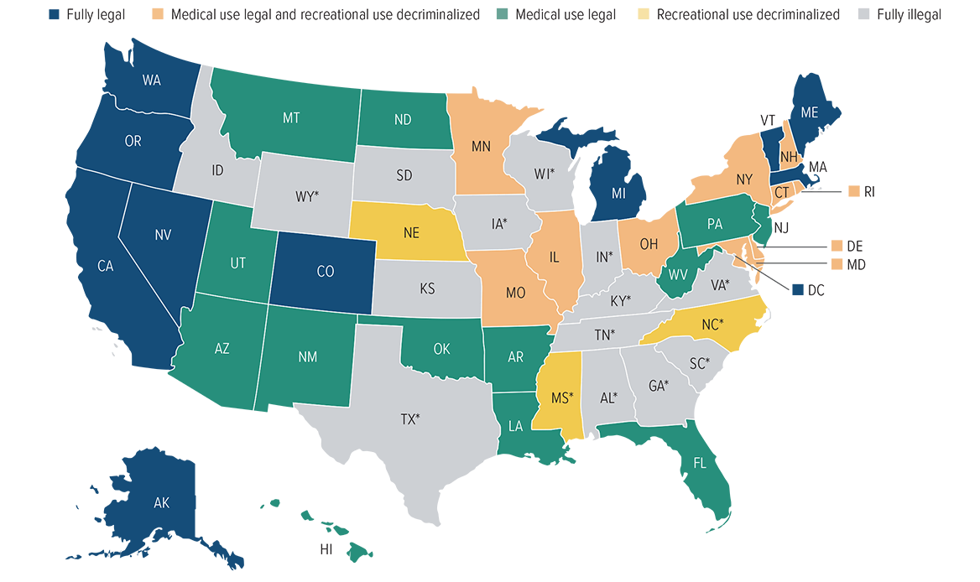
Personal Auto: Marijuana Laws by State
*CBD/Low THC medical program.
Source: National Journal; Ballotpedia, 2019.
25

Slide 26
Health: Medical Inflation Moderating
Injury Severity Typically Exceeds Medical CPI.
Annual Change (%), CPI - Medical
Fastest Growth in More Than a Decade
Sources: St. Louis Federal Reserve (FRED), Bureau of Labor Statistics Series ID CUUR0000SAM; Insurance Information Institute.
26
Notes:
26

Slide 27
US Workers Comp DWP Growth
Multi Year Downward Trend Now Crossed Negative
Growth (%)
Years
Source: NAIC data, sourced from S&P Global Market Intelligence, Insurance Information Institute.
27

Slide 28
Key I.I.I. Initiatives

Slide 29
Insurance Industry News Cycle
U.S. Media Coverage On Insurance Topics In 2018 and 2019
2%
Insurance Lawsuits
Travel & Pet Insurance
Mortgage & Title Insurance
Crop Insurance
41% on other P/C and life products
Life Insurance & Long Term Care
Auto Insurance
Wildfires
Flood & Storms
Homeowner Insurance
23% on Nat Cat risks
NFIP
Cyber Insurance
3%
16% on cyber insurance and digital trends
Insurtech
2018
2019
*Source: Quid, HPS Analysis
Nat cats, auto, tech/innovation continue as biggest P/C drivers
29

Slide 30
Our priorities in 2019 continue to reflect industry and customer conversations focus
Inform
Own
Audiences
High
Insurance As Economic Capital
B2B
Nat Cat Resilience
B2C
Life
Cyber Risk
Political Risk
B2G
Auto
Strategic Initiative
Public Discussion
Manage
Elevate
Home/Rental
Innovation
Terror
Industry Talent
Fraud
Low
Low
I.I.I. Opp/Risk
High
30

Slide 31
Insurance For Resilience Coalition
Promote resiliency through insurance by empowering individuals, small businesses, and communities to develop a holistic approach to managing extreme weather events
Help us identify the best aspirational + realistic goals
Directly contribute to hardening, retrofitting, and implementation of preemptive risk reduction strategies for 100,000 Households
Directly contribute to decreasing the protection gap for extreme weather events by $10 Billion
Support vulnerable households by ensuring that at least 20% of impact focuses on low-income communities
Extreme Weather Events Defined As
FLOODS ● HURRICANES ● TORNADOES ● WILDFIRES ● EARTHQUAKES
Track, quantity and benchmark progress towards these goals through the
I.I.I.’s insurance and resilience models & indices
31

Slide 32
Conclusion: Key Points
Economic growth likely to slow – but when?
GDP is slowing and rates are going down
Manufacturing may be running out of steam
Services are doing well
Wages are finally beating inflation
P/C industry follows economic growth cycles
Falling interest rates hurts investment income
Catastrophes drive results – and losses are up
Rates are drifting higher – but it’s not a hard market
P/C Industry will continues to follow economic cycle
Michel Leonard, PhD, CBE
Senior Economist & Vice President
110 William St, 18th Floor
New York, NY 10038 212.346.5518  michell@iii.org  www.iii.org
32

