Slide 1
Insurance: Vanguard of the Resilient
Elevate Conference
Salt Lake City, Utah
February 12, 2019
James Lynch, Chief Actuary and Vice President of Research and Education
Insurance Information Institute  Washington, DC  New York, NY
212.346.5533  jamesl@iii.org  www.iii.org
Notes:
Talk about what’s happening in the world in terms of what we are hearing a lot of lately – disruption.
But also why insurance is an industry well-poised to lead through it
Also, look at some industry trends.
At the end, will circle back to insurance leading through disruption.

Slide 2
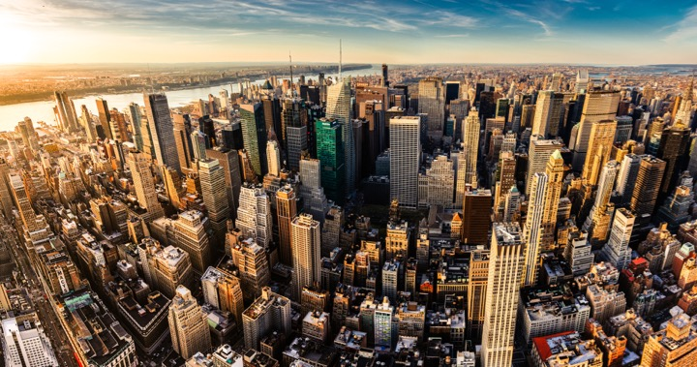
I.I.I. Mission Statement
Improving public understanding
of insurance...
…what it does and how it works.
2

Slide 3










How Insurance Drives Economic Growth
Safety/
Security
Economic/
Financial Stability
Development
Insurers are financial first responders
Insurers are capital protectors
Insurance is a partner in social policy
Insurers are community builders
Insurance enables infrastructure improvements
Insurers
are risk mitigators
Insurance sustains the supply chain
Insurers are capital infusers
Insurers are innovation catalysts
Insurers are credit facilitators
Notes:
3
Importance to educate people on the value of insurance
shows that in 2012, 8 percent answered yes, and another 27 percent did not know, meaning that more than one person in three could incorrectly expect government support where none would be forthcoming.2

Slide 4
An Age of Disruption

Slide 5



Economics
Strengthening Fundamentals:
All OECD economies growing – 1st in 10 yrs.
Tepid monetary policies; keeping interest rates at historical lows — moving slow...
Fiscal policies, i.e. tax reform and deregulation surfacing.

Slide 6



Geopolitical
Rise in Nationalism: Brexit, U.S. – Populist vote in Europe tripled since 2000*.
Political gridlock in Congress, with 2018 election lurking.
“Major conflict threat greatest since WWII“ – US Intelligence Report to Congress
* Source: Harvard University, Tony Blair Institute

Slide 7



Technology
Robotics
Artificial Intelligence
“The Fourth Industrial Revolution”
Cyber meets Physical
Big Data
Internet of Things
Social Economy

Slide 8
Catastrophes
Extreme Weather Threatens Union

Slide 9
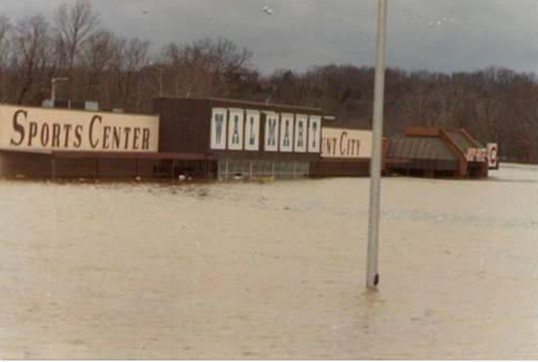
1982 Union, Missouri, Flood
A Storm for the Ages
Bourbeuse River
Record Crest
33.8 feet
12/5/1982
Source: Fox2News.com, @BoxxRadio.
Notes:
Flooded: WalMart and IGA at intersection of US 50 and State Road 47

Slide 10
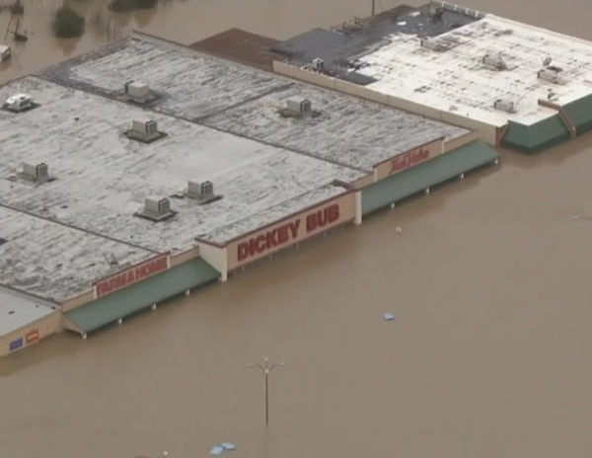
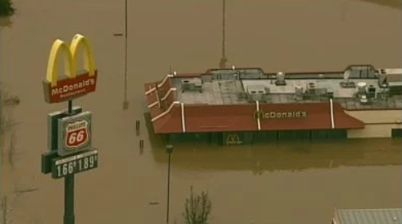
2015 Union, Missouri, Flood
A Storm for the Ages
Bourbeuse River
Record Crest
34.3 feet
12/29/2015
Sources: CBSnews.com; fox2news.com
Notes:
Flooded: grocery store, hardware store, farm and home, a couple retailers, a Super 8 motel, a gas station . . . And a McDonald’s

Slide 11
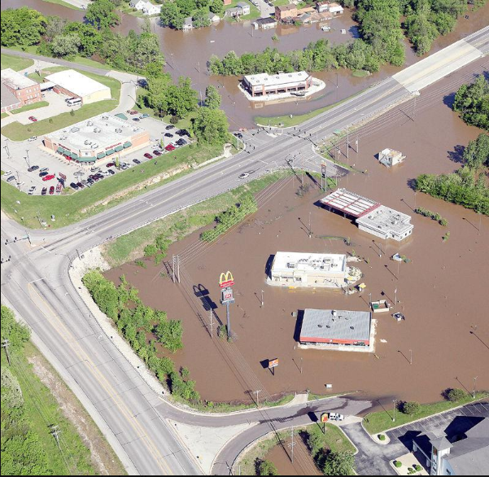
2017 Union, Missouri, Flood
“Unfortunately, it’s a river and Mother Nature.
And we can’t control her.”
Bourbeuse River
Crest
30.1 feet
May 2-3, 2017
Source: eMissourian.com
Notes:
FloDickey Bub Farm and Home made flood preparations and shut off power to its building.
The city of Union also turned off power at its lift station in that area.
Jimmy John’s, McDonald’s, Super 8 Motel, QuikTrip, Jack in the Box and surrounding businesses sandbagged and/or moved anything possible from their businesses to higher ground.

Slide 12
Extreme Events: A Troubling Trend
Rank | Date | Event | Cause
1 | Aug. 2005 | Hurricane Katrina | Hurricane
2 | Sep. 2017 | Hurricane Maria | Hurricane
3 | Sep. 2017 | Hurricane Irma | Hurricane
4 | Sep. 2001 | September 11 Events | Terrorism
5 | Oct. 2012 | Hurricane Sandy | Hurricane
6 | Aug. 2017 | Hurricane Harvey | Hurricane
7 | Aug. 1992 | Hurricane Andrew | Hurricane
8 | Jan. 1994 | Northridge, CA earthquake | Earthquake
9 | Sep. 2008 | Hurricane Ike | Hurricane
10 | Oct. 2005 | Hurricane Wilma | Hurricane
Three of 10 Worst US Catastrophes Occurred in 2017.
Source: The Property Claim Services® (PCS®) unit of ISO®, a Verisk Analytics® company.

Slide 13
U.S. Inflation-Adjusted Cat Losses
Harvey, Irma, Maria
2018 – Second worst year for U.S. Insured Catastrophe Losses. Average Insured Loss per Year for 1980-2018 is $18.5 B.
*2018: Inflation-adjusted PCS estimate, subject to change. 2010s is average of 2010 to 2018.
Sources: Property Claims Service, a Verisk Analytics business; Swiss Re; Insurance Information Institute.

Slide 14

Disruptive Forces in the World – The New Norm
Catastrophes
Economics
Geopolitical
Technology

Slide 15
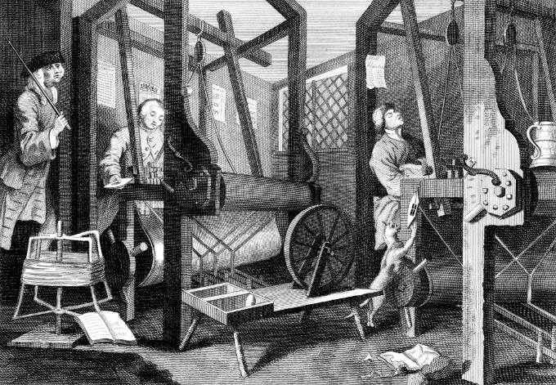
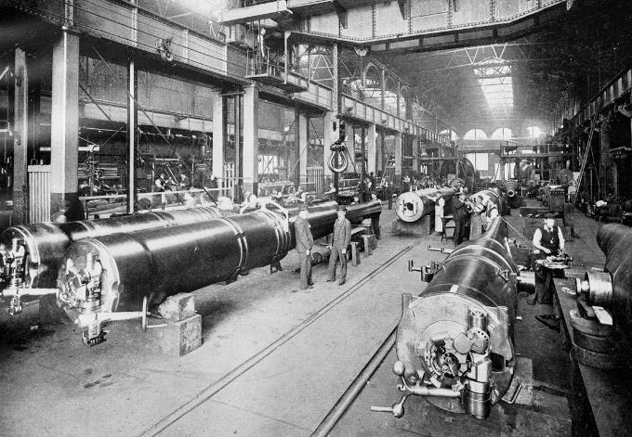
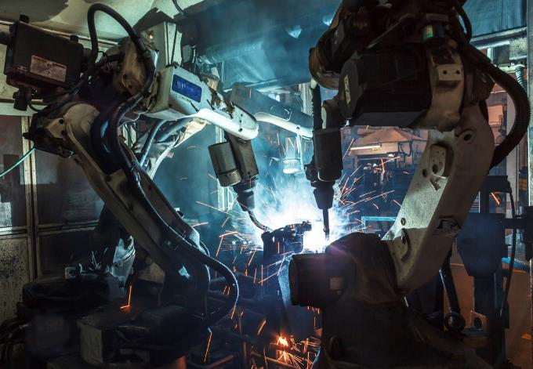

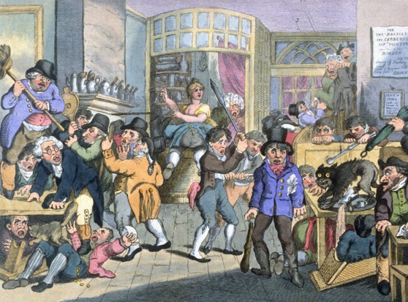
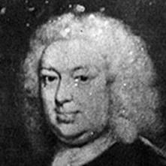
Insurance Leading Throughout History
???
1969
1870
1784
1648
Edward Lloyd’s Coffee House
Steam, Water, Mechanical Production
Division of Labor, Electricity, Mass Production
Electronics, IT, Automated Production
Cyber-Physical Systems
Notes:
We only need to look back at history to find the answer…
History shows that insurance has been helping individuals, businesses and communities look around the corner for more than 300 years – dating back to Edward Lloyd’s coffee house, which once was a center for shipping news and information, that evolved into the modern marketplace.
That marketplace was used as a tool for innovation, manufacturing and modernization.
Look at all of the three industrial revolutions:
Utilization of steam engine.
Electricity
Electronics
Insurance is what’s driving growth.
In fact we have studied this at I.I.I. and I will illustrate later that in order to have a developed economy, you need insurance
And now we find ourselves in what many are calling the Fourth Industrial Revolution – with the merging of cyber and physical systems, e.g. AI, IoT,
This will be interesting, I think most exciting for insurance.
Beyond helping the customer innovate, our own industry must look inwardly and embrace the changes that will be taking place in how we do business. This is an exciting time, no doubt.

Slide 16
Insurance: Leading the Way
Notes:
Will circle to this later, but first thought I would go through some of macro economic trends we are seeing for the industry at I.I.I.
Part of new product we are putting out quarterly at I.I.I.

Slide 17

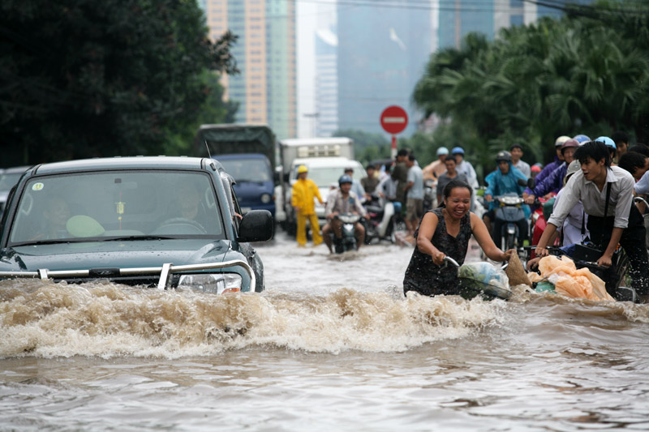
Education & Analysis
Closing the Coverage Gap
2005-2015: $1.3 Trillion in Uninsured Losses
70 Percent of Catastrophe Losses Are Uninsured
Source: Swiss Re; Wikimedia Commons; DOD

Slide 18
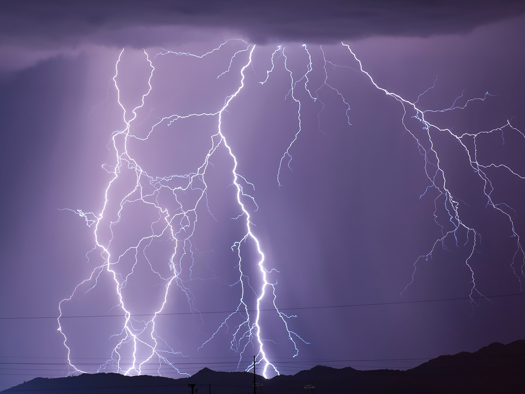
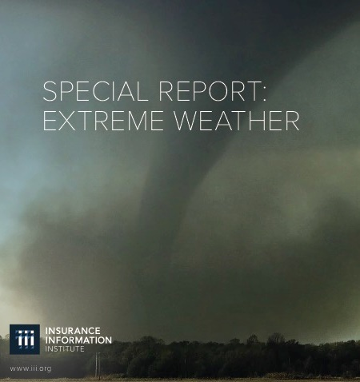
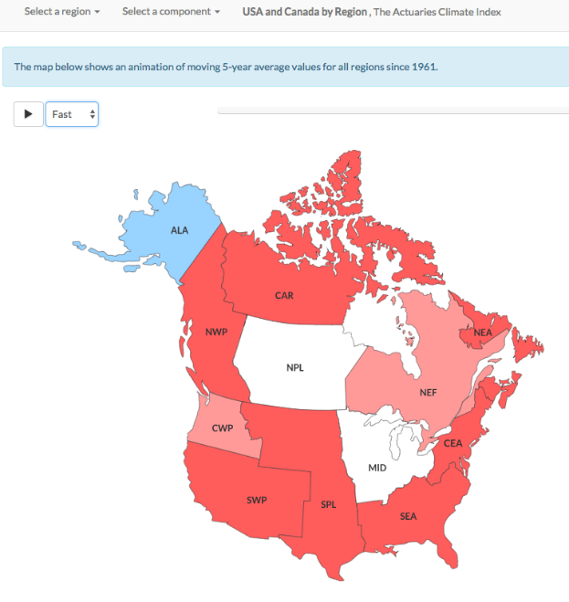
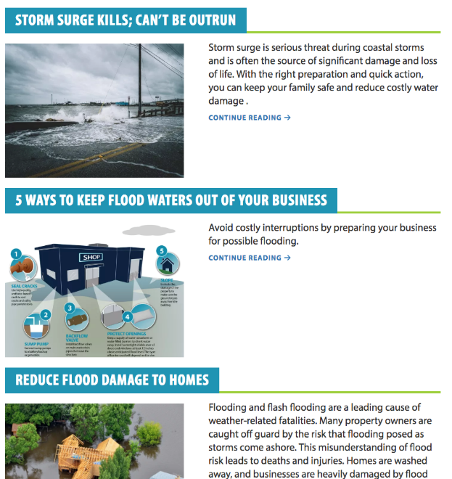
Extreme weather
Insurance industry initiatives
I.I.I. white paper
The Actuaries Climate Index: USA and Canada by Region, 2018 Winter
IBHS resources
Source: Insurance Information Institute, Actuaries Climate Index, Insurance Institute for Business & Home Safety.

Slide 19
Education & Analysis
Actuaries Climate Index – Measuring Weather Extremes
Index Measures Frequency of Extreme Events (Heat, Cold, Drought, Wind, Rain, Sea Level) Vs. 1961-1990 Average
Source: Actuaries Climate Index, http://actuariesclimateindex.org/home/
Notes:
Created 9/30/18 - lynch

Slide 20
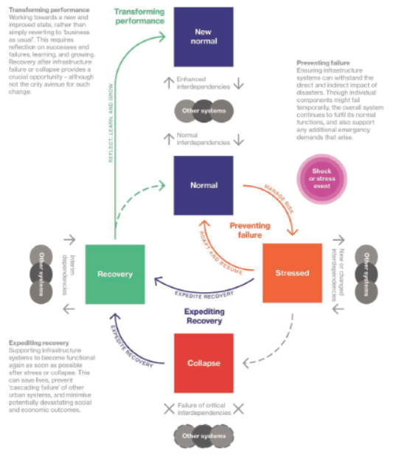
Future Cities
Lloyd’s Initiative
To Improve Resilience
Prevent Failure
Expedite Recovery
Transform Performance
Source: Lloyd’s/Arup, “Future Cities: Building
Infrastructure Resilience”

Slide 21




(Re)insurance Products
Private Industry
Case Studies
FEMA Reinsurance
Through a $150 million purchase of private reinsurance products, FEMA was able to recover approximately $1 billion, or an eighth of its total 2017 loses.
40%
2018 FEMA Reinsurance
NFIP NatCat Bonds
By issuing new natural catastrophe bonds geared towards institutional investors, the NFIP can bring an estimated $500 million of additional reinsurance coverage.
Private Market Flood Products
During 2017, the private flood insurance market added 50 new carriers. Direct private flood insurance premiums written reached $630 million, an increase of $217 million over 2016.
Source: Insurance Journal; Houston Chronicle; Insurance Journal.

Slide 22
Insurance Industry Economic Trends
Notes:
Will circle to this later, but first thought I would go through some of macro economic trends we are seeing for the industry at I.I.I.
Part of new product we are putting out quarterly at I.I.I.

Slide 23
Direct Premium Growth, Annual Change
Direct Premiums Continue to Track Economic Growth
All data through second quarter.
SOURCES:NAIC data sourced through S&P Global Intelligence, Bureau of Economic Affairs, Insurance Information Institute.
Notes:
Created 6/25/18 – lynch
Updated 9/13 lynch
Updated 2/2/19 lynch

Slide 24
P/C industry net income after taxes
Billions, 2018 dollars
Catastrophes Drove Earnings Down in 2017, Continuing a Four-Year Slide in Inflation-Adjusted Profits.
Through third quarter. Adjusted for inflation using the BLS CPI calculator, to 2018 dollars.
Sources: NAIC data, sourced from S&P Global Market Intelligence; Insurance Information Institute.
Notes:
OVERALL HEADLINE [H2]: P/C industry results
The chart shows: Industry net income after taxes for the first three quarters of the year (adjusted for inflation).
The takeaway: Three major hurricanes and the California wildfires, took their toll on profits.
http://www3.ambest.com/bestweek/DisplayBinary.aspx?TY=P&record_code=268075&URatingId=2515991

Slide 25
P/C Insurance Industry
Combined Ratio, 2000-2018*
3 Consecutive Years of U/W Profits; 1st time since 1971-73
Heavy Use of Reinsurance Lowered Net Losses.
Higher CAT Losses, Shrinking Reserve Releases, Toll of Soft Market
Hurricanes, Wildfires Drive CR Higher.
Best Combined Ratio Since 1949 (87.6)
Sandy
*Excludes Mortgage & Financial Guaranty insurers 2008-2014.
Including M&FG, 2008=105.1, 2009=100.7, 2010=102.4, 2011=108.1; 2012:=103.2; 2013: = 96.1; 2014: = 97.0.
Sources: A.M. Best; ISO, a Verisk Analytics company; I.I.I. estimate for 2018.

Slide 26
Key sources of P/C insurer profits
$ Billions
Data are before taxes and exclude extraordinary items.
Sources: NAIC data, sourced from S&P Global Market Intelligence; Insurance Information Institute.
Notes:
OVERALL HEADLINE: [none]
The chart shows: The green bars are underwriting profit or loss for the first nine months of each year. The blue bars are net investment gains (investment income net of capital gains or losses) for the same period.
The back story: A long-term downtrend in interest rates has been offset by steadily growing investment amounts, yielding generally increasing interest income.
The takeaway: Three-quarter-year profits come mainly from net investment gains; underwriting losses in occurred in 7 of the 11 three-quarter-years shown.

Slide 27
P/C Insurer Portfolio Yields
Yields Have Been Falling for Over a Decade, Reflecting the Long Downward Trend in Prevailing Interest Rates.
Sources: NAIC data, sourced from S&P Global Market Intelligence; Insurance Information Institute.

Slide 28
Insurance: Disruption or Transformation?
Notes:
Will circle to this later, but first thought I would go through some of macro economic trends we are seeing for the industry at I.I.I.
Part of new product we are putting out quarterly at I.I.I.

Slide 29
The (Re)Insurance Value Chain
Where Could Disruption/Transformation Lie?
Create Policy/ Treaty
Brains + Bank Account
Write Risk
Perform Loss Control
Settle Claims
Market Policy/ Treaty
Improve World
Price Risk
Protecting People & Organizations
These Disruptions Usually Start in Personal Insurance, Will Move to Commercial Insurance.

Slide 30
Alternative Capital
Potentially Disrupting the Bank Account
Alternative Capacity Has Grown 480% Since 2006. It Has More Than Quadrupled in the Past Six Years.
Source: Aon Benfield Analytics; Insurance Information Institute.

Slide 31
The Internet
Will It Disrupt Marketing?
Lead Generators
  InsWeb, NetQuote, Insurance.com
  Site allows comparison shopping, sells lead to insurer
Call Center Agencies
  SelectQuote, Goji
  Call center employs agents
Digital agencies
  Esurance, Policy Genius
  Quote and buy online
But Customers Still Like Agents
Did You Compare Prices When Your Auto Policy Was Up for Renewal?
SOURCES: The New Age of Insurance Aggregators, http://insurancethoughtleadership.com/the-new-age-of-insurance-aggregators/; Insurance Information Institute November 2015 Pulse Survey.

Slide 32






Pricing Disruptor: The Fragmented Risk
32
12/01/09 - 9pm
eSlide – P6466 – The Financial Crisis and the Future of the P/C
Notes:
32
The Insurance Contract Is Being Split into Tiny Pieces.
The Sharing/“On-Demand” Economy – Personal → Commercial → Personal
By-peril HO insurance
Ride-sharing insurance
Pay By Mile Insurance
Expect More As
Computers Get Stronger
Data Storage Gets Cheaper
Information Collection Grows
Workers comp – adjust rates for travel?

Slide 33

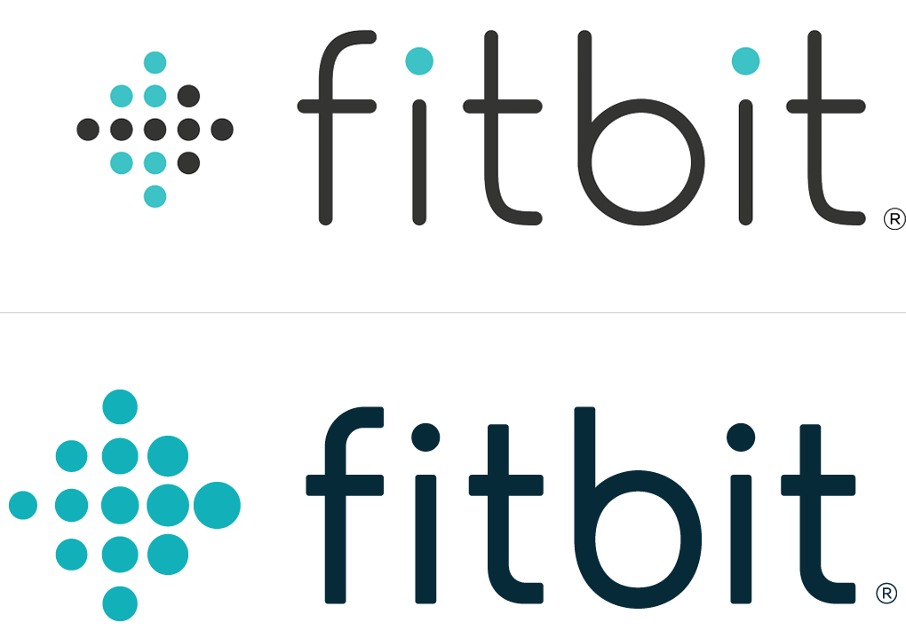
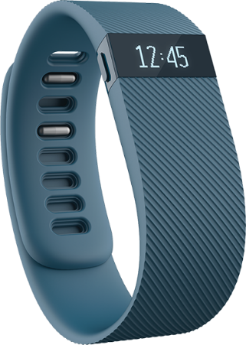
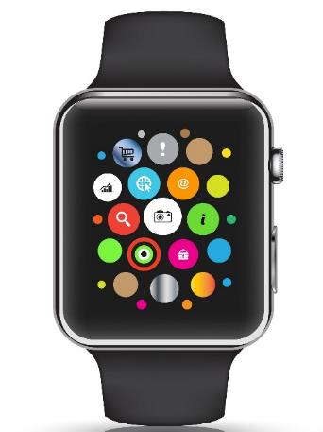
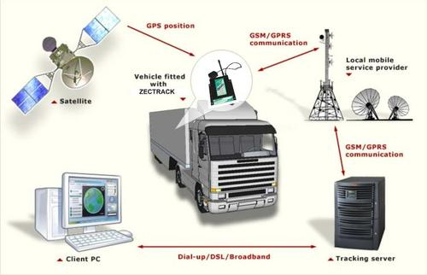

Loss Control Disruptor
The Internet of Things
Telematics Today
Telematics Tomorrow
33
12/01/09 - 9pm
eSlide – P6466 – The Financial Crisis and the Future of the P/C
Notes:
33
Gathering Big Data Affects
Underwriting
Pricing
Monitoring Could Affect
Loss Control
Pricing?

Slide 34
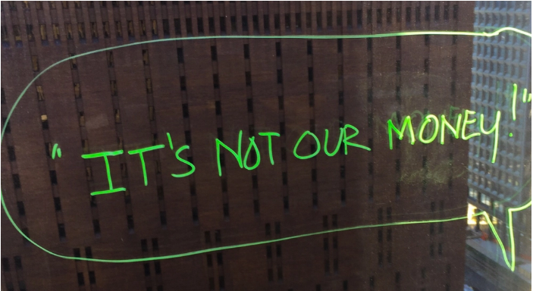



Claims Disruptor
Artificial Intelligence + Behavioral Economics
Notes:
AI Jim
IDs suspicious activity
Marries Artificial Intelligence, Behavioral Economics (file via video)
Bot handles simplest claims

Slide 35




























InsurTech Startups Have Broad Range…BUT…
Risk
Health
Insurance Marketplace
Digital Brokers
Peer to Peer
Health Navigators
Micro-duration Coverage
Telematics
Source: Aon.
Notes:
Based on our most recent count we are tracking over 500+ InsurTech Companies. Just a year ago that number was about half that. We are tracking companies across Risk and Health in a variety of themes. For us its more about business concepts than it is about individual companies.

Slide 36













…With Broad Incumbent Support
$205M
$57M
$37M
$21M
$4M
Note: Total funding.
Source: Aon.
Notes:
Some examples of insurance company investments in InsurTech…. As you can see it is across a variety of themes or business concepts….
Metromile – Telematics
CoverHound and Policy Genius- Insurance Marketplaces
One Inc. – Cloud Based IT Platform and
Slice - Micro-Duration Coverage.
These investments create an opportunity to accelerate growth, improve efficiency, enhance the customer experience and “Speed to Market” for new products in emerging risk.

Slide 37
Thank you!
www.iii.org

