Slide 1
2017 & Beyond:
Trends, Challenges & Opportunities
Focus on South Carolina Markets
PIA of South Carolina Board of Directors Meeting
Columbia, SC
December 12, 2016
Download at www.iii.org/presentations
Robert P. Hartwig, Ph.D., CPCU ♦ Special Consultant
Insurance Information Institute and
Clinical Associate Professor of Finance ♦ Darla Moore School of Business University of South Carolina
Tel: 917.453.1885 ♦ bobh@iii.org ♦ www.iii.org

Slide 2
P/C Industry Net Income After Taxes
1991–2016:Q2
$ Millions
2005 ROE*= 9.6%
2006 ROE = 12.7%
2007 ROE = 10.9%
2008 ROE = 0.1%
2009 ROE = 5.0%
2010 ROE = 6.6%
2011 ROAS¹ = 3.5%
2012 ROAS¹ = 5.9%
2013 ROAS¹ = 10.2%
2014 ROAS¹ = 8.4%
2015 ROAS = 8.4%
2016:H1 ROAS = 6.4%*
Net income in Q2:2016 on an annualized basis was on track to fall short of full-year 2015
ROE figures are GAAP; ¹Return on avg. surplus. Excluding Mortgage & Financial Guaranty insurers yields a 8.2% ROAS in 2014, 9.8% ROAS in 2013, 6.2% ROAS in 2012, 4.7% ROAS for 2011, 7.6% for 2010 and 7.4% for 2009; 2015E is annualized figure based actual figure through Q3 of $44.0
Sources: A.M. Best, ISO; Insurance Information Institute

Slide 3
Profitability Peaks & Troughs in the P/C Insurance Industry, 1975 – 2016:H1
ROE
1977:19.0%
History suggests next ROE peak will be in 2016-2017
1987:17.3%
10 Years
1997:11.6%
2006:12.7%
10 Years
2015: 8.4%
9 Years
2013 9.8%
2016:H1 6.4%
1975: 2.4%
1984: 1.8%
1992: 4.5%
2001: -1.2%
*Profitability = P/C insurer ROEs. 2011-15 figures are estimates based on ROAS data. Note: Data for 2008-2014 exclude mortgage and financial guaranty insurers.
Source: Insurance Information Institute; NAIC, ISO, A.M. Best, Conning

Slide 4
ROE: Property/Casualty Insurance by Major Event, 1987–2016:H1
(Percent)
P/C Profitability Is Both by
Cyclicality and Ordinary Volatility
Modestly higher CATs
Katrina, Rita, Wilma
Low CATs
Sept. 11
Hugo
Lowest CAT Losses in
15 Years
4 Hurricanes
Sandy
Andrew, Iniki
Northridge
Record Tornado Losses
Financial Crisis*
* Through 2016:H1. Excludes Mortgage & Financial Guarantee in 2008 – 2014.
Sources: ISO, Fortune; Insurance Information Institute.

Slide 5
P/C Insurance Industry
Combined Ratio, 2001–2016:Q2*
Heavy Use of Reinsurance Lowered Net Losses
Relatively Low CAT Losses, Reserve Releases
Higher CAT Losses, Shrinking Reserve Releases, Toll of Soft Market
As Recently as 2001, Insurers Paid Out Nearly $1.16 for Every $1 in Earned Premiums
Relatively Low CAT Losses, Reserve Releases
Avg. CAT Losses, More Reserve Releases
3 Consecutive Years of U/W Profits: First Time Since 1971-73
Sandy Impacts
Best Combined Ratio Since 1949 (87.6)
Cyclical Deterioration
Lower CAT Losses
Elevated CATs
* Excludes Mortgage & Financial Guaranty insurers 2008--2014. Including M&FG, 2008=105.1, 2009=100.7, 2010=102.4, 2011=108.1; 2012:=103.2; 2013: = 96.1; 2014: = 97.0.
Sources: A.M. Best, ISO (2014-2015); Figure for 2010-2013 is from A.M. Best P&C Review and Preview, Feb. 16, 2016.

Slide 6
Policyholder Surplus,
2006:Q4–2016:Q2
($ Billions)
2007:Q3
Pre-Crisis Peak
Drop due to near-record 2011 CAT losses
Surplus as of 6/30/16 stood at a record high $680.64B
The industry now has $1 of surplus for every $0.76 of NPW,
close to the strongest claims-paying status in its history.
2010:Q1 data includes $22.5B of paid-in capital from a holding company parent for one insurer’s investment in a non-insurance business .
The P/C insurance industry entered 2016
in very strong financial condition.
Sources: ISO, A.M .Best.
6
12/01/09 - 9pm
eSlide – P6466 – The Financial Crisis and the Future of the P/C
Notes:
6

Slide 7
US Policyholder Surplus:
1975–2016*
($ Billions)
Surplus as of 6/30/16 was a record $680.6, up 1.0% from $673.7 of 12/31/15, and up 55.7% ($243.5B) from the crisis trough of $437.1B at 3/31/09
“Surplus” is a measure of underwriting capacity. It is analogous to “Owners Equity” or “Net Worth” in non-insurance organizations
The Premium-to-Surplus Ratio Stood at $0.76:$1 as of
12/31/15, a Near Record Low (at Least in Recent History)
* As of 6/3016.
Source: A.M. Best, ISO, Insurance Information Institute.

Slide 8
RNW All Lines, 2005-2014 Average:
Highest 25 States
Profitability Benchmark: All P/C
US: 7.7%
(Percent)
The most profitable states over the past decade are widely distributed geographically, though none are in the Gulf region
Profitability in SC ranks 14th in the US
Source: NAIC; Insurance Information Institute.

Slide 9
RNW All Lines, 2005-2014 Average:
Lowest 25 States
(Percent)
Some of the least profitable states over the past decade were hit hard by catastrophes
Source: NAIC; Insurance Information Institute.

Slide 10
Net Premium Growth (All P/C Lines): Annual Change, 1971—2016:Q2
(Percent)
1975-78
1984-87
2000-03
Net Written Premiums Fell 0.7% in 2007 (First Decline Since 1943) by 2.0% in 2008, and 4.2% in 2009, the First 3-Year Decline Since 1930-33.
2016 Q2: 3.0%
2015: 3.4%
2014: 4.2
2013: 4.4%
2012: +4.2%
Outlook
2016F: 3.0%
2017F: 2.9%
Shaded areas denote “hard market” periods
Sources: A.M. Best (1971-2013), ISO (2014-16).

Slide 11
Y-o-Y Growth Rates, Direct Premiums Written, Commercial vs. Personal Lines, 2013:Q4 - 2016:Q2
Since 2013, personal lines Direct Premiums Written have generally grown faster than commercial lines DPW, and that growth has been less volatile.
Sources: NAIC, via SNL Financial; Insurance Information Institute calculations.

Slide 12
GLOBAL M&A UPDATE:
A PATH TO GROWTH?
Are Capital Accumulation, Drive for Growth and Scale Stimulating M&A Activity?
12

Slide 13
U.S. INSURANCE MERGERS AND ACQUISITIONS,
P/C SECTOR, 1994-2015 (1)
M&A activity in the P/C sector in 2015 totaled $39.6B, its highest level since 2000
($ Millions)
(1) Includes transactions where a U.S. company was the acquirer and/or the target.
Source: Conning proprietary database.

Slide 14
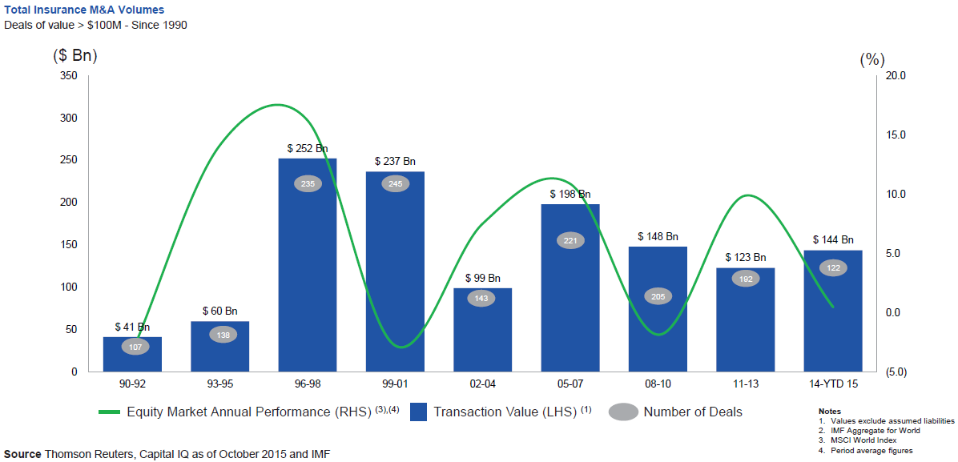
Global M&A Activity Tends to Follow Equity Market Performance
The number and volume of insurance M&A deals was up globally in 2015
.
Source: Thomson Reuters, Capital IQ as of Oct. 2015 and IMF from Geneva Association Newsletter Insurance and Finance, Jan. 2016, presentation “Facts vs. Sentiment: Deals in the Insurance Sector,” by Aviva CEO Mark Wilson.

Slide 15
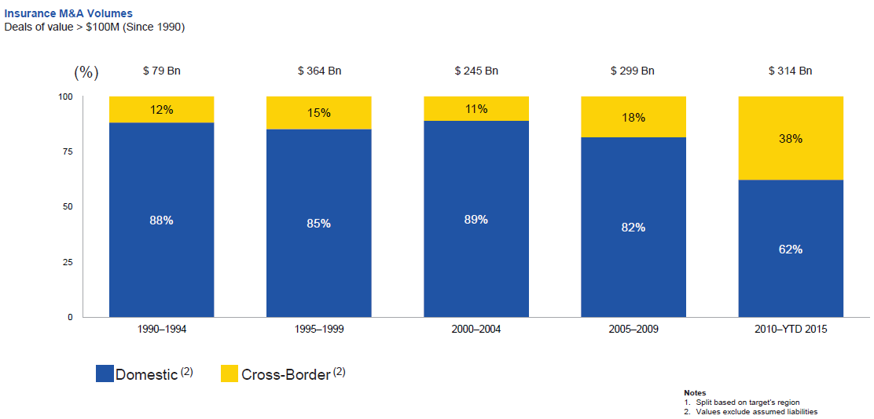
Huge Shift from Domestic M&A Activity to Cross-Border
The share of M&A deal volume that was cross-border more than doubled in 2015
.
Source: Thomson Reuters as of Oct. 2015 from Geneva Association Newsletter Insurance and Finance, Jan. 2016, presentation “Facts vs. Sentiment: Deals in the Insurance Sector,” by Aviva CEO Mark Wilson.

Slide 16
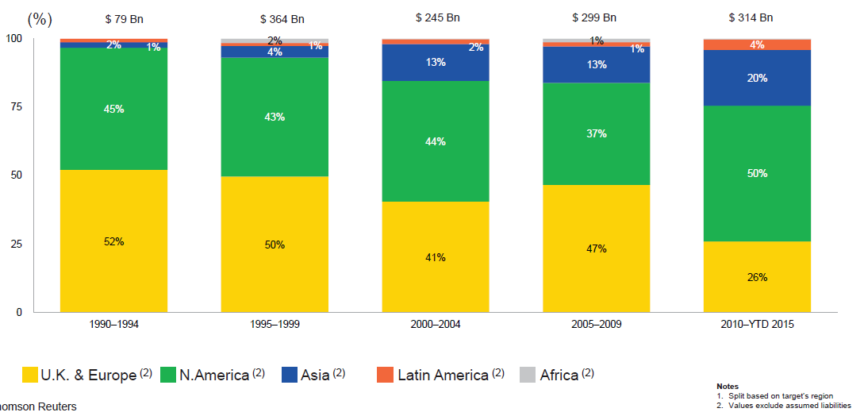
M&A Activity Has Shifted Away from Europe and Towards Asia and N. America
Asian, N. American deal volumes were up sharply in 2015
.
Source: Thomson Reuters as of Oct. 2015 from Geneva Association Newsletter Insurance and Finance, Jan. 2016, presentation “Facts vs. Sentiment: Deals in the Insurance Sector,” by Aviva CEO Mark Wilson.

Slide 17
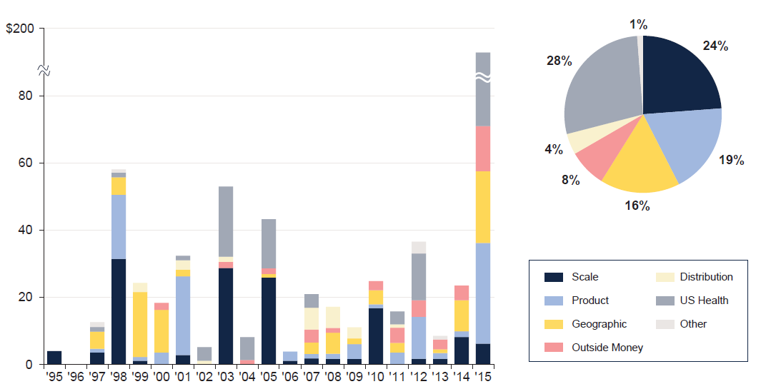
M&A: Deal Rationale by Dollar Amount
Scale drives most deals (excluding health sector)
Source: SNL Financial and WCMA estimates from Geneva Association Newsletter Insurance and Finance, Jan. 2016, presentation “What is the Logic Behind Consolidation? And Does It Create Value? A View from Outside,” by Brian Shea, Head of Willis Capital Markets & Advisory Europe (WCMA).
.

Slide 18
Profitability and Growth in South Carolina P/C Insurance Markets
Analysis by Line and Nearby State Comparisons
18

Slide 19
RNW All Lines: SC vs. U.S., 2005–2014
P/C Insurer Profitability
in SC is Above That of the U.S. Overall Over the Past Decade
U.S.: 7.7%
SC: 10.8%
Source: NAIC.

Slide 20
RNW PP Auto: SC vs. U.S., 2005–2014
Average 2005–2014
U.S.: 6.2%
SC: 5.8%
Source: NAIC.

Slide 21
RNW Comm. Auto: SC vs. U.S., 2005–2014
Average 2005–2014
U.S.: 8.1%
SC: 8.8%
Source: NAIC.

Slide 22
RNW Comm. Multi-Peril: SC vs. U.S.,
2005–2014
Average 2005–2014
U.S.: 8.9%
SC: 10.8%
Source: NAIC.

Slide 23
RNW Homeowners: SC vs. U.S., 2005–2014
Average 2005–2014
U.S.: 7.6%
SC: 18.4%
Source: NAIC.

Slide 24
All Lines: 10-Year Average RNW SC and
Nearby States, 2005–2014
South Carolina All Lines Profitability is Above the U.S. and Similar to the Regional Average (10.3%)
Sources: NAIC, Insurance Information Institute.

Slide 25
PP Auto: 10-Year Average RNW SC and
Nearby States, 2005–2014
South Carolina PP Auto Profitability is Below the U.S. and Regional Average (6.0%)
Sources: NAIC, Insurance Information Institute.

Slide 26
Top Ten Most Expensive & Least Expensive States for Automobile Insurance, 2013¹
Rank | Most Expensive States | Average Expenditure | Rank | Least Expensive States | Average Expenditure
1 | New Jersey | $1,254.10 | 1 | Idaho | $553.38
2 | D.C. | 1,187.49 | 2 | Iowa | 572.14
3 | New York | 1,181.86 | 3 | South Dakota | 580.99
4 | Louisiana | 1,146.29 | 4 | Maine | 592.82
5 | Florida | 1,143.83 | 5 | North Dakota | 604.58
6 | Michigan | 1,131.40 | 6 | Wisconsin | 621.05
7 | Delaware | 1,101.12 | 7 | Indiana | 621.71
8 | Rhode Island | 1,066.25 | 8 | North Carolina | 624.76
9 | Connecticut | 1,011.27 | 9 | Nebraska | 638.74
10 | Massachusetts | 1,007.98 | 10 | Wyoming | 639.71
South Carolina Ranked 20th in Average Expenditure for Auto Insurance in 2013. The Average Expenditure was $794.40.
¹Based on average automobile insurance expenditures.
Source: © 2016 National Association of Insurance Commissioners.

Slide 27
Comm. Auto: 10-Year Average RNW SC and Nearby States, 2005–2014
South Carolina Comm. Auto Profitability is Above the U.S. and Regional Average (8.0%)
Sources: NAIC, Insurance Information Institute.

Slide 28
Comm. M-P: 10-Year Average RNW SC and Nearby States, 2005–2014
South Carolina Comm. M-P Profitability is Above the U.S. and Below the Regional Average (13.5%)
Sources: NAIC, Insurance Information Institute.

Slide 29
Homeowners: 10-Year Average RNW SC
& Nearby States, 2005–2014
South Carolina Homeowners Profitability is Above the U.S. and Regional Average (12.2%)
Sources: NAIC, Insurance Information Institute.

Slide 30
Top Ten Most Expensive and Least Expensive States for Homeowners Insurance, 2013¹
Rank | Most Expensive States | HO Average Premium | Rank | Least Expensive States | HO Average Premium
1 | Florida | $2,115 | 1 | Idaho | $561
2 | Texas² | 1,837 | 2 | Oregon | 568
3 | Louisiana | 1,822 | 3 | Utah | 609
4 | Oklahoma | 1,654 | 4 | Wisconsin | 665
5 | Mississippi | 1,395 | 5 | Washington | 676
6 | Kansas | 1,343 | 6 | Nevada | 687
7 | Rhode Island | 1,334 | 7 | Delaware | 709
8 | Alabama | 1,323 | 8 | Arizona | 724
9 | Connecticut | 1,274 | 9 | Ohio | 763
10 | Massachusetts | 1,263 | 10 | Maine | 776
South Carolina Ranked as the 12th Most Expensive State for Homeowners Insurance in 2013, with an Average Expenditure of $1,214
¹ Includes policies written by Citizens Property Insurance Corp. (Florida) and Citizens Property Insurance Corp. (Louisiana), Alabama Insurance Underwriting Association, Mississippi Windstorm Underwriting Association, North Carolina Joint Underwriting Association and South Carolina Wind and Hail Underwriting Association. Other southeastern states have wind pools in operation and their data may not be included in this chart. Based on the HO-3 homeowner package policy for owner-occupied dwellings, 1 to 4 family units. Provides “all risks” coverage (except those specifically excluded in the policy) on buildings and broad named-peril coverage on personal property, and is the most common package written.
² The Texas Department of Insurance developed home insurance policy forms that are similar but not identical to the standard forms. In addition, due to the Texas Windstorm Association (which writes wind-only policies) classifying HO-1, 2 and 5 premiums as HO-3, the average premium for homeowners insurance is artificially high.
Note: Average premium=Premiums/exposure per house years. A house year is equal to 365 days of insured coverage for a single dwelling. The NAIC does not rank state average expenditures and does not endorse any conclusions drawn from this data.
Source: ©2016 National Association of Insurance Commissioners (NAIC). Reprinted with permission. Further reprint or distribution strictly prohibited without written permission of NAIC.

Slide 31
All Lines DWP Growth: SC vs. U.S.,
2006–2015
Average 2006–2015
U.S.: 2.1%
SC: 2.9%
Source: SNL Financial.

Slide 32
Commercial Lines DWP Growth:
SC vs. U.S., 2006–2015
Average 2006–2015
U.S.: 1.3%
SC: 1.9%
Source: SNL Financial.

Slide 33
Personal Lines DWP Growth:
SC vs. U.S., 2006–2015
Average 2006–2015
U.S.: 2.6%
SC: 3.8%
Source: SNL Financial.

Slide 34
Private Passenger Auto DWP Growth:
SC vs. U.S., 2006–2015
Average 2006–2015
U.S.: 1.8%
SC: 2.9%
Source: SNL Financial.

Slide 35
Homeowner’s MP DWP Growth: SC vs. U.S., 2006–2015
Average 2006–2015
U.S.: 4.5%
SC: 5.8%
Source: SNL Financial.

Slide 36
INVESTMENTS:
THE NEW REALITY
Investment Performance is a Key Driver of Profitability
Will Depressed Yields Begin to Rise Under a Trump Administration?
36

Slide 37
S&P 500 Index Returns, 1950 – 2016*
Annual Return
Stock market got off to its worst start ever in 2016 but markets recovered yet remained volatile. Trump Bump: Sharp surge in stock post-election
Fed Raises Rate
Tech Bubble Implosion
2016*:
+10.4%
Energy Crisis
Financial Crisis
*Through Dec. 12, 2016.
Source: NYU Stern School of Business: http://pages.stern.nyu.edu/~adamodar/New_Home_Page/datafile/histretSP.html Ins. Info. Inst.

Slide 38
Property/Casualty Insurance Industry Investment Income: 2000–2016:Q2¹
Investment earnings are still 19% below their 2007 pre-crisis peak
($ Billions)
Due to persistently low interest rates, investment income fell in 2012, 2013 and 2014 but showed a small (1.9%) increase in 2015—another drop in 2016 seems likely.
*Annualized figure based on actual Q2:2016 net investment income earned of $22.067B.
¹ Investment gains consist primarily of interest and stock dividends. Sources: ISO; Insurance Information Institute.

Slide 39
U.S. Treasury Security Yields:
A Long Downward Trend, 1990–2016*
Yields on 10-Year U.S. Treasury Notes have been essentially below 5% for more than a decade.
Despite the Fed’s December 2015 rate hike, yields remain low though there has been a post-election spike
Since roughly 80% of P/C bond/cash investments are in 10-year or shorter durations, most P/C insurer portfolios will have low-yielding bonds for years to come.
*Monthly, constant maturity, nominal rates, through Nov. 2016; Dec. figure is as of Dec. 5.
Sources: Federal Reserve Bank at http://www.federalreserve.gov/releases/h15/data.htm. National Bureau of Economic Research (recession dates); Insurance Information Institute.
39
12/01/09 - 9pm
eSlide – P6466 – The Financial Crisis and the Future of the P/C
Notes:
39

Slide 40
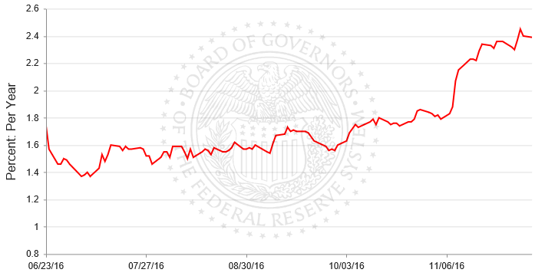
Interest Rates Surged on News of the
Trump Election Victory: 10-Year Treasury
The 10-year Treasury yield sank in the wake of the June 23 Brexit vote
The 10-year Treasury yield jumped to 2.07% on Nov. 9, the day after the election from 1.83% the day before.
The 10-year Treasury yield stood at 2.39% as of Dec. 5, up more than half a point since the election
Sources: Federal Reserve Bank at http://www.federalreserve.gov/releases/h15/data.htm; Insurance Information Institute.

Slide 41
Interest Rate Forecasts: 2016 – 2021F
Yield (%)
3-Month Treasury
10-Year Treasury
10-year yields are actually down in 2016
A full normalization of interest rates is unlikely until 2019, more than a decade after the onset of the financial crisis.
Sources: Blue Chip Economic Indicators (10/16 for 2016 and 2017; for 2018-2021 11/16 issue); Insurance Info. Institute.

Slide 42
Net Investment Yield on Property/ Casualty Insurance Invested Assets, 2007–2016P*
(Percent)
Estimated book yield in 2016 is down about 140 BP from pre-crisis levels
The yield on invested assets remains low relative to pre-crisis yields. The Fed’s plan to raise interest rates in late 2015 has pushed up some yields, albeit quite modestly.
Sources: A.M. Best; 2015E-2016P figures from A.M. Best P/C Review and Preview, Feb. 2016; Insurance Information Institute

Slide 43
Annual Inflation Rates, (CPI-U, %),
1990–2017F
Annual Inflation Rates (%)
Inflation peaked at 5.6% in August 2008 on high energy and commodity crisis. The recession and the collapse of the commodity bubble reduced inflationary pressures in 2009/10
Inflationary expectations have slipped (due in part to falling energy costs) allowing the Fed to maintain low interest rates
Slack in the U.S. economy and falling energy prices suggests that inflationary pressures should remain subdued for an extended period of times
Sources: US Bureau of Labor Statistics; Blue Chip Economic Indicators, 10/16 (forecasts).

Slide 44
Reduction in Combined Ratio Necessary to Offset 1% Decline in Investment Yield to Maintain Constant ROE, by Line*
Lower Investment Earnings Place a Greater Burden on Underwriting and Pricing Discipline
*Based on 2008 Invested Assets and Earned Premiums
**US domestic reinsurance only
Source: A.M. Best; Insurance Information Institute.
44
12/01/09 - 9pm
eSlide – P6466 – The Financial Crisis and the Future of the P/C
Notes:
44

Slide 45
Annual Inflation Rates, (CPI-U, %),
1990–2017F
Annual Inflation Rates (%)
Inflation peaked at 5.6% in August 2008 on high energy and commodity crisis. The recession and the collapse of the commodity bubble reduced inflationary pressures in 2009/10
Inflationary expectations have slipped (due in part to falling energy costs) allowing the Fed to maintain low interest rates
Slack in the U.S. economy and falling energy prices suggests that inflationary pressures should remain subdued for an extended period of times
Sources: US Bureau of Labor Statistics; Blue Chip Economic Indicators, 10/16 (forecasts).

Slide 46
P/C Insurer Net Realized
Capital Gains/Losses, 1990-2016:Q2
Realized capital gains are down from their 2013 peak
($ Billions)
Insurers Posted Net Realized Capital Gains in 2010 - 2015 Following Two Years of Realized Losses During the Financial Crisis. Realized Capital Losses Were a Primary Cause of 2008/2009’s Large Drop in Profits and ROE.
*Annualized based on actual of $4.438B through Q2 2016
Sources: A.M. Best, ISO; Insurance Information Institute.
46
12/01/09 - 9pm
eSlide – P6466 – The Financial Crisis and the Future of the P/C
Notes:
46

Slide 47
Property/Casualty Insurance Industry Investment Gain: 1994–2016:Q2¹
($ Billions)
Investment gains in 2015 were unchanged from 2014; 2016 is running slightly behind 2015 and 17% below the pre-crisis peak
Total Investment Gains Were Flat in 2015 as Investment Income Rose Marginally and Realized Capital Gains Fell Slightly
¹ Investment gains consist primarily of interest, stock dividends and realized capital gains and losses.
* 2005 figure includes special one-time dividend of $3.2B; 2016 figure is annualized based on actual Q2 2016 figure of $26.505B.
Sources: ISO, SNL; Insurance Information Institute.

Slide 48
Distribution of Bond Maturities,
P/C Insurance Industry, 2006-2015
Two main shifts over these years. From 2008 to 2011-12, from bonds with longer maturities to bonds with shorter maturities. But beginning in 2013, the reverse. Note, however, that the percentages in bonds with maturities over 10 years continues to drop.
Sources: SNL Financial; Insurance Information Institute.

Slide 49
THE ECONOMY
The Strength of the Economy Will Greatly Influence Insurer Exposure Base Across Most Lines
49

Slide 50
US Real GDP Growth*
The Q4:2008 decline was the steepest since the Q1:1982 drop of 6.8%
Real GDP Growth (%)
Recession began in Dec, 2007
Q1 2014/15 GDP data were hit hard by this year’s “Polar Vortex” and harsh winter
Demand for Insurance Should Increase in 2016 as GDP Growth Continues at a Steady, Albeit Moderate Pace and Gradually Benefits the Economy Broadly
* Estimates/Forecasts from Blue Chip Economic Indicators.
Source: US Department of Commerce, Blue Economic Indicators 10/16; Insurance Information Institute.

Slide 51
US Unemployment Rate Forecast
Rising unemployment
eroded payrolls
and WC’s
exposure base.
Unemployment peaked at 10% in late 2009.
2007:Q1 to 2017:Q4F*
Jobless figures have been revised downwards for 2016
Unemployment forecasts have been revised modestly downwards. Optimistic scenarios put the unemployment as low as 4.3% by Q4 of 2017.
* = actual; = forecasts
Sources: US Bureau of Labor Statistics; Blue Chip Economic Indicators (10/16 edition); Insurance Information Institute.

Slide 52
Household Net Worth: 2005–2016:Q2¹
($ Billions)
Household net worth is reaching new highs
Household net worth continues to recover from the Great Recession and could accelerate. This would expand the “wealth effect” which is more pronounced among higher income households.
¹ Annualized and seasonally adjusted figure.
Sources: Federal Reserve; Insurance Information Institute.

Slide 53
Mortgage Debt Outstanding:
2001–2016:Q2¹
($ Billions)
Mortgage lending is growing once again, albeit sluggishly
Mortgage debt outstanding remains below pre-crisis levels. Consumers have the capacity to resume more aggressive spending.
¹ Annualized and seasonally adjusted figure as of Q2 2016.
Sources: Federal Reserve; Insurance Information Institute.

Slide 54
Annual Growth in Household Debt:
2006 – 2016:Q2*
Household debt growth plunged during the Great Recession and has yet to recover
Annual Change
Household debt continues to expand but timidly, reflectly lingering economic uncertainties
¹ Annualized and seasonally adjusted figure.
Sources: Federal Reserve; Insurance Information Institute.

Slide 55
The Wealth Effect: Will Rising Home Prices and a Bull Market Push Up Spending?
Estimated book yield in 2016 is down about 140 BP from pre-crisis levels
(Percent)
The wealth effect is diminished in the slow-growth, post-recession economy, but could it accelerate under a Trump Administration? High net worth families could ramp up spending
Sources: Mark Zandi of Moody’s Analytics. Post-crisis estimate is for 2013; Insurance Information Institute

Slide 56
Profitability & Politics
How Is Profitability Affected by the President’s Political Party?
56

Slide 57
P/C Insurance Industry ROE by Presidential Administration, 1950-2015*
OVERALL RECORD: 1950-2015*
Democrats 7.72%
Republicans 7.85%
Party of President has marginal bearing on profitability of P/C insurance industry
*Truman administration ROE of 6.97% based on 3 years only, 1950-52;.
Source: Insurance Information Institute

Slide 58
Trumponomics, Insurance and Politics
How Might the Trump Presidency Impact the Insurance Industry?
58

Slide 59
Trump vs. Clinton:
Issues that Matter to P/C Insurers
Issue | Trump | Clinton
Economy | Supply Side-Like Philosophy: Lower taxes→Faster real GDP growth; Deficits likely grow as tax cuts are combined with targeted increased spending on Homeland Security, Defense, etc. | Keynesian Philosophy: More government spending on infrastructure, education, social services; Deficits likely increase as tax increases likely difficult to pass
Interest Rates | May trend higher with larger deficits; Shift from monetary policy to fiscal focus (tax cuts, government spending) | Status quo at the Fed; Net impact on interest rates unclear
Taxes | Favors lower tax rates for corporate and personal income tax rates; Tax code overhaul? | Unlikely to reduce taxes or embark on major overhaul of tax code
International Trade | Protectionist Tendencies (appeal primarily to manufacturing sector) | Has criticized Trans-Pacific Partnership but is a realist on international matters
Tort System | Doesn’t like trial lawyers but seems to like filing lawsuits | Status Quo
Health Care | ACA should be repealed & replaced | Incremental Change

Slide 60
Trump’s Economic Plan & Other Key Factors Impacting Insurers
Issue | Analysis
Economy | Supply Side-Like Philosophy: Lower taxes→Faster real GDP growth; Deficits likely grow as tax cuts are combined with targeted increased spending on Homeland Security, Defense, etc. Seems in favor of heavy infrastructure spending.
Interest Rates | May trend higher with larger deficits; Shift from monetary policy to fiscal focus (tax cuts, government spending). Interest rates have spiked.
Taxes | Favors lower tax rates for corporate and personal income tax rates; Tax code overhaul? Seems likely.
International Trade | Protectionist Tendencies (appeal primarily to manufacturing sector). May be more pragmatic in his approach than anticipated.
Tort System | Scalia Supreme Court seat will be filled by a conservative justice; Likely more business friendly judge appointed to the federal bench
Health Care | ACA should be repealed & replaced. Willing to retain parts of Act: Pre-existing conditions; Children can remain on parent’s plan until age 26.

Slide 61
Trump Administration: Likely Issues Impacting Insurers
Affordable Care Act (“Obamacare”)
  “Repeal” is imminent, early in 2017
    Elimination of individual mandate seems certain
  Certain provisions of the ACA will be retained
    Children can remain on parental policies until age 26
    Can’t deny coverage based on pre-existing conditions
  Possible changes
    Allow insurers to sell (and consumers to purchase) across state lines
    Expansion of Medicare (possibly to age 55 for some)???
    Will need to devise high-risk pools
    Expansion of tax-qualified Health Savings Accounts
    Tax Credits
61
12/01/09 - 9pm
eSlide – P6466 – The Financial Crisis and the Future of the P/C
Notes:
61

Slide 62
Trump Administration: Likely Issues Impacting Insurers
Dodd-Frank
  Likely to be scaled back
  Insurers may find it easier to avoid bank-centric and Euro-centric regulation
  SIFI designations could be dropped
    For Met, Pru and possibly AIG
Dept. of Labor Fiduciary Standard Rule
    Less onerous implementation of the rule possible
Climate and Energy
    Climate change no longer a priority
    Carbon-based and carbon emitting industries will benefit from reduced pressure on climate issue
62
12/01/09 - 9pm
eSlide – P6466 – The Financial Crisis and the Future of the P/C
Notes:
62

Slide 63
Trump Administration: Likely Issues Impacting Insurers
Trade
  Has vowed to be tough in (re)negotiating trade deals
  Unlikely there is any stomach in Congress for all out trade wars with Mexico, China or other major trading partners
  A crescendo in protectionist sentiments would be a net negative for all industries, including (re)insurance and financial services in general
  Despite his election rhetoric, Trump is neither a protectionist nor an isolationist
Trade
  Likely to be hostile to Corporate Inversions
  Treatment of offshore tax havens in future tax reforms will be of interest
63
12/01/09 - 9pm
eSlide – P6466 – The Financial Crisis and the Future of the P/C
Notes:
63

Slide 64
Trump Administration: Likely Issues Impacting Insurers
M&A Activity
  Few implications for P/C or Life insurers, but health insurers could see a bumpy path, especially since the “replacement” for the ACA remains to be devised
  While businesses many have a freer hand to consolidate under Trump, that activity will have its limits
  Populist movements are not historically friendly to the accumulation of market power (Teddy Roosevelt—a Manhattanite, US President and “Trust Buster” and founder of the Progressive Party—which split from the Republican Party in 1912)
64
12/01/09 - 9pm
eSlide – P6466 – The Financial Crisis and the Future of the P/C
Notes:
64

Slide 65
Likely Issues Impacting High Net Worth Consumers
Taxes
  May push through across-the-board tax personal income tax cuts as part of or as a early step toward tax reform and simplification
  Lower corporate income taxes to restore international competitiveness on rates
  Elimination/reduction of ACA tax on investment earnings(?)
Interest Rates and Inflation
  Trump’s fiscal policy (tax cuts couple with increased infrastructure and military spending) is potentially inflationary and will push up interest rates, a benefit for fixed income investors
  Lower corporate income taxes to restore international competitiveness on rates
65
12/01/09 - 9pm
eSlide – P6466 – The Financial Crisis and the Future of the P/C
Notes:
65

Slide 66
HEALTH INSURANCE
The First (Day 1) and Most Impacted Segment of the Insurance Industry, by Far
66

Slide 67
Uninsured Rate Among the Nonelderly Population, 1972 - 2015
Share of population uninsured:
Source: CDC/NCHS, National Health Interview Survey, reported in http://www.cdc.gov/nchs/health_policy/trends_hc_1968_2011.htm#table01 and http://www.cdc.gov/nchs/data/nhis/earlyrelease/insur201605.pdf from the Kaiser FamillyFoundation at www.kff.org .

Slide 68
Trump Administration: Likely Issues Impacting Insurers
Affordable Care Act (“Obamacare”)
  “Repeal” is imminent, early in 2017: Day 1 Issue
    Elimination of individual mandate seems certain (and associated penalties)
  “Replacement” to be over seen by new HHS Secretary, Sen. Tom Price (R-GA)—an orthopedic surgeon
  Certain provisions of the ACA will be retained
    “Repeal & Replace” → Reform & Restructuring
    ACA will not suffer a complete repudiation
    Children can remain on parental policies until age 26
    Protections for those with pre-existing conditions
68
12/01/09 - 9pm
eSlide – P6466 – The Financial Crisis and the Future of the P/C
Notes:
68

Slide 69
Trump Administration: Likely Issues Impacting Insurers
Affordable Care Act (“Obamacare”)
  Possible changes: Phase-in over 2-3 years
    Allow insurers to sell (and consumers to purchase) across state lines
    Quasi-privatization of Medicare?
    Expansion of Medicaid?
    Expansion of tax-qualified Health Savings Accounts
    Tax Credits
  No question that fewer people will be insured under an ACA replacement
    Will need mechanism for creating, operating and funding high-risk pools
    Many successful operating models for such pools/plans
69
12/01/09 - 9pm
eSlide – P6466 – The Financial Crisis and the Future of the P/C
Notes:
69

Slide 70

Trump Administration: Likely Issues Impacting Insurers
Paul Ryan “A Better Way” Plan
  House Speaker Paul Ryan released his “A Better Way” plan in June 2016, proposes:
    Block granting Medicaid (hence more state control)
    Creation of vouchers for Medicare (hopefully stimulating competition and increasing choice, as has been the experience of Medicare Advantage, which already enrolls 32% of seniors)
    Elimination of advanced paid premium subsidies for individual insurance
Source: https://abetterway.speaker.gov/_assets/pdf/ABetterWay-HealthCare-PolicyPaper.pdf
70
12/01/09 - 9pm
eSlide – P6466 – The Financial Crisis and the Future of the P/C
Notes:
70

Slide 71
U.S. Health Care Expenditures,
1965–2022F
$ Billions
From 1965 through 2013, US health care expenditures had increased by 69 fold. Population growth over the same period increased by a factor of just 1.6. By 2022, health spending will have increased 119 fold.
U.S. health care expenditures have been on a relentless climb for most of the past half century, far outstripping population growth, inflation of GDP growth
Sources: Centers for Medicare & Medicaid Services, Office of the Actuary at http://www.cms.gov/Research-Statistics-Data-and-Systems/Statistics-Trends-and-Reports/NationalHealthExpendData/NationalHealthAccountsProjected.html accessed 3/14/14; Insurance Information Institute.

Slide 72
National Health Care Expenditures as a Share of GDP, 1965 – 2022F*
% of GDP
Health care expenditures as a share of GDP rose from 5.8% in 1965 to 18.0% in 2013 and are expected to reach 19.9% of GDP by 2022
2022 19.9%
2010: 17.9%
2000: 13.8%
1990: 12.5%
Since 2009, heath expenditures as a % of GDP have flattened out at about 18%--the question is why and will it last?
1980: 9.2%
1965 5.8%
Sources: Centers for Medicare & Medicaid Services, Office of the Actuary at http://www.cms.gov/Research-Statistics-Data-and-Systems/Statistics-Trends-and-Reports/NationalHealthExpendData/NationalHealthAccountsProjected.html accessed 3/14/14; Insurance Information Institute.

Slide 73
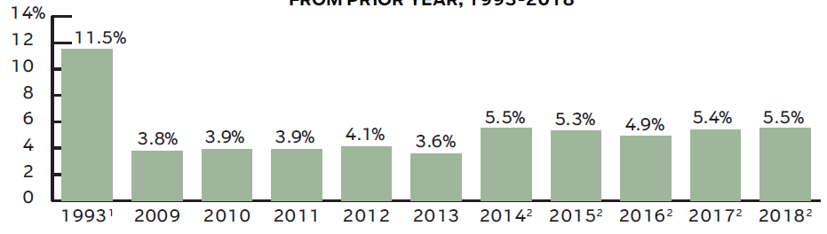

National Health Expenditures, Avg. Annual Percent Growth from Prior Year: 1993 – 2018F
The introduction of managed care in the mid/late-1990s has helped to slow the growth rate of health expenditures
from 2016 Insurance Information Institute Fact Book.

Slide 74
Basic Provisions of the ACA:
Prohibitions on Certain Insurer Practices
Lifetime and Annual Limits on Coverage Prohibited ELIMINATE
  Dollar limits on coverage prohibited
Pre-Existing Condition Exclusions Prohibited MODIFY
  Insurers are prohibited from denying claims or excluding coverage based on pre-existing conditions
Retention of Coverage Until Age 26 RETAIN
  ACA allows young adults to remain on parents policy until age 26 (can enroll immediately after turning 26)

Slide 75
Basic Provisions of the ACA:
Prohibitions on Certain Insurer Practices
Guaranteed Access to Health Insurance ELIMINATE GUARANTEED PRIVATE INSURER ISSUANCE AND RENEWAL (Guarantee may continue to exist through residual market mechanisms)
  Policies sold in the individual and small group market via the Health Insurance Market are sold on a guaranteed issue and guaranteed renewable basis. Applicants cannot be denied coverage or be required to pay highest rates because of health status. Variations in rating variables are allowed only for age (limited to 3:1 ratio), number of family members, geographical area and tobacco usage (limited to 1.5:1 ratio). Cannot charge females more.

Slide 76
Basic Provisions of the ACA:
Prohibitions on Certain Insurer Practices
Medical Loss Ratios (80/20 Rule or Medical Loss Ratio Rule) ELIMINATE
  Insurers required to meet a minimum loss ration (MLR) of 80% for individual and small group market and 85% for large group market. The MLR refers to the percentage (share) of premiums paid for health insurance coverage that is used to pay claims and activities that improve the quality of care. In other words, insurers must pay a minimum of 80% or premium collected on benefits and keep only 20% for expenses and profits.

Slide 77
Basic Provisions of the ACA:
Individual Mandate, Essential Health Benefits
Individual Mandate ELIMINATE
  ACA requires US citizens and legal residents to have qualifying health insurance of pay a penalty--$695 in 2016 or 2.5% of family income. After 2016, the penalty will be increased by annual cost of living adjustment.
Essential Health Benefits ELIMINATE
  ACA requires that most medical expense policies provide a comprehensive package of benefits and services called essential health benefits.

Slide 78
Essential Health Benefits
Essential Health Benefits must (at a minimum include):
  Ambulatory patient services
  ER services
  Hospitalization (such as surgery)
  Pregnancy, maternity, newborn care
  Mental health and substance abuse
  Prescription drugs
  Rehabilitation services
  Preventive and wellness services, chronic disease management
  Pediatric services (including oral and vision care)
Almost all federal coverage mandates will be eliminated
Should result in more competition, especially for less expensive/less comprehensive plans
Health insurers will regain most underwriting freedoms they lost under ACA
  Occasionally controversial: E.g., Women’s health benefits

Slide 79
Basic Provisions of the ACA:
Health Insurance Marketplace
Health Insurance Marketplace RESTRUCTURE
  ACA creates a Health Insurance Marketplace in each state where individuals and small businesses can purchase affordable and qualified health insurance plans. These state “exchanges” enable people to comparison shop for standard health insurance plans, facilitate enrollment in the various plans and administer health insurance premium credits so that people of all incomes can purchase coverage.

Slide 80
Basic Provisions of the ACA:
Advance Premium Tax Credits
Advanced Premium Tax Credits ELIMINATE
  ACA provides advanced premium tax credits to eligible individuals and families to make coverage more affordable. Available to people with incomes between 100% and 400% (up to $46,680 for an individual and up to $95,400 for a family of 4 in 2015). The idea is to limit the share of income that must be spent on health insurance (from 2% for the poorest people to 95% for those earning 300% - 400% of the FPL. of the federal poverty level (FPL).

Slide 81
PROPERTY/CASULATY
INSURANCE
More Positives for P/C Sector than Any Other
81

Slide 82
Trump Administration: Likely Issues Impacting P/C Insurers
Lower Corporate Tax Rates (+)
  Reduced value of Tax Loss Carry Forwards
Lower Personal Income Tax Rates (+)
  Increases disposable income, stimulating demand for vehicles, homes, etc. (insurable exposures increase→increasing demand)
Heavy Infrastructure Spending (+)
  Commercial property, liability, commercial auto, surety, WC
Dodd-Frank Rollback (+)
  Partial rollback likely
  Systemically Important Financial Institution (SIFI) Designation (Met, Pru, AIG) may be easier to shed
  Less emphasis on bank- and European centric regulations
    Solvency II
82
12/01/09 - 9pm
eSlide – P6466 – The Financial Crisis and the Future of the P/C
Notes:
82

Slide 83
Trump Administration: Likely Issues Impacting P/C Insurers
NFIP: Flood Insurance Program 2017 Reauthorization (+)
  More encouragement of private (re)insurer participation in flood insurance market
  Use of private insurance and capital markets
Trade (-)
  Danger of being caught in trade dispute crossfire
Terrorism: Terrorism Risk Insurance Act (TRIA) (?)
  Expires 12/31/2020→Administration views uncertain
  Favors free markets but Trump’s NYC real estate experience gave him a front row seat to 9/11’s impact’s on commercial property insurance
83
12/01/09 - 9pm
eSlide – P6466 – The Financial Crisis and the Future of the P/C
Notes:
83

Slide 84
LIFE INSURANCE
Mostly Favorable Impacts for Life Insurers, though Net Impact of Tax Policy Is Unclear
84

Slide 85
Trump Administration: Likely Issues Impacting Life Insurers
Lower Corporate Tax Rates (+)
  Muni/corporate bond balance affects impact
  Impact on Dividend Received Deduction unclear
Lower Personal Income Tax Rates (-)
  Lower personal income tax rates would (at least in theory) reduce the attractiveness of insurance products which have a cash value component on which interest earnings accrue on a tax deferred basis
Scaling Back of Dodd-Frank (+)
  Partial rollback likely
  Systemically Important Financial Institution (SIFI) Designation (Met, Pru, AIG) may be easier to shed
  Less emphasis on bank- and European centric regulations
Easing of Fiduciary Rule (+)
  Less onerous implementation
85
12/01/09 - 9pm
eSlide – P6466 – The Financial Crisis and the Future of the P/C
Notes:
85

Slide 86
Auto & Home Insurance:
State of the Personal Lines Market
Auto Frequency and Severity Are an Immediate Challenge
Dearth of Major CATs (Until Recently), Pricing Discipline Has Helped Home
86

Slide 87
Return on Net Worth: All P-C Lines vs. Homeowners & Pvt. Pass. Auto, 1990-2014*
(Percent)
Average RNW: 1990-2013*
All P-C Lines: 7.8% PP Auto: 8.1% Homeowners: 4.3%**
Excluding 1992’s Hurricane Andrew
Pvt.Pass. Auto Has Consistently Outperformed the P-C Industry as a Whole. Homeowners Volatility is Associated Primarily With Coastal Exposure Issues
*Latest available.
**Excludes 1992, the year of Hurricane Andrew. If 1992 is included the resulting homeowners RNW is 1.9%
Sources: NAIC; Insurance Information Institute.
87
Notes:
87

Slide 88
RNW Pvt. Passenger Auto, 2005-2014 Average: Highest 25 States
(Percent)
Hawaii was the most profitable state for auto insurers from 2005-2014
Sources: NAIC; Insurance Information Institute

Slide 89
RNW Pvt. Passenger Auto,
2005-2014 Average: Lowest 25 States
(Percent)
Michigan was the least profitable state for auto insurers from 2005-2014
Sources: NAIC; Insurance Information Institute

Slide 90
RNW Homeowners Insurance,
2005-2014 Average: Highest 25 States
(Percent)
Hawaii was the most profitable state for home insurers from 2005-2014 due to the absence of hurricanes during this period
Sources: NAIC; Insurance Information Institute

Slide 91
RNW Homeowners Insurance,
2005-2014 Average: Lowest 25 States
(Percent)
Hurricanes Katrina and Rita made Louisiana and Mississippi the least profitable states for home insurers from 2005-2014
Sources: NAIC; Insurance Information Institute

Slide 92
Shifting Winds (and Waters):
Appetite for Coastal and Flood Risks is Increasing
Can Money Be Made in the Long-Run in Hurricane Country?
92

Slide 93
U.S. Residual Market: Total Policies In-Force (1990-2014) (000)
Hurricane Sandy
(000)
Katrina, Rita and Wilma
4 Florida Hurricanes
Hurricane Andrew
From 1990-2011 the total number of policies in-force in the residual market (FAIR & Beach/Windstorm) Plans more than tripled. In 2014, total policy counts fell dramatically to 2.78 million.
Source: PIPSO; Insurance Information Institute

Slide 94
U.S. Residual Market Exposure to Loss
(1990-2014) ($ Billions)
($ Billions)
Hurricane Sandy
Katrina, Rita and Wilma
4 Florida Hurricanes
Hurricane Andrew
Between 1990 and 2011, total exposure to loss in the residual market (FAIR & Beach/Windstorm) Plans surged to record levels. Between 2011 and 2014, exposure to loss has dropped by 30 percent.
Source: PIPSO; Insurance Information Institute (I.I.I.).

Slide 95
Florida Citizens Exposure to Loss ($ Billions)
Total exposure to loss in Florida Citizens increased by 178 percent, from $154.6 billion in 2002 to $429.4 billion in 2012. Between 2012 and 2013 its exposure to loss dropped by nearly 50 percent.
Source: PIPSO; Insurance Information Institute (I.I.I.).
Notes:
95

Slide 96
Florida Citizens Policy Count,
2005 – 2016:Q1
Hawaii was the most profitable state for home insurers from 2005-2014 due to the absence of hurricanes during this period
FL Citizens policy count has shrunk significantly in recent years as more exposure as been assumed by private insurers
Sources: Insurance Information Institute research and analysis from SNL data.

Slide 97
Florida Citizens Market Share,
2005 - 2015
FL Citizens market share has shrunk significantly in recent years as more exposure as been assumed by private insurers
Sources: Insurance Information Institute research and analysis from SNL data.

Slide 98
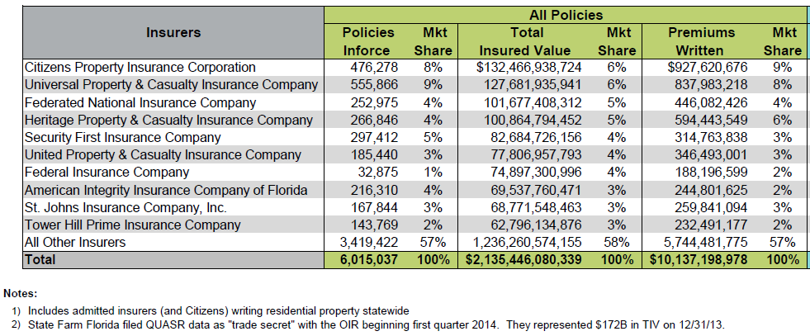
Top 10 Residential Insurers in Florida in 2016*
Note: Excludes State Farm Florida. SNL show SF Florida $613.8 million and a market share of 7.0%
*As of 3/31/16.
Source: Florida Citizens: https://www.citizensfla.com/documents/20702/93160/20160331+Market+Share+Report/ab841adc-d5fb-45ca-bff6-8dbd15d5cac5

Slide 99
Total Value of Insured Coastal Exposure In 2012
($ Billions)
Source: AIR Worldwide

Slide 100
Insured Coastal Exposure As a % Of Statewide Insured Exposure In 2012
Source: AIR Worldwide

Slide 101
Value of Insured Residential Coastal Exposure In 2012 ($ Billions)
Source: AIR Worldwide

Slide 102
Value Of Insured Commercial Coastal Exposure 2012 ($ Billions)
Source: AIR Worldwide

Slide 103
Number of National Flood Insurance Program Policies in Force at Year-End, 1980-2015*
(millions)
The number of NFIP policies in force has plunged by 549,000 or 9.6% since 2009, even as coastal development surges and sea levels rise
Private insurers are showing an increased interest in covering flood risk. NFIP’s 2017 reauthorization should help.
Source: National Flood Insurance Program.
* As of July, 2015

Slide 104
Personal Lines Underwriting Performance
Auto, Home Underwriting Performance Exhibit Periods of Both Stability and Volatility
104

Slide 105
Private Passenger Auto Combined Ratio: 1993–2017F
Private Passenger Auto Underwriting Performance Is Showing the Strains of Rising Frequency (and Severity) Trends in Many States
Sources: A.M. Best (1990-2014); Conning (2015E-17F); Insurance Information Institute.

Slide 106
Homeowners Insurance Combined Ratio: 1990–2017F
Hurricane Andrew
Record tornado activity
Hurricane Ike
Hurricane Sandy
Homeowners Performance Has Improved Markedly Since the 2011/12’s Large Cat Losses. Extreme Regional Variation Can Be Expected Due to Local Catastrophe Loss Activity. Results in 2016 Will Be Impacted by Severe Spring Weather
Sources: A.M. Best (1990-2014); Insurance Information Institute (2015E-17F).

Slide 107
Commercial Lines Combined Ratio, 1990-2017F*
Commercial lines underwriting performance improved in 2013/14 but higher cats, diminishing prior year reserves and rising loss cost trends in some lines could push combined ratios higher
*2007-2012 figures exclude mortgage and financial guaranty segments.
Source: A.M. Best (1990-2015); Conning (2016E-17F) Insurance Information Institute.

Slide 108
Claim Trends in Private Passenger Auto Insurance
Rising Frequencies and Severities in Many Coverages
Will that Pattern Be Sustained?
108

Slide 109
Auto Insurance Net Combined Ratios,
Yearly, 2005-2015
Loss Ratios Have Been Rising for A Decade.
2015 Return on Net Worth Is Likely Close to Zero
Sources: National Association of Insurance Commissioners data, sourced from S&P Global Market Intelligence;
Insurance Information Institute.

Slide 110
Return on Net Worth:
Personal Auto, 2005–2014
4.3%
Auto Insurance Profitability Has Been Stuck at Low Levels.
Source: National Association of Insurance Commissioners.

Slide 111
A Half Century of Auto Insurance:
Frequency vs. Severity
In the Long Run, Frequency Falls. Severity Increases.
Frequency
Severity
1963
1988
2013
Sources: Insurance Institute for Highway Safety, Insurance Services Office, Insurance Information Institute.

Slide 112
Collision Claims: Frequency Trending
Higher in 2015
Annual Change, 2005 through 2015
For a Long Time, Claim Frequency Was Falling,
But Since 2010 This Trend Seems to Have Reversed.
Source: ISO, a Verisk Analytics company; Insurance Information Institute.

Slide 113
Collision Claims: Severity Trending
Higher in 2009-2015
Annual Change, 2005 through 2015
The Great Recession and High Fuel Prices Helped to Temper
Claim Severity, But These forces Have Clearly Reversed,
Consistent with Experience from Past Recoveries.
Source: ISO, a Verisk Analytics company; Insurance Information Institute.

Slide 114
Some Comments on Frequency and Severity Trends and Insurance Markets
Over the long run, falling frequency and rising severity are the norm in auto insurance (personal and commercial)
The phenomenon of falling frequency and rising severity is not confined to auto lines
It is almost a “Law of Insurance Physics”
The same trends have been observed in many lines for decades:
  Workers Comp Aviation Marine
  Fire Life
Lines of insurance that do not follow this pattern tend to manifest/suffer from certain economic defects:
  Adverse Selection and Moral Hazard (e.g., Health, Flood, some Coastal Property markets, Social Security Disability)
  Some of these defects are attributable to subsidies, others to informational asymmetries (less of an issue in auto)
114
12/01/09 - 9pm
eSlide – P6466 – The Financial Crisis and the Future of the P/C
Notes:
114

Slide 115
Why Personal Auto Loss Ratios are Rising:
Severity & Frequency by Coverage, 2016* vs. 2015
Annual Change, 2016* Over 2015
Frequency and Severity Rose Are Rising Across All Personal Coverage Types in 2016
*Data are for the 4 quarters ending in 2016:Q2.
Source: ISO/PCI Fast Track data; Insurance Information Institute.

Slide 116
Collision Coverage: Severity & Frequency Trends Are Both Higher in 2016
Annual Change, 2005 through 2016*
The Recession, High Fuel Prices Helped Temper Frequency and Severity, But this Trend Has Clearly Reversed, Consistent with Experience from Past Recoveries
*Four quarters ending with 2016 Q2.
Source: ISO/PCI Fast Track data; Insurance Information Institute

Slide 117
Collision Loss Ratio Trending Upward:
Private Passenger Auto, 2010 – 2016*
Loss Ratio
Collision Loss Ratios are Trending Steadily Upward
*2016 figure is for the 4 quarters ending in 2016:Q2.
Source: ISO/PCI Fast Track data; Insurance Information Institute

Slide 118
Bodily Injury: Severity Trend Is Up, Frequency Decline Has Ended—Rising?
Annual Change, 2005 through 2016*
Cost Pressures Will Increase if BI Frequency and Severity Trends Persist
*2016 figure is for the 4 quarters ending 2016:Q2.
Source: ISO/PCI Fast Track data; Insurance Information Institute

Slide 119
Property Damage Liability: Severity and Frequency Are Up
Annual Change, 2005 through 2016*
Severity/Frequency Trends Have Been Volatile, But Rising Severity since 2011 Is a Concern
*2016 figure is for the 4 quarters ending 2016:Q2.
Source: ISO/PCI Fast Track data; Insurance Information Institute

Slide 120
Comprehensive Coverage: Frequency and Severity Trends Are Volatile
Severe weather is a principal cause of the spikes in both frequency and severity
Annual Change, 2005 through 2016*
Weather Creates Volatility for Comprehensive Coverage
*2016 figure is for the 4 quarters ending 2016:Q2.
Source: ISO/PCI Fast Track data; Insurance Information Institute

Slide 121
A Few Factors Driving Adverse Private Passenger Auto Loss Trends
More People Driving, More Miles Driven, Lower Gas Prices, Higher Speed Limits…
121

Slide 122
America is Driving More Again: 2000-2016
Percent Change, Miles Driven*
Fastest Growth Since 2000
Tremendous Growth In Miles Driven. The More People Drive, The More Frequently They Get Into Accidents.
*2000-2015: Moving 12-month total vs. prior year. 2016 data through July 2016, the latest available, vs. July 2015.
Sources: Federal Highway Administration; National Bureau of Economic Research (recession dates); Insurance Information Institute.
Notes:
122

Slide 123
Why Are People Driving More Miles?
Is it Jobs? 2006-2016:Q2
Billions of Miles Driven in Prior Year
Millions Employed
Recession
People Drive to and from Work and Drive to Entertainment.
Out of Work, They Curtail Their Movement.
Sources: Federal Highway Administration; Seasonally Adjusted Employed from Bureau of Labor Statistics (Series ID CES0000000001); Insurance Institute for Highway Safety; Insurance Information Institute.
Notes:
123

Slide 124
More Miles Driven
→ More Collisions, 2006-2016:Q2
Billions of Miles Driven in Prior Year
Overall Collision Claims Per 100 Insured Vehicles
Recession
The More Miles People Drive, the More Likely They are to
Get in an Accident, Helping Drive Claim Frequency Higher.
Sources: Federal Highway Administration; Rolling four-quarter average frequency from ISO, a Verisk Analytics company; Insurance Institute for Highway Safety; Insurance Information Institute.
Notes:
124

Slide 125
More People Working and Driving
=> More Collisions, 2006-2016
Overall Collision Claims Per 100 Insured Vehicles
Number Employed,
Millions
Recession
When people are out of work, they drive less. When they get jobs,
they drive to work, helping drive claim frequency higher.
Sources: Seasonally Adjusted Employed from Bureau of Labor Statistics; Rolling Four-Qtr Avg. Frequency from Insurance Services Office; Insurance Information Institute.
125
12/01/09 - 9pm
eSlide – P6466 – The Financial Crisis and the Future of the P/C
Notes:
125

Slide 126
Comparing Gas Prices, Employment on
Collision Frequency Through 2015
Gas Price vs.
Collision Frequency
Number Employed vs.
Collision Frequency
Sources: Seasonally Adjusted Employed from Bureau of Labor Statistics; Energy Information Administration; Rolling Four-Qtr Avg. Frequency from Insurance Services Office; Insurance Information Institute.

Slide 127
Severity: Driving Fatalities are Rising
On Track for 18% Increase in Two Years
Annual Change in Motor Vehicle Deaths
Seatbelt Use Rose to 62% of Drivers, From 49% in ‘90
Big Drop-off Due to the Great Recession
Driving Has Been Getting Safer for Decades, But Recent Trend is Discouraging—38,300 Deaths in 2015.
Sources: National Safety Council, Insurance Information Institute.

Slide 128
What About Distractions?
It’s A Problem. But Is It Growing?
What We Do Behind The Wheel
But Impact Is Not Clear
Talking Less . . .
* Property Damage Only.
SOURCES: State Farm, National Highway Transportation Safety Administration (distraction.gov)
Most Recent Year

Slide 129
Change in Auto Fatalities by State: Especially Severe in Georgia
GA’s auto fatality rate has increased at a pace nearly 3 times that of the US overall and far in excess of any other state in the region
2015 vs. 2014
Fatalities in Southeast Rising Faster Than USA as a Whole
SOURCE: Estimates from National Safety Council.

Slide 130
Personal Lines Growth Drivers
Rate and Exposure are Both Presently Important Growth Drivers
130

Slide 131
Monthly Change in Auto Insurance Prices, 1991–2016*
Cyclical peaks in PP Auto tend to occur roughly every 10 years (early 1990s, early 2000s and likely the early 2010s)
Pricing peak occurred in late 2010 at 5.3%, falling to 2.8% by Mar. 2012
“Hard” markets tend to occur during recessionary periods
Sept. 2016 reading of 6.4% is up from 5.5%
a year earlier. Current rate trend is strongest since 2002-03.
*Percentage change from same month in prior year; through Sept. 2016; seasonally adjusted
Note: Recessions indicated by gray shaded columns.
Sources: US Bureau of Labor Statistics; National Bureau of Economic Research (recession dates); Insurance Information Institutes.
131
12/01/09 - 9pm
eSlide – P6466 – The Financial Crisis and the Future of the P/C
Notes:
131

Slide 132
Average Expenditures* on Auto Insurance, 1994-2015E
Annual Pct Changes
2001: 5.2%
2002: 8.6%
2003: 5.6%
2004: 1.5%
2005: -1.3%
2006: -1.8%
2007: -2.1%
2008: -1.0%
2009: -0.5%
2010: 0.6%
2011: 0.6%
2012: 2.3%
2013: 3.3%
The average expenditure on auto insurance now finally exceeds the pre-crisis high of $842 recorded in 2004, taking a full decade to recover, but on an inflation-adjusted basis premiums are still below 2004 levels
Across the U.S., auto insurance expenditures fell by 0.8% in 2008
and 0.5% in 2009 but rose 0.5% in 2010, 0.8% in 2011, 2.3% in 2012 and 3.3% in 2013; I.I.I. estimate is for +3.4% in 2014 and 2015.
* The NAIC data are per-vehicle (actually, per insured car-year)
Sources: NAIC for 1994-2013; Insurance Information Institute estimates for 2014-2015 based on CPI and other data.

Slide 133
Private Passenger Auto Insurance
Net Written Premium, 2000–2017F
PP Auto premiums written continue to recover from a period of flat growth attributable to the weak economy impacting new vehicle sales, car choice, and increased price sensitivity among consumers
PPA will generate $6B - $8B in new premiums annually through 2017
$ Billion
PPA NWP volume in 2014 was up $26.3B or 16.7% since the 2009 trough; By 2017 the gain is expected to be $46.8B or 29.7%
Sources: A.M. Best (1990-2014); Conning (2015-17F); Insurance Information Institute.

Slide 134
Homeowners Insurance
Net Written Premium, 2000–2016F
$ Billions
Homeowners insurance NWP continues to rise (up 150% 2000-2015F) despite very little unit growth during the real estate crash. Reasons include rate increases, especially in coastal zones, ITV endorsements (e.g., “inflation guards”), compulsory for mortgaged properties and resumption of home building activity
The Homeowners line will generate about $4B in new premiums annually through 2016
Sources: A.M. Best; Insurance Information Institute.

Slide 135
Personal Lines: Economic and Demographic Considerations
Auto, Home Are Sensitive to Underlying Economic Conditions
135

Slide 136
New Private Housing Starts, 1990-2022F
Job growth, low inventories of existing homes, still-low mortgage rates and demographics should continue to stimulate new home construction for several more years
(Millions of Units)
New home starts plunged 72% from 2005-2009; A net annual decline of 1.49 million units, lowest since records began in 1959
Insurers Are Continue to See Meaningful Exposure Growth in the Wake of the “Great Recession” Associated with Home Construction: Construction Risk Exposure, Surety, Commercial Auto; Potent Driver of Workers Comp Exposure
Source: U.S. Department of Commerce; Blue Chip Economic Indicators (11/16 for 2016-17; 10/16 for 2018-22F; Insurance Information Institute.

Slide 137
Auto/Light Truck Sales, 1999-2022F
Job growth and improved credit market conditions will boost auto sales in 2015 and beyond
Sales have returned to pre-crisis levels
(Millions of Units)
New auto/light truck sales fell to the lowest level since the late 1960s. Forecast for 2014-15 is still below 1999-2007 average of 17 million units, but a robust recovery is well underway.
Truck, SUV purchases are especially strong
Yearly car/light truck sales will likely continue at current levels, in part replacing cars that were held onto in 2008-12. PP Auto premium might grow by 3.5% - 5%.
Source: U.S. Department of Commerce; Blue Chip Economic Indicators (11/16 for 2016-17; 10/16 for 2018-21F; Insurance Information Institute.

Slide 138
Number of Registered Passenger Vehicles in US, 1999 – 2015E
Vehicle registrations are growing once again and now finally exceed pre-crisis peak
Vehicle registrations are expected to increase at an annual rate of about 1.5% per year in 2015 and 2016
Sources: Bureau of Transportation Statistics; Barclays Capital estimates, August 2015.

Slide 139
Insured Catastrophe Losses
2013/14 and YTD 2015 Experienced Below Average CAT Activity After Very High CAT Losses in 2011/12
Winter Storm Losses Far Above Average in 2014 and 2015
139

Slide 140
U.S. Insured Catastrophe Losses
($ Billions, $ 2015)
2012 was the 3rd most expensive year ever for insured CAT losses
2013/14/15 Were Welcome Respites from 2011/12, among the Costliest Years for Insured Disaster Losses in US History. 2016 Is Off to a Costlier Start.
2016 will be the heaviest cat year since 2012. Figure includes a $4.4B est. for Hurricane Matthew
*Through 10/20/16. 2016 figure stated in 2016 dollars. Figure includes $17 in known loss plus an estimate of $4.4B for Hurricane Matthew.
Note: 2001 figure includes $20.3B for 9/11 losses reported through 12/31/01 ($25.9B 2011 dollars). Includes only business and personal property claims, business interruption and auto claims. Non-prop/BI losses = $12.2B ($15.6B in 2011 dollars.)
Sources: Property Claims Service/ISO; Insurance Information Institute.
140
12/01/09 - 9pm
eSlide – P6466 – The Financial Crisis and the Future of the P/C
Notes:
140

Slide 141
Top 5 Insured Catastrophe Losses of 2016*
Cat No. | Period | States | Storm Family | Estimated Loss $
1625 | Apr 10 - 15 | FL, TX | Wind and Thunderstorm Event | 2,995,100,000
1621 | 23-Mar | TX | Wind and Thunderstorm Event | 1,688,500,000
1628 | Apr 29 / May 3 | AR, GA, IL, IN, MD, MO, NC, OK, TX, VA, WV | Wind and Thunderstorm Event | 1,187,040,000
1644 | Aug 11 - 15 | LA, MS | Wind and Thunderstorm Event | 1,058,870,000
1620 | Mar 17 - 18 | AL, AR, FL, LA, MS, TX | Wind and Thunderstorm Event | 920,105,000
*As of Oct. 20. No official estimate for Hurricane Matthew was yet available from PCS.
Source: Property Claim Services division of Verisk Analytics as of Oct. 20, 2015.

Slide 142
Inflation Adjusted U.S. Catastrophe Losses by Cause of Loss, 1996–2015¹
Other Wind/Hail/Flood (3), $19.9
Fires (4), $7.3
Winter storm losses were much above average in 2014/15 pushing this share up
Other (5), $0.8
Insured cat losses from 1996-2015 totaled $404.1B, an average of $20.2B per year or $1.68B per month
Terrorism, $24.6
Winter Storms, $30.4
Hurricanes & Tropical Storms, $158.6
Tornado share of CAT losses is rising
Wind losses are by far cause the most catastrophe losses, even if hurricanes/TS are excluded.
Events Involving Tornadoes (2), $158.6
Catastrophes are defined as events causing direct insured losses to property of $25 million or more in 2015 dollars.
Excludes snow.
Does not include NFIP flood losses
Includes wildland fires
Includes civil disorders, water damage, utility disruptions and non-property losses such as those covered by workers compensation.
Source: ISO’s Property Claim Services Unit.

Slide 143
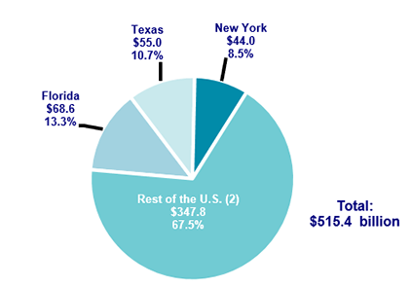
Top 3 States for Insured Catastrophe Losses, 1996-2015 (in 2015 Dollars)
Texas, Florida and New York lead the country in insured catastrophe losses over the past 20 years. These 3 states accounted for nearly 1/3 of all insured catastrophe losses over the past two decades
Source: PCS/Verisk for 2016 Insurance Fact Book, Insurance Information Institute.

Slide 144
Top 16 Most Costly Disasters in U.S. History—Katrina Still Ranks #1
(Insured Losses, 2014 Dollars, $ Billions)
Storm Sandy in 2012 was the last mega-CAT to hit the US
Includes Tuscaloosa, AL, tornado
Includes Joplin, MO, tornado
12 of the 16 Most Expensive Events in US History Have Occurred Since 2004
Sources: PCS; Insurance Information Institute inflation adjustments to 2014 dollars using the CPI.

Slide 145
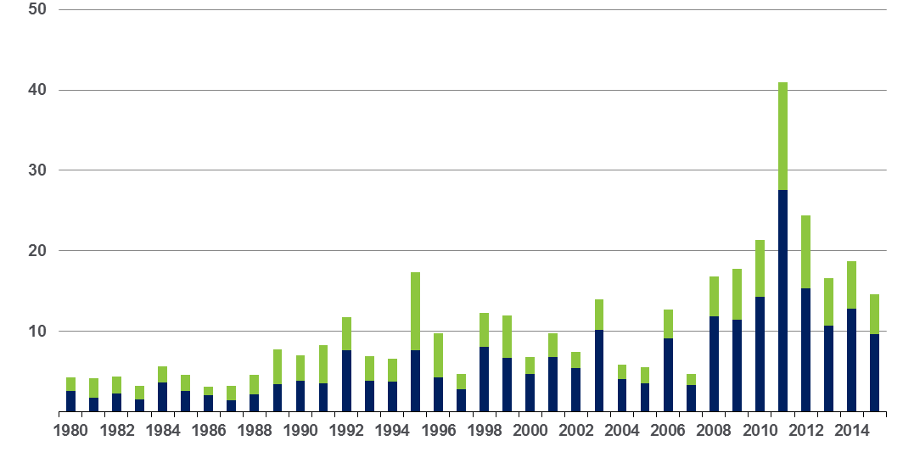
Convective Loss Events in the US
Overall and insured losses, 1980 – 2015
Overall losses
(in 2015 values)*
$ Billions
Insured losses
(in 2015 values)*
The period from 2008-2015 has been the most expensive on record for insured losses from “Convective Events” (severe thunderstorms, tornado, hail, lightning and flash flood)
*Losses adjusted to inflation based on CPI
Analysis contains:
severe storm, tornado, hail, flash flood and lightning
145
Source: Geo Risks Research, NatCatSERVICE

Slide 146
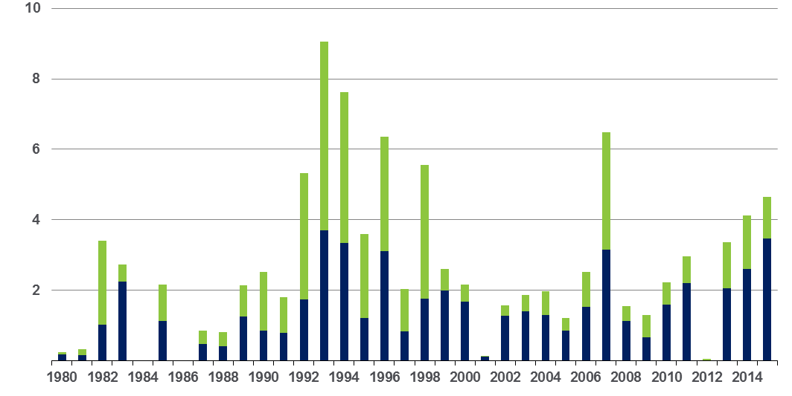
Winter Storm Losses in the US
1980 – 2015 (Overall and Insured Losses)*
$ Billions
Winter storm losses have been increasing rapidly in recent years
Overall losses
(in 2015 values)*
Insured losses
(in 2015 values)*
*Winter storms include also winter damages, blizzards and cold waves
*Losses adjusted to inflation based on CPI.
Source: Property Claim Services, MR NatCatSERVICE.
146

Slide 147
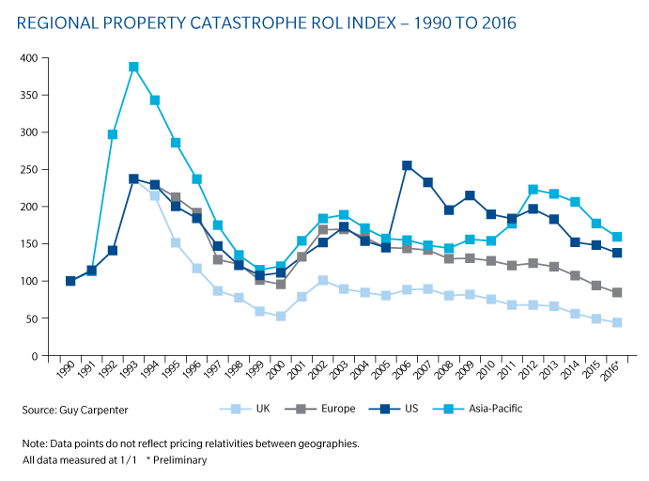
Regional Property Catastrophe ROL Index: 1990 – 2016
Record traditional capacity, alternative capital and low CAT activity have pressured reinsurance prices; ROEs are down only very modestly
Source: Guy Carpenter; Insurance Information Institute.

Slide 148
Alternative Capital
Potentially Disrupting the Bank Account
Alternative capacity has grown 263% since 2008. It has more than tripled in the past six years.
Source: Aon Benfield Analytics; Insurance Information Institute.

Slide 149
INDUSTRY DISRUPTORS
Technology, Society and the Economy Are All Changing at a Rapid Pace
Reality vs. Drinking the Silicon Valley Kool Aid
149

Slide 150
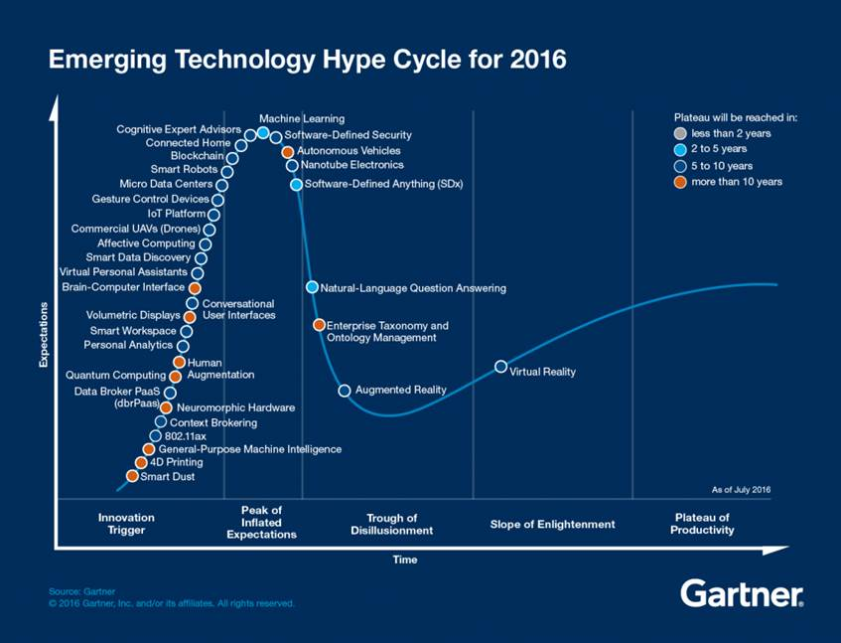
The Sharing Economy Has Grown— And Attracted Political Scrutiny
There’s no question that the hype around autonomous vehicles far exceeds the reality

Slide 151




On-Demand/Sharing/Peer-to-Peer Economy Impacts Many Lines of Insurance
The “On-Demand” Economy is or will impact many segments of the economy important to P/C insurers
  Auto (personal and commercial)
  Homeowners/Renters
  Many Liability Coverages
  Professional Liability
  Workers Comp
Many unanswered insurance questions
Insurance solutions are increasingly available to fill the many insurance gaps that arise
151
12/01/09 - 9pm
eSlide – P6466 – The Financial Crisis and the Future of the P/C
Notes:
151

Slide 152






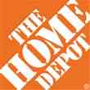

Data Breaches 2005-2015, by Number of Breaches and Records Exposed
# Data Breaches/Millions of Records Exposed
Millions
The total number of data breaches (+27.5%) hit a record high of 783 in 2014, exposing 85.6 million records. Through June 30, this year has seen 117.6 million records exposed in 400 breaches.*
*Figures as of June 30, 2015, from the Identity Theft Resource Center,
http://www.idtheftcenter.org/images/breach/ITRCBreachReport2015.pdf

Slide 153
AUTO TECHNOLOGY &
THE FUTURE OF AUTO INSURANCE
The Road to Fully Autonomous Vehicles: Long, Dark and Full of Potholes
Tales of the Death of Auto Insurance Are Greatly Exaggerated
153

Slide 154
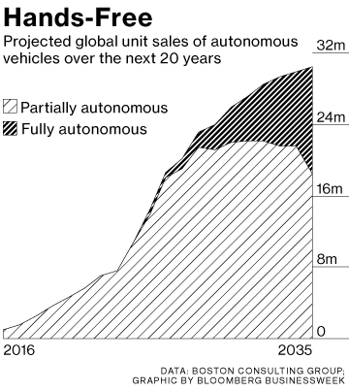
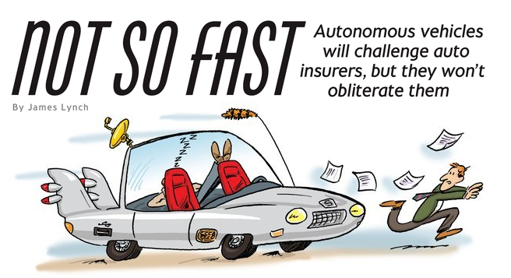
Media is Obsessed with Driverless Vehicles: Often Predicting the Demise of Auto Insurance
By 2035, it is estimated that 25% of new vehicle sales could be fully autonomous models
Questions
Are auto insurers monitoring these trends?
How are they reacting?
Will Google take over the industry?
Will the number of auto insurers shrink?
How will liability shift?
Source: Boston Consulting Group.

Slide 155
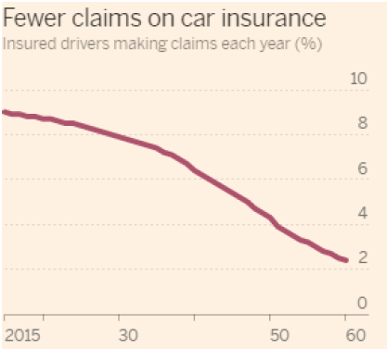
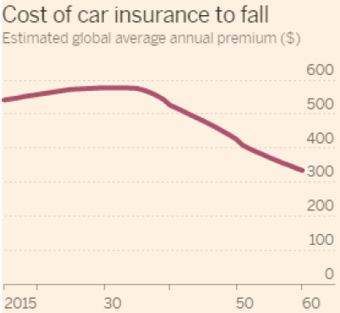
Media is Obsessed with Driverless Vehicles: Often Predicting the Demise of Auto Insurance
Some are predicting that the rise of autonomous vehicles will reduce claim frequency by 75% or more…
,,,and that this technology will cause average auto insurance premiums to plunge
Source: Autonomous Consulting as cited in the Financial Times: “Cost of Car Insurance to Plunge With Rise of Driverless Vehicles, June 28, 2016.

Slide 156
I.I.I. Poll: Driverless Cars
Q. Would you be willing to ride in a driverless car?
The Percentage Willing to Ride in a Driverless Car Remains at 43%;
71% of People Over 64 Were Unwilling to Ride.
Source: Insurance Information Institute Annual Pulse Survey.

Slide 157
I.I.I. Poll: Driverless Cars
Why Americans Would Not Want to Ride in a Driverless Car,
May 2016¹
Safety Concerns Are Paramount Among Those Who Would Avoid Driverless Cars.
¹ Based on those who would not ride in a driverless car. Respondents could give more than one answer.
Source: Insurance Information Institute Annual Pulse Survey.

Slide 158
I.I.I. Poll: Telematics—
Consumers Still Hesitant
Q
Would you allow your auto insurer to collect information about how and when you drive in order to set your auto insurance premium?
Don’t Know
Allow if Premium Went Down
Not
Allow
Allow Whether or Not Premium Went Down
More Than Half of Auto Policyholders Would Allow Their Insurer to
Collect Their Driving Information in Order to Set Premiums.
¹Asked of those who have auto insurance.
Source: Insurance Information Institute Annual Pulse Survey.

Slide 159
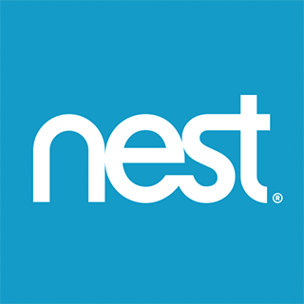

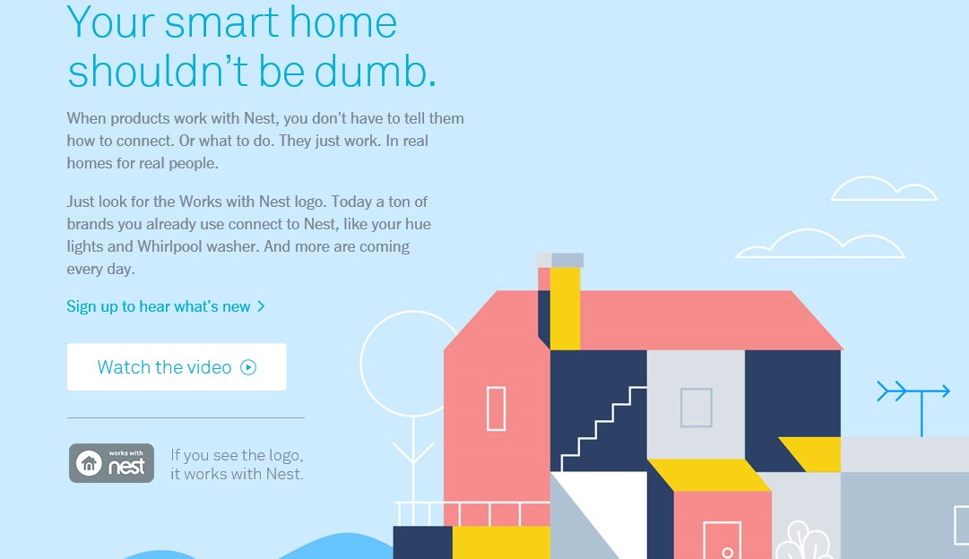
Telematics for Your Home:
The Internet of Things
The home is the next frontier for telematics
Rapidly becoming a crowded space
How and with whom will insurers partner?
Can control increasing array of household systems remotely
  Heat, A/C
  Fire, CO detection
  Security Systems
  Cameras/Monitors
  Appliances
  Lighting
Technology is adaptive
  Uses sensors and algorithms to learn about you
159
12/01/09 - 9pm
eSlide – P6466 – The Financial Crisis and the Future of the P/C
Notes:
159

Slide 160
THE ‘INTERNET OF THINGS’
Capturing Economic Value Amid a Shifting Insurer Value Chain
160

Slide 161
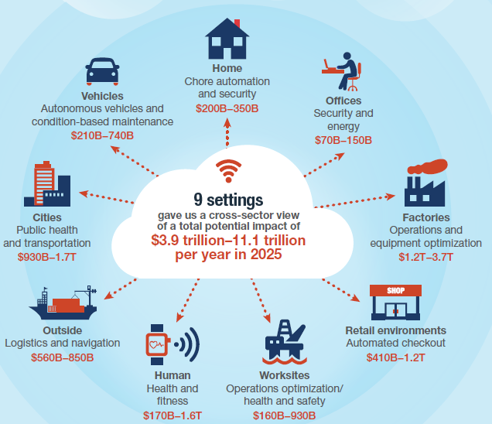
The Internet of Things and the Insurance Industry
The “Internet of Things” will create trillions in economic value throughout the global economy by 2025
What opportunities, challenges will this create for insurers?
What are the impact on the insurance industry “value chain”?
Sources: McKinsey Global Institute, The Internet of Things: Mapping the Value Beyond the Hype,
June 2015; Insurance Information Institute.
161
12/01/09 - 9pm
eSlide – P6466 – The Financial Crisis and the Future of the P/C
Notes:
161

Slide 162
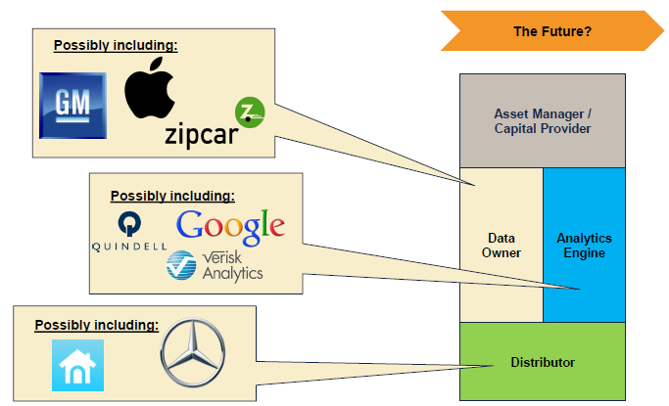
The Internet of Things and the Insurance Industry Value Chain
Who owns the data? Where does It flow? Who does the analytics? Who is the capital provider?
Source: Willis Capital Markets & Advisory; Insurance Information Institute.
162
12/01/09 - 9pm
eSlide – P6466 – The Financial Crisis and the Future of the P/C
Notes:
162

Slide 163
The (Re)Insurance Value Chain
Where Could Disruption Lie?
Create Policy/ Treaty
Brains + Bank Account
Under-write, Price Risk
Perform Loss Control
Settle Claims
Market Policy/ Treaty
Improve World
Protecting People & Organizations
Most Links in the Value Chain Have the Potential
to Be Disrupted in Next 10 Years.

Slide 164
INSURANCE TECHNOLOGY:
FIN TECH ZEROES IN
Number and Value of Deals Is Increasing
In Search of the Elusive Insurance ‘Unicorn’
164

Slide 165
Insurance Technology Financing Trend: Change Is Coming
Insurance tech deals reached a new record in 2016:Q1
($ Millions)
Investment in insurance tech is generally rising
Source: CB Insights at https://www.cbinsights.com/blog/insurance-tech-overview-q1-2016/; Insurance Information Institute.

Slide 166
The Internet
Will It Disrupt Marketing?
Lead Generators
  InsWeb, NetQuote, Insurance.com
  Site allows comparison shopping, sells lead to insurer
Call Center Agencies
  SelectQuote, Goji
  Call center employs agents
Digital agencies
  Esurance, Policy Genius
  Quote and buy online
But Customers Still Like Agents
Did You Compare Prices When Your Auto Policy Was Up for Renewal?
SOURCES: The New Age of Insurance Aggregators, http://insurancethoughtleadership.com/the-new-age-of-insurance-aggregators/; Insurance Information Institute November 2015 Pulse Survey.

Slide 167

Pricing Disruptor: The Fragmented Risk
The Insurance Contract Is Being Split into Tiny Pieces.
  By-peril HO insurance – Rate Water, Theft, Liability Risk Separately
  The Sharing/“On-Demand” Economy – Personal Exposures Become Commercial Exposures, Then Switch Back
  Pay By Mile Insurance – Exposure Basis for Auto – Vehicle-Mile Replaces Vehicle-Year
Expect More As
  Computers Get Stronger
  Data Storage Gets Cheaper
  Information Collection Grows
167
12/01/09 - 9pm
eSlide – P6466 – The Financial Crisis and the Future of the P/C
Notes:
167

Slide 168
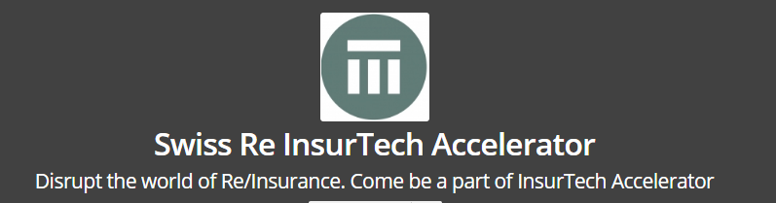
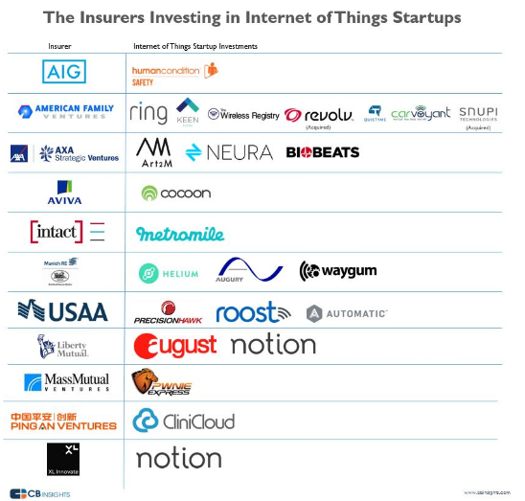
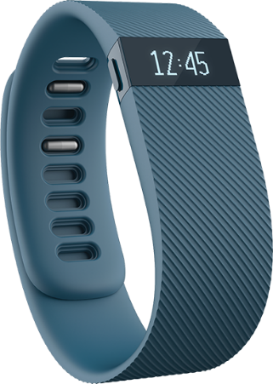
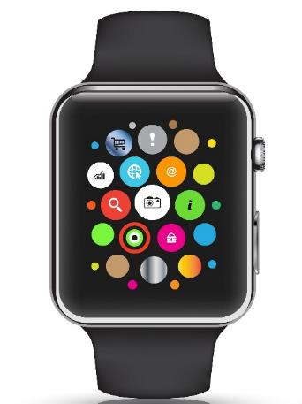
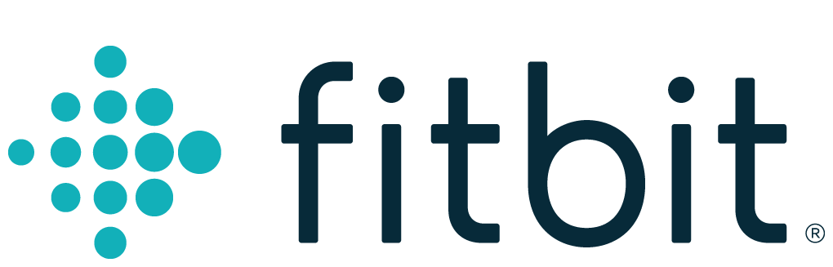

The Internet of Things
Gathering Big Data Affects
  Underwriting
  Pricing
  Claims
Monitoring Could Affect
  Loss Control
  Pricing?
SOURCE: F6S.com, CB Insights.
168
12/01/09 - 9pm
eSlide – P6466 – The Financial Crisis and the Future of the P/C
Notes:
168

Slide 169



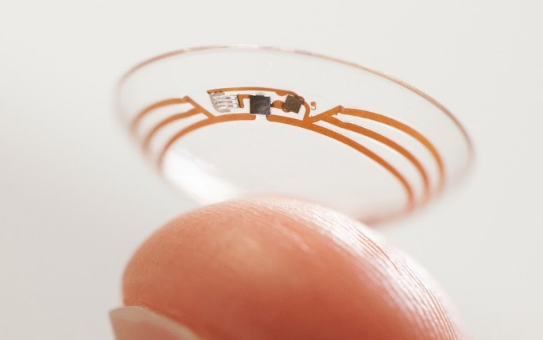
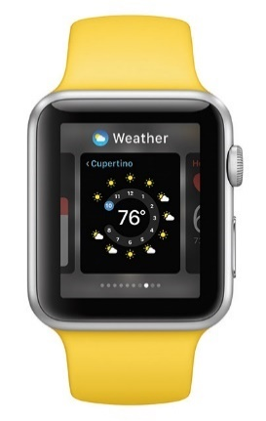


As For The Future…
IoT Could (Will) Disrupt UW, Claims, Loss Control
Image sources, clockwise: Nest, Jawbone, Automatic, Lumo, Apple, PSFK

Slide 170
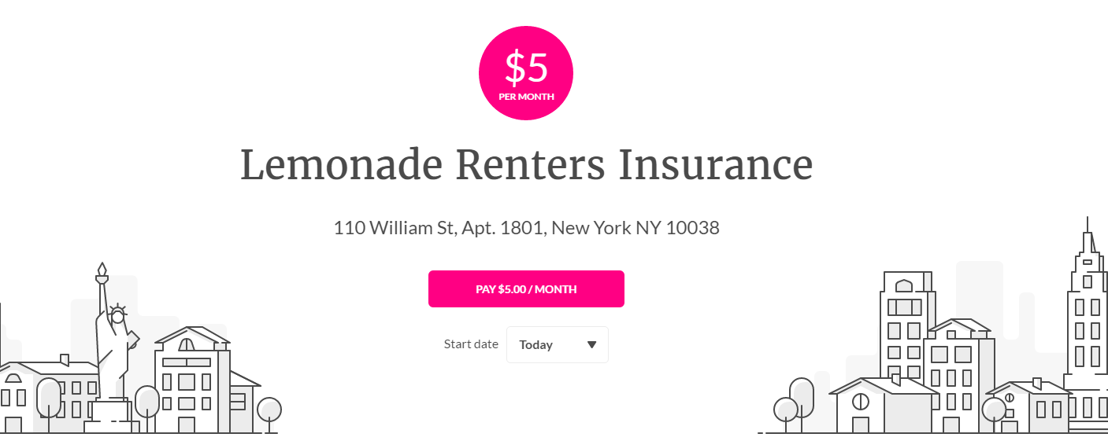
Peer-to-Peer (P2P) Insurance
Taking on the Entire Value Chain
The Business Model
Resembles Mutuals/
Reciprocals
20% of Premium to
Expenses, 80% to
Cover Risk.
Risk Pool for Each Charity
Leftover Pool Money Goes to Charity.
May Deter Fraud – You Wouldn’t Cheat Your Favorite Charity!
Lemonade Chief Behavioral Officer
Dan Ariely: “If you tried to create a system to bring out the worst in humans, it would look a lot like the insurance of today.”
Source: “UberX-ing Insurance : Is Peer-to-Peer Insurance Viable?”, presentation by Jay Sarzen, Aite Group at Drinker Biddle Insurance Conference, June 21, 2016; Financial Times; www.lemonade.com.

Slide 171
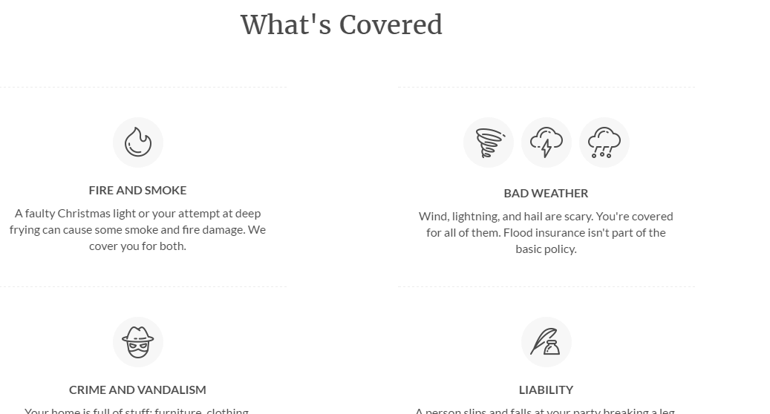
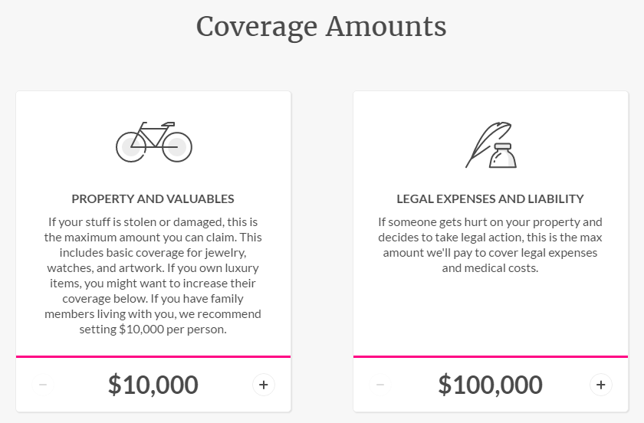
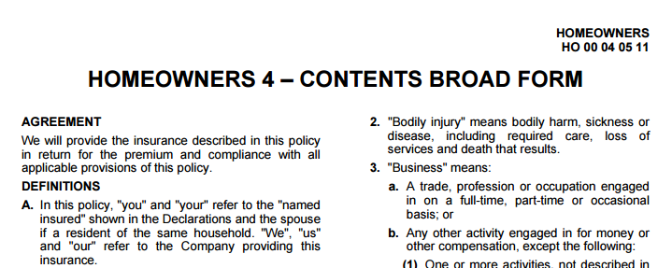
Lemonade’s P2P Model
Example: Renters’ Insurance (HO-4)
Attractive Graphics, Simple Explanations of a Basic ISO Form
SOURCE: Lemonade.com, Insurance Information Institute.

Slide 172
Lemonade’s P2P Model
Questions…
Who Holds the Risk?
Other Questions
How Are Charitable Pools Separated?
Who Gets the Float?
  Insurer, Reinsurer or Charity?
Who Gets the Tax Deduction (Worth More Than the Float)?
The Giveback Occurs on June 20 – 4 Equal Payments Over 4 Years – (Active Policies Only)
SOURCE: Lemonade.com, Insurance Information Institute.

Slide 173
Insurance Information Institute Online:
www.iii.org
Thank you for your time
and your attention!
Twitter: twitter.com/bob_Hartwig
Download at www.iii.org/presentations

